Slide 1



Chapter 20: Aging gracefully – the search for serenity

Slide 2
The acceptance playbook
Serenity is a sought-after quality not just in spiritual retreats, but also in almost every major religion in the world.
  In Buddhism, it is serenity (shamatha-bhavana) that opens the door to insight (vipassana-bhavana).
  In Hinduism, serenity is a quality that you aspire towards, to get on the road to enlightenment.
  In Christianity, its most visible presence, at least in daily life, is in the serenity prayer, created by Reinhold Niebuhr, an American theologian, but the search for serenity has deeper roots in biblical teachings.
Notwithstanding its ubiquity, serenity is still mis-defined and mis-understood by many who claim to be in search of it.
  First, it is not, as some argue, a belief that nothing bad will happen to you (as an individual or a business).
  Second, it is does not imply that you have given up and will let bad things happen to you, a distorted and defeatist view of karma, but it does imply that you will not exhaust yourself on unwinnable fights.

Slide 3
Serenity Lessons:
1. Growing old is difficult
Businesses need to recognize that not only is aging inevitable, but it does come with adjustments that are not pain-free.
  First, as businesses transition from one stage of the life cycle to the next, there are not only costs to transitioning, but changes in the way the business has to be managed.
  Second, as businesses age, they will find themselves facing limits, some the result of scaling up and getting bigger, and some coming from competition, that they might not have faced, when they were younger.
  Third, as companies age, they acquire histories, and if these include significant successes, there will be nostalgia for past glory, that may then feed into poor operating and business decisions.
Lesson 1: As businesses age, they should expect discomfort, acknowledge their limits, even if they have plans to push past them, and celebrate their pasts, while not trying to relive them.

Slide 4
2. Survive to deliver on potential
With young firms, as we have noted multiple times, the risk of failure is real and significant.
With declining firm, the first challenge with dealing with failure is defining what it means. After all, a firm in a declining business that liquidates its assets and returns cash to its owners, may be failing, if success is defined as staying in business, but it is taking the right course of action, given its prospects.
With all firms, there are macroeconomic forces that can push them into failure risk territory, as is the case with cyclical firms, amid a severe economic recession, or oil companies, if oil prices drop dramatically.
Lesson 2: Acknowledge the existence of failure risk, consider the factors that determine the likelihood of occurrence and then take actions that reduce the business’s exposure to the risk, including preserving buffer debt capacity, using risk management products and building business models that are more adaptable and flexible.

Slide 5
3. Business involves trade offs
At the beginning of the life cycle, when faced with a choice of business models, you may have to choose between a low capital intensity model, where less investment is needed to enter a market, allowing you to grow much more quickly, but with fewer barriers to entry for competitors, or a high capital intensity model, where the need for more investment up front slows down growth, while creating a more defensible business model in the long term.
For a young company facing the question of whether to give priority to scaling up (high growth) or building a better business model (longer life), it is worth noting that that ambition and longevity can be at odds with each other. Some of the longest-lived businesses in the world are family owned, niche businesses, but they have stayed small and focused.
For a mature company operating in a competitive business and in a large, albeit mature, market, the trade off can be between scaling up revenues, by growing faster, and increasing profitability, since the higher growth may require keeping product prices low and competing for market share.
For a declining company, facing a market that is shrinking and becoming less profitable, the choice can be between continuing as a going concern, struggling to earn returns that match, let alone exceed, the cost of capital or liquidating assets, and ending the business.
Lesson 3: View any decision or action that is presented as all-good, with no downsides, with skepticism. There is always a tradeoff to consider.

Slide 6
4. Building businesses is mostly perspiration, not inspiration
As a business goes from idea to product, the focus shifts from idea generation and raising capital to business building, and, in general, building businesses is more about grunt work than it is about creativity, requiring an attention to detail and a willingness to get in the weeds.
  For founders who feed off the excitement of idea generation and crave the adrenaline rush of selling their visions to investors and employees, finding more cost-efficient ways of production and working on supply chains can be a let down.
  If these founders decide to put these activities on the backburner, because of their tedium, there is a substantial risk that the business will be still born.
Lesson 4: As a founder, if you don’t want to spend your time on business building, find someone who does, and give that person freedom to make big operating decisions, without second guessing those decisions.

Slide 7
5. Scaling up is hard to do, and not always sensible
We live in a world where growth is glorified, where making a business bigger is prized far more than scaling it down.
  The heroes of the business world are empire builders, whether they be CEOs of companies or founders of new businesses, and they are held up for acclaim in academia and practice.
  Scaling up a business comes with costs, the first of which being a delay in turning the corner on profitability and the second being the reinvestment needed to generate the scaling up. There are some businesses that should stay small.
The incentives to scale up a business get stronger, if you have managers who are rewarded based on scale or growth, and they are investing other people’s (shareholders) money, and it sets up the scenarios where private equity investors and activist hedge funds are drawn in to level the playing field.
Lesson 5: Be clear eyed about the costs and benefits of scaling up and if the net effect is negative and you choose to scale up anyway, be honest about whose interests are being served by that action.

Slide 8
6. Corporate immortality is not the end game
Sustainability is the new buzzword in business, and while there are benign versions of the word, in its most malignant form, it is about what businesses can do to live longer or even forever.
With that objective, consultants and bankers come up with action plans that extend the life of a business, sometimes at the expense of profitability and value, yielding the prototype for a walking dead company. If tempted , remember two simple truths.
  The first is that no matter how creative and clever your consultants are, no business lasts forever.
  The second is that a corporation is a legal entity, and if the reason for its existence (running a viable, profitable business) disappears, the most prudent path to follow is to let it disappear as well.
Lesson 6: Using the lyrics from a legendary country music song, when running a business, “you have to know when to hold ‘em and know when to fold ‘em”. Don’t be a zombie company.

Slide 9
7. You don’t always control your fate
We have been taught to believe that the fates of businesses lie in the hands of their managers, and by extension, that good companies are run by good managers and bad companies by managers of dubious quality
Much of what happens in a business is driven by movements in macro variables, country risk shifts and political changes, none of which are controlled by managers.
At the risk of being branded a cynic, there are businesses that could be run just as well by auto pilot rules or a robot as by the existing (and expensive) management team.
Lesson 7: While managers cannot foresee acts of God or unexpected macro developments, they can stay vigilant and watchful and build adaptable businesses that can react quickly to changes.

Slide 10
Lessons for investors:
1. Uncertainty is a feature, not a bug
Uncertainty is greatest at young companies, with little operating history and unformed business models, and will tend to decrease, as companies age.
  If you view uncertainty as a problem to be avoided, you will find yourself investing only in or primarily in mature companies, and while you may view that as a positive, it does constrain you.
  If at the other extreme, you deny the existence of uncertainty and/or adopt arbitrary rules to deal with it, like the target rates made up by venture capitals, you will invest in young companies, but without a serious assessment of the risks that you face.
The path forward on uncertainty is to face up to uncertainty, make your best estimates, given the information that you have, and then use statistical tools like scenario analysis and simulations to deal with uncertainty.
Lesson 1: Face up to uncertainty, accept its existence and try to turn its presence to your advantage.

Slide 11
2. Don’t deny your biases
Investors and analysts have a fetish about being objective, when, in truth, they are always biased. With young companies, you will like some founders more than others and you will sometimes fall in love with their business stories.
  When that occurs, and you want a business story to be true, you will find facts, often selectively, to back up your beliefs.
  While there is little that you can do about your biases, being open about them will make you aware of how your assumptions and decisions are being altered by your priors, and perhaps make you more cautious about following through on your own analysis.
Lesson 2: Be open about your biases, even though you may be unable to do much about them and keep the feedback loop open by surrounding yourself with people who don’t think like you.

Slide 12
3. Investing is a skewed game
Even if you are a successful investor, most of your investments will lag the market, but your big winners will be what push your overall portfolio ahead of the market.
  This asymmetry in returns exists for companies across the life cycle, but it is greater for younger firms than for older firms.
  This asymmetry in returns also applies when you look across investors, since most lag the market, and there are only a few consistent winners. Again, that asymmetry is more extreme with investors in young companies, with a wider gulf between the most and least successful venture capitalists, than it is with investors in mature companies.
notion that holding a concentrated portfolio, where you put all your money in a small number of companies, is a sign of investor conviction is a part of value investing lore, but if your strict criteria for stock selection lead you to miss the biggest winners, you will lag the market.
Lesson 3: Be cautious about adding to or pruning your portfolio, based upon short-term performance or for emotional reasons. If you are entrusting your money to someone else, look for consistency as much as outperformance.

Slide 13
4. Management may have less effect than you think…
When investing in a company, there are two concerns that you should have about its management.
  The first is management quality, with good management adding to a company’s value and bad management doing the opposite.
  The second is conflicts of interests between management and ownership, what’s good for managers at these firms may or may not be what’s good for shareholders.
If you are an investor in young companies, where founders or insiders own significant ownership stakes, and management can make a much bigger difference to value, your focus should be on management quality, and finding ways to better assess it, especially given the paucity of historical performance data.
In more mature companies, where management generally makes less of a difference to value, and managers often have smaller ownership stakes, your bigger challenge will be evaluating corporate governance.
Lesson 4: The data that you collect and the assessments that you make about management will shift from management quality to corporate governance, as companies age.

Slide 14
5. Mean reversion works, until it does not
The essence of mean reversion is that a company’s operating metrics and pricing converge on averages, either historical or across companies, and investors draw on its powers, in developing investment strategies, with key differences.
  In some cases, investors assume that the reversion will be to historical averages, either on operating metrics like growth and operating margins, or on commodity prices.
  In others, the reversion is to industry averages, again either on operating metrics (margins, return on capital) or pricing (PE ratios, EV to EBITDA).
  Much of active investing, in fact, is built on the presumption that when a company trades at a pricing multiple very different (either higher or lower) than the industry average, there will be a correction, where its pricing multiple will converge on the average.
While mean reversion is a strong force, and works a significant portion of the time, there are two limits to it. The first is timing, since convergence in the long term will not work in your favor if your time horizon is much shorter. Second, mean reversion works only if there is no structural change in the underlying process or system.
Lesson 5: When there are structural changes, as is the case with disruption or macro shifts, falling back on mean reversion is false comfort.

Slide 15
6. Company quality ≠ investment quality
We drew a distinction between good companies and good investments, arguing that while the former is based on operating metrics like growth, margins and returns on invested capital, the latter is a function of how the investment is priced.
  With start-ups and young companies, the quality of businesses can be measured based upon potential market size, unit economics and competitive advantages, but there are some investors who seem to believe that any price is justifiable, for high quality businesses, with potential.
  With mature companies, the focus when measuring company quality is on earnings power, with more earnings (and cash flows) leading to higher value, and business moats, with more value attached to bigger and more long-lasting moats.
It is for that reason that we argued that the best investments are in companies where there is a mismatch between its business and investment qualities.
Lesson 6: Investment success does not come from assessing business or management quality, but from your assessments of a company deviating from the consensus view.

Slide 16
7. The less you bring to the table, the less you take away
Investors who succeed have a niche or an edge that they cultivate, and that niche/edge can be different for investors at different stages in the life cycle.
  With young companies, being able to gauge founder quality, failure risk and potential market size (for products or services that are still unformed) will give investors, who are better at doing this, a leg up on their competition.
  With high growth businesses, being able to better separate those companies that can scale up more quickly, and with better profitability, from those that will either struggle on scaling, or do so, at the expense of profitability, is the defining factor separating investment success from failure.
  With more mature businesses, it is superior assessments of competitive advantages or moats in conjunction with the capacity to foresee disruption that is the key to investment success.
In each of these cases, though, there are personal qualities like patience and willingness to withstand peer pressure that can augment investing payoffs.
Lesson 7: Find your niche or edge, build an investment philosophy around it, and then find a way to monetize it.

Slide 17
8. Taking risk does not entitle you to rewards
Risk is part of investing, and every risk and return model in finance is built on linking higher risk to higher expected returns.
  That linkage, though, is not an entitlement, and investors who take risk, expecting higher returns, are not entitled to those returns, even if they do their homework and have long time horizons.
  That is a point worth making, because investors who believe that they are entitled to rewards, because of the hard work that they have put in, and don’t get that reward not only become embittered, blaming markets for the shortfall, but also act accordingly.
The way this dynamic plays out will vary depending on the companies that investor target, in their investment philosophies.
  When investors in young companies under perform, they blame macroeconomic forces or short-term thinking on the part of other investors, for not seeing the growth potential in these firms.
  If short selling is a factor in prices falling, labeling those sellers as speculators, benefiting from destruction, becomes an easy out.
  With investors in mature businesses, underperformance is attributed to the rest of the market being in a bubble, with traders and shallow investors pushing up prices.
Lesson 8: If you do your homework and find “good” investments, do so on the expectation of rewards, but don’t feel entitled to those rewards

Slide 18
9. Investor or trader?
Investors assess value, try to buy at a price less than that value and make money from convergence. Traders, we noted, play a simpler game, buying at a low price and selling at a higher one, using whatever tools that they can use momentum strength and shifts.
Investors and traders exist in every phase of the life cycle, but the balance between the two will tend to shift, as you move through the life cycle.
  With younger companies, it is traders who will dominate markets, as investors stay away, unwilling or unable to deal with the uncertainties that are endemic to these companies.
  As companies mature, you will see more investing, as investors become more comfortable making estimates and dealing with uncertainties.
Lesson 9: Choose the game that you want to play, with a sense of why you think you can win at that game and stop deluding yourself. In short, if you are trading stocks, don’t masquerade as an investor or talk about value, and if you are investing, stay clear of pure momentum plays.

Slide 19
10. Luck trumps skill
Over the last century, we have tried to make investing into a discipline, with some even using the vast amounts of data that comes out of investing, to argue that it is a science.
The truth, though, is that there is far too much that investors don’t control for it to ever resemble a science. In practical terms, this does mean that separating luck from skill, when assessing investment performance, is very difficult, perhaps even impossible to do.
There are two lessons that investors can draw from this.
  First, being honest with yourself, as an investor, about how much of your success comes from being at the right place at the right time, will make you a better investor.
  Second, humility in the face of investment success is the most prudent response.
Lesson 10: View investment success and failure as two sides of the same coin, viewing neither as a measure of your worth, as a person or an investor.

Slide 20
Lessons for Regulators:
1. On disclosure, less is more!
The human mind is easily distracted and as filings get longer and more rambling, it is easy to lose sight of the mission on hand and get lost on tangents.
As disclosures mount up on multiple dimensions, it is worth remembering that not all details matter equally. Put simply, separating the information that matter from the many data points that do not becomes more difficult when you have 250 pages in a 10-K or S-1 filing.
Behavioral research indicates that as people are inundated with more data, their minds often shut down and they revert to "mental short cuts", simplistic decision-making tools that throw out much or all of the data designed to help them on that decision.

Slide 21
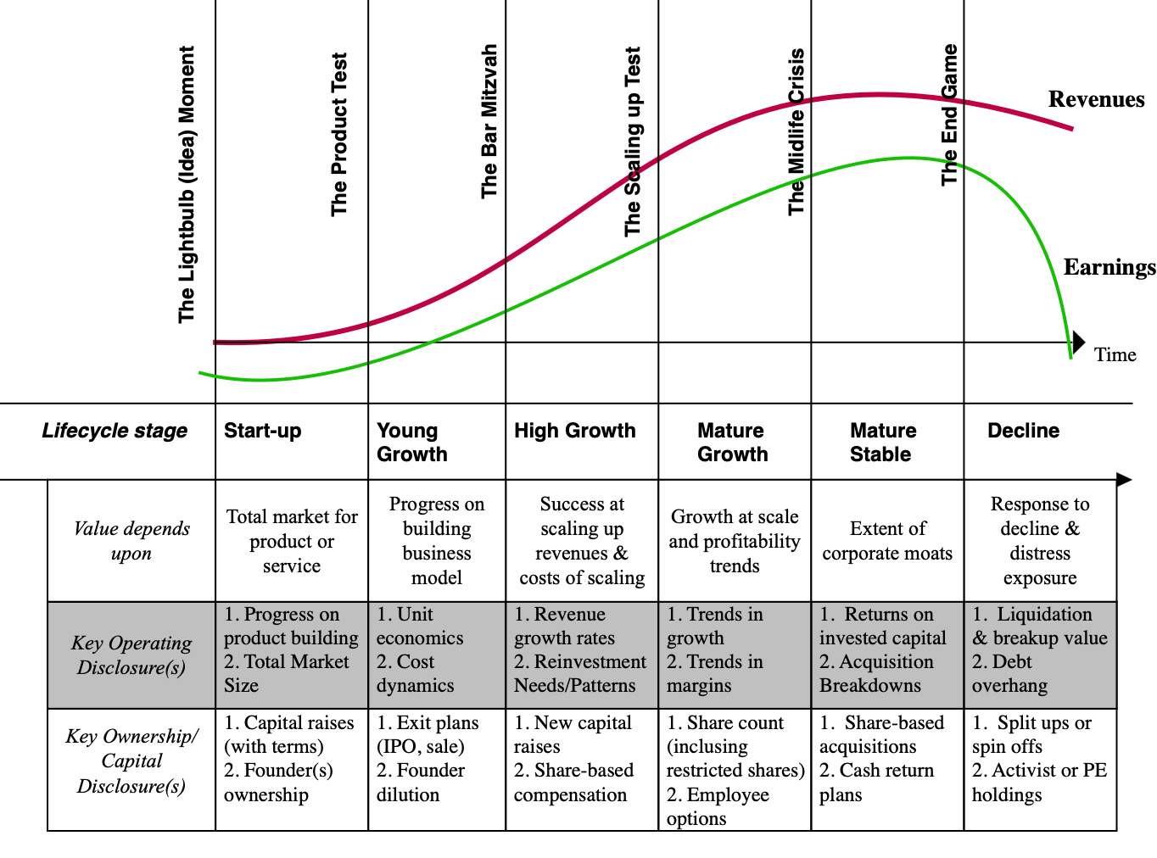
2. And targeted disclosure works better…

Slide 22
On corporate governance…
In the United States, much of corporate governance reform, in the United States and elsewhere, is built on the presumption that the core conflict of interest that needs addressing comes from managers not owning enough shares in a company, and thus not thinking like shareholders.
That type of corporate governance reform may work in more mature firms, where managers do tend to have no or very small ownership stakes and consequently tend to put their interests, as managers, ahead of those of shareholders.
As you look across the life cycle, you can see that the governance challenge changes. At start-up and young companies, it is founders or inside shareholders who own large ownership stakes and are entrusted with the management of the firm. That removes the core conflict that conventional corporate governance is trying to resolve but replaces it with a different conflict between that which is good for inside shareholders/founder and that which is good for outside shareholders.

Slide 23
And on investor protection..
Risk awareness: A fundamental premise in both disclosure and regulation seems to be the belief that the reason investors who choose to invest in very risky businesses do so because they are unaware of how much risk there is, in these companies.
  Put differently, regulators seem to believe that if these investors were made fully aware of the risks, they would not invest. That misses the reality that risk is both upside and downside, and that investments with high downside risk also offer the most upside.
  In short, those investors who choose to put their money in risky companies do so precisely because they are risky and having a hundred-page risk disclosure to that effect will not change a single mind.
Investor sophistication: Much of regulatory action on investor protection takes a paternalistic view of individual and retail investors. Specifically, not only do regulators seem to believe that individual investors are incapable of informing themselves and making reasoned judgments on risk/return tradeoffs, but that they should also be protected from their own mistakes.
Company risk versus Portfolio risk: Rather than spend the bulk of their resources containing and regulation company-level risk, which will average out across the portfolio, there should be a greater focus on exposure to macroeconomic or market-wide risks that will flow through into portfolios.

Slide 24
Lessons for policy makers
Risk capital versus Subsidy capital: Many countries that are in a hurry to develop an entrepreneurial class have tried to do so by offering capital directly to these businesses, often as subsidized loans or grants. Unfortunately, that does not seem to do much other than burn through billions of dollars over time, enriching several entities along the way, but with no pay off in terms of new businesses that are self-standing. The long-term solution that has staying power is for investors to be willing to put their money into the risky businesses (start-ups and young companies) on the expectation that they will earn high returns, but also with the recognition that they will fail often.
Top down versus Bottom up: Policy makers tend to overestimate their capacity to change the way investors and businesspeople think, leading them to believe that pronouncements and policy tweaks change behavior. Just as the risk culture is slow to build on the investor side, the entrepreneurial drive, where an individual or individuals leave well-paying jobs to start new businesses must occur from the bottom up.
Timelines: Policy makers usually work with timelines that have more to do with election cycles and bureaucratic tenure than they do with reality. Creating artificial and completely unreasonable deadlines for economic transformation will not only kill any chances of success early on, but will convert these exercises into boondoggles for consultants, scams and shady operations masquerading as businesses.

