Slide 1



Chapter 3: The Corporate life cycle – Measures & determinants

Slide 2
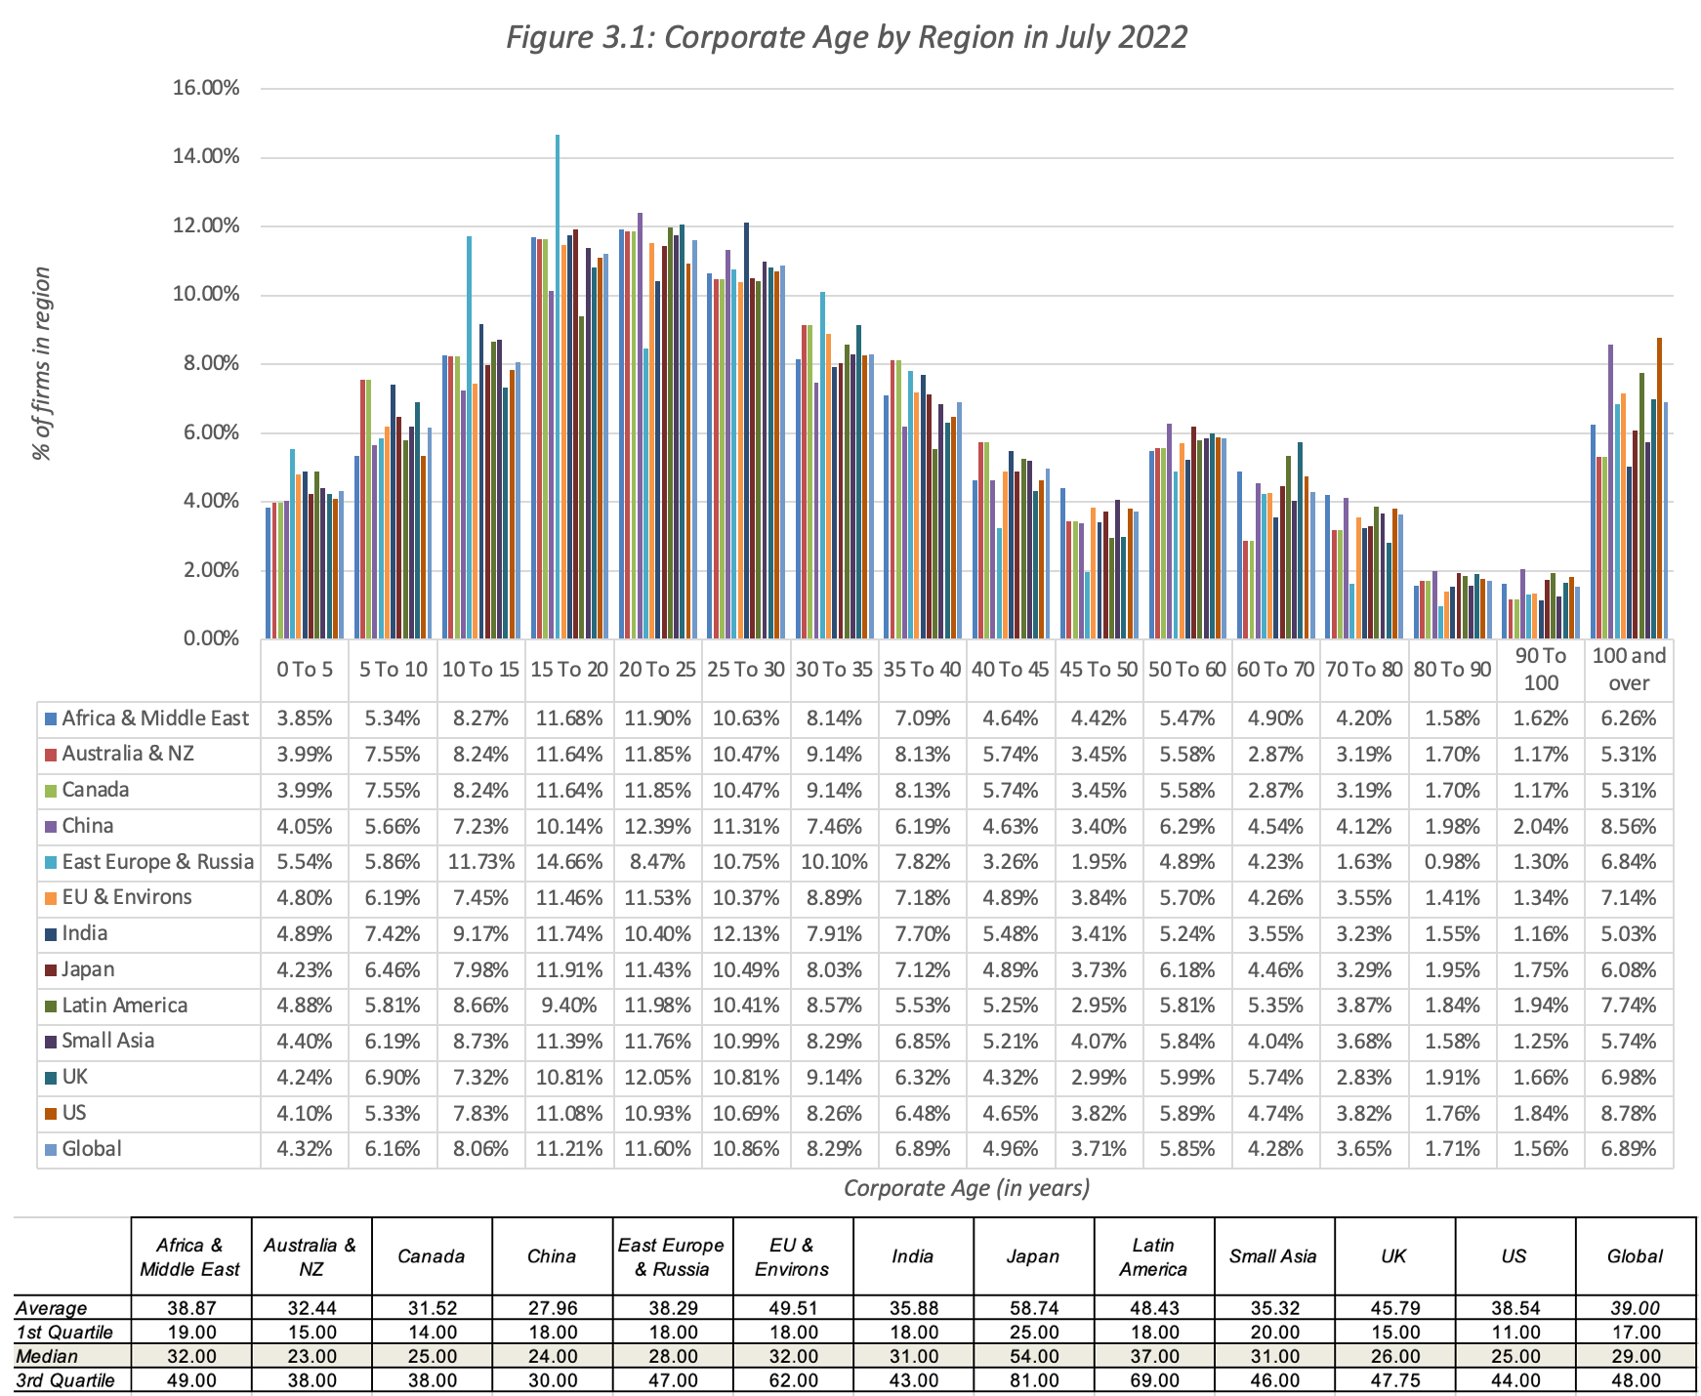
Measures of corporate life –
1. age

Slide 3
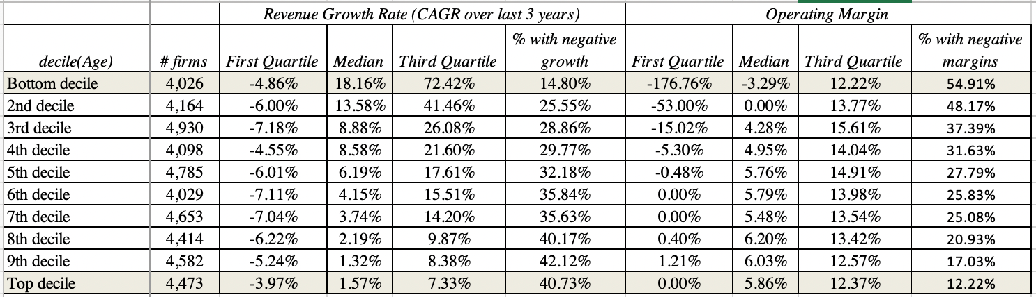
Operating metrics, by age decile

Slide 4
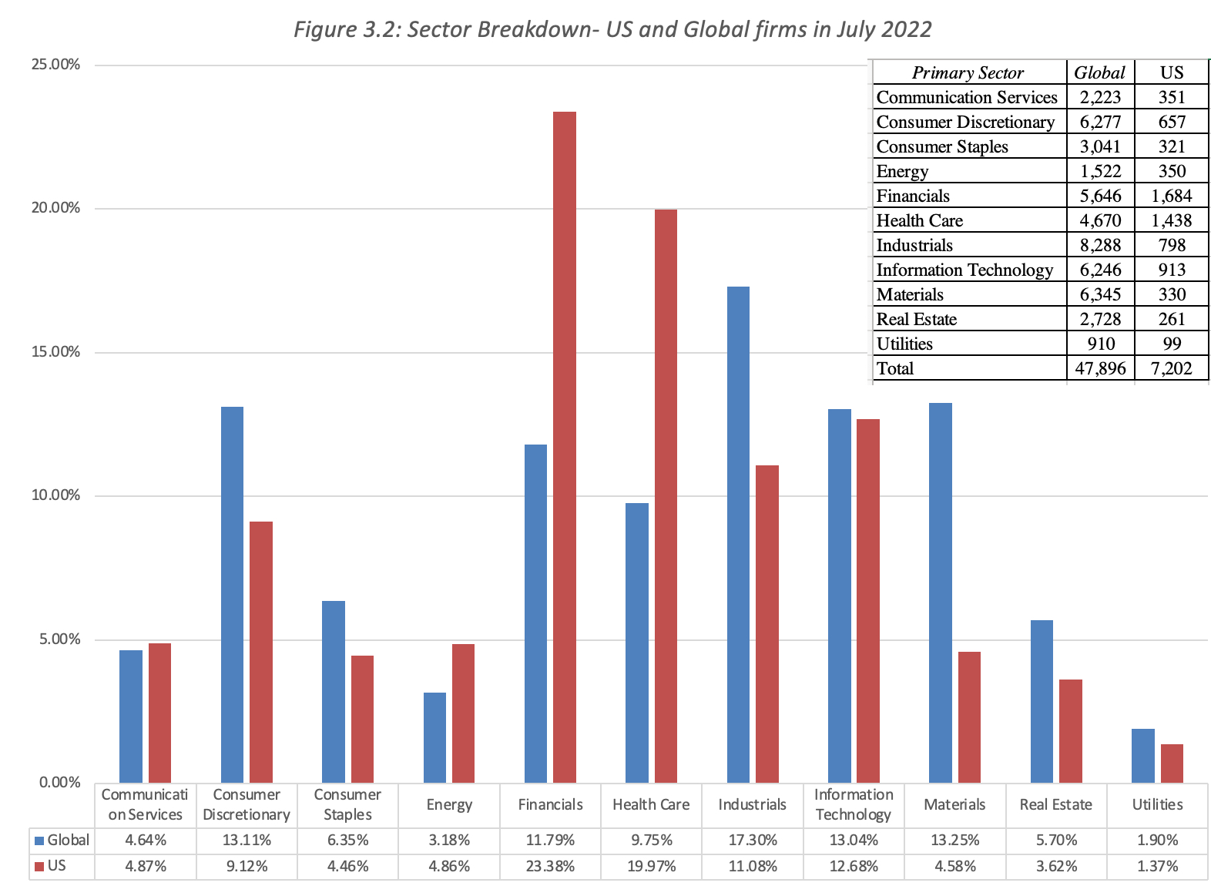
Measures of corporate life –
2. Sector

Slide 5
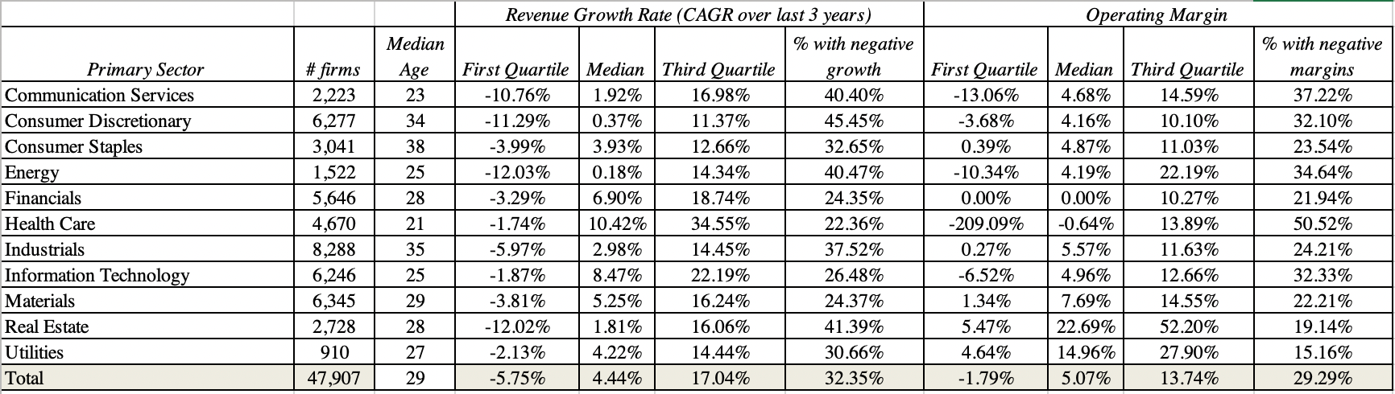
Operating metrics: By sector

Slide 6
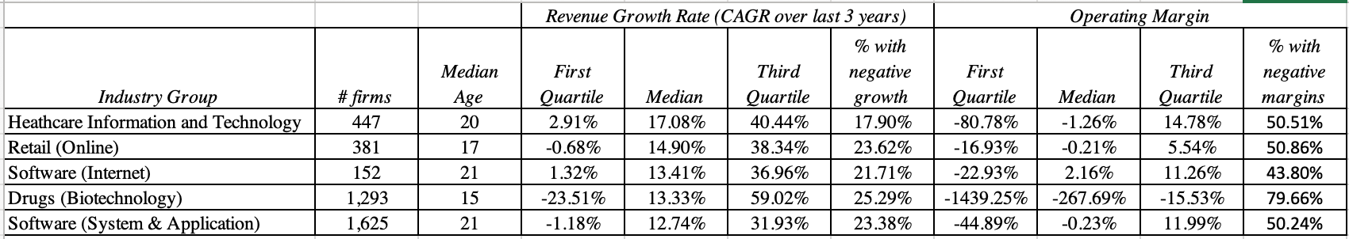
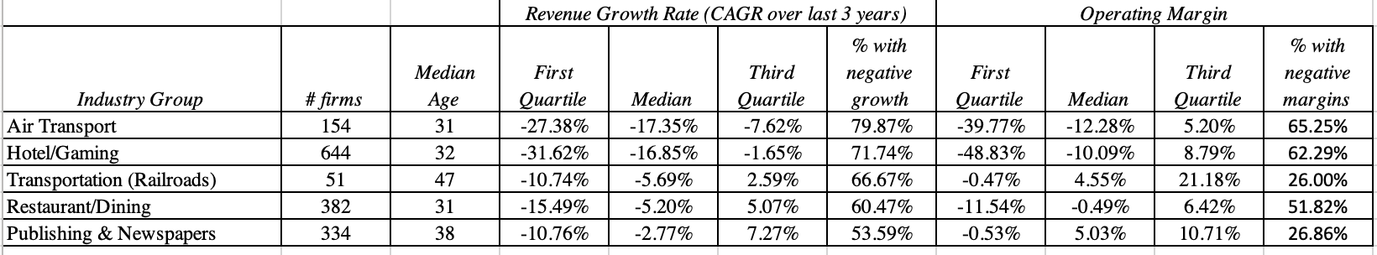
Industry contrasts: Highest and lowest growth
Highest growth industry groups in 2022
Lowest growth industry groups in 2022

Slide 7
Measures of corporate life-
3. operating metrics
Life cycle stage | Start up | Young Growth | High Growth | Mature Growth | Mature Stable | Decline
Revenue Growth | NA at pre-revenue, Very high for initial revenues | Very High | High | Moderate | Low | Close to zero or negative
Operating Margin | Very negative | Negative, perhaps becoming more so over time. | Negative, but getting less so over time | Positive, and getting more so over time | Stable and predictable | Positive, but declining
Reinvestment | High | Very high | High, but stable, relative to revenues | High, but declining relative to revenues | Low, and a function of revenues | Divestment and shrinkage
Free cash flows | Very negative | Very negative, perhaps getting more so. | Negative, but getting less so over time | Positive, and growing faster than revenues and earnings | Positive and stable | More positive that earnings.

Slide 8
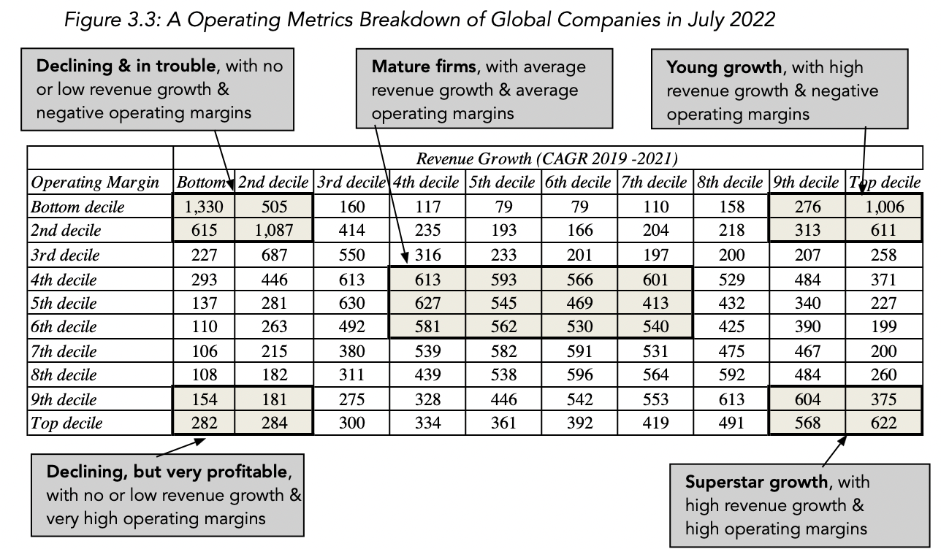
Operating metric breakdown of Global companies

Slide 9
Corporate life cycle - dimensions
The first is the length of the life cycle, the period over which a business exists, with some businesses a lot longer than others.
The second is the height of the life cycle, characterizing the peak of the business.
The third dimension is the steepness in the life cycle curve, reflecting how quickly a founder or business novice is able to scale up a company’s size, as well as how quickly it scales down.
The final dimension in the flattening part of the life cycle, a measure of how long a business is able to stay at the top, once it becomes mature.

Slide 10
1. Life cycle length
Type of Business: There are some businesses that have more staying power than others, because the products and services they offer have durable demand.
Time to build business: Businesses where it takes time to establish the business are more likely to have long lives than those that can ramp up production and be in business quickly.
Competitive barriers to entry: The decline and demise of businesses often comes from new players entering the market and having strong and long-standing barriers to entry can allow companies to stay in business far longer than if they operate in free-for-all settings.
Macroeconomic conditions: A business that operates in a more volatile macroeconomic environment will face more risks that could potentially shorten its life than an otherwise similar business in a stable environment.
Ownership structure and governance: For a business to keep going, it needs management continuity. A business that is dependent on a key person or persons for its continued operations will have a shorter life than one that has a management team and well-established succession plans.
Time horizon: In a point related to ownership structure, one reason why a successful family business may have a much longer life than a successful publicly traded company is the incentive structure of the decision makers who build the business, and how it may affect business life.

Slide 11
2. Life cycle height
Potential market for product or service: The choices made by a business on whether to offer a product or service to a niche market or a mass market can determine how much it can scale up.
Geographical reach: In the last three decades, companies all over the world have learned to look past their local markets for growth. That has allowed companies that would have been historically constrained to be small, because they operated in small domestic markets, to expand in foreign markets, and increase their size.
Technological and Economic Innovation: There have been innovations in history that have opened the door for firms to expand to levels they could not, prior to those innovations. The internet and smart phones have allowed for scaling up in many businesses that were local and constrained before they came along.
Networking benefits: One feature of the tech revolution has been a competitive advantage that is endows companies that are able to establish dominance early in a market. These companies find that their dominance makes it easier for them to attract customers and resources, as they get bigger, i.e., networking benefits. In this winner-take-all environment, you can end up with two or three very large players in a market, with each of these players capable of delivering much higher revenues
Regulatory constraints: The potential for a company to grow can be restricted by laws that crack down on oligopolies and natural monopolies, putting caps on market share and growth for larger companies.

Slide 12
3. Life cycle shape
Capital intensity: It takes more time to build a business and start generating positive cash flows in capital intensive industries than in capital light settings.
Capital access: Even for capital-light businesses like Airbnb and Uber, access to capital to fund investments is critical for rapid growth. When capital is freely accessible and available as it is in large quantities, companies can climb the life cycle quicker than when there is limited or no capital access.
Customer inertia: In marketing, customer inertia refers to the phenomenon of customers remaining attached to offering from the status quo (existing businesses that dominate the market), reluctant to try products or services from newcomers. What sets customer inertia apart from customer loyalty is that this attachment to existing offerings is rooted less in their meeting customer needs and more from a fear of trying something new. That said, customer inertia varies across different businesses, sometimes across cultures and perhaps across age groups.
Regulatory restrictions: Start-ups in businesses that require licensing or regulatory approval to expand are, by their very nature, constrained in how quickly they can start showing operating success.

Slide 13
4. Life cycle flatness (stay at the top)
 | Brand Name | Switching Costs | Network Effect | Cost Advantages | Efficient Scale
Wide | Coca Cola: Just sugar water but consumers pay a premium | Oracle: Ties to integrated databases make switching very expensive | Chicago Mercantile Exchange: Clearing house function creates captive volume. | UPS: Past logistics investments result in low marginal costs of delivery | International Speedway: Owns the one NASCAR track that each metro area can support.
Narrow | Snapple: Solid brand, but with less pricing power | Salesforce: Popular, but weaker costs to switching | NYSE Euronext: Leader in market, but leadership does not create as much of a network effect. | FedEx: Higher fixed-costs from air express segment create smaller cost advantages | Southern Company: Natural geographic monopoly, backed by regulators.
No Moat | Cott: Generic player with no brand loyalty or pricing power | TIBCO: High-end software but low or no costs to switching to competitors | Knight Capital: An order-taker/market maker, with little in networking benefits. | Con-way: Trucking company, but fragmented business with few cost advantages. | Valero: Refiner that has to be a price-taker in a commodity business

Slide 14
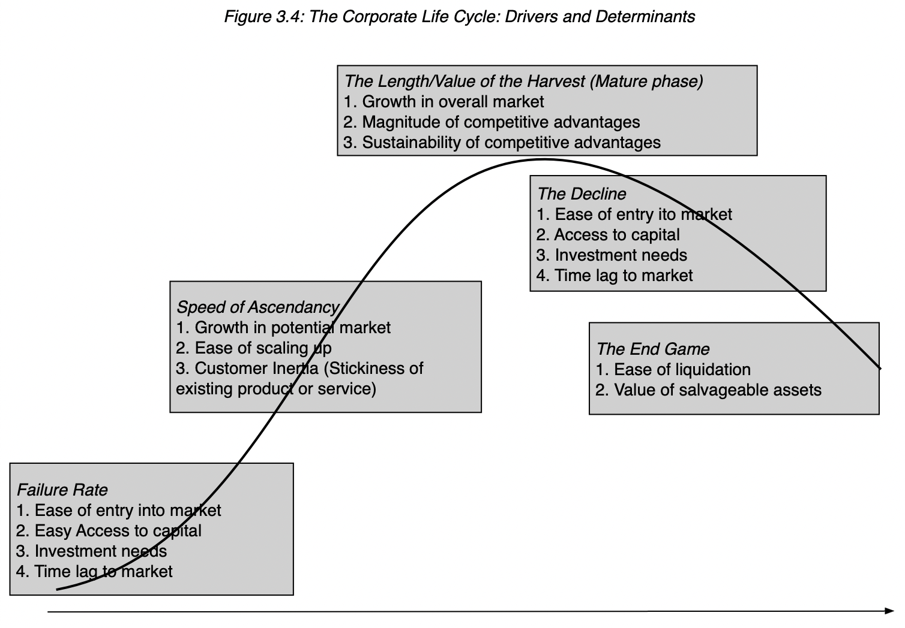
Life cycle determinants

Slide 15
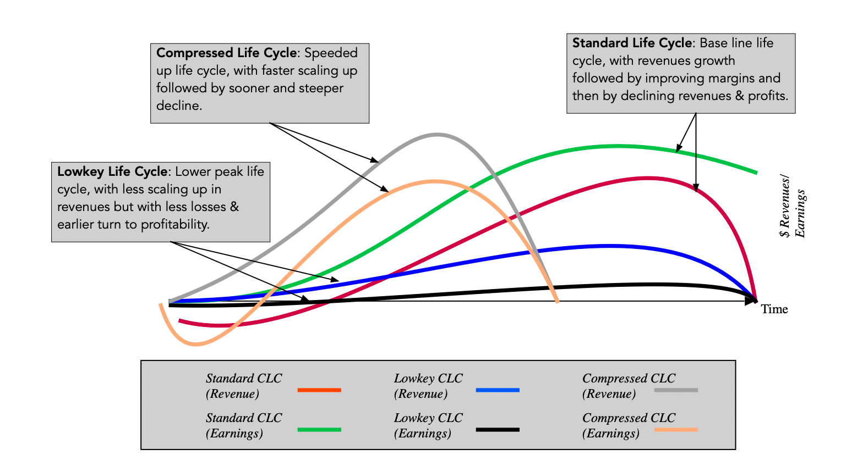
Life cycle contrasts

Slide 16
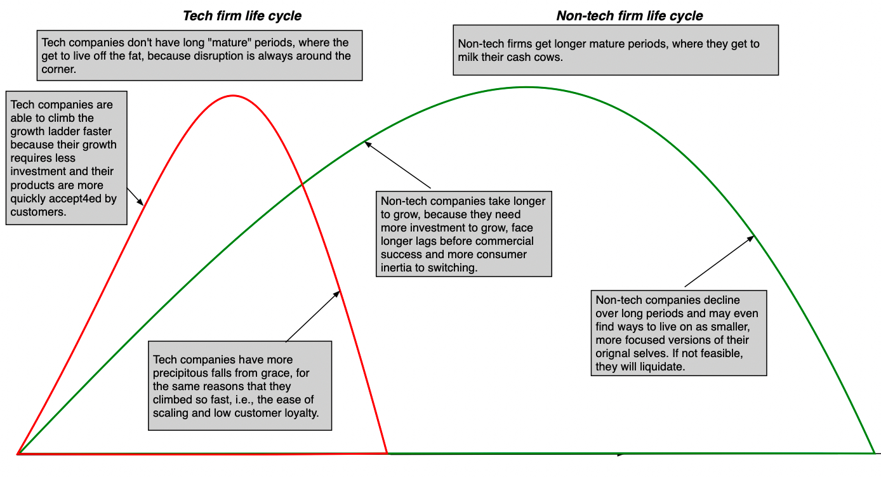
Tech companies: The compressed life cycle

Slide 17
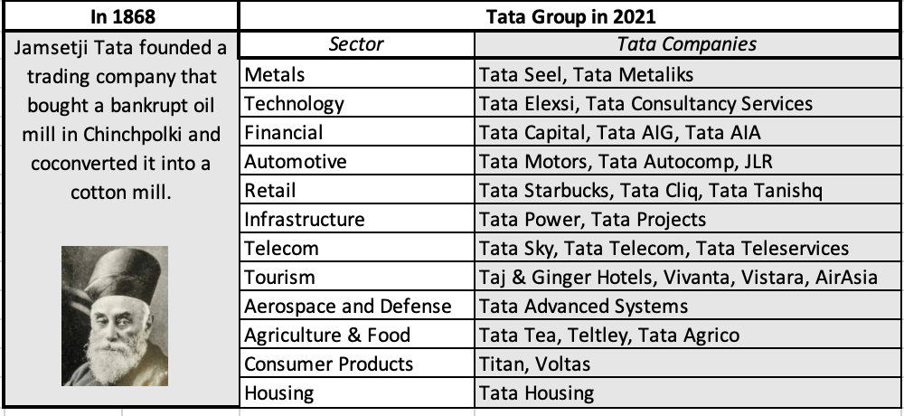
The Holding company life cycle

Slide 18
The disruptor effect
While much of the debate on disruption has focused on the disruptors, it is worth focusing just as much attention on the disrupted. Global ride-sharing companies have laid waste to the smaller and localized taxicab companies, and Google and Facebook have decimated traditional advertising businesses.
From a practical standpoint, you could argue that there is now a far greater chance of being disrupted today, for companies in almost every business, than just a few years ago, and that must show up in business and investment practices.
  First, the assumption of mean reversion that is at the heart of how many analysts run and evaluate businesses must be re-examined, i.e., a decline in margins at a company with a long history of earning high margins may not be temporary, if there is a chance of disruption, and assuming that there will be a bounce back to historical margins may not be merited.
  Second, even companies with strong competitive advantages (brand name, licensing, economies of scale) should have contingency plans, since change from disruption, when it happens, will be abrupt and damaging.
  Third, regulators and lawmakers must consider the possibilities that the rules and laws that they write to keep existing companies in check, often with the best of intentions (increase competition, protect customers), can handicap them, when disruptors enter the game.

