Slide 1



Chapter 4: The Corporate life cycle – transitions

Slide 2
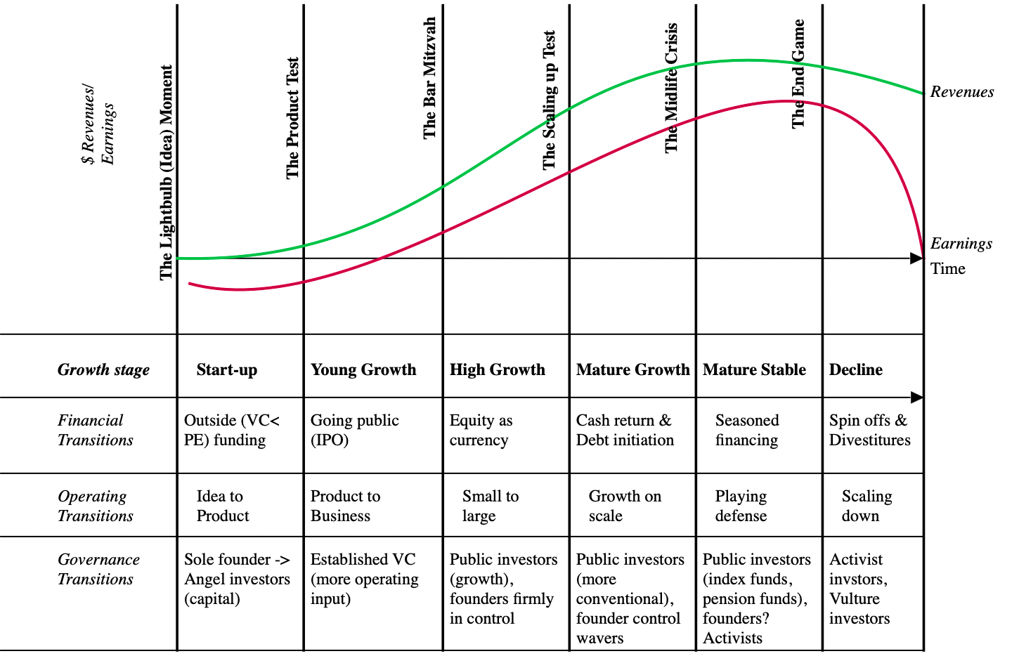
The Transitions

Slide 3
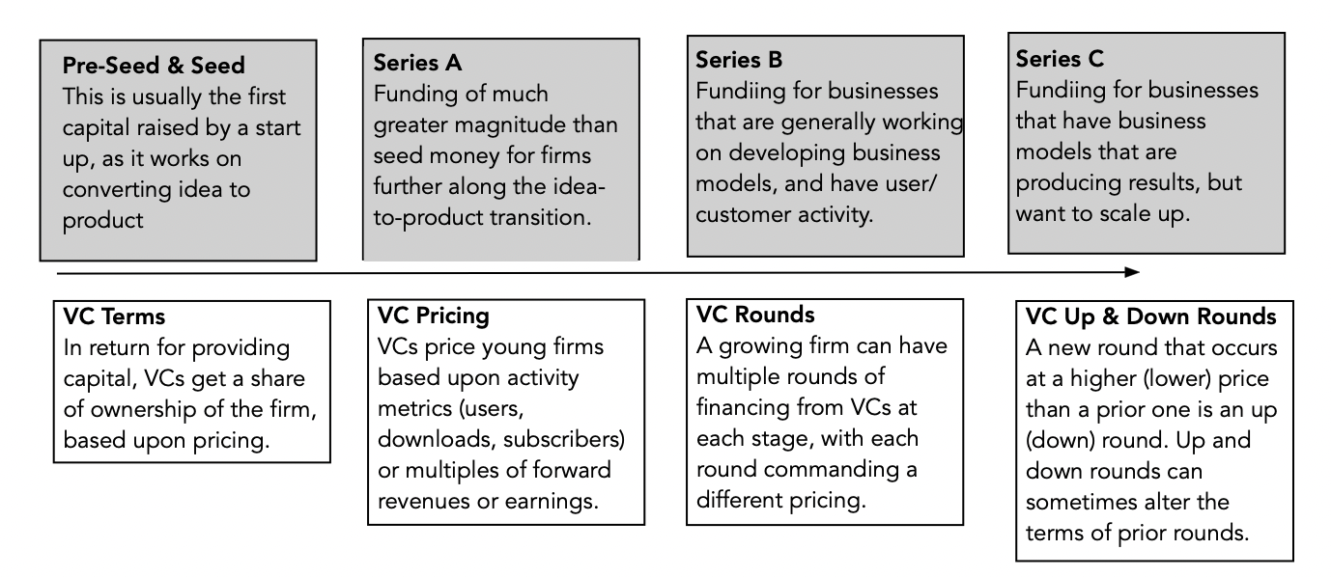
1. Young business financing – Venture capital

Slide 4
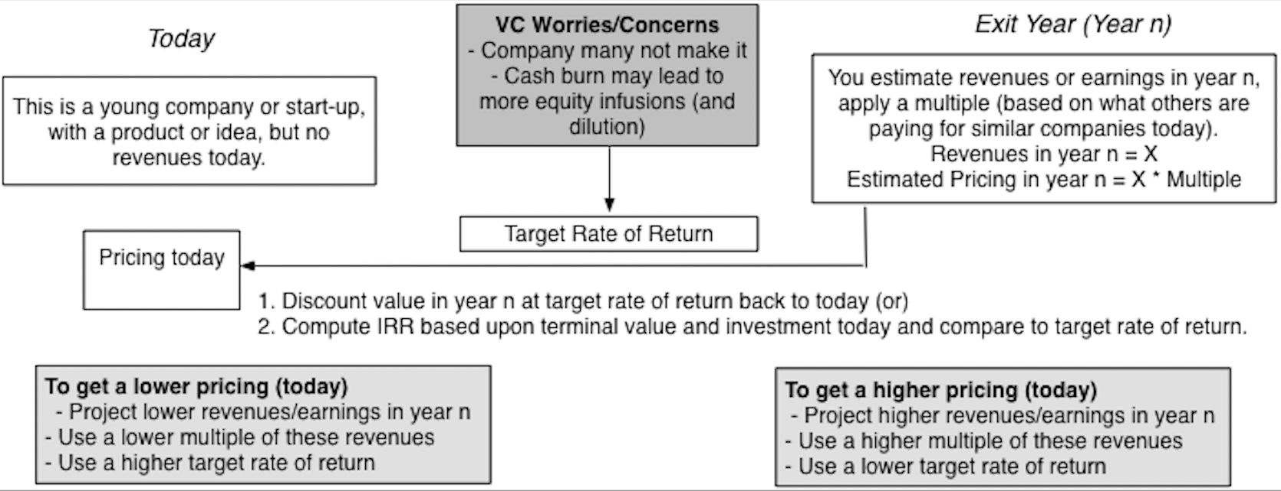
And pricing…

Slide 5
With special features…
Pre-money versus Post-money value: Venture capitalists often draw a distinction between pre-money valuation of a business (the value prior to the venture capitalist investing) and a post-money valuation of the same business (after the venture capital infusion).
  There is an element of judgment involved here, leading to different approaches to differentiating between the two estimates.
  If you are working with an existing pricing of a business, the post-money pricing is estimated by adding the capital infusion to the pricing.
  Alternatively, the venture capital pricing described in the last section is considered a post-money pricing, and netting out the capital provided from it, yields the pre-money pricing.
VC Protections: When venture capitalists invest in a young business, they are hoping for upside, but they are also concerned about the downside. Many venture capital investments provide protection against ownership loss, by adjusting ownership shares of existing venture capitalists to reflect the lower value on the down round.

Slide 6
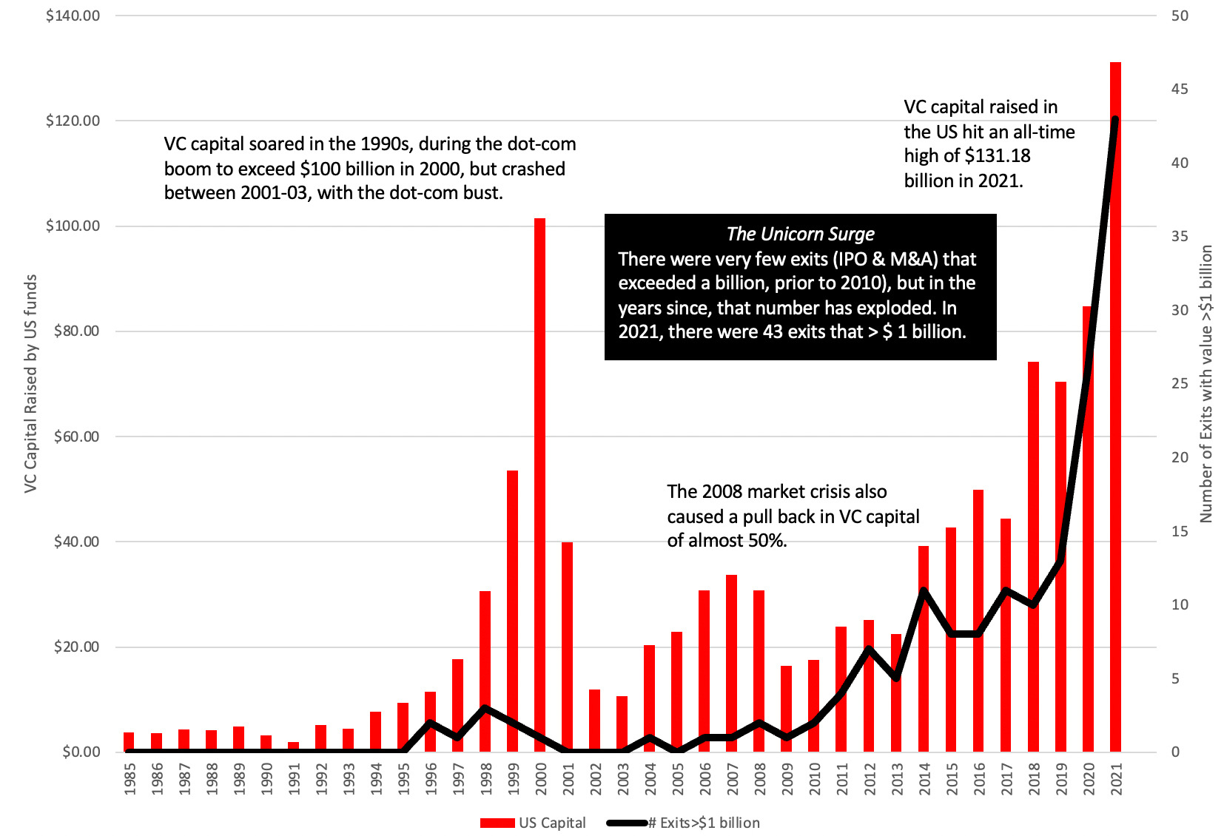
VC funding over time

Slide 7
And trends…
Globalization: For much of the last century, venture capital, at least in its structured form, was primarily US-focused, as young companies in the rest of the world either made do with government grants and bank funding to get by, putting them at a disadvantage, relative to their established domestic competitors.
Investor make-up: In its original form, venture capital was marketed as an alternative investment to institutional investors (endowment funds, pension funds) and to very wealthy investors. In the last decade, the game has opened up to individual and retail investors, with innovations made possible by technology.
Corporate venture capital: Some of the capital invested in young companies has always come from mature companies that have excess cash and relatively few organic investments or from companies seeking to make strategic investments in start-ups that may provide technology or support to their businesses. The flows from corporate venture capital have increased in the last two decades because of two developments.
  The first is the growth in the health care and technology businesses, where mature companies have discovered that the most efficient ways for them to invest is to put their capital into young companies, with promising technologies, rather than spend the same money on internal R&D.
  The second is that the winners in these businesses have also accumulated unprecedented amounts of cash on their balance sheets, giving them capital to invest in a multitude of businesses.

Slide 8
2. Public equity – initial public offerings..
For some ambitious firms, with big growth plans, there may come a point where venture capitalists are either unable to provide capital in the amounts needed and/or require disproportionately large ownership stakes in return. It is at that point that the option to go public becomes a consideration, at least for those firms where public equity markets are offering better pricing terms and the need for liquidity is higher.
There are at least two costs to going public that must be weighed into the decision.
  The first is that the information disclosure requirements for firms in public markets tend to be more onerous than for those in private businesses, and to the extent that this disclosure is costly and/or reveals information about the business that may be useful to competitors.
  The second is that the pressures on the firm to match or beat investor expectations on a short term (quarterly, semi-annual) basis on metrics (user numbers, revenues, earnings) can not only add to the stresses of managing a firm, but can, at least in some cases, lead to decisions that are damaging to the firm in the long term.

Slide 9
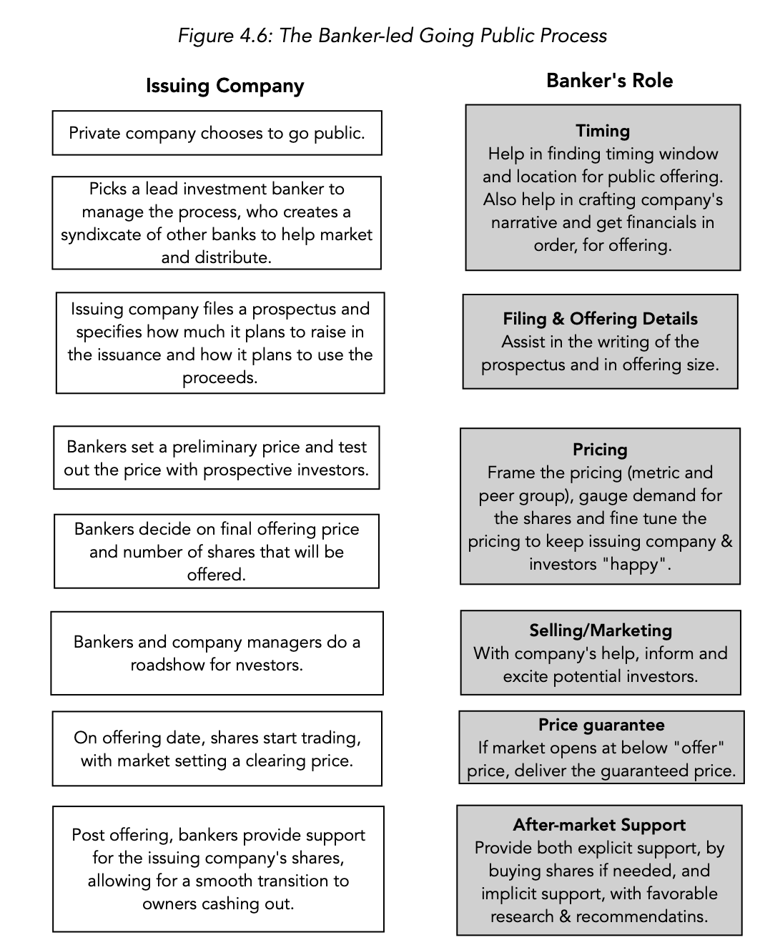
The IPO process: The Banker-led IPO

Slide 10
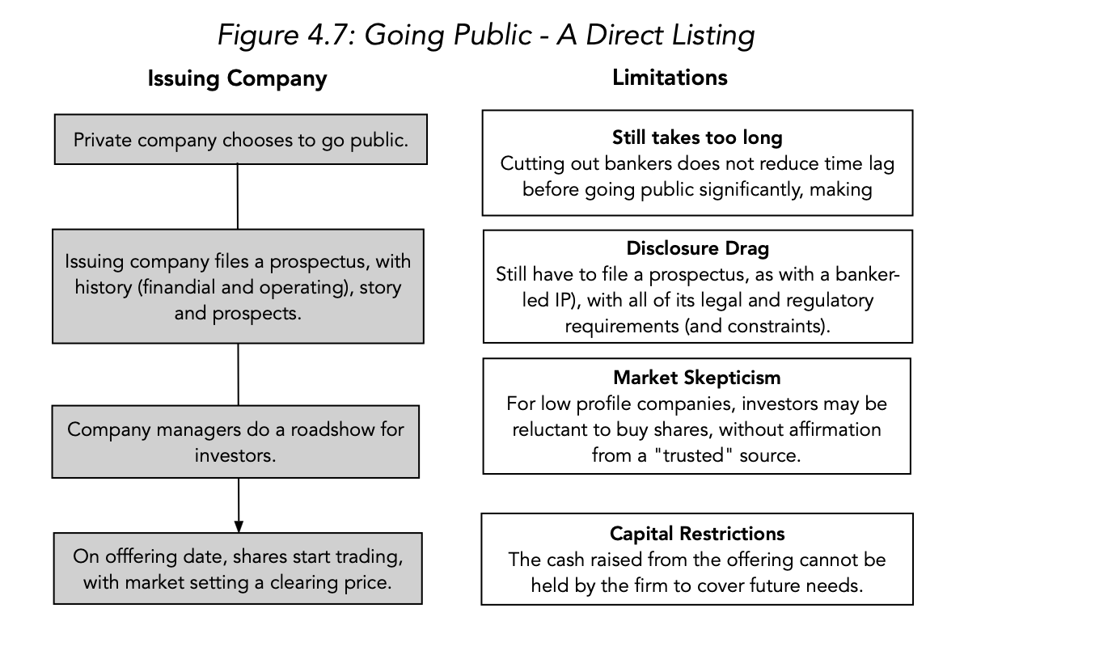
The IPO process – direct listing

Slide 11
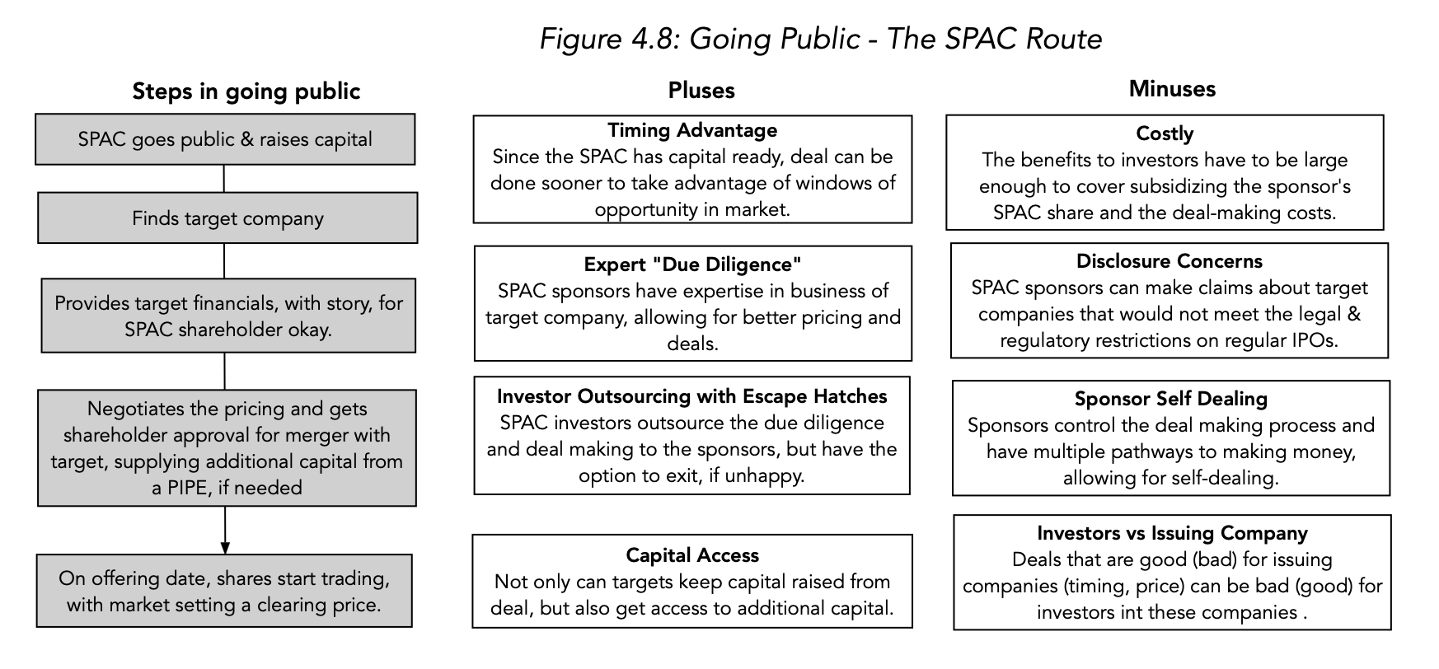
The IPO process - spacs

Slide 12
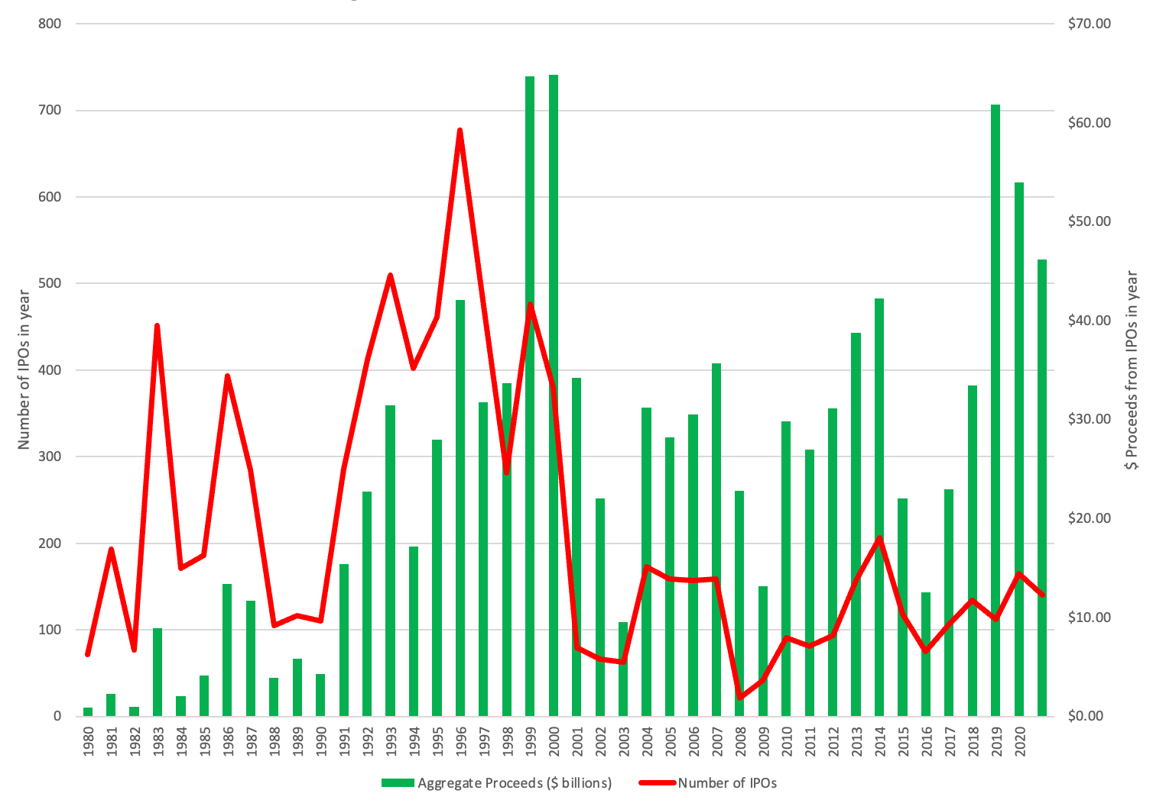
IPO Trends in offerings

Slide 13
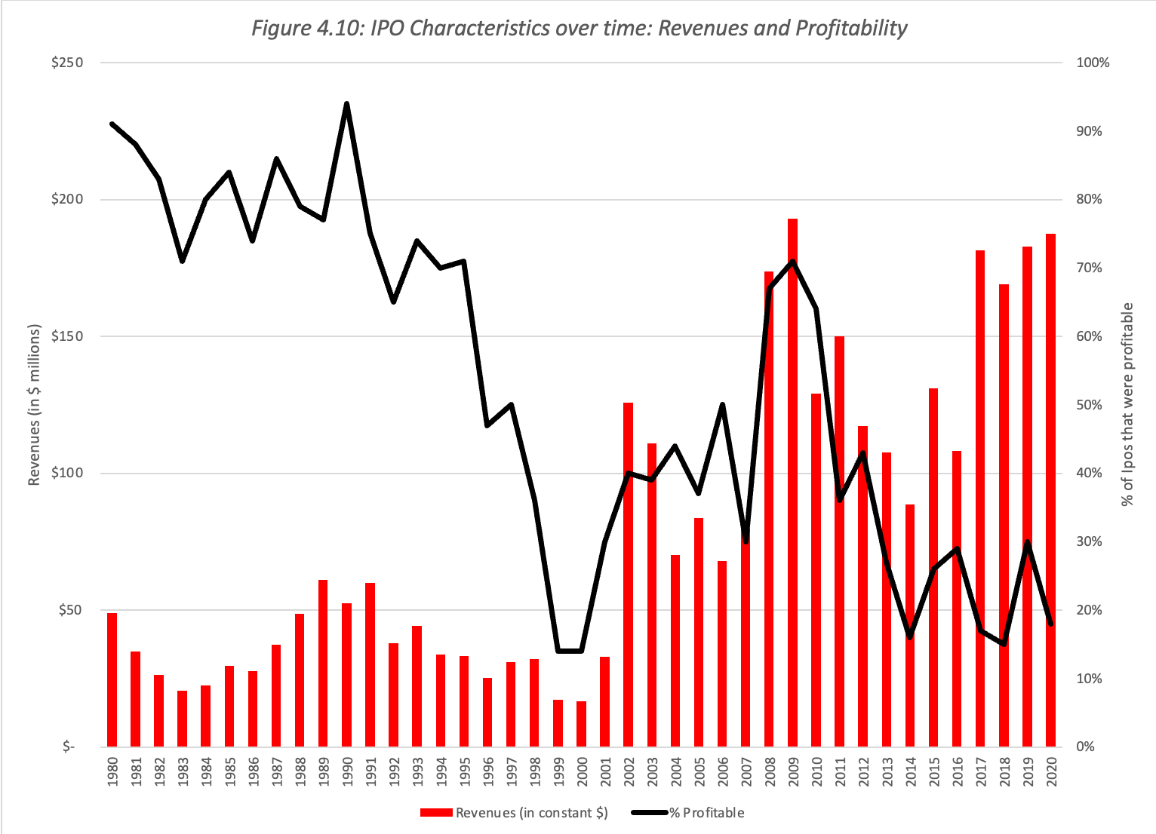
IPO trends – company characteristics

Slide 14
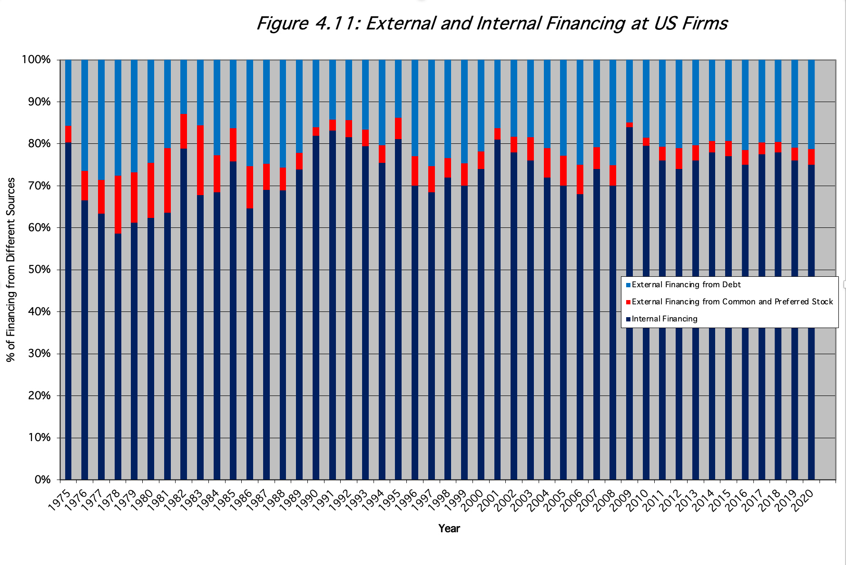
3. Seasoned equity offerings

Slide 15
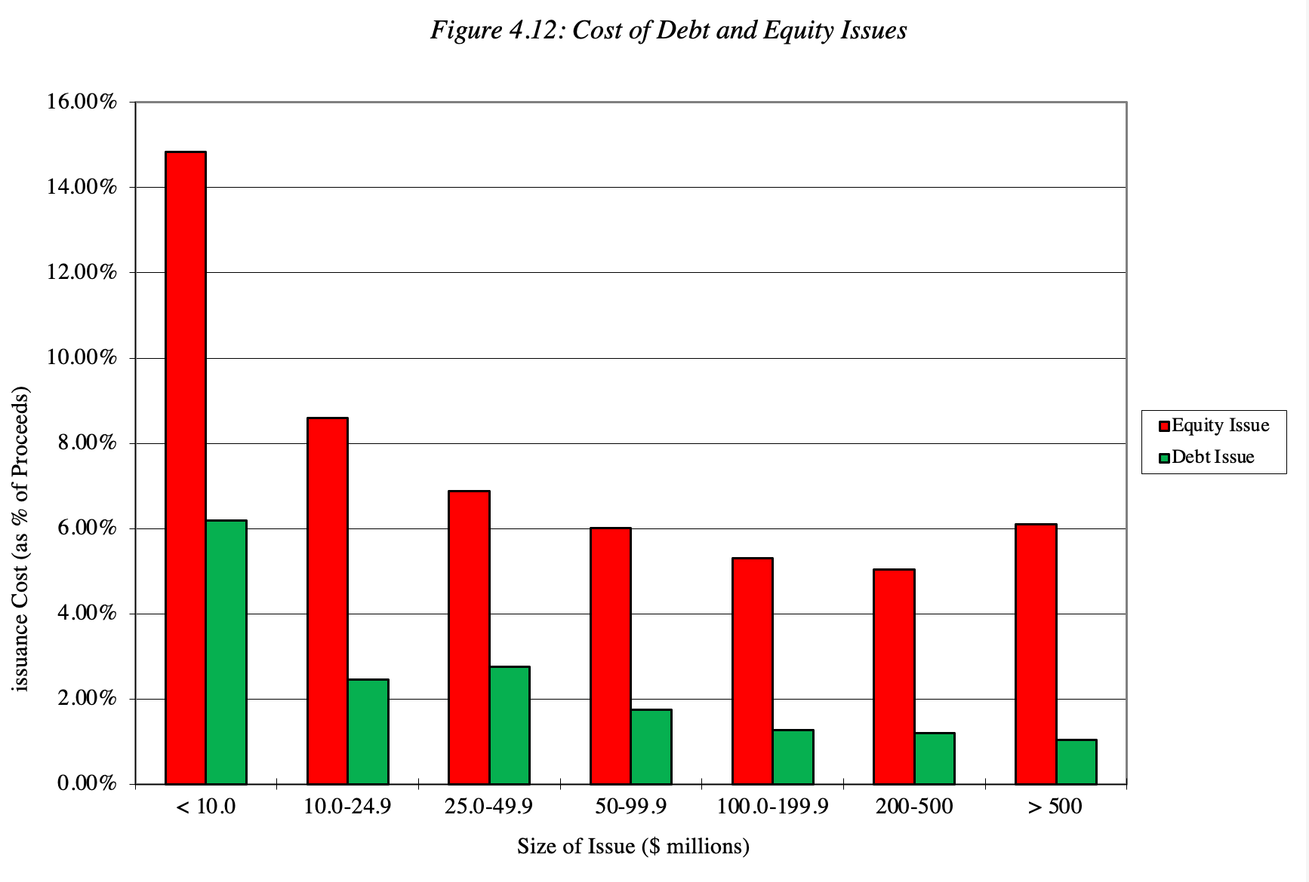
With issuance costs…

Slide 16
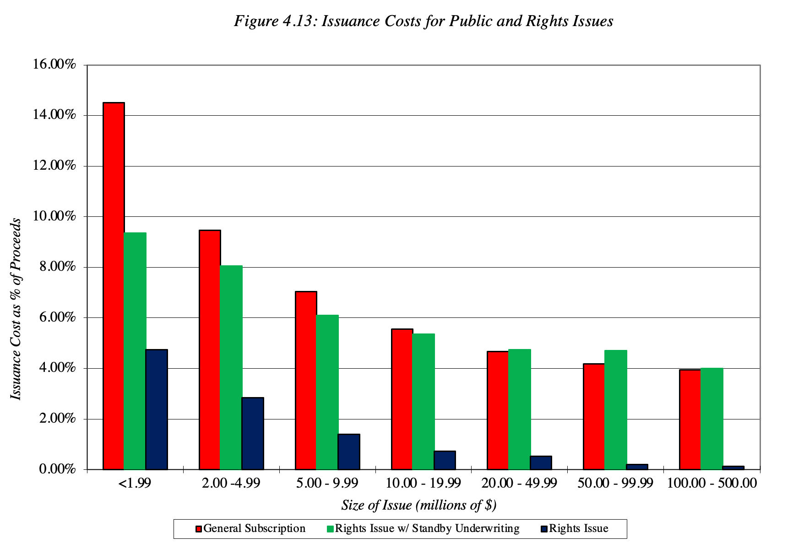
The right offering route?

Slide 17
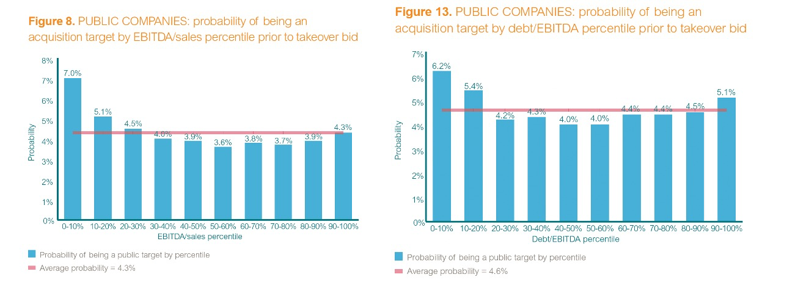
4. Private equity: Typical targets

Slide 18
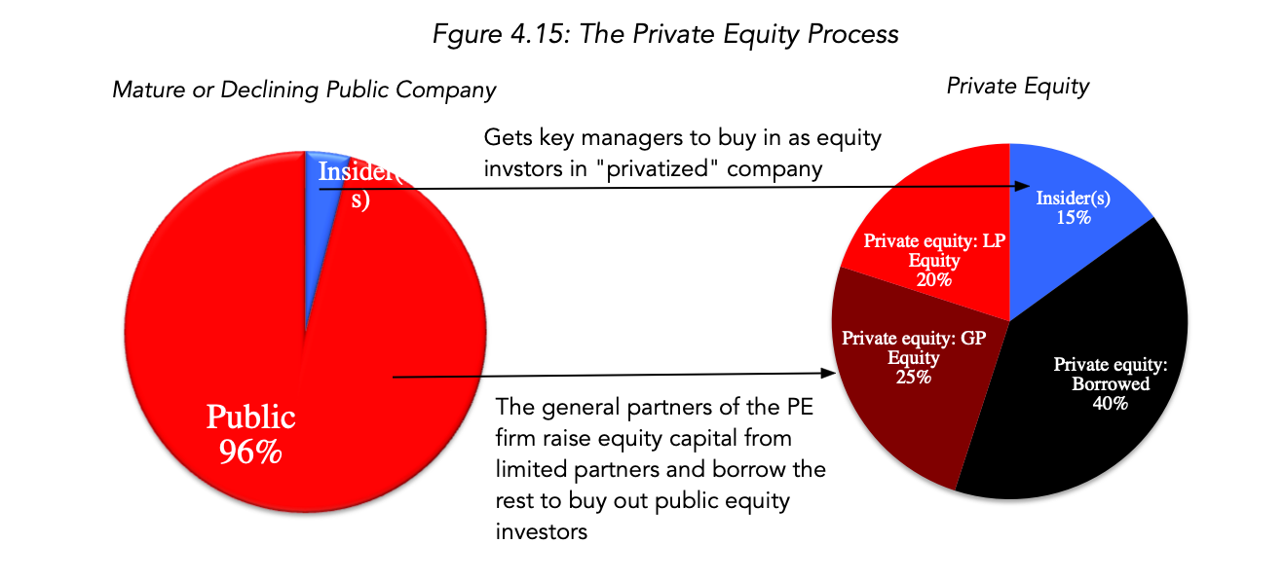
The PE process…

Slide 19
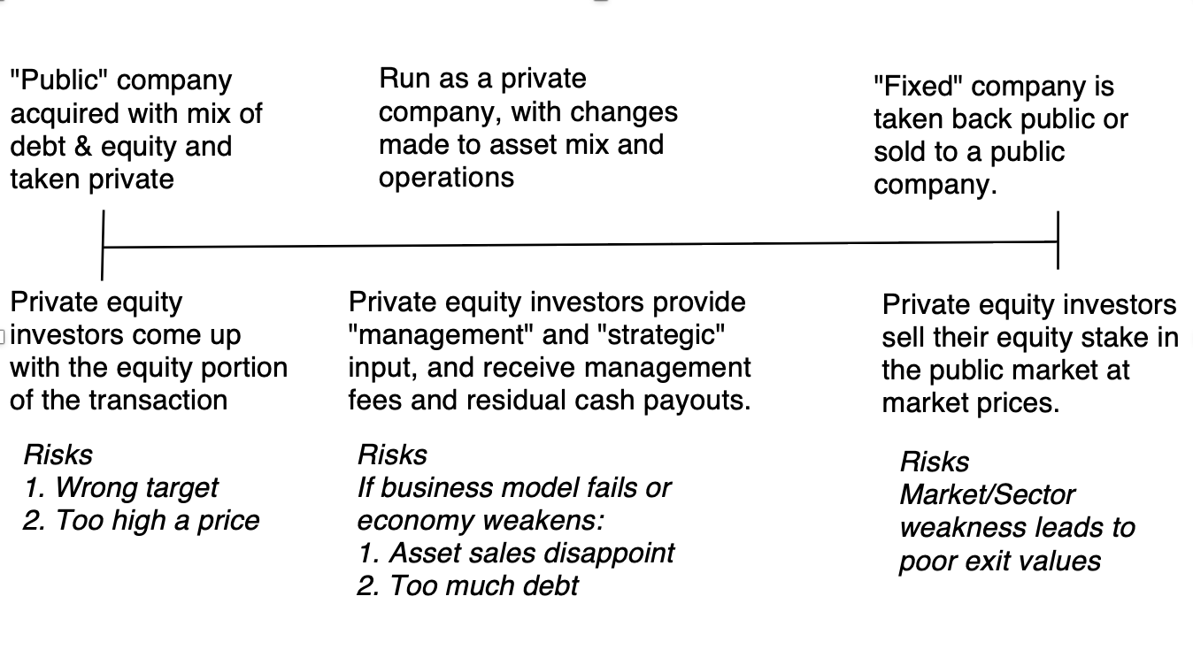
The PE timeline

Slide 20
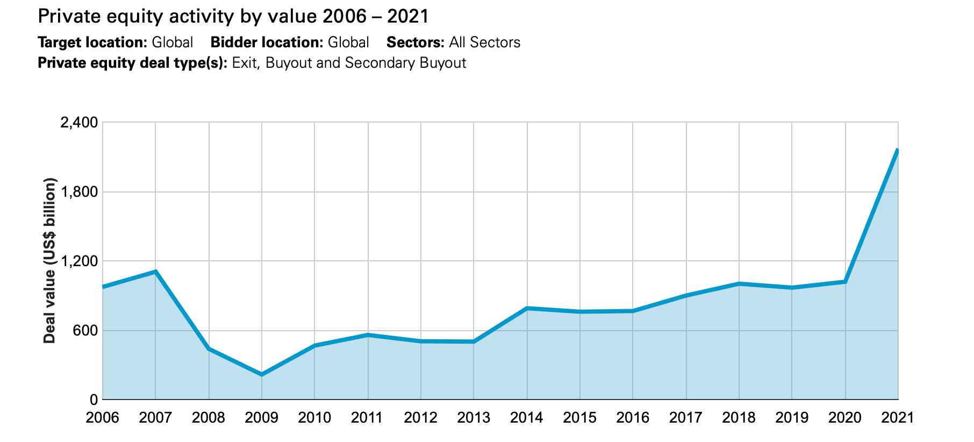
PE trends
Bigger deals: As the amount of capital flowing into private equity has increased, so has its capacity to do big deals.
Globalization: As with venture capital and initial public offerings, private equity has evolved from a primarily US phenomenon to a more global setting.
Flexibility on leverage: In the early years, almost every PE buyout was accompanied by leverage, giving rise to the LBO acronym.

