Slide 1



Chapter 5: corporate finance 101

Slide 2
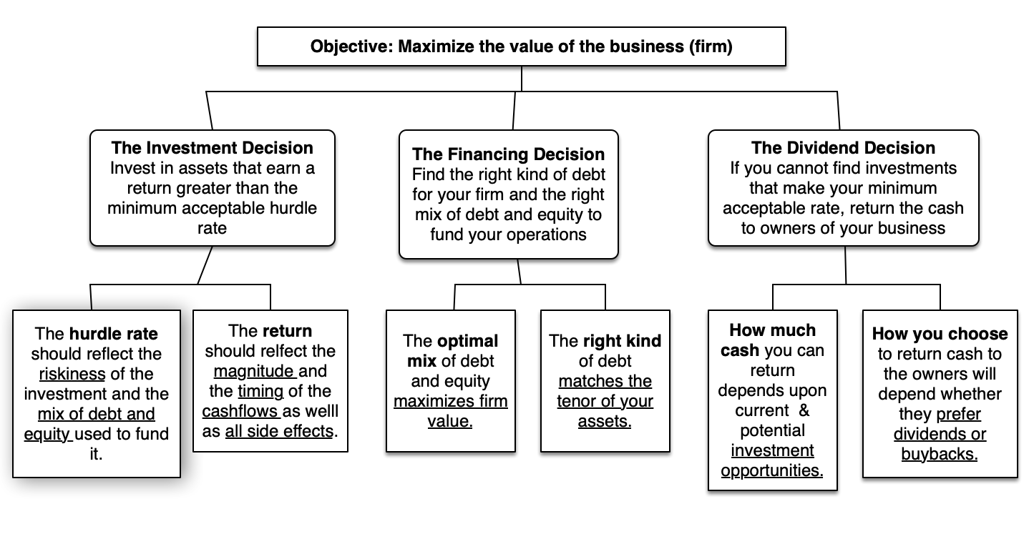
Corporate finance: The Big picture

Slide 3
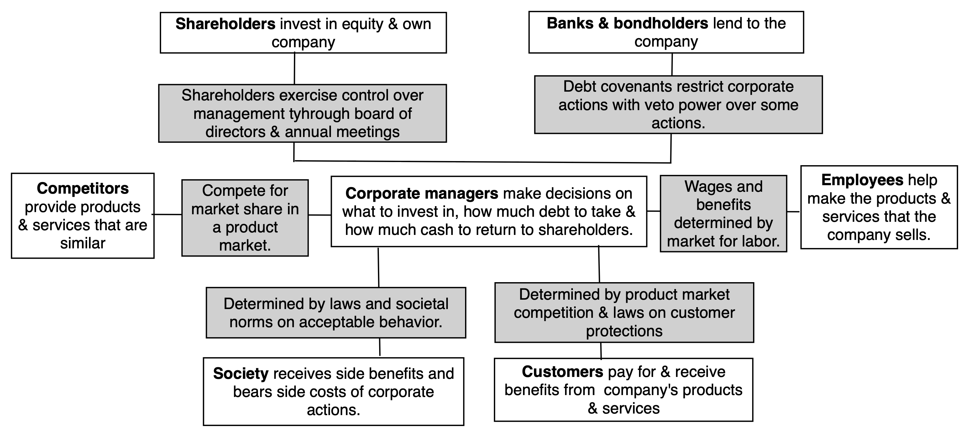
The end game in business

Slide 4
Shareholder wealth maximization
While the notion that a business should consider the interests of all of its different stakeholders is unexceptional, it fails, in our view, for two reasons:
  It leaves businesses rudderless: While all stakeholders provide key ingredients for a business to succeed, they do have very different interests in the firm, and those interests will often collide.
  It leaves managers unaccountable: If decision makers in a business are accountable to all stakeholders, we would argue that they are effectively accountable to none of them.
The shareholder value maximization objective is not perfect, by any stretch of the imagination, but the notion that it is inimical to the well-being of the other stakeholders is neither logical, nor backed by data.

Slide 5
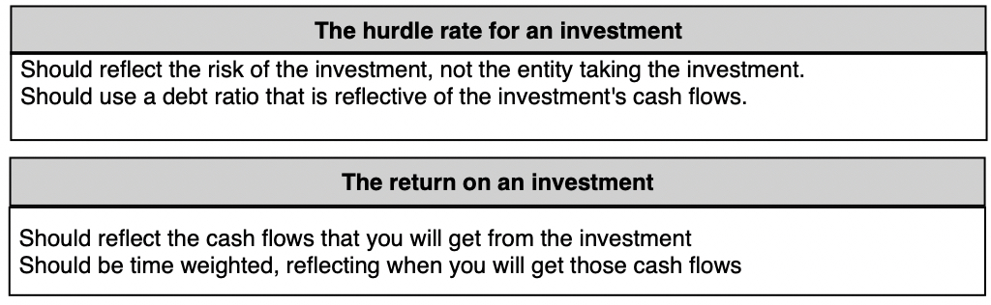
1. Investment principle

Slide 6
The hurdle rate - Risk
Type of Risk/Uncertainty | The Difference | Why we care in corporate finance
Estimation versus Economic | Economic uncertainty refers to the unexpected changes doled out by fate that no amount of research or information is going to give us insight into. Estimation uncertainty relates to judgments in investing and valuation that can be improved by collecting more information and using it better. | Businesses must make decisions in the face of uncertainty, and while more due diligence and research will reduce estimation uncertainty, they will have no effect on economic uncertainty.
Micro versus Macro | Micro uncertainty is at the company-level and comes from management decisions, legal entanglements and even from immediate competitors. Macro uncertainty can be traced back to larger forces, i.e., the swings in fortune caused by changes in inflation, interest rates and economic cycles. | The managers of a business can affect only the micro component, with better decisions translating into better payoffs. However, they cannot control the macro component, coming from overall economic or country risk.
Discrete versus Continuous | Continuous risk is risk that you are exposed to on a continuous basis, though the moment-to-moments will tend to be small. Discrete risk is risk that is uncommon but potentially catastrophic. | Risk management systems often are built to manage continuous risk, partly because you get constant reminders of its presence, and ignore or underplay discrete risks.

Slide 7
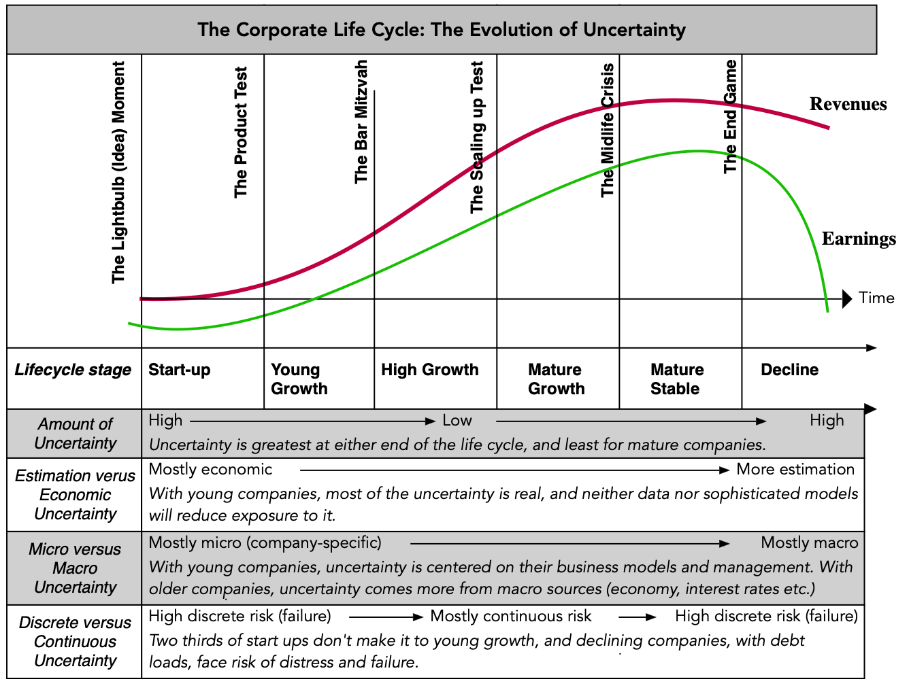
Uncertainty across the life cycle

Slide 8
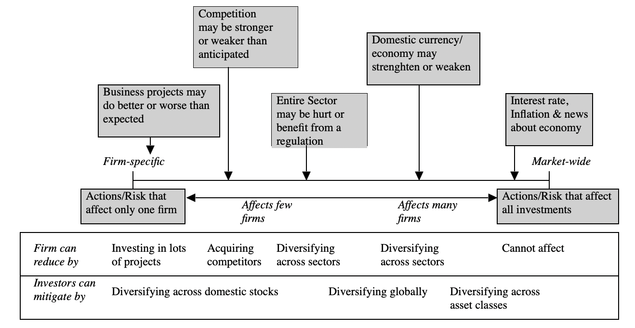
Diversifiable vs undiversifiable risk

Slide 9
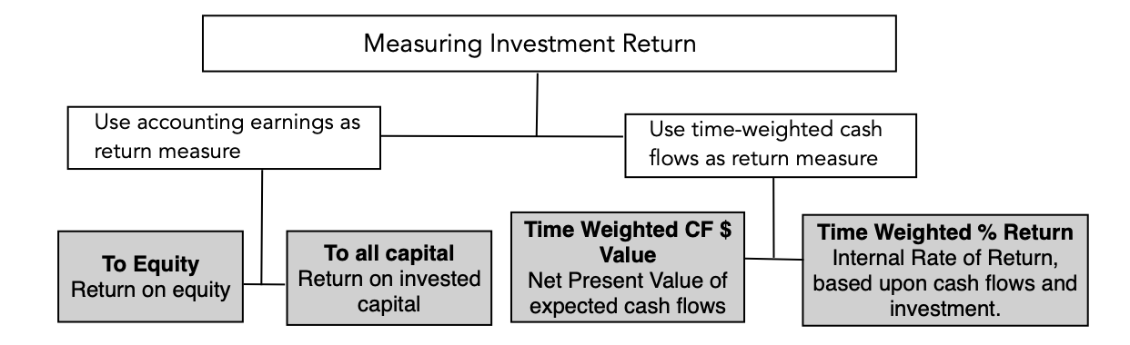
Investment returns

Slide 10
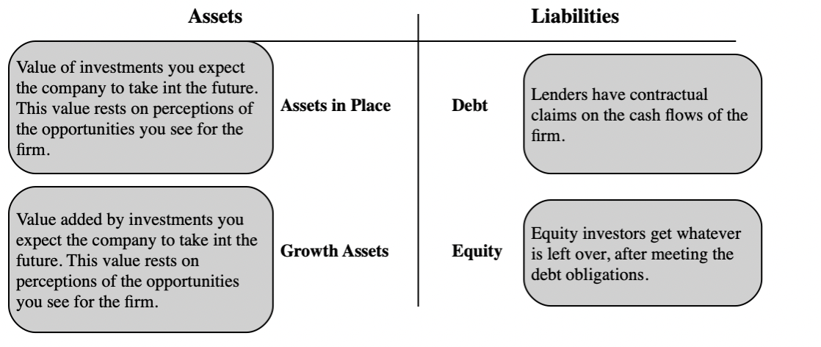
2. The financing principle

Slide 11
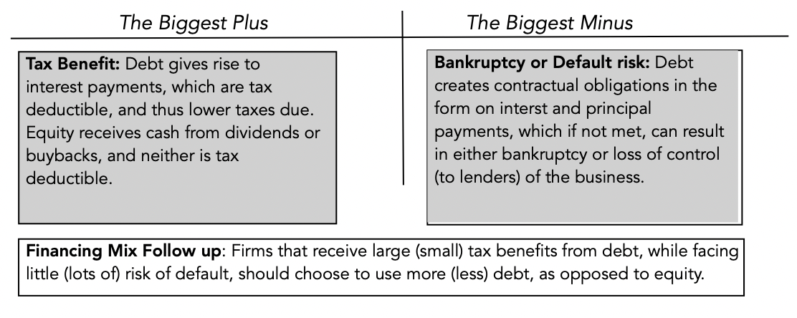
Financing mix

Slide 12
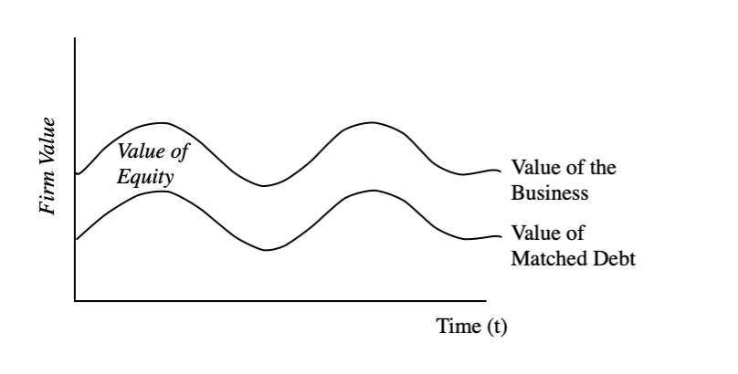
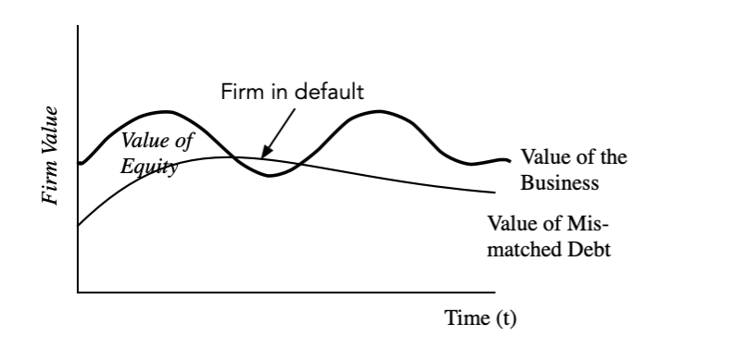
financing type
Matched debt
Unmatched debt

Slide 13
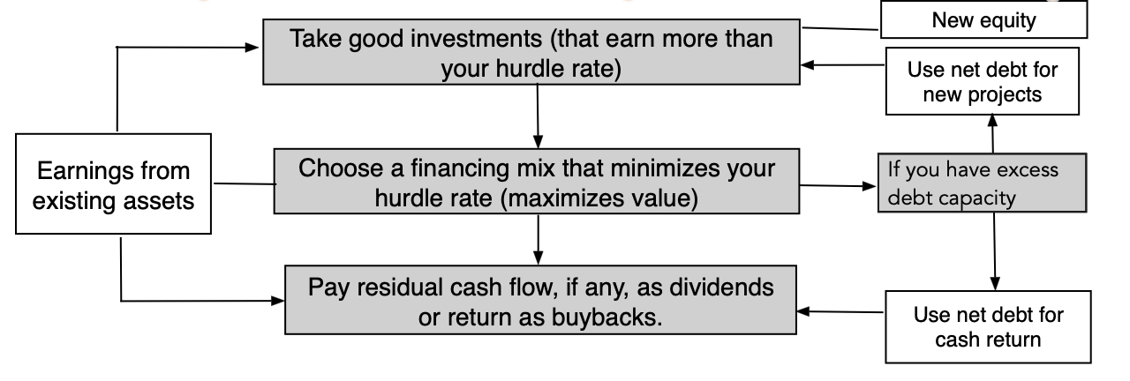
3. The dividend principle

Slide 14
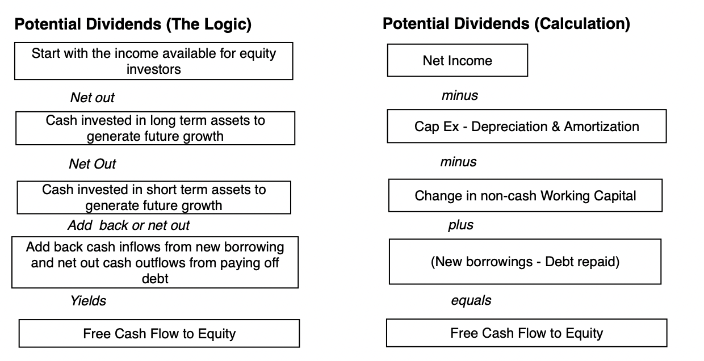
Potential dividends?

Slide 15
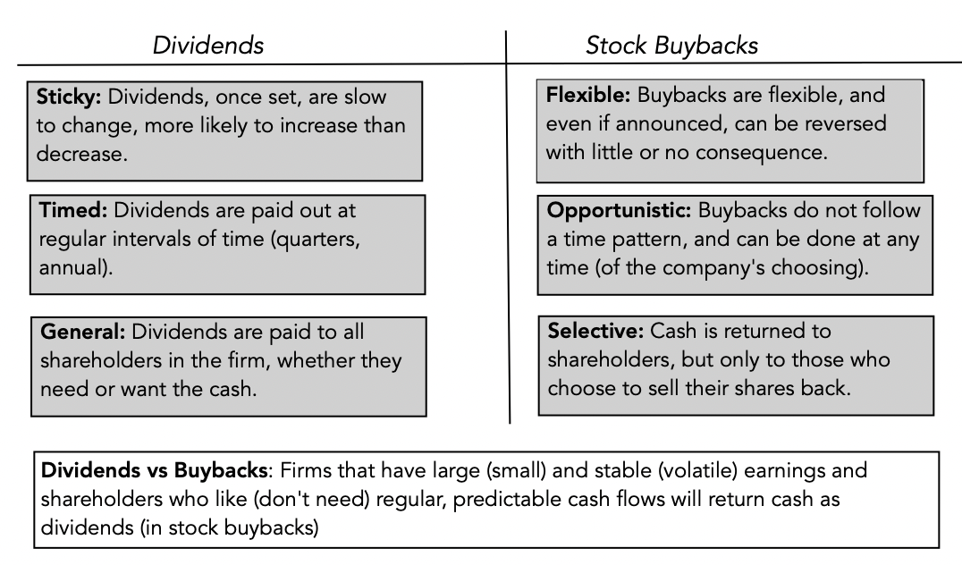
Cash return: dividends vs buybacks!

Slide 16
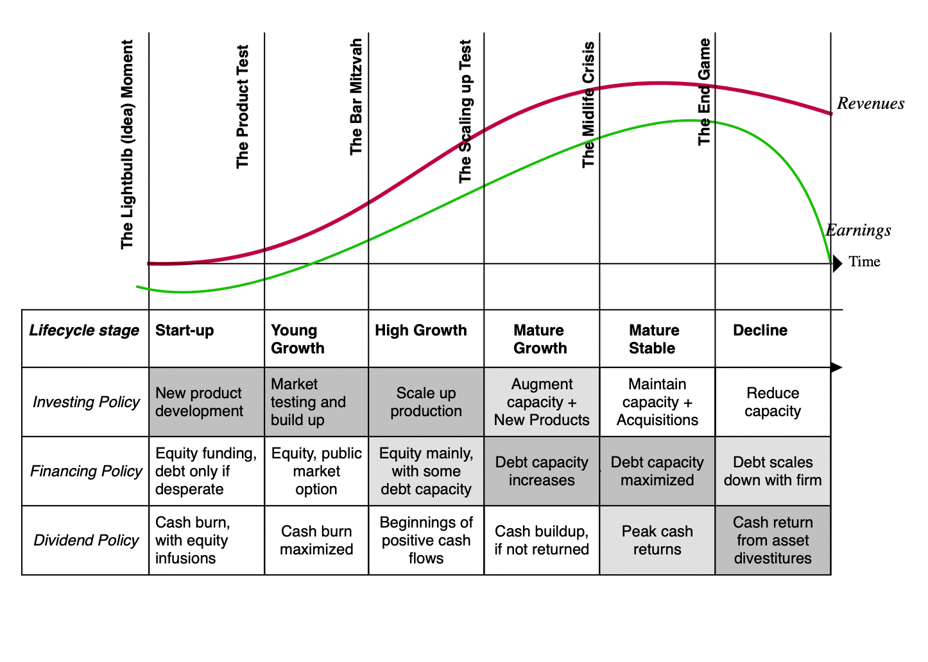
Corporate finance emphasis across life cycle

