Slide 1



Chapter 6: The Investing Decision across the life cycle

Slide 2
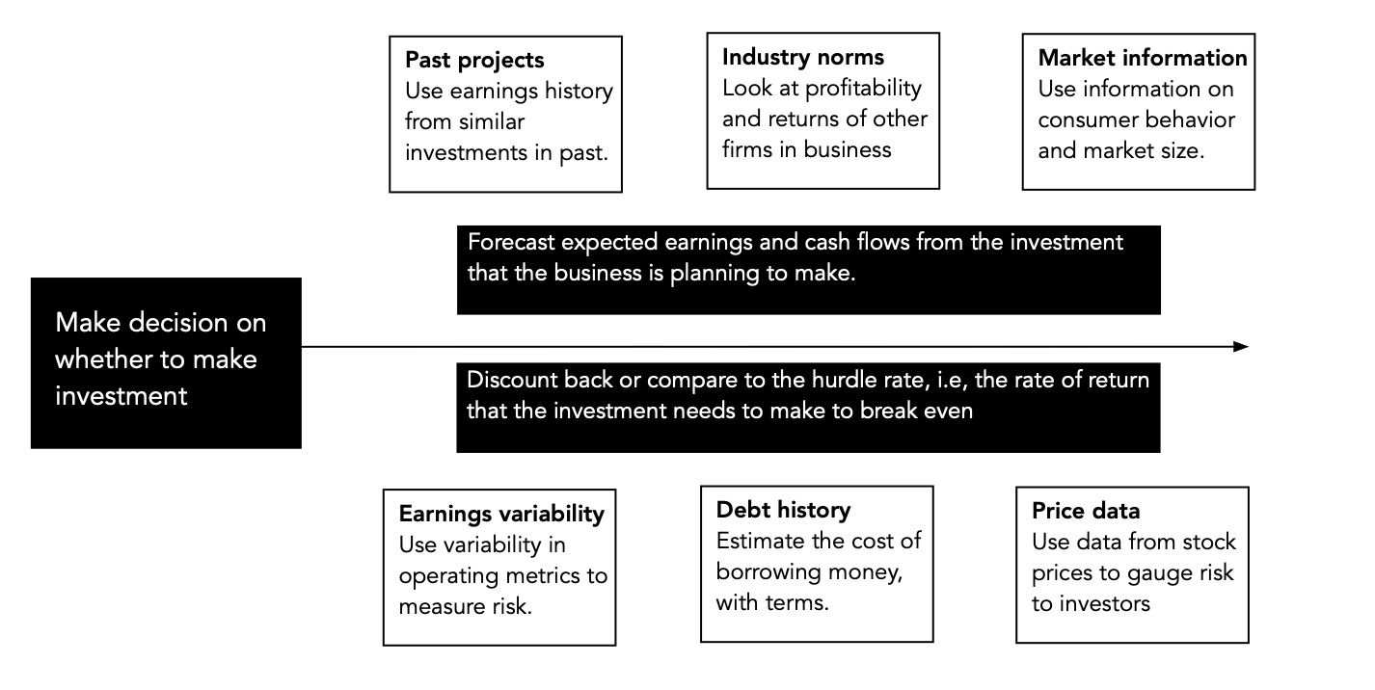
The investment process

Slide 3
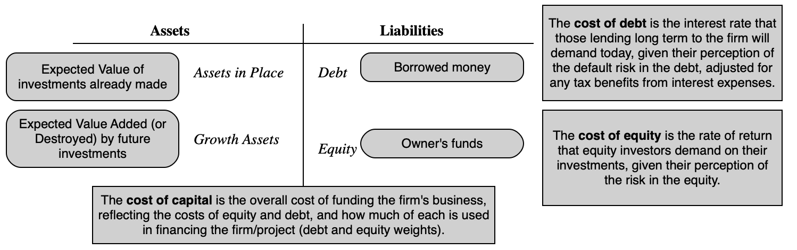
The hurdle rate: Cost of capital

Slide 4
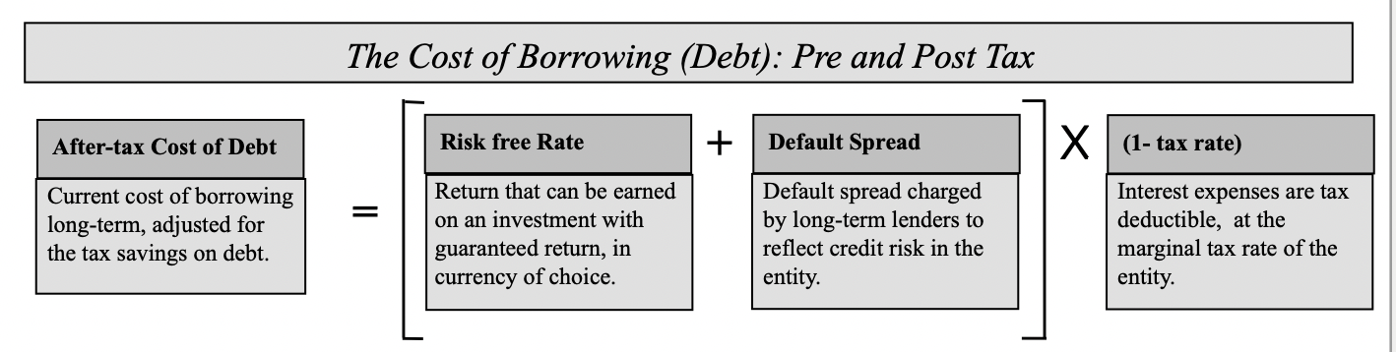
The cost of debt

Slide 5
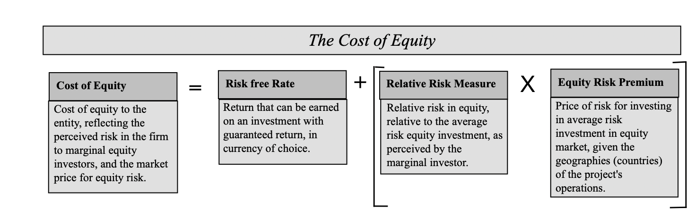
The cost of equity

Slide 6
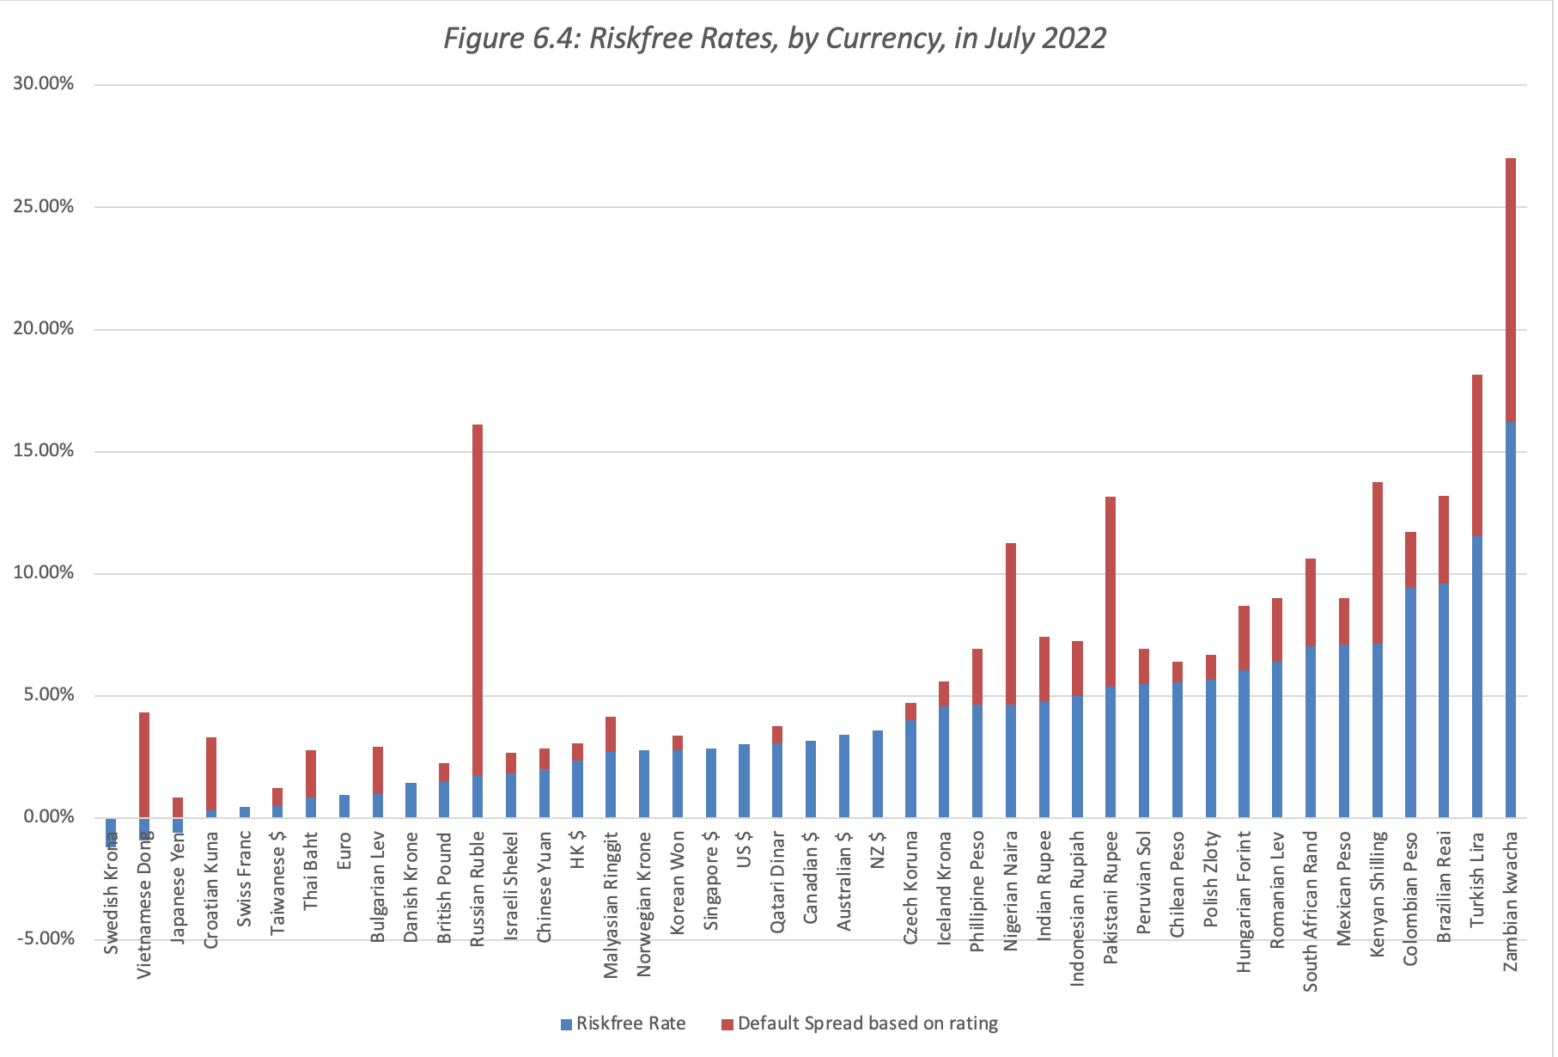
Inputs to cost of capital:
1. Riskfree rate

Slide 7
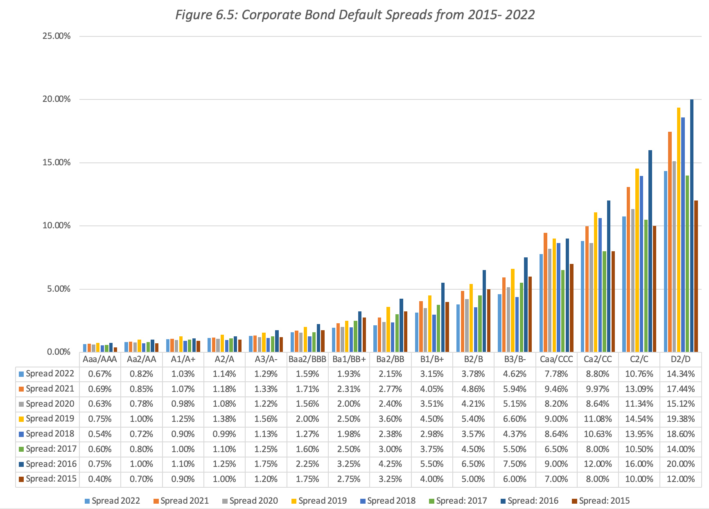
2. Default spreads

Slide 8
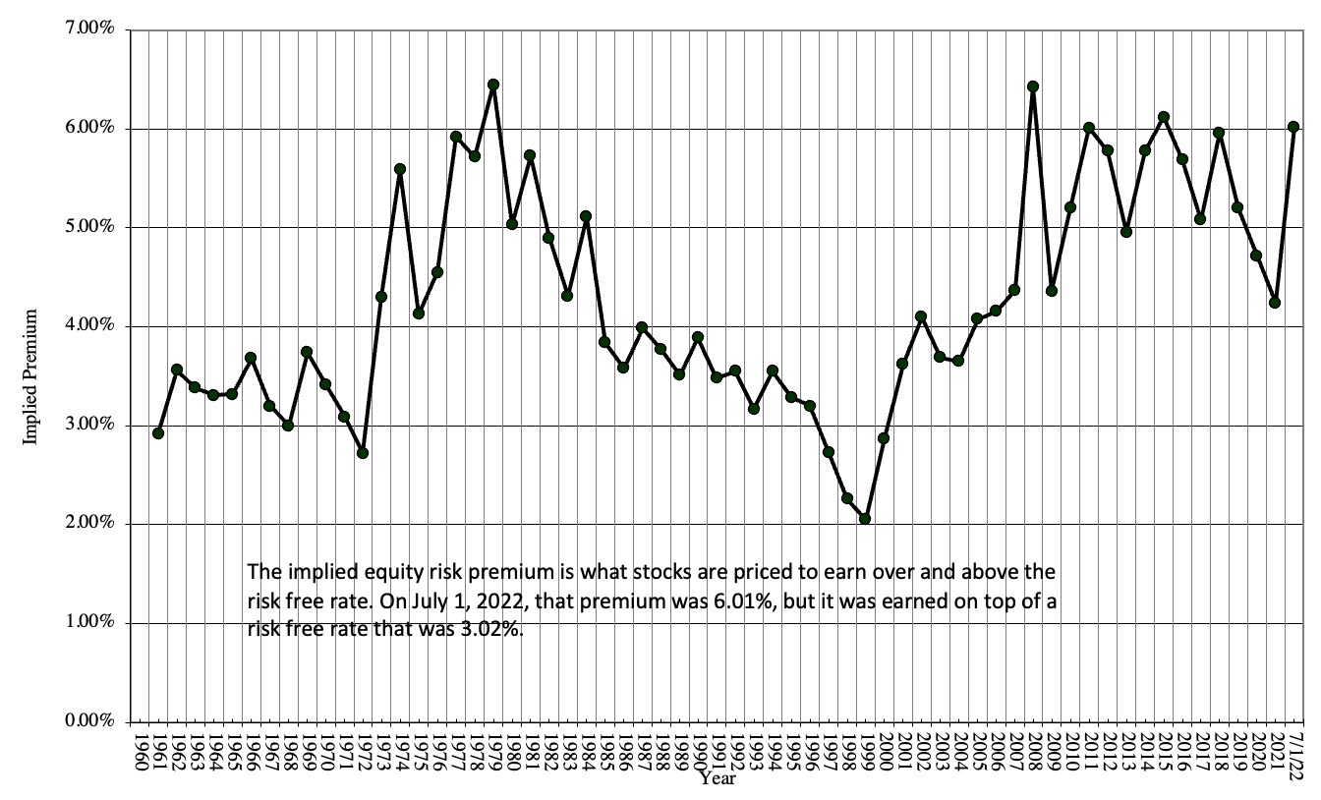
3. Equity risk premium

Slide 9
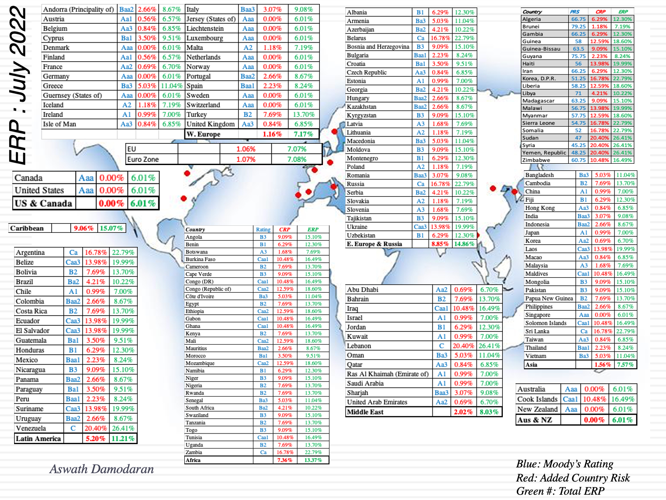
And by country, in 2022

Slide 10
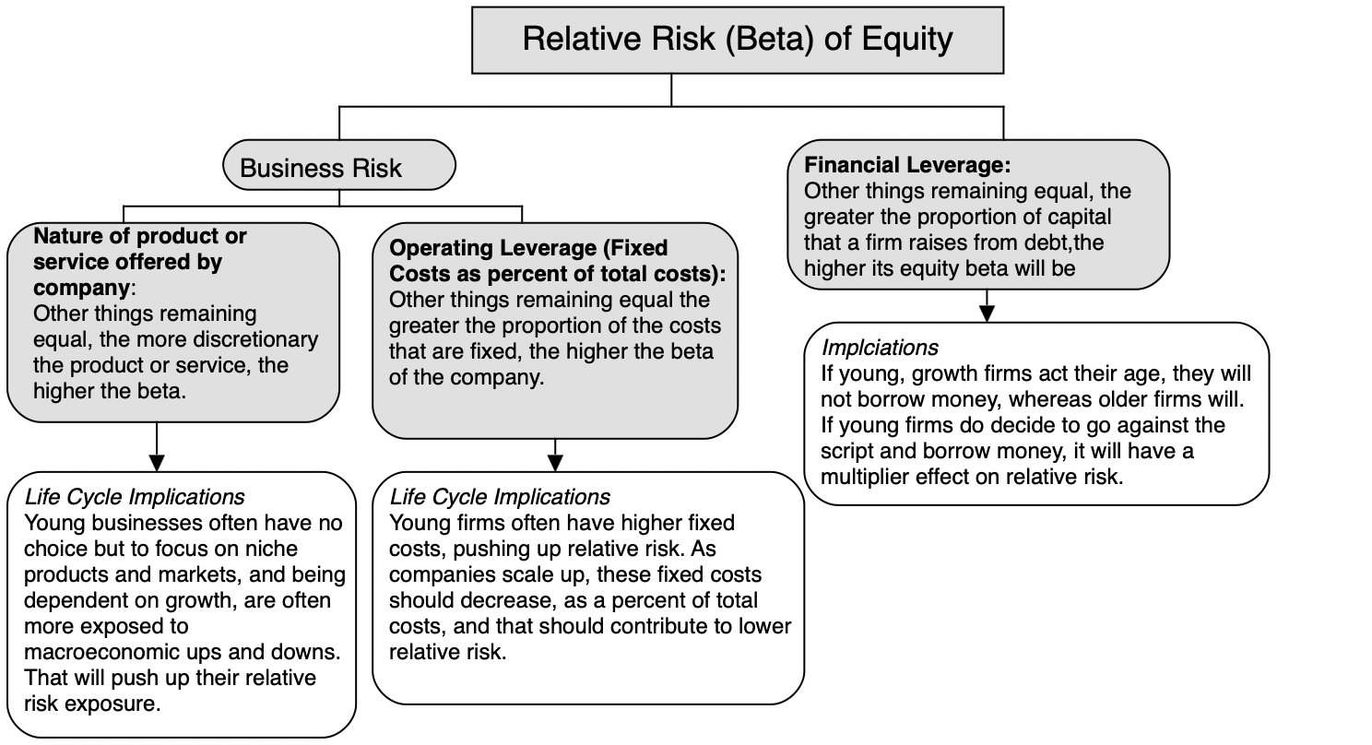
4. Relative risk (beta)

Slide 11
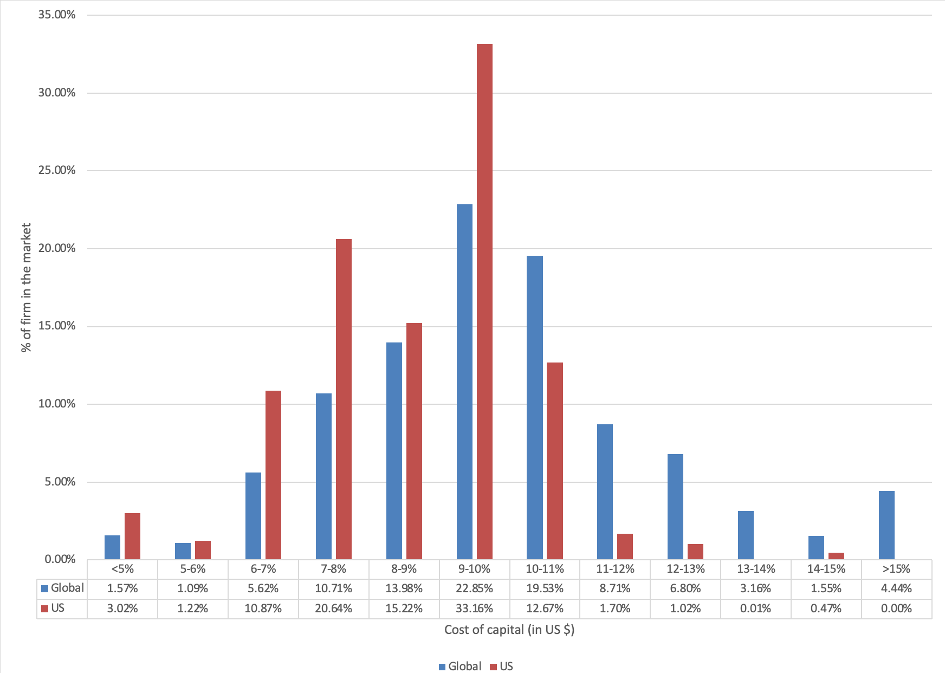
Cost of capital – distribution (all firms)

Slide 12
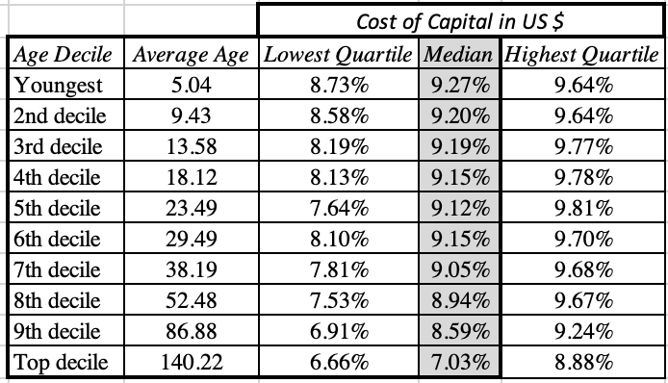
And by age decile…

Slide 13
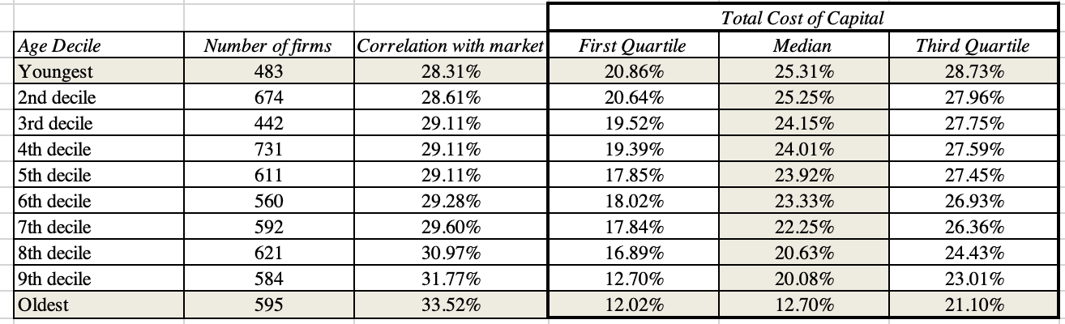
Extending to private businesses (total risk)

Slide 14
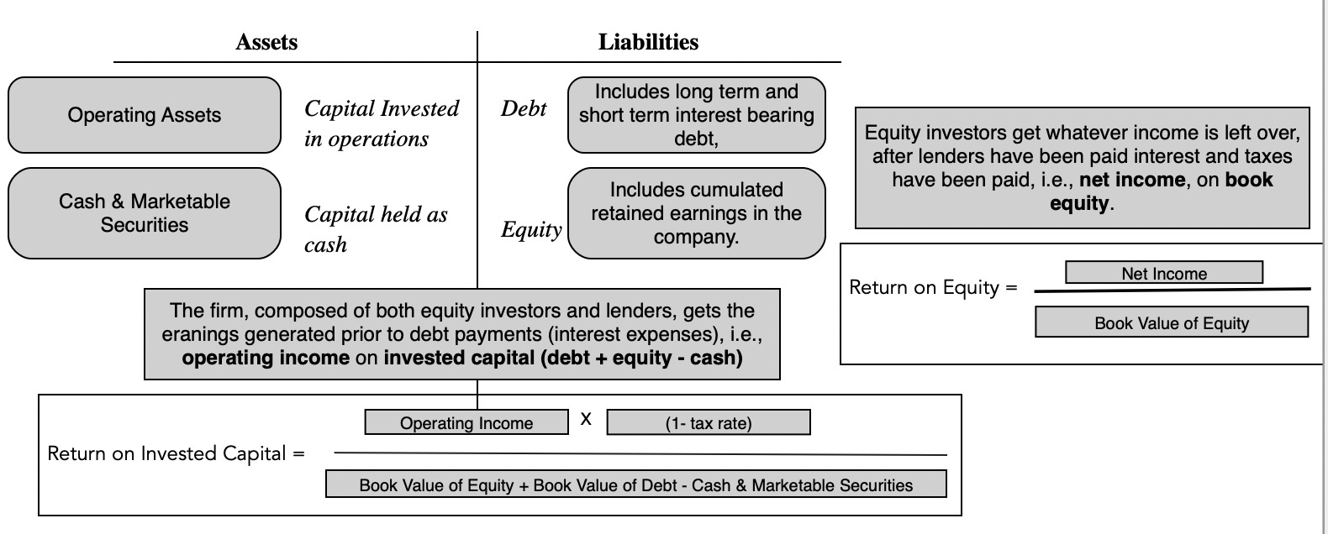
Investment decision rules:
1. Accounting returns

Slide 15
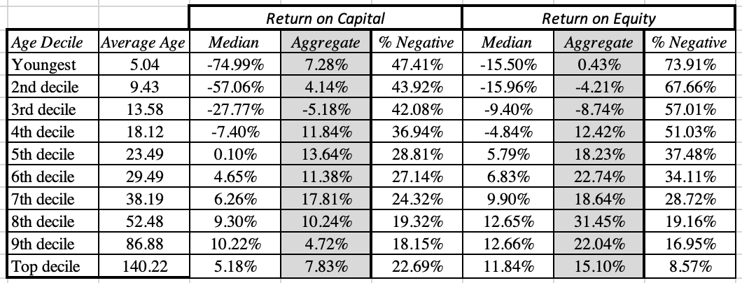
Accounting returns – by age decile

Slide 16
Investment decision rules:
2. Discounted Cashflow approaches
The net present value of a project is the sum of the present values of the expected cash flows on the project, over its lifetime, discounted back at the hurdle rate, i..e, the cost of equity or capital. If the NPV is greater (less) than zero, the project is generating a return that exceeds (trails) its hurdle rate and is a good (bad) project.
The internal rate of return is the discount rate that makes the aggregated present value of all cash flows on the project equal to zero. That internal rate of return can be compared to the hurdle rate for the project, and if it exceeds (falls below) the hurdle rate, the project is a good project

Slide 17
NPV vs irr
Percent versus Absolute Value: The first difference is that the NPV for a project is an absolute value, i.e., with expected dollar cash flows, the NPV will be a dollar value, biasing it towards investments that require more capital. The internal rate of return, as a percentage value, is likely to skew towards projects that require less capital, yielding rankings that diverge from the NPV rule.
Unique versus Multiple Values: There can be only one net present value for a project, but if a project has cash flows that change sign more than once, going from negative to positive and then back to negative, over time, there can be more than one internal rate of return for the project.
Reinvestment of intermediate cash flows: The NPV rule assumes that these intermediate cash flows are reinvested at the hurdle rate, a safe assumption if these hurdle rates represent what investors can earn in the market right now on investments of equivalent risk. The IRR rule assumes that intermediate cash flows get reinvested at the computed IRR for the project, an implicit assumption that the business will continue to have new projects very similar in quality and returns to the one that is being assessed, in the future.

Slide 18
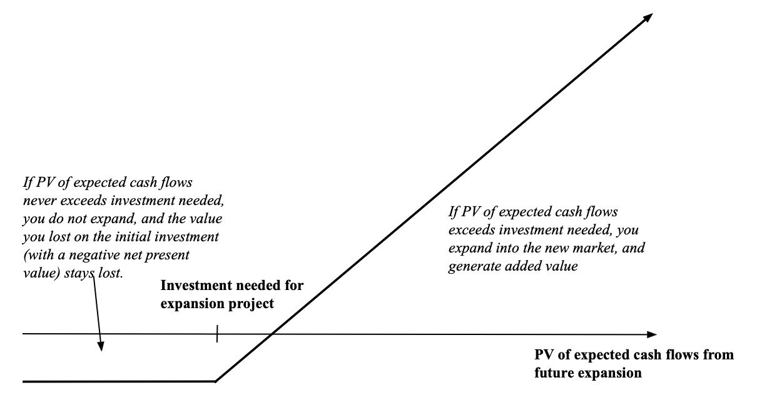
Investment decision rules:
3. Real options

Slide 19
Real options in practice
Real options are notoriously difficult to value, since the option pricing models that we use to value listed options do not adapt well to valuing project options, where the underlying asset is not traded, the options are long term and early exercise is more the rule than the exception.
However, recognizing that there is a real option embedded in a project can yield valuable insights and alter decision making. Thus, even without attaching a value to the option, we know that option to expand have the most value, when the market you plan to expand into is a big one and when you are most uncertain about its size, and whether you will be able to enter it.
While businesses across the life cycle can and often do make real options arguments for investing in projects that don’t pass financial muster (NPV is less than zero or return on capital is less than the cost of capital), you can see the appeal to young firms, especially those entering large markets, since they often face the most uncertainty about the future.

Slide 20
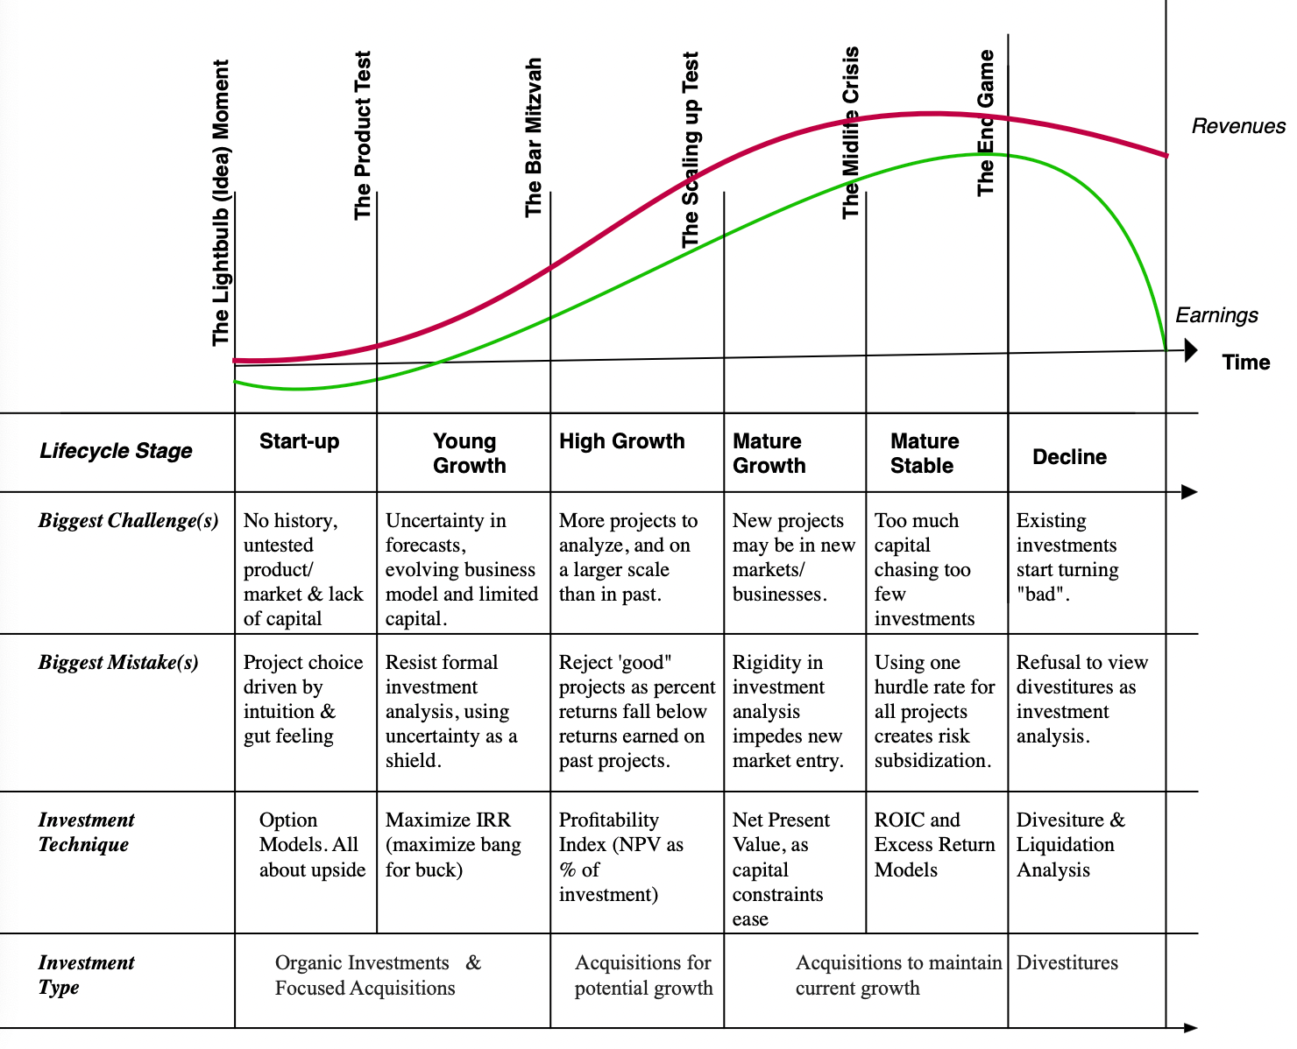
Investment decision rules across the life cyCle!

