Slide 1



Chapter 7: The Financing Decision across the life cycle

Slide 2
The Debt-Equity trade off
If the choice that businesses face is between using equity and debt, the way to determine which funding source will benefit them more is to weigh the costs and benefits of borrowing money, relative to using equity.
  We will start by arguing that many businesses are drawn to debt for what we will term illusory reasons,.
  We will then move to the other end of the spectrum, and consider just the financial tradeoffs, i.e., the fundamental costs and benefits of borrowing.
  We will end by looking at market frictions, mispricing and distortions that can lead some businesses to borrow more or less than they should, given fundamentals, and how these deviations vary across the life cycle.

Slide 3
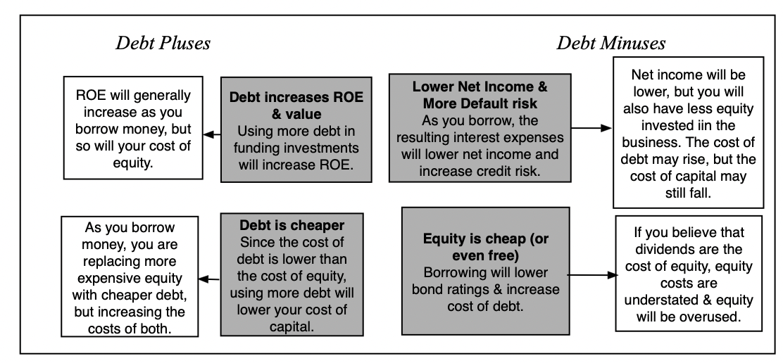
The Illusory trade off

Slide 4
And implications across life cycle
While these illusory reasons are used by firms across the life cycle, they can often explain inexplicable choices made by firms at each stage.
  There are young firms, clearly unsuited to debt, that choose to borrow money because the interest rate that they pay on the debt looks lower than the target rates demanded by venture capitalists. This illusion is fed by the inclusion of equity components in debt, as is the case with convertible debt or venture debt paired with equity warrants, that lower the interest rate on the debt.
  At the other end of the spectrum, there are mature firms that are family-run that view equity as a free or very cheap source of capital that choose to borrow very little or no money and take investments that barely make money, because of their misconceptions about funding costs. At the heart of this illusion is the belief that dividends are the only cost of equity.

Slide 5
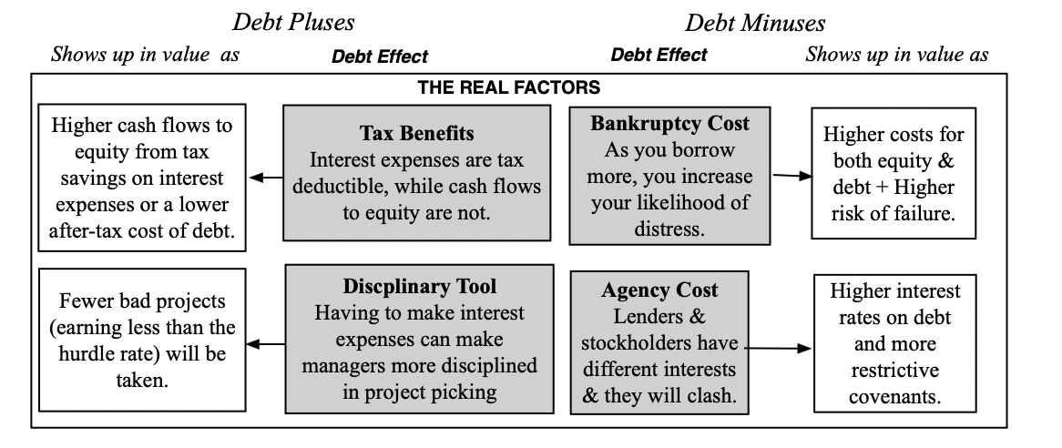
The financial trade off

Slide 6
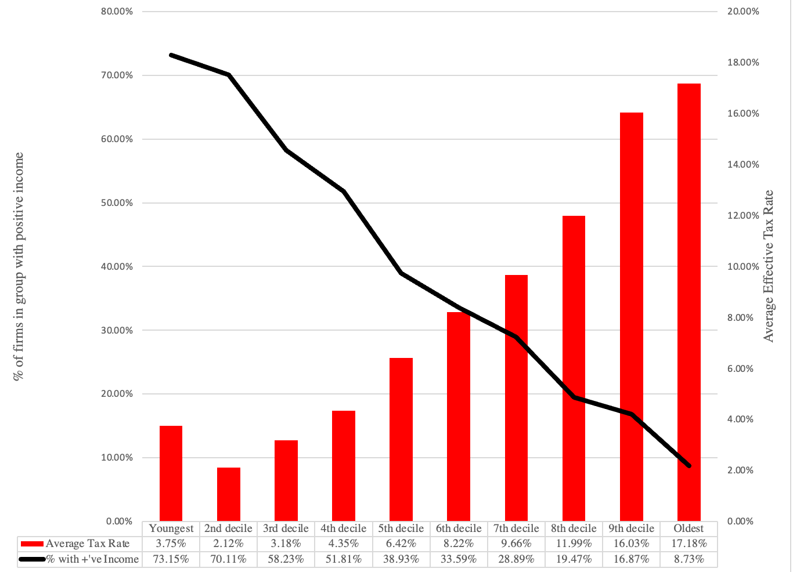
I. Tax Benefits

Slide 7
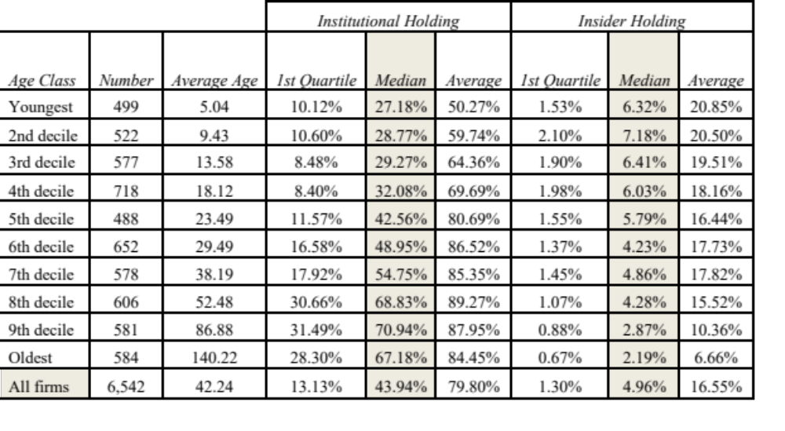
II. Added discipline

Slide 8
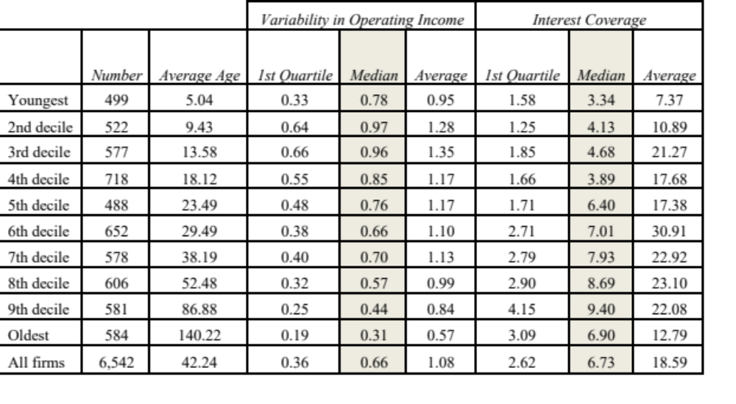
III. Bankruptcy costs

Slide 9
IV. Agency costs
When you lend money to a business, the two biggest factors determining how concerned you are about equity investors putting your interests at risk relate to the composition of your assets and your capacity to monitor how equity investors are using the capital you provide them.
  On the first count, lenders seem to feel less concerned about this agency problem when they lend based on tangible assets, such as real estate or a physical plant, than based on intangible assets. With young businesses, where the bulk of value comes from growth assets, i.e., investments that they make in the future, you can understand why lenders are leerier about letting equity investors free play with their capital.
  In addition, as young businesses experiment with different business models and try to gauge market size, lenders also often find themselves unable to monitor how money is being spent in a business, and this fear gets worse in evolving sectors such as technology, where they know far less about the business than the founders/equity investors do.
To induce a lender to lend money to a young company, not only do interest rates have to be set much higher, and covenants made more restrictive, but lenders also must be offered a share of the upside, in the form of an equity stake, to commit.

Slide 10
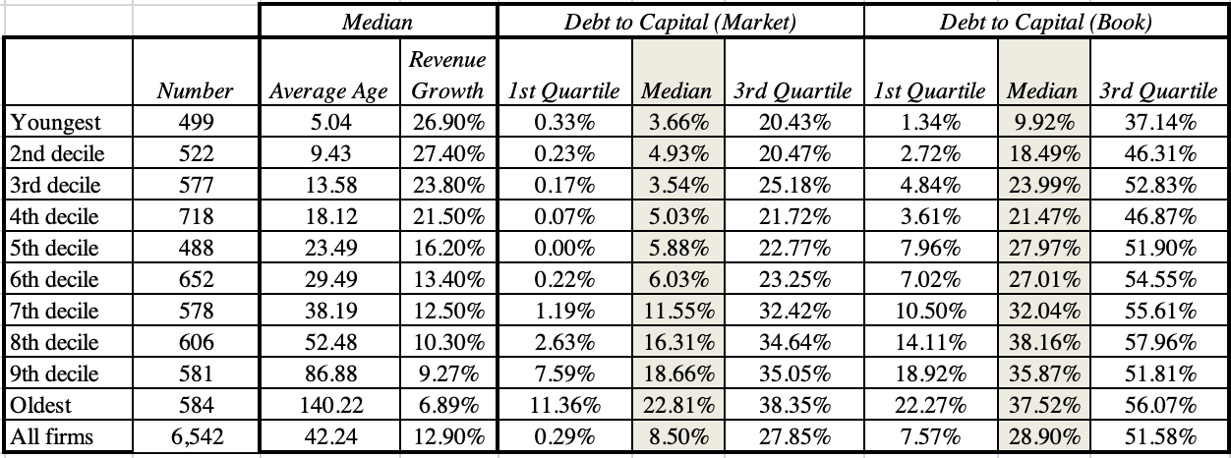
Debt MIX across the life cycle

Slide 11
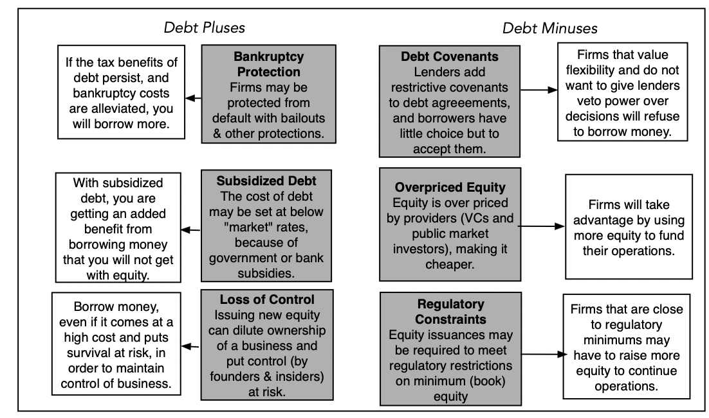
The Frictional trade offs

Slide 12
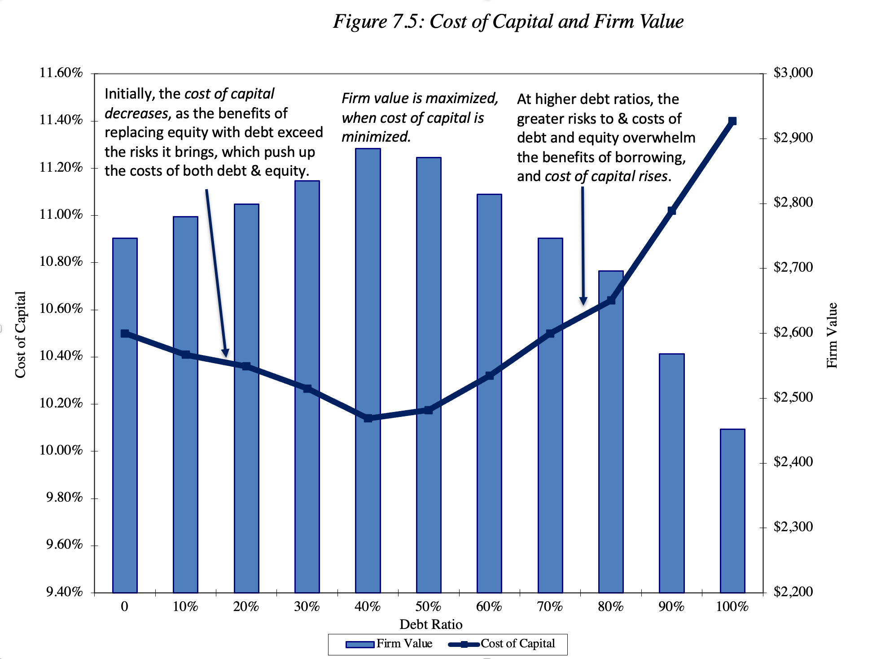
Optimizing tools: The cost of Capital

Slide 13
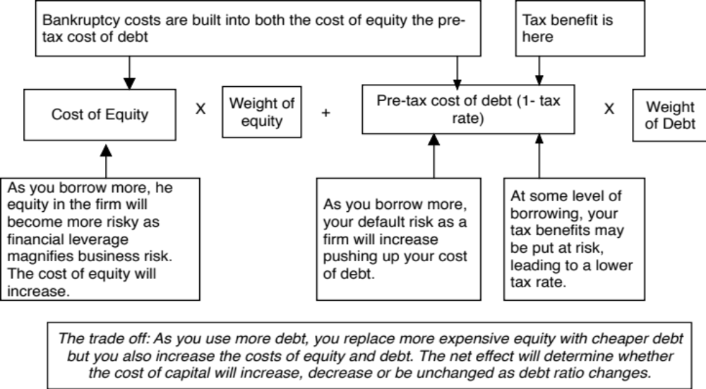
Cost of capital mechanics

Slide 14
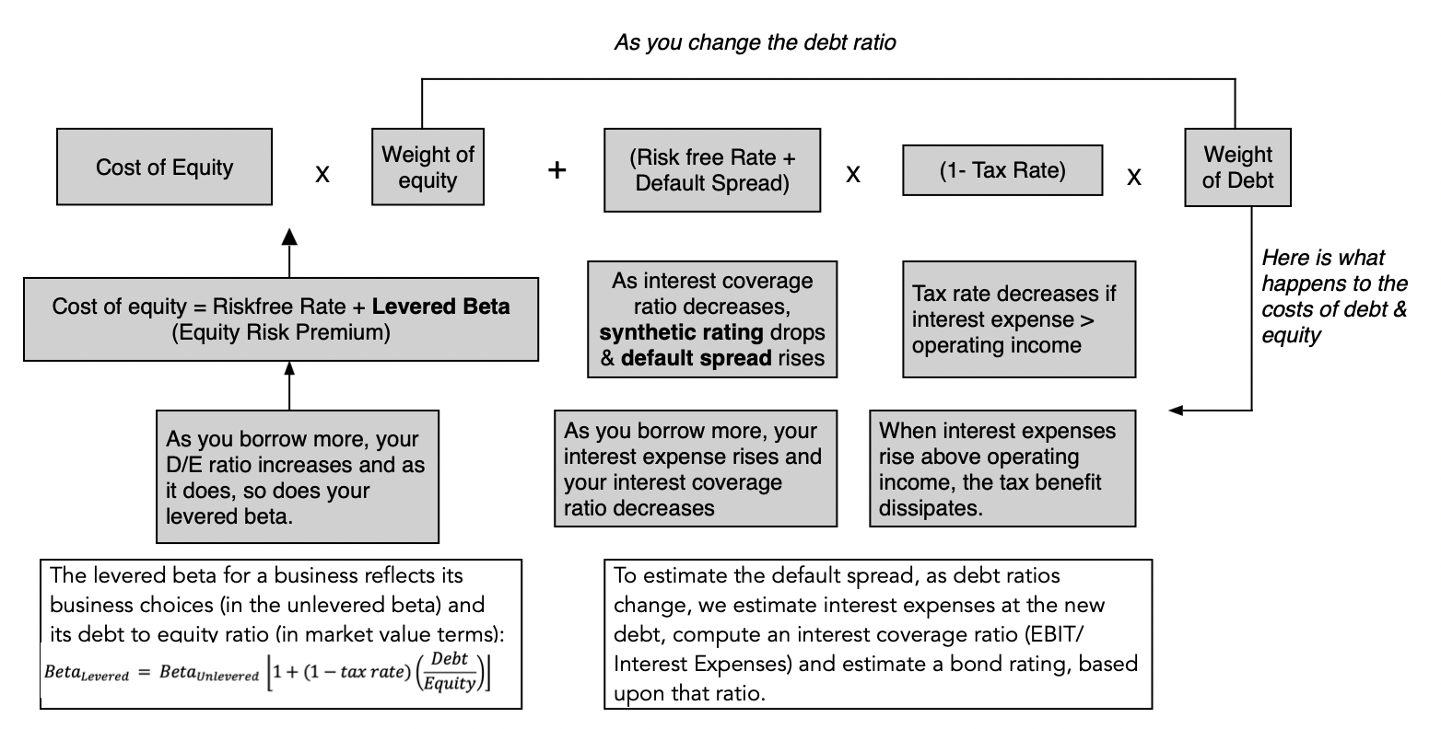
Estimation process

Slide 15
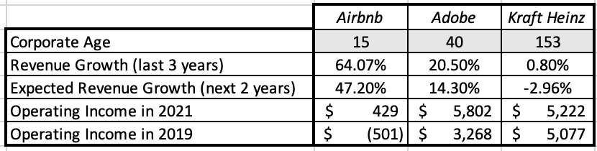
Cost of capital examples across the life cycle

Slide 16
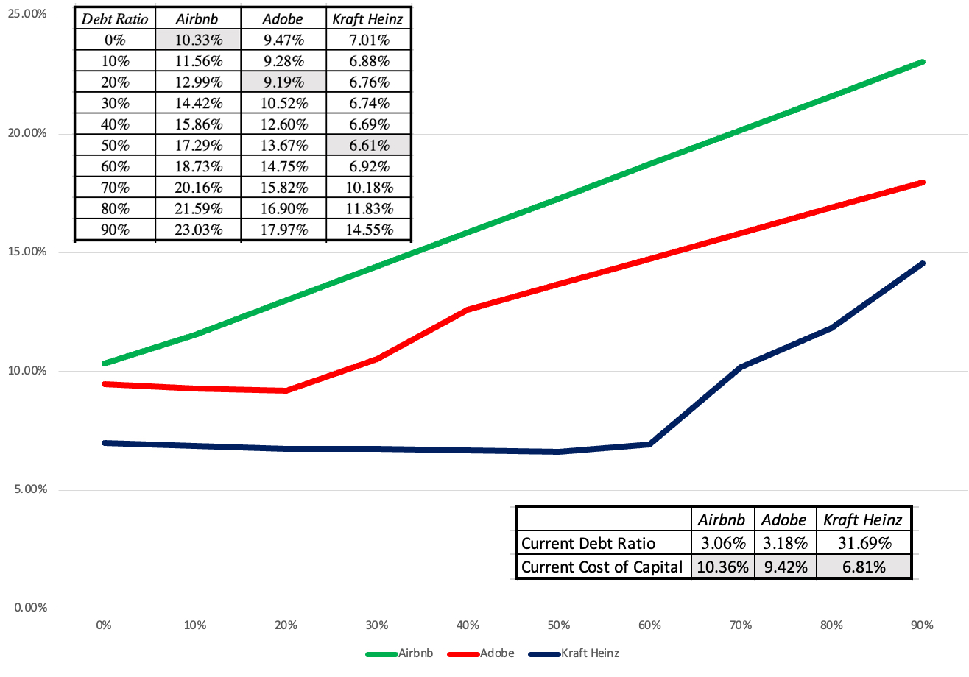
Optimal debt mix

Slide 17
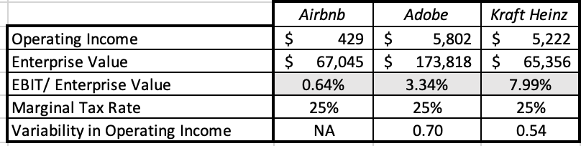
Explanation and follow up

Slide 18
Peer group assessment
For many firms, finding the right mix of debt of equity does not come from the capacity of these firms to generate tax benefits from debt or weighing these benefits off against expected bankruptcy costs, but from looking at what other companies in these peer group are choosing to borrow.
The roots of me-too finance, which is our descriptor for making major corporate finance decisions (borrowing, dividend policy and even investing) based upon what other companies in the sector are doing, lie in the belief that making mistakes, as a manager, becomes easier to defend, when you have lots of company.
The perils of peer-group driven debt decisions lie in the choices that you must make in picking companies that will comprise your peer group and coming with a metric that measures debt load.

Slide 19
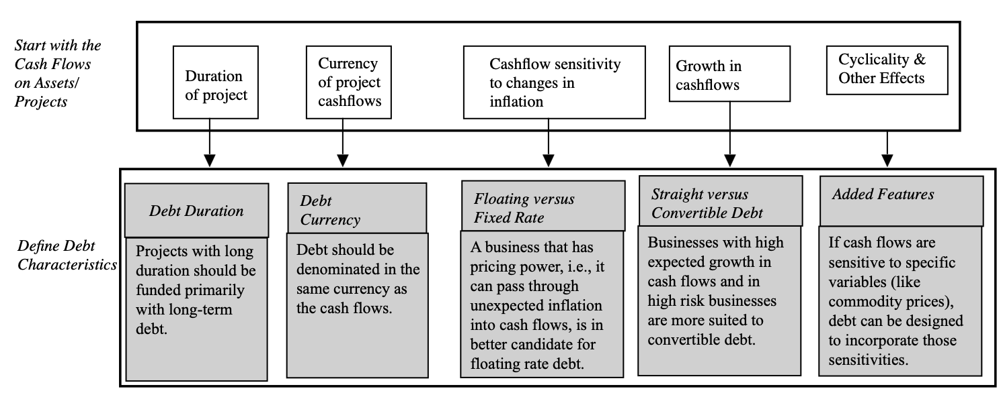
Financing type: The Matching principle

Slide 20
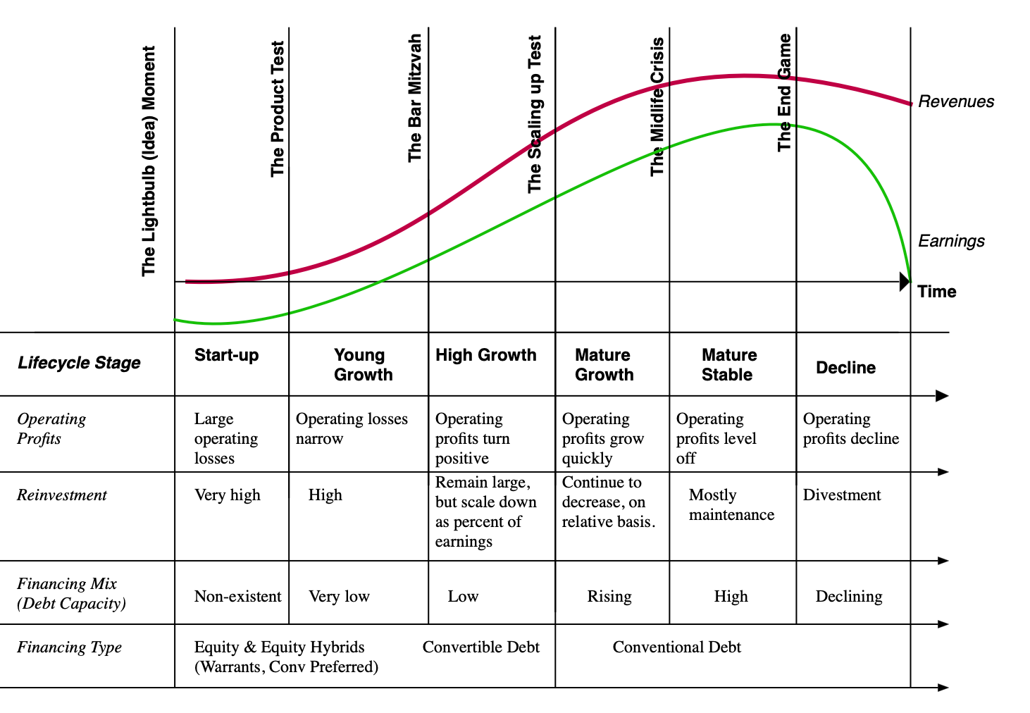
The financing principle across the life cycle

