Slide 1



Chapter 8: The Dividend Decision across the life cycle

Slide 2
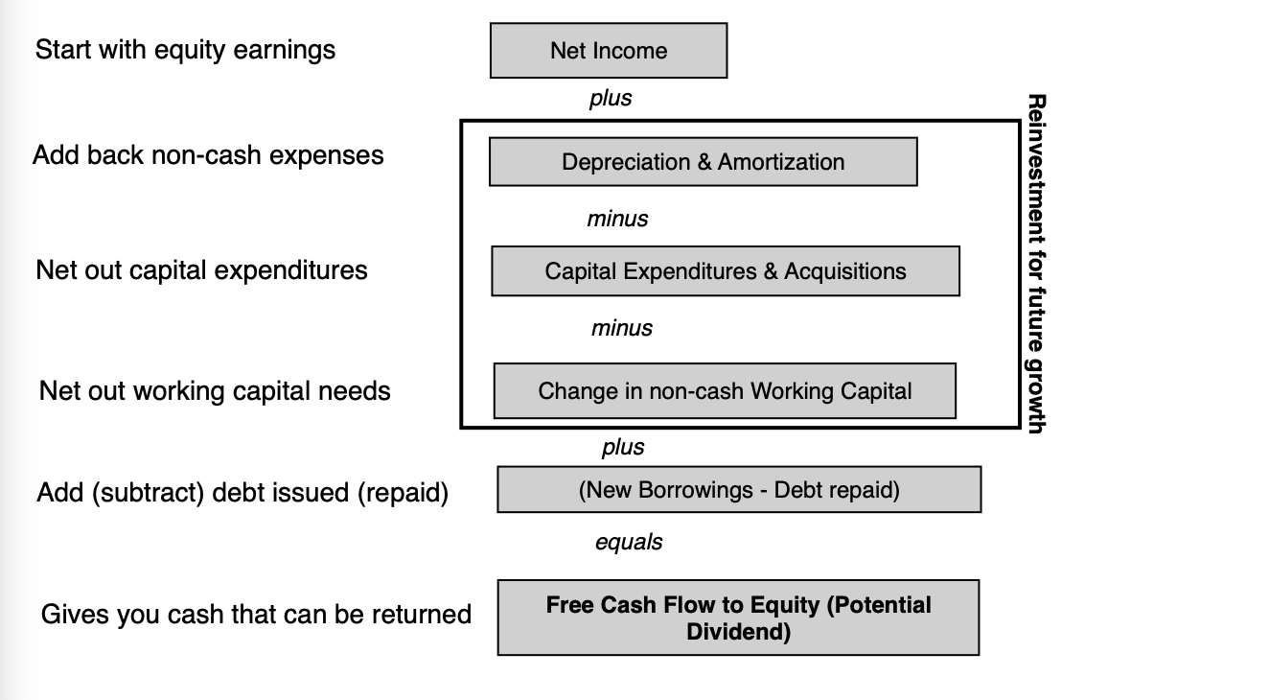
Cash return: Measuring potential dividends

Slide 3
FCFE examples
 | Airbnb | Adobe | Kraft Heinz
Net Income | -$352 | $4,822 | $1,012
+ Depreciation | $147 | $788 | $910
- Cap Expenditures | $25 | $3,030 | $905
+ Divestitures | $0 | $0 | $5,014
- Change in non-cash WC | -$138 | -$742 | -$406
FCFE before debt | -$93 | $3,322 | $6,437
+ New Debt Raised | $1,979 | $0 | $3,772
- Debt Repaid | $1,995 | $0 | $1,960
FCFE | -$109 | $3,322 | $3,235

Slide 4
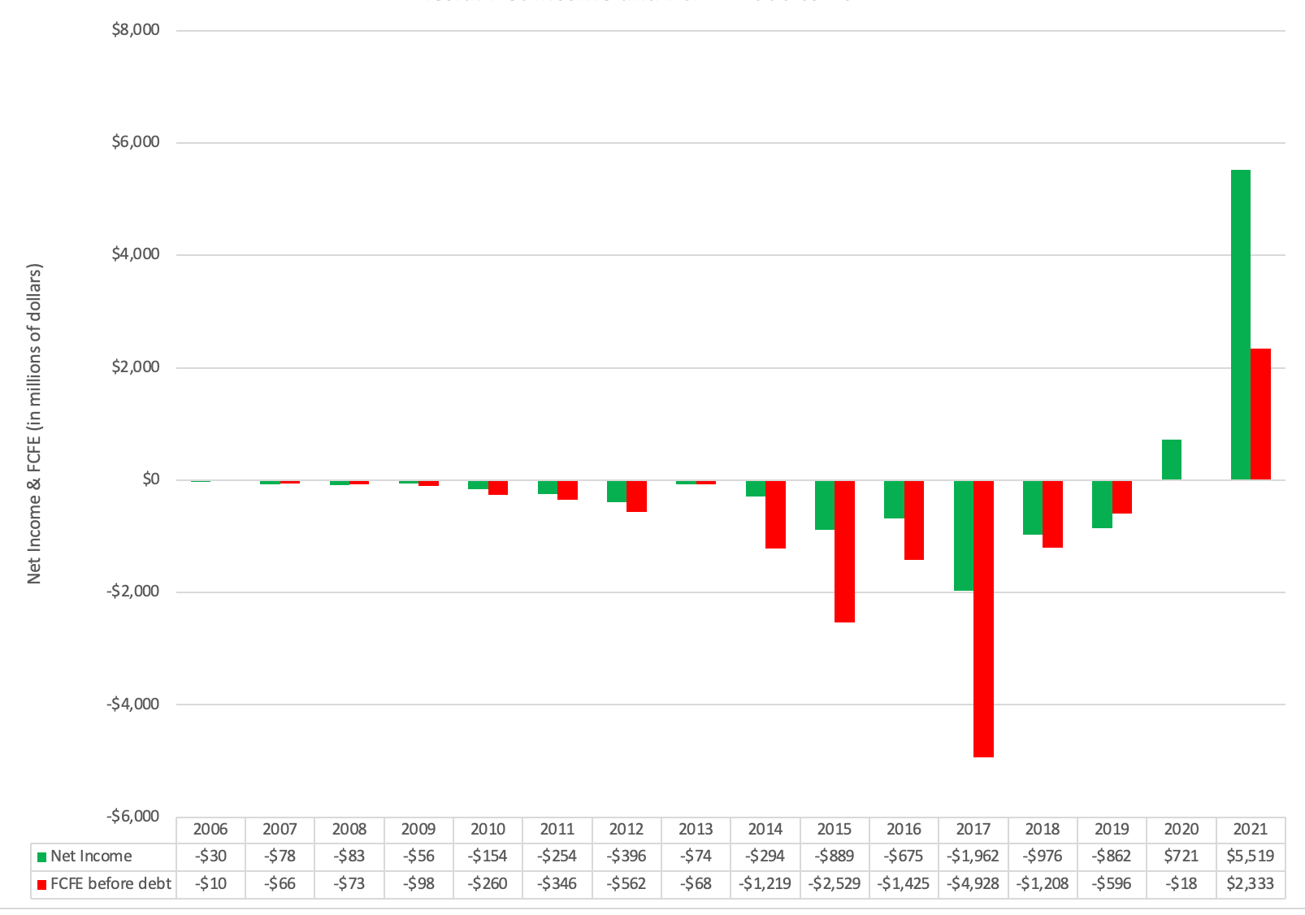
FCFE as companies age: Tesla

Slide 5
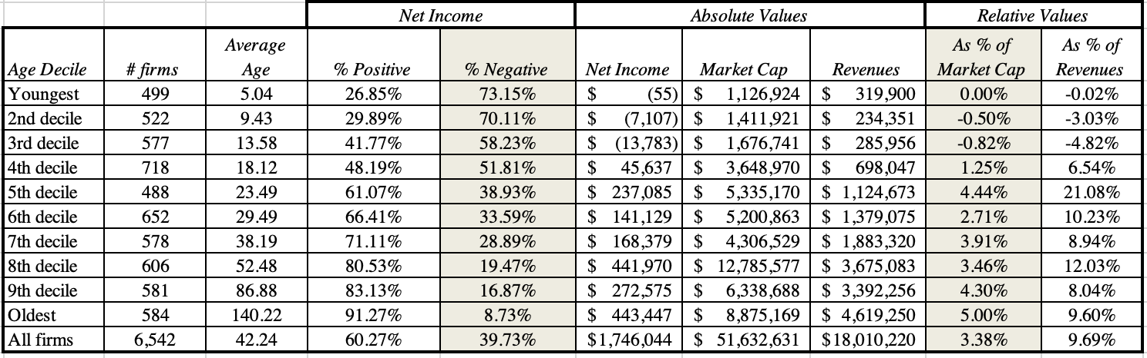
net Income ACROSS LIFE CYCL

Slide 6
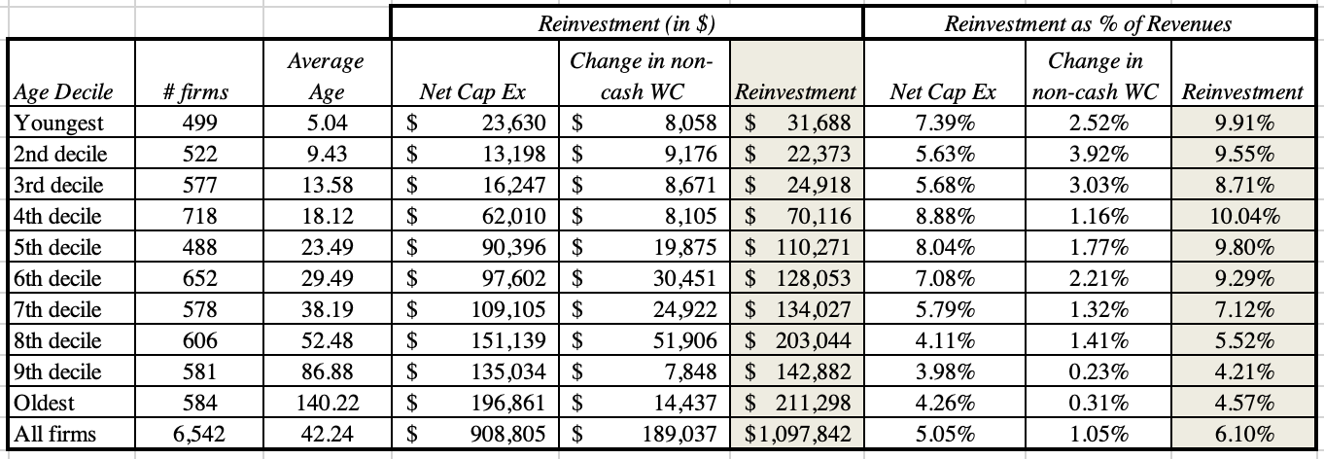
Reinvestment across life cycle

Slide 7
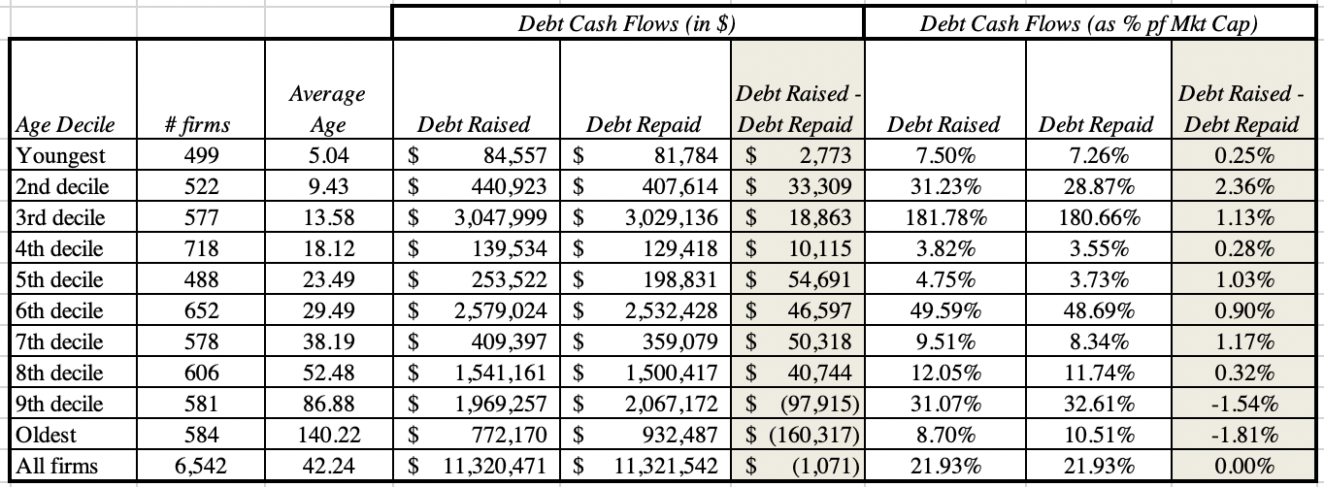
DEBT CASH FLOWS ACROSS LIFE CYCLE

Slide 8
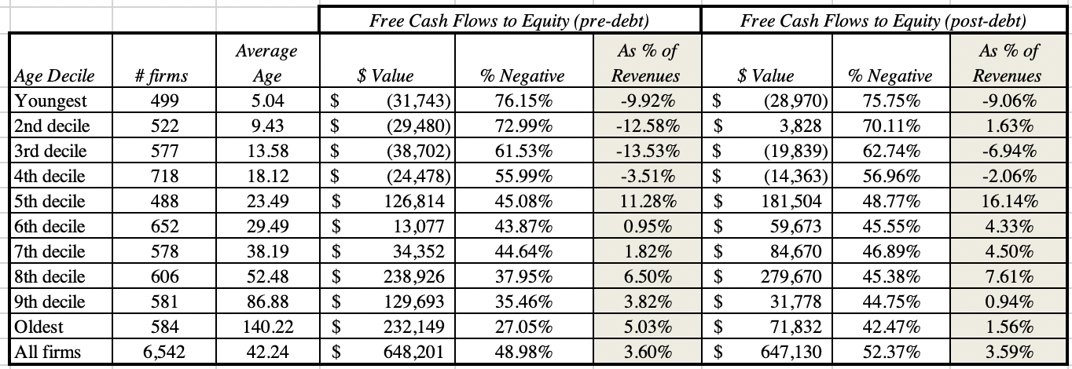
FCFE ACROSS LIFE CYCLE

Slide 9
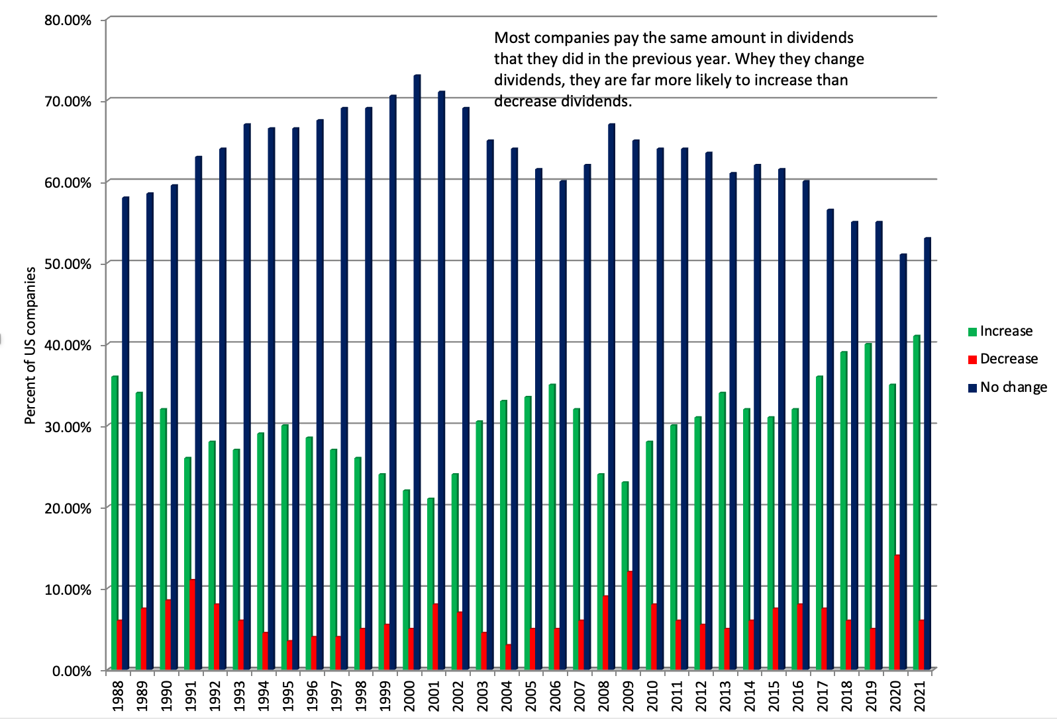
CASH RETURN: DIVIDEND STICKINESS

Slide 10
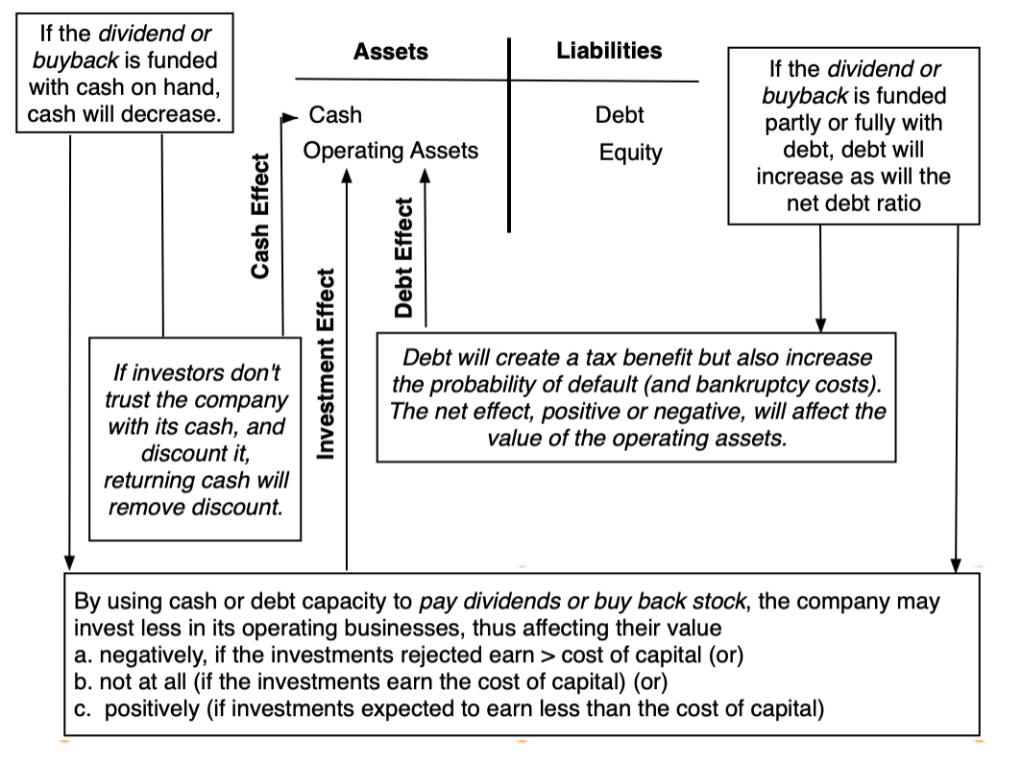
BUYBACKS AS AN ALTERNATIVE

Slide 11
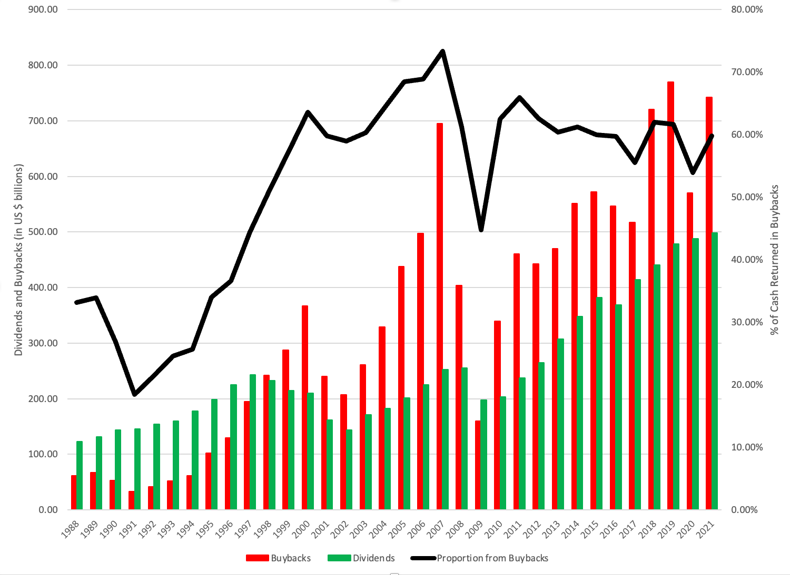
THE RISE OF BUYBACKS IN THE US

Slide 12
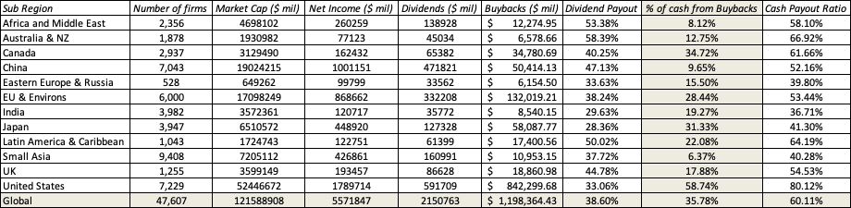
AND ACROSS THE WORLD…

Slide 13
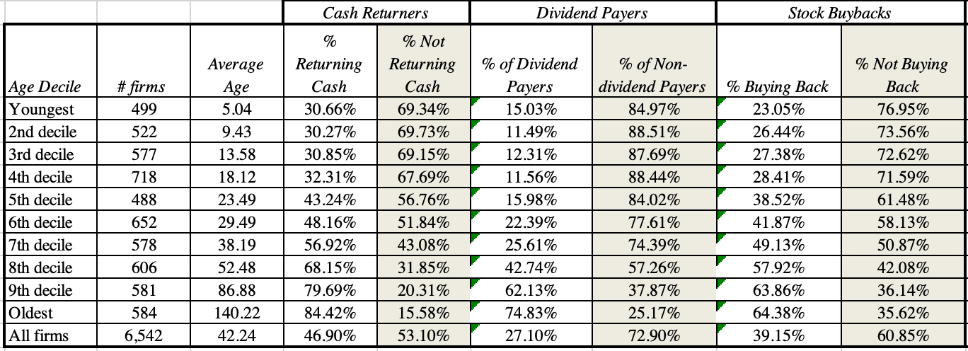
CASH RETURN CHOICES ACROSS THE LIFE CYCLE

Slide 14
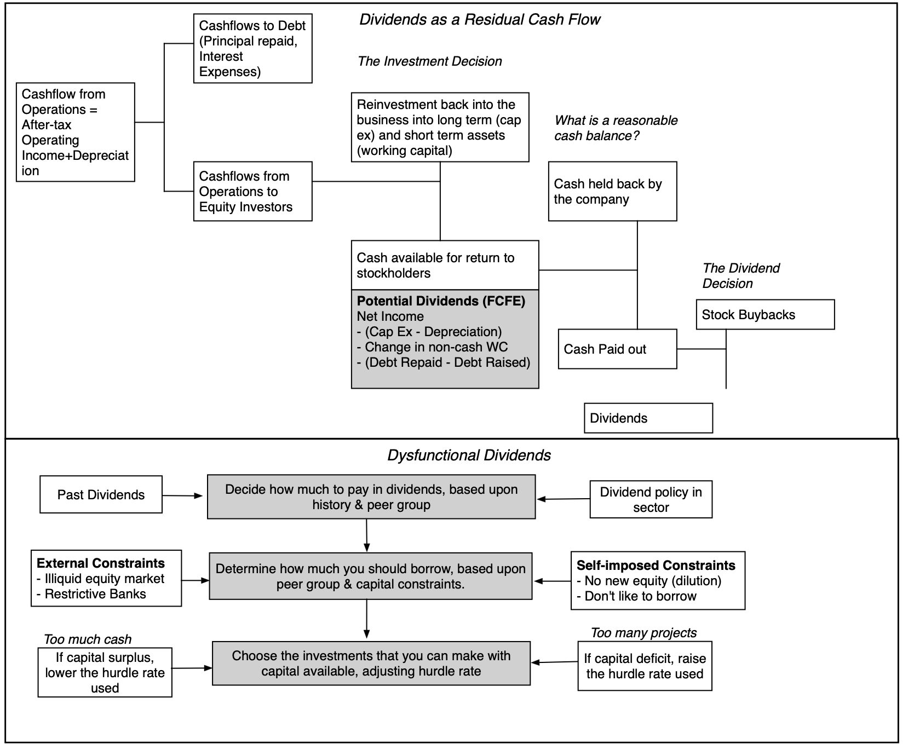
DYSFUNCTIONAL DIVIDENDS!

Slide 15
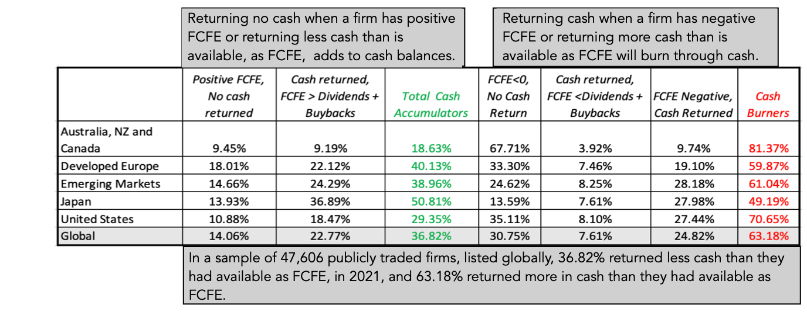
A GLOBAL PICTURE OF CASH RETURN VS FCFE

Slide 16
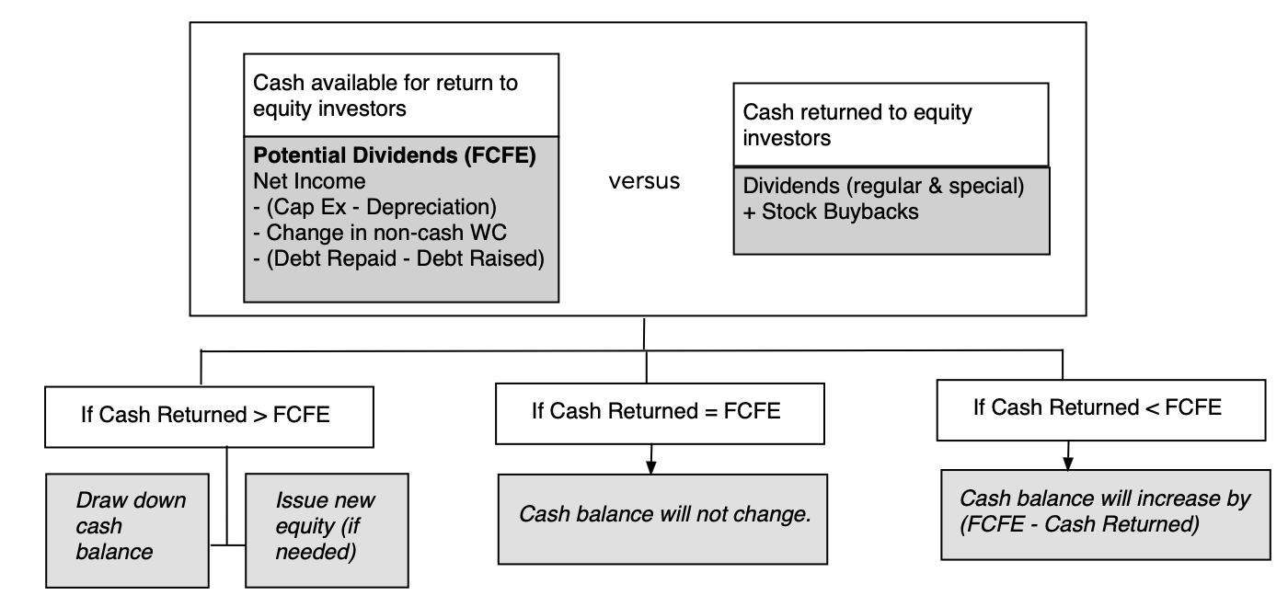
CASH RETURN AND CASH BALANCES

Slide 17
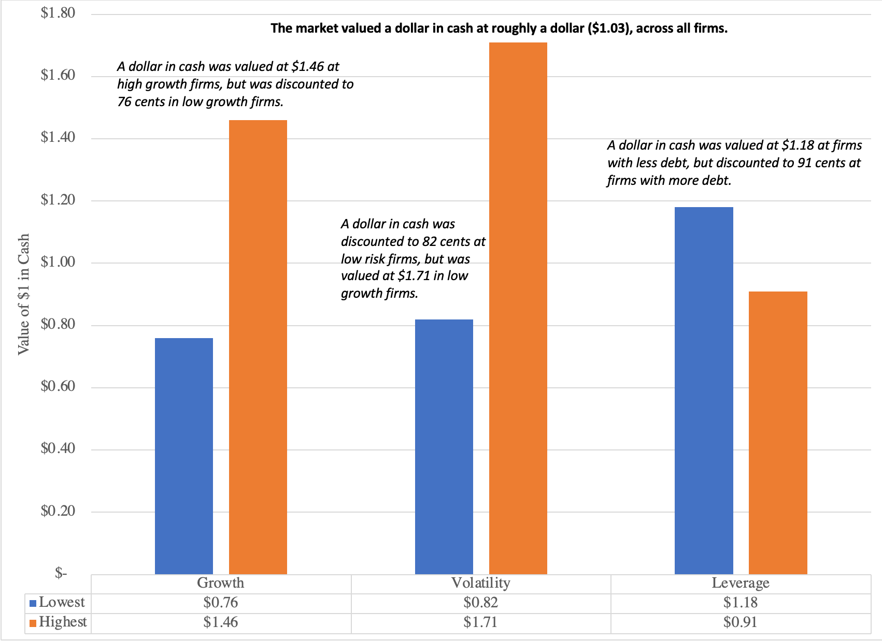
INVESTOR VIEWS OF CASH BALANCES

Slide 18
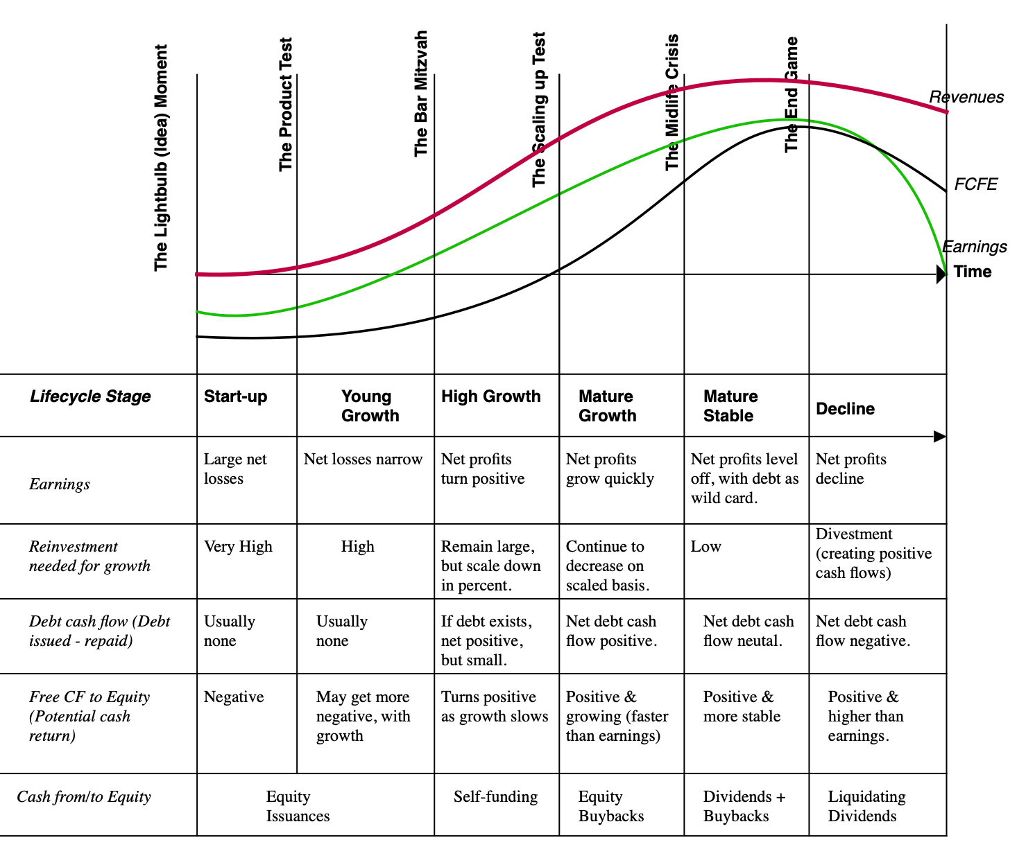
DIVIDEND POLICY ACROSS THE LIFE CYCLE!

