Slide 1



Chapter 9: VALUATION AND PRICING 101

Slide 2
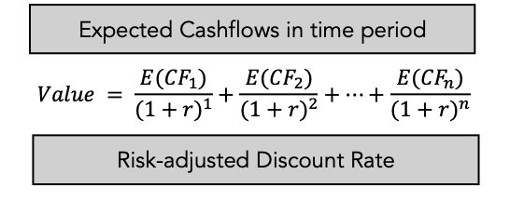
INTRINSIC VALUE: THE BASICS
Putting intrinsic valuation into practice requires grappling not only with how to define cash flows and incorporate risk into value, but also how to factor in the time value of money.

Slide 3
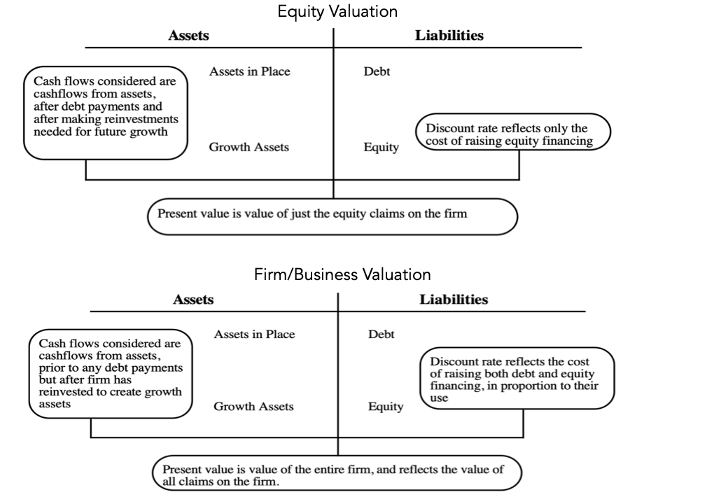
EQUITY VS FIRM VALUATION

Slide 4
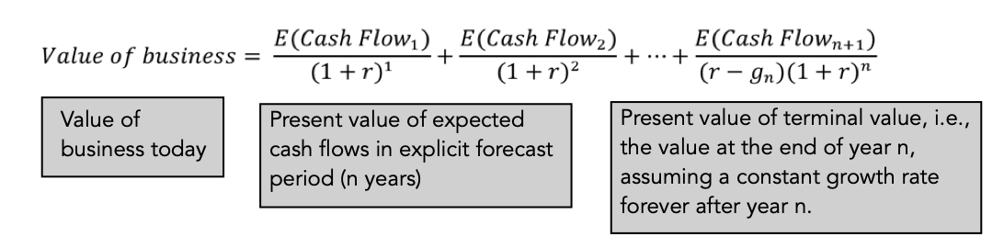
BUSINESS LIFE AND VALUE!
In theory, a publicly traded company can continue as a going concern for decades or even centuries.
To impose closure on the exercise, and one practice that valuation analysts use is to assume that cash flows beyond a point in time in the future will grow at a constant rate forever.
That assumption allows us to capture the present value of all cash flows beyond with a “terminal value”.

Slide 5
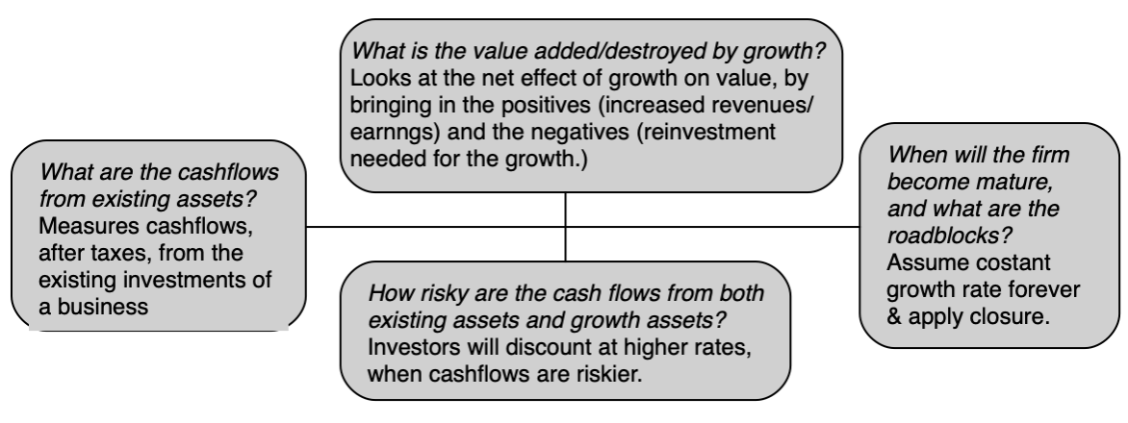
VALUE DRIVERS

Slide 6

INTRINSIC VALUE: KEY QUESTIONS

Slide 7
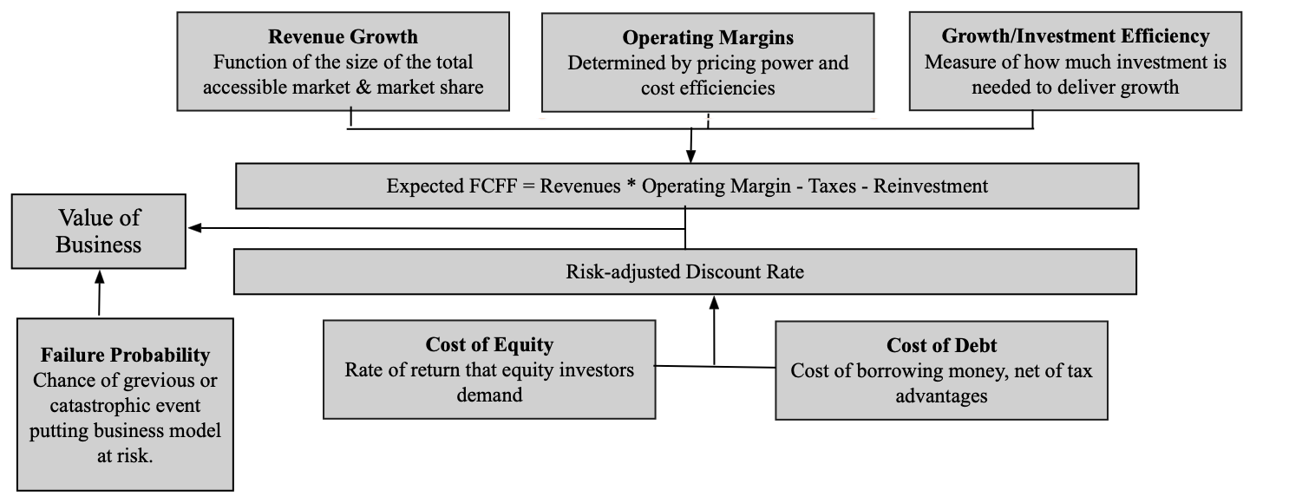
A PARSIMONIOUS VALUATION STRUCTURE

Slide 8
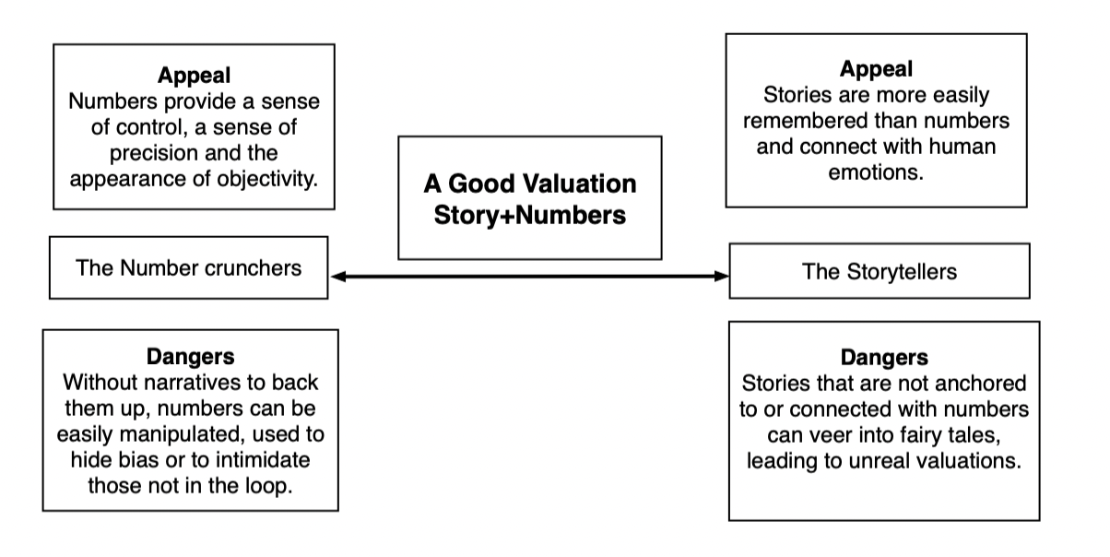
VALUE = STORY + NUMBERS

Slide 9
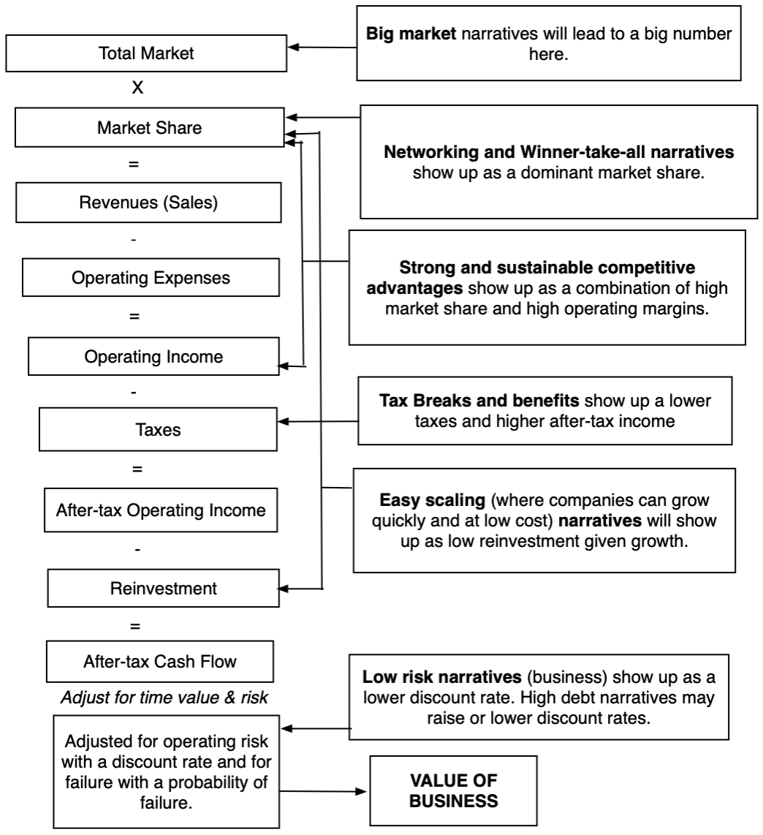
CONNECTING STORY PIECES TO VALUE INPUTS

Slide 10
VALUATION ACROSS THE LIFE CYCLE
Intrinsic value is a constant: The notion of the intrinsic value of a business as the present value of the expected cash flows from that business, over time, applies for companies across the life cycle.
With very different cash flow paths: With young companies, struggling with building business models, the cash flows will be negative in the early years, and turn positive only as they approach high growth, and grow rapidly before settle into stability. With mature companies, you are far more likely to see positive cash flows immediately, but with far less growth in future years. With declining companies, you may see shrinkage in the cash flows over time, as businesses get smaller.
And a changing dependence on terminal value: Earlier in this chapter, we noted that the value of a business today will be the sum of the present value of its expected cash flows in the forecast period and the present value of the terminal value, capturing cash flows beyond the forecast period. Young companies, with negative cash flows in the early years and positive and growing cash flows later, will get a much large proportion of their values from the cash flows in the later years and the termina value than more mature companies.

Slide 11
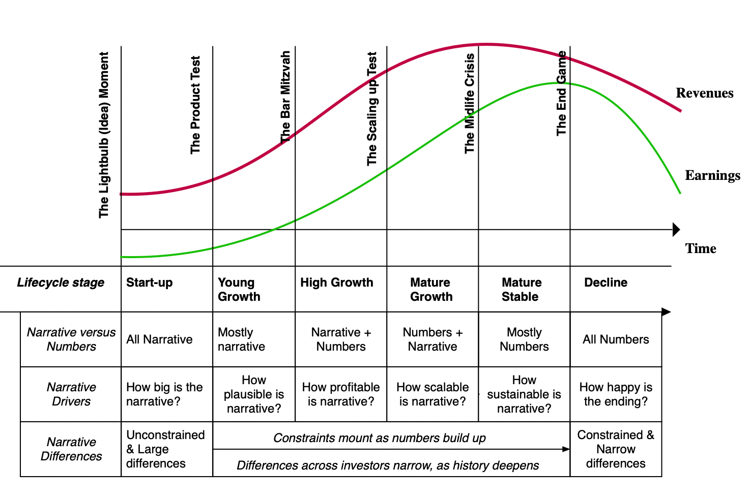
NARRATIVE VS NUMBERS: ACROSS THE LIFE CYCLE

Slide 12
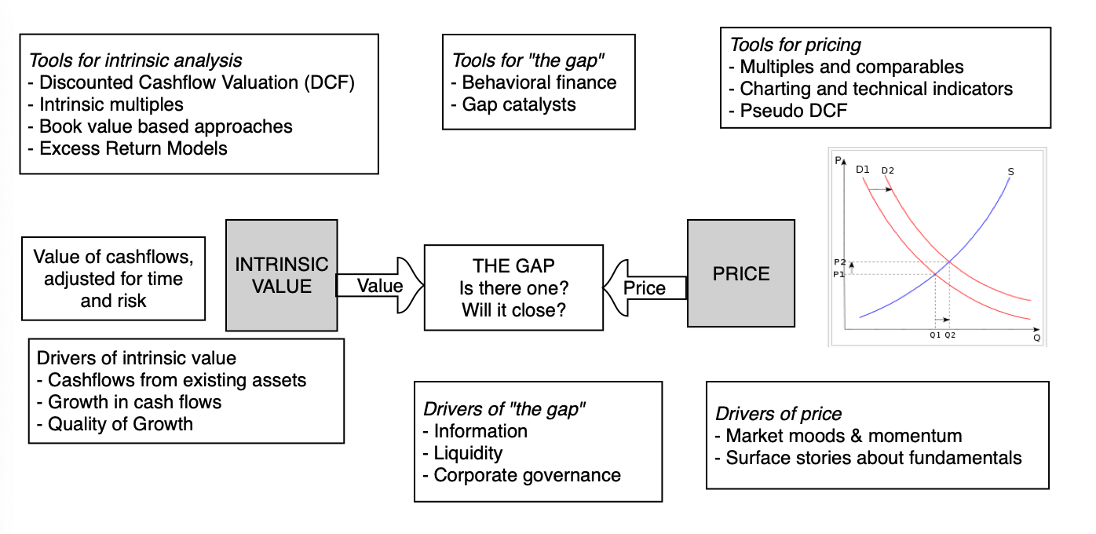
PRICING

Slide 13
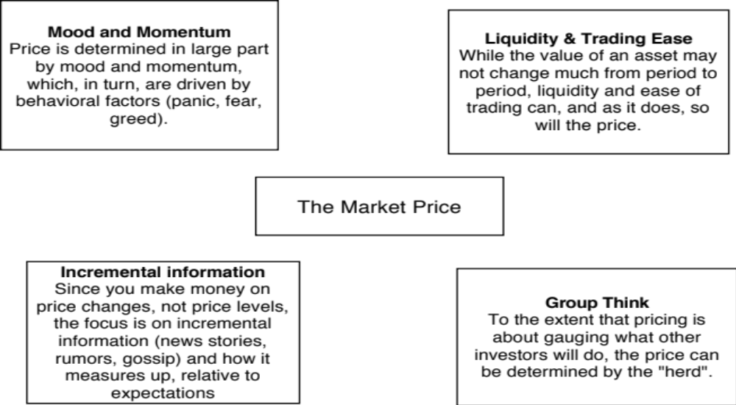
PRICE DRIVERS

Slide 14
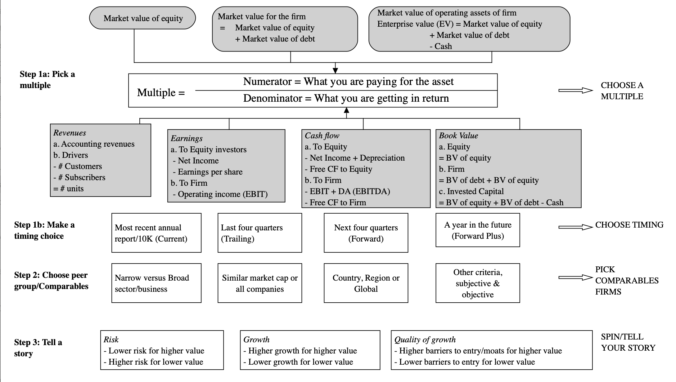
PRICING MECHANICS

Slide 15
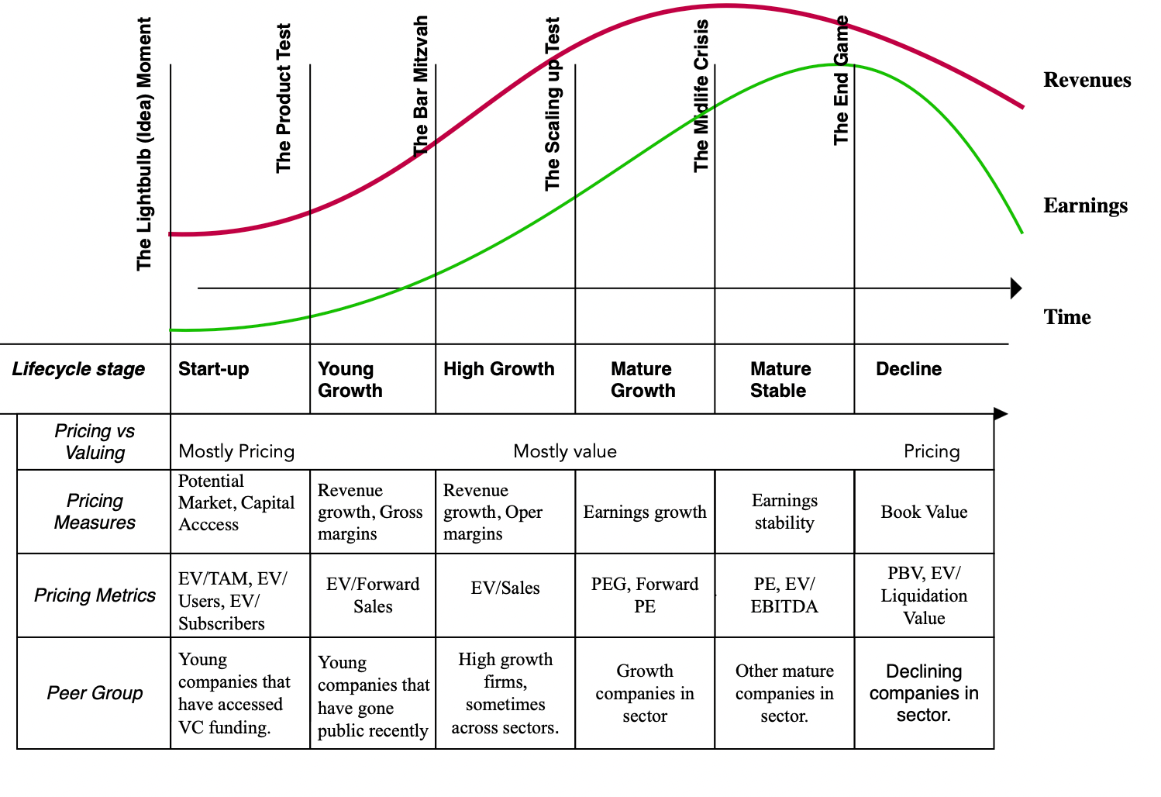
PRICING ACROSS THE LIFE CYCLE

