Slide 1



The Corporate Life cycle
Publisher: Penguin Random House
Available: 2024 at your nearest bookstore, or online

Slide 2
The ”Big” Idea
In every discipline, practitioners search for a framework that helps them explain the whys, the why nots and the what ifs of that discipline.
In corporate finance and valuation, we have seen many such attempts to build universal theories, and in our view, the structure that offers the most promise is the corporate life cycle, where companies go through the cycle of being born, growing up, growing old and eventually perishing.
It is one that we find ourselves coming back to, repeatedly, as we try to understand the behavior and misbehavior of businesses, differences across investing perspectives and the allure of the next big thing.

Slide 3
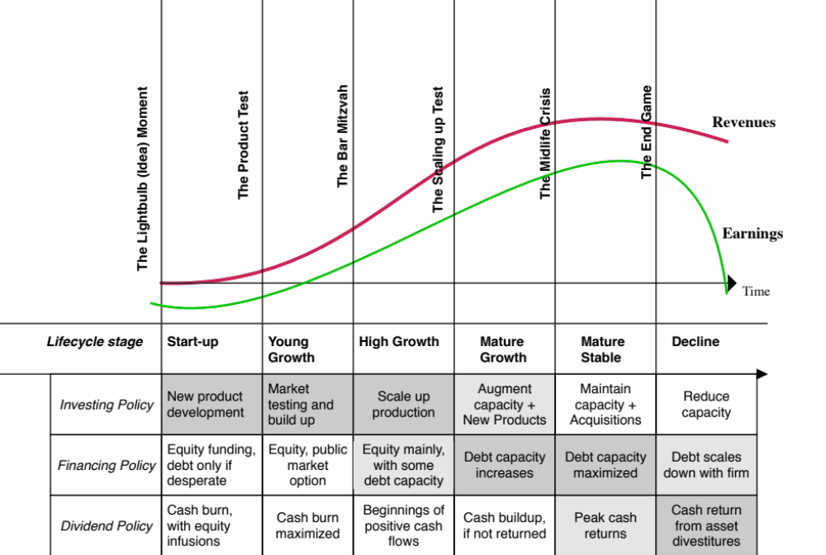
The Corporate life cycle

Slide 4
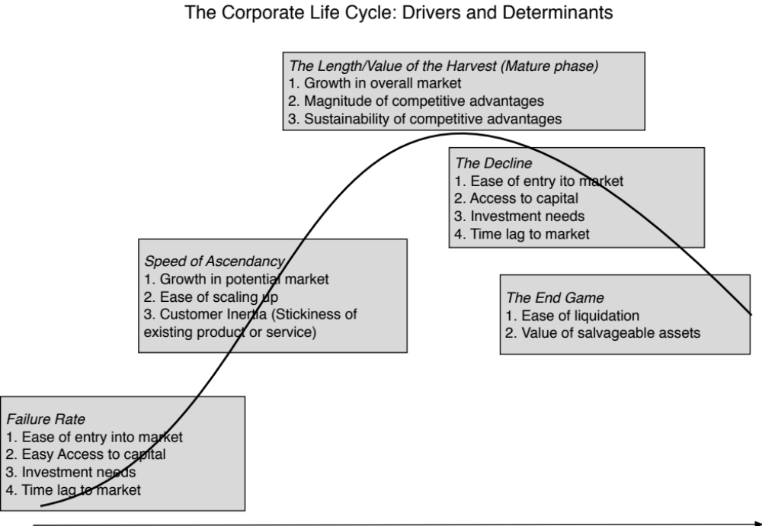
The lead in: Life cycle determinants and measures

Slide 5
Corporate finance across the life cycle

Slide 6
Valuation across the life cycle

Slide 7
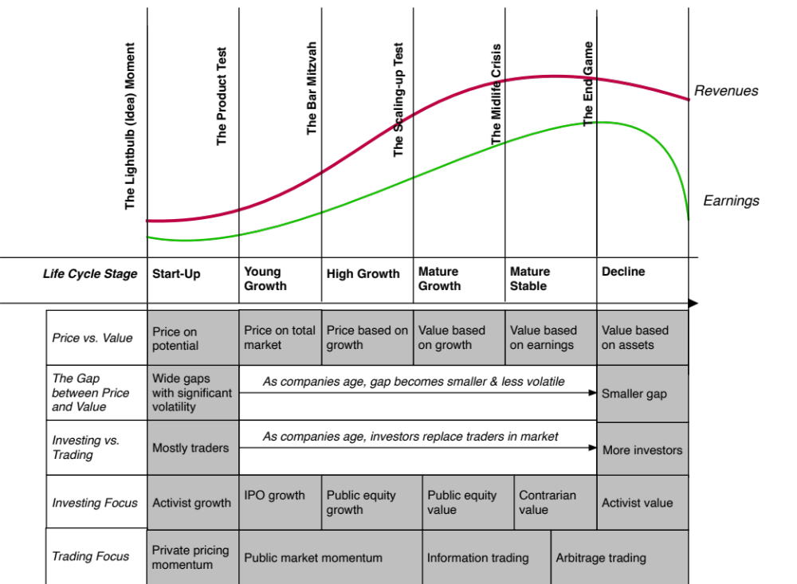
Investing across the life cycle

Slide 8
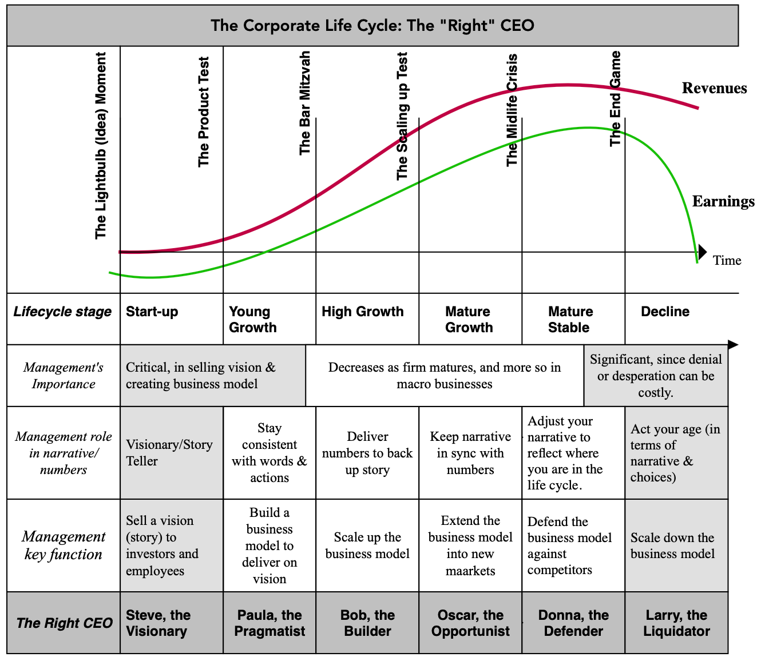
Managing across the life cycle

