Slide 1
Session 10: Value Enhancement

Slide 2
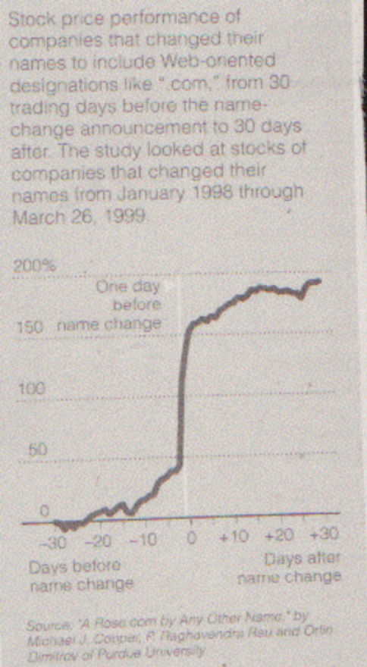

Price Enhancement versus Value Enhancement
Notes:
Value enhancement and price enhancement are equivalent in an efficient market. In a market that does not always reward long-term decision making and behaves irrationally,

Slide 3
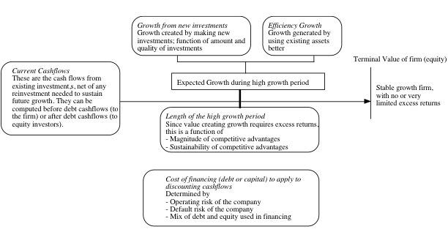
The Paths to Value Creation.. Back to the determinants of value..
Notes:
To create value, you have to change one or more of the above inputs…

Slide 4
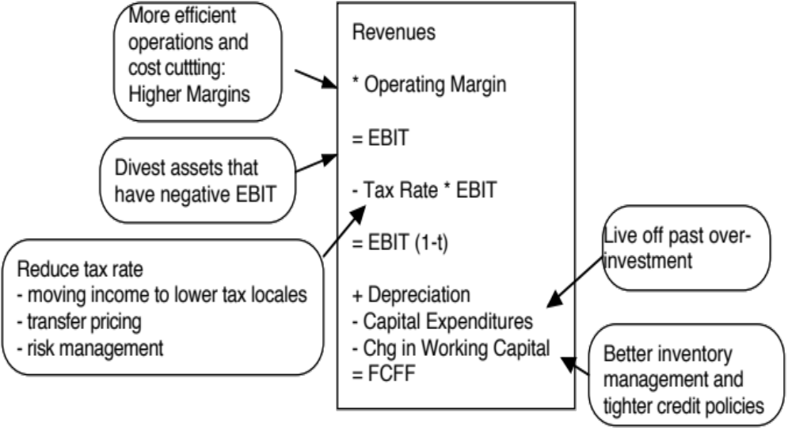
Value Creation 1: Increase Cash Flows from Assets in Place
Notes:
The key is that there is a trade off between current cashflows and future growth. If you increase current cashflows at the expense of future growth, you may destroy value rather than add to it.

Slide 5

Value Creation 2: Increase Expected Growth
Price Leader versus Volume Leader Strategies
Return on Capital = Operating Margin * Capital Turnover Ratio
Notes:
Increasing growth will increase value if and only if the return on capital > cost of capital.

Slide 6

Value Creating Growth… Evaluating the Alternatives..

Slide 7

III. Building Competitive Advantages: Increase length of the growth period

Slide 8
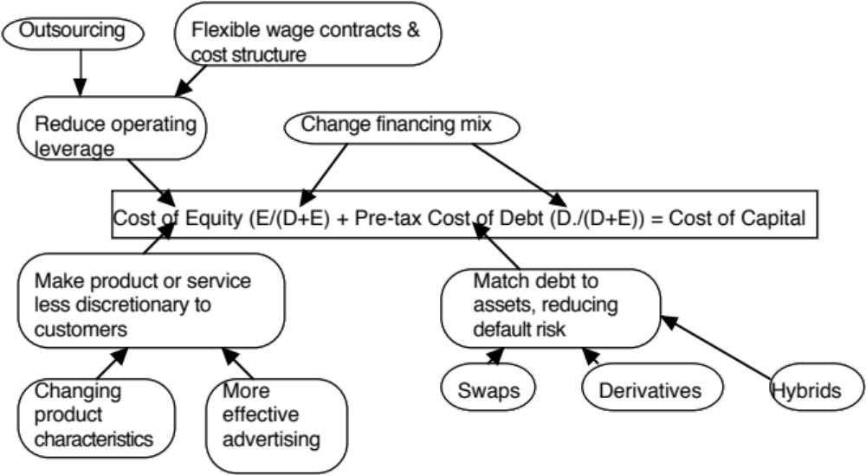
IV. Reduce Cost of Capital
Notes:
Reducing the cost of capital, holding cashflows constant, increases firm value.

Slide 9
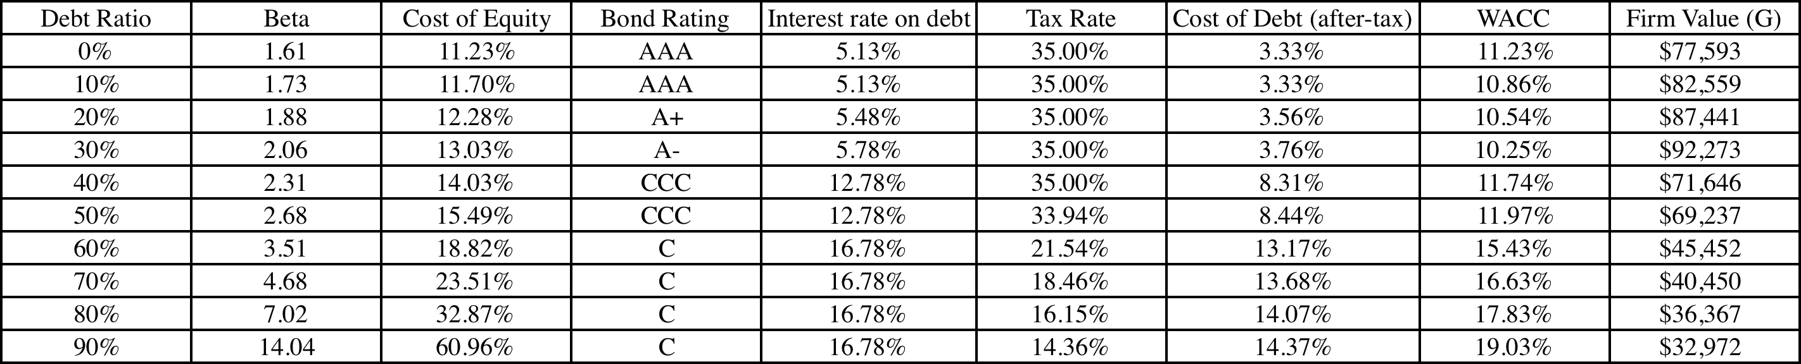
Amgen’s Optimal Financing Mix
Amgen’s current debt ratio = 10%
Amgen’s optimal debt ratio = 30%

