Slide 1
Session 16: More Earnings Multiples

Slide 2
Value/Earnings and Value/Cashflow Ratios
While Price earnings ratios look at the market value of equity relative to earnings to equity investors, Value earnings ratios look at the market value of the operating assets of the firm (Enterprise value or EV) relative to operating earnings or cash flows.
EV = Market value of equity + Debt – Cash
The form of value to cash flow ratios that has the closest parallels in DCF valuation is the ratio of Firm value to Free Cash Flow to the Firm.
  FCFF = EBIT (1-t) - Net Cap Ex - Change in WC
In practice, what we observe more commonly are firm values as multiples of operating income (EBIT), after-tax operating income (EBIT (1-t)) or EBITDA.
Notes:
In contrast to price multiples, you look at firm or enterprise value when you compute value multiples. Firm value is the market value of equity + market value of debt. Enterprise value = Firm value - cash. Why would you use one as opposed to the other? When we compute value to earnings multiples, the earnings that are used tend to be operating earnings (EBIT, EBITDA etc.). Since the income from cash and marketable securities is not included in operating income, we exclude it from the numerator as well.
The most logical denominator for enterprise value is the free cashflow to the firm, which is the cashflow prior to debt payments but after taxes and reinvestment needs.

Slide 3
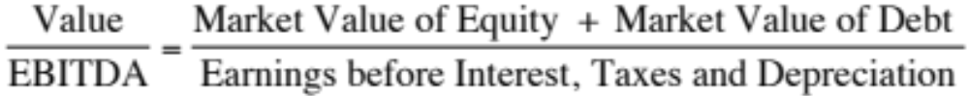
Enterprise Value/EBITDA Multiple
The Classic Definition
The No-Cash Version
Notes:
The problem with using firm value is that cash is included in the numerator but not in the denominator. That is why the enterprise value version makes more sense…
A broad problem is posed when firms have holdings in other firms. If such holdings are passive, Value to EBITDA multiples will be overstated, since the numerator will include the value of your holdings, while the EBITDA will not include any of the income from these holdings. If such holdings are majority active and consolidated, the value to EBITDA will be understated because the numerator will include only the portion of the equity you own in the subsidiary but the EBITDA will include all of the EBITDA in the subsidiary.
The safest thing to do (assuming you can do this) is to net out the market value of your holdings from the numerator (for both active and passive holdings) and the EBITDA of your holdings from the denominator ( for majority active holdings)

Slide 4
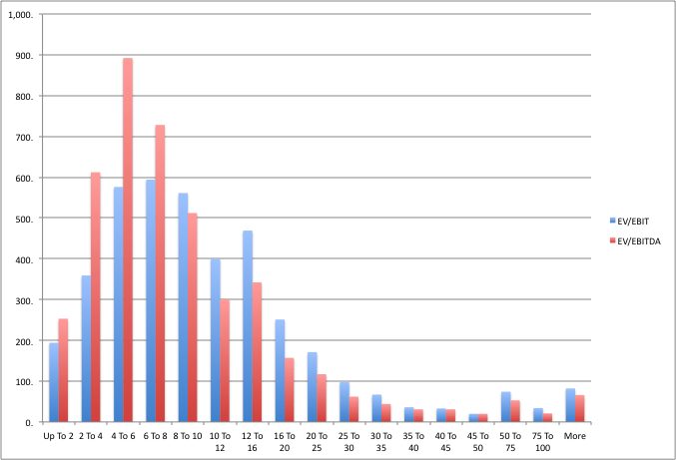
Enterprise Value/EBITDA Distribution – US – January 2011
Notes:
As with the other multiples, a heavily skewed distribution. Suggests that the rule of thumb that is often used by Wall Street (EBITDA multiple less than 8 is cheap) should be used with caution.

Slide 5
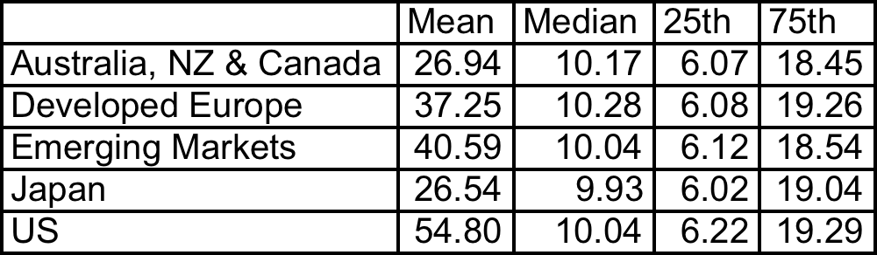
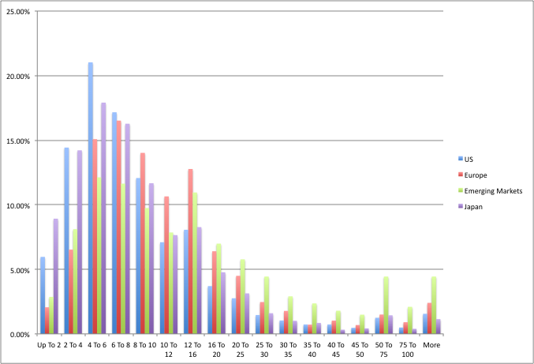
Enterprise Value/EBITDA : Global Data
6 times EBITDA seems like a good rule of thumb..
Notes:
Distribution looks very similar to the distribution in the US…

Slide 6
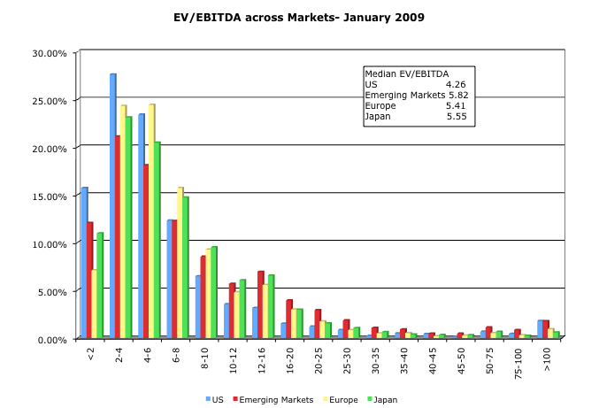
But not in early 2009…
Notes:
Rules of thumb have to adapt to data… Fixed rules of thumb work sometimes and not at others…

Slide 7
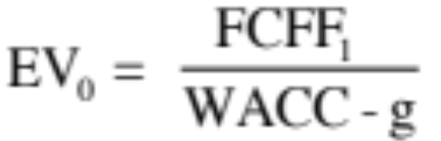
The Determinants of Value/EBITDA Multiples: Linkage to DCF Valuation
The value of the operating assets of a firm can be written as:
The numerator can be written as follows:
  FCFF = EBIT (1-t) - (Cex - Depr) - Δ Working Capital
  = (EBITDA - Depr) (1-t) - (Cex - Depr) - Δ Working Capital
  = EBITDA (1-t) + Depr (t) - Cex - Δ Working Capital
Notes:
To delve into the fundamentals that determine EBITDA multiples, we return to a FCFF valuation model. We keep things simple by using a stable growth model.

Slide 8
From Firm Value to EBITDA Multiples
Now the value of the firm can be rewritten as,
Dividing both sides of the equation by EBITDA,
Since Reinvestment = (CEx – Depreciation + Δ Working Capital), the determinants of EV/EBITDA are:
  The cost of capital
  Expected growth rate
  Tax rate
  Reinvestment rate (or ROC)
Notes:
The enterprise value to EbITDA multiple is a function of
The tax rate: Higher tax rates -> Lower multiple
Net Capital Expenditures and reinvestment (for any given growth rate): Higher net cap ex and reinvestment -> Lower multiple
Cost of capital: Higher cost of capital -> Lower multiple
Growth: Lower growth -> Lower multiple

Slide 9
A Simple Example
Consider a firm with the following characteristics:
  Tax Rate = 36%
  Capital Expenditures/EBITDA = 30%
  Depreciation/EBITDA = 20%
  Cost of Capital = 10%
  The firm has no working capital requirements
  The firm is in stable growth and is expected to grow 5% a year forever.
Notes:
A hypothetical firm. Note that I am making assumptions about the reinvestment rate and growth rate. Implicitly, I am also making assumptions about the return on capital. In fact, I am assuming (whether I want to or not) that my return on capital will be 25.60%. Note that the return on capital implied in this growth rate can be calculated as follows:
g = ROC * Reinvestment Rate
.05 = ROC * Net Cap Ex/EBIT (1-t)
= ROC * (.30-.20)/[(1-.2)(1-.36)]
Solving for ROC, ROC = 25.60%

Slide 10
Calculating Value/EBITDA Multiple
In this case, the Value/EBITDA multiple for this firm can be estimated as follows:
Notes:
If this firm were fairly valued, it should trade at 8.24 times EBITDA.

Slide 11



The Determinants of EV/EBITDA
Tax
Rates
Reinvestment
Needs
Excess
Returns

Slide 12

Value/EBITDA Multiple: Trucking Companies:
Is Ryder cheap?
Notes:
Trucking companies have fleets that they replace every few years. Thus, the capital expenditures for these firms are often discontinuous, with a year of very heavy cap ex followed by a few years of almost no cap ex…
It could well be that Ryder Systems has the oldest fleet in this group. In that case, the firm may look cheap right now but it will soon have to make a large capital expenditure to replace the fleet.
(While cap ex is discontinuous, depreciation and amortization are smoothed out…)

