Slide 1
Session 18: Revenue Multiples

Slide 2
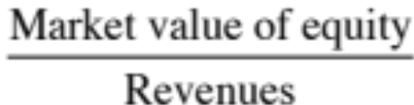
Price Sales Ratio: Definition
The price/sales ratio is the ratio of the market value of equity to the sales.
Price/ Sales=
Consistency Tests
  The price/sales ratio is internally inconsistent, since the market value of equity is divided by the total revenues of the firm.
Notes:
The problem with this ratio is that revenues belong to the entire firm rather than just the equity investors in the firm.

Slide 3
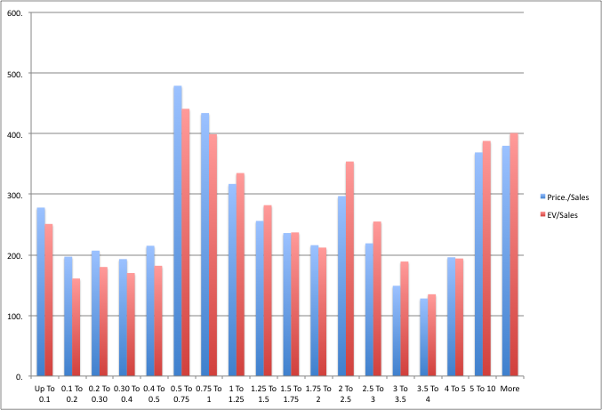
Revenue Multiples: US stocks
Notes:
Perhaps the most skewed of all multiples….

Slide 4
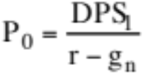
Price/Sales Ratio: Determinants
The price/sales ratio of a stable growth firm can be estimated beginning with a 2-stage equity valuation model:
Dividing both sides by the sales per share:
Notes:
The key determinant of the price to sales ratio is the net margin.. The other 3 determinants - payout, growth and cost of equity - are common to all equity multiples.

Slide 5
Price Sales Ratios and Profit Margins
The key determinant of price-sales ratios is the profit margin.
A decline in profit margins has a two-fold effect.
  First, the reduction in profit margins reduces the price-sales ratio directly.
  Second, the lower profit margin can lead to lower growth and hence lower price-sales ratios.
  Expected growth rate = Retention ratio * Return on Equity
  = Retention Ratio *(Net Profit / Sales) * ( Sales / BV of Equity)
  = Retention Ratio * Profit Margin * Sales/BV of Equity
Notes:
As net margins change, the price to sales ratio will often change more than proportionately because of the effect on expected growth.

Slide 6
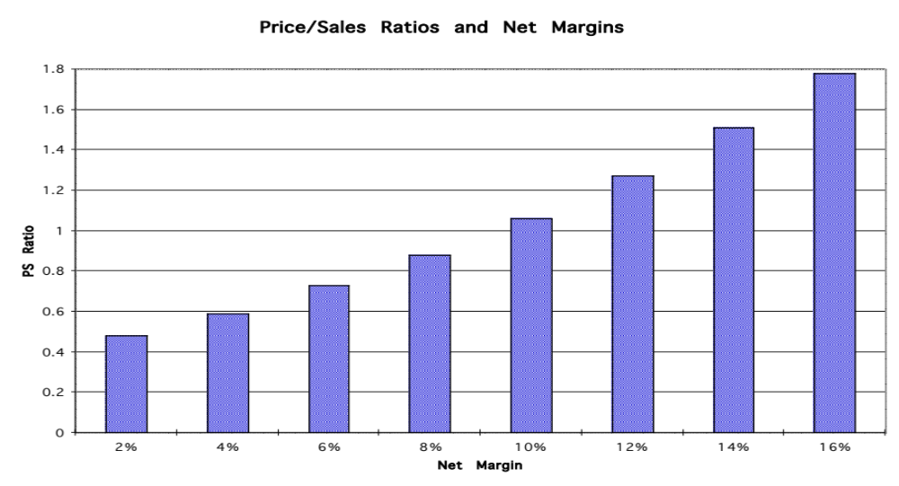
Effect of Margin Changes
Notes:
As net margin changes, holding the Sales/BV of Equity ratio constant, the price to sales ratio will also change. Note that the growth will change with the net margin.

Slide 7
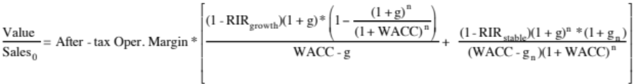
EV/Sales Ratios: Analysis of Determinants
If pre-tax operating margins are used, the appropriate value estimate is that of the firm. In particular, if one makes the assumption that
  Free Cash Flow to the Firm = EBIT (1 - tax rate) (1 - Reinvestment Rate)
Then the Value of the Firm can be written as a function of the after-tax operating margin= (EBIT (1-t)/Sales
g = Growth rate in after-tax operating income for the first n years
  g_{n} = Growth rate in after-tax operating income after n years forever (Stable growth rate)
  RIR_{Growth, Stable} = Reinvestment rate in high growth and stable periods
  WACC = Weighted average cost of capital
Notes:
The determinants of the value to sales ratio mirror the determinants of the price to sales ratio:
Price to Sales ratio -> Value to Sales Ratio
Net Margin (Net Income/Sales) Operating Margin (EBIT(1-t)/Sales
Payout ratio 1 - Reinvestment Rate
Cost of equity Cost of capital
Growth rate in Net Income Growth ate in Operating income

Slide 8
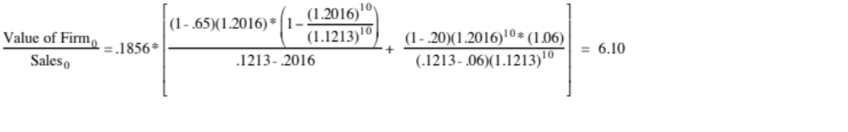
EV/Sales Ratio: An Example with Coca Cola
Consider, for example, the Value/Sales ratio of Coca Cola. The company had the following characteristics:
  After-tax Operating Margin =18.56% Sales/BV of Capital = 1.67
  Return on Capital = 1.67* 18.56% = 31.02%
  Reinvestment Rate= 65.00% in high growth; 20% in stable growth;
  Expected Growth = 31.02% * 0.65 =20.16% (Stable Growth Rate=6%)
  Length of High Growth Period = 10 years
  Cost of Equity =12.33% E/(D+E) = 97.65%
  After-tax Cost of Debt = 4.16% D/(D+E) 2.35%
  Cost of Capital= 12.33% (.9765)+4.16% (.0235) = 12.13%
Notes:
Valuation is from 1999….The high operating margin translates into high return on capital which generates high growth (during the growth period) and a low reinvestment rate (in stable growth). 6.10 times revenues is a fair value for Coca Cola.

Slide 9
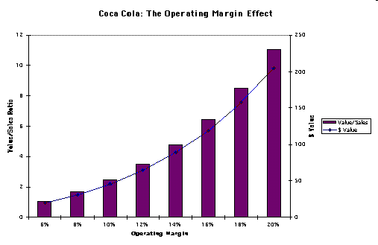
EV/Sales Ratios and Operating Margins
Notes:
The operating margin is the key determinant of the value to sales ratio…. Again, the effect is at two levels - the direct effect of changing margins on revenue multiples and the indirect effect is on growth.

Slide 10
Brand Name Premiums in Valuation
You have been hired to value Coca Cola for an analyst reports and you have valued the firm at 6.10 times revenues, using the model described in the last few pages. Another analyst is arguing that there should be a premium added on to reflect the value of the brand name. Do you agree?
Yes
No
Explain.
Notes:
No. If you do the valuation right, the brand name premium is already built into the valuation in the margin, growth and return on capital. Of course, it is possible that the brand name is not being fully utilized by a firm. But you could say that about any asset. The premium then is for control and not for the brand name.

Slide 11
Valuing Brand Name
Coca Cola With Cott Margins
Current Revenues = $21,962.00 $21,962.00
Length of high-growth period 10 10
Reinvestment Rate = 50% 50%
Operating Margin (after-tax) 15.57% 5.28%
Sales/Capital (Turnover ratio) 1.34 1.34
Return on capital (after-tax) 20.84% 7.06%
Growth rate during period (g) = 10.42% 3.53%
Cost of Capital during period = 7.65% 7.65%
Stable Growth Period
Growth rate in steady state = 4.00% 4.00%
Return on capital = 7.65% 7.65%
Reinvestment Rate = 52.28% 52.28%
Cost of Capital = 7.65% 7.65%
Value of Firm = $79,611.25 $15,371.24
Value of brand name = $79,611 -$15,371 = $64,240 million
Notes:
In the first column, Coca Cola is valued with its current characteristics - high margins, high returns, reasonably high growth - all of which can be traced to its brand name power. In the second column, we revalued Coke using the margins of a generic manufacturer (Cott). The ripple effects of the lower margins can be seen in lower return on capital (margin * sales to cap ratio) and lower growth. The net effect is a almost an 80% drop in value. That is the value of the brand name.
Alternative approaches:
Coke’s ROC = Generic ROC (instead of magins)
If no generic companies exist, the industry average can be used as a base to get a measure of relative brand name value.

