Slide 1
Session 21: The options to expand and abandon

Slide 2
The Option to Expand/Take Other Projects
Taking a project today may allow a firm to consider and take other valuable projects in the future.
Thus, even though a project may have a negative NPV, it may be a project worth taking if the option it provides the firm (to take other projects in the future) provides a more-than-compensating value.
These are the options that firms often call “strategic options” and use as a rationale for taking on “negative NPV” or even “negative return” projects.
Notes:
A project may be the first in a sequence.

Slide 3
The Option to Expand
PV of Cash Flows
from Expansion
Additional Investment
to Expand
Present Value of Expected
Cash Flows on Expansion
Expansion becomes
Firm will not expand in
attractive in this section
this section
Notes:
Here, the initial project gives you the option to invest an additional amount in the future which you will do only if the present value of the additional cash flows you will get by expanding are greater than the investment needed.
For this to work, you have to do the first project to be eligible for the option to expand.

Slide 4
An Example of an Expansion Option
Ambev is considering introducing a soft drink to the U.S. market. The drink will initially be introduced only in the metropolitan areas of the U.S. and the cost of this “limited introduction” is $ 500 million.
A financial analysis of the cash flows from this investment suggests that the present value of the cash flows from this investment to Ambev will be only $ 400 million. Thus, by itself, the new investment has a negative NPV of $ 100 million.
If the initial introduction works out well, Ambev could go ahead with a full-scale introduction to the entire market with an additional investment of $ 1 billion any time over the next 5 years. While the current expectation is that the cash flows from having this investment is only $ 750 million, there is considerable uncertainty about both the potential for the drink, leading to significant variance in this estimate.
Notes:
This is a negative net present value project, but it gives Disney the option to expand later. Implicitly, we are also saying that if Disney does not make the initial project investment (with a NPV of - $ 20 million), it cannot expand later into the rest of Latin America.

Slide 5
Valuing the Expansion Option
Value of the Underlying Asset (S) = PV of Cash Flows from Expansion to entire U.S. market, if done now =$ 750 Million
Strike Price (K) = Cost of Expansion into entire U.S market = $ 1000 Million
We estimate the standard deviation in the estimate of the project value by using the annualized standard deviation in firm value of publicly traded firms in the beverage markets, which is approximately 34.25%.
  Standard Deviation in Underlying Asset’s Value = 34.25%
Time to expiration = Period for which expansion option applies = 5 years
Call Value= $ 234 Million
Notes:
This values the option, using the Black Scholes model.
The value from the model itself is affected not only by the assumptions made about volatility and value, but also by the asssumptions underlying the model.
The value itself is not the key output from the model. It is the fact that strategic options, such as this one, can be valued, and that they can make a significant difference to your decision.

Slide 6
Considering the Project with Expansion Option
NPV of Limited Introduction = $ 400 Million - $ 500 Million
= - $ 100 Million
Value of Option to Expand to full market= $ 234 Million
NPV of Project with option to expand
  = - $ 100 million + $ 234 million
  = $ 134 million
Invest in the project
Notes:
A bad project, with options considered, becomes a good one.

Slide 7
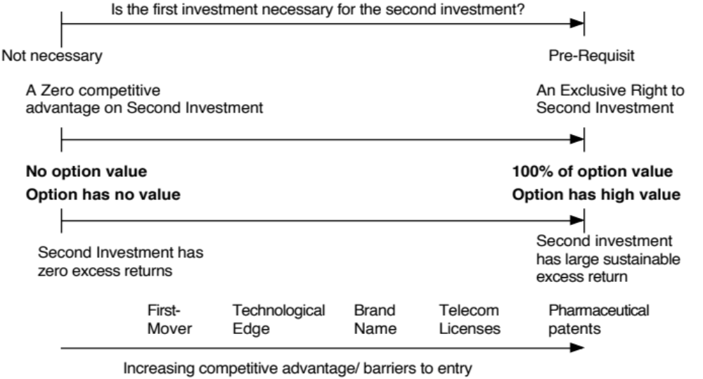
Opportunities are not Options…

Slide 8
The Option to Abandon
A firm may sometimes have the option to abandon a project, if the cash flows do not measure up to expectations.
If abandoning the project allows the firm to save itself from further losses, this option can make a project more valuable.
PV of Cash Flows
from Project
Cost of Abandonment
Present Value of Expected
Cash Flows on Project
Notes:
You would like to abandon a project, once you know that it will create only negative cash flows for you. This is not always possible, because of contracts you might have entered into with employees or customers.

Slide 9
Valuing the Option to Abandon
Airbus is considering a joint venture with Lear Aircraft to produce a small commercial airplane (capable of carrying 40-50 passengers on short haul flights)
  Airbus will have to invest $ 500 million for a 50% share of the venture
  Its share of the present value of expected cash flows is 480 million.
Lear Aircraft, which is eager to enter into the deal, offers to buy Airbus’s 50% share of the investment anytime over the next five years for $ 400 million, if Airbus decides to get out of the venture.
A simulation of the cash flows on this time share investment yields a variance in the present value of the cash flows from being in the partnership is 0.16.
The project has a life of 30 years.
Notes:
We are assuming that the developer will be in a position to honor his or her commitment to buy back Disney’s share for $ 150 million.

Slide 10
Project with Option to Abandon
Value of the Underlying Asset (S) = PV of Cash Flows from Project = $ 480 million
Strike Price (K) = Salvage Value from Abandonment = $ 400 million
Variance in Underlying Asset’s Value = 0.16
Time to expiration = Life of the Project =5 years
Dividend Yield = 1/Life of the Project = 1/30 = 0.033 (We are assuming that the project’s present value will drop by roughly 1/n each year into the project)
Assume that the five-year riskless rate is 6%. The value of the put option can be estimated as follows:
Notes:
These are the inputs to the model. The likelihood of abandonment will increase over time, as the value of the project decreases.

Slide 11
Should Airbus enter into the joint venture?
Value of Put =Ke^{-rt} (1-N(d2))- Se^{-yt} (1-N(d1))
=400 (exp^{(-0.06)(5)} (1-0.4624) - 480 exp^{(-0.033)(5)} (1-0.7882)
= $ 73.23 million
The value of this abandonment option has to be added on to the net present value of the project of -$ 20 million, yielding a total net present value with the abandonment option of $ 53.23 million.
Notes:
If you can negotiate this option into your investment projects, you increase their value. To the degree that you have to pay for this option, you would be willing to pay up to $ 7.86 million.

Slide 12
Implications for Investment Analysis/ Valuation
Having a option to abandon a project can make otherwise unacceptable projects acceptable.
Other things remaining equal, you would attach more value to companies with
  More cost flexibility, that is, making more of the costs of the projects into variable costs as opposed to fixed costs.
  Fewer long-term contracts/obligations with employees and customers, since these add to the cost of abandoning a project.
These actions will undoubtedly cost the firm some value, but this has to be weighed off against the increase in the value of the abandonment option.

