Slide 1
Session 4: Equity Risk Premium
DCF Valuation

Slide 2
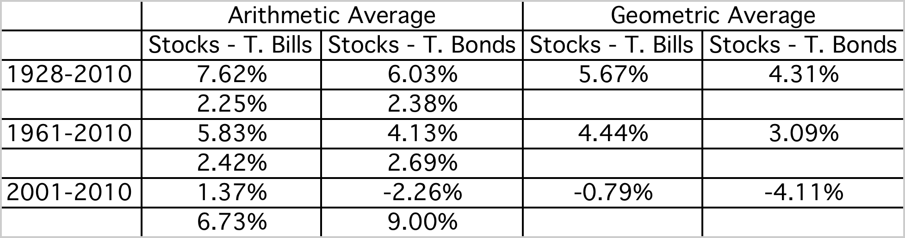
Equity Risk Premiums
The ubiquitous historical risk premium
The historical premium is the premium that stocks have historically earned over riskless securities.
While the users of historical risk premiums act as if it is a fact (rather than an estimate), it is sensitive to
  How far back you go in history…
  Whether you use T.bill rates or T.Bond rates
  Whether you use geometric or arithmetic averages.
For instance, looking at the US:
Notes:
While everyone uses historical risk premiums, the actual premium in use can vary depending upon
How far back you go in time
Whether you T.Bills or T.Bonds
Whether you use arithmetic or geometric averages
This table was developed using data that is publicly accessible on the S&P 500, treasury bills and 10-year treasury bonds on the Federal Reserve of St. Louis web site.
Dataset: histretSP.xls
An interesting issue that has been raised by some researchers is that there may be a selection bias here. The U.S. stock market was undoubtedly the most successful equity market of the 20th century. Not surprisingly, you find that it earned a healthy premium over riskless rates. A more realistic estimate of the premium would require looking at the ten largest equity markets in the early part of the century and estimating the average premium you would have earned over all ten markets. A study at the London Business School that did this found an average equity risk premium of only 4% across these markets.

Slide 3
The perils of trusting the past…….
Noisy estimates: Even with long time periods of history, the risk premium that you derive will have substantial standard error. For instance, if you go back to 1928 (about 80 years of history) and you assume a standard deviation of 20% in annual stock returns, you arrive at a standard error of greater than 2%:
Standard Error in Premium = 20%/√80 = 2.26%
(An aside: The implied standard deviation in equities rose to almost 50% during the last quarter of 2008. Think about the consequences for using historical risk premiums, if this volatility persisted)
Survivorship Bias: Using historical data from the U.S. equity markets over the twentieth century does create a sampling bias. After all, the US economy and equity markets were among the most successful of the global economies that you could have invested in early in the century.
Notes:
The noise in stock prices is such that you need 100-150 years of data to arrive at reasonably small standard errors. It is pointless estimating risk premiums with 10-20 years of data.
The survivorship bias will push historical risk premiums up, if you use the US as the base market.

Slide 4
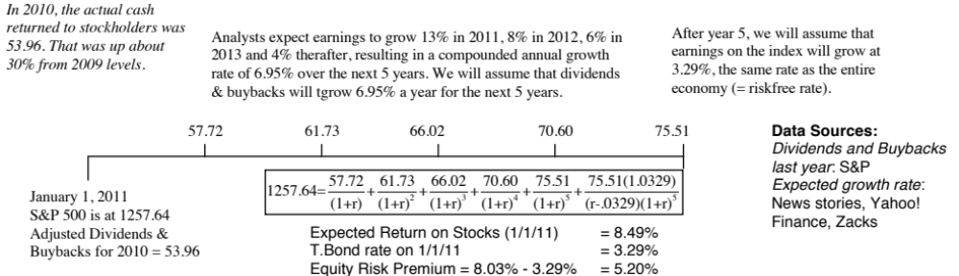
Equity Risk Premium: Watch what I pay, not what I say!
A January 2011 update
By January 1, 2011, the worst of the crisis seemed to be behind us. Fears of a depression had receded and banks looked like they were struggling back to a more stable setting. Default spreads started to drop and risk was no longer front and center in pricing.
Notes:
The key lesson I would take away is that equity risk premiums are unstable and that globalization has made them more unstable. The other is that there seems to be mean reversion in the process – implied premiums, when abnormally high or low, move back towards a longer term average.

Slide 5
Implied Premiums in the US: 1960-2010
Notes:
As the index changes (and it is the input most likely to change by large amounts in short periods), the implied premium will change. Note that as premiums rise, stock prices drop. Notice two historical phenomena: (1) Equity risk premiums spiked in the 1970s as inflation increased in the US (2) Equity risk premiums bottomed out at 2% at the end of 1999 at the peak of the dot-com boom.
Would you settle for a 2% premium? If your answer is no, you believe that stocks are overvalued.

Slide 6
Why implied premiums matter?
In many investment banks, it is common practice (especially in corporate finance departments) to use historical risk premiums (and arithmetic averages at that) as risk premiums to compute cost of equity. If all analysts in the department used the geometric average premium for 1928-2008 of 3.9% to value stocks in January 2009, given the implied premium of 6.43%, what were they likely to find?
The values they obtain will be too low (most stocks will look overvalued)
The values they obtain will be too high (most stocks will look under valued)
There should be no systematic bias as long as they use the same premium (3.9%) to value all stocks.
Notes:
Everything will look cheap…
Using any premium higher than the implied premium today will bias values downwards (and most stocks will look overvalued). This is why risk premiums used in equity research departments tend to be different than those used in corporate finance.
So, how do analysts compensate for this bias?
They make unrealistic estimates of growth and reinvestment to arrive at what they feel are reasonable values. They then put pressure on management to deliver these unrealistic numbers. Managers bend the accounting rules to pull this off… and we have the makings of accounting scandals.

Slide 7
Estimating a risk premium for an emerging market
Approach 1: Build off a mature market premium
Assume that the equity risk premium for the US and other mature equity markets was 5% in September 2011. You could then add on an additional premium for investing in an emerging markets.
Two ways of estimating the country risk premium:
  Default spread on Country Bond: In this approach, the country equity risk premium is set equal to the default spread of the bond issued by the country. Brazil’s default spread, based on its rating, in September 2011 was 1.75%.
    Equity Risk Premium for Brazil = 5% + 1.75% = 6.75%
  Adjusted for equity risk: The country equity risk premium is based upon the volatility of the equity market relative to the government bond rate.
    Standard Deviation in Bovespa = 21%
    Standard Deviation in Brazilian government bond= 14%
    Default spread on Brazilian Bond= 1.75%
    Total equity risk premium for Brazil = 5% + 1.75% (21/14) = 7.63%

Slide 8
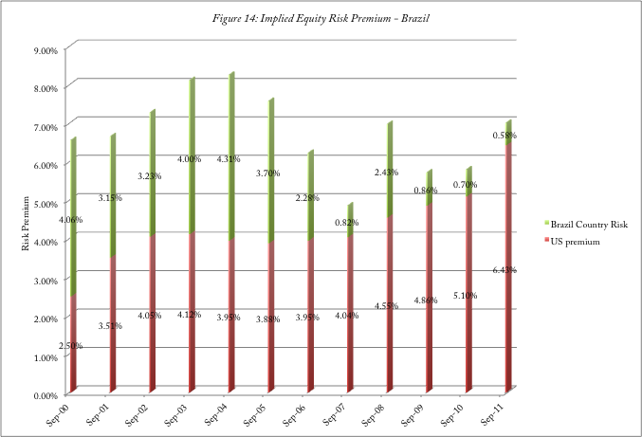
Approach 2: Estimate an implied equity risk premium for Brazil

Slide 9
From Country Risk Premiums to Corporate Equity Risk premiums
Approach 1: Assume that every company in the country is equally exposed to country risk. In this case,
E(Return) = Riskfree Rate + Country ERP + Beta (US premium)
  Implicitly, this is what you are assuming when you use the local Government’s dollar borrowing rate as your riskfree rate.
Approach 2: Assume that a company’s exposure to country risk is similar to its exposure to other market risk.
E(Return) = Riskfree Rate + Beta (US premium + Country ERP)
Approach 3: Treat country risk as a separate risk factor and allow firms to have different exposures to country risk (perhaps based upon the proportion of their revenues come from non-domestic sales)
E(Return)=Riskfree Rate+ β (US premium) + λ (Country ERP)
ERP: Equity Risk Premium
Notes:
While many analysts use the first approach, it strikes us as unreasonable to tar all companies - large and small, domestic and export oriented - with the same brush.
The second approach tends to work well for all but the most extreme examples - firms that derive the bulk of their revenues outside an emerging market.
For companies that derive most of their revenues from markets other than their domestic market, the third approach offers the most promise, though we are left with the question of how to estimate lambda. Lambda will look a lot like beta, averaging one across all stocks. A stock with a lambda greater than one is more exposed to country risk than the average stock.

Slide 10
Estimating Company Exposure to Country Risk: Determinants
Source of revenues: Other things remaining equal, a company should be more exposed to risk in a country if it generates more of its revenues from that country. A Brazilian firm that generates the bulk of its revenues in Brazil should be more exposed to country risk than one that generates a smaller percent of its business within Brazil.
Manufacturing facilities: Other things remaining equal, a firm that has all of its production facilities in Brazil should be more exposed to country risk than one which has production facilities spread over multiple countries. The problem will be accented for companies that cannot move their production facilities (mining and petroleum companies, for instance).
Use of risk management products: Companies can use both options/futures markets and insurance to hedge some or a significant portion of country risk.
Notes:
This is not meant to be an all inclusive list. While there are undoubtedly other factors to consider, you also have to be able to obtain this information not only on your firm but on other firms in the market. In fact, of the three items listed above, revenue sources may be the only publicly available information on companies.

Slide 11
Estimating Lambdas: The Revenue Approach
The easiest and most accessible data is on revenues. Most companies break their revenues down by region.
λ = % of revenues domestically_{firm}/ % of revenues domestically_{avg firm}
Consider, for instance, Embraer and Embratel, both of which are incorporated and traded in Brazil. Embraer gets 3% of its revenues from Brazil whereas Embratel gets almost all of its revenues in Brazil. The average Brazilian company gets about 77% of its revenues in Brazil:
  Lambda_{Embraer} = 3%/ 77% = .04
  Lambda_{Embratel} = 100%/77% = 1.30
There are two implications
  A company’s risk exposure is determined by where it does business and not by where it is located
  Firms might be able to actively manage their country risk exposure
Notes:
This is a simplistic approach, but it is the easiest one to use. You can usually get the percent of revenues that your firm gets in the country from its annual report.
Notice that Embraer has a lambda close to zero since it gets so little of its revenues in Brazil. Since its factories and work force are still in Brazil, this estimate seems to be too low.

