Slide 1
Session 5: Betas
Aswath Damodaran

Slide 2
Estimating Beta
The standard procedure for estimating betas is to regress stock returns (R_{j}) against market returns (R_{m}) -
R_{j} = a + b R_{m}
  where a is the intercept and b is the slope of the regression.
The slope of the regression corresponds to the beta of the stock, and measures the riskiness of the stock.
This beta has three problems:
  It has high standard error
  It reflects the firm’s business mix over the period of the regression, not the current mix
  It reflects the firm’s average financial leverage over the period rather than the current leverage.
Notes:
The standard approach for estimating betas- regressions - leads to flawed and backward looking estimates of risk.

Slide 3
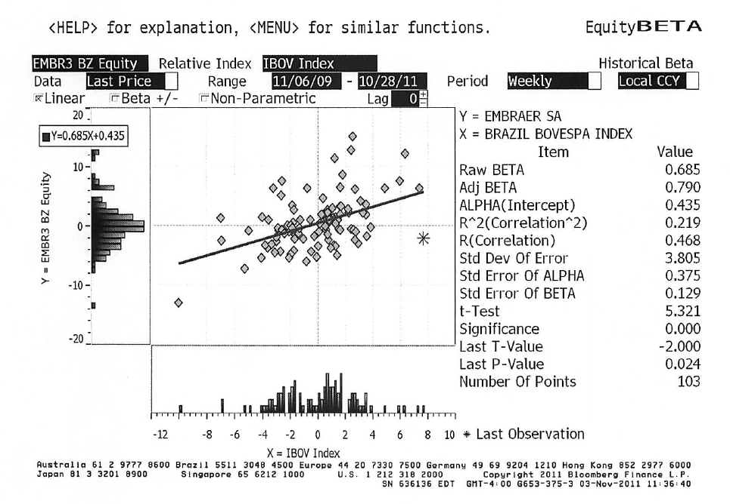
Beta Estimation: Is this Embraer’s beta?
Notes:
Note the standard error problem. Amazon has a beta estimate of 2.23, but the standard error of 0.50 results in a considerable range around this estimate.

Slide 4
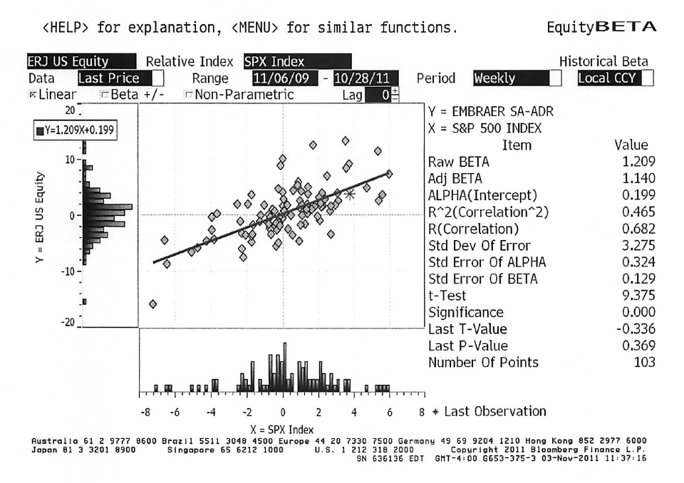
Or is this it?

Slide 5
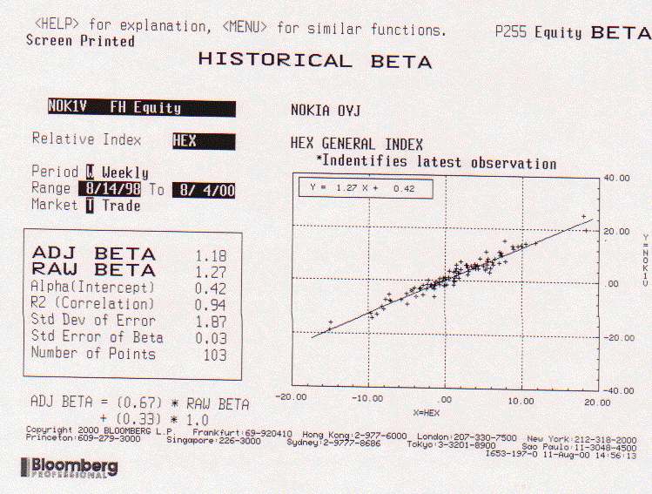
And watch out if your regression looks too good…
Notes:
This beta looks much better (in terms of standard error) but it is misleading. Nokia dominates the Helisinki index (it was 70% of the index at the time of this regression).
The reason it is misleading is because Nokia’s largest single investor was Barclays, which manages one of the worlds’ largest global index funds. Barclays would not view the beta of this regression as a good measure of risk. (They would probably prefer a beta estimate against a global equity index like the Morgan Stanley Capital Index).

Slide 6
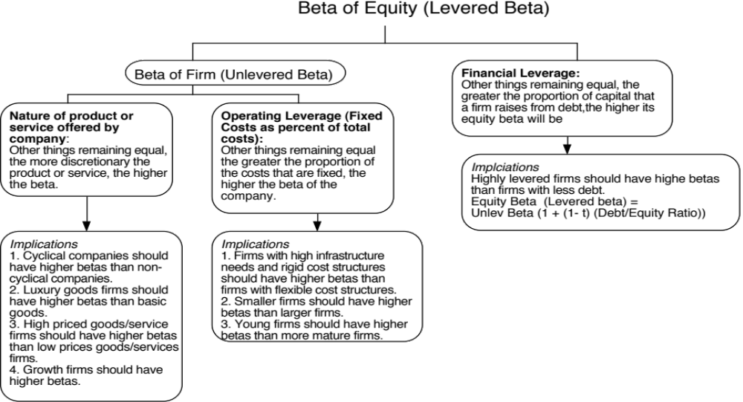
Determinants of Betas
Notes:
These are the three fundamentals that drive betas.
Firms that produce luxury goods (such as Gucci and Tiffanys) should have higher betas than firms that cater to more basic needs (Walmart). These firms tend to have revenues that are much more sensitive to changes in economic conditions.
Firms in businesses with high fixed cost structures (like airlines) should have higher betas than firms with more flexible cost structures.
Firms that borrow more money will have higher equity betas than otherwise similar firms that do not borrow money.

Slide 7
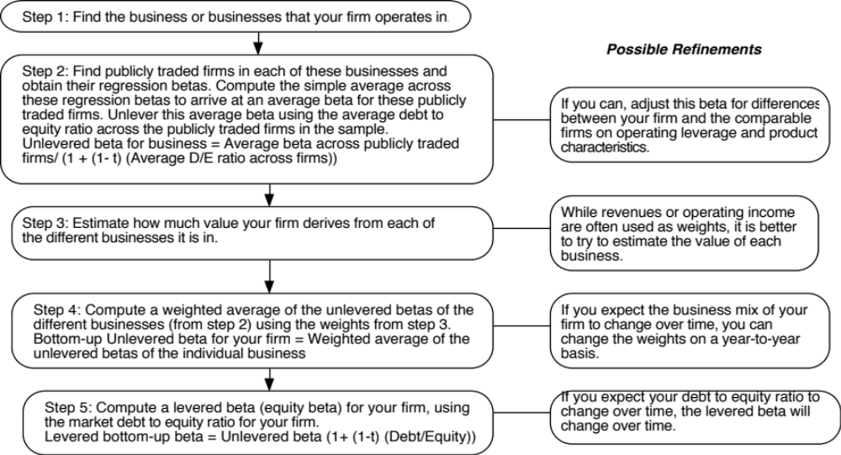
Bottom-up Betas
Notes:
Three measurement issues come up:
How broadly or narrowly do we define comparable firms?
We would argue for a broader rather than a narrow definition, because the savings in standard error increase with the number of firms.
How do we deal with differences in operating leverage and business mix that may persist across these firms?
Assume that there are no differences in operating leverage and business mix or that the differences average out.
Adjust for the differences quantitatively. For instance, you could decompose the unlevered beta further into a business beta and the operating leverage effect:
Unlevered beta = Business beta (1 + (Fixed Cost/Variable costs))
How do we compute an average - simple or weighted?
I prefer simple averages. Otherwise, your betas reflect those of the largest and most stable firms in the business.

Slide 8
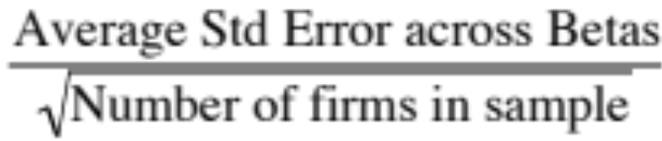
Why bottom-up betas?
The standard error in a bottom-up beta will be significantly lower than the standard error in a single regression beta. Roughly speaking, the standard error of a bottom-up beta estimate can be written as follows:
Std error of bottom-up beta =
The bottom-up beta can be adjusted to reflect changes in the firm’s business mix and financial leverage. Regression betas reflect the past.
You can estimate bottom-up betas even when you do not have historical stock prices. This is the case with initial public offerings, private businesses or divisions of companies.
Notes:
While we still use regression betas to compute bottom-up betas, the law of large numbers works in your favor. The average of a large number of imprecise betas is more precise than any one regression beta. The reason we unlever and relever is because different firms may have different debt ratios.
Even if a company is in a single business and has not changed its business over time, the bottom up beta should dominate a regression beta. If a company has changed its business mix, the argument for bottom up betas becomes irrefutable.

Slide 9
Estimating a bottom up beta for Embraer in 2004
Embraer is in a single business, aerospace, where there are no other listed firms in Latin America and very few in emerging markets. To estimate the bottom up beta, we therefore used all publicly listed companies in the aerospace business (globally), averaged their betas and estimated an average unlevered beta for the business of 0.95
We then applied Embraer’s gross debt to equity ratio of 18.95% and the Brazilian marginal tax rate of 34% to estimate a levered beta for the company.
Business Unlevered Beta D/E Ratio Levered beta
Aerospace 0.95 18.95% 1.07
Levered Beta = Unlevered Beta ( 1 + (1- tax rate) (D/E Ratio)
= 0.95 ( 1 + (1-.34) (.1895)) = 1.07
The fact that most of the other companies in this business are listed on developed markets is not a deal breaker, since betas average to one in every market. The fact that Brazil may be a riskier market is captured in the equity risk premium, not in the beta.
Notes:
The unlevered beta is the beta for aerospace companies globally. The debt to equity ratio is Embraer’s current market debt to equity ratio and the tax rate used is the marginal tax rate in Brazil.

