Slide 1
Session 8: Estimating Growth

Slide 2
Growth in Earnings
Look at the past
  The historical growth in earnings per share is usually a good starting point for growth estimation
Look at what others are estimating
  Analysts estimate growth in earnings per share for many firms. It is useful to know what their estimates are.
Look at fundamentals
  Ultimately, all growth in earnings can be traced to two fundamentals - how much the firm is investing in new projects, and what returns these projects are making for the firm.
Notes:
Three basic approaches for estimating growth. We tend to use all three but the degree to which we weight each in will depend upon the company that we are looking at.

Slide 3
I. Historical Growth in EPS
The historical growth rate in earnings for a company may seem like a fact but it is an estimate. In fact, it is sensitive to
  How it is computed: The growth rates in earnings will be different, depending upon how you compute the average. An simple (arithmetic) average growth rate will tend to be higher than a compounded (geometric) average growth rate.
  Estimation period: The starting point for the computation can make a big difference. Using a bad year as the base year will generate much higher growth rates.
In using historical growth rates, recognize the following:
  Growth rates become meaningless when earnings go from negative values to positive values
  Growth rates will go down as companies get larger
Worst of all, there is evidence that historical growth rates in earnings are not very good predictors of future earnings…
Notes:
Estimating historical growth rates may seem to be trivial, but there are a number of estimation issues that can lead different analysts to estimate different historical growth rates for the same firm.

Slide 4
II. Management/Analyst Forecasts
When valuing companies, we often fall back on management forecasts for the future (after all, they know the company better than we do) or forecasts of other analysts.
Management forecasts may reflect their “superior” knowledge, but they have a fatal flaw. They are biased.
Analyst forecasts may seem like a simple way to avoid the problem, but not only are they also biased but using them represents an abandonment of a basic requirement in valuation: that you make your own best judgment of growth.

Slide 5
III. Fundamental Growth
Growth has to be earned by a company. You and I do not have the power to endow a company with growth.
In terms of basic fundamentals, for a company to grow its earnings, it has to
  Add to its asset or capital base and generate returns on that added capital (new investment growth)
  Manage its existing assets more efficiently, generating higher margins and higher returns on existing assets (efficiency growth)

Slide 6
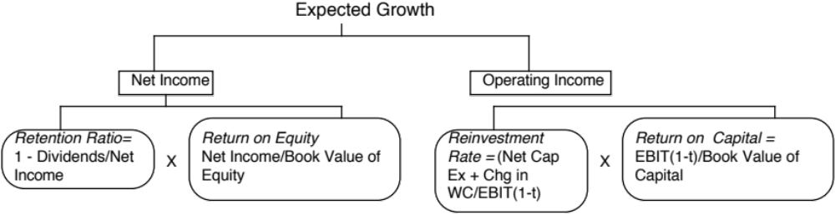
a. New Investment Growth
The growth in earnings for a firm from new investments is a function of two decisions that the firm makes:
  How much to reinvest back into the business in both long term assets and short term assets
    With equity earnings, this is the portion of net income put back into the business
    With operating earnings, this is the portion of after-tax operating income that is invested in the business.
  How well it reinvests its money, defined again
    With equity earnings, the return on equity
    With operating earnings, the return on invested capital

Slide 7
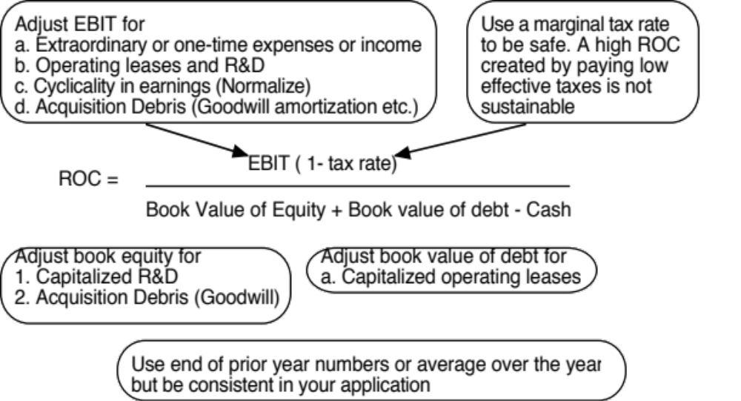
The key number
Return on Capital (Equity)

Slide 8
b. Efficiency Growth
When the return on equity or capital is changing, there will be a second component to growth, positive if the return is increasing and negative if the return is decreasing. If ROC_{t} is the return on capital in period t and ROC_{t+1} is the return on capital in period t+1, the growth rate in operating income will be:
  Expected Growth Rate = ROC_{t+1} * Reinvestment rate
+(ROC_{t+1} – ROC_{t}) / ROC_{t}
For example, assume that you have a firm that is generating a return on capital of 8% on its existing assets and expects to increase this return to 10% next year. The efficiency growth for this firm is
Efficiency growth = (10% -8%)/ 8% = 25%
Thus, if this firm has a reinvestment rate of 50% and makes a 10% return on capital on its new investments as well, its total growth next year will be 30%
Growth rate = .50 * 10% + 25% = 30%
The key difference is that growth from new investments is sustainable whereas returns from efficiency are short term (or transitory).

Slide 9
Revenue Growth and Operating Margins
Both efficiency and new investment growth are predicated on the return on equity (or capital). If a firm is losing money or its margins are changing dramatically over time, it makes far more sense to start with revenues and work down.
Input 1: Revenue growth: This growth rate allows small revenues to become bigger, but it has to be reasonable, given the size of the market and potential competition.
Input 2: Operating margins: You have to pick a target margin that you expect the firm’s margin to move towards over time.
Input 3: Reinvestment: Since revenue growth does not come easily, you should tie reinvestment to revenue changes each period. One simple way to do this is to estimate a sales to capital ratio.
Expected Reinvestment = Change in Revenue (in $ terms) / (Sales/ Capital)

