Slide 1
Session 9: Terminal Value

Slide 2
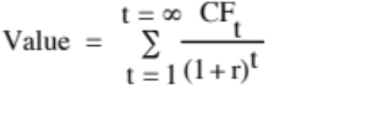
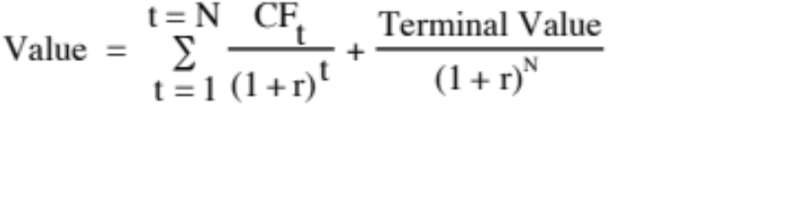
Getting Closure in Valuation
A publicly traded firm potentially has an infinite life. The value is therefore the present value of cash flows forever.
Since we cannot estimate cash flows forever, we estimate cash flows for a “growth period” and then estimate a terminal value, to capture the value at the end of the period:
Notes:
To put closure on valuation, we assume that we stop forecasting cashflows at some point in time and estimate a terminal value.

Slide 3
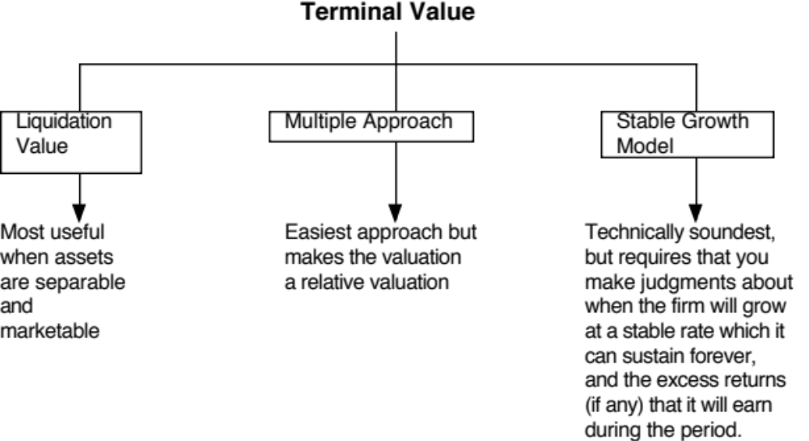
Ways of Estimating Terminal Value
Notes:
Firms have infinite lives. Since we cannot estimate cash flows forever, we assume a constant growth rate forever as a way of closing off the valuation.
A very commonly used variant is to use a multiple of the terminal year’s earnings. This brings an element of relative valuation into the analysis. In a pure DCF model, the terminal value has to be estimated with a stable growth rate.
The real choice is between stable growth models and liquidation value. One values the firm as a going concern and the other is based upon shutting the firm down and getting what you can for its assets.

Slide 4
Stable Growth and Terminal Value
When a firm’s cash flows grow at a “constant” rate forever, the present value of those cash flows can be written as:
  Value = Expected Cash Flow Next Period / (r - g)
  where,
  r = Discount rate (Cost of Equity or Cost of Capital)
  g = Expected growth rate
This “constant” growth rate is called a stable growth rate and cannot be higher than the growth rate of the economy in which the firm operates.
While companies can maintain high growth rates for extended periods, they will all approach “stable growth” at some point in time.
Notes:
In a stable growth model, the cashflows grow at a constant rate forever. Consequently, this growth rate cannot exceed the growth rate of the economy in which the firm operates - in nominal (real) terms, if you are doing a nominal (real) valuation. In fact, as a simple rule of thumb, the stable growth rate should not be higher than the riskfree rate, since the riskless rate can be viewed as the sum of expected inflation and real growth.

Slide 5
1. How high can the stable growth rate be?
The stable growth rate cannot exceed the growth rate of the economy but it can be set lower.
  If you assume that the economy is composed of high growth and stable growth firms, the growth rate of the latter will probably be lower than the growth rate of the economy.
  The stable growth rate can be negative. The terminal value will be lower and you are assuming that your firm will disappear over time.
  If you use nominal cashflows and discount rates, the growth rate should be nominal in the currency in which the valuation is denominated.
One simple proxy for the nominal growth rate of the economy is the riskfree rate.
  Riskfree rate = Expected inflation + Expected Real Interest Rate
  Nominal growth rate in economy = Expected Inflation + Expected Real Growth
Notes:
(If the overall economy is composed of high growth and mature companies, and is growing at 5%, the mature companies must be growing at a rate less than 5%).
The stable growth rate can be a negative number. This is an intermediate solution between the infinite growth model and liquidation value. Using a negative stable growth rate will make your firm disappear gradually over time.

Slide 6
2. When will the firm reach stable growth?
Size of the firm
  Success usually makes a firm larger. As firms become larger, it becomes much more difficult for them to maintain high growth rates
Current growth rate
  While past growth is not always a reliable indicator of future growth, there is a correlation between current growth and future growth. Thus, a firm growing at 30% currently probably has higher growth and a longer expected growth period than one growing 10% a year now.
Barriers to entry and differential advantages
  Ultimately, high growth comes from high project returns, which, in turn, comes from barriers to entry and differential advantages.
  The question of how long growth will last and how high it will be can therefore be framed as a question about what the barriers to entry are, how long they will stay up and how strong they will remain.
Notes:
When looking at the firm, you probably want to also look at the size of the market and the growth rate in that market. Even large firms may be able to get some breathing room on growth if they operate in markets that are growing - eg. Microsoft in the software market.
You want to give some weight to momentum in past growth. I would weight revenue growth a lot more than income growth, since accounting rules can be used to pump up the latter.
Ultimately, though, it is not growth that creates value but excess returns. The essence of value creating growth then is the existence of competitive advantages that are large and sustainable. The larger and more sustainable these advantages are, the longer the growth period can be.
Company Competitive Advantage Assessment
Coca Cola Brand Name Large and sustainable. Difficult to replicate brand name.
Bristol Myers Patents, R&D Large and sustainable because of legal protection in the U.S. Less so in overseas expansion.
Amazon First Mover, Technological, Firm seems to be still searching
Brand Name for its advantage.

Slide 7
3. What else should change in stable growth?
In stable growth, firms should have the characteristics of other stable growth firms. In particular,
  The risk of the firm, as measured by beta and ratings, should reflect that of a stable growth firm.
    Beta should move towards one
    The cost of debt should reflect the safety of stable firms (BBB or higher)
  The debt ratio of the firm might increase to reflect the larger and more stable earnings of these firms.
    The debt ratio of the firm might moved to the optimal or an industry average
    If the managers of the firm are deeply averse to debt, this may never happen
  The return on capital generated on investments should move to sustainable levels, relative to both the sector and the company’s own cost of capital.

Slide 8
4. What excess returns will you generate in stable growth and why does it matter?
Strange though this may seem, the terminal value is not as much a function of stable growth as it is a function of what you assume about excess returns in stable growth.
The key connecting link is the reinvestment rate that you have in stable growth, which is a function of your return on capital:
Reinvestment Rate = Stable growth rate/ Stable ROC
The terminal value can be written in terms of ROC as follows:
Terminal Value = EBIT_{n+1} (1-t) (1 – g/ ROC)/ (Cost of capital – g)
In the scenario where you assume that a firm earns a return on capital equal to its cost of capital in stable growth, the terminal value will not change as the growth rate changes.
If you assume that your firm will earn positive (negative) excess returns in perpetuity, the terminal value will increase (decrease) as the stable growth rate increases.

Slide 9
These are things (critiques) you should not worry about…
The terminal value is a high percentage of the estimated value of the firm today. Critics of DCF often argue that since the terminal value is a high percentage of the value today (80% or higher) that
  Your assumptions about the high growth period don’t matter; this is not true since the base on which you compute your terminal value (earnings, cash flows) are affected by your high growth inputs
  DCF is flawed; Why? It reflects the reality that the bulk of your returns from buying stocks comes from price appreciation.
The terminal value can be made as high as you want it to be, if you play with the growth rate.
  That is true, if you play with the growth rate. It is not true, if you follow the four rules we laid out.
  Bottom line: Tie growth to reinvestment and excess returns and cap your growth rate at the riskfree rate.

