Slide 1
Applied Corporate Finance
Aswath Damodaran
www.damodaran.com
www.stern.nyu.edu/~adamodar/New_Home_Page/triumdesc.html
Notes:
Sets the agenda for the class. This is a class that will be focused on the big picture of corporate finance rather than details, theories or models on a piecemeal basis.

Slide 2

What is corporate finance?
Every decision that a business makes has financial implications, and any decision which affects the finances of a business is a corporate finance decision.
Defined broadly, everything that a business does fits under the rubric of corporate finance.
Notes:
Corporate finance covers every decision that any business, small or large, public or private takes.. This is my very selfish attempt to show that corporate finance is at the heart of all the other management disciplines: marketing, strategy, accounting and even the fuzzy far reaches of human capital.

Slide 3
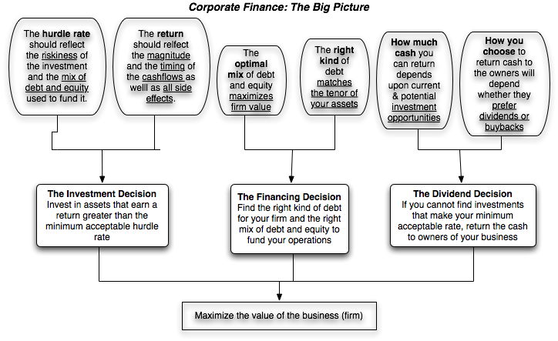
First Principles
Notes:
This is the big picture that will animate how we approach corporate finance. We will use it to anchor the class, introducing each topic by noting its presence in the big picture. Ultimately, everything we do in corporate finance has to be somewhere in the picture.
(I introduce my syllabus after this slide with session numbers framed in the big picture)

Slide 4

The Objective in Decision Making
In traditional corporate finance, the objective in decision making is to maximize the value of the firm.
A narrower objective is to maximize stockholder wealth. When the stock is traded and markets are viewed to be efficient, the objective is to maximize the stock price.
Maximize equity value
Maximize market estimate of equity value
Maximize firm value
Notes:
This is the answer to the question posed in the previous overhead.
Maximizing the value of the business is the most general objective function.
Managers answer to stockholders. Consequently, the objective gets narrowed down to “maximizing equity value”. (Implicit assumption: Bondholders/ Banks can protect themselves by writing in covenants and setting interest rates).
It is tough to assess equity value objectively. It would be nice to have a “third party” estimate that is objective. For publicly traded firms, the market (in spite of all its limitations) provides such an estimate. (Implicit assumption: Markets are rational and reasonably efficient).

Slide 5
The Classical Objective Function
STOCKHOLDERS
Hire & fire
managers
- Board
- Annual Meeting
Maximize
stockholder wealth
Lend Money
No Social Costs
BONDHOLDERS
Managers
SOCIETY
Protect
bondholder
Interests
Costs can be
traced to firm
Reveal
information
honestly and
on time
Markets are
efficient and
assess effect on
value
FINANCIAL MARKETS
Notes:
This is the utopian world. None of the assumptions are really defensible as written, and skepticism is clearly justified:
Why do we need these assumptions?
Since, in many large firms, there is a separation of ownership from management, managers have to be fearful of losing their jobs and go out and maximize stockholder wealth. If they do not have this fear, they will focus on their own interests.
If bondholders are not protected, stockholders can steal from them and make themselves better off, even as they make the firm less valuable.
If markets are not efficient, maximizing stock prices may not have anything to do with maximizing stockholder wealth or firm value.
If substantial social costs are created, maximizing stock prices may create large side costs for society (of which stockholders are members).
Note that corporate finance, done right, is not about stealing from other groups (bondholders, other stockholders or society) but about making the firm more productive and valuable.

Slide 6
What can go wrong?
STOCKHOLDERS
Managers put
their interests
above stockholders
Have little control
over managers
Lend Money
Significant Social Costs
BONDHOLDERS
Managers
SOCIETY
Bondholders can
get ripped off
Some costs cannot be
traced to firm
Delay bad
news or
provide
misleading
information
Markets make
mistakes and
can over react
FINANCIAL MARKETS
Notes:
This is my worst case scenario:
Stockholders have little or no control over managers. Managers, consequently, put their interests above stockholder interests.
Bondholders who do not protect themselves find stockholders expropriating their wealth.
Information conveyed to markets is noisy, biases and sometimes misleading. Markets do not do a very good job of assimilating this information and market price changes have little to do with true value.
Firms in the process of maximizing stockholder wealth create large social costs.
In this environment, stockholder wealth maximization is not a good objective function.

Slide 7

Who is on Board? The Disney Experience - 1997
Notes:
This may be going back in time but it may help understanding Disney’s present standing. This was Disney’s board at the height of Michael Eisner’s powers. (Eisner became CEO of Disney in 1985 and consolidated power in the years after.)
Note the number of insiders on the board. (Seven out of 16; five current employees & two ex-employees)
Also note the presence of Mr. Eisner’s private attorney (Irwin Russell) and the principal of his childrens’ elementary school (Reveta Bowers) on the board.
How independent was this board likely to be of Mr. Eisner? This may explain some of the actions taken by Disney (and specifically Eisner) during the 1990s… (Read Disney War by James Stewart for the gory details)
When Eisner was hired in 1984, he insisted on bringing in his protégé Jeffrey Katzenberg, a brilliant show-biz exec lacking in social skills, into the firm with him. Katzenberg was largely responsible for the rebirth of Disney Animation (which Eisner had considered shutting down) with The Little Mermaid, Beauty and the Beast and The Lion King all proving to be mega-winners. As a reward for this success, Esiner fired him. His lucrative contract entitled him to 2% of the revenues from the movies he made in posterity but he would have settled for $100 million. Eisner refused to pay; Disney paid $ 250 million in 1999.
In 1995, Eisner hired Ovitz, the leading agent in Hollywood, and then told the board to okay the hire. He regretted it almost immediately and fired him 453 days later for “lying” and “incompetence”. However, rather than argue that this was just cause for firing, he paid Ovitz $ 100 million to leave.

Slide 8
So, what next? When the cat is idle, the mice will play ....
When managers do not fear stockholders, they will often put their interests over stockholder interests
  Greenmail: The (managers of ) target of a hostile takeover buy out the potential acquirer's existing stake, at a price much greater than the price paid by the raider, in return for the signing of a 'standstill' agreement.
  Golden Parachutes: Provisions in employment contracts, that allows for the payment of a lump-sum or cash flows over a period, if managers covered by these contracts lose their jobs in a takeover.
  Poison Pills: A security, the rights or cashflows on which are triggered by an outside event, generally a hostile takeover, is called a poison pill.
  Shark Repellents: Anti-takeover amendments are also aimed at dissuading hostile takeovers, but differ on one very important count. They require the assent of stockholders to be instituted.
  Overpaying on takeovers: Acquisitions often are driven by management interests rather than stockholder interests.
No stockholder approval needed….. Stockholder Approval needed
Notes:
These actions could all suggest that managerial interests are being put over stockholder interests. (Some of these actions, though, may also increase stockholder wealth. Managers will, of course, always claim that these actions are in stockholders’ best interests)
The reason that I have put overpaying on poison pills and shark repellants below greenmail and golden parachutes is not because they create less damage to stockholders but because stockholders at least get a chance to voice their view (they both require stockholder approval). Greenmail and golden parachutes just require board approval.

Slide 9

6Application Test: Who owns/runs your firm?
Look at: Bloomberg printout HDS or annual report for your firm
Who are the top stockholders in your firm?
What are the potential conflicts of interests that you see emerging from this stockholding structure?
Notes:
One of your first tasks when assessing a company is to see whether managers have a significant stake in the company. You can get this information in a variety of places. I use Bloomberg to get the data on the top 17 stockholders and go down the list to see if incumbent managers have a stake in the company. I also check to see if there are other investors on the list who may not be incumbent managers but are strong advocates for stockholders - Berkshire Hathaway at Coca Cola, KKR or Blackstone at many publicly traded firms…
You can also get this information from Yahoo! Finance by going into company profiles and clicking on institutional investors…
As you look at the list of top stockholders, you should be also considering the potential conflicts of interest created by the stockholder structure.
Inside stockholders (Founding family, controlling stockholder/manager) versus outside stockholders
Government as major stockholder (or holder of golden vote)
Employees as major stockholders

Slide 10

Case 1: Splintering of Stockholders
Disney’s top stockholders in 2003
Notes:
Not a single individual investor in the list other than Roy Disney who was the 15th largest stockholder… Managers are not significant stockholders in Disney (and the same can be said for most large publicly traded firms). Consider the following scenarios:
Managers are not significant stockholders in the firm: Significant potential for conflicts of interest between managers and stockholders.
Individuals are significant stockholders in the firm as well as part of top management. Usually, these are founder-owners of the firm and the firms tend to be younger firms or family run businesses that have recently made the transition to publicly traded firms. Smaller potential for conflict between managers and stockholders, but potential for conflict between inside stockholders and outside stockholders.
The government is a large stockholder (or a stockholder with veto power). This may keep managers in some check but it will create potential conflicts of interest between the other stockholders and the government (Consider what would happen if the company tried to minimize taxes paid)
Trusts or descendants of owners are significant stockholders in the firm but are not an active part of incumbent management. Power that these stockholders retain to replace managers reduces potential for conflict of interest but is reduced as holdings get diluted among lots of family members.
Another company is largest stockholder in firm. In this case, trace out who owns stock in the other company….

Slide 11
Case 2: Voting versus Non-voting Shares:
Aracruz
Aracruz Cellulose, like most Brazilian companies, had multiple classes of shares.
  The common shares had all of the voting rights and were held by incumbent management, lenders to the company and the Brazilian government.
  Outside investors held the non-voting shares, which were called preferred shares, and had no say in the election of the board of directors. At the end of 2002,
Aracruz was managed by a board of seven directors, composed primarily of representatives of those who own the common (voting) shares, and an executive board, composed of three managers of the company.
Notes:
When voting rights vary across shares, incumbent managers can consolidate their hold on a company with relatively small holdings. This reduces the power that stockholders have in these companies.
Differences in voting rights are common outside the U.S. In Asia and Latin America, incumbent managers or family members can control companies with relatively small holdings with complete impunity.

Slide 12
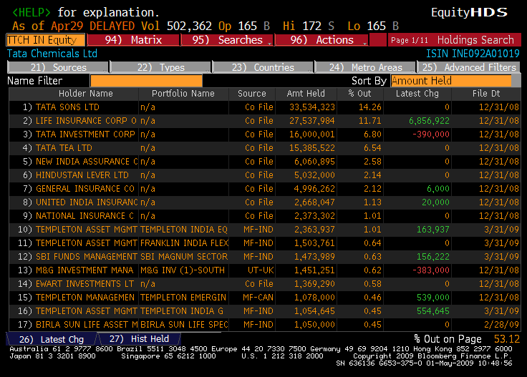
Case 3: Cross and Pyramid Holdings
Tata Chemical’s top stockholders in 2008
Notes:
Cross holding structures are often designed with control in mind. In the case of Tata Chemicals, other Tata companies (which are part of the Tata family group) represent 5 of the top 15 stockholders in the company. (At least the Tatas are up front and open about their cross holding structures… In many Indian companies, the cross holdings are disguised with front companies holding the stock for families).
In Asia and Latin America, corporate holdings structures are designed to consolidate control.

Slide 13

Things change.. Disney’s top stockholders in 2009
Notes:
Things can change… This is Disney in 2009. Note that there is now an individual at the top of the list – Steve Jobs, whose holdings come from his majority ownership at Pixar that was acquired by Disney.
As a stockholder in Disney, what are your thoughts about Jobs at the top of the list?
I think that it will shake the company up. Jobs has many shortcomings, but he is a visionary who will push Disney to take another look at its established business practices.

Slide 14
When traditional corporate financial theory breaks down, the solution is:
To choose a different mechanism for corporate governance, i.e, assign the responsibility for monitoring managers to someone other than stockholders.
To choose a different objective for the firm.
To maximize stock price, but reduce the potential for conflict and breakdown:
  Making managers (decision makers) and employees into stockholders
  Protect lenders from expropriation
  By providing information honestly and promptly to financial markets
  Minimize social costs
Notes:
At this point, things look pretty bleak for stock price maximization. These are the three choices that we have, if we abandon pure stock price maximization as an objective function.

Slide 15
I. An Alternative Corporate Governance System
Germany and Japan developed a different mechanism for corporate governance, based upon corporate cross holdings.
  In Germany, the banks form the core of this system.
  In Japan, it is the keiretsus
  Other Asian countries have modeled their system after Japan, with family companies forming the core of the new corporate families
At their best, the most efficient firms in the group work at bringing the less efficient firms up to par. They provide a corporate welfare system that makes for a more stable corporate structure
At their worst, the least efficient and poorly run firms in the group pull down the most efficient and best run firms down. The nature of the cross holdings makes its very difficult for outsiders (including investors in these firms) to figure out how well or badly the group is doing.
Notes:
In the 1980s, Michael Porter argued that US companies should move towards the Japanese system. The Japanese and German systems tend to do well in stable environments, where failure tends to be unsystematic ( a firm here and a firm there). They can take care of their “failures” and nurse them back to health, rather than exposing themselves to the costs associated with failure.
These systems break down when problems are wide spread and systematic. Contrast the way US banks dealt with problem loans on their balance sheets (markets forced them to deal with these problems quickly ) and the way Japanese banks have dealt with them (by hiding them and hoping they go away)
In recent years, people have pointed to the Chinese system (centrally planned, quasi market) as the success story. I don’t buy it (yet). The test of a system comes not during periods of success but during periods of failure. Neither the Chinese nor the Indian systems have been tested yet. The next two years will tell us whether either system is a long term sustainable system.

Slide 16
II. Choose a Different Objective Function
Firms can always focus on a different objective function. Examples would include
  maximizing earnings
  maximizing revenues
  maximizing firm size
  maximizing market share
  maximizing EVA
The key thing to remember is that these are intermediate objective functions.
  To the degree that they are correlated with the long term health and value of the company, they work well.
  To the degree that they do not, the firm can end up with a disaster
Notes:
Consider each of these objectives. If you put them through the same tests that we did stock price maximization, you come up with far more problems with each.
Note that firms might pick an intermediate objective (like market share) when it is correlated with firm value but continue to use it, even after it loses this link. Do you want a 100% market share of a losing business?
In the 1980s, American Airlines (under Robert Crandall) set itself the objective of becoming the number one domestic airline in the United States. It succeeded but by 1989, it was losing billions.

Slide 17
III. A Market Based Solution
STOCKHOLDERS
1. More activist
investors
2. Hostile takeovers
Managers of poorly
run firms are put
on notice.
Protect themselves
Corporate Good Citizen Constraints
BONDHOLDERS
Managers
SOCIETY
1. Covenants
2. New Types
1. More laws
2. Investor/Customer Backlash
Firms are
punished
for misleading
markets
Investors and
analysts become
more skeptical
FINANCIAL MARKETS
Notes:
This summarizes the objective function of maximizing stockholder wealth, with the fixes noted on the last few pages.

Slide 18

A Market Solution: Eisner’s exit… and a new age dawns? Disney’s board in 2008
Notes:
The changes made by Eisner were too little.. Too late,,, and he was forced to leave in 2005, His successor, Bob Iger, has made a break from the past. Note the differences between the board in 2008 and the one in 2004:
It is smaller, 12 members instead of 18.
There is little overlap between this board and the 2003 board, reflecting the fact that this is now Iger’s board and not Eisner’s board.
The directors with the most obvious conflicts of interests are gone.
The question, though, is an open one. As Iger becomes entrenched as CEO, will be find directors who are beholden to him?

Slide 19
The Investment Principle: Risk and Return Models
“You cannot swing upon a rope that is attached only to your own belt.”
Notes:
While the general presumption is that risk is a bad thing and some seek to avoid it at any cost, the reality is that businesses will not only always be exposed to risk but success may sometimes ride on seeking out and taking specific risks.

Slide 20
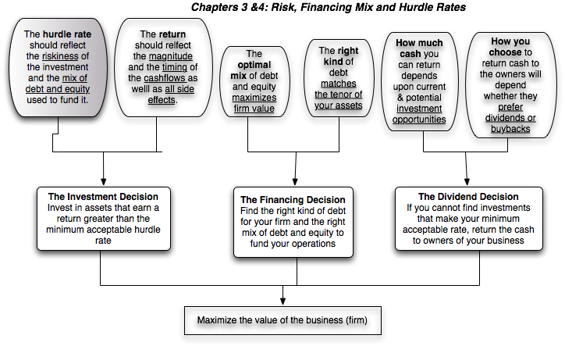
First Principles
Notes:
The focus of the first part of this investment analysis section is on coming up with a minimum acceptable hurdle rate. In the process, we have to grapple with the question of what risk is and how to bring risk into the hurdle rate.

Slide 21
What is Risk?
Risk, in traditional terms, is viewed as a ‘negative’. Webster’s dictionary, for instance, defines risk as “exposing to danger or hazard”. The Chinese symbols for risk, reproduced below, give a much better description of risk
The first symbol is the symbol for “danger”, while the second is the symbol for “opportunity”, making risk a mix of danger and opportunity. You cannot have one, without the other.
Notes:
Note that risk is neither good nor bad. It is a combination of danger and opportunity - you cannot have one without the other. Consequently, risk is neither something to be avoided nor sought out but carefully balanced. Good business avoid some risks, let others pass through to their investors and actively seek out still others.
When businesses want opportunity (higher returns), they have to live with the higher risk.
Any sales pitch that offers returns without risk is a pipe dream.
Bob Citron, treasurer of Orange County (CA), after he lost a chunk of the county’s pension fund money after investing in interest rate derivatives claimed that he was “not a finance person” and that Merrill’s market strategist (Charlie Clough) had told him he could make “15% with no risk”.
Many prominent (and intelligent) people invested with Bernie Madoff because he promised them (through third parties) that he could deliver 8% more than the treasury bill rate, guaranteed. (He was called the Jewish T.Bill). One investor, interviewed by the NY Times said, “I really did not understand what he was doing, but he said was going to do something with calls, something with puts and earn 12% every year. It sounded plausible (and all my friends were investing with him too).

Slide 22

Alternatives to the CAPM
Notes:
Note that all of the models of risk and return in finance agree on the first two steps. They deviate at the last step in the way they measure market risk, with
The CAPM, capturing all of it in one beta, relative to the market portfolio
The APM, capturing the market risk in multiple betas against unspecified economic factors
The Multi-Factor model, capturing the market risk in multiple betas against specified macro economic factors
The Regression model, capturing the market risk in proxies such as market capitalization and price/book ratios

Slide 23
Limitations of the CAPM
1. The model makes unrealistic assumptions
2. The parameters of the model cannot be estimated precisely
  - Definition of a market index
  - Firm may have changed during the 'estimation' period'
3. The model does not work well
  - If the model is right, there should be
    a linear relationship between returns and betas
    the only variable that should explain returns is betas
  - The reality is that
    the relationship between betas and returns is weak
    Other variables (size, price/book value) seem to explain differences in returns better.
Notes:
The first two critiques can be lowered against any model in finance.
The last critique is the most damaging. Fama and French (1991) noted that
Betas explained little of the difference in returns across stocks between 1962 and 1991. (Over long time periods, it should, if the CAPM is right and betas are correctly estimated), explain almost all of the difference)
Market Capitalization and price to book value ratios explained a significant portion of the differences in returns.
This test, however, is a test of which model explains past returns best, and might not necessarily be a good indication of which one is the best model for predicting expected returns in the future.

Slide 24
Why the CAPM persists…
The CAPM, notwithstanding its many critics and limitations, has survived as the default model for risk in equity valuation and corporate finance. The alternative models that have been presented as better models (APM, Multifactor model..) have made inroads in performance evaluation but not in prospective analysis because:
  The alternative models (which are richer) do a much better job than the CAPM in explaining past return, but their effectiveness drops off when it comes to estimating expected future returns (because the models tend to shift and change).
  The alternative models are more complicated and require more information than the CAPM.
  For most companies, the expected returns you get with the the alternative models is not different enough to be worth the extra trouble of estimating four additional betas.
Notes:
It takes a model to beat a model… The CAPM may not be a very good model at predicting expected returns but the alternative models don’t do much better. In fact, the tests of the CAPM are joint tests of both the effectiveness of the model and the quality of the parameters used in the testing (betas, for instance). We will argue that better beta estimates and a more careful use of the CAPM can yield far better estimates of expected return than switching to a different model.
Just as a side note, there are many who either dislike or distrust the CAPM. While we share some of their skepticism about its precision, we would not throw the basic principle that the discount rate has to be adjusted for risk out, just because we do not like the CAPM. In other words, find a different risk and return model, if so inclined, but adjust for risk.

Slide 25
Looking at Disney’s top stockholders in 2009 (again)
Notes:
Of Disney’s top 17 investors, only 1 is an individual…. And Steve Jobs does not trade often (as an insider, he is constrained), making the remaining institutional investors the marginal investors…

Slide 26
Cross and Pyramid Holdings
Tata Chemical’s top stockholders in 2008
Notes:
Cross holding structures are often designed with control in mind. In the case of Tata Chemicals, other Tata companies (which are part of the Tata family group) represent 5 of the top 15 stockholders in the company. (At least the Tatas are up front and open about their cross holding structures… In many Indian companies, the cross holdings are disguised with front companies holding the stock for families).
In Asia and Latin America, corporate holdings structures are designed to consolidate control.

Slide 27
6Application Test: Who is the marginal investor in your firm?
  You can get information on insider and institutional holdings in your firm from:
  http://finance.yahoo.com/
  Enter your company’s symbol and choose profile.
Looking at the breakdown of stockholders in your firm, consider whether the marginal investor is
  An institutional investor
  An individual investor
  An insider
Notes:
For most publicly traded US firms, most, if not all, of the 15 largest investors are institutional investors. In addition, high proportions of both the stock owned and traded are by institutional investors. Thus, the assumption that the marginal investor is well diversified is quite justifiable.
For very small firms, the marginal investor may be an individual investor or even a day trader, who is not diversified. What implications does this have for the use of risk and return models?

Slide 28
Inputs required to use the CAPM -
The capital asset pricing model yields the following expected return:
  Expected Return = Riskfree Rate+ Beta * (Expected Return on the Market Portfolio - Riskfree Rate)
To use the model we need three inputs:
  The current risk-free rate
  (b) The expected market risk premium (the premium expected for investing in risky assets (market portfolio) over the riskless asset)
  (c) The beta of the asset being analyzed.
Notes:
Summarizes the inputs. Note that we are replacing the last component (E(Rm)-Rf) with the expected equity risk premium..

Slide 29
The Riskfree Rate and Time Horizon
On a riskfree asset, the actual return is equal to the expected return. Therefore, there is no variance around the expected return.
For an investment to be riskfree, i.e., to have an actual return be equal to the expected return, two conditions have to be met –
  There has to be no default risk, which generally implies that the security has to be issued by the government. Note, however, that not all governments can be viewed as default free.
  There can be no uncertainty about reinvestment rates, which implies that it is a zero coupon security with the same maturity as the cash flow being analyzed.
Theoretically, this translates into using different riskfree rates for each cash flow - the 1 year zero coupon rate for the cash flow in year 1, the 2-year zero coupon rate for the cash flow in year 2 ...
Practically speaking, if there is substantial uncertainty about expected cash flows, the present value effect of using time varying riskfree rates is small enough that it may not be worth it.
Notes:
Reemphasize that you need to know the expected returns with certainty for something to be riskless.
No default risk and no reinvestment risk. Most people understand the first point, but don’t get the second.
If you need an investment where you will know the expected returns with certainty over a 5-year time horizon, what would that investment be?
From a present value standpoint, using different riskfree rates for each cash flow may be overkill, except in those cases where your interest rates are very different for different time horizons (a very upward sloping or downward sloping yield curve)
A T.Bill would not work - there is reinvestment risk.
Even a 5-year T.Bond would not work, because the coupons will cause the actual return to deviate from the expected return.
Thus, you need a 5-year zero coupon T.Bond

Slide 30
The Bottom Line on Riskfree Rates
Using a long term government rate (even on a coupon bond) as the riskfree rate on all of the cash flows in a long term analysis will yield a close approximation of the true value. For short term analysis, it is entirely appropriate to use a short term government security rate as the riskfree rate.
The riskfree rate that you use in an analysis should be in the same currency that your cashflows are estimated in.
  In other words, if your cashflows are in U.S. dollars, your riskfree rate has to be in U.S. dollars as well.
  If your cash flows are in Euros, your riskfree rate should be a Euro riskfree rate.
The conventional practice of estimating riskfree rates is to use the government bond rate, with the government being the one that is in control of issuing that currency. In US dollars, this has translated into using the US treasury rate as the riskfree rate. In May 2009, for instance, the ten-year US treasury bond rate was 3.5%.
Notes:
Since corporate finance generally looks at long term decisions, we will for the most part use the long term government bond rate.

Slide 31
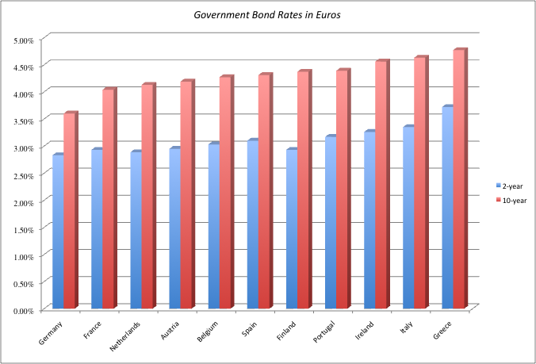
What is the Euro riskfree rate?
Notes:
Note that there are a dozen government that issue bonds denominated in Euros… with different rates on each of them. Since they are all in the same currency, the differences have to be attributed to perceptions of default risk. For a riskfree rate in Euros, I would go with the lowest of the rates in this table, which belongs to the German Euro bond; the ten-year rate is 3.60%.
A purist can argue that even the German Euro bond has some default risk embedded in it. The Euro riskfree rate would therefore have to be lower than 3.60%.

Slide 32
What if there is no default-free entity?
If the government is perceived to have default risk, the government bond rate will have a default spread component in it and not be riskfree. There are three choices we have, when this is the case.
  Adjust the local currency government borrowing rate for default risk to get a riskless local currency rate.
    In May 2009, the Indian government rupee bond rate was 7%. the local currency rating from Moody’s was Ba2 and the default spread for a Ba2 rated country bond was 3%.
    Riskfree rate in Rupees = 7% - 3% = 4%
    In May 2009, the Brazilian government $R bond rate was 11% and the local currency rating was Ba1, with a default spread of 2.5%.
    Riskfree rate in $R = 11% - 2.5% = 8.5%
  Do the analysis in an alternate currency, where getting the riskfree rate is easier. With Aracruz in 2009, we could chose to do the analysis in US dollars (rather than estimate a riskfree rate in R$). The riskfree rate is then the US treasury bond rate.
  Do your analysis in real terms, in which case the riskfree rate has to be a real riskfree rate. The inflation-indexed treasury rate is a measure of a real riskfree rate.
Notes:
- Work with the local currency but you cannot use a long-term government bond rate as a riskfree rate if the government has default risk. You need to back into a riskfree rate. If you cannot do this, you have two choices:
Work with a currency where you can get a riskfree rate
Do everything in real terms
For a real riskfree rate, an expected real growth rate for the economy should provide a reasonable approximation.
To do your analysis in real terms, you need a real riskfree rate. In the U.S., you can obtain such a rate by looking at the inflation indexed treasury bond rate. Outside the U.S., you can assume as a rough approximation that the real riskfree rate is equal to your real growth rate. IIf the real growth rate is much lower than the real interest rate, you will have significant deficits - trade or budget - to make up the shortfall. If the real growth rate is much higher than the real interest rate, you will the exact opposite - surpluses. A long term equilibrium can be reached only when the two are equal.

Slide 33
Measurement of the risk premium
The risk premium is the premium that investors demand for investing in an average risk investment, relative to the riskfree rate.
As a general proposition, this premium should be
  greater than zero
  increase with the risk aversion of the investors in that market
  increase with the riskiness of the “average” risk investment
Notes:
Implicit here are two questions - Which investor’s risk premium? What is the average risk investment?
With this assumption it is quite clear that estimating equity risk premiums will be difficult to do because different investors have different degrees of risk aversion (and will demand different premiums) and risk aversion will change over time.

Slide 34
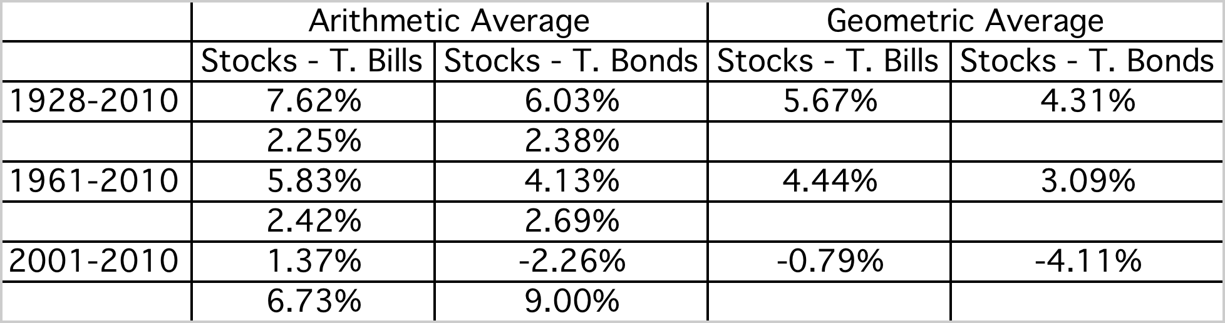

A. The Historical Risk Premium
Evidence from the United States
What is the right premium?
Go back as far as you can. Otherwise, the standard error in the estimate will be large.
Be consistent in your use of a riskfree rate.
Use arithmetic premiums for one-year estimates of costs of equity and geometric premiums for estimates of long term costs of equity.
Notes:
The US has the longest and richest historical data base for stocks (going back as far as the 1800s) and many historical premiums are based upon that data…
We are trusting mean reversion, i.e., that numbers revert back to historical averages over time..
This is based upon historical data available on the Federal Reserve site in St. Louis. There are three reasons for why the premium estimated may differ:
1. How far back you go (My personal bias is to go back as far as possible. Stock prices are so noisy that you need very long time periods to get reasonable estimates)
2. Whether you use T.Bill or T.Bond rates ( You have to be consistent. Since I will be using the T.Bond rate as my riskfree rate, I will use the premium over that rate)
3. Whether you use arithmetic or geometric means (If returns were uncorrelated over time, and you were asked to estimate a 1-year premium, the arithmetic mean would be used. Since returns are negatively correlated over time, and we are estimating premiums over longer holding periods, it makes more sense to use the compounded return, which gives us the geometric average)
Thus, I should be using the updated geometric average for stocks over bonds.

Slide 35
What about historical premiums for other markets?
Historical data for markets outside the United States is available for much shorter time periods. The problem is even greater in emerging markets.
The historical premiums that emerge from this data reflects this data problem and there is much greater error associated with the estimates of the premiums.
Notes:
Increasingly, the challenges we face are in estimating risk premiums outside the United States, not only because so many companies that we value are in younger, emerging markets but because so many US companies are looking at expanding into these markets.

Slide 36
One solution: Look at a country’s bond rating and default spreads as a start
Ratings agencies assign ratings to countries that reflect their assessment of the default risk of these countries. These ratings reflect the political and economic stability of these countries and thus provide a useful measure of country risk.
  In May 2009, the local currency rating, from Moody’s, for Brazil was Ba1. In May 2009, Brazil had dollar denominated 10-year Bonds, trading at an interest rate of 6%. The US treasury bond rate that day was 3.5%, yielding a default spread of 2.50% for Brazil.
  India has a rating of Ba2 from Moody’s but has no dollar denominated bonds. The typical default spread for Ba2 rated sovereign bonds is 3%.
Many analysts add this default spread to the US risk premium to come up with a risk premium for a country. This would yield a risk premium of 6.38% for Brazil and 6.88% for India, if we use 3.88% as the premium for the US .
Notes:
This approach is simple but it assumes that country default spreads are also good measures of additional country equity risk. The question thought is whether equities (which are riskier than bonds) should command a larger risk premium.

Slide 37
Beyond the default spread
While default risk spreads and equity risk premiums are highly correlated, one would expect equity spreads to be higher than debt spreads.
Risk Premium for Brazil in early 2009
  Standard Deviation in Bovespa (Equity) = 34%
  Standard Deviation in Brazil $ denominated Bond = 21.5%
  Default spread on $ denominated Bond = 2.5%
  Country Risk Premium (CRP) for Brazil = 2.5% (34%/21.5%) = 3.95%
  Total Risk Premium for Brazil = US risk premium (in ‘09) + CRP for Brazil
  = 3.88% + 3.95% = 7.83%
Risk Premium for India in May 2009
  Standard Deviation in Sensex (Equity) = 32%
  Standard Deviation in Indian government bond = 21.3%
  Default spread based upon rating= 3%
  Country Risk Premium for India = 3% (32%/21.3%) = 4.51%
  Total Risk Premium for India = US risk premium (in ‘09) + CRP for India
  = 3.88% + 4.51%= 8.39%
Notes:
In In this approach, we scale up the default spread to reflect the additional risk in stocks… This will result in larger equity risk premiums. We are assuming that investors, when pricing equities in an emerging market, look at what they can make on government bonds issued by that market and scale up premiums for additional risk.
There is a third approach which is closely related where you look at the standard deviation of the emerging equity market, relative to the standard deviation of the U.S. equity market, and multiply by the U.S. equity risk premium. Thus, the equity risk premium for an emerging market which is twice as volatile as the the US market should have an equity risk premium of 7.76% (twice 3.88%).

Slide 38

Austria [1] | 5.00%
Belgium [1] | 5.38%
Cyprus [1] | 6.50%
Denmark | 5.00%
Finland [1] | 5.00%
France [1] | 5.00%
Germany [1] | 5.00%
Greece [1] | 15.50%
Iceland | 8.00%
Ireland [1] | 8.60%
Italy [1] | 5.75%
Malta [1] | 6.28%
Netherlands [1] | 5.00%
Norway | 5.00%
Portugal [1] | 9.13%
Spain [1] | 5.75%
Sweden | 5.00%
Switzerland | 5.00%
United Kingdom | 5.00%
Albania | 11.00%
Armenia | 9.13%
Azerbaijan | 8.60%
Belarus | 12.50%
Bosnia and Herzegovina | 12.50%
Bulgaria | 8.00%
Croatia | 8.00%
Czech Republic | 6.28%
Estonia | 6.28%
Georgia | 9.88%
Hungary | 8.00%
Kazakhstan | 7.63%
Latvia | 8.00%
Lithuania | 7.25%
Moldova | 14.00%
Montenegro | 9.88%
Poland | 6.50%
Romania | 8.00%
Russia | 7.25%
Slovakia | 6.28%
Slovenia [1] | 5.75%
Ukraine | 12.50%
Bangladesh | 9.88%
Cambodia | 12.50%
China | 6.05%
Fiji Islands | 11.00%
Hong Kong | 5.38%
India | 8.60%
Indonesia | 8.60%
Japan | 5.75%
Korea | 6.28%
Macao | 6.05%
Mongolia | 11.00%
Pakistan | 14.00%
New Guinea | 11.00%
Philippines | 9.13%
Singapore | 5.00%
Sri Lanka | 11.00%
Taiwan | 6.05%
Thailand | 7.25%
Turkey | 9.13%
Vietnam | 11.00%
Country Risk Premiums
July 2011
Canada | 5.00%
United States | 5.00%
Argentina | 14.00%
Belize | 14.00%
Bolivia | 11.00%
Brazil | 7.63%
Chile | 6.05%
Colombia | 8.00%
Costa Rica | 8.00%
Ecuador | 17.75%
El Salvador | 9.13%
Guatemala | 8.60%
Honduras | 12.50%
Mexico | 7.25%
Nicaragua | 14.00%
Panama | 8.00%
Paraguay | 11.00%
Peru | 8.00%
Uruguay | 8.60%
Venezuela | 11.00%
Angola | 9.88%
Botswana | 6.50%
Egypt | 9.88%
Mauritius | 7.63%
Morocco | 8.60%
South Africa | 6.73%
Tunisia | 8.00%
Bahrain | 7.25%
Israel | 6.28%
Jordan | 9.13%
Kuwait | 5.75%
Lebanon | 11.00%
Oman | 6.28%
Qatar | 5.75%
Saudi Arabia | 6.05%
Senegal | 11.00%
United Arab Emirates | 5.75%
Australia | 5.00%
New Zealand | 5.00%
Notes:
Updated after the crisis. The premiums are much higher than they were in January 2008…

Slide 39
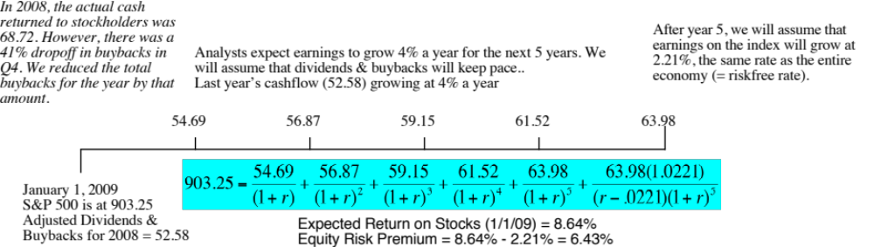
B. Implied Premiums: Watch what I pay, not what I say..
The implied premium in January 2009
Year | Market value of index | Dividends | Buybacks | Cash to equity | Dividend yield | Buyback yield | Total yield
2001 | 1148.09 | 15.74 | 14.34 | 30.08 | 1.37% | 1.25% | 2.62%
2002 | 879.82 | 15.96 | 13.87 | 29.83 | 1.81% | 1.58% | 3.39%
2003 | 1111.91 | 17.88 | 13.70 | 31.58 | 1.61% | 1.23% | 2.84%
2004 | 1211.92 | 19.01 | 21.59 | 40.60 | 1.57% | 1.78% | 3.35%
2005 | 1248.29 | 22.34 | 38.82 | 61.17 | 1.79% | 3.11% | 4.90%
2006 | 1418.30 | 25.04 | 48.12 | 73.16 | 1.77% | 3.39% | 5.16%
2007 | 1468.36 | 28.14 | 67.22 | 95.36 | 1.92% | 4.58% | 6.49%
2008 | 903.25 | 28.47 | 40.25 | 68.72 | 3.15% | 4.61% | 7.77%
Normalized | 903.25 | 28.47 | 24.11 | 52.584 | 3.15% | 2.67% | 5.82%
Notes:
As markets plummeted in 2008, the equity risk premium shot up… The increase fro, 4.37% to 6.43% over the course of a year is the largest one-year increase since 1960.

Slide 40
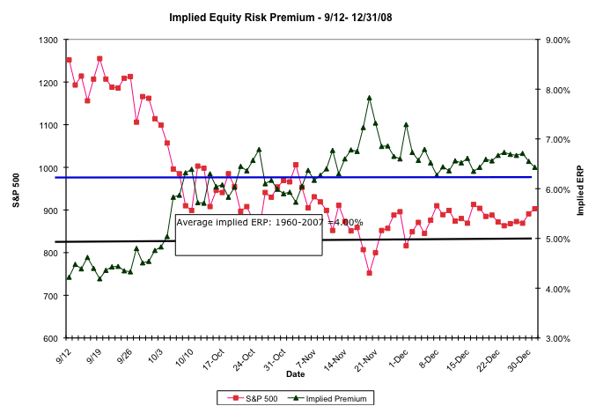
The Anatomy of a Crisis: Implied ERP from September 12, 2008 to January 1, 2009
Notes:
Equity risk premiums changed more in three months than they had in the previous 20 years put together. A wake-up call for those who stick with fixed premiums? That depends on whether we assume that this is an aberration or a break with the past.

Slide 41
The bottom line on Equity Risk Premiums in early 2009
Mature Markets: In May 2009, the number that we chose to use as the equity risk premium for all mature markets was 6%. While lower than the implied premium at the start of the year 6.43%, it is still much higher than the historical risk premium of 3.88%. It reflected our beliefs then that while the crisis was abating, it would leave a longer term impact on risk premiums.
For emerging markets, we will use the melded default spread approach (where default spreads are scaled up to reflect additional equity risk) to come up with the additional risk premium.
  ERP for Brazil = Mature market premium + CRP for Brazil = 6% + 3.95% = 9.95%
  ERP for India = Mature market premium + CRP for India = 6% + 4.51% = 10.51%
Notes:
This is a judgment call and will depend upon your point of view in May 2009.
If you thought that the crisis was just a bump in the road that markets would quickly forget and move on, you would use either the historical risk premium (3.88%) or the average implied premium over time (about 4%) as your mature market premium.
If you thought that the crisis would continue and perhaps even worsen, you would stick with 6.43%.
In hindsight, equity risk premiums dropped dramatically over the rest of 2009 to reach about 4.73% in December 2009.

Slide 42
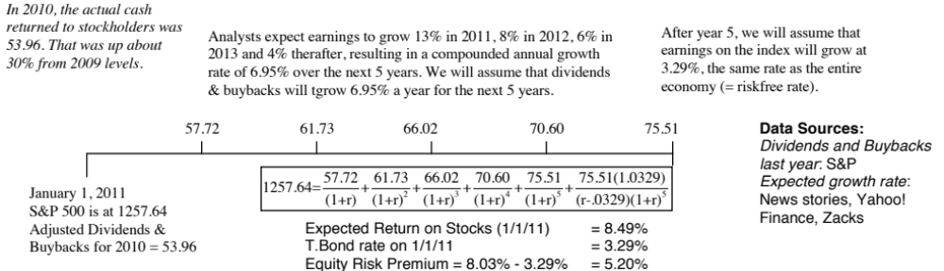
An Updated Equity Risk Premium:
By January 1, 2011, the worst of the crisis seemed to be behind us. Fears of a depression had receded and banks looked like they were struggling back to a more stable setting. Default spreads started to drop and risk was no longer front and center in pricing.
Notes:
The key lesson I would take away is that equity risk premiums are unstable and that globalization has made them more unstable. The other is that there seems to be mean reversion in the process – implied premiums, when abnormally high or low, move back towards a longer term average.

Slide 43
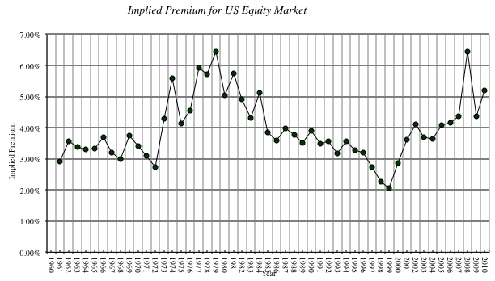
Implied Premiums in the US: 1960-2010
Notes:
As the index changes (and it is the input most likely to change by large amounts in short periods), the implied premium will change. Note that as premiums rise, stock prices drop. Notice two historical phenomena: (1) Equity risk premiums spiked in the 1970s as inflation increased in the US (2) Equity risk premiums bottomed out at 2% at the end of 1999 at the peak of the dot-com boom.
Would you settle for a 2% premium? If your answer is no, you believe that stocks are overvalued.

Slide 44
Estimating Beta
The standard procedure for estimating betas is to regress stock returns (R_{j}) against market returns (R_{m}) -
R_{j} = a + b R_{m}
  where a is the intercept and b is the slope of the regression.
The slope of the regression corresponds to the beta of the stock, and measures the riskiness of the stock.
The intercept of the regression becomes a measure of performance, when compared to what the stock would have made under the CAPM.
  a > R_{f} (1-b) .... Stock did better than expected during regression period
  a = R_{f} (1-b) .... Stock did as well as expected during regression period
  a < R_{f} (1-b) .... Stock did worse than expected during regression period
The R squared (R²) of the regression provides an estimate of the proportion of the risk (variance) of a firm that can be attributed to market risk. The balance (1 - R²) can be attributed to firm specific risk.
Notes:
Betas reflect not just the volatility of the underlying investment but also how it moves with the market:
Beta (Slope) = Correlation_{jm} (σ_{j /} σ_{m})
Note that σ_{j} can be high but beta can be low (because the asset is not very highly correlated with the market)
Key point: Betas may be estimated from regressions but they should never be considered purely statistical numbers. They convey economic weight - they measure the risk added on by an asset to a diversified portfolio.

Slide 45
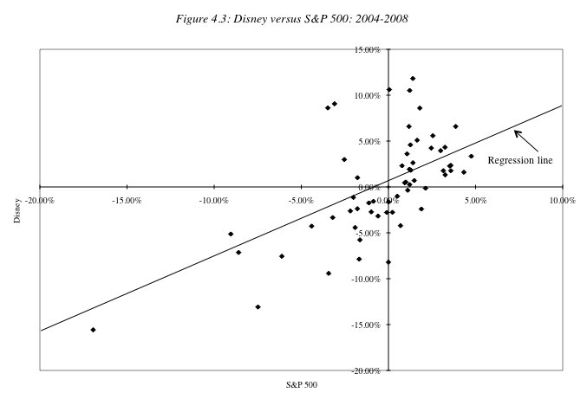
Disney’s Historical Beta
Notes:
This has both the scatter plot and the regression line. Note the there is substantial error in the regression. A statistician looking at this regression would view this as evidence that it was not a good regression. A financial economist looking the same regression sees it as a reflection of the reality that most of the risk in a given investment or stock is firm-specific.

Slide 46
Analyzing Disney’s Performance
Intercept = 0.47%
  This is an intercept based on monthly returns. Thus, it has to be compared to a monthly riskfree rate.
  Between 2004 and 2008
    Average Annualized T.Bill rate = 3.27%
    Monthly Riskfree Rate = 0.272% (=3.27%/12)
    Riskfree Rate (1-Beta) = 0.272% (1-0.95) = 0.01%
The Comparison is then between
  Intercept versus Riskfree Rate (1 - Beta)
  0.47% versus 0.01%
  Jensen’s Alpha = 0.47% -0.01% = 0.46%
Disney did 0.46% better than expected, per month, between 2004 and 2008.
  Annualized, Disney’s annual excess return = (1.0046)¹²-1= 5.62%
This positive Jensen’s alpha is a sign of good management at the firm.
  True
  False
Notes:
The intercept measures what your stock actually did in a month when the market was flat (zero return) during the time period of the regression. Rf(1- beta) measures what a stock should have done (given its beta) during the same period in a month in which the market did nothing.
Disney did 5.62% better than expected on an annual basis between 2004 and 2008. The Jensen’s alpha is a risk adjusted, market adjusted measure of performance. (Consider a simple example. Assume that the market was up 20% a year during the period of your regression and that you have a stock with a beta of 1.5. If you ignore the riskfree rate, this stock should have earned a return of 30% each year for the regression period. With a Jensen’s alpha of 5.62%, it earned 30% + 5.62% = 35.62%.)
If the regression is run using excess returns on the stock and market (over an above the riskfree rate), the intercept is already Jensen’s alpha:
Return on stock - Rf = a + b (Rm - Rf)
b. An alternate approach to estimating Jensen’s alpha is to use the average monthly return on the stock and subtract out the expected return using the risk free rate during the period, the beta and the average monthly return on the market. You should get an identical answer:

Slide 47
Estimating Disney’s Beta
Slope of the Regression of 0.95 is the beta
Regression parameters are always estimated with error. The error is captured in the standard error of the beta estimate, which in the case of Disney is 0.16.
Assume that I asked you what Disney’s true beta is, after this regression.
  What is your best point estimate?
  What range would you give me, with 67% confidence?
  What range would you give me, with 95% confidence?
Notes:
Best point estimate: 0.95
Range with 67% confidence: 0.79-1.11
Range with 95% confidence: 0.63 – 1.27

Slide 48
The Dirty Secret of “Standard Error”
Distribution of Standard Errors: Beta Estimates for U.S. stocks
1600
1400
1200
1000
800
Number of Firms
600
400
200
0
<.10
.10 - .20
.20 - .30
.30 - .40
.40 -.50
.50 - .75
> .75
Standard Error in Beta Estimate
Notes:
The standard errors of betas estimated in the US tend to be fairly high (the median is 0.20-0.25), with many beta estimates having standard errors of 0.40 or greater. These betas should come with warnings.

Slide 49
Breaking down Disney’s Risk
R Squared = 41%
This implies that
  41% of the risk at Disney comes from market sources
  59%, therefore, comes from firm-specific sources
The firm-specific risk is diversifiable and will not be rewarded
Notes:
This suggests that Disney is exposed to more macro risk than the typical firm in the US. The typical firm has an R squared of between 20-25%. Hence, the allure of diversification.
(Why might this be? Size and having a more diversified business mix may explain Disney’s high R-squared.)
About 20% of firms have R-squared of less than 10%…
Very few firms have R-squared approaching 50%…
GE has an R-squared for the 2004-2008 time period of about 55%.
Google The R-squared is about 10% over the same period

Slide 50
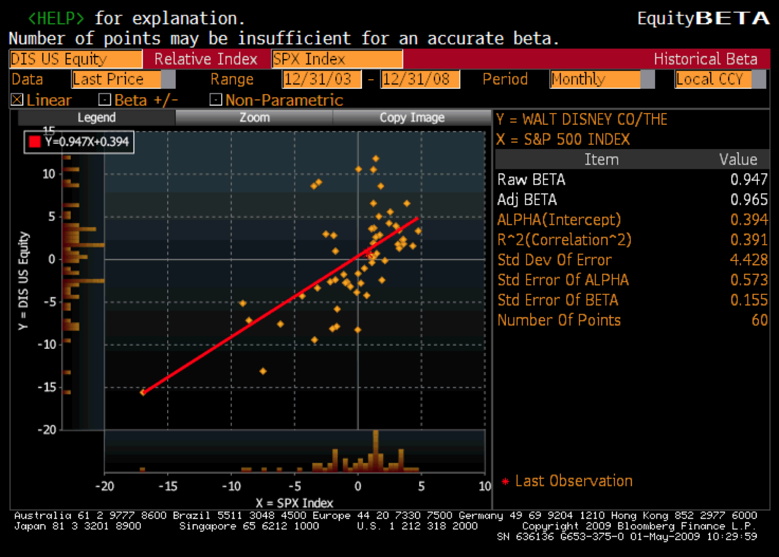
Beta Estimation: Using a Service (Bloomberg)
Notes:
This is the page for Disney’s beta, using the same period as the regression run earlier, from Bloomberg.
Bloomberg, however, uses only price returns (it ignores dividends both in the stock and the index). Hence the intercept is different.
The adjusted beta is just the regression beta moves towards one, reflecting the empirical realities that for most firms, betas tend to drift towards one as they get larger and more diversified.

Slide 51
Estimating Expected Returns for Disney in May 2009
Inputs to the expected return calculation
  Disney’s Beta = 0.95
  Riskfree Rate = 3.50% (U.S. ten-year T.Bond rate in May 2009)
  Risk Premium = 6% (Based on updated implied premium at the start of 2009)
Expected Return = Riskfree Rate + Beta (Risk Premium)
= 3.50% + 0.95 (6.00%) = 9.2%
Notes:
Note that this expected return would have been different if we had decided to use a different equity risk premium. The potential error in the beta will translate into a forecast error on the expected return as well.

Slide 52
Use to a Potential Investor in Disney
As a potential investor in Disney, what does this expected return of 9.2% tell you?
  This is the return that I can expect to make in the long term on Disney, if the stock is correctly priced and the CAPM is the right model for risk,
  This is the return that I need to make on Disney in the long term to break even on my investment in the stock
  Both
Assume now that you are an active investor and that your research suggests that an investment in Disney will yield 12.5% a year for the next 5 years. Based upon the expected return of 9.2%, you would
  Buy the stock
  Sell the stock
Notes:
Both. If the stock is correctly priced, the beta is correctly estimated and the CAPM is the right model, this is what you would expect to make on Disney in the long term. As an investor, this is what you would need to make to break even on the investment. You are not being greedy, just prudent. After all, if you don’t make higher returns when the market is going up, you will find yourself falling behind when the market is going down.
Buy the stock, since you think you can make more than the hurdle rate.

Slide 53
How managers use this expected return
Managers at Disney
  need to make at least 9.2% as a return for their equity investors to break even.
  this is the hurdle rate for projects, when the investment is analyzed from an equity standpoint
In other words, Disney’s cost of equity is 9.2%.
What is the cost of not delivering this cost of equity?
Notes:
The cost of equity is what equity investors in your company view as their required return.
The cost of not delivering this return is more unhappy stockholders, a lower stock price, and if you are a manager, maybe your job.
Going back to the corporate governance section, if stockholders have little or no control over managers, managers are less likely to view this as the cost of equity.

Slide 54
6 Application Test: Analyzing the Risk Regression
Using your Bloomberg risk and return print out, answer the following questions:
  How well or badly did your stock do, relative to the market, during the period of the regression?
  Intercept - (Riskfree Rate/n) (1- Beta) = Jensen’s Alpha
    where n is the number of return periods in a year (12 if monthly; 52 if weekly)
  What proportion of the risk in your stock is attributable to the market? What proportion is firm-specific?
  What is the historical estimate of beta for your stock? What is the range on this estimate with 67% probability? With 95% probability?
  Based upon this beta, what is your estimate of the required return on this stock?
  Riskless Rate + Beta * Risk Premium
Notes:
Try this on your company.

Slide 55

Beta: Exploring Fundamentals
Notes:
A cross selection of regression betas for companies… Lets try a story for each one:
Real Networks: Small, high growth company in risky business
Qwest: Some business risk but much more substantial overlay of financial risk created by borrowing billions.
Microsoft: Example of beta drift towards one as companies get larger and their product base (and customer base) becomes more diversified. Microsoft’s beta in the lat 1980s was much higher than 2.
GE: Most diversified US company you will find.. Beta will drift towards one for diversified companies. GE Capital’s debt acts as ballast on beta
Philip Morris: Main risk is oil price risk which cuts against the rest of the market (lower oil prices are good for many companies and the economy but not for oil companies). The litigation risk will not show up in the beta because it is firm-specific. (Changing the company name to Altria will not make a difference)
Harmony Gold Mining Company: A negative beta implies that adding this stock on to a diversified portfolio will actually reduce risk (acts as insurance). Gold has historically been an insurance against inflation.
(Consequences of a negative beta: Expected return < Riskfree rate)

Slide 56
Determinant 1: Product Type
Industry Effects: The beta value for a firm depends upon the sensitivity of the demand for its products and services and of its costs to macroeconomic factors that affect the overall market.
  Cyclical companies have higher betas than non-cyclical firms
  Firms which sell more discretionary products will have higher betas than firms that sell less discretionary products
Notes:
Betas measure risk relative to the market.
Firms which are cyclical or sell discretionary products tend to do much better when the economy is doing well (and the market is doing well) and much worse when the economy is doing badly than other firms in the market.
In terms of basic economics, companies that sell products/ services that have elastic demand should have higher betas than ones that sell products/services with inelastic demand.

Slide 57
Determinant 2: Operating Leverage Effects
Operating leverage refers to the proportion of the total costs of the firm that are fixed.
Other things remaining equal, higher operating leverage results in greater earnings variability which in turn results in higher betas.
Notes:
Firms with high fixed costs tend to see much bigger swings in operating income (and stock prices) for a given change in revenues than firms with more flexible cost structures.
Consider the case of the airline sector, which tends to have cost structures which are almost entirely fixed (plane lease expenses, fuel costs …). Firms in the sector have high betas.
Are you destined to have a high beta, once you pick a sector?
To an extent, yes, but you can take action or make decisions to change your destiny. Consider Southwest. By using only one type of aircraft, hedging fuel costs, flying from no-name airports and having a flexible workforce, Southwest has been able to lower its fixed costs as a proportion of total costs. (Focusing less on business travel and high priced tickets has also helped them on the discretionary component).

Slide 58
Determinant 3: Financial Leverage
As firms borrow, they create fixed costs (interest payments) that make their earnings to equity investors more volatile.
This increased earnings volatility which increases the equity beta.
The beta of equity alone can be written as a function of the unlevered beta and the debt-equity ratio
β_{L} = β_{u} (1+ ((1-t)D/E))
where
  β_{L} = Levered or Equity Beta D/E = Market value Debt to equity ratio
  β_{u} = Unlevered or Asset Beta t = Marginal tax rate
Earlier, we estimated the beta for Disney from a regression. Was that beta a levered or unlevered beta?
Levered
Unlevered
Notes:
Same rationale as operating leverage but the focus here is on equity earnings. Put another way, a firm with stable operating income can make its equity income much more volatile by borrowing large sums of money.
This is based upon two assumptions
Debt bears no market risk (which is consistent with studies that have found that default risk is non-systematic)
Debt creates a tax benefit
Assets Liabilities
Assets A (β_{u}) Debt D (β_{D} =0)
Tax Benefits tD (β_{D}=0) Equity E (β_{L})
Betas are weighted averages,
Β_{u} (E + D - tD)/(D+E) = β_{L}(E/(D+E))
Solve for β_{L},
β_{L} = Β_{u} (E + D - tD)/E= Β_{u} (1 + (1-t)D/E)
If debt has a beta (β_{D})
Β_{u} (E + D - tD)/(D+E) + β_{D} tD/(D+E) = β_{L}(E/(D+E)) + β_{D} D/(D+E)
β_{L} = Β_{u} (1 + (1-t)D/E) - β_{D} (1-t) [D/(D+E)]

Slide 59
Effects of leverage on betas: Disney
The regression beta for Disney is 0.95. This beta is a levered beta (because it is based on stock prices, which reflect leverage) and the leverage implicit in the beta estimate is the average market debt equity ratio during the period of the regression (2004 to 2008)
The average debt equity ratio during this period was 24.64%.
The unlevered beta for Disney can then be estimated (using a marginal tax rate of 38%)
  = Current Beta / (1 + (1 - tax rate) (Average Debt/Equity))
  = 0.95 / (1 + (1 - 0.38)(0.2464))= 0.8241
Notes:
Note that betas reflect the average leverage over the period and not the current leverage of the firms. Firms whose leverage has changed over the period will have regression betas that are different from their true betas.

Slide 60
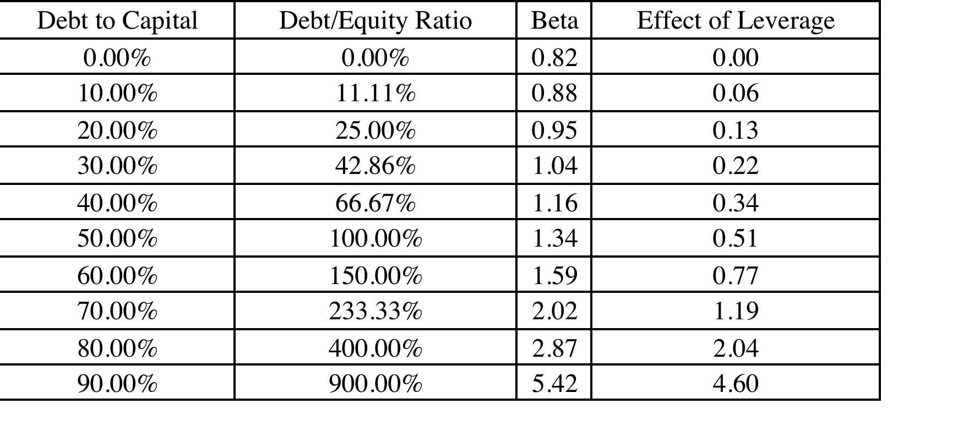
Disney : Beta and Leverage
Notes:
Since equity investors bear all of the non-diversifiable risk, the beta of Disney’s equity will increase as the leverage increases.

Slide 61
Betas are weighted Averages
The beta of a portfolio is always the market-value weighted average of the betas of the individual investments in that portfolio.
Thus,
  the beta of a mutual fund is the weighted average of the betas of the stocks and other investment in that portfolio
  the beta of a firm after a merger is the market-value weighted average of the betas of the companies involved in the merger.
Notes:
Betas are always weighted averages - where the weights are based upon market value. This is because betas measure risk relative to a market index.

Slide 62
Bottom-up versus Top-down Beta
The top-down beta for a firm comes from a regression
The bottom up beta can be estimated by doing the following:
  Find out the businesses that a firm operates in
  Find the unlevered betas of other firms in these businesses
  Take a weighted (by sales or operating income) average of these unlevered betas
  Lever up using the firm’s debt/equity ratio
The bottom up beta is a better estimate than the top down beta for the following reasons
  The standard error of the beta estimate will be much lower
  The betas can reflect the current (and even expected future) mix of businesses that the firm is in rather than the historical mix
Notes:
Bottom-up betas build up to the beta from the fundamentals, rather than trusting the regression.
The standard error of an average beta for a sector, is smaller by a factor of √n, where n is the number of firms in the sector. Thus, if there are 25 firms in a sector, the standard error of the average is 1/5 the average standard error.

Slide 63

Disney’s business breakdown
Business | Comparable firms | Number of firms | Median levered beta | Median D/E | Unlevered beta | Median Cash/Firm Value | Unlevered beta corrected for cash
Media Networks | Radio and TV broadcasting companies -US | 19 | 0.83 | 38.71% | 0.6735 | 4.54% | 0.6735/(1-.0454) =0.7056
Parks and Resorts | Theme park & Resort companies - Global | 26 | 0.80 | 65.10% | 0.5753 | 1.64% | 0.5849
Studio Entertainment | Movie companies -US | 19 | 1.57 | 53.89% | 1.1864 | 8.93% | 1.3027
Consumer Products | Toy companies- US | 12 | 0.83 | 27.21% | 0.7092 | 33.66% | 1.0690
Notes:
Disney has other businesses (like cruise lines) which are not broken out separately because they are too small… There is also a trade off to breaking businesses down too much into subsectors, since it becomes more difficult to find comparable firms.
Estimating details:
Comparable firms: are publicly traded companies in each of these businesses. However, we had a difficult time getting enough companies in two businesses:
Media networks, since the major networks (CBS, ABC, NBC and Fox) are all parts of much larger firms. We expanded the sample to include firms that fed into the network business (such as Nielsen and King World)
Theme parks: There are very few publicly traded theme parks in the US. We expanded the sample by looking globally; we were able to find a few in Europe
Average levered beta: Simple average of two-year weekly return betas for comparable firms.
Cash / Firm value: Cash holdings as a percent of firm value at comparable firms
Unlevered beta corrected for cash: Unlevered beta/ (1 - Cash/ Firm Value). We are assuming that cash has a beta of zero. We are doing this to get a beta for just the operating businesses of these companies.

Slide 64
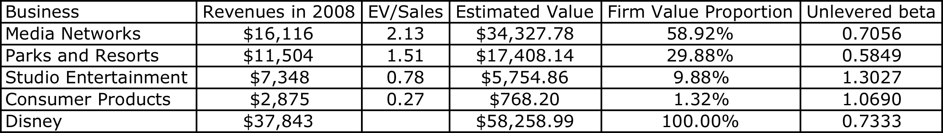

Disney’s bottom up beta
Estimate the bottom up unlevered beta for Disney’s operating assets.
Step 1: Start with Disney’s revenues by business.
Step 2: Estimate the value as a multiple of revenues by looking at what the market value of publicly traded firms in each business is, relative to revenues.
EV/Sales =
Step 3: Multiply the revenues in step 1 by the industry average multiple in step 2.
Disney has a cash balance of $3,795 million. If we wanted a beta for all of Disney’s assets (and not just the operating assets), we would compute a weighted average:
Notes:
EV/Sales = (Market Value of Equity + Market value of debt - Cash)/Sales. The number reported here is the average across the comparable firms. We are assuming that this will give us an approximate value for each business.
You can use revenue weights, if you are not inclined to estimate value, but you are then assuming that value is always proportional to revenue…
Note that we have computed two unlevered betas for Disney: one for just its operating assets and one for the firm, with its cash balance. Each will have it use later in the analysis.

Slide 65
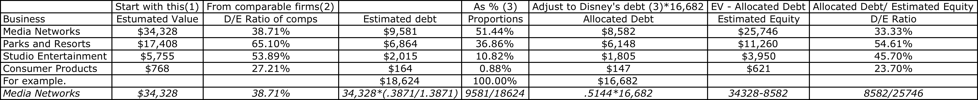
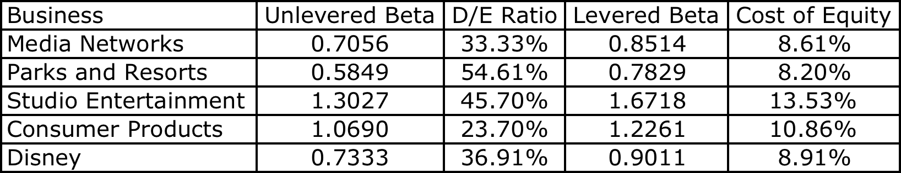
Disney’s Cost of Equity
Step 1: Allocate debt across businesses
Step 2: Compute levered betas and costs of equity for Disney’s operating businesses.
Step 2a: Compute the cost of equity for all of Disney’s assets:
  Equity Beta_{Disney as company} = 0.6885 (1 + (1 – 0.38)(0.3691)) = 0.8460
Riskfree Rate = 3.5%
Risk Premium = 6%
Notes:
Disney does not break its debt down by division. We therefore used the information we had on Disney’s consolidated debt, the values we had estimated for each business and the average debt ratios of other publicly traded firms in each business to make our allocation.
Step 1a: We estimated the debt for each division by multiplying the EV by the industry average debt ratio to get the estimated debt (in the second to last column). We used this estimated debt to get the proportions of debt in each division.
Example: Media networks: 34,328* (.3871/1.3871) = 9,581 (Note that 38.71% is a debt to equity ratio. 38.71/138.71 gives you a debt to capital ratio)
Step 1b:: We applied these proportions to Disney’s actual total debt to get the allocated debt in the third column.
Example: Total debt at Disney is $16,682 million
Media Networks Debt= 16,682*.5144 = $8582 million
Step 1c: We subtracted this allocated debt from the estimated value to get to equity value.
Example: Equity in media networks: 34,328 – 8582 = 25,746
Step 1d: We estimated a D/E ratio based on the debt from step 2 and equity from step 3.
Example: Media Networks D/E = 8582/25,746 = 33.33%

Slide 66
Discussion Issue
Assume now that you are the CFO of Disney. The head of the movie business has come to you with a new big budget movie that he would like you to fund. He claims that his analysis of the movie indicates that it will generate a return on equity of 12%. Would you fund it?
  Yes. It is higher than the cost of equity for Disney as a company
  No. It is lower than the cost of equity for the movie business.
  What are the broader implications of your choice?
Notes:
The cost of equity for each division should be used. Otherwise, the riskier divisions will over invest and the safest divisions will under invest.
Over time, the firm will become a riskier firm. Think of Bankers Trust from 1980, when it was a commercial bank, to 1992, when it had become primarily an investment bank.
It also means that any multi business company should have different hurdle rates for each business, with higher rates for riskier businesses and lower rates for safer businesses.

Slide 67
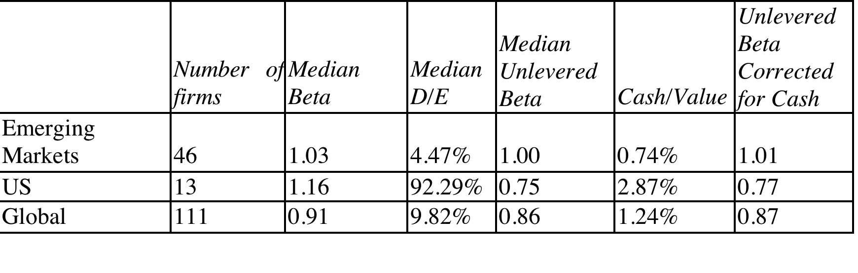
Estimating Aracruz’s Bottom Up Beta
Bottom up Betas for Paper & Pulp
The beta for emerging market paper and pulp companies of 1.01 was used as the unlevered beta for Aracruz.
When computing the levered beta for Aracruz’s paper and pulp business, we used the gross debt outstanding of 9,805 million BR and the market value of equity of 8907 million BR, in conjunction with the marginal tax rate of 34% for Brazil:
  Gross Debt to Equity ratio = Debt/Equity = 9805/8907 = 110.08%
  Levered Beta for Aracruz Paper business = 1.01 (1+(1-.34)(1.1008)) = 1.74
Notes:
The tax rates used were 32% for emerging market companies, 40% for U.S. companies and 35% for Global companies, based upon averaging the marginal tax rates in each group.
We chose to use the emerging market company average, to reflect the possibility that the paper and pulp business in emerging markets may face different market risks than in developed markets. We would have been just as comfortable using a global average.
This is a solution to the problems associated with estimating betas for emerging markets. Use bottom-up betas and lever up.
Note that
Firms which carry disproportionate amounts of cash (greater than is typical for the sector) should have lower betas.
If they hold marketable securities (or stocks) the beta of these securities can be used in computing the weighted average.

Slide 68
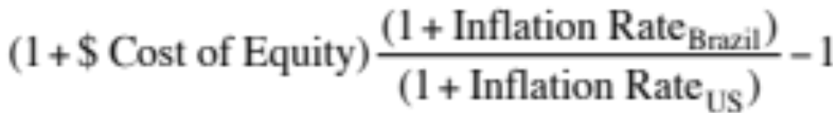
Aracruz: Cost of Equity Calculation
We will use a risk premium of 9.95% in computing the cost of equity, composed of the mature market equity risk premium (6%) and the Brazil country risk premium of 3.95% (estimated earlier).
U.S. $ Cost of Equity
  Cost of Equity = 10-yr T.Bond rate + Beta * Risk Premium
  = 3.5% + 1.74 (9.95%) = 20.82%
To convert to a Nominal $R Cost of Equity
  Cost of Equity =
  = 1.2082 (1.07/1.02) -1 = .2675 or 26.75%
  (Alternatively, you could just replace the riskfree rate with a nominal $R riskfree rate, but you would then be keeping risk premiums which were computed in dollar terms fixed while moving to a higher inflation currency)
Notes:
The cost of equity can be stated in different currencies. When computing the nominal BR cost of equity, we scale up the risk premium to reflect the fact the the inflation rates (and risk free rates in BR) are much higher.
If we replace the US dollar riskfree rate with a nominal Brazilian Real riskfere rate (estimated to be 8.5% in illustration 4.1):
Cost of Equity_{Nominal $R} = Riskfree Rate_{R$} + Beta* Risk Premium = 8.5% + 1.74 (9.95%) = 25.82%
Note that this lower than the 26.75% we estimated in the slide, because of the assumption that the risk premiums will not change as you move to higher inflation currencies.

Slide 69
Estimating Betas for Non-Traded Assets
The conventional approaches of estimating betas from regressions do not work for assets that are not traded. There are no stock prices or historical returns that can be used to compute regression betas.
There are two ways in which betas can be estimated for non-traded assets
  Using comparable firms
  Using accounting earnings
Notes:
Private firms are not traded. There are no historical price records to compute betas from.

Slide 70
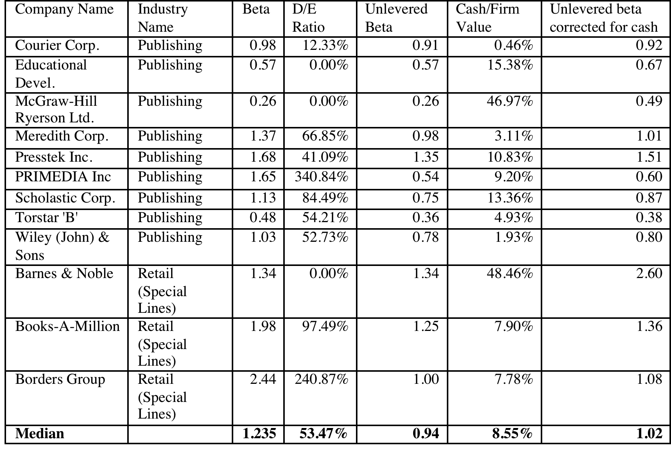
Using comparable firms to estimate beta for Bookscape
Notes:
To estimate the bottom up beta, we initially looked at publicly traded book retail firms but found only three firms. To add to the sample, we looked at publishing firms, arguing that their risk should be similar to that of book retailers (We are open to the critique that the operating leverage can be different in the two businesses).
To avoid outliers, we will use median values for the firms in the sample.

Slide 71
Estimating Bookscape Levered Beta and Cost of Equity
Because the debt/equity ratios used in computing levered betas are market debt equity ratios, and the only debt equity ratio we can compute for Bookscape is a book value debt equity ratio, we have assumed that Bookscape is close to the book industry median market debt to equity ratio of 53.47 percent.
Using a marginal tax rate of 40 percent for Bookscape, we get a levered beta of 1.35.
  Levered beta for Bookscape = 1.02 [1 + (1 – 0.40) (0.5347)] = 1.35
Using a riskfree rate of 3.5% (US treasury bond rate) and an equity risk premium of 6%:
  Cost of Equity = 3.5% + 1.35 (6%) = 11.60%
Notes:
If you cannot get a target debt to equity ratio for a private firm, use an industry -average debt to equity ratio to compute the levered beta. It will give you a more meaningful estimate than using book debt to equity ratios.

Slide 72
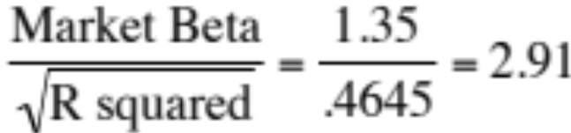
Total Risk versus Market Risk
Adjust the beta to reflect total risk rather than market risk. This adjustment is a relatively simple one, since the R squared of the regression measures the proportion of the risk that is market risk.
  Total Beta = Market Beta / Correlation of the sector with the market
In the Bookscape example, where the market beta is 1.35 and the average R-squared of the comparable publicly traded firms is 21.58%; the correlation with the market is 46.45%.
  Total Cost of Equity = 3.5% + 2.91 (6%) = 20.94%
Notes:
This assumes that
The owner of the private business has all of his or her wealth invested in the business
The reality is that most individuals will fall somewhere between the two extremes. A private equity or VC investor may hold several positions in their portfolio, pushing up the R-squared of their portfolio with the market and pushing down the total beta.
If you were a private business looking at potential acquirers - one is a publicly traded firm and the other is an individual . Which one is likely to pay the higher price and why?
If both acquirers have the same cash flow expectations, the publicly traded firm will win out (Blockbuster Video, Browning-Ferris are good examples of publicly traded firms which bought small private businesses to grow to their current stature.)
This approach can be extended to cover investors who are partially diversified such as venture capitalists and private equity investors. Instead of using the correlation of firms in the business with the market, we would use the correlation of the investor’s portfolio with the market. As the investor gets more diversified, the correlation will rise and the total beta will fall towards the market beta.

Slide 73
6 Application Test: Estimating a Bottom-up Beta
Based upon the business or businesses that your firm is in right now, and its current financial leverage, estimate the bottom-up unlevered beta for your firm.
Data Source: You can get a listing of unlevered betas by industry on my web site by going to updated data.
Notes:
The breakdown of a firm into businesses is available in the 10-K. The unlevered betas are available on my web site.

Slide 74
From Cost of Equity to Cost of Capital
The cost of capital is a composite cost to the firm of raising financing to fund its projects.
In addition to equity, firms can raise capital from debt
Notes:
Capital is more than just equity. It also includes other financing sources, particularly debt.

Slide 75
What is debt?
General Rule: Debt generally has the following characteristics:
  Commitment to make fixed payments in the future
  The fixed payments are tax deductible
  Failure to make the payments can lead to either default or loss of control of the firm to the party to whom payments are due.
As a consequence, debt should include
  Any interest-bearing liability, whether short term or long term.
  Any lease obligation, whether operating or capital.
Notes:
Debt is not restricted to what gets called debt in the balance sheet. It includes any financing with these characteristics.
Applying this test to items on the liability side of the balance sheet, we would conclude that
All interest bearing debt, short term as well as long term, is debt
Accounts payable and suppliers should not be considered debt because they don’t carry explicit interest expenses; they should be considered as part of working capital. Alternatively, you can try to make the implicit interest expenses (the discount you could have received by paying early rather than late) explicit and treat it as debt.
Other liabilities such as under funded pension or health care obligations are best not considered as debt (though there may be exceptions) since the commitments are flexible.

Slide 76
Estimating the Cost of Debt
If the firm has bonds outstanding, and the bonds are traded, the yield to maturity on a long-term, straight (no special features) bond can be used as the interest rate.
If the firm is rated, use the rating and a typical default spread on bonds with that rating to estimate the cost of debt.
If the firm is not rated,
  and it has recently borrowed long term from a bank, use the interest rate on the borrowing or
  estimate a synthetic rating for the company, and use the synthetic rating to arrive at a default spread and a cost of debt
The cost of debt has to be estimated in the same currency as the cost of equity and the cash flows in the valuation.
Notes:
There are two key components to the cost of debt:
You want a long-term cost (I use a 10-year cost) of debt even if your debt is short term. You do not want to reward companies that play the term structure by giving them a lower cost of debt and capital. In effect, you are assuming that the rolled over cost of short term debt = cost of long term debt.
You want a current cost. In other words, you do not care about the debt and interest expenses on the books. The book interest rate (interest expense/book debt) is not a good measure of the cost of debt because it does not reflect the current cost of borrowing any may even be lower than the riskfree rate.
While the cost of debt can be estimated easily for some firms, by looking up traded bonds, it can be more difficult for non-rated firms. The default spreads can be obtained from
http://www.bondsonline.com

Slide 77
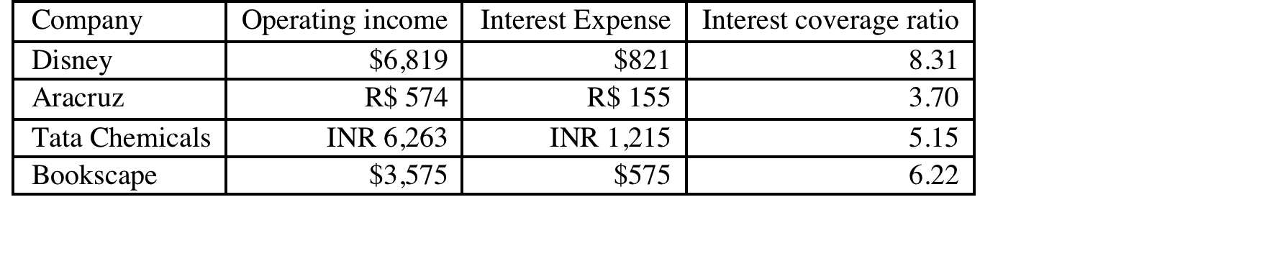
Estimating Synthetic Ratings
The rating for a firm can be estimated using the financial characteristics of the firm. In its simplest form, we can use just the interest coverage ratio:
Interest Coverage Ratio = EBIT / Interest Expenses
For the four non-financial service companies, we obtain the following:
Notes:
Basing the rating on just an interest coverage ratio will give you an approximation for the rating. A more realistic approach would use more than the interest coverage ratio. In fact, we could construct a score based upon multiple ratios (such as a Z-score) and use that score to estimate ratings.
The operating income used to compute the rating does not have to be last year’s number. It can be an average over time or a normalized value.

Slide 78
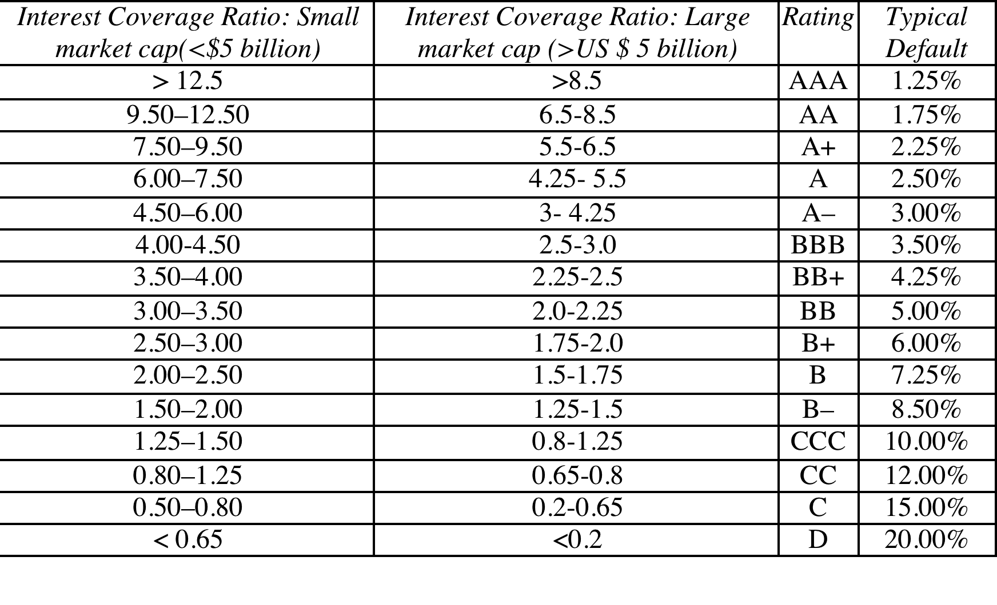
Interest Coverage Ratios, Ratings and Default Spreads- Early 2009
Disney, Market Cap > $ 5 billion: 8.31 → AA
Aracruz: Market Cap< $5 billion: 3.70 → BB+
Tata: Market Cap< $ 5 billion: 5.15 → A-
Bookscape: Market Cap<$5 billion: 6.22 → A
Notes:
This table is constructed, using smaller non-financial service companies (<$5 billion market cap) that are rated, and their interest coverage ratios. The firms were sorted based upon their ratings, and the interest coverage range was estimated.
These ranges will change over time, especially as the economy strengthens or weakens. You can get the updated ranges on my web site.

Slide 79
Synthetic versus Actual Ratings: Disney and Aracruz
Disney and Aracruz are rated companies and their actual ratings are different from the synthetic rating.
Disney’s synthetic rating is AA, whereas its actual rating is A. The difference can be attributed to any of the following:
  Synthetic ratings reflect only the interest coverage ratio whereas actual ratings incorporate all of the other ratios and qualitative factors
  Synthetic ratings do not allow for sector-wide biases in ratings
  Synthetic rating was based on 2008 operating income whereas actual rating reflects normalized earnings
Aracruz’s synthetic rating is BB+, but the actual rating for dollar debt is BB. The biggest factor behind the difference is the presence of country risk but the derivatives losses at the firm in 2008 may also be playing a role.
Deutsche Bank had an A+ rating. We will not try to estimate a synthetic rating for the bank. Defining interest expenses on debt for a bank is difficult…
Notes:
The synthetic ratings process will deliver reasonably close ratings for any firm with debt of substance. It will tend to overstate ratings for firms with little debt (technology firms often will get AAA ratings because their interest coverage ratios are so high). The fact that these ratings are too high is not an issue because these companies also have so little debt in their capital structure - the cost of capital is very close to the cost of equity.
Can we trust rating agencies? In general, ratings agencies do a reasonable job of assessing default risk and offer us these measures for free (at least to investors). They have two faults: (1) They adjust for changes in default risk too slowly. All too often ratings downgrades follow bond price declines and not the other way around (2) They sometimes get caught up in the mood of the moment and either overestimate default risk or underestimate default risk for an entire sector.
It is a good idea to estimate synthetic ratings even for firms that have actual ratings. If there is disagreement between ratings agencies or a firm has multiple bond ratings, the synthetic rating can operate as a tie-breaker. If there is a significant difference between actual and synthetic ratings and there is no fundamental reason that can be pinpointed for the difference, the synthetic rating may be providing an early signal of a ratings agency mistake.

Slide 80
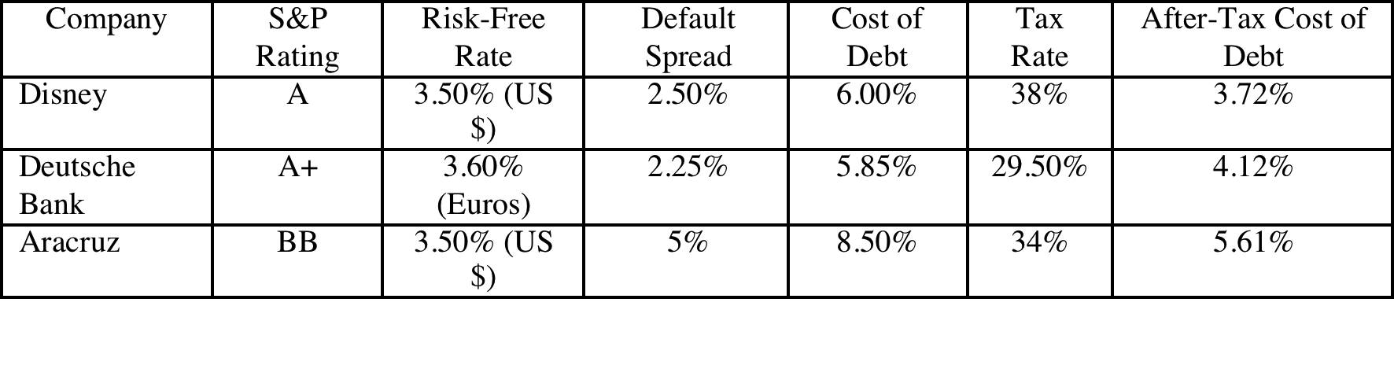
Estimating Cost of Debt
For Bookscape, we will use the synthetic rating (A) to estimate the cost of debt:
  Default Spread based upon A rating = 2.50%
  Pre-tax cost of debt = Riskfree Rate + Default Spread = 3.5% + 2.50% = 6.00%
  After-tax cost of debt = Pre-tax cost of debt (1- tax rate) = 6.00% (1-.40) = 3.60%
For the three publicly traded firms that are rated in our sample, we will use the actual bond ratings to estimate the costs of debt:
For Tata Chemicals, we will use the synthetic rating of A-, but we also consider the fact that India faces default risk (and a spread of 3%).
  Pre-tax cost of debt = Riskfree Rate(Rs) + Country Spread + Company spread
  = 4% + 3% + 3% = 10%
  After-tax cost of debt = Pre-tax cost of debt (1- tax rate) = 10% (1-.34) = 6.6%
Notes:
The tax rate used is the marginal tax rate…. Interest saves you taxes on your marginal income, not the first or average dollar of income….
The marginal tax rate comes from the tax code and as relatively little to do with your company. For US companies, it should be 35%+. For non-US companies, it will reflect the tax rates in those countries (low in HK and Singapore, higher in Europe and Latin America…)
For Tata Chemicals, we added the country default spread on to the company default spread to reflect the fact that Tata has to bear the burden of country risk when it borrows. (We skipped this step with Aracruz because we used the actual rating, which already reflects Brazil country risk)
For Disney, Deutsche Bank and Aracruz, we chose to use the actual ratings rather than the synthetic rating, because it does contain more information.

Slide 81
6 Application Test: Estimating a Cost of Debt
Based upon your firm’s current earnings before interest and taxes, its interest expenses, estimate
  An interest coverage ratio for your firm
  A synthetic rating for your firm (use the tables from prior pages)
  A pre-tax cost of debt for your firm
  An after-tax cost of debt for your firm
Notes:
To estimate the after-tax cost of debt, you need a marginal tax rate. Since the federal tax rate for corporations is 35%, I would expect the marginal tax rate to be 35% of higher for US companies. Thus, even if the effective tax rate reported in the financial statements are lower, I would use at least 35%. If the effective tax rate is higher than 35%, I would use the effective tax rate, with the assumption that it is capturing other taxes that the firm has to pay.

Slide 82
Weights for Cost of Capital Calculation
The weights used in the cost of capital computation should be market values.
There are three specious arguments used against market value
  Book value is more reliable than market value because it is not as volatile: While it is true that book value does not change as much as market value, this is more a reflection of weakness than strength
  Using book value rather than market value is a more conservative approach to estimating debt ratios: For most companies, using book values will yield a lower cost of capital than using market value weights.
  Since accounting returns are computed based upon book value, consistency requires the use of book value in computing cost of capital: While it may seem consistent to use book values for both accounting return and cost of capital calculations, it does not make economic sense.
In practical terms, estimating the market value of equity should be easy for a publicly traded firm, but some or all of the debt at most companies is not traded. As a consequence, most practitioners use the book value of debt as a proxy for the market value of debt.
Notes:
Assume that the market value debt ratio is 10%, while the book value debt ratio is 30%, for a firm with a cost of equity of 15% and an after-tax cost of debt of 5%. The cost of capital can be calculated as follows –
With market value debt ratios: 15% (.9) + 5% (.1) = 14%
With book value debt ratios: 15% (.7) + 5% (.3) = 12%
Which is the more conservative estimate?

Slide 83
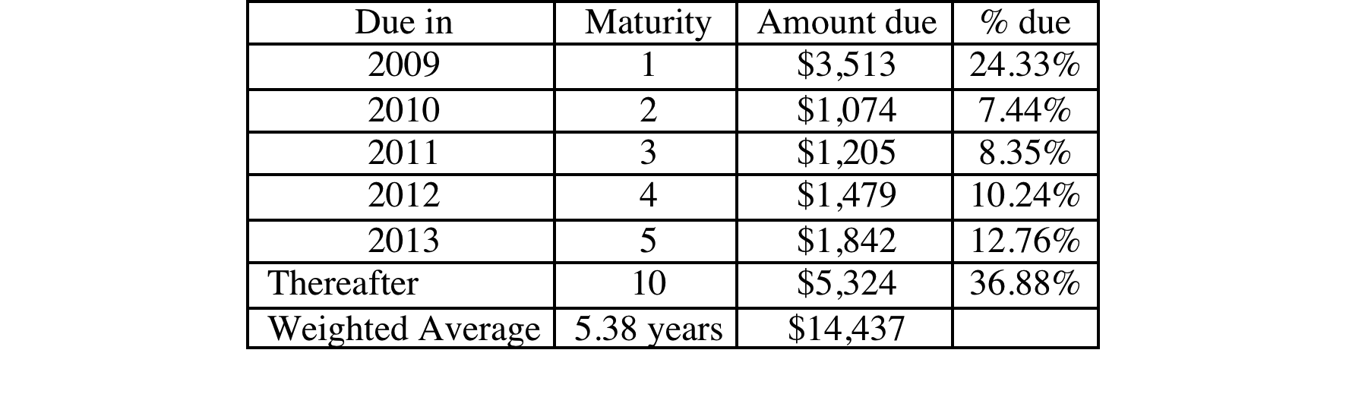
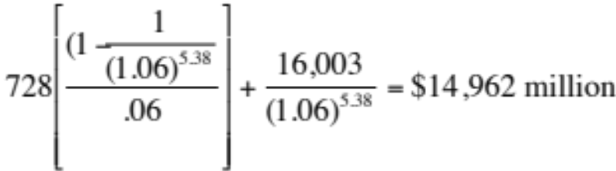
Disney: From book value to market value for interest bearing debt…
In Disney’s 2008 financial statements, the debt due over time was footnoted.
Disney’s total debt due, in book value terms, on the balance sheet is $16,003 million and the total interest expense for the year was $728 million. Assuming that the maturity that we computed above still holds and using 6% as the pre-tax cost of debt:
Estimated MV of Disney Debt =
No maturity was given for debt due after 5 years. I assumed 10 years.
Notes:
We first consolidate all of the debt outstanding and obtain an face value weighted average maturity for the debt of 5.38 years.
We then compute the market value of debt, setting the book value = face value, the interest expense = coupon, the average maturity = debt maturity and the pre-tax cost of debt based on the synthetic rating as the cost of debt.
Alternatively, we can compute the market value of each debt item separately and add up the values.

Slide 84
Operating Leases at Disney
The “debt value” of operating leases is the present value of the lease payments, at a rate that reflects their risk, usually the pre-tax cost of debt.
The pre-tax cost of debt at Disney is 6%.
Debt outstanding at Disney
= MV of Interest bearing Debt + PV of Operating Leases
= $14,962 + $ 1,720= $16,682 million
Year | Commitment | Present Value
1 | $392.00 | $369.81
2 | $351.00 | $312.39
3 | $305.00 | $256.08
4 | $265.00 | $209.90
5 | $198.00 | $147.96
Year 6 & 7 | $309.50 | $424.02
Debt Value of leases = |  | $1,720.17
Disney reported $619 million in commitments after year 5. Given that their average commitment over the first 5 years of $302 million, we assumed two years @ $309.5 million each.
Notes:
The pre-tax cost of debt was based upon Disney’s current rating.
Disney reports a lump sum as the amount due after year 6…. We break it up into annual payments based upon the average lease payments over the first 5 years…You could also use the year 5 payment as the basis for making this adjustment (Putting it all in year 6 will overstate the present value).
To get to the total market value of debt, we add the estimated market value of interest bearing debt to the present value of operating leases (already a market value number since you used the current pre-tax cost of borrowing to arrive at the value).

Slide 85
6 Application Test: Estimating Market Value
Estimate the
  Market value of equity at your firm and Book Value of equity
  Market value of debt and book value of debt (If you cannot find the average maturity of your debt, use 3 years): Remember to capitalize the value of operating leases and add them on to both the book value and the market value of debt.
Estimate the
  Weights for equity and debt based upon market value
  Weights for equity and debt based upon book value
Notes:
For most firms, the book debt ratio will be much higher than the market debt ratio. Using the book debt ratio will therefore yield a lower cost of capital (which undercuts the conservatism argument used by defenders of book value weights)

Slide 86
Current Cost of Capital: Disney
Equity
  Cost of Equity = Riskfree rate + Beta * Risk Premium = 3.5% + 0.9011 (6%) = 8.91%
  Market Value of Equity = $45.193 Billion
  Equity/(Debt+Equity ) = 73.04%
Debt
  After-tax Cost of debt =(Riskfree rate + Default Spread) (1-t)
  = (3.5%+2.5%) (1-.38) = 3.72%
  Market Value of Debt = $ 16.682 Billion
  Debt/(Debt +Equity) = 26.96%
Cost of Capital = 8.91%(.7304)+3.72%(.2696) = 7.51%
45.193/ (45.193+16.682)
Notes:
This reproduces the current cost of capital computation for Disney, using market value weights for both debt and equity, the cost of equity (based upon the bottom-up beta) and the cost of debt (based upon the bond rating)
The market value of debt is estimated by estimating the present value of total interest payments and face value at the current cost of debt.
One way to frame the capital structure question: Is there a mix of debt and equity at which Disney’s cost of capital will be lower than 7.51%?

Slide 87
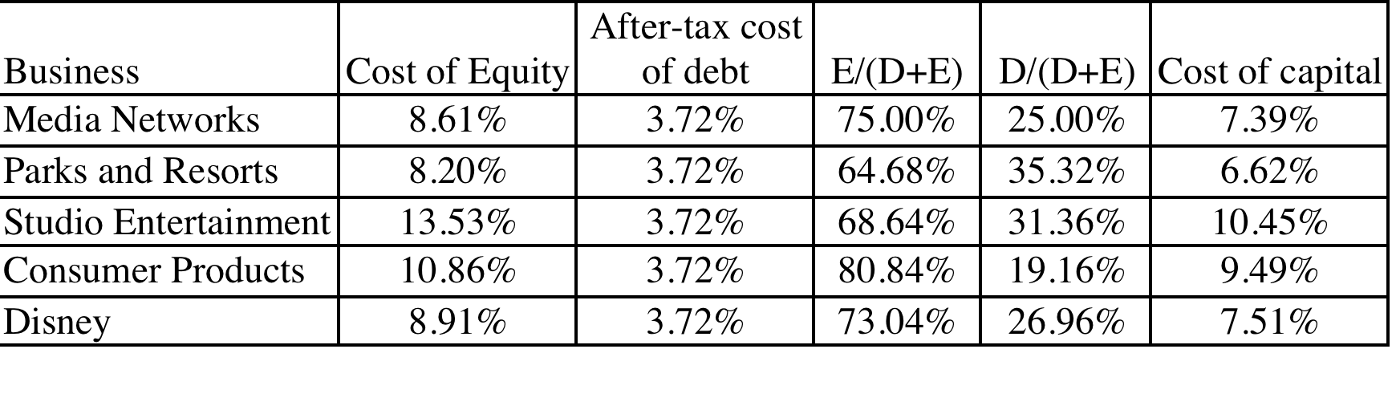
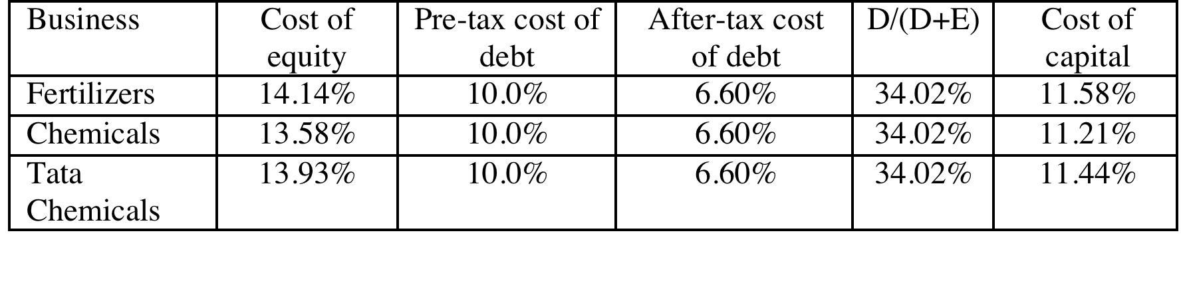

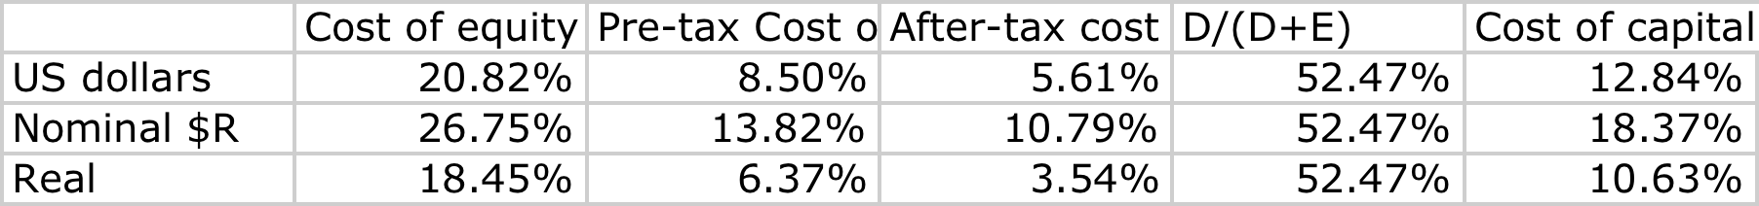
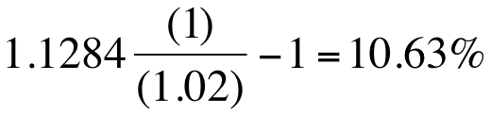
Divisional Costs of Capital: Disney and Tata Chemicals
Disney
Tata Chemicals
Tata Chemicals
Aracruz
Notes:
For Disney, we used the division specific debt ratio weights we estimated earlier (when estimating the levered beta). We did assume that all divisions borrow at Disney’s pre-tax cost of debt. If the divisions issued debt independently, we would have considered using division-specific costs of debt.
For Tata Chemicals, we used the same debt ratio and cost of debt for both divisions.
The cost of capital for Aracruz will be higher in $R, because we expect inflation to be 7% in $R and only 2% in US dollars. In real terms, we remove inflation entirely from the mix.

Slide 88
6 Application Test: Estimating Cost of Capital
Using the bottom-up unlevered beta that you computed for your firm, and the values of debt and equity you have estimated for your firm, estimate a bottom-up levered beta and cost of equity for your firm.
Based upon the costs of equity and debt that you have estimated, and the weights for each, estimate the cost of capital for your firm.
How different would your cost of capital have been, if you used book value weights?
Notes:
To go from unlevered to levered betas and then to the cost of capital, you have to
Define debt and compute market value
Compute the present value of operating leases
Compute the levered beta, using the market value of equity and the consolidated market value of debt (including lease commitmetns)
Compute the cost of capital, using the debt and equity weights.

Slide 89
Choosing a Hurdle Rate
Either the cost of equity or the cost of capital can be used as a hurdle rate, depending upon whether the returns measured are to equity investors or to all claimholders on the firm (capital)
If returns are measured to equity investors, the appropriate hurdle rate is the cost of equity.
If returns are measured to capital (or the firm), the appropriate hurdle rate is the cost of capital.
Notes:
While the cost of equity and capital can be very different numbers, they can both be used as hurdle rates, as long as the returns and cash flows are defined consistently.
If returns and cash flows are equity based (return on equity or cash flow to equity), the appropriate hurdle rate is the cost of equity.
If returns and cash flows are firm or operating asset based (return on capital or cashflows to firm), the appropriate hurdle rate is the cost of capital.

Slide 90
Back to First Principles
Notes:
Took us a while but we have the mechanics of the hurdle rate down..

Slide 91
Measuring Investment Returns
“Show me the money”
from Jerry Maguire
Notes:
If there is a theme to how we think about returns in corporate finance, this line from Jerry Maguire brings it home. We trust the concrete over the vague and cash flows over earnings.

Slide 92
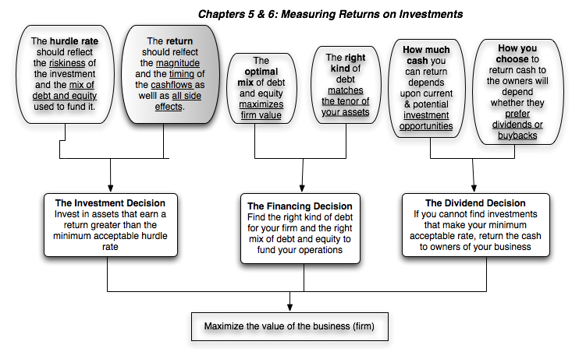
First Principles
Notes:
The next section of the notes will focus on measuring returns on investments, provide an argument for why cash flows make more sense than earnings and weighing those cash flows and discuss how best to bring in side benefits and costs into the returns.

Slide 93
Measures of return: earnings versus cash flows
Principles Governing Accounting Earnings Measurement
  Accrual Accounting: Show revenues when products and services are sold or provided, not when they are paid for. Show expenses associated with these revenues rather than cash expenses.
  Operating versus Capital Expenditures: Only expenses associated with creating revenues in the current period should be treated as operating expenses. Expenses that create benefits over several periods are written off over multiple periods (as depreciation or amortization)
To get from accounting earnings to cash flows:
  you have to add back non-cash expenses (like depreciation)
  you have to subtract out cash outflows which are not expensed (such as capital expenditures)
  you have to make accrual revenues and expenses into cash revenues and expenses (by considering changes in working capital).
Notes:
Accrual accounting income is designed to measure the “income” made by an entity during a period, on sales made during the period. Thus, accrual accounting draws lines between operating expenses (that create income in the current period), financial expenses (expenses associated with the use of debt) and capital expenditures (which create income over multiple periods). It is not always consistent. R&D, for instance, is treated as an operating expense.
Accrual accounting also tries to allocate the cost of materials to current period revenues, leading to inventory, and give the company credit for sales made during the period, even if cash has not been received, giving rise to accounts receivable. In effect, adding in the change in working capital converts accrual earnings to cash earnings.

Slide 94
Measuring Returns Right: The Basic Principles
Use cash flows rather than earnings. You cannot spend earnings.
Use “incremental” cash flows relating to the investment decision, i.e., cashflows that occur as a consequence of the decision, rather than total cash flows.
Use “time weighted” returns, i.e., value cash flows that occur earlier more than cash flows that occur later.
The Return Mantra: “Time-weighted, Incremental Cash Flow Return”
Notes:
These are the basic financial principles underlying the measurement of investment returns.
We focus on cash flows, because when cash flows and earnings are different, cash flows provide a more reliable measure of what an investment generates.
We focus on “incremental” effects on the overall business, since we care about the overall health and value of the business, not just individual projects.
We use time-weighted returns, since returns made earlier are worth more than the same returns made later.

Slide 95
Earnings versus Cash Flows: A Disney Theme Park
The theme parks to be built near Rio, modeled on Euro Disney in Paris and Disney World in Orlando.
The complex will include a “Magic Kingdom” to be constructed, beginning immediately, and becoming operational at the beginning of the second year, and a second theme park modeled on Epcot Center at Orlando to be constructed in the second and third year and becoming operational at the beginning of the fourth year.
The earnings and cash flows are estimated in nominal U.S. Dollars.
Notes:
The earnings and cash flows will really be in Brazilian $R. We will consider later the effects of looking at all the cash flows in a different currency.
Note that this investment is not going to be fully operational until the fourth year.

Slide 96
Key Assumptions on Start Up and Construction
Disney has already spent $0.5 Billion researching the proposal and getting the necessary licenses for the park; none of this investment can be recovered if the park is not built. This expenditure has been capitalized and will be depreciated straight line over ten years to a salvage value of zero.
Disney will face substantial construction costs, if it chooses to build the theme parks.
  The cost of constructing Magic Kingdom will be $3 billion, with $ 2 billion to be spent right now, and $1 Billion to be spent one year from now.
  The cost of constructing Epcot II will be $ 1.5 billion, with $ 1 billion to be spent at the end of the second year and $0.5 billion at the end of the third year.
  These investments will be depreciated based upon a depreciation schedule in the tax code, where depreciation will be different each year.
Notes:
The emphasis in the second item should be on “already spent”.
While we often classify all these investments as “initial investments”, they occur over time. Companies seldom make large investments at an instant in time.
Also worth adding: Disney will fund this investment using the same mix of debt and equity that it uses for theme parks currently.

Slide 97
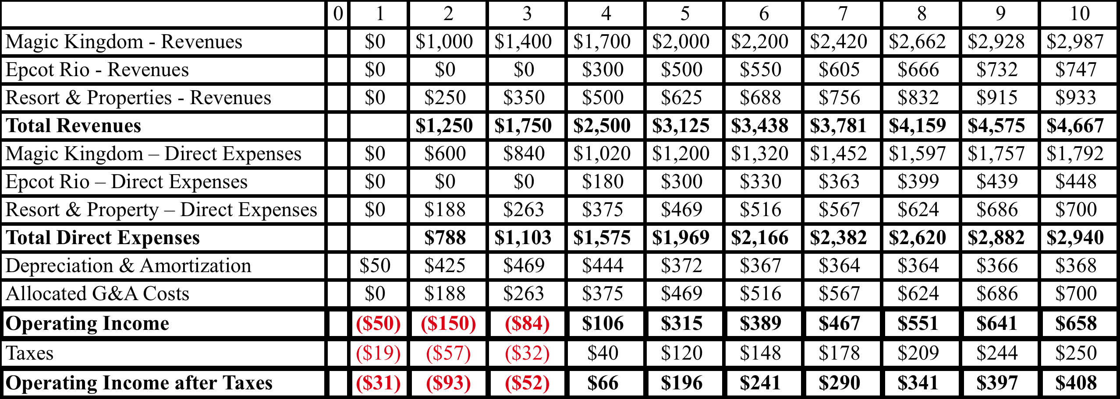
Step 1: Estimate Accounting Earnings on Project
Direct expenses: 60% of revenues for theme parks, 75% of revenues for resort properties
Allocated G&A: Company G&A allocated to project, based on projected revenues. Two thirds of expense is fixed, rest is variable.
Taxes: Based on marginal tax rate of 38%
Notes:
This shows the accounting earnings calculations for the next 10 years. Note the increasing after-tax operating income over time.
Note that loss in year 1. While this loss can be carried forward and offset against profits in future years, we have chosen to claim the losses against Disney’s profits from other projects in year 1. (You would rather save taxes now than the same taxes in the future…)
Where are the interest expenses? They do not show up because we are computing earnings to the firm - operating income - rather than earnings to equity - net income.

Slide 98
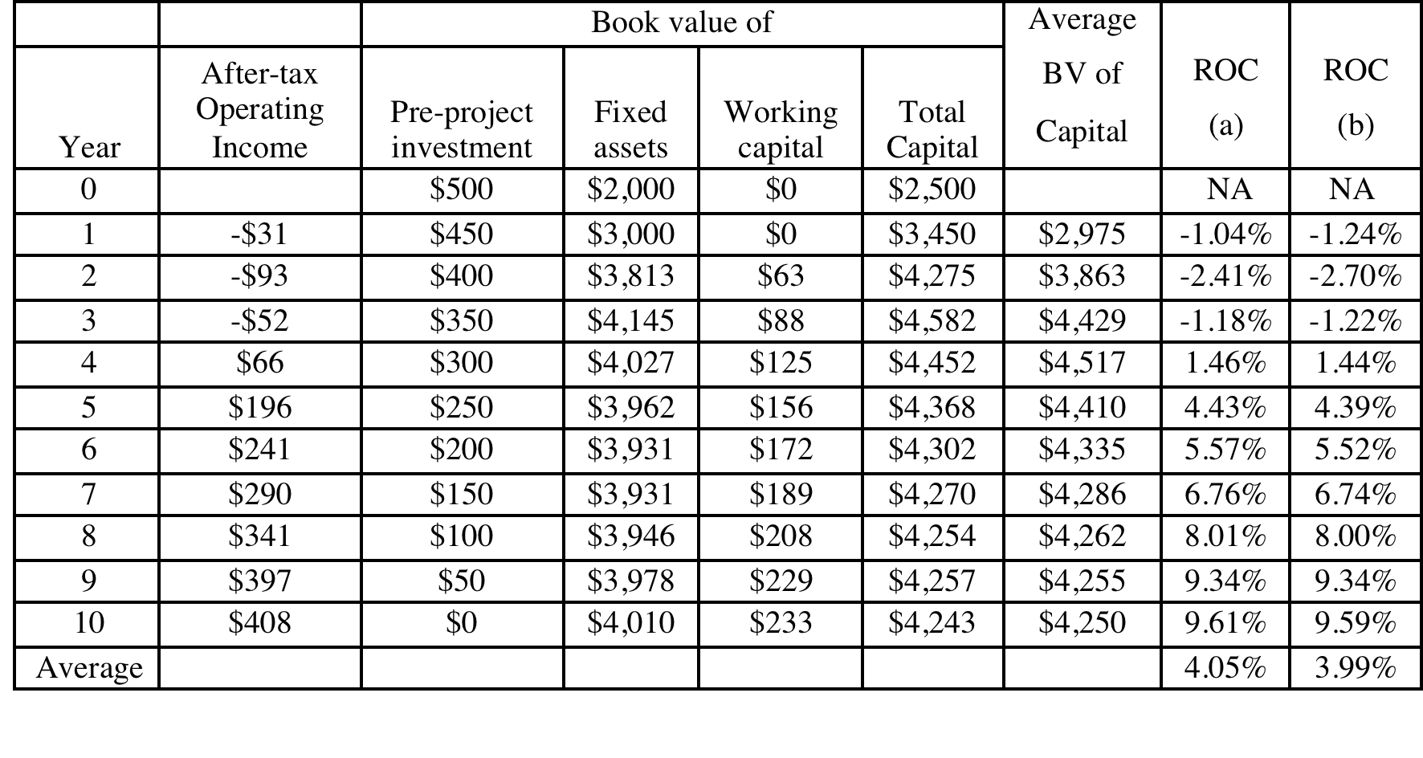
And the Accounting View of Return
Based upon book capital at the start of each year
Based upon average book capital over the year
Notes:
This converts the accounting income into a percentage return (to enable us to do the comparison to the hurdle rate, which is a percentage rate). We have computed a simple average return on capital over the next 10 years…
The average book value is computed each year using the beginning and ending book values. The book values themselves are computed as follows:
Ending BV = Beginning BV - Depreciation + Capital Expenditures

Slide 99
What should this return be compared to?
The computed return on capital on this investment is about 4%. To make a judgment on whether this is a sufficient return, we need to compare this return to a “hurdle rate”. Which of the following is the right hurdle rate? Why or why not?
  The riskfree rate of 3.5% (T. Bond rate)
  The cost of equity for Disney as a company (8.91%)
  The cost of equity for Disney theme parks (8.20%)
  The cost of capital for Disney as a company (7.51%)
  The cost of capital for Disney theme parks (6.62%)
  None of the above
Notes:
First, since we have computed return on capital, the comparison should be to the cost of capital.
Second, since it is a theme park investment, it should be the cost of capital for theme parks.
Here is the catch. This theme park is in Brazil, an emerging market. Thus, the cost of capital of 6.62% that we estimated for existing theme parks, which are in developed markets, may be too low.

Slide 100
Should there be a risk premium for foreign projects?
The exchange rate risk should be diversifiable risk (and hence should not command a premium) if
  the company has projects is a large number of countries (or)
  the investors in the company are globally diversified.
  For Disney, this risk should not affect the cost of capital used. Consequently, we would not adjust the cost of capital for Disney’s investments in other mature markets (Germany, UK, France)
The same diversification argument can also be applied against some political risk, which would mean that it too should not affect the discount rate. However, there are aspects of political risk especially in emerging markets that will be difficult to diversify and may affect the cash flows, by reducing the expected life or cash flows on the project.
For Disney, this is the risk that we are incorporating into the cost of capital when it invests in Brazil (or any other emerging market)
Notes:
This will depend upon the company. Smaller companies, with higher insider holdings, should be more likely to assess higher discount rates for expanding overseas. Larger companies, with more diverse stockholdings, should be more inclined to use the same discount rates they use in the domestic market.

Slide 101
Estimating a hurdle rate for Rio Disney
We did estimate a cost of capital of 6.62% for the Disney theme park business, using a bottom-up levered beta of 0.7829 for the business.
This cost of equity may not adequately reflect the additional risk associated with the theme park being in an emerging market.
The only concern we would have with using this cost of equity for this project is that it may not adequately reflect the additional risk associated with the theme park being in an emerging market (Brazil).
Country risk premium for Brazil = 2.50% (34/21.5) = 3.95%
Cost of Equity in US$= 3.5% + 0.7829 (6%+3.95%) = 11.29%
  We multiplied the default spread for Brazil (2.50%) by the relative volatility of Brazil’s equity index to the Brazilian government bond. (34%/21.5%)
Using this estimate of the cost of equity, Disney’s theme park debt ratio of 35.32% and its after-tax cost of debt of 3.72% (see chapter 4), we can estimate the cost of capital for the project:
  Cost of Capital in US$ = 11.29% (0.6468) + 3.72% (0.3532) = 8.62%
Notes:
Here is the other half of the equation:
The hurdle rate for an investment should reflect its risk. (That is why we use the bottom-up beta that we estimated for theme parks earlier rather than the bottom-up beta for Disney as a company). In addition, the exposure to country risk is incorporated into the investment.
We use Disney’s theme park debt ratio for this theme park, on the assumption that it is not a stand-alone investment with its own debt capacity. If it were, we would have considered using project specific financing weights. (It is usually not a good idea to compute the cost of capital for a project based on how it is financed, since firms can use disproportionate amounts of debt on some projects not because the projects can afford to carry debt but because they (the firms) have excess debt capacity.

Slide 102
Would lead us to conclude that...
Do not invest in this park. The return on capital of 4.05% is lower than the cost of capital for theme parks of 8.62%; This would suggest that the project should not be taken.
Given that we have computed the average over an arbitrary period of 10 years, while the theme park itself would have a life greater than 10 years, would you feel comfortable with this conclusion?
  Yes
  No
Notes:
I would not. I think the accounting return, which cuts off the analysis arbitrarily after 10 years, understates the true return on projects like this one, which have longer expected lives.
In general, while firms claim that using the same life for all projects is not discriminatory, it clearly creates a bias against longer term projects.

Slide 103
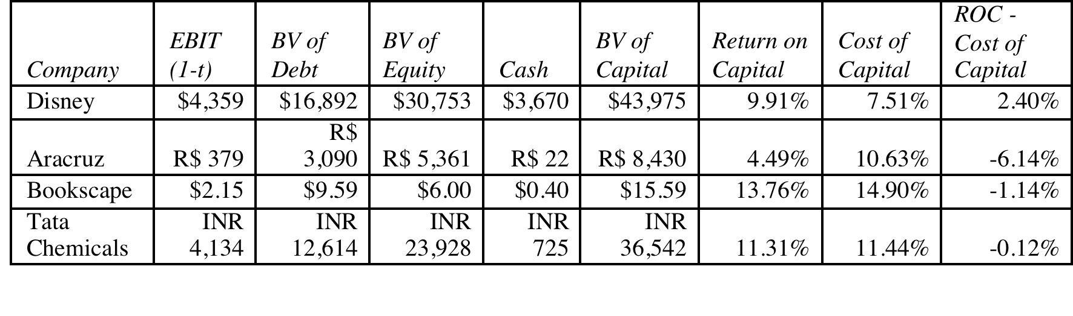
A Tangent: From New to Existing Investments: ROC for the entire firm
How “good” are the existing investments of the firm?
Measuring ROC for existing investments..
Notes:
A firm can be viewed as having a portfolio of existing projects. This approach allows you to assess whether that portfolio is earning more than the hurdle rate, but it is based upon the following assumptions:
Accounting earnings are a good measure of the earnings from current projects (They might not be, if items like R&D, which are really investments for the future, extraordinary profits or losses, or accounting changes affect the reported income.)
The book value of capital is a good measure of what is invested in current projects.
Some computational details:
Why do we use book value of debt and equity?
Because we want to focus on capital invested in assets in place. Market value has two problems. It includes growth assets and it updates the value to reflect returns earned. In fact, if you computed market value of just assets in place correctly, you should always earn your cost of capital.
Why end of last year?
To stay consistent with end-of-the-year cash flows and earnings that we use in the rest of the analysis. If we used mid-year conventions, we could use average values instead.

Slide 104
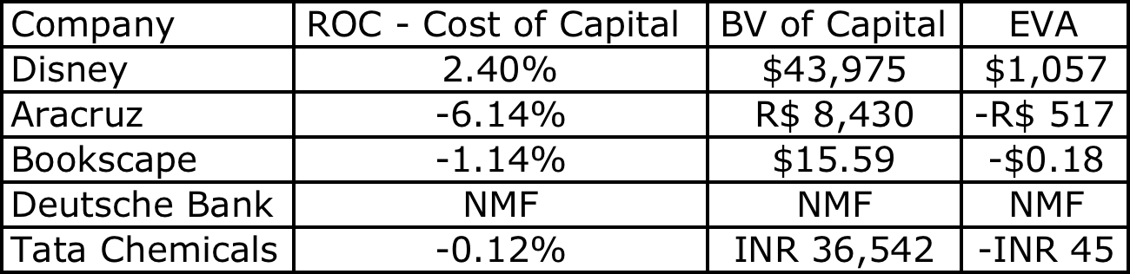
Old wine in a new bottle.. Another way of presenting the same results…
The key to value is earning excess returns. Over time, there have been attempts to restate this obvious fact in new and different ways. For instance, Economic Value Added (EVA) developed a wide following in the the 1990s:
EVA = (ROC – Cost of Capital ) (Book Value of Capital Invested)
The excess returns for the four firms can be restated as follows:
Notes:
The EVA is a measure of dollar value created in a single time period. Thus, it will be affected by how capital is measured and the ups and downs of year-to-year operating income.
EVA just restates the excess returns (ROC – Cost of capital) in dollar value terms. Thus, it will always have the same sign as the excess return, but it will be larger for larger companies. Thus, you cannot compare the EVA across companies but you can compare the EVA for the same company from year to year.

Slide 105
6 Application Test: Assessing Investment Quality
For the most recent period for which you have data, compute the after-tax return on capital earned by your firm, where after-tax return on capital is computed to be
After-tax ROC = EBIT (1-tax rate)/ (BV of debt + BV of Equity-Cash)_{previous year}
For the most recent period for which you have data, compute the return spread earned by your firm:
Return Spread = After-tax ROC - Cost of Capital
For the most recent period, compute the EVA earned by your firm
EVA = Return Spread * ((BV of debt + BV of Equity-Cash)_{previous year}
Notes:
This measure of investment quality is only as good as the measures of operating income and book value that go into it.
Note also that:
A negative EVA in a single period should not be taken as an indicator that the company is a bad or poorly managed company. It may reflect the fact that the firm had a bad year or that macro economic variables conspired to reduce operating income in that period (a recession for a cyclical firm, a downturn in commodity prices for a commodity company).
Even a string of negative EVAs may not be an indicator of a poorly run firm or business. Young businesses and infrastructure companies often have negative EVAs for extended periods (while they are building up infrastructure) before they turn positive.

Slide 106
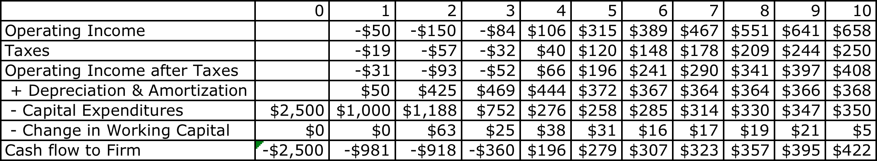
The cash flow view of this project..
To get from income to cash flow, we
added back all non-cash charges such as depreciation. Tax benefits:
subtracted out the capital expenditures
subtracted out the change in non-cash working capital
Notes:
This converts earnings to cash flows.
Depreciation and amortization are just two of the most common non-cash charges.
Any capital expenditures (whether initial or maintenance) need to be subtracted out.
It is only the change in non-cash working capital that needs to be subtracted out.

Slide 107
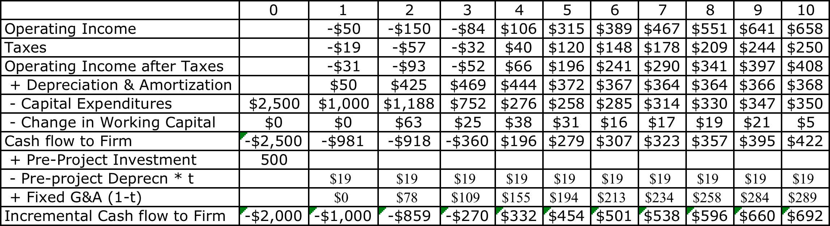
The incremental cash flows on the project
$ 500 million has already been spent & $ 50 million in depreciation will exist anyway
2/3rd of allocated G&A is fixed.
Add back this amount (1-t)
Tax rate = 38%
Notes:
A sunk cost is any cost that has already been incurred and will not be recovered even if the project under consideration is rejected.
The tax savings on the depreciation on the sunk cost is also subtracted out, since that tax savings would accrue to the firm even if it did not take this investment.
Only the after-tax amount of the non-incremental allocated costs are added back because the cash flows are after-tax cash flows.
Alternatively, the cash flows can be estimated from scratch using only the incremental cash flows.

Slide 108
To Time-Weighted Cash Flows
Incremental cash flows in the earlier years are worth more than incremental cash flows in later years.
In fact, cash flows across time cannot be added up. They have to be brought to the same point in time before aggregation.
This process of moving cash flows through time is
  discounting, when future cash flows are brought to the present
  compounding, when present cash flows are taken to the future
Notes:
Cash flows across time cannot be compared. Discounting brings cash flows back to the same point in time.
The present value factors are in a sense time-weighing factors. The riskier a cash flow and the further it is in the future, the lower the weight you attach to that cash flow.

Slide 109
Discounted cash flow measures of return
Net Present Value (NPV): The net present value is the sum of the present values of all cash flows from the project (including initial investment).
  NPV = Sum of the present values of all cash flows on the project, including the initial investment, with the cash flows being discounted at the appropriate hurdle rate (cost of capital, if cash flow is cash flow to the firm, and cost of equity, if cash flow is to equity investors)
  Decision Rule: Accept if NPV > 0
Internal Rate of Return (IRR): The internal rate of return is the discount rate that sets the net present value equal to zero. It is the percentage rate of return, based upon incremental time-weighted cash flows.
  Decision Rule: Accept if IRR > hurdle rate
Notes:
The key difference between these approaches is that Net Present Value is a dollar measure, and it measures surplus value created. Thus, even a small net present value is over and above your hurdle rate.
Internal rate of return is a percentage measure of total return (not excess return). It is only when it is compared to the hurdle rate that is provides a measure of excess return (in percentage terms)

Slide 110
Closure on Cash Flows
In a project with a finite and short life, you would need to compute a salvage value, which is the expected proceeds from selling all of the investment in the project at the end of the project life. It is usually set equal to book value of fixed assets and working capital
In a project with an infinite or very long life, we compute cash flows for a reasonable period, and then compute a terminal value for this project, which is the present value of all cash flows that occur after the estimation period ends..
Assuming the project lasts forever, and that cash flows after year 10 grow 2% (the inflation rate) forever, the present value at the end of year 10 of cash flows after that can be written as:
  Terminal Value in year 10= CF in year 11/(Cost of Capital - Growth Rate)
  =692 (1.02) /(.0862-.02) = $ 10,669 million
Notes:
When you stop estimating cash flows on a project, you have to either estimate salvage value or terminal value. For projects with finite lives (such as buying a plant or equipment), estimating salvage value is appropriate. For projects with very long lives, estimating a terminal value is more reasonable.
If you assume that the project is liquidated, any investments in working capital have to be salvaged. This does not necessarily mean that you will get 100% back.
A terminal value can also be thought off as the value that you would get by selling this project (as an on-going project) to someone else at the end of the analysis. In this case, we are estimating that the theme park in Bangkok will be worth $ 10,669 million at the end of year 10. (The perpetual growth model gives the value of the asset at the beginning of the year of the cash flow. We used year 11 cash flows in the numerator and have the terminal value as of the start of year 11, which is also the end of year 10)

Slide 111
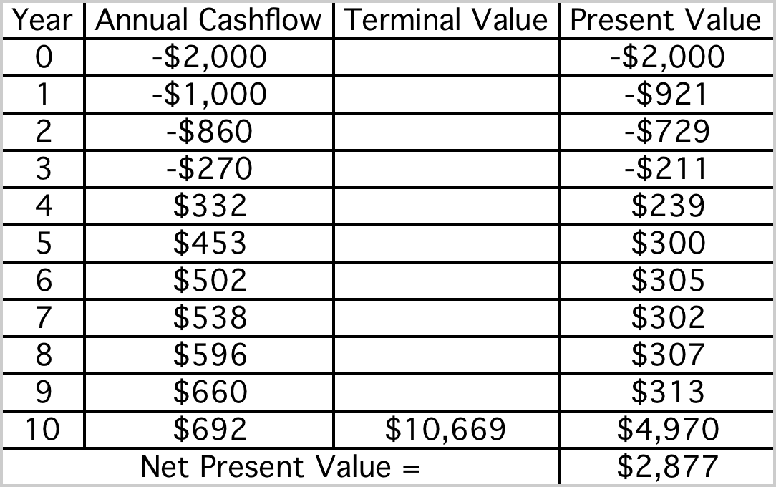
Which yields a NPV of..
Discounted at Rio Disney cost of capital of 8.62%
Notes:
This is the net present value calculation using the cost of capital of 8.62%, the theme park cost of capital adjusted for emerging market risk in Brazil.

Slide 112
Which makes the argument that..
The project should be accepted. The positive net present value suggests that the project will add value to the firm, and earn a return in excess of the cost of capital.
By taking the project, Disney will increase its value as a firm by $2,877 million.
Notes:
The net present value calculation suggests that this project is a good one.
The increase in firm value will not necessarily translate into an increase in market value, since market values reflect expectations. If expectations were such that the market expected Disney to take large positive NPV projects, the $ 2,877 million will have to be measured against these expectations.
The additive nature of NPV is useful in a variety of contexts:
The value of a business that is composed of many projects can be written as the sum of the NPVs of the projects.
When a firm over pays on an acquisition, it is the equivalent of accepting a negative NPV investment, and the value of its equity should drop by the overpayment.

Slide 113
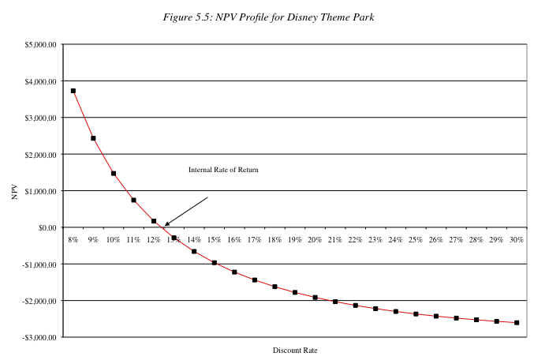
The IRR of this project
Notes:
This is a net present value profile, where NPV is plotted against discount rates. The IRR is that discount rate at which NPV is zero.
The steepness of the slope tells us something about how sensitive this investment is to changes in the discount rate. (It is the equivalent of the duration of a bond, which tells you how sensitive bond prices are to changes in interest rates).
Notice that the NPV is much more sensitive to changes in discount rates, when discount rates are low, than when they are high. (This may have consequences for how value will change in low interest rate scenarios as opposed to high interest rate ones).

Slide 114
The IRR suggests..
The project is a good one. Using time-weighted, incremental cash flows, this project provides a return of 12.35%. This is greater than the cost of capital of 8.62%.
The IRR and the NPV will yield similar results most of the time, though there are differences between the two approaches that may cause project rankings to vary depending upon the approach used. They can yield different results, especially why comparing across projects because
  A project can have only one NPV, whereas it can have more than one IRR.
  The NPV is a dollar surplus value, whereas the IRR is a percentage measure of return. The NPV is therefore likely to be larger for “large scale” projects, while the IRR is higher for “small-scale” projects.
  The NPV assumes that intermediate cash flows get reinvested at the “hurdle rate”, which is based upon what you can make on investments of comparable risk, while the IRR assumes that intermediate cash flows get reinvested at the “IRR”.
Notes:
The information needed to use IRR in investment analysis is the same as the information need to use NPV.
If the hurdle rate is changing over time, IRR becomes more complicated to use. It has to be compared to the geometric average of the hurdle rates over time.

Slide 115
Does the currency matter?
The analysis was done in dollars. Would the conclusions have been any different if we had done the analysis in Brazilian Reais?
  Yes
  No
Notes:
No. It should not. A good project should be good in any currency. But showing this in practice requires us to make some key assumptions about how exchange rates will evolve over time.

Slide 116
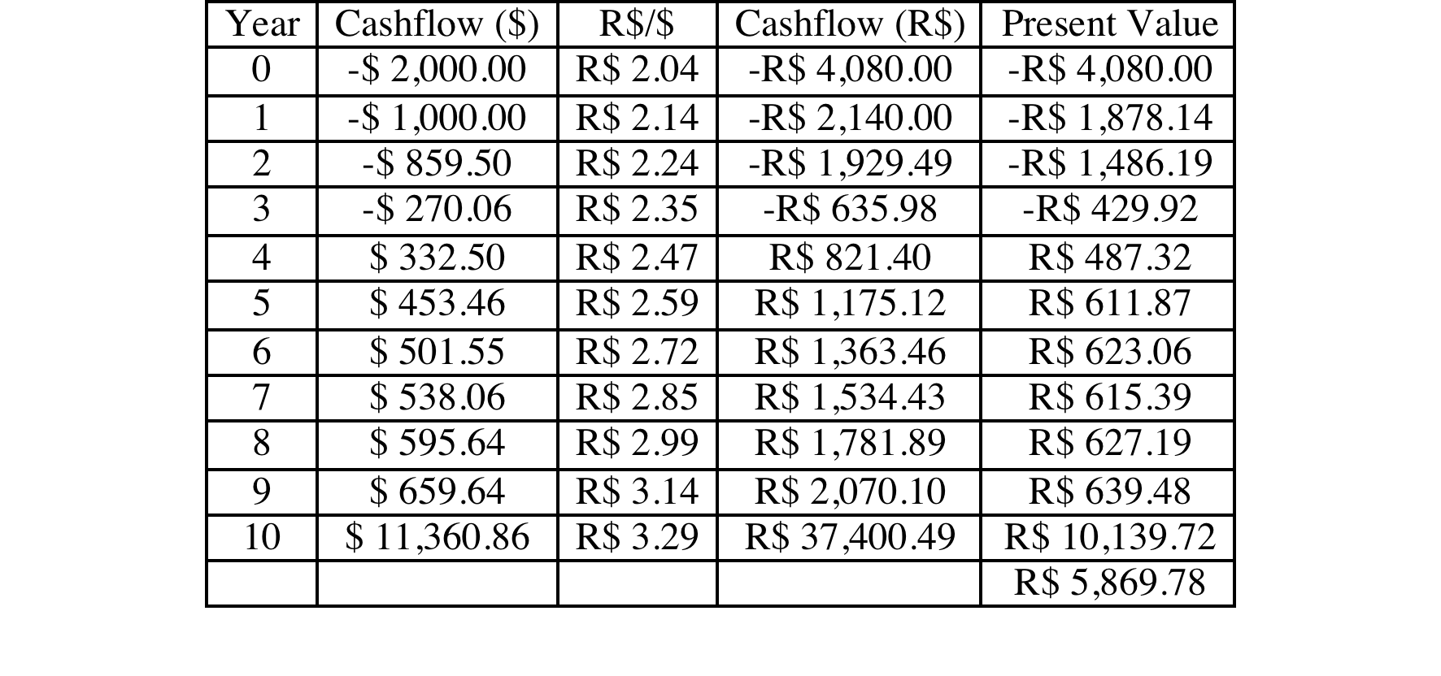
Disney Theme Park: $R NPV
  Expected Exchange Rate_{t}
  = Exchange Rate today * (1.07/1.02)^{t}
Discount at $R cost of capital
= (1.0862) (1.07/1.02) – 1 = 13.94%
NPV = R$ 5,870/2.04= $ 2,877 Million
NPV is equal to NPV in dollar terms
Notes:
The NPV is identical because what we lose by using a higher discount rate is exactly offset by what we gain in growth in the cash flows.
If you are not consistent about estimating the cash flows and the discount rates, the net present values may deviate but only because you have brought your point of view on the currency into the analysis.

Slide 117
A final thought: Side Costs and Benefits
Most projects considered by any business create side costs and benefits for that business.
  The side costs include the costs created by the use of resources that the business already owns (opportunity costs) and lost revenues for other projects that the firm may have.
  The benefits that may not be captured in the traditional capital budgeting analysis include project synergies (where cash flow benefits may accrue to other projects) and options embedded in projects (including the options to delay, expand or abandon a project).
The returns on a project should incorporate these costs and benefits.
Notes:
These costs and benefits should be incorporated, but that is easier said than done.
Some projects deliver most of their benefits indirectly…For instance, a Disney animated movie will often make four times as much revenue for Disney from merchandise sales and theme park revenues as it does in gate receipts. Thus, this is not a minor issue.

Slide 118
First Principles
Notes:
Reviewing the big picture…

Slide 119
Capital Structure: The Choices and the Trade off
“Neither a borrower nor a lender be”
Someone who obviously hated this part of corporate finance
Notes:
There is a deep seated feeling, reinforced by centuries of religious edicts, that good people do not borrow and that only the craven and the weak borrow to fund their businesses. In corporate finance, we take a much more sanguine view of debt. It is just another way of raising capital to fund a business. It is no more or less sinful that using equity…

Slide 120
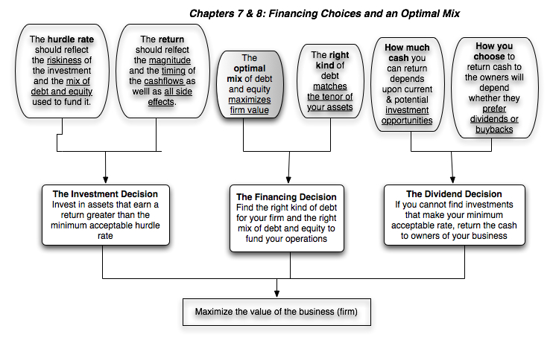
First Principles
Notes:
We shift from the investment principle to the financing principle.

Slide 121
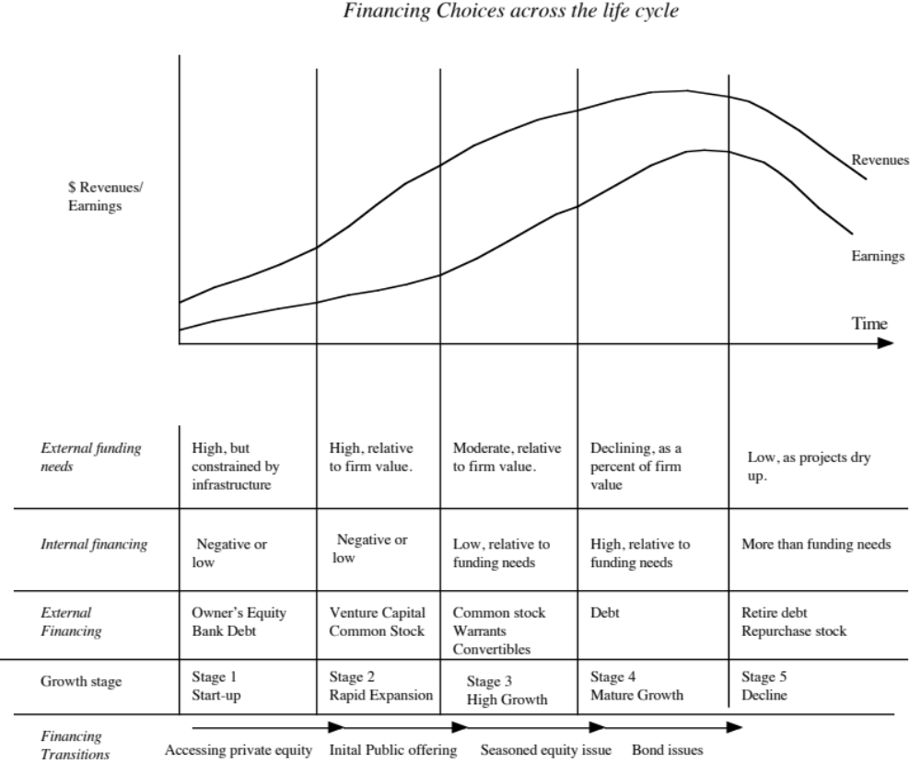
Notes:
The forms that debt and equity take will change as a firm moves through its lifecycle. Early in the process, equity will take the form of owner’s wealth or savings and debt will be bank debt. As the firm evolves, the equity choices will expand first to include venture capital and private equity. When the firm goes public, its choices expand further.
There are three transitional periods: (1) Going from being a private business entirely funded by the owner to accessing the private equity markets (venture capital) (2) Going from private to public with an initial public offering and (3) Public companies making seasoned offerings of debt and equity.

Slide 122

Debt: Summarizing the trade off
Notes:
Brings together the costs and the benefits of debt, with the implications.

Slide 123
6Application Test: Would you expect your firm to gain or lose from using a lot of debt?
Considering, for your firm,
  The potential tax benefits of borrowing
  The benefits of using debt as a disciplinary mechanism
  The potential for expected bankruptcy costs
  The potential for agency costs
  The need for financial flexibility
Would you expect your firm to have a high debt ratio or a low debt ratio?
Does the firm’s current debt ratio meet your expectations?
Notes:
This is just a qualitative analysis. It will not give you a specific optimal debt ratio but provides insight into why the firm may be using the financing mix that it is today.

Slide 124
A Hypothetical Scenario
(a) There are no taxes
(b) Managers have stockholder interests at heart and do what’s best for stockholders.
(c) No firm ever goes bankrupt
(d) Equity investors are honest with lenders; there is no subterfuge or attempt to find loopholes in loan agreements.
(e) Firms know their future financing needs with certainty
What happens to the trade off between debt and equity? How much should a firm borrow?
Notes:
Assume that you super impose these assumptions on the balance sheet on the previous page. The advantages of debt go to zero, as do the disadvantages. Under such a scenario, firms should be indifferent to issuing debt.

Slide 125
The Miller-Modigliani Theorem
In an environment, where there are no taxes, default risk or agency costs, capital structure is irrelevant.
In this world,
  Leverage is irrelevant. A firm's value will be determined by its project cash flows.
  The cost of capital of the firm will not change with leverage. As a firm increases its leverage, the cost of equity will increase just enough to offset any gains to the leverage
Notes:
With the assumptions on the previous page:
The cost of capital will remain unchanged as the debt ratio changes
The value of the firm will not be a function of leverage
Investment decisions can be made independently of financing decisions
Note that if we allow for tax benefits, and keep the other assumptions, the optimal debt ratio will go to 100%.

Slide 126
Pathways to the Optimal
The Cost of Capital Approach: The optimal debt ratio is the one that minimizes the cost of capital for a firm.
The Sector Approach: The optimal debt ratio is the one that brings the firm closes to its peer group in terms of financing mix.
Notes:
We will look at all the approaches, other than APV, though they may yield different results.

Slide 127
I. The Cost of Capital Approach
Value of a Firm = Present Value of Cash Flows to the Firm, discounted back at the cost of capital.
If the cash flows to the firm are held constant, and the cost of capital is minimized, the value of the firm will be maximized.
Notes:
This is the conventional valuation model for a firm.
If the cash flows are the same, and the discount rate is lowered, the present value has to go up. (The key is that cash flows have to remain the same. If this is not true, then minimizing cost of capital may not maximize firm value)

Slide 128


Applying Cost of Capital Approach: The Textbook Example
Notes:
This is a simple example, where both the costs of debt and equity are given. The firm has cash flows, before debt and after taxes and reinvestment, of $200 million and is in stable growth (growing 3% a year). Note that both increase as the debt ratio goes up, but the cost of capital becomes lower at least initially as you take on more debt ( because you are substituting in cheaper debt for more expensive equity)
At 40%, the cost of capital is minimized. It is the optimal debt ratio.
To get firm value, we used the same cash flow ($200 million) and same growth rate and changed the cost of capital.

Slide 129
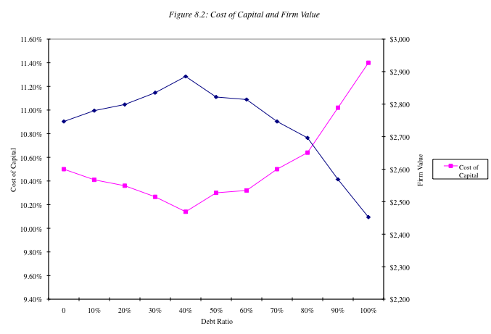
The U-shaped Cost of Capital Graph…
Notes:
Really adds nothing to the previous page.. But it is in every text book… the famous U-shaped cost of capital graph..
If you had this graph available to you, the optimal capital structure would be obvious. In most firms, all we know at the time we begin the analysis is one point on the graph - the current cost of capital. Our challenge is fleshing out the rest of the graph.

Slide 130
Current Cost of Capital: Disney
The beta for Disney’s stock in May 2009 was 0.9011. The T. bond rate at that time was 3.5%. Using an estimated equity risk premium of 6%, we estimated the cost of equity for Disney to be 8.91%:
Cost of Equity = 3.5% + 0.9011(6%) = 8.91%
Disney’s bond rating in May 2009 was A, and based on this rating, the estimated pretax cost of debt for Disney is 6%. Using a marginal tax rate of 38%, the after-tax cost of debt for Disney is 3.72%.
After-Tax Cost of Debt = 6.00% (1 – 0.38) = 3.72%
The cost of capital was calculated using these costs and the weights based on market values of equity (45,193) and debt (16,682):
Cost of capital =
Notes:
The one point we do know for Disney…
This reproduces the current cost of capital computation for Disney, using market value weights for both debt and equity, the cost of equity (based upon the bottom-up beta) and the cost of debt (based upon the bond rating)
The market value of debt is estimated by estimating the present value of total interest payments and face value at the current cost of debt.
One way to frame the capital structure question: Is there a mix of debt and equity at which Disney’s cost of capital will be lower than 8.59%?

Slide 131
Mechanics of Cost of Capital Estimation
1. Estimate the Cost of Equity at different levels of debt:
  Equity will become riskier -> Beta will increase -> Cost of Equity will increase.
  Estimation will use levered beta calculation
2. Estimate the Cost of Debt at different levels of debt:
  Default risk will go up and bond ratings will go down as debt goes up -> Cost of Debt will increase.
  To estimating bond ratings, we will use the interest coverage ratio (EBIT/Interest expense)
3. Estimate the Cost of Capital at different levels of debt
4. Calculate the effect on Firm Value and Stock Price.
Notes:
The basic inputs for computing cost of capital are cost of equity and cost of debt. This summarizes the basic approach we will use to estimate each.

Slide 132
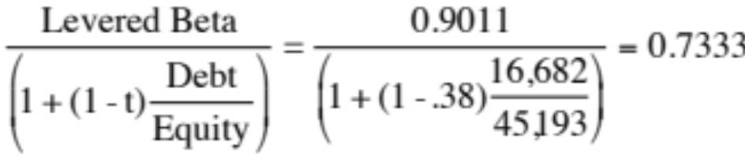
Laying the groundwork:
1. Estimate the unlevered beta for the firm
To get to the unlevered beta, we can start with the levered beta (0.9011) and work back to an unlevered beta:
Unlevered beta =
Alternatively, we can back to the source and estimate it from the betas of the businesses.
Notes:
Since we will be changing the debt ratio, we need to estimate the beta of Disney’s businesses… We can then use this unlevered beta to get to the beta at every debt ratio.

Slide 133
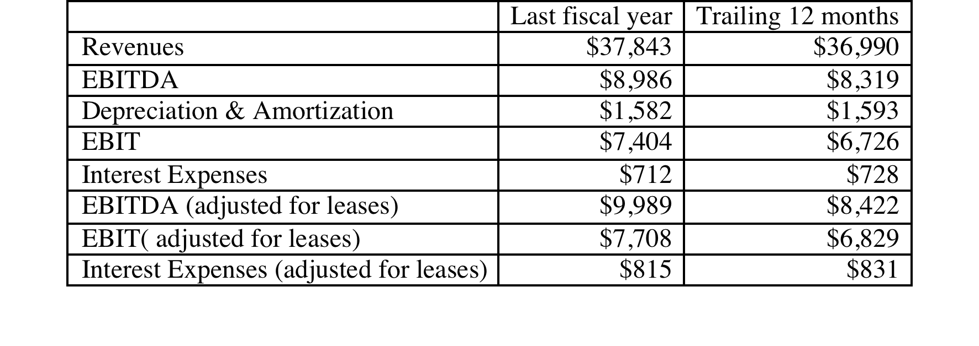
2. Get Disney’s current financials…
Notes:
This is a key step, Since you are determining your firm’s capacity to borrow long term, this is the stage at which you can modify these numbers to reflect the firm’s long term earning capacity rather than the vagaries of a single year of operations. With commodity companies, you may choose to use an average income across a commodity price cycle.
These numbers also reflect our efforts to bring leases into the financial expense column and to treat lease commitments as debt.

Slide 134
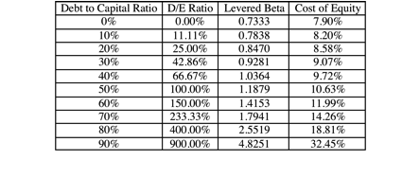
I. Cost of Equity
Levered Beta = 0.7333 (1 + (1-tax rate) (D/E))
Cost of equity = 3.5% + Levered beta * 6%
Notes:
This reproduces the levered beta, using the formula developed during the risk and return section. The unlevered beta of 1.0674 is the bottom-up unlevered beta.
Beta_{Levered} = Unlevered Beta (1 + (1-t) (Debt/Equity Ratio)) In calculating the levered beta in this table, we assumed that all market risk is borne by the equity investors; this may be unrealistic especially at higher levels of debt. We will also consider an alternative estimate of levered betas that apportions some of the market risk to the debt:
β_{levered} = β_{u} [1+(1-t)D/E] - β_{debt} (1-t) D/E
The beta of debt is based upon the rating of the bond and is estimated by regressing past returns on bonds in each rating class against returns on a market index. The levered betas estimated using this approach will generally be lower than those estimated with the conventional model

Slide 135
Estimating Cost of Debt
Start with the current market value of the firm = 45,193 + $16,682 = $61,875 million
D/(D+E) 0.00% 10.00% Debt to capital
D/E 0.00% 11.11% D/E = 10/90 = .1111
$ Debt $0 $6,188 10% of $61,875
EBITDA $8,422 $8,422 Same as 0% debt
Depreciation $1,593 $1,593 Same as 0% debt
EBIT $6,829 $6,829 Same as 0% debt
Interest $0 $294 Pre-tax cost of debt * $ Debt
Pre-tax Int. cov ∞ 23.24 EBIT/ Interest Expenses
Likely Rating AAA AAA From Ratings table
Pre-tax cost of debt 4.75% 4.75% Riskless Rate + Spread
Notes:
This is a manual computation of the cost of debt. Note the circularity in the argument, since the interest expense is needed to compute the rating, and the rating is needed to compute the cost of debt.
To get around the circularity, I start the 10% debt ratio calculation assuming that my cost of debt is the same as it was at 0% (which is 4.75%) and that my starting firm value (market value of equity + debt) remains my firm value. While neither assumption is realistic, we can revisit these numbers in subsequent iterations, if necessary.
We assume that whatever is borrowed is used to buy back equity, and that the operating assets of the firm remain unchanged (EBITDA and EBIT don’t change…). This allows us to isolate the effect of the recapitalization.

Slide 136
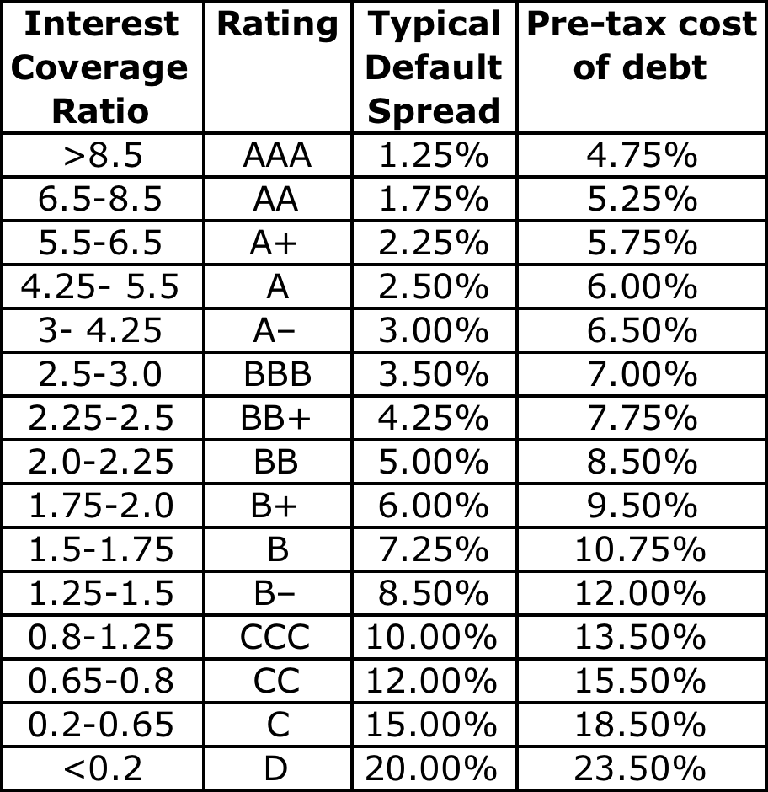
The Ratings Table
T.Bond rate in early 2009 = 3.5%
Notes:
These are interest coverage ratio/ratings classes for large manufacturing firms (Market cap > $ 5 billion) and the default spreads at the time of the analysis. This is the default spread over and above the long term (10 year) treasury bond rate at the time of this analysis.
These default spreads can be obtained in one of two ways:
Getting a sampling of liquid bonds within each ratings class and averaging out their yields to maturity.
Finding a source that provides default spreads by ratings class (bondsonline.com used to provide these for free but now requires a fee)
The interest coverage ratio needs to be much higher for smaller firms to get similar ratings. (See ratings.xls spreadsheet)
Special cases:
If you have no interest expenses, your interest coverage ratio will be infinite: AAA rating (does not matter anyway, since you probably have no debt)
2. If you have negative operating income, interest coverage ratio is negative: D rating. You may want to modify by using average operating income over last few years.

Slide 137
A Test: Can you do the 30% level?
D/(D + E) | 10.00% | 20.00% | 30%
D/E | 11.11% | 25.00%
$ Debt | $6,188 | $12,375
EBITDA | $8,422 | $8,422
Depreciation | $1,593 | $1,593
EBIT | $6,829 | $6,829
Interest | $294 | $588
Pretax int. cov | 23.24 | 11.62
Likely rating | AAA | AAA
Pretax cost of debt | 4.75% | 4.75%
Notes:
You have to start by assuming the AAA rate but you will end up with a rating that is different (AA)
You can redo the analysis using the AA rate and you can stop because you end up with the same rating at the end. (Sometimes you will need a third iteration>

Slide 138
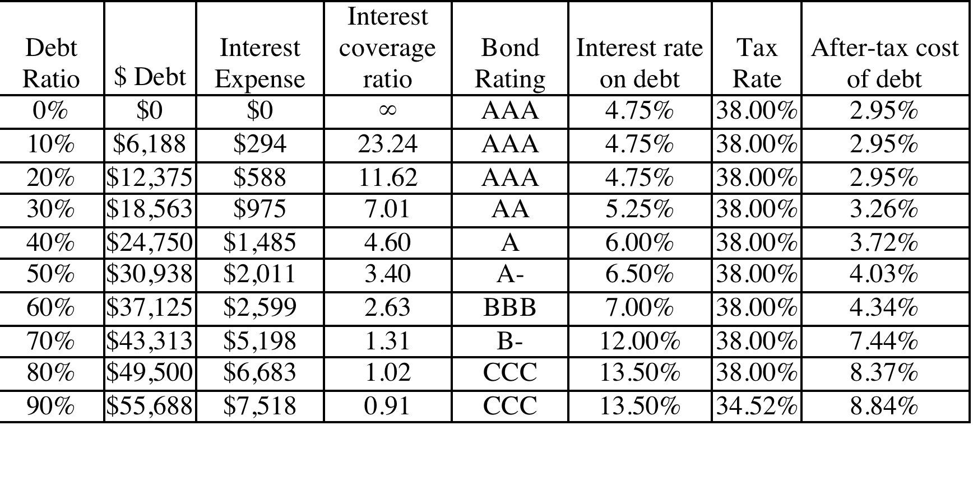
Bond Ratings, Cost of Debt and Debt Ratios
Notes:
This is the completed schedule of interest coverage ratios, ratings and costs of debt at different debt ratios ranging up to 90%.
It is significant that EBITDA not change as the debt ratio goes up. The reason is that the new debt is not used to make the firm larger by taking new projects, but to buy back equity. (This isolates the effect of the financing decision on the value of the firm)
We are being simplistic in assuming that the interest coverage ratio solely determines the ratings. We could use more than one ratio, create a consolidated score (like the Altman Z score) and make the rating a function of this score.
Note that the effective tax rate decreases after the 80% debt ratio. That is because we have insufficient income to cover the entire interest expense beyond that point. (EBIT < Interest Expenses) We therefore lose some of the tax advantage of borrowing.

Slide 139
Stated versus Effective Tax Rates
You need taxable income for interest to provide a tax savings. Note that the EBIT at Disney is $6,829 million. As long as interest expenses are less than $6,829 million, interest expenses remain fully tax-deductible and earn the 38% tax benefit. At an 80% debt ratio, the interest expenses are $6,683 million and the tax benefit is therefore 38% of this amount.
At a 90% debt ratio, however, the interest expenses balloon to $7,518 million, which is greater than the EBIT of $6,829 million. We consider the tax benefit on the interest expenses up to this amount:
  Maximum Tax Benefit = EBIT * Marginal Tax Rate = $6,829 million * 0.38 = $2,595 million
Adjusted Marginal Tax Rate = Maximum Tax Benefit/Interest Expenses = $2,595/$7,518 = 34.52%
Notes:
We are being conservative. The interest that is not tax deductible can be carried forward and will probably earn some tax benefit in future periods.
Given that this is a permanent change in capital structure, however, it seems to be more conservative to just look at the interest expenses that provide a tax benefit in the current period.

Slide 140
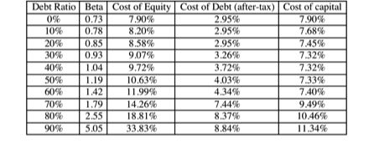
Disney’s cost of capital schedule…
Notes:
Summarizes the cost of equity and debt from prior pages, as well as the cost of capital at different debt ratios.
If the objective is to minimize cost of capital, it occurs at 30 and 40%... We did try for a more precise answer by working in 1% increments and arrived at an optimal of 43% with a cost of capital of 7.28%. (We moved in 1% increments from 30% top 50%)
This will maximize firm value, if operating cashflow (EBITDA) is unaffected by changes in leverage and the consequent changes in ratings. (In other words, we are assuming no indirect bankruptcy costs… If we did, the optimal might be affected, especially if it is at low rating).

Slide 141
The cost of capital approach suggests that Disney should do the following…
Disney currently has $16.68 billion in debt. The optimal dollar debt (at 40%) is roughly $24.75 billion. Disney has excess debt capacity of $ 8.07 billion.
To move to its optimal and gain the increase in value, Disney should borrow $ 8 billion and buy back stock.
Given the magnitude of this decision, you should expect to answer three questions:
  Why should we do it?
  What if something goes wrong?
  What if we don’t want (or cannot ) buy back stock and want to make investments with the additional debt capacity?
Notes:
The cost of capital approach holds investments constant and changes the financial mix to see the effect on the cost of capital. Consequently, the recommendation that flows out of it is a recapitalization: borrow money and buy back stock to increase the debt ratio or issue stock and repay debt to lower the debt ratio.

Slide 142
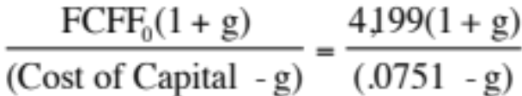
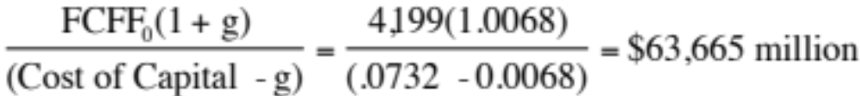
Why should we do it?
Effect on Firm Value – Full Valuation Approach
Step 1: Estimate the cash flows to Disney as a firm
  EBIT (1 – Tax Rate) = 6829 (1 – 0.38) = $4,234
  + Depreciation and amortization = $1,593
  – Capital expenditures = $1,628
  – Change in noncash working capital $0
  Free cash flow to the firm = $4,199
Step 2: Back out the implied growth rate in the current market value
Value of firm = $ 61,875 =
Growth rate = (Firm Value * Cost of Capital – CF to Firm)/(Firm Value + CF to Firm)
  = (61,875* 0.0751 – 4199)/(61,875 + 4,199) = 0.0068 or 0.68%
Step 3: Revalue the firm with the new cost of capital
  Firm value =
  The firm value increases by $1,790 million (63,665 – 61,875 = 1,790)
Notes:
We are assuming that the firm is correctly valued now, not because of any belief in market efficiency but to isolate the effect of changing the cost of capital. In other words, whatever the market’s expectations are now (realistic or unrealistic), those expectations stay unchanged as we move from the old to the new capital structure.
This approach will tend to break down with growth or money losing companies because the valuation models you will need for those are far more complicated.

Slide 143
Effect on Value: Capital Structure Isolation…
In this approach, we start with the current market value and isolate the effect of changing the capital structure on the cash flow and the resulting value.
Firm Value before the change = 45,193 + $16,682 = $61,875 million
  WACC_{b} = 7.51% Annual Cost = 61,875 * 0.0751 = $4,646.82 million
  WACC_{a} = 7.32% Annual Cost = 61,875 * 0.0732 = $ 4,529.68 million
  Δ WACC = 0.19% Change in Annual Cost = $117.14 million
If we assume a perpetual growth of 0.68% in firm value over time,
  Increase in firm value =
  The total number of shares outstanding before the buyback is 1856.732 million.
  Change in Stock Price = $1,763/1856.732 = $ 0.95 per share
Notes:
The reduction in the cost of capital translates into annual savings. Most of these savings are implicit, being savings in the cost of equity. Thus, the firm’s accounting earnings will not reflect these savings directly.
These savings can be converted into a present value by discounting back at the new cost of capital.
It is more realistic to assume growth in firm value. A simple way to estimate what the current growth attributed to the firm by the market is to estimate it using the firm value today, the free cash flow to the firm and the current cost of capital.
Note that the simple valuation formula used above assumes stable growth forever. For high growth firms, this formula will yield an implied growth rate that is too high (It will be very close to the cost of capital). In those cases, it is better to put a cap on the growth rate of around 4% (the nominal growth rate of the US economy).
In this case, maximizing firm value also maximizes stock price, because we assume that
Debt is refinanced at current market rates, thus protecting bondholders
Markets are rational and efficient.

Slide 144
A Test: The Repurchase Price
Let us suppose that the CFO of Disney approached you about buying back stock. He wants to know the maximum price that he should be willing to pay on the stock buyback. (The current price is $ 24.34 and there are 1856.732 million shares outstanding).
If we assume that investors are rational, i.e., that the investor who sell their shares back want the same share of firm value increase as those who remain:
  Increase in Value per Share = $1,763/1856.732 = $ 0.95
  New Stock Price = $24.34 + $0.95= $25.29
Buying shares back $25.29 will leave you as a stockholder indifferent between selling and not selling.
What would happen to the stock price after the buyback if you were able to buy stock back at $ 24.34?
Notes:
When we divide the increase in firm value by the total number of shares, we are implicitly assuming that all stockholders (including those who sell back their shares) will get an equal share of the firm value increase(since the announcement is public). Thus, we are assuming that the stock will be bought back at 25.29
If the firm can buy the stock back at the current price of $ 24.34, the remaining stockholders will get a much greater increase in the stock price. To compute this change in value per share, we first compute how many shares we would buy back with the additional debt taken on of $ 8,068 billion (Debt at 40% optimal – Current Debt) and the stock price of $ 24.34. We then divide the increase in firm value of $ 1,763 million by the remaining shares outstanding:
Change in Stock Price = $1,763 million/(– [8068/24.34]) = $1.16 per share

Slide 145
2. What if something goes wrong?
The Downside Risk
Doing What-if analysis on Operating Income
  A. Statistical Approach
    Standard Deviation In Past Operating Income
    Standard Deviation In Earnings (If Operating Income Is Unavailable)
    Reduce Base Case By One Standard Deviation (Or More)
  B. “Economic Scenario” Approach
    Look At What Happened To Operating Income During The Last Recession. (How Much Did It Drop In % Terms?)
    Reduce Current Operating Income By Same Magnitude
Constraint on Bond Ratings
Notes:
This analysis is based upon the firm continuing as a going concern. To the extent that more debt can put this survival at risk, it is important to do “what-if” analyses or build in survival constraints into the analysis.

Slide 146
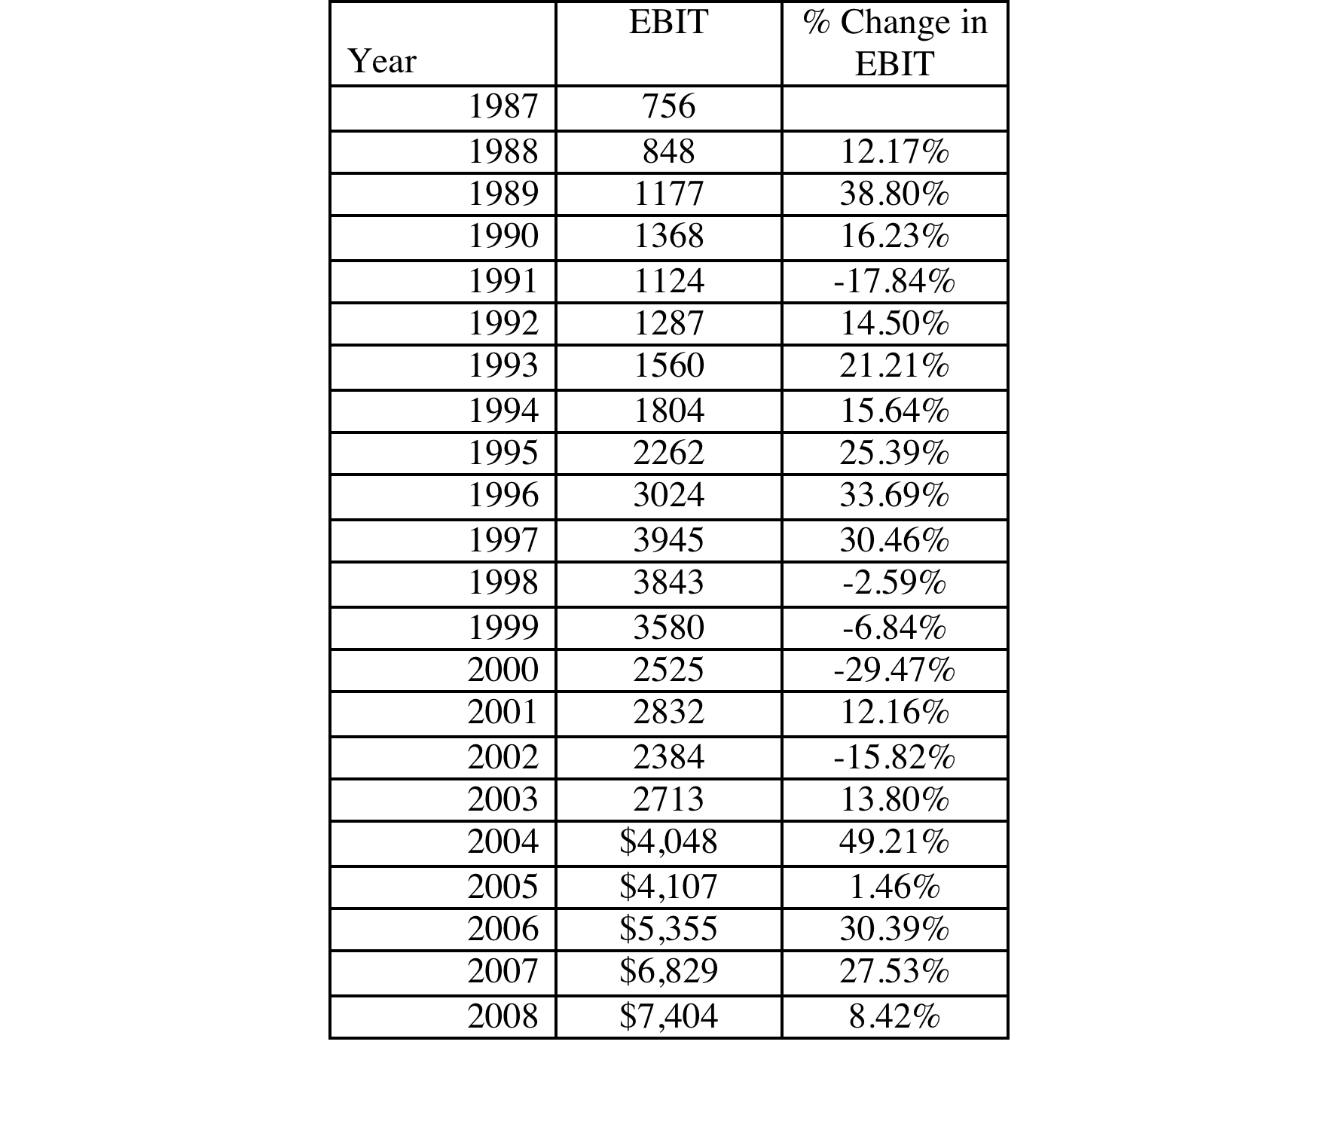
Disney’s Operating Income: History
Notes:
These are percentage changes in operating income at Disney.

Slide 147

Disney: Safety Buffers?
Recession Decline in Operating Income
2002 Drop of 15.82%
1991 Drop of 22.00%
1981-82 Increased
Worst Year Drop of 29.47%
The standard deviation in past operating income is about 20%.
Notes:
Both are designed to measure how much Disney’s operating income will drop in a “downside” scenario. The first approach gives a more intuitive estimate than the latter.
Note that the downside does not have to be framed in terms of a recession. It could be in terms of something that the firm fears (the loss of a large contract, for instance)
Alternatively, this entire analysis could have been based upon “normalized operating income”, which would be the operating income that the firm will earn in a “normal year”, rather than on current operating income.

Slide 148
Constraints on Ratings
Management often specifies a 'desired Rating' below which they do not want to fall.
The rating constraint is driven by three factors
  it is one way of protecting against downside risk in operating income (so do not do both)
  a drop in ratings might affect operating income
  there is an ego factor associated with high ratings
Caveat: Every Rating Constraint Has A Cost.
  Provide Management With A Clear Estimate Of How Much The Rating Constraint Costs By Calculating The Value Of The Firm Without The Rating Constraint And Comparing To The Value Of The Firm With The Rating Constraint.
Notes:
Rating constraints are one way of buffering your analysis against the assumption that operating income will not change as leverage changes. If the operating income will suffer when ratings fall below a certain point (say BBB or investment grade), it makes sense to build in that constraint into the analysis.
When managers brag about their high ratings, the questions that should come up are whether the high rating is paying off in terms of higher operating income, and if not, how much stockholders are paying for managers’ bragging rights.

Slide 149
Ratings Constraints for Disney
At its optimal debt ratio of 40%, Disney has an estimated rating of A.
If managers insisted on a AA rating, the optimal debt ratio for Disney is then 30% and the cost of the ratings constraint is fairly small:
  Cost of AA Rating Constraint = Value at 40% Debt – Value at 30% Debt
  = $63,651 – $63,596 = $55 million
If managers insisted on a AAA rating, the optimal debt ratio would drop to 20% and the cost of the ratings constraint would rise:
  Cost of AAA rating constraint = Value at 40% Debt – Value at 20% Debt
  = $63,651 - $62,371 = $1,280 million
Notes:
This is a little unfair, since it is based upon the assumption that operating income is unaffected by the change in ratings. To the degree that Disney’s operating income will drop if its rating drops below BBB, this will overstate the cost of the constraint.
This process can be modified to allow for other constraints. For instance, some firms do not want their book value debt ratios to rise above a certain level (say, industry averages). In other cases, existing bond covenants may restrict a financial ratio from exceeding a specified number.

Slide 150
3. What if you do not buy back stock..
The optimal debt ratio is ultimately a function of the underlying riskiness of the business in which you operate and your tax rate.
Will the optimal be different if you invested in projects instead of buying back stock?
  No. As long as the projects financed are in the same business mix that the company has always been in and your tax rate does not change significantly.
  Yes, if the projects are in entirely different types of businesses or if the tax rate is significantly different.
Notes:
The analysis is built on the assumption that debt is used to buy back stock. Many firms would rather use the debt to take projects, or might be barred from buying back stock (as is the case in markets like Germany)
If we assume that projects in the same line of business have the same cash flow generating capacity as the current firm (EBITDA/Firm Value), the optimal debt ratio will remain unchanged, but the optimal dollar debt will be a much higher number. (This analysis is impervious to changes in scale. If you double all the numbers, the optimal debt ratio will remain unchanged)
If the business you are expanding into has more risk and more negative cashflows, your optimal will decrease.

Slide 151

Determinants of the Optimal Debt Ratio:
1. The marginal tax rate
The primary benefit of debt is a tax benefit. The higher the marginal tax rate, the greater the benefit to borrowing:
Notes:
Note that with zero taxes, the optimal debt ratio goes to zero. Intuitively, if the costs of borrowing (higher bankruptcy cost, agency costs) and the primary benefit disappears, there will always by a net cost to borrowing.
If debt is cheaper than equity on a pre-tax basis (and it generally is), why do we not gain by borrowing?
Because the additional debt makes both debt and equity more expensive. (Ratings drop and betas increase…)

Slide 152
2. Pre-tax Cash flow Return
Firms that have more in operating income and cash flows, relative to firm value (in market terms), should have higher optimal debt ratios. We can measure operating income with EBIT and operating cash flow with EBITDA.
Cash flow potential = EBITDA/ (Market value of equity + Debt)
Disney, for example, has operating income of $6,829 million, which is 11% of the market value of the firm of $61,875 million in the base case, and an optimal debt ratio of 40%. Increasing the operating income to 15% of the firm value will increase the optimal debt ratio to 60%.
In general, growth firms will have lower cash flows, as a percent of firm value, and lower optimal debt ratios.
Notes:
This is the answer to the puzzle of why growth firms, even extremely profitable ones like Apple and Google, tend to have low optimal debt ratios. While they may generate huge dollar profits, their market values are

Slide 153
3. Operating Risk
Firms that face more risk or uncertainty in their operations (and more variable operating income as a consequence) will have lower optimal debt ratios than firms that have more predictable operations.
Operating risk enters the cost of capital approach in two places:
  Unlevered beta: Firms that face more operating risk will tend to have higher unlevered betas. As they borrow, debt will magnify this already large risk and push up costs of equity much more steeply.
  Bond ratings: For any given level of operating income, firms that face more risk in operations will have lower ratings. The ratings are based upon normalized income.
Notes:
A risky firm can be very profitable in a good year. However, it should be cautious about borrowing on the basis of that income, since earnings can drop quickly.

Slide 154

4. The only macro determinant:
Equity vs Debt Risk Premiums
Notes:
The cost of equity is determined by the equity risk premium and the cost of debt by the default spread. When ERP rise (fall) relative to default spreads, firms will borrow more (less).
This graph has the implied equity risk premium and the default spread on a Baa rated bond going back to 1960. While they generally move together, there have been periods of disconnect between the two.
In the late 1990s, equity risk premiums dropped relative to default spreads: Firms should have shifted to equity from debt and optimal debt ratios should have decreased.
Between 2004 and 2007, default spreads dropped while equity risk premiums remained unchanged. It was a golden age for leveraged transactions.
In 2008, risk premia climbed across the board but default spreads increased at a far faster pace than equity risk premium. On a relative basis, debt became more expensive relative to equity.
We would expect optimal debt ratios to decrease across the board as a consequence. . (Between 2004 and 2007, default spreads fell while equity risk premiums stagnated… ushering in the age of leveraged recaps and buyouts)

Slide 155
6 Application Test: Your firm’s optimal financing mix
Using the optimal capital structure spreadsheet provided:
  Estimate the optimal debt ratio for your firm
  Estimate the new cost of capital at the optimal
  Estimate the effect of the change in the cost of capital on firm value
  Estimate the effect on the stock price
In terms of the mechanics, what would you need to do to get to the optimal immediately?
Notes:
The best way to see how capital structure is determined by fundamentals is to try it for a real firm and see how the optimal changes as you change the inputs.

Slide 156
Another Approach to the Optimal:
Relative Analysis
The “safest” place for any firm to be is close to the industry average
Subjective adjustments can be made to these averages to arrive at the right debt ratio.
  Higher tax rates -> Higher debt ratios (Tax benefits)
  Lower insider ownership -> Higher debt ratios (Greater discipline)
  More stable income -> Higher debt ratios (Lower bankruptcy costs)
  More intangible assets -> Lower debt ratios (More agency problems)
Notes:
Most firms pick their debt ratios by looking at industry averages. By staying close to the average, managers get cover in case they make mistakes - everyone else has made the same mistake.
Managers also try to stay close to the industry average, because ratings agencies and equity research analysts look at these averages.

Slide 157

Comparing to industry averages
Notes:
Based on this comparison, Disney is operating at a debt ratio lower than those of other firms in the industry in both market and book value terms, whereas Aracruz and Tata Chemicals have debt ratios much higher than the averages for their sector.
The underlying assumptions in this comparison are that firms within the same industry are comparable and that, on average, these firms are operating at or close to their optimal. Both assumptions can be questioned, however. Firms within the same industry can have different product mixes, different amounts of operating risk, different tax rates, and different project returns. In fact, most do. For instance, Disney is considered part of the entertainment industry, but its mix of businesses is very different from that of Lion’s Gate, which is primarily a movie company, or Liberty Media, which is primarily a cable broadcasting company. Furthermore, Disney’s size and risk characteristics are very different from that of Westwood One, which is also considered part of the same industry group. The other problem is that, as we noted in Chapter 4, both Disney and Tata Chemicals are multi-business companies and picking a sector to compare these firms is difficult to do.

Slide 158
Now that we have an optimal.. And an actual.. What next?
At the end of the analysis of financing mix (using whatever tool or tools you choose to use), you can come to one of three conclusions:
  The firm has the right financing mix
  It has too little debt (it is under levered)
  It has too much debt (it is over levered)
The next step in the process is
  Deciding how much quickly or gradually the firm should move to its optimal
  Assuming that it does, the right kind of financing to use in making this adjustment
Notes:
When a firm is under or over levered, the natural reaction of the analyst looking at the numbers is that the firm should fix the problem instantaneously. However, there is a cost to abrupt shifts in capital structures:
You could be wrong in your assessment of the optimal: In other words, you may have misestimated the optimal, in which case the firm may have to back track, if it has followed your recommendations. That is expensive to do (and sometimes fatal).
Macro variables may shift: If there is a shift in the macro environment (interest rates and risk premiums could change), your recommendations can be wrong in hindisight
Adjustment costs: Changes in capital structure can change the way a company is managed and decision makers may not be ready to make the shift. Managers at highly levered firms have to make decisions differently (and perhaps focus on different decision rules) than managers at lightly levered firms. Increasing the debt ratio for a firm overnight can create adjustment problems for these managers.

Slide 159
A Framework for Getting to the Optimal
Is the actual debt ratio greater than or lesser than the optimal debt ratio?
Actual > Optimal
Actual < Optimal
Overlevered
Underlevered
Is the firm under bankruptcy threat?
Is the firm a takeover target?
Yes
No
Yes
No
Reduce Debt quickly
Does the firm have good
Increase leverage
Does the firm have good
1. Equity for Debt swap
projects?
quickly
projects?
2. Sell Assets; use cash
ROE > Cost of Equity
1. Debt/Equity swaps
ROE > Cost of Equity
to pay off debt
ROC > Cost of Capital
2. Borrow money&
ROC > Cost of Capital
3. Renegotiate with lenders
buy shares.
Yes
No
Yes
No
Take good projects with
1. Pay off debt with retained
Take good projects with
new equity or with retained
earnings.
debt.
earnings.
2. Reduce or eliminate dividends.
Do your stockholders like
3. Issue new equity and pay off
dividends?
debt.
Yes
No
Pay Dividends
Buy back stock
Notes:
Studies that have looked at the likelihood of a firm being taken over (in a hostile takeover) have concluded that
Small firms are more likely to be taken over than larger firms
Closely held firms are less likely to be taken over than widely held firms
Firms with anti-takeover restrictions in the corporate charter (or from the state) are less likely to be taken over than firms without these restrictions
Firms which have done well for their stockholders (positive Jensen’s alpha, Positive EVA) are less likely to be taken over than firms which have done badly.
Whether a firm is under bankruptcy threat can be assessed by looking at its rating. If its rating is BB or less, you can argue that the bankruptcy threat is real.
Looking at historical ROE or ROC, relative to the cost of equity and capital, does assume that the future will look like the past.

Slide 160
Disney: Applying the Framework
Is the actual debt ratio greater than or lesser than the optimal debt ratio?
Actual > Optimal
Actual < Optimal
Overlevered
Actual (26%) < Optimal (40%)
Is the firm under bankruptcy threat?
Is the firm a takeover target?
Yes
No
Yes
No. Large mkt cap & positive Jensen’s α
Reduce Debt quickly
Does the firm have good
Increase leverage
Does the firm have good
1. Equity for Debt swap
projects?
quickly
projects?
2. Sell Assets; use cash
ROE > Cost of Equity
1. Debt/Equity swaps
ROE > Cost of Equity
to pay off debt
ROC > Cost of Capital
2. Borrow money&
ROC > Cost of Capital
3. Renegotiate with lenders
buy shares.
Yes
No
Yes. ROC > Cost of capital
No
Take good projects with
1. Pay off debt with retained
Take good projects
new equity or with retained
earnings.
With debt.
earnings.
2. Reduce or eliminate dividends.
Do your stockholders like
3. Issue new equity and pay off
dividends?
debt.
Yes
No
Pay Dividends
Buy back stock
Notes:
This is the analysis for Disney in 2009.
I am assuming that future projects will be more successful than current projects..
Over time, our assessments have changed:
In 2003, we would have pushed for higher dividends (since Disney was earning terrible returns on capital and we did not trust management)
In 2000, Disney would have been a takeover target (because its market cap had dropped and its performance was awful on both accounting and stock price returns)
In 1997, Disney would not have been a takeover target (high market cap, good performance) and its excess debt capacity would have been directed to good investments.

Slide 161
6 Application Test: Getting to the Optimal
Based upon your analysis of both the firm’s capital structure and investment record, what path would you map out for the firm?
Immediate change in leverage
Gradual change in leverage
No change in leverage
Would you recommend that the firm change its financing mix by
Paying off debt/Buying back equity
Take projects with equity/debt
Notes:
Map out your firm’s path to the optimal debt ratio depending upon
Urgency: If your is a likely target for an acquisition or bankruptcy, go for an immediate change. If not, go for a gradual change.
If your stock price performance has been poor (Jensen’s alpha < 0) and your project choice has yielded negative excess returns (EVA <0) , go for recapitalization (paying off debt or buying back equity). If you have good projects, go for good investments.

Slide 162


Designing Debt: The Fundamental Principle
The objective in designing debt is to make the cash flows on debt match up as closely as possible with the cash flows that the firm makes on its assets.
By doing so, we reduce our risk of default, increase debt capacity and increase firm value.
Unmatched Debt
Matched Debt
Notes:
Your objective is issue securities that bring you all of the tax benefits of debt while providing you with the flexibility of equity. It is not the reduction in risk but the increase in debt capacity that generates the value. A firm that does not use this debt capacity will not gain from matching debt to assets in the first place.

Slide 163

Design the perfect financing instrument
The perfect financing instrument will
  Have all of the tax advantages of debt
  While preserving the flexibility offered by equity
Notes:
There is ample scope for creativity in trying to design the perfect bond. The idea is to design debt that looks and acts like equity, in terms of the cash flows.
Consider each aspect;
Duration: Companies with long term projects (Boeing) should use long term debt. Companies with short term projects (Dell) should use short term debt.
Currency: Companies that get a high proportion of their revenues from non-domestic operations should use more foreign currency debt (especially if the currency mix is stable.
Inflation: Companies with pricing power can pass inflation through into their cash flows. These companies should be much better candidates for floating rate debt (because interest expenses on the debt will rise and fall with inflation).
Growth pattern: Mature companies with level , steady cash flows should be much better candidates for straight debt, whereas growth companies are much better candidates for convertible debt.

Slide 164

Ensuring that you have not crossed the line drawn by the tax code
All of this design work is lost, however, if the security that you have designed does not deliver the tax benefits.
In addition, there may be a trade off between mismatching debt and getting greater tax benefits.
Notes:
Note though that all is lost if the tax authorities do not allow you to subtract interest expenses for tax purposes.
It is also possible that you could increase your tax benefits by deviating from your perfect bond and issuing bonds in the wrong currency or the wrong maturity.

Slide 165

While keeping equity research analysts, ratings agencies and regulators applauding
Ratings agencies want companies to issue equity, since it makes them safer. Equity research analysts want them not to issue equity because it dilutes earnings per share. Regulatory authorities want to ensure that you meet their requirements in terms of capital ratios (usually book value). Financing that leaves all three groups happy is nirvana.
Notes:
This is a tough balancing act to pull off. You have to issue a security that looks like equity to the ratings agency, debt to the equity research analysts and equity again to your regulatory authorities (if you are a financial service firm).
While it may seem impossible, trust preferred and several other very profitable innovations (at least to investment bankers) have succeeded in doing this.

Slide 166
Debt or Equity: The Strange Case of Trust Preferred
Trust preferred stock has
  A fixed dividend payment, specified at the time of the issue
  That is tax deductible
  And failing to make the payment can cause ? (Can it cause default?)
When trust preferred was first created, ratings agencies treated it as equity. As they have become more savvy, ratings agencies have started giving firms only partial equity credit for trust preferred.
Assuming that trust preferred stock gets treated as equity by ratings agencies, which of the following firms is the most appropriate firm to be issuing it?
A firm that is under levered, but has a rating constraint that would be violated if it moved to its optimal
A firm that is over levered that is unable to issue debt because of the rating agency concerns.
Notes:
Ratings agencies have learnt over time, but slowly. As they have learnt, investment banks have come up with new securities that have the same objective.
I would expect under levered firms to gain, and over levered firms to lose by doing this. The latter might fool the ratings agencies but they lose because of the expected default cost that they create for themselves.

Slide 167

Soothe bondholder fears
There are some firms that face skepticism from bondholders when they go out to raise debt, because
  Of their past history of defaults or other actions
  They are small firms without any borrowing history
Bondholders tend to demand much higher interest rates from these firms to reflect these concerns.
Notes:
While adding these conditions to debt may make it less attractive to the firm, it may be only way they can borrow.

Slide 168
And do not lock in market mistakes that work against you
Ratings agencies can sometimes under rate a firm, and markets can under price a firm’s stock or bonds. If this occurs, firms should not lock in these mistakes by issuing securities for the long term. In particular,
  Issuing equity or equity based products (including convertibles), when equity is under priced transfers wealth from existing stockholders to the new stockholders
  Issuing long term debt when a firm is under rated locks in rates at levels that are far too high, given the firm’s default risk.
What is the solution
  If you need to use equity?
  If you need to use debt?
Notes:
When you feel that your equity or debt is under valued, you do not want to lock in the under valuation. You should use short-term solutions (bridge financing) until they feel more comfortable with the valuations. Bridge financing includes short term debt and short term warrants.

Slide 169

Designing Disney’s Debt
Notes:
There is plenty of room to be creative in this approach.
Look at firms which operate in each of these businesses and see what financing they use. That might be useful in designing the right kind of debt.

Slide 170
Recommendations for Disney
The debt issued should be long term and should have duration of about 5 years.
A significant portion of the debt should be floating rate debt, reflecting Disney’s capacity to pass inflation through to its customers and the fact that operating income tends to increase as interest rates go up.
Given Disney’s sensitivity to a stronger dollar, a portion of the debt should be in foreign currencies. The specific currency used and the magnitude of the foreign currency debt should reflect where Disney makes its revenues. Based upon 2008 numbers at least, this would indicate that about 20% of the debt should be in Euros and about 10% of the debt in Japanese Yen reflecting Disney’s larger exposures in Europe and Asia. As its broadcasting businesses expand into Latin America, it may want to consider using either Mexican Peso or Brazilian Real debt as well.
Notes:
Converts the numbers into tangible recommendations…

Slide 171
Analyzing Disney’s Current Debt
Disney has $16 billion in debt with a face-value weighted average maturity of 5.38 years. Allowing for the fact that the maturity of debt is higher than the duration, this would indicate that Disney’s debt is of the right maturity.
Of the debt, about 10% is yen denominated debt but the rest is in US dollars. Based on our analysis, we would suggest that Disney increase its proportion of debt in other currencies to about 20% in Euros and about 5% in Chinese Yuan.
Disney has no convertible debt and about 24% of its debt is floating rate debt, which is appropriate given its status as a mature company with significant pricing power. In fact, we would argue for increasing the floating rate portion of the debt to about 40%.
Notes:
There may be good reasons for the mismatch but for most firms, the existing debt structure is more a result of history and inertia. Disney’s business mix has changed significantly over the last decade - more broadcasting, less theme park - and it is not surprising that the debt structure has not kept pace.
In some cases, market frictions and limitations may contribute to the mismatch. In fact, many emerging market companies were unable to borrow long term until recently because banks would not lend long term in those markets.

Slide 172
Adjusting Debt at Disney
It can swap some of its existing fixed rate, dollar debt for floating rate, foreign currency debt. Given Disney’s standing in financial markets and its large market capitalization, this should not be difficult to do.
If Disney is planning new debt issues, either to get to a higher debt ratio or to fund new investments, it can use primarily floating rate, foreign currency debt to fund these new investments. Although it may be mismatching the funding on these investments, its debt matching will become better at the company level.
Notes:
Disney’s large size and access to capital markets give it lots of options. Smaller firms and emerging market firms will have fewer options. In the extreme scenario, it may take more time to adjust the debt.

Slide 173
6 Application Test: Choosing your Financing Type
Based upon the business that your firm is in, and the typical investments that it makes, what kind of financing would you expect your firm to use in terms of
  Duration (long term or short term)
  Currency
  Fixed or Floating rate
  Straight or Convertible
Notes:
Based upon what a typical investment looks like, assess the right type of debt for your firm….

Slide 174
Returning Cash to the Owners: Dividend Policy
“Companies don’t have cash. They hold cash for their stockholders.”

Slide 175

First Principles
Notes:
Third and final principle of corporate finance.

Slide 176

I. Dividends are sticky
Notes:
Most companies in most years pay out what they did last year as dividends. Among firms that change dividends, increases are more common than decreases.

Slide 177

II. Dividends tend to follow earnings
Notes:
Dividends tend to follow earnings. They don’t lead them and they are not contemporaneous. In other words, don’t expect a company to pay out more in dividends if their earnings go up… If earnings go up two years in a row, maybe.. Three years in a row and the odds increase.

Slide 178

III. Are affected by tax laws…
Notes:
In 2003, for the first time in decades, the tax rate on dividends was cut to 15% to match the tax rate on capital gains. How firms responded in terms of dividend policy is a good test of the tax effect.
More firms initiated dividends in 2003 and more dividends were paid, but the effect was muted. Stock buybacks still overwhelmed dividends.
The lesson: Taxes may affect dividend policy but they are not the key determinant.

Slide 179

IV. More and more firms are buying back stock, rather than pay dividends...
Notes:
This trend accelerated through the 1990s. It can be partially explained by
An increase in the volatility of earnings at all companies, making dividends much more difficult to maintain
An increasing proportion of investors who invested primarily for capital gains
Managers being compensated with options like stock buybacks more than dividends since the latter leads to lower stock prices.

Slide 180

V. And there are differences across countries…
Notes:
Dividend policy vary across countries.
1. Differences in Stage of Growth: Just as higher-growth companies tend to pay out less of their earnings in dividends countries with higher growth pay out less in dividends. For instance, Japan had much higher expected growth in 1982–84 than the other G-7 countries and paid out a much smaller percentage of its earnings as dividends. As Japan’s growth declined, its payout ratio has risen.
2. Differences in Tax Treatment: Unlike the United States, where dividends are doubly taxed, some countries provide at least partial protection against the double taxation of dividends. For instance, Germany taxes corporate retained earnings at a higher rate than corporate dividends and the United Kingdom allows investors to offset corporate taxes against taxes due on dividends, thus reducing the effective tax rate on dividends.
3. Differences in Corporate Control: When there is a separation between ownership and management, as there is in many large publicly traded firms, and where stockholders have little control over managers, the dividends paid by firms will be lower. Managers, left to their own devices, have an incentive to accumulate cash. Russia, with its abysmal corporate governance system, has a dividend payout ratio of less than 10% in 2009.
4. Stock buyback restrictions: Especially in earlier perods, non_US companies faced restrictions on stock buybacks.
Not surprisingly, the dividend payout ratios of companies in most emerging markets are much lower than the dividend payout ratios in the G-7 countries. The higher growth and relative power of incumbent management in these countries contribute to keeping these payout ratios low.

Slide 181
Three Schools Of Thought On Dividends
1. If
  (a) there are no tax disadvantages associated with dividends
  (b) companies can issue stock, at no cost, to raise equity, whenever needed
  Dividends do not matter, and dividend policy does not affect value.
2. If dividends create a tax disadvantage for investors (relative to capital gains)
  Dividends are bad, and increasing dividends will reduce value
3. If stockholders like dividends or dividends operate as a signal of future prospects,
  Dividends are good, and increasing dividends will increase value
Notes:
Note that the schools span the spectrum. Firms which increase, decrease or do nothing on dividends can all find something in one of these schools to justify their actions.
There is truth in each of these schools of thought. The key to sensible dividend analysis is extracting that which makes sense from each school and bringing them all together in a composite analysis.

Slide 182
The balanced viewpoint
If a company has excess cash, and few good investment opportunities (NPV>0), returning money to stockholders (dividends or stock repurchases) is good.
If a company does not have excess cash, and/or has several good investment opportunities (NPV>0), returning money to stockholders (dividends or stock repurchases) is bad.
Notes:
These propositions are really not about dividends, but about returning cash to the owners of the business. Firms which want to return money to stockholders can buy back stock or pay dividends.

Slide 183
Assessing Dividend Policy
Approach 1: The Cash/Trust Nexus
  Assess how much cash a firm has available to pay in dividends, relative what it returns to stockholders. Evaluate whether you can trust the managers of the company as custodians of your cash.
Approach 2: Peer Group Analysis
  Pick a dividend policy for your company that makes it comparable to other firms in its peer group.
Notes:
Two very different approaches to assessing dividend policy. The first is more comprehensive but the second is simpler.

Slide 184
I. The Cash/Trust Assessment
Step 1: How much could the company have paid out during the period under question?
Step 2: How much did the the company actually pay out during the period in question?
Step 3: How much do I trust the management of this company with excess cash?
  How well did they make investments during the period in question?
  How well has my stock performed during the period in question?
Notes:
By paid out to stockholders in this phase of the analysis, we mean both dividends and stock buybacks.

Slide 185

How much has the company returned to stockholders?
As firms increasing use stock buybacks, we have to measure cash returned to stockholders as not only dividends but also buybacks.
For instance, for the four companies we are analyzing the cash returned looked as follows.
Notes:
All four companies paid dividends over the five-year period, but there are interesting differences between the companies. Disney, and Tata Chemicals increased dividends in each of the five years, but Aracruz had more volatile dividends over the period, with dividends dropping significantly in 2007. This reflects the convention of focusing on absolute dividends in the United States and India, but the practice of maintaining payout ratios in Brazil. Deutsche Bank had a precipitous drop in dividends in 2008, reflecting the effects of the market crisis and the desire to maintain regulatory capital ratios.
Looking at stock buybacks, Disney has been the most active player buying stock in all five years, with buybacks exceeding $ 6 billion in 2006 and 2007. None of the other companies have bought back stock. The key difference with treasury stock that stays on the books is that the number of shares in the company remains unchanged. In the U.S., companies are not allowed to keep treasury stock on their books for extended periods.

Slide 186
A Measure of How Much a Company Could have Afforded to Pay out: FCFE
The Free Cashflow to Equity (FCFE) is a measure of how much cash is left in the business after non-equity claimholders (debt and preferred stock) have been paid, and after any reinvestment needed to sustain the firm’s assets and future growth.
  Net Income
  + Depreciation & Amortization
  = Cash flows from Operations to Equity Investors
  - Preferred Dividends
  - Capital Expenditures
  - Working Capital Needs
  - Principal Repayments
  + Proceeds from New Debt Issues
  = Free Cash flow to Equity
Notes:
This cashflow is
Free: because it cashflow left over after debt payments and investment needs have been met
To Equity Investors: because it is after payments to all non-equity claimholders
In coming up with the numbers, we define
Capital expenditures as including all capital investments. We do not distinguish between discretionary and non-discretionary cap ex. Once we assume growth in earnings, all cap ex is non-discretionary.
Working capital needs refers to the increase in non-cash working capital.

Slide 187

Disney’s FCFE
Notes:
The depreciation numbers also include amortization and the capital expenditures include cash acquisitions. Increases in noncash working capital, shown as positive numbers, represent a drain on the cash, whereas decreases in noncash working capital, shown as negative numbers, represent positive cash flows. In 1999, for example, noncash working capital decreased by $363 million, increasing the cash available for stockholders in that year by the same amount. Finally, the net cash flow from debt is the cash generated by the issuance of new debt, netted out against the cash outflow from the repayment of old debt. Again, using 1999 as an example, Disney issued $176 million more in new debt than it paid off on old debt, and this represents a positive cash flow in that year. We have computed two measures of FCFE, one before the net debt cash flow and one after. Using 1999 as an illustration, we compute each as follows:
FCFE_{Before Debt CF}= Net Income + Depreciation – Capital Expenditures – Change in Noncash Working Capital = 1300+3779-6113-(-363) = -$ 671 million
FCFE_{After Debt CF}= FCFE_{Before Debt CF} + Net Debt CF = -$671 + $176 = -$495 million

Slide 188
A Practical Framework for Analyzing Dividend Policy
How much did the firm pay out? How much could it have afforded to pay out?
What it could have paid out
What it actually paid out
Net Income
Dividends
- (Cap Ex - Depr’n) (1-DR)
+ Equity Repurchase
- Chg Working Capital (1-DR)
= FCFE
Firm pays out too little
Firm pays out too much
FCFE > Dividends
FCFE < Dividends
Do you trust managers in the company with
What investment opportunities does the
your cash?
firm have?
Look at past project choice:
Look at past project choice:
Compare
ROE to Cost of Equity
Compare
ROE to Cost of Equity
ROC to WACC
ROC to WACC
Firm has history of
Firm has history
Firm has good
Firm has poor
good project choice
of poor project
projects
projects
and good projects in
choice
the future
Give managers the
Force managers to
Firm should
Firm should deal
flexibility to keep
justify holding cash
cut dividends
with its investment
cash and set
or return cash to
and reinvest
problem first and
dividends
stockholders
more
then cut dividends
Notes:
Most firms return less in cash than they have available to return. Whether they will find themselves under pressure (like Chrysler) or relatively untouched (like Microsoft) will depend upon how much stockholders trust the managers of the firm to use the cash wisely.
Stockholders will tend to be less aggressive about demanding that the cash be returned to them for firms
With a good investment track record
In a sector with high returns
Where managers have substantial equity stakes in the firm
They will tend to be most aggressive when these conditions do not hold.

Slide 189
Case 1: Disney in 2003
FCFE versus Dividends
  Between 1994 & 2003, Disney generated $969 million in FCFE each year.
  Between 1994 & 2003, Disney paid out $639 million in dividends and stock buybacks each year.
Cash Balance
  Disney had a cash balance in excess of $ 4 billion at the end of 2003.
Performance measures
  Between 1994 and 2003, Disney has generated a return on equity, on it’s projects, about 2% less than the cost of equity, on average each year.
  Between 1994 and 2003, Disney’s stock has delivered about 3% less than the cost of equity, on average each year.
  The underperformance has been primarily post 1996 (after the Capital Cities acquisition).
Notes:
In

Slide 190
Can you trust Disney’s management?
Given Disney’s track record between 1994 and 2003, if you were a Disney stockholder, would you be comfortable with Disney’s dividend policy?
Yes
No
Does the fact that the company is run by Michael Eisner, the CEO for the last 10 years and the initiator of the Cap Cities acquisition have an effect on your decision.
Yes
No
Notes:
The fact that Disney has underperformed the market both in terms of stock price performance and return on equity suggests that stockholders are unlikely to have much patience with Disney accumulating cash (afraid of what they will do with the cash).
That conclusion is reinforced by the fact that the managers responsible for the damage are still at the helm of the firm.

Slide 191
Following up: Disney in 2009
Between 2004 and 2008, Disney made significant changes:
  It replaced its CEO, Michael Eisner, with a new CEO, Bob Iger, who at least on the surface seemed to be more receptive to stockholder concerns.
  It’s stock price performance improved (positive Jensen’s alpha)
  It’s project choice improved (ROC moved from being well below cost of capital to above)
The firm also shifted from cash returned < FCFE to cash returned > FCFE and avoided making large acquisitions.
If you were a stockholder in 2009 and Iger made a plea to retain cash in Disney to pursue investment opportunities, would you be more receptive?
Yes
No
Notes:
I would trust Disney’s management more now than I used to. I would probably agree that they should retain more cash, especially in light of last year’s liquidity crisis, but it would not be a blank check. I would watch their new investments (say the acquisition of Marvel to see if they are continue to be deserving of my trust.

Slide 192
Case 2: Aracruz Celulose - Assessment of dividends paid in 2003
FCFE versus Dividends
  Between 1999 and 2003, Aracruz generated $37 million in FCFE each year.
  Between 1999 and 2003, Aracruz paid out $80 million in dividends and stock buybacks each year.
Performance measures
  Between 1999 and 2003, Aracruz has generated a return on equity, on it’s projects, about 1.5% more than the cost of equity, on average each year.
  Between 1999 and 2003, Aracruz’s stock has delivered about 2% more than the cost of equity, on average each year.
Notes:
Aracruz was clearly paying too much in dividends and seemed to be performing well both in terms of operating measures and stock returns.

Slide 193
Aracruz: Its your call..
Aracruz’s managers have asked you for permission to cut dividends (to more manageable levels). Are you likely to go along?
  Yes
  No
The reasons for Aracruz’s dividend problem lie in it’s equity structure. Like most Brazilian companies, Aracruz has two classes of shares - common shares with voting rights and preferred shares without voting rights. However, Aracruz has committed to paying out 35% of its earnings as dividends to the preferred stockholders. If they fail to meet this threshold, the preferred shares get voting rights. If you own the preferred shares, would your answer to the question above change?
  Yes
  No
Notes:
Aracruz can make a reasonable case that they should be cutting dividends and reinvesting more back into the business… Whether their investors will accept this reasoning is a different issue. After all, preferred stockholders have not had voting rights and have received large dividends to compensate for the lack of control. At the minimum, I would demand voting rights in exchange for giving up dividends.
The broader lesson: Many emerging market companies have created multiple classes of shares, with different voting rights. The lower voting right shares are often compensated with a higher dividend. Sooner or later, these firms will be confronted by the conflict between their desire to maintain voting control and the need to have a sustainable dividend policy.

Slide 194
Aracruz: Ready to reassess?
In 2008, Aracruz had a catastrophic year, with losses in excess of a billion. The reason for the losses, though, was speculation on the part of the company’s managers on currency derivatives. The FCFE in 2008 was -$1.226 billion but the company still had to pay out $448 million in dividends. As owners of the non-voting, dividend receiving shares, would you reassess your unwillingness to accept dividend cuts now?
Yes
No
Notes:
The reason that Aracruz is still in the hole is because the company has been unwilling to revisit the voting/non-voting share divergence. In fact, the same managers who own the voting shares and have driven the firm to the brink of ruin want the non-voting shareholders to bail them out. If the answer was no in 2003, it is “Hell, no” in 2009.

Slide 195
Case 3: BP: Summary of Dividend Policy: 1982-1991
Summary of calculations
Average
Standard Deviation
Maximum
Minimum
Free CF to Equity
$571.10
$1,382.29
$3,764.00
($612.50)
Dividends
$1,496.30
$448.77
$2,112.00
$831.00
Dividends+Repurchases
$1,496.30
$448.77
$2,112.00
$831.00
Dividend Payout Ratio
84.77%
Cash Paid as % of FCFE
262.00%
ROE - Required return
-1.67%
11.49%
20.90%
-21.59%
Notes:
BP clearly paid out more than it could have afforded to during this period. It financed the shortfall (in each year except 1987, when it issued stock) by borrowing money.

Slide 196

BP: Just Desserts!
Notes:
While it is pretty clear the BP should cut dividends, the stock price response was not positive when it did. This reflects the fact that investor clienteles cannot be changed overnight. In BP’s case, its history of high dividends had attracted investors who liked the high dividends. When they cut the dividends, these investors sold and a new clientele moved in, but not immediately. (It took a few months)
In hindsight, by cutting dividends, BP became a much healthier firm, with higher returns and lower leverage, after the dividend cut.

Slide 197
6 Application Test: Assessing your firm’s dividend policy
Compare your firm’s dividends to its FCFE, looking at the last 5 years of information.
Based upon your earlier analysis of your firm’s project choices, would you encourage the firm to return more cash or less cash to its owners?
If you would encourage it to return more cash, what form should it take (dividends versus stock buybacks)?
Notes:
Customize a solution for your firm’s dividend policy… but think about your earlier analysis of its capital structure as well.

Slide 198
Valuation
Cynic: A person who knows the price of everything but the value of nothing..
Oscar Wilde
Notes:
If corporate finance is all about maximizing value, you do have to know how to estimate value.

Slide 199

First Principles
Notes:
Back, full circle to the objective.

Slide 200
Three approaches to valuation
Intrinsic valuation: The value of an asset is a function of its fundamentals – cash flows, growth and risk. In general, discounted cash flow models are used to estimate intrinsic value.
Relative valuation: The value of an asset is estimated based upon what investors are paying for similar assets. In general, this takes the form of value or price multiples and comparing firms within the same business.
Contingent claim valuation: When the cash flows on an asset are contingent on an external event, the value can be estimated using option pricing models.
Notes:
While there are hundreds of valuation models in practice, they will all fall into one of these three categories. There are some who argue that liquidation value is a fourth approach, but we estimate the values of assets in liquidation using either discounted cash flow or relative valuation models.
Intrinsic value and relative value will converge in efficient markets, but can diverge in inefficient markets. One way to frame how companies approach corporate finance is in terms of whether they focus on maximizing intrinsic value or relative value.

Slide 201

Discounted Cashflow Valuation: Basis for Approach
  where,
  n = Life of the asset
  r = Discount rate reflecting the riskiness of the estimated cashflows
Notes:
In discounted cash flow, the value of any asset is the present value of the expected cash flows on the assets. The discount rate becomes the vehicle for considering risks and the cash flow is an expectation across all possible outcomes.
Note: There is a misconception that computing the expected cash flow across multiple scenarios is somehow risk adjusting the cash flow. It is not.

Slide 202

Equity Valuation
The value of equity is obtained by discounting expected cashflows to equity, i.e., the residual cashflows after meeting all expenses, tax obligations and interest and principal payments, at the cost of equity, i.e., the rate of return required by equity investors in the firm.
  where,
  CF to Equityt = Expected Cashflow to Equity in period t
  ke = Cost of Equity
The dividend discount model is a specialized case of equity valuation, and the value of a stock is the present value of expected future dividends.
Notes:
The value of equity is the present value of cash flows to the equity investors discounted back at the rate of return that those equity investors need to make to break even (the cost of equity).
In the strictest sense of the word, the only cash flow stockholders in a publicly traded firm get from their investment is dividends, and the dividend discount model is the simplest and most direct version of an equity valuation model.

Slide 203

Firm Valuation
The value of the firm is obtained by discounting expected cashflows to the firm, i.e., the residual cashflows after meeting all operating expenses and taxes, but prior to debt payments, at the weighted average cost of capital, which is the cost of the different components of financing used by the firm, weighted by their market value proportions.
  where,
  CF to Firmt = Expected Cashflow to Firm in period t
  WACC = Weighted Average Cost of Capital
Notes:
A firm includes not just the equity, but all claim holders. The cash flow to the firm is the collective cash flow that all claim holders make from the firm, and it is discounted at the weighted average of their different costs.

Slide 204

The Ingredients that determine value.
Notes:
Sets up the basic inputs:
1. Discount rates
2. Cash flows
3. Expected Growth
4. Length of the period that they can sustain a growth rate higher than the growth rate of the economy.
How we estimate each of these numbers depends on whether we are taking an equity perspective or a firm perspective.
The answer to the fourth question matters because we cannot estimate cash flows forever and a publicly traded company, at least in theory, can last forever. If cash flows grow at the same rate forever, we can short circuit the cash flow estimation and compute the present value of all cash flows beyond that point in time with one equation (CF/ (r-g)).

Slide 205
Choosing a Cash Flow to Discount
When you cannot estimate the free cash flows to equity or the firm, the only cash flow that you can discount is dividends. For financial service firms, it is difficult to estimate free cash flows. For Deutsche Bank, we will be discounting dividends.
If a firm’s debt ratio is not expected to change over time, the free cash flows to equity can be discounted to yield the value of equity. For Aracruz, we will discount free cash flows to equity.
If a firm’s debt ratio might change over time, free cash flows to equity become cumbersome to estimate. Here, we would discount free cash flows to the firm. For Disney, we will discount the free cash flow to the firm.
Notes:
As a general rule, we should use a free cash flow (rather than a dividend) to discount, if we can estimate the free cash flow. It is difficult to estimate cap ex and working capital for a financial service firm.
When leverage is changing, we need to forecast debt repayments and new debt issues to estimate the free cash flow to equity. The free cash flow to the firm can be estimated much more directly.

Slide 206

I. Estimating Cash Flows
Notes:
Shows the different cash flows that can be used in valuation.
In equity valuation,
The simplest and most direct measure of cash flow is dividends paid (Implicitly we are assuming that companies pay out their residual cash flows as dividends)
A slightly modified approach is to add stock buybacks to dividends. Since buybacks tend to be lumpy, you may need to average buybacks over time.
FCFE: You estimate the residual cash flow, after every conceivable need has been met. Again, there can be volatility in the reinvestment numbers that may need to be normalized.
In firm valuation, you are computing the cash flow to all claim holders in the firm. In effect, you are computing the cash flow before debt payments. That is why we start with operating income (EBIT) and act like we pay taxes on the EBIT. In effect, we ignore any tax benefits from interest expenses, since those will be captured in the cost of capital (through the use of an after-tax cost of debt)
Cap Ex includes acquisitions and the effect of R&D. (R&D is capitalized)

Slide 207

Estimating FCFF: Disney
Notes:
We include $516 million in acquisitions made during 2008 in capital expenditures, but this is a volatile item. Disney does not make large acquisitions every year, but it does so infrequently - $ 7.5 billion to buy Pixar in 2006 and $ 11.5 billion to buy Capital Cities in 1996. Averaging out acquisitions from 1994-2008, we estimate an average annual value of $1,761 million for acquisitions over this period. Replacing the current year’s acquisition with this normalized value yields a higher reinvestment rate

Slide 208
II. Discount Rates
Critical ingredient in discounted cashflow valuation. Errors in estimating the discount rate or mismatching cashflows and discount rates can lead to serious errors in valuation.
At an intuitive level, the discount rate used should be consistent with both the riskiness and the type of cashflow being discounted.
The cost of equity is the rate at which we discount cash flows to equity (dividends or free cash flows to equity). The cost of capital is the rate at which we discount free cash flows to the firm.
Notes:
Recaps what we stated when we talked about investment analysis.

Slide 209
Current Cost of Capital: Disney
The beta for Disney’s stock in May 2009 was 0.9011. The T. bond rate at that time was 3.5%. Using an estimated equity risk premium of 6%, we estimated the cost of equity for Disney to be 8.91%:
Cost of Equity = 3.5% + 0.9011(6%) = 8.91%
Disney’s bond rating in May 2009 was A, and based on this rating, the estimated pretax cost of debt for Disney is 6%. Using a marginal tax rate of 38%, the after-tax cost of debt for Disney is 3.72%.
After-Tax Cost of Debt = 6.00% (1 – 0.38) = 3.72%
The cost of capital was calculated using these costs and the weights based on market values of equity (45,193) and debt (16,682):
Cost of capital =
Notes:
The one point we do know for Disney…
This reproduces the current cost of capital computation for Disney, using market value weights for both debt and equity, the cost of equity (based upon the bottom-up beta) and the cost of debt (based upon the bond rating)
The market value of debt is estimated by estimating the present value of total interest payments and face value at the current cost of debt.
One way to frame the capital structure question: Is there a mix of debt and equity at which Disney’s cost of capital will be lower than 8.59%?

Slide 210

But costs of equity and capital can and should change over time…
Notes:
In the case of Disney, the only input I changed was the beta but every input can shift. (The reason the shift is relatively minor for Disney is because it is a large and fairly mature firm)
For evolving firms, with rapidly changing growth rates, the beta, the cost of debt and the debt ratio can all change over time as the firm matures.

Slide 211

III. Expected Growth
Notes:
Note that the approaches are similar, with the only difference being in how we define how much the firm reinvests and how well it reinvests.

Slide 212


Estimating Growth in EBIT: Disney
We begin by estimating the reinvestment rate and return on capital for Disney in 2008 using the numbers from the latest financial statements. We converted operating leases into debt and adjusted the operating income and capital expenditure accordingly.
Reinvestment Rate₂₀₀₈ =
We include $516 million in acquisitions made during 2008 in capital expenditures, but this is a volatile item. Disney does not make large acquisitions every year, but it does so infrequently - $ 7.5 billion to buy Pixar in 2006 and $ 11.5 billion to buy Capital Cities in 1996. Averaging out acquisitions from 1994-2008, we estimate an average annual value of $1,761 million for acquisitions over this period:
Reinvestment Rate_{Normalized} =
We compute the return on capital, using operating income in 2008 and capital invested at the start of 2008 (end of 2007):
Return on Capital₂₀₀₈ =
If Disney maintains its 2008 reinvestment rate and return on capital for the next few years, its growth rate will be only 2.35 percent.
Expected Growth Rate from Existing Fundamentals = 53.72% * 9.91% = 5.32%
Notes:
The book value of debt is augmented by the $1,720 million in present value of operating lease commitments. The unadjusted operating income for Disney was $6,726 million. The operating lease adjustment adds the current year’s operating lease expense to capital expenditures ($550 million), and subtracts out the depreciation on the leased asset to depreciation ($246 million) to arrive at an adjusted operating income of $7,030 million. See earlier FCFF page for details on cap ex and working capital.
We considered normalizing the ROC as well but Disney has been on an upward trend and we believe that the changes made at the firm over the last 5 years will allow this ROC to be sustained in the future.

Slide 213

IV. Getting Closure in Valuation
Since we cannot estimate cash flows forever, we estimate cash flows for a “growth period” and then estimate a terminal value, to capture the value at the end of the period:
When a firm’s cash flows grow at a “constant” rate forever, the present value of those cash flows can be written as:
  Value = Expected Cash Flow Next Period / (r - g)
  where,
  r = Discount rate (Cost of Equity or Cost of Capital)
  g = Expected growth rate forever.
This “constant” growth rate is called a stable growth rate and cannot be higher than the growth rate of the economy in which the firm operates.
Notes:
Firms have infinite lives. Since we cannot estimate cash flows forever, we assume a constant growth rate forever as a way of closing off the valuation.
A very commonly used variant is to use a multiple of the terminal year’s earnings. This brings an element of relative valuation into the analysis. In a pure DCF model, the terminal value has to be estimated with a stable growth rate.

Slide 214
Getting to stable growth…
A key assumption in all discounted cash flow models is the period of high growth, and the pattern of growth during that period. In general, we can make one of three assumptions:
  there is no high growth, in which case the firm is already in stable growth
  there will be high growth for a period, at the end of which the growth rate will drop to the stable growth rate (2-stage)
  there will be high growth for a period, at the end of which the growth rate will decline gradually to a stable growth rate(3-stage)
The assumption of how long high growth will continue will depend upon several factors including:
  the size of the firm (larger firm -> shorter high growth periods)
  current growth rate (if high -> longer high growth period)
  barriers to entry and differential advantages (if high -> longer growth period)
Notes:
This is the shakiest area of valuation. The high growth period should be a function of a firm’s capacity to earn excess returns and erect and maintain barriers to entry. This is where corporate strategy meets corporate valuation.

Slide 215
Estimating Stable Period Inputs: Disney
Respect the cap: The growth rate forever is assumed to be 3%. This is set lower than the riskfree rate (3.5%).
Stable period excess returns: The return on capital for Disney will drop from its high growth period level of 9.91% to a stable growth return of 9%. This is still higher than the cost of capital of 7.95% but the competitive advantages that Disney has are unlikely to dissipate completely by the end of the 10th year.
Reinvest to grow: The expected growth rate in stable growth will be 3%. In conjunction with the return on capital of 9%, this yields a stable period reinvestment rate of 33.33%:
  Reinvestment Rate = Growth Rate / Return on Capital = 3% /9% = 33.33%
Adjust risk and cost of capital: The beta for the stock will drop to one, reflecting Disney’s status as a mature company.
  Cost of Equity = Riskfree Rate + Beta * Risk Premium = 3.5% + 6% = 9.5%
  The debt ratio for Disney will stay at 26.73%. Since we assume that the cost of debt remains unchanged at 6%, this will result in a cost of capital of 7.95%
Cost of capital = 9.5% (.733) + 6% (1-.38) (.267) = 7.95%
Notes:
As Disney moves into stable growth, it should exhibit the characteristics of stable growth firms. If you want to be conservative in your estimates, you could set the return on capital = cost of capital in stable growth.
The riskfree rate is a useful proxy for the nominal growth rate in the economy.
Riskfree rate = Expected inflation + Expected real interest rate
Nominal growth rate in economy = Expected inflation + Expected real growth rate
In the long term, expected real growth rate should converge on the expected real interest rate

Slide 216
V. From firm value to equity value per share
Approach used | To get to equity value per share
Discount dividends per share at the cost of equity | Present value is value of equity per share
Discount aggregate FCFE at the cost of equity | Present value is value of aggregate equity. Subtract the value of equity options given to managers and divide by number of shares.
Discount aggregate FCFF at the cost of capital | PV = Value of operating assets + Cash & Near Cash investments + Value of minority cross holdings Debt outstanding = Value of equity Value of equity options =Value of equity in common stock / Number of shares
Notes:
The present value of the cash flows yields different output, depending upon the model used. If the ultimate mission is to compute the value of equity per share, getting there can take quite a trek, especially if you use a firm valuation model.
In effect, you have add the values of any assets whose earnings are not part of operating income (cash and minority cross holdings), subtract out the market value of non equity claims (debt foremost but also leases) and then net out the value of equity in options granted to managers and others to get to the value of equity in common stock. Since we have already considered the effect of options outstanding, this value can then be divided by the primary (not diluted) number of shares to get to value per share.

Slide 217

Disney: Inputs to Valuation
Notes:
The transition period is used as a phase where the inputs from the high growth period can be adjusted towards stable growth levels (which reflect industry or market averages).
Note that we estimate reinvestment needs using the expected growth rate and the return on capital.
We are making the assumption that Disney will continue to earn excess returns even in stable growth. (The return on capital is moved towards the cost of capital, but it is still higher than the cost of capital). If that assumption seems over optimistic, the return on capital in stable growth can be set equal to the cost of capital.
The leverage is pushed up to 30%, which was the constrained optimal we arrived at in the capital structure section.

Slide 218

Notes:
Brings it all together. Stock looks under valued… or maybe the valuation is wrong…
Note that the non operating investment is the value of their minority holdings in Hong Kong Disney (they own 43% and the Chinese government owns 57%) and the minority interests represents the value of external equity investors in fully consolidated ventures. In both cases, we used book value because we had no way of accessing the market value.
The equity options is the value of management options, valued using an option pricing model, and adjusted for taxes.

Slide 219

Notes:
Shows the link between our valuation and the earlier corporate financial analysis.

Slide 220

Ways of changing value…
Notes:
To change value, you have to take actions that affect one of four inputs:
Cash flows from existing assets
Expected growth
Cost of capital
Length of the growth period

Slide 221

Notes:
Note that with two changes, a higher return on capital on new investments over the high growth phase (from 9,.91% to 12%) and moving to the optimal debt ratio of 40%, we can raise the value per share from $28.16 to $36.67. The difference of $8.51 can be viewed as the value of control. In general, the better managed a firm is, the lower will be the value of control.

Slide 222
First Principles
Notes:
As we begin, so we end.

