Slide 1
Corporate Finance 101

Slide 2
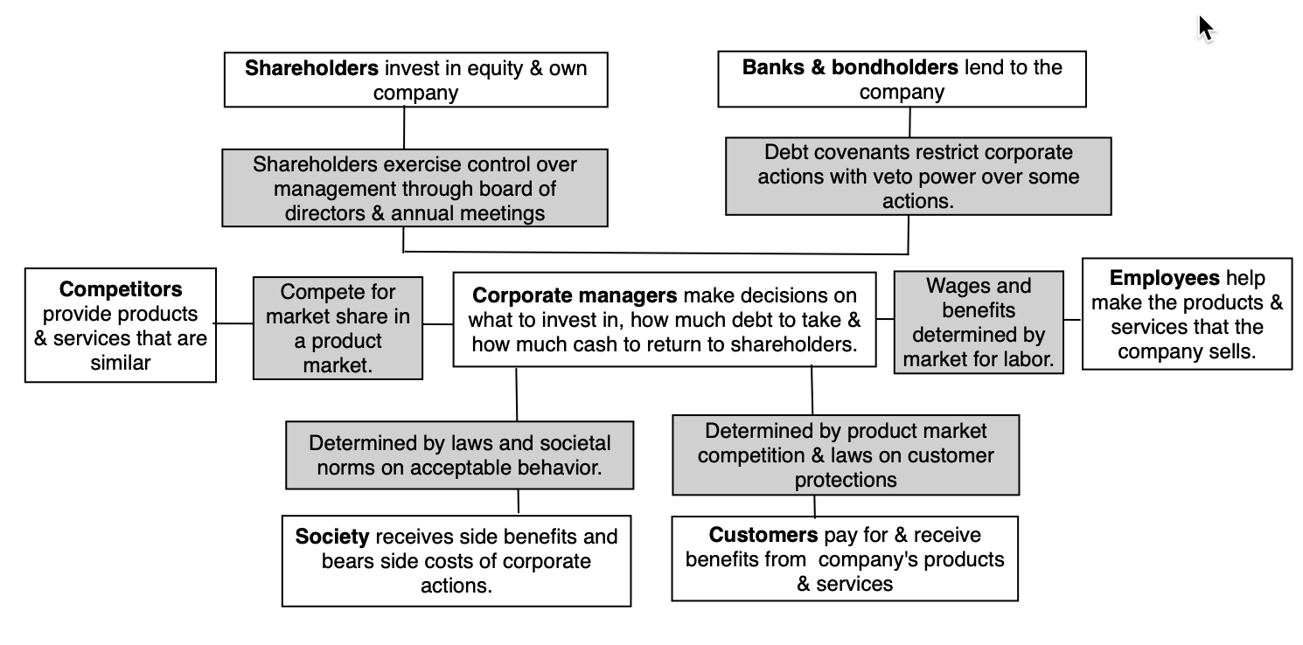
A business has many stakeholders…

Slide 3

In running a business, one of these stakeholders has to be given primacy…
In traditional corporate finance, the objective in decision making is to maximize the value of the firm.
A narrower objective is to maximize stockholder wealth. When the stock is traded and markets are viewed to be efficient, the objective is to maximize the stock price.
Maximize equity value
Maximize market estimate of equity value
Maximize firm value
Notes:
Why only one objective? Why not have many? Because you can have only objective. You can have multiple constraints that are imposed on you or you impose on yourself. If you have many objectives, and you have to pick between alternatives where you get different answers depending upon which objective you look at, you will be stuck.
This is the answer to the question posed in the previous overhead.
Maximizing the value of the business is the most general objective function. Remember that value of the business includes assets in place and growth assets. If you are managing a growth company,, increasing earnings may not necessarily increase firm value. The other problem is that firm value itself is a difficult number to estimate. While there are models available, they all need inputs, most of which allow for subjective judgments.
Managers answer to stockholders. Consequently, the objective gets narrowed down to “maximizing equity value”. (Implicit assumption: Bondholders/ Banks can protect themselves by writing in covenants and setting interest rates).
It is tough to assess equity value objectively. It would be nice to have a “third party” estimate that is objective. For publicly traded firms, the market (in spite of all its limitations) provides such an estimate. (Implicit assumption: Markets are rational and reasonably efficient).

Slide 4
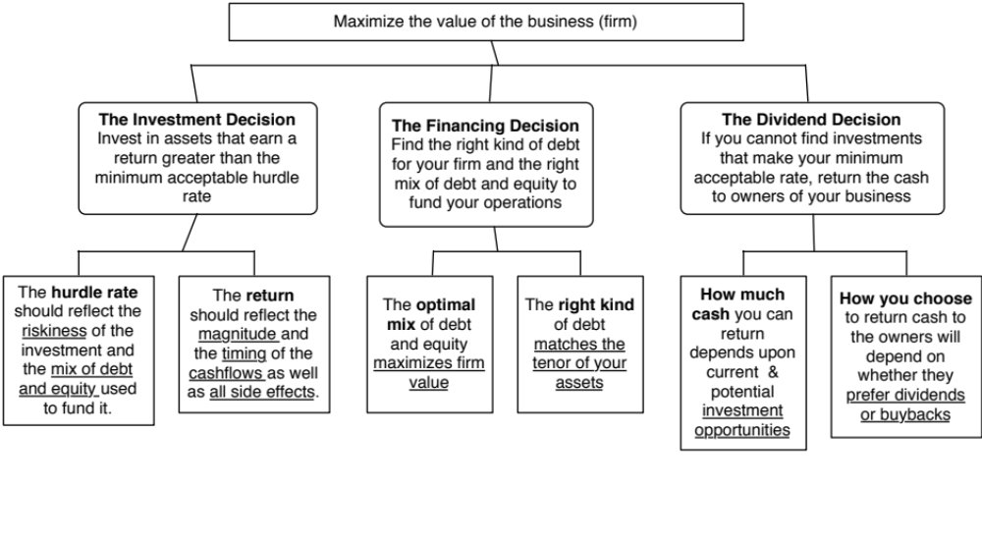
Giving corporate finance its focus…
Notes:
Our focus will be on the objective: Maximize firm value.
Since so much of corporate finance is built on this objective, it is important that we be clear about what it means and why we choose it. In addition, it is also worth exploring what the alternatives are and why this objective is preferable to the alternatives.

Slide 5
Intrinsic Value: The Drivers

Slide 6
Theme 1: Corporate finance is “common sense”
There is nothing earth shattering about any of the first principles that govern corporate finance.
  Arguing that taking investments that make 9% with funds that cost 10% to raise seems to be stating the obvious (the investment decision)
  So is noting that it is better to find a funding mix which costs 10% instead of 11% (the financing decision)
  And positing that if most of your investment opportunities generate returns less than your cost of funding, it is best to return the cash to the owners of the business and shrink the business.
Shrewd business people, notwithstanding their lack of exposure to corporate finance theory, have always recognized these fundamentals and put them into practice.
Notes:
Do you need a course in corporate finance to run a firm wisely? Obviously not, since shrewd business people through the ages have built up great businesses, without the benefits of corporate financial theory. They have been able to do so because the first principles of corporate finance are common sense ones: try to find the cheapest way to raise financing, make sure that you invest your funds in assets that earn you more than it costs you to raise them and take funds out of the business, if you cannot find these investments. Theories and models are often provided as justifications for actions that violate common sense. It is usually theories and models that are at fault, not common sense.

Slide 7
Theme 2: Corporate finance is focused…
It is the focus on maximizing the value of the business that gives corporate finance its focus. As a result of this singular objective, we can
  Choose the “right” investment decision rule to use, given a menu of such rules.
  Determine the “right” mix of debt and equity for a specific business
  Examine the “right” amount of cash that should be returned to the owners of a business and the “right” amount to hold back as a cash balance.
This certitude does come at a cost. To the extent that you accept the objective of maximizing firm value, everything in corporate finance makes complete sense. If you do not, nothing will.
Notes:
The presences of a singular objective – maximizing firm value – allows corporate finance to be able to hone in on best practices and focused models. To the extent that you agree with this objective, corporate finance makes complete sense. To the extent that you do not, nothing makes sense. That is why we will spend two sessions focusing on why we choose the objective and considering alternative objectives (and why we reject them).

Slide 8
Theme 3: Corporate finance is universal…
Every business, small or large, public or private, US or emerging market, has to make investment, financing and dividend decisions.
The objective in corporate finance for all of these businesses remains the same: maximizing value.
While the constraints and challenges that firms face can vary dramatically across firms, the first principles do not change.
  A publicly traded firm, with its greater access to capital markets and more diversified investor base, may have much lower costs of debt and equity than a private business, but they both should look for the financing mix that minimizes their costs of capital.
  A firm in an emerging market may face greater uncertainty, when assessing new investments, than a firm in a developed market, but both firms should invest only if they believe they can generate higher returns on their investments than they face as their respective (and very different) hurdle rates.
Notes:
The first principles of corporate finance apply for all companies, small and large, public and private, developed market and emerging market. The estimation issues may vary and we may face greater uncertainty in some cases than others, but the first principles will be identical.

Slide 9
Theme 4: If you violate first principles, you will pay a price, no matter who you are..
There are some investors/analysts/managers who convince themselves that the first principles don’t apply to them because of their superior education, standing or past successes, and then proceed to put into place strategies or schemes that violate first principles.
  Sooner or later, these strategies will blow up and create huge costs.
  Almost every corporate disaster or bubble has its origins in a violation of first principles.
Notes:
You can take your pick of bubbles. Here are a few:
Sub-prime crisis: At its core, the sub-prime crisis emanated from the fact that banks/bondholders lent money (or bought bonds) to entities with high credit risk and assumed that these entities would not default (because their models told them so). Reality proved otherwise.
Dot com bubble: We were told that internet companies in the late 1990s did not really have to worry about investing their money in good investments. The sector had so much promise (we were again told) that all investments would ultimately pay off, thus justifying the huge martket values of these firms.

Slide 10
The Corporate Life Cycle

Slide 11
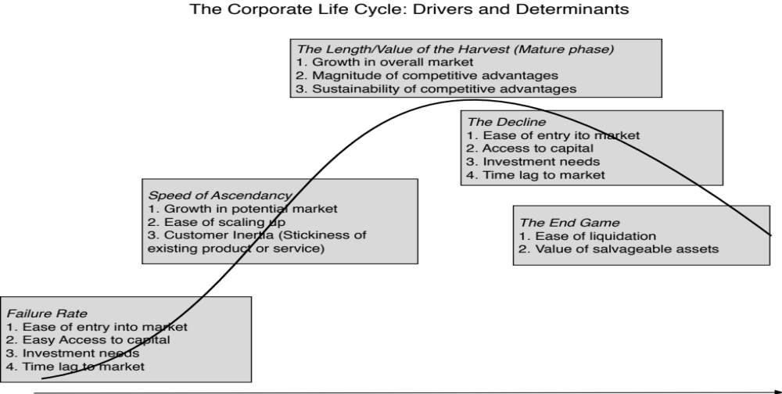
The determinants of the life cycle

Slide 12
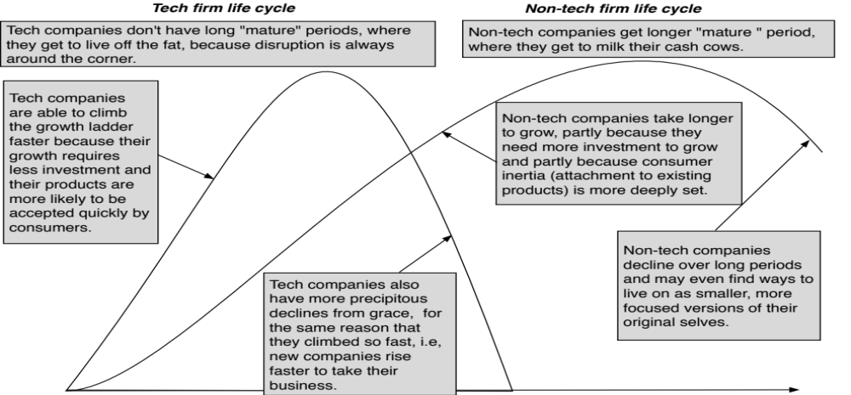
Tech versus Non-tech life cycles

Slide 13
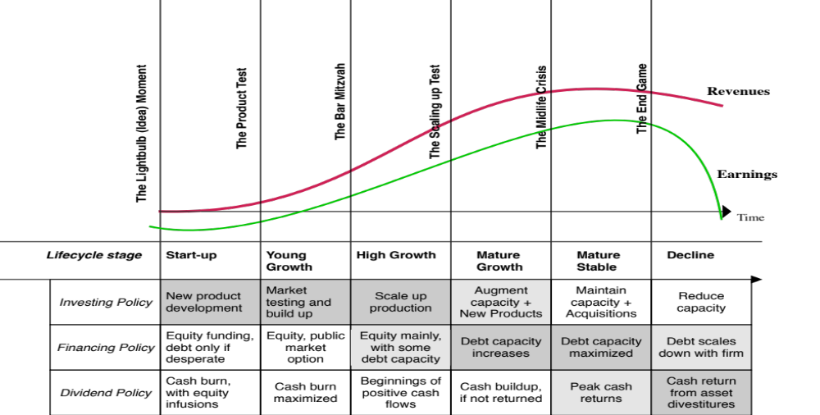
The emphasis in corporate finance shifts..

Slide 14
In value, the emphasis shifts as well, from narrative to numbers…

Slide 15
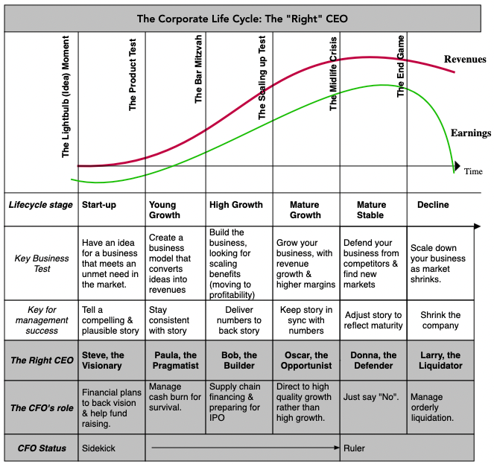
And the focus changes.... And so does the right CEO/CFO for the company

Slide 16
Companies, act your age!
For many reasons, companies try to speed up or slow down aging
  Young companies that borrow money to grow faster, invest without a purpose or with too much focus on short term profits or pay dividends.
  Mature growth companies that act young and refuse to return cash.
  Stable companies that try to be growth companies through acquisitions.
  Declining companies that think they can reverse decline, with new management and a new business plan.
Companies that don’t “act their age” will not only destroy value for their owners but will also be drags on the economy.

Slide 17
The Dream of Reincarnation..
The dream of mature and declining companies is rebirth, i.e., the possibility that they can rediscover their youth, and become young, growth companies again.
In every period, there are a few companies that seem to succeed at this venture, and the companies and their CEOs become legendary, with case studies written about them.
  In some of these companies, it is a combination of great management, luck and timing that allow for this success.
  In others, the change is cosmetic.
There is an ecosystem that is built around these “success stories” that markets them to other aging companies.

Slide 18
The Sustainability Siren Song, with four variations…
The Enlighted one(s): In this model, those in charge of sustainability are capable (more so than the mere mortals that surround them at businesses) to see into the future and bring in long term consequences into decisions.
The Jiminy Cricket model: In this model, those in charge of sustainability acts as the corporate conscience, reminding decision makers of their responsibilities to society and the broader good.
The Mummy Makers: In this model, decision makers try to make companies live forever, no matter what the cost, and devise strategies to advance towards this end.
The Checkboxers: In this model, the objective is to check all of the boxes that make up the sustainability to-do list, and ensure that you get labeled as sustainable.

