Slide 1
Don’t sweat the small stuff: A big picture perspective on finance
Email: adamodar@stern.nyu.edu
Website: http://www.damodaran.com
Blog: http://aswathdamodaran.blogspot.com
Twitter: @AswathDamodaran
Valuation app for iPad/iPhone: uValue on iTunes U
Aswath Damodaran
Notes:
Sets the agenda for the class. This is a class that will be focused on the big picture of corporate finance rather than details, theories or models on a piecemeal basis.

Slide 2

Lesson 1: Every business decision is ultimately a financial one
Every decision that a business makes has financial implications, and any decision which affects the finances of a business is a corporate finance decision.
Defined broadly, everything that a business does fits under the rubric of corporate finance.
Notes:
Corporate finance covers every decision that any business, small or large, public or private takes.. This is my very selfish attempt to show that corporate finance is at the heart of all the other management disciplines: marketing, strategy, accounting and even the fuzzy far reaches of human capital.

Slide 3
So, watch out for these justifications
The “Expert” Cop out: For many firms, the easiest way to explain the unexplainable is to pass the buck and get a consultant/expert to sign off on an action.
Weapons of distraction: Managers/investors/analysts seem to find ways of over riding the numbers with buzz words. Here are some to watch out for:
  “Gut feeling” or “Intuition”: Older, more experienced managers often claim to have a gut feeling about decisions. Psychological studies of gut feeling find that they are almost never based upon good data, are often completely wrong and get worse as managers get smarter/ more experienced.
  “Strategic”: The word “strategic” almost always goes to describe actions that cannot be justified based upon the numbers…

Slide 4
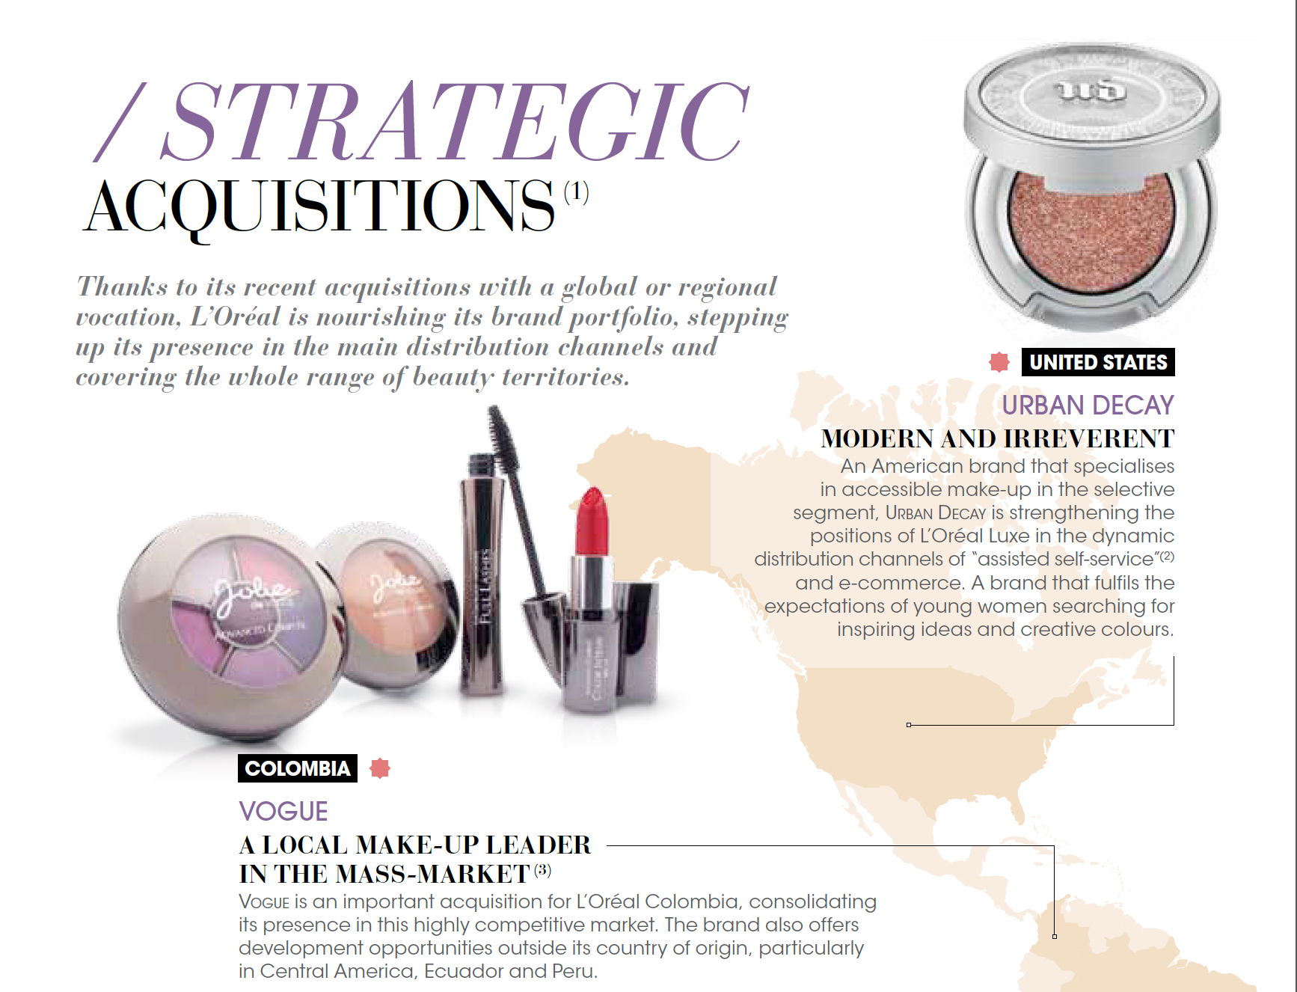
The scariest page in your annual report

Slide 5
Lesson 2: Have a destination before you leave:
Have a dominant objective that is measurable…
If you don’t have an objective, your decision making process has no rudder. Each manager will then create his or her own vision of where the business is going, and make decisions based on that vision.
If you have multiple objectives, you will still have to make choices. If you are not clear about which objective should dominate, managers again will pick their own dominant objectives, leading to them working at cross purposes.
If you have a fuzzy objective, you are giving no guidance on both how decisions should be made and no accountability for decisions, once made.

Slide 6
What is L’Oreal’s objective in business?
The Beauty Mission? Giving everyone access to beauty by offering products in harmony with their needs, culture and expectations in their infinite diversity.
The Innovation Mission? The exploration of new scientific and technological territories…
The Global Mission? Based on its international positions and its power of innovation, the Group’s ambition is to conquer a billion new consumers by 2020...
The Social Mission? As a company which seeks to be exemplary, and sets itself demanding standards in order to limit its footprint on the planet.

Slide 7
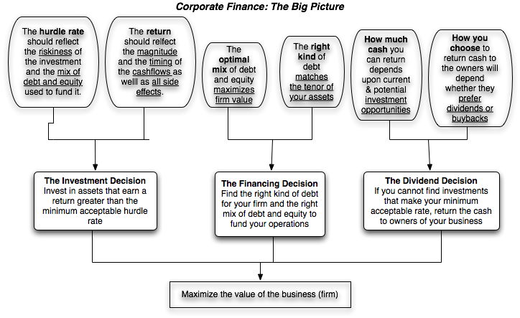
Here is my choice…
Notes:
This is the big picture that will animate how we approach corporate finance. We will use it to anchor the class, introducing each topic by noting its presence in the big picture. Ultimately, everything we do in corporate finance has to be somewhere in the picture.
(I introduce my syllabus after this slide with session numbers framed in the big picture)

Slide 8
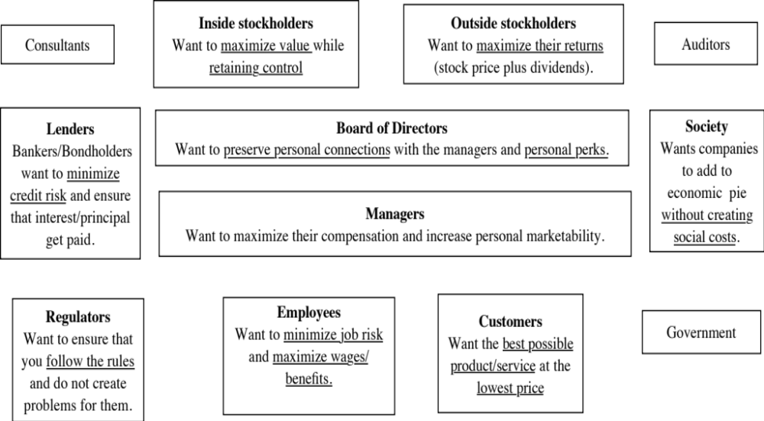
Lesson 3: In any business, you are juggling conflicting interests..

Slide 9
With the board of directors as a good example of the conflict of interest…
In theory, the board of directors should work to protect the best interests of stockholders, monitoring top management to ensure that they do their fiduciary duty.
In practice, boards are not effective because:
  They are rubber stamps for CEOs: In many companies, the directors who sit on the board are picked by the CEO and inside stockholders. While outside stockholders get to nominally vote on these directors, they are not given any real say in the process.
  Directors are ill equipped to play the role of monitors: Directors often lack the expertise to question top managers, lack the information to raise questions and the time to follow through.
  Directors are generally not large stockholders nor do they represent them: In most companies, directors own only token stakes in the company.

Slide 10
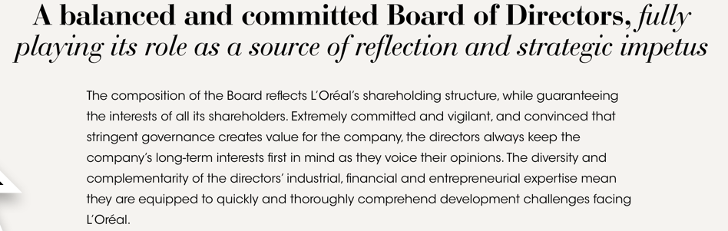
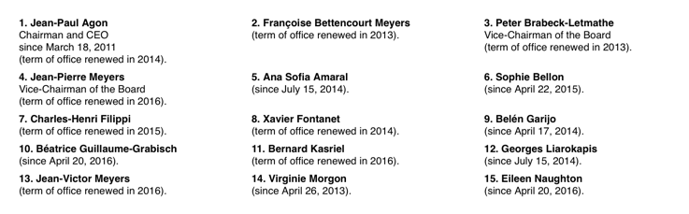
The L’Oreal Board: Be the judge!

Slide 11
Lesson 4: Understand the essence of risk
Risk, in traditional terms, is viewed as a ‘negative’. Webster’s dictionary, for instance, defines risk as “exposing to danger or hazard”. The Chinese symbols for risk, reproduced below, give a much better description of risk:
  危機
The first symbol is the symbol for “danger”, while the second is the symbol for “opportunity”, making risk a mix of danger and opportunity. You cannot have one, without the other.
Notes:
Note that risk is neither good nor bad. It is a combination of danger and opportunity - you cannot have one without the other. Consequently, risk is neither something to be avoided nor sought out but carefully balanced. Good business avoid some risks, let others pass through to their investors and actively seek out still others.
When businesses want opportunity (higher returns), they have to live with the higher risk.
Any sales pitch that offers returns without risk is a pipe dream.
Bob Citron, treasurer of Orange County (CA), after he lost a chunk of the county’s pension fund money after investing in interest rate derivatives claimed that he was “not a finance person” and that Merrill’s market strategist (Charlie Clough) had told him he could make “15% with no risk”.
Many prominent (and intelligent) people invested with Bernie Madoff because he promised them (through third parties) that he could deliver 8% more than the treasury bill rate, guaranteed. (He was called the Jewish T.Bill). One investor, interviewed by the NY Times said, “I really did not understand what he was doing, but he said was going to do something with calls, something with puts and earn 12% every year. It sounded plausible (and all my friends were investing with him too).

Slide 12
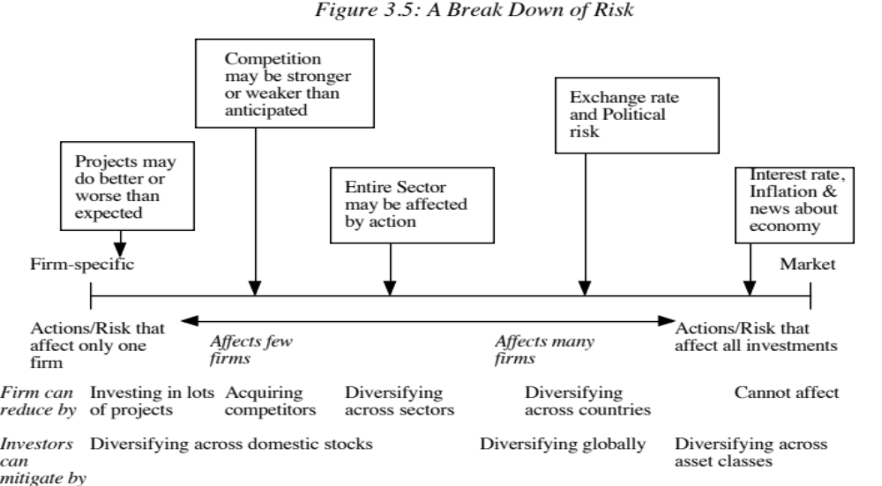
Risk can come from many places…

Slide 13
And not all risk is made equal…
If you are a sole owner of a business, you are exposed to all of the risks in a business. Thus, your hurdle rate should reflect those risks.
If you are a publicly traded company, the game changes. As a manager, you have look at risk through the eyes of the marginal investor in your company. There are two criteria that go into being a marginal investor:
  You need to own enough stock to make a difference. In other words, you have to be a large stockholder.
  You have to trade that stock. Thus, a founder who owns a lot of stock but does not trade is not the marginal investor.
If that marginal investor is a mutual fund or institutional investor, the only risk they see in an investment is the risk that it adds to a diversified portfolio. Consequently, the only risk you as a manager should build into your hurdle rate is the risk that cannot be diversified away.

Slide 14
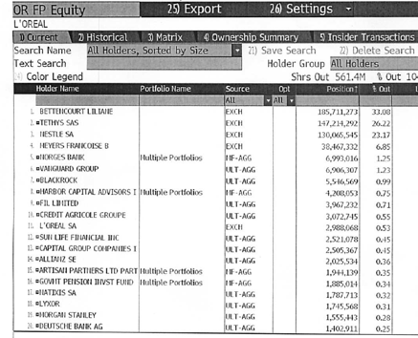
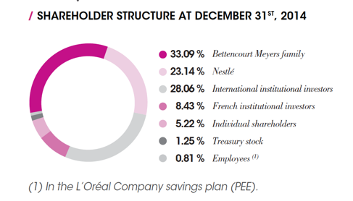
Know your marginal investor..

Slide 15
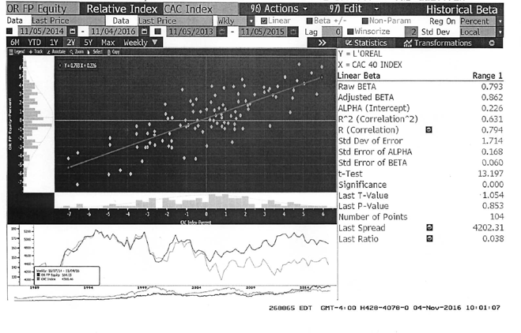
Your risk is not a statistical number or a Greek alphabet..

Slide 16
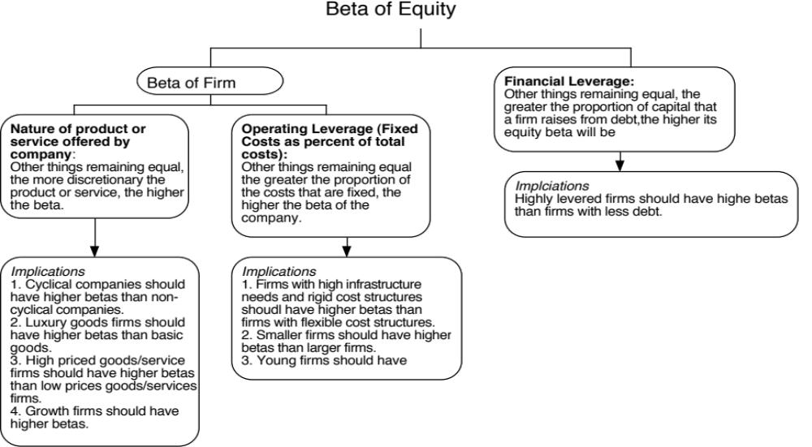
But comes from your choices as a business..

Slide 17
Let’s do an intuitive check on L’Oreal
In your annual report, you break yourself down into six businesses:
  Consumer Products (growth = 2.5%)
  L’Oreal Luxe (growth = 6.1%)
  Professional Products (growth = 3.4%)
  Active Cosmetics (growth = 7.8%)
  The Body Shop (growth = -0.9%)
Do you see them all as equally risky businesses? If not, how would you rank them (from most to least risky)?
What happened to Travel Retail? It seems to no longer be listed as a business.

Slide 18
Here is my try
Business | Exposure to market risk | Beta
Cosmetics, Professional Products & Active Cosmetics | Risk of the cosmetics business. Customers tend to continue to buy preferred products. | 0.90 (Average for cosmetics business)
L’Oreal Luxe | Luxury products. More susceptible to economics ups and downs. | 1.10 (Average for luxury products)
The Body Shop and Travel Retail | High end retailers, exposed to economic cycles | 1.20 (Average for high-end retailers)
Business | Revenues | % | Unlevered Beta | D/E Ratio | Levered Beta | Cost of equity | Growth Rate
Cosmetics, Professional Products & Active Cosmetics | € 17,052 | 67.51% | 0.95 | 0.89% | 0.96 | 7.54% | 2.50%
L'Oreal Luxe | € 7,238 | 28.66% | 1.15 | 0.89% | 1.16 | 9.11% | 6.10%
Body Shop & Travel Retail | € 967 | 3.83% | 1.20 | 0.89% | 1.21 | 9.50% | -0.90%
L'Oreal | € 25,257 | 100.00% | 1.02 | 0.89% | 1.02 | 8.06%

Slide 19
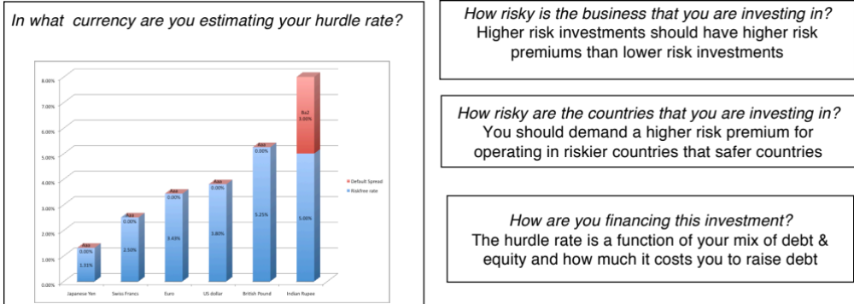
Lesson 5: Know your “hurdle” rate
Since financial resources are finite, there is a “hurdle rate” that projects have to cross before being deemed acceptable. A simple representation of the hurdle rate is as follows:
Hurdle rate = Riskless Rate + Risk Premium

Slide 20
Currencies matter, but not for the reasons you think that they do..

Slide 21
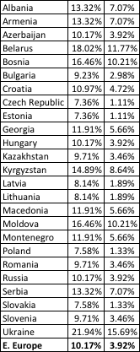

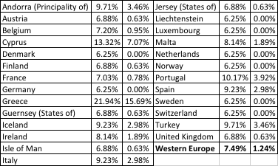
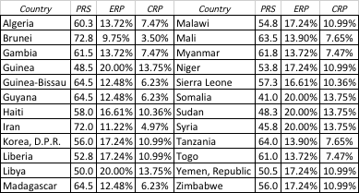
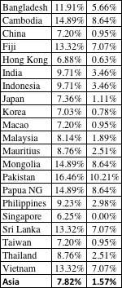

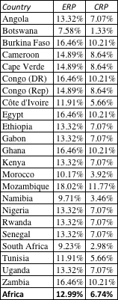
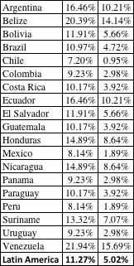
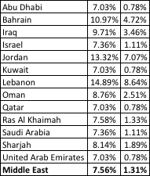

ERP : July 2016
Black #: Total ERP
Red #: Country risk premium
AVG: GDP weighted average
Notes:
Updated country risk premiums.

Slide 22
One hurdle rate will generally not work across the company
If you are a single business company, but you are a multinational, your hurdle rate will vary, depending on where you are investing. If you use the beta of 1.02 that we estimated for L’Oreal earlier, the cost of equity (even in Euro terms) will vary depending on where the investment is going to be made:
Region | % of Loreal Revenues | Risk free Rate | Regional ERP | Beta for L'Oreal | Cost of equity
Africa | 1.80% | 0.10% | 12.99% | 1.02 | 13.39%
Asia-Pacific | 22.50% | 0.10% | 7.82% | 1.02 | 8.10%
Central and South America | 7.70% | 0.10% | 11.27% | 1.02 | 11.63%
Eastern Europe | 6.30% | 0.10% | 10.17% | 1.02 | 10.50%
Middle East | 1.20% | 0.10% | 7.56% | 1.02 | 7.83%
North America | 27.40% | 0.10% | 6.25% | 1.02 | 6.49%
Western Europe | 33.10% | 0.10% | 7.49% | 1.02 | 7.76%
L"Oreal | 100.00% | 0.10% | 7.78% | 1.02 | 8.06%

Slide 23
A Test: Acquiring Niely
During 2014, you acquired Niely, a Brazilian hair products company (that would fall under the cosmetics business). If you wanted to estimate a hurdle rate for Niely in Euros, what would you use as:
The Risk free Rate
The Beta
The Equity Risk Premium
How would your answer change if you were estimating the number in Brazilian Reais?

Slide 24
Lesson 6: Your investments need to earn returns that beat the hurdle rate…
Your hurdle rate is both a cost of financing your business and an opportunity cost, i.e,, a return you can make elsewhere if you invest in a project of equivalent risk. If that is the case, you should only take investments that generate returns that earn more than the hurdle rate.
To measure returns, though, here are three simple propositions to follow:
  Look at the cash flows that you will make on the investment, rather than earnings. You cannot spend earnings.
  Look at incremental cash flows that come out because of the investment. Be wary of allocated costs (that will be there whether you take the investment or not) and ignore sunk costs (costs that you have already incurred).
  Time weight the cash flows, with cash flows occurring earlier being valued more than cash flows later.

Slide 25
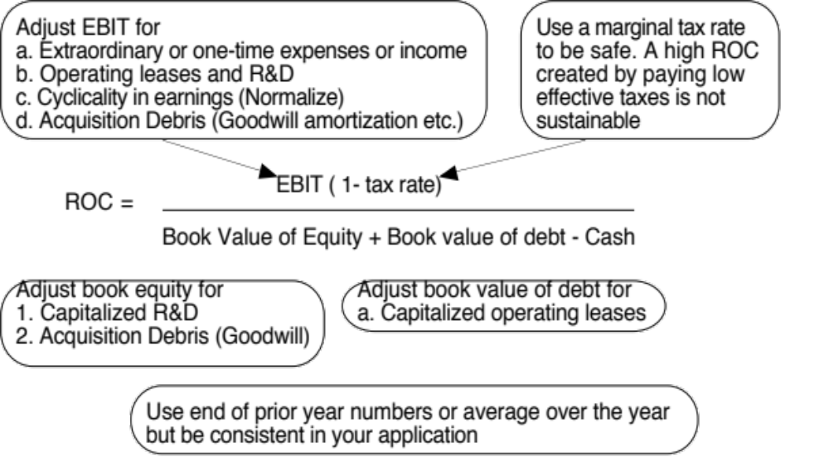
Here is a short cut that you can use to assess the quality of your existing investments…

Slide 26
Your best businesses, your worst ones and where you stand as a company..
Business | Revenue | Operating Profit (2015) | Invested Capital (2014) | Pre-tax ROIC | After-tax ROIC | Cost of Capital | ROIC - Cost of Capital
Professional Products | € 3,400 | € 678 | € 3,090 | 21.94% | 16.02% | 7.48% | 8.54%
Consumer Products | € 11,844 | € 2,386 | € 8,217 | 29.04% | 21.20% | 7.48% | 13.72%
L'Oreal Luxe | € 7,230 | € 1,497 | € 4,870 | 30.74% | 22.44% | 9.03% | 13.41%
Active Cosmetics | € 1,816 | € 415 | € 915 | 45.36% | 33.11% | 7.48% | 25.63%
The Body Shop | € 967 | € 55 | € 1,269 | 4.33% | 3.16% | 9.42% | -6.26%
Headquarters |  | -€ 643 | € 2,499 | -25.73% | -18.78% | 8.00% | -26.78%
L'Oreal | € 25,257 | € 3,891 | € 20,860 | 18.65% | 13.62% | 8.00% | 5.62%

Slide 27
Lesson 7: Acquisitions are just big investments and have to meet the same standards..
An acquisition is just a large-scale project. All of the rules that apply to individual investments apply to acquisitions, as well. For an acquisition to create value, it has to
  Generate a higher return on capital, after allowing for synergy and control factors, than the cost of capital.
  Put another way, an acquisition will create value only if the present value of the cash flows on the acquired firm, inclusive of synergy and control benefits, exceeds the cost of the acquisitons
A divestiture is the reverse of an acquisition, with a cash inflow now (from divesting the assets) followed by cash outflows (i.e., cash flows foregone on the divested asset) in the future. If the present value of the future cash outflows is less than the cash inflow today, the divestiture will increase value.
A fair-price acquisition or divestiture is value neutral.

Slide 28
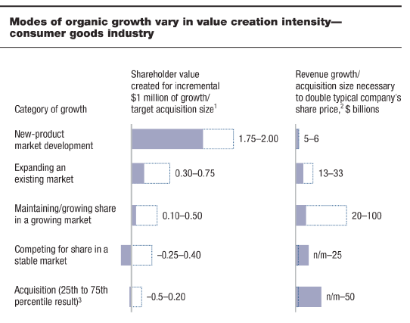
And of all the ways to create growth, acquisitions rank worst…

Slide 29
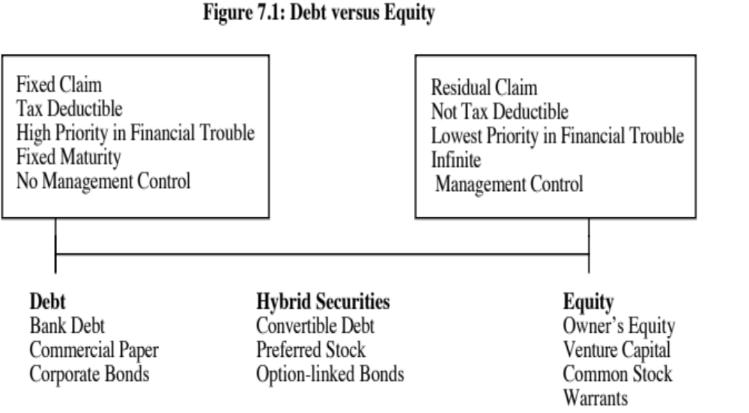
Lesson 8: You have only two ways of raising funding for a business…

Slide 30

And here is the trade off….

Slide 31
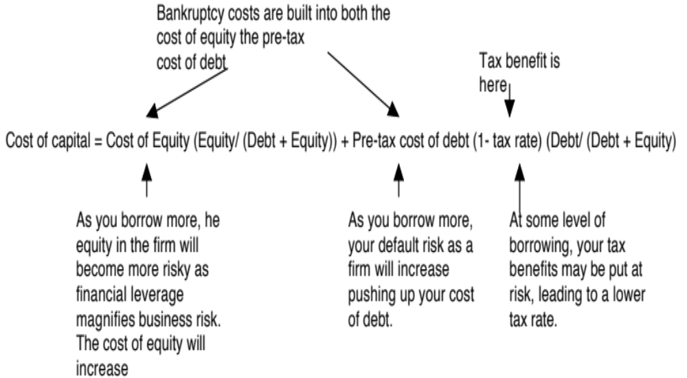
Lesson 9: There is a “right” mix of debt and equity for your business…

Slide 32
Be wary of companies that are too aggressive… and too conservative… in their use of debt…
If you use too little debt (you are too conservative), you are missing the tax benefits from using debt that would have lowered your cost of capital and increased your value as a business.
  Prime candidates: Mature companies that have large, stable cash flows, face high tax rates and use little or no debt to capitalize themselves.
  Fixes: At the minimum, borrow more when funding new projects and pay more dividends. More radically, borrow money and recapitalize.
If you use too much debt, your tax benefits may be overwhelmed by the cost of distress and default. Consequently, you have a higher cost of capital and lower value as a business, because you have chosen to borrow too much.
  Prime candidates: Companies in risky businesses that have other fixed commitments to meet and low or volatile income, while borrowing large amounts.
  Fixes: At the minimum, cut back or stop paying dividends and utilize retained earnings to fund investments. More radically, raise new equity and retire debt.

Slide 33
L’Oreal: Current versus Optimal
Debt Ratio | Beta | Cost of Equity | Bond Rating | Interest rate on debt | Tax Rate | Cost of Debt (after-tax) | WACC | Enterprise Value
0% | 0.9814 | 7.74% | Aaa/AAA | 0.85% | 27.00% | 0.62% | 7.74% | $71,182
10% | 1.0610 | 8.35% | Aaa/AAA | 0.85% | 27.00% | 0.62% | 7.58% | $72,648
20% | 1.1605 | 9.13% | Aaa/AAA | 0.85% | 27.00% | 0.62% | 7.43% | $74,176
30% | 1.2884 | 10.12% | Aaa/AAA | 0.85% | 27.00% | 0.62% | 7.27% | $75,770
40% | 1.4590 | 11.45% | Aaa/AAA | 0.85% | 27.00% | 0.62% | 7.12% | $77,433
50% | 1.6978 | 13.31% | Aaa/AAA | 0.85% | 27.00% | 0.62% | 6.96% | $79,171
60% | 2.2148 | 17.33% | C2/C | 16.10% | 16.21% | 13.49% | 15.03% | $36,410
70% | 2.9530 | 23.07% | C2/C | 16.10% | 13.90% | 13.86% | 16.63% | $32,885
80% | 4.4295 | 34.56% | C2/C | 16.10% | 12.16% | 14.14% | 18.23% | $29,983
90% | 8.8591 | 69.02% | C2/C | 16.10% | 10.81% | 14.36% | 19.83% | $27,551

Slide 34


Lesson 10: The “right” debt for your firm depends on your firm
The objective in designing debt is to make the cash flows on debt match up as closely as possible with the cash flows that the firm makes on its assets.
By doing so, we reduce our risk of default, increase debt capacity and increase firm value.
Unmatched Debt
Matched Debt
Notes:
Your objective is issue securities that bring you all of the tax benefits of debt while providing you with the flexibility of equity. It is not the reduction in risk but the increase in debt capacity that generates the value. A firm that does not use this debt capacity will not gain from matching debt to assets in the first place.

Slide 35

The perfect debt for you is….
The perfect financing instrument will
  Have all of the tax advantages of debt
  While preserving the flexibility offered by equity
Notes:
There is ample scope for creativity in trying to design the perfect bond. The idea is to design debt that looks and acts like equity, in terms of the cash flows.
Consider each aspect;
Duration: Companies with long term projects (Boeing) should use long term debt. Companies with short term projects (Dell) should use short term debt.
Currency: Companies that get a high proportion of their revenues from non-domestic operations should use more foreign currency debt (especially if the currency mix is stable.
Inflation: Companies with pricing power can pass inflation through into their cash flows. These companies should be much better candidates for floating rate debt (because interest expenses on the debt will rise and fall with inflation).
Growth pattern: Mature companies with level , steady cash flows should be much better candidates for straight debt, whereas growth companies are much better candidates for convertible debt.

Slide 36
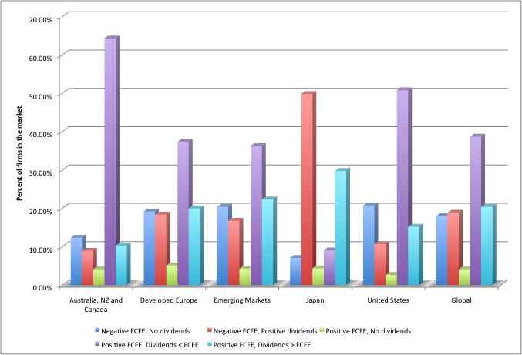
Lesson 11: Cash is not accumulated by accident, & cash does not belong to the company
FCFE = Potential Dividends = Cash left over after all operating expenses, taxes, reinvestment and debt payments have been made.

Slide 37
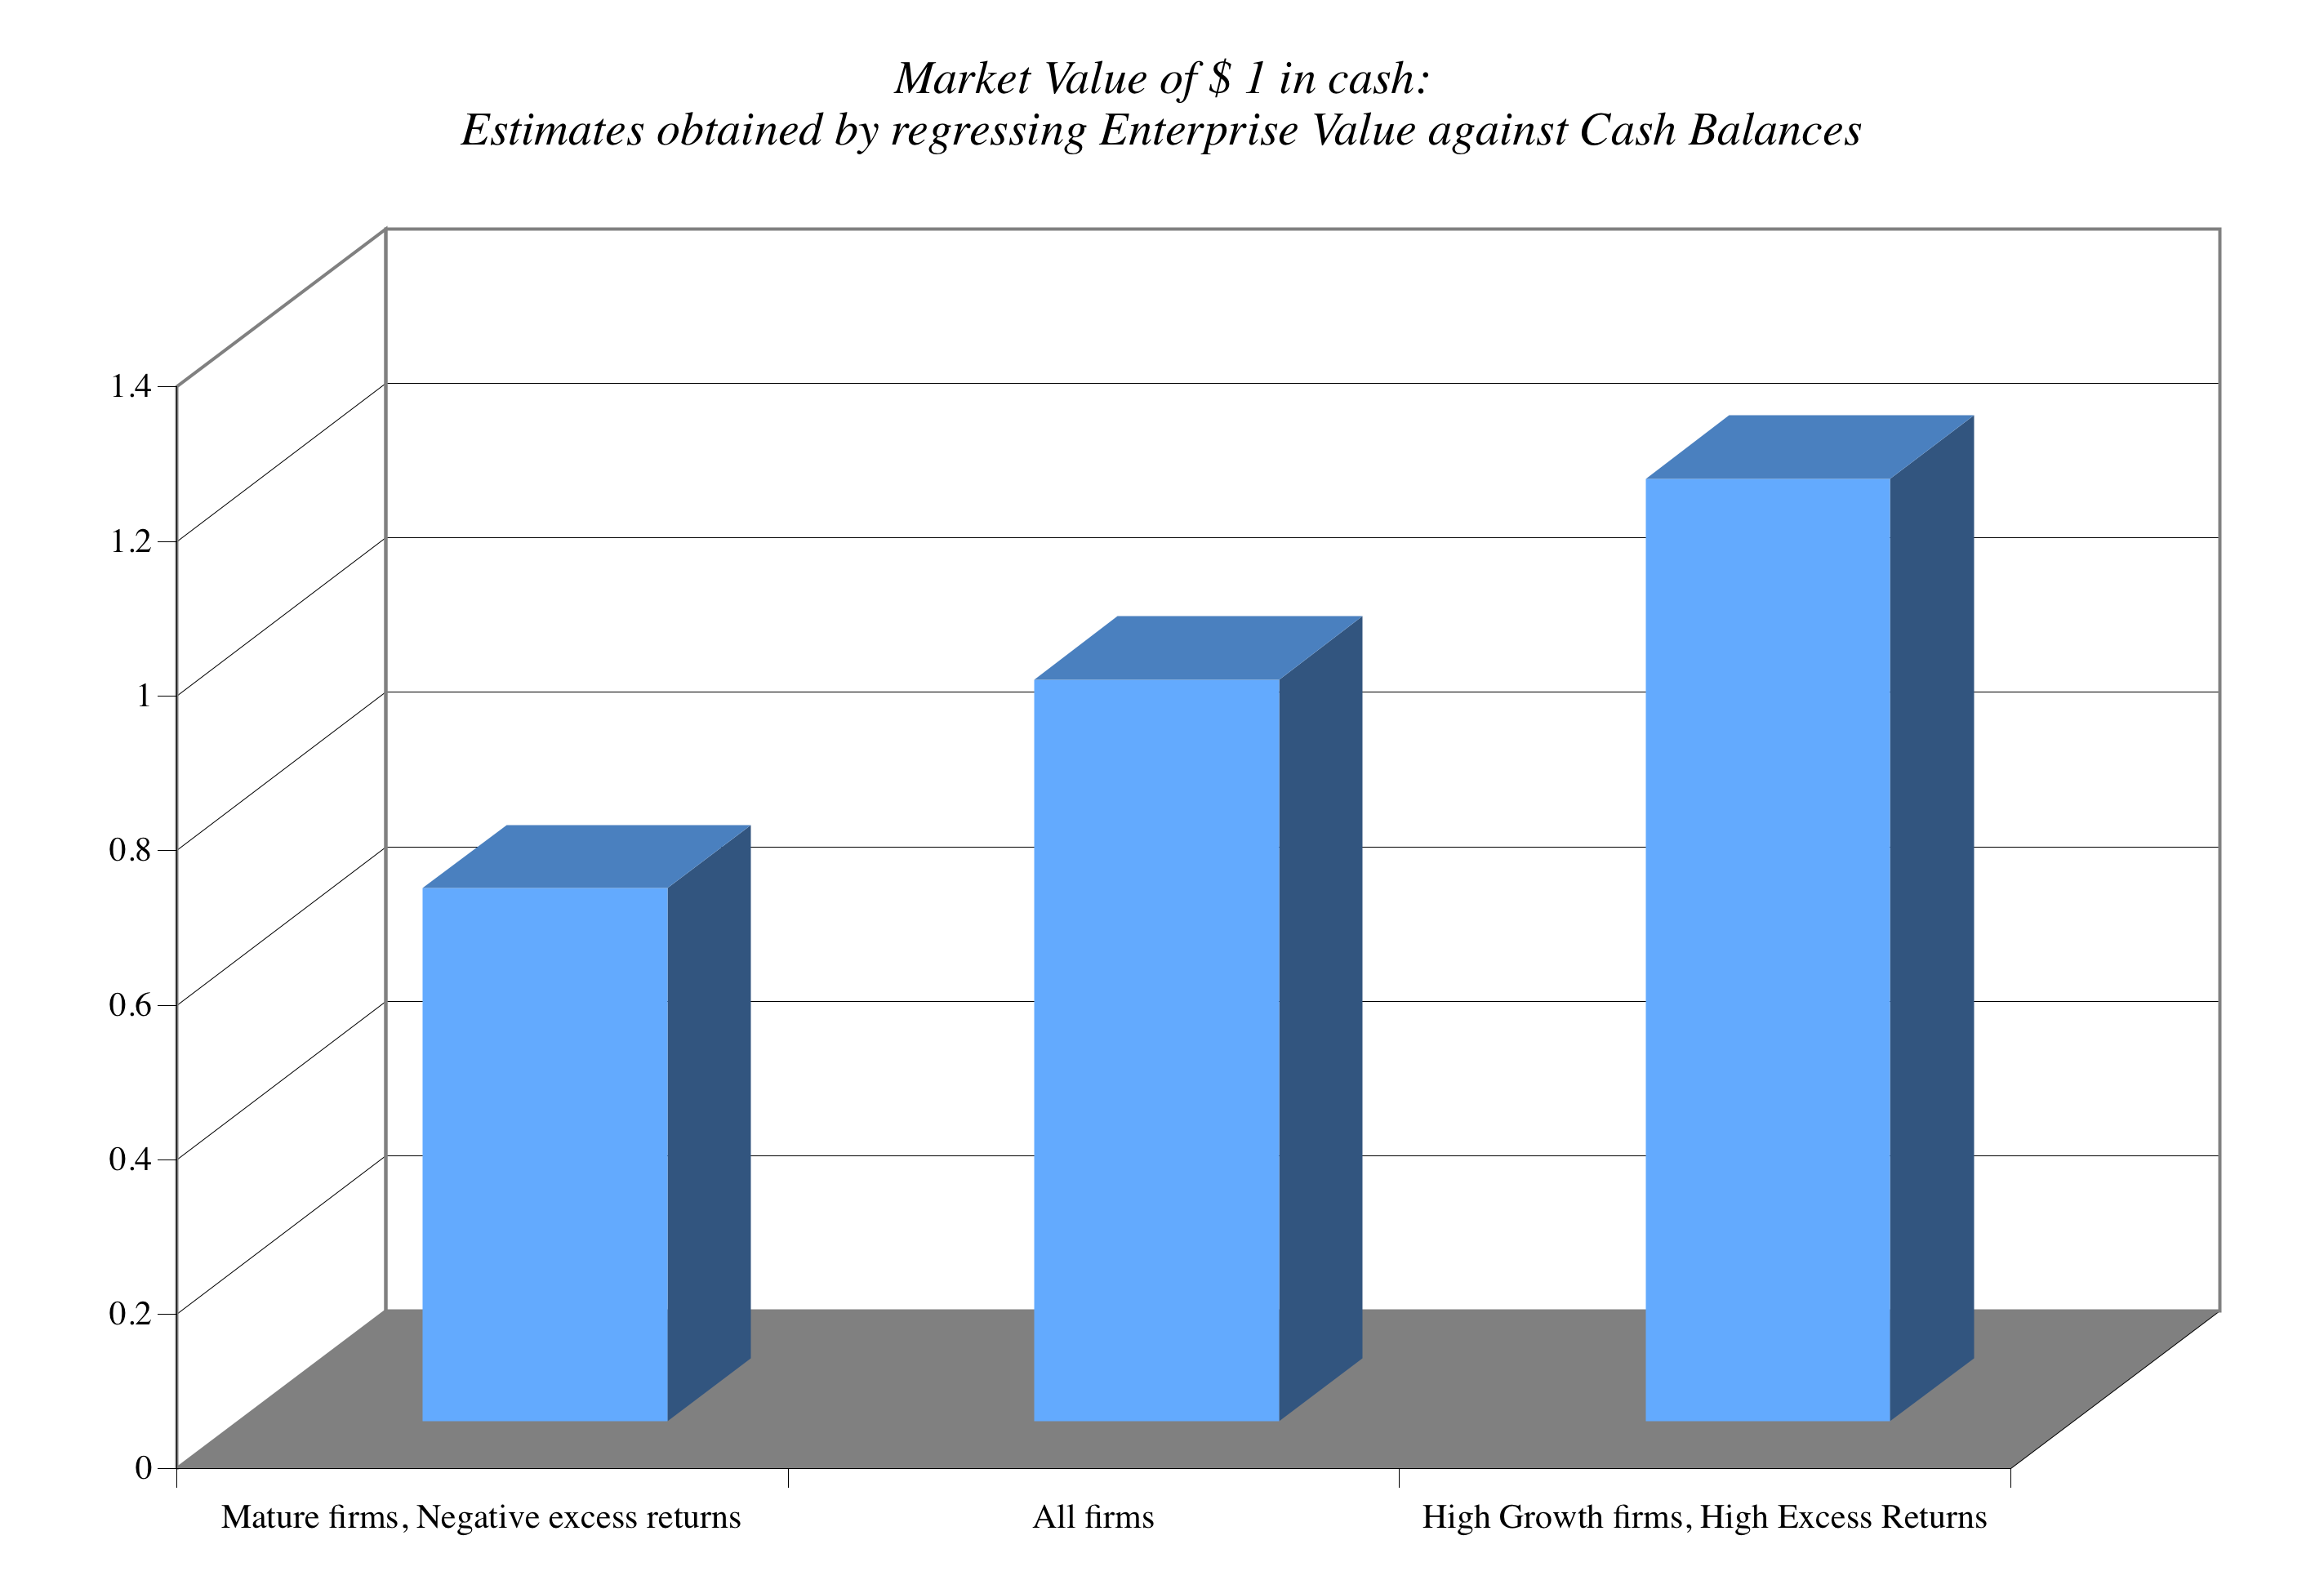
Not all cash balances are created equal…

Slide 38

Lesson 12: The value of your business is a function of these variables…

Slide 39
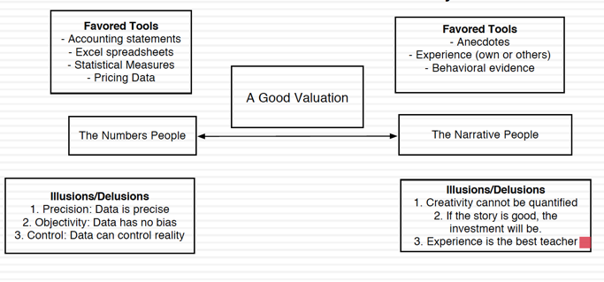
And behind those numbers, there is a story..

Slide 40
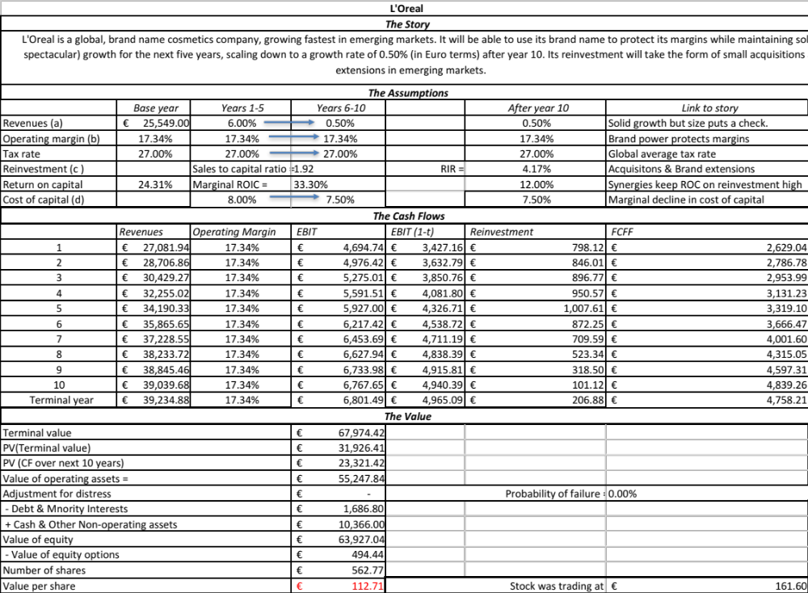

Slide 41

And here is how you can change your value

