Slide 1
Don’t sweat the small stuff: A big picture perspective on corporate finance
Email: adamodar@stern.nyu.edu
Website: http://www.damodaran.com
Blog: http://aswathdamodaran.blogspot.com
Twitter: @AswathDamodaran
Valuation app for iPad/iPhone: uValue on iTunes U
Aswath Damodaran
Notes:
Sets the agenda for the class. This is a class that will be focused on the big picture of corporate finance rather than details, theories or models on a piecemeal basis.

Slide 2
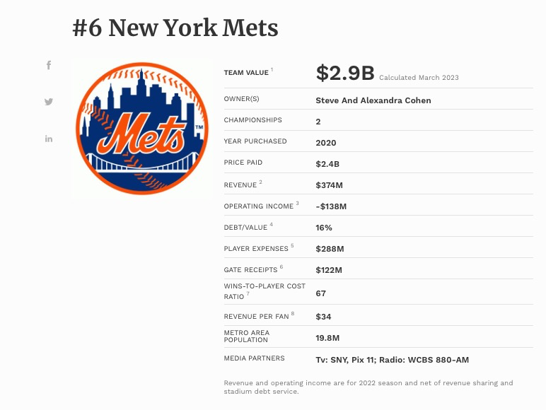
The Lead in…

Slide 3

Lesson 1: Every business decision is ultimately a financial one
Every decision that a business makes has financial implications, and any decision which affects the finances of a business is a corporate finance decision.
Defined broadly, everything that a business does fits under the rubric of corporate finance.
Notes:
Corporate finance covers every decision that any business, small or large, public or private takes.. This is my very selfish attempt to show that corporate finance is at the heart of all the other management disciplines: marketing, strategy, accounting and even the fuzzy far reaches of human capital.

Slide 4
So, watch out for these justifications
The “Expert” Cop out: For many firms, the easiest way to explain the unexplainable is to pass the buck and get a consultant/expert to sign off on an action.
Weapons of distraction: Managers/investors/analysts seem to find ways of over riding the numbers with buzz words. Here are some to watch out for:
  “Gut feeling” or “Intuition”: Older, more experienced managers often claim to have a gut feeling about decisions. Psychological studies of gut feeling find that they are almost never based upon good data, are often completely wrong and get worse as managers get smarter/ more experienced.
  “Strategic”: The word “strategic” almost always goes to describe actions that cannot be justified based upon the numbers…

Slide 5
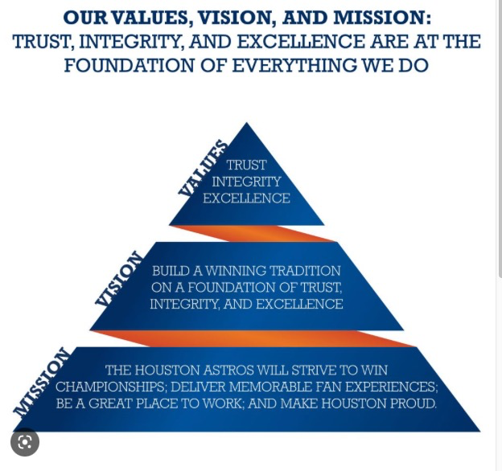
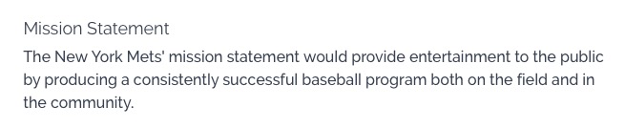
Weapons of mass distraction in the MLB: The Houston Astros

Slide 6
Lesson 2: Have a destination before you leave:
Have a dominant objective that is measurable…
If you don’t have an objective, your decision-making process has no rudder. Each manager will then create his or her own vision of where the business is going, and make decisions based on that vision.
If you have multiple objectives, you will still have to make choices. If you are not clear about which objective should dominate, managers again will pick their own dominant objectives, leading to them working at cross purposes.
If you have a fuzzy objective, you are giving no guidance on both how decisions should be made and no accountability for decisions, once made.

Slide 7
What is the objective for an MLB team’s management?
Objective 1: To build a viable business (that makes enough money to cover the capital invested in it…)
Constraint: Win as much as you can, given your budget constraints
Objective 2: To win the big prize (World Series, divisional championship, make it to playoffs)
Constraint: Player contracts < Specified limit (<$230 million to avoid tax or Owner specified value, which can be lower than or higher than the MLB limits)
Objective 3: To do just enough (winning, making money) to not get fired
Constraint: Keep owner, fans and players happy enough or not so unhappy that they try to get rid of you…

Slide 8
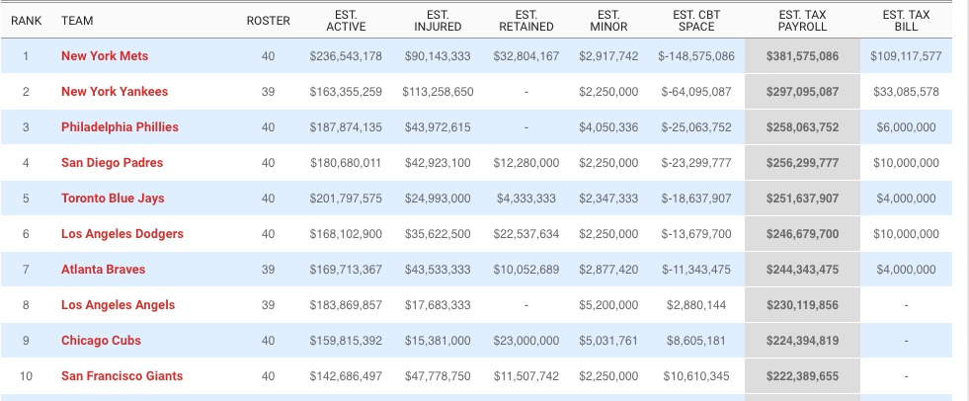
An outsider’s guess of the Met’s objective?

Slide 9
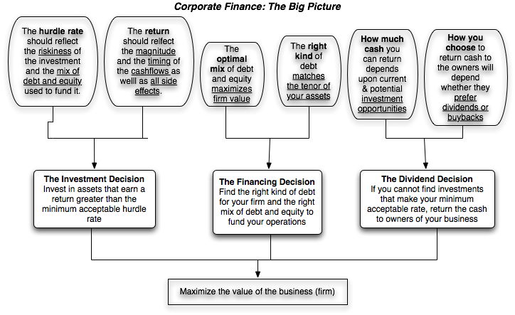
How your objective choice plays out in decision-making?
Notes:
This is the big picture that will animate how we approach corporate finance. We will use it to anchor the class, introducing each topic by noting its presence in the big picture. Ultimately, everything we do in corporate finance has to be somewhere in the picture.
(I introduce my syllabus after this slide with session numbers framed in the big picture)

Slide 10
Lesson 3: In any business, you are juggling conflicting interests..
Notes:
The focus on maximizing value, and especially value to stockholders, may seem narrow for some, especially when you consider the other stakeholders in the firm. In fact, there are some who have argued that we should focus on maximizing stakeholder wealth, not stockholders. In 2019, the Corporate Roundtable effectively endorsed this concept. We will push back against this concept as we go through the session with a simple counter. You cannot have multiple objectives in running any entity. You have to pick a group as your central stakeholder and view the other stakeholder interests as constraints. The reason we pick on shareholders is that the rest of the stakeholders all have contractual claims against the company that they can use to protect their interests (at least partially), the bondholders and banks have loan/bond agreements that set their terms, the employees negotiate either directly or through unions for their wages, customers can choose to buy a company’s products/services and even society collects its share (as taxes) from the company. Shareholders have no contractual claims. They get whatever is left over after the other claimholders have been paid.

Slide 11
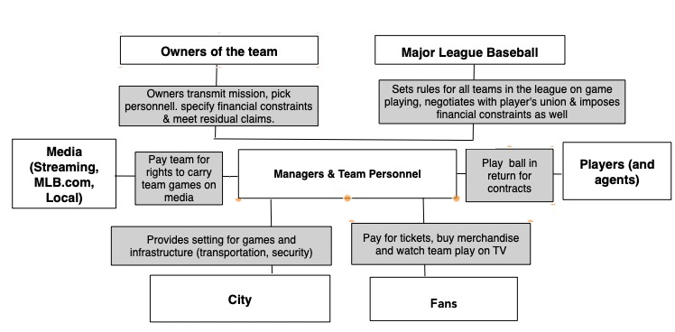
The stakeholders in an MLB team…
Notes:
In the Utopian world, where markets (both human capital, product & financial) are efficient, and all costs can be traced and charged to the firm, society and the economy are made better off by each firm’s managers focusing on maximizing stock prices.

Slide 12
Lesson 4: Understand the essence of risk
Risk, in traditional terms, is viewed as a ‘negative’. Webster’s dictionary, for instance, defines risk as “exposing to danger or hazard”. The Chinese symbols for risk, reproduced below, give a much better description of risk:
  危機
The first symbol is the symbol for “danger”, while the second is the symbol for “opportunity”, making risk a mix of danger and opportunity. You cannot have one, without the other.
Notes:
Note that risk is neither good nor bad. It is a combination of danger and opportunity - you cannot have one without the other. Consequently, risk is neither something to be avoided nor sought out but carefully balanced. Good business avoid some risks, let others pass through to their investors and actively seek out still others.
When businesses want opportunity (higher returns), they have to live with the higher risk.
Any sales pitch that offers returns without risk is a pipe dream.
Bob Citron, treasurer of Orange County (CA), after he lost a chunk of the county’s pension fund money after investing in interest rate derivatives claimed that he was “not a finance person” and that Merrill’s market strategist (Charlie Clough) had told him he could make “15% with no risk”.
Many prominent (and intelligent) people invested with Bernie Madoff because he promised them (through third parties) that he could deliver 8% more than the treasury bill rate, guaranteed. (He was called the Jewish T.Bill). One investor, interviewed by the NY Times said, “I really did not understand what he was doing, but he said was going to do something with calls, something with puts and earn 12% every year. It sounded plausible (and all my friends were investing with him too).

Slide 13
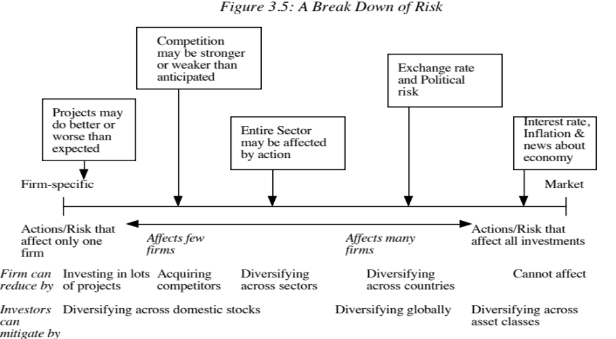
For a business, risk can come from many places…

Slide 14
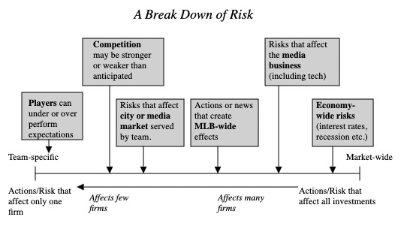
For an MLB team, risk can come from many places as well…

Slide 15
And not all risk is created equal…
If you are a sole owner of a business, you are exposed to all of the risks in a business. Thus, your hurdle rate should reflect those risks.
If you are a publicly traded company, the game changes. As a manager, you have look at risk through the eyes of the marginal investor in your company. There are two criteria that go into being a marginal investor:
  You need to own enough stock to make a difference. In other words, you have to be a large stockholder.
  You have to trade that stock. Thus, a founder who owns a lot of stock but does not trade is not the marginal investor.
If that marginal investor is a mutual fund or institutional investor, the only risk they see in an investment is the risk that it adds to a diversified portfolio. Consequently, the only risk you as a manager should build into your hurdle rate is the risk that cannot be diversified away.

Slide 16
Know your marginal investor..
For a publicly traded company, with many and diverse shareholders, the marginal investor is the shareholder or shareholder group that determines prices at the margin.
  Since that requires a large shareholding and the capacity to trade that shareholding, that marginal investor in public companies is likely to be institutional.
For a privately owned business, the marginal investor is the owner of the business, if it is a sole ownership, or the ownership partners, if it is owned by multiple people.
  The owner can sometimes be wealthy enough to be diversified
  Alternatively, the investor may have much or all of his/her wealth tied up in the business.

Slide 17
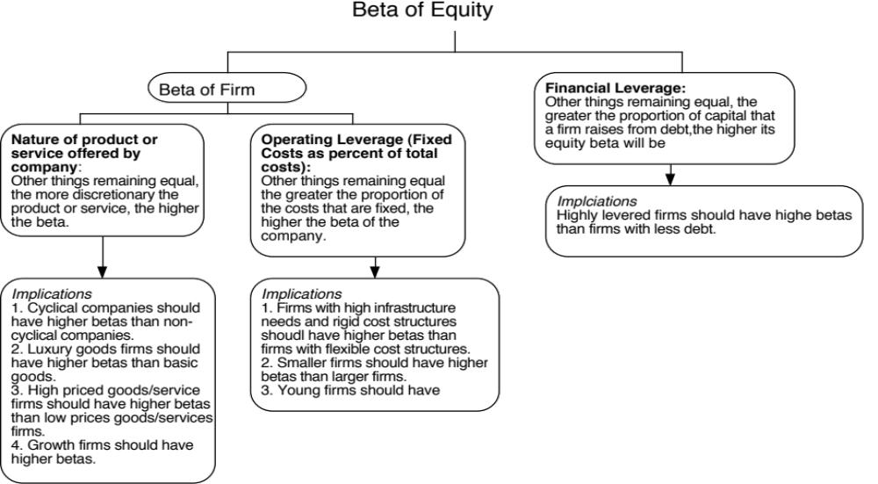
Your risk exposure comes from your choices as a business..

Slide 18
Let’s do an intuitive check on the Mets
How risky is your underlying business?
  How discretionary is your product to your customers (fans)?
  How are your media contracts structured?
  How is your merchandising business structured? (Licensed, Owned etc.)
What does your cost structure look like?
  How much of your expenses is fixed?
  If you have a bad year (business-wise), what happens to your expense structure?
How much debt do you have?

Slide 19
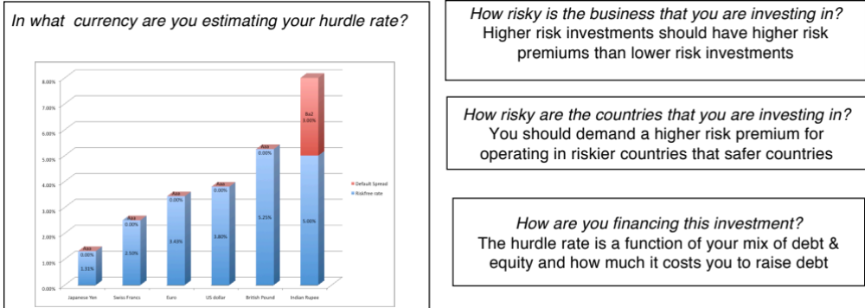
Lesson 5: Know your “hurdle” rate
Since financial resources are finite, there is a “hurdle rate” that projects have to cross before being deemed acceptable. A simple representation of the hurdle rate is as follows:
Hurdle rate = Riskless Rate + Risk Premium

Slide 20
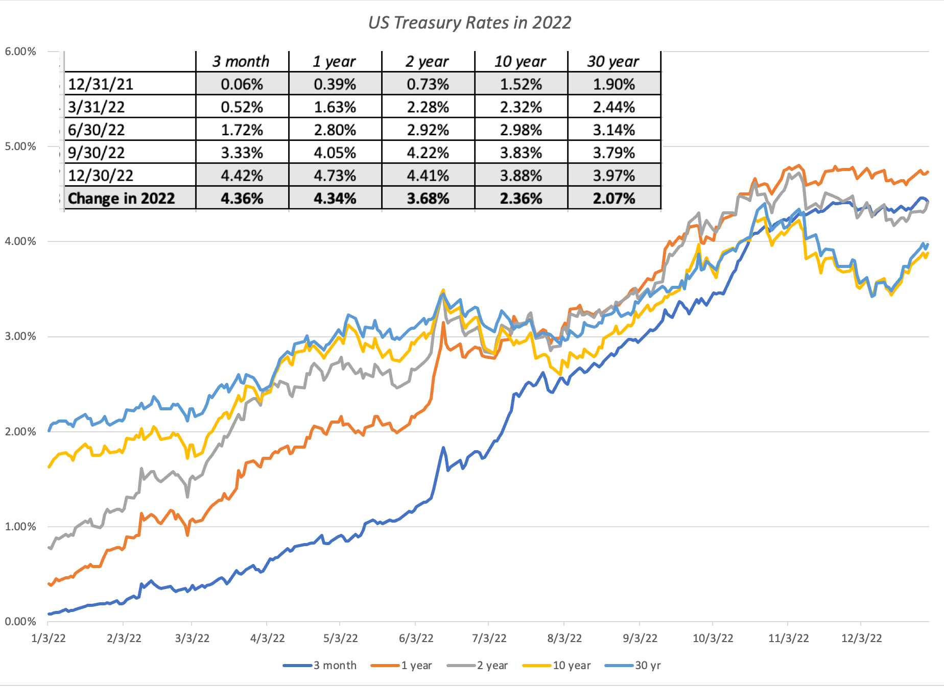
The Riskfree Rate

Slide 21
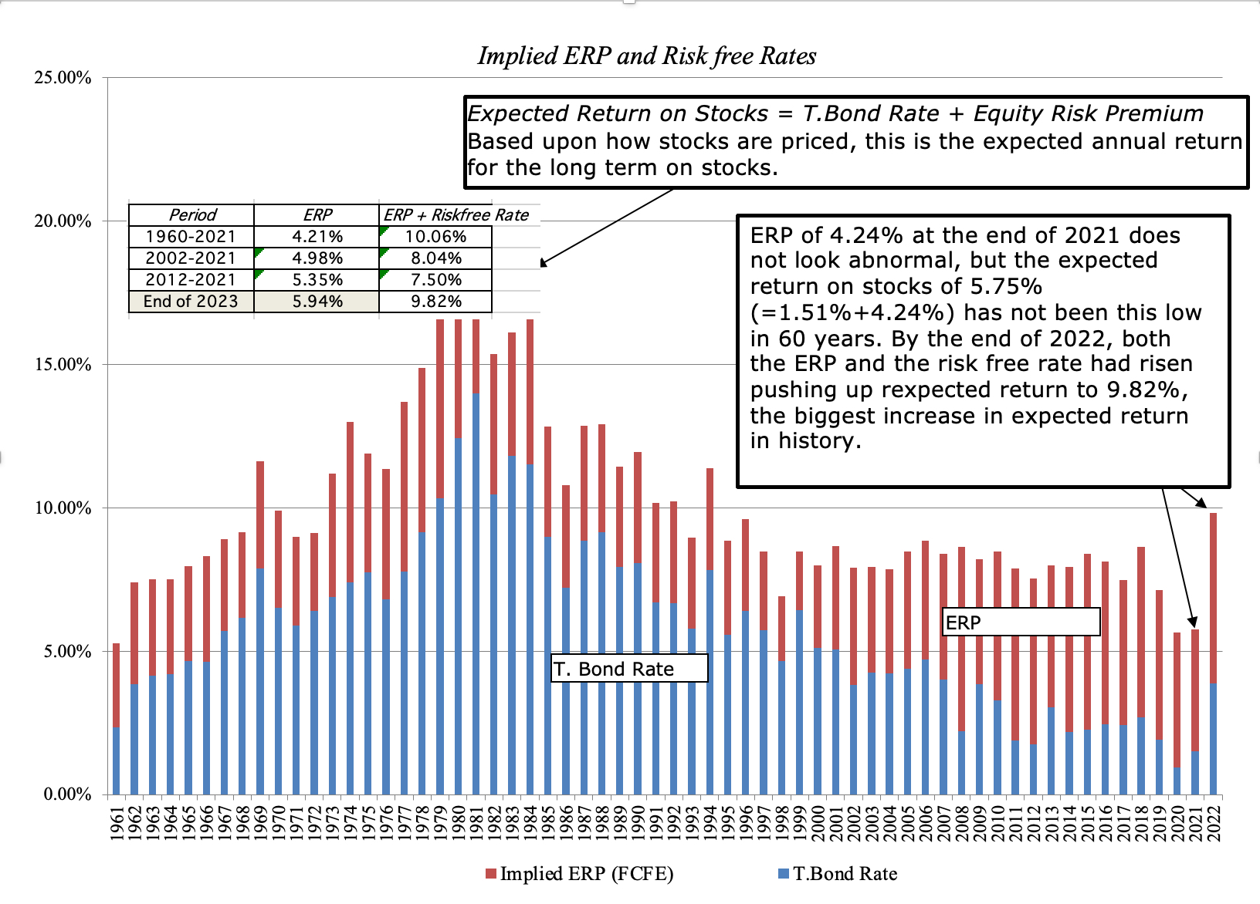
The Equity Risk Premium

Slide 22
The Relative Risk of investing in an MLB team…
There are no professionally traded baseball teams in the United States. In fact, there are no professionally traded sports teams in the US (with MSG coming closest).
There are two choices when it comes to measuring relative risk:
  One is to look at professional sports teams (almost all soccer) that are publicly traded in Europe. The median beta across these companies is 1.10.
  The other is to look at entertainment companies in the US, arguing that the forces that determine how the MLB do are the same ones driving other entertainment businesses. The median unlevered beta is 1.16.

Slide 23
A hurdle rate for the Mets..
Bringing together these inputs, using updated numbers for 2022:
  Riskfree Rate on April 1, 2023 = 3.47%
  ERP on April 1, 2023 = 5.54%
  Beta (based upon comps) = 1.15
  Expected Return = 3.47% + 1.15 (5.54%) = 9.84%
This required return works only for investors who are diversified.
  Does that work for the Mets?
  How about for the Yankees?

Slide 24
Lesson 6: Your investments need to earn returns that beat the hurdle rate…
Your hurdle rate is both a cost of financing your business and an opportunity cost, i.e,, a return you can make elsewhere if you invest in a project of equivalent risk. If that is the case, you should only take investments that generate returns that earn more than the hurdle rate.
To measure returns, though, here are three simple propositions to follow:
  Look at the cash flows that you will make on the investment, rather than earnings. You cannot spend earnings.
  Look at incremental cash flows that come out because of the investment. Be wary of allocated costs (that will be there whether you take the investment or not) and ignore sunk costs (costs that you have already incurred).
  Time weight the cash flows, with cash flows occurring earlier being valued more than cash flows later.

Slide 25
The Problems with Investment Analysis for Professional Sports
For professional sports teams, the biggest investments that they will make is in the contracts that they offer their biggest stars.
In assessing these contracts, from a purely business (cash flow) perspective, the challenge you face is in isolating how much an individual player will affect your collective cash flows as a team, since those cash flows can show up as:
  Higher merchandise sales
  More season tickets sold (Bryce Harper’s signing with the Phillies increased the number of season ticket holders from 10000 to 13000)
  More wins for the team, and perhaps a greater likelihood of making it to the playoffs and winning it all (Being in the playoffs will increase revenues from both gate receipts and TV revenues)
Even if you can get these financial analysis done, there is the very real danger that the teams that are competing for the player are not bound by the same business constraints.

Slide 26
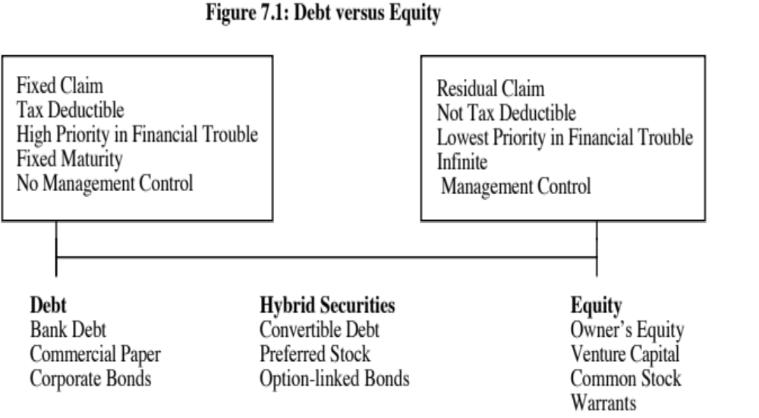
Lesson 7: You have only two ways of raising funding for a business…

Slide 27
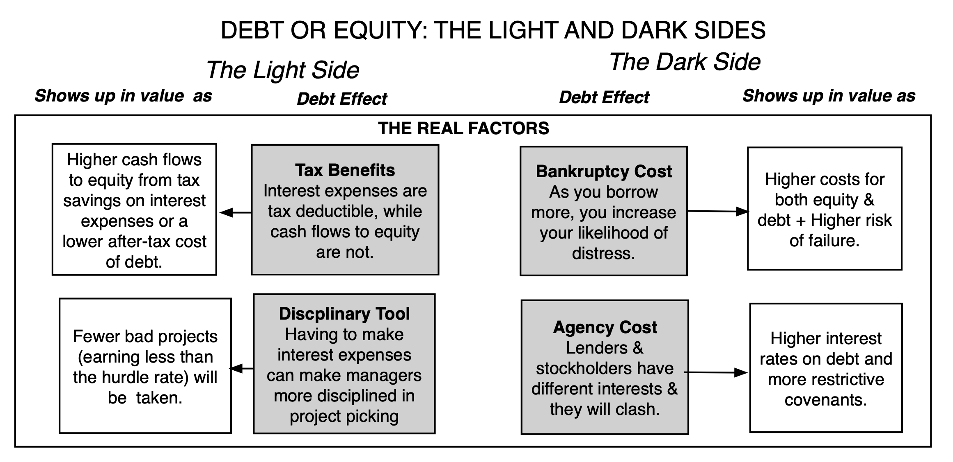
And here is the trade off….

Slide 28
MLB teams don’t look very indebted…

Slide 29
But that look can be misleading..
While debt as a percent of estimated team value is modest, even for the most highly levered MLB teams, it is high relative to the cash generated by these teams from their businesses.
In addition, and perhaps more critically, the contractual commitments that MLB teams have on their player contracts are effectively debt, and capitalizing those contracts pushes up the debt load at these firms.
Bottom line: Professional sports teams are heavily levered, even if they are all equity funded.

Slide 30
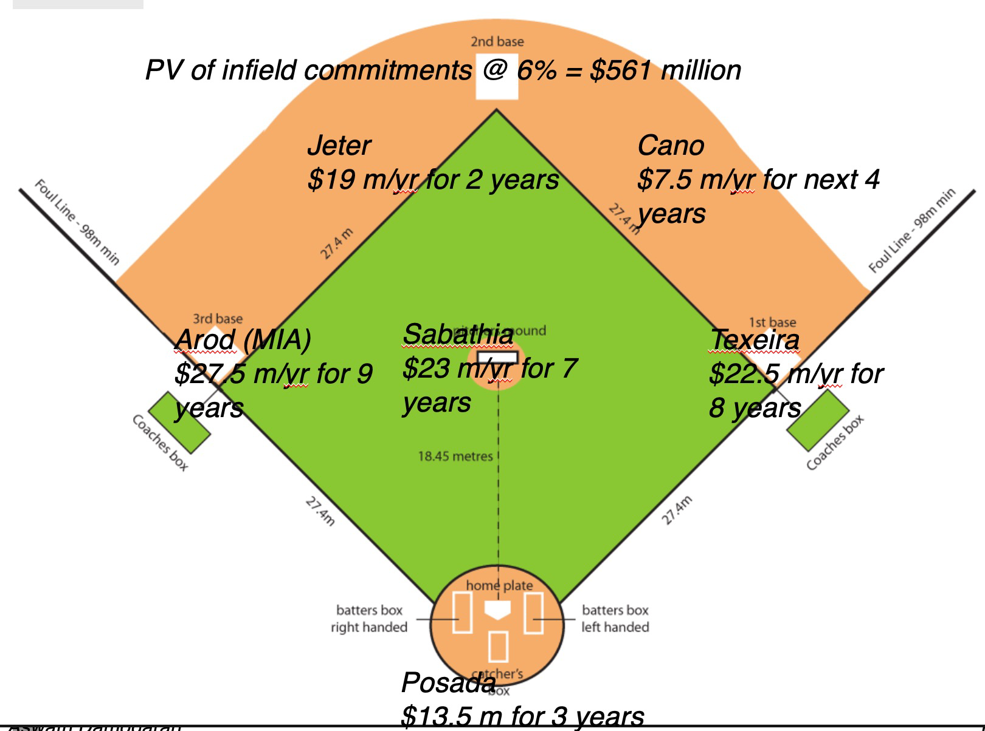
The Yankee infield on opening day, 2009…

Slide 31


Lesson 8: The “right” financing type for your firm depends on your firm
The objective in designing debt is to make the cash flows on debt match up as closely as possible with the cash flows that the firm makes on its assets.
By doing so, we reduce our risk of default, increase debt capacity and increase firm value.
Unmatched Debt
Matched Debt
Notes:
Your objective is issue securities that bring you all of the tax benefits of debt while providing you with the flexibility of equity. It is not the reduction in risk but the increase in debt capacity that generates the value. A firm that does not use this debt capacity will not gain from matching debt to assets in the first place.

Slide 32

The perfect debt for you is….
The perfect financing instrument will
  Have all of the tax advantages of debt
  While preserving the flexibility offered by equity
Notes:
There is ample scope for creativity in trying to design the perfect bond. The idea is to design debt that looks and acts like equity, in terms of the cash flows.
Consider each aspect;
Duration: Companies with long term projects (Boeing) should use long term debt. Companies with short term projects (Dell) should use short term debt.
Currency: Companies that get a high proportion of their revenues from non-domestic operations should use more foreign currency debt (especially if the currency mix is stable.
Inflation: Companies with pricing power can pass inflation through into their cash flows. These companies should be much better candidates for floating rate debt (because interest expenses on the debt will rise and fall with inflation).
Growth pattern: Mature companies with level , steady cash flows should be much better candidates for straight debt, whereas growth companies are much better candidates for convertible debt.

Slide 33
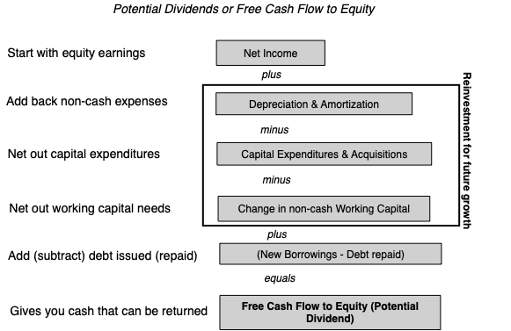
Lesson 9: Cash is not accumulated by accident, & cash does not belong to the company

Slide 34
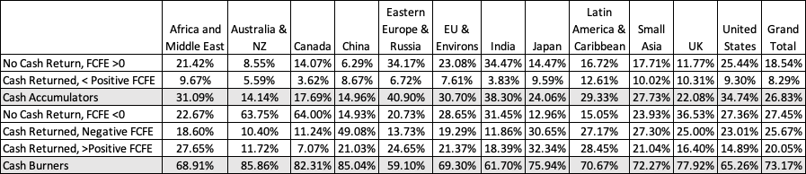
And companies don’t pay out what they can afford to….
FCFE = Potential Dividends = Cash left over after all operating expenses, taxes, reinvestment and debt payments have been made.

Slide 35
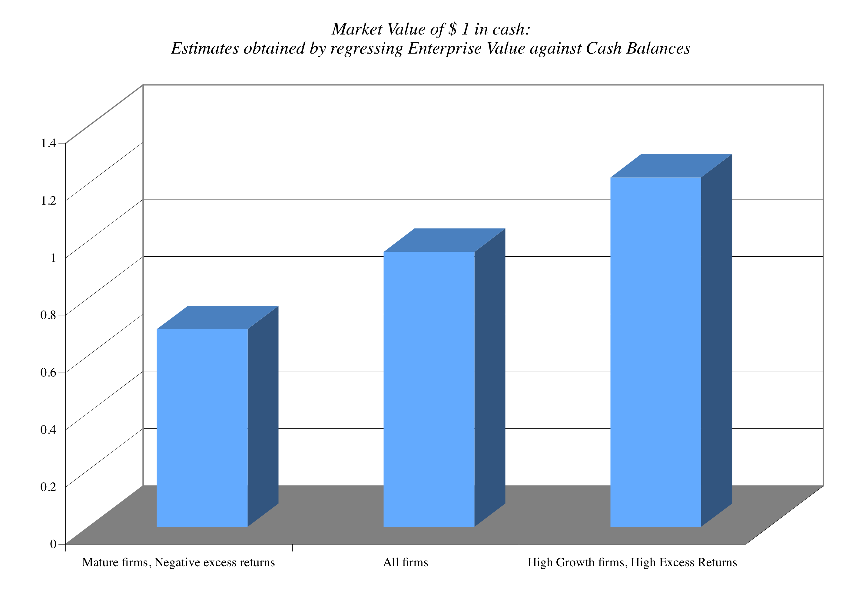
Not all cash balances are created equal…

Slide 36
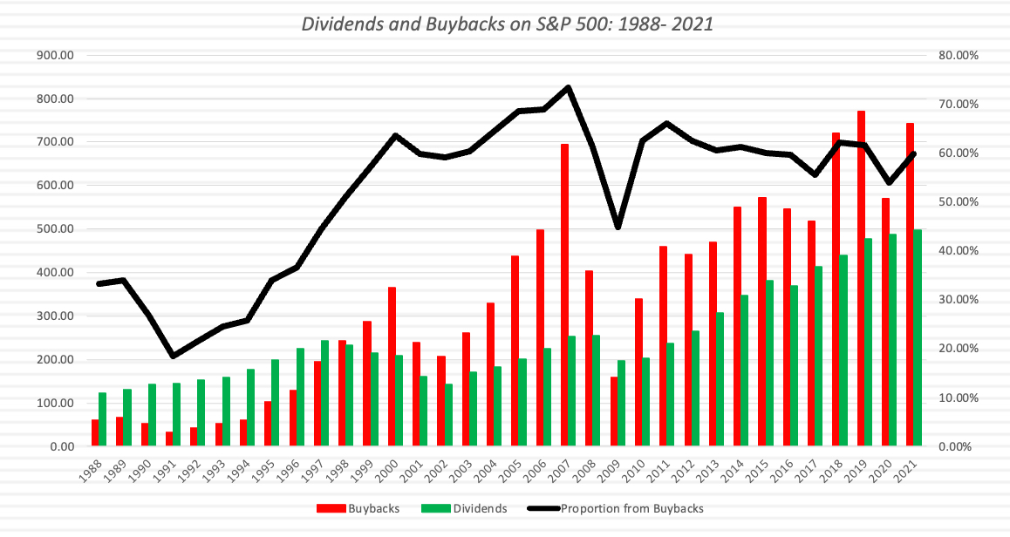
And buybacks are flexible dividends…

Slide 37
Why the decision is moot at most MLB franchises…
Most MLB teams are cash flow poor, because much of their revenue is eaten up by player contract payments, and what is left by other expenses.
Luckily (for these teams), most of them have owners who do not pressure on them to generate cash flows for them, because they are:
  Wealthy enough to not need these cash…
  Are playing a trading game, where they plan to sell their teams to someone else in the near term at a much higher price..

Slide 38
Lesson 10: The value of your business is a function of these variables…

Slide 39
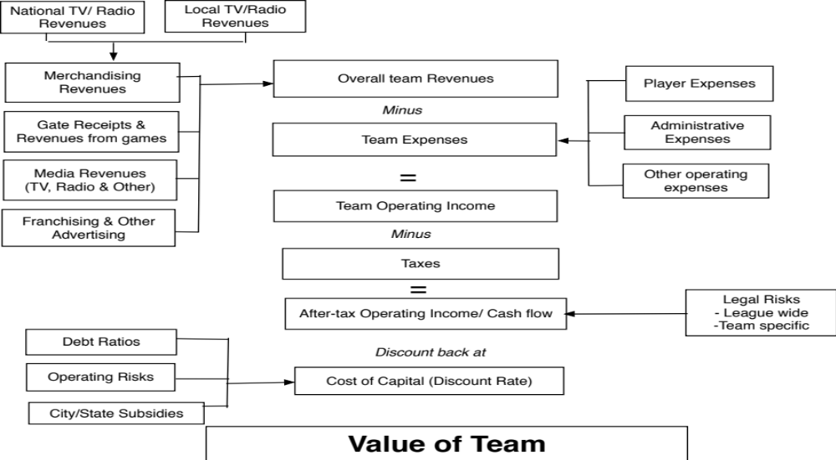
The Drivers of Franchise Value

Slide 40
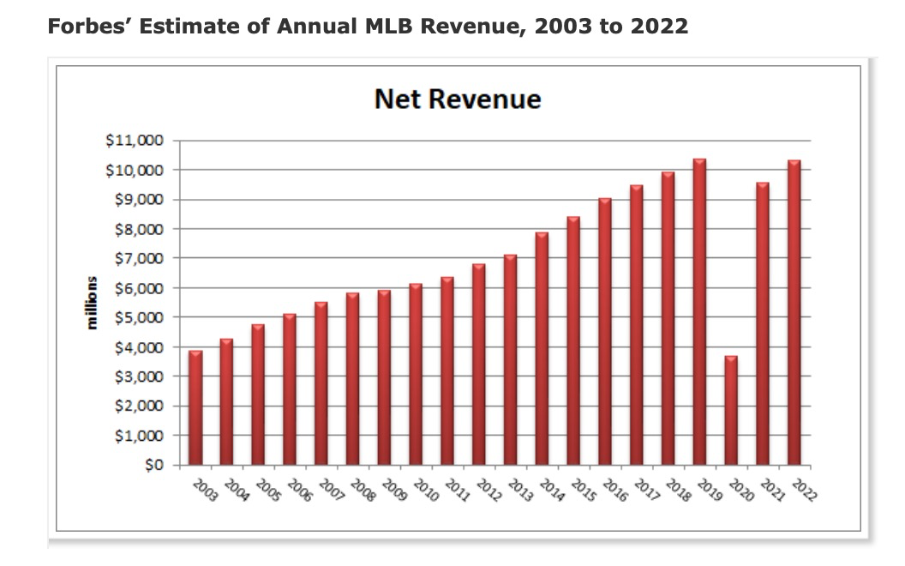
MLB: The Revenue Problem
Revenues are growing slowly over time, and attendance has declined nine years in a row..

Slide 41
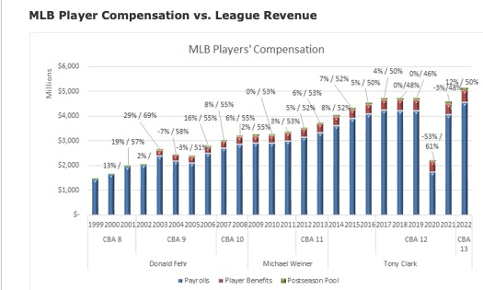
MLB: The Expense Problem
The biggest expense for MLB teams is player contracts and not only do they eat a large chunk of revenues, they are increasing over time...

Slide 42
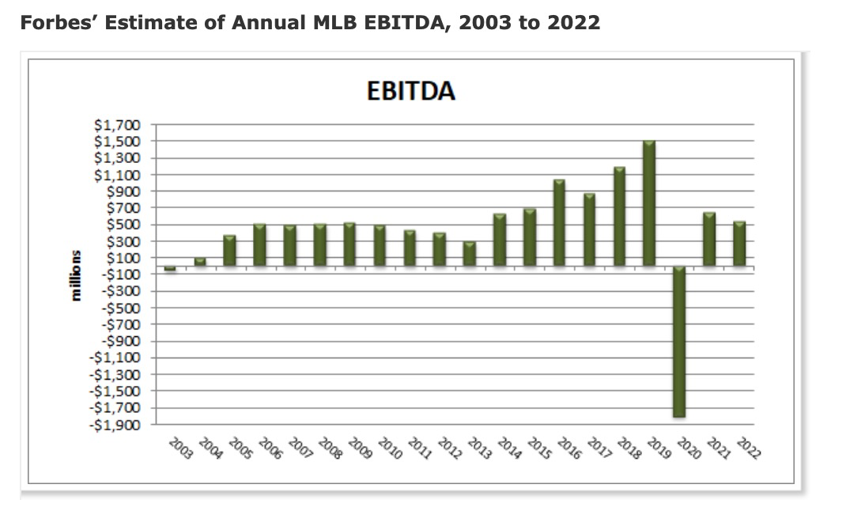
With predictable consequences…

Slide 43
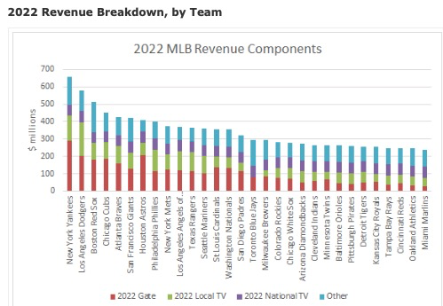
Team Revenues in 2022

Slide 44
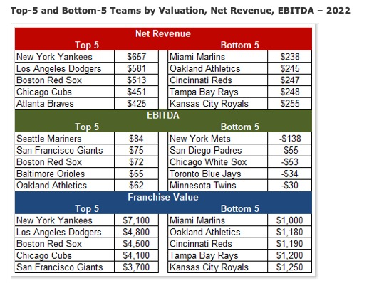
And even the best of the MLB teams barely make money..

Slide 45
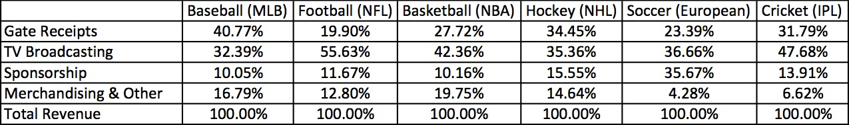
Revenue Breakdown across Franchises

Slide 46
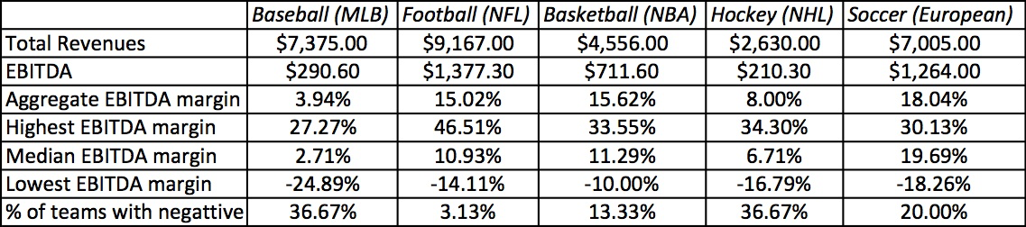
EBITDA Margins across Franchises

Slide 47
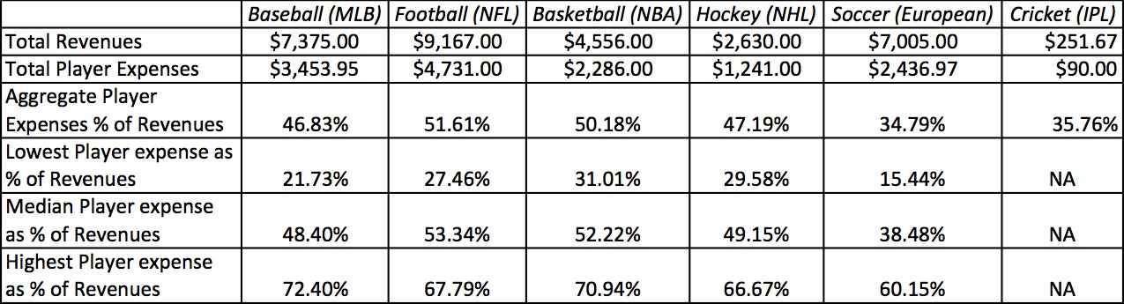
Player Expenses across Franchises

Slide 48
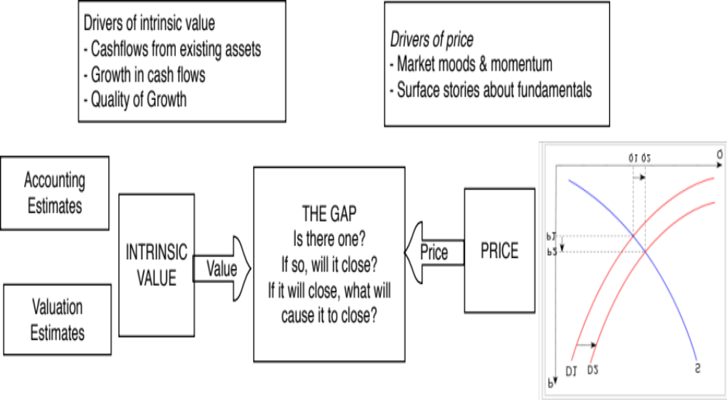
Value ≠ Price
Notes:
There are three levels at which this class will approach valuation.
At the most elevated level, it will talk about different approaches to valuation, there financial underpinnings and why they may give different answers to valuation. Rather than taking the dogmatic view that DCF valuation is the only approach that a rational person will choose, we will consider why we may prefer relative valuation in some scenarios at least.
At its second level, the class will emphasize how you are and what your task is can affect the value that you attach to an asset. The same firm can have different values to different people, depending upon the information and biases they bring to the process. Some people (managers, acquirers) may have more degrees of freedom when it comes to how a firm is managed and run.
At its most detailed level, all of the philosophical understanding of valuation in the world and deep thinking is of little use unless you can actually value a business (with number). This is where the rubber meets the road. There are many who have trouble at this stage because they are unwilling to make mistakes. Valutation is about using the information you have (not the information you wish you had) to make reasonable estimates of the future.

Slide 49
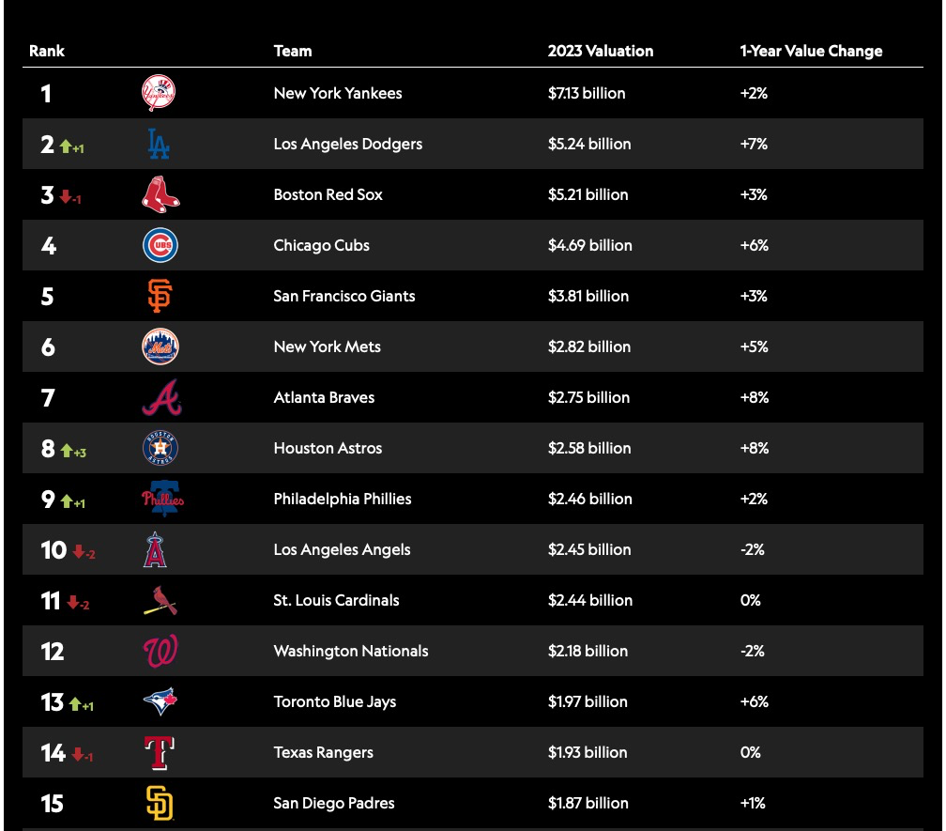
Ranking in pricing…

Slide 50
Factors driving pricing…
National versus Local Profile: Teams that manage to acquire following outside of their local markets are priced higher.
Media Market size: Companies in larger media markets are priced higher than companies in smaller media markets.
Nostalgia/ History: The the extent that sports teams are trophy assets to some of their owners, teams with longer and more illustrious history will be priced higher than teams without that history.
Play on the field: The question of whether a team is a winning or losing team right now seems to have only a marginal impact on the pricing of that team.
Buyer/team match: Since the buyers of teams are often also fans, there is an element of chance that determines pricing, but your odds of finding a wealthy buyer increase significantly if you play in a part of the country where there are far more rich people.
Stadium: To the extent that a stadium becomes the stage on which a team is presented to the world, having an appealing stage makes a difference.

Slide 51
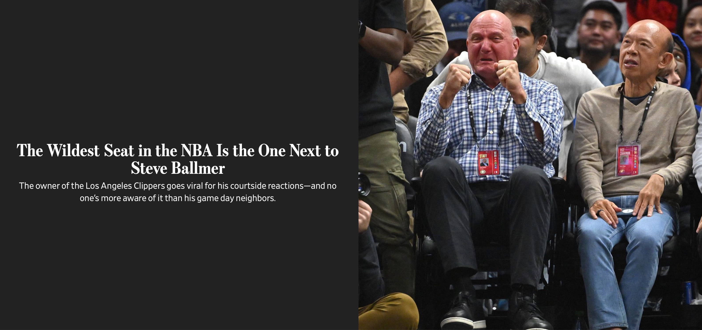
How much would you pay for a trophy asset? A picture is worth a thousand words…

Slide 52
A few reality checks
It is easy to value a sports franchise and it is more a function of media contracts and market size than winning on the field.
It is difficult to price a sports franchise, because there are so few franchises being bought and sold.
Forbes does not value sports franchises. It prices them, and through no fault of its own, it prices them badly.
Pricing dominates valuation, as the number of professional franchises is outnumbered by the number of wealthy people who would like to own them.
  If you are an investor, don’t invest in a professional sports franchise. You may have a better shot if you invest in semi-professional sports franchise.
  If you are a trader, you can get rich “trading” sports franchises, if you can predict the drivers of prices (and they have little to do with financials).

Slide 53
Implications for managers and the sport….
To the extent that the owners of professional teams view these teams less as financial investments and more as expensive toys, the decisions that are made at these teams will reflect how much they are willing to make those toys shiny and desirable.
If the owners of professional teams are more interested more in trading the teams, i.e., selling to someone at a higher price, you will see decisions made at these teams to push up the pricing, including:
  Signing players with the presence that increases the team’s profile (Shohei Ohtani
  Moving the team to a city or location that is more desirable to potential buyers

