Slide 1
Applied Corporate Finance:
A big picture view
Aswath Damodaran
www.damodaran.com
Notes:
Sets the agenda for the class. This is a class that will be focused on the big picture of corporate finance rather than details, theories or models on a piecemeal basis.

Slide 2
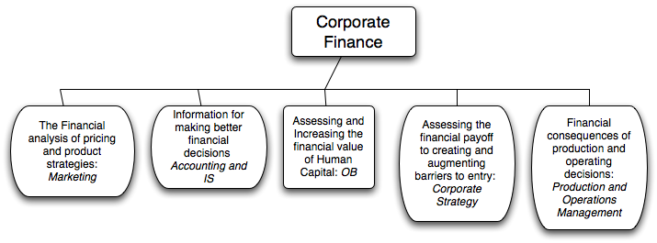
What is corporate finance?
Every decision that a business makes has financial implications, and any decision which affects the finances of a business is a corporate finance decision.
Defined broadly, everything that a business does fits under the rubric of corporate finance.
Notes:
Corporate finance covers every decision that any business, small or large, public or private takes.. This is my very selfish attempt to show that corporate finance is at the heart of all the other management disciplines: marketing, strategy, accounting and even the fuzzy far reaches of human capital.

Slide 3
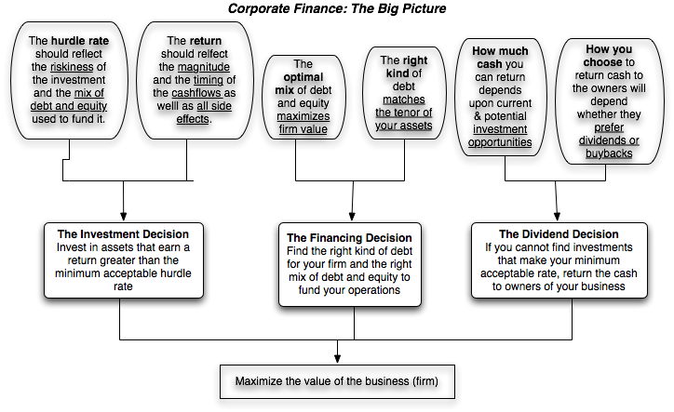
First Principles
Notes:
This is the big picture that will animate how we approach corporate finance. We will use it to anchor the class, introducing each topic by noting its presence in the big picture. Ultimately, everything we do in corporate finance has to be somewhere in the picture.
(I introduce my syllabus after this slide with session numbers framed in the big picture)

Slide 4
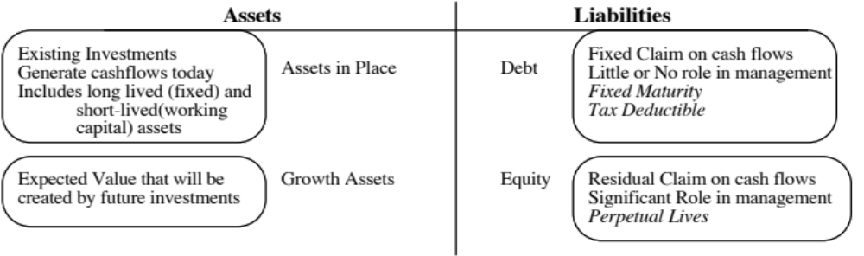
The Objective in Decision Making
In traditional corporate finance, the objective in decision making is to maximize the value of the firm.
A narrower objective is to maximize stockholder wealth. When the stock is traded and markets are viewed to be efficient, the objective is to maximize the stock price.
Maximize equity value
Maximize market estimate of equity value
Maximize firm value
Notes:
This is the answer to the question posed in the previous overhead.
Maximizing the value of the business is the most general objective function. Remember that value of the business includes assets in place and growth assets. If you are managing a growth company,, increasing earnings may not necessarily increase firm value. The other problem is that firm value itself is a difficult number to estimate. While there are models available, they all need inputs, most of which allow for subjective judgments.
Managers answer to stockholders. Consequently, the objective gets narrowed down to “maximizing equity value”. (Implicit assumption: Bondholders/ Banks can protect themselves by writing in covenants and setting interest rates).
It is tough to assess equity value objectively. It would be nice to have a “third party” estimate that is objective. For publicly traded firms, the market (in spite of all its limitations) provides such an estimate. (Implicit assumption: Markets are rational and reasonably efficient).

Slide 5
The Classical Objective Function
STOCKHOLDERS
Hire & fire
managers
- Board
- Annual Meeting
Maximize
stockholder wealth
Lend Money
No Social Costs
BONDHOLDERS
Managers
SOCIETY
Protect
bondholder
Interests
Costs can be
traced to firm
Reveal
information
honestly and
on time
Markets are
efficient and
assess effect on
value
FINANCIAL MARKETS
Notes:
This is the utopian world. None of the assumptions are really defensible as written, and skepticism is clearly justified:
Why do we need these assumptions?
Since, in many large firms, there is a separation of ownership from management, managers have to be fearful of losing their jobs and go out and maximize stockholder wealth. If they do not have this fear, they will focus on their own interests.
If bondholders are not protected, stockholders can steal from them and make themselves better off, even as they make the firm less valuable.
If markets are not efficient, maximizing stock prices may not have anything to do with maximizing stockholder wealth or firm value.
If substantial social costs are created, maximizing stock prices may create large side costs for society (of which stockholders are members).
Note that corporate finance, done right, is not about stealing from other groups (bondholders, other stockholders or society) but about making the firm more productive and valuable.

Slide 6
What can go wrong?
STOCKHOLDERS
Managers put
their interests
above stockholders
Have little control
over managers
Lend Money
Significant Social Costs
BONDHOLDERS
Managers
SOCIETY
Bondholders can
get ripped off
Some costs cannot be
traced to firm
Delay bad
news or
provide
misleading
information
Markets make
mistakes and
can over react
FINANCIAL MARKETS
Notes:
This is my worst case scenario:
Stockholders have little or no control over managers. Managers, consequently, put their interests above stockholder interests.
Bondholders who do not protect themselves find stockholders expropriating their wealth.
Information conveyed to markets is noisy, biases and sometimes misleading. Markets do not do a very good job of assimilating this information and market price changes have little to do with true value.
Firms in the process of maximizing stockholder wealth create large social costs.
In this environment, stockholder wealth maximization is not a good objective function.

Slide 7
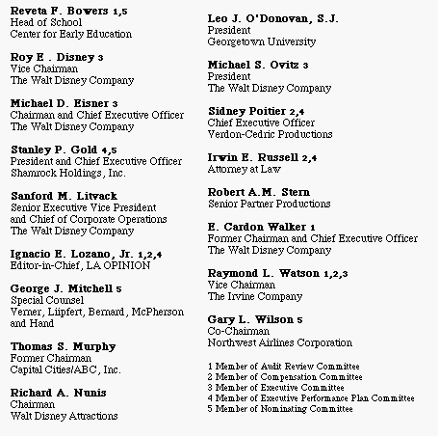
Who’s on Board? The Disney Experience - 1997
Notes:
This may be going back in time but it may help understanding Disney’s present standing. This was Disney’s board at the height of Michael Eisner’s powers. (Eisner became CEO of Disney in 1985 and consolidated power in the years after.)
Note the number of insiders on the board. (Seven out of 16; five current employees & two ex-employees)
Also note the presence of Mr. Eisner’s private attorney (Irwin Russell) and the principal of his childrens’ elementary school (Reveta Bowers) on the board.
How independent was this board likely to be of Mr. Eisner? This may explain some of the actions taken by Disney (and specifically Eisner) during the 1990s… (Read Disney War by James Stewart for the gory details)
When Eisner was hired in 1984, he insisted on bringing in his protégé Jeffrey Katzenberg, a brilliant show-biz exec lacking in social skills, into the firm with him. Katzenberg was largely responsible for the rebirth of Disney Animation (which Eisner had considered shutting down) with The Little Mermaid, Beauty and the Beast and The Lion King all proving to be mega-winners. As a reward for this success, Esiner fired him. His lucrative contract entitled him to 2% of the revenues from the movies he made in posterity but he would have settled for $100 million. Eisner refused to pay; Disney paid $ 250 million in 1999.
In 1995, Eisner hired Ovitz, the leading agent in Hollywood, and then told the board to okay the hire. He regretted it almost immediately and fired him 453 days later for “lying” and “incompetence”. However, rather than argue that this was just cause for firing, he paid Ovitz $ 100 million to leave.

Slide 8
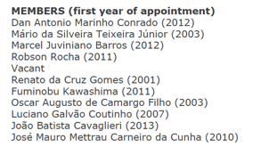
Who is on Board? Vale’s board
Does Vale have an independent board?
Yes
No
Does Vale have an effective board?
Yes
No
Notes:
This may be going back in time but it may help understanding Disney’s present standing. This was Disney’s board at the height of Michael Eisner’s powers. (Eisner became CEO of Disney in 1985 and consolidated power in the years after.)
Note the number of insiders on the board. (Seven out of 16; five current employees & two ex-employees)
Also note the presence of Mr. Eisner’s private attorney (Irwin Russell) and the principal of his childrens’ elementary school (Reveta Bowers) on the board.
How independent was this board likely to be of Mr. Eisner? This may explain some of the actions taken by Disney (and specifically Eisner) during the 1990s… (Read Disney War by James Stewart for the gory details)
When Eisner was hired in 1984, he insisted on bringing in his protégé Jeffrey Katzenberg, a brilliant show-biz exec lacking in social skills, into the firm with him. Katzenberg was largely responsible for the rebirth of Disney Animation (which Eisner had considered shutting down) with The Little Mermaid, Beauty and the Beast and The Lion King all proving to be mega-winners. As a reward for this success, Esiner fired him. His lucrative contract entitled him to 2% of the revenues from the movies he made in posterity but he would have settled for $100 million. Eisner refused to pay; Disney paid $ 250 million in 1999.
In 1995, Eisner hired Ovitz, the leading agent in Hollywood, and then told the board to okay the hire. He regretted it almost immediately and fired him 453 days later for “lying” and “incompetence”. However, rather than argue that this was just cause for firing, he paid Ovitz $ 100 million to leave.

Slide 9
When traditional corporate financial theory breaks down, the solution is:
To choose a different mechanism for corporate governance, i.e, assign the responsibility for monitoring managers to someone other than stockholders.
To choose a different objective for the firm.
To maximize stock price, but reduce the potential for conflict and breakdown:
  Making managers (decision makers) and employees into stockholders
  Protect lenders from expropriation
  By providing information honestly and promptly to financial markets
  Minimize social costs
Notes:
At this point, things look pretty bleak for stock price maximization. These are the three choices that we have, if we abandon pure stock price maximization as an objective function.

Slide 10
A Market Based Solution
STOCKHOLDERS
1. More activist
investors
2. Hostile takeovers
Managers of poorly
run firms are put
on notice.
Protect themselves
Corporate Good Citizen Constraints
BONDHOLDERS
Managers
SOCIETY
1. Covenants
2. New Types
1. More laws
2. Investor/Customer Backlash
Firms are
punished
for misleading
markets
Investors and
analysts become
more skeptical
FINANCIAL MARKETS
Notes:
This summarizes the objective function of maximizing stockholder wealth, with the fixes noted on the last few pages.

Slide 11
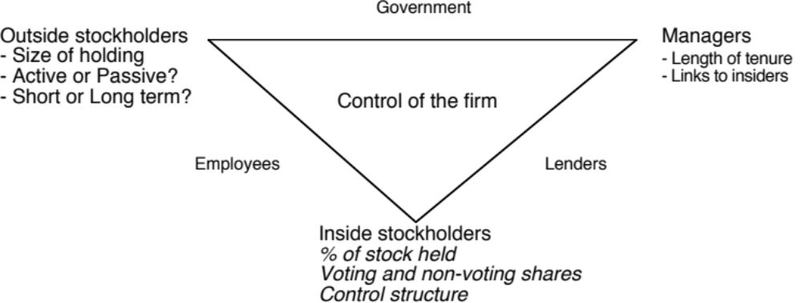
Application Test: Who owns/runs your firm?
Who are the top stockholders in your firm?
What are the potential conflicts of interests that you see emerging from this stockholding structure?
Notes:
One of your first tasks when assessing a company is to see whether managers have a significant stake in the company. You can get this information in a variety of places. I use Bloomberg to get the data on the top 17 stockholders and go down the list to see if incumbent managers have a stake in the company. I also check to see if there are other investors on the list who may not be incumbent managers but are strong advocates for stockholders - Berkshire Hathaway at Coca Cola, KKR or Blackstone at many publicly traded firms…
You can also get this information from Yahoo! Finance by going into company profiles and clicking on institutional investors…
As you look at the list of top stockholders, you should be also considering the potential conflicts of interest created by the stockholder structure.
Inside stockholders (Founding family, controlling stockholder/manager) versus outside stockholders
Government as major stockholder (or holder of golden vote)
Employees as major stockholders

Slide 12
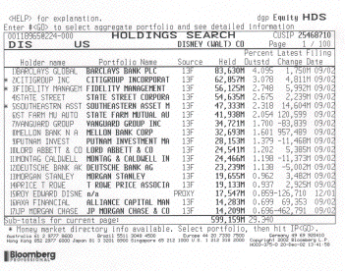
Splintering of Stockholders
Disney’s top stockholders in 2003
Notes:
Not a single individual investor in the list other than Roy Disney who was the 15th largest stockholder… Managers are not significant stockholders in Disney (and the same can be said for most large publicly traded firms). Consider the following scenarios:
Managers are not significant stockholders in the firm: Significant potential for conflicts of interest between managers and stockholders.
Individuals are significant stockholders in the firm as well as part of top management. Usually, these are founder-owners of the firm and the firms tend to be younger firms or family run businesses that have recently made the transition to publicly traded firms. Smaller potential for conflict between managers and stockholders, but potential for conflict between inside stockholders and outside stockholders.
The government is a large stockholder (or a stockholder with veto power). This may keep managers in some check but it will create potential conflicts of interest between the other stockholders and the government (Consider what would happen if the company tried to minimize taxes paid)
Trusts or descendants of owners are significant stockholders in the firm but are not an active part of incumbent management. Power that these stockholders retain to replace managers reduces potential for conflict of interest but is reduced as holdings get diluted among lots of family members.
Another company is largest stockholder in firm. In this case, trace out who owns stock in the other company….

Slide 13
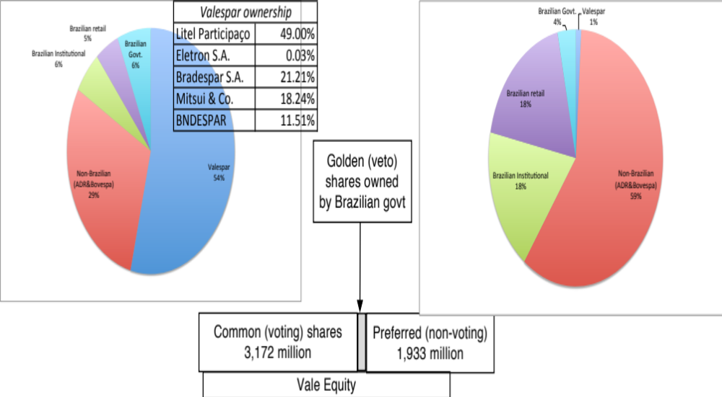
Vale: Shareholder Ownership Structure
Vale has eleven members on its board of directors, ten of whom were nominated by Valepar and the board was chaired by Don Conrado, the CEO of Valepar.
Notes:
Voting right differences: When voting rights vary across shares, incumbent managers can consolidate their hold on a company with relatively small holdings. This reduces the power that stockholders have in these companies. Differences in voting rights are common outside the U.S. In Asia and Latin America, incumbent managers or family members can control companies with relatively small holdings with complete impunity.
Golden shares: When the government has veto power over major decisions, that also acts as a constraint on shareholders. Consequently, shareholders have to be realistic about what they can change and not change at these companies.

Slide 14
Brazil Spotlight 2016: Ownership
Company | Biggest Holder | Holding | Other comments
Gerdau | Metalurgica Gerdau | 22.00% | Blackrock, Vanguard
Natura | Lisis Participacoes | 22.25% | Blackrock, Vanguard
Cosan | Cosan | 61.99% | Barbosa family holdings
Braskem | Oderbrecht Servicos | 22.95% | Petrobras owns 21.84%
DASA | Cromossoho Participacoes | 73.92% | De Godoy Holdings (23%)
Dias Branco | Dibra Fundo | 63.62% | Blackrock, FMR etc.
GOL | Fund Invest Partic | 33.89% | Delta Airlines owns 16.19%
Eletrobras | Brazilian Government | 54.46% | BNDES next biggest holder
Marisa Lojas | Coronation Fund Manager | 11.19% | Goldfarb family holdings
Embraer | Massachusetts Mutuals | 13.19% | Blackrock, Vanguard

Slide 15
First Principles
Notes:
This is the big picture that will animate how we approach corporate finance. We will use it to anchor the class, introducing each topic by noting its presence in the big picture. Ultimately, everything we do in corporate finance has to be somewhere in the picture.
(I introduce my syllabus after this slide with session numbers framed in the big picture)

Slide 16

What is Risk?
Risk, in traditional terms, is viewed as a ‘negative’. Webster’s dictionary, for instance, defines risk as “exposing to danger or hazard”. The Chinese symbols for risk, reproduced below, give a much better description of risk:
The first symbol is the symbol for “danger”, while the second is the symbol for “opportunity”, making risk a mix of danger and opportunity. You cannot have one, without the other.
Notes:
Note that risk is neither good nor bad. It is a combination of danger and opportunity - you cannot have one without the other. Consequently, risk is neither something to be avoided nor sought out but carefully balanced. Good business avoid some risks, let others pass through to their investors and actively seek out still others.
When businesses want opportunity (higher returns), they have to live with the higher risk.
Any sales pitch that offers returns without risk is a pipe dream.
Bob Citron, treasurer of Orange County (CA), after he lost a chunk of the county’s pension fund money after investing in interest rate derivatives claimed that he was “not a finance person” and that Merrill’s market strategist (Charlie Clough) had told him he could make “15% with no risk”.
Many prominent (and intelligent) people invested with Bernie Madoff because he promised them (through third parties) that he could deliver 8% more than the treasury bill rate, guaranteed. (He was called the Jewish T.Bill). One investor, interviewed by the NY Times said, “I really did not understand what he was doing, but he said was going to do something with calls, something with puts and earn 12% every year. It sounded plausible (and all my friends were investing with him too).

Slide 17
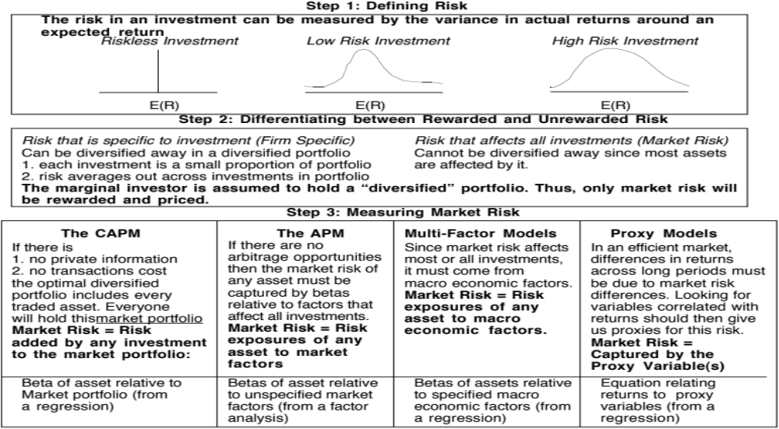
Alternatives to the CAPM
Notes:
Note that all of the models of risk and return in finance agree on the first two steps. They deviate at the last step in the way they measure market risk, with
The CAPM, capturing all of it in one beta, relative to the market portfolio
The APM, capturing the market risk in multiple betas against unspecified economic factors
The Multi-Factor model, capturing the market risk in multiple betas against specified macro economic factors
The Regression model, capturing the market risk in proxies such as market capitalization and price/book ratios

Slide 18
Inputs required to use the CAPM -
The capital asset pricing model yields the following expected return:
  Expected Return = Riskfree Rate+ Beta * (Expected Return on the Market Portfolio - Riskfree Rate)
To use the model we need three inputs:
  The current risk-free rate
  The expected market risk premium (the premium expected for investing in risky assets (market portfolio) over the riskless asset)
  The beta of the asset being analyzed.
Notes:
Summarizes the inputs. Note that we are replacing the last component (E(Rm)-Rf) with the expected equity risk premium..

Slide 19
I. A Riskfree Rate
On a riskfree asset, the actual return is equal to the expected return. Therefore, there is no variance around the expected return.
For an investment to be riskfree, then, it has to have
  No default risk
  No reinvestment risk
Time horizon matters: Thus, the riskfree rates in valuation will depend upon when the cash flow is expected to occur and will vary across time.
Not all government securities are riskfree: Some governments face default risk and the rates on bonds issued by them will not be riskfree.
The conventional practice of estimating riskfree rates is to use the government bond rate, with the government being the one that is in control of issuing that currency. In November 2013, for instance, the rate on a ten-year US treasury bond (2.75%) is used as the risk free rate in US dollars.
Notes:
Treasury bills may be default free but there is reinvestment risk when they are used as riskless rates for longer-term cashflows. A 6-month T.Bill is not riskless when looking at a 5-year cashflow.
Would a 5-year treasury be riskfree? Not really. The coupons would still expose you to reinvestment risk. Only a 5-year zero-coupon treasury would be riskfree for a 5-year cash flow.
If you were a purist, you would need different riskfree rates for different cashflows. A pragmatic solution would be to estimate the duration of the cashflows in a valuation and use a treasury of similar duration. (Since the duration is the weighted average of when the cashflows come in, this should be fairly long, especially when you count in the fact that the terminal value is the present value of cashflows forever).

Slide 20
What if there is no default-free entity?
Risk free rates in November 2013
PB Page 14-21
If the government is perceived to have default risk, the government bond rate will have a default spread component in it and not be riskfree. There are three choices we have, when this is the case.
  Adjust the local currency government borrowing rate for default risk to get a riskless local currency rate.
    In November 2013, the Brazilian government rupee bond rate was 12.18%. the local currency rating from Moody’s was Baa3 and the default spread for a Baa2 rated country bond was 2%.
    Riskfree rate in $R = 12.18% - 2.00% = 10.18%
  Do the analysis in an alternate currency, where getting the riskfree rate is easier. With Vale in 2013, we could chose to do the analysis in US dollars (rather than estimate a riskfree rate in R$). The riskfree rate is then the US treasury bond rate.
  Do your analysis in real terms, in which case the riskfree rate has to be a real riskfree rate. The inflation-indexed treasury rate is a measure of a real riskfree rate.
Notes:
- Work with the local currency but you cannot use a long-term government bond rate as a riskfree rate if the government has default risk. You need to back into a riskfree rate. If you cannot do this, you have two choices:
Work with a currency where you can get a riskfree rate
Do everything in real terms
For a real riskfree rate, an expected real growth rate for the economy should provide a reasonable approximation.
To do your analysis in real terms, you need a real riskfree rate. In the U.S., you can obtain such a rate by looking at the inflation indexed treasury bond rate. Outside the U.S., you can assume as a rough approximation that the real riskfree rate is equal to your real growth rate. IIf the real growth rate is much lower than the real interest rate, you will have significant deficits - trade or budget - to make up the shortfall. If the real growth rate is much higher than the real interest rate, you will the exact opposite - surpluses. A long term equilibrium can be reached only when the two are equal.

Slide 21
Risk free rates by currency: March 2016

Slide 22
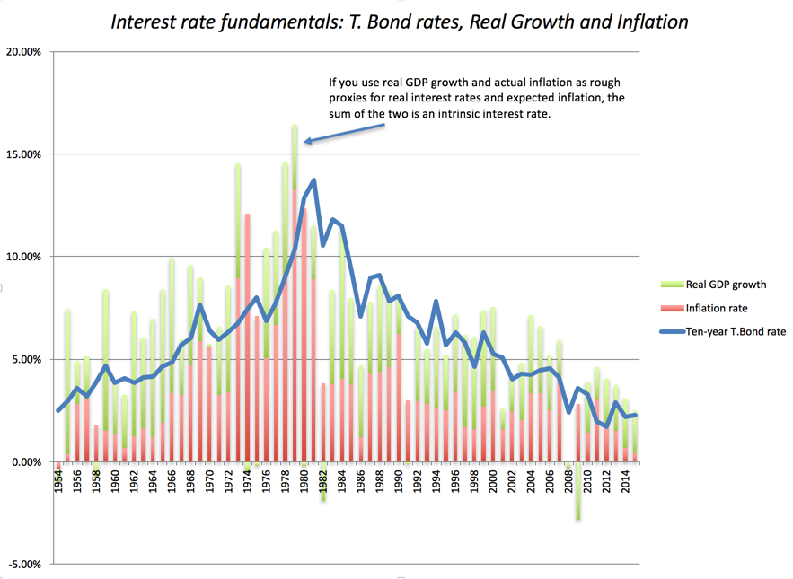
But the risk free rate is ”too low”

Slide 23
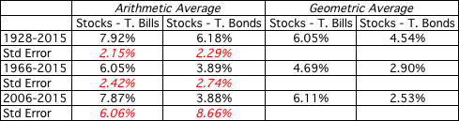
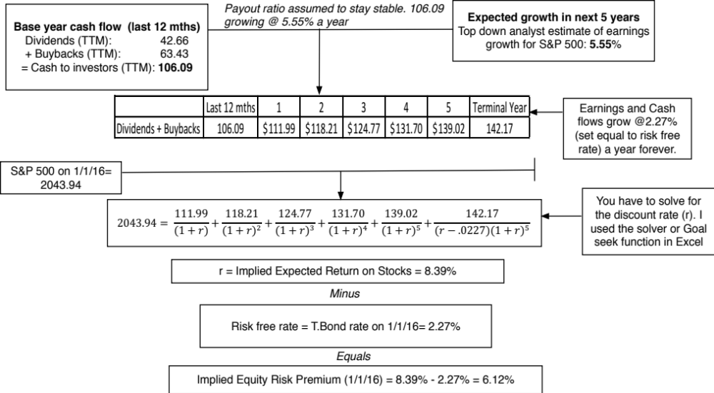
II. The Equity Risk Premium
Historical premium for the US

Slide 24
Country Risk: Look at a country’s bond rating and default spreads as a start
In this approach, the country equity risk premium is set equal to the default spread for the country, estimated in one of three ways:
  The default spread on a dollar denominated bond issued by the country. (In January 2013, that spread was 1.55% for the Brazilian $ bond)
  The sovereign CDS spread for the country. In November 2013, the ten year CDS spread for Brazil was 2.86%.
  The default spread based on the local currency rating for the country. Brazil’s sovereign local currency rating is Baa2 and the default spread for a Baa2 rated sovereign was about 2.00% in January 2013.
Many analysts add this default spread to the US risk premium to come up with a risk premium for a country. This would yield a risk premium of 7.5% for Brazil, if we use 5.5% as the US risk premium and the default spread based on the rating.
Notes:
This approach is simple but it assumes that country default spreads are also good measures of additional country equity risk. The question thought is whether equities (which are riskier than bonds) should command a larger risk premium.

Slide 25
Beyond the default spread
Country ratings measure default risk. While default risk premiums and equity risk premiums are highly correlated, one would expect equity spreads to be higher than debt spreads.
Another is to multiply the bond default spread by the relative volatility of stock and bond prices in that market. Using this approach for Brazil in November 2013, you would get:
  Country Equity risk premium = Default spread on country bond* _{Country Equity} / _{Country Bond}
    Standard Deviation in Bovespa (Equity) = 21%
    Standard Deviation in Brazil government bond = 14%
    Default spread on Brazilian $ bond = 2.00
  Brazil Country Risk Premium = 2.-0% (21%/14%) = 3.0%
  Mature Market Premium in November 2013 = 5.5%
  Brazil Total ERP = Mature Market Premium + CRP = 5.5% + 3.0% = 8.50%
Notes:
In In this approach, we scale up the default spread to reflect the additional risk in stocks… This will result in larger equity risk premiums. We are assuming that investors, when pricing equities in an emerging market, look at what they can make on government bonds issued by that market and scale up premiums for additional risk.
There is a third approach which is closely related where you look at the standard deviation of the emerging equity market, relative to the standard deviation of the U.S. equity market, and multiply by the U.S. equity risk premium. Thus, the equity risk premium for an emerging market which is twice as volatile as the the US market should have an equity risk premium of 7.76% (twice 3.88%).

Slide 26

ERP : Nov 2013
Andorra | 7.45% | 1.95% | Liechtenstein | 5.50% | 0.00%
Austria | 5.50% | 0.00% | Luxembourg | 5.50% | 0.00%
Belgium | 6.70% | 1.20% | Malta | 7.45% | 1.95%
Cyprus | 22.00% | 16.50% | Netherlands | 5.50% | 0.00%
Denmark | 5.50% | 0.00% | Norway | 5.50% | 0.00%
Finland | 5.50% | 0.00% | Portugal | 10.90% | 5.40%
France | 5.95% | 0.45% | Spain | 8.88% | 3.38%
Germany | 5.50% | 0.00% | Sweden | 5.50% | 0.00%
Greece | 15.63% | 10.13% | Switzerland | 5.50% | 0.00%
Iceland | 8.88% | 3.38% | Turkey | 8.88% | 3.38%
Ireland | 9.63% | 4.13% | United Kingdom | 5.95% | 0.45%
Italy | 8.50% | 3.00% | Western Europe | 6.72% | 1.22%
Albania | 12.25% | 6.75%
Armenia | 10.23% | 4.73%
Azerbaijan | 8.88% | 3.38%
Belarus | 15.63% | 10.13%
Bosnia | 15.63% | 10.13%
Bulgaria | 8.50% | 3.00%
Croatia | 9.63% | 4.13%
Czech Republic | 6.93% | 1.43%
Estonia | 6.93% | 1.43%
Georgia | 10.90% | 5.40%
Hungary | 9.63% | 4.13%
Kazakhstan | 8.50% | 3.00%
Latvia | 8.50% | 3.00%
Lithuania | 8.05% | 2.55%
Macedonia | 10.90% | 5.40%
Moldova | 15.63% | 10.13%
Montenegro | 10.90% | 5.40%
Poland | 7.15% | 1.65%
Romania | 8.88% | 3.38%
Russia | 8.05% | 2.55%
Serbia | 10.90% | 5.40%
Slovakia | 7.15% | 1.65%
Slovenia | 9.63% | 4.13%
Ukraine | 15.63% | 10.13%
E. Europe & Russia | 8.60% | 3.10%
Bangladesh | 10.90% | 5.40%
Cambodia | 13.75% | 8.25%
China | 6.94% | 1.44%
Fiji | 12.25% | 6.75%
Hong Kong | 5.95% | 0.45%
India | 9.10% | 3.60%
Indonesia | 8.88% | 3.38%
Japan | 6.70% | 1.20%
Korea | 6.70% | 1.20%
Macao | 6.70% | 1.20%
Malaysia | 7.45% | 1.95%
Mauritius | 8.05% | 2.55%
Mongolia | 12.25% | 6.75%
Pakistan | 17.50% | 12.00%
Papua NG | 12.25% | 6.75%
Philippines | 9.63% | 4.13%
Singapore | 5.50% | 0.00%
Sri Lanka | 12.25% | 6.75%
Taiwan | 6.70% | 1.20%
Thailand | 8.05% | 2.55%
Vietnam | 13.75% | 8.25%
Asia | 7.27% | 1.77%
Canada | 5.50% | 0.00%
United States of America | 5.50% | 0.00%
North America | 5.50% | 0.00%
Country | TRP | CRP
Angola | 10.90% | 5.40%
Benin | 13.75% | 8.25%
Botswana | 7.15% | 1.65%
Burkina Faso | 13.75% | 8.25%
Cameroon | 13.75% | 8.25%
Cape Verde | 12.25% | 6.75%
Egypt | 17.50% | 12.00%
Gabon | 10.90% | 5.40%
Ghana | 12.25% | 6.75%
Kenya | 12.25% | 6.75%
Morocco | 9.63% | 4.13%
Mozambique | 12.25% | 6.75%
Namibia | 8.88% | 3.38%
Nigeria | 10.90% | 5.40%
Rwanda | 13.75% | 8.25%
Senegal | 12.25% | 6.75%
South Africa | 8.05% | 2.55%
Tunisia | 10.23% | 4.73%
Uganda | 12.25% | 6.75%
Zambia | 12.25% | 6.75%
Africa | 11.22% | 5.82%
Argentina | 15.63% | 10.13%
Belize | 19.75% | 14.25%
Bolivia | 10.90% | 5.40%
Brazil | 8.50% | 3.00%
Chile | 6.70% | 1.20%
Colombia | 8.88% | 3.38%
Costa Rica | 8.88% | 3.38%
Ecuador | 17.50% | 12.00%
El Salvador | 10.90% | 5.40%
Guatemala | 9.63% | 4.13%
Honduras | 13.75% | 8.25%
Mexico | 8.05% | 2.55%
Nicaragua | 15.63% | 10.13%
Panama | 8.50% | 3.00%
Paraguay | 10.90% | 5.40%
Peru | 8.50% | 3.00%
Suriname | 10.90% | 5.40%
Uruguay | 8.88% | 3.38%
Venezuela | 12.25% | 6.75%
Latin America | 9.44% | 3.94%
Bahrain | 8.05% | 2.55%
Israel | 6.93% | 1.43%
Jordan | 12.25% | 6.75%
Kuwait | 6.40% | 0.90%
Lebanon | 12.25% | 6.75%
Oman | 6.93% | 1.43%
Qatar | 6.40% | 0.90%
Saudi Arabia | 6.70% | 1.20%
United Arab Emirates | 6.40% | 0.90%
Middle East | 6.88% | 1.38%
Australia | 5.50% | 0.00%
Cook Islands | 12.25% | 6.75%
New Zealand | 5.50% | 0.00%
Australia & NZ | 5.50% | 0.00%
Black #: Total ERP
Red #: Country risk premium
AVG: GDP weighted average
Notes:
Updated country risk premiums.

Slide 27
Estimating ERP for Disney: November 2013
Incorporation: The conventional practice on equity risk premiums is to estimate an ERP based upon where a company is incorporated. Thus, the cost of equity for Disney would be computed based on the US equity risk premium, because it is a US company, and the Brazilian ERP would be used for Vale, because it is a Brazilian company.
Operations: The more sensible practice on equity risk premium is to estimate an ERP based upon where a company operates. For Disney in 2013:
Region/ Country | Proportion of Disney’s Revenues | ERP
US& Canada | 82.01% | 5.50%
Europe | 11.64% | 6.72%
Asia-Pacific | 6.02% | 7.27%
Latin America | 0.33% | 9.44%
Disney | 100.00% | 5.76%
Notes:
The ERP for a company should reflect where it does business rather than where it is incorporation. While I have used revenues as my basis for estimating the composite premium for Disney, you may chose an alternate variable (% of production, identifiable assets) to make the allocation. If you use the country of incorporation as your only basis, you will over estimated the costs of capital for emerging market companies and under estimate them for developed market companies.

Slide 28
Vale: Equity Risk Premium (based on revenues)
Region/ Country | Weight | ERP
US & Canada | 4.90% | 5.50%
Brazil | 16.90% | 8.50%
Rest of Latin America | 1.70% | 10.09%
China | 37.00% | 6.94%
Japan | 10.30% | 6.70%
Rest of Asia | 8.50% | 8.61%
Europe | 17.20% | 6.72%
Rest of World | 3.50% | 10.06%
Company | 100.00% | 7.38%

Slide 29
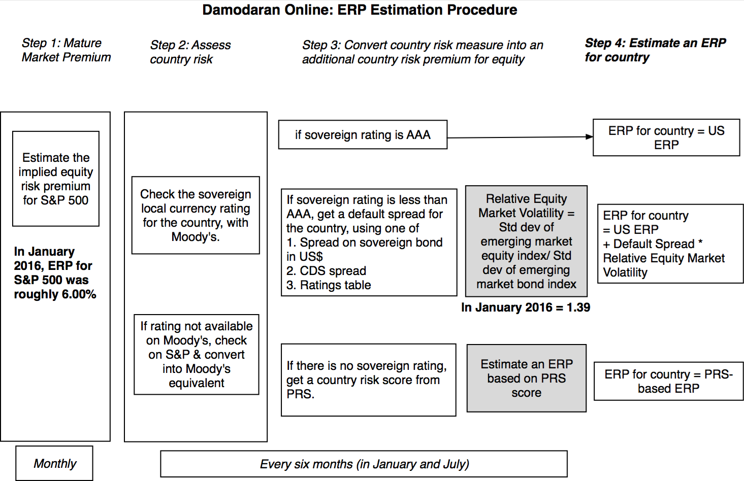
Updating to January 2016: Global ERP
Notes:
In In this approach, we scale up the default spread to reflect the additional risk in stocks… This will result in larger equity risk premiums. We are assuming that investors, when pricing equities in an emerging market, look at what they can make on government bonds issued by that market and scale up premiums for additional risk.
There is a third approach which is closely related where you look at the standard deviation of the emerging equity market, relative to the standard deviation of the U.S. equity market, and multiply by the U.S. equity risk premium. Thus, the equity risk premium for an emerging market which is twice as volatile as the the US market should have an equity risk premium of 7.76% (twice 3.88%).

Slide 30
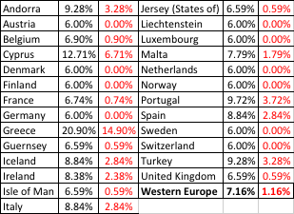
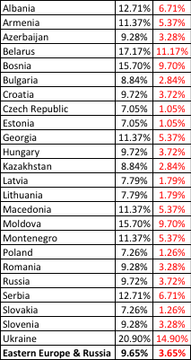
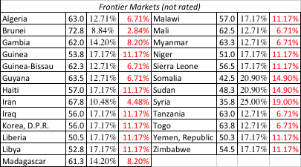
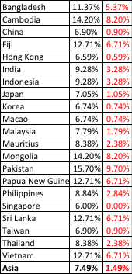

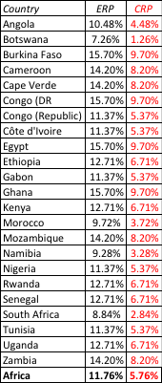
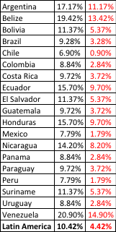
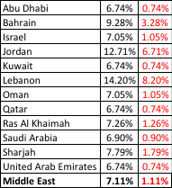

ERP : Jan 2016
Black #: Total ERP
Red #: Country risk premium
AVG: GDP weighted average
Notes:
Updated country risk premiums.

Slide 31
Brazil Spotlight 2016: ERP
Company | Exposure | Revenues | Proportion | ERP | Weighted ERP
Gerdau | North America | 19800 | 45.41% | 6.00% | 8.02%
 | Brazil | 14000 | 32.11% | 9.40%
 | Rest of Latin America | 6700 | 15.37% | 11.37%
 | Europe & Asia | 3100 | 7.11% | 7.39%
Natura | Brazil | 5610 | 71.16% | 9.40% | 10.27%
 | Argentina, Chile & Peru | 1842 | 23.36% | 12.85%
 | Mexico, Venezuela & Colombia | 432 | 5.48% | 10.58%
Cosan | Brazil | 8085 | 95.66% | 9.40% | 9.31%
 | Rest of the World | 367 | 4.34% | 7.44%
Braskem | Brazil | 24561 | 52.06% | 9.40% | 8.57%
 | Argentina | 1340 | 2.84% | 17.58%
 | Mexico | 968 | 2.05% | 7.85%
 | Rest of Latin America | 1824 | 3.87% | 11.37%
 | United States | 9503 | 20.14% | 6.00%
 | Europe | 5899 | 12.50% | 7.20%
 | Asia | 1997 | 4.23% | 7.54%
 | Canada | 902 | 1.91% | 6.00%
 | Rest of the World | 185 | 0.39% | 7.44%
DASA | Brazil | 2794 | 100.00% | 9.40% | 9.40%
Dias Branco | Brazil | 4622 | 100.00% | 9.40% | 9.40%
GOL | Brazil | 8670 | 88.67% | 9.40% | 9.178%
 | Rest of the world | 1108 | 11.33% | 7.44%
Eletrobras | Brazil | 32588 | 100.00% | 9.40% | 9.40%
Marisa Lojas | Brazil | 3164 | 100.00% | 9.40% | 9.40%
Embraer | North America | 13298 | 67.85% | 6.00% | 6.68%
 | Brazil | 2352 | 12.00% | 9.40%
 | Europe | 2189 | 11.17% | 7.20%
 | Asia Pacific | 1759 | 8.98% | 7.54%

Slide 32
III. The Beta
The beta of a stock (asset) measures its exposure to market risk, i.e., the risk that cannot be diversified away by the marginal investors. It is therefore a measure of exposure to broad macroeconomic risk factors.
The beta of a stock is standardized around one.
  A beta that is greater than one indicates above-average risk
  A beta that is close to one indicates average risk
  A beta less than one indicates below average risk
  A beta below zero is a indication of a market risk reducing investment
Implications:
  The weighted average beta of stocks in any market (even the most risky ones) is one. Thus, beta cannot carry the weight of country risk.
  A stock can be risky and have a low beta, if most of the risk in the stock is firm-specific risk.

Slide 33
Measuring Beta
The standard procedure is to regress stock returns (Rj) against market returns (Rm):
  R_{j} = a + b R_{m}
Risk measure: The slope of the regression (b) corresponds to the beta of the stock, and measures the riskiness of the stock. The regression yields a range on the beta that can be computed from the standard error of the beta estimate.
  Plus (minus) one standard errors: 67% confidence interval
  Plus (minus) two standard errors: 95% confidence interval
Performance measure: The intercept (a) of the regression is a measure of how well or badly the stock performed during the period of the regression, after adjusting for risk and market performance. If the regression is run with raw returns, the intercept has to be compared to Rf (1- Beta) to measure what’s called Jensen’s alpha (a – Rf (1- Beta)
  a > Rf (1-b) : Positive Jensen’s alpha = Stock did better than expected during regression period
  a = Rf (1-b): : Zero Jensen’s alpha = Stock did better than expected during regression period
  a < Rf (1-b) : Negative Jensen’s alpha = Stock did better than expected during regression period
Risk source: The R squared (R²) of the regression provides an estimate of the proportion of the risk (variance) of a firm that can be attributed to market risk.

Slide 34
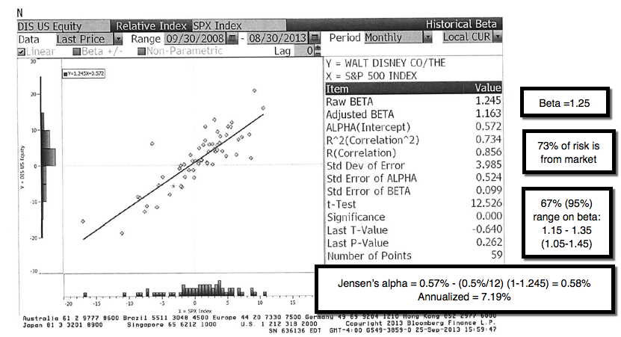
Disney: Beta Regression

Slide 35
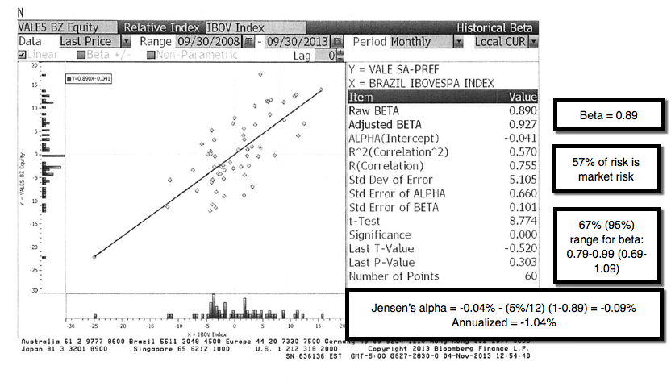
Vale: Beta Regression
Notes:
This is the page for Disney’s beta, using the same period as the regression run earlier, from Bloomberg.
Bloomberg, however, uses only price returns (it ignores dividends both in the stock and the index). Hence the intercept is different.
The adjusted beta is just the regression beta moves towards one, reflecting the empirical realities that for most firms, betas tend to drift towards one as they get larger and more diversified.

Slide 36
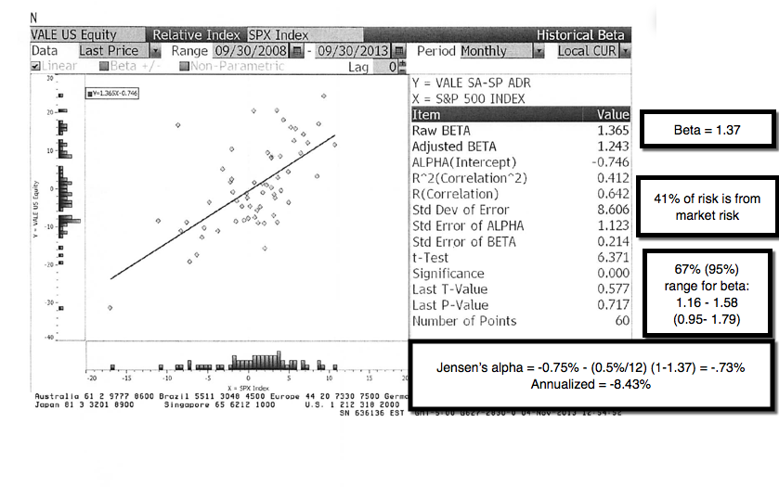
And another regression…

Slide 37
Brazil Spotlight 2016: Beta Regressions
Company | Intercept | Beta | R-squared | Rf (1-Beta) | Jensen's alpha (monthy) | Jensen's alpha (annual)
Gerdau | -0.44% | 1.25 | 33.20% | -0.05% | -0.39% | -18.47%
Natura | -0.42% | 0.84 | 31.00% | 0.03% | -0.45% | -20.94%
Cosan | 0.12% | 0.99 | 48.10% | 0.00% | 0.12% | 6.33%
Braskem | 0.50% | 0.48 | 8.10% | 0.10% | 0.40% | 23.07%
DASA | -0.25% | 0.17 | 1.20% | 0.16% | -0.41% | -19.22%
Dias Branco | -0.03% | 0.53 | 24.90% | 0.09% | -0.12% | -6.07%
GOL | -0.97% | 1.52 | 27.50% | -0.10% | -0.87% | -36.52%
Eletrobras | 0.41% | 1.08 | 43.50% | -0.02% | 0.43% | 24.70%
Marisa Lojas | -0.45% | 0.47 | 6.60% | 0.10% | -0.55% | -25.01%
Embraer | 0.06% | -0.14 | 1.70% | 0.22% | -0.16% | -7.95%

Slide 38
The problem with regression betas
They are backward looking: By definition, a regression beta is backward looking because it is computed based upon past returns. Consequently, if a company’s business mix or financial leverage has changed during the regression period, the regression beta (even if well estimated) is no longer operational.
They are subject to manipulation: Changing the market index used, the time period of the regression or even the return intervals (daily, weekly,monthly) can yield very different regression output.
They are noisy: A regression slope (which is what we use as a beta) comes with a standard error, and if you regress a stock against a broad enough index, the regression beta should have a high standard error (it is a feature, not a bug)>

Slide 39
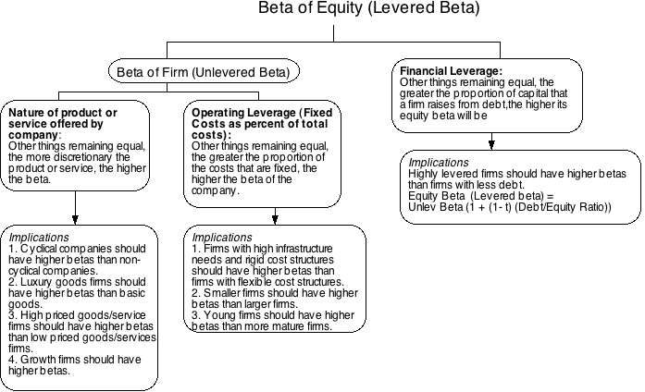
Determinants of Betas
Notes:
These are the three fundamentals that drive betas.
Firms that produce luxury goods (such as Gucci and Tiffanys) should have higher betas than firms that cater to more basic needs (Walmart). These firms tend to have revenues that are much more sensitive to changes in economic conditions.
Firms in businesses with high fixed cost structures (like airlines) should have higher betas than firms with more flexible cost structures.
Firms that borrow more money will have higher equity betas than otherwise similar firms that do not borrow money.

Slide 40
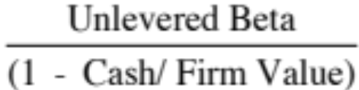
Disney’s business betas
Business | Comparable firms | Sample size | Median Beta | Median D/E | Median Tax rate | Company Unlevered Beta | Median Cash/ Firm Value | Business Unlevered Beta
Media Networks | US firms in broadcasting business | 26 | 1.43 | 71.09% | 40.00% | 1.0024 | 2.80% | 1.0313
Parks & Resorts | Global firms in amusement park business | 20 | 0.87 | 46.76% | 35.67% | 0.6677 | 4.95% | 0.7024
Studio Entertainment | US movie firms | 10 | 1.24 | 27.06% | 40.00% | 1.0668 | 2.96% | 1.0993
Consumer Products | Global firms in toys/games production & retail | 44 | 0.74 | 29.53% | 25.00% | 0.6034 | 10.64% | 0.6752
Interactive | Global computer gaming firms | 33 | 1.03 | 3.26% | 34.55% | 1.0085 | 17.25% | 1.2187
Notes:
Comes from the companies in each sector. Judgment calls had to be made and when the sample size was too small (as was the case with broadcasting and theme parks), I had to broaden my sample, by going up and down the food chain of revenues in the case of broadcasting (by including companies that make revenues from syndicating TV shows, for instance) or going global (with theme parks).

Slide 41
Disney’s Levered beta by division
Business | Revenues | EV/Sales | Value of Business | Proportion of Disney | Unlevered beta | Value | Proportion
Media Networks | $20,356 | 3.27 | $66,580 | 49.27% | 1.03 | $66,579.81 | 49.27%
Parks & Resorts | $14,087 | 3.24 | $45,683 | 33.81% | 0.70 | $45,682.80 | 33.81%
Studio Entertainment | $5,979 | 3.05 | $18,234 | 13.49% | 1.10 | $18,234.27 | 13.49%
Consumer Products | $3,555 | 0.83 | $2,952 | 2.18% | 0.68 | $2,951.50 | 2.18%
Interactive | $1,064 | 1.58 | $1,684 | 1.25% | 1.22 | $1,683.72 | 1.25%
Disney Operations | $45,041 |  | $135,132 | 100.00% | 0.9239 | $135,132.11
Business | Unlevered beta | Value of business | D/E ratio | Levered beta | Cost of Equity
Media Networks | 1.0313 | $66,580 | 10.03% | 1.0975 | 9.07%
Parks & Resorts | 0.7024 | $45,683 | 11.41% | 0.7537 | 7.09%
Studio Entertainment | 1.0993 | $18,234 | 20.71% | 1.2448 | 9.92%
Consumer Products | 0.6752 | $2,952 | 117.11% | 1.1805 | 9.55%
Interactive | 1.2187 | $1,684 | 41.07% | 1.5385 | 11.61%
Disney Operations | 0.9239 | $135,132 | 13.10% | 1.0012 | 8.52%
Notes:
I used revenues and revenue multiples to estimate the values of each business. I could have also used EBIT or EBITDA, by business, and applied a multiple but the problem is with divisions that have negative values for either (as is the case with Interactive for Disney).
The reason that I compute two unlevered beta, one for just the operations and one that includes the cash (and is thus for the entire firm) is that each has its use somewhere along. When computing the cost of capital, which is a cost of funding your operating assets, I will use the former. If I needed a beta for a dividend discount model, where the dividends are paid out of composite earnings, I would use the latter.

Slide 42
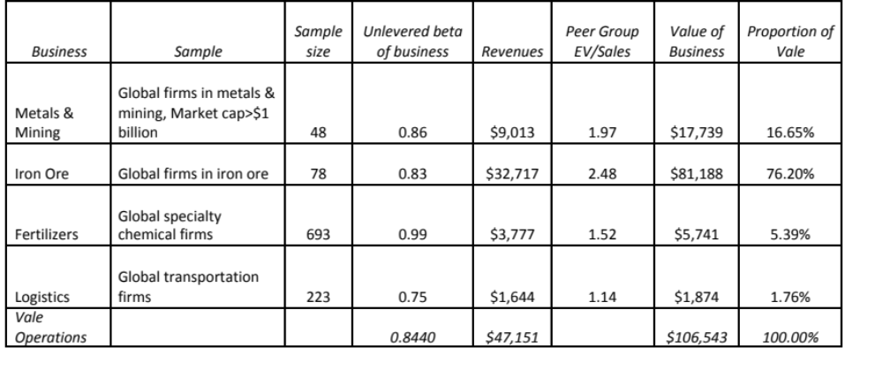
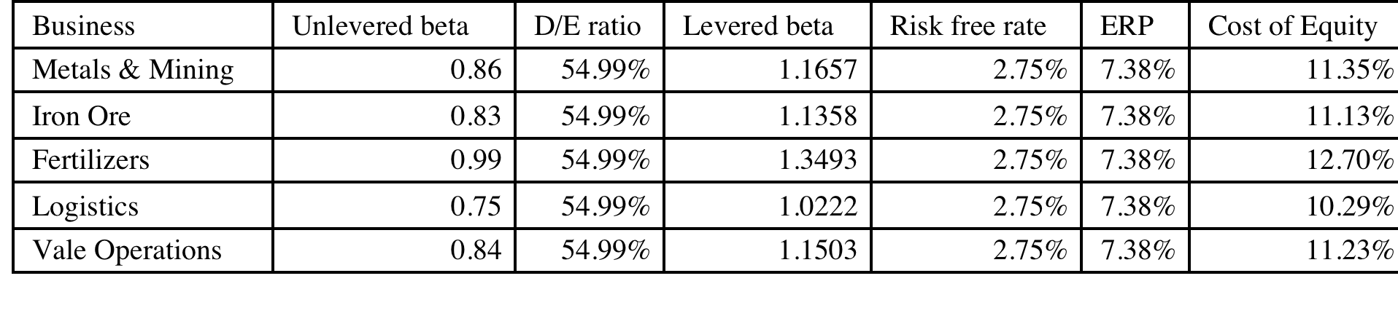
Estimating Bottom Up Betas & Costs of Equity: Vale
Notes:
Following the same script that I did for Disney, but I did not attempt to allocate the debt across businesses, partly because there was little information available on the allocation and partly because they businesses are more similar in terms of their debt capacity.

Slide 43
Discussion Issue
The head of the fertilizer business has come to you with a new investment in Brazil that he would like you to fund. He claims that his analysis of the investment indicates that it will generate a return on equity of 12% (in Brazilian Reais). Would you fund it?
  Yes.
  No.
  What return on equity would this investment need to make to be justified? Why? (The inflation rate in Reais is 9% whereas the inflation rate in US dollars is 2%).
Notes:
The cost of equity for each division should be used. Otherwise, the riskier divisions will over invest and the safest divisions will under invest.
Over time, the firm will become a riskier firm. Think of Bankers Trust from 1980, when it was a commercial bank, to 1992, when it had become primarily an investment bank.
It also means that any multi business company should have different hurdle rates for each business, with higher rates for riskier businesses and lower rates for safer businesses.

Slide 44

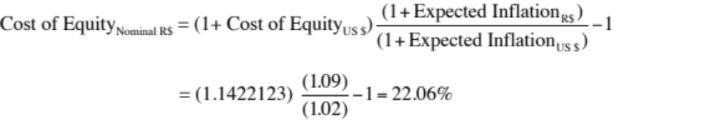
Vale: Cost of Equity for a Brazilian fertilizer investment in nominal $R
To convert a discount rate in one currency to another, all you need are expected inflation rates in the two currencies.
To estimate the cost of equity that Vale should use for a fertilizer investment in Brazil, let’s start by estimating the cost of equity in US dollars:
  Cost of equity = 2.75% + 1.3493 (8.50%) = 14.22%
  The risk free rate is in US dollars, the beta is that of the fertilizer business and the equity risk premium is for Brazil.
Notes:
The cost of equity can be stated in different currencies. When computing the nominal BR cost of equity, we scale up the risk premium to reflect the fact the the inflation rates (and risk free rates in BR) are much higher.
I prefer the first approach, which is to start with a dollar based cost of capital and scale up for inflation differentials, since all of the risk premiums that I am using come from dollar based markets and scaling up with inflation allows me to scale up the premiums as well..

Slide 45
Brazil Spotlight 2016: Bottom up Betas
Company | Business | Unlevered Beta | Total Debt | Market Cap | D/E Ratio | Levered Beta
Gerdau | Steel | 0.6499 | R$ 23,684 | R$ 9,440 | 250.89% | 1.73
Natura | Household Products | 0.9289 | R$ 5,185 | R$ 9,737 | 53.25% | 1.26
Cosan | Green & Renewable Energy | 0.6904 | R$ 9,274 | R$ 14,318 | 64.77% | 0.99
Braskem | Chemical (Specialty) | 0.9676 | R$ 25,379 | R$ 14,989 | 169.32% | 2.05
DASA | Healthcare Support Services | 0.9175 | R$ 1,224 | R$ 3,053 | 40.09% | 1.16
Dias Branco | Food Processing | 0.6848 | R$ 696 | R$ 10,419 | 6.68% | 0.72
GOL | Air Transport | 0.5587 | R$ 7,868 | R$ 955 | 823.87% | 3.60
Eletrobras | Power | 0.5099 | R$ 46,861 | R$ 10,088 | 464.52% | 2.07
Marisa Lojas | Retail (Special Lines) | 0.7846 | R$ 1,050 | R$ 1,663 | 63.14% | 1.11
Embraer | Aerospace/Defense | 0.9812 | R$ 13,037 | R$ 14,069 | 92.66% | 1.58

Slide 46
Estimating the Cost of Debt
If the firm has bonds outstanding, and the bonds are traded, the yield to maturity on a long-term, straight (no special features) bond can be used as the interest rate.
If the firm is rated, use the rating and a typical default spread on bonds with that rating to estimate the cost of debt.
If the firm is not rated,
  and it has recently borrowed long term from a bank, use the interest rate on the borrowing or
  estimate a synthetic rating for the company, and use the synthetic rating to arrive at a default spread and a cost of debt
The cost of debt has to be estimated in the same currency as the cost of equity and the cash flows in the valuation.
Notes:
There are two key components to the cost of debt:
You want a long-term cost (I use a 10-year cost) of debt even if your debt is short term. You do not want to reward companies that play the term structure by giving them a lower cost of debt and capital. In effect, you are assuming that the rolled over cost of short term debt = cost of long term debt.
You want a current cost. In other words, you do not care about the debt and interest expenses on the books. The book interest rate (interest expense/book debt) is not a good measure of the cost of debt because it does not reflect the current cost of borrowing any may even be lower than the riskfree rate.
While the cost of debt can be estimated easily for some firms, by looking up traded bonds, it can be more difficult for non-rated firms. The default spreads can be obtained from
http://www.bondsonline.com

Slide 47
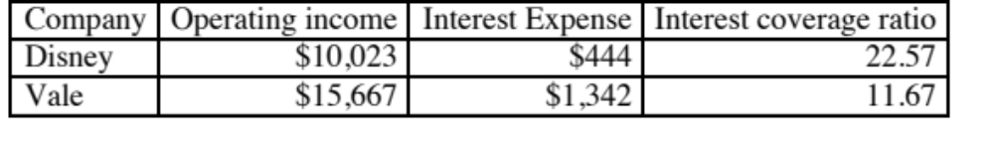
Estimating Synthetic Ratings
The rating for a firm can be estimated using the financial characteristics of the firm. In its simplest form, we can use just the interest coverage ratio:
Interest Coverage Ratio = EBIT / Interest Expenses
The interest coverage ratio measures how much operating income a firm generates relative to a dollar of interest expenses.
Notes:
Basing the rating on just an interest coverage ratio will give you an approximation for the rating. A more realistic approach would use more than the interest coverage ratio. In fact, we could construct a score based upon multiple ratios (such as a Z-score) and use that score to estimate ratings.
The operating income used to compute the rating does not have to be last year’s number. It can be an average over time or a normalized value.

Slide 48
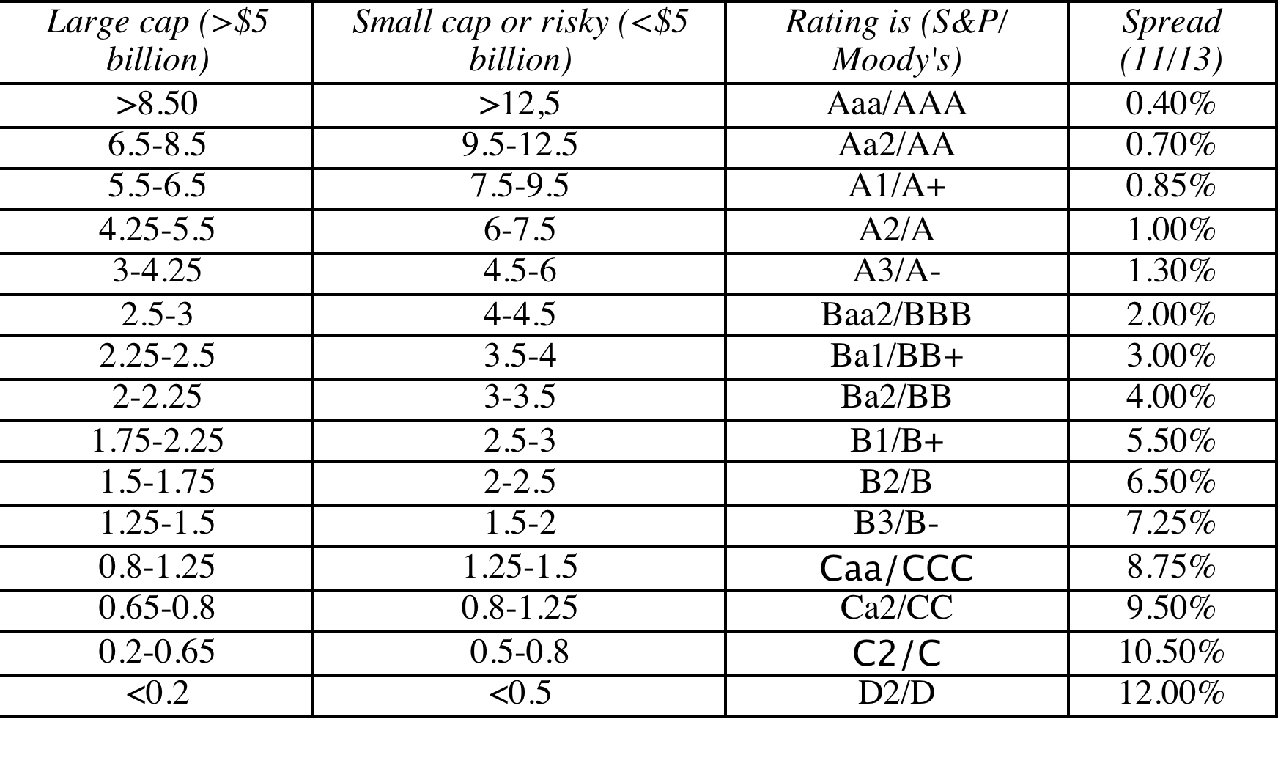
Interest Coverage Ratios, Ratings and Default Spreads- November 2013
Disney: Large cap, developed 22.57 → AAA
Vale: Large cap, emerging 11.67 → AA
Notes:
This table is constructed, using smaller non-financial service companies (<$5 billion market cap) that are rated, and their interest coverage ratios. The firms were sorted based upon their ratings, and the interest coverage range was estimated.
These ranges will change over time, especially as the economy strengthens or weakens. You can get the updated ranges on my web site.

Slide 49
Synthetic versus Actual Ratings: Rated Firms
Disney’s synthetic rating is AAA, whereas its actual rating is A. The difference can be attributed to any of the following:
  Synthetic ratings reflect only the interest coverage ratio whereas actual ratings incorporate all of the other ratios and qualitative factors
  Synthetic ratings do not allow for sector-wide biases in ratings
  Synthetic rating was based on 2013 operating income whereas actual rating reflects normalized earnings
Vale’s synthetic rating is AA, but the actual rating for dollar debt is A-. The biggest factor behind the difference is the presence of country risk, since Vale is probably being rated lower for being a Brazil-based corporation.
Notes:
The synthetic ratings process will deliver reasonably close ratings for any firm with debt of substance. It will tend to overstate ratings for firms with little debt (technology firms often will get AAA ratings because their interest coverage ratios are so high). The fact that these ratings are too high is not an issue because these companies also have so little debt in their capital structure - the cost of capital is very close to the cost of equity.
Can we trust rating agencies? In general, ratings agencies do a reasonable job of assessing default risk and offer us these measures for free (at least to investors). They have two faults: (1) They adjust for changes in default risk too slowly. All too often ratings downgrades follow bond price declines and not the other way around (2) They sometimes get caught up in the mood of the moment and either overestimate default risk or underestimate default risk for an entire sector.
It is a good idea to estimate synthetic ratings even for firms that have actual ratings. If there is disagreement between ratings agencies or a firm has multiple bond ratings, the synthetic rating can operate as a tie-breaker. If there is a significant difference between actual and synthetic ratings and there is no fundamental reason that can be pinpointed for the difference, the synthetic rating may be providing an early signal of a ratings agency mistake.

Slide 50
Brazil Spotlight 2016: Costs of Debt
US dollar risk free rate = |  | 1.80%
Default Spread for Brazil = |  | 2.44%
Marginal tax rate = |  | 34.00%
Company | EBIT | Interest Expense | Interest coverage ratio | Synthetic Rating | Actual Rating | Pre-tax cost of debt | After-tax cost of debt
Gerdau | 1535 | 1528 | 1.00 | Ca2/CC | Ba1/BB+ | 7.49% | 4.94%
Natura | 1181 | 342 | 3.45 | Ba2/BB | Ba1/BB+ | 7.49% | 4.94%
Cosan | 1587 | 1531 | 1.04 | Ca2/CC | Ba2/BB | 8.49% | 5.60%
Braskem | 8555 | 1788 | 4.78 | A3/A- | Ba1/BB+ | 7.49% | 4.94%
DASA | 200 | 206 | 0.97 | Ca2/CC | NA | 16.24% | 10.72%
Dias Branco | 539 | 30 | 17.97 | Aaa/AAA | NA | 4.99% | 3.29%
GOL | 106 | 951 | 0.11 | D2/D | Ca2/CC | 16.24% | 10.72%
Eletrobras | -16610 | 6838 | -2.43 | D2/D | Ba2/BB | 8.49% | 5.60%
Marisa Lojas | 70 | 132 | 0.53 | C2/C | NA | 20.24% | 13.36%
Embraer | 1200 | 686 | 1.75 | B3/B- | Ba1/BB+ | 7.49% | 4.94%

Slide 51
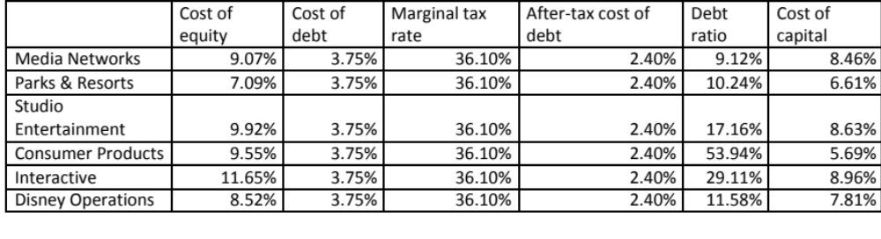
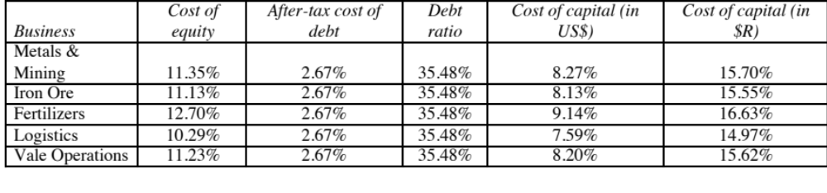
Divisional Costs of Capital: Disney and Vale
Disney
Vale
Notes:
For Disney, we used the division specific debt ratio weights we estimated earlier (when estimating the levered beta). We did assume that all divisions borrow at Disney’s pre-tax cost of debt. If the divisions issued debt independently, we would have considered using division-specific costs of debt.
For Vale, we used the same debt ratio and cost of debt for both divisions.
The cost of capital for Vale will be higher in $R, because we expect inflation to be 9% in $R and only 2% in US dollars.

Slide 52
Brazil Spotlight 2016: Costs of Capital
Expected inflation in US$ = |  | 1.50%
Expected inflation in $R = |  | 10.00%
Company | Levered Beta | ERP | Cost of Equity | After-tax cost of debt | Debt/Capital | Cost of capital ($) | Cost of Capital ($R)
Gerdau | 1.73 | 8.02% | 15.64% | 4.94% | 71.50% | 7.99% | 17.03%
Natura | 1.26 | 10.27% | 14.69% | 4.94% | 34.75% | 11.31% | 20.63%
Cosan | 0.99 | 9.31% | 10.98% | 5.60% | 39.31% | 8.87% | 17.98%
Braskem | 2.05 | 8.57% | 19.35% | 4.94% | 62.87% | 10.29% | 19.53%
DASA | 1.16 | 9.40% | 12.71% | 10.72% | 28.62% | 12.14% | 21.53%
Dias Branco | 0.72 | 9.40% | 8.52% | 3.29% | 6.26% | 8.19% | 17.25%
GOL | 3.60 | 9.18% | 34.81% | 10.72% | 89.18% | 13.33% | 22.82%
Eletrobras | 2.07 | 9.40% | 21.29% | 5.60% | 82.29% | 8.38% | 17.46%
Marisa Lojas | 1.11 | 9.40% | 12.25% | 13.36% | 38.70% | 12.68% | 22.11%
Embraer | 1.58 | 6.68% | 12.36% | 4.94% | 48.10% | 8.79% | 17.91%

Slide 53
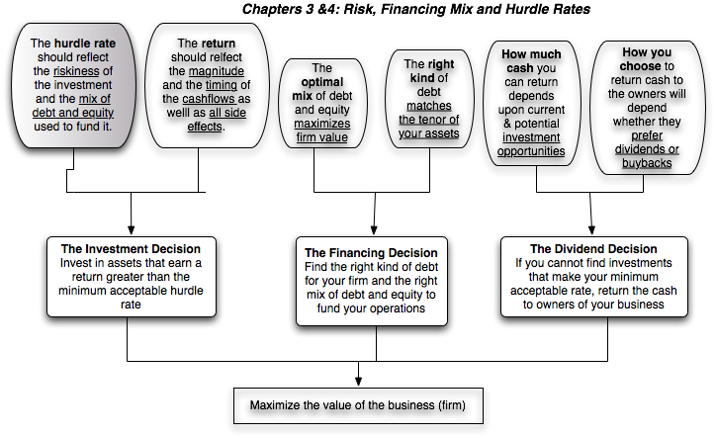
Back to First Principles
Notes:
Took us a while but we have the mechanics of the hurdle rate down..

Slide 54
Measuring Returns Right: The Basic Principles
Use cash flows rather than earnings. You cannot spend earnings.
Use “incremental” cash flows relating to the investment decision, i.e., cashflows that occur as a consequence of the decision, rather than total cash flows.
Use “time weighted” returns, i.e., value cash flows that occur earlier more than cash flows that occur later.
The Return Mantra: “Time-weighted, Incremental Cash Flow Return”
Notes:
These are the basic financial principles underlying the measurement of investment returns.
We focus on cash flows, because when cash flows and earnings are different, cash flows provide a more reliable measure of what an investment generates.
We focus on “incremental” effects on the overall business, since we care about the overall health and value of the business, not just individual projects.
We use time-weighted returns, since returns made earlier are worth more than the same returns made later.

Slide 55
Earnings versus Cash Flows: A Disney Theme Park
The theme parks to be built near Rio, modeled on Euro Disney in Paris and Disney World in Orlando.
The complex will include a “Magic Kingdom” to be constructed, beginning immediately, and becoming operational at the beginning of the second year, and a second theme park modeled on Epcot Center at Orlando to be constructed in the second and third year and becoming operational at the beginning of the fourth year.
The earnings and cash flows are estimated in nominal U.S. Dollars.
Notes:
The earnings and cash flows will really be in Brazilian $R. We will consider later the effects of looking at all the cash flows in a different currency.
Note that this investment is not going to be fully operational until the fourth year.

Slide 56
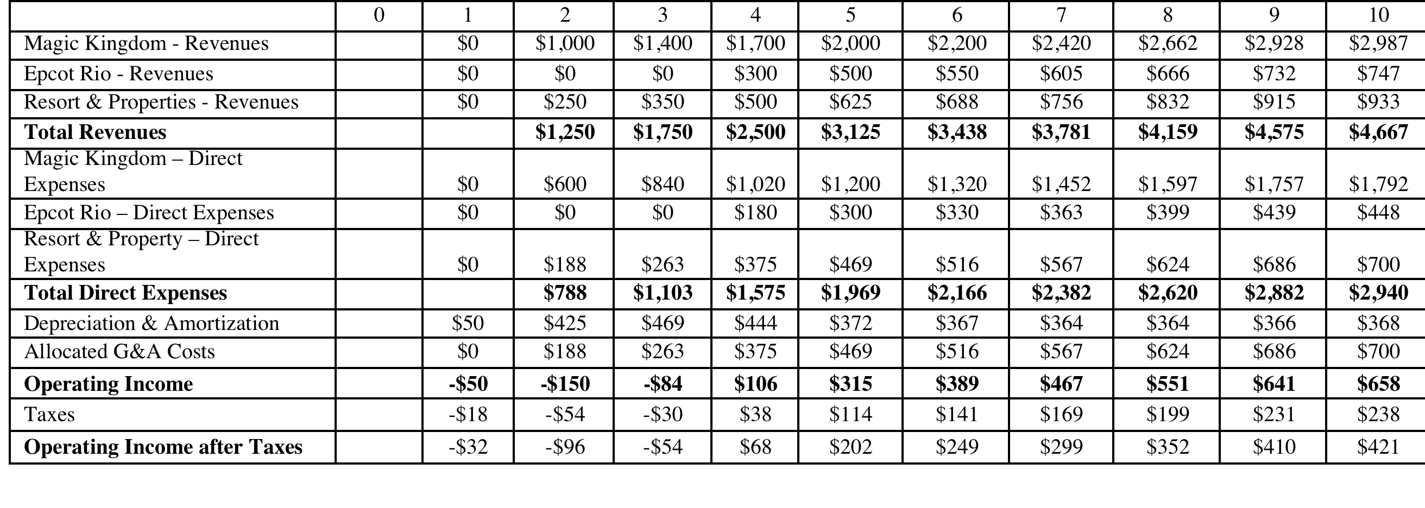
Step 1: Estimate Accounting Earnings on Project
Direct expenses: 60% of revenues for theme parks, 75% of revenues for resort properties
Allocated G&A: Company G&A allocated to project, based on projected revenues. Two thirds of expense is fixed, rest is variable.
Taxes: Based on marginal tax rate of 36.1%
Notes:
This shows the accounting earnings calculations for the next 10 years. Note the increasing after-tax operating income over time.
Note that loss in year 1. While this loss can be carried forward and offset against profits in future years, we have chosen to claim the losses against Disney’s profits from other projects in year 1. (You would rather save taxes now than the same taxes in the future…)
Where are the interest expenses? They do not show up because we are computing earnings to the firm - operating income - rather than earnings to equity - net income.

Slide 57
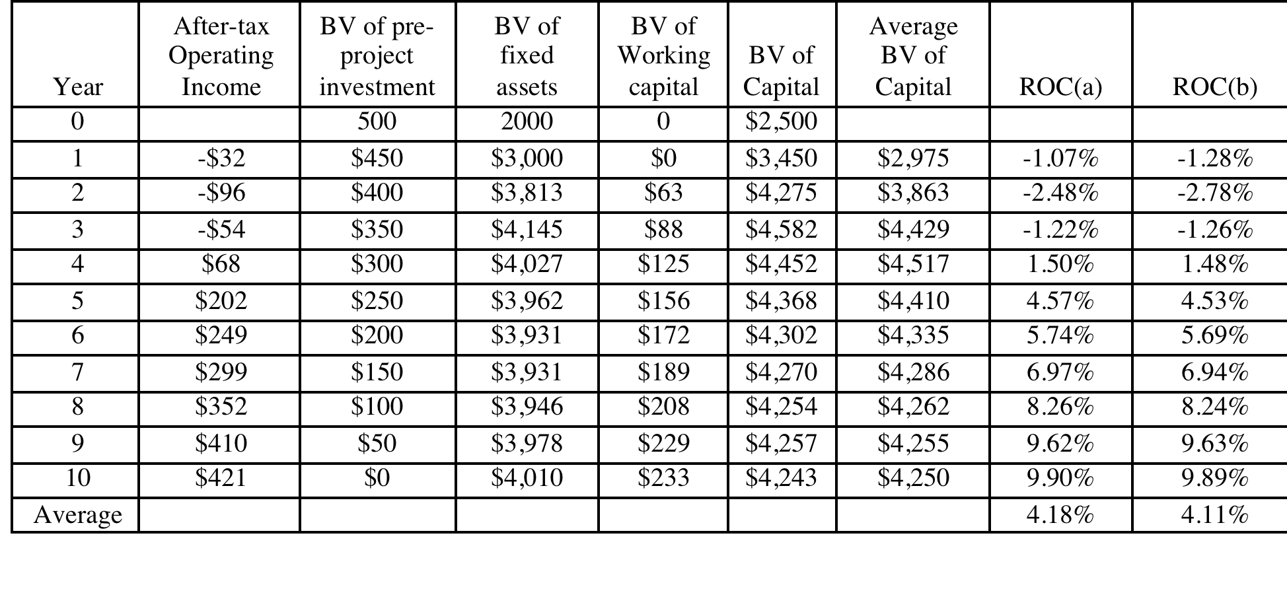
And the Accounting View of Return
Based upon book capital at the start of each year
Based upon average book capital over the year
Notes:
This converts the accounting income into a percentage return (to enable us to do the comparison to the hurdle rate, which is a percentage rate). We have computed a simple average return on capital over the next 10 years…
The average book value is computed each year using the beginning and ending book values. The book values themselves are computed as follows:
Ending BV = Beginning BV - Depreciation + Capital Expenditures

Slide 58
Estimating a hurdle rate for Rio Disney
We did estimate a cost of capital of 6.61% for the Disney theme park business, using a bottom-up levered beta of 0.7537 for the business.
This cost of equity may not adequately reflect the additional risk associated with the theme park being in an emerging market.
The only concern we would have with using this cost of equity for this project is that it may not adequately reflect the additional risk associated with the theme park being in an emerging market (Brazil). We first computed the Brazil country risk premium (by multiplying the default spread for Brazil by the relative equity market volatility) and then re-estimated the cost of equity:
  Country risk premium for Brazil = 5.5%+ 3% = 8.5%
  Cost of Equity in US$= 2.75% + 0.7537 (8.5%) = 9.16%
Using this estimate of the cost of equity, Disney’s theme park debt ratio of 10.24% and its after-tax cost of debt of 2.40% (see chapter 4), we can estimate the cost of capital for the project:
  Cost of Capital in US$ = 9.16% (0.8976) + 2.40% (0.1024) = 8.46%
Notes:
Here is the other half of the equation:
The hurdle rate for an investment should reflect its risk. (That is why we use the bottom-up beta that we estimated for theme parks earlier rather than the bottom-up beta for Disney as a company). In addition, the exposure to country risk is incorporated into the investment.
We use Disney’s theme park debt ratio for this theme park, on the assumption that it is not a stand-alone investment with its own debt capacity. If it were, we would have considered using project specific financing weights. (It is usually not a good idea to compute the cost of capital for a project based on how it is financed, since firms can use disproportionate amounts of debt on some projects not because the projects can afford to carry debt but because they (the firms) have excess debt capacity.

Slide 59
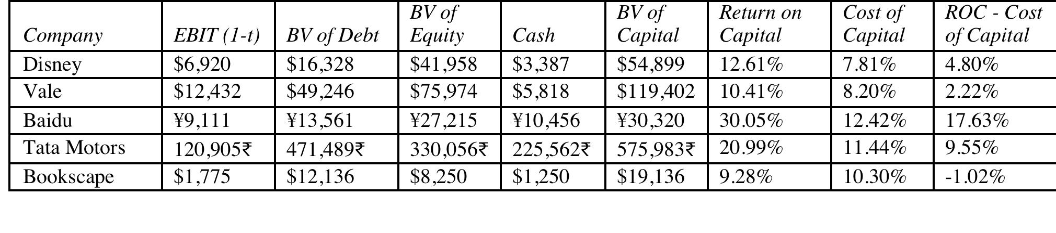
A Tangent: From New to Existing Investments: ROC for the entire firm
How “good” are the existing investments of the firm?
Measuring ROC for existing investments..
Notes:
A firm can be viewed as having a portfolio of existing projects. This approach allows you to assess whether that portfolio is earning more than the hurdle rate, but it is based upon the following assumptions:
Accounting earnings are a good measure of the earnings from current projects (They might not be, if items like R&D, which are really investments for the future, extraordinary profits or losses, or accounting changes affect the reported income.)
The book value of capital is a good measure of what is invested in current projects.
Some computational details:
Why do we use book value of debt and equity?
Because we want to focus on capital invested in assets in place. Market value has two problems. It includes growth assets and it updates the value to reflect returns earned. In fact, if you computed market value of just assets in place correctly, you should always earn your cost of capital.
Why end of last year?
To stay consistent with end-of-the-year cash flows and earnings that we use in the rest of the analysis. If we used mid-year conventions, we could use average values instead.

Slide 60
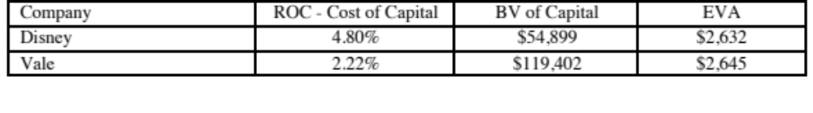
Old wine in a new bottle.. Another way of presenting the same results…
The key to value is earning excess returns. Over time, there have been attempts to restate this obvious fact in new and different ways. For instance, Economic Value Added (EVA) developed a wide following in the the 1990s:
EVA = (ROC – Cost of Capital ) (Book Value of Capital Invested)
The excess returns for the four firms can be restated as follows:
Notes:
The EVA is a measure of dollar value created in a single time period. Thus, it will be affected by how capital is measured and the ups and downs of year-to-year operating income.
EVA just restates the excess returns (ROC – Cost of capital) in dollar value terms. Thus, it will always have the same sign as the excess return, but it will be larger for larger companies. Thus, you cannot compare the EVA across companies but you can compare the EVA for the same company from year to year.

Slide 61
Brazil Spotlight 2016: Measuring ROIC versus Cost of Capital
Company | EBIT | Effective Tax Rate | Total Debt | Book Equity | Cash | Invested Capital | ROIC | Cost of Capital | Real Cost of Capital
Gerdau | R$ 1,535 | 20.93% | R$ 23,684 | R$ 30,286 | R$ 5,525 | R$ 48,445 | 2.51% | 17.03% | 6.39%
Natura | R$ 1,181 | 32.38% | R$ 5,185 | R$ 930 | R$ 2,424 | R$ 3,691 | 21.64% | 20.63% | 9.66%
Cosan | R$ 1,587 | 21.64% | R$ 9,274 | R$ 12,025 | R$ 2,660 | R$ 18,639 | 6.67% | 17.98% | 7.26%
Braskem | R$ 8,555 | 25.15% | R$ 25,379 | R$ 3,642 | R$ 7,562 | R$ 21,459 | 29.84% | 19.53% | 8.66%
DASA | R$ 200 | 35.00% | R$ 1,224 | R$ 2,794 | R$ 523 | R$ 3,495 | 3.72% | 21.53% | 10.48%
Dias Branco | R$ 539 | 8.66% | R$ 696 | R$ 3,812 | R$ 435 | R$ 4,073 | 12.09% | 17.25% | 6.59%
GOL | R$ 106 | 0.00% | R$ 7,868 | -R$ 3,572 | R$ 1,402 | R$ 2,894 | 3.66% | 22.82% | 11.65%
Eletrobras | -R$ 16,610 | 0.00% | R$ 46,861 | R$ 37,796 | R$ 8,812 | R$ 75,845 | -21.90% | 17.46% | 6.78%
Marisa Lojas | R$ 70 | 9.48% | R$ 1,050 | R$ 1,094 | R$ 450 | R$ 1,694 | 3.74% | 22.11% | 11.01%
Embraer | R$ 1,200 | 31.00% | R$ 13,037 | R$ 14,043 | R$ 12,254 | R$ 14,826 | 5.58% | 17.91% | 7.19%

Slide 62
The cash flow view of this project..
 | 0 | 1 | 2 | 3 | 4 | 5 | 6 | 7 | 8 | 9 | 10
After-tax Operating Income |  | -$32 | -$96 | -$54 | $68 | $202 | $249 | $299 | $352 | $410 | $421
+ Depreciation & Amortization | $0 | $50 | $425 | $469 | $444 | $372 | $367 | $364 | $364 | $366 | $368
- Capital Expenditures | $2,500 | $1,000 | $1,188 | $752 | $276 | $258 | $285 | $314 | $330 | $347 | $350
- Change in non-cash Work Capital |  | $0 | $63 | $25 | $38 | $31 | $16 | $17 | $19 | $21 | $5
Cashflow to firm | ($2,500) | ($982) | ($921) | ($361) | $198 | $285 | $314 | $332 | $367 | $407 | $434
To get from income to cash flow, we
added back all non-cash charges such as depreciation. Tax benefits:
subtracted out the capital expenditures
subtracted out the change in non-cash working capital
 | 1 | 2 | 3 | 4 | 5 | 6 | 7 | 8 | 9 | 10
Depreciation | $50 | $425 | $469 | $444 | $372 | $367 | $364 | $364 | $366 | $368
Tax Bendfits from Depreciation | $18 | $153 | $169 | $160 | $134 | $132 | $132 | $132 | $132 | $133
Notes:
This converts earnings to cash flows.
Depreciation and amortization are just two of the most common non-cash charges.
Any capital expenditures (whether initial or maintenance) need to be subtracted out.
It is only the change in non-cash working capital that needs to be subtracted out.

Slide 63
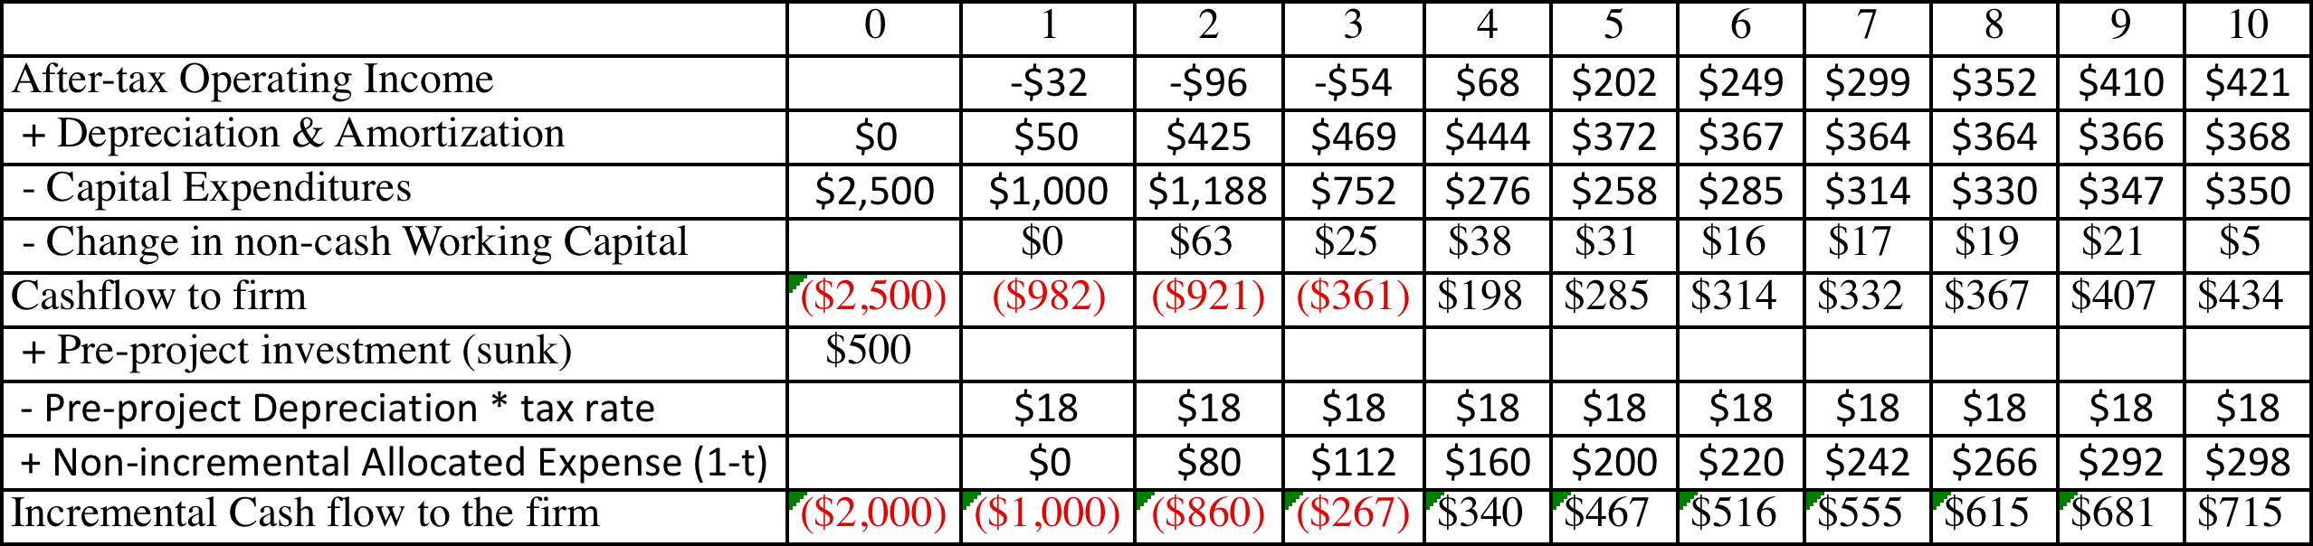
The incremental cash flows on the project
$ 500 million has already been spent & $ 50 million in depreciation will exist anyway
2/3rd of allocated G&A is fixed.
Add back this amount (1-t)
Tax rate = 36.1%
Notes:
A sunk cost is any cost that has already been incurred and will not be recovered even if the project under consideration is rejected.
The tax savings on the depreciation on the sunk cost is also subtracted out, since that tax savings would accrue to the firm even if it did not take this investment.
Only the after-tax amount of the non-incremental allocated costs are added back because the cash flows are after-tax cash flows.
Alternatively, the cash flows can be estimated from scratch using only the incremental cash flows.

Slide 64
Closure on Cash Flows
In a project with a finite and short life, you would need to compute a salvage value, which is the expected proceeds from selling all of the investment in the project at the end of the project life. It is usually set equal to book value of fixed assets and working capital
In a project with an infinite or very long life, we compute cash flows for a reasonable period, and then compute a terminal value for this project, which is the present value of all cash flows that occur after the estimation period ends..
Assuming the project lasts forever, and that cash flows after year 10 grow 2% (the inflation rate) forever, the present value at the end of year 10 of cash flows after that can be written as:
  Terminal Value in year 10= CF in year 11/(Cost of Capital - Growth Rate)
  =715 (1.02) /(.0846-.02) = $ 11,275 million
Notes:
When you stop estimating cash flows on a project, you have to either estimate salvage value or terminal value. For projects with finite lives (such as buying a plant or equipment), estimating salvage value is appropriate. For projects with very long lives, estimating a terminal value is more reasonable.
If you assume that the project is liquidated, any investments in working capital have to be salvaged. This does not necessarily mean that you will get 100% back.
A terminal value can also be thought off as the value that you would get by selling this project (as an on-going project) to someone else at the end of the analysis. In this case, we are estimating that the theme park in Bangkok will be worth $ 10,669 million at the end of year 10. (The perpetual growth model gives the value of the asset at the beginning of the year of the cash flow. We used year 11 cash flows in the numerator and have the terminal value as of the start of year 11, which is also the end of year 10)

Slide 65
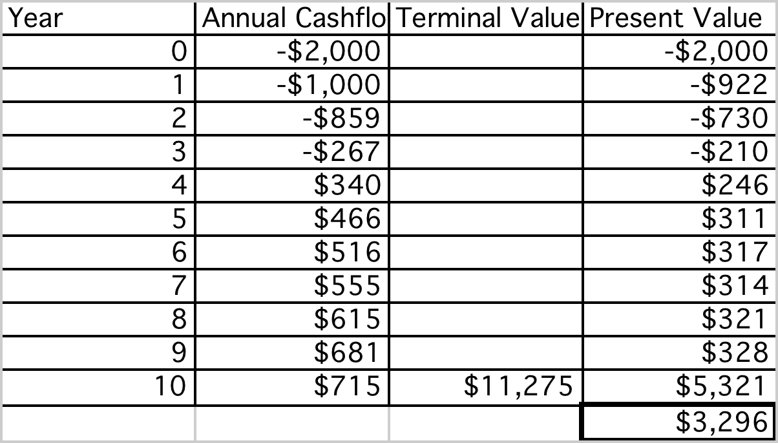
Which yields a NPV of..
Discounted at Rio Disney cost of capital of 8.46%
Notes:
This is the net present value calculation using the cost of capital of 8.62%, the theme park cost of capital adjusted for emerging market risk in Brazil.

Slide 66
The IRR of this project
Notes:
This is a net present value profile, where NPV is plotted against discount rates. The IRR is that discount rate at which NPV is zero.
The steepness of the slope tells us something about how sensitive this investment is to changes in the discount rate. (It is the equivalent of the duration of a bond, which tells you how sensitive bond prices are to changes in interest rates).
Notice that the NPV is much more sensitive to changes in discount rates, when discount rates are low, than when they are high. (This may have consequences for how value will change in low interest rate scenarios as opposed to high interest rate ones).

Slide 67
Disney Theme Park: $R NPV
  Expected Exchange Rate_{t}
  = Exchange Rate today * (1.09/1.02)^{t}
Discount at $R cost of capital
= (1.0846) (1.09/1.02) – 1 = 15.91%
Year | Cashflow ($) | $R/$ | Cashflow ($R) | Present Value
0 | -R$ 2,000.00 | R$ 2.35 | -R$ 4,700.00 | -R$ 4,700.00
1 | -R$ 1,000.00 | R$ 2.51 | -R$ 2,511.27 | -R$ 2,166.62
2 | -R$ 859.03 | R$ 2.68 | -R$ 2,305.29 | -R$ 1,715.95
3 | -R$ 267.39 | R$ 2.87 | -R$ 766.82 | -R$ 492.45
4 | R$ 340.22 | R$ 3.06 | R$ 1,042.63 | R$ 577.68
5 | R$ 466.33 | R$ 3.27 | R$ 1,527.21 | R$ 730.03
6 | R$ 516.42 | R$ 3.50 | R$ 1,807.31 | R$ 745.36
7 | R$ 555.08 | R$ 3.74 | R$ 2,075.89 | R$ 738.63
8 | R$ 614.95 | R$ 4.00 | R$ 2,457.65 | R$ 754.45
9 | R$ 681.46 | R$ 4.27 | R$ 2,910.36 | R$ 770.81
10 | R$ 11,989.85 | R$ 4.56 | R$ 54,719.84 | R$ 12,503.50
 |  |  |  | R$ 7,745.43
NPV = R$ 7,745/2.35= $ 3,296 Million
NPV is equal to NPV in dollar terms
Notes:
The NPV is identical because what we lose by using a higher discount rate is exactly offset by what we gain in growth in the cash flows.
If you are not consistent about estimating the cash flows and the discount rates, the net present values may deviate but only because you have brought your point of view on the currency into the analysis.

Slide 68
Equity Analysis: The Parallels
The investment analysis can be done entirely in equity terms, as well. The returns, cashflows and hurdle rates will all be defined from the perspective of equity investors.
If using accounting returns,
  Return will be Return on Equity (ROE) = Net Income/BV of Equity
  ROE has to be greater than cost of equity
If using discounted cashflow models,
  Cashflows will be cashflows after debt payments to equity investors
  Hurdle rate will be cost of equity
Notes:
The Disney analysis was a firm analysis, looking at cost of capital and returns on capital. (Note that while we borrowed money, we did not consider any of the cash flows associated with borrowing. The earnings were before interest expenses and the cash flows were before debt repayments.
The analysis could have been done entirely in terms of cash flows and returns to equity investors in the business.

Slide 69
A Vale Iron Ore Mine in Canada Investment Operating Assumptions
The mine will require an initial investment of $1.25 billion and is expected to have a production capacity of 8 million tons of iron ore, once established. The initial investment of $1.25 billion will be depreciated over ten years, using double declining balance depreciation, down to a salvage value of $250 million at the end of ten years.
The mine will start production midway through the next year, producing 4 million tons of iron ore for year 1, with production increasing to 6 million tons in year 2 and leveling off at 8 million tons thereafter (until year 10). The price, in US dollars per ton of iron ore is currently $100 and is expected to keep pace with inflation for the life of the plant.
The variable cost of production, including labor, material and operating expenses, is expected to be $45/ton of iron ore produced and there is a fixed cost of $125 million in year 1. Both costs, which will grow at the inflation rate of 2% thereafter. The costs will be in Canadian dollars, but the expected values are converted into US dollars, assuming that the current parity between the currencies (1 Canadian $ = 1 US dollar) will continue, since interest and inflation rates are similar in the two currencies.
The working capital requirements are estimated to be 20% of total revenues, and the investments have to be made at the beginning of each year. At the end of the tenth year, it is anticipated that the entire working capital will be salvaged.
Vale’s corporate tax rate of 34% will apply to this project as well.
Notes:
This project differs from the Disney analysis on three dimensions:
The cash flows are in real terms.
The investment is a finite life investment
The analysis will be done in equity terms.

Slide 70
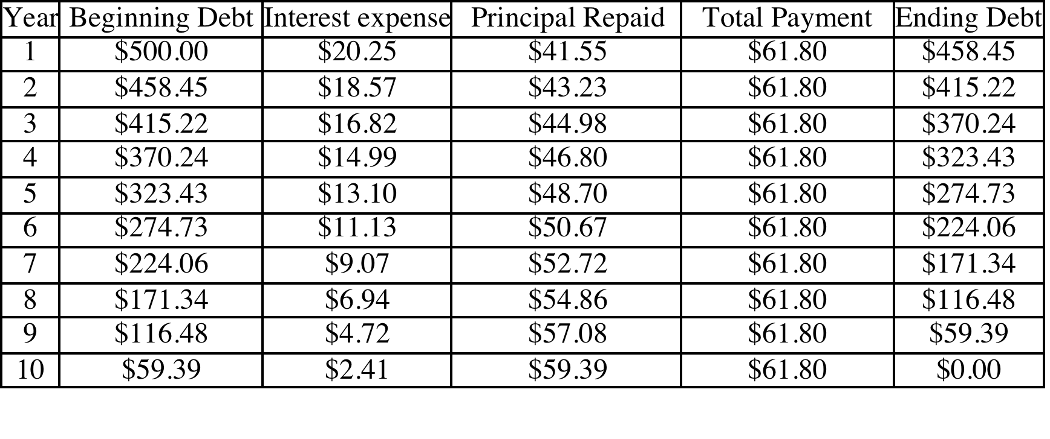
Financing Assumptions
Vale plans to borrow $0.5 billion at its current cost of debt of 4.05% (based upon its rating of A-), using a ten-year term loan (where the loan will be paid off in equal annual increments). The breakdown of the payments each year into interest and principal are provided below:
Notes:
The mine will be partly funded with debt, which will be paid off in equal annual installments. However, the composition of these payments will change over time.
Start by estimating the annual payment, using the loan amount of $50 million and the interest rate of 4.05%, with a ten-year maturity. Then, break the payment down by year into interest and principal. If you do it right, there should be no principal left at the end of the 10th year.

Slide 71
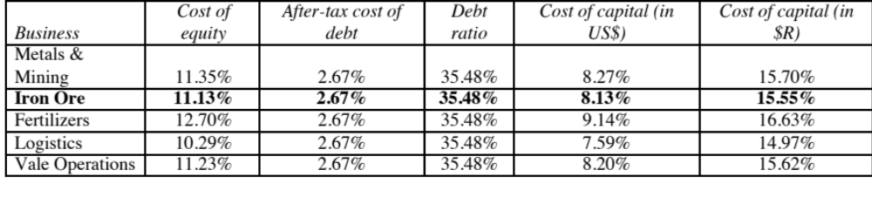
The Hurdle Rate
The analysis is done US dollar terms and to equity investors. Thus, the hurdle rate has to be a US $ cost of equity.
In the earlier section, we estimated costs of equity, debt and capital in US dollars and $R for Vale’s iron ore business.
Notes:
Everything is done in real, equity terms.
Note that we are using the levered beta for just the iron ore business and not Vale as a whole

Slide 72
Net Income: Vale Iron Ore Mine
 | 1 | 2 | 3 | 4 | 5 | 6 | 7 | 8 | 9 | 10
Production (millions of tons) | 4.00 | 6.00 | 8.00 | 8.00 | 8.00 | 8.00 | 8.00 | 8.00 | 8.00 | 8.00
* Price per ton | 102 | 104.04 | 106.12 | 108.24 | 110.41 | 112.62 | 114.87 | 117.17 | 119.51 | 121.9
= Revenues (millions US$) | $408.00 | $624.24 | $848.97 | $865.95 | $883.26 | $900.93 | $918.95 | $937.33 | $956.07 | $975.20
- Variable Costs | $180.00 | $275.40 | $374.54 | $382.03 | $389.68 | $397.47 | $405.42 | $413.53 | $421.80 | $430.23
- Fixed Costs | $125.00 | $127.50 | $130.05 | $132.65 | $135.30 | $138.01 | $140.77 | $143.59 | $146.46 | $149.39
- Depreciation | $200.00 | $160.00 | $128.00 | $102.40 | $81.92 | $65.54 | $65.54 | $65.54 | $65.54 | $65.54
EBIT | -$97.00 | $61.34 | $216.37 | $248.86 | $276.37 | $299.91 | $307.22 | $314.68 | $322.28 | $330.04
- Interest Expenses | $20.25 | $18.57 | $16.82 | $14.99 | $13.10 | $11.13 | $9.07 | $6.94 | $4.72 | $2.41
Taxable Income | -$117.25 | $42.77 | $199.56 | $233.87 | $263.27 | $288.79 | $298.15 | $307.74 | $317.57 | $327.63
- Taxes | ($39.87) | $14.54 | $67.85 | $79.51 | $89.51 | $98.19 | $101.37 | $104.63 | $107.97 | $111.40
= Net Income (millions US$) | -$77.39 | $28.23 | $131.71 | $154.35 | $173.76 | $190.60 | $196.78 | $203.11 | $209.59 | $216.24
Book Value and Depreciation
Beg. Book Value | $1,250.00 | $1,050.00 | $890.00 | $762.00 | $659.60 | $577.68 | $512.14 | $446.61 | $381.07 | $315.54
- Depreciation | $200.00 | $160.00 | $128.00 | $102.40 | $81.92 | $65.54 | $65.54 | $65.54 | $65.54 | $65.54
+ Capital Exp. | $0.00 | $0.00 | $0.00 | $0.00 | $0.00 | $0.00 | $0.00 | $0.00 | $0.00 | $0.00
End Book Value | $1,050.00 | $890.00 | $762.00 | $659.60 | $577.68 | $512.14 | $446.61 | $381.07 | $315.54 | $250.00
- Debt Outstanding | $458.45 | $415.22 | $370.24 | $323.43 | $274.73 | $224.06 | $171.34 | $116.48 | $59.39 | $0.00
End Book Value of Equity | $591.55 | $474.78 | $391.76 | $336.17 | $302.95 | $288.08 | $275.27 | $264.60 | $256.14 | $250.00
Notes:
The mine takes a little while to transition to full production and the price per ton rises at 2% (inflation rate) every year.
The depreciation is 20% of the remaining depreciable value until you get to year 6, when the straight line depreciation exceeds it and we switch to it.

Slide 73
A ROE Analysis
Year | Net Income | Beg. BV: Assets | Depreciation | Capital Expense | Ending BV: Assets | BV of Working Capital | Debt | BV: Equity | Average BV: Equity | ROE
0 |  | $0.00 | $0.00 | $1,250.00 | $1,250.00 | $81.60 | $500.00 | $831.60
1 | ($77.39) | $1,250.00 | $200.00 | $0.00 | $1,050.00 | $124.85 | $458.45 | $716.40 | $774.00 | -10.00%
2 | $28.23 | $1,050.00 | $160.00 | $0.00 | $890.00 | $169.79 | $415.22 | $644.57 | $680.49 | 4.15%
3 | $131.71 | $890.00 | $128.00 | $0.00 | $762.00 | $173.19 | $370.24 | $564.95 | $604.76 | 21.78%
4 | $154.35 | $762.00 | $102.40 | $0.00 | $659.60 | $176.65 | $323.43 | $512.82 | $538.89 | 28.64%
5 | $173.76 | $659.60 | $81.92 | $0.00 | $577.68 | $180.19 | $274.73 | $483.13 | $497.98 | 34.89%
6 | $190.60 | $577.68 | $65.54 | $0.00 | $512.14 | $183.79 | $224.06 | $471.87 | $477.50 | 39.92%
7 | $196.78 | $512.14 | $65.54 | $0.00 | $446.61 | $187.47 | $171.34 | $462.74 | $467.31 | 42.11%
8 | $203.11 | $446.61 | $65.54 | $0.00 | $381.07 | $191.21 | $116.48 | $455.81 | $459.27 | 44.22%
9 | $209.59 | $381.07 | $65.54 | $0.00 | $315.54 | $195.04 | $59.39 | $451.18 | $453.50 | 46.22%
10 | $216.24 | $315.54 | $65.54 | $0.00 | $250.00 | $0.00 | $0.00 | $250.00 | $350.59 | 61.68%
Average ROE over the ten-year period = |  |  |  |  |  |  |  |  |  | 31.36%
  US $ ROE of 31.36% is greater than
  Vale Iron Ore US$ Cost of Equity of 11.13%
Notes:
The return on equity is computed by dividing the net income by the average book value of equity. Note the increase in return on equity as you move through to the later years (income rises as depreciation falls, and the book value of the equity investment becomes smaller because of the depreciation)
The fact that this is a finite life project allows us to get away with no small capital maintenance expenditure.

Slide 74
An Incremental CF Analysis
 | 0 | 1 | 2 | 3 | 4 | 5 | 6 | 7 | 8 | 9 | 10
Net Income |  | ($77.39) | $28.23 | $131.71 | $154.35 | $173.76 | $190.60 | $196.78 | $203.11 | $209.59 | $216.24
+ Depreciation & Amortization |  | $200.00 | $160.00 | $128.00 | $102.40 | $81.92 | $65.54 | $65.54 | $65.54 | $65.54 | $65.54
- Capital Expenditures | $750.00 | $0.00 | $0.00 | $0.00 | $0.00 | $0.00 | $0.00 | $0.00 | $0.00 | $0.00 | $0.00
- Change in Working Capital | $81.60 | $43.25 | $44.95 | $3.40 | $3.46 | $3.53 | $3.60 | $3.68 | $3.75 | $3.82 | ($195.04)
- Principal Repayments |  | $41.55 | $43.23 | $44.98 | $46.80 | $48.70 | $50.67 | $52.72 | $54.86 | $57.08 | $59.39
+ Salvage Value of mine |  |  |  |  |  |  |  |  |  |  | $250.00
Cashflow to Equity | ($831.60) | $37.82 | $100.05 | $211.33 | $206.48 | $203.44 | $201.86 | $205.91 | $210.04 | $214.22 | $667.42
Notes:
This converts the equity earnings on the previous page into cash flows to equity. Note that we reduce the initial investment by the new debt (since it reduces the equity investment needed). The salvage value is shown in the final year.
The real cash flows to equity are discounted at the real cost of equity to arrive at a NPV (which should be the same in real and nominal terms)
FCFE : Free Cash Flow to Equity. This measures the cash flow left over for equity investors after all needs on this project are met, including debt payments and capital expenditures.

Slide 75
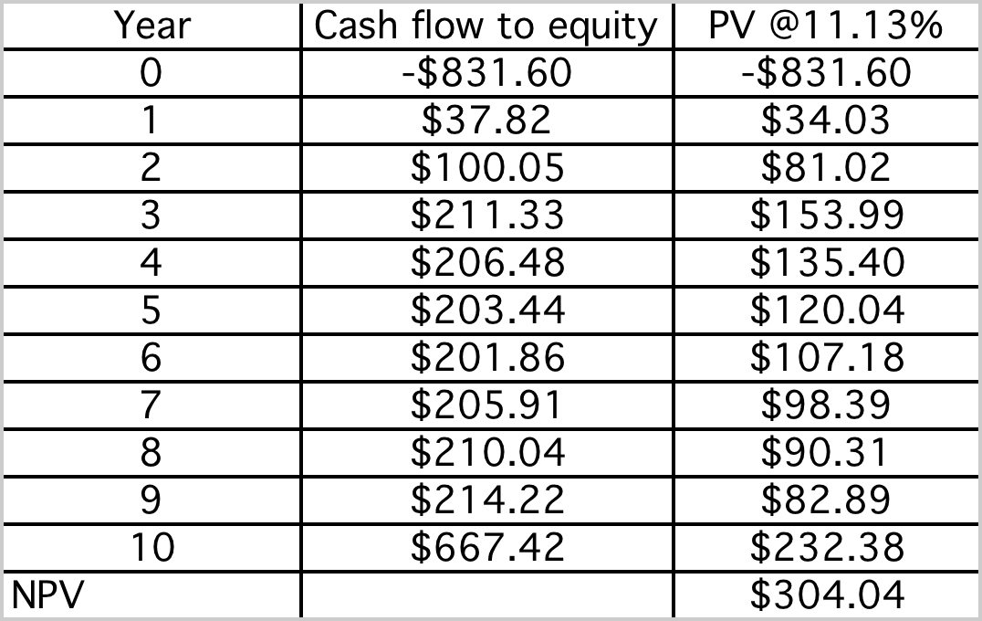
An Equity NPV
Discounted at US$ cost of equity of 11.13% for Vale’s iron ore business
Notes:
The caswhflows to equity are US $ cashflows and are discounted back at the US $ cost of equity for the iron ore business.

Slide 76
Dealing with Macro Uncertainty: The Effect of Iron Ore Price
Like the Disney Theme Park, the Vale Iron Ore Mine’s actual value will be buffeted as the variables change. The biggest source of variability is an external factor –the price of iron ore.
Notes:
The breakeven price is about $325. if pulp prices fall below that value, this plant will become value destructive.
A key difference between breakeven analysis and simulation is that you can change only on variable at a time in breakeven analysis, while holding all else constant…. To the extent that the other variables (other than revenues) are affected by pulp prices I may get a poor measure of the effect on NPV of changing pulp prices.

Slide 77
And Exchange Rates…
Notes:
The mine will be in Canada, with the costs in Canadian dollars, and the revenues will be in US $, creating an exchange rate risk exposure.

Slide 78
Should you hedge?
The value of this mine is very much a function iron ore prices. There are futures, forward and option markets iron ore that Vale can use to hedge against price movements. Should it?
  Yes
  No
Explain.
The value of the mine is also a function of exchange rates. There are forward, futures and options markets on currency. Should Vale hedge against exchange rate risk?
  Yes
  No
Explain.
On the last question, would your answer have been different if the mine were in Brazil.
  Yes
  No
Notes:
Vale is not unique in this respect. All commodity companies are exposed to commodity price risk. However, here is the catch. Many investors in these companies invest in them because they want to play the commodity price game. Thus, investors who believe that oil prices will go up often buy oil companies. If these companies then hedge against oil price variability, they are undercutting that rationale. On an empirical basis, there have been studies that have compared commodity prices that hedge against commodity price movements against companies that do not, as investments. The general consensus seems to be that companies that do not hedge are much better investments, even on a risk adjusted basis, than companies that do.
Here are the possible exceptions. A commodity company that prides itself on its operating prowess may choose to isolate that strength by hedging against commodity price risk. Thus, an oil company that is consistently more efficient about finding and exploiting new oil reserves may hedge against oil price to show the market its strength.
On exchange rates, the answer is more nuanced. Investors do not buy Vale to bet on exchange rates. To the extent that Vale’s managers feel that their competitive advantage is in the mining business and not in forecasting exchange rates, there is an argument to be made that hedging against exchange rate risk is not expensive and can allow managers to focus on what matters. (This may also explain why airlines like Southwest and Singapore Airlines hedge against oil price variability…) Here is the hidden danger. It is very easy to step across the line from hedging to speculation.

Slide 79
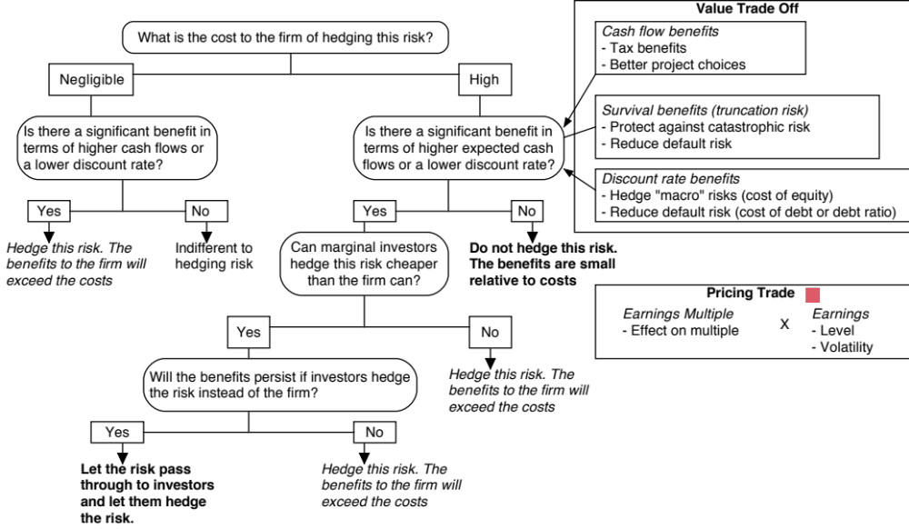
Notes:
Whether you should hedge a risk or not depends on who you are, who your investors are, what risk you are considering, how transparent that risk is and how costly it is to hedge.

Slide 80
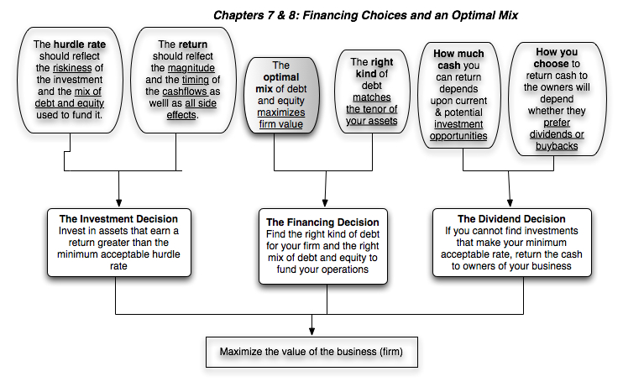
First Principles
Notes:
We shift from the investment principle to the financing principle.

Slide 81

Debt: Summarizing the trade off
Notes:
Brings together the costs and the benefits of debt, with the implications.

Slide 82
Mechanics of Cost of Capital Estimation
1. Estimate the Cost of Equity at different levels of debt:
  Equity will become riskier -> Beta will increase -> Cost of Equity will increase.
  Estimation will use levered beta calculation
2. Estimate the Cost of Debt at different levels of debt:
  Default risk will go up and bond ratings will go down as debt goes up -> Cost of Debt will increase.
  To estimating bond ratings, we will use the interest coverage ratio (EBIT/Interest expense)
3. Estimate the Cost of Capital at different levels of debt
4. Calculate the effect on Firm Value and Stock Price.
Notes:
The basic inputs for computing cost of capital are cost of equity and cost of debt. This summarizes the basic approach we will use to estimate each.

Slide 83
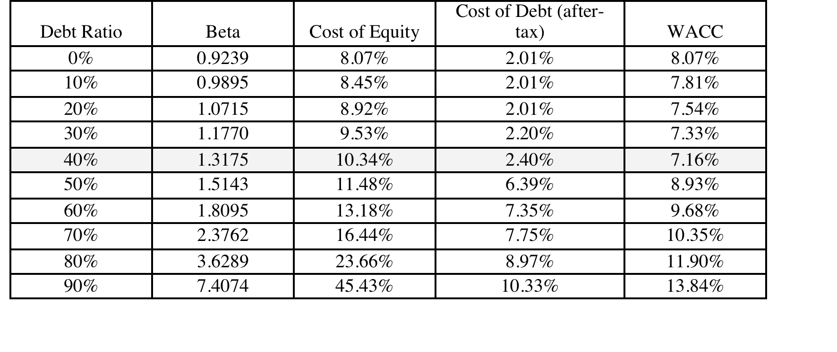
Disney’s cost of capital schedule…
Notes:
Summarizes the cost of equity and debt from prior pages, as well as the cost of capital at different debt ratios.
If the objective is to minimize cost of capital, it occurs at 30 and 40%... We did try for a more precise answer by working in 1% increments and arrived at an optimal of 43% with a cost of capital of 7.28%. (We moved in 1% increments from 30% top 50%)
This will maximize firm value, if operating cashflow (EBITDA) is unaffected by changes in leverage and the consequent changes in ratings. (In other words, we are assuming no indirect bankruptcy costs… If we did, the optimal might be affected, especially if it is at low rating).

Slide 84
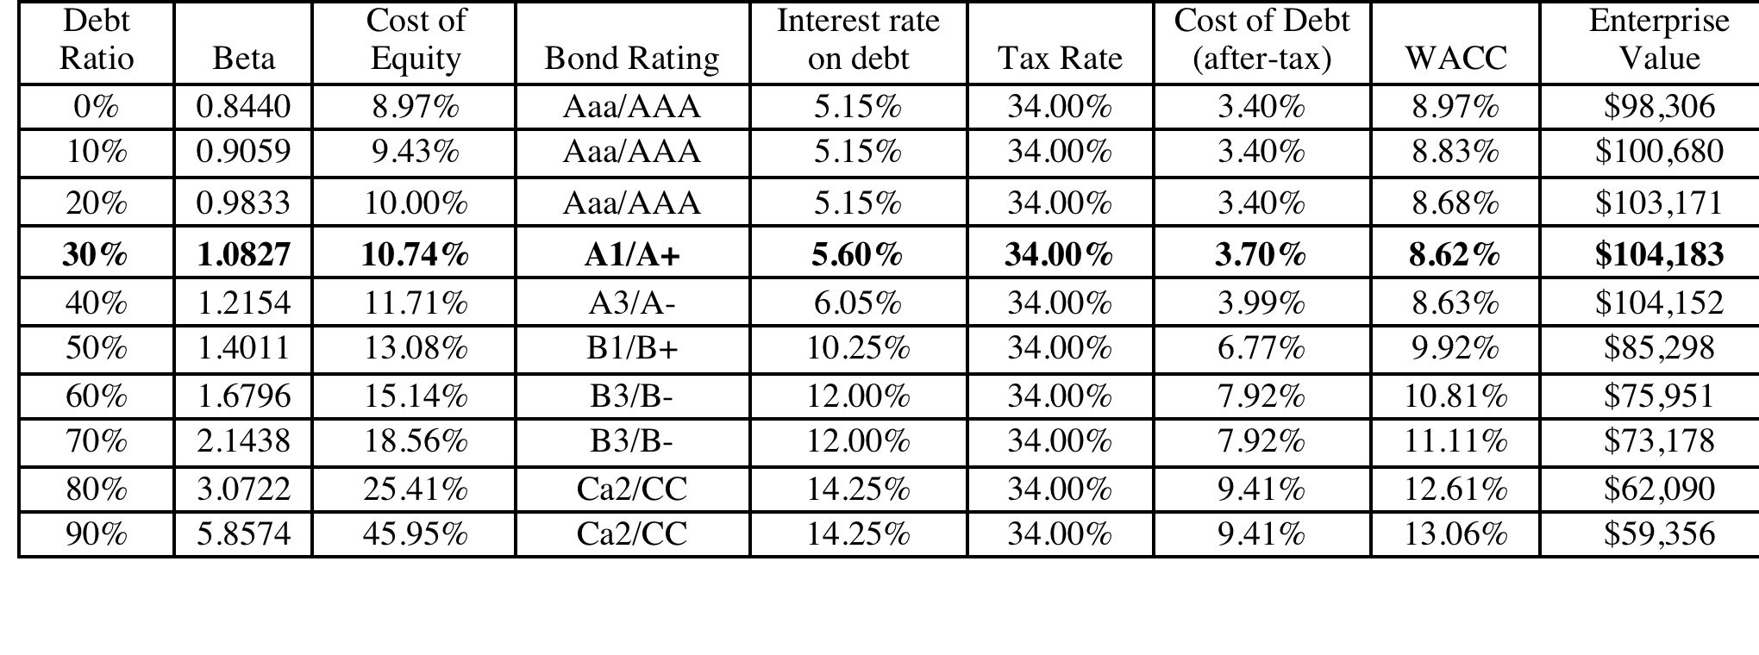
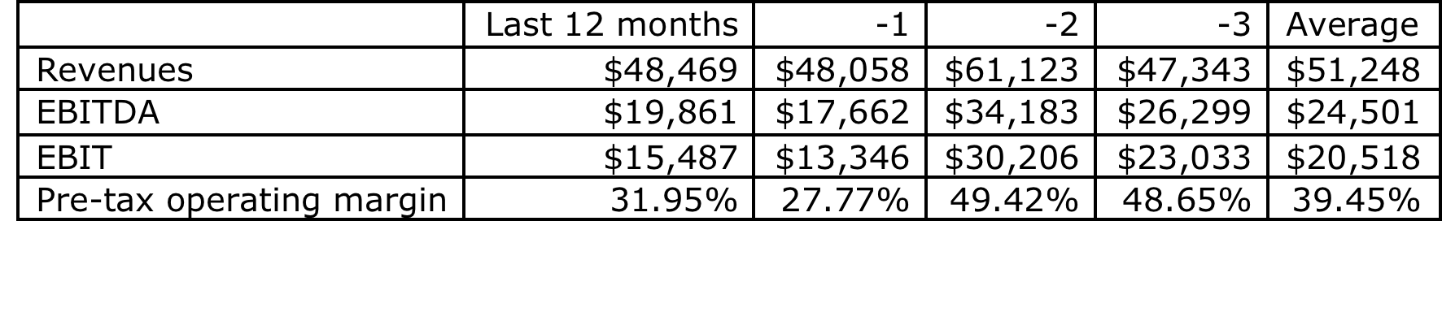
Extension to a firm with volatile earnings:
Vale’s Optimal Debt Ratio
Notes:
Vale looks over levered at its current operating income, but since it is a mining company and its normalized income is higher, I think it is less worrisome.

Slide 85
A Framework for Getting to the Optimal
Is the actual debt ratio greater than or lesser than the optimal debt ratio?
Actual > Optimal
Actual < Optimal
Overlevered
Underlevered
Is the firm under bankruptcy threat?
Is the firm a takeover target?
Yes
No
Yes
No
Reduce Debt quickly
Does the firm have good
Increase leverage
Does the firm have good
1. Equity for Debt swap
projects?
quickly
projects?
2. Sell Assets; use cash
ROE > Cost of Equity
1. Debt/Equity swaps
ROE > Cost of Equity
to pay off debt
ROC > Cost of Capital
2. Borrow money&
ROC > Cost of Capital
3. Renegotiate with lenders
buy shares.
Yes
No
Yes
No
Take good projects with
1. Pay off debt with retained
Take good projects with
new equity or with retained
earnings.
debt.
earnings.
2. Reduce or eliminate dividends.
Do your stockholders like
3. Issue new equity and pay off
dividends?
debt.
Yes
No
Pay Dividends
Buy back stock
Notes:
Studies that have looked at the likelihood of a firm being taken over (in a hostile takeover) have concluded that
Small firms are more likely to be taken over than larger firms
Closely held firms are less likely to be taken over than widely held firms
Firms with anti-takeover restrictions in the corporate charter (or from the state) are less likely to be taken over than firms without these restrictions
Firms which have done well for their stockholders (positive Jensen’s alpha, Positive EVA) are less likely to be taken over than firms which have done badly.
Whether a firm is under bankruptcy threat can be assessed by looking at its rating. If its rating is BB or less, you can argue that the bankruptcy threat is real.
Looking at historical ROE or ROC, relative to the cost of equity and capital, does assume that the future will look like the past.

Slide 86
Disney: Applying the Framework
Is the actual debt ratio greater than or lesser than the optimal debt ratio?
Actual > Optimal
Actual < Optimal
Overlevered
Actual (11.58%) < Optimal (40%)
Is the firm under bankruptcy threat?
Is the firm a takeover target?
Yes
No
Yes
No. Large mkt cap & positive Jensen’s α
Reduce Debt quickly
Does the firm have good
Increase leverage
Does the firm have good
1. Equity for Debt swap
projects?
quickly
projects?
2. Sell Assets; use cash
ROE > Cost of Equity
1. Debt/Equity swaps
ROE > Cost of Equity
to pay off debt
ROC > Cost of Capital
2. Borrow money&
ROC > Cost of Capital
3. Renegotiate with lenders
buy shares.
Yes
No
Yes. ROC > Cost of capital
No
Take good projects with
1. Pay off debt with retained
Take good projects
new equity or with retained
earnings.
With debt.
earnings.
2. Reduce or eliminate dividends.
Do your stockholders like
3. Issue new equity and pay off
dividends?
debt.
Yes
No
Pay Dividends
Buy back stock
Notes:
This is the analysis for Disney in 2009.
I am assuming that future projects will be more successful than current projects..
Over time, our assessments have changed:
In 2003, we would have pushed for higher dividends (since Disney was earning terrible returns on capital and we did not trust management)
In 2000, Disney would have been a takeover target (because its market cap had dropped and its performance was awful on both accounting and stock price returns)
In 1997, Disney would not have been a takeover target (high market cap, good performance) and its excess debt capacity would have been directed to good investments.

Slide 87
Vale: Applying the Framework
Is the actual debt ratio greater than or lesser than the optimal debt ratio?
Actual > Optimal
Actual < Optimal
Overlevered
Is the firm under bankruptcy threat?
Is the firm a takeover target?
Yes
No
Yes
No
Reduce Debt quickly
Does the firm have good
Increase leverage
Does the firm have good
1. Equity for Debt swap
projects?
quickly
projects?
2. Sell Assets; use cash
ROE > Cost of Equity
1. Debt/Equity swaps
ROE > Cost of Equity
to pay off debt
ROC > Cost of Capital
2. Borrow money&
ROC > Cost of Capital
3. Renegotiate with lenders
buy shares.
Yes
Not at current iron ore prices
Yes. ROC > Cost of capital
No
Take good projects with
Pay down debt with operating
cash
Take good projects
new equity or with retained
With debt.
earnings.
2. Reduce or eliminate dividends.
Do your stockholders like
dividends?
Yes
No
Pay Dividends
Buy back stock
Notes:
This is the analysis for Disney in 2009.
I am assuming that future projects will be more successful than current projects..
Over time, our assessments have changed:
In 2003, we would have pushed for higher dividends (since Disney was earning terrible returns on capital and we did not trust management)
In 2000, Disney would have been a takeover target (because its market cap had dropped and its performance was awful on both accounting and stock price returns)
In 1997, Disney would not have been a takeover target (high market cap, good performance) and its excess debt capacity would have been directed to good investments.

Slide 88
Brazil Spotlight 2016: Debt Ratios
Company | Market Debt to Capital | Industry for comparison | Industry Average Debt to Capital (Market)
Gerdau | 71.50% | Steel | 51.69%
Natura | 34.75% | Household Products | 12.15%
Cosan | 39.31% | Green & Renewable Energy | 42.94%
Braskem | 62.87% | Chemical (Specialty) | 20.52%
DASA | 28.62% | Healthcare Support Services | 23.25%
Dias Branco | 6.26% | Food Processing | 19.37%
GOL | 89.18% | Air Transport | 45.79%
Eletrobras | 82.29% | Power | 49.63%
Marisa Lojas | 38.70% | Retail (Special Lines) | 26.04%
Embraer | 48.10% | Aerospace/Defense | 18.86%

Slide 89
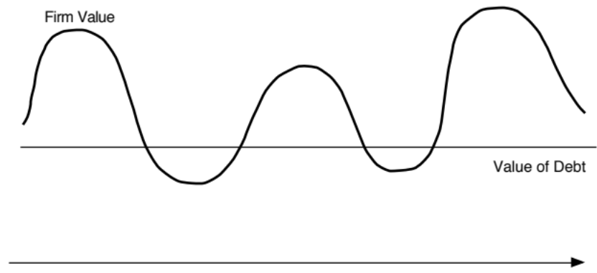

Designing Debt: The Fundamental Principle
The objective in designing debt is to make the cash flows on debt match up as closely as possible with the cash flows that the firm makes on its assets.
By doing so, we reduce our risk of default, increase debt capacity and increase firm value.
Matched Debt
Unmatched Debt
Notes:
Your objective is issue securities that bring you all of the tax benefits of debt while providing you with the flexibility of equity. It is not the reduction in risk but the increase in debt capacity that generates the value. A firm that does not use this debt capacity will not gain from matching debt to assets in the first place.

Slide 90
Designing Debt: Bringing it all together
Start with the
Cyclicality &
Cash Flows
Duration
Currency
Effect of Inflation
Growth Patterns
Other Effects
on Assets/
Uncertainty about Future
Projects
Fixed vs. Floating Rate
Straight versus
Special Features
Commodity Bonds
Define Debt
Duration/
Currency
* More floating rate
Convertible
on Debt
Catastrophe Notes
Characteristics
Maturity
Mix
- if CF move with
- Convertible if
- Options to make
inflation
cash flows low
cash flows on debt
- with greater uncertainty
now but high
match cash flows
on future
exp. growth
on assets
Design debt to have cash flows that match up to cash flows on the assets financed
Overlay tax
Deductibility of cash flows
Differences in tax rates
Zero Coupons
preferences
for tax purposes
across different locales
If tax advantages are large enough, you might override results of previous step
Consider
Analyst Concerns
Ratings Agency
Regulatory Concerns
ratings agency
- Effect on EPS
- Effect on Ratios
- Measures used
Operating Leases
& analyst concerns
- Value relative to comparables
- Ratios relative to comparables
MIPs
Surplus Notes
Can securities be designed that can make these different entities happy?
Observability of Cash Flows
Type of Assets financed
Existing Debt covenants
Convertibiles
Factor in agency
by Lenders
- Tangible and liquid assets
- Restrictions on Financing
Puttable Bonds
conflicts between stock
- Less observable cash flows
create less agency problems
Rating Sensitive
and bond holders
lead to more conflicts
Notes
If agency problems are substantial, consider issuing convertible bonds
LYONs
Consider Information
Uncertainty about Future Cashflows
Credibility & Quality of the Firm
Asymmetries
- When there is more uncertainty, it
- Firms with credibility problems
may be better to use short term debt
will issue more short term debt
Notes:
This provides the basic framework for designing the right kind of debt.
You begin by trying to match up financing type to asset type (in terms of duration, currency, growth patterns and special features). By doing so, you reduce your risk of bankruptcy, increase your capacity to borrow and consequently the tax benefits of debt.
Then, you modify the “perfect debt”
For tax factors, to ensure that you get the maximum tax benefit
To meet the needs and objectives of equity research analysts and ratings agencies
To fix any agency conflicts that might prevent lenders from lending
To prevent an undeservedly low rating from pushing up the cost of debt above what it should be. (If you are under rated, you should probably use short term debt until you feel your rating is justified)

Slide 91
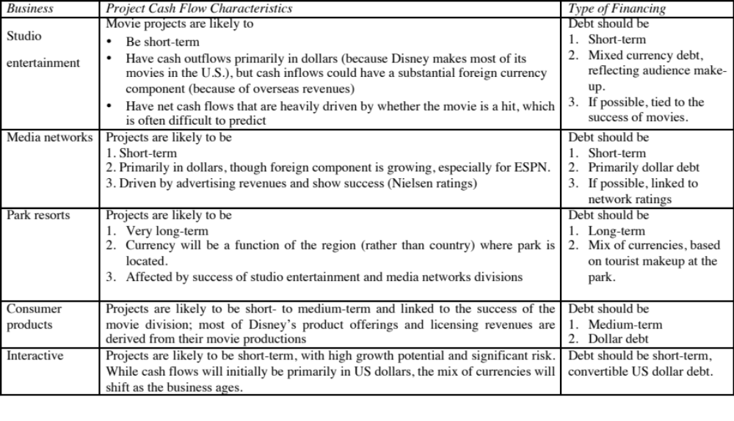
I. Disney’s perfect debt
Notes:
There is plenty of room to be creative in this approach.
Look at firms which operate in each of these businesses and see what financing they use. That might be useful in designing the right kind of debt.

Slide 92
II. Vale’s perfect debt
Vale’s mines are spread around the world, and it generates a large portion of its revenues in China (37%). Its mines typically have very long lives and require large up-front investments, and the costs are usually in the local currencies but its revenues are in US dollars.
Recommendation: Long term, dollar-denominated debt (with hedging of local currency risk exposure) and if possible, tied to commodity prices.
Actual: The existing debt at Vale is primarily US dollar debt (65.48%), with an average maturity of 14.70 years. All of the debt, as far as we can assess, is fixed rate and there is no commodity-linked debt.

Slide 93
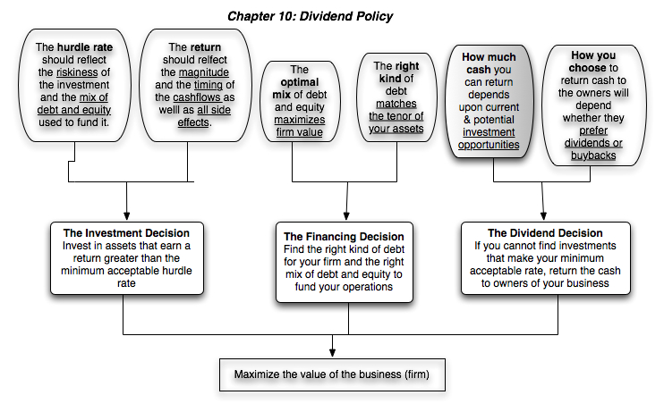
First Principles
Notes:
Third and final principle of corporate finance.

Slide 94
Assessing Dividend Policy
Step 1: How much could the company have paid out during the period under question?
Step 2: How much did the the company actually pay out during the period in question?
Step 3: How much do I trust the management of this company with excess cash?
  How well did they make investments during the period in question?
  How well has my stock performed during the period in question?
Notes:
By paid out to stockholders in this phase of the analysis, we mean both dividends and stock buybacks.

Slide 95
How much has the company returned to stockholders?
As firms increasing use stock buybacks, we have to measure cash returned to stockholders as not only dividends but also buybacks.
Looking at Disney & Vale
 | Disney |  | Vale
Year | Dividends | Buybacks | Dividends | Buybacks
2008 | $648 | $648 | $2,993 | $741
2009 | $653 | $2,669 | $2,771 | $9
2010 | $756 | $4,993 | $3,037 | $1,930
2011 | $1,076 | $3,015 | $9,062 | $3,051
2012 | $1,324 | $4,087 | $6,006 | $0
2008-12 | $4,457 | $15,412 | $23,869 | $5,731
Notes:
All four companies paid dividends over the five-year period, but there are interesting differences between the companies. Disney, and Tata Chemicals increased dividends in each of the five years, but Aracruz had more volatile dividends over the period, with dividends dropping significantly in 2007. This reflects the convention of focusing on absolute dividends in the United States and India, but the practice of maintaining payout ratios in Brazil. Deutsche Bank had a precipitous drop in dividends in 2008, reflecting the effects of the market crisis and the desire to maintain regulatory capital ratios.
Looking at stock buybacks, Disney has been the most active player buying stock in all five years, with buybacks exceeding $ 6 billion in 2006 and 2007. None of the other companies have bought back stock. The key difference with treasury stock that stays on the books is that the number of shares in the company remains unchanged. In the U.S., companies are not allowed to keep treasury stock on their books for extended periods.

Slide 96
A Measure of How Much a Company Could have Afforded to Pay out: FCFE
The Free Cashflow to Equity (FCFE) is a measure of how much cash is left in the business after non-equity claimholders (debt and preferred stock) have been paid, and after any reinvestment needed to sustain the firm’s assets and future growth.
  Net Income
  + Depreciation & Amortization
  = Cash flows from Operations to Equity Investors
  - Preferred Dividends
  - Capital Expenditures
  - Working Capital Needs
  - Principal Repayments
  + Proceeds from New Debt Issues
  = Free Cash flow to Equity
Notes:
This cashflow is
Free: because it cashflow left over after debt payments and investment needs have been met
To Equity Investors: because it is after payments to all non-equity claimholders
In coming up with the numbers, we define
Capital expenditures as including all capital investments. We do not distinguish between discretionary and non-discretionary cap ex. Once we assume growth in earnings, all cap ex is non-discretionary.
Working capital needs refers to the increase in non-cash working capital.

Slide 97
Disney’s FCFE and Cash Returned: 2008 – 2012
 | 2012 | 2011 | 2010 | 2009 | 2008 | Aggregate
Net Income | $6,136 | $5,682 | $4,807 | $3,963 | $3,307 | $23,895
- (Cap. Exp - Depr) | $604 | $1,797 | $1,718 | $397 | $122 | $4,638
- ∂ Working Capital | ($133) | $940 | $950 | $308 | ($109) | $1,956
Free CF to Equity (pre-debt) | $5,665 | $2,945 | $2,139 | $3,258 | $3,294 | $17,301
+ Net Debt Issued | $1,881 | $4,246 | $2,743 | $1,190 | ($235) | $9,825
= Free CF to Equity (actual debt) | $7,546 | $7,191 | $4,882 | $4,448 | $3,059 | $27,126
Free CF to Equity (target debt ratio) | $5,720 | $3,262 | $2,448 | $3,340 | $3,296 | $18,065
Dividends | $1,324 | $1,076 | $756 | $653 | $648 | $4,457
Dividends + Buybacks | $5,411 | $4,091 | $5,749 | $3,322 | $1,296 | $19,869
Disney returned about $1.5 billion more than the $18.1 billion it had available as FCFE with a normalized debt ratio of 11.58% (its current debt ratio).
Notes:
The depreciation numbers also include amortization and the capital expenditures include cash acquisitions. Increases in noncash working capital, shown as positive numbers, represent a drain on the cash, whereas decreases in noncash working capital, shown as negative numbers, represent positive cash flows. In 2008, for example, noncash working capital decreased by $109 million, increasing the cash available for stockholders in that year by the same amount. Finally, the net cash flow from debt is the cash generated by the issuance of new debt, netted out against the cash outflow from the repayment of old debt. Again, using 2008 as an example, Disney repaid $235 more in old debt than it raised in new debt, and this represents a negative cash flow in that year. We have computed three measures of FCFE, one before the net debt cash flow, one after the actual net debt cash flow and one computed assuming that they had stuck with a target debt ratio of 40%. Using 2008 as an illustration, we compute each as follows:
FCFE_{Before Debt CF}= Net Income + Depreciation – Capital Expenditures – Change in Noncash Working Capital = 3307 -122 –(-109) = 3294
FCFE_{After Debt CF}= FCFE_{Before Debt CF} + Net Debt CF = 3296 - 235 = 3059
FCFE target debt ratio = 3307 – (122-109) (1-.40) =3296

Slide 98
Vale – Dividends versus FCFE
 | Aggregate | Average
Net Income | $57,404 | $5,740
Dividends | $36,766 | $3,677
Dividend Payout Ratio | $1 | $1
Stock Buybacks | $6,032 | $603
Dividends + Buybacks | $42,798 | $4,280
Cash Payout Ratio | $1
Free CF to Equity (pre-debt) | ($1,903) | ($190)
Free CF to Equity (actual debt) | $1,036 | $104
Free CF to Equity (target debt ratio) | $19,138 | $1,914
Cash payout as % of pre-debt FCFE | FCFE negative
Cash payout as % of actual FCFE | 4131.08%
Cash payout as % of target FCFE | 223.63%
Notes:
Vale was clearly paying too much in dividends.

Slide 99
A Practical Framework for Analyzing Dividend Policy
How much did the firm pay out? How much could it have afforded to pay out?
What it could have paid out
What it actually paid out
Net Income
Dividends
- (Cap Ex - Depr’n) (1-DR)
+ Equity Repurchase
- Chg Working Capital (1-DR)
= FCFE
Firm pays out too little
Firm pays out too much
FCFE > Dividends
FCFE < Dividends
Do you trust managers in the company with
What investment opportunities does the
your cash?
firm have?
Look at past project choice:
Look at past project choice:
Compare
ROE to Cost of Equity
Compare
ROE to Cost of Equity
ROC to WACC
ROC to WACC
Firm has history of
Firm has history
Firm has good
Firm has poor
good project choice
of poor project
projects
projects
and good projects in
choice
the future
Give managers the
Force managers to
Firm should
Firm should deal
flexibility to keep
justify holding cash
cut dividends
with its investment
cash and set
or return cash to
and reinvest
problem first and
dividends
stockholders
more
then cut dividends
Notes:
Most firms return less in cash than they have available to return. Whether they will find themselves under pressure (like Chrysler) or relatively untouched (like Microsoft) will depend upon how much stockholders trust the managers of the firm to use the cash wisely.
Stockholders will tend to be less aggressive about demanding that the cash be returned to them for firms
With a good investment track record
In a sector with high returns
Where managers have substantial equity stakes in the firm
They will tend to be most aggressive when these conditions do not hold.

Slide 100
Can investors trust Vale’s management?
Given Vale’s track record, if you were a Vale common stockholder, would you be comfortable with Vale’s dividend policy?
  Yes
  No
How would your answer be different if you were a Vale preferred stockholder?
Notes:
The fact that Disney has underperformed the market both in terms of stock price performance and return on equity suggests that stockholders are unlikely to have much patience with Disney accumulating cash (afraid of what they will do with the cash).
That conclusion is reinforced by the fact that the managers responsible for the damage are still at the helm of the firm.

Slide 101
Brazil Spotlight 2016: Dividend Policy
Company | Dividends | Net Income | Market Cap | Dividend Yield | Dividend Payout | Industry | Industry Dividend Yield | Industry Dividend Payout
Gerdau | R$ 237 | -R$ 4,836 | R$ 9,440 | 2.51% | NA | Steel | 3.61% | 0.95%
Natura | R$ 686 | R$ 325 | R$ 9,737 | 7.05% | 211.08% | Household Products | 2.09% | 58.30%
Cosan | R$ 1,411 | R$ 959 | R$ 14,318 | 9.85% | 147.13% | Green & Renewable Energy | 3.26% | 77.27%
Braskem | R$ 482 | R$ 3,663 | R$ 14,989 | 3.22% | 13.16% | Chemical (Specialty) | 2.14% | 41.85%
DASA | R$ 20 | R$ 27 | R$ 3,053 | 0.66% | 73.26% | Healthcare Support Services | 1.07% | 26.03%
Dias Branco | R$ 194 | R$ 453 | R$ 10,419 | 1.86% | 42.83% | Food Processing | 1.73% | 44.64%
GOL | R$ 119 | -R$ 3,053 | R$ 955 | 12.46% | NA | Air Transport | 1.38% | 19.58%
Eletrobras | R$ 23 | -R$ 19,595 | R$ 10,088 | 0.23% | NA | Power | 4.00% | 59.53%
Marisa Lojas | R$ 12 | -R$ 48 | R$ 1,663 | 0.72% | NA | Retail (Special Lines) | 1.43% | 32.54%
Embraer | R$ 134 | R$ 823 | R$ 14,069 | 0.95% | 16.28% | Aerospace/Defense | 1.89% | 51.76%

Slide 102

First Principles
Notes:
Back, full circle to the objective.

Slide 103

The Ingredients that determine value.
Notes:
Sets up the basic inputs:
1. Discount rates
2. Cash flows
3. Expected Growth
4. Length of the period that they can sustain a growth rate higher than the growth rate of the economy.
How we estimate each of these numbers depends on whether we are taking an equity perspective or a firm perspective.
The answer to the fourth question matters because we cannot estimate cash flows forever and a publicly traded company, at least in theory, can last forever. If cash flows grow at the same rate forever, we can short circuit the cash flow estimation and compute the present value of all cash flows beyond that point in time with one equation (CF/ (r-g)).

Slide 104

Notes:
Brings it all together. Stock looks slightly over valued… or maybe the valuation is wrong…
Note that the non operating investment is the value of their minority holdings in other companies and that the minority interest reflects the value of others’ holdings in companies that Disney owns a majority stake in (and has consolidated). Both were taken at book value. Optimally, we would like to get both in market value terms.
The equity options is the value of management options, valued using an option pricing model, and adjusted for taxes.

Slide 106

Value Creation 1: Increase Cash Flows from Assets in Place
Notes:
The key is that there is a trade off between current cashflows and future growth. If you increase current cashflows at the expense of future growth, you may destroy value rather than add to it.

Slide 107

Value Creation 2: Increase Expected Growth
Keeping all else constant, increasing the expected growth in earnings will increase the value of a firm, but only if the firm earns a return on capital that exceeds the cost of capital:

Slide 108
A postscript on creating growth: The Role of Acquisitions and Divestitures
An acquisition is just a large-scale project. All of the rules that apply to individual investments apply to acquisitions, as well. For an acquisition to create value, it has to
  Generate a higher return on capital, after allowing for synergy and control factors, than the cost of capital.
  Put another way, an acquisition will create value only if the present value of the cash flows on the acquired firm, inclusive of synergy and control benefits, exceeds the cost of the acquisitons
A divestiture is the reverse of an acquisition, with a cash inflow now (from divesting the assets) followed by cash outflows (i.e., cash flows foregone on the divested asset) in the future. If the present value of the future cash outflows is less than the cash inflow today, the divestiture will increase value.
A fair-price acquisition or divestiture is value neutral.

Slide 109

Value Creating Growth… Evaluating the Alternatives..

Slide 110

III. Building Competitive Advantages: Increase length of the growth period

Slide 111

Value Creation 4: Reduce Cost of Capital
Notes:
Reducing the cost of capital, holding cashflows constant, increases firm value.

Slide 112


You can always play the pricing game..
The market gives…
And takes away….
Notes:
Value enhancement and price enhancement are equivalent in an efficient market. In a market that does not always reward long-term decision making and behaves irrationally,

Slide 113

Ways of changing value…
Notes:
To change value, you have to take actions that affect one of four inputs:
Cash flows from existing assets
Expected growth
Cost of capital
Length of the growth period

Slide 114

Notes:
Note that with two changes, a higher return on capital on new investments over the high growth phase (from 12.61% to 14%, with a slight drop in reinvestment) and moving to the optimal debt ratio of 40%, we can raise the value per share from $62.56 to $74.91. The difference of $11.35 can be viewed as the value of control. In general, the better managed a firm is, the lower will be the value of control.

Slide 115


Slide 116
First Principles
Notes:
As we begin, so we end.

