Slide 1
Applied Corporate Finance:
A big picture view
Aswath Damodaran
www.damodaran.com
Notes:
Sets the agenda for the class. This is a class that will be focused on the big picture of corporate finance rather than details, theories or models on a piecemeal basis.

Slide 2
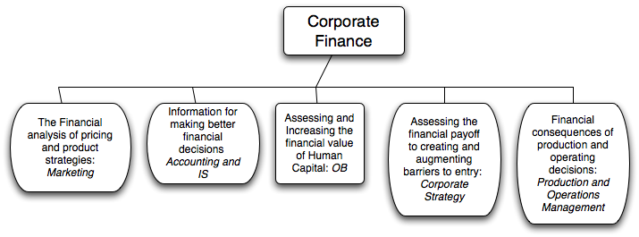
What is corporate finance?
Every decision that a business makes has financial implications, and any decision which affects the finances of a business is a corporate finance decision.
Defined broadly, everything that a business does fits under the rubric of corporate finance.
Notes:
Corporate finance covers every decision that any business, small or large, public or private takes.. This is my very selfish attempt to show that corporate finance is at the heart of all the other management disciplines: marketing, strategy, accounting and even the fuzzy far reaches of human capital.

Slide 3
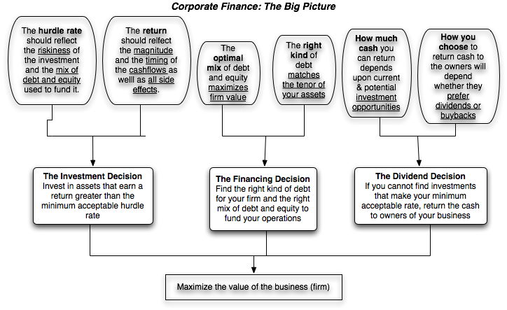
First Principles
Notes:
This is the big picture that will animate how we approach corporate finance. We will use it to anchor the class, introducing each topic by noting its presence in the big picture. Ultimately, everything we do in corporate finance has to be somewhere in the picture.
(I introduce my syllabus after this slide with session numbers framed in the big picture)

Slide 4
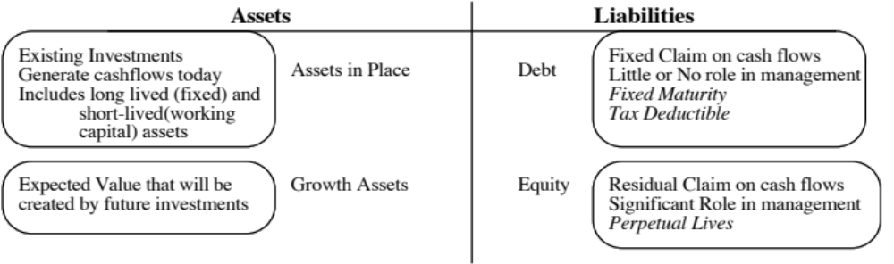
The Objective in Decision Making
In traditional corporate finance, the objective in decision making is to maximize the value of the firm.
A narrower objective is to maximize stockholder wealth. When the stock is traded and markets are viewed to be efficient, the objective is to maximize the stock price.
Maximize equity value
Maximize market estimate of equity value
Maximize firm value
Notes:
This is the answer to the question posed in the previous overhead.
Maximizing the value of the business is the most general objective function. Remember that value of the business includes assets in place and growth assets. If you are managing a growth company,, increasing earnings may not necessarily increase firm value. The other problem is that firm value itself is a difficult number to estimate. While there are models available, they all need inputs, most of which allow for subjective judgments.
Managers answer to stockholders. Consequently, the objective gets narrowed down to “maximizing equity value”. (Implicit assumption: Bondholders/ Banks can protect themselves by writing in covenants and setting interest rates).
It is tough to assess equity value objectively. It would be nice to have a “third party” estimate that is objective. For publicly traded firms, the market (in spite of all its limitations) provides such an estimate. (Implicit assumption: Markets are rational and reasonably efficient).

Slide 5
The Classical Objective Function
STOCKHOLDERS
Hire & fire
managers
- Board
- Annual Meeting
Maximize
stockholder wealth
Lend Money
No Social Costs
BONDHOLDERS
Managers
SOCIETY
Protect
bondholder
Interests
Costs can be
traced to firm
Reveal
information
honestly and
on time
Markets are
efficient and
assess effect on
value
FINANCIAL MARKETS
Notes:
This is the utopian world. None of the assumptions are really defensible as written, and skepticism is clearly justified:
Why do we need these assumptions?
Since, in many large firms, there is a separation of ownership from management, managers have to be fearful of losing their jobs and go out and maximize stockholder wealth. If they do not have this fear, they will focus on their own interests.
If bondholders are not protected, stockholders can steal from them and make themselves better off, even as they make the firm less valuable.
If markets are not efficient, maximizing stock prices may not have anything to do with maximizing stockholder wealth or firm value.
If substantial social costs are created, maximizing stock prices may create large side costs for society (of which stockholders are members).
Note that corporate finance, done right, is not about stealing from other groups (bondholders, other stockholders or society) but about making the firm more productive and valuable.

Slide 6
What can go wrong?
STOCKHOLDERS
Managers put
their interests
above stockholders
Have little control
over managers
Lend Money
Significant Social Costs
BONDHOLDERS
Managers
SOCIETY
Bondholders can
get ripped off
Some costs cannot be
traced to firm
Delay bad
news or
provide
misleading
information
Markets make
mistakes and
can over react
FINANCIAL MARKETS
Notes:
This is my worst case scenario:
Stockholders have little or no control over managers. Managers, consequently, put their interests above stockholder interests.
Bondholders who do not protect themselves find stockholders expropriating their wealth.
Information conveyed to markets is noisy, biases and sometimes misleading. Markets do not do a very good job of assimilating this information and market price changes have little to do with true value.
Firms in the process of maximizing stockholder wealth create large social costs.
In this environment, stockholder wealth maximization is not a good objective function.

Slide 7
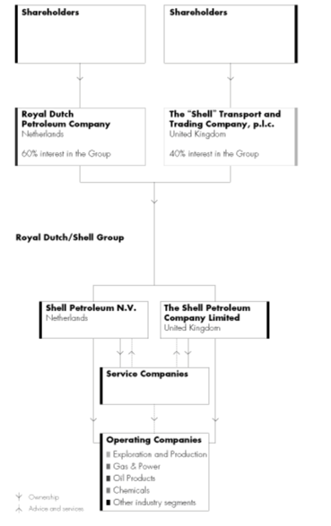
The Old Royal Dutch Shell

Slide 8
RDS: The Corporate Governance History
Until 1995, RDS was organized geographically, with each regional head wielding substantial power over operating decisions in that geography. That year, it was reorganized around businesses (and the notion of jobs-for-life was removed.)
In 2004, there were 1500 shares held by the Dutch board that had 800 times the voting rights of the rest of the shares. Those shares gave the board effective control of the company.
In 2005, after four downgrades of its oil reserves, numerous scandals, stockholder upheaval and a general sense that the company was being left behind, the Dutch board gave up its high voting shares.
The company is now one company, with two classes of shares, with no differences in voting rights but differences in the tax treatment of dividends, with the Dutch government withholding taxes on the class A shares.

Slide 9
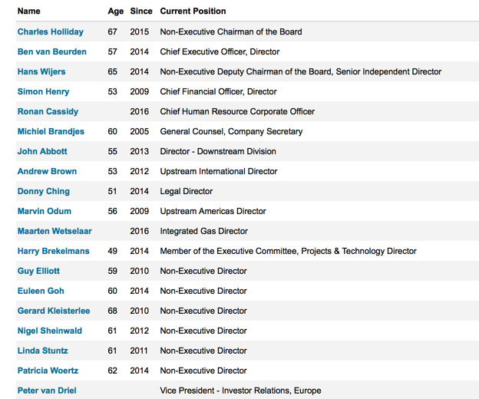
RDS: Who’s on board?
Does Shell have an independent board?
Yes
No
Does Shell have an effective board?
Yes
No

Slide 10
When traditional corporate financial theory breaks down, the solution is:
To choose a different mechanism for corporate governance, i.e, assign the responsibility for monitoring managers to someone other than stockholders.
To choose a different objective for the firm.
To maximize stock price, but reduce the potential for conflict and breakdown:
  Making managers (decision makers) and employees into stockholders
  Protect lenders from expropriation
  By providing information honestly and promptly to financial markets
  Minimize social costs
Notes:
At this point, things look pretty bleak for stock price maximization. These are the three choices that we have, if we abandon pure stock price maximization as an objective function.

Slide 11
A Market Based Solution
STOCKHOLDERS
1. More activist
investors
2. Hostile takeovers
Managers of poorly
run firms are put
on notice.
Protect themselves
Corporate Good Citizen Constraints
BONDHOLDERS
Managers
SOCIETY
1. Covenants
2. New Types
1. More laws
2. Investor/Customer Backlash
Firms are
punished
for misleading
markets
Investors and
analysts become
more skeptical
FINANCIAL MARKETS
Notes:
This summarizes the objective function of maximizing stockholder wealth, with the fixes noted on the last few pages.

Slide 12
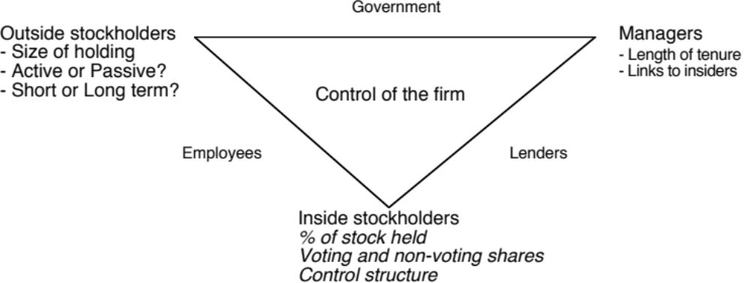
Application Test: Who owns/runs your firm?
Who are the top stockholders in your firm?
What are the potential conflicts of interests that you see emerging from this stockholding structure?
Notes:
One of your first tasks when assessing a company is to see whether managers have a significant stake in the company. You can get this information in a variety of places. I use Bloomberg to get the data on the top 17 stockholders and go down the list to see if incumbent managers have a stake in the company. I also check to see if there are other investors on the list who may not be incumbent managers but are strong advocates for stockholders - Berkshire Hathaway at Coca Cola, KKR or Blackstone at many publicly traded firms…
You can also get this information from Yahoo! Finance by going into company profiles and clicking on institutional investors…
As you look at the list of top stockholders, you should be also considering the potential conflicts of interest created by the stockholder structure.
Inside stockholders (Founding family, controlling stockholder/manager) versus outside stockholders
Government as major stockholder (or holder of golden vote)
Employees as major stockholders

Slide 13
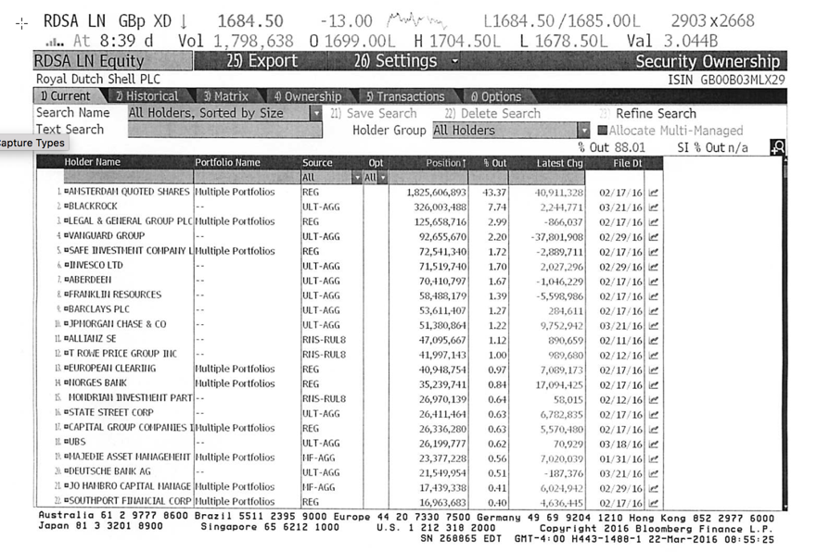
Who owns your equity?
Shell’s top stockholders in 2016 – Class A
Notes:
Not a single individual investor in the list other than Roy Disney who was the 15th largest stockholder… Managers are not significant stockholders in Disney (and the same can be said for most large publicly traded firms). Consider the following scenarios:
Managers are not significant stockholders in the firm: Significant potential for conflicts of interest between managers and stockholders.
Individuals are significant stockholders in the firm as well as part of top management. Usually, these are founder-owners of the firm and the firms tend to be younger firms or family run businesses that have recently made the transition to publicly traded firms. Smaller potential for conflict between managers and stockholders, but potential for conflict between inside stockholders and outside stockholders.
The government is a large stockholder (or a stockholder with veto power). This may keep managers in some check but it will create potential conflicts of interest between the other stockholders and the government (Consider what would happen if the company tried to minimize taxes paid)
Trusts or descendants of owners are significant stockholders in the firm but are not an active part of incumbent management. Power that these stockholders retain to replace managers reduces potential for conflict of interest but is reduced as holdings get diluted among lots of family members.
Another company is largest stockholder in firm. In this case, trace out who owns stock in the other company….

Slide 14
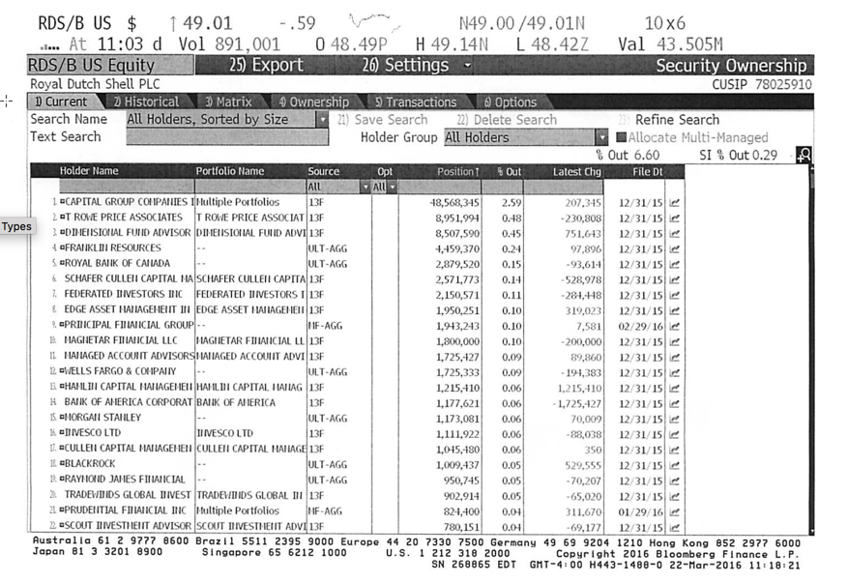
And Class B..

Slide 15
First Principles
Notes:
This is the big picture that will animate how we approach corporate finance. We will use it to anchor the class, introducing each topic by noting its presence in the big picture. Ultimately, everything we do in corporate finance has to be somewhere in the picture.
(I introduce my syllabus after this slide with session numbers framed in the big picture)

Slide 16

What is Risk?
Risk, in traditional terms, is viewed as a ‘negative’. Webster’s dictionary, for instance, defines risk as “exposing to danger or hazard”. The Chinese symbols for risk, reproduced below, give a much better description of risk:
The first symbol is the symbol for “danger”, while the second is the symbol for “opportunity”, making risk a mix of danger and opportunity. You cannot have one, without the other.
Notes:
Note that risk is neither good nor bad. It is a combination of danger and opportunity - you cannot have one without the other. Consequently, risk is neither something to be avoided nor sought out but carefully balanced. Good business avoid some risks, let others pass through to their investors and actively seek out still others.
When businesses want opportunity (higher returns), they have to live with the higher risk.
Any sales pitch that offers returns without risk is a pipe dream.
Bob Citron, treasurer of Orange County (CA), after he lost a chunk of the county’s pension fund money after investing in interest rate derivatives claimed that he was “not a finance person” and that Merrill’s market strategist (Charlie Clough) had told him he could make “15% with no risk”.
Many prominent (and intelligent) people invested with Bernie Madoff because he promised them (through third parties) that he could deliver 8% more than the treasury bill rate, guaranteed. (He was called the Jewish T.Bill). One investor, interviewed by the NY Times said, “I really did not understand what he was doing, but he said was going to do something with calls, something with puts and earn 12% every year. It sounded plausible (and all my friends were investing with him too).

Slide 17
Risk, from many places..
Estimation versus Economic uncertainty
  Estimation uncertainty reflects the possibility that you could have the “wrong model” or estimated inputs incorrectly within this model.
  Economic uncertainty comes the fact that markets and economies can change over time and that even the best medals will fail to capture these unexpected changes.
Micro uncertainty versus Macro uncertainty
  Micro uncertainty refers to uncertainty about the potential market for a firm’s products, the competition it will face and the quality of its management team.
  Macro uncertainty reflects the reality that your firm’s fortunes can be affected by changes in the macro economic environment.
Discrete versus continuous uncertainty
  Discrete risk: Risks that lie dormant for periods but show up at points in time. (Examples: A drug working its way through the FDA pipeline may fail at some stage of the approval process or a company in Venezuela may be nationalized)
  Continuous risk: Risks changes in interest rates or economic growth occur continuously and affect value as they happen.

Slide 18
Your biggest driver (and no surprise) is..
Revenues = 39,992.77 + 4,039.39 * Average Oil Price R squared = 96.44%

Slide 19
Though you do have some power to alter your income..
Operating Income = 6,436.38 + 284.15 * Average Oil Price R squared = 59.55%

Slide 20
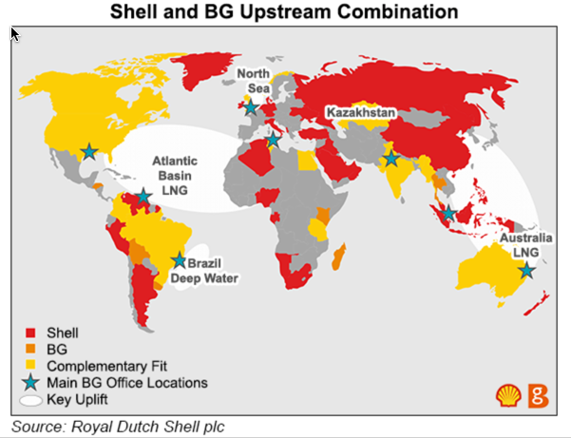
The geography of your reserves..

Slide 21
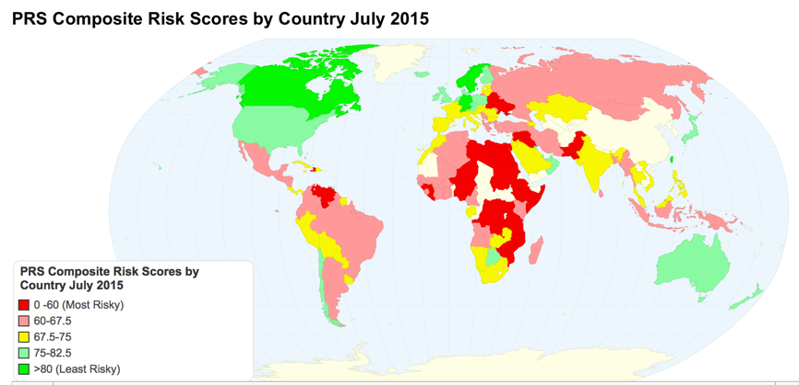
Your secondary driver..

Slide 22
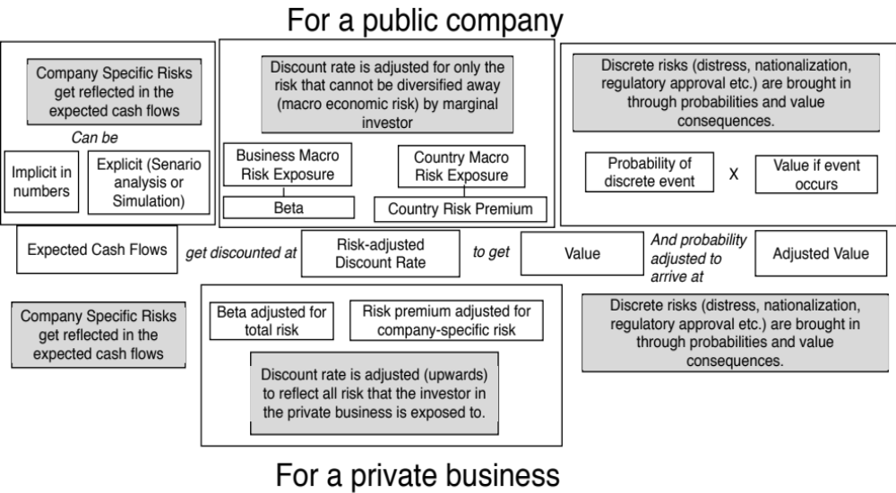
A Risk Template

Slide 23
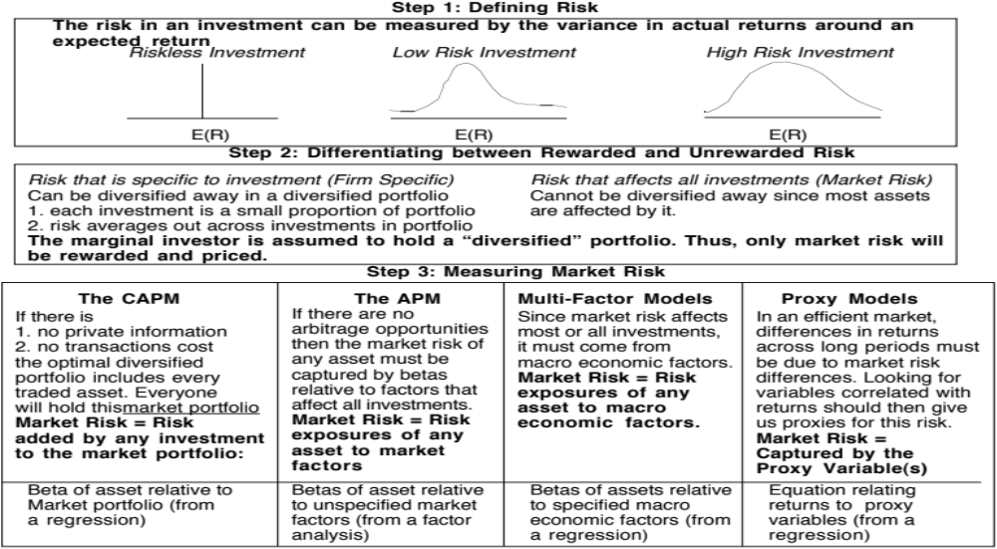
Risk and Discount Rates: The Models
Notes:
Note that all of the models of risk and return in finance agree on the first two steps. They deviate at the last step in the way they measure market risk, with
The CAPM, capturing all of it in one beta, relative to the market portfolio
The APM, capturing the market risk in multiple betas against unspecified economic factors
The Multi-Factor model, capturing the market risk in multiple betas against specified macro economic factors
The Regression model, capturing the market risk in proxies such as market capitalization and price/book ratios

Slide 24
Inputs required to use the CAPM -
The capital asset pricing model yields the following expected return:
  Expected Return = Riskfree Rate+ Beta * (Expected Return on the Market Portfolio - Riskfree Rate)
To use the model we need three inputs:
  The current risk-free rate
  The expected market risk premium (the premium expected for investing in risky assets (market portfolio) over the riskless asset)
  The beta of the asset being analyzed.
Notes:
Summarizes the inputs. Note that we are replacing the last component (E(Rm)-Rf) with the expected equity risk premium..

Slide 25
I. A Riskfree Rate
On a riskfree asset, the actual return is equal to the expected return. Therefore, there is no variance around the expected return.
For an investment to be riskfree, then, it has to have
  No default risk
  No reinvestment risk
Time horizon matters: Thus, the riskfree rates in valuation will depend upon when the cash flow is expected to occur and will vary across time.
Not all government securities are riskfree: Some governments face default risk and the rates on bonds issued by them will not be riskfree.
Notes:
Treasury bills may be default free but there is reinvestment risk when they are used as riskless rates for longer-term cashflows. A 6-month T.Bill is not riskless when looking at a 5-year cashflow.
Would a 5-year treasury be riskfree? Not really. The coupons would still expose you to reinvestment risk. Only a 5-year zero-coupon treasury would be riskfree for a 5-year cash flow.
If you were a purist, you would need different riskfree rates for different cashflows. A pragmatic solution would be to estimate the duration of the cashflows in a valuation and use a treasury of similar duration. (Since the duration is the weighted average of when the cashflows come in, this should be fairly long, especially when you count in the fact that the terminal value is the present value of cashflows forever).

Slide 26
Getting to a Risk free Rate
If you can find a default free entity (generally a government) issuing a bond in the currency, use the rate on that bond.
  With US dollars, you can use the US 10-year T.Bond rate as risk free, if you are willing to consider the US treasury as default free.
  With Euros, you can use the German 10-year Euro bond rate as the risk free rate.
If you can find a government bond rate in that currency, but that government is not viewed as default free, you have to adjust that rate to get to a risk free rate.
  The Nigerian Government has a 10-year Naira denominated bond with an interest rate of 11.75%.
  The Nigerian Government has a local currency sovereign rating of Ba3 and the default spread on that rating is 3.99%.
  Nigerian Naira Risk free rate = 11.75% - 3.99% = 7.76%
If you cannot find long term bonds denominated in the currency, you can use a synthetic risk free rate = expected inflation in that currency + expected real interest rate, with the US TIPs rate standing in for the latter.

Slide 27
Risk free rates by currency: March 2016

Slide 28
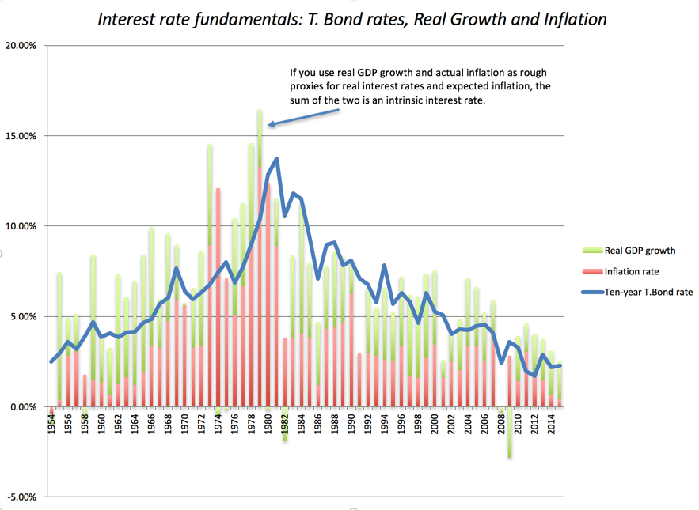
But the risk free rate is ”too low”

Slide 29
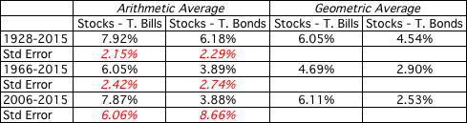
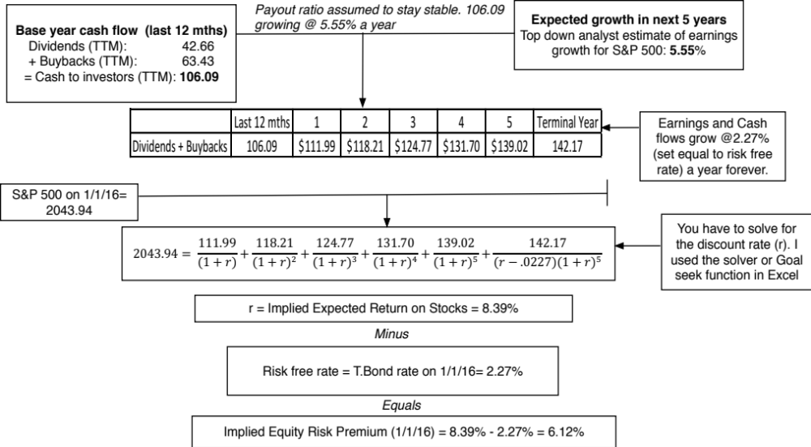
II. The Equity Risk Premium
Historical premium for the US

Slide 30
Country Risk: Look at a country’s bond rating and default spreads as a start
In this approach, the country equity risk premium is set equal to the default spread for the country, estimated in one of three ways:
  The default spread on a dollar denominated bond issued by the country. (In January 2016, that spread was 5.08% for the Brazilian $ bond)
  The sovereign CDS spread for the country. In January 2016, the ten year CDS spread for Brazil was 5.19%.
  The default spread based on the local currency rating for the country. Brazil’s sovereign local currency rating is Baa3 and the default spread for a Baa2 rated sovereign was about 2.44% in January 2016.
Many analysts add this default spread to the US risk premium to come up with a risk premium for a country. This would yield a risk premium of 8.44% for Brazil, if we use 6.40% as the US risk premium and the default spread based on the rating.
Notes:
This approach is simple but it assumes that country default spreads are also good measures of additional country equity risk. The question thought is whether equities (which are riskier than bonds) should command a larger risk premium.

Slide 31
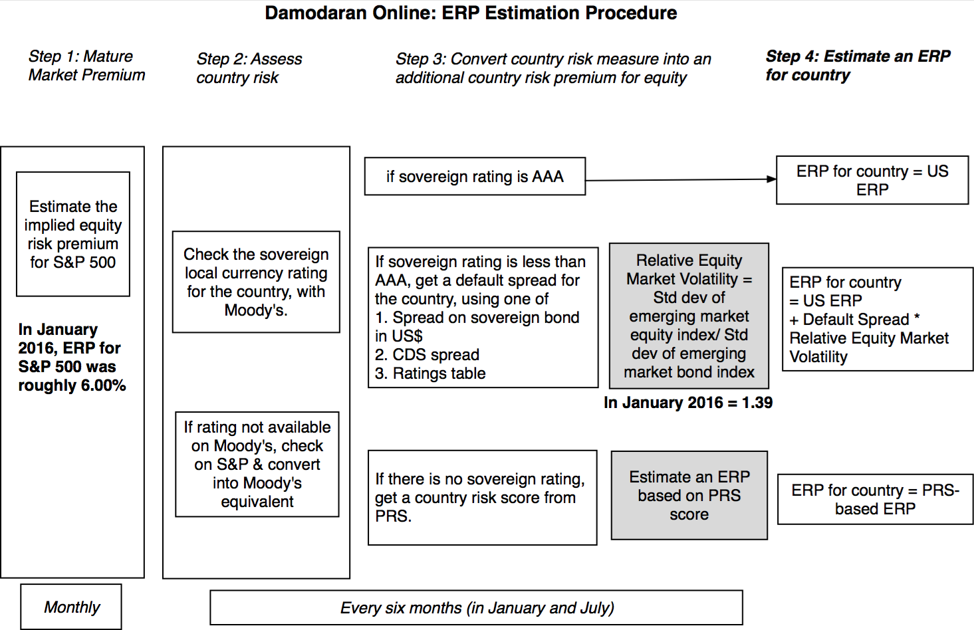
Beyond the default spread
Notes:
In In this approach, we scale up the default spread to reflect the additional risk in stocks… This will result in larger equity risk premiums. We are assuming that investors, when pricing equities in an emerging market, look at what they can make on government bonds issued by that market and scale up premiums for additional risk.
There is a third approach which is closely related where you look at the standard deviation of the emerging equity market, relative to the standard deviation of the U.S. equity market, and multiply by the U.S. equity risk premium. Thus, the equity risk premium for an emerging market which is twice as volatile as the the US market should have an equity risk premium of 7.76% (twice 3.88%).

Slide 32
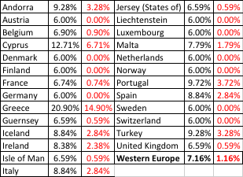
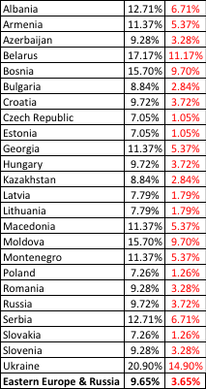
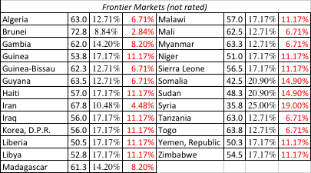

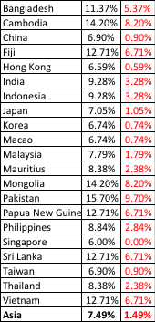

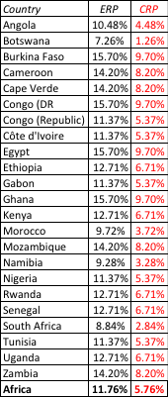
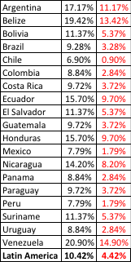
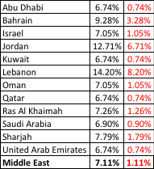

ERP : Jan 2016
Black #: Total ERP
Red #: Country risk premium
AVG: GDP weighted average
Notes:
Updated country risk premiums.

Slide 33
Shell: Equity Risk Premium- March 2016
Country | Oil & Gas Production | % of Total | ERP
Denmark | 17396 | 3.83% | 6.20%
Italy | 11179 | 2.46% | 9.14%
Norway | 14337 | 3.16% | 6.20%
UK | 20762 | 4.57% | 6.81%
Rest of Europe | 874 | 0.19% | 7.40%
Brunei | 823 | 0.18% | 9.04%
Iraq | 20009 | 4.40% | 11.37%
Malaysia | 22980 | 5.06% | 8.05%
Oman | 78404 | 17.26% | 7.29%
Russia | 22016 | 4.85% | 10.06%
Rest of Asia & ME | 24480 | 5.39% | 7.74%
Oceania | 7858 | 1.73% | 6.20%
Gabon | 12472 | 2.75% | 11.76%
Nigeria | 67832 | 14.93% | 11.76%
Rest of Africa | 6159 | 1.36% | 12.17%
USA | 104263 | 22.95% | 6.20%
Canada | 8599 | 1.89% | 6.20%
Brazil | 13307 | 2.93% | 9.60%
Rest of Latin America | 576 | 0.13% | 10.78%
Royal Dutch Shell | 454326 | 100.00% | 8.26%

Slide 34
Implications for Investing
Implication 1: A Shell investment in Canada, in any given business or currency, will require a lower cost of equity than an equivalent investment in Nigeria or Brazil.
Implication 2: Given the divergence of ERP within the Middle East and Asia, an investment in Oman is safer than an investment in Brunei or Iraq.
Implication 3: The ERP in some parts of the world that Shell operates in can change dramatically overnight.

Slide 35
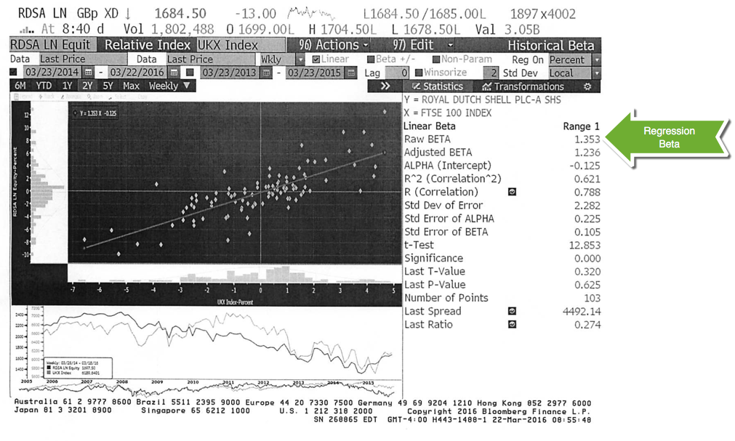
Estimating Beta: The Regression Approach
Notes:
This is the page for Disney’s beta, using the same period as the regression run earlier, from Bloomberg.
Bloomberg, however, uses only price returns (it ignores dividends both in the stock and the index). Hence the intercept is different.
The adjusted beta is just the regression beta moves towards one, reflecting the empirical realities that for most firms, betas tend to drift towards one as they get larger and more diversified.

Slide 36
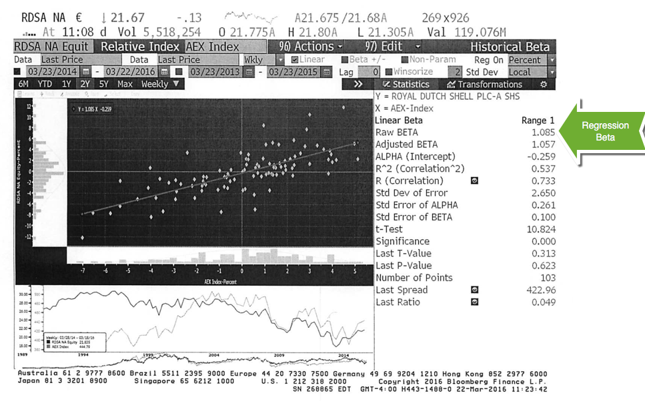
And another regression…

Slide 37
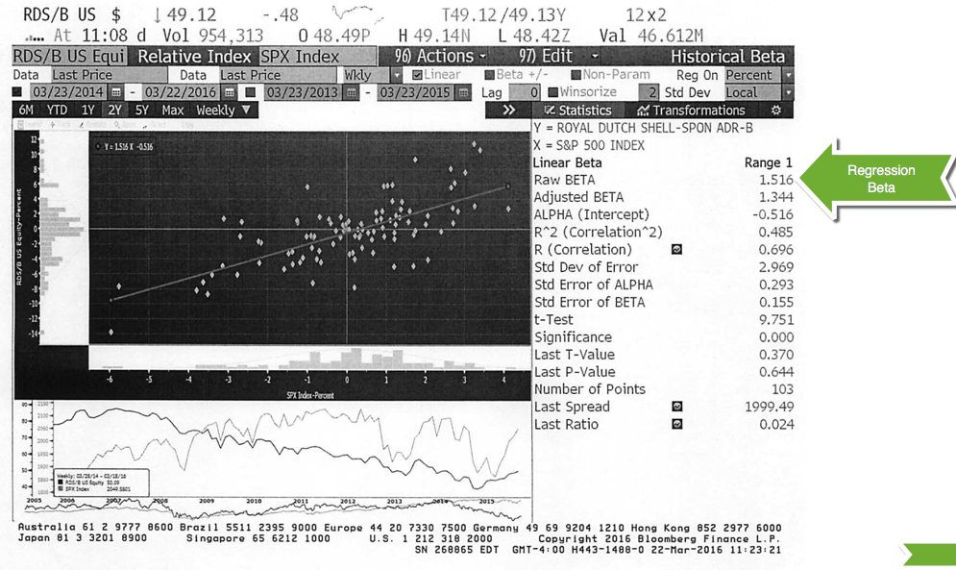
And yet another one..

Slide 38
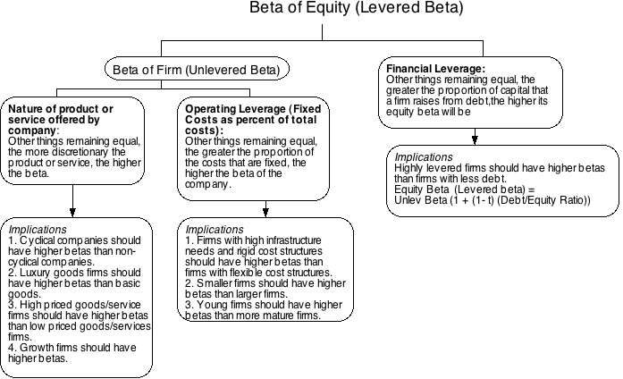
Determinants of Betas
Notes:
These are the three fundamentals that drive betas.
Firms that produce luxury goods (such as Gucci and Tiffanys) should have higher betas than firms that cater to more basic needs (Walmart). These firms tend to have revenues that are much more sensitive to changes in economic conditions.
Firms in businesses with high fixed cost structures (like airlines) should have higher betas than firms with more flexible cost structures.
Firms that borrow more money will have higher equity betas than otherwise similar firms that do not borrow money.

Slide 39
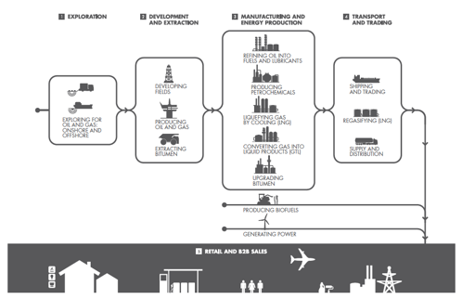
Breaking down the Oil Business

Slide 40
Bottom up beta for Shell..
Shell classifies its business into upstream (exploration and development) and downstream.
The proportion of Shell’s value that comes from upstream and downstream is very different, depending on whether you look at revenues (which weight downstream a lot more) than at earnings. I used the earnings because the margins are very different across the businesses.
When the numbers are volatile, as is evidenced in the 2015 values, the averages across time are better indicators.
 | Revenues (2015) | Earnings (2015) | Revenues (2013-15) | Earnings (2013-15) | % of firm | Unlevered Beta
Upstream | $53,927 | $(5,663) | $239,125 | $22,816 | 56.56% | 1.13
Downstream | $237,746 | $10,243 | $1,020,219 | $17,523 | 43.44% | 0.85
Corporate | $96 | $(425) | $362 | $(209)
Shell | $291,769 | $4,155 | $1,259,706 | $40,130 | 100.00% | 1.01
Notes:
EV/Sales = (Market Value of Equity + Market value of debt - Cash)/Sales. The number reported here is the average across the comparable firms. We are assuming that this will give us an approximate value for each business.
You can use revenue weights, if you are not inclined to estimate value, but you are then assuming that value is always proportional to revenue…
Note that we have computed two unlevered betas for Disney: one for just its operating assets and one for the firm, with its cash balance. Each will have it use later in the analysis.

Slide 41
Shell’s Cost of Equity
Business | % of Company | Unlevered Beta | D/E Ratio | Beta | Cost of Equity (in US$)
Upstream | 56.56% | 1.13 | 30.63% | 1.39 | 13.47%
Downstream | 43.44% | 0.85 | 30.63% | 1.05 | 10.63%
Shell | 100.00% | 1.01 | 30.63% | 1.24 | 12.24%
Risk free rate in US $ = 2.00%
Equity Risk Premium for Shell = 8.26%
I have allocated debt proportionately to the two businesses. Is this a fair assumption? If not, how would you allocate debt across the businesses?
Notes:
Disney does not break its debt down by division. We therefore used the information we had on Disney’s consolidated debt, the values we had estimated for each business and the average debt ratios of other publicly traded firms in each business to make our allocation.
Step 1a: We estimated the debt for each division by multiplying the EV by the industry average debt ratio to get the estimated debt (in the second to last column). We used this estimated debt to get the proportions of debt in each division.
Example: Media networks: 34,328* (.3871/1.3871) = 9,581 (Note that 38.71% is a debt to equity ratio. 38.71/138.71 gives you a debt to capital ratio)
Step 1b:: We applied these proportions to Disney’s actual total debt to get the allocated debt in the third column.
Example: Total debt at Disney is $16,682 million
Media Networks Debt= 16,682*.5144 = $8582 million
Step 1c: We subtracted this allocated debt from the estimated value to get to equity value.
Example: Equity in media networks: 34,328 – 8582 = 25,746
Step 1d: We estimated a D/E ratio based on the debt from step 2 and equity from step 3.
Example: Media Networks D/E = 8582/25,746 = 33.33%

Slide 42
Discussion Issue
Shell is considering investing in a new refinery in Nigeria. An analysis of the earnings suggests that it will generate a return on equity of 15% (in Naira). Would you fund it?
  Yes.
  No.
  What return on equity would this investment need to make to be justified? Why?
Notes:
The cost of equity for each division should be used. Otherwise, the riskier divisions will over invest and the safest divisions will under invest.
Over time, the firm will become a riskier firm. Think of Bankers Trust from 1980, when it was a commercial bank, to 1992, when it had become primarily an investment bank.
It also means that any multi business company should have different hurdle rates for each business, with higher rates for riskier businesses and lower rates for safer businesses.

Slide 43
Estimating the Cost of Debt
If the firm has bonds outstanding, and the bonds are traded, the yield to maturity on a long-term, straight (no special features) bond can be used as the interest rate.
If the firm is rated, use the rating and a typical default spread on bonds with that rating to estimate the cost of debt.
If the firm is not rated,
  and it has recently borrowed long term from a bank, use the interest rate on the borrowing or
  estimate a synthetic rating for the company, and use the synthetic rating to arrive at a default spread and a cost of debt
The cost of debt has to be estimated in the same currency as the cost of equity and the cash flows in the valuation.
Notes:
There are two key components to the cost of debt:
You want a long-term cost (I use a 10-year cost) of debt even if your debt is short term. You do not want to reward companies that play the term structure by giving them a lower cost of debt and capital. In effect, you are assuming that the rolled over cost of short term debt = cost of long term debt.
You want a current cost. In other words, you do not care about the debt and interest expenses on the books. The book interest rate (interest expense/book debt) is not a good measure of the cost of debt because it does not reflect the current cost of borrowing any may even be lower than the riskfree rate.
While the cost of debt can be estimated easily for some firms, by looking up traded bonds, it can be more difficult for non-rated firms. The default spreads can be obtained from
http://www.bondsonline.com

Slide 44
Estimating Synthetic Ratings
The rating for a firm can be estimated using the financial characteristics of the firm. In its simplest form, we can use just the interest coverage ratio:
Interest Coverage Ratio = EBIT / Interest Expenses
For Shell, we obtain the following:
  For 2015: Operating Income/ Interest Expense = -3261/1832 = -1.78
  For 2014: Operating Income/ Interest Expense = 19879/1517 = 13.1
  For 2014-15: (19879-3261)/ (1832+1517)= 4.96
Notes:
Basing the rating on just an interest coverage ratio will give you an approximation for the rating. A more realistic approach would use more than the interest coverage ratio. In fact, we could construct a score based upon multiple ratios (such as a Z-score) and use that score to estimate ratings.
The operating income used to compute the rating does not have to be last year’s number. It can be an average over time or a normalized value.

Slide 45
Interest Coverage Ratios, Ratings and Default Spreads
Interest coverage ratio | Rating is | Spread is
> 8.5 | Aaa/AAA | 0.40%
6.5-8.5 | Aa2/AA | 0.70%
5.5-6.5 | A1/A+ | 0.90%
4.25-5.5 | A2/A | 1.00%
3-4.25 | A3/A- | 1.20%
2.5-3 | Baa2/BBB | 1.75%
2.25-2.5 | Ba1/BB+ | 2.75%
2-2.25 | Ba2/BB | 3.25%
1.75-2 | B1/B+ | 4.00%
1.5-1.75 | B2/B | 5.00%
1.25-1.5 | B3/B- | 6.00%
0.8-1.25 | C2/C | 7.00%
0.65-0.85 | Ca2/CC | 8.00%
0.2-0.65 | Caa/CCC | 10.00%
<0.25 | D2/D | 12.00%
Shell’s actual rating is A+
Shell, Market Cap > $ 5 billion: 4.96 → Synthetic rating = A2/A
Notes:
This table is constructed, using smaller non-financial service companies (<$5 billion market cap) that are rated, and their interest coverage ratios. The firms were sorted based upon their ratings, and the interest coverage range was estimated.
These ranges will change over time, especially as the economy strengthens or weakens. You can get the updated ranges on my web site.

Slide 46
Shell’s cost of debt
Based on the actual rating, the default spread is 1.10%, which can be added to the risk free rate of 2.00% to arrive at a pre-tax cost of debt of 3.10% (in US$).
  Pre-tax cost of debt = Risk free Rate + Default Spread
  = 2.00% + 1.10% = 3.10%
Shell is a global company and does have the freedom to put its interest expenses where it can get the maximum tax benefit. Given its conservative nature, I will use the Dutch marginal tax rate of 25%.
  After-tax cost of debt = 3.10% (1-.25) = 2.33%

Slide 47
Current Cost of Capital: Shell
Business | Cost of Equity | E/(D+E) | Pre-tax Cost of Debt | After-tax Cost of debt | D/(D+E) | Cost of Capital
Upstream | 13.47% | 76.55% | 3.10% | 2.33% | 23.45% | 10.86%
Downstream | 10.63% | 76.55% | 3.10% | 2.33% | 23.45% | 8.68%
Shell | 12.24% | 76.55% | 3.10% | 2.33% | 23.45% | 9.91%
Notes:
This reproduces the current cost of capital computation for Disney, using market value weights for both debt and equity, the cost of equity (based upon the bottom-up beta) and the cost of debt (based upon the bond rating)
The market value of debt is estimated by estimating the present value of total interest payments and face value at the current cost of debt.
One way to frame the capital structure question: Is there a mix of debt and equity at which Disney’s cost of capital will be lower than 7.51%?

Slide 48
The Oil Business: Cost of Capital

Slide 49
Relative to your peer group..
Company Name | Country | Bottom up levered beta | Cost of equity in US$ | Pre-tax cost of debt in US $ | After-tax cost of debt in US $ | Cost of capital in US$
Exxon Mobil Corporation (NYSE:XOM) | United States | 1.4456 | 10.94% | 3.02% | 1.81% | 9.94%
PetroChina Co. Ltd. (SEHK:857) | China | 1.8570 | 15.08% | 4.19% | 3.14% | 11.07%
Chevron Corporation (NYSE:CVX) | United States | 1.5322 | 11.46% | 3.27% | 1.96% | 9.69%
Royal Dutch Shell plc (ENXTAM:RDSA) | Netherlands | 1.9203 | 12.24% | 3.10% | 2.33% | 9.91%
TOTAL S.A. (ENXTPA:FP) | France | 1.8731 | 14.89% | 3.82% | 3.06% | 10.52%
BP p.l.c. (LSE:BP.) | UK | 2.1810 | 16.64% | 3.96% | 2.77% | 10.59%
China Petroleum & Chemical Corp. (SEHK:386) | China | 2.3158 | 18.25% | 3.94% | 2.96% | 10.76%
Eni SpA (BIT:ENI) | Italy | 1.9516 | 19.52% | 6.13% | 4.90% | 13.73%
Occidental Petroleum Corporation (NYSE:OXY) | United States | 1.4964 | 11.25% | 3.52% | 2.11% | 9.82%
BG Group plc (LSE:BG.) | UK | 1.8541 | 14.49% | 4.46% | 3.12% | 10.85%
Statoil ASA (OB:STL) | Norway | 2.0664 | 14.67% | 3.27% | 2.62% | 9.57%
Public Joint Stock Company Gazprom (MICEX:GAZP) | Russia | 2.4838 | 26.41% | 8.29% | 6.05% | 15.95%
Suncor Energy Inc. (TSX:SU) | Canada | 1.7175 | 12.58% | 4.02% | 2.95% | 9.95%
Imperial Oil Ltd. (TSX:IMO) | Canada | 1.5874 | 11.79% | 3.02% | 2.22% | 9.92%
Public Joint Stock Company Oil Company LUKOIL | Russia | 1.9614 | 21.34% | 7.29% | 5.32% | 15.51%
PTT Public Company Limited (SET:PTT) | Thailand | 2.4166 | 22.52% | 6.29% | 5.22% | 13.90%
Sasol Ltd. (JSE:SOL) | South Africa | 1.5679 | 16.13% | 6.63% | 2.98% | 13.68%
Open Joint Stock Company Surgutneftegas ( | Russia | 1.3463 | 15.36% | 6.29% | 4.59% | 15.36%
Repsol, S.A. (CATS:REP) | Spain | 2.9094 | 27.99% | 6.63% | 5.30% | 13.99%
Ecopetrol SA (BVC:ECOPETROL) | Colombia | 2.5277 | 24.62% | 6.63% | 4.85% | 13.96%

Slide 50
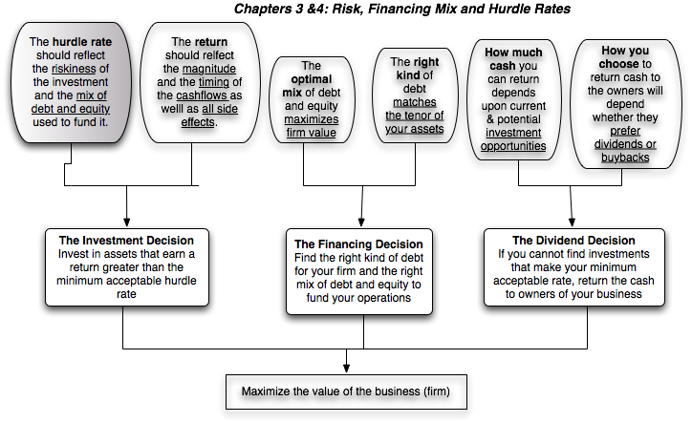
Back to First Principles
Notes:
Took us a while but we have the mechanics of the hurdle rate down..

Slide 51
Measuring Returns Right: The Basic Principles
Use cash flows rather than earnings. You cannot spend earnings.
Use “incremental” cash flows relating to the investment decision, i.e., cashflows that occur as a consequence of the decision, rather than total cash flows.
Use “time weighted” returns, i.e., value cash flows that occur earlier more than cash flows that occur later.
The Return Mantra: “Time-weighted, Incremental Cash Flow Return”
Notes:
These are the basic financial principles underlying the measurement of investment returns.
We focus on cash flows, because when cash flows and earnings are different, cash flows provide a more reliable measure of what an investment generates.
We focus on “incremental” effects on the overall business, since we care about the overall health and value of the business, not just individual projects.
We use time-weighted returns, since returns made earlier are worth more than the same returns made later.

Slide 52
Shell’s bid for BG Group
In August 2015, Shell bid almost £47 billion ($70 billion) for BG Group (BRGYY), a UK-based firm with oil reserves in Brazil and East Africa and natural gas holdings in Australia. The price paid represented a 50% premium on BG’s market price at the time.
If completed, the purchase will add 25% to Shell's oil and gas reserves and 20% to production. Shell also expects "synergies" of around $2.5 billion, raising the possibility of job cuts.
Shell expects to pay for the merger with a combination of cash and stock. BG shareholders will end up with approximately 19% of the shares in Shell after the merger.
Many analysts praised the logic in the deal, praising Shell for making a “bold mover”. Shares in BG soared 38% in London, while Shell slipped nearly 6%.

Slide 53
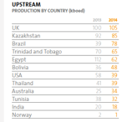
What are you buying?
Business: In 2014, the company reported that about 60% of its profits came from upstream and about 40% from LNG Shipping and Marketing.
Operations: BG reported operating income of about $6.2 billion on revenues of $19.2 billion in 2014. However, they also reported more than $8.6 billion in losses from disposals, re-measurement and impairment, leading to an overall loss of -$2.33 billion.

Slide 54
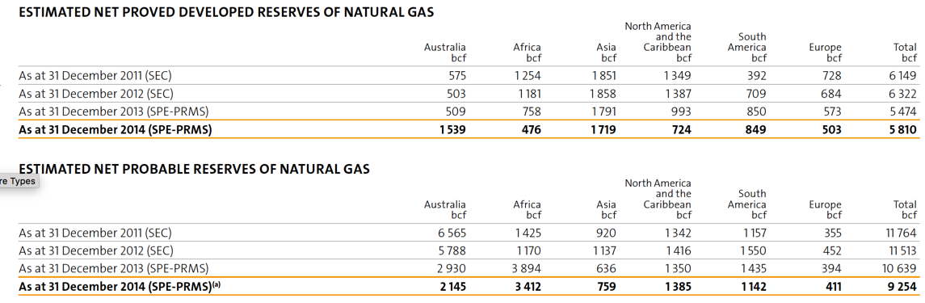
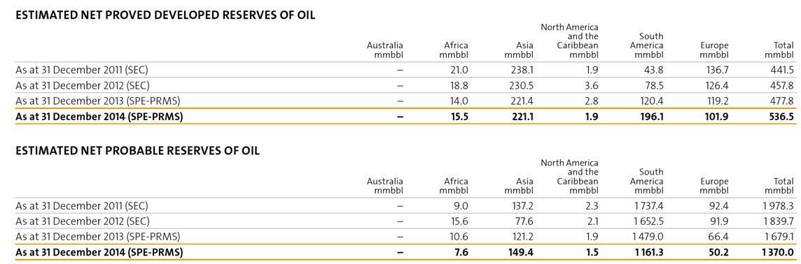
The sought after reserves..

Slide 55
Estimating a cost of capital for this asset acquisition
In estimating a ‘hurdle rate’ to use in assessing this acquisition, what should you use as
  The risk free rate?
  The beta for the investment (risk)?
  The equity risk premium?
  The debt mix?

Slide 56
Cost of capital for the BG acquisition

Slide 57

Expected Cashflows at BG
A press release for the company reported that the company generated operating $1,921 million (down from $6.155 million in 2014) on revenues of $16,148 million (down from $19.2 billion in 2014).
Notes:
The earnings and cash flows will really be in Brazilian $R. We will consider later the effects of looking at all the cash flows in a different currency.
Note that this investment is not going to be fully operational until the fourth year.

Slide 58
Valuing BG

Slide 59
Valuing Synergy
Assume that $47 billion is a fair stand-alone value for BG. The premium paid on the acquisition was approximately $23 billion and one reason provided was synergy.
What is the synergy that you see in this deal and where would you expect it to show up on the consolidated entity’s financials?
Higher cash flows today (cost cutting)
Higher growth in the future (from reserves)
Lower risk (from ?)
Something else
How would you value this synergy?

Slide 60
A tangent: How do Shell’s existing investments measure up?

Slide 61
The Oil Sector: ROIC vs Cost of Capital

Slide 62
Relative to your peer group..
Company Name | ROIC | Cost of capital in US$ | ROIC - Cost of Capital
Exxon Mobil Corporation (NYSE:XOM) | 7.38% | 9.94% | -2.56%
PetroChina Co. Ltd. (SEHK:857) | 2.74% | 11.07% | -8.33%
Chevron Corporation (NYSE:CVX) | 0.55% | 9.69% | -9.14%
Royal Dutch Shell plc (ENXTAM:RDSA) | 0.67% | 9.91% | -9.24%
TOTAL S.A. (ENXTPA:FP) | 3.40% | 10.52% | -7.11%
BP p.l.c. (LSE:BP.) | -4.85% | 10.59% | -15.44%
China Petroleum & Chemical Corp. (SEHK:386) | 0.35% | 10.76% | -10.41%
Eni SpA (BIT:ENI) | 1.63% | 13.73% | -12.10%
Occidental Petroleum Corporation (NYSE:OXY) | -16.29% | 9.82% | -26.11%
BG Group plc (LSE:BG.) | 3.58% | 10.85% | -7.27%
Statoil ASA (OB:STL) | 3.93% | 9.57% | -5.64%
Public Joint Stock Company Gazprom (MICEX:GAZP) | 4.73% | 15.95% | -11.23%
Suncor Energy Inc. (TSX:SU) | 2.74% | 9.95% | -7.22%
Imperial Oil Ltd. (TSX:IMO) | 4.86% | 9.92% | -5.06%
Public Joint Stock Company Oil Company LUKOIL (MICEX:LKOH) | 2.19% | 15.51% | -13.32%
PTT Public Company Limited (SET:PTT) | 3.31% | 13.90% | -10.59%
Sasol Ltd. (JSE:SOL) | 17.16% | 13.68% | 3.48%
Open Joint Stock Company Surgutneftegas (MICEX:SNGS) | 4.92% | 15.36% | -10.43%
Repsol, S.A. (CATS:REP) | 1.79% | 13.99% | -12.20%
Ecopetrol SA (BVC:ECOPETROL) | 3.39% | 13.96% | -10.57%

Slide 63
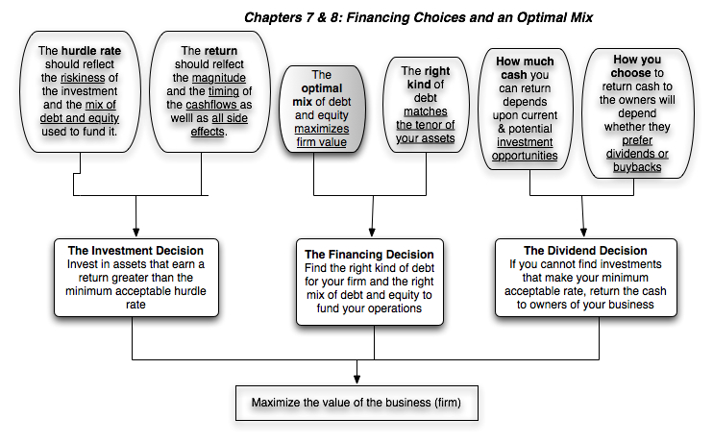
First Principles
Notes:
We shift from the investment principle to the financing principle.

Slide 64

Debt: Summarizing the trade off
Notes:
Brings together the costs and the benefits of debt, with the implications.

Slide 65
Mechanics of Cost of Capital Estimation
1. Estimate the Cost of Equity at different levels of debt:
  Equity will become riskier -> Beta will increase -> Cost of Equity will increase.
  Estimation will use levered beta calculation
2. Estimate the Cost of Debt at different levels of debt:
  Default risk will go up and bond ratings will go down as debt goes up -> Cost of Debt will increase.
  To estimating bond ratings, we will use the interest coverage ratio (EBIT/Interest expense)
3. Estimate the Cost of Capital at different levels of debt
4. Calculate the effect on Firm Value and Stock Price.
Notes:
The basic inputs for computing cost of capital are cost of equity and cost of debt. This summarizes the basic approach we will use to estimate each.

Slide 66
Finding an optimal mix:
Shell’s cost of capital schedule…
Debt Ratio | Beta | Cost of Equity | Bond Rating | Interest rate on debt | Tax Rate | Cost of Debt (after-tax) | WACC
0% | 0.9987 | 10.25% | Aaa/AAA | 2.75% | 25.00% | 2.06% | 10.25%
10% | 1.0819 | 10.94% | Aaa/AAA | 2.75% | 25.00% | 2.06% | 10.05%
20% | 1.1859 | 11.80% | Aaa/AAA | 2.75% | 25.00% | 2.06% | 9.85%
30% | 1.3197 | 12.90% | Aa2/AA | 3.00% | 25.00% | 2.25% | 9.71%
40% | 1.4980 | 14.37% | A3/A- | 3.75% | 25.00% | 2.81% | 9.75%
50% | 1.7477 | 16.44% | Caa/CCC | 11.00% | 25.00% | 8.25% | 12.34%
60% | 2.2768 | 20.81% | C2/C | 18.00% | 14.68% | 15.36% | 17.54%
70% | 3.0358 | 27.08% | C2/C | 18.00% | 12.58% | 15.74% | 19.14%
80% | 4.5537 | 39.61% | C2/C | 18.00% | 11.01% | 16.02% | 20.74%
90% | 9.1073 | 77.23% | C2/C | 18.00% | 9.79% | 16.24% | 22.34%
Notes:
Summarizes the cost of equity and debt from prior pages, as well as the cost of capital at different debt ratios.
If the objective is to minimize cost of capital, it occurs at 30 and 40%... We did try for a more precise answer by working in 1% increments and arrived at an optimal of 43% with a cost of capital of 7.28%. (We moved in 1% increments from 30% top 50%)
This will maximize firm value, if operating cashflow (EBITDA) is unaffected by changes in leverage and the consequent changes in ratings. (In other words, we are assuming no indirect bankruptcy costs… If we did, the optimal might be affected, especially if it is at low rating).

Slide 67
Debt Ratios across the Sector

Slide 68
And a more immediate measure of the danger from debt

Slide 69
Debt Ratios with your peer groups..
Company Name | Market Cap (in US $) | Total Debt incl leases (in US $) | Book Debt to capital ratio | Market Debt to capital ratio | Book Debt to Equity Ratio | Market Debt to Equity ratio | Debt/EBITDA
Exxon Mobil Corporation (NYSE:XOM) | $325,167.20 | $39,970.38 | 18.44% | 10.95% | 22.60% | 12.29% | 1.01
PetroChina Co. Ltd. (SEHK:857) | $222,078.10 | $112,310.63 | 35.26% | 33.59% | 54.45% | 50.57% | 2.43
Chevron Corporation (NYSE:CVX) | $169,552.70 | $39,003.07 | 20.01% | 18.70% | 25.01% | 23.00% | 1.74
Royal Dutch Shell plc (ENXTAM:RDSA) | $145,239.30 | $82,559.95 | 33.69% | 36.24% | 50.81% | 56.84% | 2.60
TOTAL S.A. (ENXTPA:FP) | $104,216.90 | $61,159.32 | 38.15% | 36.98% | 61.68% | 58.68% | 2.68
BP p.l.c. (LSE:BP.) | $95,507.80 | $74,008.64 | 41.91% | 43.66% | 72.13% | 77.49% | 5.42
China Petroleum & Chemical Corp. | $88,409.00 | $84,883.14 | 40.76% | 48.98% | 68.82% | 96.01% | 3.39
Eni SpA (BIT:ENI) | $54,220.40 | $35,533.60 | 34.23% | 39.59% | 52.05% | 65.54% | 2.18
Occidental Petroleum Corporation | $51,185.60 | $9,510.78 | 24.14% | 15.67% | 31.83% | 18.58% | 1.55
BG Group plc (LSE:BG.) | $49,648.10 | $23,406.25 | 44.25% | 32.04% | 79.38% | 47.14% | 3.57
Statoil ASA (OB:STL) | $44,530.00 | $32,624.90 | 43.77% | 42.28% | 77.85% | 73.26% | 1.74
Public Joint Stock Company Gazprom | $43,529.90 | $45,970.70 | 19.54% | 51.36% | 24.28% | 105.61% | 1.60
Suncor Energy Inc. (TSX:SU) | $37,236.30 | $13,968.43 | 31.26% | 27.28% | 45.47% | 37.51% | 2.06
Imperial Oil Ltd. (TSX:IMO) | $27,445.80 | $6,686.75 | 27.89% | 19.59% | 38.67% | 24.36% | 2.21
Public Joint Stock Company Oil Company | $23,259.00 | $13,282.70 | 13.88% | 36.35% | 16.12% | 57.11% | 1.08
PTT Public Company Limited (SET:PTT) | $19,335.10 | $19,212.56 | 39.12% | 49.84% | 64.26% | 99.37% | 3.04
Sasol Ltd. (JSE:SOL) | $17,700.90 | $4,046.36 | 20.01% | 18.61% | 25.02% | 22.86% | 0.79
Open Joint Stock Company Surgutneftegas | $16,879.90 | $0.00 | 0.00% | 0.00% | 0.00% | 0.00% | 0.00
Repsol, S.A. (CATS:REP) | $15,201.70 | $24,512.35 | 41.67% | 61.72% | 71.44% | 161.25% | 6.93
Ecopetrol SA (BVC:ECOPETROL) | $14,650.30 | $17,140.40 | 50.87% | 53.92% | 103.52% | 117.00% | 3.16

Slide 70
A Framework for Getting to the Optimal
Is the actual debt ratio greater than or lesser than the optimal debt ratio?
Actual > Optimal
Actual < Optimal
Overlevered
Underlevered
Is the firm under bankruptcy threat?
Is the firm a takeover target?
Yes
No
Yes
No
Reduce Debt quickly
Does the firm have good
Increase leverage
Does the firm have good
1. Equity for Debt swap
projects?
quickly
projects?
2. Sell Assets; use cash
ROE > Cost of Equity
1. Debt/Equity swaps
ROE > Cost of Equity
to pay off debt
ROC > Cost of Capital
2. Borrow money&
ROC > Cost of Capital
3. Renegotiate with lenders
buy shares.
Yes
No
Yes
No
Take good projects with
1. Pay off debt with retained
Take good projects with
new equity or with retained
earnings.
debt.
earnings.
2. Reduce or eliminate dividends.
Do your stockholders like
3. Issue new equity and pay off
dividends?
debt.
Yes
No
Pay Dividends
Buy back stock
Notes:
Studies that have looked at the likelihood of a firm being taken over (in a hostile takeover) have concluded that
Small firms are more likely to be taken over than larger firms
Closely held firms are less likely to be taken over than widely held firms
Firms with anti-takeover restrictions in the corporate charter (or from the state) are less likely to be taken over than firms without these restrictions
Firms which have done well for their stockholders (positive Jensen’s alpha, Positive EVA) are less likely to be taken over than firms which have done badly.
Whether a firm is under bankruptcy threat can be assessed by looking at its rating. If its rating is BB or less, you can argue that the bankruptcy threat is real.
Looking at historical ROE or ROC, relative to the cost of equity and capital, does assume that the future will look like the past.

Slide 71
Shell’s Pathways to the Optimal
Is the actual debt ratio greater than or lesser than the optimal debt ratio?
Actual > Optimal
Actual < Optimal
Overlevered
Underlevered
Is the firm under bankruptcy threat?
Is the firm a takeover target?
Yes
No
Yes
No
Reduce Debt quickly
Does the firm have good
Increase leverage
Does the firm have good
1. Equity for Debt swap
projects?
quickly
projects?
2. Sell Assets; use cash
ROE > Cost of Equity
1. Debt/Equity swaps
ROE > Cost of Equity
to pay off debt
ROC > Cost of Capital
2. Borrow money&
ROC > Cost of Capital
3. Renegotiate with lenders
buy shares.
Yes
No
Yes
No
Take good projects with
1. Pay off debt with retained
Take good projects with
new equity or with retained
earnings.
debt.
earnings.
2. Reduce or eliminate dividends.
Do your stockholders like
3. Issue new equity and pay off
dividends?
debt.
Yes
No
Pay Dividends
Buy back stock
Notes:
Studies that have looked at the likelihood of a firm being taken over (in a hostile takeover) have concluded that
Small firms are more likely to be taken over than larger firms
Closely held firms are less likely to be taken over than widely held firms
Firms with anti-takeover restrictions in the corporate charter (or from the state) are less likely to be taken over than firms without these restrictions
Firms which have done well for their stockholders (positive Jensen’s alpha, Positive EVA) are less likely to be taken over than firms which have done badly.
Whether a firm is under bankruptcy threat can be assessed by looking at its rating. If its rating is BB or less, you can argue that the bankruptcy threat is real.
Looking at historical ROE or ROC, relative to the cost of equity and capital, does assume that the future will look like the past.

Slide 72
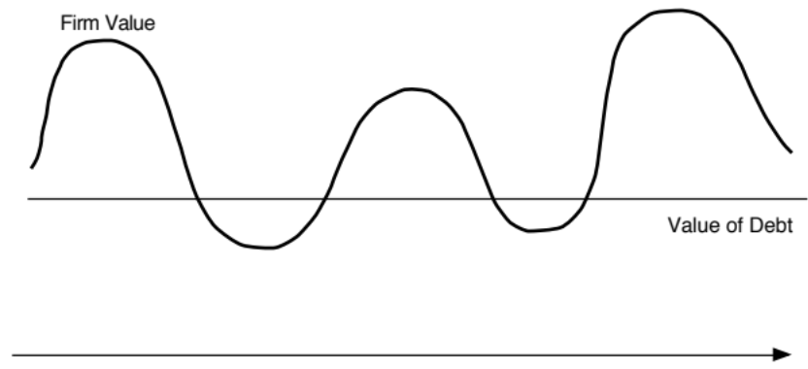

Designing Debt: The Fundamental Principle
The objective in designing debt is to make the cash flows on debt match up as closely as possible with the cash flows that the firm makes on its assets.
By doing so, we reduce our risk of default, increase debt capacity and increase firm value.
Matched Debt
Unmatched Debt
Notes:
Your objective is issue securities that bring you all of the tax benefits of debt while providing you with the flexibility of equity. It is not the reduction in risk but the increase in debt capacity that generates the value. A firm that does not use this debt capacity will not gain from matching debt to assets in the first place.

Slide 73
Designing Debt: Bringing it all together
Start with the
Cyclicality &
Cash Flows
Duration
Currency
Effect of Inflation
Growth Patterns
Other Effects
on Assets/
Uncertainty about Future
Projects
Fixed vs. Floating Rate
Straight versus
Special Features
Commodity Bonds
Define Debt
Duration/
Currency
* More floating rate
Convertible
on Debt
Catastrophe Notes
Characteristics
Maturity
Mix
- if CF move with
- Convertible if
- Options to make
inflation
cash flows low
cash flows on debt
- with greater uncertainty
now but high
match cash flows
on future
exp. growth
on assets
Design debt to have cash flows that match up to cash flows on the assets financed
Overlay tax
Deductibility of cash flows
Differences in tax rates
Zero Coupons
preferences
for tax purposes
across different locales
If tax advantages are large enough, you might override results of previous step
Consider
Analyst Concerns
Ratings Agency
Regulatory Concerns
ratings agency
- Effect on EPS
- Effect on Ratios
- Measures used
Operating Leases
& analyst concerns
- Value relative to comparables
- Ratios relative to comparables
MIPs
Surplus Notes
Can securities be designed that can make these different entities happy?
Observability of Cash Flows
Type of Assets financed
Existing Debt covenants
Convertibiles
Factor in agency
by Lenders
- Tangible and liquid assets
- Restrictions on Financing
Puttable Bonds
conflicts between stock
- Less observable cash flows
create less agency problems
Rating Sensitive
and bond holders
lead to more conflicts
Notes
If agency problems are substantial, consider issuing convertible bonds
LYONs
Consider Information
Uncertainty about Future Cashflows
Credibility & Quality of the Firm
Asymmetries
- When there is more uncertainty, it
- Firms with credibility problems
may be better to use short term debt
will issue more short term debt
Notes:
This provides the basic framework for designing the right kind of debt.
You begin by trying to match up financing type to asset type (in terms of duration, currency, growth patterns and special features). By doing so, you reduce your risk of bankruptcy, increase your capacity to borrow and consequently the tax benefits of debt.
Then, you modify the “perfect debt”
For tax factors, to ensure that you get the maximum tax benefit
To meet the needs and objectives of equity research analysts and ratings agencies
To fix any agency conflicts that might prevent lenders from lending
To prevent an undeservedly low rating from pushing up the cost of debt above what it should be. (If you are under rated, you should probably use short term debt until you feel your rating is justified)

Slide 74
Designing Shell’s debt
What is the duration of a typical project for Shell?
  Very short term (< 1 year)
  Short term (1-3 years)
  Medium term (3-5 years)
  Long term
What currency are your cash flows in?
How much pricing power do you have (to deal with changes in inflation)?
  None. We are price takers
  Some.
  A great deal.
What macro-economic variables most affect your cash flows?

Slide 75
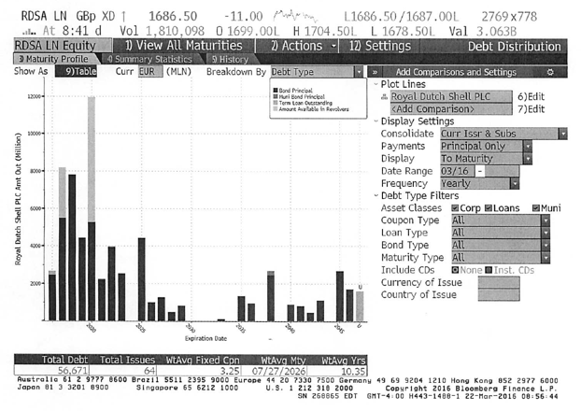
Analyzing Shell’s Current Debt
Notes:
There may be good reasons for the mismatch but for most firms, the existing debt structure is more a result of history and inertia. Disney’s business mix has changed significantly over the last decade - more broadcasting, less theme park - and it is not surprising that the debt structure has not kept pace.
In some cases, market frictions and limitations may contribute to the mismatch. In fact, many emerging market companies were unable to borrow long term until recently because banks would not lend long term in those markets.

Slide 76
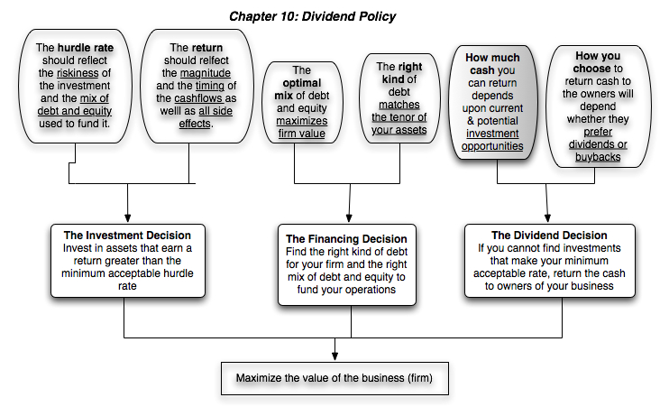
First Principles
Notes:
Third and final principle of corporate finance.

Slide 77
Assessing Dividend Policy
Step 1: How much could the company have paid out during the period under question?
Step 2: How much did the the company actually pay out during the period in question?
Step 3: How much do I trust the management of this company with excess cash?
  How well did they make investments during the period in question?
  How well has my stock performed during the period in question?
Notes:
By paid out to stockholders in this phase of the analysis, we mean both dividends and stock buybacks.

Slide 78
How much has the company returned to stockholders?
As firms increasing use stock buybacks, we have to measure cash returned to stockholders as not only dividends but also buybacks.
For Shell, we obtain the following:
 | 2006 | 2007 | 2008 | 2009 | 2010 | 2011 | 2012 | 2013 | 2014 | 2015 | 2006-2015
Dividends | $8,142 | $9,001 | $9,516 | $10,526 | $9,584 | $6,877 | $7,390 | $7,198 | $9,444 | $9,370 | $87,048
Stock Buybacks | $8,047 | $4,387 | $3,573 | $- | $- | $2,035 | $1,526 | $5,565 | $3,328 | $448 | $28,909
Cash Returned | $16,189 | $13,388 | $13,089 | $10,526 | $9,584 | $8,912 | $8,916 | $12,763 | $12,772 | $9,818 | $115,957
Notes:
All four companies paid dividends over the five-year period, but there are interesting differences between the companies. Disney, and Tata Chemicals increased dividends in each of the five years, but Aracruz had more volatile dividends over the period, with dividends dropping significantly in 2007. This reflects the convention of focusing on absolute dividends in the United States and India, but the practice of maintaining payout ratios in Brazil. Deutsche Bank had a precipitous drop in dividends in 2008, reflecting the effects of the market crisis and the desire to maintain regulatory capital ratios.
Looking at stock buybacks, Disney has been the most active player buying stock in all five years, with buybacks exceeding $ 6 billion in 2006 and 2007. None of the other companies have bought back stock. The key difference with treasury stock that stays on the books is that the number of shares in the company remains unchanged. In the U.S., companies are not allowed to keep treasury stock on their books for extended periods.

Slide 79
A Measure of How Much a Company Could have Afforded to Pay out: FCFE
The Free Cashflow to Equity (FCFE) is a measure of how much cash is left in the business after non-equity claimholders (debt and preferred stock) have been paid, and after any reinvestment needed to sustain the firm’s assets and future growth.
  Net Income
  + Depreciation & Amortization
  = Cash flows from Operations to Equity Investors
  - Preferred Dividends
  - Capital Expenditures
  - Working Capital Needs
  - Principal Repayments
  + Proceeds from New Debt Issues
  = Free Cash flow to Equity
Notes:
This cashflow is
Free: because it cashflow left over after debt payments and investment needs have been met
To Equity Investors: because it is after payments to all non-equity claimholders
In coming up with the numbers, we define
Capital expenditures as including all capital investments. We do not distinguish between discretionary and non-discretionary cap ex. Once we assume growth in earnings, all cap ex is non-discretionary.
Working capital needs refers to the increase in non-cash working capital.

Slide 80
Shell’s FCFE
 | 2006 | 2007 | 2008 | 2009 | 2010 | 2011 | 2012 | 2013 | 2014 | 2015
Net Income | $25,442 | $31,331 | $26,277 | $12,518 | $20,127 | $30,826 | $26,712 | $16,371 | $14,874 | $1,939
Depreciation & Amort. | $12,411 | $12,563 | $13,082 | $12,623 | $12,688 | $11,713 | $13,518 | $16,099 | $17,196 | $16,779
Goodwill Amortized |  |  |  |  |  |  |  |  | $671 | $609
Capital Expenditure | $(22,922) | $(24,576) | $(35,065) | $(26,516) | $(26,940) | $(26,301) | $(32,576) | $(39,975) | $(31,676) | $(26,131)
- Change in WC | $4,052 | $6,206 | $(7,935) | $2,331 | $5,929 | $6,471 | $(3,391) | $(2,988) | $(6,405) | $(5,521)
- *(Debt repaid - Debt issued) | $(2,106) | $(1,314) | $(4,826) | $(10,701) | $(9,256) | $7,124 | $17 | $(5,395) | $(357) | $(14,891)
FCFE | $12,985 | $14,426 | $17,055 | $6,995 | $9,202 | $2,643 | $11,028 | $878 | $7,827 | $13,608
Notes:
The depreciation numbers also include amortization and the capital expenditures include cash acquisitions. Increases in noncash working capital, shown as positive numbers, represent a drain on the cash, whereas decreases in noncash working capital, shown as negative numbers, represent positive cash flows. In 1999, for example, noncash working capital decreased by $363 million, increasing the cash available for stockholders in that year by the same amount. Finally, the net cash flow from debt is the cash generated by the issuance of new debt, netted out against the cash outflow from the repayment of old debt. Again, using 1999 as an example, Disney issued $176 million more in new debt than it paid off on old debt, and this represents a positive cash flow in that year. We have computed two measures of FCFE, one before the net debt cash flow and one after. Using 1999 as an illustration, we compute each as follows:
FCFE_{Before Debt CF}= Net Income + Depreciation – Capital Expenditures – Change in Noncash Working Capital = 1300+3779-6113-(-363) = -$ 671 million
FCFE_{After Debt CF}= FCFE_{Before Debt CF} + Net Debt CF = -$671 + $176 = -$495 million

Slide 81
Shell: Cash Returned vs FCFE
Notes:
While payout ratios are used widely to assess how much companies are paying out, the cash/FCFE ratio is both more comprehensive (since it includes buybacks) and more meaningful (because it looks at the cash available for dividends rather than earnings). In Disney’s case, for example, while the payout ratio may look low, the firm has been returning all of the cash it can and more over the ten year period.

Slide 82
The Oil Sector: Dividend Payout Ratios

Slide 83
Dividends across the peer group..
Company Name | Payout ratio | Dividend Yield | Trailing Net Income | Dividends | FCFE | Dividends + Buybacks
Exxon Mobil Corporation (NYSE:XOM) | 59.98% | 3.68% | $19,940.00 | $11,960.00 | $3,589.00 | $18,563.00
PetroChina Co. Ltd. (SEHK:857) | 65.86% | 1.95% | $6,564.00 | $4,323.20 | -$1,785.75 | $4,323.20
Chevron Corporation (NYSE:CVX) | 92.47% | 4.72% | $8,646.00 | $7,995.00 | -$2,825.00 | $9,233.00
Royal Dutch Shell plc (ENXTAM:RDSA) | 663.01% | 7.28% | $1,595.00 | $10,575.00 | $3,436.00 | $12,030.00
TOTAL S.A. (ENXTPA:FP) | 378.01% | 3.83% | $1,055.00 | $3,988.00 | -$7,778.00 | $4,225.00
BP p.l.c. (LSE:BP.) | NA | 6.12% | -$7,582.00 | $5,848.00 | -$3,302.00 | $6,641.00
China Petroleum & Chemical Corp. (SEHK:386) | 111.59% | 4.31% | $3,413.40 | $3,809.10 | $3,479.30 | $3,809.10
Eni SpA (BIT:ENI) | NA | 7.14% | -$3,063.40 | $3,871.40 | $1,684.10 | $3,969.60
Occidental Petroleum Corporation (NYSE:OXY) | NA | 4.40% | -$6,064.00 | $2,251.00 | $229.00 | $3,254.00
BG Group plc (LSE:BG.) | NA | 1.97% | -$2,667.00 | $980.00 | -$5,784.00 | $980.00
Statoil ASA (OB:STL) | NA | 6.03% | -$4,359.40 | $2,683.60 | -$6,726.60 | $2,683.60
Public Joint Stock Company Gazprom (MICEX:GAZP) | 43.34% | 6.89% | $6,917.30 | $2,998.30 | -$16,544.70 | $2,998.30
Suncor Energy Inc. (TSX:SU) | 1701.26% | 3.28% | $71.70 | $1,219.80 | -$1,267.60 | $1,617.70
Imperial Oil Ltd. (TSX:IMO) | 26.02% | 1.20% | $1,262.30 | $328.50 | -$1,236.20 | $328.50
Public Joint Stock Company Oil Company LUKOIL (MICEX:LKOH) | 146.75% | 8.34% | $1,322.00 | $1,940.00 | $2,021.00 | $1,940.00
PTT Public Company Limited (SET:PTT) | NA | 5.63% | -$245.80 | $1,089.10 | -$2,596.16 | $1,089.10
Sasol Ltd. (JSE:SOL) | 42.87% | 5.92% | $2,446.10 | $1,048.60 | $243.70 | $1,048.60
Open Joint Stock Company Surgutneftegas (MICEX:SNGS) | 2.69% | 2.54% | $15,939.90 | $428.70 | $14,263.50 | $428.70
Repsol, S.A. (CATS:REP) | 61.27% | 3.59% | $890.60 | $545.70 | -$9,348.80 | $1,024.50
Ecopetrol SA (BVC:ECOPETROL) | 364.05% | 13.00% | $523.20 | $1,904.70 | -$3,847.00 | $1,904.70

Slide 84
A Practical Framework for Analyzing Dividend Policy
How much did the firm pay out? How much could it have afforded to pay out?
What it could have paid out
What it actually paid out
Net Income
Dividends
- (Cap Ex - Depr’n) (1-DR)
+ Equity Repurchase
- Chg Working Capital (1-DR)
= FCFE
Firm pays out too little
Firm pays out too much
FCFE > Dividends
FCFE < Dividends
Do you trust managers in the company with
What investment opportunities does the
your cash?
firm have?
Look at past project choice:
Look at past project choice:
Compare
ROE to Cost of Equity
Compare
ROE to Cost of Equity
ROC to WACC
ROC to WACC
Firm has history of
Firm has history
Firm has good
Firm has poor
good project choice
of poor project
projects
projects
and good projects in
choice
the future
Give managers the
Force managers to
Firm should
Firm should deal
flexibility to keep
justify holding cash
cut dividends
with its investment
cash and set
or return cash to
and reinvest
problem first and
dividends
stockholders
more
then cut dividends
Notes:
Most firms return less in cash than they have available to return. Whether they will find themselves under pressure (like Chrysler) or relatively untouched (like Microsoft) will depend upon how much stockholders trust the managers of the firm to use the cash wisely.
Stockholders will tend to be less aggressive about demanding that the cash be returned to them for firms
With a good investment track record
In a sector with high returns
Where managers have substantial equity stakes in the firm
They will tend to be most aggressive when these conditions do not hold.

Slide 85
Do investors trust Shell’s management?
Given Shell’s track record, if you were a Shell stockholder, would you be comfortable with Shell’s dividend policy?
  Yes
  No
As managers at Shell, are you comfortable with Shell’s dividend policy?
  Yes
  No
Notes:
The fact that Disney has underperformed the market both in terms of stock price performance and return on equity suggests that stockholders are unlikely to have much patience with Disney accumulating cash (afraid of what they will do with the cash).
That conclusion is reinforced by the fact that the managers responsible for the damage are still at the helm of the firm.

Slide 86
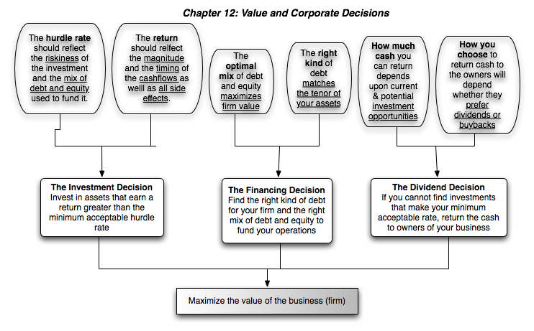
First Principles
Notes:
Back, full circle to the objective.

Slide 87
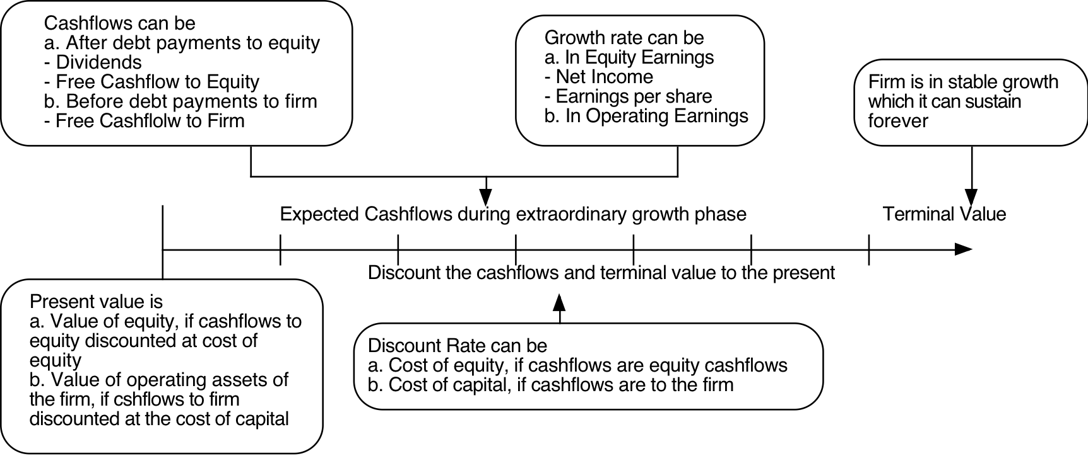
The Ingredients that determine value.
Notes:
Sets up the basic inputs:
1. Discount rates
2. Cash flows
3. Expected Growth
4. Length of the period that they can sustain a growth rate higher than the growth rate of the economy.
How we estimate each of these numbers depends on whether we are taking an equity perspective or a firm perspective.
The answer to the fourth question matters because we cannot estimate cash flows forever and a publicly traded company, at least in theory, can last forever. If cash flows grow at the same rate forever, we can short circuit the cash flow estimation and compute the present value of all cash flows beyond that point in time with one equation (CF/ (r-g)).

Slide 88
Valuing Shell at today’s oil price ($40)

Slide 90
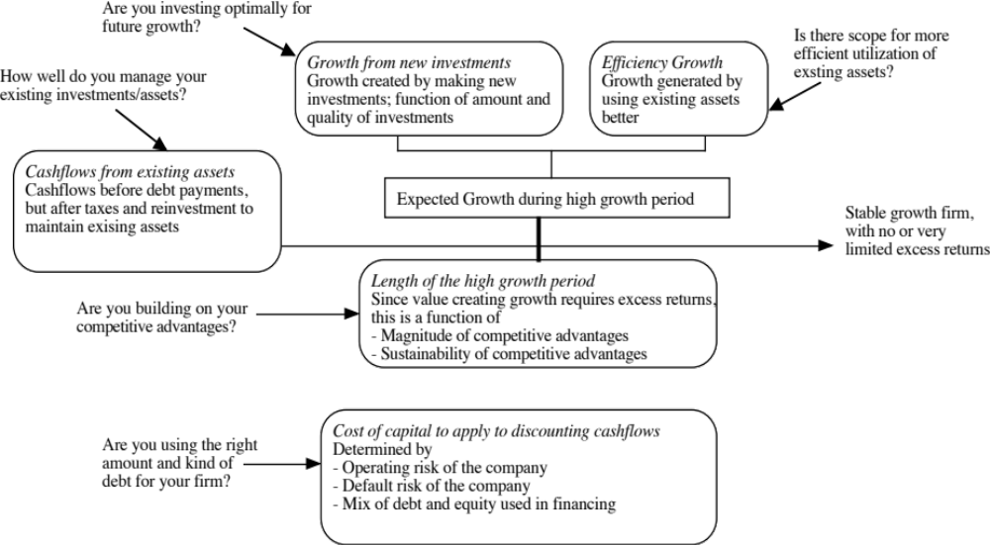
Ways of changing value…
Notes:
To change value, you have to take actions that affect one of four inputs:
Cash flows from existing assets
Expected growth
Cost of capital
Length of the growth period

Slide 91

Value Creation 1: Increase Cash Flows from Assets in Place
Notes:
The key is that there is a trade off between current cashflows and future growth. If you increase current cashflows at the expense of future growth, you may destroy value rather than add to it.

Slide 92

Value Creation 2: Increase Expected Growth
Keeping all else constant, increasing the expected growth in earnings will increase the value of a firm, but only if the firm earns a return on capital that exceeds the cost of capital:

Slide 93
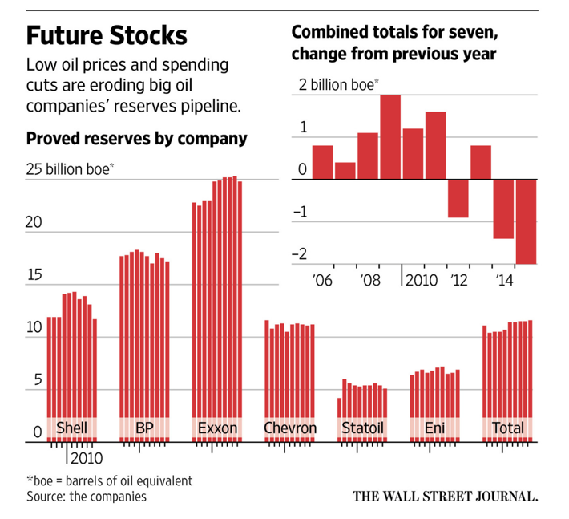
The Effect of Oil Prices on the Value of Growth

Slide 94
A postscript on creating growth: The Role of Acquisitions and Divestitures
An acquisition is just a large-scale project. All of the rules that apply to individual investments apply to acquisitions, as well. For an acquisition to create value, it has to
  Generate a higher return on capital, after allowing for synergy and control factors, than the cost of capital.
  Put another way, an acquisition will create value only if the present value of the cash flows on the acquired firm, inclusive of synergy and control benefits, exceeds the cost of the acquisitons
A divestiture is the reverse of an acquisition, with a cash inflow now (from divesting the assets) followed by cash outflows (i.e., cash flows foregone on the divested asset) in the future. If the present value of the future cash outflows is less than the cash inflow today, the divestiture will increase value.
A fair-price acquisition or divestiture is value neutral.

Slide 95

Value Creating Growth… Evaluating the Alternatives..

Slide 96
A more general problem… Growing through acquisitions has never been easy…
Firms that grow through acquisitions have generally had far more trouble creating value than firms that grow through internal investments.
In general, acquiring firms tend to
  Pay too much for target firms
  Over estimate the value of “synergy” and “control”
  Have a difficult time delivering the promised benefits
Worse still, there seems to be very little learning built into the process. The same mistakes are made over and over again, often by the same firms with the same advisors.
Conclusion: There is something structurally wrong with the process for acquisitions which is feeding into the mistakes.

Slide 97
Seven reasons why acquisitions fail…
Risk Transference: Attributing acquiring company risk characteristics to the target firm. Just because you are a safe firm and operate in a secure market, does not mean that you can transfer these characteristics to a target firm.
Debt subsidies: Subsiding target firm stockholders for the strengths of the acquiring firm is providing them with a benefit they did not earn.
Auto-pilot Control: Adding 20% or some arbitrary number to the market price just because other people do it is a recipe for overpayment. Using silly rules such as EPS accretion just makes the problem worse.
Elusive Synergy: While there is much talk about synergy in mergers, it is seldom valued realistically or appropriately.
Its all relative: The use of transaction multiples (multiples paid by other acquirers in acquisitions) perpetuates over payment.
Verdict first, trial afterwards: Deciding you want to do an acquisition first and then looking for justification for the price paid does not make sense.
It’s not my fault: Holding no one responsible for delivering results is a sure-fire way not to get results…

Slide 98

III. Building Competitive Advantages: Increase length of the growth period

Slide 99
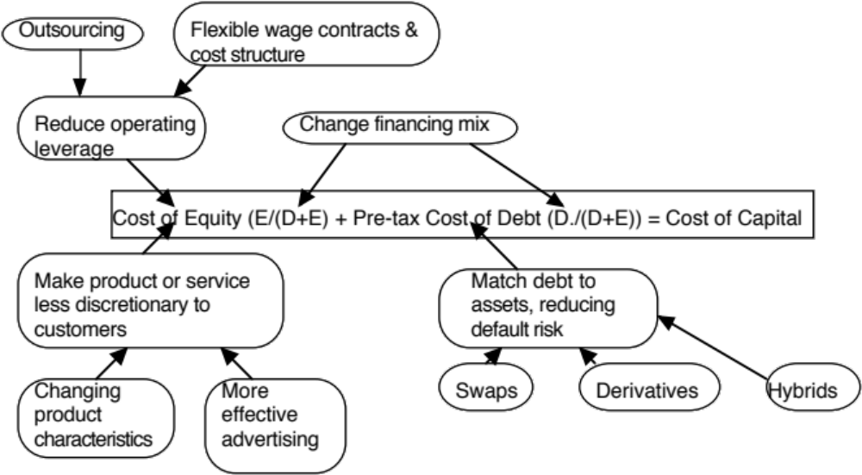
Value Creation 4: Reduce Cost of Capital
Notes:
Reducing the cost of capital, holding cashflows constant, increases firm value.

Slide 100
Shell: Where’s the value?
Of the options available to increase Shell’s value per share, which of the following offers the most promise?
  Improve efficiency, cut costs and go for higher margins.
  Acquire other companies (to get growth)
  Invest in reserves (exploration & acquisition)
  Financial engineering (change debt mix and type)
  Cash return (Dividends and stock buybacks)

Slide 101


You can always play the pricing game..
The market gives…
And takes away….
Notes:
Value enhancement and price enhancement are equivalent in an efficient market. In a market that does not always reward long-term decision making and behaves irrationally,

Slide 102
First Principles
Notes:
As we begin, so we end.

