Slide 1
Corporate Governance: Defining the end game
“If I have to choose between you and me - I like me better.”
Notes:
Since the objective in corporate finance (to maximize firm value) is central to everything we do, we need to look at both its strengths and weaknesses. In fact, many disagreements that people have with corporate finance theory stems from the fact that they have a different objective for the business in mind. Thus, if you view a firm’s objective as maximizing the number of jobs created, choosing projects based upon the highest NPV (which is the corporate finance prescription) will make little sense.

Slide 2
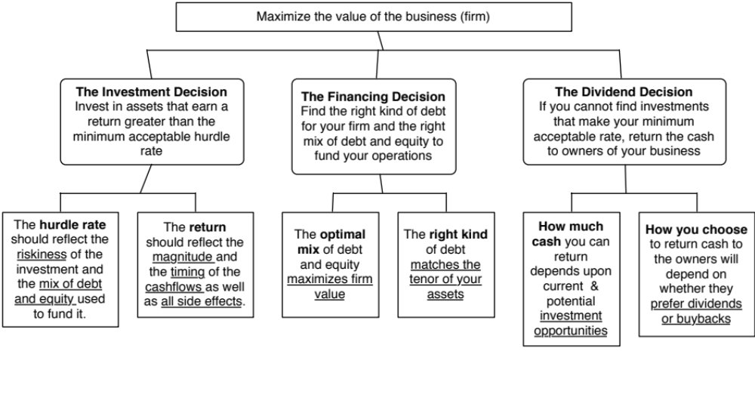
First Principles
Notes:
Our focus will be on the objective: Maximize firm value.
Since so much of corporate finance is built on this objective, it is important that we be clear about what it means and why we choose it. In addition, it is also worth exploring what the alternatives are and why this objective is preferable to the alternatives.

Slide 3
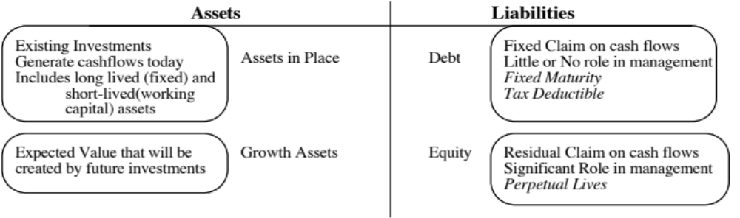
The Objective in Decision Making
In traditional corporate finance, the objective in decision making is to maximize the value of the firm.
A narrower objective is to maximize stockholder wealth. When the stock is traded and markets are viewed to be efficient, the objective is to maximize the stock price.
Maximize equity value
Maximize market estimate of equity value
Maximize firm value
Notes:
Why only one objective? Why not have many? Because you can have only objective. You can have multiple constraints that are imposed on you or you impose on yourself. If you have many objectives, and you have to pick between alternatives where you get different answers depending upon which objective you look at, you will be stuck.
This is the answer to the question posed in the previous overhead.
Maximizing the value of the business is the most general objective function. Remember that value of the business includes assets in place and growth assets. If you are managing a growth company,, increasing earnings may not necessarily increase firm value. The other problem is that firm value itself is a difficult number to estimate. While there are models available, they all need inputs, most of which allow for subjective judgments.
Managers answer to stockholders. Consequently, the objective gets narrowed down to “maximizing equity value”. (Implicit assumption: Bondholders/ Banks can protect themselves by writing in covenants and setting interest rates).
It is tough to assess equity value objectively. It would be nice to have a “third party” estimate that is objective. For publicly traded firms, the market (in spite of all its limitations) provides such an estimate. (Implicit assumption: Markets are rational and reasonably efficient).

Slide 4
Maximizing Stock Prices is too “narrow” an objective: A preliminary response
Maximizing stock price is not incompatible with meeting employee needs/objectives. In particular:
  Employees are often stockholders in many firms
  Firms that maximize stock price generally are profitable firms that can afford to treat employees well.
Maximizing stock price does not mean that customers are not critical to success. In most businesses, keeping customers happy is the route to stock price maximization.
Maximizing stock price does not imply that a company has to be a social outlaw.
Notes:
Critique: Stock price maximization implies not caring for your employees.
Response: Use a recent story of layoffs to illustrate this criticism (XYZ Co. announced it was laying of 15,000 employees and stock price jumped $3.50). Then note that this is the exception rather than the rule. A Conference Board study from 1994 found that companies whose stock prices have gone up are more likely to hire people than one whose stock prices have gone down. Also note that employees, especially in high tech companies, have a large stake in how well their company does because they have stock options or stock in the company.
Critique: If you maximize value, you don’t care about customers.
Response: Note that customer satisfaction is important but only in the context that satisfied customers buy more from you. What would happen to a firm that defined its objective as maximizing customer satisfaction? You would give away your products for free…
Critique: Firms that maximize firm value are bad social citizens.
Response: A healthy company whose stock price has done well is much more likely to do social good than a company which is financially healthy. Again, note that there are social outlaws who might create social costs in the pursuit of stock price maximization (Those nasty corporate raiders..) but they are the exception rather than the rule.
To those who would like to have it all (they take different forms, but they talk about stakeholder wealth maximization or balanced scorecards or running a great company): It never works:
You cannot be all things to all people; keeping everyone happy leaves no one happy. You need a central objective. Otherwise, how do you choose between competing objectives?
You cannot mix up means with ends. You want satisfied and motivated employees and happy customers, but only as a means to an end: making money off them.
It gives poor performing managers an excuse for not performing because they can always pass the buck.
The Super Bowl in February 2013 was a showcase of means/ends at play. The two teams were coached by brothers: Jim (SF 49ers) and John (Ravens). During the season, Jim replaced his starting quarterback, Alex Smith, (making him, quite a few of his players, many fans and some in the press) unhappy. John fired his offensive coordinator (making his coaching staff unhappy and uncomfortable). Both coaches, though, had a singular objective which was to win the Super Bowl. They did not come into the season with fuzzy objectives (having a great season), misplaced objectives (win the most games in the regular season, win by the most points, gain the most yards) or mistaking means for ends (coaching a happy team, keeping fans happy, keeping the press happy).

Slide 5
The Classical Objective Function
STOCKHOLDERS
Hire & fire
managers
- Board
- Annual Meeting
Maximize
stockholder wealth
Lend Money
No Social Costs
BONDHOLDERS/
LENDERS
Managers
SOCIETY
Protect
bondholder
Interests
All costs can be
traced to firm
Reveal
information
honestly and
on time
Markets are
efficient and
assess effect on
value
FINANCIAL MARKETS
Notes:
This is the utopian world. None of the assumptions are really defensible as written, and skepticism is clearly justified:
Why do we need these assumptions?
Since, in many large firms, there is a separation of ownership from management, managers have to be fearful of losing their jobs and go out and maximize stockholder wealth. If they do not have this fear, they will focus on their own interests.
If bondholders are not protected, stockholders can steal from them and make themselves better off, even as they make the firm less valuable.
If markets are not efficient, maximizing stock prices may not have anything to do with maximizing stockholder wealth or firm value.
If substantial social costs are created, maximizing stock prices may create large side costs for society (of which stockholders are members).
Note that corporate finance, done right, is not about expropriating or transferring wealth from other groups (bondholders, other stockholders or society) but about making the firm more productive and valuable. In this utopian world, the only way to increase value is to go out and take good investments. In the process, you contribute positively to the overall economy.

Slide 6
What can go wrong?
STOCKHOLDERS
Have little control
over managers
Managers put
their interests
above stockholders
Lend Money
Significant Social Costs
BONDHOLDERS
Managers
SOCIETY
Bondholders can
get ripped off
Some costs cannot be
traced to firm
Delay bad
news or
provide
misleading
information
Markets make
mistakes and
can over react
FINANCIAL MARKETS
Notes:
This is my worst case scenario:
Stockholders have little or no control over managers. Managers, consequently, put their interests above stockholder interests.
Bondholders who do not protect themselves find stockholders expropriating their wealth.
Information conveyed to markets is noisy, biases and sometimes misleading. Markets do not do a very good job of assimilating this information and market price changes have little to do with true value.
Firms in the process of maximizing stockholder wealth create large social costs.
In this environment, stockholder wealth maximization is not a good objective function.

Slide 7
The Annual Meeting as a disciplinary venue
The power of stockholders to act at annual meetings is diluted by three factors
  Most small stockholders do not go to meetings because the cost of going to the meeting exceeds the value of their holdings.
  Incumbent management starts off with a clear advantage when it comes to the exercise of proxies. Proxies that are not voted becomes votes for incumbent management.
  For large stockholders, the path of least resistance, when confronted by managers that they do not like, is to vote with their feet.
Annual meetings are also tightly scripted and controlled events, making it difficult for outsiders and rebels to bring up issues that are not to the management’s liking.
Notes:
It is not irrational for small stockholders to not actively involve themselves in the management of firms, because it is not economical for them to do so.
A significant percentage of proxies do not get turned in. In many firms, the managers of the firm get the votes commanded by these proxies. That would be the equivalent of having an election and allowing the incumbent to get the votes of anyone who does not vote.
For a large stockholder like Fidelity Magellan, with its hundreds of holdings, it just might not be feasible to be an active investor. There are also potential conflicts of interest, since Fidelity is also in the business of managing corporate pension funds… Even activist investment funds (such as the California Pension Fund), have pulled back in recent years. (Putnam exception? See WSJ article on Putnam: Putnam is one of the few mutual fund companies to contest management)
The annual meeting is tightly scripted and run, making it difficult for dissident stockholders to be heard. (In Japan, in the 1980s, trouble makers were hired to heckle stockholders who tried to ask managers tough questions. In Europe, until very recently, annual meetings were exquisitely well mannered affairs where elite managers told plebian stockholders what was good for them - shades of Marie Antoinette and “let them eat cake”…. (At Tattingers, the French luxury good company, Claudia Tattinger said that she felt ashamed for the stockholders who would ask “such rude questions” after Asher Edelman demanded to know whether the company owned chateaus and who lived in them…)

Slide 8
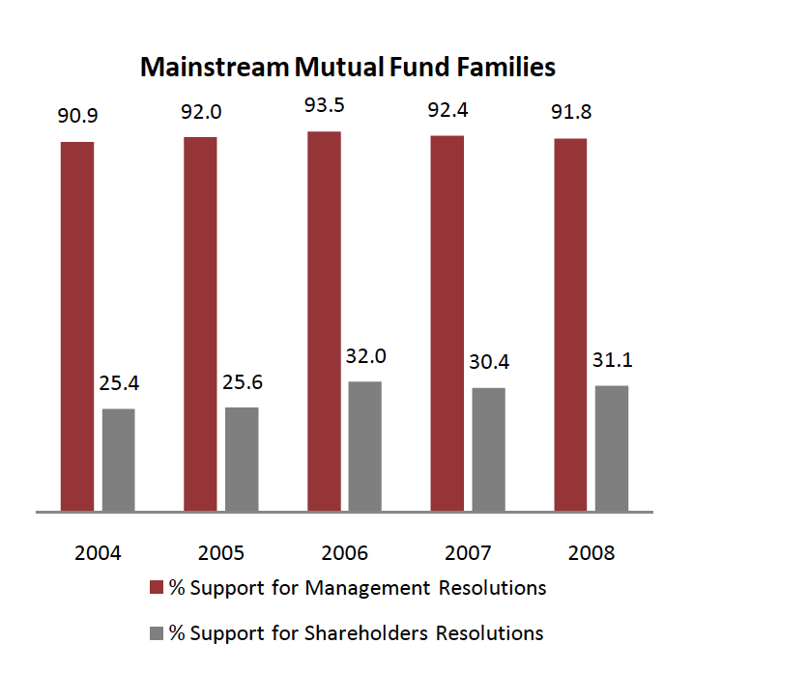
And institutional investors go along with incumbent managers…
Notes:
You would expect mutual funds and other institutional investors to take a more activist role and act as a check on the incumbent managers at annual meetings. For the most part, though, they seem to be supporters of the status quo, seldom challenging managers (even when they are wrong). This can be attributed to two factors:
Cost: It is costly to challenge incumbent managers. For institutional investors spread over multiple firms, this cost may be too high to bear.
Conflicts of interest: Many mutual fund families also look to companies for business. To the extent that challenging managers may cost them this business, they may hold back.

Slide 9
Board of Directors as a disciplinary mechanism
Directors are paid well: In 2010, the median board member at a Fortune 500 company was paid $212,512, with 54% coming in stock and the remaining 46% in cash. If a board member was a non-executive chair, he or she received about $150,000 more in compensation.
Spend more time on their directorial duties than they used to: A board member worked, on average, about 227.5 hours a year (and that is being generous), or 4.4 hours a week, according to the National Associate of Corporate Directors. Of this, about 24 hours a year are for board meetings. Those numbers are up from what they were a decade ago.
Even those hours are not very productive: While the time spent on being a director has gone up, a significant portion of that time was spent on making sure that they are legally protected (regulations & lawsuits).
And they have many loyalties: Many directors serve on three or more boards, and some are full time chief executives of other companies.
Notes:
This sounds judgmental and it is meant to be. Directors do not spend a great deal of time overseeing managers, and they are well paid.
The pay shown here understates the true compensation that directors make from other perks and benefits that they get (pensions, for instance).
As a postscript, the pay of directors has kept rising. While the number of hours spent has also increased somewhat though how much of this additional time is spent on getting legal protection (against stockholder lawsuits) is debatable.
Post Sarbanes-Oxley, directors seem to spend more time with lawyers, making sure that they don’t get sued than they do with managers, trying to figure out whether the company is well run. This may be the unintended consequence when you try to get good corporate governance by law.

Slide 10
The CEO often hand-picks directors..
CEOs pick directors: A 1992 survey by Korn/Ferry revealed that 74% of companies relied on recommendations from the CEO to come up with new directors and only 16% used an outside search firm. While that number has changed in recent years, CEOs still determine who sits on their boards. While more companies have outsiders involved in picking directors now, CEOs exercise significant influence over the process.
Directors don’t have big equity stakes: Directors often hold only token stakes in their companies. Most directors in companies today still receive more compensation as directors than they gain from their stockholdings. While share ownership is up among directors today, they usually get these shares from the firm (rather than buy them).
And some directors are CEOs of other firms: Many directors are themselves CEOs of other firms. Worse still, there are cases where CEOs sit on each other’s boards.
Notes:
When John Mack became CEO of Morgan Stanley, the fist two directors he picked to sit on the board were members of his golf club in Purchase, NY…
This adds to why directors spend so little time on oversight. CEOs, left to themselves, will seldom pick adversarial directors. Directors also make far more money from directorships than they do from owning stock in the firm. Not surprisingly, they do not take the side of stockholders.
A Wall Street Journal article, a few years ago, looked at the phenomenon of CEOs sitting on each other’s boards. It is very difficult to see how they can be objective in those cases.

Slide 11
Directors lack the expertise (and the willingness) to ask the necessary tough questions..
Robert’s Rules of Order? In most boards, the CEO continues to be the chair. Not surprisingly, the CEO sets the agenda, chairs the meeting and controls the information provided to directors.
Be a team player? The search for consensus overwhelms any attempts at confrontation.
The CEO as authority figure: Studies of social psychology have noted that loyalty is hardwired into human behavior. While this loyalty is an important tool in building up organizations, it can also lead people to suppress internal ethical standards if they conflict with loyalty to an authority figure. In a board meeting, the CEO generally becomes the authority figure.
Notes:
Harold Geneen who ruled ITT with an iron fist during the sixties when ITT built itself up through acquisitions, mentions in his memoirs that almost all decisions, during his tenure, that were made by the board, were unanimous.
CEOs often chair the board, and establish the agenda for what the board discusses.

Slide 12
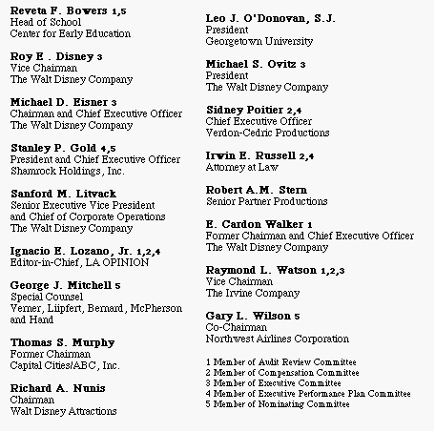
The worst board ever? The Disney Experience - 1997
Notes:
This may be going back in time but it may help understanding Disney’s present standing. This was Disney’s board at the height of Michael Eisner’s powers. (Eisner became CEO of Disney in 1985 and consolidated power in the years after.)
Note the number of insiders on the board. (Seven out of 16; five current employees & two ex-employees) Also note the presence of Mr. Eisner’s private attorney (Irwin Russell) and the principal of his childrens’ elementary school (Reveta Bowers) on the board.
How independent was this board likely to be of Mr. Eisner? This may explain some of the actions taken by Disney (and specifically Eisner) during the 1990s… (Read Disney War by James Stewart for the gory details)
When Eisner was hired in 1984, he insisted on bringing in his protégé Jeffrey Katzenberg, his young assistant, into the firm with him. He put Katzenberg in charge of Disney Animation, which was not doing well. Katzenberg was largely responsible for the rebirth of that division (which Eisner had considered shutting down) with The Little Mermaid, Beauty and the Beast and The Lion King all proving to be mega-winners. As a reward for this success, Eisner fired him. His lucrative contract entitled him to 2% of the revenues from the movies he made in posterity but he would have settled for $100 million. Eisner refused to pay; Disney paid $ 250 million in 1999.
In 1995, Eisner hired Ovitz, a leading agent in Hollywood, and then told the board to okay the hire. He regretted it almost immediately and fired him 453 days later for “lying” and “incompetence”. However, rather than argue that this was just cause for firing, he paid Ovitz $ 100 million to leave.

Slide 13
Application Test: Who’s on board?
Look at the board of directors for your firm.
  How many of the directors are inside directors (Employees of the firm, ex-managers)?
  Is there any information on how independent the directors in the firm are from the managers?
Are there any external measures of the quality of corporate governance of your firm?
  Yahoo! Finance now reports on a corporate governance score for firms, where it ranks firms against the rest of the market and against their sectors.
Is there tangible evidence that your board acts independently of management?
  Check news stories to see if there are actions that the CEO has wanted to take that the board has stopped him or her from taking or at least slowed him or her down.
Notes:
You can usually find this information for your firm in the 14-DEF filing that all firms in the US have to make with the SEC. If you have a non-US firm, this becomes more difficult to do. While you can usually find the names of the directors from the annual report, you may have a difficult time finding out the linkages (and potential conflicts) these directors may have with the managers of the firm.
You may also be able to find a corporate governance score for your company, especially if it is a large market cap company. Even if you cannot, you can make your own judgments on whether you (as a stockholder) are likely to have much influence on how this company is run.
Unfortunately, corporate governance scores have become checkbox based rather than principle based. So, you may want to look for tangible evidence of board independence.

Slide 14
So, what next? When the cat is idle, the mice will play ....
When managers do not fear stockholders, they will often put their interests over stockholder interests
  Greenmail: The (managers of ) target of a hostile takeover buy out the potential acquirer's existing stake, at a price much greater than the price paid by the raider, in return for the signing of a 'standstill' agreement.
  Golden Parachutes: Provisions in employment contracts, that allows for the payment of a lump-sum or cash flows over a period, if managers covered by these contracts lose their jobs in a takeover.
  Poison Pills: A security, the rights or cashflows on which are triggered by an outside event, generally a hostile takeover, is called a poison pill.
  Shark Repellents: Anti-takeover amendments are also aimed at dissuading hostile takeovers, but differ on one very important count. They require the assent of stockholders to be instituted.
  Overpaying on takeovers: Acquisitions often are driven by management interests rather than stockholder interests.
No stockholder approval needed….. Stockholder Approval needed
Notes:
These actions could all suggest that managerial interests are being put over stockholder interests. (Some of these actions, though, may also increase stockholder wealth. Managers will, of course, always claim that these actions are in stockholders’ best interests)
The reason that I have put overpaying on poison pills and shark repellants below greenmail and golden parachutes is not because they create less damage to stockholders but because stockholders at least get a chance to voice their view (they both require stockholder approval). Greenmail and golden parachutes just require board approval.

Slide 15
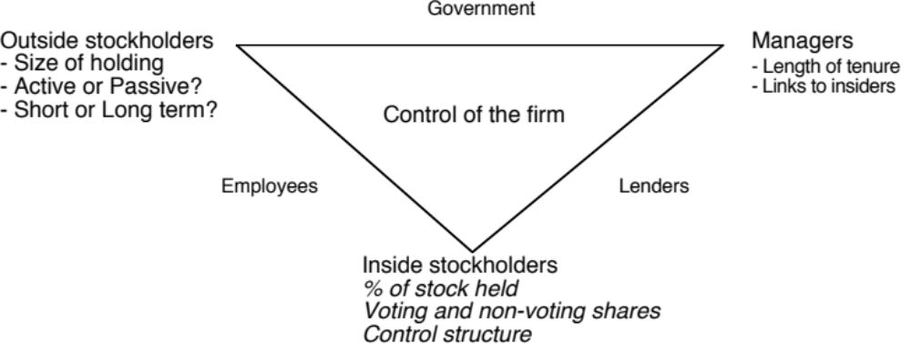
Application Test: Who owns/runs your firm?
Look at the top shareholders in your firm.
  Who are the top stockholders in your firm?
  What are the potential conflicts of interests that you see emerging from this stockholding structure?
Make your judgment on where the power lies.
Notes:
One of your first tasks when assessing a company is to see whether managers have a significant stake in the company. You can get this information in a variety of places. I use Bloomberg to get the data on the top 17 stockholders and go down the list to see if incumbent managers have a stake in the company. I also check to see if there are other investors on the list who may not be incumbent managers but are strong advocates for stockholders - Berkshire Hathaway at Coca Cola, KKR or Blackstone at many publicly traded firms…
You can also get this information from Yahoo! Finance by going into company profiles and clicking on institutional investors…
As you look at the list of top stockholders, you should be also considering the potential conflicts of interest created by the stockholder structure.
Inside stockholders (Founding family, controlling stockholder/manager) versus outside stockholders
Government as major stockholder (or holder of golden vote)
Employees as major stockholders

Slide 16
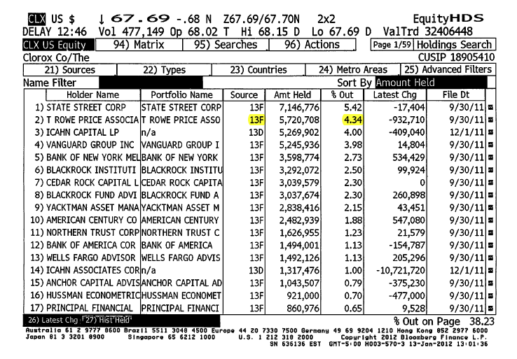
Source for data: Will vary across markets. 13F is SEC filing for US mutual/pension funds
Percent of outstanding shares in company

Slide 17
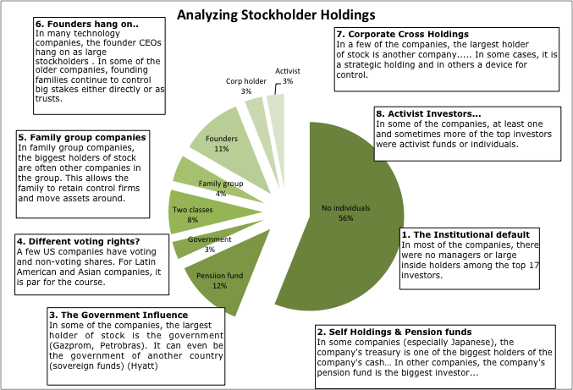
Corporate Governance: Assessing where the power lies and potential conflicts of interest

Slide 18
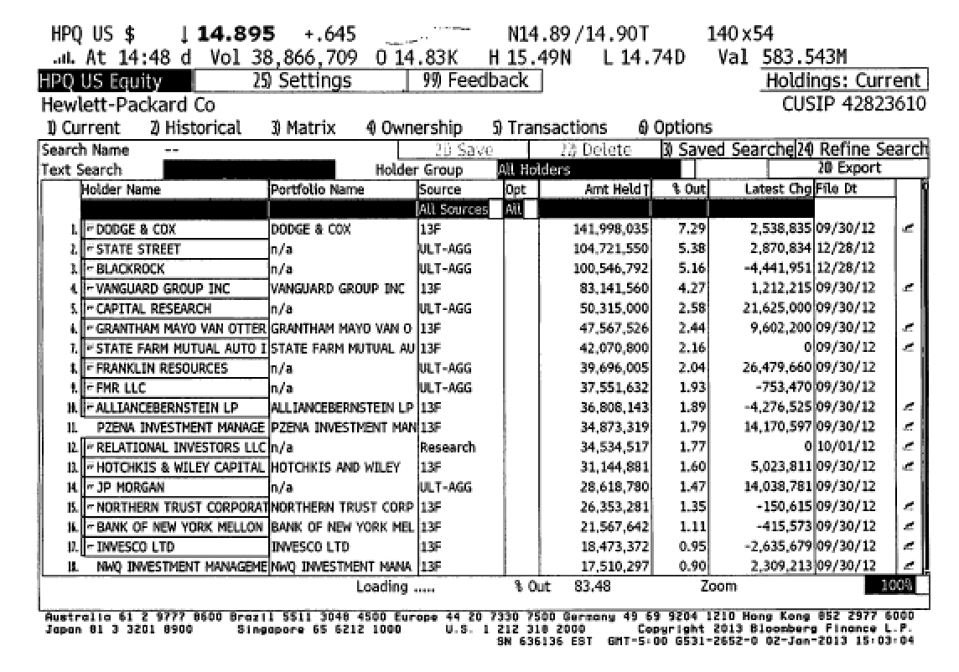
1. Institutional Default

Slide 19
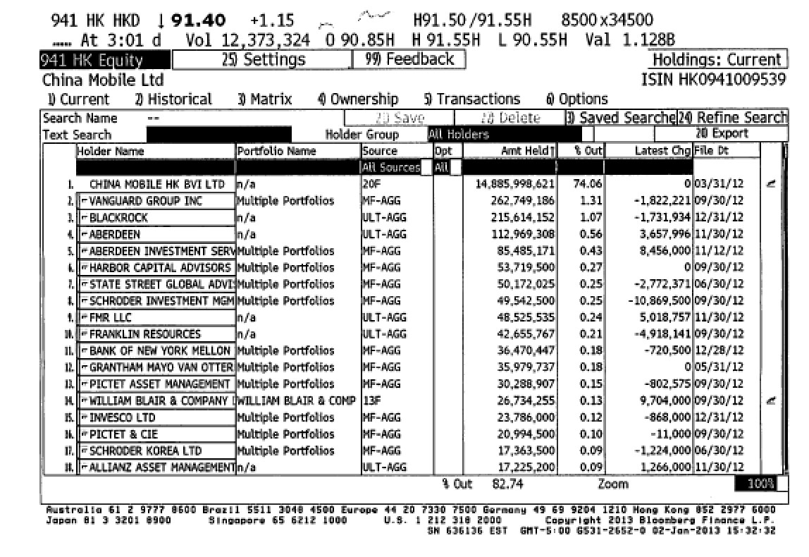
2. Self Holdings?

Slide 20
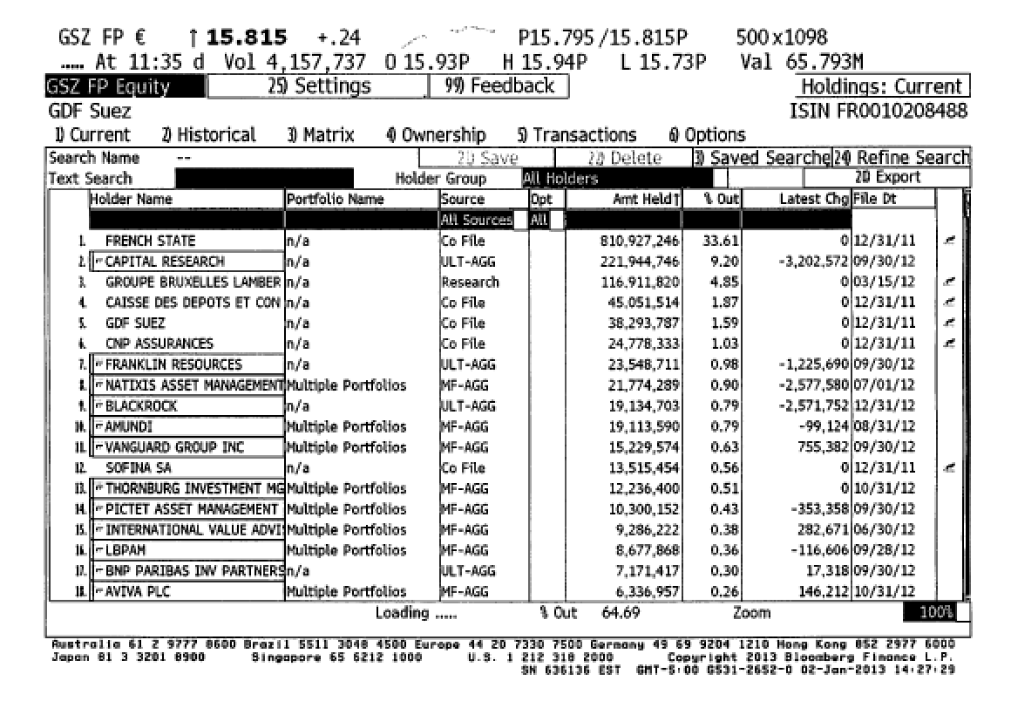
3. The Government Influence?

Slide 21
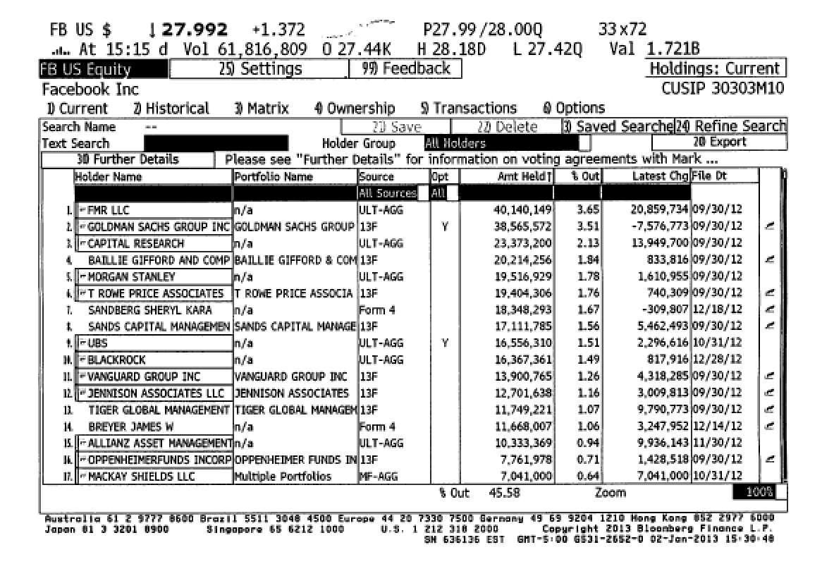
4. Different voting rights?

Slide 22
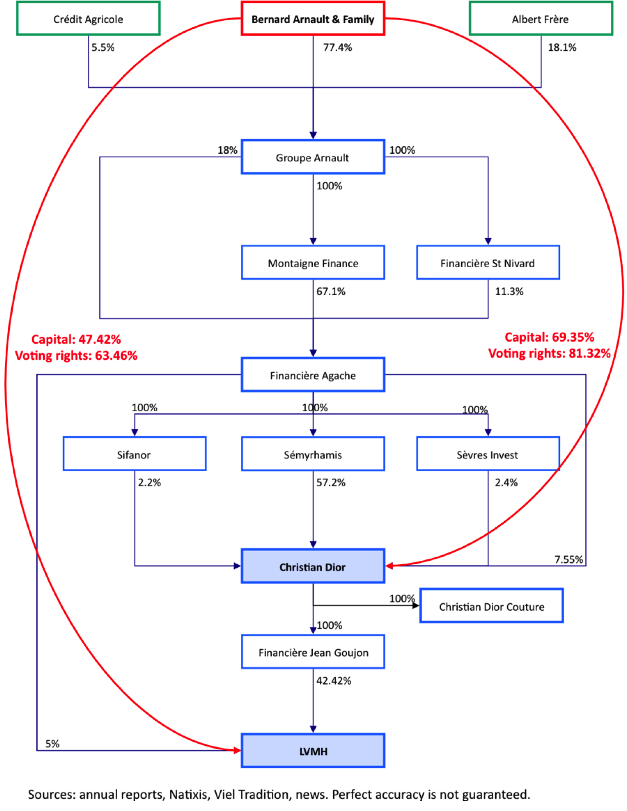
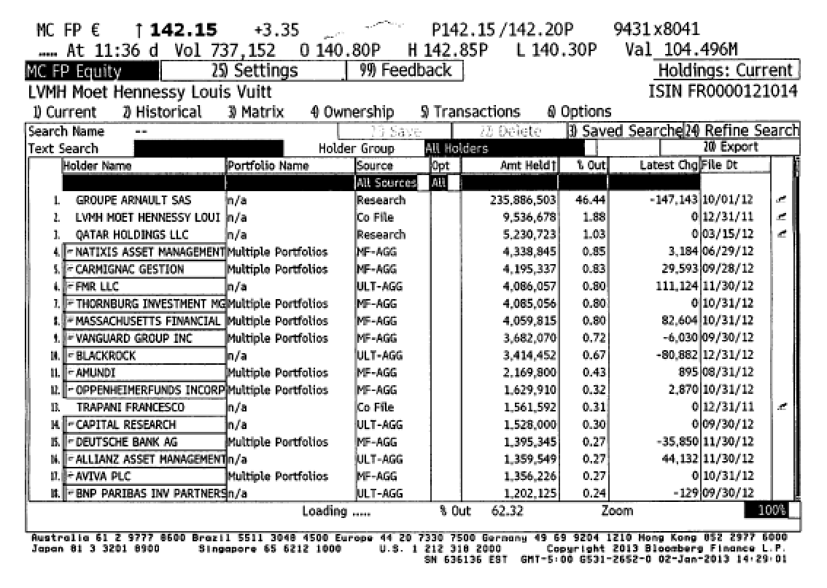
5. Family Group Companies

Slide 23
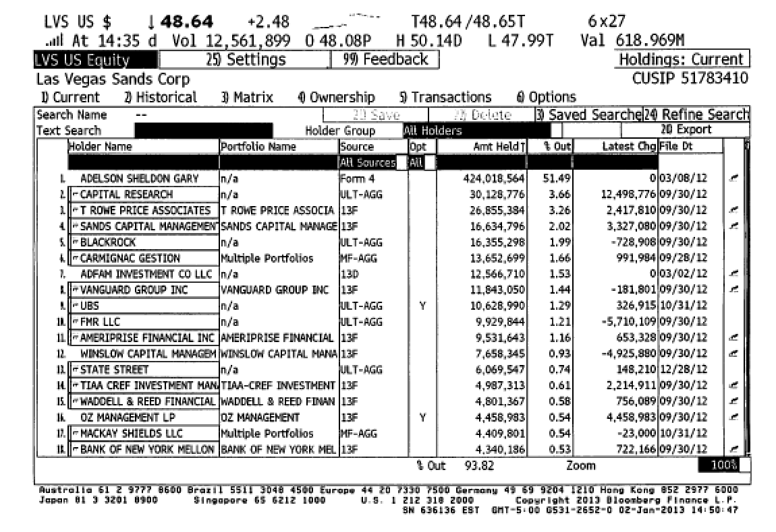
6. Founders hang on…

Slide 24
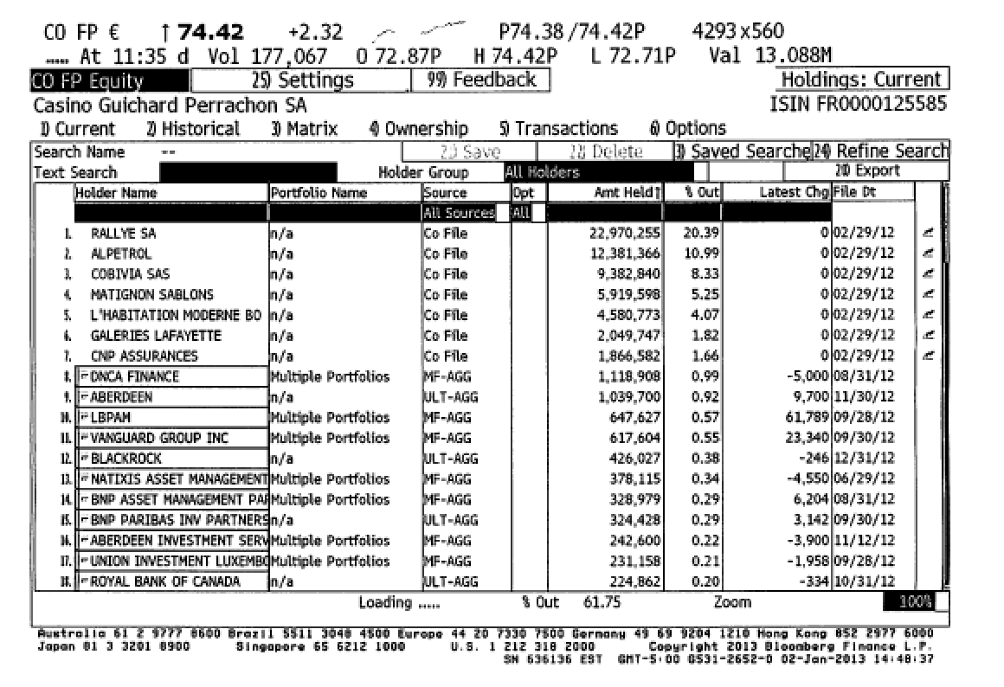
7. Corporate Cross Holdings

Slide 25
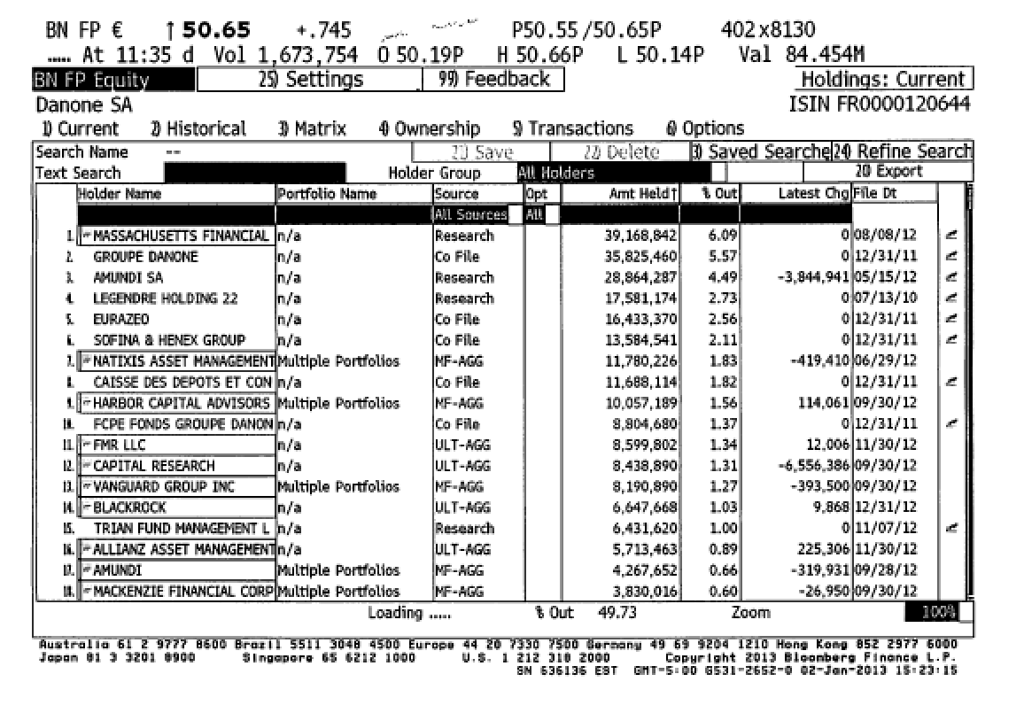
8. Activist investors

Slide 26
So this is what can go wrong...
STOCKHOLDERS
Managers put
their interests
above stockholders
Have little control
over managers
Lend Money
Significant Social Costs
BONDHOLDERS
Managers
SOCIETY
Bondholders can
get ripped off
Some costs cannot be
traced to firm
Delay bad
news or
provide
misleading
information
Markets make
mistakes and
can over react
FINANCIAL MARKETS
Notes:
This is my worst case scenario:
Stockholders have little or no control over managers. Managers, consequently, put their interests above stockholder interests.
Bondholders who do not protect themselves find stockholders expropriating their wealth.
Information conveyed to markets is noisy, biases and sometimes misleading. Markets do not do a very good job of assimilating this information and market price changes have little to do with true value.
Firms in the process of maximizing stockholder wealth create large social costs.
In this environment, stockholder wealth maximization is not a good objective function.

Slide 27
Traditional corporate financial theory breaks down when ...
Managerial self-interest: The interests/objectives of the decision makers in the firm conflict with the interests of stockholders.
Unprotected debt holders: Bondholders (Lenders) are not protected against expropriation by stockholders.
Inefficient markets: Financial markets do not operate efficiently, and stock prices do not reflect the underlying value of the firm.
Large social side costs: Significant social costs can be created as a by-product of stock price maximization.
Notes:
This summarizes the break down in each of the linkages noted on the previous page.

Slide 28
When traditional corporate financial theory breaks down, the solution is:
A non-stockholder based governance system: To choose a different mechanism for corporate governance, i.e, assign the responsibility for monitoring managers to someone other than stockholders.
A better objective than maximizing stock prices? To choose a different objective for the firm.
Maximize stock prices but minimize side costs: To maximize stock price, but reduce the potential for conflict and breakdown:
  Making managers (decision makers) and employees into stockholders
  Protect lenders from expropriation
  By providing information honestly and promptly to financial markets
  Minimize social costs
Notes:
At this point, things look pretty bleak for stock price maximization. These are the three choices that we have, if we abandon pure stock price maximization as an objective function.

Slide 29
I. An Alternative Corporate Governance System
Germany and Japan developed a different mechanism for corporate governance, based upon corporate cross holdings.
  In Germany, the banks form the core of this system.
  In Japan, it is the keiretsus
  Other Asian countries have modeled their system after Japan, with family companies forming the core of the new corporate families
At their best, the most efficient firms in the group work at bringing the less efficient firms up to par. They provide a corporate welfare system that makes for a more stable corporate structure
At their worst, the least efficient and poorly run firms in the group pull down the most efficient and best run firms down. The nature of the cross holdings makes its very difficult for outsiders (including investors in these firms) to figure out how well or badly the group is doing.
Notes:
In the 1980s, Michael Porter argued that US companies should move towards the Japanese system. The Japanese and German systems tend to do well in stable environments, where failure tends to be unsystematic ( a firm here and a firm there). They can take care of their “failures” and nurse them back to health, rather than exposing themselves to the costs associated with failure.
These systems break down when problems are wide spread and systematic. Contrast the way US banks dealt with problem loans on their balance sheets (markets forced them to deal with these problems quickly ) and the way Japanese banks have dealt with them (by hiding them and hoping they go away).
In the last decade, the success of China as an economy has evoked interest in their corporate governance system, which is rooted neither in stockholders nor in cross holding structures. Instead, it has been largely directed by a government or central authority. The plus that the centralized power brings is the capacity to see the big picture and make companies bend to the larger public good. The minus is that centralized powers do make mistakes and when they do, they are reluctant to admit it. The test of a system comes not during periods of success but during periods of failure, and the Chinese system has not been tested yet. Let’s see how it holds up.

Slide 30
II. Choose a Different Objective Function
Firms can always focus on a different objective function. Examples would include
  maximizing earnings
  maximizing revenues
  maximizing firm size
  maximizing market share
  maximizing EVA
The key thing to remember is that these are intermediate objective functions.
  To the degree that they are correlated with the long term health and value of the company, they work well.
  To the degree that they do not, the firm can end up with a disaster
Notes:
Consider each of these objectives. If you put them through the same tests that we did stock price maximization, you come up with far more problems with each.
Note that firms might pick an intermediate objective (like market share) when it is correlated with firm value but continue to use it, even after it loses this link. Do you want a 100% market share of a losing business?
In the 1980s, American Airlines (under Robert Crandall) set itself the objective of becoming the number one domestic airline in the United States. It succeeded but by 1989, it was losing billions.

Slide 31
III. Maximize Stock Price, subject to ..
The strength of the stock price maximization objective function is its internal self correction mechanism. Excesses on any of the linkages lead, if unregulated, to counter actions which reduce or eliminate these excesses
In the context of our discussion,
  managers taking advantage of stockholders has led to a much more active market for corporate control.
  stockholders taking advantage of bondholders has led to bondholders protecting themselves at the time of the issue.
  firms revealing incorrect or delayed information to markets has led to markets becoming more “skeptical” and “punitive”
  firms creating social costs has led to more regulations, as well as investor and customer backlashes.
Notes:
The strength of market based systems is that they are both ruthless and quick in correcting errors, once they are spotted.
These constraints flow from the earlier framework, where we introduced what can go wrong with each linkage.

Slide 32
The Counter Reaction
STOCKHOLDERS
1. More activist
investors
2. Hostile takeovers
Managers of poorly
run firms are put
on notice.
Protect themselves
Corporate Good Citizen Constraints
BONDHOLDERS
Managers
SOCIETY
1. Covenants
2. New Types
1. More laws
2. Investor/Customer Backlash
Firms are
punished
for misleading
markets
Investors and
analysts become
more skeptical
FINANCIAL MARKETS
Notes:
This summarizes the objective function of maximizing stockholder wealth, with the fixes noted on the last few pages.

Slide 33
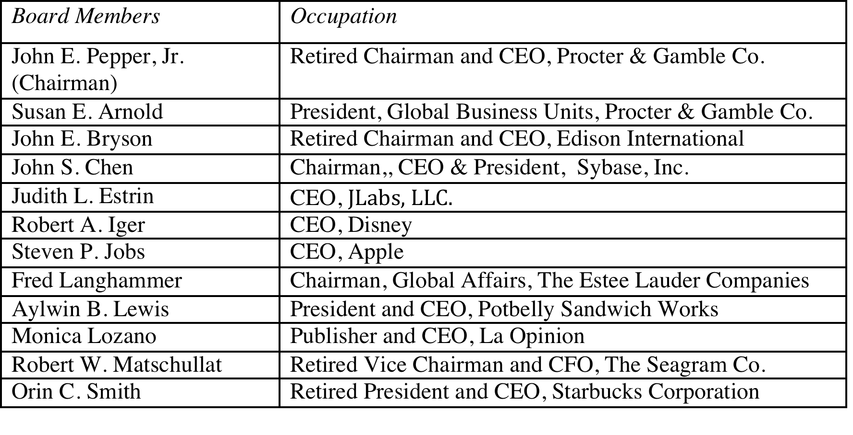
Eisner’s exit… and a new age dawns? Disney’s board in 2008
Notes:
The changes made by Eisner were too little.. Too late,,, and he was forced to leave in 2005, His successor, Bob Iger, has made a break from the past. Note the differences between the board in 2008 and the one in 2004:
It is smaller, 12 members instead of 18.
There is little overlap between this board and the 2003 board, reflecting the fact that this is now Iger’s board and not Eisner’s board.
The directors with the most obvious conflicts of interests are gone.
The question, though, is an open one. As Iger becomes entrenched as CEO, will be find directors who are beholden to him?
In 2011, Iger announced his intention to step down as CEO. It will be interesting to see what the new CEO brings to the table.

Slide 34
Disney: Eisner’s rise & fall from grace
In his early years at Disney, Michael Eisner brought about long-delayed changes in the company and put it on the path to being an entertainment giant that it is today. His success allowed him to consolidate power and the boards that he created were increasingly captive ones (see the 1997 board).
In 1996, Eisner spearheaded the push to buy ABC and the board rubberstamped his decision, as they had with other major decisions. In the years following, the company ran into problems both on its ABC acquisition and on its other operations and stockholders started to get restive, especially as the stock price halved between 1998 and 2002.
In 2003, Roy Disney and Stanley Gold resigned from the Disney board, arguing against Eisner’s autocratic style.
In early 2004, Comcast made a hostile bid for Disney and later in the year, 43% of Disney shareholders withheld their votes for Eisner’s reelection to the board of directors. Following that vote, the board of directors at Disney voted unanimously to elect George Mitchell as the Chair of the board, replacing Eisner, who vowed to stay on as CEO.
Notes:
Eisner was a good CEO when he came into Disney, partly because it was a company badly in need of change and partly because he had a solid COO in Frank Wells, who acted as a counterweight. Two things changed in the 1990s. The first was that Eisner was successful, and the ego boost that he received was the basis for acquiring more power (a compliant board). The second was that Frank Wells dies in an air accident, leaving Eisner as the imperial CEO. Power corrupts and absolute power does so absolutely.
As long as Disney was doing well, though, shareholders were willing to cut Eisner slack. However a bad acquisition followed by under performance (share prices and earnings) gradually ate away that support, until you get to the tipping point which in this case were the resignations and the hostile acquisition bid.

Slide 35
But as a CEO’s tenure lengthens, does corporate governance suffer?
In 2011, Iger announced his intent to step down as CEO in 2015 to allow a successor to be groomed.
The board voted reinstate Iger as chair of the board in 2011, reversing a decision made to separate the CEO and Chair positions after the Eisner years.
There were signs of restiveness among Disney’s stockholders, especially those interested in corporate governance. Activist investors (CalSTRS) starting making noise and Institutional Shareholder Services (ISS), which gauges corporate governance at companies, raised red flags about compensation and board monitoring at Disney.
Notes:
The longer the tenure of a CEO, the more power he or she accumulates. Perhaps, we need term limits for CEOs.

Slide 36
Iger’s non-exit and the Domino effect
In 2015 but Disney’s board convinced Iger to stay on as CEO for an extra year, for the “the good of the company”.
In 2016, Thomas Staggs who was considered heir apparent to Iger left Disney. Others who were considered potential CEOs also left.
In 2017, Disney acquired Fox and announced that Iger’s term would be extended to 2019 (and perhaps beyond) because his stewardship was essential for the merger to work.
  Now, what?
Notes:
The decision by the board to make Iger feel indispensable had consequences for both succession planning and corporate governance. In a publicly traded company, it is healthiest if the company can be weaned away from a CEO, no matter how powerful and effective.

Slide 37
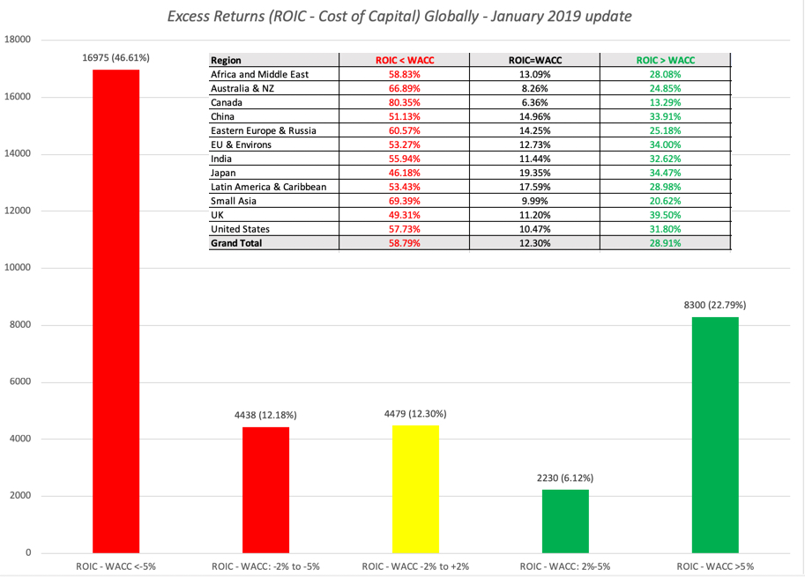
Do we need good corporate governance? Managers do a good job, don’t they?

Slide 38
Is there a payoff to better corporate governance?
In the most comprehensive study of the effect of corporate governance on value, a governance index was created for each of 1500 firms based upon 24 distinct corporate governance provisions.
  Buying stocks that had the strongest investor protections while simultaneously selling shares with the weakest protections generated an annual excess return of 8.5%.
  Every one point increase in the index towards fewer investor protections decreased market value by 8.9% in 1999
  Firms that scored high in investor protections also had higher profits, higher sales growth and made fewer acquisitions.
The link between the composition of the board of directors and firm value is weak. Smaller boards do tend to be more effective.
On a purely anecdotal basis, a common theme at problem companies and is an ineffective board that fails to ask tough questions of an imperial CEO.
Notes:
The bottom line is this. Changing the way boards of directors are chosen cannot change the way companies are governed. You need informed and active stockholders and a responsive management to make corporate governance work. When it does, stockholders are better off.
Think of companies that have been destroyed or severely damaged by fraud and scandal over the last decade - Enron, Tyco, Cendant and Worldcom come to mind. In each of these firms, the board was largely ineffective and the top management ran the company.
Perhaps the best indicator that corporate governance matters is that independent services have come into being to measure the strength of corporate governance at companies. (You can get the Corporate Governance Score for many US companies on Yahoo! Finance)

Slide 39
Should we legislate it?
Every corporate scandal creates impetus for a legislative response. The scandals at Enron and WorldCom laid the groundwork for Sarbanes-Oxley.
You cannot legislate good corporate governance.
  The costs of meeting legal requirements often exceed the benefits
  Laws always have unintended consequences
  In general, laws tend to be blunderbusses that penalize good companies more than they punish the bad companies.
Notes:
While the motives for passing these laws may be good, there are significant costs. Sarbanes-Oxley has created new business for consultants, corporate governance experts and lawyers but it is debatable whether it has made boards more effective. In fact, while laws can require that directors be independent, it cannot force them to be competent.
You can try suing managers and directors who do not do their job but it is difficult to win. Disney’s stockholders sued in a Delaware court over the Ovitz fiasco, arguing that directors had not done their jobs. The court largely agreed with them on the failures of directors but ruled against the stockholders because the directors acted in good faith.
Ultimately, the best antidote to poor corporate governance is a stockholder base that takes its responsibilities seriously. Mutual funds need to think like stockholders and take a role in overseeing management (or at least demanding accountability).

