Slide 1
Cost of capital: revisiting basics & getting perspective
Aswath Damodaran

Slide 2
Cost of Capital: A Financial Balance Sheet Perspective

Slide 3
The Swiss Army Knife

Slide 4
Every Risk has a place

Slide 5
1. Business Risk
If you are diversified, I argued that you would measure the risk in an investment with the covariance of that investment with the market, or in its standardized form, its beta.
To get the beta for a company, then, you can adopt one of two approaches.
  The first, and the one that is taught in every finance class, is to run a regression of returns on the stock against a market index and to use the regression beta.
  The second, and my preferred approach, is to estimate a beta by looking at the business or businesses a company operates in, and taking a weighted average of the betas of companies in that business.

Slide 6
2. Financial Leverage
Debt Ratio: Th mix of debt and equity that you use represents the weights in your cost of capital.
Beta Effect: As you borrow money, your equity will become riskier, because it is a residual claim, and having more interest expenses will make that claim more volatile.
Cost of Debt: The cost of debt, which is set by lenders based upon how much default risk that they see in a company. To the extent that the tax law is tilted towards debt, the after-tax cost of borrowing will reflect that tax benefit.

Slide 7
3. Country Risk
Sovereign Ratings and Default Spreads: The vast majority of countries have sovereign ratings, measuring their default risk.
Sovereign CDS spreads: The Credit Default Swap (CDS) market is one where you can buy insurance against sovereign default, and it offers a market-based estimate of sovereign risk.
Country Risk Premiums: I start with the default spreads, but I add a scaling factor to reflect the reality that equities are riskier than government bonds to come up with country risk premiums. The scaling factor that I use is obtained by dividing the volatility of an emerging market equity index by the volatility of emerging market bonds.

Slide 8
ERP Estimation in January 2019

Slide 9
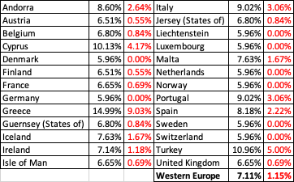
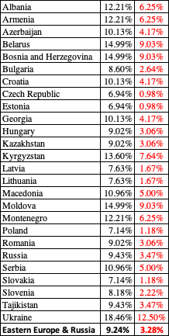
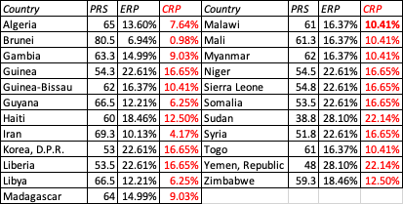
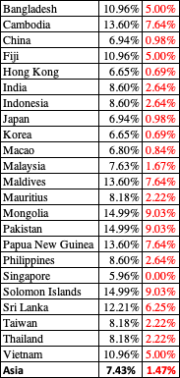

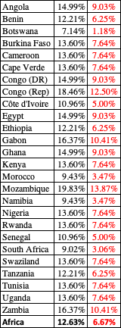
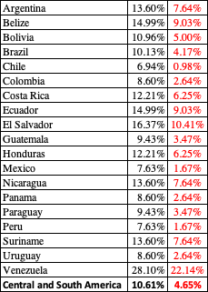
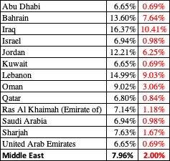

ERP : Jan 2019
Black #: Total ERP
Red #: Country risk premium
Regional #: GDP weighted average
Notes:
Updated country risk premiums at the start of 2019, with 5.96% as the mature market base.

Slide 10
4. Currency Risk (or is it Choice)

Slide 11
Approach 1: Risk free Rate

Slide 12
Approach 2: Differential Inflation
You estimate the cost of capital in a currency that you feel comfortable with (in terms of estimating risk free rates and risk premiums) and then add on or incorporate the differential inflation between that currency and the local currency that you want to convert the cost of capital to.
Thus, to convert the cost of capital in US $ terms to a different currency, you would do the following:

Slide 13
Proposition 1: A hurdle rate is an opportunity cost, not a funding cost
Most people, when asked what a cost of capital is, will respond with the answer that it is the cost of raising capital. In the context of its usage as a hurdle rate, that is not true.
It is an opportunity cost, a rate of return that you (as a company or investor) can earn on other investments in the market of equivalent risk.

Slide 14
Application 1: The Beta for a Target Firm!
When valuing a target firm in an acquisition, which of the following unlevered betas should you use to come up with your cost of equity?
  Beta of the acquiring firm
  Beta of the target firm
  Weighted average (by market value) of the betas of the two firms
  Simple average of the betas of the two firms
Notes:
The reason lies in a basic principle in capital budgeting - that a project’s discount rate should reflect the risk of the project and not of the entity taking the project. (Of course, this would also imply that you would use project specific costs of equity and capital….)
If you fail on this principle, safe companies will end up overvaluing and overpaying for risky companies (as many did in the late 1990s)

Slide 15
Application 2: The Debt Ratio to use
In computing the cost of capital to use in valuing the target firm, which of the following debt choices should you make in your computation:
  The debt ratio and the cost of debt of acquiring firm
  The debt ratio and the cost of debt of the target firm
  The debt ratio used in the acquisition, with the cost of debt used for the acquisition
  The optimal debt ratio and cost of debt of the target firm
  The debt ratio for the combined firm after the acquisition, and the cost of debt after
Notes:
The minute you start building into the valuation strengths that flow from you (as the acquiring firm), you start giving target firm stockholders premiums that they do not deserve.

Slide 16
Proposition 2: A company-wide hurdle rate can be misleading and dangerous
In corporate finance, the hurdle rate becomes the number to beat, when you do investment analysis. Most companies claim to have a corporate hurdle rate, a number that all projects that are assessed within the company get measured against.
If your company operates in only one business and one country, this may work, but to the extent that companies operate in many businesses across multiple countries, there can be no one hurdle rate. Even if you use only one currency in analysis, your cost of capital will be a function of which business a project is in, and what country it is aimed at.
The consequences of not making these differential adjustments will be that your safe businesses will end up subsidizing your risky businesses, and over time, both will be hurt, in what I term the "curse of the lazy conglomerate".

Slide 17
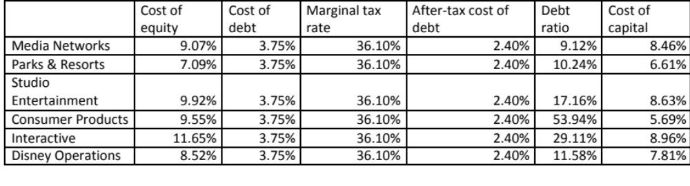
Test: A Multi Business Company!
Disney has some major investments coming up in setting up a streaming competitor to Netflix. What cost of capital would you use in your assessment?
Disney’s cost of capital as a company
Disney’s media networks cost of capital
Other

Slide 18
Proposition 3: Currency is a choice, but one that should not change outcomes
If you follow the consistency rule on currency, incorporating inflation into both cash flows and discount rates, your analyses should be currency neutral.
In other words, a project that looks like it is a bad project, when the analysis is done in US dollar terms, cannot become a good project, just because you decide to do the analysis in Indian rupees.
If you do get divergent answers with different currencies, it is because there are inflation inconsistencies in your assessments of discount rates and cash flows.

Slide 19
Proposition 4: Your cost of capital cannot be insulated from the market
There are many who remain wary of financial markets and their capacity to be irrational and volatile.
Consequently, they try to generate hurdle rates that are unaffected by market movements, a futile and dangerous exercise, because we have to be price takers on at least some of the inputs into hurdle rates.
Your cost of capital will change, and should change, as risk free rates and the prices of risk (equity risk premiums and default spreads) change.

Slide 20
Proposition 5: Gain perspective on cost of capital

