Slide 1
ESG: Empty and Toxic!
Goodness requires sacrifice!

Slide 2
Why now?
50 years since Friedman: The first is that it is the fiftieth anniversary of one of the most influential opinion pieces in media history, where Milton Friedman argued that the focus of a company should be profitability, not social good.
COVID and ESG: The second were multiple news stories about how "good" companies have done better during the COVID crisis and how much money was flowing into ESG funds.
The Establishment has bought in: The third is a more long-standing story line, where the establishment seems to have bought into ESG consciousness, with business leaders in the Conference Board signing on to a "stakeholder interest" statement last year and institutional investors shifting more money into ESG funds.

Slide 3
1. Measuring ESG: Challenges
It is fuzzy: The first is that much of social impact is qualitative and developing a numerical value for that impact is difficult to do.
And personal: The second is even trickier, which is that there is little consensus on what social impacts to measure, and the weights to assign to them.
But it is still being measured: If your counter is that there are multiple services now that measure ESG at companies, you are right, but the lack of clarity and consensus results in the companies being ranked very differently by different services.

Slide 4
What is “goodness”?
As an investor, rank the following companies from best to worst purely on goodness:
Company | Your Rank (1 = Best on ESG, 2 (Worst on ESG)
Exxon Mobil
Tesla
Altria
Facebook
Microsoft
Coca Cola
Apple

Slide 5
What ESG Services think…
ISS ESG Ranking | MSCI ESGI Rating | S&P ESG Score
High Score = More ESG Risk | Higher Rating = Better on ESG | High Score = Less ESG Risk
Microsoft (15) | Microsoft (AAA) | Microsoft (58)
Apple (17) | Coca Cola (AA) | Altria (37)
Altria (25) | Tesla (A) | Exxon Mobil (36)
Facebook (25) | Exxon Mobil (BBB) | Coca Cola (33)
Coca Cola (25) | Apple (BBB) | Apple (29)
Tesla (31) | Altria (BB) | Tesla (15)
Exxon Mobil (35) | Facebook (B) | Facebook (14)

Slide 6
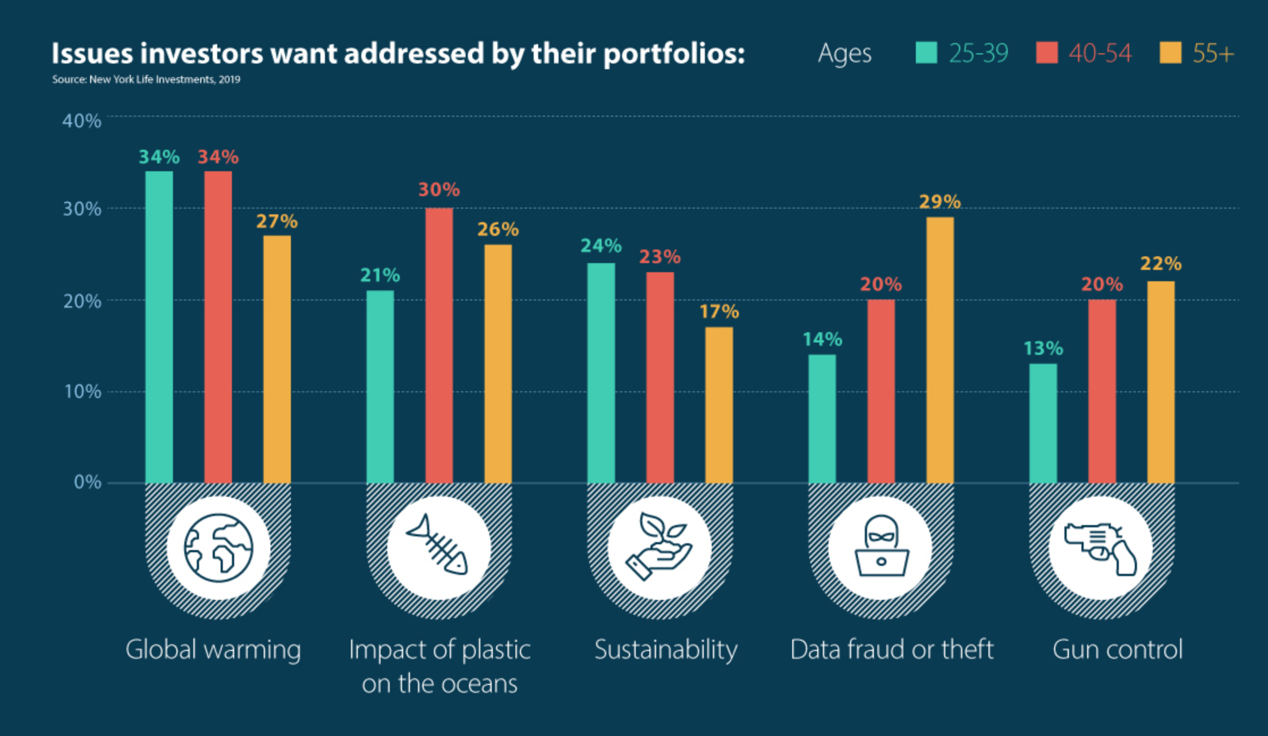
Value Issues for Investors

Slide 7
ESG Services disagree…

Slide 8
Even on high profile companies…

Slide 9
What exactly do ESG scores measure? The Revisionist History of ESG
Goodness: Much as ESG services and advocates like to scrub away the original intent of ESG, ESG was created as a measure that could measure how well companies were contributing to the planet’s well being.
Risk: It was only a few years ago, and just after the first backlash against goodness measures that ESG services changed their tune and argued that ESG scores were a measure of risk.
Disclosure of material impact: In the last year, in particular, as the pushback against ESG’s use by investment managers has mounted, ESG has been reframed as a mechanism of disclosure of “material” impact.

Slide 10
If it is goodness, it certainly generates some odd results…
Manufacturing versus Service: ESG scores through most of the period that ESG has been around have been skewed away from manufacturing and towards service businesses, perhaps because of the focus on carbon footprint.
Tangible versus Intangible: Until recently, technology companies were ESG favorites, reflecting the same focus on carbon footprint and an implicit bias towards price momentum in markets. (Just as analysts rush out with buy (sel) recommendations for companies after their stock prices go up (down), ESG scores drift up after stock prices go up for a company, and drift down after they go down).

Slide 11
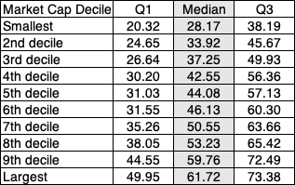
Odd fact 1: ESG Scores are higher for bigger firms

Slide 12
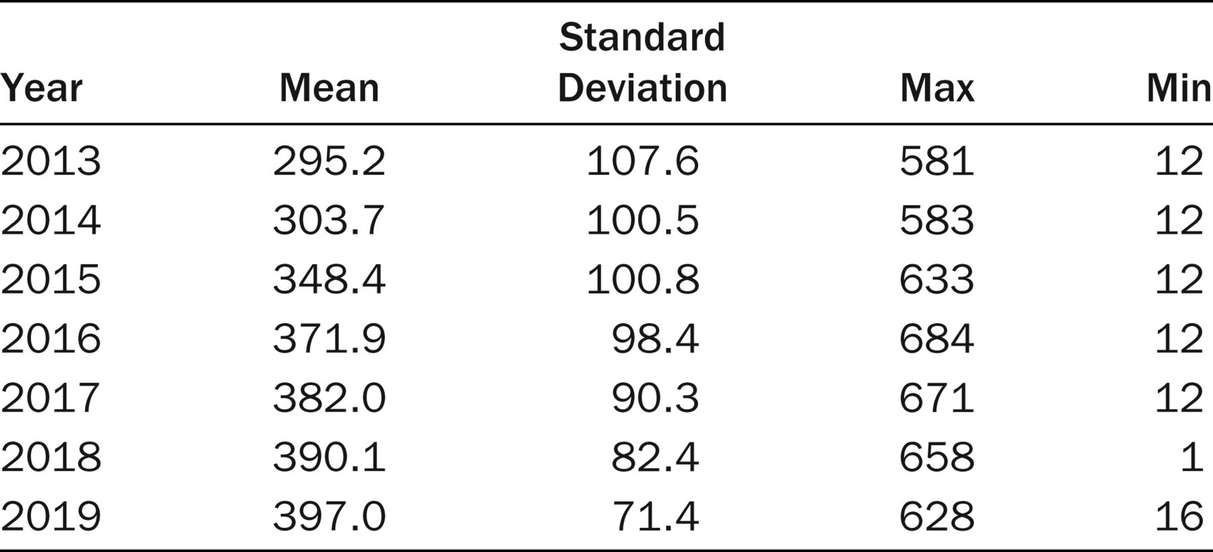
Odd fact 2: ESG scores increase with disclosure
Source: Chen et al, JPM

Slide 13
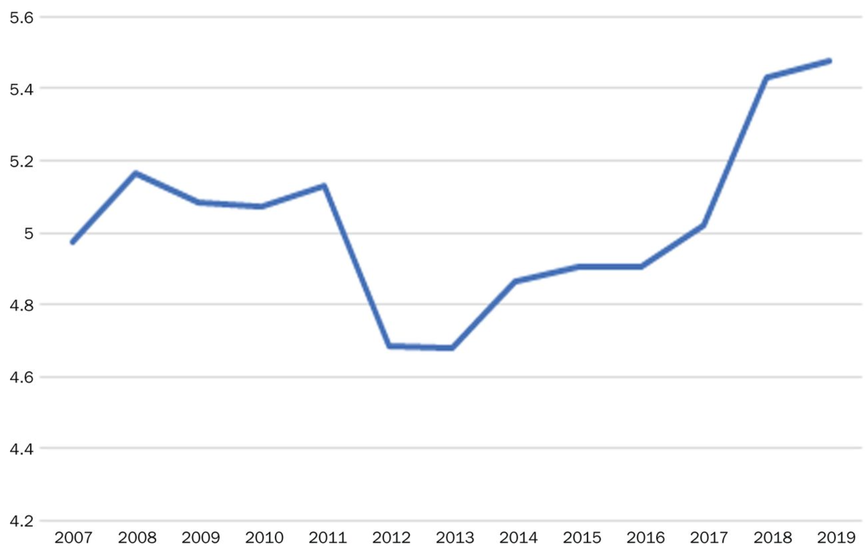
Odd fact 3: Everyone is behaving better (at least according to ESG scores)
This study also finds that a company’s ESG score improves as the number of ESG data items it reports go up.
Source: Chen et al, JPM

Slide 14
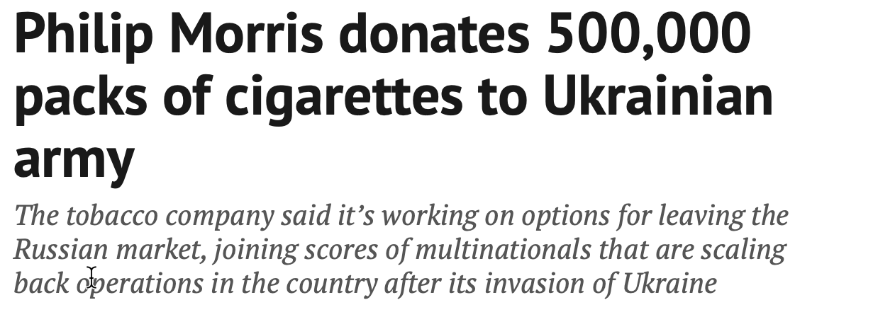
Goodness is not absolute….

Slide 15
If your answer is risk… look again
In the last three or four years, ESG services seem to have changed their tune about what they are measuring, from “goodness” to “risk”.
At various points, ESG services have claimed that
  Companies with higher ESG scores have lower costs of capital than companies with lower ESG scores
  Companies with higher ESG scores have more stable earnings than companies with lower ESG scores
  Companies with higher ESG scores are less likely to face crises or catastrophic risk
Each of those statements is misleading, at the very least, and untrue, at its core.

Slide 16
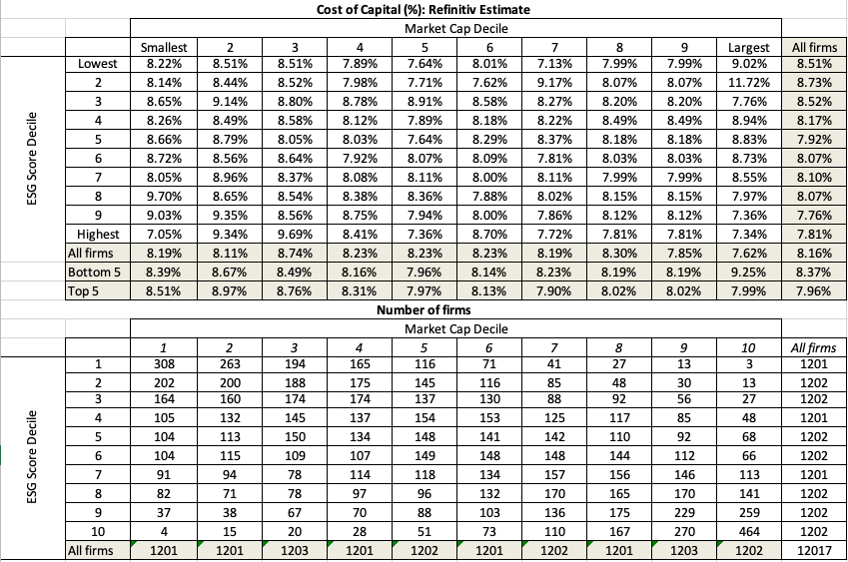
Refinitiv’s ESG and Cost of Capital: Is there an ESG link?
Controlling for the fact that ESG scores tend to be higher for larger firms, there is no correlation between ESG and cost of capital.

Slide 17
As for catastrophic risks, the evidence, at least on the highest profile firms, is to the contrary
To the extent that ESG is on the side of “goodness”, any company that wears the ESG mantle acquires some degree of protection against questioning, not just about ESG actions, but also against legitimate business questions.
  While the evidence is anecdotal, at least for the moment, there is some backing for the contention that the companies that claim to have the purest of motives often have the most to hide.
  Materially, any evidence that claims to show that higher ESG scores would have protected you from corporate scandals and scams is based on contorted definitions of what comprises catastrophic risk.

Slide 18
The Runaway Story: ESG as a lubricant
With a runaway business story, you usually have three ingredients:
  Charismatic, likeable Narrator: The narrator of the business story is someone that you want to see succeed, either because you like the narrator or because he/she will be a good role model.
  Telling a story about disrupting a much business, where you dislike the status quo: The status quo in the business that the story is disrupting is dissatisfying (to everyone involved)>
  With a societal benefit as bonus: And if the story holds, society and humanity will benefit.
Since you want this story to work out, you stop asking questions, because the answers may put the story at risk. And since it will benefit society, you are reluctant to be churlish enough to ask questions about the basic business models.

Slide 19
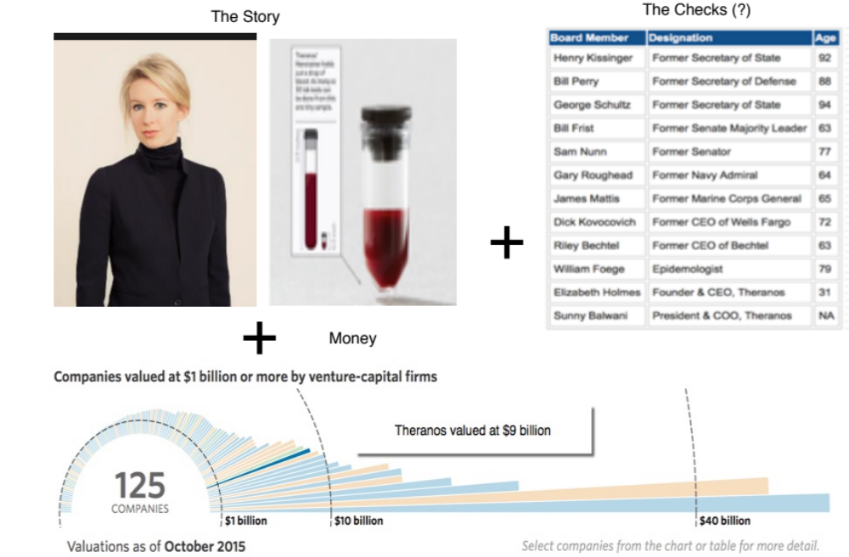
The Impossible: The Runaway Story

Slide 20
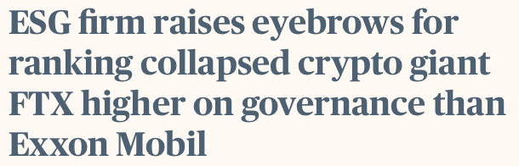
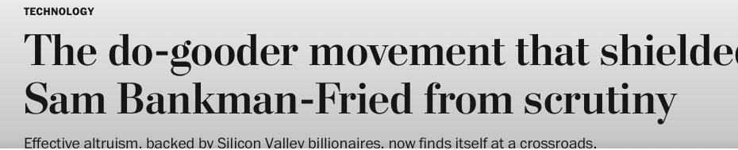
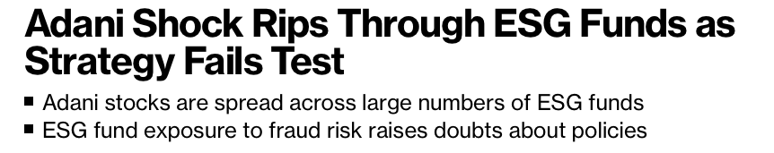
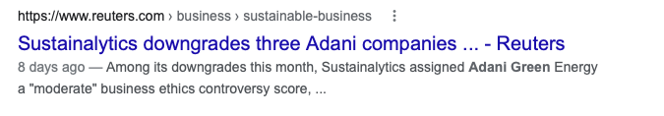
With more examples…
FTX
Adani Group
It is true that this is anecdotal evidence, but as a challenge, is there a single high-profile firm that you can think of where a low ESG score would have warned you ahead of a crisis?
Too little, too late

Slide 21
ESG score differences will not only persist…
There are some who believe that this reflects a measurement process that is still evolving, and that as companies provide more disclosure on ESG data and ESG measurement services mature, there will be consensus.
  I don’t believe it, because. if there were consensus, it is unlikely that we would not need to convince businesses to reflect that consensus.
  If there is a consensus that emerges, it will be because ESG services will draw on a small subset of people who have been trained in ESG talk, bring the same mindset and indulge in group think.
Even if you overlook disagreements on ESG as growing pains, there is one more component that adds noise to the mix and that is the direction of causality:
  Do companies perform better because they are socially conscious (good) companies, or do companies that are doing well find it easier to do good?
  Put simply, if ESG metrics are based upon actions/measures that companies that are doing better, either operationally and/or in markets, can perform/deliver more easily than companies that are doing badly, researchers will find that ESG and performance

Slide 22
And the gaming will get worse..
The nature of any scoring system is that the “scored” will learn (either because it explicitly lays out the components that lead to a high score) or scores can be reverse engineered to figure out what causes high and low scores.
  The bottom line is that gaming is a feature of any scored system than a bug in the system.
  As scoring systems mature, the gaming gets easier (not harder) making the scores even less useful.
Put simply, greenwashing is not a bug in ESG, that if fixed will lead to green heaven, but a feature of ESG, with its reliance on disclosures and scores.

Slide 23
2. The ESG Promises: Cake for all, with no calories!
For companies, the promise is that being "good" will generate higher profits for the company, at least in the long term, with lower risk, and thus make them more valuable.
For investors in these companies, the promise is that investing in "good" companies will generate higher returns than investing in "bad" or middling companies.
For society, the promise is that not only would good companies help fight problems directly related to ESG, like climate change and low wages, but also counter more general problems like income inequality and healthcare crises.

Slide 24
The ESG Questions

Slide 25
I. ESG and Value
The "It Proposition” applied to ESG: For ESG to affect value, its practices have to show up in one or more of these inputs.

Slide 26
The Promise of Heaven : The Good shall be rewarded

Slide 27
Examples and Counters: Patagonia and Etsy
A company that is often used as an example of “goodness” is Patagonia, and the company has stayed true to its mission by:
  Remaining an annual benefit corporation, owned by the Chouinard family (Yvon and his children)
  Being willing to pay to do the “right” thing (at least as it sees them)
  But is has paid the price (lower revenues, less in profits)
Etsy went public as a benefit corporation, but that mission clashed with its endgame of being a much larger player in online merchandising. It eventually abandoned its benefit corporation status, so as to be able to access more capital, and is now embroiled in public fights with the craftsmen who provide its merchandise.

Slide 28
The Warning of Hell: The Bad shall be punished

Slide 29
ESG’s biggest success? Fossil Fuel..

Slide 30
The Bad Guys win: Hell on Earth?

Slide 31
ESG and Growth
There have been very few studies that have looked at the link between ESG and growth. If there is any evidence of a link, it is that it becomes more difficult to wear the goodness cloak, as companies get bigger.
One simple comparison is between two companies, Patagonia, outspoken about its “purity of purpose” and Nike, accused of being more mushy in its ESG practices.
  Patagonia has revenues of less than a billion a year, and a focused market (of wealthy millennials).
  Nike has revenues in excess of $40 billion and has to market its goods to a much wider audience.

Slide 32
ESG and Profitability
The link to profitability is weak: There are meta studies (summaries of all other studies) that find a small positive link between ESG and profitability, but one that is very sensitive to how profits are measured and over what period.
E, S and G have different payoffs: Breaking down ESG into its component parts, some studies find that environment (E) offered the strongest positive link to performance and social (S) the weakest, with governance (G) falling in the middle. Others find that governance is the dominant variable, but if so, it is the one variable that predates ESG and actually pushes in the opposite direction.
Uncertainty about direction of Causation: The studies that find a link between profitability and ESG scores face the question of which direction the causation runs: are good firms more profitable or are more profitable firms more likely to be picked as good firms?

Slide 33
And what’s with the meta studies?
ESG backers constantly point to meta studies, which are really an aggregation of studies done on a topic over time.
While there is a ”law of large numbers” reasoning that can be used to back up this practice, it is not a good one for many reasons:
  Averaging studies that are done at different time periods, with different metrics yield averaging mush.
  Averaging many studies averages out mistakes, but it does not eliminate bias.
The cynical way of looking at meta studies is that they point to the absence of studies that can be trusted to stand on their own, either because their findings are specific to the sample that they are studying or the timing of the study (or worse).

Slide 34
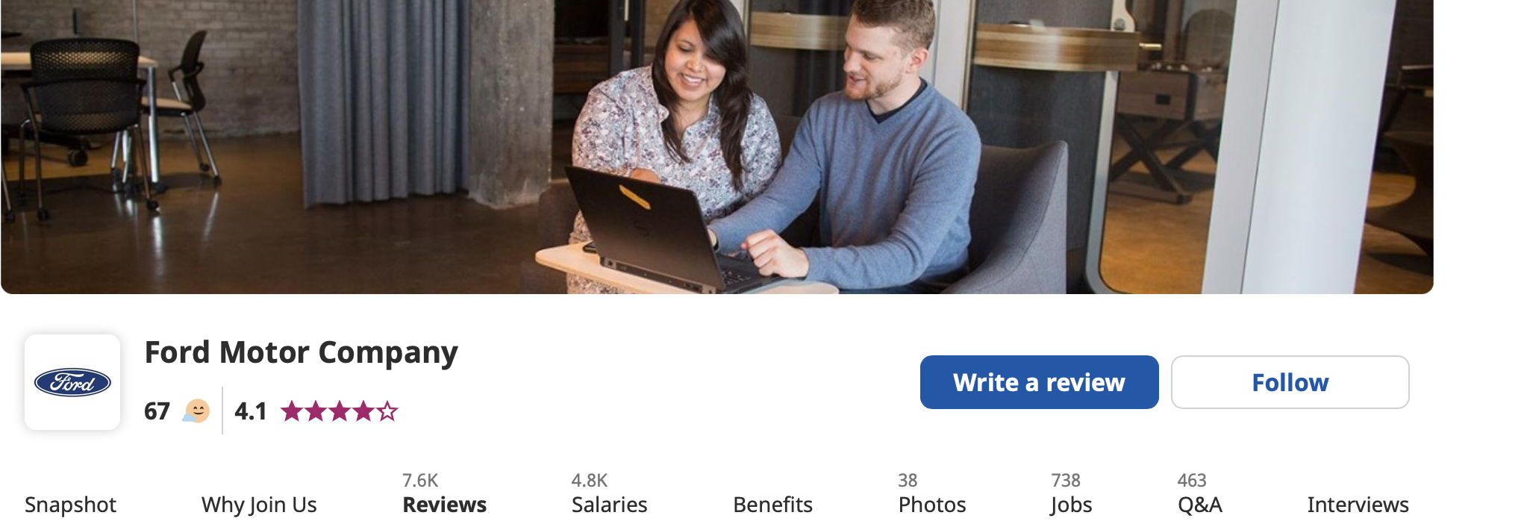
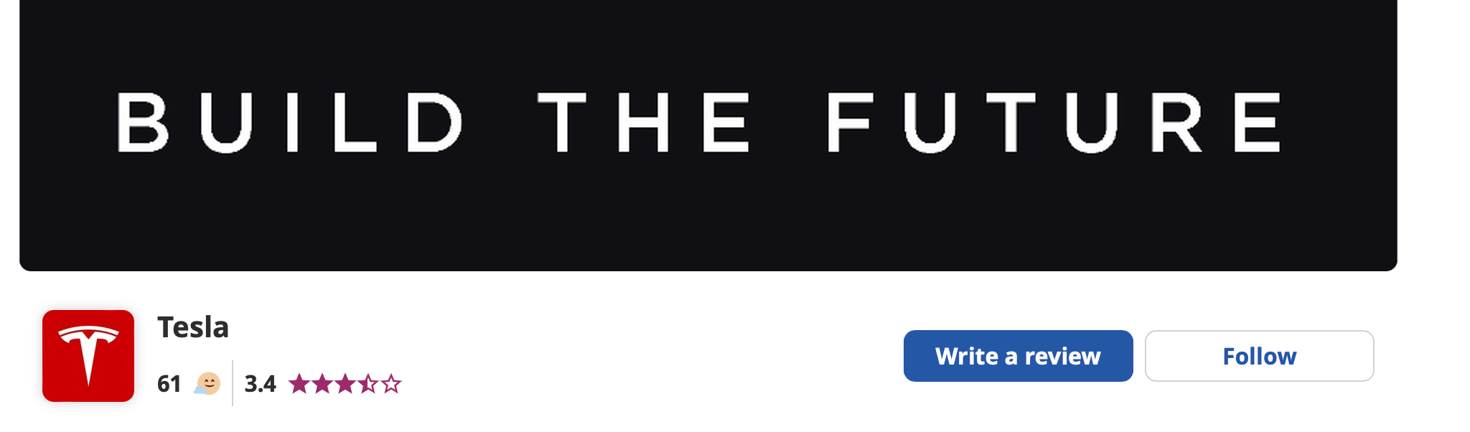
ESG and Employee Satisfaction…

Slide 35
ESG and Funding Costs
There is a stronger Link to Funding Costs: Studies of “sin” stocks, i.e., companies involved in businesses such as producing alcohol, tobacco, and gaming, find that these stocks are less commonly held by institutions and that they face higher costs for funding, from equity and debt).
The evidence for this is strongest in sectors like tobacco (starting in the 1990s) and fossil fuels (especially in the last decade), but these findings come with a troubling catch. While these companies face higher costs, and have lower value, investors in these companies generate higher returns.
If this is the argument, though, be clear about the consequences:
  Equity investors in good companies will settle for much lower returns, given risk, on their investment than in bad companies.
  Lenders to good companies will earn lower interest rates, given default risk, than lenders to bad companies.

Slide 36
ESG and Catastrophic Risk
Legal ≠ Sensible: The peril of playing fast and loose with the rules is that sooner or later, you will be entangled in a ”scandal”, and that scandal will not only damage you in the near term but also create reputational damage that can haunt you in the long term.
There is a link to Failure/Disaster Risk: “Bad” companies are exposed to disaster risks, where a combination of missteps by the company, luck, and a failure to build in enough protective controls (because they cost too much) can cause a disaster, in human and financial terms.
Social Constraints: We have known this for as long as businesses have been around, and argued that businesses that want to maximize value (which is long term, by nature) and not earnings next period should hold back from pushing too close to the limits of acceptable behavior, even if that behavior is legal.

Slide 37
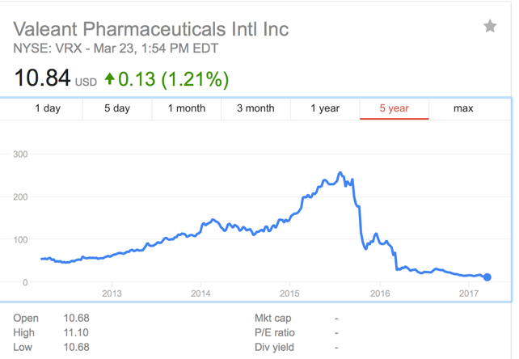
Valeant: A Cautionary Tale

Slide 38
ESG and Value: Propositions
Proposition 1: Don’t be a “bad” company. The costs of being bad exceed any benefits you may get from operating close to the edge of what is legal or a business model that is at the edge of social acceptance.
Proposition 2: If you want to go beyond ”not being bad” and try to be “good”, do it with the recognition that goodness will often cost you in the short term (lost business, higher costs), and that you may not recover that cost even in the very, very long term. Put simply, the notion that being good is always good for value is nonsense.
Proposition 3: If being good is at the base of your business model, and you generate benefits from that perception, in terms of earnings and cash flows, you may have to accept a lower scale (and settle for being a smaller company).

Slide 39
II. ESG and Returns
Constrained optimal? To begin with, the notion that adding an ESG constraint to investing increases expected returns is counter intuitive. After all, a constrained optimum can, at best, match an unconstrained one, and most of the time, the constraint will create a cost.
Truth in Advertising: In one of the few cases where honesty seems to have prevailed over platitudes, the TIAA-CREF Social Choice Equity Fund explicitly acknowledges this cost and uses it to explain its underperformance, stating that “The CREF Social Choice Account returned 13.88 percent for the year [2017] compared with the 14.34 percent return of its composite benchmark … Because of its ESG criteria, the Account did not invest in a number of stocks and bonds ... the net effect was that the Account underperformed its benchmark.”
Internal contradiction: In fact, there is an inherent contradiction, at least on the surface, between arguing that ESG leads to higher value and stock prices, made to CEOs and CFOs of companies, and simultaneously arguing that investors in ESG stocks will earn higher (positive excess) returns.

Slide 40
And the research is all over the place…
Invest in bad companies: A comparison of two Vanguard Index funds, the Vice fund (invested in tobacco, gambling, and defense companies) and the FTSE Social Index fund (invested in companies screened for good corporate behavior on multiple dimensions) and note that a dollar invested in the former in August 2002 would have been worth almost 20% more by 2015 than a dollar invested in the latter.
Invest in good companies: At the other end of the spectrum, there are studies that seem to indicate that there are positive excess returns to investing in good companies. A study showed that stocks in the Anno Domini Index (of socially conscious companies) outperformed the market, but that the outperformance was more due to factor and industry tilts than to social responsiveness. Some of the strongest links between returns and ESG come from the governance portion, which, as we noted earlier, is ironic, because the essence of governance, at least as measured in most of these studies, is fealty to shareholder rights, which is at odds with the current ESG framework that pushes for a stakeholder perspective.
ESG has no effect: Splitting the difference, there are other studies that find little or no differences in returns between good and bad companies. In fact, studies that more broadly look at factors that have driven stock returns for the last few decades find that much of the positive payoff attributed to ESG comes from its correlation with momentum and growth.

Slide 41
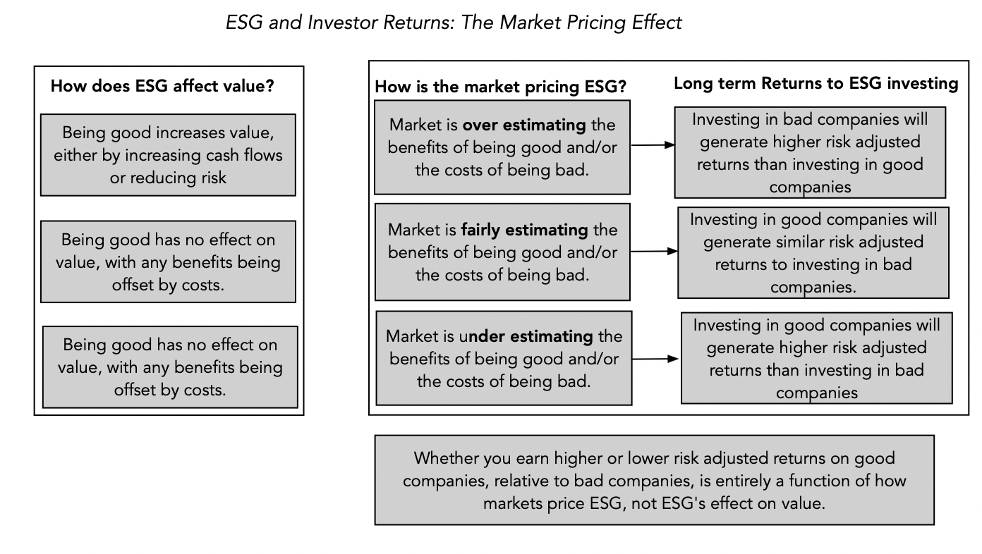
Why returns to ESG are tough to read…

Slide 42
The Pricing Effect
Put simply, a study that finds a relationship (positive, negative or zero) between ESG and returns is really a test of whether ESG is being priced in correctly and not one of whether ESG is good for investing or bad for investing.
The only worthwhile conclusion that you can draw is that investing in good companies (or avoiding investing in bad companies) will generate higher returns if the market is underpricing the “positive” effects of being good or the “negative” effects of being bad.
In fact, if ESG is front and center and investors are rushing into “good” companies and selling “bad” companies, the reverse will be true, i.e., the market will be overpricing the positive effects of being good and the negative effects of being bad. In this world, investing in bad companies will generate higher risk-adjusted returns that investing in good companies.

Slide 43
Two plays on ESG investing
ESG Exclusionary Investing
  You remove firms that you classify as “bad” firms from your investment universe.
  Implicitly, you are assuming that bad firms are more likely to deliver negative returns and that avoiding them will improve returns on your portfolio.
ESG Inclusionary Investing
  You seek out firms that are “good’ firms for your portfolio
  Implicitly, you are assuming that firms that do good are also good investments and that adding them will raise the returns on your portfolio.

Slide 44
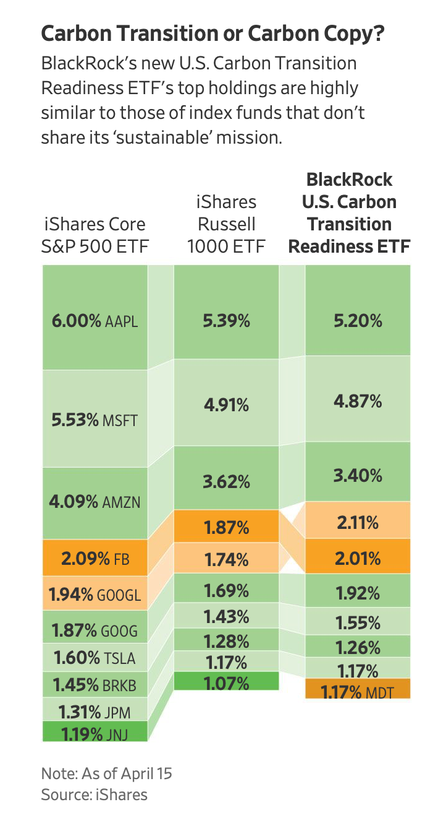
Fake ESG? BlackRock’s Carbon Transition ETF
Expenses: 0.03%
Expenses: 0.15%

Slide 45
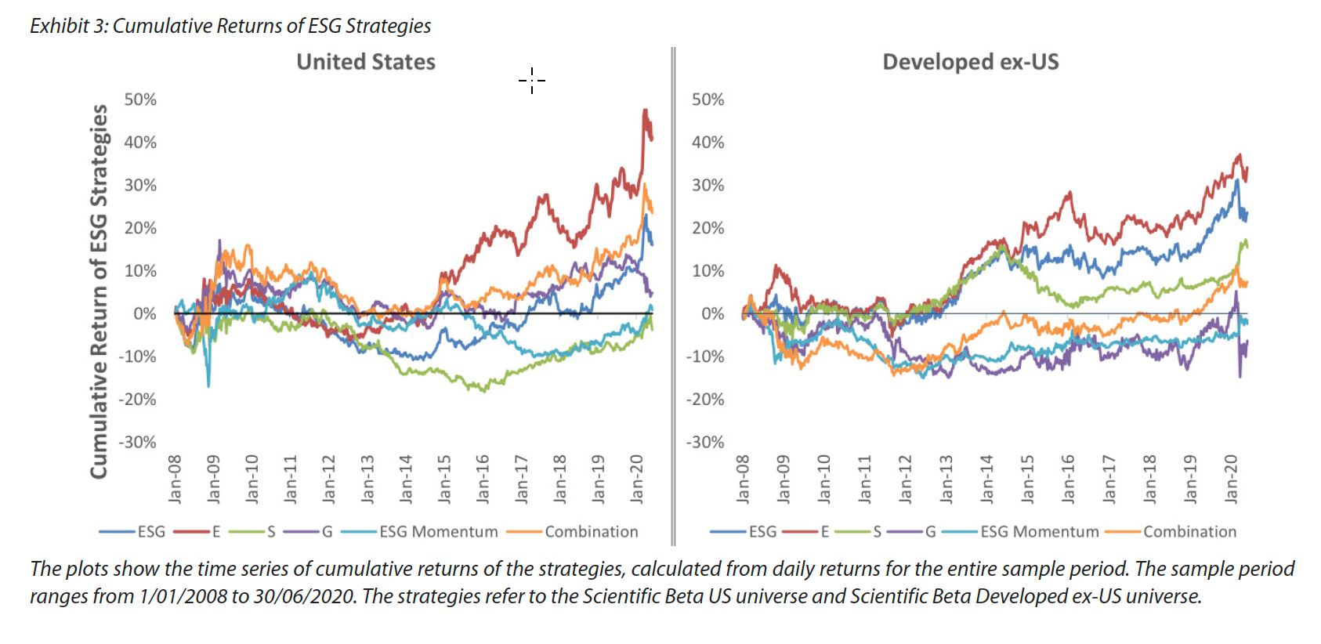
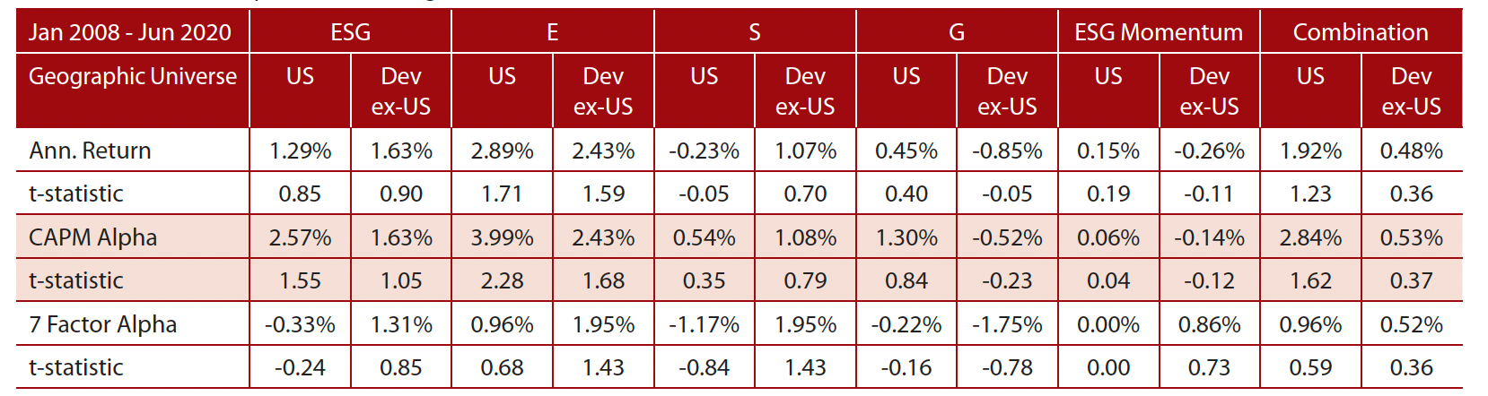
A Sales Pitch for ESG Investing
Source: Honey, I shrunk the ESG alpha

Slide 46
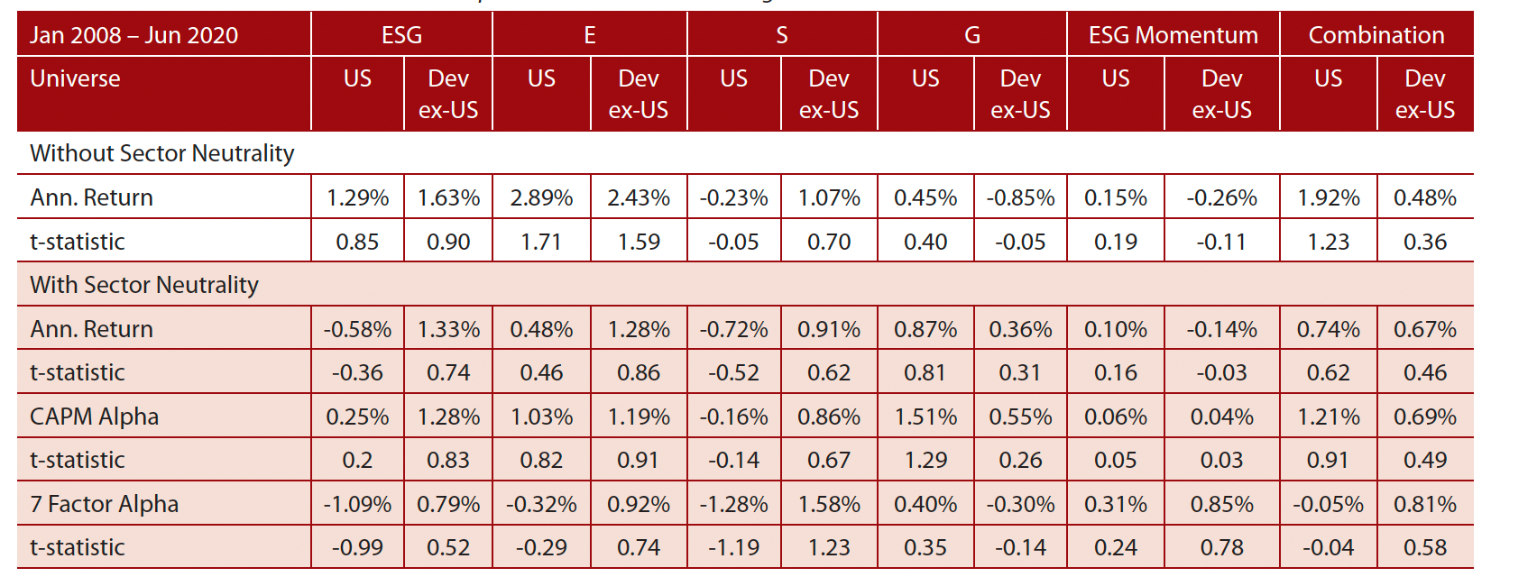
With a caveat…
ESG scores are correlated with many factors that we know already generated excess returns during the 2008-2020 time period. For instance, tech companies have historically had higher ESG scores than non-tech companies. Correcting for these factor skews in ESG rankings, the alphas become much smaller.

Slide 47
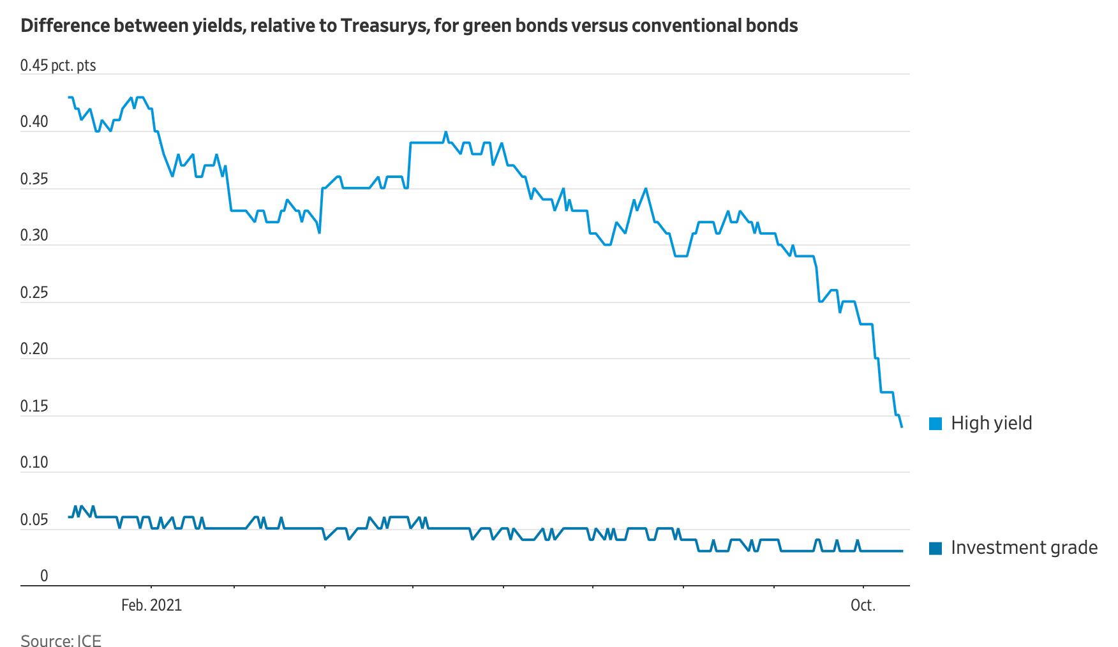
Green Bonds: The Shrinking Premium

Slide 48
Glimmers of hope?
While the overall evidence linking ESG to returns is weak, there are two pathways that offer promise:
  Transition Period Payoff: The first scenario requires an adjustment period, where being good increases value, but investors are slow to price in this reality. During the adjustment period the highly rated ESG stocks will outperform the low ESG stocks, as markets slowly incorporate ESG effects, but that is a one-time adjustment effect.
  Limit Downside: To the extent that socially responsible companies are less likely to be caught up in controversy and court disaster, the argument is that they will also have less downside risk as their counterparts who are less careful.
Investing lesson: Investors who hope to benefit from ESG cannot do so by investing mechanically in companies that already identified as good (or bad). They have to adopt a more dynamic strategy built around either aspects of corporate social responsibility that are not easily measured and captured in scores but also affect value, or from getting ahead of the market in recognizing aspects of corporate behavior that will hurt or help the company in the long term.

Slide 49
The Investing Bottom Line
If success in active investing is defined as attracting investor money, ESG has had a successful run, but if it is defined as delivering returns, it is far too early to be doing victory dances in the end zone.
The consensus view that ESG investing outperformed the market is now getting push back, with some arguing that once you control for the sector tilt of ESG funds (they tend to be more heavily invested in tech companies), ESG, by itself, has provided little or no payoff to those investing on its basis.
The sales pitch to investors that ESG is good for investors is at cross purposes with the sales pitch to companies that ranking high on ESG will reduce their risk and give them lower costs of equity and debt.

Slide 50
III. ESG Disclosure
If ESG does not add to value, at companies, or to returns, for investors, there are some who argue that the primary benefit of the ESG movement has been increased disclosure.
  In short, the new push for ESG seems to be that it just a disclosure movement, that is attempting to let investors know about “material” risks that they might be exposed to.
  Implicit in this argument is the assumption that more disclosure will not only induce better behavior on the parts of the ”disclosing” firms, but also allow consumers and investors to make more informed judgments.
That push has already created results with the EU leading the way on new disclosure requirements, with different interest groups pushing for disclosures on their favorite causes.

Slide 51
The Magic of Materiality
While there seems to be this consensus that we can define materiality, that is far from true. There are three different definitions of materiality:
  Accounting materiality: Reflecting the accounting attention to detail and absence of perspective, accounting materiality is designed to mix the small with the big, and expend resources on details that don’t matter to anyone other than the accountants (Goodwill impairment).
  Value materiality: Value materiality focused on items that change the value of a business by having a significant effect on future cash flows, growth and risk.
  Pricing materiality: Price materiality is built around any item that can cause prices to change substantially, which may or may not overlap with value materiality.
  Legal materiality: Legal materiality is about disclosing any item, no matter how minor, that if things go wrong could be highlighted as material.

Slide 52
Disclosure as information
In theory, disclosures should make us more informed as consumers and investors, but here again, there are caveats.
  Legalese: In an age of litigation and regulation, disclosures seem to be written by lawyers and for lawyers, and there is no reason to believe that ESG disclosures will be any different.
  Information overload: As we have seen with accounting disclosures, there is a danger that if ESG disclosures become too extensive, they will be ignored even by people who claim to care about the disclosed information.
It is almost unavoidable that what starts as value materiality will become legal materiality somewhere along the way, especially when there are laws and regulations that will punish firms, with the benefit of hindsight.

Slide 53
Disclosure and Corporate Behavior
While it is possible that disclosure could lead to better behavior, there are at least two potential problems.
  Greenwashing and Game Playing: Once the disclosure requirements are set, there will be companies that find ways to play the disclosure game to make themselves look better.
  Confess and then sin again: A more dangerous problem is that companies may view disclosure as license for the disclosed bad behavior.
In short, the notion that requiring companies to disclose more will induce better behavior is at odds with the evidence on almost every aspect of disclosure that we have seen so far.
  Did increased risk disclosures make companies more careful about taking risk?
  Have corporate governance disclosures, which have exploded over the last two decades, improved corporate governance at companies?

Slide 54
IV. The Payoff for Society
There are some who believe that even if ESG makes firms less valuable and investors make lower returns, it is a net positive for society.
  It is premised on the notion that society has developed a consensus on what comprises goodness.
  It is also based upon the presumption that companies that behave well will create less side costs for society and perhaps even contribute to societal good.
If you accept this proposition, the trade off will be positive for society.

Slide 55
The Law of Unintended Consequences…
As publicly traded companies that are exposed to ESG shaming are forced to divest themselves of their “bad” businesses, it is worth remembering that selling or divesting a business does not erase it from the face of the earth, but just transfers it to a different owner, presumably one is less exposed to the ESG shaming.
In the fossil fuel business, for instance, the pressure on the easily pressured (the big US/European oil companies) has led them to cut back on investments in the fossil fuel space.
  That absence of investment is and will continue to push up the price of fossil fuels, making their production more profitable.
  A subset of the investments are now being made by foreign companies (in markets where stockholders has little power) or private equity funds.

Slide 56
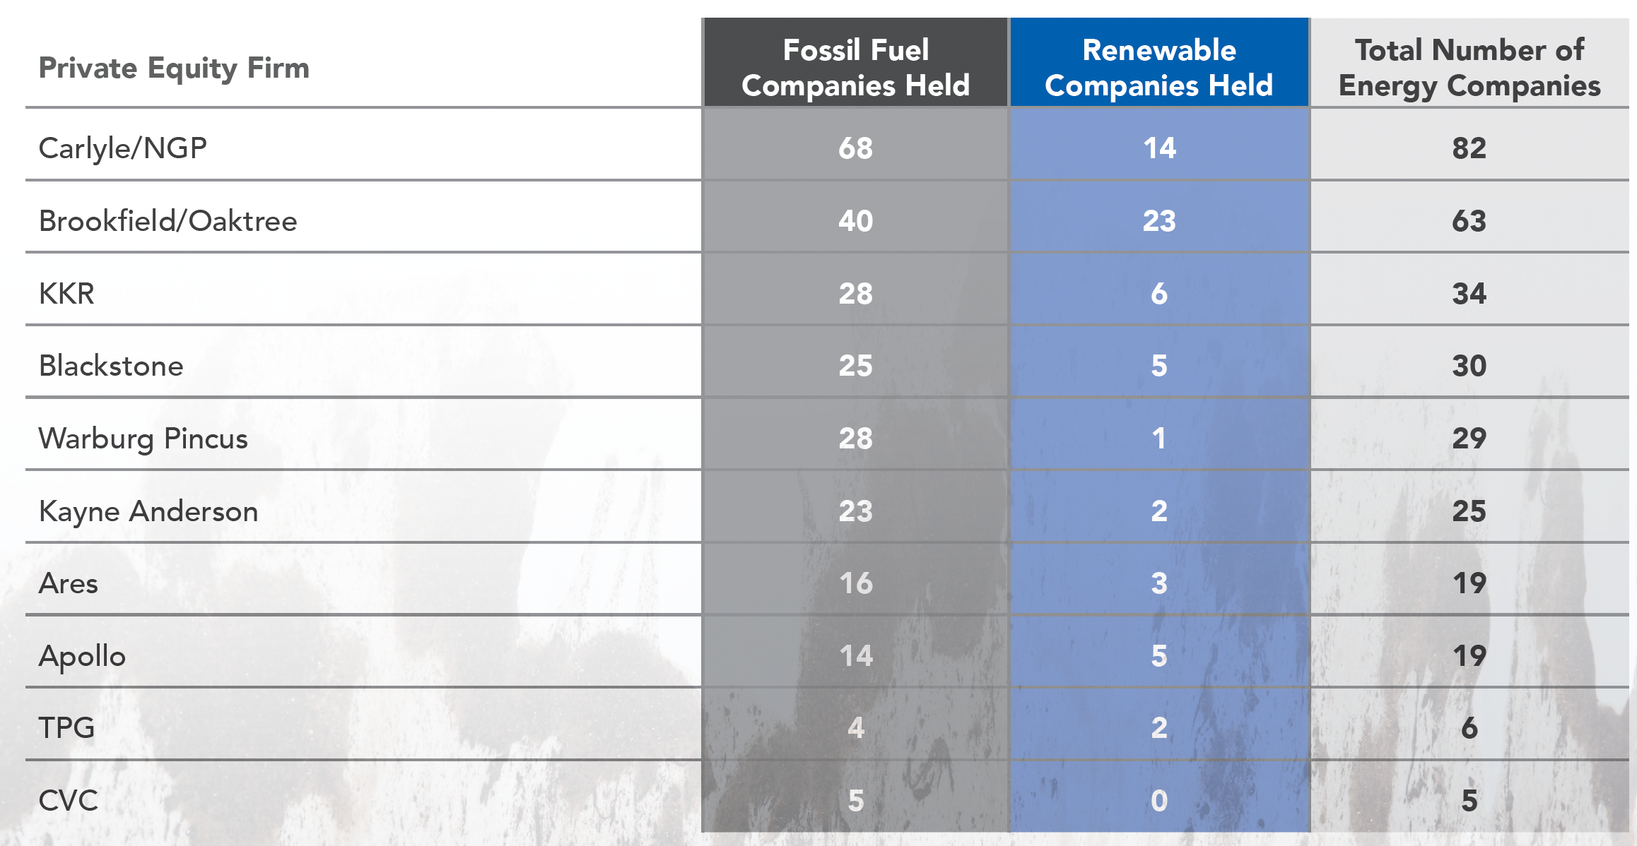
Private Equity in Fossil Fuels
Between 2010 and 2020, private equity funds have invested a trillion dollars in fossil fuel investments…

Slide 57
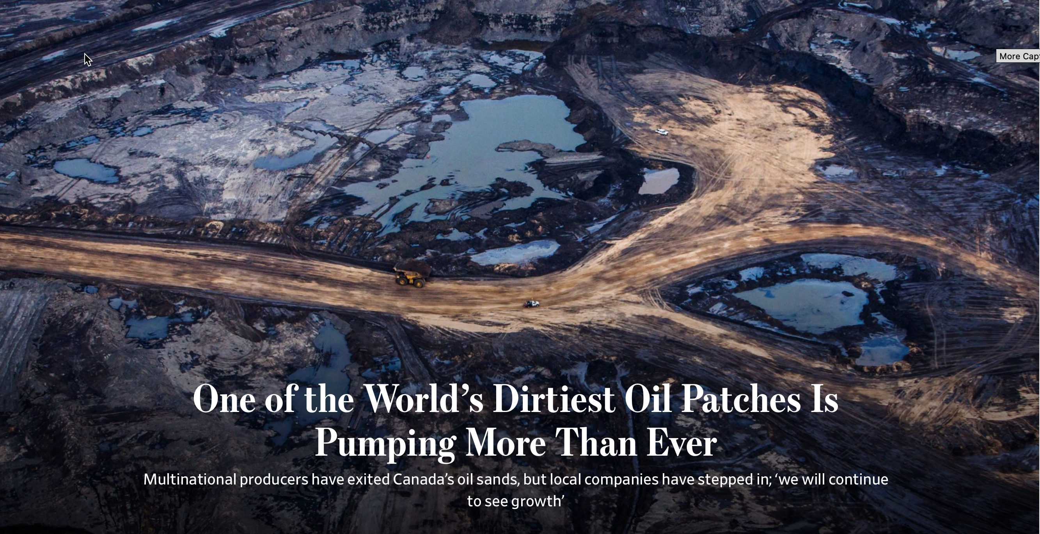
Behind the curtain…

Slide 58
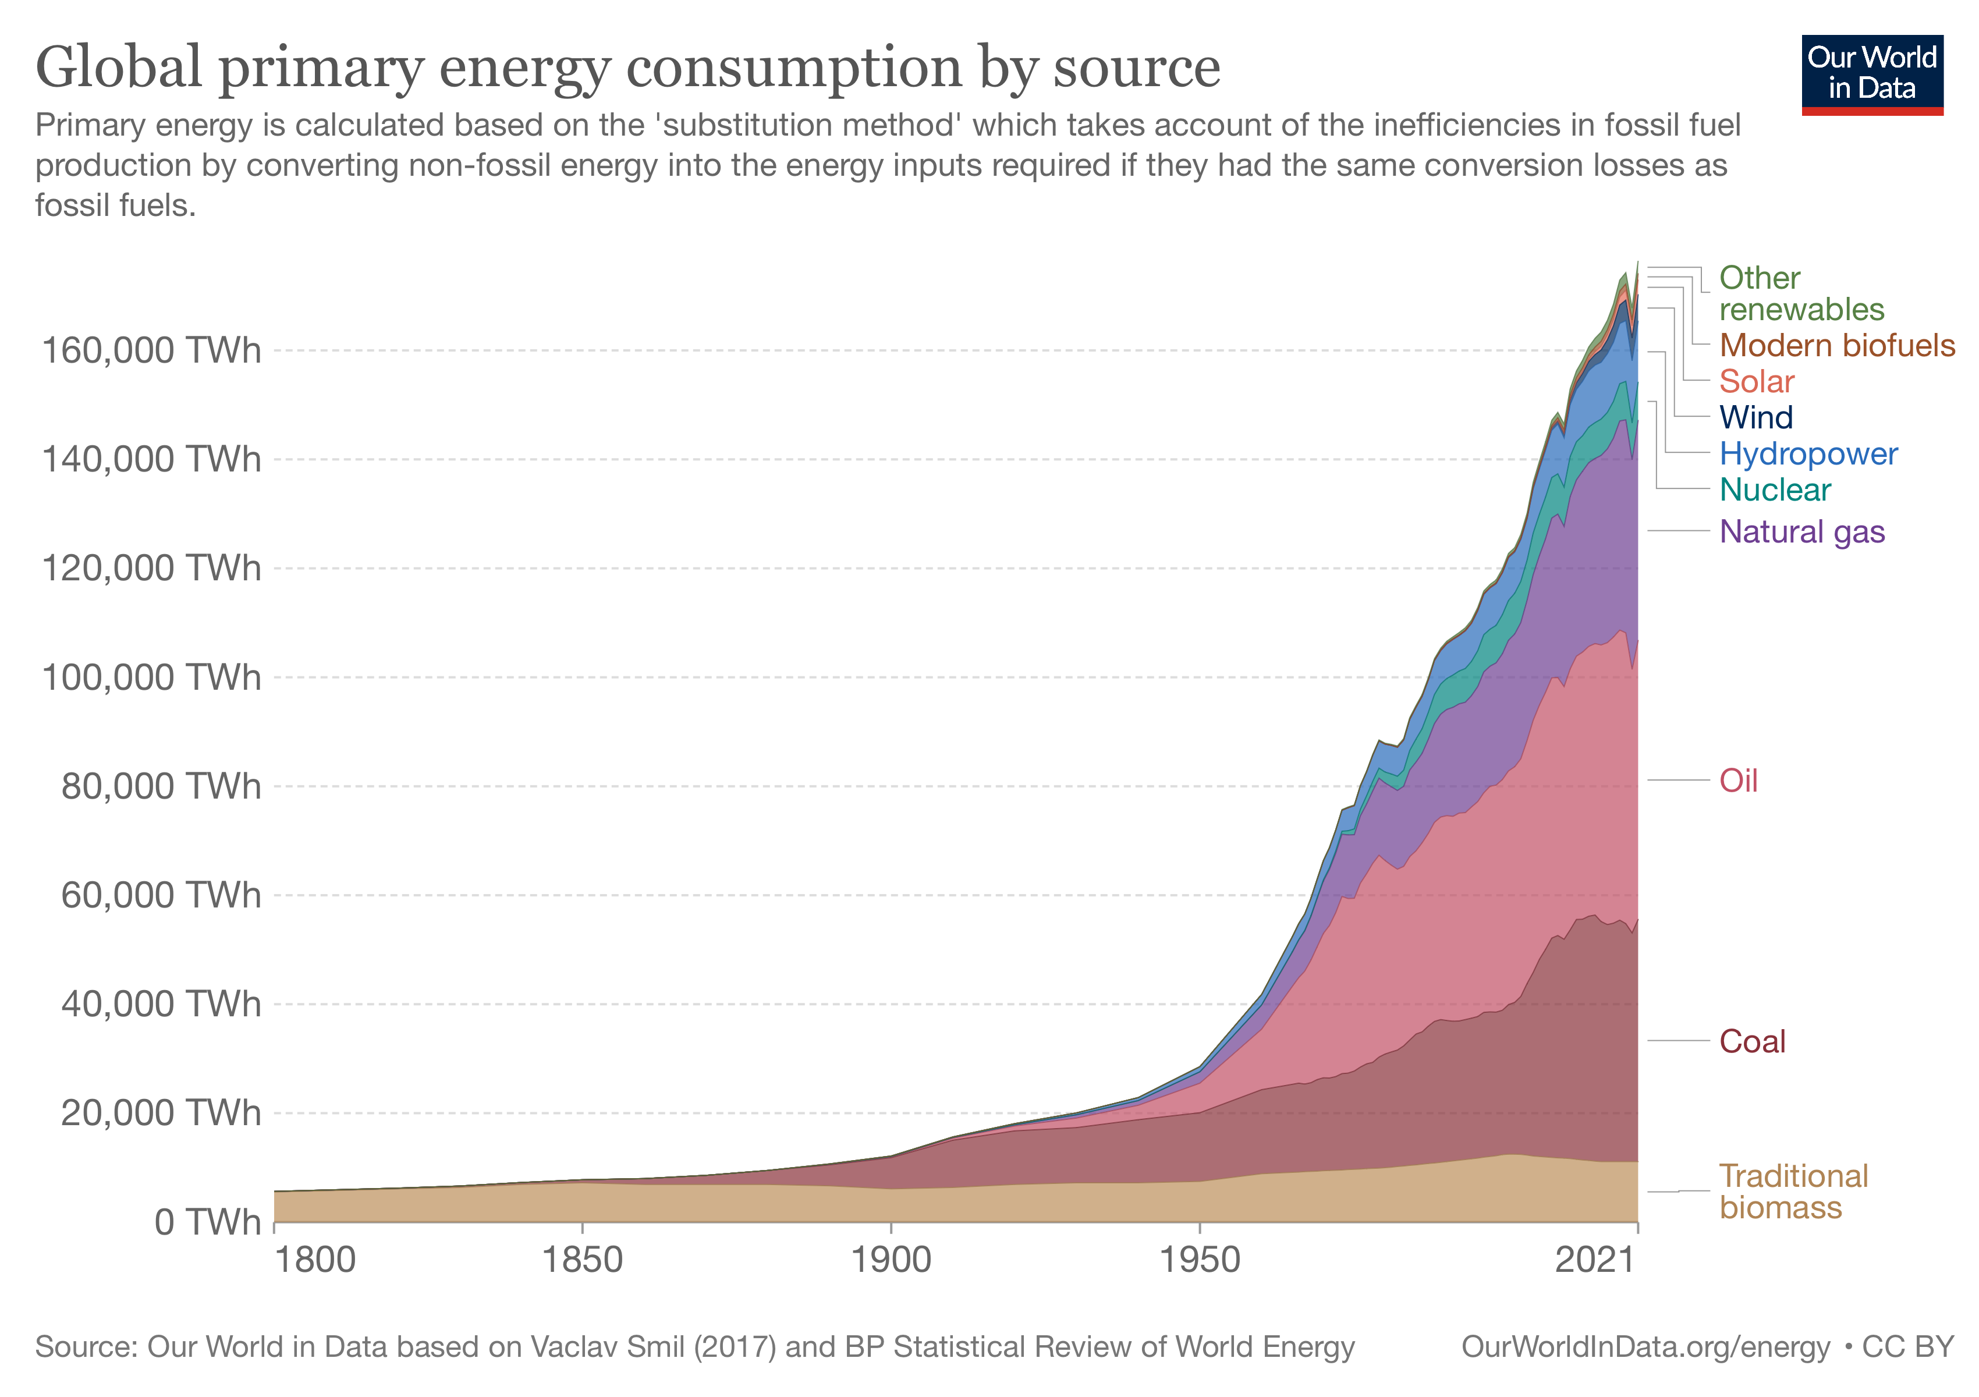
And not surprisingly.. Barely a dent in dependence on fossil fuels

Slide 59
While increasing its costs…
As ESG pressures amp up on publicly traded fossil fuel companies, especially in the US and Europe, to reduce exploration and production of fossil fuels, the laws of demand and supply have created a predictable consequence, which is higher prices for these fossil fuels (gas and oil).
While ESG advocates may view rising oil prices as a win, it is worth remembering
  That 80% of global energy still comes from fossil fuels, and that the people who are most exposed to price increases are not the well off, urban advocates of ESG but the people who are least well off (within countries and across countries)
  That

Slide 60
3. The Virtue Card….
The notion that until ESG came along, companies (and individuals) are businesses operated without a care for society would be comical, if the people pushing it were not so insistent that it is true.
That is nonsense. People who have wanted to do good have always been able to do so.
  In privately owned businesses, owners have always been free to share their profits or give away their wealth, to meet whatever societal need they felt most strongly about.
  In publicly traded companies, that responsibility fell to the owners of its shares, who again were free to share their winnings with society, in any way they though fit.

Slide 61
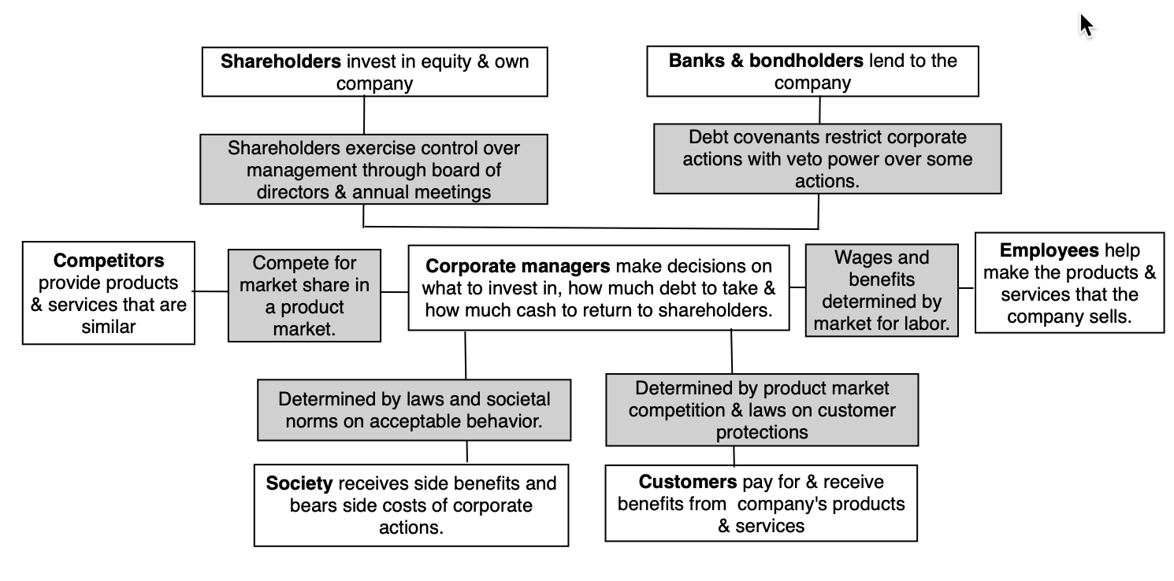
Do you want corporate managers and big fund managers to be arbiters of good and bad?

Slide 62
Outsourcing your conscience is a salve, not a solution!
The ESG movement has given each of us an easy way out of having to make choices, by outsourcing these choices to corporate CEOs and investment fund managers, asking them to be “good” for us, while not charging us more for their products and services (as consumers) and delivering above-average returns (as investors).
Implicit in the ESG push is the presumption that unless companies that are explicitly committed to ESG, they cannot contribute to society, but that is not true. Consider Bill Gates and Warren Buffett, two men who built extraordinarily valuable companies, have not only made giving pledges, promising to give away most of their wealth to their favorite causes in their lifetimes, and living up to that promise, but they have also made their shareholders wealthy, and many of them give money back to society.
As I see it, the difference between this “old” model of business and the proposed “new ESG” version is in who does the giving to society, with corporate CEOs and management taking over that responsibility from shareholders. I am not willing to concede, without challenge, that a corporate CEO knows my value system better than I do, as a shareholder, and is better positioned to make judgments on how much to give back to society, and to whom, than I am.

Slide 63
An inside perspective…
For a perspective more informed and eloquent than mine, I would strongly recommend this piece by Tariq Fancy, whose stint at BlackRock, as chief investment officer for sustainable investing, put him at the heart of the ESG investing movement.
  He argues that trusting companies and investment fund managers to make the right judgments for society will fail, because their views (and actions) will be driven by profits, for companies, and investment returns, for fund managers.
  He also believes that governments and regulators have been derelict in writing rules and laws, allowing companies to step into the void.
While I don’t share Tariq’s faith that government actions are the solution, I share his view that entities whose prime reasons for existence are to generate profits for shareholders (companies) or returns for investors (investment funds) all ill suited to be custodians of public good.

Slide 64
So, why the hype?
Cui Bono?

Slide 65
The ESG Gravy Train (or Circle)

Slide 66
And why it keeps on rolling..
Given that shareholders in companies and investors in funds are paying for this gravy, you may wonder why corporate CEOs not only go along with this charade, but also actively encourage it, and the answer lies in the power it gives them to bypass shareholders and to evade accountability.
After all, these are the same CEOs who, in 2019, put forth the fanciful, but great sounding, argument that it is a company’s responsibility to maximize stakeholder wealth, rather than cater to shareholders, which I argued in a post then that being accountable to everyone effectively meant that CEOs were accountable to no one.
In some cases, flaunting goodness has become a way that founders and CEOs use to cover business model weaknesses and overreach. It is a point that I made in my posts on Theranos, at the time of its implosion in October 2015, and on WeWork, during its IPO debacle in 2019, noting that Elizabeth Holmes and Adam Neumann used their “noble purpose” credentials to cover up fraud and narcissism.

Slide 67
Do you want to do good?

Slide 68
A Roadmap for being and doing good
Start with a personalized measure of goodness, and don’t overreach: The key with moral codes is that they are personal, and you have to bring in your value judgments into your decisions, rather than leave it to ESG measurement services or to portfolio managers.
As a businessperson, be clear on how being good will affect business models and value: If you own a business, you are absolutely within your rights to bring your personal views on morality into your business decisions, but you should be at peace with the fact that staying true to your values may, and probably will, cost you money.
If you are making decisions at a publicly traded company or at an investment fund, as an employee, manager or even CEO, you are investing other people’s money and if you choose to make decisions based upon your moral code, you have to be open about what your conscience will cost your shareholders and offer them buy in (or out).
As an investor, understand how much goodness has been priced in: If you are an investor, you don’t have to compromise on your values, as long as you realize, at least in the long term, you will have to accept lower returns. Goodness requires sacrifice!
As a consumer and citizen, make choices that are consistent with your moral code: Your consumption decisions (on which products and services you buy) and your citizenship decisions (on voting and community participation) have as big, if not greater, an effect.

Slide 69
Can ESG be rescued?
In its current form, and with its existing advocates, the answer is no.
If corporate action to advance social good is the end game, here is what has to happen:
  For the (E) environmental mission, the primary drivers must be laws and regulations that affect everyone, not just companies that voluntarily toe the lien.
  On the (S) social mission, pick your fights selectively, don’t be holier-than-thou and be clear about what it will cost the people who are paying for your mission.
  On the (G) governance, accept that it never really belonged in the concept, and that you threw it in there for the same Orwellian reason that led to East Germany calling itself the German Democratic Republic
If corporate disclosure to allow consumers and investors to make more informed judgments is the end game:
  Less is more: Drowning people in more disclosure will have perverse consequences.
  One size does not fit all: Disclosures should be tailored to companies.

Slide 70
And in conclusion..
On a personal note, I have always found that the people that I've known who do good, spend very little time talking about being good or lecturing other people on goodness. I would extend that perspective to companies and investment funds as well.
The ESG movement’s biggest disservice is the sense that it has given those who are torn between morality and money, that they can have it all. Telling companies that being good will always make them more valuable, investors that they can add morality constraints to their investments and earn higher returns at the same time, and young job seekers that they can be paid like bankers, while doing peace corps work, is delusional.
In the long term, as the truth emerges, it will breed cynicism in everyone involved, and if you care about the social good, it will do more damage than good.

