Slide 1
The theocratic Trifecta: Decoding ESG, Sustainability and stakeholder wealth
Morality plays in markets!

Slide 2
The End Game in Business
Businesses have always struggled with mission statements. Put simply, what should the end game of a business?
  The simplest and most pragmatic answer is that it is to sell products and services that customers want, while generating the most you can in profits for their owners, over the long term.
  The pushback, often from non-business critics, has been that businesses should also serve society, not just minimizing social costs but also providing social benefits.
In recent years, that pushback has found backing within business, with movements to expand business missions:
  To put business sustainability first
  To maximize the value to all stakeholders, not just owners
  To incorporate environmental, social and governance goals

Slide 3
Corporate Finance 101

Slide 4
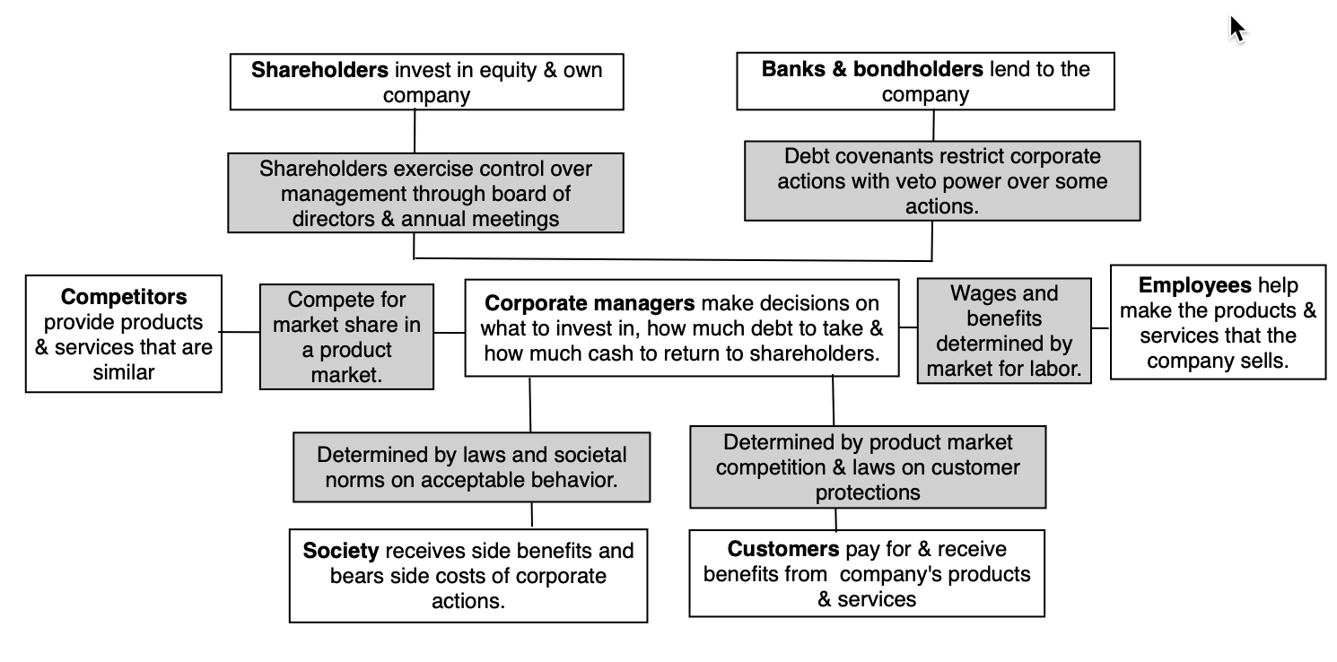
A business has many stakeholders…

Slide 5

In running a business, one of these stakeholders has to be given primacy…
In traditional corporate finance, the objective in decision making is to maximize the value of the firm.
A narrower objective is to maximize stockholder wealth. When the stock is traded and markets are viewed to be efficient, the objective is to maximize the stock price.
Maximize equity value
Maximize market estimate of equity value
Maximize firm value
Notes:
Why only one objective? Why not have many? Because you can have only objective. You can have multiple constraints that are imposed on you or you impose on yourself. If you have many objectives, and you have to pick between alternatives where you get different answers depending upon which objective you look at, you will be stuck.
This is the answer to the question posed in the previous overhead.
Maximizing the value of the business is the most general objective function. Remember that value of the business includes assets in place and growth assets. If you are managing a growth company,, increasing earnings may not necessarily increase firm value. The other problem is that firm value itself is a difficult number to estimate. While there are models available, they all need inputs, most of which allow for subjective judgments.
Managers answer to stockholders. Consequently, the objective gets narrowed down to “maximizing equity value”. (Implicit assumption: Bondholders/ Banks can protect themselves by writing in covenants and setting interest rates).
It is tough to assess equity value objectively. It would be nice to have a “third party” estimate that is objective. For publicly traded firms, the market (in spite of all its limitations) provides such an estimate. (Implicit assumption: Markets are rational and reasonably efficient).

Slide 6
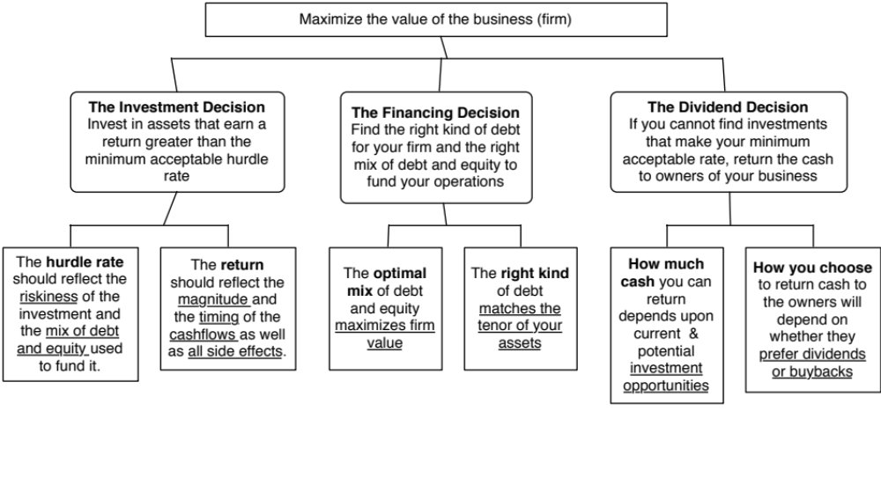
Giving corporate finance its focus…
Notes:
Our focus will be on the objective: Maximize firm value.
Since so much of corporate finance is built on this objective, it is important that we be clear about what it means and why we choose it. In addition, it is also worth exploring what the alternatives are and why this objective is preferable to the alternatives.

Slide 7

Intrinsic Value 101: Maligned and Misunderstood
The value of a risky asset can be estimated by discounting the expected cash flows on the asset over its life at a risk-adjusted discount rate:
Value is about cash flows, not earnings: Though much is made of the games that companies play with earnings, and there are many, value has always been about cash in and cash out, not earnings.
Value is about the long term: Value comes from looking at cash flows over time. The notion that a company increases value by increasing next year’s cash flows is nonsensical, since if it does so by giving up cashflows in future years, its value will decrease.
Value is risk-adjusted: While more risky cash flows are valued less than safer cash flows, a business may choose the former, if the payoff in terms of growth offsets risk.
The IT Proposition: For it (you name it) to affect value, it has to affect either cash flows or risk.

Slide 8
Where is “it”?

Slide 9
The Pushback..
Many have argued that giving shareholders primacy is bad for companies (separating them from shareholders), unfair to other stakeholders, and bad for society.
  Those who believe that markets are short term and that companies can create significant untraceable costs to society (externalities) argue that the objective should be to build the most sustainable (rather than the most valuable) business.
  Those who believe that it is unfair to other stakeholders argue that a much better model would be one that maximizes stakeholder wealth, and many strategists and even CEOs seem to have bought into that argument.
  Those who believe that it is bad for society has pushed for a different model, where ”goodness” operates not just as a constraint but is a central objective for businesses. This is the ESG framework.

Slide 10
The Myth of Sustainability
Nothing lasts (or should last) forever!

Slide 11
The Corporate Life Cycle

Slide 12
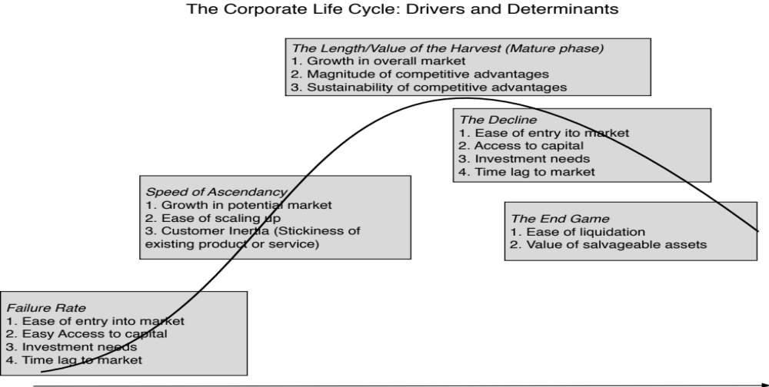
The determinants of the life cycle

Slide 13
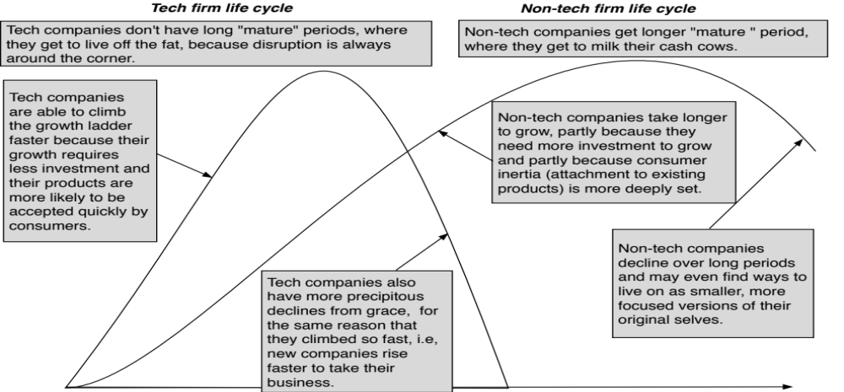
Tech versus Non-tech life cycles

Slide 14
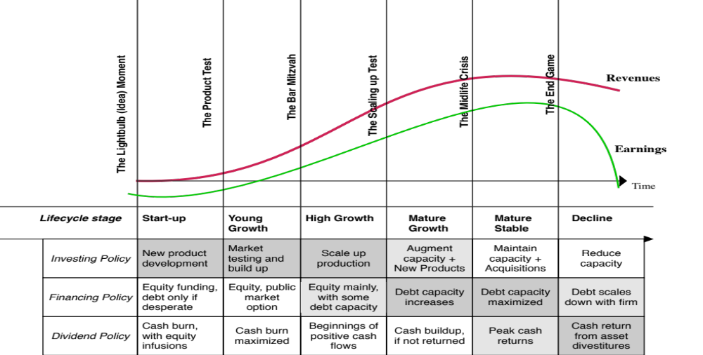
The emphasis in corporate finance shifts..

Slide 15
In value, the emphasis shifts as well, from narrative to numbers…

Slide 16
And the focus changes.... And so does the right CEO for the company

Slide 17
Companies, act your age!
For many reasons, companies try to speed up or slow down aging
  Young companies that borrow money to grow faster, invest without a purpose or with too much focus on short term profits or pay dividends.
  Mature growth companies that act young and refuse to return cash.
  Stable companies that try to be growth companies through acquisitions.
  Declining companies that think they can reverse decline, with new management and a new business plan.
Companies that don’t “act their age” will destroy value not only for their owners, but will drain overall economies.

Slide 18
The Dream of Reincarnation..
The dream of mature and declining companies is rebirth, i.e., the possibility that they can rediscover their youth, and become young, growth companies again.
In every period, there are a few companies that seem to succeed at this venture, and the companies and their CEOs become legendary, with case studies written about them.
  In some of these companies, it is a combination of great management, luck and timing that allow for this success.
  In others, the change is cosmetic.
There is an ecosystem that is built around these “success stories” that markets them to other aging companies.

Slide 19
The Sustainability Siren Song..
The Enlightenment version: Sustainability officers/consultants are able to develop and provide “long term” perspective on how decisions will affect the company making the decisions and society.
The Jiminy Cricket version: Sustainability officers/consultants operate as corporate consciences, reminding companies to be good and not be tempted by short term profits that cost society.
The Walking Dead version: If the end game of sustainability is that companies should focus on “survival” and extending their corporate lives, it has lost its way. There is no glory in growth for the sake of growth, or in survival, for the sake of survival.

Slide 20
Stakeholder Wealth Maximization
A fair solution or kumbaya moment?

Slide 21
Maximize stakeholder wealth
A fairness argument: To the extent that shareholder wealth maximization seems to, at least at first sight, put all other stakeholders in the back seat, it seems unfair.
An Easy Fix? The logical response seems to be stakeholder wealth maximization, where the collective wealth of all stakeholders is maximized. That is the promise of stakeholder wealth maximization.
Protective response: As corporations have found themselves losing the battle for public opinions, many CEOs and even some institutional investors seem to have bought into this idea.
Notes:
Stakeholder wealth maximization sounds good, because everyone gets what they want. The problem is that there

Slide 22
The Business Roundtable’s Message..
While each of our individual companies serves its own corporate purpose, we share a fundamental commitment to all of our stakeholders. We commit to:
  Delivering value to our customers. We will further the tradition of American companies leading the way in meeting or exceeding customer expectations.
  Investing in our employees. This starts with compensating them fairly and providing important benefits. It also includes supporting them through training and education that help develop new skills for a rapidly changing world. We foster diversity and inclusion, dignity and respect.
  Dealing fairly and ethically with our suppliers. We are dedicated to serving as good partners to the other companies, large and small, that help us meet our missions.
  Supporting the communities in which we work. We respect the people in our communities and protect the environment by embracing sustainable practices across our businesses.
  Generating long-term value for shareholders, who provide the capital that allows companies to invest, grow and innovate. We are committed to transparency and effective engagement with shareholders
Notes:
In 2019, the Business Roundtable, composed of the CEOs of the largest US companies seemed to capitulate to critics and accept a new mission for corporations, where companies would be all things to all people, delivering higher wages to employees, lower priced products for customers, more benefits to society, while also delivering more value for shareholders.

Slide 23
Maximizing stockholder wealth often requires that you take care of other stakeholders…
Implicit in the stakeholder wealth maximization argument is the belief that what benefits stockholders make other stakeholders worse off. That is not true.
  Maximizing stock price is not incompatible with meeting employee needs/objectives. In particular:
    Employees are often stockholders in many firms
    Firms that maximize stock price generally are profitable firms that can afford to treat employees well.
  Maximizing stock price does not mean that customers are not critical to success. In most businesses, keeping customers happy is the route to stock price maximization.
  Maximizing stock price does not imply that a company has to be a social outlaw.
There are clearly exceptions, but to use those as the basis for a revolution is foolish.

Slide 24
If you still want to maximize stakeholder wealth, you risk confusion and paralysis…
Notes:
The peril with maximizing stakeholder wealth is that is just not doable, since the interest of the groups are often at cross purposes. Organizations with multiple and conflicting objectives end up being pulled in different directions and making none of the stakeholders happy.

Slide 25
And if confused corporatism sounds like a good deal, some cautionary notes..
Government-owned companies: The managers of these companies were given a laundry list of objectives, resembling in large part the listing of stakeholder objectives, and told to deliver on them all. The end results were some of the most inefficient companies on the face of the earth, with every stakeholder group feeling ill-served in the process.
US research universities: These entities lack a central focus, where whose interests dominate and why shifts, depending on who you talk to and when. The end result is not just economically inefficient operations, capable of running a deficit no matter how much tuition is collection, but one where every stakeholder group feels aggrieved.
Notes:
The problem with trying to cater to multiple (and competing) interest groups is that you muddle decision making (when interests clash, whose interests get put first, and who gets to decide?) It also allows managers to cop out and defend poor performance with each interest group, using other interest groups as an excuse.

Slide 26
The ESG Bandwagon…
Goodness requires sacrifice!

Slide 27
Why now?
50 years since Friedman: The first is that it is the fiftieth anniversary of one of the most influential opinion pieces in media history, where Milton Friedman argued that the focus of a company should be profitability, not social good.
COVID and ESG: The second were multiple news stories about how "good" companies have done better during the COVID crisis and how much money was flowing into ESG funds.
The Establishment has bought in: The third is a more long-standing story line, where the establishment seems to have bought into ESG consciousness, with business leaders in the Conference Board signing on to a "stakeholder interest" statement last year and institutional investors shifting more money into ESG funds.

Slide 28
The Four Big Questions
What is ESG and can it be measured?
  Implicit in the ESG movement is the assumption that there is collective consensus on what comprises good, and that it can be measured.
  But is there?
How (if at all) does ESG affect value?
  ESG is being marketed to companies as being value increasing.
  The marketing pitch is based upon anecdotal evidence (usually from fossil fuel/mining companies) and studies that are more advocacy than serious research.
As an investor, can (will) you make money investing based on ESG?
  Investment funds are pushing ESG to the forefront, with the pitch that investors in “good” companies will earn higher returns.
Is society better off, if companies follow the ESG path?
  If all of the above fail to convince you, the fall back is that since it is good for society, why does it matter?
  But is it?

Slide 29
1. Goodness is person-specific, and cannot be generalized…
The starting point for the ESG argument is the premise that we can come up with measures of goodness that can then be targeted by corporate managers and used by investors. To meet this demand, services have popped up around the world, claiming to measure ESG with scores and ratings.
As I noted in my last post, there seems to be little consensus across services on how to measure goodness, and the low correlation across service measures of ESG has been well chronicled.
The counter from the ESG services and ESG advocates is that these differences reflect growing pains, and just as bond ratings agencies found convergence on measuring default risk, services will also find commonalities. I think that view misses a key difference between default risk and goodness, insofar as default is an observable event and services were able to learn from corporate defaults and fine tune their ratings.

Slide 30
ESG Scores and Company Size

Slide 31
ESG Scores and Disclosure Bulk

Slide 32
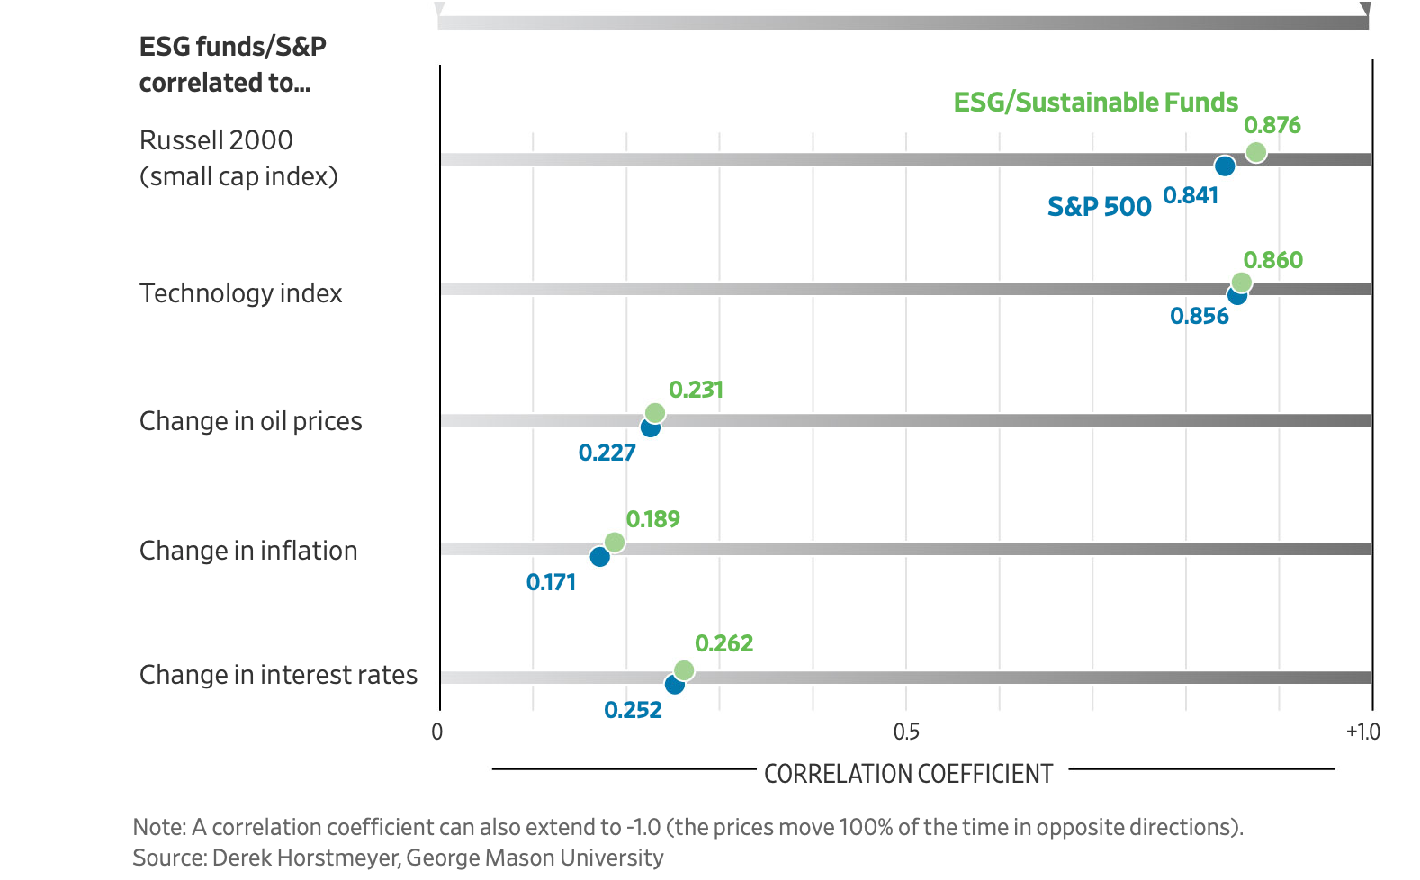
And if your argument is that it measures risk, not goodness…

Slide 33
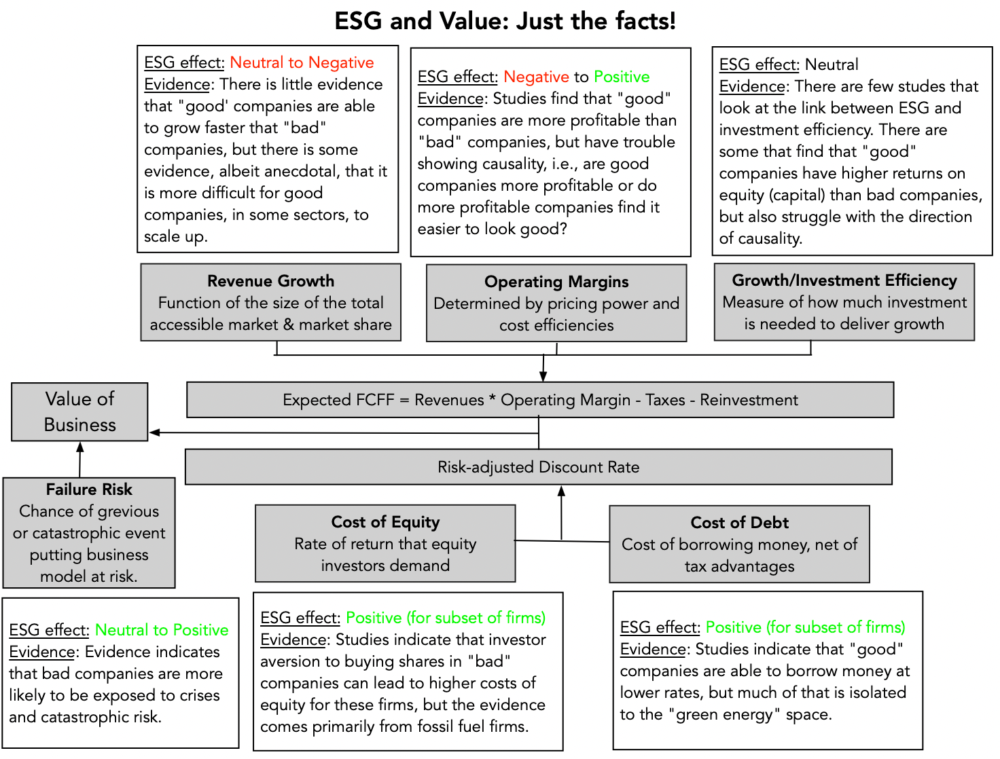
2. Being good will help some firms, hurt others and leave others unaffected!

Slide 34
Is ESG good for companies?
The notion that ESG is good for companies is being sold strongly, with research that is
  Anecdotal, in the form of case studies
  From advocates, with strong priors that ESG matters
  Statistically a mess, because it is so difficult to tell the direction of causation. Put simply, are higher ESG companies more profitable or do more profitable companies find it easier to game ESG measures to score higher?
The truth is much grayer and predates the entire ESG movement, and is that
  Companies that are “bad” or perceived to be so, because they have crossed a good corporate citizen line are exposed to punishment. That punishment, right now, is coming from investors and lenders more than from customers and employees.
  There are some companies that benefit from being “good”, but they have trouble scaling up
  For other companies, ESG is just a marketing tactic, which loses (or already has lost) its effectiveness, as everyone uses it.

Slide 35
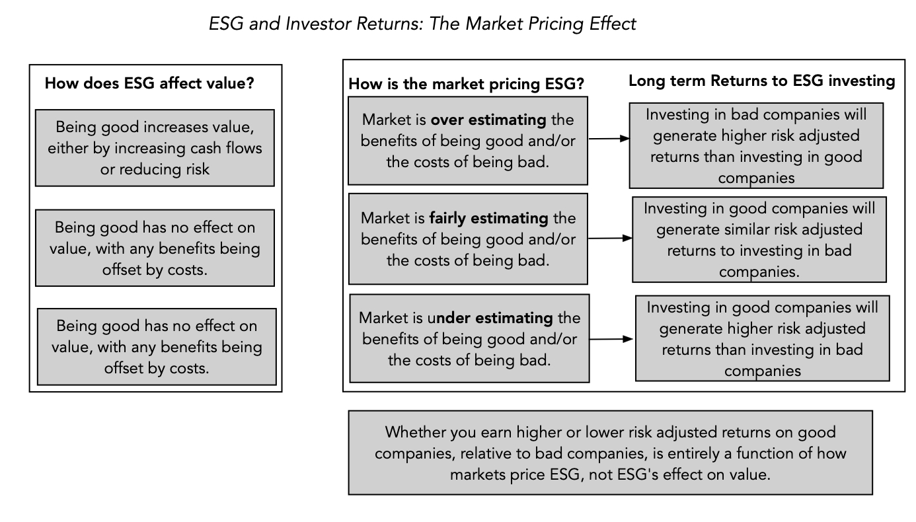
3. The ESG sales pitch is internally inconsistent and fundamentally incoherent

Slide 36
Implications for investing
The first is that it suggests that much of the research on the relationship between ESG and returns yields murky findings. Put simply, there is very little that we learn from these studies, whether they find positive or negative relationships between ESG and investor returns, since much of the linkage comes from ESG’s historical sector focus (on technology), not ESG itself.
The second is that bringing in market pricing does shed some light on perhaps the only aspect of ESG investing that seems to deliver a payoff for investors, which is investing ahead or during market transitions.
If you are interested in making market transitions on ESG work in your favor, you also have to be clear about the strengths you will need to get the payoffs, including skills in divining not only what social values are gaining and losing ground and which changes have staying power.

Slide 37
4. Outsourcing your conscience is a salve, not a solution!
The ESG movement has given each of us an easy way out of having to make choices, by outsourcing these choices to corporate CEOs and investment fund managers, asking them to be “good” for us, while not charging us more for their products and services and delivering above-average returns .
Implicit in the ESG push is the presumption that unless companies that are explicitly committed to ESG, they cannot contribute to society, but that is not true. Good people, through the ages, have always found ways to build in societal good into their decision making.
As I see it, the difference between this “old” model of business and the proposed “new ESG” version is in who does the giving to society, with corporate CEOs and management taking over that responsibility from shareholders. I am not willing to concede, without challenge, that a corporate CEO knows my value system better than I do, as a shareholder, and is better positioned to make judgments on how much to give back to society, and to whom, than I am.

Slide 38
Wanting to do good for society predates ESG…
The notion that until ESG came along, companies (and individuals) are businesses operated without a care for society would be comical, if the people pushing it were not so insistent that it is true.
That is nonsense. People who have wanted to do good have always been able to do so.
  In privately owned businesses, owners have always been free to share their profits or give away their wealth, to meet whatever societal need they felt most strongly about.
  In publicly traded companies, that responsibility fell to the owners of its shares, who again were free to share their winnings with society, in any way they though fit.

Slide 39
Cui Bono? (Who benefits?)

Slide 40
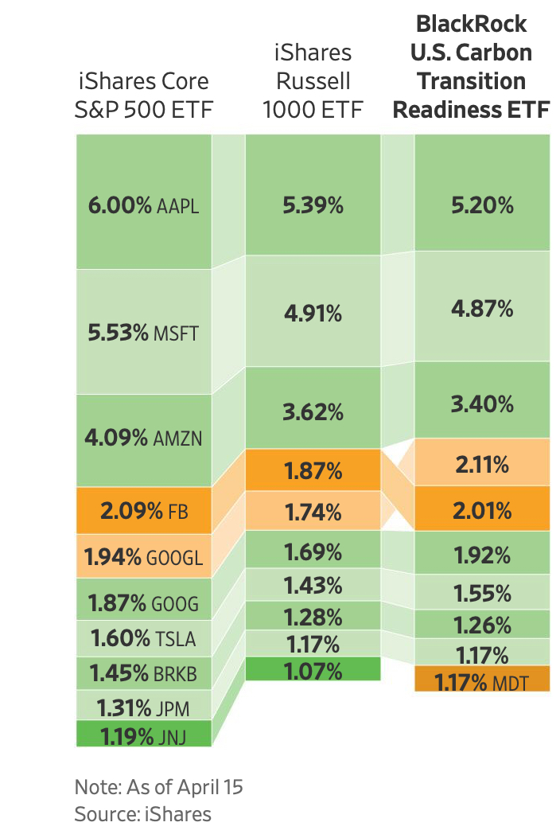
Fake ESG? BlackRock’s Carbon Transition ETF
Blackrock offers a Carbon Transition ETF that is almost identical to its traditional ETFs, in terms of holdings and weights.
It charges five time more (.15%) for the Carbon Transition ETF as fees than it does for its traditional ETFs.

Slide 41
And why it keeps on rolling..
Given that shareholders in companies and investors in funds are paying for this gravy, you may wonder why corporate CEOs not only go along with this charade, but also actively encourage it, and the answer lies in the power it gives them to bypass shareholders and to evade accountability.
After all, these are the same CEOs who, in 2019, put forth the fanciful, but great sounding, argument that it is a company’s responsibility to maximize stakeholder wealth, rather than cater to shareholders, which I argued in a post then that being accountable to everyone effectively meant that CEOs were accountable to no one.
In some cases, flaunting goodness has become a way that founders and CEOs use to cover business model weaknesses and overreach. It is a point that I made in my posts on Theranos, at the time of its implosion in October 2015, and on WeWork, during its IPO debacle in 2019, noting that Elizabeth Holmes and Adam Neumann used their “noble purpose” credentials to cover up fraud and narcissism.

Slide 42
The Payoff for Society
There are some who believe that even if ESG makes firms less valuable and investors make lower returns, it is a net positive for society.
  It is premised on the notion that society has developed a consensus on what comprises goodness.
  It is also based upon the presumption that companies that behave well will create less side costs for society and perhaps even contribute to societal good.
If you accept this proposition, the trade off will be positive for society.

Slide 43
The Law of Unintended Consequences…
As publicly traded companies that are exposed to ESG shaming are forced to divest themselves of their “bad” businesses, it is worth remembering that selling or divesting a business does not erase it from the face of the earth, but just transfers it to a different owner, presumably one is less exposed to the ESG shaming.
In the fossil fuel business, for instance, the pressure on the easily pressured (the big US/European oil companies) has led them to cut back on investments in the fossil fuel space.
  That absence of investment is and will continue to push up the price of fossil fuels, making their production more profitable.
  A subset of the investments are now being made by foreign companies (in markets where stockholders has little power) or private equity funds.

Slide 44
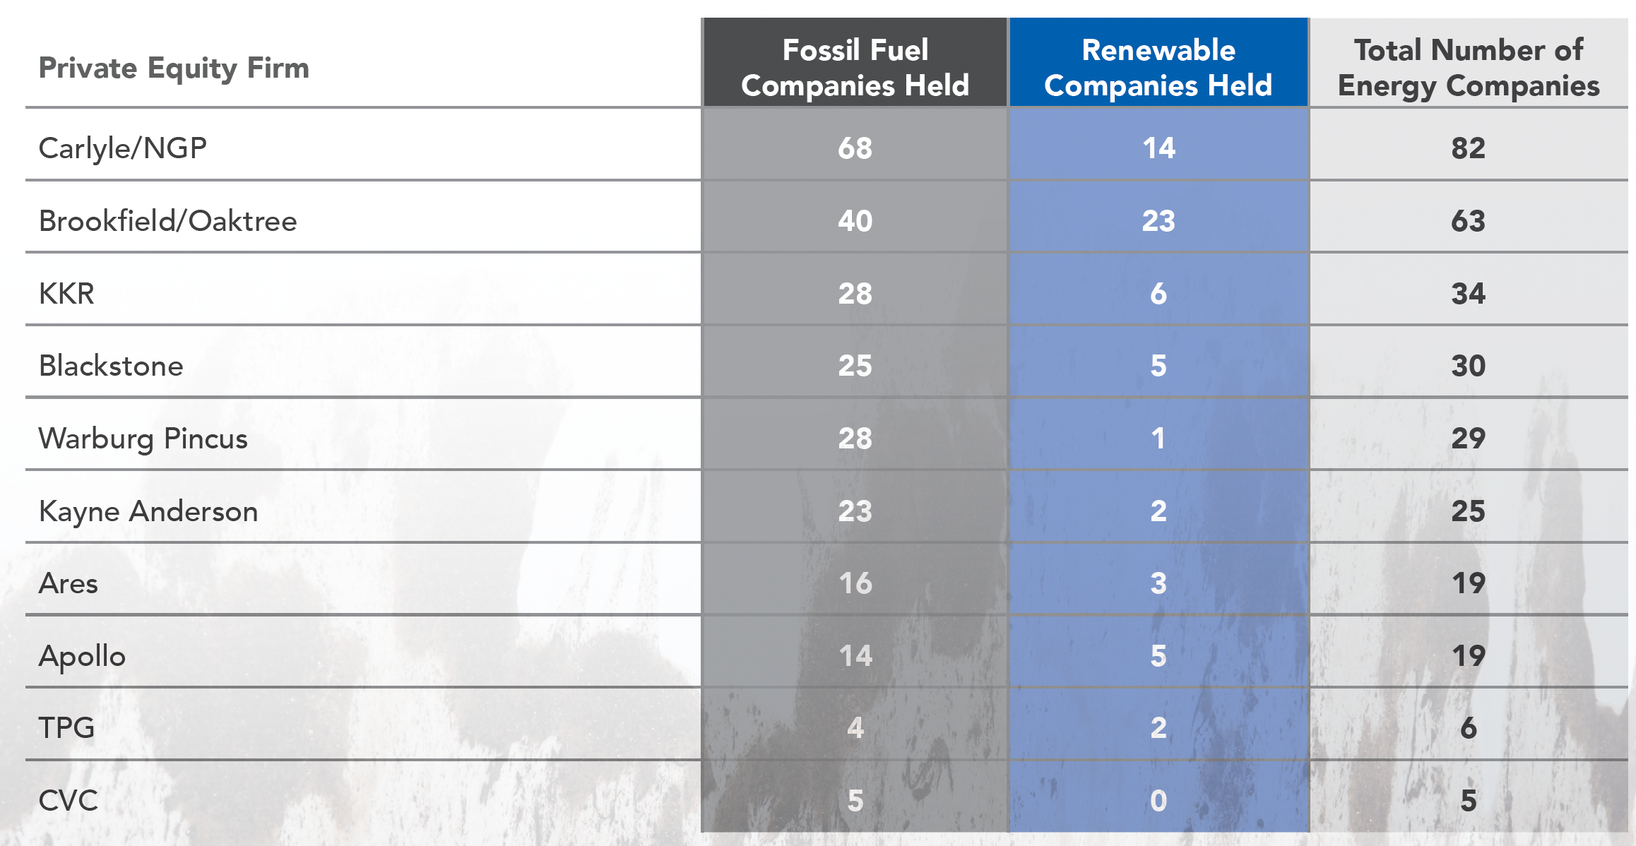
Private Equity in Fossil Fuels
Between 2010 and 2020, private equity funds have invested a trillion dollars in fossil fuel investments…

Slide 45
Rising costs of fossil fuel…
As ESG pressures amp up on publicly traded fossil fuel companies, especially in the US and Europe, to reduce exploration and production of fossil fuels, the laws of demand and supply have created a predictable consequence, which is higher prices for these fossil fuels (gas and oil).
While ESG advocates may view this as a win, it is worth remembering that 80% of global energy still comes from fossil fuels, and that the people who are most exposed to price increases are not the well off, urban advocates of ESG but the people who are least well off (within countries and across countries).

Slide 46
A Roadmap for being and doing good
Start with a personalized measure of goodness, and don’t overreach: The key with moral codes is that they are personal, and you have to bring in your value judgments into your decisions, rather than leave it to ESG measurement services or to portfolio managers.
As a business person, be clear on how being good will affect business models and value: If you own a business, you are absolutely within your rights to bring your personal views on morality into your business decisions, but you should be at peace with the fact that staying true to your values may, and probably will, cost you money. If you are making decisions at a publicly traded company, as an employee, manager or even CEO, you are investing other people’s money and if you choose to make decisions based upon your moral code, you have to be open about what your conscience will cost your shareholders.
As an investor, understand how much goodness has been priced in: If you are an investor, you don’t have to compromise on your values, as long as you realize, at least in the long term, you will have to accept lower returns. Goodness requires sacrifice!
As a consumer and citizen, make choices that are consistent with your moral code: Your consumption decisions (on which products and services you buy) and your citizenship decisions (on voting and community participation) have as big, if not greater, an effect.

Slide 47
And in conclusion..
On a personal note, I have always found that the people that I've known who do good, spend very little time talking about being good or lecturing other people on goodness. I would extend that perspective to companies and investment funds as well, and I reserve my skepticism for those companies that spend hundreds of pages of their annual filings telling me how much "good" they do.
The ESG movement’s biggest disservice is the sense that it has given those who are torn between morality and money, that they can have it all. Telling companies that being good will always make them more valuable, investors that they can add morality constraints to their investments and earn higher returns at the same time, and young job seekers that they can be paid like bankers, while doing peace corps work, is delusional.
In the long term, as the truth emerges, it will breed cynicism in everyone involved, and if you care about the social good, it will do more damage than good. The truth is that, most of the time, being good will cost you and/or inconvenience you (as businesses, investors or employees), and that you choose to be good, in spite of that concern.

