Slide 1
In Practice webcast: Valuing Control
Aswath Damodaran

Slide 2
The Value of Control
The value of controlling a firm derives from the fact that you believe that you or someone else would operate the firm differently (and better) from the way it is operated currently.
The expected value of control is the product of two variables:
  the change in value from changing the way a firm is operated
  the probability that this change will occur

Slide 3
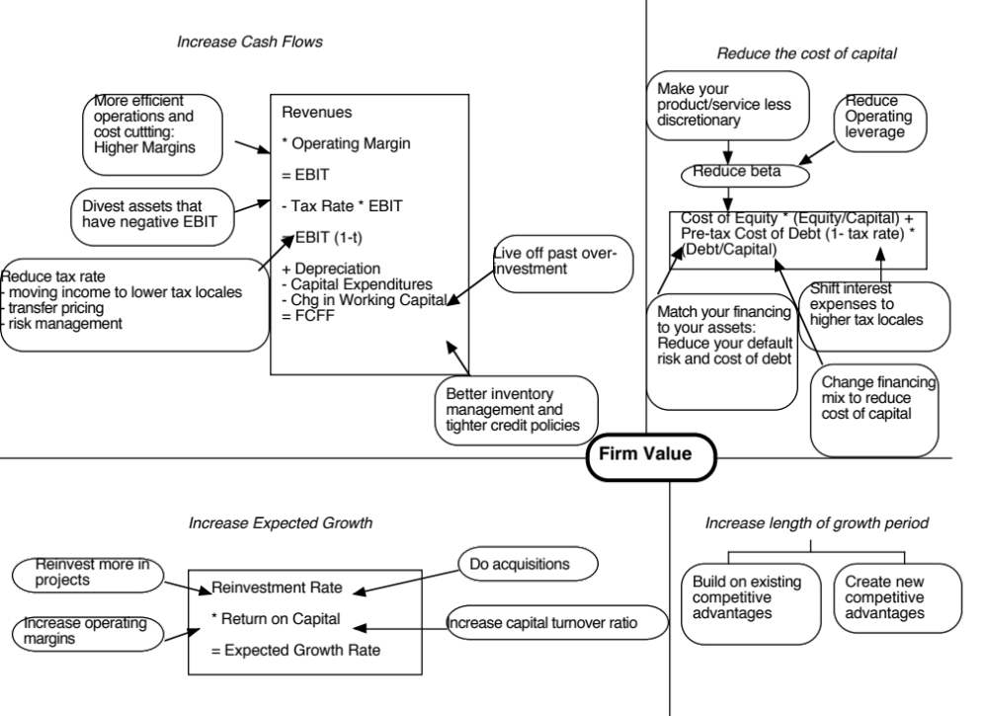
Optimal Debt Ratio
Operating Margin
Effective Tax Rate
Working Capital/Sales
Revenue Growth
Return on Capital
Reinvestment Rate
Excess Returns

Slide 4
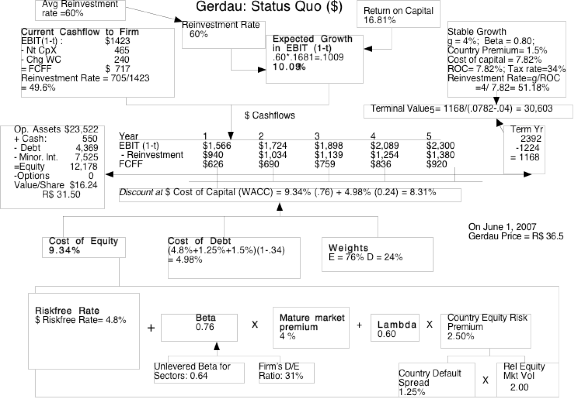

Slide 6
An Assessment of Gerdau: Where is there most promise?
If you were running Gerdau, where do you see the most promise in value enhancement?
Increase cash flows from existing assets (Current margin = 19.5%; Tax rate = 34%; Non-cash WC = 18.33%)
Increase growth rate during high growth period (Reinvestment rate = 60%, Return on capital = 16.81%; Growth rate = 10.09%)
Increase length of growth period (5 years)
Reduce cost of capital (Debt ratio = 24%)

Slide 7
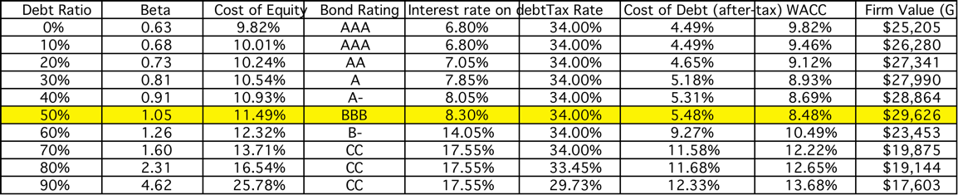
Gerdau : Optimal Capital Structure

Slide 8
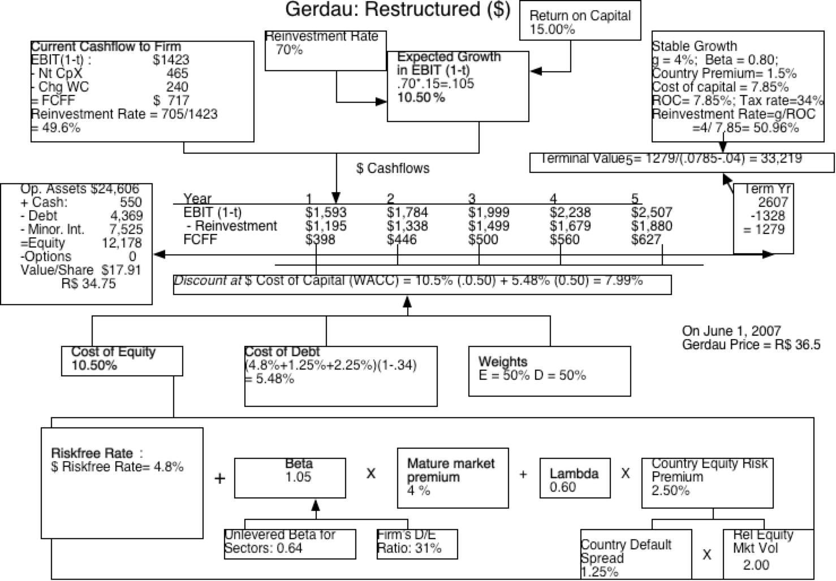

Slide 9
An Assessment of Genting Berhad
If you were running Genting Berhad, where do you see the most promise in value enhancement?
Go for more revenue growth: Revenue growth is only 5%. Increasing it may push up value.
Increase operating margins to the average(27.9%) generated over the last decade.
Change mix of debt, type of debt, to lower cost of capital. (Genting is close to its optimal debt ratio currently, with an actual debt ratio of 34% and an optimal debt ratio of 30%)
Sell of assets (especially real estate) that have higher alternative value uses.
Of these, the action with the most potential for value change is to push to improve operating margins.

Slide 11
The Probability of Changing Control
The probability of changing management will be different across different companies and will vary across different markets.
In general, the more power stockholders have and the stronger corporate governance systems are, the greater is the probability of management change for any given firm.
The probability of changing management will change over time as a function of legal changes, market developments and investor shifts.

Slide 12
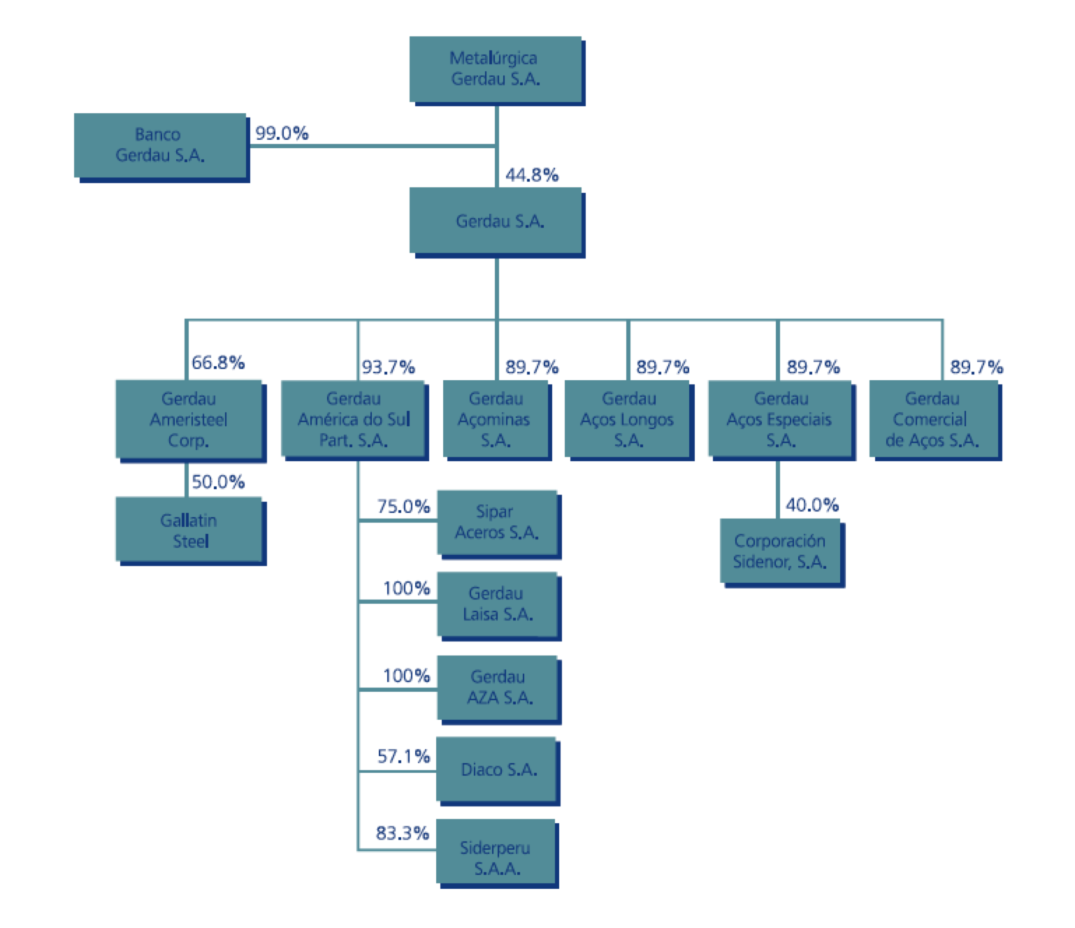
Gerdau’s Cross Holdings…

Slide 13
Genting Berhad: Change Probability
As a Malaysian company, with a web of companies holding shares in each change, change will be difficult, unless one of the leading stockholders signs on, or management has a change of heart.
The probability of change is low, but not zero. There is also the possibility that an acquirer may find the company attractive for its turn around potential.

Slide 14
Bottom Line
There is only a moderate value of control at Gerdau Steel in 2007, because the company was for the most part, well run. Even if you believed that there was value to controlling Gerdau, the expected value of control would have been close to zero, since the holding structure of Gerdau would have made it almost impossible to change the way the firm was run.
At Genting Berhad, in 2016, the value of control and the expected value of control are both much higher.

