Slide 1
In Practice webcast: Optimal Debt ratio Special cases
Aswath Damodaran

Slide 2
Optimizing Debt: Earnings as a Driver
In the cost of capital and adjusted present value approaches, it is a company’s capacity to generate operating income that determines it debt capacity.
With negative or very low operating income, the benefits of debt dissipate, because
  There are no tax benefits from interest expenses without the income to offset them against.
  The synthetic ratings collapses quickly, as interest coverage ratios turn negative.
  The cost of equity also rises faster, since the levered beta does not get the partial protection that taxes offer.
If you are wondering why it is not EBITDA, but EBIT, that determines optimal debt ratio, a company that is a going concern with growing earnings will have to reinvest the DA back as cap ex to keep itself going.

Slide 3
Using last year’s earnings
When computing optimal debt ratios, it is natural to latch on to the most recent year’s financial statements, and use the operating income from that year. After all, it is the most updated value that you have on that metric.
This can create problems with
  Commodity or Cyclical companies, where earnings go through cycles of down and up years.
  Companies that had a really good or bad year, for transient reasons.
  Companies that play operating income games, moving non operating income into the operating income column or claiming non operating expenses as operating expenses.

Slide 4
With cyclical companies, it is best to determine debt capacity with normal income
With cyclical companies, earnings will track the economy, looked abnormally high in boom years and abnormally low or negative in recession years.
Since you are making a judgment on debt capacity for the long term, you should be borrowing on income that you can generate across a cycle, not just the most recent year.
To normalize,
  Go back over time to cover an entire cycle, or better still, more than one economic cycle.
  You can average across the cycle, using
    Average absolute earnings, for firms that are stable
    Average pre-tax operating margin for firms which are growing or shrinking. Your normalized income can be estimated by multiplying revenues in the most recent year by the pre-tax operating margin.

Slide 5
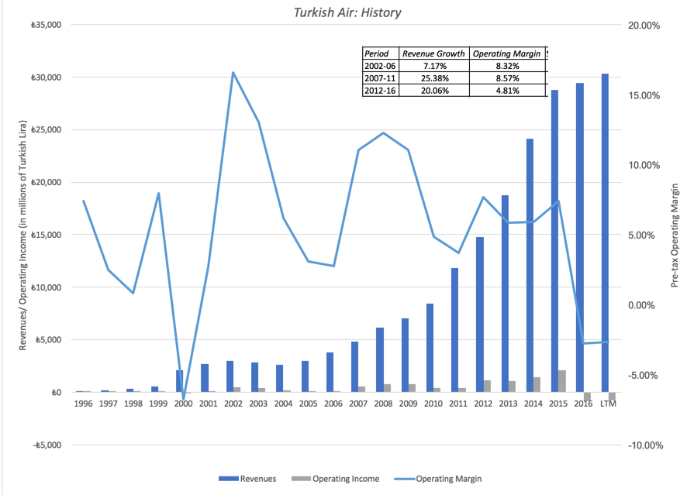
Turkish: Ups and Downs, with Growth Ambitions!
Operating Margin | Optimal
Current | 0%
2012-2016 | 10%
2007-2011 | 30%
2002-2006 | 40%

Slide 6
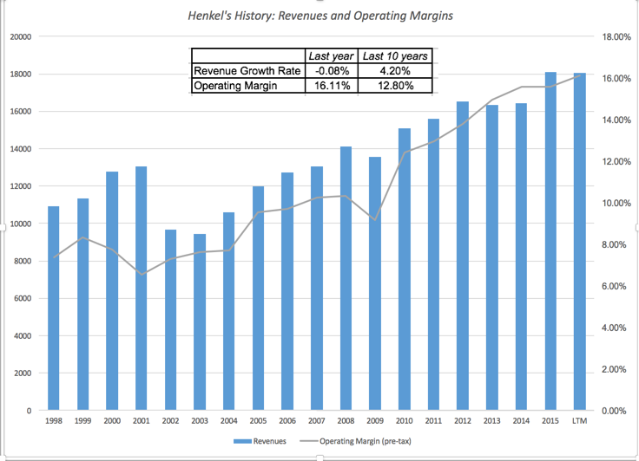
Henkel: Margin Compression?
Operating Margin | Optimal
Current | 40%
Average (Last 10 years) | 30%

Slide 7
PZ Cussons Nigeria: Country and Currency Risk Overlay
Operating Margin | Optimal
2001-2007 level | 40%
2009-2016 level | 20%
Current | 0%

Slide 8
With commodity companies, it is trickier..
If you believe that commodity cycles are short and predictable, you can use the same normalization approach that you would use for cyclical companies, either averaging earnings or margins over a cycle.
If you feel that commodity cycles are very long term and/or unpredictable, you can do one of two things:
  Compute operating income that you would have at a “conservative” commodity price, normalizing earnings to reflect that commodity price.
  Compute operating income at today’s commodity price, compute an optimal based on that number, and then build a buffer by setting your actual below the optimal.

Slide 9
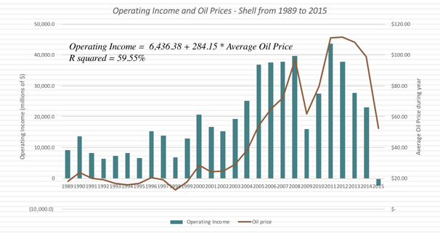
Royal Dutch: The Oil Price Driver
Oil Price | Optimal Debt Ratio
$30 | 10%
$40 | 20%
$50 | 20%
$60 | 30%
$70 | 40%
$80 | 40%
$90 | 50%

Slide 10
With companies playing operating earnings games..
If an extraordinary or one-time item is causing the earnings to be too low or too high, estimate the earnings without that item and compute the optimal debt ratio, with the re-estimated operating income.
If the item that is distorting earnings is not one-time, but is causing distortions every year, re-compute the earnings without that item over time and us the normalization approaches mentioned earlier.
One simple way of checking is to compare the company’s margins to the sector averages and if they are wildly different, you may consider using the sector average or a number closer to it, in computing the optimal.

