Slide 1
OPTIMAL FINANCING MIX I: THE TRADE OFF
Neither a borrower nor a lender be! Good or bad advice?
Notes:
Sets the agenda for the class. This is a class that will be focused on the big picture of corporate finance rather than details, theories or models on a piecemeal basis.

Slide 2
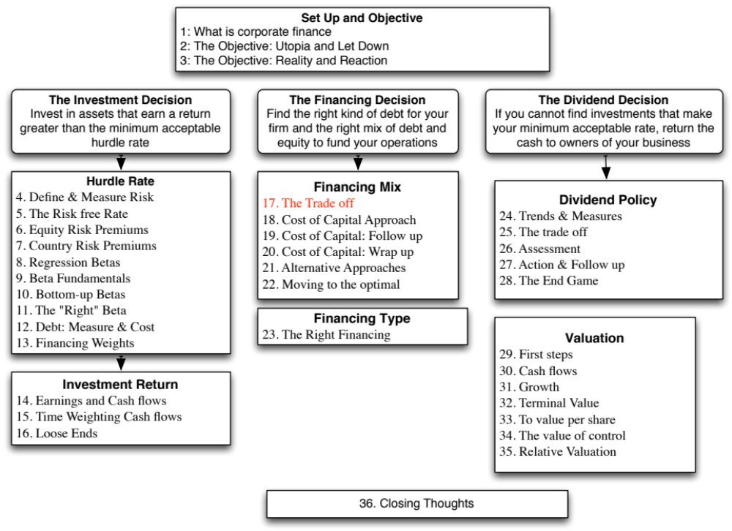

Slide 3
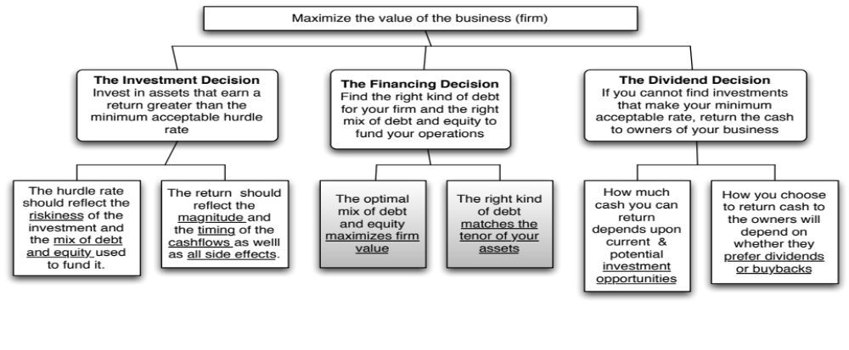
First Principles
Notes:
We shift from the investment principle to the financing principle.

Slide 4
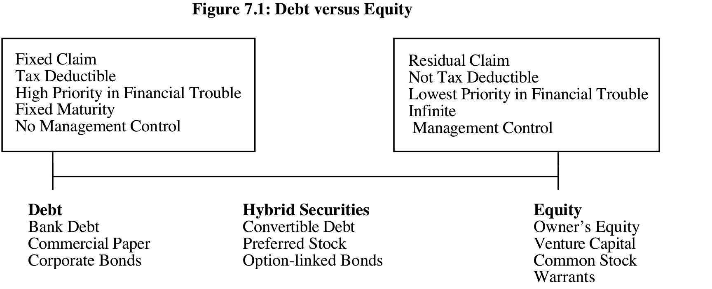
Debt or Equity: The Continuum
The simplest measure of how much debt and equity a firm is using currently is to look at the proportion of debt in the total financing. This ratio is called the debt to capital ratio:
Debt to Capital Ratio = Debt / (Debt + Equity)
In general, this ratio should be computed using market values for both debt and equity, and include all debt.
Notes:
Rather than categorizing financing based on what it is called or categorized as by accountants, we should be thinking whether financing is debt or equity by looking at the following questions:
1. Are the payments on the securities contractual or residual?
If contractually set, it is closer to debt.
If residual, it is closer to equity.
2. Are the payments tax-deductible?
If yes, it is closer to debt.
If no, if is closer to equity.
3. Do the cash flows on the security have a high priority or a low priority if the firm is in financial trouble?
If it has high priority, it is closer to debt.
If it has low priority, it is closer to equity.
4. Does the security have a fixed life?
If yes, it is closer to debt.
If no, it is closer to equity.
5. Does the owner of the security get a share of the control of management of the firm?
If no, it is closer to debt.
If yes, if is closer to equity

Slide 5
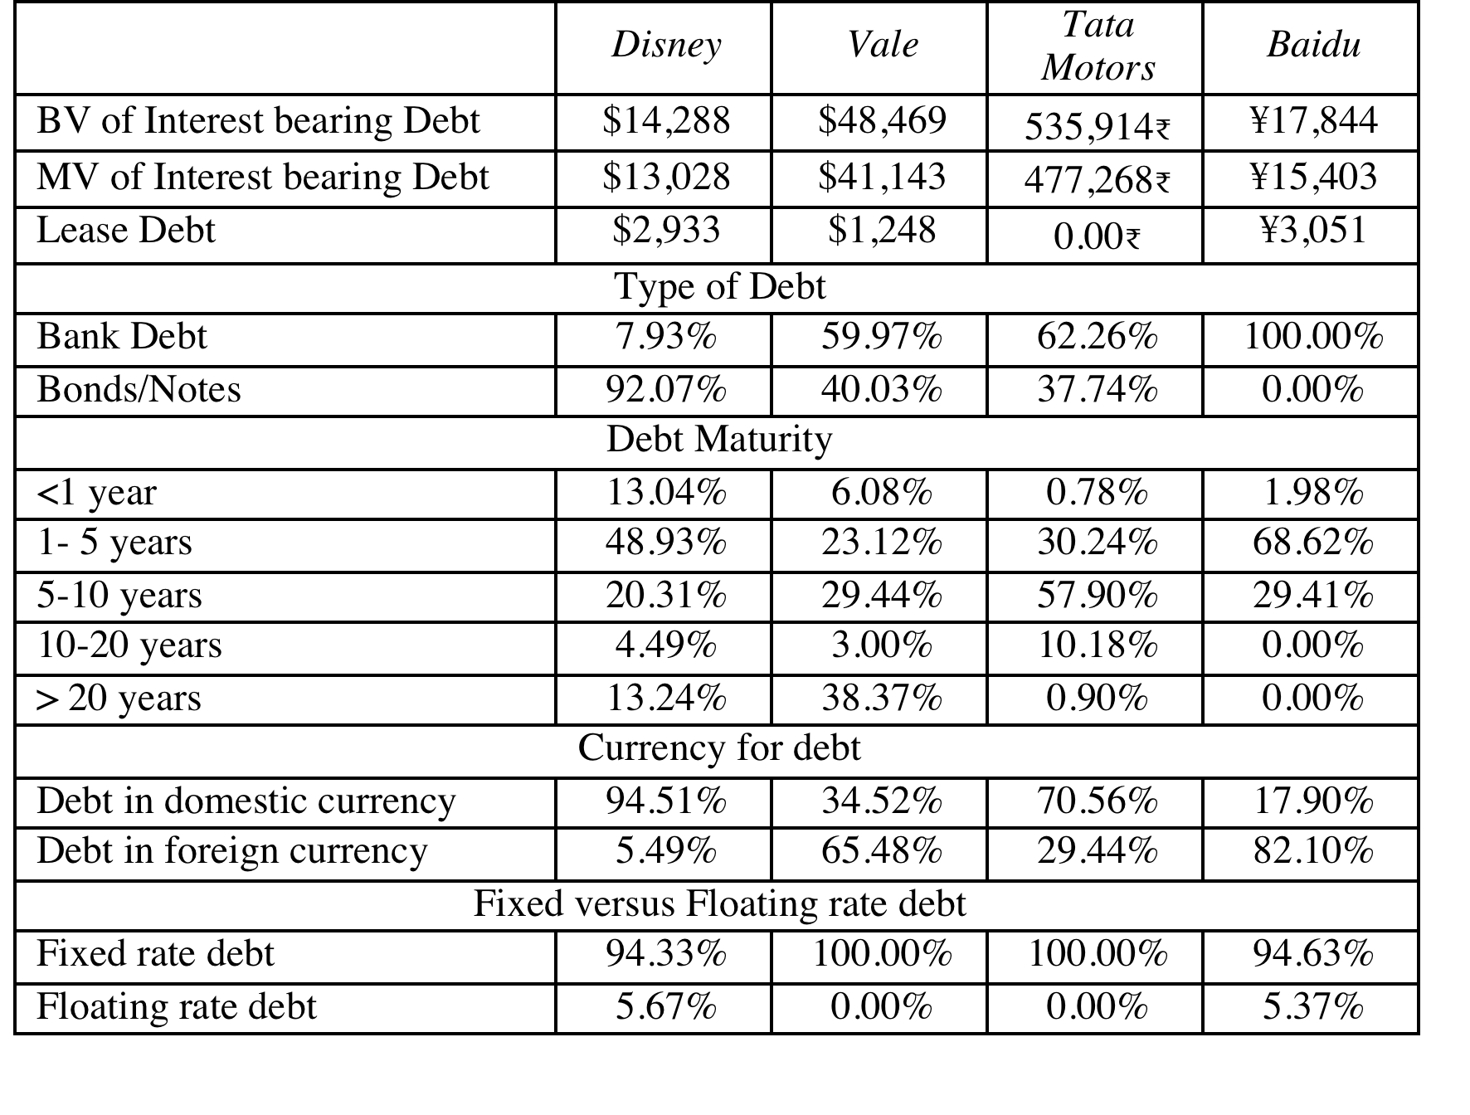
Assessing the existing financing choices: Disney, Vale, Tata Motors & Baidu
Notes:
Disney used the corporate bond market much more extensively than the other companies in this group, with 92% of its debt coming from bonds rather than bank loans.
While Disney has the higher proportion of short term debt of the three companies, it also has some very long term debt. That may also be a reflection of its use of the bond market, since banks, especially in emerging markets, may be unwilling to commit to long term loans.
Disney and Tata Motors both use floating rate debt, but only to a limited extent.
Disney & Tata Motors borrow predominantly in their domestic currencies. Vale and Baidu have most of their debt in foreign currencies.

Slide 6
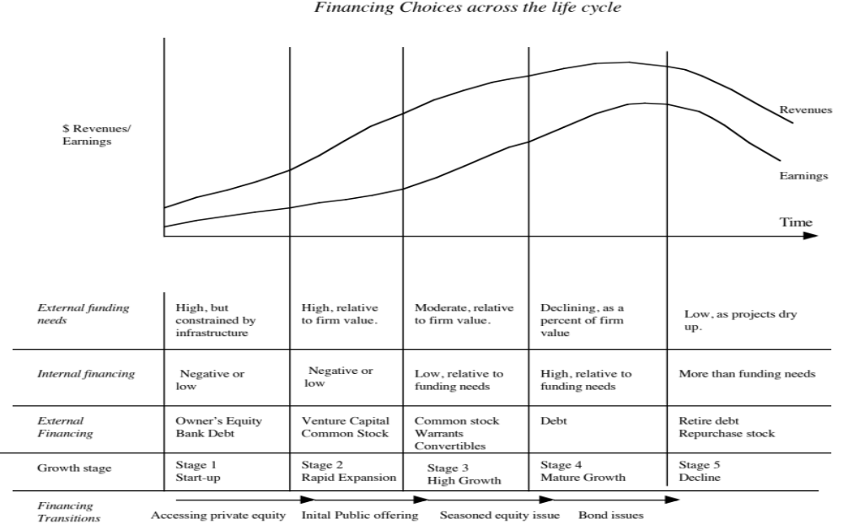
Notes:
The forms that debt and equity take will change as a firm moves through its lifecycle. Early in the process, equity will take the form of owner’s wealth or savings and debt will be bank debt. As the firm evolves, the equity choices will expand first to include venture capital and private equity. When the firm goes public, its choices expand further.
There are three transitional periods: (1) Going from being a private business entirely funded by the owner to accessing the private equity markets (venture capital) (2) Going from private to public with an initial public offering and (3) Public companies making seasoned offerings of debt and equity.

Slide 7

Debt: Summarizing the trade off
Notes:
Brings together the costs and the benefits of debt, with the implications.

Slide 8
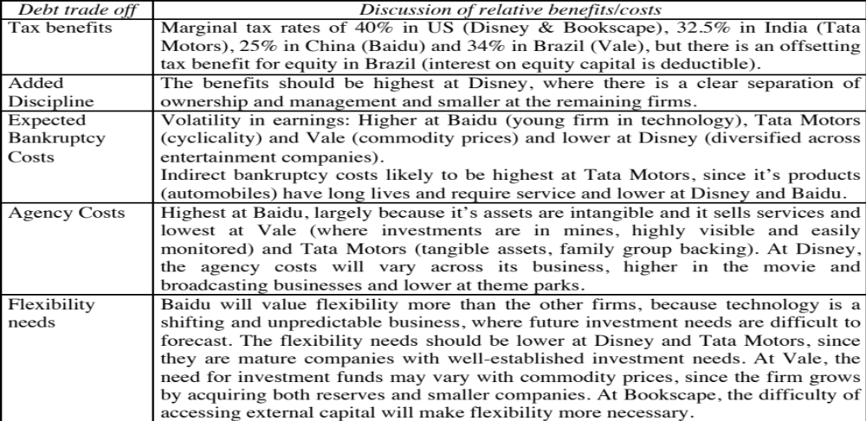
The Trade off for Disney, Vale, Tata Motors and Baidu
Notes:
None of these firms seems like a candidate for a really high debt ratio. With each firm, one or another cost gets in the way.
For Disney, the biggest impediments to borrowing more are the variability of its income and the fact that its assets are mostly “intangible” and difficult to monitor.
For Aracruz, it is the variability in paper prices.
For Tata Chemicals, it is the cross holding structure and the fear that the debt will be channeled to other subsidiaries.
Notwithstanding these issues, I would expect Disney to have more debt than other entertainment companies because it is larger and more diverse than its competitors. I would also expect to see significant debt on both Tata’s and Aracruz’s balance sheets, given the tax benefits.

Slide 9
6Application Test: Would you expect your firm to gain or lose from using debt?
Consider, for your firm,
  The potential tax benefits of borrowing
  The benefits of using debt as a disciplinary mechanism
  The potential for expected bankruptcy costs
  The potential for agency costs
  The need for financial flexibility
Would you expect your firm to have a high debt ratio or a low debt ratio?
Does the firm’s current debt ratio meet your expectations?
Notes:
This is just a qualitative analysis. It will not give you a specific optimal debt ratio but provides insight into why the firm may be using the financing mix that it is today.

Slide 10
A Hypothetical Scenario
Assume that you live in a world where
  (a) There are no taxes
  (b) Managers have stockholder interests at heart and do what’s best for stockholders.
  (c) No firm ever goes bankrupt
  (d) Equity investors are honest with lenders; there is no subterfuge or attempt to find loopholes in loan agreements.
  (e) Firms know their future financing needs with certainty
Benefits of debt | Costs of debt
Tax benefits | Expected Bankruptcy Cost
Added Discipline | Agency Costs
 | Need for financial flexibility
Notes:
Assume that you super impose these assumptions on the balance sheet on the previous page. The advantages of debt go to zero, as do the disadvantages. Under such a scenario, firms should be indifferent to issuing debt.

Slide 11
The Miller-Modigliani Theorem
In an environment, where there are no taxes, default risk or agency costs, capital structure is irrelevant.
In this world,
  Leverage is irrelevant. A firm's value will be determined by its project cash flows.
  The cost of capital of the firm will not change with leverage. As a firm increases its leverage, the cost of equity will increase just enough to offset any gains to the leverage
Notes:
With the assumptions on the previous page:
The cost of capital will remain unchanged as the debt ratio changes
The value of the firm will not be a function of leverage
Investment decisions can be made independently of financing decisions
Note that if we allow for tax benefits, and keep the other assumptions, the optimal debt ratio will go to 100%.

Slide 12

Task
Evaluate the trade off on debt & equity for your company.
Read
Chapter 7

