Slide 1
RELATIVE VALUATION
It’s all relative.

Slide 2
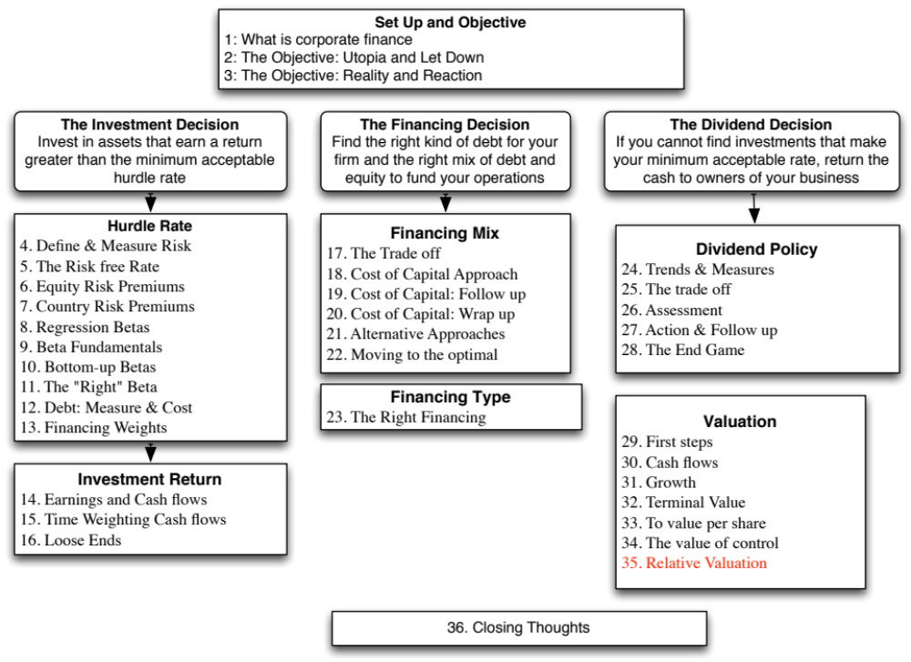

Slide 3
The Essence of relative valuation?
In relative valuation, the value of an asset is compared to the values assessed by the market for similar or comparable assets.
To do relative valuation then,
  we need to identify comparable assets and obtain market values for these assets
  convert these market values into standardized values, since the absolute prices cannot be compared This process of standardizing creates price multiples.
  compare the standardized value or multiple for the asset being analyzed to the standardized values for comparable asset, controlling for any differences between the firms that might affect the multiple, to judge whether the asset is under or over valued
Notes:
These are the three ingredients you find in almost every equity research report - comparables, a multiple (or standardized price) and a story (which represents the attempt to control for differences).

Slide 4
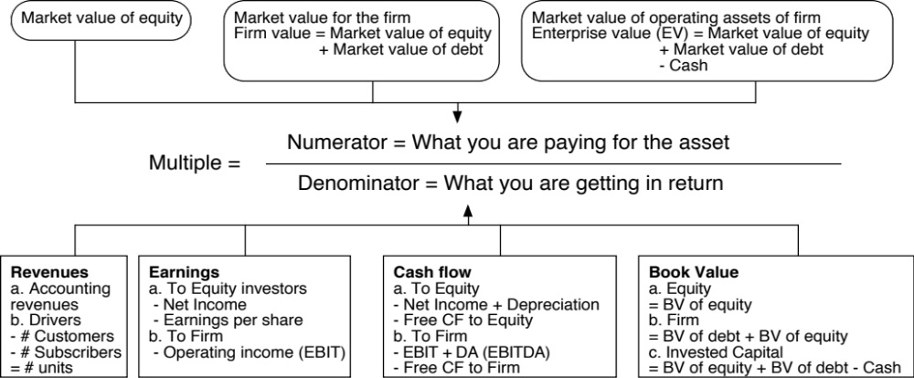
Multiples are just standardized estimates of price…
Notes:
The distinction between price (representing equity value) and value (representing the combined market value of equity and debt) and enterprise value (representing firm value - cash and marketable securities) should be noted.
Note that the denominator can be a number from the income statement (revenues, earnings) or one from the balance sheet (book value). It can even be a non-financial input (number of employees or units of the product produced).

Slide 5
The Four Steps to Deconstructing Multiples
Define the multiple
  In use, the same multiple can be defined in different ways by different users. When comparing and using multiples, estimated by someone else, it is critical that we understand how the multiples have been estimated
Describe the multiple
  Too many people who use a multiple have no idea what its cross sectional distribution is. If you do not know what the cross sectional distribution of a multiple is, it is difficult to look at a number and pass judgment on whether it is too high or low.
Analyze the multiple
  It is critical that we understand the fundamentals that drive each multiple, and the nature of the relationship between the multiple and each variable.
Apply the multiple
  Defining the comparable universe and controlling for differences is far more difficult in practice than it is in theory.
Notes:
While we can rail about the fact that a valuation based upon multiples is not as detailed as a discounted cashflow valuation,, the reality is that analysts will continue to use multiples to value companies and that we will often have to use these valuations.
Given this reality, we have to think about how best to use multiples. These four steps represent a way in which we can deconstruct any multiple, understand how to use it well and discover when it is being misused.

Slide 6
Definitional Tests
Is the multiple consistently defined?
  Proposition 1: Both the value (the numerator) and the standardizing variable ( the denominator) should be to the same claimholders in the firm. In other words, the value of equity should be divided by equity earnings or equity book value, and firm value should be divided by firm earnings or book value.
Is the multiple uniformly estimated?
  The variables used in defining the multiple should be estimated uniformly across assets in the “comparable firm” list.
  If earnings-based multiples are used, the accounting rules to measure earnings should be applied consistently across assets. The same rule applies with book-value based multiples.
Notes:
Consistent definition:
Consider two widely used multiples that are consistently defined. In the price-earnings ratio (PE), the numerator is equity value per share and the denominator is equity earnings per share. In the enterprise value/ EBITDA multiple, the numerator is firm value and the denominator is a pre-tax cash flow to all claimholders in the firm. In contrast, the price to EBITDA multiple is inconsistent. Why is this a problem? If you are comparing firms with different debt ratios, the firms will more debt will look cheaper on a price to EBITDA basis.
Uniformally Estimated:
This is actually much more difficult than it looks. Even if accounting standards are the same across firms, you run into two problems:
The degree to which firms bend accounting rules for their own purposes varies across firms. Some firms are inherently more conservative in reporting earnings than others.
The financial year ends at different points for different firms. If the denominator is the earnings in the most recent financial year, the multiple may not be comparable if some firms have December year-ends and some have June year-ends.

Slide 7
Example 1: Price Earnings Ratio: Definition
PE = Market Price per Share / Earnings per Share
There are a number of variants on the basic PE ratio in use. They are based upon how the price and the earnings are defined.
Price: is usually the current price
is sometimes the average price for the year
EPS: EPS in most recent financial year
EPS in trailing 12 months (Trailing PE)
Forecasted EPSnnext year (Forward PE)
Forecasted EPS in future year
Notes:
This is only the tip of the iceberg. You can have EPS before and after extraordinary items, primary and diluted EPS..
When you are negotiating with someone else and you are both using PE ratios to make your case, the first step is to make sure that you are using the same PE ratio.
There is also the tendency on the part of analysts to pick the definition of pE that best fits their biases. For instance, bullish analysts in the 1990s almost always used forward PE whereas bearish analysts used trailing PE. Since earnings were rising the former were generally much lower than the latter.

Slide 8
Example 2: Enterprise Value /EBITDA Multiple
The enterprise value to EBITDA multiple is obtained by netting cash out against debt to arrive at enterprise value and dividing by EBITDA.
Why do we net out cash from firm value?
What happens if a firm has cross holdings which are categorized as:
  Minority interests?
  Majority active interests?
Notes:
The problem with using firm value is that cash is included in the numerator but not in the denominator. That is why the enterprise value version makes more sense…
A broad problem is posed when firms have holdings in other firms. If such holdings are passive, Value to EBITDA multiples will be overstated, since the numerator will include the value of your holdings, while the EBITDA will not include any of the income from these holdings. If such holdings are majority active and consolidated, the value to EBITDA will be understated because the numerator will include only the portion of the equity you own in the subsidiary but the EBITDA will include all of the EBITDA in the subsidiary.
The safest thing to do (assuming you can do this) is to net out the market value of your holdings from the numerator (for both active and passive holdings) and the EBITDA of your holdings from the denominator ( for majority active holdings)

Slide 9
Descriptive Tests
What is the average and standard deviation for this multiple, across the universe (market)?
What is the median for this multiple?
  The median for this multiple is often a more reliable comparison point.
How large are the outliers to the distribution, and how do we deal with the outliers?
  Throwing out the outliers may seem like an obvious solution, but if the outliers all lie on one side of the distribution (they usually are large positive numbers), this can lead to a biased estimate.
Are there cases where the multiple cannot be estimated? Will ignoring these cases lead to a biased estimate of the multiple?
How has this multiple changed over time?
Notes:
Before you use a multiple and develop rules of thumb (8 times EBITDA is cheap), you need to get a sense of the cross-sectional distribution.
Multiples have skewed distributions. Because a multiple cannot be less than zero but can potentially be infinite, the averages for multiples will be much higher than their medians, and the difference will increase as the outliers become larger. Many services cap outliers to prevent them from altering the averages too much, results…
The PE ratio cannot be estimated when the earnings per share are negative. Thus, if you have a sample of 20 firms and 10 have negative earnings, you will be able to compute the PE ratio for only the 10 that have positive earnings and will throw out the remaining firms. This will induce a bias in your sample. One way to avoid this is to take the cumulative values for market capitalization and net income for all 20 firms, and compute a PE ratio based upon the cumulated values. The resulting PE ratio will generally be much higher….

Slide 10
Multiples have skewed distributions…
Notes:
This graph for all U.S. firms with data available on the Value Line CD ROM (contains about 7200 firms in the overall sample). Notice that the distributions are skewed to the left and that we have capped the PE ratios at 100….

Slide 11
Analytical Tests
What are the fundamentals that determine and drive these multiples?
  Proposition 2: Embedded in every multiple are all of the variables that drive every discounted cash flow valuation - growth, risk and cash flow patterns.
  In fact, using a simple discounted cash flow model and basic algebra should yield the fundamentals that drive a multiple
How do changes in these fundamentals change the multiple?
  The relationship between a fundamental (like growth) and a multiple (such as PE) is seldom linear. For example, if firm A has twice the growth rate of firm B, it will generally not trade at twice its PE ratio
  Proposition 3: It is impossible to properly compare firms on a multiple, if we do not know the nature of the relationship between fundamentals and the multiple.

Slide 12




PE Ratio: Understanding the Fundamentals
To understand the fundamentals, start with a basic equity discounted cash flow model.
With the dividend discount model,
Dividing both sides by the current earnings per share,
If this had been a FCFE Model,
Notes:
To get to the heart of equity multiples, we start with an equity DCF model. In this case, we consider the simplest equity valuation model - a stable growth dividend discount model. Restated in terms of the PE ratio, we find that the PE ratio fo a stable growth firm can be written in terms of three variables:
The expected growth rate in earnings per share
The riskiness of the equity, which determines the cost of equity
The efficiency with which the firm generates growth,which is measured by how much the firm can pay out or afford to pay out after reinvested to create the growth.

Slide 13
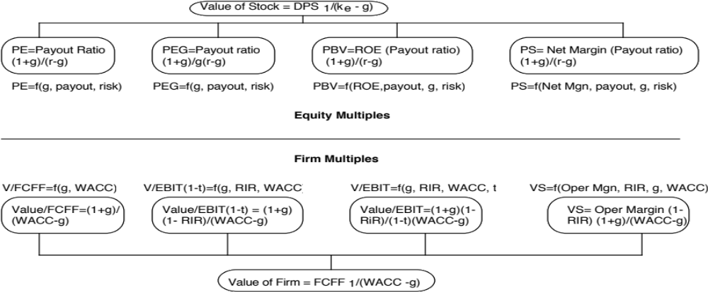
The Determinants of Multiples…

Slide 14
Application Tests
Given the firm that we are valuing, what is a “comparable” firm?
  While traditional analysis is built on the premise that firms in the same sector are comparable firms, valuation theory would suggest that a comparable firm is one which is similar to the one being analyzed in terms of fundamentals.
  Proposition 4: There is no reason why a firm cannot be compared with another firm in a very different business, if the two firms have the same risk, growth and cash flow characteristics.
Given the comparable firms, how do we adjust for differences across firms on the fundamentals?
  Proposition 5: It is impossible to find an exactly identical firm to the one you are valuing.
Notes:
In practice, we all too often define comparable as a firm in the same industry or business. This is too narrow a definition. You can have firms in different businesses that have similar cashflow, growth and risk characteristics. These firms can be viewed as comparable firms.
You will never find two identical firms, no matter how hard you search. You therefore have to always control for the residual differences when making comparisons.

Slide 15
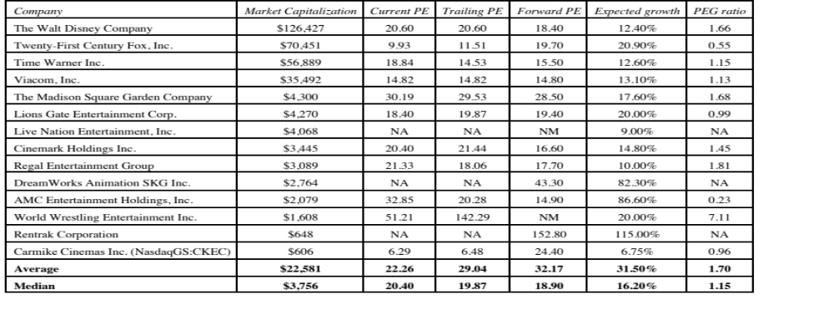
An Example: Comparing PE Ratios across a Sector
Notes:
In this sample, note that some of the firms in the sample are emerging market firms any may be exposed to more risk (political risk, economic risk, inflation risk…)

Slide 16
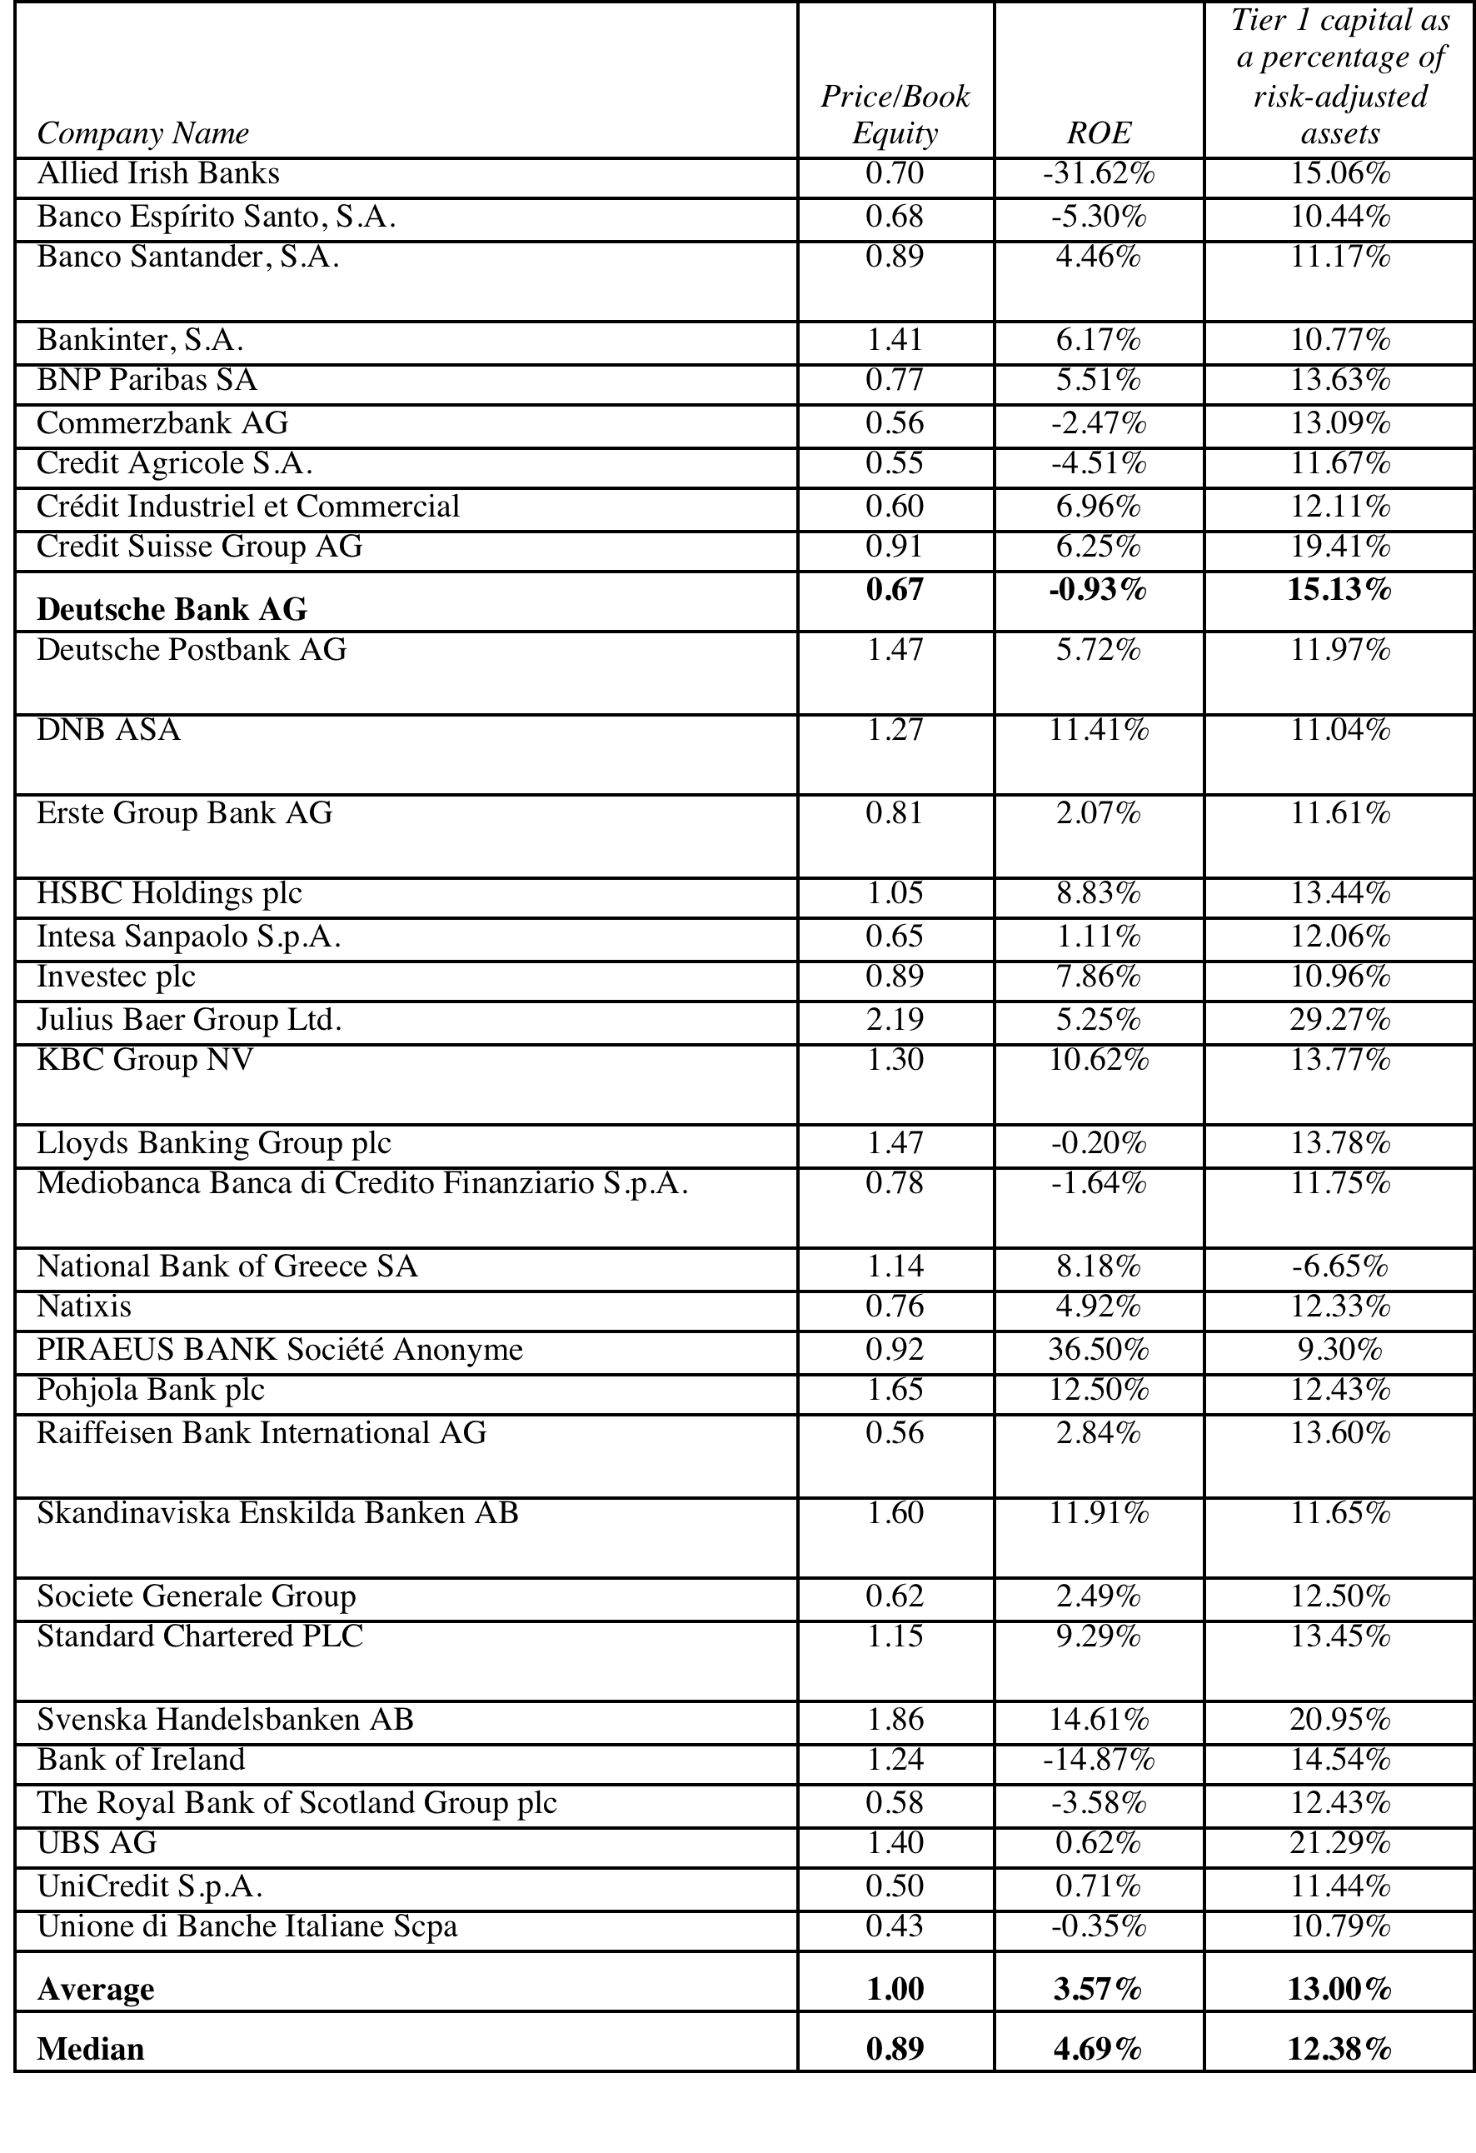
Another example: European Banks

Slide 17
Is Deutsche Bank cheap?
Trading at 0.67 times book equity, Deutsche looks cheap, relative to the rest of the sector. However, part of the reason for this may be its low return on equity of -0.93% in 2013.
Because these firms differ on both capital policy and return on equity, we run a regression of PBV ratios on both variables:
  PBV = 0.48 + 1.58 ROE + 3.55 Tier 1 capital ratio R² = 23.66%
  (2.63) (2.44) (2.76)
The predicted PBV ratio for Deutsche Bank, based on its return on equity of -0.93 percent and its tier 1 capital ratio of 15.13%, would be 1.003.
Predicted PBV_{Deutsche Bank} = 0.48 + 1.58 (-0.0093) + 3.55 (.1513) = 1.003
Because the actual PBV ratio for Deutsche Bank at the time of the analysis was 0.67, this would suggest that the stock is under valued, relative to other banks.

Slide 18

Task
Given how the sector in which your firm operates is being priced, estimate a relative value for your firm.
Read
Chapter 12

