Slide 1
Financial Statement Analysis

Slide 2
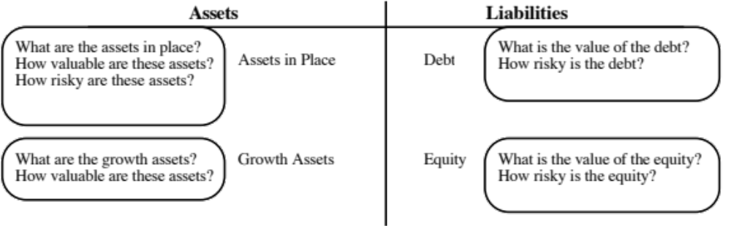
Questions we would like answered…
Notes:
These are the fundamental questions to which we would like the answer from financial statements. Unfortunately, financial statements do not always do a good job at answering these questions.

Slide 3
Basic Financial Statements
The balance sheet, which summarizes what a firm owns and owes at a point in time.
The income statement, which reports on how much a firm earned in the period of analysis
The statement of cash flows, which reports on cash inflows and outflows to the firm during the period of analysis
Notes:
We get most of the information we use in financial analysis from accounting statements. Knowing how to navigate through them and recognizing their limitations is a crucial part of financial analysis.

Slide 4
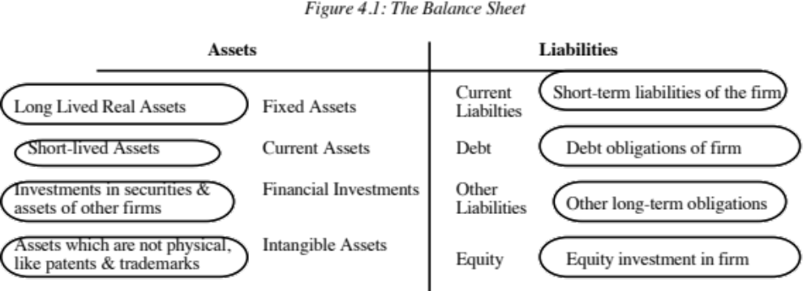
The Balance Sheet
Notes:
The balance sheet reports on what a firm owns (as assets) and where it received the funds to finance them (as liabilities). The values assigned to these assets may not reflect what they are worth today because the principles underlying valuation are accounting principles. In general,
Fixed assets: are shown at what was originally paid for them, net of any loss in value from use (shown as depreciation). The older the asset, the less likely it is that book value will be close to the current market value.
Current assets: are shown at what was paid for them, but this is likely to be closer to current market value. Current assets include
Inventory: which can be valued at prices paid at the the end of the year for the material (called FIFO accounting ) or the beginning of the year (called LIFO)
Accounts receivable: which is valued at what customers owe to the firm, net of any expected bad debts
Cash: which is valued at its stated value
Marketable securities can be valued differently depending how they are categorized - as majority active or minority passive investments. Investments held for trading purposes are valued at market value.
The most common intangible asset is goodwill, which arises from acquisitions. If the market value of the acquired company is greater than the book value, the difference is shown as goodwill (if purchase accounting is used)

Slide 5
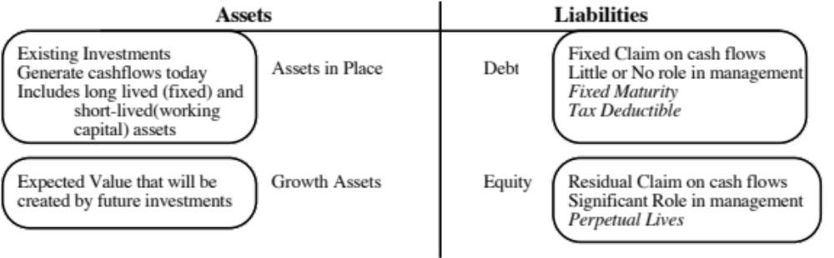
A Financial Balance Sheet
Notes:
In a financial balance sheet, we are much less concerned with recording what a firm paid for what it owns and much more concerned about how much it it is worth. There is therefore a greater emphasis on growth assets and the market values of equity and debt.

Slide 6
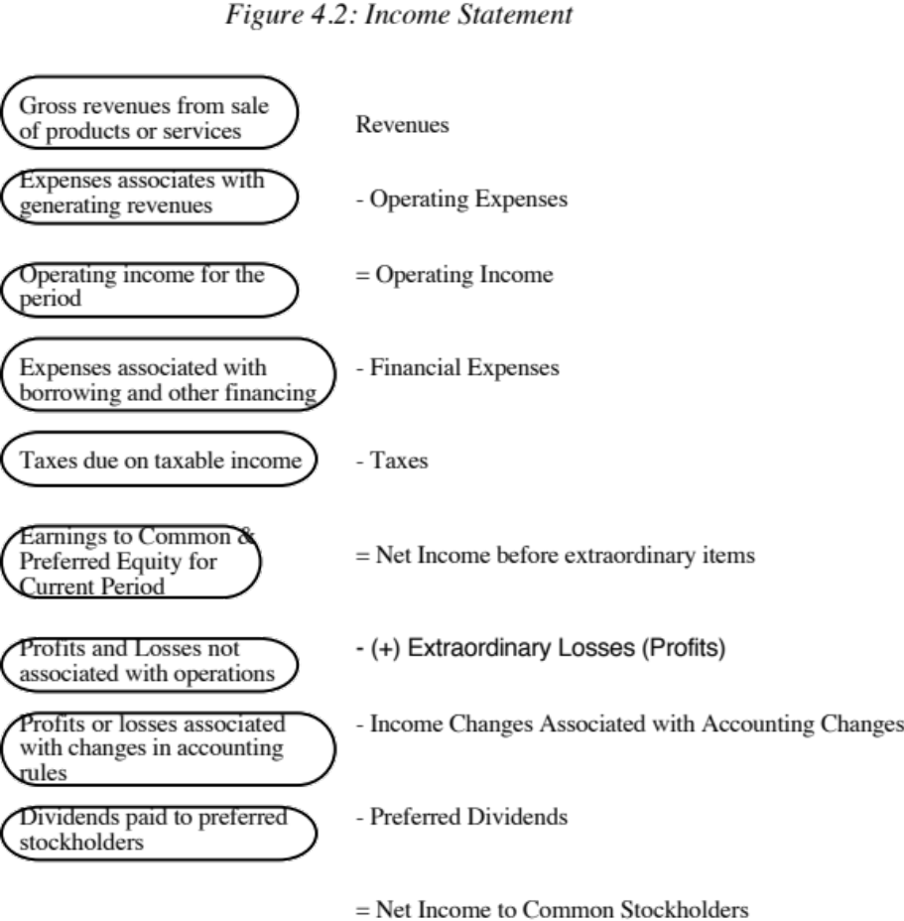
The Income Statement
Notes:
Accrual accounting principles require that
Revenues be recorded as the transaction is completed, not when payment is made
Expenses associated with these revenues be shown, even though payment might not have been made in the current period.
Expenses are categorized as operating or capital expenses. Operating expenses are expenses designed to generate benefits only in the current period and are shown in the income statement. Capital expenses are expenses generating benefits over multiple periods, and are shown on the balance sheet and depreciated or amortized.
Financial expenses are expenses associated with debt financing and generally represent interest expenses.
If a firm maintains two sets of books - tax and reporting - the taxes due may not match up to the taxable income in the books
Extraordinary gains or losses are supposed to be separated out from operating gains and losses (though there is some discretion that firms seem to have in this process)

Slide 7
Modifications to Income Statement
There are a few expenses that consistently are miscategorized in financial statements.In particular,
  Operating leases are considered as operating expenses by accountants but they are really financial expenses
  R &D expenses are considered as operating expenses by accountants but they are really capital expenses.
The degree of discretion granted to firms on revenue recognition and extraordinary items is used to manage earnings and provide misleading pictures of profitability.

Slide 8
Dealing with Operating Lease Expenses
Debt Value of Operating Leases = PV of Operating Lease Expenses at the pre-tax cost of debt
This now creates an asset - the value of which is equal to the debt value of operating leases. This asset now has to be depreciated over time.
Finally, the operating earnings has to be adjusted to reflect these changes:
  Adjusted Operating Earnings = Operating Earnings + Operating Lease Expense - Depreciation on the leased asset
  If we assume that depreciation = principal payment on the debt value of operating leases, we can use a short cut:
  Adjusted Operating Earnings = Operating Earnings + Debt value of Operating leases * Cost of debt
Notes:
An operating lease creates a commitment to make lease payments much as a debt commitment with a bank creates a commitment to make interest payments. There is a ripple effect created when operating leases are converted into debt.

Slide 9
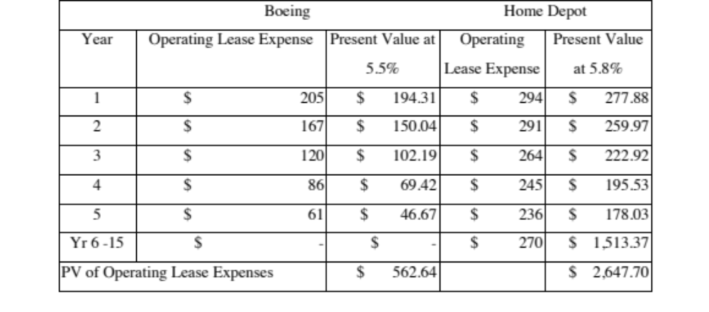
Operating Leases at Boeing and The Home Depot in 1998
Notes:
The Home Depotand Boeing reports lease commitments in their financial statements. The present value of operating lease expenses is computed using the pre-tax cost of debt. (An argument can be made that the unsecured cost of debt should be used.)

Slide 10
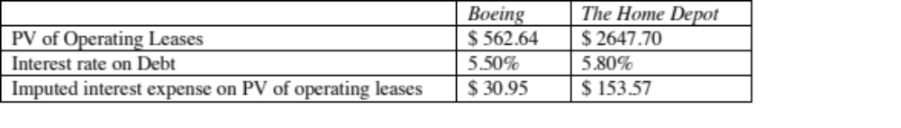
Imputed Interest Expenses on Operating Leases
Notes:
These will be added back to the operating income at Boeing and the Home Depot to get the corrected operating income.

Slide 11
The Effects of Capitalizing Operating Leases
Debt : will increase, leading to an increase in debt ratios used in the cost of capital and levered beta calculation
Operating income: will increase, since operating leases will now be before the imputed interest on the operating lease expense
Net income: will be unaffected since it is after both operating and financial expenses anyway
Return on Capital will generally decrease since the increase in operating income will be proportionately lower than the increase in book capital invested
Notes:
It is not just debt that is changed when operating leases are converted into debt.

Slide 12
R&D Expenses: Operating or Capital Expenses
Accounting standards require us to consider R&D as an operating expense even though it is designed to generate future growth. It is more logical to treat it as capital expenditures.
To capitalize R&D,
  Specify an amortizable life for R&D (2 - 10 years)
  Collect past R&D expenses for as long as the amortizable life
  Sum up the unamortized R&D over the period. (Thus, if the amortizable life is 5 years, the research asset can be obtained by adding up 1/5th of the R&D expense from five years ago, 2/5th of the R&D expense from four years ago...:
Notes:
R&D is the ultimate capital expenditure. The benefits are in the long term. The fact that the benefits are uncertain does not take away from this fact.

Slide 13
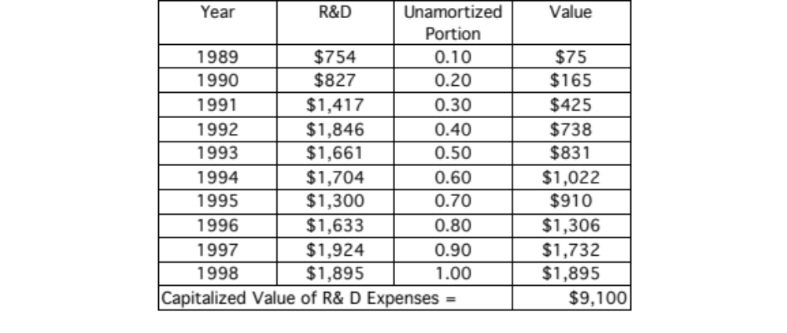
Capitalizing R&D Expenses: Boeing
Notes:
I used a 10-year amortizable life. There seems to be a long gestation period between research and commercial products in this business. I am using straight line amortization (10% a year) for simplicity.

Slide 14
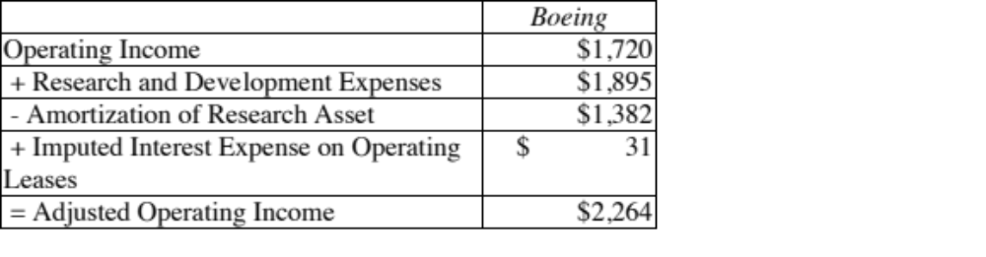
Boeing’s Corrected Operating Income
Notes:
The amortization of the research asset is obtained by adding up the amortization on each of the expenses on the previous page. The $31 million in imputed interest expense on operating leases is carried over from a couple of pages prior.

Slide 15
The Effect of Capitalizing R&D
Operating Income will generally increase, though it depends upon whether R&D is growing or not. If it is flat, there will be no effect since the amortization will offset the R&D added back. The faster R&D is growing the more operating income will be affected.
  Net income will increase proportionately, depending again upon how fast R&D is growing
  Book value of equity (and capital) will increase by the capitalized Research asset
  Capital expenditures will increase by the amount of R&D; Depreciation will increase by the amortization of the research asset; For all firms, the net cap ex will increase by the same amount as the after-tax operating income.
Notes:
Here again, the effects are in many items in the financial statements.

Slide 16
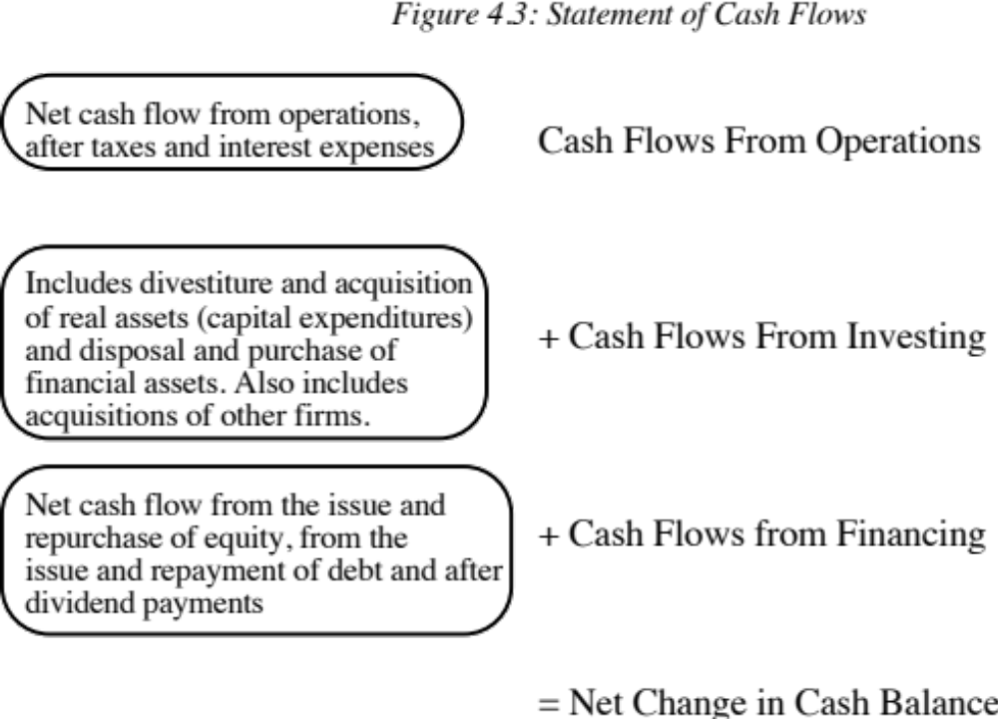
The Statement of Cash Flows
Notes:
This show all cash flows. The objective is to explain changes in the cash balance rather than to measure the health or value of the firm.

Slide 17
The Financial perspective on cash flows
In financial analysis, we are much more concerned about
  Cash flows to the firm or operating cash flows, which are before cash flows to debt and equity)
  Cash flows to equity, which are after cash flows to debt but prior to cash flows to equity
Notes:
Cash flows to debt: interest payments, new debt issues, debt repayments
Cash flows to equity: dividends, stock buybacks, new stock issues

