Slide 1
Applied Corporate Finance
4th Edition
Instructor manual
Aswath Damodaran
Notes:
This is an unconventional instructor’s manual. Rather than provide notes on each chapter, I have attached the notes to the slides that I use in my class. Feel free to modify, adapt, delete or add to this presentation. By the way, while this packet will stay static (Spring 2014 notes), I will update the slides each year. You can get the latest version of the slides (and the notes) by downloading the following two files:
http://www.stern.nyu.edu/~adamodar/pptfiles/acf4E/cfpacket1.ppt
http://www.stern.nyu.edu/~adamodar/pptfiles/acf4E/cfpacket2.ppt
And have fun teaching this class. I always do!

Slide 2
The Objective in Corporate Finance
“If you don’t know where you are going, it does’nt matter how you get there”
Notes:
Since the objective in corporate finance (to maximize firm value) is central to everything we do, we need to look at both its strengths and weaknesses. In fact, many disagreements that people have with corporate finance theory stems from the fact that they have a different objective for the business in mind. Thus, if you view a firm’s objective as maximizing the number of jobs created, choosing projects based upon the highest NPV (which is the corporate finance prescription) will make little sense.

Slide 3
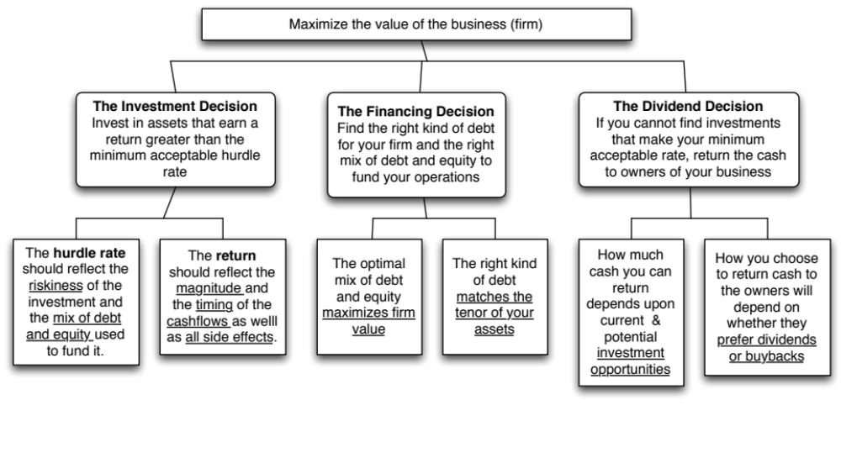
First Principles
Notes:
Our focus will be on the objective: Maximize firm value.
Since so much of corporate finance is built on this objective, it is important that we be clear about what it means and why we choose it. In addition, it is also worth exploring what the alternatives are and why this objective is preferable to the alternatives.

Slide 4

The Objective in Decision Making
In traditional corporate finance, the objective in decision making is to maximize the value of the firm.
A narrower objective is to maximize stockholder wealth. When the stock is traded and markets are viewed to be efficient, the objective is to maximize the stock price.
Maximize equity value
Maximize market estimate of equity value
Maximize firm value
Notes:
This is the answer to the question posed in the previous overhead.
Maximizing the value of the business is the most general objective function. Remember that value of the business includes assets in place and growth assets. If you are managing a growth company,, increasing earnings may not necessarily increase firm value. The other problem is that firm value itself is a difficult number to estimate. While there are models available, they all need inputs, most of which allow for subjective judgments.
Managers answer to stockholders. Consequently, the objective gets narrowed down to “maximizing equity value”. (Implicit assumption: Bondholders/ Banks can protect themselves by writing in covenants and setting interest rates).
It is tough to assess equity value objectively. It would be nice to have a “third party” estimate that is objective. For publicly traded firms, the market (in spite of all its limitations) provides such an estimate. (Implicit assumption: Markets are rational and reasonably efficient).

Slide 5
Maximizing Stock Prices is too “narrow” an objective: A preliminary response
Maximizing stock price is not incompatible with meeting employee needs/objectives. In particular:
  Employees are often stockholders in many firms
  Firms that maximize stock price generally are profitable firms that can afford to treat employees well.
Maximizing stock price does not mean that customers are not critical to success. In most businesses, keeping customers happy is the route to stock price maximization.
Maximizing stock price does not imply that a company has to be a social outlaw.
Notes:
Critique: Stock price maximization implies not caring for your employees.
Response: Use a recent story of layoffs to illustrate this criticism (XYZ Co. announced it was laying of 15,000 employees and stock price jumped $3.50). Then note that this is the exception rather than the rule. A Conference Board study from 1994 found that companies whose stock prices have gone up are more likely to hire people than one whose stock prices have gone down. Also note that employees, especially in high tech companies, have a large stake in how well their company does because they have stock options or stock in the company.
Critique: If you maximize value, you don’t care about customers.
Response: Note that customer satisfaction is important but only in the context that satisfied customers buy more from you. What would happen to a firm that defined its objective as maximizing customer satisfaction? You would give away your products for free…
Critique: Firms that maximize firm value are bad social citizens.
Response: A healthy company whose stock price has done well is much more likely to do social good than a company which is financially healthy. Again, note that there are social outlaws who might create social costs in the pursuit of stock price maximization (Those nasty corporate raiders..) but they are the exception rather than the rule.
To those who would like to have it all (they take different forms, but they talk about stakeholder wealth maximization or balanced scorecards or running a great company): It never works:
You cannot be all things to all people; keeping everyone happy leaves no one happy. You need a central objective. Otherwise, how do you choose between competing objectives?
You cannot mix up means with ends. You want satisfied and motivated employees and happy customers, but only as a means to an end: making money off them.
It gives poor performing managers an excuse for not performing because they can always pass the buck.
The Super Bowl in February 2013 was a showcase of means/ends at play. The two teams were coached by brothers: Jim (SF 49ers) and John (Ravens). During the season, Jim replaced his starting quarterback, Alex Smith, (making him, quite a few of his players, many fans and some in the press) unhappy. John fired his offensive coordinator (making his coaching staff unhappy and uncomfortable). Both coaches, though, had a singular objective which was to win the Super Bowl. They did not come into the season with fuzzy objectives (having a great season), misplaced objectives (win the most games in the regular season, win by the most points, gain the most yards) or mistaking means for ends (coaching a happy team, keeping fans happy, keeping the press happy).

Slide 6
Why traditional corporate financial theory focuses on maximizing stockholder wealth.
Stock price is easily observable and constantly updated (unlike other measures of performance, which may not be as easily observable, and certainly not updated as frequently).
If investors are rational (are they?), stock prices reflect the wisdom of decisions, short term and long term, instantaneously.
The objective of stock price performance provides some very elegant theory on:
  Allocating resources across scarce uses (which investments to take and which ones to reject)
  how to finance these investments
  how much to pay in dividends
Notes:
It is important it is to have an objective function that is observable and measurable. Fuzzy or multiple objectives are disastrous for several reasons:
Different decision makers define it to mean different things and can work at cross purposes with each other.
If your objective is fuzzy, it becomes very difficult to measure performance and how close you are to accomplishing your objective.
Note that stock prices provide almost instantaneous feedback (some of which is unwelcome) on every decision you make as a firm. Markets may not be perfect (they are far from it) but they are quick and unbiased.
Consider the example of an acquisition announcement and the market reaction to it. Stock prices of the acquiring firm tend to drop in a significant proportion of acquisitions. Why might markets be more pessimistic than managers about the expected success of an acquisition? Because the track record of firms on acquisitions is not very good.
There is also a legal basis for this focus. Courts (especially in Delaware, where most US corporations are incorporated) have long held that managers and board members have a primary fiduciary responsibility to the owners (stockholders). All other players in the game are secondary…

Slide 7
The Classical Objective Function
STOCKHOLDERS
Hire & fire
managers
- Board
- Annual Meeting
Maximize
stockholder wealth
Lend Money
No Social Costs
BONDHOLDERS/
LENDERS
Managers
SOCIETY
Protect
bondholder
Interests
All costs can be
traced to firm
Reveal
information
honestly and
on time
Markets are
efficient and
assess effect on
value
FINANCIAL MARKETS
Notes:
This is the utopian world. None of the assumptions are really defensible as written, and skepticism is clearly justified:
Why do we need these assumptions?
Since, in many large firms, there is a separation of ownership from management, managers have to be fearful of losing their jobs and go out and maximize stockholder wealth. If they do not have this fear, they will focus on their own interests.
If bondholders are not protected, stockholders can steal from them and make themselves better off, even as they make the firm less valuable.
If markets are not efficient, maximizing stock prices may not have anything to do with maximizing stockholder wealth or firm value.
If substantial social costs are created, maximizing stock prices may create large side costs for society (of which stockholders are members).
Note that corporate finance, done right, is not about expropriating or transferring wealth from other groups (bondholders, other stockholders or society) but about making the firm more productive and valuable. In this utopian world, the only way to increase value is to go out and take good investments. In the process, you contribute positively to the overall economy.

Slide 8
What can go wrong?
STOCKHOLDERS
Have little control
over managers
Managers put
their interests
above stockholders
Lend Money
Significant Social Costs
BONDHOLDERS
Managers
SOCIETY
Bondholders can
get ripped off
Some costs cannot be
traced to firm
Delay bad
news or
provide
misleading
information
Markets make
mistakes and
can over react
FINANCIAL MARKETS
Notes:
This is my worst case scenario:
Stockholders have little or no control over managers. Managers, consequently, put their interests above stockholder interests.
Bondholders who do not protect themselves find stockholders expropriating their wealth.
Information conveyed to markets is noisy, biases and sometimes misleading. Markets do not do a very good job of assimilating this information and market price changes have little to do with true value.
Firms in the process of maximizing stockholder wealth create large social costs.
In this environment, stockholder wealth maximization is not a good objective function.

Slide 9
I. Stockholder Interests vs. Management Interests
In theory: The stockholders have significant control over management. The two mechanisms for disciplining management are the annual meeting and the board of directors. Specifically, we assume that
  Stockholders who are dissatisfied with managers can not only express their disapproval at the annual meeting, but can use their voting power at the meeting to keep managers in check.
  The board of directors plays its true role of representing stockholders and acting as a check on management.
In Practice: Neither mechanism is as effective in disciplining management as theory posits.
Notes:
In theory, stockholders are supposed to come to the annual meeting, and make informed judgments about whether they want to keep incumbent management in place. Large stockholders act like private business owners and are vigilant about protecting their interests.
The board of directors is supposed to protect the stockholders and keep an eye on top managers.
So why don’t these mechanisms work?

Slide 10
The Annual Meeting as a disciplinary venue
The power of stockholders to act at annual meetings is diluted by three factors
  Most small stockholders do not go to meetings because the cost of going to the meeting exceeds the value of their holdings.
  Incumbent management starts off with a clear advantage when it comes to the exercise of proxies. Proxies that are not voted becomes votes for incumbent management.
  For large stockholders, the path of least resistance, when confronted by managers that they do not like, is to vote with their feet.
Annual meetings are also tightly scripted and controlled events, making it difficult for outsiders and rebels to bring up issues that are not to the management’s liking.
Notes:
It is not irrational for small stockholders to not actively involve themselves in the management of firms, because it is not economical for them to do so.
A significant percentage of proxies do not get turned in. In many firms, the managers of the firm get the votes commanded by these proxies. That would be the equivalent of having an election and allowing the incumbent to get the votes of anyone who does not vote.
For large institutional stockholders like Fidelity and Black Rock, with its hundreds of holdings, it just might not be feasible to be an active investor. There are also potential conflicts of interest, since Fidelity is also in the business of managing corporate pension funds… Even activist investment funds (such as the California Pension Fund), have pulled back in recent years. (Putnam exception? See WSJ article on Putnam: Putnam is one of the few mutual fund companies to contest management)
The annual meeting is tightly scripted and run, making it difficult for dissident stockholders to be heard. (In Japan, in the 1980s, trouble makers were hired to heckle stockholders who tried to ask managers tough questions. In Europe, until very recently, annual meetings were exquisitely well mannered affairs where elite managers told plebian stockholders what was good for them - shades of Marie Antoinette and “let them eat cake”…. (At Tattingers, the French luxury good company, Claudia Tattinger said that she felt ashamed for the stockholders who would ask “such rude questions” after Asher Edelman demanded to know whether the company owned chateaus and who lived in them…)

Slide 11
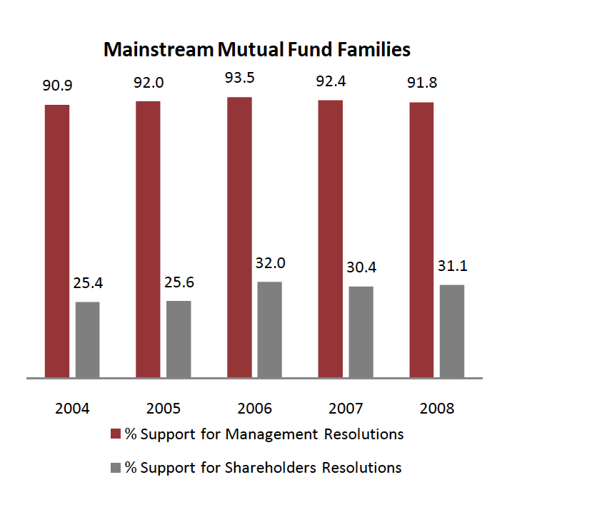
And institutional investors go along with incumbent managers…
Notes:
You would expect mutual funds and other institutional investors to take a more activist role and act as a check on the incumbent managers at annual meetings. For the most part, though, they seem to be supporters of the status quo, seldom challenging managers (even when they are wrong). This can be attributed to two factors:
Cost: It is costly to challenge incumbent managers. For institutional investors spread over multiple firms, this cost may be too high to bear.
Conflicts of interest: Many mutual fund families also look to companies for business. To the extent that challenging managers may cost them this business, they may hold back.

Slide 12
Board of Directors as a disciplinary mechanism
Directors are paid well: In 2010, the median board member at a Fortune 500 company was paid $212,512, with 54% coming in stock and the remaining 46% in cash. If a board member was a non-executive chair, he or she received about $150,000 more in compensation.
Spend more time on it than they used to: A board member worked, on average, about 227.5 hours a year (and that is being generous), or 4.4 hours a week, according to the National Associate of Corporate Directors. Of this, about 24 hours a year are for board meetings. Those numbers are up from what they were a decade ago.
Even those hours are not very productive: While the time spent on being a director has gone up, a significant portion of that time was spent on making sure that they are legally protected (regulations & lawsuits).
And they have many loyalties: Many directors serve on three or more boards, and some are full time chief executives of other companies.
Notes:
This sounds judgmental and it is meant to be. Directors do not spend a great deal of time overseeing managers, and they are well paid.
The pay shown here understates the true compensation that directors make from other perks and benefits that they get (pensions, for instance).
As a postscript, the pay of directors has kept rising. While the number of hours spent has also increased somewhat though how much of this additional time is spent on getting legal protection (against stockholder lawsuits) is debatable.
Post Sarbanes-Oxley, directors seem to spend more time with lawyers, making sure that they don’t get sued than they do with managers, trying to figure out whether the company is well run. This may be the unintended consequence when you try to get good corporate governance by passing laws.

Slide 13
The CEO often hand-picks directors..
CEOs pick directors: A 1992 survey by Korn/Ferry revealed that 74% of companies relied on recommendations from the CEO to come up with new directors and only 16% used an outside search firm. While that number has changed in recent years, CEOs still determine who sits on their boards. While more companies have outsiders involved in picking directors now, CEOs exercise significant influence over the process.
Directors don’t have big equity stakes: Directors often hold only token stakes in their companies. Most directors in companies today still receive more compensation as directors than they gain from their stockholdings. While share ownership is up among directors today, they usually get these shares from the firm (rather than buy them).
And some directors are CEOs of other firms: Many directors are themselves CEOs of other firms. Worse still, there are cases where CEOs sit on each other’s boards.
Notes:
When John Mack became CEO of Morgan Stanley, the fist two directors he picked to sit on the board were members of his golf club in Purchase, NY… Most CEOs get a say in who gets to sit on their boards. Even when there are nominating committees on boards, they seldom operate independently.
This adds to why directors spend so little time on oversight. CEOs, left to themselves, will seldom pick adversarial directors. Directors also make far more money from directorships than they do from owning stock in the firm. Not surprisingly, they do not take the side of stockholders.
A large percentage of directors on boards also happened to be CEOs of other companies. Given that they already have full time jobs as CEOs, it is difficult to believe that they have the time to perform their directorial duties.

Slide 14
Directors lack the expertise (and the willingness) to ask the necessary tough questions..
Robert’s Rules of Order? In most boards, the CEO continues to be the chair. Not surprisingly, the CEO sets the agenda, chairs the meeting and controls the information provided to directors.
Be a team player? The search for consensus overwhelms any attempts at confrontation.
The CEO as authority figure: Studies of social psychology have noted that loyalty is hardwired into human behavior. While this loyalty is an important tool in building up organizations, it can also lead people to suppress internal ethical standards if they conflict with loyalty to an authority figure. In a board meeting, the CEO generally becomes the authority figure.
Notes:
Harold Geneen who ruled ITT with an iron fist during the sixties when ITT built itself up through acquisitions, mentions in his memoirs that almost all decisions, during his tenure, that were made by the board, were unanimous. CEOs often chair the board, and establish the agenda for what the board discusses.
Behavioral aside: Studies show that over time, even boards that are constructed to be independent tend to bend more and more towards viewing the CEO as an authority figure.

Slide 15

The worst board ever? The Disney Experience - 1997
Notes:
This may be going back in time but it may help understanding Disney’s present standing. This was Disney’s board at the height of Michael Eisner’s powers. (Eisner became CEO of Disney in 1985 and consolidated power in the years after.)
Note the number of insiders on the board. (Seven out of 16; five current employees & two ex-employees) Also note the presence of Mr. Eisner’s private attorney (Irwin Russell) and the principal of his childrens’ elementary school (Reveta Bowers) on the board.
How independent was this board likely to be of Mr. Eisner? This may explain some of the actions taken by Disney (and specifically Eisner) during the 1990s… (Read Disney War by James Stewart for the gory details)
When Eisner was hired in 1984, he insisted on bringing in his protégé Jeffrey Katzenberg, his young assistant, into the firm with him. He put Katzenberg in charge of Disney Animation, which was not doing well. Katzenberg was largely responsible for the rebirth of that division (which Eisner had considered shutting down) with The Little Mermaid, Beauty and the Beast and The Lion King all proving to be mega-winners. As a reward for this success, Eisner fired him. His lucrative contract entitled him to 2% of the revenues from the movies he made in posterity but he would have settled for $100 million. Eisner refused to pay; Disney paid $ 250 million in 1999.
In 1995, Eisner hired Ovitz, a leading agent in Hollywood, and then told the board to okay the hire. He regretted it almost immediately and fired him 453 days later for “lying” and “incompetence”. However, rather than argue that this was just cause for firing, he paid Ovitz $ 100 million to leave.

Slide 16
The Calpers Tests for Independent Boards
Calpers, the California Employees Pension fund, suggested three tests in 1997 of an independent board:
  Are a majority of the directors outside directors?
  Is the chairman of the board independent of the company (and not the CEO of the company)?
  Are the compensation and audit committees composed entirely of outsiders?
Disney was the only S&P 500 company to fail all three tests.
Notes:
Calpers was one of the first institutional investors to pay attention to corporate governance. Every year, Calpers lists the 10 companies that were the worst culprits when it came to putting managerial interests over stockholder interests.
In the last twenty years, investors have become more aware of how important corporate governance is and there are an increasing number of services that focus on measuring and reporting on corporate governance.

Slide 17
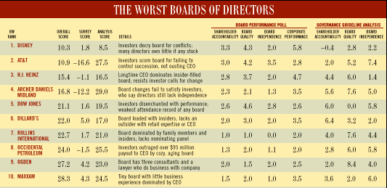
Business Week piles on… The Worst Boards in 1997..
Notes:
A poor board does not necessarily translate into a poorly managed firm. However, a poor board give CEOs carte blanche to do what they want to do… At some point in time, even good managers need restraint and good counsel. A rubber-stamp board will not provide that. (The best analogy is to a dictator… the line between a benevolent dictator and a malevolent one is a very fine one…)
As a stockholder, however, the fact that returns are good might not compensate for the fact that you do not believe that managers are responsive to your interests. (At the Disney stockholder meetings in both 1996 and 1997, there was substantial stockholder dissension in spite of the fact that the stock had performed reasonably in both periods.)

Slide 18
Application Test: Who’s on board?
Look at the board of directors for your firm.
  How many of the directors are inside directors (Employees of the firm, ex-managers)?
  Is there any information on how independent the directors in the firm are from the managers?
Are there any external measures of the quality of corporate governance of your firm?
  Yahoo! Finance now reports on a corporate governance score for firms, where it ranks firms against the rest of the market and against their sectors.
Is there tangible evidence that your board acts independently of management?
  Check news stories to see if there are actions that the CEO has wanted to take that the board has stopped him or her from taking or at least slowed him or her down.
Notes:
You can usually find this information for your firm in the 14-DEF filing that all firms in the US have to make with the SEC. If you have a non-US firm, this becomes more difficult to do. While you can usually find the names of the directors from the annual report, you may have a difficult time finding out the linkages (and potential conflicts) these directors may have with the managers of the firm.
You may also be able to find a corporate governance score for your company, especially if it is a large market cap company. Even if you cannot, you can make your own judgments on whether you (as a stockholder) are likely to have much influence on how this company is run.

Slide 19
So, what next? When the cat is idle, the mice will play ....
When managers do not fear stockholders, they will often put their interests over stockholder interests
  Greenmail: The (managers of ) target of a hostile takeover buy out the potential acquirer's existing stake, at a price much greater than the price paid by the raider, in return for the signing of a 'standstill' agreement.
  Golden Parachutes: Provisions in employment contracts, that allows for the payment of a lump-sum or cash flows over a period, if managers covered by these contracts lose their jobs in a takeover.
  Poison Pills: A security, the rights or cashflows on which are triggered by an outside event, generally a hostile takeover, is called a poison pill.
  Shark Repellents: Anti-takeover amendments are also aimed at dissuading hostile takeovers, but differ on one very important count. They require the assent of stockholders to be instituted.
  Overpaying on takeovers: Acquisitions often are driven by management interests rather than stockholder interests.
No stockholder approval needed….. Stockholder Approval needed
Notes:
These actions could all suggest that managerial interests are being put over stockholder interests. (Some of these actions, though, may also increase stockholder wealth. Managers will, of course, always claim that these actions are in stockholders’ best interests)
The reason that I have put overpaying on poison pills and shark repellants below greenmail and golden parachutes is not because they create less damage to stockholders but because stockholders at least get a chance to voice their view (they both require stockholder approval). Greenmail and golden parachutes just require board approval.

Slide 20
Overpaying on takeovers
The quickest and perhaps the most decisive way to impoverish stockholders is to overpay on a takeover.
The stockholders in acquiring firms do not seem to share the enthusiasm of the managers in these firms. Stock prices of bidding firms decline on the takeover announcements a significant proportion of the time.
Many mergers do not work, as evidenced by a number of measures.
  The profitability of merged firms relative to their peer groups, does not increase significantly after mergers.
  An even more damning indictment is that a large number of mergers are reversed within a few years, which is a clear admission that the acquisitions did not work.
Notes:
Managers of acquiring firms almost always make every acquisition sound like a good idea. Stockholders are more skeptical (as is evidenced by the behavior of acquiring firm stock prices on the announcement of acquisitions).
Stockholders must be right, on average, since many takeovers do not seem to work in terms of increasing stockholder wealth or delivering higher profitability.
(Good references:
The Synergy Trap, Mark Sirower)

Slide 21
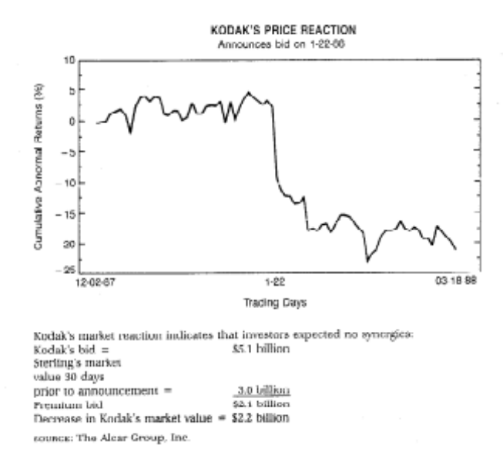
A case study in value destruction:
Eastman Kodak & Sterling Drugs
Kodak enters bidding war
Kodak wins!!!!
In late 1987, Eastman Kodak entered into a bidding war with Hoffman La Roche for Sterling Drugs, a pharmaceutical company.
The bidding war started with Sterling Drugs trading at about $40/share.
At $72/share, Hoffman dropped out of the bidding war, but Kodak kept bidding.
At $89.50/share, Kodak won and claimed potential synergies explained the premium.
Notes:
Note the difference in stock price behavior of the target and bidding firms.
Note also the symmetry between premium paid over the market price at Sterling Drugs ($ 2.1 billion) and value lost at Kodak ($2.2 billion). Kodak argued that this merger would create synergy and that was why they were paying the premium. The market did not seem to see any synergy.

Slide 22
Earnings and Revenues at Sterling Drugs
Sterling Drug under Eastman Kodak: Where is the synergy?
5,000
4,500
4,000
3,500
3,000
2,500
2,000
1,500
1,000
500
0
1988
1989
1990
1991
1992
Revenue
Operating Earnings
Notes:
Where is the synergy?
Profits essentially stagnated at Sterling after the Kodak acquisition. The rest of the drug industry reported an annual growth in earnings of 15% a year during this period.
Why is synergy so hard to deliver?
Firms do not plan for it at the time of the acquisitions
Culture shock
Unrealistic assumptions
The added problem is that there is evidence in the literature that over confident CEOs tend to over estimate their powers to deliver results (synergy included) and thus overpay.

Slide 23
Kodak Says Drug Unit Is Not for Sale … but…
An article in the NY Times in August of 1993 suggested that Kodak was eager to shed its drug unit.
  In response, Eastman Kodak officials say they have no plans to sell Kodak’s Sterling Winthrop drug unit.
  Louis Mattis, Chairman of Sterling Winthrop, dismissed the rumors as “massive speculation, which flies in the face of the stated intent of Kodak that it is committed to be in the health business.”
A few months later…Taking a stride out of the drug business, Eastman Kodak said that the Sanofi Group, a French pharmaceutical company, agreed to buy the prescription drug business of Sterling Winthrop for $1.68 billion.
  Shares of Eastman Kodak rose 75 cents yesterday, closing at $47.50 on the New York Stock Exchange.
  Samuel D. Isaly an analyst , said the announcement was “very good for Sanofi and very good for Kodak.”
  “When the divestitures are complete, Kodak will be entirely focused on imaging,” said George M. C. Fisher, the company's chief executive.
  The rest of the Sterling Winthrop was sold to Smithkline for $2.9 billion.
Notes:
As in the old Soviet Union, nothing is true until it is officially denied.
It is also worth noting that analysts sometimes say the most inane things in response to corporate actions and strategic buzzwords will often be offered by corporate chieftains (focus, diversification, synergy, strategic considerations..)

Slide 24
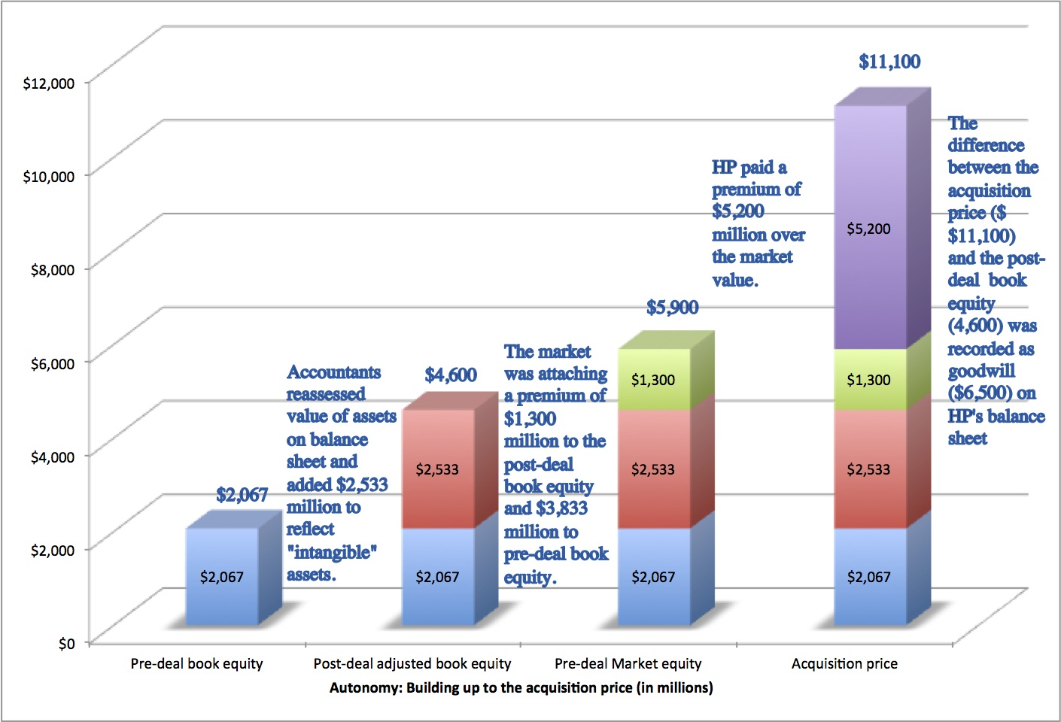
The connection to corporate governance: HP buys Autonomy… and explains the premium
Notes:
HP acquired Autonomy, a UK-based business software company, for $11.1 billion in 2011. At the time, almost everyone except for HP’s management thought that they were paying too much. Leo Apotheker, HP’s CEO at the time, claimed that they had done their homework and that the investment bankers had done a DCF and found the deal to be an accretive, good deal. The board of HP went along with the deal… and Meg Whitman was on the board. This is the same board that a year earlier had been caught sleeping on the job as the previous CEO, Mark Hurd, was found to have been involved in personal misconduct… And guess what…. This board met all of the Sarbanes Oxley requirements for independence.

Slide 25
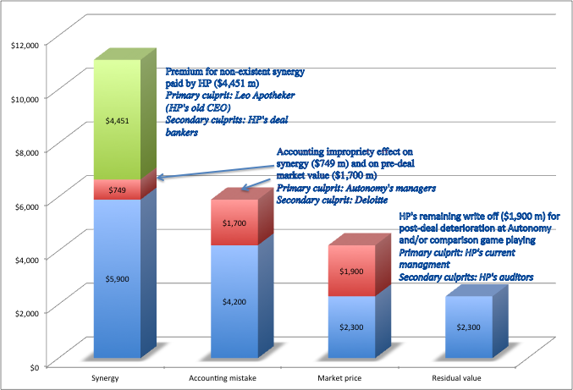
A year later… HP admits a mistake…and explains it…
Notes:
About a year later, HP announced that it was writing off almost $8.9 billion off its original deal value and claimed that Autonomy had cooked the books. This was my attempt to break down the write off, even with the presumption of accounting impropriety. The CEO of HP, Meg Whitman, claimed no responsibility…

Slide 26

Application Test: Who owns/runs your firm?
Look at: Bloomberg printout HDS for your firm
Who are the top stockholders in your firm?
What are the potential conflicts of interests that you see emerging from this stockholding structure?
Notes:
One of your first tasks when assessing a company is to see whether managers have a significant stake in the company. You can get this information in a variety of places. I use Bloomberg to get the data on the top 17 stockholders and go down the list to see if incumbent managers have a stake in the company. I also check to see if there are other investors on the list who may not be incumbent managers but are strong advocates for stockholders - Berkshire Hathaway at Coca Cola, KKR or Blackstone at many publicly traded firms…
You can also get this information from Yahoo! Finance by going into company profiles and clicking on institutional investors…
As you look at the list of top stockholders, you should be also considering the potential conflicts of interest created by the stockholder structure.
Inside stockholders (Founding family, controlling stockholder/manager) versus outside stockholders
Government as major stockholder (or holder of golden vote)
Employees as major stockholders
If there are multiple classes of shares, with some classes having higher voting rights than others, check to see whether managers/insiders own a disproportionate share of the higher voting right hares.

Slide 27

Case 1: Splintering of Stockholders
Disney’s top stockholders in 2003
Notes:
Not a single individual investor in the list other than Roy Disney who was the 15th largest stockholder… Managers are not significant stockholders in Disney (and the same can be said for most large publicly traded firms). Consider the following scenarios:
Managers are not significant stockholders in the firm: Significant potential for conflicts of interest between managers and stockholders.
Individuals are significant stockholders in the firm as well as part of top management. Usually, these are founder-owners of the firm and the firms tend to be younger firms or family run businesses that have recently made the transition to publicly traded firms. Smaller potential for conflict between managers and stockholders, but potential for conflict between inside stockholders and outside stockholders.
The government is a large stockholder (or a stockholder with veto power). This may keep managers in some check but it will create potential conflicts of interest between the other stockholders and the government (Consider what would happen if the company tried to minimize taxes paid)
Trusts or descendants of owners are significant stockholders in the firm but are not an active part of incumbent management. Power that these stockholders retain to replace managers reduces potential for conflict of interest but is reduced as holdings get diluted among lots of family members.
Another company is largest stockholder in firm. In this case, trace out who owns stock in the other company….

Slide 28

Case 2: Voting versus Non-voting Shares & Golden Shares: Vale
Vale has eleven members on its board of directors, ten of whom were nominated by Valepar and the board was chaired by Don Conrado, the CEO of Valepar.
Notes:
Voting right differences: When voting rights vary across shares, incumbent managers can consolidate their hold on a company with relatively small holdings. This reduces the power that stockholders have in these companies. Differences in voting rights are common outside the U.S. In Asia and Latin America, incumbent managers or family members can control companies with relatively small holdings with complete impunity.
Golden shares: When the government has veto power over major decisions, that also acts as a constraint on shareholders. Consequently, shareholders have to be realistic about what they can change and not change at these companies.

Slide 29

Case 3: Cross and Pyramid Holdings
Tata Motor’s top stockholders in 2013
Notes:
Cross holding structures are often designed with control in mind. In the case of Tata Motors, other Tata companies (which are part of the Tata family group) represent a large number of the top 15 stockholders in the company. (At least the Tatas are up front and open about their cross holding structures… In many Indian companies, the cross holdings are disguised with front companies holding the stock for families).
In Asia and Latin America, corporate holdings structures are designed to consolidate control.

Slide 30
Case 4: Legal rights and Corporate Structures: Baidu
The Board: The company has six directors, one of whom is Robin Li, who is the founder/CEO of Baidu. Mr. Li also owns a majority stake of Class B shares, which have ten times the voting rights of Class A shares, granting him effective control of the company.
The structure: Baidu is a Chinese company, but it is incorporated in the Cayman Islands, its primary stock listing is on the NASDAQ and the listed company is structured as a shell company, to get around Chinese government restrictions of foreign investors holding shares in Chinese corporations.
The legal system: Baidu’s operating counterpart in China is structured as a Variable Interest Entity (VIE), and it is unclear how much legal power the shareholders in the shell company have to enforce changes at the VIE.
Notes:
When you invest in Baidu, you have to do so with the recognition that your rights to make changes in the company or have a say in how it is run are very limited. There have been cases in the last few years, where US investors in companies structured just like Baidu have found that the Chinese courts are not protective of their legal rights.

Slide 31

Things change.. Disney’s top stockholders in 2009
Notes:
Things can change… This is Disney in 2009. Note that there is now an individual at the top of the list – Steve Jobs, whose holdings came from his majority ownership at Pixar that was acquired by Disney.
As a stockholder in Disney, what would have been your thoughts about Jobs at the top of the list?
Jobs had many shortcomings, but he was a visionary who would have pushed Disney to take another look at its established business practices.

Slide 32
II. Stockholders' objectives vs. Bondholders' objectives
In theory: there is no conflict of interests between stockholders and bondholders.
In practice: Stockholder and bondholders have different objectives. Bondholders are concerned most about safety and ensuring that they get paid their claims. Stockholders are more likely to think about upside potential
Notes:
Bondholders include all lenders (including banks). What is good for stockholders is not necessarily good for lenders….

Slide 33
Examples of the conflict..
A dividend/buyback surge: When firms pay cash out as dividends, lenders to the firm are hurt and stockholders may be helped. This is because the firm becomes riskier without the cash.
Risk shifting: When a firm takes riskier projects than those agreed to at the outset, lenders are hurt. Lenders base interest rates on their perceptions of how risky a firm’s investments are. If stockholders then take on riskier investments, lenders will be hurt.
Borrowing more on the same assets: If lenders do not protect themselves, a firm can borrow more money and make all existing lenders worse off.
Notes:
In each of these cases, you are likely to see stock prices go up on the action and bond prices go down. Lenders value stability and security. Equity investors share in upside and may prefer to cash out…

Slide 34
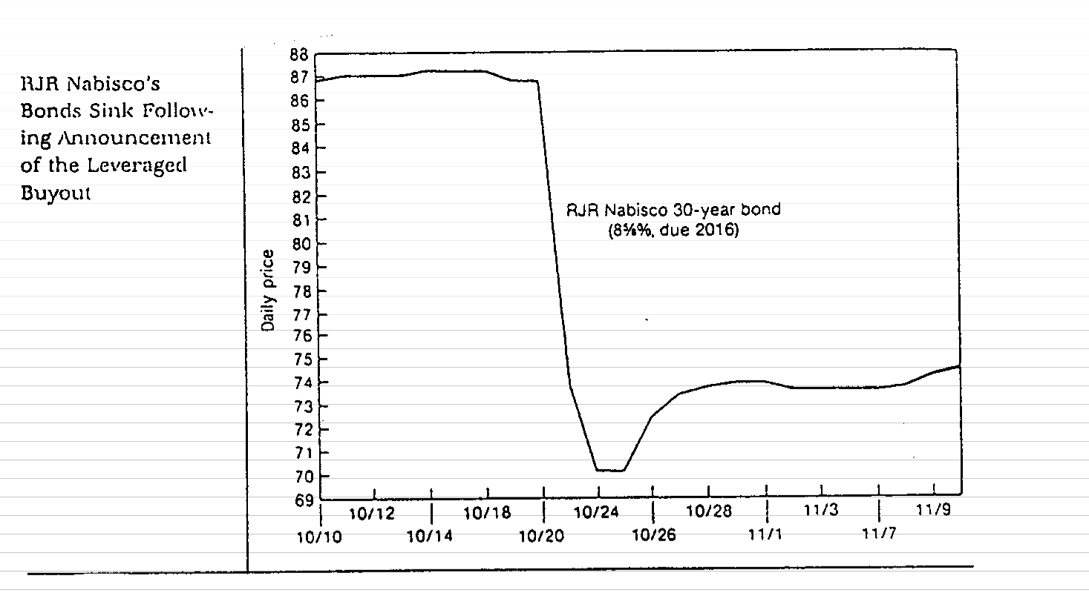
An Extreme Example: Unprotected Lenders?
Notes:
The fact that a company is well known and has a good reputation (as Nabisco did in the early 1980s, when you bought the bond) will not protect you as a lender. Nabisco’s bond price plummeted on the day of the LBO, while the stock price soared.
Is this just a paper loss? (You still get the same coupons. Only the price has changed)
Not really. There is now a greater chance of default in Nabisco, for which you as a lender are not compensated.
How could Nabisco’s bondholders have protected themselves?
Put in a covenant that allowed them to turn the bonds into the firm in the event of an event like an LBO and receive the face value of the bond. (Puttable bonds)
Make the coupon payments on the bond a function of the company’s rating (Rating sensitive bonds)

Slide 35
III. Firms and Financial Markets
In theory: Financial markets are efficient. Managers convey information honestly and and in a timely manner to financial markets, and financial markets make reasoned judgments of the effects of this information on 'true value'. As a consequence-
  A company that invests in good long term projects will be rewarded.
  Short term accounting gimmicks will not lead to increases in market value.
  Stock price performance is a good measure of company performance.
In practice: There are some holes in the 'Efficient Markets' assumption.
Notes:
An efficient market is one where the market price reflects the true value of the equity in the firm (and any changes in it). It does not imply perfection on the part of markets, but it does imply a link between what happens to the stock price and what happens to true value.
Note:
Efficient markets can and often should be volatile. True values change on a minute by minute basis, and so should the price.
Information should still affect prices in an efficient market.

Slide 36
Managers control the release of information to the general public
Information management (timing and spin): Information (especially negative) is sometimes suppressed or delayed by managers seeking a better time to release it. When the information is released, firms find ways to “spin” or “frame” it to put themselves in the best possible light.
Outright fraud: In some cases, firms release intentionally misleading information about their current conditions and future prospects to financial markets.
Notes:
Consider an example of Bre-X, which told markets that it had found one of the largest gold reserves in the world in Indonesia in the early 1990s. In 1997, it was revealed that there was no gold, and that the firm had salted the mine with gold to fool investors. When the news eventually came out, the stock price dropped to zero. Bre-X was followed by 9 analysts, all of whom professed to be shocked by the revelation.
Or Satyam Computer (a CFO who could not find the cash)….Or Mercury Finance (a company that could not find its CFO..) … Or Comverse, the Israeli company that could not find its CEO (until someone spotted him in Sri Lanka… and later in Namibia)
For a non-US example, consider Parmalat, the Italian dairy company. The managers and promoters of the firm went to jail because billions in debt raised by the firm could not be traced.
And there is Enron… and WorldCom… and Tyco…
Notwithstanding these examples, outright fraud remains the exception rather than the rule… What is more common is for firms to fudge the truth or to try to control the release of bad news to the market.

Slide 37
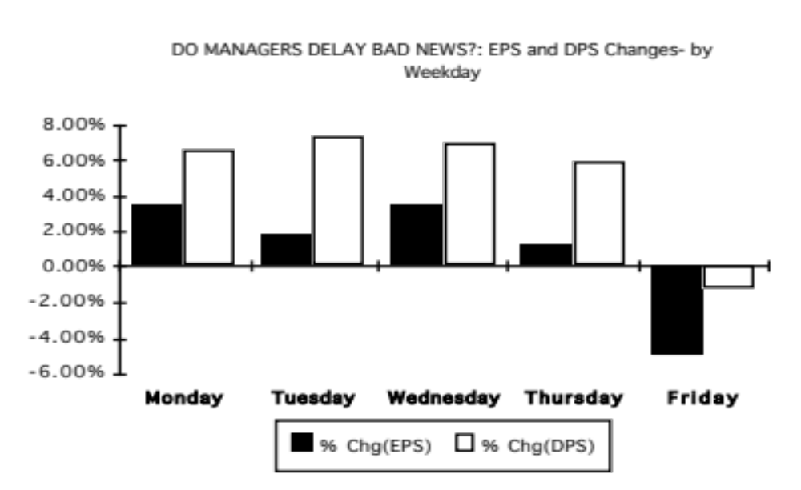
Evidence that managers delay bad news?
Notes:
This study looked at thousands of earnings and dividend announcements, categorized by day of the week in the 1980s. Note how announcements on Fridays contain far worse news than announcement on the other weekdays. Either bad things tend to happen on Fridays, or managers are trying to hold on to bad news until Friday. I am inclined to believe the latter.
Managers do not trust markets to not panic on bad news.
This may explain a portion of the weekend effect - stock prices tend to go down on Mondays.

Slide 38
Some critiques of market efficiency..
Investor irrationality: The base argument is that investors are irrational and prices often move for not reason at all. As a consequence, prices are much more volatile than justified by the underlying fundamentals. Earnings and dividends are much less volatile than stock prices.
Manifestations of irrationality
  Reaction to news: Some believe that investors overreact to news, both good and bad. Others believe that investors sometimes under react to big news stories.
  An insider conspiracy: Financial markets are manipulated by insiders; Prices do not have any relationship to value.
  Short termism: Investors are short-sighted, and do not consider the long-term implications of actions taken by the firm
Notes:
The Shiller effect - stock prices are much volatile than justified by looking at the underlying dividends and other fundamentals - is debatable. While people often present anecdotal evidence on the phenomenon, they under estimate the volatility of the underlying fundamentals.
For every researcher who claims to find evidence that markets overreact, there seems to be another researcher who finds evidence that they under react. And few investors seems to be able to systematically make real money (as opposed to hypothetical money) on these supposed over or under reactions.
Corporate strategists, like Michael Porter, argue that market prices are based upon short term forecasts of earnings and do not factor in the long term.
In some emerging markets outside the US, the argument is that prices are moved by insiders and that they have no relationship to value.

Slide 39
Are markets short sighted and too focused on the near term? What do you think?
Focusing on market prices will lead companies towards short term decisions at the expense of long term value.
  a. I agree with the statement
  b. I do not agree with this statement
Allowing managers to make decisions without having to worry about the effect on market prices will lead to better long term decisions.
  I agree with this statement
  I do not agree with this statement
Neither managers nor markets are trustworthy. Regulations/laws should be written that force firms to make long term decisions.
  I agree with this statement
  I do not agree with this statement
Notes:
This again has no right answers. Most participants, given the barrage of criticism that they hear about markets on the outside, come in with the perception that prices are short term.
However, most people are also unwilling to trust managers to make good long-term decisions, which brings the real problem to the forefront. The question should not be whether you trust the market to be long term, but whether you trust markets more than managers…
The point is that markets are imperfect, but someone has to make the judgments. Managers argue that they do it better. Governments argued (especially in the socialist heyday) that they have a long term focus. The Ministry of Finance in Japan thought it had the monopoly on long term perspective.

Slide 40
Are markets short term? Some evidence that they are not..
Value of young firms: There are hundreds of start-up and small firms, with no earnings expected in the near future, that raise money on financial markets. Why would a myopic market that cares only about short term earnings attach high prices to these firms?
Current earnings vs Future growth: If the evidence suggests anything, it is that markets do not value current earnings and cashflows enough and value future earnings and cashflows too much. After all, studies suggest that low PE stocks are under priced relative to high PE stocks
Market reaction to investments: The market response to research and development and investment expenditures is generally positive.
Notes:
None of these pieces of evidence is conclusive proof that markets are long term, but the evidence does add up to markets being much more long term than they are given credit for. There is little evidence, outside of anecdotal evidence, that markets are short term.
The best support for markets comes from looking at how well they do relative to expert prognosticators:
Forward currency rates are better predictors of expected currency rates in the future than economic forecasters.
Orange juice futures markets seem to predict the weather in Florida better than weather forecasters.
The Iowa Election Market has predicted election results better than political pundits.
It is true that there are many short term investors and analysts in the market, but the real question is whether the market price is able to get past their short term considerations and focus on the long term. Sometimes, it does not, but surprisingly often, it does.

Slide 41
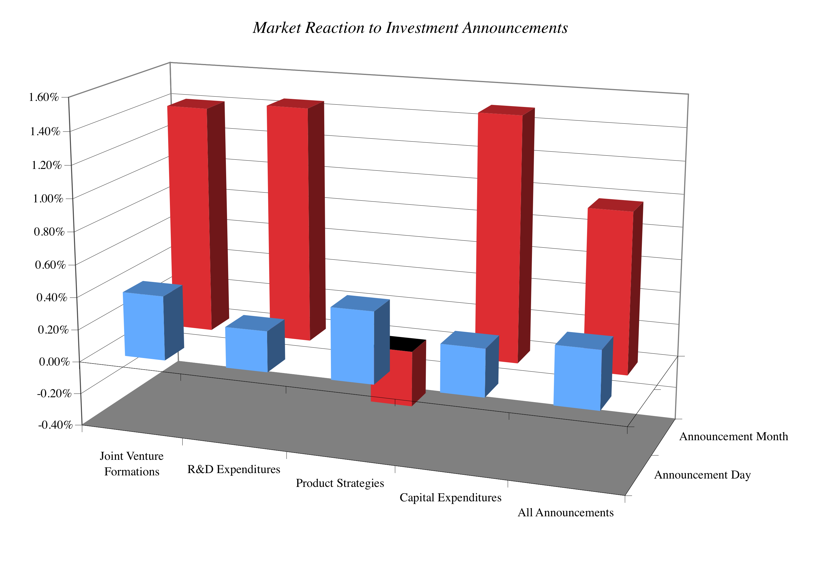
If markets are so short term, why do they react to big investments (that potentially lower short term earnings) so positively?
Notes:
Note that the price increases tend to be small, since these announcements tend to affect value by only small amounts. The effect seems to correlate with the weightiness of each announcement, being lower for product strategy announcements (which might signify little or no real investment) and being higher for the other three.
Markets also tend to be discriminating and look at both the type of business where the R&D is being spent (Intel versus Kellogg) and the track record of the managers spending the money.
You may argue that investors may be reacting this way because they want to make short term profits and that could be true, but so what? As long as the end-result is a price that reflects long term value, does it matter that what allowed that to happen was greedy, short term investors.

Slide 42
But what about market crises?
Markets are the problem: Many critics of markets point to market bubbles and crises as evidence that markets do not work. For instance, the market turmoil between September and December 2008 is pointed to as backing for the statement that free markets are the source of the problem and not the solution.
The counter: There are two counter arguments that can be offered:
  The events of the last quarter of 2008 illustrate that we are more dependent on functioning, liquid markets, with risk taking investors, than ever before in history. As we saw, no government or other entity (bank, Buffett) is big enough to step in and save the day.
  The firms that caused the market collapse (banks, investment banks) were among the most regulated businesses in the market place. If anything, their failures can be traced to their attempts to take advantage of regulatory loopholes (badly designed insurance programs… capital measurements that miss risky assets, especially derivatives)
Notes:
Note that only down markets are viewed as failures.. But not up markets! In other words, we are selective about our outrage. We feed off the positives of markets, attributing success to everything but the presence of markets but when markets fail, we blame their existence.
Here is a follow up. If it is market volatility that is the culprit, note that the they reflected some real uncertainty – about economic growth, bank failures and government actions.
As a thought experiment, consider a world without financial markets and ask yourself whether the gains would exceed the losses. (This does not have to be an experiment.. After all, Asia prior to the 1990s was a world without functioning financial markets for millennia… What was the real growth rate in India and China prior to 1995 and pos-1995? )
Do I have less trust in markets now than I did a few years ago? Perhaps. But I have even less trust in the other (alternate) institutions that I would have used instead – managers, governments, central banks, experts… This may sound weird. But, on a relative basis, I trust markets more now than I did in September 2008.

Slide 43
IV. Firms and Society
In theory: All costs and benefits associated with a firm’s decisions can be traced back to the firm.
In practice: Financial decisions can create social costs and benefits.
  A social cost or benefit is a cost or benefit that accrues to society as a whole and not to the firm making the decision.
    Environmental costs (pollution, health costs, etc..)
    Quality of Life' costs (traffic, housing, safety, etc.)
  Examples of social benefits include:
    creating employment in areas with high unemployment
    supporting development in inner cities
    creating access to goods in areas where such access does not exist
Notes:
Social costs and benefits exist in almost every financial decision.

Slide 44
Social Costs and Benefits are difficult to quantify because ..
Cannot know the unknown: They might not be known at the time of the decision. In other words, a firm may think that it is delivering a product that enhances society, at the time it delivers the product but discover afterwards that there are very large costs. (Asbestos was a wonderful product, when it was devised, light and easy to work with… It is only after decades that the health consequences came to light)
Eyes of the beholder: They are ‘person-specific’, since different decision makers can look at the same social cost and weight them very differently.
Decision paralysis: They can be paralyzing if carried to extremes.
Notes:
Economists may measure social benefits in “utils”. Few, if any, businesses (or economists) have figured out a way of actually putting this into practice.

Slide 45
A test of your social consciousness:
Put your money where you mouth is…
Assume that you work for Disney and that you have an opportunity to open a store in an inner-city neighborhood. The store is expected to lose about a million dollars a year, but it will create much-needed employment in the area, and may help revitalize it.
Would you open the store?
  Yes
  No
If yes, would you tell your stockholders and let them vote on the issue?
  Yes
  No
If no, how would you respond to a stockholder query on why you were not living up to your social responsibilities?
Notes:
I do this survey in three parts.
First, I allow people to make the choice of whether they would open the store. I then pick someone who would open the store and press them on whether they would reveal this to their stockholders. If the answer is No, I point out that it is after all the stockholders’ wealth. If the answer is Yes, I then ask them whether they would let stockholders vote (if not on individual store openings, on the money that the firm will spend collectively on being socially responsible)
I also ask people why they would open the store. If the answer is that they would do it for the publicity, I counter that it is advertising and not social responsibility that is driving the decision. There is nothing wrong with being socially responsible and getting economically rewarded for it. In fact, if societies want to make firms socially responsible they have to make it in their economic best interests to do so.
The bottom line is the following. If you own a private business, you can do whatever you want with your money. If you are a managers of a publicly traded firm, you are being charitable with other people’s money. You have an obligation to be open and up-front with your stockholders about how much you are spending to be socially conscious and give them a chance to decide whether you should continue on your path.

Slide 46
So this is what can go wrong...
STOCKHOLDERS
Managers put
their interests
above stockholders
Have little control
over managers
Lend Money
Significant Social Costs
BONDHOLDERS
Managers
SOCIETY
Bondholders can
get ripped off
Some costs cannot be
traced to firm
Delay bad
news or
provide
misleading
information
Markets make
mistakes and
can over react
FINANCIAL MARKETS
Notes:
This is my worst case scenario:
Stockholders have little or no control over managers. Managers, consequently, put their interests above stockholder interests.
Bondholders who do not protect themselves find stockholders expropriating their wealth.
Information conveyed to markets is noisy, biases and sometimes misleading. Markets do not do a very good job of assimilating this information and market price changes have little to do with true value.
Firms in the process of maximizing stockholder wealth create large social costs.
In this environment, stockholder wealth maximization is not a good objective function.

Slide 47
Traditional corporate financial theory breaks down when ...
Managerial self-interest: The interests/objectives of the decision makers in the firm conflict with the interests of stockholders.
Unprotected debt holders: Bondholders (Lenders) are not protected against expropriation by stockholders.
Inefficient markets: Financial markets do not operate efficiently, and stock prices do not reflect the underlying value of the firm.
Large social side costs: Significant social costs can be created as a by-product of stock price maximization.
Notes:
This summarizes the break down in each of the linkages noted on the previous page.

Slide 48
When traditional corporate financial theory breaks down, the solution is:
A non-stockholder based governance system: To choose a different mechanism for corporate governance, i.e, assign the responsibility for monitoring managers to someone other than stockholders.
A better objective than maximizing stock prices? To choose a different objective for the firm.
Maximize stock prices but minimize side costs: To maximize stock price, but reduce the potential for conflict and breakdown:
  Making managers (decision makers) and employees into stockholders
  Protect lenders from expropriation
  By providing information honestly and promptly to financial markets
  Minimize social costs
Notes:
At this point, things look pretty bleak for stock price maximization. These are the three choices that we have, if we abandon pure stock price maximization as an objective function.

Slide 49
I. An Alternative Corporate Governance System
Germany and Japan developed a different mechanism for corporate governance, based upon corporate cross holdings.
  In Germany, the banks form the core of this system.
  In Japan, it is the keiretsus
  Other Asian countries have modeled their system after Japan, with family companies forming the core of the new corporate families
At their best, the most efficient firms in the group work at bringing the less efficient firms up to par. They provide a corporate welfare system that makes for a more stable corporate structure
At their worst, the least efficient and poorly run firms in the group pull down the most efficient and best run firms down. The nature of the cross holdings makes its very difficult for outsiders (including investors in these firms) to figure out how well or badly the group is doing.
Notes:
In the 1980s, Michael Porter argued that US companies should move towards the Japanese system. The Japanese and German systems tend to do well in stable environments, where failure tends to be unsystematic ( a firm here and a firm there). They can take care of their “failures” and nurse them back to health, rather than exposing themselves to the costs associated with failure.
These systems break down when problems are wide spread and systematic. Contrast the way US banks dealt with problem loans on their balance sheets (markets forced them to deal with these problems quickly ) and the way Japanese banks have dealt with them (by hiding them and hoping they go away).
In the last decade, the success of China as an economy has evoked interest in their corporate governance system, which is rooted neither in stockholders nor in cross holding structures. Instead, it has been largely directed by a government or central authority. The plus that the centralized power brings is the capacity to see the big picture and make companies bend to the larger public good. The minus is that centralized powers do make mistakes and when they do, they are reluctant to admit it. The test of a system comes not during periods of success but during periods of failure, and the Chinese system has not been tested yet. Let’s see how it holds up.

Slide 50
II. Choose a Different Objective Function
Firms can always focus on a different objective function. Examples would include
  maximizing earnings
  maximizing revenues
  maximizing firm size
  maximizing market share
  maximizing EVA
The key thing to remember is that these are intermediate objective functions.
  To the degree that they are correlated with the long term health and value of the company, they work well.
  To the degree that they do not, the firm can end up with a disaster
Notes:
Consider each of these objectives. If you put them through the same tests that we did stock price maximization, you come up with far more problems with each.
Note that firms might pick an intermediate objective (like market share) when it is correlated with firm value but continue to use it, even after it loses this link. Do you want a 100% market share of a losing business?
In the 1980s, American Airlines (under Robert Crandall) set itself the objective of becoming the number one domestic airline in the United States. It succeeded but by 1989, it was losing billions.

Slide 51
III. Maximize Stock Price, subject to ..
The strength of the stock price maximization objective function is its internal self correction mechanism. Excesses on any of the linkages lead, if unregulated, to counter actions which reduce or eliminate these excesses
In the context of our discussion,
  managers taking advantage of stockholders has led to a much more active market for corporate control.
  stockholders taking advantage of bondholders has led to bondholders protecting themselves at the time of the issue.
  firms revealing incorrect or delayed information to markets has led to markets becoming more “skeptical” and “punitive”
  firms creating social costs has led to more regulations, as well as investor and customer backlashes.
Notes:
The strength of market based systems is that they are both ruthless and quick in correcting errors, once they are spotted.
These constraints flow from the earlier framework, where we introduced what can go wrong with each linkage.

Slide 52
The Stockholder Backlash
Activist Institutional investors have become much more active in monitoring companies that they invest in and demanding changes in the way in which business is done. They have been joined by private equity funds like KKR and Blackstone.
Activist individuals like Carl Icahn specialize in taking large positions in companies which they feel need to change their ways (Blockbuster, Time Warner, Motorola & Apple) and push for change.
Vocal stockholders, armed with more information and new powers: At annual meetings, stockholders have taken to expressing their displeasure with incumbent management by voting against their compensation contracts or their board of directors
Notes:
All of these developments represent the backlash to managers putting their interests over stockholder interests.
In recent years, private equity investors have joined the fray as activist investors pushing managers to change the way they run their firms.

Slide 53
The Hostile Acquisition Threat
The typical target firm in a hostile takeover has
  a return on equity almost 5% lower than its peer group
  had a stock that has significantly under performed the peer group over the previous 2 years
  has managers who hold little or no stock in the firm
In other words, the best defense against a hostile takeover is to run your firm well and earn good returns for your stockholders
Conversely, when you do not allow hostile takeovers, this is the firm that you are most likely protecting (and not a well run or well managed firm)
Notes:
This is the ultimate threat. Managers often have deathbed conversions to become advocates for stockholder wealth maximization, when faced with the threat of a hostile takeover.
For Disney, this wake-up call came in 2004, when Comcast announced a hostile acquisition bid for Disney. Though the bid failed, it shook up the company and led to Eisner’s decision to step down in 2006.

Slide 54
In response, boards are becoming more independent…
Boards have become smaller over time. The median size of a board of directors has decreased from 16 to 20 in the 1970s to between 9 and 11 in 1998. The smaller boards are less unwieldy and more effective than the larger boards.
There are fewer insiders on the board. In contrast to the 6 or more insiders that many boards had in the 1970s, only two directors in most boards in 1998 were insiders.
Directors are increasingly compensated with stock and options in the company, instead of cash. In 1973, only 4% of directors received compensation in the form of stock or options, whereas 78% did so in 1998.
More directors are identified and selected by a nominating committee rather than being chosen by the CEO of the firm. In 1998, 75% of boards had nominating committees; the comparable statistic in 1973 was 2%.
Notes:
While these trends are positive, note that many of these better boards (at least as seen from the vantage point of 1998) were responsible for the scandals of the bull market (Enron, Worldcom, Tyco…) In bull markets and strong economies, boards tend to get lazy.
The scandals at Enron and Tyco created the impetus for Sarbanes-Oxley, which in turn created a legal mandate for more independent boards..
The annual reports of more and more companies include corporate governance rules that they have adopted.

Slide 55
Disney: Eisner’s rise & fall from grace
In his early years at Disney, Michael Eisner brought about long-delayed changes in the company and put it on the path to being an entertainment giant that it is today. His success allowed him to consolidate power and the boards that he created were increasingly captive ones (see the 1997 board).
In 1996, Eisner spearheaded the push to buy ABC and the board rubberstamped his decision, as they had with other major decisions. In the years following, the company ran into problems both on its ABC acquisition and on its other operations and stockholders started to get restive, especially as the stock price halved between 1998 and 2002.
In 2003, Roy Disney and Stanley Gold resigned from the Disney board, arguing against Eisner’s autocratic style.
In early 2004, Comcast made a hostile bid for Disney and later in the year, 43% of Disney shareholders withheld their votes for Eisner’s reelection to the board of directors. Following that vote, the board of directors at Disney voted unanimously to elect George Mitchell as the Chair of the board, replacing Eisner, who vowed to stay on as CEO.
Notes:
Eisner was a good CEO when he came into Disney, partly because it was a company badly in need of change and partly because he had a solid COO in Frank Wells, who acted as a counterweight. Two things changed in the 1990s. The first was that Eisner was successful, and the ego boost that he received was the basis for acquiring more power (a compliant board). The second was that Frank Wells dies in an air accident, leaving Eisner as the imperial CEO. Power corrupts and absolute power does so absolutely.
As long as Disney was doing well, though, shareholders were willing to cut Eisner slack. However a bad acquisition followed by under performance (share prices and earnings) gradually ate away that support, until you get to the tipping point which in this case were the resignations and the hostile acquisition bid.

Slide 56
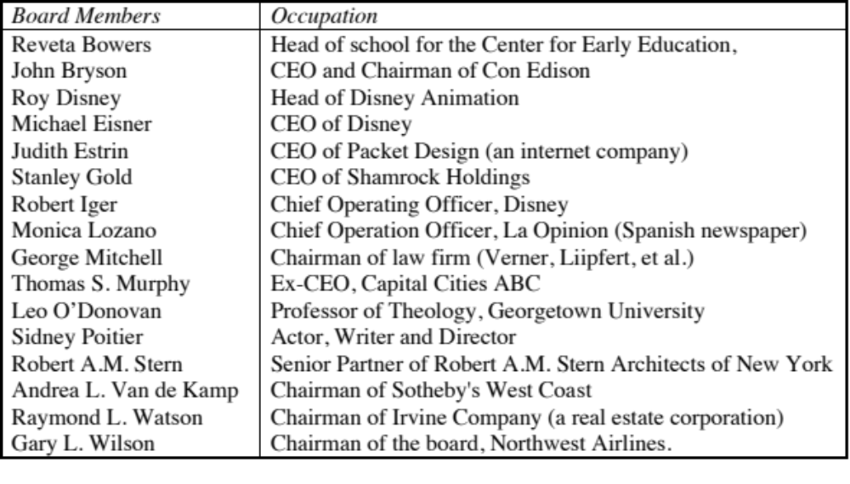
Eisner’s concession: Disney’s Board in 2003
Notes:
By 2003, stockholders were in open revolt at Disney. A hostile bid by Comcast for Disney was rebuffed by the board, with little discussion of its merits. In the 2004 meeting, 45% of the stockholders voted against Eisner’s compensation contract and 23% voted against George Mitchell for Chairman. Some improvement over 1997 but most of the directors are still there…
The most obvious conflict (Irwin Russell) has been removed. Still, there are far too many directors on this board (16), too many of them are still insiders (4) and there are too many CEOs of other firms. The jobs of CEO and Chairman were separated. Nevertheless, this board is a better one than the 1997 board. What precipitated the changes?
Poor financial and stock price performance
Pressure from major stockholders (like Stanley Gold)
Stockholder distrust of management
Big deals (like the Cap Cities acquisition) that have gone bad…
Enronitis… (the fear that complete power would corrupt and create financial consequences, as it did at Enron)>
Shortly after this filing, Stanley Gold and Roy Disney resigned from the board in protest over its ineffectiveness.

Slide 57
Changes in corporate governance at Disney
Required at least two executive sessions of the board, without the CEO or other members of management present, each year.
Created the position of non-management presiding director, and appointed Senator George Mitchell to lead those executive sessions and assist in setting the work agenda of the board.
Adopted a new and more rigorous definition of director independence.
Required that a substantial majority of the board be comprised of directors meeting the new independence standards.
Provided for a reduction in committee size and the rotation of committee and chairmanship assignments among independent directors.
Added new provisions for management succession planning and evaluations of both management and board performance
Provided for enhanced continuing education and training for board members.
Notes:
These changes were all welcome but they were being made in response to widespread stockholder anger. They would have been more effective and credible if they had been adopted at the height of Eisner’s powers (say, in 1994)….

Slide 58

Eisner’s exit… and a new age dawns? Disney’s board in 2008
Notes:
The changes made by Eisner were too little.. Too late,,, and he was forced to leave in 2005, His successor, Bob Iger, has made a break from the past. Note the differences between the board in 2008 and the one in 2004:
It is smaller, 12 members instead of 18.
There is little overlap between this board and the 2003 board, reflecting the fact that this is now Iger’s board and not Eisner’s board.
The directors with the most obvious conflicts of interests are gone.
The question, though, is an open one. As Iger becomes entrenched as CEO, will be find directors who are beholden to him?
In 2011, Iger announced his intention to step down as CEO.

Slide 59
But as a CEO’s tenure lengthens, does corporate governance suffer?
While the board size has stayed compact (at twelve members), there has been only one change since 2008, with Sheryl Sandberg, COO of Facebook, replacing the deceased Steve Jobs.
The board voted reinstate Iger as chair of the board in 2011, reversing a decision made to separate the CEO and Chair positions after the Eisner years.
In 2011, Iger announced his intent to step down as CEO in 2015 but Disney’s board convinced Iger to stay on as CEO for an extra year, for the “the good of the company”.
There were signs of restiveness among Disney’s stockholders, especially those interested in corporate governance. Activist investors (CalSTRS) starting making noise and Institutional Shareholder Services (ISS), which gauges corporate governance at companies, raised red flags about compensation and board monitoring at Disney.
Notes:
Iger was prevailed upon to change his mind, but it is clear that he did not need much convincing. The longer the tenure of a CEO, the more power he or she accumulates. Perhaps, we need term limits for CEOs.

Slide 60
What about legislation?
Every corporate scandal creates impetus for a legislative response. The scandals at Enron and WorldCom laid the groundwork for Sarbanes-Oxley.
You cannot legislate good corporate governance.
  The costs of meeting legal requirements often exceed the benefits
  Laws always have unintended consequences
  In general, laws tend to be blunderbusses that penalize good companies more than they punish the bad companies.
Notes:
While the motives for passing these laws may be good, there are significant costs. Sarbanes-Oxley has created new business for consultants, corporate governance experts and lawyers but it is debatable whether it has made boards more effective. In fact, while laws can require that directors be independent, it cannot force them to be competent.
You can try suing managers and directors who do not do their job but it is difficult to win. Disney’s stockholders sued in a Delaware court over the Ovitz fiasco, arguing that directors had not done their jobs. The court largely agreed with them on the failures of directors but ruled against the stockholders because the directors acted in good faith.
Ultimately, the best antidote to poor corporate governance is a stockholder base that takes its responsibilities seriously. Mutual funds need to think like stockholders and take a role in overseeing management (or at least demanding accountability).

Slide 61
Is there a payoff to better corporate governance?
In the most comprehensive study of the effect of corporate governance on value, a governance index was created for each of 1500 firms based upon 24 distinct corporate governance provisions.
  Buying stocks that had the strongest investor protections while simultaneously selling shares with the weakest protections generated an annual excess return of 8.5%.
  Every one point increase in the index towards fewer investor protections decreased market value by 8.9% in 1999
  Firms that scored high in investor protections also had higher profits, higher sales growth and made fewer acquisitions.
The link between the composition of the board of directors and firm value is weak. Smaller boards do tend to be more effective.
On a purely anecdotal basis, a common theme at problem companies and is an ineffective board that fails to ask tough questions of an imperial CEO.
Notes:
The bottom line is this. Changing the way boards of directors are chosen cannot change the way companies are governed. You need informed and active stockholders and a responsive management to make corporate governance work. When it does, stockholders are better off.
Think of companies that have been destroyed or severely damaged by fraud and scandal over the last decade - Enron, Tyco, Cendant and Worldcom come to mind. In each of these firms, the board was largely ineffective and the top management ran the company.
Perhaps the best indicator that corporate governance matters is that independent services have come into being to measure the strength of corporate governance at companies. (You can get the Corporate Governance Score for many US companies on Yahoo! Finance)

Slide 62
The Bondholders’ Defense Against Stockholder Excesses
More restrictive covenants on investment, financing and dividend policy have been incorporated into both private lending agreements and into bond issues, to prevent future “Nabiscos”.
New types of bonds have been created to explicitly protect bondholders against sudden increases in leverage or other actions that increase lender risk substantially. Two examples of such bonds
  Puttable Bonds, where the bondholder can put the bond back to the firm and get face value, if the firm takes actions that hurt bondholders
  Ratings Sensitive Notes, where the interest rate on the notes adjusts to that appropriate for the rating of the firm
More hybrid bonds (with an equity component, usually in the form of a conversion option or warrant) have been used. This allows bondholders to become equity investors, if they feel it is in their best interests to do so.
Notes:
Bondholders, responding to the Nabisco fiasco and other cases where stockholders expropriated their wealth, have become much more savvy about protecting themselves (using covenants or special features added to bonds) or getting an equity stake in the business (as is the case with convertibles).
The process never ends, though. A new set of lessons seem to be in order after the banking and loan crisis of 2008: that accounting statements are deceptive, that credit risk can change quickly and that macro problems can very quickly make even safe firms into risky ones. It will be interesting to see how bonds change to reflect these lessons.

Slide 63
The Financial Market Response
While analysts are more likely still to issue buy rather than sell recommendations, the payoff to uncovering negative news about a firm is large enough that such news is eagerly sought and quickly revealed (at least to a limited group of investors).
As investor access to information improves, it is becoming much more difficult for firms to control when and how information gets out to markets.
As option trading has become more common, it has become much easier to trade on bad news. In the process, it is revealed to the rest of the market.
When firms mislead markets, the punishment is not only quick but it is savage.
Notes:
The distinction between the US and many foreign markets is the existence of a private market for information. In many countries, firms are the only source of information about themselves, leading to very biased information.
The more avenues there are for investors to trade on information (including option markets), the more likely it is that prices will contain that information. The development of hedge funds (which can go short) and long term put options is good from this perspective. Short term solutions that prevent trading (restrictions on short selling, increased transactions costs) will only make this response less effective.
It is also important that investors be allowed to trade on both under and over valuation. In other words, there is nothing bad inherently about short selling and virtuous about being long on a stock.

Slide 64
The Societal Response
If firms consistently flout societal norms and create large social costs, the governmental response (especially in a democracy) is for laws and regulations to be passed against such behavior.
For firms catering to a more socially conscious clientele, the failure to meet societal norms (even if it is legal) can lead to loss of business and value.
Finally, investors may choose not to invest in stocks of firms that they view as socially irresponsible.
Notes:
None of these measures is perfect or complete, but they reflect the tug-of-war between private and public interests. Ultimately, if you want companies to be socially conscious, you have to make it in their economic interests to behave as such.
Here are some good examples for each:
After the Exxon-Valdez oil spill in the alter 1980s, many states and the federal government tightened regulations on oil tankers… The same is true for tobacco firms, where laws were tightened both on smoking in general and tobacco company advertising in particular.
After public interest groups claimed that specialty retailers were using under-age labor to run their factories, many retailers saw sales decline.
Many pension funds (and university endowment funds) are restricted from investing in sin stocks.

Slide 65
The Counter Reaction
STOCKHOLDERS
1. More activist
investors
2. Hostile takeovers
Managers of poorly
run firms are put
on notice.
Protect themselves
Corporate Good Citizen Constraints
BONDHOLDERS
Managers
SOCIETY
1. Covenants
2. New Types
1. More laws
2. Investor/Customer Backlash
Firms are
punished
for misleading
markets
Investors and
analysts become
more skeptical
FINANCIAL MARKETS
Notes:
This summarizes the objective function of maximizing stockholder wealth, with the fixes noted on the last few pages.

Slide 66
So what do you think?
At this point in time, the following statement best describes where I stand in terms of the right objective function for decision making in a business
  Maximize stock price, with no constraints
  Maximize stock price, with constraints on being a good social citizen.
  Maximize stockholder wealth, with good citizen constraints, and hope/pray that the market catches up with you.
  Maximize profits or profitability
  Maximize earnings growth
  Maximize market share
  Maximize revenues
  Maximize social good
  None of the above
Notes:
If the sales pitch has worked, and you believe in financial markets, you would choose to maximize stock price, subject to constraint.
If the sales pitch has worked but you remain skeptical about the short term efficiency of markets, you would maximize stockholder wealth.
If it has not, you have a long semester ahead of you.
In reasonably efficient markets, where bondholders and lenders are protected, stock prices are maximized where firm value is maximized. Thus, these objective functions become equivalent.

Slide 67
The Modified Objective Function
For publicly traded firms in reasonably efficient markets, where bondholders (lenders) are protected:
  Maximize Stock Price: This will also maximize firm value
For publicly traded firms in inefficient markets, where bondholders are protected:
  Maximize stockholder wealth: This will also maximize firm value, but might not maximize the stock price
For publicly traded firms in inefficient markets, where bondholders are not fully protected
  Maximize firm value, though stockholder wealth and stock prices may not be maximized at the same point.
For private firms, maximize stockholder wealth (if lenders are protected) or firm value (if they are not)
Notes:
These are the guiding objectives that we will use. For the publicly traded firms in our analysis, we will view maximizing stock prices as our objective function (but in the context of efficient markets and protected lenders). For the private firm, we will focus on maximizing stockholder wealth.
My bottom line. Companies should focus on making decisions that increase long term value but remain cognizant of what the market thinks (and the market price). They should consider market reactions to their actions and consider the possibility that the market is right (and that they are wrong). If they believe that the market reaction is wrong and that it is based upon incomplete or erroneous information, they should try to set the record straight.
As for social obligations, companies have to recognize that it is in their best long term interests to not violate social norms (even if such violations are legal). They should be open about their social consciousness (but not holier than thou) and be willing to expend real resources (not just words) and be open about their social investments.

Slide 68
The Investment Principle: Risk and Return Models
“You cannot swing upon a rope that is attached only to your own belt.”
Notes:
While the general presumption is that risk is a bad thing and some seek to avoid it at any cost, the reality is that businesses will not only always be exposed to risk but success may sometimes ride on seeking out and taking specific risks.

Slide 69
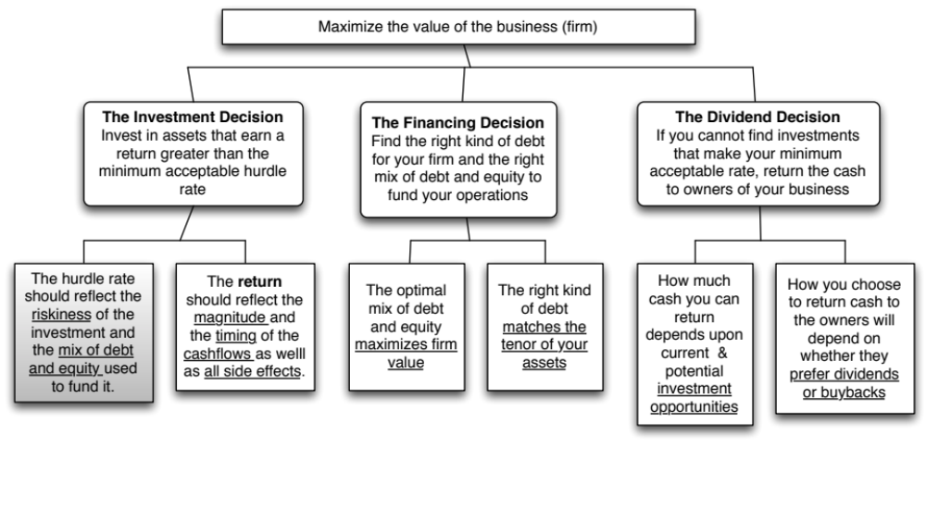
First Principles
Notes:
The focus of the first part of this investment analysis section is on coming up with a minimum acceptable hurdle rate. In the process, we have to grapple with the question of what risk is and how to bring risk into the hurdle rate.

Slide 70
The notion of a benchmark
Since financial resources are finite, there is a hurdle that projects have to cross before being deemed acceptable. This hurdle should be higher for riskier projects than for safer projects.
A simple representation of the hurdle rate is as follows:
  Hurdle rate = Riskless Rate + Risk Premium
The two basic questions that every risk and return model in finance tries to answer are:
  How do you measure risk?
  How do you translate this risk measure into a risk premium?
Notes:
Underlying the idea of a hurdle rate is the notion that projects have to earn a benchmark rate of return to be accepted, and that this benchmark should be higher for riskier projects than for safer ones.

Slide 71
What is Risk?
Risk, in traditional terms, is viewed as a ‘negative’. Webster’s dictionary, for instance, defines risk as “exposing to danger or hazard”. The Chinese symbols for risk, reproduced below, give a much better description of risk
  危机
The first symbol is the symbol for “danger”, while the second is the symbol for “opportunity”, making risk a mix of danger and opportunity. You cannot have one, without the other.
Risk is therefore neither good nor bad. It is just a fact of life. The question that businesses have to address is therefore not whether to avoid risk but how best to incorporate it into their decision making.
Notes:
Note that risk is neither good nor bad. It is a combination of danger and opportunity - you cannot have one without the other. Consequently, risk is neither something to be avoided nor sought out but carefully balanced. Good business avoid some risks, let others pass through to their investors and actively seek out still others.
When businesses want opportunity (higher returns), they have to live with the higher risk.
Any sales pitch that offers returns without risk is a pipe dream.
Bob Citron, treasurer of Orange County (CA), after he lost a chunk of the county’s pension fund money after investing in interest rate derivatives claimed that he was “not a finance person” and that Merrill’s market strategist (Charlie Clough) had told him he could make “15% with no risk”.
Many prominent (and intelligent) people invested with Bernie Madoff because he promised them (through third parties) that he could deliver 8% more than the treasury bill rate, guaranteed. One investor, interviewed by the NY Times said, “I really did not understand what he was doing, but he said was going to do something with calls, something with puts and earn 12% every year. It sounded plausible (and all my friends were investing with him too).

Slide 72
A good risk and return model should…
It should come up with a measure of risk that applies to all assets and not be asset-specific.
It should clearly delineate what types of risk are rewarded and what are not, and provide a rationale for the delineation.
It should come up with standardized risk measures, i.e., an investor presented with a risk measure for an individual asset should be able to draw conclusions about whether the asset is above-average or below-average risk.
It should translate the measure of risk into a rate of return that the investor should demand as compensation for bearing the risk.
It should work well not only at explaining past returns, but also in predicting future expected returns.
Notes:
Before we embark on looking at risk and return models, it pays to specify what a good model will look like…
A risk measure that works only for US stocks or even for only publicly traded firms is inferior to one that applies across all stocks.

Slide 73
The Capital Asset Pricing Model
Uses variance of actual returns around an expected return as a measure of risk.
Specifies that a portion of variance can be diversified away, and that is only the non-diversifiable portion that is rewarded.
Measures the non-diversifiable risk with beta, which is standardized around one.
Translates beta into expected return -
  Expected Return = Riskfree rate + Beta * Risk Premium
Works as well as the next best alternative in most cases.
Notes:
This is a summary of the CAPM, before we get into the details. This is the intuitive step-by-step process that I am going to use to bring the CAPM into being.

Slide 74
1. The Mean-Variance Framework
The variance on any investment measures the disparity between actual and expected returns.
Low Variance Investment
High Variance Investment
Expected Return
Notes:
Note that the variance that the CAPM is built around is the variance of actual returns around an expected return.
If you were an investor with a 1-year time horizon, and you bought a 1-year T.Bill, your actual returns (at least in nominal terms) will be equal to your expected return. It is riskfree.
If you were the same investor, and you bought a stock (say Intel), your actual returns will almost certainly not be equal to your expected returns.
In practice, we often look at historical (past) returns to estimate variances. Implicitly, we are assuming that this variance is a good proxy for expected future variance.

Slide 75
How risky is Disney? A look at the past…
Notes:
Disney’s stock price has been volatile, yielding a standard deviation of 26.47% (on an annualized basis) between 2008 and 2013. If you were an investor looking at Disney in 2014, what concerns (if any) would you have in using this as your measure of the forward looking risk in Disney stock?
Disney as a company changed over this period. The standard deviation from the past may not be a good indicator or future risk.
If historical standard deviations are your only way of estimating risk, it makes it impossible to measure risk in non-traded assets.

Slide 76
Do you live in a mean-variance world?
Assume that you had to pick between two investments. They have the same expected return of 15% and the same standard deviation of 25%; however, investment A offers a very small possibility that you could quadruple your money, while investment B’s highest possible payoff is a 60% return. Would you
  be indifferent between the two investments, since they have the same expected return and standard deviation?
  prefer investment A, because of the possibility of a high payoff?
  prefer investment B, because it is safer?
Would your answer change if you were not told that there is a small possibility that you could lose 100% of your money on investment A but that your worst case scenario with investment B is -50%?
Notes:
While some people may be indifferent, most pick investment A. The possibility of a high payoff, even though it is captured in the expected value, seems to tilt investors. In statistical terms, this can be viewed as evidence that investors prefer positive skewness (high positive payoffs) and value it. It is a direct contradiction to the mean-variance framework that underlies so much of conventional risk theory.
Once you add the possibility that the big positive jumps are matched by the possibility of big negative jumps, the game changes again. This propensity, called kurtosis, is not desirable to most investors.
In the real world, investments reveal far too much skewness and kurtosis than would be expected in the standard normal distribution. In fact, there are some (Mandelbrot decades ago to Taleb in the Black Swan today) who have argued that the dependence on the normal distribution is what causes risk management systems like Value at Risk (VAR) to fail.

Slide 77
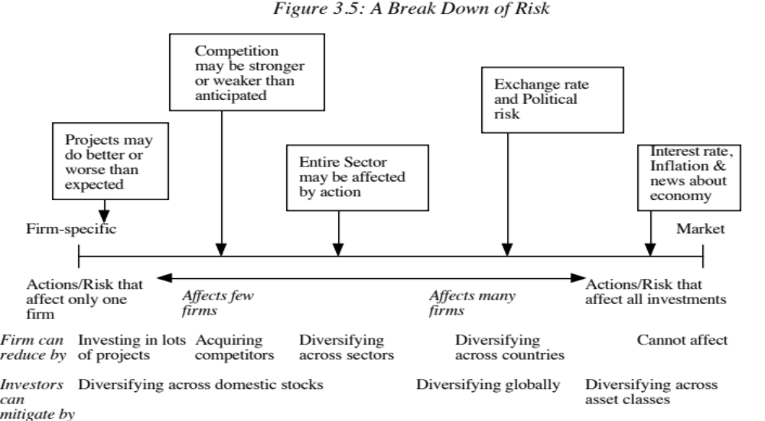
The Importance of Diversification: Risk Types
Notes:
This is the critical second step that all risk and return models in finance take.
As examples,
Project-specific Risk: Disney’s new Hong Kong theme park: To the degree that actual revenues at this park may be greater or less than expected. (Other examples: A big budget movie, ESPN Asia…)
Competitive Risk: The competition (Universal Studios, for instance) may take actions (like opening or closing a park) that affect Disney’s revenues at its theme parks.
Industry-specific risk: Congress may pass laws affecting cable and network television, and affect expected revenues at Disney and ABC, as well as all other firms in the sector, perhaps to varying degrees.
Exchange rate Risk: Disney owns NDTV, an Indian television group and has theme parks in Paris, Hong Kong and Tokyo. As the dollar strengthens or weakens, Disney will feel its effects. In fact, it may feel the effects of exchange rates even at its Orlando and Anaheim theme parks.
Market risk: If interest rates in the US go up or the economy weakens, Disney’s value as a firm will be affected.
From the perspective of an investor who holds only Disney, all risk is relevant.
From the perspective of a diversified investor, the first three risks can be diversified away, the fourth might be diversifiable (with a globally diversified portfolio) but the last risk I not.

Slide 78
Why diversification reduces/eliminates firm specific risk
Firm-specific risk can be reduced, if not eliminated, by increasing the number of investments in your portfolio (i.e., by being diversified). Market-wide risk cannot. This can be justified on either economic or statistical grounds.
On economic grounds, diversifying and holding a larger portfolio eliminates firm-specific risk for two reasons-
  Each investment is a much smaller percentage of the portfolio, muting the effect (positive or negative) on the overall portfolio.
  Firm-specific actions can be either positive or negative. In a large portfolio, it is argued, these effects will average out to zero. (For every firm, where something bad happens, there will be some other firm, where something good happens.)
Notes:
The first argument (that each investment is a small percent of your portfolio) is a pretty weak one. The second one (that things average out over investments and time) is a much stronger one.
Consider the news stories in the WSJ on any given day. About 85% to 90% of the stories are on individual firms (rather than affecting the entire market or about macro economic occurrences) and they cut both ways - some stories are good news (with the stock price rising) and some are bad news (with stock prices falling)

Slide 79
The Role of the Marginal Investor
The marginal investor in a firm is the investor who is most likely to be the buyer or seller on the next trade and to influence the stock price.
Generally speaking, the marginal investor in a stock has to own a lot of stock and also trade that stock on a regular basis.
Since trading is required, the largest investor may not be the marginal investor, especially if he or she is a founder/manager of the firm (Larry Ellison at Oracle, Mark Zuckerberg at Facebook)
In all risk and return models in finance, we assume that the marginal investor is well diversified.
Notes:
We assume that the marginal investor, who sets prices, is well diversified. (Note that we do not need to assume that all investors are diversified)
An argument for the marginally diversified investor: Assume that a diversified investor and a non-diversified investor are both looking at Disney. The latter looks at the stock and sees all risk. The former looks at it and sees only the non-diversifiable risk. If they agree on the expected earnings and cash flows, the former will be willing to pay a higher price. Thus, the latter will get driven out of the market (perhaps into mutual funds).

Slide 80
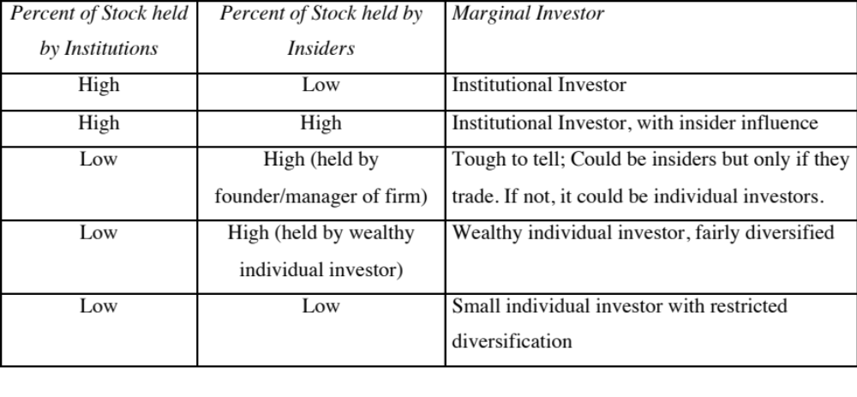
Identifying the Marginal Investor in your firm…
Notes:
This is meant to be a rough guide to identifying the marginal investor. The key is to recognize that you are not identifying a particular investor but a type of investor and considering whether that investor is likely to be diversified. One useful statistic is the proportion of total trading that is done by a group. Thus, if institutional investors account for only 15% of the shares outstanding but 60% of the trading, they will have an outsized effect on the price and are thus marginal investors.

Slide 81

Gauging the marginal investor: Disney in 2013
Notes:
Of Disney’s top 17 investors, only 2 are individuals…. Laurene Jobs and George Lucas are big stockholders (getting those shares when their companies were sold to Disney) but neither is an active trader.

Slide 82


Extending the assessment of the investor base
In all five of the publicly traded companies that we are looking at, institutions are big holders of the company’s stock.
Notes:
It may also make sense to look at the proportion of trading at these companies that comes from institutions. Thus, if institutions own 20% of the shares but account for 80% of the trading, they may still be the marginal investors in the company.

Slide 83
The Limiting Case: The Market Portfolio
The big assumptions & the follow up: Assuming diversification costs nothing (in terms of transactions costs), and that all assets can be traded, the limit of diversification is to hold a portfolio of every single asset in the economy (in proportion to market value). This portfolio is called the market portfolio.
The consequence: Individual investors will adjust for risk, by adjusting their allocations to this market portfolio and a riskless asset (such as a T-Bill):
  Preferred risk level Allocation decision
  No risk 100% in T-Bills
  Some risk 50% in T-Bills; 50% in Market Portfolio;
  A little more risk 25% in T-Bills; 75% in Market Portfolio
  Even more risk 100% in Market Portfolio
  A risk hog.. Borrow money; Invest in market portfolio
Notes:
There are two reasons investors choose to stay undiversified:
They think that they can pick undervalued investments (private information)
There are transactions costs. Since the marginal benefits of diversification decrease as the number of investments increases, you will stop diversifying.
If we assume no costs to diversifying and no private information, we take away these reasons fro not diversifying. Consequently, you will keep adding traded assets to your portfolio until you have every single one. This portfolio is called the market portfolio. This portfolio should include all traded assets, held in proportion to their market value.
The only differences between investors then will be in not what is in the market portfolio but how much they allocate to the riskless asset and how much to the market portfolio.

Slide 84
The Risk of an Individual Asset
The essence: The risk of any asset is the risk that it adds to the market portfolio Statistically, this risk can be measured by how much an asset moves with the market (called the covariance)
The measure: Beta is a standardized measure of this covariance, obtained by dividing the covariance of any asset with the market by the variance of the market. It is a measure of the non-diversifiable risk for any asset can be measured by the covariance of its returns with returns on a market index, which is defined to be the asset's beta.
The result: The required return on an investment will be a linear function of its beta:
  Expected Return = Riskfree Rate+ Beta * (Expected Return on the Market Portfolio - Riskfree Rate)
Notes:
If an investor holds the market portfolio, the risk of any asset is the risk that it adds to the portfolio. That is what beta measures.
The cost of equity is a linear function of the beta of the portfolio.

Slide 85
Limitations of the CAPM
1. The model makes unrealistic assumptions
2. The parameters of the model cannot be estimated precisely
  The market index used can be wrong.
  The firm may have changed during the 'estimation' period'
3. The model does not work well
  - If the model is right, there should be:
    A linear relationship between returns and betas
    The only variable that should explain returns is betas
  - The reality is that
    The relationship between betas and returns is weak
    Other variables (size, price/book value) seem to explain differences in returns better.
Notes:
The first two critiques can be lowered against any model in finance.
The last critique is the most damaging. Fama and French (1991) noted that
Betas explained little of the difference in returns across stocks between 1962 and 1991. (Over long time periods, it should, if the CAPM is right and betas are correctly estimated), explain almost all of the difference)
Market Capitalization and price to book value ratios explained a significant portion of the differences in returns.
This test, however, is a test of which model explains past returns best, and might not necessarily be a good indication of which one is the best model for predicting expected returns in the future.

Slide 86

Alternatives to the CAPM
Notes:
Note that all of the models of risk and return in finance agree on the first two steps. They deviate at the last step in the way they measure market risk, with
The CAPM, capturing all of it in one beta, relative to the market portfolio
The APM, capturing the market risk in multiple betas against unspecified economic factors
The Multi-Factor model, capturing the market risk in multiple betas against specified macro economic factors
The Regression model, capturing the market risk in proxies such as market capitalization and price/book ratios

Slide 87
Why the CAPM persists…
The CAPM, notwithstanding its many critics and limitations, has survived as the default model for risk in equity valuation and corporate finance. The alternative models that have been presented as better models (APM, Multifactor model..) have made inroads in performance evaluation but not in prospective analysis because:
  The alternative models (which are richer) do a much better job than the CAPM in explaining past return, but their effectiveness drops off when it comes to estimating expected future returns (because the models tend to shift and change).
  The alternative models are more complicated and require more information than the CAPM.
  For most companies, the expected returns you get with the the alternative models is not different enough to be worth the extra trouble of estimating four additional betas.
Notes:
It takes a model to beat a model… The CAPM may not be a very good model at predicting expected returns but the alternative models don’t do much better. In fact, the tests of the CAPM are joint tests of both the effectiveness of the model and the quality of the parameters used in the testing (betas, for instance). We will argue that better beta estimates and a more careful use of the CAPM can yield far better estimates of expected return than switching to a different model.
Just as a side note, there are many who either dislike or distrust the CAPM. While we share some of their skepticism about its precision, we would not throw the basic principle that the discount rate has to be adjusted for risk out, just because we do not like the CAPM. In other words, find a different risk and return model, if so inclined, but adjust for risk.

Slide 88
Application Test: Who is the marginal investor in your firm?
You can get information on insider and institutional holdings in your firm from:
  http://finance.yahoo.com/
  Enter your company’s symbol and choose profile.
Looking at the breakdown of stockholders in your firm, consider whether the marginal investor is
  An institutional investor
  An individual investor
  An insider
Notes:
For most publicly traded US firms, most, if not all, of the 15 largest investors are institutional investors. In addition, high proportions of both the stock owned and traded are by institutional investors. Thus, the assumption that the marginal investor is well diversified is quite justifiable.
For very small firms, the marginal investor may be an individual investor or even a day trader, who is not diversified. What implications does this have for the use of risk and return models?

Slide 89
From Risk & Return Models to Hurdle Rates:
Estimation Challenges
“The price of purity is purists…”
Anonymous
Notes:
As we struggle to take the theory and models of risk and return and try to use them to estimate discount rates, we will be faced with the fact that the real world is a messy place and that data is not always clear and clean. We have to be pragmatic and make compromises along the way to get to usable discount rates.

Slide 90
Inputs required to use the CAPM -
The capital asset pricing model yields the following expected return:
  Expected Return = Riskfree Rate+ Beta * (Expected Return on the Market Portfolio - Riskfree Rate)
To use the model we need three inputs:
  The current risk-free rate
  The expected market risk premium, the premium expected for investing in risky assets, i.e. the market portfolio, over the riskless asset.
  The beta of the asset being analyzed.
Notes:
Summarizes the inputs. Note that we are replacing the last component (E(Rm)-Rf) with the expected equity risk premium..

Slide 91
The Riskfree Rate and Time Horizon
On a riskfree asset, the actual return is equal to the expected return. Therefore, there is no variance around the expected return.
For an investment to be riskfree, i.e., to have an actual return be equal to the expected return, two conditions have to be met –
  There has to be no default risk, which generally implies that the security has to be issued by the government. Note, however, that not all governments can be viewed as default free.
  There can be no uncertainty about reinvestment rates, which implies that it is a zero coupon security with the same maturity as the cash flow being analyzed.
Notes:
Reemphasize that you need to know the expected returns with certainty for something to be riskless.
No default risk and no reinvestment risk. Most people understand the first point, but don’t get the second.
If you need an investment where you will know the expected returns with certainty over a 5-year time horizon, what would that investment be?
A T.Bill would not work - there is reinvestment risk.
Even a 5-year T.Bond would not work, because the coupons will cause the actual return to deviate from the expected return.
Thus, you need a 5-year zero coupon T.Bond

Slide 92
Riskfree Rate in Practice
The riskfree rate is the rate on a zero coupon government bond matching the time horizon of the cash flow being analyzed.
Theoretically, this translates into using different riskfree rates for each cash flow - the 1 year zero coupon rate for the cash flow in year 1, the 2-year zero coupon rate for the cash flow in year 2 ...
Practically speaking, if there is substantial uncertainty about expected cash flows, the present value effect of using time varying riskfree rates is small enough that it may not be worth it.
Notes:
From a present value standpoint, using different riskfree rates for each cash flow may be overkill, except in those cases where your interest rates are very different for different time horizons (a very upward sloping or downward sloping yield curve)

Slide 93
The Bottom Line on Riskfree Rates
Using a long term government rate (even on a coupon bond) as the riskfree rate on all of the cash flows in a long term analysis will yield a close approximation of the true value. For short term analysis, it is entirely appropriate to use a short term government security rate as the riskfree rate.
The riskfree rate that you use in an analysis should be in the same currency that your cashflows are estimated in.
  In other words, if your cashflows are in U.S. dollars, your riskfree rate has to be in U.S. dollars as well.
  If your cash flows are in Euros, your riskfree rate should be a Euro riskfree rate.
The conventional practice of estimating riskfree rates is to use the government bond rate, with the government being the one that is in control of issuing that currency. In November 2013, for instance, the rate on a ten-year US treasury bond (2.75%) is used as the risk free rate in US dollars.
Notes:
Since corporate finance generally looks at long term decisions, we will for the most part use the long term risk free rate.

Slide 94
What is the Euro riskfree rate? An exercise in November 2013
Notes:
Note that there are ten government that issue bonds denominated in Euros… with different rates on each of them. Since they are all in the same currency, the differences have to be attributed to perceptions of default risk. For a riskfree rate in Euros, I would go with the lowest of the rates in this table, which belongs to the German Euro bond; the ten-year rate is 1.75%.
A purist can argue that even the German Euro bond has some default risk embedded in it. The Euro riskfree rate would therefore have to be lower than 1.75%.

Slide 95
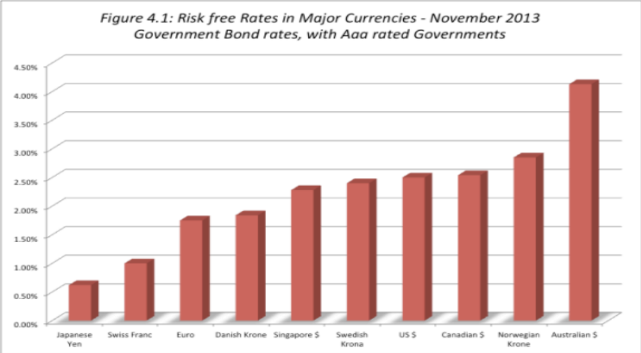
When the government is default free: Risk free rates – in November 2013
Notes:
These are currencies where there is at least one government issuing bonds in that currency that has a Aaa rating. Note, though, that the fact that a ratings agency claims that a rating is Aaa does not necessarily mean that the government is default free.

Slide 96
What if there is no default-free entity?
Risk free rates in November 2013
Adjust the local currency government borrowing rate for default risk to get a riskless local currency rate.
  In November 2013, the Indian government rupee bond rate was 8.82%. the local currency rating from Moody’s was Baa3 and the default spread for a Baa3 rated country bond was 2.25%.
  Riskfree rate in Rupees = 8.82% - 2.25% = 6.57%
  In November 2013, the Chinese Yuan government bond rate was 4.30% and the local currency rating was Aa3, with a default spread of 0.8%.
  Riskfree rate in Chinese Yuan = 4.30% - 0.8% = 3.5%
Do the analysis in an alternate currency, where getting the riskfree rate is easier. With Vale in 2013, we could chose to do the analysis in US dollars (rather than estimate a riskfree rate in R$). The riskfree rate is then the US treasury bond rate.
Do your analysis in real terms, in which case the riskfree rate has to be a real riskfree rate. The inflation-indexed treasury rate is a measure of a real riskfree rate.
Notes:
When you cannot find a default free entity in the local currency, you can start with a long-term government bond rate and net out a default spread from that rate. That default spread can be estimated using the local currency sovereign rating for the country or even a sovereign CDS spread. While this will give you a lower rate as your risk free rate, the default spread you net out will revisit your expected return computation in your equity risk premium. In fact, if you use the local government bond rate as risk free and add a country risk premium to your equity risk premium, you will be double counting country risk.
If you cannot find a local currency long-term government bond, you can either switch currencies and work with one (US dollar, Euro) where getting a risk free rate is easier. If you do so, you have to convert your local currency cash flows into US dollar or Euro cash flows, using expected exchange rates. You can also construct a synthetic risk free rate by adding the expected inflation rate to an expected real interest rate.
To do your analysis in real terms, you need a real riskfree rate. In the U.S., you can obtain such a rate by looking at the inflation indexed treasury bond rate. Outside the U.S., you can assume as a rough approximation that the real riskfree rate is equal to your real growth rate. IIf the real growth rate is much lower than the real interest rate, you will have significant deficits - trade or budget - to make up the shortfall. If the real growth rate is much higher than the real interest rate, you will the exact opposite - surpluses. A long term equilibrium can be reached only when the two are equal.

Slide 97
Three paths to estimating sovereign default spreads
Sovereign dollar or euro denominated bonds: The difference between the interest rate on a sovereign US $ bond, issued by the country, and the US treasury bond rate can be used as the default spread. For example, in November 2013, the 10-year Brazil US $ bond, denominated in US dollars had a yield of 4.25% and the US 10-year T.Bond rate traded at 2.75%.
Default spread = 4.25% - 2.75% = 1.50%
CDS spreads: Obtain the default spreads for sovereigns in the CDS market. The CDS spread for Brazil in November 2013 was 2.50%.
Average spread: If you know the sovereign rating for a country, you can estimate the default spread based on the rating. In November 2013, Brazil’s rating was Baa2, yielding a default spread of 2%.
Notes:
The default spread is a key input into estimating a risk free rate in a currency where the government has default risk. All three of these approaches yield dollar-based measure of default risk.

Slide 98
Risk free rates in currencies: Sovereigns with default risk
Notes:
Netting out the default spread from the government bond yields very different risk free rates for different currencies. The differences, though, are a result of different expected inflation rates in the currencies. As a consequence, there is no benefit to a company from switching currencies to compute hurdle rates. Using a lower inflation currency will result in a lower discount rate but the expected cash flows that you discount will have to be in the same currency and reflect the same lower inflation.

Slide 99
Measurement of the risk premium
The risk premium is the premium that investors demand for investing in an average risk investment, relative to the riskfree rate.
As a general proposition, this premium should be
  greater than zero
  increase with the risk aversion of the investors in that market
  increase with the riskiness of the “average” risk investment
Notes:
Implicit here are two questions - Which investor’s risk premium? What is the average risk investment?
With this assumption it is quite clear that estimating equity risk premiums will be difficult to do because different investors have different degrees of risk aversion (and will demand different premiums) and risk aversion will change over time.
Studies show that there is a genetic component to risk aversion (some people are born more risk averse than others) and that there is an environmental component. Individuals who experience a severe recession when they are in their twenties are more risk averse for the rest of their lives.

Slide 100
What is your risk premium?
Assume that stocks are the only risky assets and that you are offered two investment options:
  a riskless investment (say a Government Security), on which you can make 3%
  a mutual fund of all stocks, on which the returns are uncertain
How much of an expected return would you demand to shift your money from the riskless asset to the mutual fund?
  Less than 3%
  Between 3% - 5%
  Between 5% - 7%
  Between 7% -9%
  Between 9%- 11%
  More than 11%
Notes:
I usually find that the median number that I get in the US is 7-9%, though the distribution is pretty spread out. This translates into a risk premium of 4-6%. (I have also run a survey on my web site for three years. With more than 30,000 responses, the median risk premium is about 4-6% as well.)
If this were the entire market, the risk premium would be a weighted average of the risk premiums demanded by each and every investor.
The weights will be determined by the wealth that each investor brings to the market. Thus, Warren Buffett’s risk aversion counts more towards determining the “equilibrium” premium than yours’ and mine.
As investors become more risk averse, you would expect the “equilibrium” premium to increase.

Slide 101
Risk Aversion and Risk Premiums
If this were the entire market, the risk premium would be a weighted average of the risk premiums demanded by each and every investor.
The weights will be determined by the wealth that each investor brings to the market. Thus, Warren Buffett’s risk aversion counts more towards determining the “equilibrium” premium than yours’ and mine.
As investors become more risk averse, you would expect the “equilibrium” premium to increase.
Notes:
The wealthier you are, the more your estimate of the risk premium will weight into the final market premium.

Slide 102
Risk Premiums do change..
Go back to the previous example. Assume now that you are making the same choice but that you are making it in the aftermath of a stock market crash (it has dropped 25% in the last month). Would you change your answer?
  I would demand a larger premium
  I would demand a smaller premium
  I would demand the same premium
Notes:
Quite a few will demand a larger premium, suggesting that this is a dynamic estimate, changing from period to period. Some will settle for a smaller premium, arguing that if stocks were a bargain before the drop, they should be even more so now. The broader point is that risk premiums change over time.
You can ask the same question about how a recession or losing your job will affect your risk premium.

Slide 103
Estimating Risk Premiums in Practice
Survey investors on their desired risk premiums and use the average premium from these surveys.
Assume that the actual premium delivered over long time periods is equal to the expected premium - i.e., use historical data
Estimate the implied premium in today’s asset prices.
Notes:
Lists the basic approaches. Not all of them are equally useful… So, let’s look at each one separately.

Slide 104
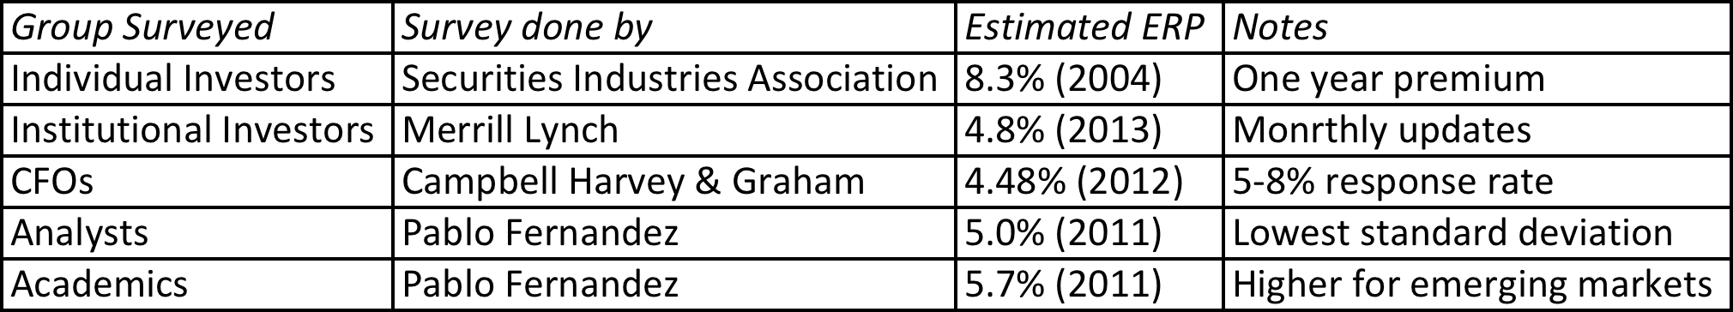
The Survey Approach
Surveying all investors in a market place is impractical.
However, you can survey a few individuals and use these results. In practice, this translates into surveys of the following:
The limitations of this approach are:
  There are no constraints on reasonability (the survey could produce negative risk premiums or risk premiums of 50%)
  The survey results are more reflective of the past than the future.
  They tend to be short term; even the longest surveys do not go beyond one year.
Notes:
Merrill Lynch does surveys of portfolio managers (who presumably have more wealth to invest and hence should be weighted more) asking investors what they think the market will do over the next year. They report the number but do not use it internally as a risk premium.
Morningstar does surveys of individual investors and reports absurdly high premiums. It is not clear whether these are wishes of expectations.
Campbell and Harvey have been doing surveys of CFOs for a decade and they report their results in detail every year. (The full surveys are well worth reading and are on ssrn.com)
Generally survey premiums seem to be more backward looking than forward looking. In other words, they seem to decrease in good times and jump after market crises (the key word is after… no predictive power here)

Slide 105
The Historical Premium Approach
This is the default approach used by most to arrive at the premium to use in the model
In most cases, this approach does the following
  Defines a time period for the estimation (1928-Present, last 50 years...)
  Calculates average returns on a stock index during the period
  Calculates average returns on a riskless security over the period
  Calculates the difference between the two averages and uses it as a premium looking forward.
The limitations of this approach are:
  it assumes that the risk aversion of investors has not changed in a systematic way across time. (The risk aversion may change from year to year, but it reverts back to historical averages)
  it assumes that the riskiness of the “risky” portfolio (stock index) has not changed in a systematic way across time.
Notes:
This is the basic approach used by almost every large investment bank and consulting firm.
The US has the longest and richest historical data base for stocks (going back as far as the 1800s) and many historical premiums are based upon that data…
We are trusting mean reversion, i.e., that numbers revert back to historical averages over time..

Slide 106
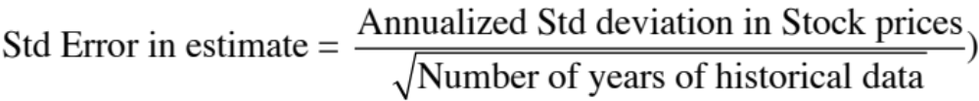
B. The Historical Risk Premium
Evidence from the United States
What is the right premium?
Go back as far as you can. Otherwise, the standard error in the estimate will be large.
Be consistent in your use of a riskfree rate.
Use arithmetic premiums for one-year estimates of costs of equity and geometric premiums for estimates of long term costs of equity.
 | Arithmetic Average |  | Geometric Average
 | Stocks - T. Bills | Stocks - T. Bonds | Stocks - T. Bills | Stocks - T. Bonds
1928-2013 | 7.93% | 6.29% | 6.02% | 4.62%
Std Error | 2.19% | 2.34%
1964-2013 | 6.18% | 4.32% | 4.83% | 3.33%
Std Error | 2.42% | 2.75%
2004-2013 | 7.55% | 4.41% | 5.80% | 3.07%
Std Error | 6.02% | 8.66%
Notes:
The US has the longest and richest historical data base for stocks (going back as far as the 1800s) and many historical premiums are based upon that data…
We are trusting mean reversion, i.e., that numbers revert back to historical averages over time..
This is based upon historical data available on the Federal Reserve site in St. Louis. There are three reasons for why the premium estimated may differ:
1. How far back you go (My personal bias is to go back as far as possible. Stock prices are so noisy that you need very long time periods to get reasonable estimates)
2. Whether you use T.Bill or T.Bond rates ( You have to be consistent. Since I will be using the T.Bond rate as my riskfree rate, I will use the premium over that rate)
3. Whether you use arithmetic or geometric means (If returns were uncorrelated over time, and you were asked to estimate a 1-year premium, the arithmetic mean would be used. Since returns are negatively correlated over time, and we are estimating premiums over longer holding periods, it makes more sense to use the compounded return, which gives us the geometric average)
Thus, I should be using the updated geometric average for stocks over bonds.
Update this table: This table will require updating at the start of every year. You can get the latest version of this table by going to
http://www.stern.nyu.edu/~adamodar/pc/datasets/histretSP.xls

Slide 107
What about historical premiums for other markets?
Historical data for markets outside the United States is available for much shorter time periods. The problem is even greater in emerging markets.
The historical premiums that emerge from this data reflects this data problem and there is much greater error associated with the estimates of the premiums.
Notes:
Increasingly, the challenges we face are in estimating risk premiums outside the United States, not only because so many companies that we value are in younger, emerging markets but because so many US companies are looking at expanding into these markets.

Slide 108
One solution: Bond default spreads as CRP – November 2013
In November 2013, the historical risk premium for the US was 4.20% (geometric average, stocks over T.Bonds, 1928-2012)
Using the default spread on the sovereign bond or based upon the sovereign rating and adding that spread to the mature market premium (4.20% for the US) gives you a total ERP for a country.
If you prefer CDS spreads:
 | Arithmetic Average |  | Geometric Average
 | Stocks - T. Bills | Stocks - T. Bonds | Stocks - T. Bills | Stocks - T. Bonds
1928-2012 | 7.65% | 5.88% | 5.74% | 4.20%
 | 2.20% | 2.33%
Country | Rating | Default Spread (Country Risk Premium) | US ERP | Total ERP for country
India | Baa3 | 2.25% | 4.20% | 6.45%
China | Aa3 | 0.80% | 4.20% | 5.00%
Brazil | Baa2 | 2.00% | 4.20% | 6.20%
Country | Sovereign CDS Spread | US ERP | Total ERP for country
India | 4.20% | 4.20% | 8.40%
China | 1.20% | 4.20% | 5.40%
Brazil | 2.59% | 4.20% | 6.79%
Notes:
This approach is simple but it assumes that country default spreads are also good measures of additional country equity risk. The question thought is whether equities (which are riskier than bonds) should command a larger risk premium.

Slide 109
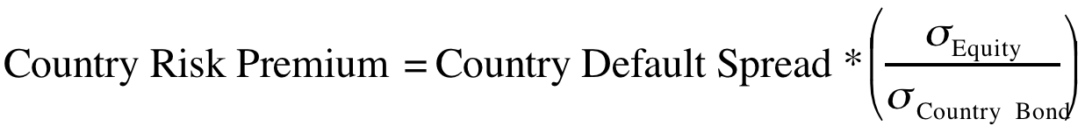

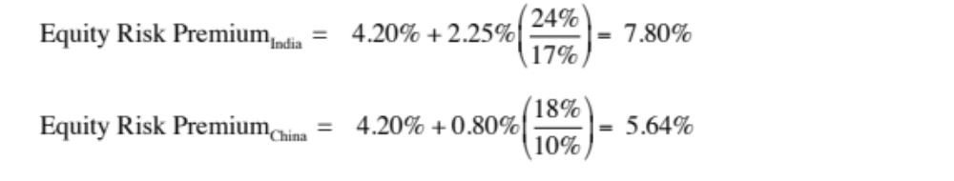
Beyond the default spread? Equities are riskier than bonds
While default risk spreads and equity risk premiums are highly correlated, one would expect equity spreads to be higher than debt spreads. One approach to scaling up the premium is to look at the relative volatility of equities to bonds and to scale up the default spread to reflect this:
Brazil: The annualized standard deviation in the Brazilian equity index over the previous year is 21 percent, whereas the annualized standard deviation in the Brazilian C-bond is 14 percent.
Using the same approach for China and India:
Notes:
In In this approach, we scale up the default spread to reflect the additional risk in stocks… This will result in larger equity risk premiums. We are assuming that investors, when pricing equities in an emerging market, look at what they can make on government bonds issued by that market and scale up premiums for additional risk.
There is a third approach which is closely related where you look at the standard deviation of the emerging equity market, relative to the standard deviation of the U.S. equity market, and multiply by the U.S. equity risk premium. Thus, the equity risk premium for an emerging market which is twice as volatile as the the US market should have twice the equity risk premium for the US.

Slide 110
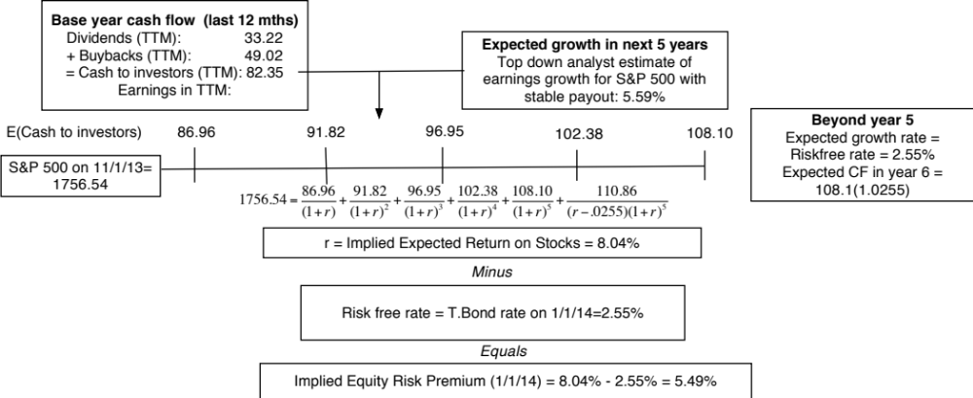
Implied ERP in November 2013: Watch what I pay, not what I say..
If you can observe what investors are willing to pay for stocks, you can back out an expected return from that price and an implied equity risk premium.
Notes:
View stocks like you would a bond. This is the analog to computing the YTM on a bond. The expected return is the IRR that makes the present value of expected cash flows on stocks = level of the index today. This implied equity risk premium will change over time, as the index and treasury bond rates change every minute of every day and the cash flows and growth numbers also change (though they get updated less frequently).
Implicit assumptions:
Total cash returned by firms in base year is not skewed by the year being an exceptionally good or bad year. You can counter this by using an average cash yield from the last 5 or 10 years to compute the cash flow.
The cash returned will grow at the same rate as earnings on the index for the next 5 years. (Cash yield remains constant)
The expected growth rate in perpetuity in cash flows will converge on the risk free rate.

Slide 111
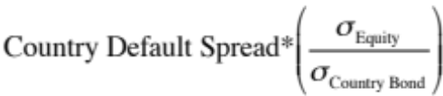
The bottom line on Equity Risk Premiums in November 2013
Mature Markets: In November 2013, the number that we chose to use as the equity risk premium for all mature markets was 5.5%. This was set equal to the implied premium at that point in time and it was much higher than the historical risk premium of 4.20% prevailing then (1928-2012 period).
For emerging markets, we will use the melded default spread approach (where default spreads are scaled up to reflect additional equity risk) to come up with the additional risk premium that we will add to the mature market premium. Thus, markets in countries with lower sovereign ratings will have higher risk premiums that 5.5%.
  Emerging Market ERP = 5.5% +
 | Arithmetic Average |  | Geometric Average
 | Stocks - T. Bills | Stocks - T. Bonds | Stocks - T. Bills | Stocks - T. Bonds
1928-2012 | 7.65% | 5.88% | 5.74% | 4.20%
 | 2.20% | 2.33%
1962-2012 | 5.93% | 3.91% | 4.60% | 2.93%
 | 2.38% | 2.66%
2002-2012 | 7.06% | 3.08% | 5.38% | 1.71%
 | 5.82% | 8.11%
Notes:
This is a judgment call and will depend upon your point of view in November 2013. If you believe in mean reversion and that history is the best guide to the future, you have a case for using the historical risk premium (4.20%). If you believe that the world is changing, that mean reversion may not be to historic norms and that risk premiums are dynamic, you will use an implied premium (5.5%).
If you thought that the 2008 crisis was just a bump in the road that markets would quickly forget and move on, you would use either the historical risk premium (4.20%) or the average implied premium over time (about 4%) as your mature market premium.
If you thought that the crisis has fundamentally changed markets (and perceived risk in mature markets), you should use the updated number.

Slide 112
A Composite way of estimating ERP for countries
Step 1: Estimate an equity risk premium for a mature market. If your preference is for a forward looking, updated number, you can estimate an implied equity risk premium for the US (assuming that you buy into the contention that it is a mature market)
  My estimate: In January 2014, my estimate for the implied premium in the US was 5%. That will also be my estimate for a mature market ERP.
Step 2: Come up with a generic and measurable definition of a mature market.
  My estimate: Any AAA rated country is mature.
Step 3: Estimate the additional risk premium that you will charge for markets that are not mature. You have two choices:
  The default spread for the country, estimated based either on sovereign ratings or the CDS market.
  A scaled up default spread, where you adjust the default spread upwards for the additional risk in equity markets.
Notes:
You could compute implied equity risk premiums for all markets and dispense with this three step process, but the inputs for implied ERP can be difficult to get in many emerging markets.
You may also take issue with my definition of a mature market (AAA) and my use of default spreads as measures of country risk. I share many of your concerns about whether these are adequate measures of country risk, but until we can come up with better measures, we are stuck with these.

Slide 113

ERP : Nov 2013
Andorra | 7.45% | 1.95% | Liechtenstein | 5.50% | 0.00%
Austria | 5.50% | 0.00% | Luxembourg | 5.50% | 0.00%
Belgium | 6.70% | 1.20% | Malta | 7.45% | 1.95%
Cyprus | 22.00% | 16.50% | Netherlands | 5.50% | 0.00%
Denmark | 5.50% | 0.00% | Norway | 5.50% | 0.00%
Finland | 5.50% | 0.00% | Portugal | 10.90% | 5.40%
France | 5.95% | 0.45% | Spain | 8.88% | 3.38%
Germany | 5.50% | 0.00% | Sweden | 5.50% | 0.00%
Greece | 15.63% | 10.13% | Switzerland | 5.50% | 0.00%
Iceland | 8.88% | 3.38% | Turkey | 8.88% | 3.38%
Ireland | 9.63% | 4.13% | United Kingdom | 5.95% | 0.45%
Italy | 8.50% | 3.00% | Western Europe | 6.72% | 1.22%
Albania | 12.25% | 6.75%
Armenia | 10.23% | 4.73%
Azerbaijan | 8.88% | 3.38%
Belarus | 15.63% | 10.13%
Bosnia | 15.63% | 10.13%
Bulgaria | 8.50% | 3.00%
Croatia | 9.63% | 4.13%
Czech Republic | 6.93% | 1.43%
Estonia | 6.93% | 1.43%
Georgia | 10.90% | 5.40%
Hungary | 9.63% | 4.13%
Kazakhstan | 8.50% | 3.00%
Latvia | 8.50% | 3.00%
Lithuania | 8.05% | 2.55%
Macedonia | 10.90% | 5.40%
Moldova | 15.63% | 10.13%
Montenegro | 10.90% | 5.40%
Poland | 7.15% | 1.65%
Romania | 8.88% | 3.38%
Russia | 8.05% | 2.55%
Serbia | 10.90% | 5.40%
Slovakia | 7.15% | 1.65%
Slovenia | 9.63% | 4.13%
Ukraine | 15.63% | 10.13%
E. Europe & Russia | 8.60% | 3.10%
Bangladesh | 10.90% | 5.40%
Cambodia | 13.75% | 8.25%
China | 6.94% | 1.44%
Fiji | 12.25% | 6.75%
Hong Kong | 5.95% | 0.45%
India | 9.10% | 3.60%
Indonesia | 8.88% | 3.38%
Japan | 6.70% | 1.20%
Korea | 6.70% | 1.20%
Macao | 6.70% | 1.20%
Malaysia | 7.45% | 1.95%
Mauritius | 8.05% | 2.55%
Mongolia | 12.25% | 6.75%
Pakistan | 17.50% | 12.00%
Papua NG | 12.25% | 6.75%
Philippines | 9.63% | 4.13%
Singapore | 5.50% | 0.00%
Sri Lanka | 12.25% | 6.75%
Taiwan | 6.70% | 1.20%
Thailand | 8.05% | 2.55%
Vietnam | 13.75% | 8.25%
Asia | 7.27% | 1.77%
Canada | 5.50% | 0.00%
United States of America | 5.50% | 0.00%
North America | 5.50% | 0.00%
Country | TRP | CRP
Angola | 10.90% | 5.40%
Benin | 13.75% | 8.25%
Botswana | 7.15% | 1.65%
Burkina Faso | 13.75% | 8.25%
Cameroon | 13.75% | 8.25%
Cape Verde | 12.25% | 6.75%
Egypt | 17.50% | 12.00%
Gabon | 10.90% | 5.40%
Ghana | 12.25% | 6.75%
Kenya | 12.25% | 6.75%
Morocco | 9.63% | 4.13%
Mozambique | 12.25% | 6.75%
Namibia | 8.88% | 3.38%
Nigeria | 10.90% | 5.40%
Rwanda | 13.75% | 8.25%
Senegal | 12.25% | 6.75%
South Africa | 8.05% | 2.55%
Tunisia | 10.23% | 4.73%
Uganda | 12.25% | 6.75%
Zambia | 12.25% | 6.75%
Africa | 11.22% | 5.82%
Argentina | 15.63% | 10.13%
Belize | 19.75% | 14.25%
Bolivia | 10.90% | 5.40%
Brazil | 8.50% | 3.00%
Chile | 6.70% | 1.20%
Colombia | 8.88% | 3.38%
Costa Rica | 8.88% | 3.38%
Ecuador | 17.50% | 12.00%
El Salvador | 10.90% | 5.40%
Guatemala | 9.63% | 4.13%
Honduras | 13.75% | 8.25%
Mexico | 8.05% | 2.55%
Nicaragua | 15.63% | 10.13%
Panama | 8.50% | 3.00%
Paraguay | 10.90% | 5.40%
Peru | 8.50% | 3.00%
Suriname | 10.90% | 5.40%
Uruguay | 8.88% | 3.38%
Venezuela | 12.25% | 6.75%
Latin America | 9.44% | 3.94%
Bahrain | 8.05% | 2.55%
Israel | 6.93% | 1.43%
Jordan | 12.25% | 6.75%
Kuwait | 6.40% | 0.90%
Lebanon | 12.25% | 6.75%
Oman | 6.93% | 1.43%
Qatar | 6.40% | 0.90%
Saudi Arabia | 6.70% | 1.20%
United Arab Emirates | 6.40% | 0.90%
Middle East | 6.88% | 1.38%
Australia | 5.50% | 0.00%
Cook Islands | 12.25% | 6.75%
New Zealand | 5.50% | 0.00%
Australia & NZ | 5.00% | 0.00%
Black #: Total ERP
Red #: Country risk premium
AVG: GDP weighted average
Notes:
Country risk premiums in November 2013. I use the sovereign rating for each country to estimate a default spread based on that rating (I compute this spread by averaging out the observed spreads on all countries with a given rating, using either $ denominated bonds or the CDS as my measure of the spread) and then scale that spread up by 1.5 (reflecting the average ratio of equity market volatility to government bond market volatility in each market). The number I obtain is then added to my base mature market premium of 5.5% (computed as the updated implied equity risk premium for the S&P 500).

Slide 114
Estimating ERP for Disney: November 2013
Incorporation: The conventional practice on equity risk premiums is to estimate an ERP based upon where a company is incorporated. Thus, the cost of equity for Disney would be computed based on the US equity risk premium, because it is a US company, and the Brazilian ERP would be used for Vale, because it is a Brazilian company.
Operations: The more sensible practice on equity risk premium is to estimate an ERP based upon where a company operates. For Disney in 2013:
Region/ Country | Proportion of Disney’s Revenues | ERP
US& Canada | 82.01% | 5.50%
Europe | 11.64% | 6.72%
Asia-Pacific | 6.02% | 7.27%
Latin America | 0.33% | 9.44%
Disney | 100.00% | 5.76%
Notes:
The ERP for a company should reflect where it does business rather than where it is incorporation. While I have used revenues as my basis for estimating the composite premium for Disney, you may chose an alternate variable (% of production, identifiable assets) to make the allocation. If you use the country of incorporation as your only basis, you will over estimated the costs of capital for emerging market companies and under estimate them for developed market companies.

Slide 115
ERP for Companies: November 2013
Company | Region/ Country | Weight | ERP
Bookscape | United States | 100% | 5.50%
Vale | US & Canada | 4.90% | 5.50%
 | Brazil | 16.90% | 8.50%
 | Rest of Latin America | 1.70% | 10.09%
 | China | 37.00% | 6.94%
 | Japan | 10.30% | 6.70%
 | Rest of Asia | 8.50% | 8.61%
 | Europe | 17.20% | 6.72%
 | Rest of World | 3.50% | 10.06%
 | Company | 100.00% | 7.38%
Tata Motors | India | 23.90% | 9.10%
 | China | 23.60% | 6.94%
 | UK | 11.90% | 5.95%
 | United States | 10.00% | 5.50%
 | Mainland Europe | 11.70% | 6.85%
 | Rest of World | 18.90% | 6.98%
 | Company | 100.00% | 7.19%
Baidu | China | 100% | 6.94%
Deutsche Bank | Germany | 35.93% | 5.50%
 | North America | 24.72% | 5.50%
 | Rest of Europe | 28.67% | 7.02%
 | Asia-Pacific | 10.68% | 7.27%
 | South America | 0.00% | 9.44%
 | Company | 100.00% | 6.12%
In November 2013, the mature market premium used was 5.5%
Notes:
Bookscape and Baidu are easy, since they get all of their revenues in one market. Baidu, though, may look different in future years if its plans to expand come to fruition. Deutshe, Tata Motors and Vale are multinationals.

Slide 116
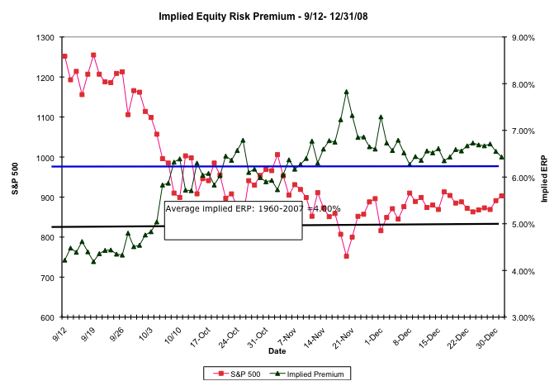
The Anatomy of a Crisis: Implied ERP from September 12, 2008 to January 1, 2009
Notes:
Equity risk premiums changed more in three months than they had in the previous 20 years put together. A wake-up call for those who stick with fixed premiums? That depends on whether we assume that this is an aberration or a break with the past.

Slide 117
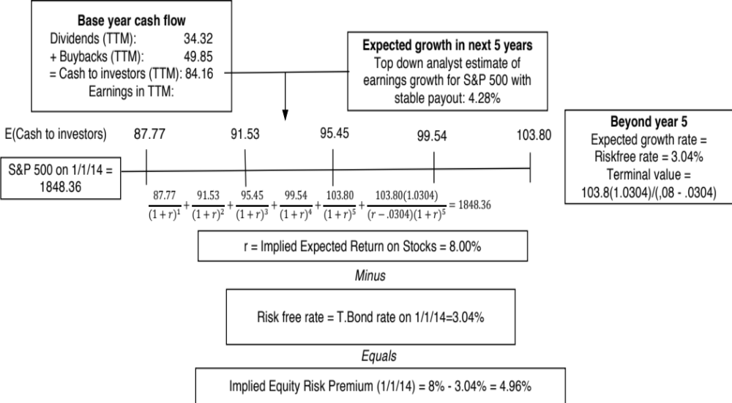
An Updated Equity Risk Premium: January 2014
Notes:
The key lesson I would take away is that equity risk premiums are unstable and that globalization has made them more unstable. The other is that there seems to be mean reversion in the process – implied premiums, when abnormally high or low, move back towards a longer term average.

Slide 118
Implied Premiums in the US: 1960-2013
Notes:
As the index changes (and it is the input most likely to change by large amounts in short periods), the implied premium will change. Note that as premiums rise, stock prices drop. Notice two historical phenomena: (1) Equity risk premiums spiked in the 1970s as inflation increased in the US (2) Equity risk premiums bottomed out at 2% at the end of 1999 at the peak of the dot-com boom.
Would you settle for a 2% premium? If your answer is no, you believe that stocks are overvalued.

Slide 119
ERP : Jan 2014
Andorra | 6.80% | 1.80% | Liechtenstein | 5.00% | 0.00%
Austria | 5.00% | 0.00% | Luxembourg | 5.00% | 0.00%
Belgium | 5.90% | 0.90% | Malta | 6.80% | 1.80%
Cyprus | 20.00% | 15.00% | Netherlands | 5.00% | 0.00%
Denmark | 5.00% | 0.00% | Norway | 5.00% | 0.00%
Finland | 5.00% | 0.00% | Portugal | 10.40% | 5.40%
France | 5.60% | 0.60% | Spain | 8.30% | 3.30%
Germany | 5.00% | 0.00% | Sweden | 5.00% | 0.00%
Greece | 20.00% | 15.00% | Switzerland | 5.00% | 0.00%
Iceland | 8.30% | 3.30% | Turkey | 8.30% | 3.30%
Ireland | 8.75% | 3.75% | United Kingdom | 5.60% | 0.60%
Italy | 7.85% | 2.85% | Western Europe | 6.29% | 1.29%
Albania | 11.75% | 6.75%
Armenia | 9.50% | 4.50%
Azerbaijan | 8.30% | 3.30%
Belarus | 14.75% | 9.75%
Bosnia and Herzegovina | 14.75% | 9.75%
Bulgaria | 7.85% | 2.85%
Croatia | 8.75% | 3.75%
Czech Republic | 6.05% | 1.05%
Estonia | 6.05% | 1.05%
Georgia | 10.40% | 5.40%
Hungary | 8.75% | 3.75%
Kazakhstan | 7.85% | 2.85%
Latvia | 7.85% | 2.85%
Lithuania | 7.40% | 2.40%
Macedonia | 10.40% | 5.40%
Moldova | 14.75% | 9.75%
Montenegro | 10.40% | 5.40%
Poland | 6.28% | 1.28%
Romania | 8.30% | 3.30%
Russia | 7.40% | 2.40%
Serbia | 11.75% | 6.75%
Slovakia | 6.28% | 1.28%
Slovenia | 8.75% | 3.75%
Ukraine | 16.25% | 11.25%
E. Europe & Russia | 7.96% | 2.96%
Bangladesh | 10.40% | 5.40%
Cambodia | 13.25% | 8.25%
China | 5.90% | 0.90%
Fiji | 11.75% | 6.75%
Hong Kong | 5.60% | 0.60%
India | 8.30% | 3.30%
Indonesia | 8.30% | 3.30%
Japan | 5.90% | 0.90%
Korea | 5.90% | 0.90%
Macao | 5.90% | 0.90%
Malaysia | 6.80% | 1.80%
Mauritius | 7.40% | 2.40%
Mongolia | 11.75% | 6.75%
Pakistan | 16.25% | 11.25%
Papua New Guinea | 11.75% | 6.75%
Philippines | 8.30% | 3.30%
Singapore | 5.00% | 0.00%
Sri Lanka | 11.75% | 6.75%
Taiwan | 5.90% | 0.90%
Thailand | 7.40% | 2.40%
Vietnam | 13.25% | 8.25%
Asia | 6.51% | 1.51%
Canada | 5.00% | 0.00%
United States of America | 5.00% | 0.00%
North America | 5.00% | 0.00%
Angola | 10.40% | 5.40%
Benin | 13.25% | 8.25%
Botswana | 6.28% | 1.28%
Burkina Faso | 13.25% | 8.25%
Cameroon | 13.25% | 8.25%
Cape Verde | 13.25% | 8.25%
DR Congo | 14.75% | 9.75%
Egypt | 16.25% | 11.25%
Gabon | 10.40% | 5.40%
Ghana | 11.75% | 6.75%
Kenya | 11.75% | 6.75%
Morocco | 8.75% | 3.75%
Mozambique | 11.75% | 6.75%
Namibia | 8.30% | 3.30%
Nigeria | 10.40% | 5.40%
Rep Congo | 10.40% | 5.40%
Rwanda | 13.25% | 8.25%
Senegal | 11.75% | 6.75%
South Africa | 7.40% | 2.40%
Tunisia | 10.40% | 5.40%
Uganda | 11.75% | 6.75%
Zambia | 11.75% | 6.75%
Africa | 10.04% | 5.04%
Argentina | 14.75% | 9.75%
Belize | 18.50% | 13.50%
Bolivia | 10.40% | 5.40%
Brazil | 7.85% | 2.85%
Chile | 5.90% | 0.90%
Colombia | 8.30% | 3.30%
Costa Rica | 8.30% | 3.30%
Ecuador | 16.25% | 11.25%
El Salvador | 10.40% | 5.40%
Guatemala | 8.75% | 3.75%
Honduras | 13.25% | 8.25%
Mexico | 7.40% | 2.40%
Nicaragua | 14.75% | 9.75%
Panama | 7.85% | 2.85%
Paraguay | 10.40% | 5.40%
Peru | 7.85% | 2.85%
Suriname | 10.40% | 5.40%
Uruguay | 8.30% | 3.30%
Venezuela | 16.25% | 11.25%
Latin America | 8.62% | 3.62%
Abu Dhabi | 5.75% | 0.75%
Bahrain | 7.85% | 2.85%
Israel | 6.05% | 1.05%
Jordan | 11.75% | 6.75%
Kuwait | 5.75% | 0.75%
Lebanon | 11.75% | 6.75%
Oman | 6.05% | 1.05%
Qatar | 5.75% | 0.75%
Saudi Arabia | 5.90% | 0.90%
United Arab Emirates | 5.75% | 0.75%
Middle East | 6.14% | 1.14%
Australia | 5.00% | 0.00%
Cook Islands | 11.75% | 6.75%
New Zealand | 5.00% | 0.00%
Australia & New Zealand | 5.00% | 0.00%
Black #: Total ERP
Red #: Country risk premium
AVG: GDP weighted average
Notes:
Updated country risk premiums. . I use the sovereign rating for each country to estimate a default spread based on that rating (I compute this spread by averaging out the observed spreads on all countries with a given rating, using either $ denominated bonds or the CDS as my measure of the spread) and then scale that spread up by 1.5 (reflecting the average ratio of equity market volatility to government bond market volatility in each market). The number I obtain is then added to my base mature market premium (computed as the updated implied equity risk premium for the S&P 500).
Update this table: This table will require updating at the start of every year. You can get the latest version of this table by going to
http://www.stern.nyu.edu/~adamodar/pc/datasets/ctryprem.xls

Slide 120
Application Test: Estimating a Market Risk Premium
For your company, get the geographical breakdown of revenues in the most recent year. Based upon this revenue breakdown and the most recent country risk premiums, estimate the equity risk premium that you would use for your company.
This computation was based entirely on revenues. With your company, what concerns would you have about your estimate being too high or too low?
Notes:
Companies often break down revenues into broad regions, rather than countries. Use the regional weighted averages. Some companies do provide more information than others. Use what you can and make your best estimates.

Slide 121
Estimating Beta
The standard procedure for estimating betas is to regress stock returns (R_{j}) against market returns (R_{m}):
R_{j} = a + b R _{m}
  where a is the intercept and b is the slope of the regression.
The slope of the regression corresponds to the beta of the stock, and measures the riskiness of the stock.
The R squared (R²) of the regression provides an estimate of the proportion of the risk (variance) of a firm that can be attributed to market risk. The balance (1 - R²) can be attributed to firm specific risk.
Notes:
Betas reflect not just the volatility of the underlying investment but also how it moves with the market:
Beta (Slope) = Correlation_{jm} (σ_{ϕ /} s_{m})
Note that a stock can have a high standard deviation but the beta can be low, if the stock is lightly correlated with the market.
Key point: Betas may be estimated from regressions but they should never be considered purely statistical numbers. They convey economic weight - they measure the risk added on by an asset to a diversified portfolio.

Slide 122
Estimating Performance
The intercept of the regression provides a simple measure of performance during the period of the regression, relative to the capital asset pricing model.
  R_{j} = R_{f} + b (R_{m} - R_{f})
  = R_{f} (1-b) + b R_{m} ........... Capital Asset Pricing Model
  R_{j} = a + b R_{m} ........... Regression Equation
If
  a > R_{f} (1-b) .... Stock did better than expected during regression period
  a = R_{f} (1-b) .... Stock did as well as expected during regression period
  a < R_{f} (1-b) .... Stock did worse than expected during regression period
The difference between the intercept and Rf (1-b) is Jensen's alpha. If it is positive, your stock did perform better than expected during the period of the regression.
Notes:
Think of Riskfree rate (1- Beta) as the return your stock should make in a period when the market is flat (market return is zero). Note that it will be negative if the beta >1; a riskier stock will actually deliver negative returns in a month in which the market is flat.
The intercept is what your stock actually made in a month in which the market was flat.
The difference measures whether your stock under or over performed the market index over the period. It is called Jensen’s alpha (Michael Jensen used the measure to evaluate mutual fund performance in 1968).
Jensen’s alpha can also be computed by estimating the expected return during the period of the regression, using the actual return on the market during the period, the riskfree rate during the period and the estimated beta, and then comparing it to the actual return over the period.
Algebraically, you should get the same answer.
In some cases, the regression is run using excess returns over the risk free rate on both sides - excess return for the stock on the left hand side and excess returns for the market on the right hand side. In that case, the intercept is itself Jensen’s alpha.

Slide 123
Setting up for the Estimation
Decide on an estimation period
  Services use periods ranging from 2 to 5 years for the regression
  Longer estimation period provides more data, but firms change.
  Shorter periods can be affected more easily by significant firm-specific event that occurred during the period
Decide on a return interval - daily, weekly, monthly
  Shorter intervals yield more observations, but suffer from more noise.
  Noise is created by stocks not trading and biases all betas towards one.
Estimate returns (including dividends) on stock
  Return = (Price_{End} - Price_{Beginning} + Dividends_{Period})/ Price_{Beginning}
  Included dividends only in ex-dividend month
Choose a market index, and estimate returns (inclusive of dividends) on the index for each interval for the period.
Notes:
Note the number of subjective judgments that have to be made. The estimated beta is going to be affected by all these judgments. On each one, there are trade offs to be made, which may explain why different services make different choices.
My personal biases are to
Use five years of data (because I use monthly data)
Use monthly returns (to avoid non-trading problems)
Use returns with dividends
Use an index that is broad, market weighted and with a long history (I use the S&P 500. The NYSE composite is not market weighted, and the Wilshire 5000 has both non-trading and measurement issues that have not been resolved.) You want to get as close the mythical market portfolio as you can get…

Slide 124
Choosing the Parameters: Disney
Period used: 5 years
Return Interval = Monthly
Market Index: S&P 500 Index.
For instance, to calculate returns on Disney in December 2009,
  Price for Disney at end of November 2009 = $ 30.22
  Price for Disney at end of December 2009 = $ 32.25
  Dividends during month = $0.35 (It was an ex-dividend month)
  Return =($32.25 - $30.22 + $ 0.35)/$30.22= 7.88%
To estimate returns on the index in the same month
  Index level at end of November 2009 = 1095.63
  Index level at end of December 2009 = 1115.10
  Dividends on index in December 2009 = 1.683
  Return =(1115.1 – 1095.63+1.683)/ 1095.63 = 1.78%
Notes:
Reports parameters used. Returns in each month include dividends, if any, in that month. For most dividend paying U.S. stocks, there will be four months in the year where there are dividends and eight months without dividends. (Will the returns in those months be better? Not if you factor in what happens to stock prices on ex dividend days)

Slide 125
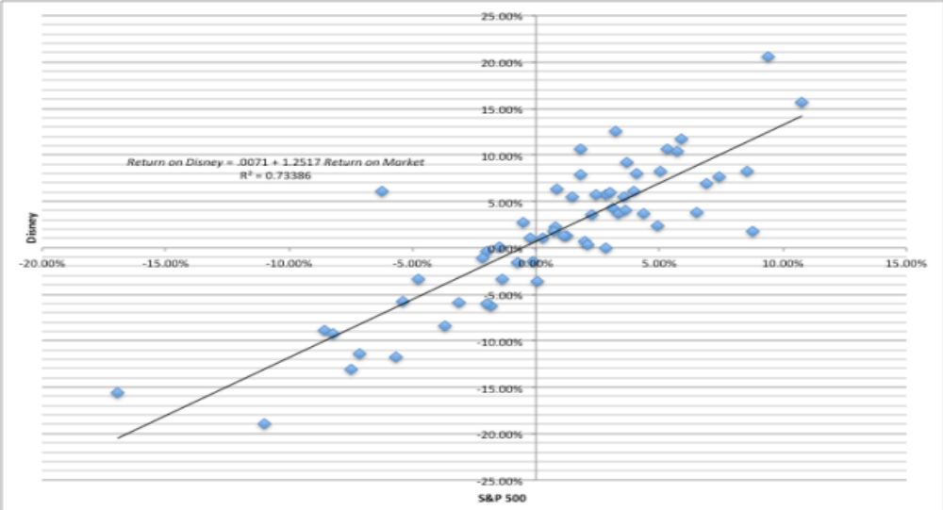
Disney’s Historical Beta
Return on Disney = .0071 + 1.2517 Return on Market R² = 0.73386
(0.10)
Notes:
This has both the scatter plot and the regression line. Note the there is substantial error in the regression. A statistician looking at this regression would view this as evidence that it was not a good regression. A financial economist looking the same regression sees it as a reflection of the reality that most of the risk in a given investment or stock is firm-specific.

Slide 126
Analyzing Disney’s Performance
Intercept = 0.712%
  This is an intercept based on monthly returns. Thus, it has to be compared to a monthly riskfree rate.
  Between 2008 and 2013
    Average Annualized T.Bill rate = 0.50%
    Monthly Riskfree Rate = 0.5%/12 = 0.042%
    Riskfree Rate (1-Beta) = 0.042% (1-1.252) = -.0105%
The Comparison is then between
  Intercept versus Riskfree Rate (1 - Beta)
  0.712% versus 0.0105%
  Jensen’s Alpha = 0.712% - (-0.0105)% = 0.723%
Disney did 0.723% better than expected, per month, between October 2008 and September 2013
  Annualized, Disney’s annual excess return = (1.00723)¹² -1= 9.02%
Notes:
The intercept measures what your stock actually did in a month when the market was flat (zero return) during the time period of the regression. Rf(1- beta) measures what a stock should have done (given its beta) during the same period in a month in which the market did nothing.
Disney did 9.02% better than expected on an annual basis between 2004 and 2008. The Jensen’s alpha is a risk adjusted, market adjusted measure of performance. (Consider a simple example. Assume that the market was up 20% a year during the period of your regression and that you have a stock with a beta of 1.5. If you ignore the riskfree rate, this stock should have earned a return of 30% each year for the regression period. With a Jensen’s alpha of 9.02%, it earned 30% + 9.02% = 39.02%.)
If the regression is run using excess returns on the stock and market (over an above the riskfree rate), the intercept is already Jensen’s alpha:
Return on stock - Rf = a + b (Rm - Rf)
b. An alternate approach to estimating Jensen’s alpha is to use the average monthly return on the stock and subtract out the expected return using the risk free rate during the period, the beta and the average monthly return on the market. You should get an identical answer:

Slide 127
More on Jensen’s Alpha
If you did this analysis on every stock listed on an exchange, what would the average Jensen’s alpha be across all stocks?
  Depend upon whether the market went up or down during the period
  Should be zero
  Should be greater than zero, because stocks tend to go up more often than down.
Disney has a positive Jensen’s alpha of 9.02% a year between 2008 and 2013. This can be viewed as a sign that management in the firm did a good job, managing the firm during the period.
  True
  False
Disney has had a positive Jensen’s alpha between 2008 and 2013. If you were an investor in early 2014, looking at the stock, you would view this as a sign that the stock will be a:
  Good investment for the future
  Bad investment for the future
  No information about the future
Notes:
Should be zero, if it is weighted by market value. The market cannot beat or lag itself.
What should the Jensen’s alpha of an index fund be?
- Should be zero
If I claim to be a successful stock picker and run a mutual fund, what should my Jensen’s alpha be?
- Should be positive for the entire portfolio (though not all stocks may have positive Jensen’s alphas)
If I pick a hundred stocks at random, what should my Jensen’s alpha be?
- Zero
What if I incur a 1.5% management fee and transactions costs in picking these stocks?
- Should be -1.5% (which is roughly what the Jensen’s alpha is across all actively managed mutual funds)

Slide 128
Estimating Disney’s Beta
Slope of the Regression of 1.25 is the beta
Regression parameters are always estimated with error. The error is captured in the standard error of the beta estimate, which in the case of Disney is 0.10.
Assume that I asked you what Disney’s true beta is, after this regression.
  What is your best point estimate?
  What range would you give me, with 67% confidence?
  What range would you give me, with 95% confidence?
Notes:
Best point estimate: 1.25
Range with 67% confidence: 1.15-1.35
Range with 95% confidence: 1.05-1.45

Slide 129
The Dirty Secret of “Standard Error”
Distribution of Standard Errors: Beta Estimates for U.S. stocks
1600
1400
1200
1000
800
Number of Firms
600
400
200
0
<.10
.10 - .20
.20 - .30
.30 - .40
.40 -.50
.50 - .75
> .75
Standard Error in Beta Estimate
Notes:
The standard errors of betas estimated in the US tend to be fairly high (the median is 0.20-0.25), with many beta estimates having standard errors of 0.40 or greater. These betas should come with warnings.

Slide 130
Breaking down Disney’s Risk
R Squared = 73%
This implies that
  73% of the risk at Disney comes from market sources
  27%, therefore, comes from firm-specific sources
The firm-specific risk is diversifiable and will not be rewarded.
The R-squared for companies, globally, has increased significantly since 2008. Why might this be happening?
What are the implications for investors?
Notes:
This suggests that Disney is exposed to more macro risk than the typical firm in the US. The typical firm has an R squared of between 25-30%, down from 35-40% prior to 2008. Hence, the allure of diversification.
(Why might this be? Size and having a more diversified business mix may explain Disney’s high R-squared.)
About 20% of firms have R-squared of less than 10%…
About 20% of firms have R-squared exceeding 50%…
If you were undiversified, which group would you like to hold? (Answer: The latter)
If you are diversified, which group would you like to hold? (Does not matter, since you get rid of the firm-specific risk anyway)

Slide 131
The Relevance of R Squared
You are a diversified investor trying to decide whether you should invest in Disney or Amgen. They both have betas of 1.25, but Disney has an R Squared of 73% while Amgen’s R squared is only 25%. Which one would you invest in?
  Amgen, because it has the lower R squared
  Disney, because it has the higher R squared
  You would be indifferent
Would your answer be different if you were an undiversified investor?
Notes:
If you were a diversified investor, you would not care, since you would diversify away all of the firm specific risk anyway. After you are done diversifying, what you will be left with on both stocks is the market risk which is best measured using the betas.
If you were undiversified, you would prefer Disney, which has less firm-specific risk.
How can two companies have the same betas but different R-squared?
The R-squared measures the proportion of the risk in a stock that is market risk.. The beta measures the units of market risk (in standardized terms). Amgen, in this case, has far more total risk than Disney (approximately three times as much). Thus, 25% of Amgen’s risk works out to the same number of units of market risk as 73% of Disney’s risk.

Slide 132
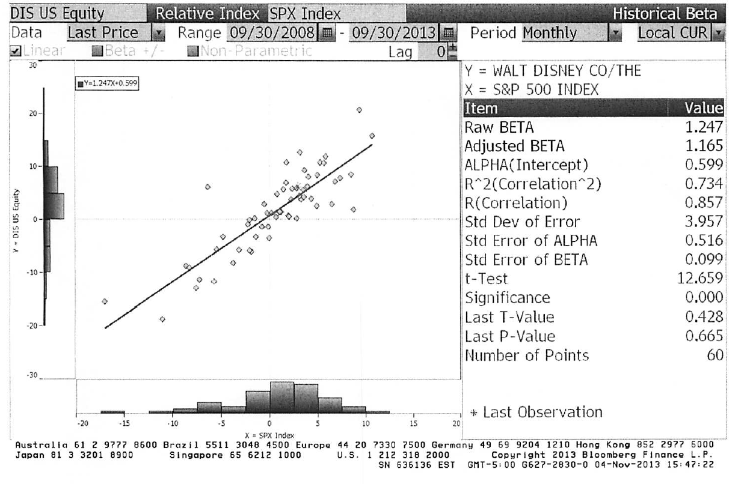
Beta Estimation: Using a Service (Bloomberg)
Notes:
This is the page for Disney’s beta, using the same period as the regression run earlier, from Bloomberg.
Bloomberg, however, uses only price returns (it ignores dividends both in the stock and the index). Hence the intercept is different.
The adjusted beta is just the regression beta moves towards one, reflecting the empirical realities that for most firms, betas tend to drift towards one as they get larger and more diversified.

Slide 133
Estimating Expected Returns for Disney in November 2013
Inputs to the expected return calculation
  Disney’s Beta = 1.25
  Riskfree Rate = 2.75% (U.S. ten-year T.Bond rate in November 2013)
  Risk Premium = 5.76% (Based on Disney’s operating exposure)
Expected Return = Riskfree Rate + Beta (Risk Premium)
= 2.75% + 1.25 (5.76%) = 9.95%
Notes:
Note that this expected return would have been different if we had decided to use a different equity risk premium. The potential error in the beta will translate into a forecast error on the expected return as well.

Slide 134
Use to a Potential Investor in Disney
As a potential investor in Disney, what does this expected return of 9.95% tell you?
  This is the return that I can expect to make in the long term on Disney, if the stock is correctly priced and the CAPM is the right model for risk,
  This is the return that I need to make on Disney in the long term to break even on my investment in the stock
  Both
Assume now that you are an active investor and that your research suggests that an investment in Disney will yield 12.5% a year for the next 5 years. Based upon the expected return of 9.95%, you would
  Buy the stock
  Sell the stock
Notes:
Both. If the stock is correctly priced, the beta is correctly estimated and the CAPM is the right model, this is what you would expect to make on Disney in the long term. As an investor, this is what you would need to make to break even on the investment. You are not being greedy, just prudent. After all, if you don’t make higher returns when the market is going up, you will find yourself falling behind when the market is going down.
Buy the stock, since you think you can make more than the hurdle rate.

Slide 135
How managers use this expected return
Managers at Disney
  need to make at least 9.95% as a return for their equity investors to break even.
  this is the hurdle rate for projects, when the investment is analyzed from an equity standpoint
In other words, Disney’s cost of equity is 9.95%.
What is the cost of not delivering this cost of equity?
Notes:
The cost of equity is what equity investors in your company view as their required return.
The cost of not delivering this return is more unhappy stockholders, a lower stock price, and if you are a manager, maybe your job.
Going back to the corporate governance section, if stockholders have little or no control over managers, managers are less likely to view this as the cost of equity.

Slide 136
Application Test: Analyzing the Risk Regression
Using your Bloomberg risk and return print out, answer the following questions:
  How well or badly did your stock do, relative to the market, during the period of the regression?
  Intercept - (Riskfree Rate/n) (1- Beta) = Jensen’s Alpha
    where n is the number of return periods in a year (12 if monthly; 52 if weekly)
  What proportion of the risk in your stock is attributable to the market? What proportion is firm-specific?
  What is the historical estimate of beta for your stock? What is the range on this estimate with 67% probability? With 95% probability?
  Based upon this beta, what is your estimate of the required return on this stock?
  Riskless Rate + Beta * Risk Premium
Notes:
Try this on your company. It is a useful starting point to assessing your company, the equivalent of a doctor looking at the blood work of a new patient.

Slide 137
A Quick Test
You are advising a very risky software firm on the right cost of equity to use in project analysis. You estimate a beta of 3.0 for the firm and come up with a cost of equity of 20%. The CFO of the firm is concerned about the high cost of equity and wants to know whether there is anything he can do to lower his beta.
How do you bring your beta down?
Should you focus your attention on bringing your beta down?
  Yes
  No
Notes:
There are three ways to bring down your beta.
Pay off debt, if you have any
Move into safer businesses
Sell off assets, and keep cash on your balance sheet
Note that each of these actions may lower the company’s beta, but may not be in the company’s (or its stockholders’) best interests. What matters is the difference between what you make on your projects (return on equity) and your cost of equity. If you lower your cost of equity, but lower your return on equity even more, you are not serving your stockholders.

Slide 138

Regression Diagnostics for Tata Motors
Beta = 1.83
67% range
1.67-1.99
69% market risk
31% firm specific
Jensen’s α
= 2.28% - 4%/12 (1-1.83) = 2.56%
Annualized = (1+.0256)¹²-1= 35.42%
Average monthly riskfree rate (2008-13) = 4%
Expected Return (in Rupees)
= Riskfree Rate+ Beta*Risk premium
= 6.57%+ 1.83 (7.19%) = 19.73%
Notes:
Deconstructing Tata Motor’s beta page, we find that
Tata Motors did better than expected over the period by 19.73% in an annual basis.
Tata Motors is above average risk (1.83 times as risky as the typical Indian firm)
About 69% of the risk in Tata Motors is market risk

Slide 139
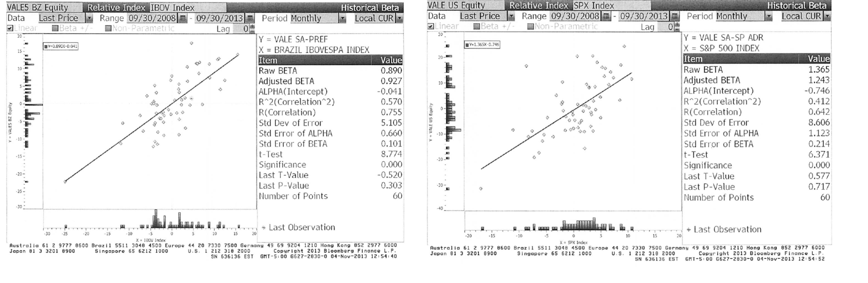
A better beta? Vale
Notes:
Shows how easy it is to get your betas to move, if you get to try different indices (and different time periods and different return intervals).

Slide 140
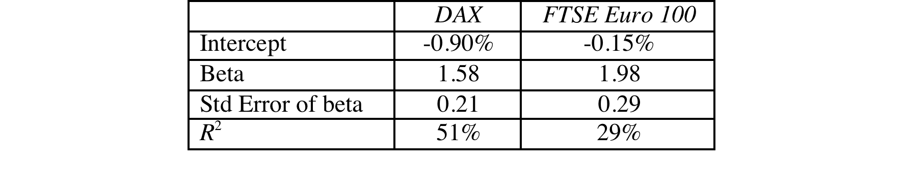
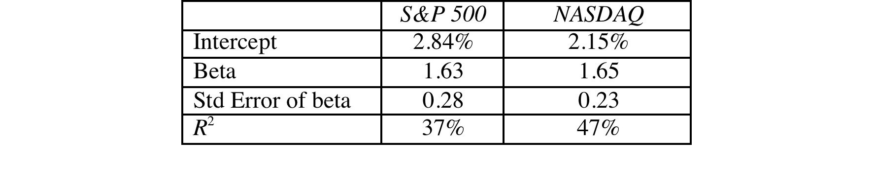
Deutsche Bank and Baidu: Index Effects on Risk Parameters
For Deutsche Bank, a widely held European stock, we tried both the DAX (German index) and the FTSE European index.
For Baidu, a NASDAQ listed stock, we ran regressions against both the S&P 500 and the NASDAQ.
Notes:
As the index used expands and becomes broader, the R-squared drops off and the standard error increases.
Which one would you use? It depends upon who your marginal investors are. If they are investors who are local and stay focused only on the local market, you may be able to get away with the DAX regression. As your marginal investors become more diversified, you should move from the local index to wider indices. The least precise beta estimate (with the highest standard error) may be the most meaningful.
As investors become globalized, there is an argument to be made that we should be abandoning the use of local indices and replacing them with global indices.
With Baidu, the best index is not the one that fits it best (which would be the NASDAQ) but the one that best captures what marginal investors are invested in.

Slide 141

Beta: Exploring Fundamentals
Notes:
A cross selection of regression betas for companies… Lets try a story for each one:
Real Networks: Small, high growth company in risky business
Qwest: Some business risk but much more substantial overlay of financial risk created by borrowing billions.
Microsoft: Example of beta drift towards one as companies get larger and their product base (and customer base) becomes more diversified. Microsoft’s beta in the lat 1980s was much higher than 2.
GE: Most diversified US company you will find.. Beta will drift towards one for diversified companies. GE Capital’s debt acts as ballast on beta
Philip Morris: Main risk is oil price risk which cuts against the rest of the market (lower oil prices are good for many companies and the economy but not for oil companies). The litigation risk will not show up in the beta because it is firm-specific. (Changing the company name to Altria will not make a difference)
Harmony Gold Mining Company: A negative beta implies that adding this stock on to a diversified portfolio will actually reduce risk (acts as insurance). Gold has historically been an insurance against inflation.
(Consequences of a negative beta: Expected return < Riskfree rate)

Slide 142
Determinant 1: Product Type
Industry Effects: The beta value for a firm depends upon the sensitivity of the demand for its products and services and of its costs to macroeconomic factors that affect the overall market.
  Cyclical companies have higher betas than non-cyclical firms
  Firms which sell more discretionary products will have higher betas than firms that sell less discretionary products
Notes:
Betas measure risk relative to the market.
Firms which are cyclical or sell discretionary products tend to do much better when the economy is doing well (and the market is doing well) and much worse when the economy is doing badly than other firms in the market.
In terms of basic economics, companies that sell products/ services that have elastic demand should have higher betas than ones that sell products/services with inelastic demand.

Slide 143
A Simple Test
Phone service is close to being non-discretionary in the United States and Western Europe. However, in much of Asia and Latin America, there are large segments of the population for which phone service is a luxury.
Given our discussion of discretionary and non-discretionary products, which of the following conclusions would you be willing to draw:
  Emerging market telecom companies should have higher betas than developed market telecom companies.
  Developed market telecom companies should have higher betas than emerging market telecom companies
  The two groups of companies should have similar betas
Notes:
I would expect emerging market telecom company betas to be higher… A product or service that is more discretionary will translate into more volatile earnings and more sensitivity to overall macro economic conditions and a highr beta.

Slide 144
Determinant 2: Operating Leverage Effects
Operating leverage refers to the proportion of the total costs of the firm that are fixed.
Other things remaining equal, higher operating leverage results in greater earnings variability which in turn results in higher betas.
Notes:
Firms with high fixed costs tend to see much bigger swings in operating income (and stock prices) for a given change in revenues than firms with more flexible cost structures.
Consider the case of the airline sector, which tends to have cost structures which are almost entirely fixed (plane lease expenses, fuel costs …). Firms in the sector have high betas.
Are you destined to have a high beta, once you pick a sector?
To an extent, yes, but you can take action or make decisions to change your destiny. Consider Southwest. By using only one type of aircraft, hedging fuel costs, flying from no-name airports and having a flexible workforce, Southwest has been able to lower its fixed costs as a proportion of total costs. (Focusing less on business travel and high priced tickets has also helped them on the discretionary component).

Slide 145
Measures of Operating Leverage
Fixed Costs Measure = Fixed Costs / Variable Costs
  This measures the relationship between fixed and variable costs. The higher the proportion, the higher the operating leverage.
EBIT Variability Measure = % Change in EBIT / % Change in Revenues
  This measures how quickly the earnings before interest and taxes changes as revenue changes. The higher this number, the greater the operating leverage.
Notes:
The direct measures of fixed costs and variable costs are difficult to obtain. Hence we use the second.

Slide 146
Disney’s Operating Leverage: 1987- 2013
Year | Net Sales | % Change in Sales | EBIT | % Change in EBIT
1987 | $2,877 |  | $756
1988 | $3,438 | 19.50% | $848 | 12.17%
1989 | $4,594 | 33.62% | $1,177 | 38.80%
1990 | $5,844 | 27.21% | $1,368 | 16.23%
1991 | $6,182 | 5.78% | $1,124 | -17.84%
1992 | $7,504 | 21.38% | $1,287 | 14.50%
1993 | $8,529 | 13.66% | $1,560 | 21.21%
1994 | $10,055 | 17.89% | $1,804 | 15.64%
1995 | $12,112 | 20.46% | $2,262 | 25.39%
1996 | $18,739 | 54.71% | $3,024 | 33.69%
1997 | $22,473 | 19.93% | $3,945 | 30.46%
1998 | $22,976 | 2.24% | $3,843 | -2.59%
1999 | $23,435 | 2.00% | $3,580 | -6.84%
2000 | $25,418 | 8.46% | $2,525 | -29.47%
2001 | $25,172 | -0.97% | $2,832 | 12.16%
2002 | $25,329 | 0.62% | $2,384 | -15.82%
2003 | $27,061 | 6.84% | $2,713 | 13.80%
2004 | $30,752 | 13.64% | $4,048 | 49.21%
2005 | $31,944 | 3.88% | $4,107 | 1.46%
2006 | $33,747 | 5.64% | $5,355 | 30.39%
2007 | $35,510 | 5.22% | $6,829 | 27.53%
2008 | $37,843 | 6.57% | $7,404 | 8.42%
2009 | $36,149 | -4.48% | $5,697 | -23.06%
2010 | $38,063 | 5.29% | $6,726 | 18.06%
2011 | $40,893 | 7.44% | $7,781 | 15.69%
2012 | $42,278 | 3.39% | $8,863 | 13.91%
2013 | $45,041 | 6.54% | $9,450 | 6.62% | Operating Leverage
Average: 87-13 |  | 11.79% |  | 11.91% | 11.91/11.79 =1.01
Average: 96-13 |  | 8.16% |  | 10.20% | 10.20/8.16 =1.25
Average across entertainment companies = 1.35
Given Disney’s operating leverage measures (1.01 or 1.25), would you expect Disney to have a higher or a lower beta than other entertainment companies?
Higher
Lower
No effect
Notes:
This measures Disney’s operating leverage historically. You need a number of years of data before you can get reasonable estimates.

Slide 147
Determinant 3: Financial Leverage
As firms borrow, they create fixed costs (interest payments) that make their earnings to equity investors more volatile. This increased earnings volatility which increases the equity beta.
The beta of equity alone can be written as a function of the unlevered beta and the debt-equity ratio
_{L} = _{u} (1+ ((1-t)D/E))
  where
  _{L} = Levered or Equity Beta D/E = Market value Debt to equity ratio
  _{u} = Unlevered or Asset Beta t = Marginal tax rate
Earlier, we estimated the beta for Disney from a regression. Was that beta a levered or unlevered beta?
Levered
Unlevered
Notes:
Same rationale as operating leverage but the focus here is on equity earnings. Put another way, a firm with stable operating income can make its equity income much more volatile by borrowing large sums of money.
The levered beta equation on this page are built on two assumptions of convenience: that the beta for debt is zero and that the tax benefit from debt reduces its impact on debt. It is easy to modify the equation to allow for changes in both assumptions.
The regression beta is a levered beta.

Slide 148
Effects of leverage on betas: Disney
The regression beta for Disney is 1.25. This beta is a levered beta (because it is based on stock prices, which reflect leverage) and the leverage implicit in the beta estimate is the average market debt equity ratio during the period of the regression (2008 to 2013)
The average debt equity ratio during this period was 19.44%.
The unlevered beta for Disney can then be estimated (using a marginal tax rate of 36.1%)
  = Current Beta / (1 + (1 - tax rate) (Average Debt/Equity))
  = 1.25 / (1 + (1 - 0.361)(0.1944))= 1.1119
Notes:
Note that betas reflect the average leverage over the period and not the current leverage of the firms. Firms whose leverage has changed over the period will have regression betas that are different from their true betas.

Slide 149

Disney : Beta and Financial Leverage
Notes:
Since equity investors bear all of the non-diversifiable risk, the beta of Disney’s equity will increase as the leverage increases.

Slide 150
Betas are weighted Averages
The beta of a portfolio is always the market-value weighted average of the betas of the individual investments in that portfolio.
Thus,
  the beta of a mutual fund is the weighted average of the betas of the stocks and other investment in that portfolio
  the beta of a firm after a merger is the market-value weighted average of the betas of the companies involved in the merger.
Notes:
Betas are always weighted averages - where the weights are based upon market value. This is because betas measure risk relative to a market index.

Slide 151
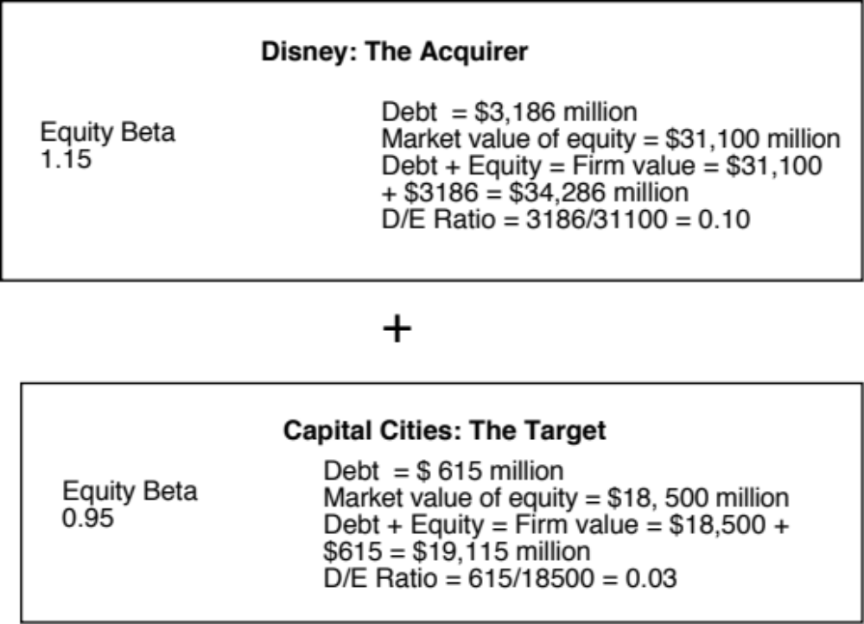
The Disney/Cap Cities Merger (1996): Pre-Merger
Notes:
These are the betas of the firms at the time of Disney’s acquisition. The tax rate used for both betas is 36%.
Equity betas are levered betas and we will assume that the leverage built into them is the current debt to equity ratio for the two firms.

Slide 152
Disney Cap Cities Beta Estimation: Step 1
Calculate the unlevered betas for both firms
  Disney’s unlevered beta = 1.15/(1+0.64*0.10) = 1.08
  Cap Cities unlevered beta = 0.95/(1+0.64*0.03) = 0.93
Calculate the unlevered beta for the combined firm
  Unlevered Beta for combined firm
  = 1.08 (34286/53401) + 0.93 (19115/53401)
  = 1.026
  The weights used are the firm values (and not just the equity values) of the two firms, since these are unlevered betas and thus reflects the risks of the entire businesses and not just the equity]
Notes:
The unlevered beta of the combined firm will always be the weighted average of the two firms’ unlevered betas. The firm values (rather than the equity values) are used for the weights because we are looking at the unlevered betas of the firms .
(In computing the values of the two businesses, I added debt to equity. To the extent that each of these companies has large cash balance (I am assuming that they do not, you may want to net cash out of each firm’s value).

Slide 153
Disney Cap Cities Beta Estimation: Step 2
If Disney had used all equity to buy Cap Cities equity, while assuming Cap Cities debt, the consolidated numbers would have looked as follows:
  Debt = $ 3,186+ $615 = $ 3,801 million
  Equity = $ 31,100 + $18,500 = $ 49,600 m (Disney issues $18.5 billion in equity)
  D/E Ratio = 3,801/49600 = 7.66%
  New Beta = 1.026 (1 + 0.64 (.0766)) = 1.08
Since Disney borrowed $ 10 billion to buy Cap Cities/ABC, funded the rest with new equity and assumed Cap Cities debt:
  The market value of Cap Cities equity is $18.5 billion. If $ 10 billion comes from debt, the balance ($8.5 billion) has to come from new equity.
  Debt = $ 3,186 + $615 million + $ 10,000 = $ 13,801 million
  Equity = $ 31,100 + $8,500 = $39,600 million
  D/E Ratio = 13,801/39600 = 34.82%
  New Beta = 1.026 (1 + 0.64 (.3482)) = 1.25
Notes:
This reflects the effects of the financing of the acquisition. In the second scenario, note that $ 10 billion of the $ 18.5 billion is borrowed. The remaining $ 8.5 billion has to come from new equity issues.
Exercise: What would Disney’s beta be if it had borrowed the entire $ 18.5 billion?
Debt = $ 615 + $ 3,186 + $ 18,500 = $ 22,301 million
Equity = $ 31,100 million
D/E Ratio = 71.70%
New Beta = 1.026 ( 1 + 0.64 (.717)) = 1.50
What is the significance of assuming Cap Cities debt?
If the debt had not been assumed and had to be retired, Disney would have had to raise $19,115 million ($18,500 + $615) to fund the acquisition. You would not have added $615 million in debt to the consolidated company after the transaction.

Slide 154
Firm Betas versus divisional Betas
Firm Betas as weighted averages: The beta of a firm is the weighted average of the betas of its individual projects.
Firm Betas and Business betas: At a broader level of aggregation, the beta of a firm is the weighted average of the betas of its individual division.
Notes:
The same principle applies to a firm. To the degree that the firm is in multiple businesses, its beta reflects all of these businesses.

Slide 155
Bottom-up versus Top-down Beta
The top-down beta for a firm comes from a regression
The bottom up beta can be estimated by doing the following:
  Find out the businesses that a firm operates in
  Find the unlevered betas of other firms in these businesses
  Take a weighted (by sales or operating income) average of these unlevered betas
  Lever up using the firm’s debt/equity ratio
The bottom up beta is a better estimate than the top down beta for the following reasons
  The standard error of the beta estimate will be much lower
  The betas can reflect the current (and even expected future) mix of businesses that the firm is in rather than the historical mix
Notes:
Bottom-up betas build up to the beta from the fundamentals, rather than trusting the regression.
The standard error of an average beta for a sector, is smaller by a factor of √n, where n is the number of firms in the sector. Thus, if there are 25 firms in a sector, the standard error of the average is 1/5 the average standard error.

Slide 156

Disney’s businesses: The financial breakdown (from 2013 annual report)
Notes:
Disney does break down its divisions very well in its financial statements. Not all companies are this forthcoming and you may have to go on much coarser data, in some cases.

Slide 157

Unlevered Betas for businesses
Business | Comparable firms | Sample size | Median Beta | Median D/E | Median Tax rate | Company Unlevered Beta | Median Cash/ Firm Value | Business Unlevered Beta
Media Networks | US firms in broadcasting business | 26 | 1.43 | 71.09% | 40.00% | 1.0024 | 2.80% | 1.0313
Parks & Resorts | Global firms in amusement park business | 20 | 0.87 | 46.76% | 35.67% | 0.6677 | 4.95% | 0.7024
Studio Entertainment | US movie firms | 10 | 1.24 | 27.06% | 40.00% | 1.0668 | 2.96% | 1.0993
Consumer Products | Global firms in toys/games production & retail | 44 | 0.74 | 29.53% | 25.00% | 0.6034 | 10.64% | 0.6752
Interactive | Global computer gaming firms | 33 | 1.03 | 3.26% | 34.55% | 1.0085 | 17.25% | 1.2187
Notes:
Comes from the companies in each sector. Judgment calls had to be made and when the sample size was too small (as was the case with broadcasting and theme parks), I had to broaden my sample, by going up and down the food chain of revenues in the case of broadcasting (by including companies that make revenues from syndicating TV shows, for instance) or going global (parks and resorts). Another solution is to define your business more broadly, allowing for more comparable firms.
When looking for comparable firms, you are not trying to get exact matches with the company you are analyzing. Instead, you are focusing on companies whose economic fortunes are tied to the same macro economic variables as your revenues/earnings are. It is okay to stray out of your specific business, if you follow this principle.

Slide 158

A closer look at the process…
Studio Entertainment Betas
Notes:
This shows the raw numbers behind one of the line items on the previous page – studio entertainment. It lists the companies used, their market values of equity, total debt outstanding and cash.
We show three summary numbers – the average, the aggregate and the median. The average is skewed by outliers. While both the aggregate and median yield meaningful values, we have chosen to go with the median.
In the last three columns, I have computed the enterprise value = mkt cap + debt – cash, revenues and EV/Revenues. These will be used on the next page.

Slide 159

Backing into a pure play beta: Studio Entertainment
1. Start with the median regression beta (equity beta) of 1.24
2. Unlever the beta, using the median gross D/E ratio of 27.06%
Gross D/E ratio = 21.30/78.70 = 27.06%
Unlevered beta = 1.24/ (1+ (1-.4) (.2706)) = 1.0668
3. Take out the cash effect, using the median cash/value of 2.96%
(.0296) (0) + (1-.0296) (Beta of movie business) = 1.0668
Beta of movie business = 1.0668/(1-.0296) = 1.0993
Alternatively, you could have used the net debt to equity ratio
Net D/E ratio = (21.30-2.96)/78.70 = 23.30%
Unlevered beta for movies = 1.24/ (1+(1-.4)(.233)) = 1.0879
Notes:
Using the studio entertainment companies as the base, this page explains the process, step by step.
You always start with a regression or equity beta, then clean up for debt and then for cash. (I assumed a marginal tax rate of 40%, since these were all US firms)
When you use the net debt to equity ratio, which is the practice in much of Europe and Latin America, the answers are close but they will not be the same. With the net debt ratio, you are assuming that debt and cash not only cancel out in terms of risk (equally riskless) but have the same tax effect (that you pay a 40% tax rate on income from cash and get a 40% tax benefit from interest expenses).

Slide 160

Disney’s unlevered beta: Operations & Entire Company
Business | Revenues | EV/Sales | Value of Business | Proportion of Disney | Unlevered beta | Value | Proportion
Media Networks | $20,356 | 3.27 | $66,580 | 49.27% | 1.03 | $66,579.81 | 49.27%
Parks & Resorts | $14,087 | 3.24 | $45,683 | 33.81% | 0.70 | $45,682.80 | 33.81%
Studio Entertainment | $5,979 | 3.05 | $18,234 | 13.49% | 1.10 | $18,234.27 | 13.49%
Consumer Products | $3,555 | 0.83 | $2,952 | 2.18% | 0.68 | $2,951.50 | 2.18%
Interactive | $1,064 | 1.58 | $1,684 | 1.25% | 1.22 | $1,683.72 | 1.25%
Disney Operations | $45,041 |  | $135,132 | 100.00% | 0.9239 | $135,132.11
Disney has $3.93 billion in cash, invested in close to riskless assets (with a beta of zero). You can compute an unlevered beta for Disney as a company (inclusive of cash):
Notes:
I used revenues and revenue multiples to estimate the values of each business. I could have also used EBIT or EBITDA, by business, and applied a multiple but the problem is with divisions that have negative values for either (as is the case with Interactive for Disney).
The reason that I compute two unlevered beta, one for just the operations and one that includes the cash (and is thus for the entire firm) is that each has its use somewhere along. When computing the cost of capital, which is a cost of funding your operating assets, I will use the former. If I needed a beta for a dividend discount model, where the dividends are paid out of composite earnings, I would use the latter.

Slide 161

The levered beta: Disney and its divisions
To estimate the debt ratios for division, we allocate Disney’s total debt ($15,961 million) to its divisions based on identifiable assets.
We use the allocated debt to compute D/E ratios and levered betas.
Business | Unlevered beta | Value of business | D/E ratio | Levered beta | Cost of Equity
Media Networks | 1.0313 | $66,580 | 10.03% | 1.0975 | 9.07%
Parks & Resorts | 0.7024 | $45,683 | 11.41% | 0.7537 | 7.09%
Studio Entertainment | 1.0993 | $18,234 | 20.71% | 1.2448 | 9.92%
Consumer Products | 0.6752 | $2,952 | 117.11% | 1.1805 | 9.55%
Interactive | 1.2187 | $1,684 | 41.07% | 1.5385 | 11.61%
Disney Operations | 0.9239 | $135,132 | 13.10% | 1.0012 | 8.52%
Notes:
I allocated the debt based upon the identifiable assets (since these tend to be large, fixed assets, as defined by accountants) and thus more likely to require the use of debt.

Slide 162
Discussion Issue
Assume now that you are the CFO of Disney. The head of the movie business has come to you with a new big budget movie that he would like you to fund. He claims that his analysis of the movie indicates that it will generate a return on equity of 9.5%. Would you fund it?
  Yes. It is higher than the cost of equity for Disney as a company
  No. It is lower than the cost of equity for the movie business.
  What are the broader implications of your choice?
Notes:
The cost of equity for each division should be used. Otherwise, the riskier divisions will over invest and the safest divisions will under invest.
Over time, the firm will become a riskier firm. Think of Bankers Trust from 1980, when it was a commercial bank, to 1992, when it had become primarily an investment bank.
It also means that any multi business company should have different hurdle rates for each business, with higher rates for riskier businesses and lower rates for safer businesses.

Slide 163


Estimating Bottom Up Betas & Costs of Equity: Vale
Notes:
Following the same script that I did for Disney, but I did not attempt to allocate the debt across businesses, partly because there was little information available on the allocation and partly because they businesses are more similar in terms of their debt capacity.

Slide 164


Vale: Cost of Equity Calculation – in nominal R$
To convert a discount rate in one currency to another, all you need are expected inflation rates in the two currencies.
From US $ to R$: If we use 2% as the inflation rate in US dollars and 9% as the inflation ratio in Brazil, we can convert Vale’s US dollar cost of equity of 11.23% to a R$ cost of equity:
Alternatively, you can compute a cost of equity, starting with the R$ riskfree rate of 10.18%.
  Cost of Equity in R$ = = 10.18% + 1.15 (7.38%) = 18.67%
Notes:
The cost of equity can be stated in different currencies. When computing the nominal R$ cost of equity, we scale up the risk premium to reflect the fact the the inflation rates (and risk free rates in BR) are much higher.
I prefer the first approach, which is to start with a dollar based cost of capital and scale up for inflation differentials, since all of the risk premiums that I am using come from dollar based markets and scaling up with inflation allows me to scale up the premiums as well..

Slide 165
Bottom up betas & Costs of Equity: Tata Motors & Baidu
Tata Motors: We estimated an unlevered beta of 0.8601 across 76 publicly traded automotive companies (globally) and estimated a levered beta based on Tata Motor’s D/E ratio of 41.41% and a marginal tax rate of 32.45% for India:
  Levered Beta for Tata Motors = 0.8601 (1 + (1-.3245) (.4141)) = 1.1007
  Cost of equity for Tata Motors (Rs) = 6.57% + 1.1007 (7.19%) = 14.49%
Baidu: To estimate its beta, we looked at 42 global companies that derive all or most of their revenues from online advertising and estimated an unlevered beta of 1.30 for the business. Incorporating Baidu’s current market debt to equity ratio of 5.23% and the marginal tax rate for China of 25%, we estimate Baidu’s current levered beta to be 1.3560.
  Levered Beta for Baidu = 1.30 (1 + (1-.25) (.0523)) = 1.356
  Cost of Equity for Baidu (Yuan) = 3.50% + 1.356 (6.94%) = 12.91%
Notes:
Both are single business companies and the beta estimation is made a little easier. I used the global averages for both, simply because there are very few companies in either the domestic markets or even across all emerging markets.

Slide 166


Bottom up Betas and Costs of Equity: Deutsche Bank
We break Deutsche Bank down into two businesses – commercial and investment banking.
We do not unlever or relever betas, because estimating debt and equity for banks is an exercise in futility. Using a riskfree rate of 1.75% (Euro risk free rate) and Deutsche’s ERP of 6.12%:
Notes:
Investment banking is riskier and should require a higher return. (In fact, if you could break investment banking down into its component parts, you could get very different costs of equity within that business).

Slide 167
Estimating Betas for Non-Traded Assets
The conventional approaches of estimating betas from regressions do not work for assets that are not traded. There are no stock prices or historical returns that can be used to compute regression betas.
There are two ways in which betas can be estimated for non-traded assets
  Using comparable firms
  Using accounting earnings
Notes:
Private firms are not traded. There are no historical price records to compute betas from.

Slide 168

Using comparable firms to estimate beta for Bookscape
Unlevered beta for book company = 0.8130/ (1+ (1-.4) (.2141)) = 0.7205
Unlevered beta for book business = 0.7205/(1-.05) = 0.7584
Notes:
To estimate the bottom up beta, we initially looked at publicly traded book retail firms but found only two firms. To add to the sample, we looked at publishing firms, arguing that their risk should be similar to that of book retailers (We are open to the critique that the operating leverage can be different in the two businesses). To keep outliers (like the 3190% debt to equity ratio for Dex Media) from skewing results, we will use median values for the firms in the sample.

Slide 169
Estimating Bookscape Levered Beta and Cost of Equity
Because the debt/equity ratios used in computing levered betas are market debt equity ratios, and the only debt equity ratio we can compute for Bookscape is a book value debt equity ratio, we have assumed that Bookscape is close to the book industry median market debt to equity ratio of 21.41 percent.
Using a marginal tax rate of 40 percent for Bookscape, we get a levered beta of 0.8558.
  Levered beta for Bookscape = 0.7584[1 + (1 – 0.40) (0.2141)] = 0.8558
Using a riskfree rate of 2.75% (US treasury bond rate) and an equity risk premium of 5.5%:
  Cost of Equity = 2.75%+ 0.8558 (5.5%) = 7.46%
Notes:
If you cannot get a target debt to equity ratio for a private firm, use an industry -average debt to equity ratio to compute the levered beta. It will give you a more meaningful estimate than using book debt to equity ratios.

Slide 170
Is Beta an Adequate Measure of Risk for a Private Firm?
Beta measures the risk added on to a diversified portfolio. The owners of most private firms are not diversified. Therefore, using beta to arrive at a cost of equity for a private firm will
  Under estimate the cost of equity for the private firm
  Over estimate the cost of equity for the private firm
  Could under or over estimate the cost of equity for the private firm
Notes:
Using beta (that looks at only market risk) will tend to under estimate the cost of equity since private owners feel exposed to all risk, if they are not diversified.

Slide 171

Total Risk versus Market Risk
Adjust the beta to reflect total risk rather than market risk. This adjustment is a relatively simple one, since the R squared of the regression measures the proportion of the risk that is market risk.
  Total Beta = Market Beta / Correlation of the sector with the market
In the Bookscape example, where the market beta is 0.8558 and the median R-squared of the comparable publicly traded firms is 26.00%; the correlation with the market is 50.99%.
  Total Cost of Equity = 2.75 + 1.6783 (5.5%) = 11.98%
Notes:
This assumes that
The owner of the private business has all of his or her wealth invested in the business
The reality is that most individuals will fall somewhere between the two extremes. A private equity or VC investor may hold several positions in their portfolio, pushing up the R-squared of their portfolio with the market and pushing down the total beta.
If you were a private business looking at potential acquirers - one is a publicly traded firm and the other is an individual . Which one is likely to pay the higher price and why?
If both acquirers have the same cash flow expectations, the publicly traded firm will win out (Blockbuster Video, Browning-Ferris are good examples of publicly traded firms which bought small private businesses to grow to their current stature.)
This approach can be extended to cover investors who are partially diversified such as venture capitalists and private equity investors. Instead of using the correlation of firms in the business with the market, we would use the correlation of the investor’s portfolio with the market. As the investor gets more diversified, the correlation will rise and the total beta will fall towards the market beta.

Slide 172
Application Test: Estimating a Bottom-up Beta
Based upon the business or businesses that your firm is in right now, and its current financial leverage, estimate the bottom-up unlevered beta for your firm.
Data Source: You can get a listing of unlevered betas by industry on my web site by going to updated data.
Notes:
The breakdown of a firm into businesses is available in the 10-K. The unlevered betas are available on my web site.

Slide 173
From Cost of Equity to Cost of Capital
The cost of capital is a composite cost to the firm of raising financing to fund its projects.
In addition to equity, firms can raise capital from debt
Notes:
Capital is more than just equity. It also includes other financing sources, particularly debt.

Slide 174
What is debt?
General Rule: Debt generally has the following characteristics:
  Commitment to make fixed payments in the future
  The fixed payments are tax deductible
  Failure to make the payments can lead to either default or loss of control of the firm to the party to whom payments are due.
As a consequence, debt should include
  Any interest-bearing liability, whether short term or long term.
  Any lease obligation, whether operating or capital.
Notes:
Debt is not restricted to what gets called debt in the balance sheet. It includes any financing with these characteristics.
Applying this test to items on the liability side of the balance sheet, we would conclude that
All interest bearing debt, short term as well as long term, is debt
Accounts payable and suppliers should not be considered debt because they don’t carry explicit interest expenses; they should be considered as part of working capital. Alternatively, you can try to make the implicit interest expenses (the discount you could have received by paying early rather than late) explicit and treat it as debt.
Other liabilities such as under funded pension or health care obligations are best not considered as debt (though there may be exceptions) since the commitments are flexible.

Slide 175
Estimating the Cost of Debt
If the firm has bonds outstanding, and the bonds are traded, the yield to maturity on a long-term, straight (no special features) bond can be used as the interest rate.
If the firm is rated, use the rating and a typical default spread on bonds with that rating to estimate the cost of debt.
If the firm is not rated,
  and it has recently borrowed long term from a bank, use the interest rate on the borrowing or
  estimate a synthetic rating for the company, and use the synthetic rating to arrive at a default spread and a cost of debt
The cost of debt has to be estimated in the same currency as the cost of equity and the cash flows in the valuation.
Notes:
There are two key components to the cost of debt:
You want a long-term cost (I use a 10-year cost) of debt even if your debt is short term. You do not want to reward companies that play the term structure by giving them a lower cost of debt and capital. In effect, you are assuming that the rolled over cost of short term debt = cost of long term debt.
You want a current cost. In other words, you do not care about the debt and interest expenses on the books. The book interest rate (interest expense/book debt) is not a good measure of the cost of debt because it does not reflect the current cost of borrowing any may even be lower than the riskfree rate.
While the cost of debt can be estimated easily for some firms, by looking up traded bonds, it can be more difficult for non-rated firms. The default spreads can be obtained from
http://www.bondsonline.com
It will cost you money, but you will get updated values. You can get partially updated numbers from my website (under updated data)>

Slide 176


The easy route: Outsourcing the measurement of default risk
For those firms that have bond ratings from global ratings agencies, I used those ratings:
If you want to estimate Vale’s cost of debt in R$ terms, we can again use the differential inflation approach we used for the cost of equity:
Notes:
You are trusting the ratings agencies to be right and to have incorporated all default risk (company as well as country) into the rating. With Vale, therefore, you are assuming that the ratings agency has incorporated both the risk of Vale and Brazil in its rating. (Ratings agencies claim they do…)

Slide 177

A more general route: Estimating Synthetic Ratings
The rating for a firm can be estimated using the financial characteristics of the firm. In its simplest form, we can use just the interest coverage ratio:
Interest Coverage Ratio = EBIT / Interest Expenses
For the non-financial service companies, we obtain the following:
Notes:
Basing the rating on just an interest coverage ratio will give you an approximation for the rating. A more realistic approach would use more than the interest coverage ratio. In fact, we could construct a score based upon multiple ratios (such as a Z-score) and use that score to estimate ratings.
The operating income used to compute the rating does not have to be last year’s number. It can be an average over time or a normalized value.

Slide 178

Interest Coverage Ratios, Ratings and Default Spreads- November 2013
Disney: Large cap, developed 22.57 → AAA
Vale: Large cap, emerging 11.67 → AA
Tata Motors: Large cap, Emerging 4.51 → A-
Baidu: Small cap, Emerging 23.72 → AAA
Bookscape: Small cap, private 5.16 → A-
Notes:
This table is constructed, using smaller non-financial service companies (<$5 billion market cap) that are rated, and their interest coverage ratios. The firms were sorted based upon their ratings, and the interest coverage range was estimated.
These ranges will change over time, especially as the economy strengthens or weakens. You can get the updated ranges on my web site.

Slide 179
Synthetic versus Actual Ratings: Rated Firms
Disney’s synthetic rating is AAA, whereas its actual rating is A. The difference can be attributed to any of the following:
  Synthetic ratings reflect only the interest coverage ratio whereas actual ratings incorporate all of the other ratios and qualitative factors
  Synthetic ratings do not allow for sector-wide biases in ratings
  Synthetic rating was based on 2013 operating income whereas actual rating reflects normalized earnings
Vale’s synthetic rating is AA, but the actual rating for dollar debt is A-. The biggest factor behind the difference is the presence of country risk, since Vale is probably being rated lower for being a Brazil-based corporation.
Deutsche Bank had an A rating. We will not try to estimate a synthetic rating for the bank. Defining interest expenses on debt for a bank is difficult…
Notes:
The synthetic ratings process will deliver reasonably close ratings for any firm with debt of substance. It will tend to overstate ratings for firms with little debt (technology firms often will get AAA ratings because their interest coverage ratios are so high). The fact that these ratings are too high is not an issue because these companies also have so little debt in their capital structure - the cost of capital is very close to the cost of equity.
Can we trust rating agencies? In general, ratings agencies do a reasonable job of assessing default risk and offer us these measures for free (at least to investors). They have two faults: (1) They adjust for changes in default risk too slowly. All too often ratings downgrades follow bond price declines and not the other way around (2) They sometimes get caught up in the mood of the moment and either overestimate default risk or underestimate default risk for an entire sector.
It is a good idea to estimate synthetic ratings even for firms that have actual ratings. If there is disagreement between ratings agencies or a firm has multiple bond ratings, the synthetic rating can operate as a tie-breaker. If there is a significant difference between actual and synthetic ratings and there is no fundamental reason that can be pinpointed for the difference, the synthetic rating may be providing an early signal of a ratings agency mistake.

Slide 180

Estimating Cost of Debt
For Bookscape, we will use the synthetic rating (A-) to estimate the cost of debt:
  Default Spread based upon A- rating = 1.30%
  Pre-tax cost of debt = Riskfree Rate + Default Spread = 2.75% + 1.30% = 4.05%
  After-tax cost of debt = Pre-tax cost of debt (1- tax rate) = 4.05% (1-.40) = 2.43%
For the three publicly traded firms that are rated in our sample, we will use the actual bond ratings to estimate the costs of debt.
For Tata Motors, we have a rating of AA- from CRISIL, an Indian bond-rating firm, that measures only company risk. Using that rating:
  Cost of debt_{TMT} = Risk free rate_{Rupees} + Default spread_{India} + Default spread_{TMT}
  = 6.57% + 2.25% + 0.70% = 9.62%
  After-tax cost of debt = 9.62% (1-.3245) = 6.50%
Notes:
The tax rate used is the marginal tax rate…. Interest saves you taxes on your marginal income, not the first or average dollar of income….
The marginal tax rate comes from the tax code and as relatively little to do with your company. For US companies, it should be 35%+. For non-US companies, it will reflect the tax rates in those countries (low in HK and Singapore, higher in Europe and Latin America…)
For Tata Motors, we added the country default spread on to the company default spread to reflect the fact that Tata has to bear the burden of country risk when it borrows. (We skipped this step with Vale because we used the actual rating, which already reflects Brazil country risk)
For Disney, Deutsche Bank and Vale, we chose to use the actual ratings rather than the synthetic rating, because it does contain more information.

Slide 181
Updated Default Spreads – January 2014
Rating | 1 year | 5 year | 10 Year | 30 year
Aaa/AAA | 0.05% | 0.18% | 0.42% | 0.65%
Aa1/AA+ | 0.11% | 0.37% | 0.57% | 0.82%
Aa2/AA | 0.16% | 0.55% | 0.71% | 0.98%
Aa3/AA- | 0.22% | 0.60% | 0.75% | 0.99%
A1/A+ | 0.26% | 0.65% | 0.78% | 1.00%
A2/A | 0.33% | 0.67% | 0.84% | 1.12%
A3/A- | 0.46% | 0.84% | 1.00% | 1.26%
Baa1/BBB+ | 0.58% | 1.09% | 1.32% | 1.67%
Baa2/BBB | 0.47% | 1.27% | 1.52% | 1.91%
Baa3/BBB- | 0.95% | 1.53% | 1.78% | 2.18%
Ba1/BB+ | 1.68% | 2.29% | 2.59% | 2.97%
Ba2/BB | 2.40% | 3.04% | 3.39% | 3.77%
Ba3/BB- | 3.12% | 3.80% | 4.20% | 4.57%
B1/B+ | 3.84% | 4.56% | 5.01% | 5.36%
B2/B | 4.56% | 5.31% | 5.81% | 6.16%
B3/B- | 5.28% | 6.06% | 6.62% | 6.96%
Caa/CCC+ | 6.00% | 6.82% | 7.43% | 7.75%
Notes:
This table should be updated frequently and should have current default spreads in it. These will be the spreads you use for your synthetic ratings today.

Slide 182
Application Test: Estimating a Cost of Debt
Based upon your firm’s current earnings before interest and taxes, its interest expenses, estimate
  An interest coverage ratio for your firm
  A synthetic rating for your firm (use the tables from prior pages)
  A pre-tax cost of debt for your firm
  An after-tax cost of debt for your firm
Notes:
To estimate the after-tax cost of debt, you need a marginal tax rate. Since the federal tax rate for corporations is 35%, I would expect the marginal tax rate to be 35% of higher for US companies. Thus, even if the effective tax rate reported in the financial statements are lower, I would use at least 35%. If the effective tax rate is higher than 35%, I would use the effective tax rate, with the assumption that it is capturing other taxes that the firm has to pay.
To get marginal tax rates for other countries, try this data set that I keep updated on my website:
http://www.stern.nyu.edu/~adamodar/pc/datasets/countrytaxrates.xls

Slide 183
Costs of Hybrids
Preferred stock shares some of the characteristics of debt - the preferred dividend is pre-specified at the time of the issue and is paid out before common dividend -- and some of the characteristics of equity - the payments of preferred dividend are not tax deductible. If preferred stock is viewed as perpetual, the cost of preferred stock can be written as follows:
  kps = Preferred Dividend per share/ Market Price per preferred share
Convertible debt is part debt (the bond part) and part equity (the conversion option). It is best to break it up into its component parts and eliminate it from the mix altogether.
Notes:
The easiest way to break down a convertible bond is to value it as a straight bond and to then assign the remaining market value to the conversion option. In March 2004,for example, Disney had convertible bonds outstanding with 19 years left to maturity and a coupon rate of 2.125%, trading at $1,064 a bond. Holders of this bond have the right to convert the bond into 33.9444 shares of stock anytime over the bond’s remaining life. To break the convertible bond into straight bond and conversion option components, we will value the bond using Disney’s pre-tax cost of debt of 5.25%:
At this conversion ratio, the price that investors would be paying for Disney shares would be $29.46, much higher than the stock price of $20.46 prevailing at the time of the analysis.
This rate was based upon a 10-year treasury bond rate. If the 5-year treasury bond rate had been substantially different, we would have recomputed a pre-tax cost of debt by adding the default spread to the 5-year rate.
Straight Bond component
= Value of a 2.125% coupon bond due in 19 years with a market interest rate of 5.25%
= PV of $21.25 in coupons each year for 19 years + PV of $1000 at end of year 19 = $629.91
Conversion Option= Market value of convertible – Value of straight bond
= 1064 - $629.91 = $434.09
The straight bond component of $630 is treated as debt, while the conversion option of $434 is treated as equity.
Disney has long since retired these bonds.

Slide 184
Weights for Cost of Capital Calculation
The weights used in the cost of capital computation should be market values.
There are three specious arguments used against market value
  Book value is more reliable than market value because it is not as volatile: While it is true that book value does not change as much as market value, this is more a reflection of weakness than strength
  Using book value rather than market value is a more conservative approach to estimating debt ratios: For most companies, using book values will yield a lower cost of capital than using market value weights.
  Since accounting returns are computed based upon book value, consistency requires the use of book value in computing cost of capital: While it may seem consistent to use book values for both accounting return and cost of capital calculations, it does not make economic sense.
Notes:
Assume that the market value debt ratio is 10%, while the book value debt ratio is 30%, for a firm with a cost of equity of 15% and an after-tax cost of debt of 5%. The cost of capital can be calculated as follows –
With market value debt ratios: 15% (.9) + 5% (.1) = 14%
With book value debt ratios: 15% (.7) + 5% (.3) = 12%
Which is the more conservative estimate?
Since 85% of US firms have market values of equity that exceed the book values of equity by significant percentages, it follows that using book value debt ratios will understate costs of capital for most companies.

Slide 185

Disney: From book value to market value for interest bearing debt…
In Disney’s 2013 financial statements, the debt due over time was footnoted.
Disney’s total debt due, in book value terms, on the balance sheet is $14,288 million and the total interest expense for the year was $349 million. Using 3.75% as the pre-tax cost of debt:
Estimated MV of Disney Debt =
Time due | Amount due | Weight | Weight *Maturity
0.5 | $1,452 | 11.96% | 0.06
2 | $1,300 | 10.71% | 0.21
3 | $1,500 | 12.36% | 0.37
4 | $2,650 | 21.83% | 0.87
6 | $500 | 4.12% | 0.25
8 | $1,362 | 11.22% | 0.9
9 | $1,400 | 11.53% | 1.04
19 | $500 | 4.12% | 0.78
26 | $25 | 0.21% | 0.05
28 | $950 | 7.83% | 2.19
29 | $500 | 4.12% | 1.19
 | $12,139 |  | 7.92
The debt in this table does not add up to the book value of debt, because Disney does not break down the maturity of all of its debt.
Notes:
We first consolidate all of the debt outstanding and obtain an face value weighted average maturity for the debt of 7.92 years.
We then compute the market value of debt, setting the book value = face value, the interest expense = coupon, the average maturity = debt maturity and the pre-tax cost of debt based on the synthetic rating as the cost of debt.
Alternatively, we can compute the market value of each debt item separately and add up the values.

Slide 186

Operating Leases at Disney
The “debt value” of operating leases is the present value of the lease payments, at a rate that reflects their risk, usually the pre-tax cost of debt.
The pre-tax cost of debt at Disney is 3.75%.
Debt outstanding at Disney = $13,028 + $ 2,933= $15,961 million
Disney reported $1,784 million in commitments after year 5. Given that their average commitment over the first 5 years, we assumed 5 years @ $356.8 million each.
Notes:
The pre-tax cost of debt was based upon Disney’s current rating.
Disney reports a lump sum as the amount due after year 6…. We break it up into annual payments based upon the average lease payments over the first 5 years…You could also use the year 5 payment as the basis for making this adjustment (Putting it all in year 6 will overstate the present value).
To get to the total market value of debt, we add the estimated market value of interest bearing debt to the present value of operating leases (already a market value number since you used the current pre-tax cost of borrowing to arrive at the value).

Slide 187
Application Test: Estimating Market Value
Estimate the
  Market value of equity at your firm and Book Value of equity
  Market value of debt and book value of debt (If you cannot find the average maturity of your debt, use 3 years): Remember to capitalize the value of operating leases and add them on to both the book value and the market value of debt.
Estimate the
  Weights for equity and debt based upon market value
  Weights for equity and debt based upon book value
Notes:
For most firms, the book debt ratio will be much higher than the market debt ratio. Using the book debt ratio will therefore yield a lower cost of capital (which undercuts the conservatism argument used by defenders of book value weights)

Slide 188
Current Cost of Capital: Disney
Equity
  Cost of Equity = Riskfree rate + Beta * Risk Premium = 2.75% + 1.0013 (5.76%) = 8.52%
  Market Value of Equity = $121,878 million
  Equity/(Debt+Equity ) = 88.42%
Debt
  After-tax Cost of debt =(Riskfree rate + Default Spread) (1-t)
  = (2.75%+1%) (1-.361) = 2.40%
  Market Value of Debt = $13,028+ $2933 = $ 15,961 million
  Debt/(Debt +Equity) = 11.58%
Cost of Capital = 8.52%(.8842)+ 2.40%(.1158) = 7.81%
121,878/ (121,878+15,961)
Notes:
This reproduces the current cost of capital computation for Disney, using market value weights for both debt and equity, the cost of equity (based upon the bottom-up beta) and the cost of debt (based upon the bond rating)
The market value of debt is estimated by estimating the present value of total interest payments and face value at the current cost of debt.
One way to frame the capital structure question: Is there a mix of debt and equity at which Disney’s cost of capital will be lower than 7.81%?

Slide 189


Divisional Costs of Capital: Disney and Vale
Disney
Vale
Notes:
For Disney, we used the division specific debt ratio weights we estimated earlier (when estimating the levered beta). We did assume that all divisions borrow at Disney’s pre-tax cost of debt. If the divisions issued debt independently, we would have considered using division-specific costs of debt.
For Vale, we used the same debt ratio and cost of debt for both divisions.
The cost of capital for Vale will be higher in R$, because we expect inflation to be 9% in R$ and only 2% in US dollars.

Slide 190

Costs of Capital: Tata Motors, Baidu and Bookscape
To estimate the costs of capital for Tata Motors in Indian rupees:
  Cost of capital= 14.49% (1-.2928) + 6.50% (.2928) = 12.15%
For Baidu, we follow the same path to estimate a cost of equity in Chinese RMB:
  Cost of capital = 12.91% (1-.0523) + 3.45% (.0523) = 12.42%
For Bookscape, the cost of capital is different depending on whether you look at market or total beta:
Notes:
For Bookscape, the cost of capital is much higher for the undiversified owner than it is for a diversified investor in a similar company.

Slide 191
Application Test: Estimating Cost of Capital
Using the bottom-up unlevered beta that you computed for your firm, and the values of debt and equity you have estimated for your firm, estimate a bottom-up levered beta and cost of equity for your firm.
Based upon the costs of equity and debt that you have estimated, and the weights for each, estimate the cost of capital for your firm.
How different would your cost of capital have been, if you used book value weights?
Notes:
To go from unlevered to levered betas and then to the cost of capital, you have to
Define debt and compute market value
Compute the present value of operating leases
Compute the levered beta, using the market value of equity and the consolidated market value of debt (including lease commitmetns)
Compute the cost of capital, using the debt and equity weights.

Slide 192
Choosing a Hurdle Rate
Either the cost of equity or the cost of capital can be used as a hurdle rate, depending upon whether the returns measured are to equity investors or to all claimholders on the firm (capital)
If returns are measured to equity investors, the appropriate hurdle rate is the cost of equity.
If returns are measured to capital (or the firm), the appropriate hurdle rate is the cost of capital.
Notes:
While the cost of equity and capital can be very different numbers, they can both be used as hurdle rates, as long as the returns and cash flows are defined consistently.
If returns and cash flows are equity based (return on equity or cash flow to equity), the appropriate hurdle rate is the cost of equity.
If returns and cash flows are firm or operating asset based (return on capital or cashflows to firm), the appropriate hurdle rate is the cost of capital.

Slide 193
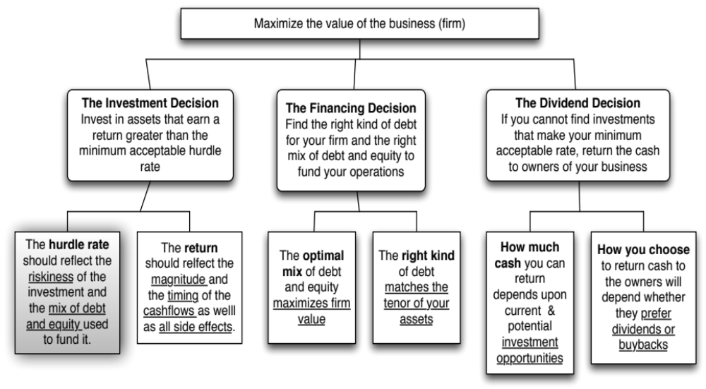
Back to First Principles
Notes:
Took us a while but we have the mechanics of the hurdle rate down..

Slide 194
Measuring Investment Returns
I: The Mechanics of Investment Analysis
“Show me the money”
from Jerry Maguire
Notes:
If there is a theme to how we think about returns in corporate finance, this line from Jerry Maguire brings it home. We trust the concrete over the vague and cash flows over earnings.

Slide 195
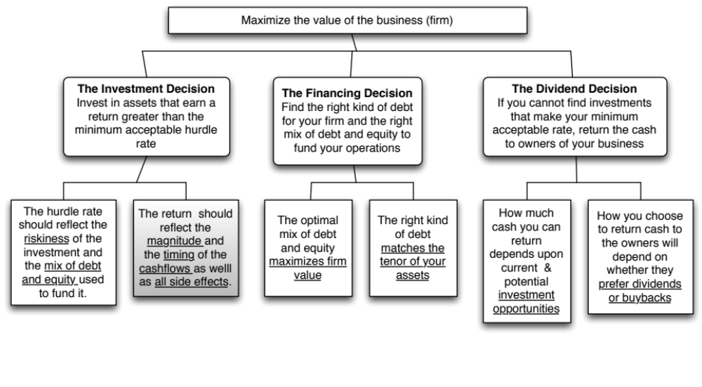
First Principles
Notes:
The next section of the notes will focus on measuring returns on investments, provide an argument for why cash flows make more sense than earnings and weighing those cash flows and discuss how best to bring in side benefits and costs into the returns.

Slide 196
Measures of return: earnings versus cash flows
Principles Governing Accounting Earnings Measurement
  Accrual Accounting: Show revenues when products and services are sold or provided, not when they are paid for. Show expenses associated with these revenues rather than cash expenses.
  Operating versus Capital Expenditures: Only expenses associated with creating revenues in the current period should be treated as operating expenses. Expenses that create benefits over several periods are written off over multiple periods (as depreciation or amortization)
To get from accounting earnings to cash flows:
  you have to add back non-cash expenses (like depreciation)
  you have to subtract out cash outflows which are not expensed (such as capital expenditures)
  you have to make accrual revenues and expenses into cash revenues and expenses (by considering changes in working capital).
Notes:
Accrual accounting income is designed to measure the “income” made by an entity during a period, on sales made during the period. Thus, accrual accounting draws lines between operating expenses (that create income in the current period), financial expenses (expenses associated with the use of debt) and capital expenditures (which create income over multiple periods). It is not always consistent. R&D, for instance, is treated as an operating expense.
Accrual accounting also tries to allocate the cost of materials to current period revenues, leading to inventory, and give the company credit for sales made during the period, even if cash has not been received, giving rise to accounts receivable. In effect, adding in the change in working capital converts accrual earnings to cash earnings.

Slide 197
Measuring Returns Right: The Basic Principles
Use cash flows rather than earnings. You cannot spend earnings.
Use “incremental” cash flows relating to the investment decision, i.e., cashflows that occur as a consequence of the decision, rather than total cash flows.
Use “time weighted” returns, i.e., value cash flows that occur earlier more than cash flows that occur later.
The Return Mantra: “Time-weighted, Incremental Cash Flow Return”
Notes:
These are the basic financial principles underlying the measurement of investment returns.
We focus on cash flows, because when cash flows and earnings are different, cash flows provide a more reliable measure of what an investment generates.
We focus on “incremental” effects on the overall business, since we care about the overall health and value of the business, not just individual projects.
We use time-weighted returns, since returns made earlier are worth more than the same returns made later.

Slide 198
Setting the table: What is an investment/project?
An investment/project can range the spectrum from big to small, money making to cost saving:
  Major strategic decisions to enter new areas of business or new markets.
  Acquisitions of other firms are projects as well, notwithstanding attempts to create separate sets of rules for them.
  Decisions on new ventures within existing businesses or markets.
  Decisions that may change the way existing ventures and projects are run.
  Decisions on how best to deliver a service that is necessary for the business to run smoothly.
Put in broader terms, every choice made by a firm can be framed as an investment.
Notes:
The discussion of what is a “good investment” that follows applies to pretty much everything that firms do… Put another way, the rules we develop are general ones and cannot be altered or modified just because a specific investment is too big or too small…

Slide 199
Here are four examples…
Rio Disney: We will consider whether Disney should invest in its first theme parks in South America. These parks, while similar to those that Disney has in other parts of the world, will require us to consider the effects of country risk and currency issues in project analysis.
New iron ore mine for Vale: This is an iron ore mine that Vale is considering in Western Labrador, Canada.
An Online Store for Bookscape: Bookscape is evaluating whether it should create an online store to sell books. While it is an extension of their basis business, it will require different investments (and potentially expose them to different types of risk).
Acquisition of Harman by Tata Motors: A cross-border bid by Tata for Harman International, a publicly traded US firm that manufactures high-end audio equipment, with the intent of upgrading the audio upgrades on Tata Motors’ automobiles. This investment will allow us to examine currency and risk issues in such a transaction.
Notes:
These investments range the spectrum, from small to large, extensions of existing businesses to acquisitions. The emphasis will be that the principles of investment analysis do not change, no matter what type of investment you are looking at.

Slide 200
Earnings versus Cash Flows: A Disney Theme Park
The theme parks to be built near Rio, modeled on Euro Disney in Paris and Disney World in Orlando.
The complex will include a “Magic Kingdom” to be constructed, beginning immediately, and becoming operational at the beginning of the second year, and a second theme park modeled on Epcot Center at Orlando to be constructed in the second and third year and becoming operational at the beginning of the fourth year.
The earnings and cash flows are estimated in nominal U.S. Dollars.
Notes:
The earnings and cash flows will really be in Brazilian R$. We will consider later the effects of looking at all the cash flows in a different currency.
Note that this investment is not going to be fully operational until the fourth year.

Slide 201
Key Assumptions on Start Up and Construction
Disney has already spent $0.5 Billion researching the proposal and getting the necessary licenses for the park; none of this investment can be recovered if the park is not built. This expenditure has been capitalized and will be depreciated straight line over ten years to a salvage value of zero.
Disney will face substantial construction costs, if it chooses to build the theme parks.
  The cost of constructing Magic Kingdom will be $3 billion, with $ 2 billion to be spent right now, and $1 Billion to be spent one year from now.
  The cost of constructing Epcot II will be $ 1.5 billion, with $ 1 billion to be spent at the end of the second year and $0.5 billion at the end of the third year.
  These investments will be depreciated based upon a depreciation schedule in the tax code, where depreciation will be different each year.
Notes:
The emphasis in the second item should be on “already spent”.
While we often classify all these investments as “initial investments”, they occur over time. Companies seldom make large investments at an instant in time.
Also worth adding: Disney will fund this investment using the same mix of debt and equity that it uses for theme parks currently.

Slide 202
Key Revenue Assumptions
Revenue estimates for the parks and resort properties (in millions)
Year Magic Kingdom Epcot II Resort Properties Total
1 $0 $0 $0 $0
2 $1,000 $0 $250 $1,250
3 $1,400 $0 $350 $1.750
4 $1,700 $300 $500 $2.500
5 $2,000 $500 $625 $3.125
6 $2,200 $550 $688 $3,438
7 $2,420 $605 $756 $3,781
8 $2,662 $666 $832 $4,159
9 $2,928 $732 $915 $4,575
10 $2,987 $747 $933 $4,667
Notes:
These are assumptions. Most real investments involve uncertainty about the future, but we have to make a judgment on what we “expect” to make. These expectations may be based upon past experience or market testing. (For instance, Disney would make these forecasts by looking at the history of Disneyland., EuroDisney and DisneyWorld).
Note that these are not conservative or low-ball estimates. Using lower numbers than expected (because a project is risky or because you are risk-averse) can lead to risk being double counted.
There is an alternative approach to capital budgeting where we can estimate what are called certainty equivalent cash flows, but the discount rate in that case would be the riskfree rate.
Finally, note that the project continues after year 10.

Slide 203
Key Expense Assumptions
The operating expenses are assumed to be 60% of the revenues at the parks, and 75% of revenues at the resort properties.
Disney will also allocate corporate general and administrative costs to this project, based upon revenues; the G&A allocation will be 15% of the revenues each year. It is worth noting that a recent analysis of these expenses found that only one-third of these expenses are variable (and a function of total revenue) and that two-thirds are fixed.
Notes:
Again, these numbers are easier to estimate in an investment like this one, where Disney can look at similar investments that it has made in the past.
Most large firms have significant expenses that cannot be traced to individual projects. These expenses are sometimes lumped under General and Administrative expenses (G&A) and get allocated to projects.

Slide 204
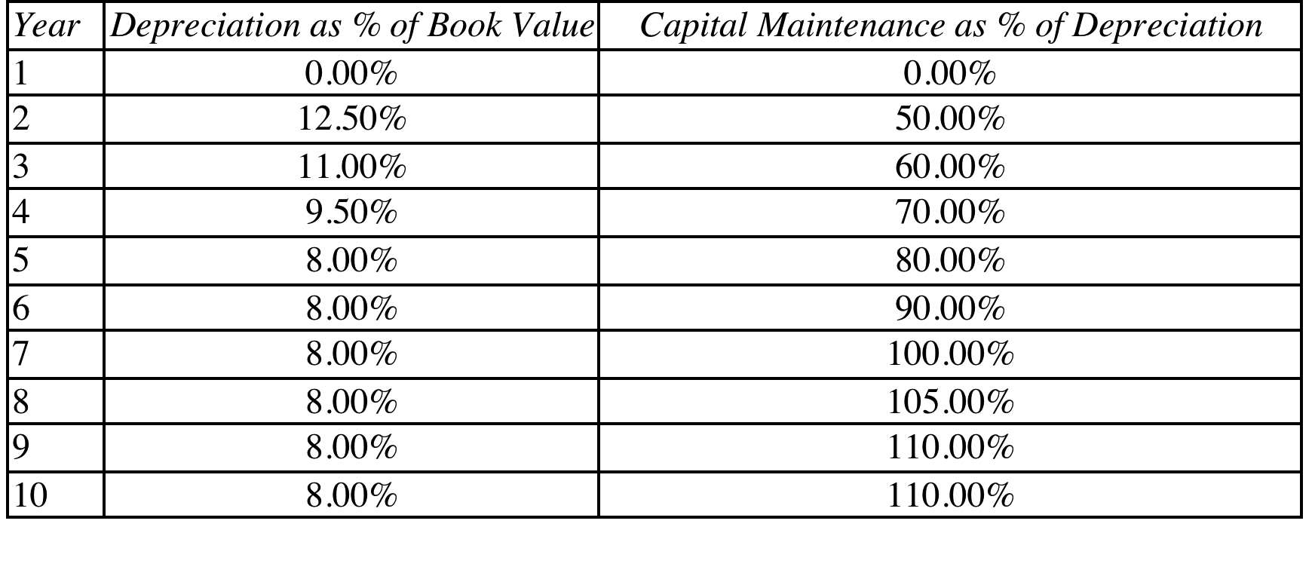
Depreciation and Capital Maintenance
The capital maintenance expenditures are low in the early years, when the parks are still new but increase as the parks age.
Notes:
This is accrual accounting at work. Some expenses such as regular maintenance expenses will be treated as operating, but some expenses (such as replacing a significant portion of an existing amusement park ride) will be treated as capital expenditures. The capital expenditures on this page are maintenance capital expenditures, designed to keep the parks in operational condition, generating revenues in the long term, and are on top of the initial capital expenditures.
The depreciation is the total depreciation on all fixed assets. Note that capital expenditures moves towards depreciation over time, reflecting the fact that on a long lived project, the cash inflow from depreciation will have to be reinvested back into the project to preserve the earning power of the assets.

Slide 205
Other Assumptions
Disney will have to maintain non-cash working capital (primarily consisting of inventory at the theme parks and the resort properties, netted against accounts payable) of 5% of revenues, with the investments being made at the end of each year.
The income from the investment will be taxed at Disney’s marginal tax rate of 38%.
Notes:
This will be a drain on the cash flows, since revenues are growing. This, in turn, will create larger inventory and working capital needs each year, which will tie up more cash in the project.
The tax rate used is the marginal tax rate (as opposed to the effective tax rate reported in income statements and annual reports) because projects create income at the margin and will be taxed at the margin.

Slide 206
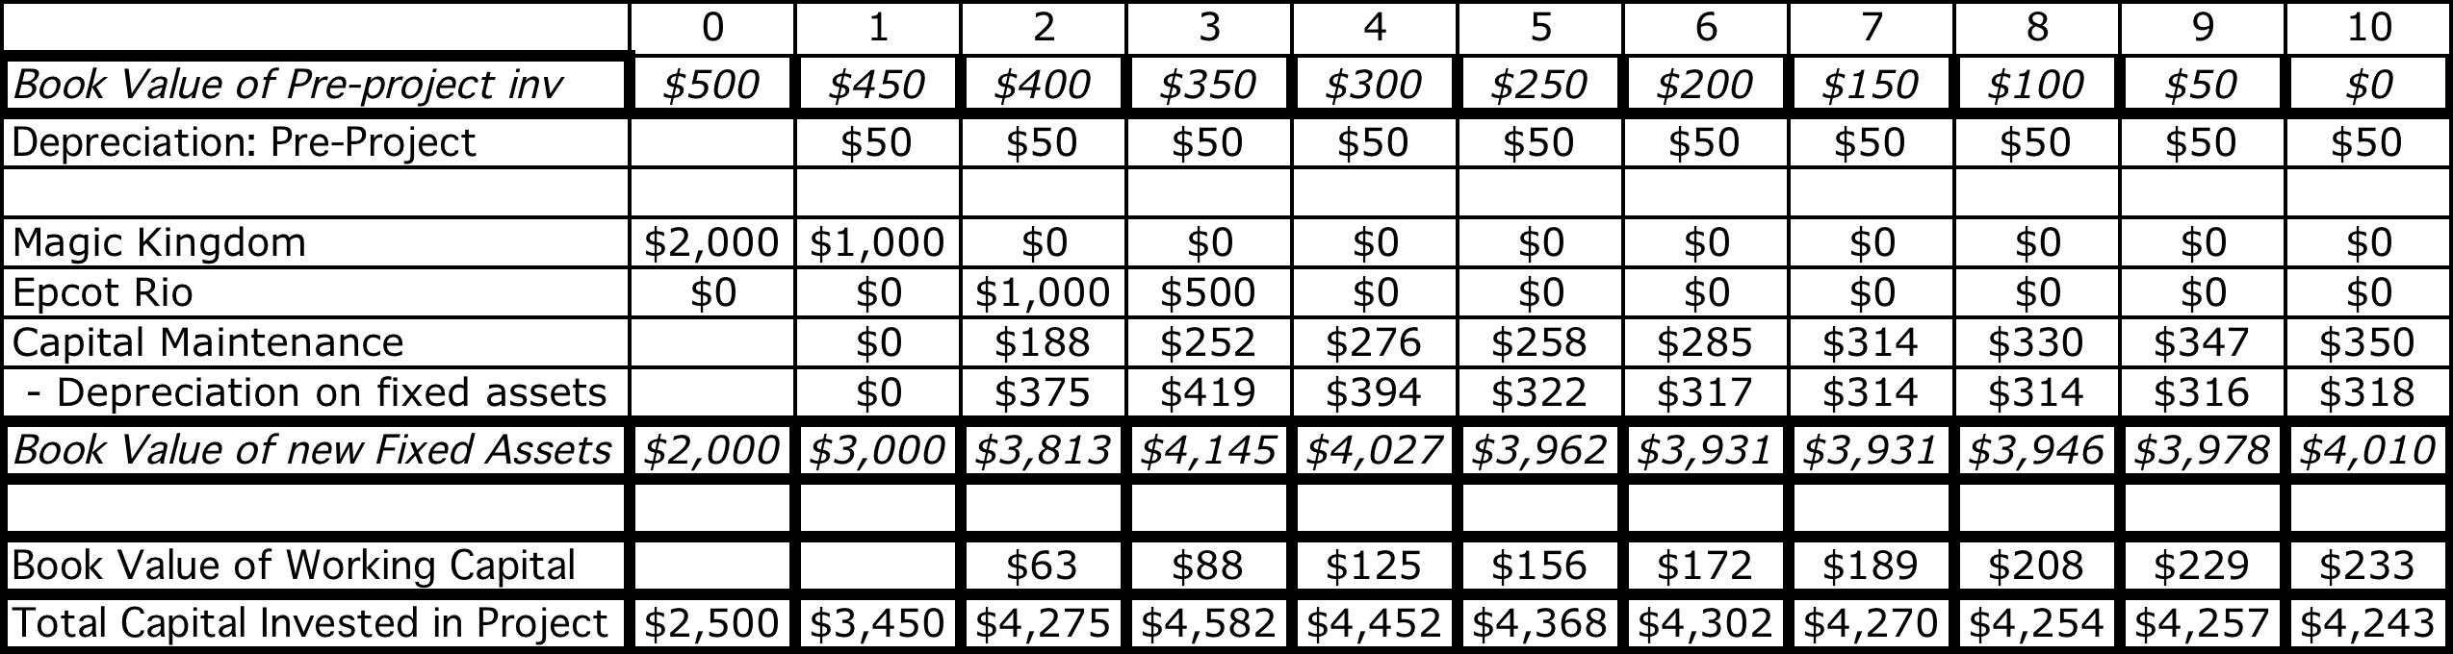
Laying the groundwork:
Book Capital, Working Capital and Depreciation
12.5% of book value at end of prior year ($3,000)
Notes:
The depreciation each year is computed by multiplying the book value of fixed assets at the end of the previous year and multiplying by the depreciation percentage specified in the earlier table. IN year 2, for instance, the depreciation is 12.5% of the book value of fixed assets at the end of year 1 ($3,000), yielding $375 million.
The $ 500 million that has been spent already on the project was capitalized. It is depreciated straight line over the 10 years. (If it had been expensed, this would not be necessary)

Slide 207

Step 1: Estimate Accounting Earnings on Project
Notes:
This shows the accounting earnings calculations for the next 10 years. Note the increasing after-tax operating income over time.
Note that loss in year 1. While this loss can be carried forward and offset against profits in future years, we have chosen to claim the losses against Disney’s profits from other projects in year 1. (You would rather save taxes now than the same taxes in the future…)
Where are the interest expenses? They do not show up because we are computing earnings to the firm - operating income - rather than earnings to equity - net income.

Slide 208

And the Accounting View of Return
Based upon book capital at the start of each year
Based upon average book capital over the year
Notes:
This converts the accounting income into a percentage return (to enable us to do the comparison to the hurdle rate, which is a percentage rate). We have computed a simple average return on capital over the next 10 years…
The average book value is computed each year using the beginning and ending book values. The book values themselves are computed as follows:
Ending BV = Beginning BV - Depreciation + Capital Expenditures

Slide 209
What should this return be compared to?
The computed return on capital on this investment is about 4.18%. To make a judgment on whether this is a sufficient return, we need to compare this return to a “hurdle rate”. Which of the following is the right hurdle rate? Why or why not?
  The riskfree rate of 2.75% (T. Bond rate)
  The cost of equity for Disney as a company (8.52%)
  The cost of equity for Disney theme parks (7.09%)
  The cost of capital for Disney as a company (7.81%)
  The cost of capital for Disney theme parks (6.61%)
  None of the above
Notes:
First, since we have computed return on capital, the comparison should be to the cost of capital.
Second, since it is a theme park investment, it should be the cost of capital for theme parks.
Here is the catch. This theme park is in Brazil, an emerging market. Thus, the cost of capital of 6.61% that we estimated for existing theme parks, which are in developed markets, may be too low.
So, the answer is “none of the above”.

Slide 210
Should there be a risk premium for foreign projects?
The exchange rate risk should be diversifiable risk (and hence should not command a premium) if
  the company has projects is a large number of countries (or)
  the investors in the company are globally diversified.
  For Disney, this risk should not affect the cost of capital used. Consequently, we would not adjust the cost of capital for Disney’s investments in other mature markets (Germany, UK, France)
The same diversification argument can also be applied against some political risk, which would mean that it too should not affect the discount rate. However, there are aspects of political risk especially in emerging markets that will be difficult to diversify and may affect the cash flows, by reducing the expected life or cash flows on the project.
For Disney, this is the risk that we are incorporating into the cost of capital when it invests in Brazil (or any other emerging market)
Notes:
This will depend upon the company. Smaller companies, with higher insider holdings, should be more likely to assess higher discount rates for expanding overseas. Larger companies, with more diverse stockholdings, should be more inclined to use the same discount rates they use in the domestic market.

Slide 211
Should there be a risk premium for foreign projects?
The exchange rate risk should be diversifiable risk (and hence should not command a premium) if
  the company has projects is a large number of countries (or)
  the investors in the company are globally diversified.
  For Disney, this risk should not affect the cost of capital used. Consequently, we would not adjust the cost of capital for Disney’s investments in other mature markets (Germany, UK, France)
The same diversification argument can also be applied against some political risk, which would mean that it too should not affect the discount rate. However, there are aspects of political risk especially in emerging markets that will be difficult to diversify and may affect the cash flows, by reducing the expected life or cash flows on the project.
For Disney, this is the risk that we are incorporating into the cost of capital when it invests in Brazil (or any other emerging market)
Notes:
This will depend upon the company. Smaller companies, with higher insider holdings, should be more likely to assess higher discount rates for expanding overseas. Larger companies, with more diverse stockholdings, should be more inclined to use the same discount rates they use in the domestic market.

Slide 212
Estimating a hurdle rate for Rio Disney
We did estimate a cost of capital of 6.61% for the Disney theme park business, using a bottom-up levered beta of 0.7537 for the business.
This cost of equity may not adequately reflect the additional risk associated with the theme park being in an emerging market.
The only concern we would have with using this cost of equity for this project is that it may not adequately reflect the additional risk associated with the theme park being in an emerging market (Brazil). We first computed the Brazil country risk premium (by multiplying the default spread for Brazil by the relative equity market volatility) and then re-estimated the cost of equity:
  Country risk premium for Brazil = 5.5%+ 3% = 8.5%
  Cost of Equity in US$= 2.75% + 0.7537 (8.5%) = 9.16%
Using this estimate of the cost of equity, Disney’s theme park debt ratio of 10.24% and its after-tax cost of debt of 2.40% (see chapter 4), we can estimate the cost of capital for the project:
  Cost of Capital in US$ = 9.16% (0.8976) + 2.40% (0.1024) = 8.46%
Notes:
Here is the other half of the equation:
The hurdle rate for an investment should reflect its risk. (That is why we use the bottom-up beta that we estimated for theme parks earlier rather than the bottom-up beta for Disney as a company). In addition, the exposure to country risk is incorporated into the investment.
We use Disney’s theme park debt ratio for this theme park, on the assumption that it is not a stand-alone investment with its own debt capacity. If it were, we would have considered using project specific financing weights. (It is usually not a good idea to compute the cost of capital for a project based on how it is financed, since firms can use disproportionate amounts of debt on some projects not because the projects can afford to carry debt but because they (the firms) have excess debt capacity.

Slide 213
Would lead us to conclude that...
Do not invest in this park. The return on capital of 4.18% is lower than the cost of capital for theme parks of 8.46%; This would suggest that the project should not be taken.
Given that we have computed the average over an arbitrary period of 10 years, while the theme park itself would have a life greater than 10 years, would you feel comfortable with this conclusion?
  Yes
  No
Notes:
I would not. I think the accounting return, which cuts off the analysis arbitrarily after 10 years, understates the true return on projects like this one, which have longer expected lives.
In general, while firms claim that using the same life for all projects is not discriminatory, it clearly creates a bias against longer term projects.

Slide 214

A Tangent: From New to Existing Investments: ROC for the entire firm
How “good” are the existing investments of the firm?
Measuring ROC for existing investments..
Notes:
A firm can be viewed as having a portfolio of existing projects. This approach allows you to assess whether that portfolio is earning more than the hurdle rate, but it is based upon the following assumptions:
Accounting earnings are a good measure of the earnings from current projects (They might not be, if items like R&D, which are really investments for the future, extraordinary profits or losses, or accounting changes affect the reported income.)
The book value of capital is a good measure of what is invested in current projects.
Some computational details:
Why do we use book value of debt and equity?
Because we want to focus on capital invested in assets in place. Market value has two problems. It includes growth assets and it updates the value to reflect returns earned. In fact, if you computed market value of just assets in place correctly, you should always earn your cost of capital.
Why end of last year?
To stay consistent with end-of-the-year cash flows and earnings that we use in the rest of the analysis. If we used mid-year conventions, we could use average values instead.

Slide 215
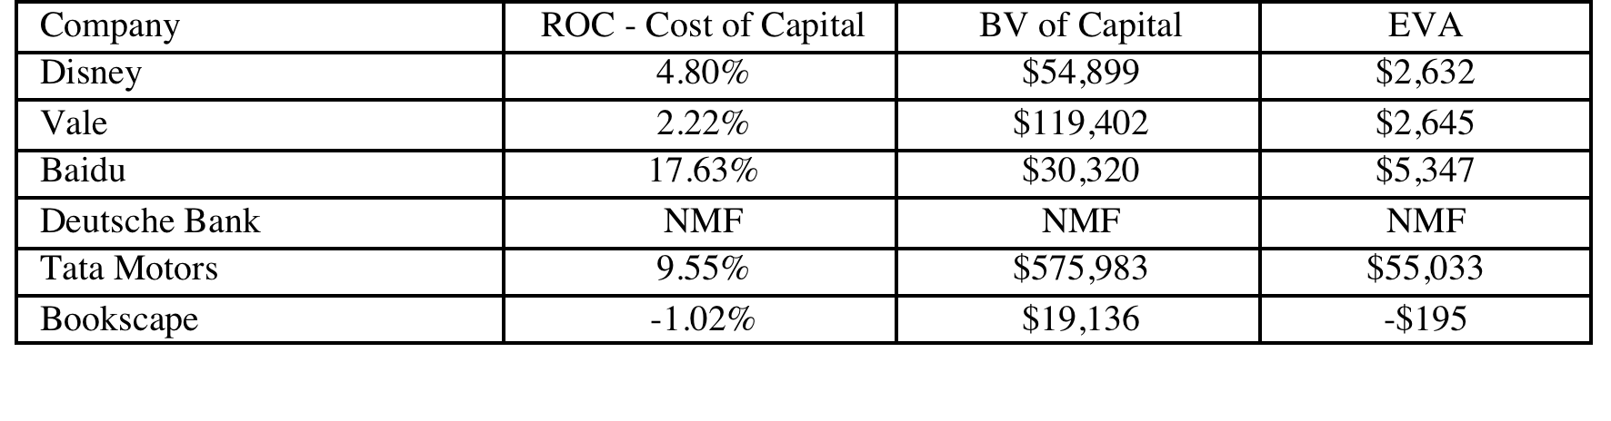
Old wine in a new bottle.. Another way of presenting the same results…
The key to value is earning excess returns. Over time, there have been attempts to restate this obvious fact in new and different ways. For instance, Economic Value Added (EVA) developed a wide following in the the 1990s:
EVA = (ROC – Cost of Capital ) (Book Value of Capital Invested)
The excess returns for the four firms can be restated as follows:
Notes:
The EVA is a measure of dollar value created in a single time period. Thus, it will be affected by how capital is measured and the ups and downs of year-to-year operating income.
EVA just restates the excess returns (ROC – Cost of capital) in dollar value terms. Thus, it will always have the same sign as the excess return, but it will be larger for larger companies. Thus, you cannot compare the EVA across companies but you can compare the EVA for the same company from year to year.

Slide 216
Return Spreads Globally….
Notes:
Looking across all 40,000 firms, you can see that almost a third of all firms earn more than 5% less than their cost of capital. It is true that we are looking at one year’s returns, but many of these firms have been earning less than their cost of capital for years.
Implication: A large proportion of all publicly traded firms earn less than their cost of capital on their investments. Some of these firms can attribute their under performance to bad luck or a bad year. A few others may be young firms that have not had a chance to see their investments pay off (yet). However, quite a large percent of these firms have been badly managed and continue to be run by the same managers. If the question is why stockholders have not replaced these managers, the answer lies in the very first section on corporate governance. (If you don’t like the way Tata Motors, Baidu or Vale is run, what can you do?)

Slide 217
6 Application Test: Assessing Investment Quality
For the most recent period for which you have data, compute the after-tax return on capital earned by your firm, where after-tax return on capital is computed to be
After-tax ROC = EBIT (1-tax rate)/ (BV of debt + BV of Equity-Cash)previous year
For the most recent period for which you have data, compute the return spread earned by your firm:
Return Spread = After-tax ROC - Cost of Capital
For the most recent period, compute the EVA earned by your firm
EVA = Return Spread * ((BV of debt + BV of Equity-Cash)previous year
Notes:
This measure of investment quality is only as good as the measures of operating income and book value that go into it.
Note also that:
A negative EVA in a single period should not be taken as an indicator that the company is a bad or poorly managed company. It may reflect the fact that the firm had a bad year or that macro economic variables conspired to reduce operating income in that period (a recession for a cyclical firm, a downturn in commodity prices for a commodity company).
Even a string of negative EVAs may not be an indicator of a poorly run firm or business. Young businesses and infrastructure companies often have negative EVAs for extended periods (while they are building up infrastructure) before they turn positive.

Slide 218
The cash flow view of this project..
 | 0 | 1 | 2 | 3 | 4 | 5 | 6 | 7 | 8 | 9 | 10
After-tax Operating Income |  | -$32 | -$96 | -$54 | $68 | $202 | $249 | $299 | $352 | $410 | $421
+ Depreciation & Amortization | $0 | $50 | $425 | $469 | $444 | $372 | $367 | $364 | $364 | $366 | $368
- Capital Expenditures | $2,500 | $1,000 | $1,188 | $752 | $276 | $258 | $285 | $314 | $330 | $347 | $350
- Change in non-cash Work Capital |  | $0 | $63 | $25 | $38 | $31 | $16 | $17 | $19 | $21 | $5
Cashflow to firm | ($2,500) | ($982) | ($921) | ($361) | $198 | $285 | $314 | $332 | $367 | $407 | $434
To get from income to cash flow, we
added back all non-cash charges such as depreciation. Tax benefits:
subtracted out the capital expenditures
subtracted out the change in non-cash working capital
Notes:
This converts earnings to cash flows.
Depreciation and amortization are just two of the most common non-cash charges.
Any capital expenditures (whether initial or maintenance) need to be subtracted out.
It is only the change in non-cash working capital that needs to be subtracted out.

Slide 219
The Depreciation Tax Benefit
While depreciation reduces taxable income and taxes, it does not reduce the cash flows.
The benefit of depreciation is therefore the tax benefit. In general, the tax benefit from depreciation can be written as:
Tax Benefit = Depreciation * Tax Rate
Disney Theme Park: Depreciation tax savings (Tax rate = 36.1%)
Proposition 1: The tax benefit from depreciation and other non-cash charges is greater, the higher your tax rate.
Proposition 2: Non-cash charges that are not tax deductible (such as amortization of goodwill) and thus provide no tax benefits have no effect on cash flows.
 | 1 | 2 | 3 | 4 | 5 | 6 | 7 | 8 | 9 | 10
Depreciation | $50 | $425 | $469 | $444 | $372 | $367 | $364 | $364 | $366 | $368
Tax Bendfits from Depreciation | $18 | $153 | $169 | $160 | $134 | $132 | $132 | $132 | $132 | $133
Notes:
While you subtract depreciation from EBITDA to get to EBIT, and then add it back again to after-tax EBIT, it leaves an imprint on the cash flows, because it reduces taxes. Consequently, if a firm pays no taxes (it is a tax-exempt entity, for instance), there is no benefit to depreciation.
As your tax rates increase, the benefit to depreciation also increases. In the 1970s, when tax rates for wealthy individuals were much higher than tax rates for corporations, the former (who get much higher tax benefits from depreciation) would buy expensive assets (such as airplanes) and lease them back to the latter.
Non-cash charges that are not tax deductible do not create a benefit from a cash flow standpoint. They are subtracted out from after-tax income and then added back. Thus, the debate in acquisitions about whether to use purchase accounting (which leads to goodwill, the amortization of which reduces after-tax earnings in future periods) or pooling (which does not affect earnings) has no implications for cash flows) is really a debate that affects earnings but not cash flows.

Slide 220
Depreciation Methods
Broadly categorizing, depreciation methods can be classified as straight line or accelerated methods. In straight line depreciation, the capital expense is spread evenly over time, In accelerated depreciation, the capital expense is depreciated more in earlier years and less in later years. Assume that you made a large investment this year, and that you are choosing between straight line and accelerated depreciation methods. Which will result in higher net income this year?
  Straight Line Depreciation
  Accelerated Depreciation
Which will result in higher cash flows this year?
  Straight Line Depreciation
  Accelerated Depreciation
Notes:
Straight line depreciation will lead to higher income and accelerated depreciation to higher cash flows.
Most US firms use straight line depreciation for financial reporting (as in annual reports) and accelerated depreciation (for tax purposes). This is one reason why effective tax rates in annual reports look low. (Effective Tax Rate = Taxes Paid / Reported Pre-tax Income).

Slide 221
The Capital Expenditures Effect
Capital expenditures are not treated as accounting expenses but they do cause cash outflows.
Capital expenditures can generally be categorized into two groups
  New (or Growth) capital expenditures are capital expenditures designed to create new assets and future growth
  Maintenance capital expenditures refer to capital expenditures designed to keep existing assets.
Both initial and maintenance capital expenditures reduce cash flows
The need for maintenance capital expenditures will increase with the life of the project. In other words, a 25-year project will require more maintenance capital expenditures than a 2-year project.
Notes:
While most analysts who look at projects remember to consider the initial capital investment, many of them fail to consider the need for capital maintenance expenditure.
Depreciation and capital expenditures are highly interrelated assumptions. You cannot depreciate what you do not cap ex.

Slide 222
To cap ex or not to cap ex?
Assume that you run your own software business, and that you have an expense this year of $ 100 million from producing and distribution promotional CDs in software magazines. Your accountant tells you that you can expense this item or capitalize and depreciate it over three years. Which will have a more positive effect on income?
  Expense it
  Capitalize and Depreciate it
Which will have a more positive effect on cash flows?
  Expense it
  Capitalize and Depreciate it
Notes:
Capitalizing and amortizing the expense will have a more positive effect on income. Assuming you have the income to expense it, expensing it will have a more positive effect on cash flows.
Here are the two times when you may prefer to capitalize and depreciate, rather than expense:
When you are losing money and expect to make money in the future (and are worried about losing loss carry forwards)
When you expect your tax rates to go up over time.

Slide 223
The Working Capital Effect
Intuitively, money invested in inventory or in accounts receivable cannot be used elsewhere. It, thus, represents a drain on cash flows
To the degree that some of these investments can be financed using supplier credit (accounts payable), the cash flow drain is reduced.
Investments in working capital are thus cash outflows
  Any increase in working capital reduces cash flows in that year
  Any decrease in working capital increases cash flows in that year
To provide closure, working capital investments need to be salvaged at the end of the project life.
Proposition 1: The failure to consider working capital in a capital budgeting project will overstate cash flows on that project and make it look more attractive than it really is.
Proposition 2: Other things held equal, a reduction in working capital requirements will increase the cash flows on all projects for a firm.
Notes:
By working capital, we consider only non-cash working capital. Defined even more tightly,
Non-cash WC = Inventory + Accounts Receivable - Accounts Payable
Why do we not include cash? Because the investment in working capital is considered to be an investment in wasting assets, i.e., assets on which you cannot make a fair rate of return. To the extent that most US firms that have cash today invest that cash in treasury bills or commercial paper (where they earn a low but a fair rate of return), treating the cash as part of non-cash working capital may be requiring it to earn a return twice.
Some businesses do need to maintain wasting cash balances, i.e., cash in the form of currency but this requirement should be small. If that is the case, that cash can be counted into working capital.
Question to consider: Can non-cash working capital be a source of cash in some businesses?
Yes… There are businesses that have little need for inventory and take full advantage of supplier credit, thus making working capital a negative number and a source of cash.

Slide 224

The incremental cash flows on the project
$ 500 million has already been spent & $ 50 million in depreciation will exist anyway
2/3rd of allocated G&A is fixed.
Add back this amount (1-t)
Tax rate = 36.1%
Notes:
A sunk cost is any cost that has already been incurred and will not be recovered even if the project under consideration is rejected.
The tax savings on the depreciation on the sunk cost is also subtracted out, since that tax savings would accrue to the firm even if it did not take this investment.
Only the after-tax amount of the non-incremental allocated costs are added back because the cash flows are after-tax cash flows.
Alternatively, the cash flows can be estimated from scratch using only the incremental cash flows.

Slide 225
A more direct way of getting to incremental cash flows
 | 0 | 1 | 2 | 3 | 4 | 5 | 6 | 7 | 8 | 9 | 10
Revenues |  | $0 | $1,250 | $1,750 | $2,500 | $3,125 | $3,438 | $3,781 | $4,159 | $4,575 | $4,667
Direct Expenses |  | $0 | $788 | $1,103 | $1,575 | $1,969 | $2,166 | $2,382 | $2,620 | $2,882 | $2,940
Incremental Depreciation |  | $0 | $375 | $419 | $394 | $322 | $317 | $314 | $314 | $316 | $318
Incremental G&A |  | $0 | $63 | $88 | $125 | $156 | $172 | $189 | $208 | $229 | $233
Incremental Operating Income |  | $0 | $25 | $141 | $406 | $678 | $783 | $896 | $1,017 | $1,148 | $1,175
- Taxes |  | $0 | $9 | $51 | $147 | $245 | $283 | $323 | $367 | $415 | $424
Incremental after-tax Operating income |  | $0 | $16 | $90 | $260 | $433 | $500 | $572 | $650 | $734 | $751
+ Incremental Depreciation |  | $0 | $375 | $419 | $394 | $322 | $317 | $314 | $314 | $316 | $318
- Capital Expenditures | $2,000 | $1,000 | $1,188 | $752 | $276 | $258 | $285 | $314 | $330 | $347 | $350
- Change in non-cash Working Capital |  | $0 | $63 | $25 | $38 | $31 | $16 | $17 | $19 | $21 | $5
Cashflow to firm | ($2,000) | ($1,000) | ($859) | ($267) | $340 | $466 | $516 | $555 | $615 | $681 | $715
Notes:
Rather than start with accounting earnings and work backwards to get to incremental cash flows, we could just incremental revenues and expenses all the way through and save ourselves the trouble. The answers should match up.

Slide 226
Sunk Costs
What is a sunk cost? Any expenditure that has already been incurred, and cannot be recovered (even if a project is rejected) is called a sunk cost. A test market for a consumer product and R&D expenses for a drug (for a pharmaceutical company) would be good examples.
The sunk cost rule: When analyzing a project, sunk costs should not be considered since they are not incremental.
A Behavioral Aside: It is a well established finding in psychological and behavioral research that managers find it almost impossible to ignore sunk costs.
Notes:
Sunk costs should not be considered an investment analysis. After all, rejecting an investment that adds value is self-defeating even if the value added < Sunk costs….
It is human nature, though, to try to make back what has already been lost. It is what keeps casinos going…
In what is known as the Concorde fallacy, managers were presented with a hypothetical scenario. Assume that you have spent $ 9 million, developing a new technology, and that you will need to spend an additional million to complete your development. Assume now that a competitor has just come up with a much better technology (that will make yours obsolete). The subjects of this experiment were asked to decide whether they would invest the extra million, in light of this new information.
When managers were just asked about investing an extra million in a technology that would be obsolete when it came out (and not told about the $ 9 million already spent) they all rejected the investment.
When made aware of what had already been spent, 40% chose to make the additional investment.

Slide 227
Test Marketing and R&D: The Quandary of Sunk Costs
A consumer product company has spent $ 100 million on test marketing. Looking at only the incremental cash flows (and ignoring the test marketing), the project looks like it will create $25 million in value for the company. Should it take the investment?
  Yes
  No
Now assume that every investment that this company has shares the same characteristics (Sunk costs > Value Added). The firm will clearly not be able to survive. What is the solution to this problem?
Notes:
Companies with substantial test marketing and R&D expenses have to put into place processes where these costs are assessed before they occur since it is too late to do it afterwards. These assessments will be based upon fairly primitive information but they are necessary. For instance, proposals for basic research will have to include probabilities that the research will lead to commercial products and the potential markets for such products.

Slide 228
Allocated Costs
Firms allocate costs to individual projects from a centralized pool (such as general and administrative expenses) based upon some characteristic of the project (sales is a common choice, as is earnings)
For large firms, these allocated costs can be significant and result in the rejection of projects
To the degree that these costs are not incremental (and would exist anyway), this makes the firm worse off. Thus, it is only the incremental component of allocated costs that should show up in project analysis.
Notes:
Allocation is the accountant’s mechanism for fairness.
If the allocation is of an expense that would be incurred anyway, whether the project is taken or not, it is not incremental.
It is difficult to figure out what allocated expenses are fixed and what are incremental. One approach that works reasonably well for firms with a history is to look at the expense (say, G&A) over time and compare it with some base variable (revenues or number of units). If the expense is fixed, it should not vary with the base variable. If it is variable, it will, and the nature of the variation will help define how much is fixed and how much is variable.

Slide 229
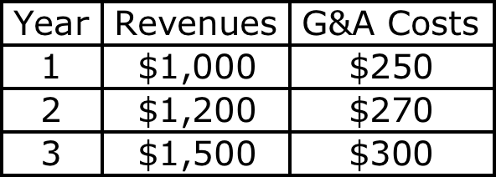
Breaking out G&A Costs into fixed and variable components: A simple example
Assume that you have a time series of revenues and G&A costs for a company.
  What percentage of the G&A cost is variable?
Notes:
If the pattern of this three year period tells the whole story,roughly 40% of the G&A cost is variable. Note that the incremental G&A/incremental revenues was 10% in both years 2 and 3. Using this 10% on total revenue in year 1 yields the variable G&A cost of $100 million in year 1 which is 40% of the total G&A costs.
In the real world, it is likely that this relationship will be far more jagged. You will need more data and your estimates will have more error. One way to estimate the variable G&A costs as a proportion of revenues, if you have a long time series of data, is to run a regression of G&A Costs against revenues:
G&A = a + b Revenues
The coefficient on revenue should provide a measure of how much G&A cots increase for every dollar increase in revenue.

Slide 230
To Time-Weighted Cash Flows
Incremental cash flows in the earlier years are worth more than incremental cash flows in later years.
In fact, cash flows across time cannot be added up. They have to be brought to the same point in time before aggregation.
This process of moving cash flows through time is
  discounting, when future cash flows are brought to the present
  compounding, when present cash flows are taken to the future
Notes:
Cash flows across time cannot be compared. Discounting brings cash flows back to the same point in time.
The present value factors are in a sense time-weighing factors. The riskier a cash flow and the further it is in the future, the lower the weight you attach to that cash flow.

Slide 231
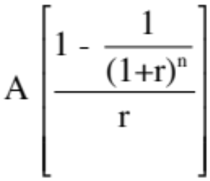
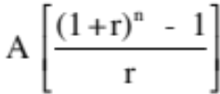
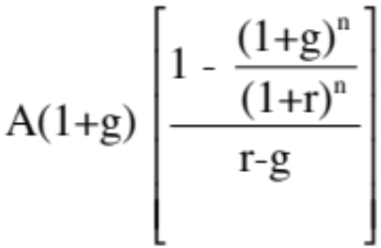
Present Value Mechanics
Cash Flow Type Discounting Formula Compounding Formula
1. Simple CF CF_{n} / (1+r)^{n} CF₀ (1+r)^{n}
2. Annuity
3. Growing Annuity
4. Perpetuity A/r
5. Growing Perpetuity Expected Cashflow next year/(r-g)
Notes:
These are the basic present value formulae. All except the growing annuity, can be done using the PV key on any financial calculator.
These formulae are based upon the assumptions that cash flows occur at the end of each period. If cash flows occur at the end of each period, the equations can be modified by multiplying each one by (1+r) to get end-of-the-period equivalents.

Slide 232
Discounted cash flow measures of return
Net Present Value (NPV): The net present value is the sum of the present values of all cash flows from the project (including initial investment).
  NPV = Sum of the present values of all cash flows on the project, including the initial investment, with the cash flows being discounted at the appropriate hurdle rate (cost of capital, if cash flow is cash flow to the firm, and cost of equity, if cash flow is to equity investors)
  Decision Rule: Accept if NPV > 0
Internal Rate of Return (IRR): The internal rate of return is the discount rate that sets the net present value equal to zero. It is the percentage rate of return, based upon incremental time-weighted cash flows.
  Decision Rule: Accept if IRR > hurdle rate
Notes:
The key difference between these approaches is that Net Present Value is a dollar measure, and it measures surplus value created. Thus, even a small net present value is over and above your hurdle rate.
Internal rate of return is a percentage measure of total return (not excess return). It is only when it is compared to the hurdle rate that is provides a measure of excess return (in percentage terms)

Slide 233
Closure on Cash Flows
In a project with a finite and short life, you would need to compute a salvage value, which is the expected proceeds from selling all of the investment in the project at the end of the project life. It is usually set equal to book value of fixed assets and working capital
In a project with an infinite or very long life, we compute cash flows for a reasonable period, and then compute a terminal value for this project, which is the present value of all cash flows that occur after the estimation period ends..
Assuming the project lasts forever, and that cash flows after year 10 grow 2% (the inflation rate) forever, the present value at the end of year 10 of cash flows after that can be written as:
  Terminal Value in year 10= CF in year 11/(Cost of Capital - Growth Rate)
  =715 (1.02) /(.0846-.02) = $ 11,275 million
Notes:
When you stop estimating cash flows on a project, you have to either estimate salvage value or terminal value. For projects with finite lives (such as buying a plant or equipment), estimating salvage value is appropriate. For projects with very long lives, estimating a terminal value is more reasonable.
If you assume that the project is liquidated, any investments in working capital have to be salvaged. This does not necessarily mean that you will get 100% back.
A terminal value can also be thought off as the value that you would get by selling this project (as an on-going project) to someone else at the end of the analysis. In this case, we are estimating that the theme park in Bangkok will be worth $ 11,275 million at the end of year 10. (The perpetual growth model gives the value of the asset at the beginning of the year of the cash flow. We used year 11 cash flows in the numerator and have the terminal value as of the start of year 11, which is also the end of year 10)

Slide 234

Which yields a NPV of..
Discounted at Rio Disney cost of capital of 8.46%
Notes:
This is the net present value calculation using the cost of capital of 8.46%, the theme park cost of capital adjusted for emerging market risk in Brazil.

Slide 235
Which makes the argument that..
The project should be accepted. The positive net present value suggests that the project will add value to the firm, and earn a return in excess of the cost of capital.
By taking the project, Disney will increase its value as a firm by $3,296 million.
Notes:
The net present value calculation suggests that this project is a good one.
The increase in firm value will not necessarily translate into an increase in market value, since market values reflect expectations. If expectations were such that the market expected Disney to take large positive NPV projects, the $3,296 million will have to be measured against these expectations.
The additive nature of NPV is useful in a variety of contexts:
The value of a business that is composed of many projects can be written as the sum of the NPVs of the projects.
When a firm over pays on an acquisition, it is the equivalent of accepting a negative NPV investment, and the value of its equity should drop by the overpayment.

Slide 236
The IRR of this project
Notes:
This is a net present value profile, where NPV is plotted against discount rates. The IRR is that discount rate at which NPV is zero.
The steepness of the slope tells us something about how sensitive this investment is to changes in the discount rate. It is the equivalent of the duration of a bond, which tells you how sensitive bond prices are to changes in interest rates.
Notice that the NPV is much more sensitive to changes in discount rates, when discount rates are low, than when they are high. (This may have consequences for how value will change in low interest rate scenarios as opposed to high interest rate ones).

Slide 237
The IRR suggests..
The project is a good one. Using time-weighted, incremental cash flows, this project provides a return of 12.60%. This is greater than the cost of capital of 8.46%.
The IRR and the NPV will yield similar results most of the time, though there are differences between the two approaches that may cause project rankings to vary depending upon the approach used. They can yield different results, especially why comparing across projects because
  A project can have only one NPV, whereas it can have more than one IRR.
  The NPV is a dollar surplus value, whereas the IRR is a percentage measure of return. The NPV is therefore likely to be larger for “large scale” projects, while the IRR is higher for “small-scale” projects.
  The NPV assumes that intermediate cash flows get reinvested at the “hurdle rate”, which is based upon what you can make on investments of comparable risk, while the IRR assumes that intermediate cash flows get reinvested at the “IRR”.
Notes:
The information needed to use IRR in investment analysis is the same as the information need to use NPV.
If the hurdle rate is changing over time, IRR becomes more complicated to use. It has to be compared to the geometric average of the hurdle rates over time.

Slide 238
Does the currency matter?
The analysis was done in dollars. Would the conclusions have been any different if we had done the analysis in Brazilian Reais?
  Yes
  No
Notes:
No. It should not. A good project should be good in any currency. But showing this in practice requires us to make some key assumptions about how exchange rates will evolve over time.

Slide 239
The ‘‘Consistency Rule” for Cash Flows
The cash flows on a project and the discount rate used should be defined in the same terms.
  If cash flows are in dollars (R$), the discount rate has to be a dollar (R$) discount rate
  If the cash flows are nominal (real), the discount rate has to be nominal (real).
If consistency is maintained, the project conclusions should be identical, no matter what cash flows are used.
Notes:
When working with higher inflation currencies, the discount rates will be higher but so will the expected growth (because of the inflation)
We are implicitly assuming that current exchange rates are correct and that expected changes in exchange rates over time will reflect differences in inflation. To the degree that this is not true, the project analysis might be affected by the currency in which the analysis is done.

Slide 240
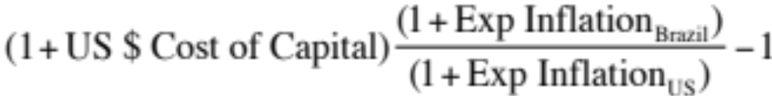
Disney Theme Park: Project Analysis in R$
The inflation rates were assumed to be 9% in Brazil and 2% in the United States. The R$/dollar rate at the time of the analysis was 2.35 R$/dollar.
The expected exchange rate was derived assuming purchasing power parity.
  Expected Exchange Rate_{t} = Exchange Rate today * (1.09/1.02)^{t}
The expected growth rate after year 10 is still expected to be the inflation rate, but it is the 9% R$ inflation rate.
The cost of capital in R$ was derived from the cost of capital in dollars and the differences in inflation rates:
  R$ Cost of Capital =
  = (1.0846) (1.09/1.02) – 1 = 15.91%
Notes:
Note that the expected exchange rate reflects purchasing power parity.
Many companies in Asia, during the early 1990s used the then prevailing exchange rate to forecast future cash flows, because governments in these markets had pegged their currencies to the dollar (essentially promising a fixed exchange rate). While this held up for a while, the differences in inflation eventually caused the local currency to collapse, taking many real projects down with it.

Slide 241
Disney Theme Park: $R NPV
  Expected Exchange Rate_{t}
  = Exchange Rate today * (1.09/1.02)^{t}
Discount at $R cost of capital
= (1.0846) (1.09/1.02) – 1 = 15.91%
Year | Cashflow ($) | $R/$ | Cashflow ($R) | Present Value
0 | -R$ 2,000.00 | R$ 2.35 | -R$ 4,700.00 | -R$ 4,700.00
1 | -R$ 1,000.00 | R$ 2.51 | -R$ 2,511.27 | -R$ 2,166.62
2 | -R$ 859.03 | R$ 2.68 | -R$ 2,305.29 | -R$ 1,715.95
3 | -R$ 267.39 | R$ 2.87 | -R$ 766.82 | -R$ 492.45
4 | R$ 340.22 | R$ 3.06 | R$ 1,042.63 | R$ 577.68
5 | R$ 466.33 | R$ 3.27 | R$ 1,527.21 | R$ 730.03
6 | R$ 516.42 | R$ 3.50 | R$ 1,807.31 | R$ 745.36
7 | R$ 555.08 | R$ 3.74 | R$ 2,075.89 | R$ 738.63
8 | R$ 614.95 | R$ 4.00 | R$ 2,457.65 | R$ 754.45
9 | R$ 681.46 | R$ 4.27 | R$ 2,910.36 | R$ 770.81
10 | R$ 11,989.85 | R$ 4.56 | R$ 54,719.84 | R$ 12,503.50
 |  |  |  | R$ 7,745.43
NPV = R$ 7,745/2.35= $ 3,296 Million
NPV is equal to NPV in dollar terms
Notes:
The NPV is identical because what we lose by using a higher discount rate is exactly offset by what we gain in growth in the cash flows.
If you are not consistent about estimating the cash flows and the discount rates, the net present values may deviate but only because you have brought your point of view on the currency into the analysis.

Slide 242
Uncertainty in Project Analysis: What can we do?
Based on our expected cash flows and the estimated cost of capital, the proposed theme park looks like a very good investment for Disney. Which of the following may affect your assessment of value?
  Revenues may be over estimated (crowds may be smaller and spend less)
  Actual costs may be higher than estimated costs
  Tax rates may go up
  Interest rates may rise
  Risk premiums and default spreads may increase
  All of the above
How would you respond to this uncertainty?
  Will wait for the uncertainty to be resolved
  Will not take the investment
  Ask someone else (consultant, boss, colleague) to make the decision
  Ignore it.
  Other
Notes:
All of the above will affect the actual value of the project. However, note that if your estimates are unbiased, there should be almost a good a chance that the outcome will be better than expected rather than worse than expected.
The uncertainty will never be resolved (new uncertainties will creep up) and if you do wait, you will never invest. The only two choices are to ignore it, arguing that the discount rate already reflects your uncertainty or to try to at least get a better handle on uncertainty before you make your final decision.

Slide 243
One simplistic solution: See how quickly you can get your money back…
If your biggest fear is losing the billions that you invested in the project, one simple measure that you can compute is the number of years it will take you to get your money back.
Year | Cash Flow | Cumulated CF | PV of Cash Flow | Cumulated DCF
0 | -$2,000 | -$2,000 | -$2,000 | -$2,000
1 | -$1,000 | -$3,000 | -$922 | -$2,922
2 | -$859 | -$3,859 | -$730 | -$3,652
3 | -$267 | -$4,126 | -$210 | -$3,862
4 | $340 | -$3,786 | $246 | -$3,616
5 | $466 | -$3,320 | $311 | -$3,305
6 | $516 | -$2,803 | $317 | -$2,988
7 | $555 | -$2,248 | $314 | -$2,674
8 | $615 | -$1,633 | $321 | -$2,353
9 | $681 | -$952 | $328 | -$2,025
10 | $715 | -$237 | $317 | -$1,708
11 | $729 | $491 | $298 | -$1,409
12 | $743 | $1,235 | $280 | -$1,129
13 | $758 | $1,993 | $264 | -$865
14 | $773 | $2,766 | $248 | -$617
15 | $789 | $3,555 | $233 | -$384
16 | $805 | $4,360 | $219 | -$165
17 | $821 | $5,181 | $206 | $41
Payback = 10.3 years
Discounted Payback = 16.8 years
Notes:
There are some decision makers who use payback as a decision rule. In other words, any investment that pays off in less than X years is a good investment. That strikes us as dangerous for many reasons. Payback asks and answers a very narrow question, which is when you make your initial investment back. Once that happens, we lose interest in the project, no matter how large or small the cash flows are after that.
Payback does offer more promise as a risk measure, especially in long term projects where you are concerned about whether the project will last as long as you thought and the cash flows in the later years. In more practical terms, you may accept only those investments that have positive NPV and pay off in less than X years.

Slide 244
A slightly more sophisticated approach: Sensitivity Analysis & What-if Questions…
The NPV, IRR and accounting returns for an investment will change as we change the values that we use for different variables.
One way of analyzing uncertainty is to check to see how sensitive the decision measure (NPV, IRR..) is to changes in key assumptions. While this has become easier and easier to do over time, there are caveats that we would offer.
Caveat 1: When analyzing the effects of changing a variable, we often hold all else constant. In the real world, variables move together.
Caveat 2: The objective in sensitivity analysis is that we make better decisions, not churn out more tables and numbers.
  Corollary 1: Less is more. Not everything is worth varying…
  Corollary 2: A picture is worth a thousand numbers (and tables).
Notes:
It is natural to ask what-if questions about a project once an analysis is complete.
Given how easy it is today to do sensitivity analysis, it is important that we focus only on the most important variables. Doing sensitivity analysis on too many minor variables may draw attention away from the key factors underlying the conclusion.
It is probably a good idea to also focus on variables where you have some effect over the outcome. Thus, asking what will happen if competition increases and margins shrink is useful, since you may be able to increase advertising and fight off the competition but working out what will happen if the economy goes into a recession will yield little of value (unless it affects how much you borrow to fund the investment.)

Slide 245

And here is a really good picture…
Notes:
A good way to show the effects of sensitivity analysis is with a graph and a good graph tells a story. This is one of my all-time favorites, from a book on charting by Edward Tufte (The Visual Display of Information)…
This graph shows the size of Napoleon’s army on his ill-fated attempt to invade Russia on one axis and the temperature on the other. It tells the story without any text… Note that the army shrinks on its way back from Moscow as temperatures drop below freezing.

Slide 246



The final step up: Incorporate probabilistic estimates.. Rather than expected values..
Actual Revenues as % of Forecasted Revenues (Base case = 100%)
Country Risk Premium (Base Case = 3% (Brazil))
Operating Expenses at Parks as % of Revenues (Base Case = 60%)
Notes:
The key to doing simulations is
Picking the variables that you want to use probability distributions for (Hint: Don’t pick every input. Choose only the key inputs)
Choosing the type of distribution to use for each input (Review your probability distributions... And the paper I have on my site on how to pick the right one)
Estimating the parameters of the distribution (Use both historical and industry wide data…)

Slide 247

The resulting simulation…
Average = $3.40 billion
Median = $3.28 billion
NPV ranges from -$1 billion to +$8.5 billion. NPV is negative 12% of the time.
Notes:
This is the output from 100,000 simulations. I used Crystal Ball.
The average should be close to your base case value, though it will not be identical because of the distributional assumptions. The key issues are the spread in the distribution and the probability that the number is a negative value…. You also have the best and worst case scenarios embedded in the distribution.
Here are some questions that you can answer:
What is the likelihood that this is a bad investment? (A little less than 10%)
What are your best case and worst case scenarios? (About $8.5 billion and - $1 billion)
If you are planning on using risk hedging, you can see the effect on the distribution.

Slide 248
You are the decision maker…
Assume that you are the person at Disney who is given the results of the simulation. The average and median NPV are close to your base case values of $3.29 billion. However, there is a 10% probability that the project could have a negative NPV and that the NPV could be a large negative value? How would you use this information?
  I would accept the investment and print the results of this simulation and file them away to show that I exercised due diligence.
  I would reject the investment, because it is too risky (there is a 10% chance that it could be a bad project)
  Other
Notes:
Not a. If the purpose of the analysts is to provide cover to decision makers, it does not add any real value to the firm. (It does to the decision maker)
Not b. Seems to be double counting. After all, we have captured the risk in the discount rate already….. If a firm is not diversified or in danger of default, though, it may make sense to alter your decision to reflect the results from the simulation.
I would actually choose c. I would accept this investment, but use the results of the simulation to guide how I manage the project in the aftermath. Thus, if the variability in the NPV is coming primarily from a macro variable (say the cost of a commodity), I would consider hedging that risk. If it is coming from labor costs, I would try to negotiate a long term contract with my workers to stabilize costs.

Slide 249
Equity Analysis: The Parallels
The investment analysis can be done entirely in equity terms, as well. The returns, cashflows and hurdle rates will all be defined from the perspective of equity investors.
If using accounting returns,
  Return will be Return on Equity (ROE) = Net Income/BV of Equity
  ROE has to be greater than cost of equity
If using discounted cashflow models,
  Cashflows will be cashflows after debt payments to equity investors
  Hurdle rate will be cost of equity
Notes:
The Disney analysis was an analysis from the perspective of the entire firm (and not just its equity investors), looking at cash flows to all claimholders, the cost of capital and returns on capital. Note that while we borrowed money, we did not consider any of the cash flows associated with borrowing. The earnings were before interest expenses and the cash flows were before debt repayments.
The analysis could have been done entirely in terms of cash flows and returns to equity investors in the business.

Slide 250
A Vale Iron Ore Mine in Canada Investment Operating Assumptions
The mine will require an initial investment of $1.25 billion and is expected to have a production capacity of 8 million tons of iron ore, once established. The initial investment of $1.25 billion will be depreciated over ten years, using double declining balance depreciation, down to a salvage value of $250 million at the end of ten years.
The mine will start production midway through the next year, producing 4 million tons of iron ore for year 1, with production increasing to 6 million tons in year 2 and leveling off at 8 million tons thereafter (until year 10). The price, in US dollars per ton of iron ore is currently $100 and is expected to keep pace with inflation for the life of the plant.
The variable cost of production, including labor, material and operating expenses, is expected to be $45/ton of iron ore produced and there is a fixed cost of $125 million in year 1. Both costs, which will grow at the inflation rate of 2% thereafter. The costs will be in Canadian dollars, but the expected values are converted into US dollars, assuming that the current parity between the currencies (1 Canadian $ = 1 US dollar) will continue, since interest and inflation rates are similar in the two currencies.
The working capital requirements are estimated to be 20% of total revenues, and the investments have to be made at the beginning of each year. At the end of the tenth year, it is anticipated that the entire working capital will be salvaged.
Vale’s corporate tax rate of 34% will apply to this project as well.
Notes:
This project differs from the Disney analysis on two dimensions:
The investment is a finite life investment
The analysis will be done in equity terms.

Slide 251
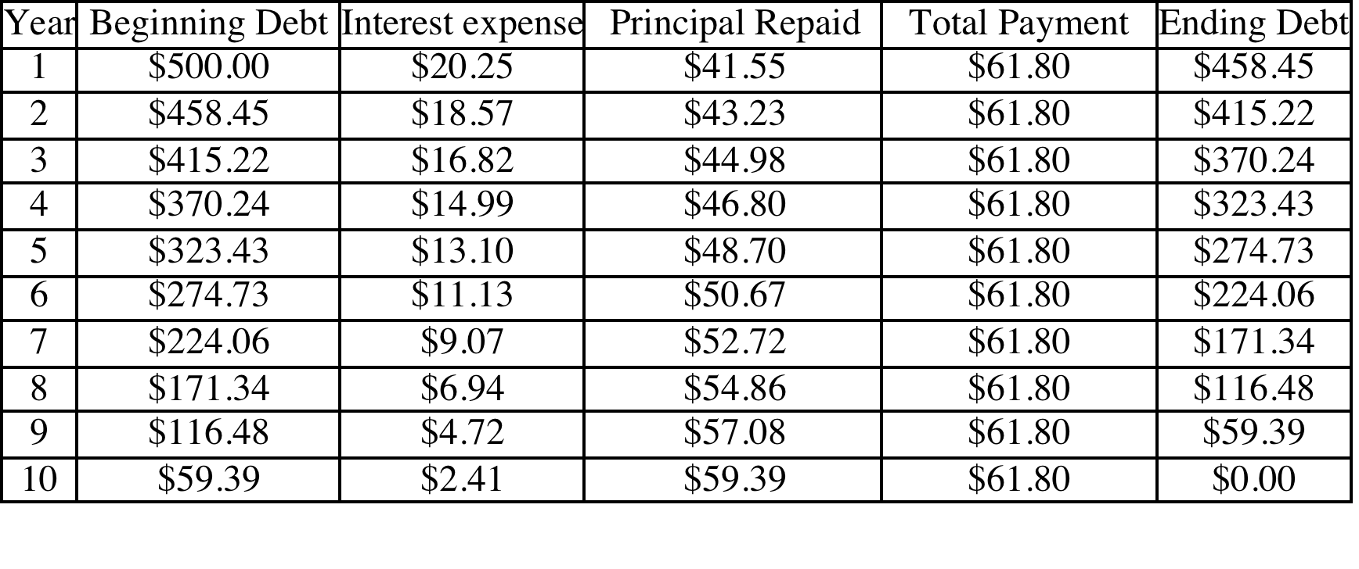
Financing Assumptions
Vale plans to borrow $0.5 billion at its current US$ cost of debt of 4.05% (based upon its rating of A-), using a ten-year term loan (where the loan will be paid off in equal annual increments). The breakdown of the payments each year into interest and principal are provided below:
Notes:
The mine will be partly funded with debt, which will be paid off in equal annual installments. However, the composition of these payments will change over time.
Start by estimating the annual payment, using the loan amount of $50 million and the US $ interest rate of 4.05%, with a ten-year maturity. Then, break the payment down by year into interest and principal. If you do it right, there should be no principal left at the end of the 10th year.

Slide 252
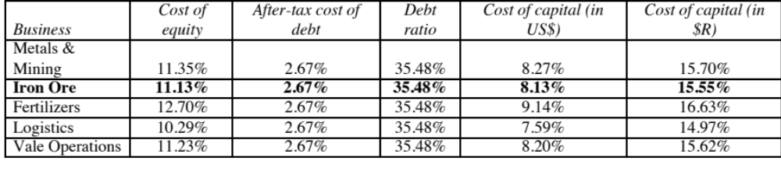
The Hurdle Rate
The analysis is done US dollar terms and to equity investors. Thus, the hurdle rate has to be a US $ cost of equity.
In the earlier section, we estimated costs of equity, debt and capital in US dollars and R$ for Vale’s iron ore business.
Notes:
Everything is done in US dollar and equity terms.
Note that we are using the levered beta for just the iron ore business and not Vale as a whole

Slide 253
Net Income: Vale Iron Ore Mine
 | 1 | 2 | 3 | 4 | 5 | 6 | 7 | 8 | 9 | 10
Production (millions of tons) | 4.00 | 6.00 | 8.00 | 8.00 | 8.00 | 8.00 | 8.00 | 8.00 | 8.00 | 8.00
* Price per ton | 102 | 104.04 | 106.12 | 108.24 | 110.41 | 112.62 | 114.87 | 117.17 | 119.51 | 121.9
= Revenues (millions US$) | $408.00 | $624.24 | $848.97 | $865.95 | $883.26 | $900.93 | $918.95 | $937.33 | $956.07 | $975.20
- Variable Costs | $180.00 | $275.40 | $374.54 | $382.03 | $389.68 | $397.47 | $405.42 | $413.53 | $421.80 | $430.23
- Fixed Costs | $125.00 | $127.50 | $130.05 | $132.65 | $135.30 | $138.01 | $140.77 | $143.59 | $146.46 | $149.39
- Depreciation | $200.00 | $160.00 | $128.00 | $102.40 | $81.92 | $65.54 | $65.54 | $65.54 | $65.54 | $65.54
EBIT | -$97.00 | $61.34 | $216.37 | $248.86 | $276.37 | $299.91 | $307.22 | $314.68 | $322.28 | $330.04
- Interest Expenses | $20.25 | $18.57 | $16.82 | $14.99 | $13.10 | $11.13 | $9.07 | $6.94 | $4.72 | $2.41
Taxable Income | -$117.25 | $42.77 | $199.56 | $233.87 | $263.27 | $288.79 | $298.15 | $307.74 | $317.57 | $327.63
- Taxes | ($39.87) | $14.54 | $67.85 | $79.51 | $89.51 | $98.19 | $101.37 | $104.63 | $107.97 | $111.40
= Net Income (millions US$) | -$77.39 | $28.23 | $131.71 | $154.35 | $173.76 | $190.60 | $196.78 | $203.11 | $209.59 | $216.24
Book Value and Depreciation
Beg. Book Value | $1,250.00 | $1,050.00 | $890.00 | $762.00 | $659.60 | $577.68 | $512.14 | $446.61 | $381.07 | $315.54
- Depreciation | $200.00 | $160.00 | $128.00 | $102.40 | $81.92 | $65.54 | $65.54 | $65.54 | $65.54 | $65.54
+ Capital Exp. | $0.00 | $0.00 | $0.00 | $0.00 | $0.00 | $0.00 | $0.00 | $0.00 | $0.00 | $0.00
End Book Value | $1,050.00 | $890.00 | $762.00 | $659.60 | $577.68 | $512.14 | $446.61 | $381.07 | $315.54 | $250.00
- Debt Outstanding | $458.45 | $415.22 | $370.24 | $323.43 | $274.73 | $224.06 | $171.34 | $116.48 | $59.39 | $0.00
End Book Value of Equity | $591.55 | $474.78 | $391.76 | $336.17 | $302.95 | $288.08 | $275.27 | $264.60 | $256.14 | $250.00
Notes:
The mine takes a little while to transition to full production and the price per ton rises at 2% (inflation rate) every year.
The depreciation is 20% of the remaining depreciable value until you get to year 6, when the straight line depreciation exceeds it and we switch to it.

Slide 254
A ROE Analysis
Year | Net Income | Beg. BV: Assets | Depreciation | Capital Expense | Ending BV: Assets | BV of Working Capital | Debt | BV: Equity | Average BV: Equity | ROE
0 |  | $0.00 | $0.00 | $1,250.00 | $1,250.00 | $81.60 | $500.00 | $831.60
1 | ($77.39) | $1,250.00 | $200.00 | $0.00 | $1,050.00 | $124.85 | $458.45 | $716.40 | $774.00 | -10.00%
2 | $28.23 | $1,050.00 | $160.00 | $0.00 | $890.00 | $169.79 | $415.22 | $644.57 | $680.49 | 4.15%
3 | $131.71 | $890.00 | $128.00 | $0.00 | $762.00 | $173.19 | $370.24 | $564.95 | $604.76 | 21.78%
4 | $154.35 | $762.00 | $102.40 | $0.00 | $659.60 | $176.65 | $323.43 | $512.82 | $538.89 | 28.64%
5 | $173.76 | $659.60 | $81.92 | $0.00 | $577.68 | $180.19 | $274.73 | $483.13 | $497.98 | 34.89%
6 | $190.60 | $577.68 | $65.54 | $0.00 | $512.14 | $183.79 | $224.06 | $471.87 | $477.50 | 39.92%
7 | $196.78 | $512.14 | $65.54 | $0.00 | $446.61 | $187.47 | $171.34 | $462.74 | $467.31 | 42.11%
8 | $203.11 | $446.61 | $65.54 | $0.00 | $381.07 | $191.21 | $116.48 | $455.81 | $459.27 | 44.22%
9 | $209.59 | $381.07 | $65.54 | $0.00 | $315.54 | $195.04 | $59.39 | $451.18 | $453.50 | 46.22%
10 | $216.24 | $315.54 | $65.54 | $0.00 | $250.00 | $0.00 | $0.00 | $250.00 | $350.59 | 61.68%
Average ROE over the ten-year period = |  |  |  |  |  |  |  |  |  | 31.36%
  US $ ROE of 31.36% is greater than
  Vale Iron Ore US$ Cost of Equity of 11.13%
Notes:
The return on equity is computed by dividing the net income by the average book value of equity. Note the increase in return on equity as you move through to the later years (income rises as depreciation falls, and the book value of the equity investment becomes smaller because of the depreciation)
The fact that this is a finite life project allows us to get away with no small capital maintenance expenditure.

Slide 255
From Project ROE to Firm ROE
As with the earlier analysis, where we used return on capital and cost of capital to measure the overall quality of projects at firms, we can compute return on equity and cost of equity to pass judgment on whether firms are creating value to its equity investors.
Specifically, we can compute the return on equity (net income as a percentage of book equity) and compare to the cost of equity. The return spread is then:
  Equity Return Spread = Return on Equity – Cost of equity
This measure is particularly useful for financial service firms, where capital, return on capital and cost of capital are difficult measures to nail down.
For non-financial service firms, it provides a secondary (albeit a more volatile measure of performance). While it usually provides the same general result that the excess return computed from return on capital, there can be cases where the two measures diverge.
Notes:
Equity return spreads diverge (in direction) from capital return spreads, when the book interest rate on debt diverges from the market interest rate (if the book interest rate is much lower than the market interest rate, the capital return spread can be be negative & the equity return spread can be positive) and or when there are other non-operating sources of income (that are not captured in operating income but become part of net income).

Slide 256
An Incremental CF Analysis
 | 0 | 1 | 2 | 3 | 4 | 5 | 6 | 7 | 8 | 9 | 10
Net Income |  | ($77.39) | $28.23 | $131.71 | $154.35 | $173.76 | $190.60 | $196.78 | $203.11 | $209.59 | $216.24
+ Depreciation & Amortization |  | $200.00 | $160.00 | $128.00 | $102.40 | $81.92 | $65.54 | $65.54 | $65.54 | $65.54 | $65.54
- Capital Expenditures | $750.00 | $0.00 | $0.00 | $0.00 | $0.00 | $0.00 | $0.00 | $0.00 | $0.00 | $0.00 | $0.00
- Change in Working Capital | $81.60 | $43.25 | $44.95 | $3.40 | $3.46 | $3.53 | $3.60 | $3.68 | $3.75 | $3.82 | ($195.04)
- Principal Repayments |  | $41.55 | $43.23 | $44.98 | $46.80 | $48.70 | $50.67 | $52.72 | $54.86 | $57.08 | $59.39
+ Salvage Value of mine |  |  |  |  |  |  |  |  |  |  | $250.00
Cashflow to Equity | ($831.60) | $37.82 | $100.05 | $211.33 | $206.48 | $203.44 | $201.86 | $205.91 | $210.04 | $214.22 | $667.42
Notes:
This converts the equity earnings on the previous page into cash flows to equity. Note that we reduce the initial investment by the new debt (since it reduces the equity investment needed). The salvage value is shown in the final year.
The US$ cash flows to equity are discounted at the US$ cost of equity to arrive at a NPV (which should be the same in real and nominal terms)
FCFE : Free Cash Flow to Equity. This measures the cash flow left over for equity investors after all needs on this project are met, including debt payments and capital expenditures.

Slide 257
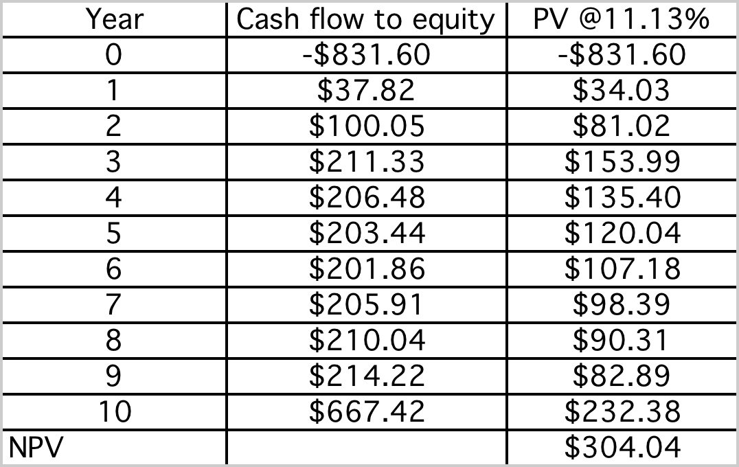
An Equity NPV
Discounted at US$ cost of equity of 11.13% for Vale’s iron ore business
Notes:
The caswhflows to equity are US $ cashflows and are discounted back at the US $ cost of equity for the iron ore business.

Slide 258
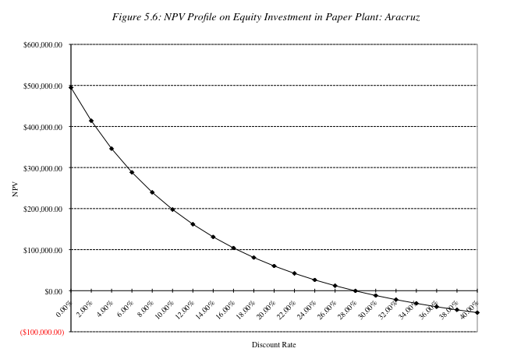
An Equity IRR
Notes:
The IRR for this project, using US $ equity cashflows, is 28%, higher than the cost of equity of 11.13%.

Slide 259
Real versus Nominal Analysis
In computing the NPV of the plant, we estimated US $ cash flows and discounted them at the US $ cost of equity. We could have estimated the cash flows in real terms (with no inflation) and discounted them at a real cost of equity. Would the answer be different?
Yes
No
Explain
Notes:
If we remain consistent about using the same expected inflation to deflate the cash flows and adjust the cost of equity downwards, there should be no effect on value.

Slide 260
Dealing with Macro Uncertainty: The Effect of Iron Ore Price
Like the Disney Theme Park, the Vale Iron Ore Mine’s actual value will be buffeted as the variables change. The biggest source of variability is an external factor –the price of iron ore.
Notes:
The breakeven price is about $75/ton. If iron ore prices drop below that level, the mine becomes non-viable.
A key difference between breakeven analysis and simulation is that you can change only on variable at a time in breakeven analysis, while holding all else constant…. To the extent that the other variables (other than revenues) are affected by iron ore prices I may get a poor measure of the effect on NPV of changing ore prices.

Slide 261
And Exchange Rates…
Notes:
The mine will be in Canada, with the costs in Canadian dollars, and the revenues will be in US $, creating an exchange rate risk exposure.

Slide 262
Should you hedge?
The value of this mine is very much a function iron ore prices. There are futures, forward and option markets iron ore that Vale can use to hedge against price movements. Should it?
  Yes
  No
Explain.
The value of the mine is also a function of exchange rates. There are forward, futures and options markets on currency. Should Vale hedge against exchange rate risk?
  Yes
  No
Explain.
On the last question, would your answer have been different if the mine were in Brazil.
  Yes
  No
Notes:
Vale is not unique in this respect. All commodity companies are exposed to commodity price risk. However, here is the catch. Many investors in these companies invest in them because they want to play the commodity price game. Thus, investors who believe that oil prices will go up often buy oil companies. If these companies then hedge against oil price variability, they are undercutting that rationale. On an empirical basis, there have been studies that have compared commodity prices that hedge against commodity price movements against companies that do not, as investments. The general consensus seems to be that companies that do not hedge are much better investments, even on a risk adjusted basis, than companies that do.
Here are the possible exceptions. A commodity company that prides itself on its operating prowess may choose to isolate that strength by hedging against commodity price risk. Thus, an oil company that is consistently more efficient about finding and exploiting new oil reserves may hedge against oil price to show the market its strength.
On exchange rates, the answer is more nuanced. Investors do not buy Vale to bet on exchange rates. To the extent that Vale’s managers feel that their competitive advantage is in the mining business and not in forecasting exchange rates, there is an argument to be made that hedging against exchange rate risk is not expensive and can allow managers to focus on what matters. (This may also explain why airlines like Southwest and Singapore Airlines hedge against oil price variability…) Here is the hidden danger. It is very easy to step across the line from hedging to speculation.

Slide 263

Notes:
Whether you should hedge a risk or not depends on who you are, who your investors are, what risk you are considering, how transparent that risk is and how costly it is to hedge. No one answer fits all firms, and even for the same firm, across different types of risk.

Slide 264
Acquisitions and Projects
An acquisition is an investment/project like any other and all of the rules that apply to traditional investments should apply to acquisitions as well. In other words, for an acquisition to make sense:
  It should have positive NPV. The present value of the expected cash flows from the acquisition should exceed the price paid on the acquisition.
  The IRR of the cash flows to the firm (equity) from the acquisition > Cost of capital (equity) on the acquisition
In estimating the cash flows on the acquisition, we should count in any possible cash flows from synergy.
The discount rate to assess the present value should be based upon the risk of the investment (target company) and not the entity considering the investment (acquiring company).
Notes:
All too often, firms seem to use different and often far looser rules to assess acquisitions than they do traditional investments. In many cases, acquisitions are justified, even when the make no financial sense, using fuzzy words such as strategic considerations and synergy. We are not denying that these considerations exist but we would argue that we these words have to be converted into expected cash flows (uncertain though we might be) and assess these cash flows exactly the same way that we assess all other cash flows.

Slide 265
Tata Motors and Harman International
Harman International is a publicly traded US firm that manufactures high end audio equipment. Tata Motors is an automobile company, based in India.
Tata Motors is considering an acquisition of Harman, with an eye on using its audio equipment in its Indian automobiles, as optional upgrades on new cars.
Notes:
Harman is in a very different business, country and currency than Tata Motors. We have to take all of those differences into account in assessing the value of Harman.

Slide 266
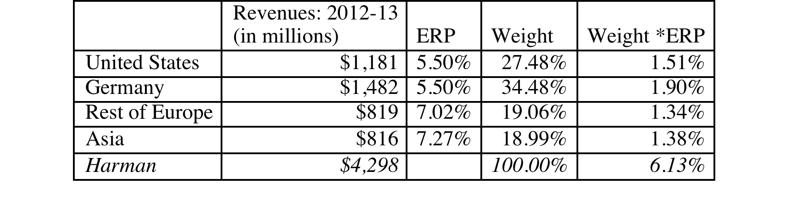
Estimating the Cost of Capital for the Acquisition (no synergy)
Currency: Estimated in US $, since cash flows will be estimated in US $.
Beta: Harman International is an electronic company and we use the unlevered beta (1.17) of electronics companies in the US.
Equity Risk Premium: Computed based on Harman’s operating exposure:
Debt ratio & cost of debt: Tata Motors plans to assume the existing debt of Harman International and to preserve Harman’s existing debt ratio. Harman currently has a debt (including lease commitments) to capital ratio of 7.39% (translating into a debt to equity ratio of 7.98%) and faces a pre-tax cost of debt of 4.75% (based on its BBB- rating).
Levered Beta = 1.17 (1+ (1-.40) (.0798)) = 1.226
Cost of Equity= 2.75% + 1.226 (6.13%) = 10.26%
Cost of Capital = 10.26% (1-.0739) + 4.75% (1-.40) (.0739) = 9.71%
Notes:
Note that the discount rate is assessed in dollars because all of the cash flows will be estimated in dollars.
To compute the cost of capital, we use Harman-specific numbers rather than the numbers from Tata Motors. The only inputs where there could have been some variation are in the debt ratio and cost of debt. If Tata Motors had been under levered (had too little debt) or over levered (too much debt), a case can be made for replacing the current debt ratio and cost of debt with the optimal. Again, this would have nothing to do with Tata Motors capacity to borrow money…

Slide 267
Estimating Cashflows- First Steps
Operating Income: The firm reported operating income of $201.25 million on revenues of $4.30 billion for the year. Adding back non-recurring expenses (restructuring charge of $83.2 million in 2013) and adjusting income for the conversion of operating lease commitments to debt, we estimated an adjusted operating income of $313.2 million. The firm paid 18.21% of its income as taxes in 2013 and we will use this as the effective tax rate for the cash flows.
Reinvestment: Depreciation in 2013 amounted to $128.2 million, whereas capital expenditures and acquisitions for the year were $206.4 million. Non-cash working capital increased by $272.6 million during 2013 but was 13.54% of revenues in 2013.
Notes:
Here is the lease conversion details. The present value of lease commitments over the next 7 years, discounted back at Harman’s pre-tax cost of debt of 4.75% is $143.95 million. We added back the operating lease expense from 2013 ($49.3 million) and subtracted out an estimated depreciation of $20.6 million to arrive at the adjusted value:
Adjusted Operating Income = 201.25+ 83.2 + (49.3-20.6) = $313.2

Slide 268
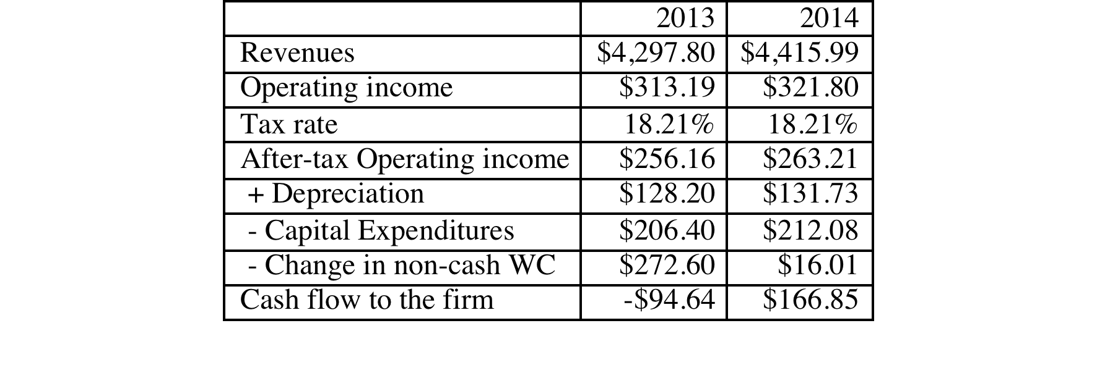
Bringing in growth
We will assume that Harman International is a mature firm, growing 2.75% in perpetuity.
We assume that revenues, operating income, capital expenditures and depreciation will all grow 2.75% for the year and that the non-cash working capital remain 13.54% of revenues in future periods.
Notes:
We are normalizing working capital changes because they are so volatile. We will be using $166.85 million as the expected cash flows for 2014.

Slide 269
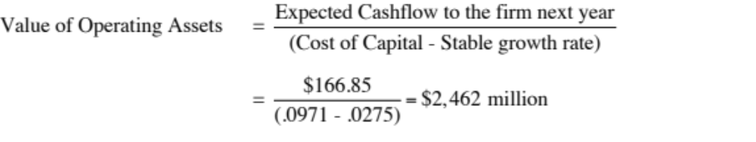
Value of Harman International: Before Synergy
Earlier, we estimated the cost of capital of 9.67% as the right discount rate to apply in valuing Harman International and the cash flow to the firm of $166.85 million for 2014 (next year), assuming a 2.75% growth rate in revenues, operating income, depreciation, capital expenditures and total non-cash working capital. We also assumed that these cash flows would continue to grow 2.75% a year in perpetuity.
Adding the cash balance of the firm ($515 million) and subtracting out the existing debt ($313 million, including the debt value of leases) yields the value of equity in the firm:
Value of Equity = Value of Operating Assets + Cash – Debt
= $2,462 + $ 515 - $313 million = $2,664 million
The market value of equity in Harman in November 2013 was $5,428 million.
To the extent that Tata Motors pays the market price, it will have to generate benefits from synergy that exceed $2764 million.
Notes:
When we discount cash flows to the firm at the cost of capital, we are valuing the operating assets of the firm. We add cash and subtract out debt to get to the value of equity.
We will return to examine how best to value synergy later in the presentation.

Slide 270
Measuring Investment Returns
II. Investment Interactions, Options and Remorse…
Life is too short for regrets, right?
Notes:
Now that we have looked at how best to assess an investment that stands alone (independent investments), it is time to make life complicated.

Slide 271
Independent investments are the exception…
In all of the examples we have used so far, the investments that we have analyzed have stood alone. Thus, our job was a simple one. Assess the expected cash flows on the investment and discount them at the right discount rate.
In the real world, most investments are not independent. Taking an investment can often mean rejecting another investment at one extreme (mutually exclusive) to being locked in to take an investment in the future (pre-requisite).
More generally, accepting an investment can create side costs for a firm’s existing investments in some cases and benefits for others.
Notes:
At most firms, an investment cannot be assessed by itself since it affects not only other investments that the firm has on its books already but future investments.

Slide 272
I. Mutually Exclusive Investments
We have looked at how best to assess a stand-alone investment and concluded that a good investment will have positive NPV and generate accounting returns (ROC and ROE) and IRR that exceed your costs (capital and equity).
In some cases, though, firms may have to choose between investments because
  They are mutually exclusive: Taking one investment makes the other one redundant because they both serve the same purpose
  The firm has limited capital and cannot take every good investment (i.e., investments with positive NPV or high IRR).
Using the two standard discounted cash flow measures, NPV and IRR, can yield different choices when choosing between investments.
Notes:
In some cases, exclusivity will be thrust upon you because two investments serve the same purpose. This is the case, for instance, when you choose between different distribution or computer systems to serve your needs or between alternative marketing strategies.
In other cases, the exclusivity is created by the fact that you do not have the capital (or the access to it) to take every good investment that comes along. Thus, good investments compete against each other.

Slide 273
Comparing Projects with the same (or similar) lives..
When comparing and choosing between investments with the same lives, we can
  Compute the accounting returns (ROC, ROE) of the investments and pick the one with the higher returns
  Compute the NPV of the investments and pick the one with the higher NPV
  Compute the IRR of the investments and pick the one with the higher IRR
While it is easy to see why accounting return measures can give different rankings (and choices) than the discounted cash flow approaches, you would expect NPV and IRR to yield consistent results since they are both time-weighted, incremental cash flow return measures.
Notes:
Discounted cash flow measures (NPV and IRR) share the same DNA and yield the same conclusions when looking at independent investments. If an investment has a positive NPV, the IRR> Discount rate. However, this may no longer hold when you are comparing two or more investments, as we will see by looking at three cases where the choices vary.

Slide 274
Case 1: IRR versus NPV
Consider two projects with the following cash flows:
Year Project 1 CF Project 2 CF
0 -1000 -1000
1 800 200
2 1000 300
3 1300 400
4 -2200 500
Notes:
Provides cash flows on a single project. You could compute the net present value or compute the IRR.

Slide 275
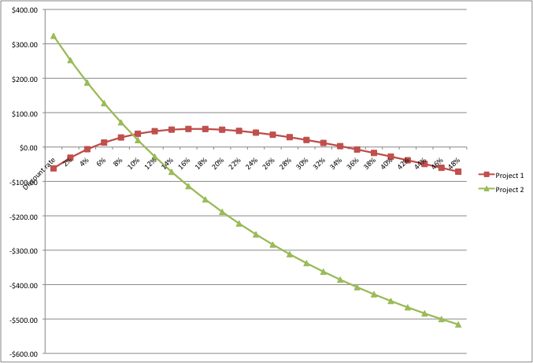
Project’s NPV Profile
Notes:
Project 1 has two Internal Rates of Return (IRR) - one is around 7% and the other is over 36%…
Project 2 has one internal rate of return: about 12%

Slide 276
What do we do now?
Project 1 has two internal rates of return. The first is 6.60%, whereas the second is 36.55%. Project 2 has one internal rate of return, about 12.8%.
Why are there two internal rates of return on project 1?
If your cost of capital is 12%, which investment would you accept?
  Project 1
  Project 2
Explain.
Notes:
Because there are two sign changes fn the cash flows, one in year 1 and one in year 4.
I would accept project 2, if the discount rate is 12% because it has a higher NPV.

Slide 277
Case 2: NPV versus IRR
Project A
Cash Flow
$ 350,000
$ 450,000
$ 600,000
$ 750,000
Investment
$ 1,000,000
NPV = $467,937
IRR= 33.66%
Project B
Cash Flow
$ 3,000,000
$ 3,500,000
$ 4,500,000
$ 5,500,000
Investment
$ 10,000,000
NPV = $1,358,664
IRR=20.88%
Notes:
These investments are mutually exclusive. Note the difference in scale. IRR, as a percent measure, will be biased towards smaller investments whereas NPV as a dollar value, will be biased towards larger investments.

Slide 278
Which one would you pick?
Assume that you can pick only one of these two projects. Your choice will clearly vary depending upon whether you look at NPV or IRR. You have enough money currently on hand to take either. Which one would you pick?
  Project A. It gives me the bigger bang for the buck and more margin for error.
  Project B. It creates more dollar value in my business.
If you pick A, what would your biggest concern be?
If you pick B, what would your biggest concern be?
Notes:
Depends upon whether you face capital rationing. If you do not have capital rationing, you should use NPV (and pick project B). The more serious the capital rationing constraint, the more likely that IRR will be used (to pick project A)
If you pick project A, the biggest risk is that no other projects come along during the course of the period, and the funds stay uninvested (earning a NPV of zero).
If you pick project B, the biggest risk is that lots of very good projects earning higher returns than B come along and you do not have the funds to accept them.

Slide 279
Capital Rationing, Uncertainty and Choosing a Rule
If a business has limited access to capital, has a stream of surplus value projects and faces more uncertainty in its project cash flows, it is much more likely to use IRR as its decision rule.
  Small, high-growth companies and private businesses are much more likely to use IRR.
If a business has substantial funds on hand, access to capital, limited surplus value projects, and more certainty on its project cash flows, it is much more likely to use NPV as its decision rule.
As firms go public and grow, they are much more likely to gain from using NPV.
Notes:
Small firms that are successful become large firms, but some continue to act as if they have a capital rationing constraint and maintain unrealistically high hurdle rates. These firms will often accumulate cash while turning away projects that earn more than their cost of capital.

Slide 280
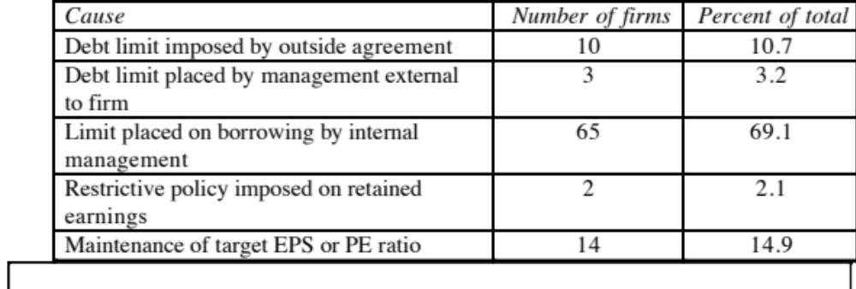
The sources of capital rationing…
Notes:
In a world where firms had free and complete access to capital markets and information could be conveyed credibly to financial markets, there would be no capital rationing constraints. Any firm with a good project (positive NPV) would be able to raise the funds to take the investment. In the real world, there are market frictions that can cause capital rationing. This table is the result of an old survey (1976) which tried to identify the reasons for capital rationing.
More often than not, the source of capital rationing s not external (lack of access to markets, inability to convey information, transactions costs) but by internal factors (management is conservative, restrictions on human capital…)
Many firms also create implicit capital constraints by setting their hurdle rates higher than their cost of capital.

Slide 281
An Alternative to IRR with Capital Rationing
The problem with the NPV rule, when there is capital rationing, is that it is a dollar value. It measures success in absolute terms.
The NPV can be converted into a relative measure by dividing by the initial investment. This is called the profitability index.
  Profitability Index (PI) = NPV/Initial Investment
In the example described, the PI of the two projects would have been:
  PI of Project A = $467,937/1,000,000 = 46.79%
  PI of Project B = $1,358,664/10,000,000 = 13.59%
  Project A would have scored higher.
Notes:
It is possible to convert NPV, which is dollar measure of value, into a percentage measure by dividing by the initial investment.
The rankings will be similar to IRR but the two approaches make different assumptions about what rate the intermediate cash flows get reinvested at. (This will be illustrated on the next two overheads)

Slide 282
Case 3: NPV versus IRR
Project A
Cash Flow
$ 5,000,000
$ 4,000,000
$ 3,200,000
$ 3,000,000
Investment
$ 10,000,000
NPV = $1,191,712
IRR=21.41%
Project B
Cash Flow
$ 3,000,000
$ 3,500,000
$ 4,500,000
$ 5,500,000
Investment
$ 10,000,000
NPV = $1,358,664
IRR=20.88%
Notes:
The projects have the same scale. Why are the two approaches yielding different rankings? (They are both discounted cash flow approaches, but they must be time-weighting the cash flows slightly differently to yield different rankings)

Slide 283
Why the difference?
These projects are of the same scale. Both the NPV and IRR use time-weighted cash flows. Yet, the rankings are different. Why?
Which one would you pick?
  Project A. It gives me the bigger bang for the buck and more margin for error.
  Project B. It creates more dollar value in my business.
Notes:
NPV assumes that intermediate cash flows get reinvested at the cost of capital, while IRR assumes that they get reinvested at the IRR.
I would pick project B. It is much more reasonable to assume that you can earn the cost of capital on the intermediate cash flows (since the cost of capital is based upon what investments of similar risk are making in the market place)

Slide 284
NPV, IRR and the Reinvestment Rate Assumption
The NPV rule assumes that intermediate cash flows on the project get reinvested at the hurdle rate (which is based upon what projects of comparable risk should earn).
The IRR rule assumes that intermediate cash flows on the project get reinvested at the IRR. Implicit is the assumption that the firm has an infinite stream of projects yielding similar IRRs.
Conclusion: When the IRR is high (the project is creating significant surplus value) and the project life is long, the IRR will overstate the true return on the project.
Notes:
The higher the IRR, the more dangerous this reinvestment assumption becomes. Note that this reinvestment assumption will never make a bad project into a good project. It just makes a good project look better than it really is.

Slide 285
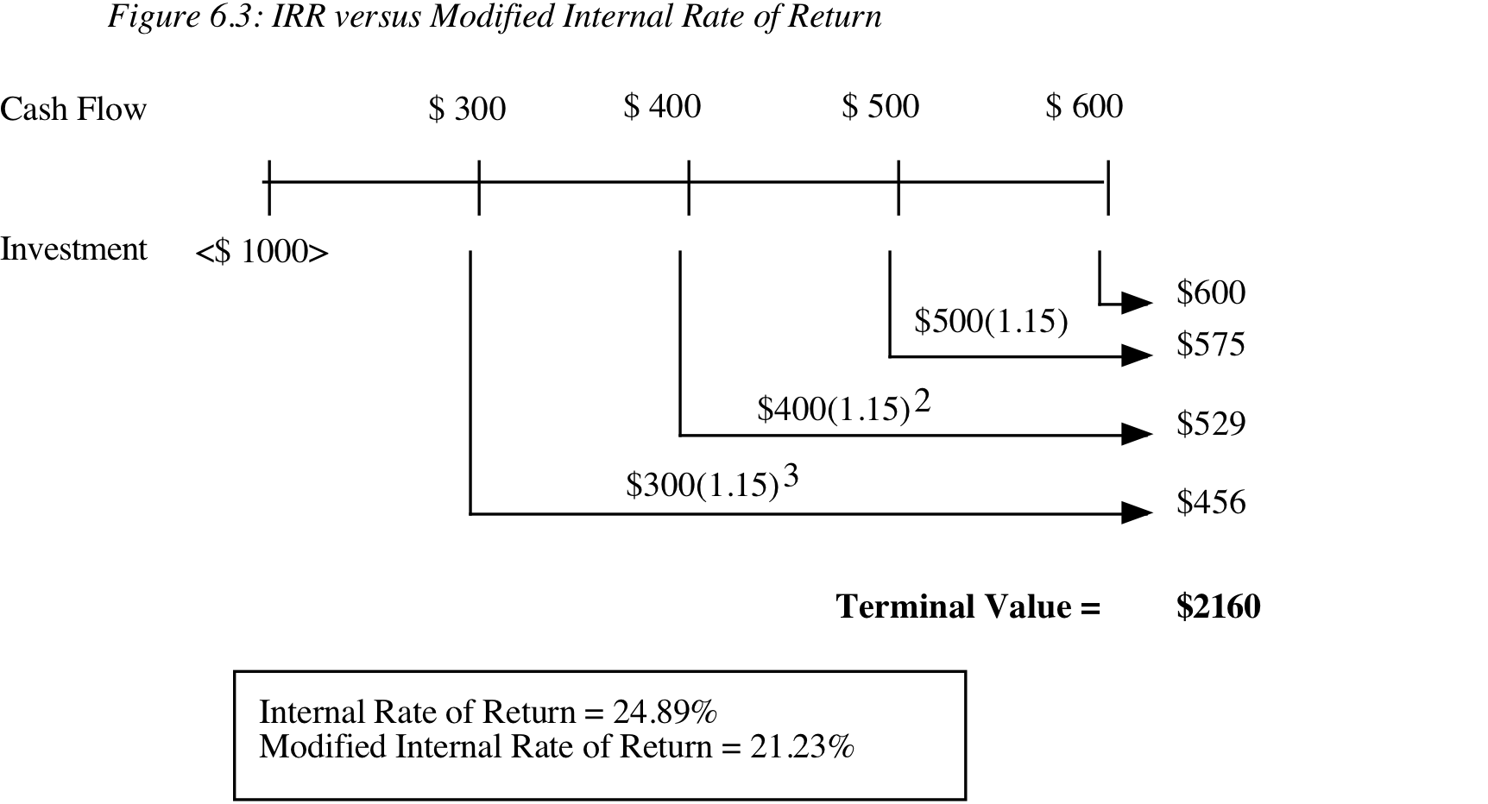
Solution to Reinvestment Rate Problem
Notes:
This is the modified IRR. Its rankings are going to be very similar to those yielded by the PI approach.

Slide 286
Why NPV and IRR may differ.. Even if projects have the same lives
A project can have only one NPV, whereas it can have more than one IRR.
The NPV is a dollar surplus value, whereas the IRR is a percentage measure of return. The NPV is therefore likely to be larger for “large scale” projects, while the IRR is higher for “small-scale” projects.
The NPV assumes that intermediate cash flows get reinvested at the “hurdle rate”, which is based upon what you can make on investments of comparable risk, while the IRR assumes that intermediate cash flows get reinvested at the “IRR”.
Notes:
This summarizes the conclusions of the last 3 illustrations. Generally, the NPV approach is based upon sounder fundamental assumptions, but does assume that the firm has the capital to take positive NPV projects.

Slide 287
Comparing projects with different lives..
Project A
$400
$400
$400
$400
$400
-$1000
NPV of Project A = $ 442
IRR of Project A = 28.7%
Project B
$350
$350
$350
$350
$350
$350
$350
$350
$350
$350
-$1500
NPV of Project B = $ 478
IRR for Project B = 19.4%
Hurdle Rate for Both Projects = 12%
Notes:
The NPV of the shorter life project will generally be lower than the NPV of the longer-life project. This is an issue only if they are mutually exclusive, i.e. you can pick only one.

Slide 288
Why NPVs cannot be compared.. When projects have different lives.
The net present values of mutually exclusive projects with different lives cannot be compared, since there is a bias towards longer-life projects. To compare the NPV, we have to
  replicate the projects till they have the same life (or)
  convert the net present values into annuities
The IRR is unaffected by project life. We can choose the project with the higher IRR.
Notes:
If you pick projects based on NPV, you will tend to accept longer life projects over shorter life projects. In effect, you are assuming that you have no other excess return investments on the horizon after these projects run out.
You can use IRR, but it comes with its own baggage (reinvestment rate assumptions, scaling issues)

Slide 289
Solution 1: Project Replication
Project A: Replicated
$400
$400
$400
$400
$400
$400
$400
$400
$400
$400
-$1000
-$1000 (Replication)
NPV of Project A replicated = $ 693
Project B
$350
$350
$350
$350
$350
$350
$350
$350
$350
$350
-$1500
NPV of Project B= $ 478
Notes:
Here, we have done the replication assuming that the cash flows are identical for the second replication. (This does not have to be the case)
This process will become more complicated if you are comparing projects with 7 and 9 year lives, for instance.

Slide 290
Solution 2: Equivalent Annuities
Equivalent Annuity for 5-year project
  = $442 * PV(A,12%,5 years)
  = $ 122.62
Equivalent Annuity for 10-year project
  = $478 * PV(A,12%,10 years)
  = $ 84.60
Notes:
This is simpler than replication but it is actually based upon the principle of infinite replication. The conclusions will be the same as with replication with the same cash flows. (Implicitly, you are making the same assumptions).

Slide 291
What would you choose as your investment tool?
Given the advantages/disadvantages outlined for each of the different decision rules, which one would you choose to adopt?
  Return on Investment (ROE, ROC)
  Payback or Discounted Payback
  Net Present Value
  Internal Rate of Return
  Profitability Index
Do you think your choice has been affected by the events of the last quarter of 2008? If so, why? If not, why not?
Notes:
If you believe that access to capital markets is easy, you will tend to go with the NPV rule.
One effect of a market crisis like 2008 is that it makes us all more leery about assuming capital market access and may push people to go back to the IRR rule, with perhaps a reinvestment rate modification (MIRR) since we are also probably less likely to assume a constant stream of good projects coming our way.

Slide 292
What firms actually use ..
Decision Rule % of Firms using as primary decision rule in
1976 1986 1998
IRR 53.6% 49.0% 42.0%
Accounting Return 25.0% 8.0% 7.0%
NPV 9.8% 21.0% 34.0%
Payback Period 8.9% 19.0% 14.0%
Profitability Index 2.7% 3.0% 3.0%
Notes:
Why do so many firms pick IRR, if NPV is the superior approach?
Because many firms, whether it is true or not, perceive themselves to be operating with a capital rationing constraint.
Most decision-makers, for whatever reason, are more comfortable looking at percentage rates of return rather than dollar values.

Slide 293
II. Side Costs and Benefits
Most projects considered by any business create side costs and benefits for that business.
  The side costs include the costs created by the use of resources that the business already owns (opportunity costs) and lost revenues for other projects that the firm may have.
  The benefits that may not be captured in the traditional capital budgeting analysis include project synergies (where cash flow benefits may accrue to other projects) and options embedded in projects (including the options to delay, expand or abandon a project).
The returns on a project should incorporate these costs and benefits.
Notes:
These costs and benefits should be incorporated, but that is easier said than done.
Some projects deliver most of their benefits indirectly…For instance, a Disney animated movie will often make four times as much revenue for Disney from merchandise sales and theme park revenues as it does in gate receipts. Thus, this is not a minor issue.

Slide 294
A. Opportunity Cost
An opportunity cost arises when a project uses a resource that may already have been paid for by the firm.
When a resource that is already owned by a firm is being considered for use in a project, this resource has to be priced on its next best alternative use, which may be
  a sale of the asset, in which case the opportunity cost is the expected proceeds from the sale, net of any capital gains taxes
  renting or leasing the asset out, in which case the opportunity cost is the expected present value of the after-tax rental or lease revenues.
  use elsewhere in the business, in which case the opportunity cost is the cost of replacing it.
Notes:
In most established businesses, this occurs frequently. Companies constantly redeploy assets that they own to new investments rather than buy new assets. These assets do have alternate uses and have to be costed out.
This can involve
Real assets, like land, buildings or equipment
Individuals, who work for the firm already on other project or divisions
Excess capacity in computer systems, distribution systems etc.

Slide 295
Case 1: Foregone Sale?
Assume that Disney owns land in Rio already. This land is undeveloped and was acquired several years ago for $ 5 million for a hotel that was never built. It is anticipated, if this theme park is built, that this land will be used to build the offices for Disney Rio. The land currently can be sold for $ 40 million, though that would create a capital gain (which will be taxed at 20%). In assessing the theme park, which of the following would you do:
  Ignore the cost of the land, since Disney owns its already
  Use the book value of the land, which is $ 5 million
  Use the market value of the land, which is $ 40 million
  Other:
Notes:
Use the market value of the land, net of capital gains taxes.
$ 40 million - 0.2 (40 - 5) = $ 33 million
This is the cash flow you would have generated if the project was not taken.

Slide 296
Case 2: Incremental Cost?
An Online Retailing Venture for Bookscape
The initial investment needed to start the service, including the installation of additional phone lines and computer equipment, will be $1 million. These investments are expected to have a life of four years, at which point they will have no salvage value. The investments will be depreciated straight line over the four-year life.
The revenues in the first year are expected to be $1.5 million, growing 20% in year two, and 10% in the two years following. The cost of the books will be 60% of the revenues in each of the four years.
The salaries and other benefits for the employees are estimated to be $150,000 in year one, and grow 10% a year for the following three years.
The working capital, which includes the inventory of books needed for the service and the accounts receivable will be10% of the revenues; the investments in working capital have to be made at the beginning of each year. At the end of year 4, the entire working capital is assumed to be salvaged.
The tax rate on income is expected to be 40%.
Notes:
Bookscape is considering this expansion into online retailing.

Slide 297
Cost of capital for investment
We will re-estimate the beta for this online project by looking at publicly traded online retailers. The unlevered total beta of online retailers is 3.02, and we assume that this project will be funded with the same mix of debt and equity (D/E = 21.41%, Debt/Capital = 17.63%) that Bookscape uses in the rest of the business. We will assume that Bookscape’s tax rate (40%) and pretax cost of debt (4.05%) apply to this project.
  Levered Beta _{Online Service} = 3.02 [1 + (1 – 0.4) (0.2141)] = 3.41
  Cost of Equity _{Online Service} = 2.75% + 3.41 (5.5%) = 21.48%
  Cost of Capital_{Online Service}= 21.48% (0.8237) + 4.05% (1 – 0.4) (0.1763) = 18.12%
This is much higher than the cost of capital (10.30%) we computed for Bookscape earlier, but it reflects the higher risk of the online retail venture.
Notes:
The median unlevered market beta across 29 online retailers in the US is 1.45, and the average correlation of these stocks with the market is 0.48. The unlevered total beta is therefore 1.45/0.48 = 3.02.

Slide 298
Incremental Cash flows on Investment
 | 0 | 1 | 2 | 3 | 4
Revenues |  | $1,500,000 | $1,800,000 | $1,980,000 | $2,178,000
Operating Expenses
Labor |  | $150,000 | $165,000 | $181,500 | $199,650
Materials |  | $900,000 | $1,080,000 | $1,188,000 | $1,306,800
Depreciation |  | $250,000 | $250,000 | $250,000 | $250,000
Operating Income |  | $200,000 | $305,000 | $360,500 | $421,550
Taxes |  | $80,000 | $122,000 | $144,200 | $168,620
After-tax Operating Income |  | $120,000 | $183,000 | $216,300 | $252,930
+ Depreciation |  | $250,000 | $250,000 | $250,000 | $250,000
- Change in Working Capital | $150,000 | $30,000 | $18,000 | $19,800 | -$217,800
+ Salvage Value of Investment |  |  |  |  | $0
Cash flow after taxes | -$1,150,000 | $340,000 | $415,000 | $446,500 | $720,730
Present Value | -$1,150,000 | $287,836 | $297,428 | $270,908 | $370,203
NPV of investment = $76,375
Notes:
The NPV for this project is positive, suggesting that Bookscape will gain from expanding online.

Slide 299
The side costs…
It is estimated that the additional business associated with online ordering and the administration of the service itself will add to the workload for the current general manager of the bookstore. As a consequence, the salary of the general manager will be increased from $100,000 to $120,000 next year; it is expected to grow 5 percent a year after that for the remaining three years of the online venture. After the online venture is ended in the fourth year, the manager’s salary will revert back to its old levels.
It is also estimated that Bookscape Online will utilize an office that is currently used to store financial records. The records will be moved to a bank vault, which will cost $1000 a year to rent.
Notes:
These are the side costs to the firm from taking the investment.

Slide 300
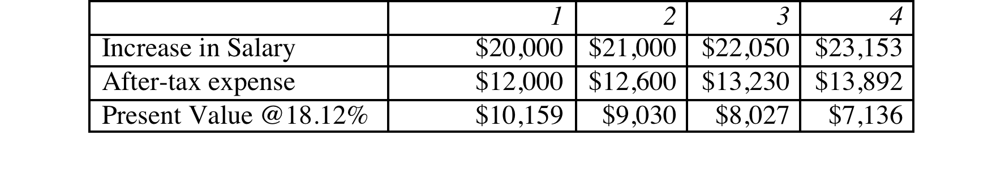
NPV with side costs…
Additional salary costs = PV of $34,352
Office Costs
  After-Tax Additional Storage Expenditure per Year = $1,000 (1 – 0.40) = $600
  PV of expenditures = $600 (PV of annuity, 18.12%,4 yrs) = $1,610
NPV with Opportunity Costs = $76,375 – $34,352 – $1,610= $ 40,413
Opportunity costs aggregated into cash flows
Year | Cashflows | Opportunity costs | Cashflow with opportunity costs | Present Value
0 | ($1,150,000) |  | ($1,150,000) | ($1,150,000)
1 | $340,000 | $12,600 | $327,400 | $277,170
2 | $415,000 | $13,200 | $401,800 | $287,968
3 | $446,500 | $13,830 | $432,670 | $262,517
4 | $720,730 | $14,492 | $706,238 | $362,759
Adjusted NPV |  |  |  | $40,413
Notes:
We can either consider the side costs separately and add them to the NPV or incorporate them into the cash flows/ The answer is the same using either.

Slide 301
Case 3: Excess Capacity
In the Vale example, assume that the firm will use its existing distribution system to service the production out of the new iron ore mine. The mine manager argues that there is no cost associated with using this system, since it has been paid for already and cannot be sold or leased to a competitor (and thus has no competing current use). Do you agree?
  Yes
  No
Notes:
No. Using that excess capacity will create a cost down the road for the firm.

Slide 302
A Framework for Assessing The Cost of Using Excess Capacity
If I do not add the new product, when will I run out of capacity?
If I add the new product, when will I run out of capacity?
When I run out of capacity, what will I do?
  Cut back on production: cost is PV of after-tax cash flows from lost sales
  Buy new capacity: cost is difference in PV between earlier & later investment
Notes:
Answering these three questions will help you map out the cost to the company of what will happen in the future.

Slide 303
Product and Project Cannibalization: A Real Cost?
Assume that in the Disney theme park example, 20% of the revenues at the Rio Disney park are expected to come from people who would have gone to Disney theme parks in the US. In doing the analysis of the park, you would
  Look at only incremental revenues (i.e. 80% of the total revenue)
  Look at total revenues at the park
  Choose an intermediate number
Would your answer be different if you were analyzing whether to introduce a new show on the Disney cable channel on Saturday mornings that is expected to attract 20% of its viewers from ABC (which is also owned by Disney)?
  Yes
  No
Notes:
The answer will depend upon whether the cannibalization would occur anyway (to a competitor, if Disney does not take the project). The greater the barriers to entry or the competitive advantage that Disney has over its competitors, the less likely it is that cannibalization would occur anyway. In that case, it should be treated as an incremental cost. If not, it should be treated as non-incremental and ignored.
I would argue that Disney has far greater competitive advantages at its theme parks, than it does in TV broadcasting. Therefore, I would look at only the incremental revenue for the theme park, and the total revenues for the TV show.

Slide 304
B. Project Synergies
A project may provide benefits for other projects within the firm. Consider, for instance, a typical Disney animated movie. Assume that it costs $ 50 million to produce and promote. This movie, in addition to theatrical revenues, also produces revenues from
  the sale of merchandise (stuffed toys, plastic figures, clothes ..)
  increased attendance at the theme parks
  stage shows (see “Beauty and the Beast” and the “Lion King”)
  television series based upon the movie
In investment analysis, however, these synergies are either left unquantified and used to justify overriding the results of investment analysis, i.e,, used as justification for investing in negative NPV projects.
If synergies exist and they often do, these benefits have to be valued and shown in the initial project analysis.
Notes:
Disney is a master at creating project synergies. In analyzing new investments, we have two choices in how we deal with synergies.
Assume that they exist and will be large enough to offset any negatives associated with the investment. (This is all too common in big investments, where companies fall back on the “strategic benefits” argument to overwhelm financial considerations).
Try to quantify the benefits and bring them into the cash flows and returns and make sure that the project meets its financial hurdles.

Slide 305
Case 1: Adding a Café to a bookstore: Bookscape
Assume that you are considering adding a café to the bookstore. Assume also that based upon the expected revenues and expenses, the café standing alone is expected to have a net present value of -$87,571.
The cafe will increase revenues at the book store by $500,000 in year 1, growing at 10% a year for the following 4 years. In addition, assume that the pre-tax operating margin on these sales is 10%.
The net present value of the added benefits is $135,268. Added to the NPV of the standalone Café of -$87,571 yields a net present value of $47,697.
 |  | 1 | 2 | 3 | 4 | 5
Increased Revenues |  | $500,000 | $550,000 | $605,000 | $665,500 | $732,050
Operating Margin |  | 10.00% | 10.00% | 10.00% | 10.00% | 10.00%
Operating Income |  | $50,000 | $55,000 | $60,500 | $66,550 | $73,205
Operating Income after Taxes |  | $30,000 | $33,000 | $36,300 | $39,930 | $43,923
PV of Additional Cash Flows |  | $27,199 | $27,126 | $27,053 | $26,981 | $26,908
PV of Synergy Benefits |  | $135,268
Notes:
This is a café being added on to an existing bookstore. The revenues shown here are the revenues at the café.
With the side benefits, the café looks like a good investment.
Interesting side questions;
Should we be using different discount rates for the café revenues and the bookstore revenues? (I don’t think so since the café is an extension of the bookstore)
If we had used different discount rates, whose discount rate should be used to discount the synergies?

Slide 306
Case 2: Synergy in a merger..
We valued Harman International for an acquisition by Tata Motors and estimated a value of $ 2,476 million for the operating assets and $ 2,678 million for the equity in the firm, concluding that it would not be a value-creating acquisition at its current market capitalization of $5,248 million. In estimating this value, though, we treated Harman International as a stand-alone firm.
Assume that Tata Motors foresees potential synergies in the combination of the two firms, primarily from using its using Harman’s high-end audio technology (speakers, tuners) as optional upgrades for customers buying new Tata Motors cars in India. To value this synergy, let us assume the following:
  It will take Tata Motors approximately 3 years to adapt Harman’s products to Tata Motors cars.
  Tata Motors will be able to generate Rs 10 billion in after-tax operating income in year 4 from selling Harman audio upgrades to its Indian customers, growing at a rate of 4% a year after that in perpetuity (but only in India).
Notes:
In most acquisitions, synergy is provided as a motive and used to justify large premiums. While synergy does exist, we believe that it is often not valued correctly (or at all) and that acquirers pay too much for it.
In our earlier assessment of the value of Sensient to Tata, we ignored synergy all together. Now we are considering what form the synergy will take.

Slide 307
Estimating the cost of capital to use in valuing synergy..
Business risk: The perceived synergies flow from optional add-ons in auto sales. We will begin with the levered beta of 1.10, that we estimated for Tata Motors in chapter 4, in estimating the cost of equity.
Geographic risk: The second is that the synergies are expected to come from India; consequently, we will add the country risk premium of 3.60% for India, estimated in chapter 4 (for Tata Motors) to the mature market premium of 5.5%.
Debt ratio: Finally, we will assume that the expansion will be entirely in India, with Tata Motors maintain its existing debt to capital ratio of 29.28% and its current rupee cost of debt of 9.6% and its marginal tax rate of 32.45%.
  Cost of equity in Rupees = 6.57% + 1.10 (5.5%+3.60%) = 16.59%
  Cost of debt in Rupees = 9.6% (1-.3245) = 6.50%
  Cost of capital in Rupees = 16.59% (1-.2928) + 6.50% (.2928) = 13.63%
Notes:
To estimate the right discount rate to use to value synergy, we have to assess where the cash flows are coming from,. The right discount rate to use for synergy will therefore vary from case to case.. While we used Sensient’s risk and debt characteristics to estimate the value of synergy in this case, we may use the combined firm’s cost of capital, if synergy takes a different form.

Slide 308
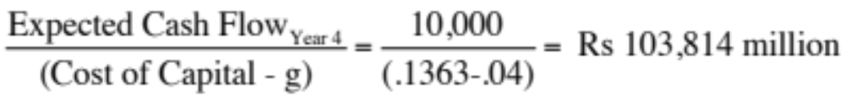

Estimating the value of synergy… and what Tata can pay for Harman
Value of synergy_{Year 3} =
Value of synergy today =
Converting the synergy value into dollar terms at the prevailing exchange rate of Rs 60/$, we can estimate a dollar value for the synergy from the potential acquisition:
  Value of synergy in US $ = Rs 70,753/60 = $ 1,179 million
Adding this value to the intrinsic value of $2,678 million that we estimated for Harman’s equity in chapter 5, we get a total value for the equity of $3,857 million.
  Value of Harman = $2,664 million + $1,179 million = $3,843 million
Since Harman’s equity trades at $5,248 million, the acquisition still does not make sense, even with the synergy incorporated into value.
Notes:
Note that we are not recommending that Tata pay $1,179 million for synergy. To create value, you have to pay less than what you derive in return. Thus, Tata should be looking for ways in which It can pay below $1,179 million on this acquisition.

Slide 309
III. Project Options
One of the limitations of traditional investment analysis is that it is static and does not do a good job of capturing the options embedded in investment.
  The first of these options is the option to delay taking a project, when a firm has exclusive rights to it, until a later date.
  The second of these options is taking one project may allow us to take advantage of other opportunities (projects) in the future
  The last option that is embedded in projects is the option to abandon a project, if the cash flows do not measure up.
These options all add value to projects and may make a “bad” project (from traditional analysis) into a good one.
Notes:
Most projects have one or more than one option embedded in them. These options can not only have significant economic value but can lead us to reverse the decisions that we would have made with conventional capital budgeting analysis.

Slide 310
The Option to Delay
When a firm has exclusive rights to a project or product for a specific period, it can delay taking this project or product until a later date. A traditional investment analysis just answers the question of whether the project is a “good” one if taken today. The rights to a “bad” project can still have value.
PV of Cash Flows
Initial Investment in
Project
NPV is positive in this section
Present Value of Expected
Cash Flows on Product
Notes:
Traditional investment analysis just looks at the question of whether a project is a good one, if taken today. It does not say the rights to this project are worthless.
Consequently, the rights to a bad project can be worth money, if viewed as an option.
This looks at the option to delay a project, to which you have exclusive rights.
The initial investment in the project is what you would need to invest to convert this project from a right to a real project.
The present value of the cash flows will change over time.
If the perceived present value of the cash flows stays below the investment needed, the project should never be taken.

Slide 311
Insights for Investment Analyses
Having the exclusive rights to a product or project is valuable, even if the product or project is not viable today.
The value of these rights increases with the volatility of the underlying business.
The cost of acquiring these rights (by buying them or spending money on development - R&D, for instance) has to be weighed off against these benefits.
Notes:
The value of an option will increase with the uncertainty associated with the cash flows and value of the project.
Thus, firms should be willing to pay large amounts for the rights to technology in areas where there is tremendous uncertainty about what the future will bring, and much less in sectors where there is more stability.
The expenses incurred on R&D can be viewed as the cost of acquiring these rights.

Slide 312
The Option to Expand/Take Other Projects
Taking a project today may allow a firm to consider and take other valuable projects in the future. Thus, even though a project may have a negative NPV, it may be a project worth taking if the option it provides the firm (to take other projects in the future) has a more-than-compensating value.
PV of Cash Flows
from Expansion
Additional Investment
to Expand
Cash Flows on Expansion
Expansion becomes
Firm will not expand in
attractive in this section
this section
Notes:
A project may be the first in a sequence and give you the right to far more lucrative investments in the future.

Slide 313
The Option to Abandon
A firm may sometimes have the option to abandon a project, if the cash flows do not measure up to expectations.
If abandoning the project allows the firm to save itself from further losses, this option can make a project more valuable.
PV of Cash Flows
from Project
Cost of Abandonment
Present Value of Expected
Cash Flows on Project
Notes:
You would like to abandon a project, once you know that it will create only negative cash flows for you. This is not always possible, because of contracts you might have entered into with employees or customers.

Slide 314
IV. Assessing Existing or Past investments…
While much of our discussion has been focused on analyzing new investments, the techniques and principles enunciated apply just as strongly to existing investments.
With existing investments, we can try to address one of two questions:
  Post –mortem: We can look back at existing investments and see if they have created value for the firm.
  What next? We can also use the tools of investment analysis to see whether we should keep, expand or abandon existing investments.
Notes:
While looking at new investments is a key part of investment analysis, we cannot ignore investments made in the past. Not only can they offer lessons for the future but they can also be used to improve our assessments of new investments.

Slide 315

Analyzing an Existing Investment
In a post-mortem, you look at the actual cash flows, relative to forecasts.
You can also reassess your expected cash flows, based upon what you have learned, and decide whether you should expand, continue or divest (abandon) an investment
Notes:
When looking at an existing investment, you can look back (in regret or celebration) and forward ( to make the best assessment of what to do next)

Slide 316
a. Post Mortem Analysis
The actual cash flows from an investment can be greater than or less than originally forecast for a number of reasons but all these reasons can be categorized into two groups:
  Chance: The nature of risk is that actual outcomes can be different from expectations. Even when forecasts are based upon the best of information, they will invariably be wrong in hindsight because of unexpected shifts in both macro (inflation, interest rates, economic growth) and micro (competitors, company) variables.
  Bias: If the original forecasts were biased, the actual numbers will be different from expectations. The evidence on capital budgeting is that managers tend to be over-optimistic about cash flows and the bias is worse with over-confident managers.
While it is impossible to tell on an individual project whether chance or bias is to blame, there is a way to tell across projects and across time. If chance is the culprit, there should be symmetry in the errors – actuals should be about as likely to beat forecasts as they are to come under forecasts. If bias is the reason, the errors will tend to be in one direction.
Notes:
When assessing risky investments, you will always be wrong (at least in hindsight). However, why you are wrong makes a difference, If is due to chance, you will be at least partially protected by having a portfolio of projects, The larger that portfolio, the more likely it is that your mistakes will average out over time. With bias, though, the law of averages will not work for you.
That is the part of the reason why the objective in designing an investment analysis process should be minimizing bias and not minimizing errors.
There are two beneifts to post-mortems. The first is that you can hold the project analysts responsible for their own forecasts. The second is that you can use the information from the actuals to reassess your forecasts for the rest of the project life.

Slide 317




b. What should we do next?
........ Liquidate the project
........ Terminate the project
........ Divest the project
........ Continue the project
Notes:
At first sight, whether to liquidate or continue a project seems like a no brainer. Projects that deliver cash flows that are less than expected should be terminated whereas those that deliver more than expected cash flows should be continued and even expanded. Unfortunately, it is not that simple. Terminating a project will not mean that you will get the capital your originally invested in it back. Thus, even a bad project may be worth continuing because divesting it now yields too low a value. Conversely, your best projects may be worth divesting if someone is willing to pay a much higher price for them than what you would make from continuing the investment.

Slide 318
Example: Disney California Adventure – The 2008 judgment call
Disney opened the Disney California Adventure (DCA) Park in 2001, at a cost of $1.5 billion, with a mix of roller coaster ridesand movie nostalgia. Disney expected about 60% of its visitors to Disneyland to come across to DCA and generate about $ 100 million in annual after-cash flows for the firm.
By 2008, DCA had not performed up to expectations. Of the 15 million people who came to Disneyland in 2007, only 6 million visited California Adventure, and the cash flow averaged out to only $ 50 million between 2001 and 2007.
In early 2008, Disney faced three choices:
  Shut down California Adventure and try to recover whatever it can of its initial investment. It is estimated that the firm recover about $ 500 million of its investment.
  Continue with the status quo, recognizing that future cash flows will be closer to the actual values ($ 50 million) than the original projections.
  Invest about $ 600 million to expand and modify the par, with the intent of increasing the number of attractions for families with children, is expected to increase the percentage of Disneyland visitors who come to DCA from 40% to 60% and increase the annual after tax cash flow by 60% (from $ 50 million to $ 80 million) at the park.
Notes:
DCA has been a huge investment for Disney that has not paid off. Disney has to do something, but what?

Slide 319


DCA: Evaluating the alternatives…
Continuing Operation: Assuming the current after-tax cash flow of $ 50 million will continue in perpetuity, growing at the inflation rate of 2% and discounting back at the theme park cost of capital in 2008 of 6.62% yields a value for continuing with the status quo
Value of DCA =
Abandonment: Abandoning this investment currently would allow Disney to recover only $ 500 million of its original investment.
Abandonment value of DCA = $ 500 million
Expansion: The up-front cost of $ 600 million will lead to more visitors in the park and an increase in the existing cash flows from $ 50 to $ 80 million.
Value of CF from expansion =
Notes:
Abandonment makes no sense since the value of abandonment is less than the value from continuing. Since the NPV from expansion is positive, the optimal solution is to invest the additional $ 600 million into the park.

Slide 320

First Principles
Notes:
Reviewing the big picture…

Slide 321
Capital Structure: The Choices and the Trade off
“Neither a borrower nor a lender be”
Someone who obviously hated this part of corporate finance
Notes:
There is a deep seated feeling, reinforced by centuries of religious edicts, that good people do not borrow and that only the craven and the weak borrow to fund their businesses. In corporate finance, we take a much more sanguine view of debt. It is just another way of raising capital to fund a business. It is no more or less sinful that using equity…

Slide 322

First principles
Notes:
We shift from the investment principle to the financing principle.

Slide 323

The Choices in Financing
There are only two ways in which a business can raise money.
  The first is debt. The essence of debt is that you promise to make fixed payments in the future (interest payments and repaying principal). If you fail to make those payments, you lose control of your business.
  The other is equity. With equity, you do get whatever cash flows are left over after you have made debt payments.
Notes:
Rather than categorizing financing based on what it is called or categorized as by accountants, we should be thinking whether financing is debt or equity by looking at the following questions:
1. Are the payments on the securities contractual or residual?
If contractually set, it is closer to debt.
If residual, it is closer to equity.
2. Are the payments tax-deductible?
If yes, it is closer to debt.
If no, if is closer to equity.
3. Do the cash flows on the security have a high priority or a low priority if the firm is in financial trouble?
If it has high priority, it is closer to debt.
If it has low priority, it is closer to equity.
4. Does the security have a fixed life?
If yes, it is closer to debt.
If no, it is closer to equity.
5. Does the owner of the security get a share of the control of management of the firm?
If no, it is closer to debt.
If yes, if is closer to equity

Slide 324

Global Patterns in Financing…
Notes:
Net equity refers to the difference between new equity issues and stock buybacks.
Firms in the United States, during the period of this comparison, bought back more stock than they issued, leading to negative net equity.
A comparison of financing patterns in the United States, Germany, and Japan reveals that German and Japanese firms were much more dependent on bank debt than firms in the United States, which are much likely to issue bonds.
Things are changing as corporate bond markets have expanded in Europe as well as in Asia and Latin America.

Slide 325

And a much greater dependence on bank loans outside the US…
Notes:
When borrowing money, US companies have historically had more access to bond markets than firms in other markets which are far more dependent on banks.
Interesting follow up questions:
If you can issue bonds, why would you use bank loans instead? (Answer: You may be able to supply proprietary information to a bank that you could not make public…. Special relationships with banks…)
In markets where there is no choice and you have to borrow from a bank, would you expect see lower debt ratios? Higher interest rates? (Answer: Not necessarily, but access to debt may be available only to well established firms that have long-standing relationships with banks. Smaller and younger firms may find themselves shut out of the process..)

Slide 326

Assessing the existing financing choices: Disney, Vale, Tata Motors, Baidu & Bookscape
Notes:
Disney used the corporate bond market much more extensively than the other companies, with 92% of its debt taking the form of bonds, reflecting both its standing as a large market capitalization company and its access to capital markets as a US-based company.
While Disney has the higher proportion of short term debt of the four companies, Vale has the higher proportion of long term debt (reflecting the long lives of its mines).
Disney and Baidu have a little floating rate debt, and none of the companies has convertible debt (currently).
Finally, the bulk of Vale’s debt is in foreign currency (which makes sense given its mines are spread across the world) as is Baidu’s (which is tougher to rationalize, since it gets almost all of its revenues in China).

Slide 327

Notes:
The forms that debt and equity take will change as a firm moves through its lifecycle. Early in the process, equity will take the form of owner’s wealth or savings and debt will be bank debt. As the firm evolves, the equity choices will expand first to include venture capital and private equity. When the firm goes public, its choices expand further.
There are three transitional periods: (1) Going from being a private business entirely funded by the owner to accessing the private equity markets (venture capital) (2) Going from private to public with an initial public offering and (3) Public companies making seasoned offerings of debt and equity.

Slide 328
The Transitional Phases..
The transitions that we see at firms – from fully owned private businesses to venture capital, from private to public and subsequent seasoned offerings are all motivated primarily by the need for capital.
In each transition, though, there are costs incurred by the existing owners:
  When venture capitalists enter the firm, they will demand their fair share and more of the ownership of the firm to provide equity.
  When a firm decides to go public, it has to trade off the greater access to capital markets against the increased disclosure requirements (that emanate from being publicly lists), loss of control and the transactions costs of going public.
  When making seasoned offerings, firms have to consider issuance costs while managing their relations with equity research analysts and rat
Notes:
As a firm goes through the lifecycle, there are usually three transition points worth watching…
Note, though, that whether and when these transition points occur can vary widely across firms. For some firms like Google and Amazon, the transition from owner funded businesses to large publicly traded companies was speedy. Other firms, like Cargill and Koch, never make the transition and stay privately owned businesses as they grow, using internal funding to grow over time. Still others never make it to the transitional phases and fade away, go bankrupt or are acquired.

Slide 329
Measuring a firm’s financing mix …
The simplest measure of how much debt and equity a firm is using currently is to look at the proportion of debt in the total financing. This ratio is called the debt to capital ratio:
Debt to Capital Ratio = Debt / (Debt + Equity)
Debt includes all interest bearing liabilities, short term as well as long term. It should also include other commitments that meet the criteria for debt: contractually pre-set payments that have to be made, no matter what the firm’s financial standing.
Equity can be defined either in accounting terms (as book value of equity) or in market value terms (based upon the current price). The resulting debt ratios can be very different.
Notes:
The difference between book value and market value debt ratios can give rise to problems. For instance, most published debt ratios are book value debt ratios and many analysts talk about book debt ratios when talking about financial leverage. When firms raise financing, though, they do so in market value terms.
When “debt ratios” are used in analysis, it is best to define them up front. For the rest of this analysis, we will debt ratio to mean market value, total debt ratios, with debt including the present value of operating lease commitments.

Slide 330
The Financing Mix Question
In deciding to raise financing for a business, is there an optimal mix of debt and equity?
  If yes, what is the trade off that lets us determine this optimal mix?
      What are the benefits of using debt instead of equity?
      What are the costs of using debt instead of equity?
  If not, why not?
Notes:
This is the basic question that we will cover in the first part of the analysis.

Slide 331
Costs and Benefits of Debt
Benefits of Debt
  Tax Benefits
  Adds discipline to management
Costs of Debt
  Bankruptcy Costs
  Agency Costs
  Loss of Future Flexibility
Notes:
This summarizes the trade off that we make when we choose between using debt and equity. If the benefits exceed the costs, you should borrow. If not, it is better to use equity.

Slide 332
Tax Benefits of Debt
When you borrow money, you are allowed to deduct interest expenses from your income to arrive at taxable income. This reduces your taxes. When you use equity, you are not allowed to deduct payments to equity (such as dividends) to arrive at taxable income.
The dollar tax benefit from the interest payment in any year is a function of your tax rate and the interest payment:
  Tax benefit each year = Tax Rate * Interest Payment
Proposition 1: Other things being equal, the higher the marginal tax rate of a business, the more debt it will have in its capital structure.
Notes:
The tax benefit of debt will be lower if the tax code allows some or all of the cash flows to equity to be tax deductible, as well. For instance, in Germany, dividends paid to stockholders are taxed at a lower rate than retained earnings. In these cases, the tax advantage of debt will be lower.
If you do not pay taxes, debt becomes a lot less attractive. Carnival Cruise Lines, which gets most of its business from the United States pays no taxes because it is domiciled in Liberia. We would expect it to have less debt in its capital structure than a competitor in the US which pays taxes.
Implications:
Debt ratios for firms should go up as corporate tax rates increase.
Debt ratios of firms incorporated in high-tax locales should be higher than debt ratios of firms in low-tax or tax exempt locales.

Slide 333

The Effects of Taxes
You are comparing the debt ratios of real estate corporations, which pay the corporate tax rate, and real estate investment trusts, which are not taxed, but are required to pay 95% of their earnings as dividends to their stockholders. Which of these two groups would you expect to have the higher debt ratios?
The real estate corporations
The real estate investment trusts
Cannot tell, without more information
Notes:
If I consider only entity-level taxes, I would expect real estate corporations to have more debt. The forced payout of 95% of earnings as dividends by REITs to their stockholders may expose their investors to substantial personal taxes, but the absence of taxes at the entity level will make debt a less attractive option.
In practice, REITs do use debt. On reason might be that they can borrow at a lower rate at the REIT level than at the property level. Another might be that their investors still get tax benefits indirectly, when the REIT borrows money, effectively implying that REITs get tax benefits from debt, at the tax rates of their investors.

Slide 334
Debt adds discipline to management
If you are managers of a firm with no debt, and you generate high income and cash flows each year, you tend to become complacent. The complacency can lead to inefficiency and investing in poor projects. There is little or no cost borne by the managers
Forcing such a firm to borrow money can be an antidote to the complacency. The managers now have to ensure that the investments they make will earn at least enough return to cover the interest expenses. The cost of not doing so is bankruptcy and the loss of such a job.
Notes:
Managers of publicly traded firms with substantial cash flows and little debt are much more protected from the consequences of their mistakes (especially when stockholders are powerless and boards toothless).
Left to themselves, managers (especially lazy ones) would rather run all-equity financed firms with substantial cash reserves.
There are two pieces of evidence that you can point to in support of this proposition.
First, poorly managed, poorly run firms, where managers are not significant stockholders, are more likely to be targeted for leveraged buyouts.
Second, there is evidence of improvements in operating efficiency at firms that increase their debt ratio substantially.

Slide 335
Debt and Discipline
Assume that you buy into this argument that debt adds discipline to management. Which of the following types of companies will most benefit from debt adding this discipline?
Conservatively financed (very little debt), privately owned businesses
Conservatively financed, publicly traded companies, with stocks held by millions of investors, none of whom hold a large percent of the stock.
Conservatively financed, publicly traded companies, with an activist and primarily institutional holding.
Notes:
Conservatively financed (Equity financed), publicly traded firms with a wide and diverse stockholding should be the best candidates for debt (with discipline as the argument)
Private firms should have the incentive to be efficient without debt, because the owner/manager has his or her wealth at stake.
Publicly traded firms with activist stockholders (like Michael Price) might not need debt to be disciplined. Investors looking over managers’ shoulders will keep them honest.

Slide 336
Bankruptcy Cost
The expected bankruptcy cost is a function of two variables--
  the probability of bankruptcy, which will depend upon how uncertain you are about future cash flows
  the cost of going bankrupt
    direct costs: Legal and other Deadweight Costs
    indirect costs: Costs arising because people perceive you to be in financial trouble
Proposition 2: Firms with more volatile earnings and cash flows will have higher probabilities of bankruptcy at any given level of debt and for any given level of earnings.
Proposition 3: Other things being equal, the greater the indirect bankruptcy cost, the less debt the firm can afford to use for any given level of debt.
Notes:
Studies (see Warner) seem to indicate that the direct costs of bankruptcy are fairly small (10% or less or firm value)
The indirect cost of going bankrupt comes from the perception that you are in financial trouble, which in turn affects sales and the capacity to raise credit. We would expect indirect bankruptcy costs to vary across firms and be higher at
a. Firms that sell durable products with long lives that require replacement parts and service
b. Firms that provide goods or services for which quality is an important attribute but is difficult to determine in advance.
c. Firms producing products whose value to customers depends on the services and complementary products supplied by independent companies
As an example, when Apple Computer was perceived to be in financial trouble in early 1997, first-time buyers and businesses stopped buying Apple computers and software firms stopped coming up with upgrades for Mac products.
Similarly, Kmart found that suppliers started demanding payments in 30 days instead of 60 days, when it got into financial trouble.
The probability of bankruptcy should be a function of the predictability (or variability) of earnings.

Slide 337
Debt & Bankruptcy Cost
Rank the following companies on the magnitude of bankruptcy costs from most to least, taking into account both explicit and implicit costs:
A Grocery Store
An Airplane Manufacturer
High Technology company
Notes:
I would expect a grocery store to have the lowest bankruptcy costs. Customers generally do not consider the rating or default risk of grocery stores when they shop, but they definitely do consider both when placing an order for an airplane.
Technology companies can have high bankruptcy costs, but the costs will vary depending upon what type of product they produce. A PC manufacturer might be affected more than someone who manufacturers software; a company which serves businesses might be affected more than one which creates games for children.
Finally, aircraft manufacturers enter into long term contract with customers (airlines) to deliver and service planes over very long periods. Thus, an aircraft manufacturer that is perceives to be in financial trouble could face huge indirect bankruptcy costs. That will therefore lead them to borrow less than they would have otherwise.

Slide 338
Agency Cost
An agency cost arises whenever you hire someone else to do something for you. It arises because your interests(as the principal) may deviate from those of the person you hired (as the agent).
When you lend money to a business, you are allowing the stockholders to use that money in the course of running that business. Stockholders interests are different from your interests, because
  You (as lender) are interested in getting your money back
  Stockholders are interested in maximizing their wealth
In some cases, the clash of interests can lead to stockholders
  Investing in riskier projects than you would want them to
  Paying themselves large dividends when you would rather have them keep the cash in the business.
Proposition 4: Other things being equal, the greater the agency problems associated with lending to a firm, the less debt the firm can afford to use.
Notes:
What is good for equity investors might not be good for bondholders and lenders…. Equity investors describe the projects that they will be funding with debt as safe and secure. However…
A risky project, with substantial upside, may make equity investors happy, but they might cause bondholders, who do not share in the upside, much worse off.
Similarly, paying a large dividend may make stockholders happier but they make lenders less well off.
Lenders recognize this tendency and factor them into their lending by
Charging a higher interest rate up front for the loan
Putting restrictive covenants on the loan
Hire and pay for the monitoring of borrowers
These costs get passed on to borrowers. Thus, the larger the potential agency problem, the less you will borrow.

Slide 339
Debt and Agency Costs
Assume that you are a bank. Which of the following businesses would you perceive the greatest agency costs?
A Large Technology firm
A Large Regulated Electric Utility
Why?
Notes:
Lenders will probably perceive less agency costs in the regulated utility because:
The assets are tangible and easy to monitor (much easier to monitor a power plant than R&D)
The regulatory authorities will operate as brake on the investment activities of the utility and thus do the lender’s work for them.
With technology firms, not only are earnings unstable and unpredictable, but the assets/investments of these firms are often intangible and difficult to monitor. That will increase agency problems and lead to less debt.

Slide 340
Loss of future financing flexibility
When a firm borrows up to its capacity, it loses the flexibility of financing future projects with debt.
Proposition 5: Other things remaining equal, the more uncertain a firm is about its future financing requirements and projects, the less debt the firm will use for financing current projects.
Notes:
Firms like to preserve flexibility. The value of flexibility should be a function of how uncertain future investment requirements are, and the firm’s capacity to raise fresh capital quickly.
Firms with uncertain future needs and the inability to access markets quickly will tend to value flexibility the most, and borrow the least.

Slide 341
What managers consider important in deciding on how much debt to carry...
A survey of Chief Financial Officers of large U.S. companies provided the following ranking (from most important to least important) for the factors that they considered important in the financing decisions
  Factor Ranking (0-5)
  1. Maintain financial flexibility 4.55
  2. Ensure long-term survival 4.55
  3. Maintain Predictable Source of Funds 4.05
  4. Maximize Stock Price 3.99
  5. Maintain financial independence 3.88
  6. Maintain high debt rating 3.56
  7. Maintain comparability with peer group 2.47
Notes:
This survey suggests that financial flexibility (which is not explicitly allowed for in the trade off) is valued very highly. What implications does this have for whether firms will borrow as much as the trade off suggests they should?
What is financial flexibility? Flexibility to do what? What do we need to assume about access to capital markets for financial flexibility to have high value? What kinds of firms will value flexibility the most?
The flexibility that firms want to maintain is the flexibility to be able to fund that once in a lifetime investment that may come along or to protect themselves against that devastating downside risk…
If we assumed perfect capital markets, you would not need flexibility, which must imply that flexibility is valued most highly by firms with the least access to capital markets (private firms, small firms…)

Slide 342

Debt: Summarizing the trade off
Notes:
Brings together the costs and the benefits of debt, with the implications.

Slide 343

The Trade off for Disney, Vale, Tata Motors and Baidu
Notes:
None of these firms seems like a candidate for a really high debt ratio. With each firm, one or another cost gets in the way.
For Disney, the biggest impediments to borrowing more are the variability of its income and the fact that its assets are mostly “intangible” and difficult to monitor.
For Vale, it is the variability in commodity prices.
For Tata Motors, it is the cross holding structure and the fear that the debt will be channeled to other subsidiaries.
For Baidu, it is the fact that it is a young company with small cash flows (relative to market value).
Notwithstanding these issues, I would expect Disney to have more debt than other entertainment companies because it is larger and more diverse than its competitors. I would also expect to see significant debt on both Tata’s and Vale’s balance sheets, given the tax benefits.

Slide 344
6 Application Test: Would you expect your firm to gain or lose from using a lot of debt?
Considering, for your firm,
  The potential tax benefits of borrowing
  The benefits of using debt as a disciplinary mechanism
  The potential for expected bankruptcy costs
  The potential for agency costs
  The need for financial flexibility
Would you expect your firm to have a high debt ratio or a low debt ratio?
Does the firm’s current debt ratio meet your expectations?
Notes:
This is just a qualitative analysis. It will not give you a specific optimal debt ratio but provides insight into why the firm may be using the financing mix that it is today.

Slide 345
A Hypothetical Scenario
Assume that you live in a world where
  (a) There are no taxes
  (b) Managers have stockholder interests at heart and do what’s best for stockholders.
  (c) No firm ever goes bankrupt
  (d) Equity investors are honest with lenders; there is no subterfuge or attempt to find loopholes in loan agreements.
  (e) Firms know their future financing needs with certainty
What happens to the trade off between debt and equity? How much should a firm borrow?
Notes:
Assume that you super impose these assumptions on the balance sheet on the previous page. The advantages of debt go to zero, as do the disadvantages. Under such a scenario, firms should be indifferent to issuing debt.

Slide 346

The Miller-Modigliani Theorem
In an environment, where there are no taxes, default risk or agency costs, capital structure is irrelevant.
If the Miller Modigliani theorem holds:
  A firm's value will be determined the quality of its investments and not by its financing mix.
  The cost of capital of the firm will not change with leverage. As a firm increases its leverage, the cost of equity will increase just enough to offset any gains to the leverage.
Notes:
With the assumptions on the previous page:
The cost of capital will remain unchanged as the debt ratio changes
The value of the firm will not be a function of leverage
Investment decisions can be made independently of financing decisions
Note that if we allow for tax benefits, and keep the other assumptions, the optimal debt ratio will go to 100%.

Slide 347
What do firms look at in financing?
There are some who argue that firms follow a financing hierarchy, with retained earnings being the most preferred choice for financing, followed by debt and that new equity is the least preferred choice. In particular,
  Managers value flexibility. Managers value being able to use capital (on new investments or assets) without restrictions on that use or having to explain its use to others.
  Managers value control. Managers like being able to maintain control of their businesses.
With flexibility and control being key factors:
  Would you rather use internal financing (retained earnings) or external financing?
  With external financing, would you rather use debt or equity?
Notes:
Firms have fairly strong preferences in terms of where they would like to raise capital. They seem to prefer internal over external sources of capital and new debt over new equity.
Managers make financing decisions, not stockholders. The survey results indicate that what they value will have consequences for what kind of financing gets used. And they seem to value flexibility and control…
What type of financing gives you the most flexibility and the least need to answer to anyone?
Internal financing or External financing (With internal financing, you do not have to file with the SEC or explain to investors what you plan to do with the money… you may, in hindsight, have to come up with a good story to tell your stockholders about why you retained earnings…)
New debt or new equity (If you do have to access external financing, it is a closer call. While new debt may come with covenants (which restrict your operating flexibility) and the need to explain your actions to ratings agencies or banks, issuing new equity requires filings with the SEC and the possible loss of control.

Slide 348
Preference rankings long-term finance: Results of a survey
Ranking
Source
Score
1
Retained Earnings
5.61
2
Straight Debt
4.88
3
Convertible Debt
3.02
4
External Common Equity
2.42
5
Straight Preferred Stock
2.22
6
Convertible Preferred
1.72
Notes:
Notice that
Internal equity is vastly preferred to external equity.
Straight debt over convertible debt,
Debt will be preferred over new common stock and
Preferred stock will be lest preferred (Is that due to debt having a tax advantage?)

Slide 349

And the unsurprising consequences..
Notes:
At US companies, internal financing has comprised the bulk of financing over much of history. When raising external funds from markets, firms are far more likely to use debt than equity….

Slide 350
Financing Choices
You are reading the Wall Street Journal and notice a tombstone ad for a company, offering to sell convertible preferred stock. What would you hypothesize about the health of the company issuing these securities?
Nothing
Healthier than the average firm
In much more financial trouble than the average firm
Notes:
I would expect the firm to be in much more financial trouble than the average firm. Why else would it use convertible preferred stock when it could have used an alternate source of financing?
The stock price response to the issue of securities seems to mirror this financing hierarchy, with new bond issues eliciting more positive stock price responses than new stock issues.

Slide 351
Capital Structure:
Finding the Right Financing Mix
You can have too much debt… or too little..
Notes:
While we can talk about the trade off between debt and equity in qualitative terms, ultimately we have to get down to the details. In this section, we will look at approaches that can be used to estimate the right debt ratio for a firm.

Slide 352

The Big Picture..
Notes:
Is there an optimal mix? And can we find it for a given firm? Time to get down to pragmatic questions.

Slide 353
Pathways to the Optimal
The Cost of Capital Approach: The optimal debt ratio is the one that minimizes the cost of capital for a firm.
The Enhanced Cost of Capital approach: The optimal debt ratio is the one that generates the best combination of (low) cost of capital and (high) operating income.
The Adjusted Present Value Approach: The optimal debt ratio is the one that maximizes the overall value of the firm.
The Sector Approach: The optimal debt ratio is the one that brings the firm closes to its peer group in terms of financing mix.
The Life Cycle Approach: The optimal debt ratio is the one that best suits where the firm is in its life cycle.
Notes:
We will look at all five approaches, though they may yield different results.

Slide 354
I. The Cost of Capital Approach
Value of a Firm = Present Value of Cash Flows to the Firm, discounted back at the cost of capital.
If the cash flows to the firm are held constant, and the cost of capital is minimized, the value of the firm will be maximized.
Notes:
This is the conventional valuation model for a firm.
If the cash flows are the same, and the discount rate is lowered, the present value has to go up. (The key is that cash flows have to remain the same. If this is not true, then minimizing cost of capital may not maximize firm value)

Slide 355
Measuring Cost of Capital
Recapping our discussion of cost of capital:
The cost of debt is the market interest rate that the firm has to pay on its long term borrowing today, net of tax benefits. It will be a function of:
  (a) The long-term riskfree rate
  (b) The default spread for the company, reflecting its credit risk
  (c) The firm’s marginal tax rate
The cost of equity reflects the expected return demanded by marginal equity investors. If they are diversified, only the portion of the equity risk that cannot be diversified away (beta or betas) will be priced into the cost of equity.
The cost of capital is the cost of each component weighted by its relative market value.
Cost of capital = Cost of equity (E/(D+E)) + After-tax cost of debt (D/(D+E))
Notes:
The cost of equity reflects the non-diversifiable risk in a business and the cost of debt is the rate at which a business can borrow today. In a sense, this is what it would cost you to refinance the entire firm from scratch today.
The cost of capital is the weighted average of the cost of all the different sources of financing.
Note that there are only two components in the computation – debt and equity. But what about hybrids?
a. Convertible debt: It is best to break convertible debt into its debt and equity components, with the bond portion being treated as debt and the conversion option as equity.
b. Preferred stock is messier. It is not debt (because preferred dividends are not tax deductible) and not equity (because preferred dividends are fixed). There are two ways of dealing with it:
Treat it as a third item on the cost of capital computation, with its own cost. The simplest measure of this cost is the preferred dividend yield. (Preferred dividend/Preferred stock price)
Treat it as debt but gross up the amount to reflect the absence of tax advantages on preferred dividends. Thus, $ 100 million in preferred stock, when the marginal tax rate is 40% can be grossed up as follows:
Grossed up value = 100/(1-.4) = 166.67 million

Slide 356
Costs of Debt & Equity
An article in an Asian business magazine argued that equity was cheaper than debt, because dividend yields are much lower than interest rates on debt. Do you agree with this statement?
Yes
No
Can equity ever be cheaper than debt?
Yes
No
Notes:
No. Dividend yields are only a portion of what you have to deliver to equity investors to keep them satisfied (To which, the Asian manager might well respond: What if they are not satisfied? What can the do to me? The more power stockholders have over managers, the more likely it is that they will subscribe to viewing cost of equity as including dividend yield and price appreciation)
Equity can never be cheaper than debt for any firm at any stage in its life cycle, since equity investors always stand behind debt holders in line when it comes to claims on cash flows (each year) and on assets (on liquidation). I know.. I know.. There is one exception. If you have a company with a negative or very low beta, its cost of equity may be so low that it is lower than the default-risk adjusted cost of debt. Such a company should never borrow money in the first place, making the exception moot.

Slide 357

Applying Cost of Capital Approach: The Textbook Example
Assume the firm has $200 million in cash flows, expected to grow 3% a year forever.
Notes:
This is a simple example, where both the costs of debt and equity are given. The firm has cash flows, before debt and after taxes and reinvestment, of $200 million and is in stable growth (growing 3% a year). Note that both increase as the debt ratio goes up, but the cost of capital becomes lower at least initially as you take on more debt ( because you are substituting in cheaper debt for more expensive equity)
At 40%, the cost of capital is minimized. It is the optimal debt ratio.
To get firm value, we used the same cash flow ($200 million) and same growth rate and changed the cost of capital.

Slide 358

The U-shaped Cost of Capital Graph…
Notes:
Really adds nothing to the previous page.. But it is in every text book… the famous U-shaped cost of capital graph..
If you had this graph available to you, the optimal capital structure would be obvious. In most firms, all we know at the time we begin the analysis is one point on the graph - the current cost of capital. Our challenge is fleshing out the rest of the graph.

Slide 359

Current Cost of Capital: Disney
The beta for Disney’s stock in November 2013 was 1.0013. The T. bond rate at that time was 2.75%. Using an estimated equity risk premium of 5.76%, we estimated the cost of equity for Disney to be 8.52%:
Cost of Equity = 2.75% + 1.0013(5.76%) = 8.52%
Disney’s bond rating in May 2009 was A, and based on this rating, the estimated pretax cost of debt for Disney is 3.75%. Using a marginal tax rate of 36.1, the after-tax cost of debt for Disney is 2.40%.
After-Tax Cost of Debt = 3.75% (1 – 0.361) = 2.40%
The cost of capital was calculated using these costs and the weights based on market values of equity (121,878) and debt (15.961):
Cost of capital =
Notes:
The one point we do know for Disney…
This reproduces the current cost of capital computation for Disney, using market value weights for both debt and equity, the cost of equity (based upon the bottom-up beta) and the cost of debt (based upon the bond rating)
The market value of debt is estimated by estimating the present value of total interest payments and face value at the current cost of debt.
One way to frame the capital structure question: Is there a mix of debt and equity at which Disney’s cost of capital will be lower than 7.81%?

Slide 360
Mechanics of Cost of Capital Estimation
1. Estimate the Cost of Equity at different levels of debt:
  Equity will become riskier -> Beta will increase -> Cost of Equity will increase.
  Estimation will use levered beta calculation
2. Estimate the Cost of Debt at different levels of debt:
  Default risk will go up and bond ratings will go down as debt goes up -> Cost of Debt will increase.
  To estimating bond ratings, we will use the interest coverage ratio (EBIT/Interest expense)
3. Estimate the Cost of Capital at different levels of debt
4. Calculate the effect on Firm Value and Stock Price.
Notes:
The basic inputs for computing cost of capital are cost of equity and cost of debt. This summarizes the basic approach we will use to estimate each.

Slide 361
Laying the groundwork:
1. Estimate the unlevered beta for the firm
The Regression Beta: One approach is to use the regression beta (1.25) and then unlever, using the average debt to equity ratio (19.44%) during the period of the regression to arrive at an unlevered beta.
  Unlevered beta = = 1.25 / (1 + (1 - 0.361)(0.1944))= 1.1119
The Bottom up Beta: Alternatively, we can back to the source and estimate it from the betas of the businesses.
Business | Revenues | EV/Sales | Value of Business | Proportion of Disney | Unlevered beta | Value | Proportion
Media Networks | $20,356 | 3.27 | $66,580 | 49.27% | 1.03 | $66,579.81 | 49.27%
Parks & Resorts | $14,087 | 3.24 | $45,683 | 33.81% | 0.70 | $45,682.80 | 33.81%
Studio Entertainment | $5,979 | 3.05 | $18,234 | 13.49% | 1.10 | $18,234.27 | 13.49%
Consumer Products | $3,555 | 0.83 | $2,952 | 2.18% | 0.68 | $2,951.50 | 2.18%
Interactive | $1,064 | 1.58 | $1,684 | 1.25% | 1.22 | $1,683.72 | 1.25%
Disney Operations | $45,041 |  | $135,132 | 100.00% | 0.9239 | $135,132.11 | 100.00%
Notes:
Since we will be changing the debt ratio, we need to estimate the beta of Disney’s businesses… We can then use this unlevered beta to get to the beta at every debt ratio.

Slide 362

2. Get Disney’s current financials…
Notes:
This is a key step, Since you are determining your firm’s capacity to borrow long term, this is the stage at which you can modify these numbers to reflect the firm’s long term earning capacity rather than the vagaries of a single year of operations. With commodity companies, you may choose to use an average income across a commodity price cycle.
These numbers also reflect our efforts to bring leases into the financial expense column and to treat lease commitments as debt.

Slide 363

I. Cost of Equity
Levered Beta = 0.9239 (1 + (1- .361) (D/E))
Cost of equity = 2.75% + Levered beta * 5.76%
Notes:
This reproduces the levered beta, using the formula developed during the risk and return section. The unlevered beta of 1.0674 is the bottom-up unlevered beta.
Beta_{Levered} = Unlevered Beta (1 + (1-t) (Debt/Equity Ratio)) In calculating the levered beta in this table, we assumed that all market risk is borne by the equity investors; this may be unrealistic especially at higher levels of debt. We will also consider an alternative estimate of levered betas that apportions some of the market risk to the debt:
β_{levered} = β_{u} [1+(1-t)D/E] - β_{debt} (1-t) D/E
The beta of debt is based upon the rating of the bond and is estimated by regressing past returns on bonds in each rating class against returns on a market index. The levered betas estimated using this approach will generally be lower than those estimated with the conventional model

Slide 364
Estimating Cost of Debt
Start with the market value of the firm = = 121,878 + $15,961 = $137,839 million
D/(D+E) 0.00% 10.00% Debt to capital
D/E 0.00% 11.11% D/E = 10/90 = .1111
$ Debt $0 $13,784 10% of $137,839
EBITDA $12,517 $12,517 Same as 0% debt
Depreciation $ 2,485 $ 2,485 Same as 0% debt
EBIT $10,032 $10,032 Same as 0% debt
Interest $0 $434 Pre-tax cost of debt * $ Debt
Pre-tax Int. cov ∞ 23.10 EBIT/ Interest Expenses
Likely Rating AAA AAA From Ratings table
Pre-tax cost of debt 3.15% 3.15% Riskless Rate + Spread
Notes:
This is a manual computation of the cost of debt. Note the circularity in the argument, since the interest expense is needed to compute the rating, and the rating is needed to compute the cost of debt.
To get around the circularity, I start the 10% debt ratio calculation assuming that my cost of debt is the same as it was at 0% (which is 4.75%) and that my starting firm value (market value of equity + debt) remains my firm value. While neither assumption is realistic, we can revisit these numbers in subsequent iterations, if necessary.
We assume that whatever is borrowed is used to buy back equity, and that the operating assets of the firm remain unchanged (EBITDA and EBIT don’t change…). This allows us to isolate the effect of the recapitalization.

Slide 365
The Ratings Table
Interest coverage ratio is | Rating is | Spread is | Interest rate
> 8.50 | Aaa/AAA | 0.40% | 3.15%
6.5 – 8.5 | Aa2/AA | 0.70% | 3.45%
5.5 – 6.5 | A1/A+ | 0.85% | 3.60%
4.25 – 5.5 | A2/A | 1.00% | 3.75%
3 – 4.25 | A3/A- | 1.30% | 4.05%
2.5 -3 | Baa2/BBB | 2.00% | 4.75%
2.25 –2.5 | Ba1/BB+ | 3.00% | 5.75%
2 – 2.25 | Ba2/BB | 4.00% | 6.75%
1.75 -2 | B1/B+ | 5.50% | 8.25%
1.5 – 1.75 | B2/B | 6.50% | 9.25%
1.25 -1.5 | B3/B- | 7.25% | 10.00%
0.8 -1.25 | Caa/CCC | 8.75% | 11.50%
0.65 – 0.8 | Ca2/CC | 9.50% | 12.25%
0.2 – 0.65 | C2/C | 10.50% | 13.25%
<0.2 | D2/D | 12.00% | 14.75%
T.Bond rate =2.75%
Notes:
These are interest coverage ratio/ratings classes for large manufacturing firms (Market cap > $ 5 billion) and the default spreads at the time of the analysis. This is the default spread over and above the long term (10 year) treasury bond rate at the time of this analysis.
These default spreads can be obtained in one of two ways:
Getting a sampling of liquid bonds within each ratings class and averaging out their yields to maturity.
Finding a source that provides default spreads by ratings class (bondsonline.com used to provide these for free but now requires a fee)
The interest coverage ratio needs to be much higher for smaller firms to get similar ratings. (See ratings.xls spreadsheet)
Special cases:
If you have no interest expenses, your interest coverage ratio will be infinite: AAA rating (does not matter anyway, since you probably have no debt)
2. If you have negative operating income, interest coverage ratio is negative: D rating. You may want to modify by using average operating income over last few years.

Slide 366

A Test: Can you do the 30% level?
Notes:
You have to start by assuming the AAA rate but you will end up with a rating that is different (AA)
You can redo the analysis using the AA rate and you can stop because you end up with the same rating at the end. (Sometimes you will need a third iteration).
Iteration 1 Iteration 2
(Debt @AAA rate) (Debt @AA rate)
D/(D + E) 20.00% 30.00% 30.00%
D/E 25.00% 42.86% 42.86%
$ Debt $27,568 $41,352 $41,352
EBITDA $12,517 $12,517 $12,517
Depreciation $2,485 $2,485 $2,485
EBIT $10,032 $10,032 $10,032
Interest expense $868 $1,302.59 $1,426.64
Interest coverage ratio 11.55 7.70 7.03
Likely rating AAA AA AA
Pretax cost of debt 3.15% 3.45% 3.45%

Slide 367

Bond Ratings, Cost of Debt and Debt Ratios
Notes:
This is the completed schedule of interest coverage ratios, ratings and costs of debt at different debt ratios ranging up to 90%.
It is significant that EBITDA not change as the debt ratio goes up. The reason is that the new debt is not used to make the firm larger by taking new projects, but to buy back equity. (This isolates the effect of the financing decision on the value of the firm)
We are being simplistic in assuming that the interest coverage ratio solely determines the ratings. We could use more than one ratio, create a consolidated score (like the Altman Z score) and make the rating a function of this score.
Note that the effective tax rate decreases after the 70% debt ratio. That is because we have insufficient income to cover the entire interest expense beyond that point. (EBIT < Interest Expenses) We therefore lose some of the tax advantage of borrowing.

Slide 368
Stated versus Effective Tax Rates
You need taxable income for interest to provide a tax savings. Note that the EBIT at Disney is $10,032 million. As long as interest expenses are less than $10,032 million, interest expenses remain fully tax-deductible and earn the 36.1% tax benefit. At an 60% debt ratio, the interest expenses are $9,511 million and the tax benefit is therefore 36.1% of this amount.
At a 70% debt ratio, however, the interest expenses balloon to $11,096 million, which is greater than the EBIT of $10,032 million. We consider the tax benefit on the interest expenses up to this amount:
  Maximum Tax Benefit = EBIT * Marginal Tax Rate = $10,032 million * 0.361 = $ 3,622 million
  Adjusted Marginal Tax Rate = Maximum Tax Benefit/Interest Expenses = $3,622/$11,096 = 32.64%
Notes:
We are being conservative. The interest that is not tax deductible can be carried forward and will probably earn some tax benefit in future periods.
Given that this is a permanent change in capital structure, however, it seems to be more conservative to just look at the interest expenses that provide a tax benefit in the current period.

Slide 369

Disney’s cost of capital schedule…
Notes:
Summarizes the cost of equity and debt from prior pages, as well as the cost of capital at different debt ratios.
If the objective is to minimize cost of capital, it occurs at 40%, or more precisely, somewhere around 40%.
This will maximize firm value, if operating cashflow (EBITDA) is unaffected by changes in leverage and the consequent changes in ratings. (In other words, we are assuming no indirect bankruptcy costs… If we did, the optimal might be affected, especially if it is at low rating).

Slide 370

Disney: Cost of Capital Chart
Notes:
The cost of capital is minimized at 40% but notes that the cost of capital does not rise smoothly. Note that surge in cost of capital just beyond 40%. This is not unusual and represents a tipping point, where you go from being comfortable with your debt to pushing the limit…. Interest coverage ratios decrease, pushing up the cost of debt, pushing up interest expenses, pushing down interest coverage ratios, thus creating a spiral.
For those who may still be fixated on the assuming that we made that debt has a zero beta, when computing levered betas, we re-estimated the optimal allowing debt to have a beta (We backed into a beta for debt by taking the default spread at debt rating, assuming that 25% of that spread was due to market risk and estimating an imputed beta)

Slide 371

Disney: Cost of Capital Chart: 1997
Note the kink in the cost of capital graph at 60% debt. What is causing it?
Notes:
Note the kink in the cost of capital curve at 70%. This occurs largely because the cost of debt in this calculation is discontinuous. It changes only when the rating changes. In reality, the cost of debt, even within a ratings class, will vary depending upon where in the class the firm falls (low AA rated versus high AA rated).
We can make the cost of debt a continuous function of default risk or interest coverage ratios.

Slide 372
The cost of capital approach suggests that Disney should do the following…
Disney currently has $15.96 billion in debt. The optimal dollar debt (at 40%) is roughly $55.1 billion. Disney has excess debt capacity of 39.14 billion.
To move to its optimal and gain the increase in value, Disney should borrow $ 39.14 billion and buy back stock.
Given the magnitude of this decision, you should expect to answer three questions:
  Why should we do it?
  What if something goes wrong?
  What if we don’t want (or cannot ) buy back stock and want to make investments with the additional debt capacity?
Notes:
The cost of capital approach holds investments constant and changes the financial mix to see the effect on the cost of capital. Consequently, the recommendation that flows out of it is a recapitalization: borrow money and buy back stock to increase the debt ratio or issue stock and repay debt to lower the debt ratio.

Slide 373


Why should we do it?
Effect on Firm Value – Full Valuation
Step 1: Estimate the cash flows to Disney as a firm
  EBIT (1 – Tax Rate) = 10,032 (1 – 0.361) = $6,410
  + Depreciation and amortization = $2,485
  – Capital expenditures = $5,239
  – Change in noncash working capital $0
  Free cash flow to the firm = $3,657
Step 2: Back out the implied growth rate in the current market value
  Current enterprise value = $121,878 + 15,961 - 3,931 = 133,908
  Value of firm = $ 133,908 =
  Growth rate = (Firm Value * Cost of Capital – CF to Firm)/(Firm Value + CF to Firm)
  = (133,908* 0.0781 – 3,657)/(133,908+ 3,657) = 0.0494 or 4.94%
Step 3: Revalue the firm with the new cost of capital
  Firm value =
  Increase in firm value = $172,935 - $133,908 = $39,027 million
Notes:
We are assuming that the firm is correctly valued now, not because of any belief in market efficiency but to isolate the effect of changing the cost of capital. In other words, whatever the market’s expectations are now (realistic or unrealistic), those expectations stay unchanged as we move from the old to the new capital structure.
This approach will tend to break down with growth or money losing companies because the valuation models you will need for those are far more complicated.

Slide 374
Effect on Value: Incremental approach
In this approach, we start with the current market value and isolate the effect of changing the capital structure on the cash flow and the resulting value.
  Enterprise Value before the change = $133,908 million
  Cost of financing Disney at existing debt ratio = $ 133,908 * 0.0781 = $10,458 million
  Cost of financing Disney at optimal debt ratio = $ 133,908 * 0.0716 = $ 9,592 million
  Annual savings in cost of financing = $10,458 million – $9,592 million = $866 million
  Enterprise value after recapitalization
  = Existing enterprise value + PV of Savings = $133,908 + $19,623 = $153,531 million
Notes:
The reduction in the cost of capital translates into annual savings. Most of these savings are implicit, being savings in the cost of equity. Thus, the firm’s accounting earnings will not reflect these savings directly.
These savings can be converted into a present value by discounting back at the new cost of capital.
It is more realistic to assume growth in firm value. A simple way to estimate what the current growth attributed to the firm by the market is to estimate it using the firm value today, the free cash flow to the firm and the current cost of capital.
Note that the simple valuation formula used above assumes stable growth forever. For high growth firms, this formula will yield an implied growth rate that is too high (It will be very close to the cost of capital). In those cases, it is better to put a cap on the growth rate of around the risk free rate.
In this case, maximizing firm value also maximizes stock price, because we assume that
Debt is refinanced at current market rates, thus protecting bondholders
Markets are rational and efficient.

Slide 375
From firm value to value per share: The Rational Investor Solution
Because the increase in value accrues entirely to stockholders, we can estimate the increase in value per share by dividing by the total number of shares outstanding (1,800 million).
  Increase in Value per Share = $19,623/1800 = $ 10.90
  New Stock Price = $67.71 + $10.90= $78.61
Implicit in this computation is the assumption that the increase in firm value will be spread evenly across both the stockholders who sell their stock back to the firm and those who do not and that is why we term this the “rational” solution, since it leaves investors indifferent between selling back their shares and holding on to them.
Notes:
If investors are rational, the price on the buyback should be such that investors are indifferent between selling back their shares and holding on to them. At $78.61, that will happen.

Slide 376

The more general solution, given a buyback price
Start with the buyback price and compute the number of shares outstanding after the buyback:
  Increase in Debt = Debt at optimal – Current Debt
  # Shares after buyback = # Shares before –
Then compute the equity value after the recapitalization, starting with the enterprise value at the optimal, adding back cash and subtracting out the debt at the optimal:
  Equity value after buyback = Optimal Enterprise value + Cash – Debt
Divide the equity value after the buyback by the post-buyback number of shares.
  Value per share after buyback = Equity value after buyback/ Number of shares after buyback
Notes:
In the more general scenario, you are looking at the division of spoils between those who sell their shares back and those who stay on as stockholders.

Slide 377
Let’s try a price: What if can buy shares back at the old price ($67.71)?
Start with the buyback price and compute the number of shares outstanding after the buyback
  Debt issued = $ 55,136 - $15,961 = $39,175 million
  # Shares after buyback = 1800 - $39,175/$67.71 = 1221.43 m
Then compute the equity value after the recapitalization, starting with the enterprise value at the optimal, adding back cash and subtracting out the debt at the optimal:
  Optimal Enterprise Value = $153,531
  Equity value after buyback = $153,531 + $3,931– $55,136 = $102,326
Divide the equity value after the buyback by the post-buyback number of shares.
  Value per share after buyback = $102,326/1221.43 = $83.78
Notes:
This is the best case scenario for those who stay on as stockholders, since they claim the entire surplus.

Slide 378
Back to the rational price ($78.61): Here is the proof
Start with the buyback price and compute the number of shares outstanding after the buyback
  # Shares after buyback = 1800 - $39,175/$78.61 = 1301.65 m
Then compute the equity value after the recapitalization, starting with the enterprise value at the optimal, adding back cash and subtracting out the debt at the optimal:
  Optimal Enterprise Value = $153,531
  Equity value after buyback = $153,531 + $3,931– $55,136 = $102,326
Divide the equity value after the buyback by the post-buyback number of shares.
  Value per share after buyback = $102,326/1301.65 = $78.61
Notes:
Proof that the $78.61 leaves everyone equally well off.
Try different prices and see how the increase in value is apportioned between the groups.
In fact, try estimating the buyback price at which the entire value increase goes to those who sell their shares back.

Slide 379
2. What if something goes wrong?
The Downside Risk
Sensitivity to Assumptions
  A. “What if” analysis
  The optimal debt ratio is a function of our inputs on operating income, tax rates and macro variables. We could focus on one or two key variables – operating income is an obvious choice – and look at history for guidance on volatility in that number and ask what if questions.
  B. “Economic Scenario” Approach
  We can develop possible scenarios, based upon macro variables, and examine the optimal debt ratio under each one. For instance, we could look at the optimal debt ratio for a cyclical firm under a boom economy, a regular economy and an economy in recession.
Constraint on Bond Ratings/ Book Debt Ratios
  Alternatively, we can put constraints on the optimal debt ratio to reduce exposure to downside risk. Thus, we could require the firm to have a minimum rating, at the optimal debt ratio or to have a book debt ratio that is less than a “specified” value.
Notes:
This analysis is based upon the firm continuing as a going concern. To the extent that more debt can put this survival at risk, it is important to do “what-if” analyses or build in survival constraints into the analysis.

Slide 380

Disney’s Operating Income: History
Recession Decline in Operating Income
2009 Drop of 23.06%
2002 Drop of 15.82%
1991 Drop of 22.00%
1981-82 Increased by 12%
Worst Year Drop of 29.47%
Standard deviation in % change in EBIT = 19.17%
Notes:
These are percentage changes in operating income at Disney.

Slide 381

Disney: Safety Buffers?
Notes:
Disney’s optimal debt ratio is robust and survives up to a 30% drop in EBIT, which is worse than their worst year in the last three decades.

Slide 382
Constraints on Ratings
Management often specifies a 'desired rating' below which they do not want to fall.
The rating constraint is driven by three factors
  it is one way of protecting against downside risk in operating income (so do not do both)
  a drop in ratings might affect operating income
  there is an ego factor associated with high ratings
Caveat: Every rating constraint has a cost.
  The cost of a rating constraint is the difference between the unconstrained value and the value of the firm with the constraint.
  Managers need to be made aware of the costs of the constraints they impose.
Notes:
Rating constraints are one way of buffering your analysis against the assumption that operating income will not change as leverage changes. If the operating income will suffer when ratings fall below a certain point (say BBB or investment grade), it makes sense to build in that constraint into the analysis.
When managers brag about their high ratings, the questions that should come up are whether the high rating is paying off in terms of higher operating income, and if not, how much stockholders are paying for managers’ bragging rights.

Slide 383
Ratings Constraints for Disney
At its optimal debt ratio of 40%, Disney has an estimated rating of A.
If managers insisted on a AA rating, the optimal debt ratio for Disney is then 30% and the cost of the ratings constraint is fairly small:
  Cost of AA Rating Constraint = Value at 40% Debt – Value at 30% Debt = $153,531 m – $147,835 m = $ 5,696 million
If managers insisted on a AAA rating, the optimal debt ratio would drop to 20% and the cost of the ratings constraint would rise:
  Cost of AAA rating constraint = Value at 40% Debt – Value at 20% Debt = $153,531 m – $141,406 m = $ 12,125 million
Notes:
This may be overstated, since it is based upon the assumption that operating income is unaffected by the change in ratings. To the degree that Disney’s operating income will drop if its rating drops below BBB, this will overstate the cost of the constraint.
This process can be modified to allow for other constraints. For instance, some firms do not want their book value debt ratios to rise above a certain level (say, industry averages). In other cases, existing bond covenants may restrict a financial ratio from exceeding a specified number.

Slide 384
3. What if you do not buy back stock..
The optimal debt ratio is ultimately a function of the underlying riskiness of the business in which you operate and your tax rate.
Will the optimal be different if you invested in projects instead of buying back stock?
  No. As long as the projects financed are in the same business mix that the company has always been in and your tax rate does not change significantly.
  Yes, if the projects are in entirely different types of businesses or if the tax rate is significantly different.
Notes:
The analysis is built on the assumption that debt is used to buy back stock. Many firms would rather use the debt to take projects, or might be barred from buying back stock (as is the case in markets like Germany)
If we assume that projects in the same line of business have the same cash flow generating capacity as the current firm (EBITDA/Firm Value), the optimal debt ratio will remain unchanged, but the optimal dollar debt will be a much higher number. (This analysis is impervious to changes in scale. If you double all the numbers, the optimal debt ratio will remain unchanged)
If the business you are expanding into has more risk and more negative cashflows, your optimal will decrease.

Slide 385

Extension to a family group company: Tata Motor’s Optimal Capital Structure
Tata Motors looks like it is over levered (29% actual versus 20% optimal), perhaps because it is drawing on the debt capacity of other companies in the Tata Group.
Notes:
While Tata Motors looks over levered, it is possible that the company is borrowing money on the basis of the Tata Group’s financial strength…. Thus, to assess whether there is too much or too little debt, we should be looking at the overall group’s optimal and actual debt ratio.

Slide 386


Extension to a firm with volatile earnings:
Vale’s Optimal Debt Ratio
Replacing Vale’s current operating income with the average over the last three years pushes up the optimal to 50%.
Notes:
Vale looks over levered at its current operating income, but since it is a mining company and its normalized income is higher, I think it is less worrisome.

Slide 387

Optimal Debt Ratio for a young, growth firm: Baidu
The optimal debt ratio for Baidu is between 0 and 10%, close to its current debt ratio of 5.23%, and much lower than the optimal debt ratios computed for Disney, Vale and Tata Motors.
Notes:
May be a high flyer in terms of market cap, but cannot afford much debt, since its operating income is low, relative to its market value.

Slide 388

Extension to a private business
Optimal Debt Ratio for Bookscape
Debt value of leases = $12,136 million (only debt)
Estimated market value of equity = Net Income * Average PE for Publicly Traded Book Retailers = 1.575 * 20 = $31.5 million
Debt ratio = 12,136/(12,136+31,500) = 27.81%
The firm value is maximized (and the cost of capital is minimized) at a debt ratio of 30%. At its existing debt ratio of 27.81%, Bookscape is at its optimal.
Notes:
The optimal debt ratio for the private firm is 30%. The firm value is maximized at that point.
To the extent that private business owners view default risk more seriously than stockholders in a publicly traded firm, they will probably be more cautious about moving to the optimal.
We can extend the argument to closely held publicly traded firms. We would expect these firms to have lower debt ratios than publicly traded firms with diverse stockholdings.

Slide 389
Limitations of the Cost of Capital approach
It is static: The most critical number in the entire analysis is the operating income. If that changes, the optimal debt ratio will change.
It ignores indirect bankruptcy costs: The operating income is assumed to stay fixed as the debt ratio and the rating changes.
Beta and Ratings: It is based upon rigid assumptions of how market risk and default risk get borne as the firm borrows more money and the resulting costs.
Notes:
While the traditional cost of capital approach is a powerful tool, it has its limitations. In particular, the fact that it leaves the operating income fixed as ratings and debt ratios change implies that we are ignoring indirect bankruptcy costs and thus over estimating optimal debt ratios.

Slide 390
II. Enhanced Cost of Capital Approach
Distress cost affected operating income: In the enhanced cost of capital approach, the indirect costs of bankruptcy are built into the expected operating income. As the rating of the firm declines, the operating income is adjusted to reflect the loss in operating income that will occur when customers, suppliers and investors react.
Dynamic analysis: Rather than look at a single number for operating income, you can draw from a distribution of operating income (thus allowing for different outcomes).
Notes:
The most significant innovation is that the operating income is a function of the ratings. As he firm borrows more and its rating drops, its operating income will drop to reflect the indirect bankruptcy costs.

Slide 391

Estimating the Distress Effect- Disney
Notes:
To estimate these values, we looked at firms that had been downgraded and looked the change in operating income in the next year. There is a lot of estimation noise in these values…. And a lot of variation across firms.

Slide 392
The Optimal Debt Ratio with Indirect Bankruptcy Costs
Debt Ratio | Beta | Cost of Equity | Bond Rating | Interest rate on debt | Tax Rate | Cost of Debt (after-tax) | WACC | Enterprise Value
0% | 0.9239 | 8.07% | Aaa/AAA | 3.15% | 36.10% | 2.01% | 8.07% | $122,633
10% | 0.9895 | 8.45% | Aaa/AAA | 3.15% | 36.10% | 2.01% | 7.81% | $134,020
20% | 1.0715 | 8.92% | Aaa/AAA | 3.15% | 36.10% | 2.01% | 7.54% | $147,739
30% | 1.1769 | 9.53% | Aa2/AA | 3.45% | 36.10% | 2.20% | 7.33% | $160,625
40% | 1.3175 | 10.34% | A2/A | 3.75% | 36.10% | 2.40% | 7.16% | $172,933
50% | 1.5573 | 11.72% | C2/C | 11.50% | 31.44% | 7.88% | 9.80% | $35,782
60% | 1.9946 | 14.24% | Caa/CCC | 13.25% | 22.74% | 10.24% | 11.84% | $25,219
70% | 2.6594 | 18.07% | Caa/CCC | 13.25% | 19.49% | 10.67% | 12.89% | $21,886
80% | 3.9892 | 25.73% | Caa/CCC | 13.25% | 17.05% | 10.99% | 13.94% | $19,331
90% | 7.9783 | 48.72% | Caa/CCC | 13.25% | 15.16% | 11.24% | 14.99% | $17,311
The optimal debt ratio stays at 40% but the cliff becomes much steeper.
Notes:
When both operating income and cost of capital change, the optimal debt ratio may no longer be at the point where cost of capital is minimized. Firm value may be maximized at a different point, with higher operating income and a a higher cost of capital.

Slide 393
Extending this approach to analyzing Financial Service Firms
Interest coverage ratio spreads, which are critical in determining the bond ratings, have to be estimated separately for financial service firms; applying manufacturing company spreads will result in absurdly low ratings for even the safest banks and very low optimal debt ratios.
It is difficult to estimate the debt on a financial service company’s balance sheet. Given the mix of deposits, repurchase agreements, short-term financing, and other liabilities that may appear on a financial service firm’s balance sheet, one solution is to focus only on long-term debt, defined tightly, and to use interest coverage ratios defined using only long-term interest expenses.
Financial service firms are regulated and have to meet capital ratios that are defined in terms of book value. If, in the process of moving to an optimal market value debt ratio, these firms violate the book capital ratios, they could put themselves in jeopardy.
Notes:
Financial service firms often do not consider debt to be a source of capital, as much as they consider it to be raw material that they use to produce their products.
Thus, most banks borrow, using the regulatory capital ratios as constraints, rather than to minimize cost of capital.

Slide 394
Capital Structure for a bank:
A Regulatory Capital Approach
Consider a bank with $ 100 million in loans made and a book value of equity of $ 6 million. Furthermore, assume that the regulatory requirement is that equity capital be maintained at 5% of loans made. Finally, assume that this bank wants to increase its loan base by $ 50 million to $ 150 million and to augment its equity capital ratio to 7% of loans outstanding.
  Loans made after Expansion = $ 150 million
  Equity after expansion = 7% of $150 = $10.5 million
  Existing Equity = $ 6.0 million
  New Equity needed = $ 4.5 million
Your need for “external” equity as a bank/financial service company will depend upon
  Your growth rate: Higher growth -> More external equity
  Existing capitalization vs Target capitalization: Under capitalized -> More external equity
  Current earnings: Less earnings -> More external equity
  Current dividends: More dividends -> More external equity
Notes:
As regulatory capital ratios increase, banks will have to raise more equity (which adds to regulatory capital) to grow. Conservative banks will raise more equity than aggressive banks.
Assessing the financing mix for a bank or financial service firm boils down to equity. In effect, the firm can have too little or too much book equity, and that judgment is made based upon capital ratios (actual versus required). Unlike non-financial service firms, where debt can be reduced or increased to change the ratio, financial service firms generally have much less flexibility.
So, what can cause book equity to vary across time? Retained earnings obviously. Profits will increase book equity and losses will reduce them. Any dividends paid reduce book equity. For banks, loan losses can reduce book equity dramatically. In other words, a bank can go from being comfortably over funded to significantly under funded overnight.
The one issue in this approach is that it is framed by regulatory defintiions.of equity. Thus, preferred stock is usually counted as equity. After the crisis of 2008, there was a debate about whether wartrants should be counted in book equity.

Slide 395
Deutsche Bank’s Financial Mix
 | Current | 1 | 2 | 3 | 4 | 5
Asset Base | 439,851 € | 453,047 € | 466,638 € | 480,637 € | 495,056 € | 509,908 €
Capital ratio | 15.13% | 15.71% | 16.28% | 16.85% | 17.43% | 18.00%
Tier 1 Capital | 66,561 € | 71,156 € | 75,967 € | 81,002 € | 86,271 € | 91,783 €
Change in regulatory capital |  | 4,595 € | 4,811 € | 5,035 € | 5,269 € | 5,512 €
Book Equity | 76,829 € | 81,424 € | 86,235 € | 91,270 € | 96,539 € | 102,051 €
ROE | -1.08% | 0.74% | 2.55% | 4.37% | 6.18% | 8.00%
Net Income | -716 € | 602 € | 2,203 € | 3,988 € | 5,971 € | 8,164 €
- Investment in Regulatory Capital |  | 4,595 € | 4,811 € | 5,035 € | 5,269 € | 5,512 €
FCFE |  | -3,993 € | -2,608 € | -1,047 € | 702 € | 2,652 €
The cumulative FCFE over the next 5 years is -4,294 million Euros. Clearly, it does not make the sense to pay dividends or buy back stock.
Notes:
Assessing the financing mix for a bank or financial service firm boils down to equity. In effect, the firm can have too little or too much book equity, and that judgment is made based upon capital ratios (actual versus required). Unlike non-financial service firms, where debt can be reduced or increased to change the ratio, financial service firms generally have much less flexibility.
So, what can cause book equity to vary across time? Retained earnings obviously. Profits will increase book equity and losses will reduce them. Any dividends paid reduce book equity. For banks, loan losses can reduce book equity dramatically. In other words, a bank can go from being comfortably over funded to significantly under funded overnight.
The one issue in this approach is that it is framed by regulatory defintiions.of equity. Thus, preferred stock is usually counted as equity. After the crisis of 2008, there was a debate about whether wartrants should be counted in book equity.

Slide 396
Financing Strategies for a financial institution
The Regulatory minimum strategy: In this strategy, financial service firms try to stay with the bare minimum equity capital, as required by the regulatory ratios. In the most aggressive versions of this strategy, firms exploit loopholes in the regulatory framework to invest in those businesses where regulatory capital ratios are set too low (relative to the risk of these businesses).
The Self-regulatory strategy: The objective for a bank raising equity is not to meet regulatory capital ratios but to ensure that losses from the business can be covered by the existing equity. In effect, financial service firms can assess how much equity they need to hold by evaluating the riskiness of their businesses and the potential for losses.
Combination strategy: In this strategy, the regulatory capital ratios operate as a floor for established businesses, with the firm adding buffers for safety where needed..
Notes:
The regulatory minimum strategy is likely to yield the highest profits and ROE during good times but is most likely to expose the firm to problems in bad times. To the extent that governments bail firms out when trouble strikes, firms are going to move towards this strategy because they do not see a downside.
The self regulatory strategy is the only option for firms that have no regulatory overlay or downside protection from an external entity but want to ensure their own survival. For hundreds of years, banks self regulated with mixed results. This is a more resource intensive approach, since you have to examine the risk in your business carefully and make your assessments of possible downside risk.
Combination strategy: In this strategy, you start with regulatory minimum but add to it, based upon how much risk you want to run of facing downside risk. Thus, conservative banks will keep higher capital ratios than required, which will lead to lower ROE.

Slide 397

Determinants of the Optimal Debt Ratio:
1. The marginal tax rate
The primary benefit of debt is a tax benefit. The higher the marginal tax rate, the greater the benefit to borrowing:
Notes:
Note that with zero taxes, the optimal debt ratio goes to zero. Intuitively, if the costs of borrowing (higher bankruptcy cost, agency costs) and the primary benefit disappears, there will always by a net cost to borrowing.
If debt is cheaper than equity on a pre-tax basis (and it generally is), why do we not gain by borrowing?
Because the additional debt makes both debt and equity more expensive. (Ratings drop and betas increase…)

Slide 398

2. Pre-tax Cash flow Return
Higher cash flows, as a percent of value, give you a higher debt capacity, though less so in emerging markets with substantial country risk.
Notes:
This is the answer to the puzzle of why growth firms, even extremely profitable ones like Facebook and Google, tend to have low optimal debt ratios. While they may generate huge dollar profits, their market values are

Slide 399
3. Operating Risk
Firms that face more risk or uncertainty in their operations (and more variable operating income as a consequence) will have lower optimal debt ratios than firms that have more predictable operations.
Operating risk enters the cost of capital approach in two places:
  Unlevered beta: Firms that face more operating risk will tend to have higher unlevered betas. As they borrow, debt will magnify this already large risk and push up costs of equity much more steeply.
  Bond ratings: For any given level of operating income, firms that face more risk in operations will have lower ratings. The ratings are based upon normalized income.
Notes:
A risky firm can be very profitable in a good year. However, it should be cautious about borrowing on the basis of that income, since earnings can drop quickly.

Slide 400
4. The only macro determinant:
Equity vs Debt Risk Premiums
Notes:
The cost of equity is determined by the equity risk premium and the cost of debt by the default spread. When ERP rise (fall) relative to default spreads, firms will borrow more (less).
This graph has the implied equity risk premium and the default spread on a Baa rated bond going back to 1960. While they generally move together, there have been periods of disconnect between the two.
In the late 1990s, equity risk premiums dropped relative to default spreads: Firms should have shifted to equity from debt and optimal debt ratios should have decreased.
Between 2004 and 2007, default spreads dropped while equity risk premiums remained unchanged. It was a golden age for leveraged transactions.
In 2008, risk premia climbed across the board but default spreads increased at a far faster pace than equity risk premium. On a relative basis, debt became more expensive relative to equity.
We would expect optimal debt ratios to decrease across the board as a consequence. . (Between 2004 and 2007, default spreads fell while equity risk premiums stagnated… ushering in the age of leveraged recaps and buyouts)
Since 2008, both equity risk premiums and default spread have dropped, though the ratio has not changed much.

Slide 401
6 Application Test: Your firm’s optimal financing mix
Using the optimal capital structure spreadsheet provided:
  Estimate the optimal debt ratio for your firm
  Estimate the new cost of capital at the optimal
  Estimate the effect of the change in the cost of capital on firm value
  Estimate the effect on the stock price
In terms of the mechanics, what would you need to do to get to the optimal immediately?
Notes:
The best way to see how capital structure is determined by fundamentals is to try it for a real firm and see how the optimal changes as you change the inputs.

Slide 402
III. The APV Approach to Optimal Capital Structure
In the adjusted present value approach, the value of the firm is written as the sum of the value of the firm without debt (the unlevered firm) and the effect of debt on firm value
  Firm Value = Unlevered Firm Value + (Tax Benefits of Debt - Expected Bankruptcy Cost from the Debt)
The optimal dollar debt level is the one that maximizes firm value
Notes:
This is an alternative approach with the same objective of maximizing firm value. It assesses the costs and benefits of debt in dollar value terms rather than through the cost of capital.

Slide 403
Implementing the APV Approach
Step 1: Estimate the unlevered firm value. This can be done in one of two ways:
  Estimating the unlevered beta, a cost of equity based upon the unlevered beta and valuing the firm using this cost of equity (which will also be the cost of capital, with an unlevered firm)
  Alternatively, Unlevered Firm Value = Current Market Value of Firm - Tax Benefits of Debt (Current) + Expected Bankruptcy cost from Debt
Step 2: Estimate the tax benefits at different levels of debt. The simplest assumption to make is that the savings are perpetual, in which case
  Tax benefits = Dollar Debt * Tax Rate
Step 3: Estimate a probability of bankruptcy at each debt level, and multiply by the cost of bankruptcy (including both direct and indirect costs) to estimate the expected bankruptcy cost.
Notes:
In practice, analysts often do the first two steps but skip the third because the inputs are so difficult to get. The result is that the value of the firm always go up as you borrow money, since you count in the tax benefits but you don’t consider the bankrutpcy costs.

Slide 404
Estimating Expected Bankruptcy Cost
Probability of Bankruptcy
  Estimate the synthetic rating that the firm will have at each level of debt
  Estimate the probability that the firm will go bankrupt over time, at that level of debt (Use studies that have estimated the empirical probabilities of this occurring over time - Altman does an update every year)
Cost of Bankruptcy
  The direct bankruptcy cost is the easier component. It is generally between 5-10% of firm value, based upon empirical studies
  The indirect bankruptcy cost is much tougher. It should be higher for sectors where operating income is affected significantly by default risk (like airlines) and lower for sectors where it is not (like groceries)
Notes:
The two key inputs you need to estimate the expected bankruptcy cost. The first one is easier to get than the second. There have been attempts to measure the magnitude of indirect bankruptcy costs and they conclude that
Indirect bankruptcy costs can be as high as 20-30% of firm value
Indirect bankrtupcy costs as a percent of firm value are different for different firms. In general, they tend to be higher for firms that produce longer life assets than for assets that have shorter lives and for firms where reputation matters more.

Slide 405
Ratings and Default Probabilities: Results from Altman study of bonds
Rating Likelihood of Default
AAA 0.07%
AA 0.51%
A+ 0.60%
A 0.66%
A- 2.50%
BBB 7.54%
BB 16.63%
B+ 25.00%
B 36.80%
B- 45.00%
CCC 59.01%
CC 70.00%
C 85.00%
D 100.00%
Altman estimated these probabilities by looking at bonds in each ratings class ten years prior and then examining the proportion of these bonds that defaulted over the ten years.
Notes:
This table is updated every year by Ed Altman at the Stern School of Business. It is the probability that a bond is each of these ratings classes will default and is based upon actual default rates over 10 years of bonds in each ratings class. This is from the 2009 update.

Slide 406
Disney: Estimating Unlevered Firm Value
Current Value of firm = $121,878+ $15,961 = $ 137,839
- Tax Benefit on Current Debt = $15,961 * 0.361 = $ 5,762
+ Expected Bankruptcy Cost = 0.66% * (0.25 * 137,839) = $ 227
Unlevered Value of Firm = = $ 132,304
  Cost of Bankruptcy for Disney = 25% of firm value
  Probability of Bankruptcy = 0.66%, based on firm’s current rating of A
  Tax Rate = 36.1%
Notes:
To implement APV, you have to first estimate the unlevered firm value.We are using a short-cut to derive the tax benefit from current debt and the indirect bankruptcy cost is an assumption (we went right for the mid-point of the 10-40% range for all companies.

Slide 407
Disney: APV at Debt Ratios
Debt Ratio | $ Debt | Tax Rate | Unlevered Firm Value | Tax Benefits | Bond Rating | Probability of Default | Expected Bankruptcy Cost | Value of Levered Firm
0% | $0 | 36.10% | $132,304 | $0 | AAA | 0.07% | $23 | $132,281
10% | $13,784 | 36.10% | $132,304 | $4,976 | Aaa/AAA | 0.07% | $24 | $137,256
20% | $27,568 | 36.10% | $132,304 | $9,952 | Aaa/AAA | 0.07% | $25 | $142,231
30% | $41,352 | 36.10% | $132,304 | $14,928 | Aa2/AA | 0.51% | $188 | $147,045
40% | $55,136 | 36.10% | $132,304 | $19,904 | A2/A | 0.66% | $251 | $151,957
50% | $68,919 | 36.10% | $132,304 | $24,880 | B3/B- | 45.00% | $17,683 | $139,501
60% | $82,703 | 36.10% | $132,304 | $29,856 | C2/C | 59.01% | $23,923 | $138,238
70% | $96,487 | 32.64% | $132,304 | $31,491 | C2/C | 59.01% | $24,164 | $139,631
80% | $110,271 | 26.81% | $132,304 | $29,563 | Ca2/CC | 70.00% | $28,327 | $133,540
90% | $124,055 | 22.03% | $132,304 | $27,332 | Caa/CCC | 85.00% | $33,923 | $125,713
The optimal debt ratio is 40%, which is the point at which firm value is maximized.
Notes:
Disney’s optimal debt ratio is 40%, which matches the optimal debt ratio from the cost of capital approach.

Slide 408
IV. Relative Analysis
The “safest” place for any firm to be is close to the industry average
Subjective adjustments can be made to these averages to arrive at the right debt ratio.
  Higher tax rates -> Higher debt ratios (Tax benefits)
  Lower insider ownership -> Higher debt ratios (Greater discipline)
  More stable income -> Higher debt ratios (Lower bankruptcy costs)
  More intangible assets -> Lower debt ratios (More agency problems)
Notes:
Most firms pick their debt ratios by looking at industry averages. By staying close to the average, managers get cover in case they make mistakes - everyone else has made the same mistake.
Managers also try to stay close to the industry average, because ratings agencies and equity research analysts look at these averages.

Slide 409

Comparing to industry averages
Notes:
Based on this comparison, Disney is operating at a debt ratio lower than those of other firms in the industry in both market and book value terms, whereas Vale and Tata Motors have debt ratios much higher than the averages for their sector.
The underlying assumptions in this comparison are that firms within the same industry are comparable and that, on average, these firms are operating at or close to their optimal. Both assumptions can be questioned, however. Firms within the same industry can have different product mixes, different amounts of operating risk, different tax rates, and different project returns. In fact, most do. For instance, Disney is considered part of the entertainment industry, but its mix of businesses is very different from that of Lion’s Gate, which is primarily a movie company, or Liberty Media, which is primarily a cable broadcasting company. Furthermore, Disney’s size and risk characteristics are very different from that of Westwood One, which is also considered part of the same industry group. The other problem is that, as we noted in Chapter 4, both Disney and Vale are multi-business companies and picking a sector to compare these firms is difficult to do.

Slide 410
Getting past simple averages
Step 1: Run a regression of debt ratios on the variables that you believe determine debt ratios in the sector. For example,
  Debt Ratio = a + b (Tax rate) + c (Earnings Variability) + d (EBITDA/Firm Value)
Check this regression for statistical significance (t statistics) and predictive ability (R squared)
Step 2: Estimate the values of the proxies for the firm under consideration. Plugging into the cross sectional regression, we can obtain an estimate of predicted debt ratio.
Step 3: Compare the actual debt ratio to the predicted debt ratio.
Notes:
This is one way to control for differences across firms. The variables in the regression should be proxies for the factors that drive the debt trade-off
Tax Benefit -> Tax Rate
Bankruptcy Risk -> Earnings Variability
Agency Costs-> EBITDA/Firm Value

Slide 411
Applying the Regression Methodology: Global Auto Firms
Using a sample of 56 global auto firms, we arrived at the following regression:
Debt to capital = 0.09 + 0.63 (Effective Tax Rate) + 1.01 (EBITDA/ Enterprise Value) - 0.93 (Cap Ex/ Enterprise Value)
The R squared of the regression is 21%. This regression can be used to arrive at a predicted value for Tata Motors of:
Predicted Debt Ratio = 0.09 + 0.63 (0.252) +1.01 (0.1167) - 0.93 (0.1949) = .1854 or 18.54%
Based upon the capital structure of other firms in the automobile industry, Tata Motors should have a market value debt ratio of 18.54%. It is over levered at its existing debt ratio of 29.28%.
Notes:
This assumes a linear relationship between the independent variables and the debt ratio. The variables can be transformed if the relationship is non-linear.
I plugged in the values for Tata Motors into the regression. This suggest that TMT is underlevered, relative to comparable firms, after controlling for differences across these firms. Note that the low R-squared will also result in large prediction errors.

Slide 412
Extending to the entire market
Using 2014 data for US listed firms, we looked at the determinants of the market debt to capital ratio. The regression provides the following results –
DFR = 0.27 - 0.24 ETR -0.10 g– 0.065 INST -0.338 CVOI+ 0.59 E/V
(15.79) (9.00) (2.71) (3.55) (3.10) (6.85)
  DFR = Debt / ( Debt + Market Value of Equity)
  ETR = Effective tax rate in most recent twelve months
  INST = % of Shares held by institutions
  CVOI = Std dev in OI in last 10 years/ Average OI in last 10 years
  E/V = EBITDA/ (Market Value of Equity + Debt- Cash)
  The regression has an R-squared of 8%.
Notes:
This looks at the entire market and uses the following variables (from Value Line CD-ROM)
Tax Rate as proxy for tax benefits
Effective tax rate for Tax benefits of debt
INST for Disciplinary power of debt (more institutions – Less need?)
CVOI for Bankruptcy costs
EBITDA/Value for Cash flow generating capacity
Low R-squared is typical of these large cross sectional regressions.

Slide 413
Applying the Regression
Disney had the following values for these inputs in 2008. Estimate the optimal debt ratio using the debt regression.
  ETR = 31.02%
  Expected Revenue Growth = 6.45%
  INST = 70.2%
  CVOI = 0.0296
  E/V = 9.35%
Optimal Debt Ratio
= 0.27 - 0.24 (.3102) -0.10 (.0645)– 0.065 (.702) -0.338 (.0296)+ 0.59 (.0935)
= 0.1886 or 18.86%
What does this optimal debt ratio tell you?
Why might it be different from the optimal calculated using the weighted average cost of capital?
Notes:
Based upon the debt ratios of other firms in the market and Disney’s financial characteristics, we would expect Disney to have a debt ratio of 19%. Since its actual debt ratio is 12%, Disney is under levered.
It may be different from the optimal because it is based upon the assumption that firms, on average, get their debt ratios right. If most firms are under levered, for instance, you will get a lower predicted value from the regression than for a cost of capital approach.

Slide 414

Summarizing the optimal debt ratios…
Notes:
Disney is under levered, no matter how you slice it. Vale is close to fairly levered, if you assume that income will bounce back. Tata Motors is over levered and Baidu is very mildly under levered.

Slide 415
Getting to the Optimal:
Timing and Financing Choices
You can take it slow.. Or perhaps not…
Notes:
There is no one path to get from the actual to the optimal. It will vary from firm to firm, and even for the same firm, across time.

Slide 416

Big Picture…
Notes:
Completes the financing principle part of the analysis…

Slide 417
Now that we have an optimal.. And an actual.. What next?
At the end of the analysis of financing mix (using whatever tool or tools you choose to use), you can come to one of three conclusions:
  The firm has the right financing mix
  It has too little debt (it is under levered)
  It has too much debt (it is over levered)
The next step in the process is
  Deciding how much quickly or gradually the firm should move to its optimal
  Assuming that it does, the right kind of financing to use in making this adjustment
Notes:
When a firm is under or over levered, the natural reaction of the analyst looking at the numbers is that the firm should fix the problem instantaneously. However, there is a cost to abrupt shifts in capital structures:
You could be wrong in your assessment of the optimal: In other words, you may have misestimated the optimal, in which case the firm may have to back track, if it has followed your recommendations. That is expensive to do (and sometimes fatal).
Macro variables may shift: If there is a shift in the macro environment (interest rates and risk premiums could change), your recommendations can be wrong in hindisight
Adjustment costs: Changes in capital structure can change the way a company is managed and decision makers may not be ready to make the shift. Managers at highly levered firms have to make decisions differently (and perhaps focus on different decision rules) than managers at lightly levered firms. Increasing the debt ratio for a firm overnight can create adjustment problems for these managers.

Slide 418
A Framework for Getting to the Optimal
Is the actual debt ratio greater than or lesser than the optimal debt ratio?
Actual > Optimal
Actual < Optimal
Overlevered
Underlevered
Is the firm under bankruptcy threat?
Is the firm a takeover target?
Yes
No
Yes
No
Reduce Debt quickly
Does the firm have good
Increase leverage
Does the firm have good
1. Equity for Debt swap
projects?
quickly
projects?
2. Sell Assets; use cash
ROE > Cost of Equity
1. Debt/Equity swaps
ROE > Cost of Equity
to pay off debt
ROC > Cost of Capital
2. Borrow money&
ROC > Cost of Capital
3. Renegotiate with lenders
buy shares.
Yes
No
Yes
No
Take good projects with
1. Pay off debt with retained
Take good projects with
new equity or with retained
earnings.
debt.
earnings.
2. Reduce or eliminate dividends.
Do your stockholders like
3. Issue new equity and pay off
dividends?
debt.
Yes
No
Pay Dividends
Buy back stock
Notes:
Studies that have looked at the likelihood of a firm being taken over (in a hostile takeover) have concluded that
Small firms are more likely to be taken over than larger firms
Closely held firms are less likely to be taken over than widely held firms
Firms with anti-takeover restrictions in the corporate charter (or from the state) are less likely to be taken over than firms without these restrictions
Firms which have done well for their stockholders (positive Jensen’s alpha, Positive EVA) are less likely to be taken over than firms which have done badly.
Whether a firm is under bankruptcy threat can be assessed by looking at its rating. If its rating is BB or less, you can argue that the bankruptcy threat is real.
Looking at historical ROE or ROC, relative to the cost of equity and capital, does assume that the future will look like the past.

Slide 419
Disney: Applying the Framework
Is the actual debt ratio greater than or lesser than the optimal debt ratio?
Actual > Optimal
Actual < Optimal
Overlevered
Actual (11.58%) < Optimal (40%)
Is the firm under bankruptcy threat?
Is the firm a takeover target?
Yes
No
Yes
No. Large mkt cap & positive Jensen’s α
Reduce Debt quickly
Does the firm have good
Increase leverage
Does the firm have good
1. Equity for Debt swap
projects?
quickly
projects?
2. Sell Assets; use cash
ROE > Cost of Equity
1. Debt/Equity swaps
ROE > Cost of Equity
to pay off debt
ROC > Cost of Capital
2. Borrow money&
ROC > Cost of Capital
3. Renegotiate with lenders
buy shares.
Yes
No
Yes. ROC > Cost of capital
No
Take good projects with
1. Pay off debt with retained
Take good projects
new equity or with retained
earnings.
With debt.
earnings.
2. Reduce or eliminate dividends.
Do your stockholders like
3. Issue new equity and pay off
dividends?
debt.
Yes
No
Pay Dividends
Buy back stock
Notes:
This is the analysis for Disney in 2013.
I am assuming that future projects will be more successful than current projects..
Over time, our assessments have changed:
In 2009, the firm was close to correctly levered and there was little to do
In 2003, we would have pushed for higher dividends (since Disney was earning terrible returns on capital and we did not trust management)
In 2000, Disney would have been a takeover target (because its market cap had dropped and its performance was awful on both accounting and stock price returns)
In 1997, Disney would not have been a takeover target (high market cap, good performance) and its excess debt capacity would have been directed to good investments.

Slide 420
6 Application Test: Getting to the Optimal
Based upon your analysis of both the firm’s capital structure and investment record, what path would you map out for the firm?
Immediate change in leverage
Gradual change in leverage
No change in leverage
Would you recommend that the firm change its financing mix by
Paying off debt/Buying back equity
Take projects with equity/debt
Notes:
Map out your firm’s path to the optimal debt ratio depending upon
Urgency: If your is a likely target for an acquisition or bankruptcy, go for an immediate change. If not, go for a gradual change.
If your stock price performance has been poor (Jensen’s alpha < 0) and your project choice has yielded negative excess returns (EVA <0) , go for recapitalization (paying off debt or buying back equity). If you have good projects, go for good investments.

Slide 421

The Mechanics of Changing Debt Ratio quickly…
Notes:
To change the debt ratio, we can use either a pure recapitalization (where the assets remain unchanged but the liability side changes) or a mixed strategy where both sides of the balance sheet change. Which one you adopt will depend upon the market you are in (when capital markets are open and liquid, it is easier to do recapitalizations), the nature of your assets (liquid assets are easier to sell) and the magnitude of the change (bigger changes are more likely to require mixed strategies).

Slide 422
The mechanics of changing debt ratios over time… gradually…
To change debt ratios over time, you use the same mix of tools that you used to change debt ratios gradually:
  Dividends and stock buybacks: Dividends and stock buybacks will reduce the value of equity.
  Debt repayments: will reduce the value of debt.
The complication of changing debt ratios over time is that firm value is itself a moving target.
  If equity is fairly valued today, the equity value should change over time to reflect the expected price appreciation:
  Expected Price appreciation = Cost of equity – Dividend Yield
  Debt will also change over time, in conjunction as firm value changes.
Notes:
When debt ratios are changed over time, the biggest complication is that the firm value itself will change over time as a function of new investments made and expected growth in both equity and debt values. Put another way, trying to get to 40% of the firm value 5 years from now is more complicated than getting to 40% of firm value today… since firm value 5 years from now will be different from firm value today.

Slide 423
Designing Debt: The Fundamental Principle
The objective in designing debt is to make the cash flows on debt match up as closely as possible with the cash flows that the firm makes on its assets.
By doing so, we reduce our risk of default, increase debt capacity and increase firm value.
Notes:
Your objective is issue securities that bring you all of the tax benefits of debt while providing you with the flexibility of equity. It is not the reduction in risk but the increase in debt capacity that generates the value. A firm that does not use this debt capacity will not gain from matching debt to assets in the first place.

Slide 424

Firm with mismatched debt
Notes:
Note that the firm goes bankrupt in the two periods, when the firm value falls below the value of the debt.

Slide 425

Firm with matched Debt
Notes:
The same firm never goes bankrupt, even though it has borrowed a lot more.

Slide 426

Design the perfect financing instrument
The perfect financing instrument will
  Have all of the tax advantages of debt
  While preserving the flexibility offered by equity
Notes:
There is ample scope for creativity in trying to design the perfect bond. The idea is to design debt that looks and acts like equity, in terms of the cash flows.
Consider each aspect;
Duration: Companies with long term projects (Boeing) should use long term debt. Companies with short term projects (Dell) should use short term debt.
Currency: Companies that get a high proportion of their revenues from non-domestic operations should use more foreign currency debt (especially if the currency mix is stable.
Inflation: Companies with pricing power can pass inflation through into their cash flows. These companies should be much better candidates for floating rate debt (because interest expenses on the debt will rise and fall with inflation).
Growth pattern: Mature companies with level , steady cash flows should be much better candidates for straight debt, whereas growth companies are much better candidates for convertible debt.

Slide 427

Ensuring that you have not crossed the line drawn by the tax code
All of this design work is lost, however, if the security that you have designed does not deliver the tax benefits.
In addition, there may be a trade off between mismatching debt and getting greater tax benefits.
Notes:
Note though that all is lost if the tax authorities do not allow you to subtract interest expenses for tax purposes.
It is also possible that you could increase your tax benefits by deviating from your perfect bond and issuing bonds in the wrong currency or the wrong maturity.

Slide 428

While keeping equity research analysts, ratings agencies and regulators applauding
Ratings agencies want companies to issue equity, since it makes them safer.
Equity research analysts want them not to issue equity because it dilutes earnings per share.
Regulatory authorities want to ensure that you meet their requirements in terms of capital ratios (usually book value).
Financing that leaves all three groups happy is nirvana.
Notes:
This is a tough balancing act to pull off. You have to issue a security that looks like equity to the ratings agency, debt to the equity research analysts and equity again to your regulatory authorities (if you are a financial service firm).
While it may seem impossible, trust preferred and several other very profitable innovations (at least to investment bankers) have succeeded in doing this.

Slide 429
Debt or Equity: The Strange Case of Trust Preferred
Trust preferred stock has
  A fixed dividend payment, specified at the time of the issue
  That is tax deductible
  And failing to make the payment can give these shareholders voting rights
When trust preferred was first created, ratings agencies treated it as equity. As they have become more savvy, ratings agencies have started giving firms only partial equity credit for trust preferred.
Notes:
Ratings agencies have learnt over time, but slowly. As they have learnt, investment banks have come up with new securities that have the same objective.

Slide 430
Debt, Equity and Quasi Equity
Assuming that trust preferred stock gets treated as equity by ratings agencies, which of the following firms is the most appropriate firm to be issuing it?
  A firm that is under levered, but has a rating constraint that would be violated if it moved to its optimal
  A firm that is over levered that is unable to issue debt because of the rating agency concerns.
Notes:
I would expect under levered firms to gain, and over levered firms to lose by doing this. The latter might fool the ratings agencies but they lose because of the expected default cost that they create for themselves.

Slide 431

Soothe bondholder fears
There are some firms that face skepticism from bondholders when they go out to raise debt, because
  Of their past history of defaults or other actions
  They are small firms without any borrowing history
Bondholders tend to demand much higher interest rates from these firms to reflect these concerns.
Notes:
While adding these conditions to debt may make it less attractive to the firm, it may be only way they can borrow.

Slide 432
And do not lock in market mistakes that work against you
Ratings agencies can sometimes under rate a firm, and markets can under price a firm’s stock or bonds. If this occurs, firms should not lock in these mistakes by issuing securities for the long term. In particular,
  Issuing equity or equity based products (including convertibles), when equity is under priced transfers wealth from existing stockholders to the new stockholders
  Issuing long term debt when a firm is under rated locks in rates at levels that are far too high, given the firm’s default risk.
What is the solution
  If you need to use equity?
  If you need to use debt?
Notes:
When you feel that your equity or debt is under valued, you do not want to lock in the under valuation. You should use short-term solutions (bridge financing) until they feel more comfortable with the valuations. Bridge financing includes short term debt and short term warrants.

Slide 433
Designing Debt: Bringing it all together
Start with the
Cyclicality &
Cash Flows
Duration
Currency
Effect of Inflation
Growth Patterns
Other Effects
on Assets/
Uncertainty about Future
Projects
Fixed vs. Floating Rate
Straight versus
Special Features
Commodity Bonds
Define Debt
Duration/
Currency
* More floating rate
Convertible
on Debt
Catastrophe Notes
Characteristics
Maturity
Mix
- if CF move with
- Convertible if
- Options to make
inflation
cash flows low
cash flows on debt
- with greater uncertainty
now but high
match cash flows
on future
exp. growth
on assets
Design debt to have cash flows that match up to cash flows on the assets financed
Overlay tax
Deductibility of cash flows
Differences in tax rates
Zero Coupons
preferences
for tax purposes
across different locales
If tax advantages are large enough, you might override results of previous step
Consider
Analyst Concerns
Ratings Agency
Regulatory Concerns
ratings agency
- Effect on EPS
- Effect on Ratios
- Measures used
Operating Leases
& analyst concerns
- Value relative to comparables
- Ratios relative to comparables
MIPs
Surplus Notes
Can securities be designed that can make these different entities happy?
Observability of Cash Flows
Type of Assets financed
Existing Debt covenants
Convertibiles
Factor in agency
by Lenders
- Tangible and liquid assets
- Restrictions on Financing
Puttable Bonds
conflicts between stock
- Less observable cash flows
create less agency problems
Rating Sensitive
and bond holders
lead to more conflicts
Notes
If agency problems are substantial, consider issuing convertible bonds
LYONs
Consider Information
Uncertainty about Future Cashflows
Credibility & Quality of the Firm
Asymmetries
- When there is more uncertainty, it
- Firms with credibility problems
may be better to use short term debt
will issue more short term debt
Notes:
This provides the basic framework for designing the right kind of debt.
You begin by trying to match up financing type to asset type (in terms of duration, currency, growth patterns and special features). By doing so, you reduce your risk of bankruptcy, increase your capacity to borrow and consequently the tax benefits of debt.
Then, you modify the “perfect debt”
For tax factors, to ensure that you get the maximum tax benefit
To meet the needs and objectives of equity research analysts and ratings agencies
To fix any agency conflicts that might prevent lenders from lending
To prevent an undeservedly low rating from pushing up the cost of debt above what it should be. (If you are under rated, you should probably use short term debt until you feel your rating is justified)

Slide 434
Approaches for evaluating Asset Cash Flows
I. Intuitive Approach
  Are the projects typically long term or short term? What is the cash flow pattern on projects?
  How much growth potential does the firm have relative to current projects?
  How cyclical are the cash flows? What specific factors determine the cash flows on projects?
II. Project Cash Flow Approach
  Estimate expected cash flows on a typical project for the firm
  Do scenario analyses on these cash flows, based upon different macro economic scenarios
III. Historical Data
  Operating Cash Flows
  Firm Value
Notes:
These are the three basic approaches to assessing the cash flow characteristics of your asset base. The last two approaches provide more quantitative answers but may not work for companies which have a short history or have changed their asset mixes over time.

Slide 435

I. Intuitive Approach - Disney
Notes:
There is plenty of room to be creative in this approach.
Look at firms which operate in each of these businesses and see what financing they use. That might be useful in designing the right kind of debt.

Slide 436
6 Application Test: Choosing your Financing Type
Based upon the business that your firm is in, and the typical investments that it makes, what kind of financing would you expect your firm to use in terms of
  Duration (long term or short term)
  Currency
  Fixed or Floating rate
  Straight or Convertible
Notes:
Based upon what a typical investment looks like, assess the right type of debt for your firm….

Slide 437
II. Project Specific Financing
With project specific financing, you match the financing choices to the project being funded. The benefit is that the the debt is truly customized to the project.
Project specific financing makes the most sense when you have a few large, independent projects to be financed. It becomes both impractical and costly when firms have portfolios of projects with interdependent cashflows.
Notes:
If you have large, stand alone projects, you can try to match the debt specifically to the project’s characteristics. If you take lots of smaller projects, you will often find it less costly to finance a portfolio of projects rather than each project individually.

Slide 438

Duration of Disney Theme Park
Duration of the Project = 62,355/3296 = 18.92 years
Notes:
We have used the projected cash flows on the Disney theme park to estimate the duration of the theme park.
This understates the duration,
Since cash flows are likely to drop if interest rates go up
Since we have arbitrarily estimated a terminal value at the end of year 10.

Slide 439
The perfect theme park debt…
The perfect debt for this theme park would have a duration of roughly 19 years and be in a mix of Latin American currencies (since it is located in Brazil), reflecting where the visitors to the park are coming from.
If possible, you would tie the interest payments on the debt to the number of visitors at the park.
Notes:
It is entirely possible that the park will pull visitors from a wider global area (say Australia and New Zealand), in which case we should alter the currency mix.

Slide 440
III. Firm-wide financing
Rather than look at individual projects, you could consider the firm to be a portfolio of projects. The firm’s past history should then provide clues as to what type of debt makes the most sense.
Operating Cash Flows
    The question of how sensitive a firm’s asset cash flows are to a variety of factors, such as interest rates, inflation, currency rates and the economy, can be directly tested by regressing changes in the operating income against changes in these variables.
    This analysis is useful in determining the coupon/interest payment structure of the debt.
Firm Value
    The firm value is clearly a function of the level of operating income, but it also incorporates other factors such as expected growth & cost of capital.
    The firm value analysis is useful in determining the overall structure of the debt, particularly maturity.
Notes:
Each measures a different aspect of the firm.
The operating cash flows measure the year-to-year capacity of the firm to generate cash flows.
Firm value reflects current operating income, as well as the expected growth and the cost of capital.

Slide 441
Disney: Historical Data
Date | Operating Income | Enterprise Value (V) | % Chg in OI | % Chg in V
2013 | 9450 | $126,815 | 6.62% | 21.09%
2012 | 8863 | $104,729 | 13.91% | 56.85%
2011 | 7781 | $66,769 | 15.69% | -9.19%
2010 | 6726 | $73,524 | 18.06% | 22.84%
2009 | 5697 | $59,855 | -23.06% | -18.11%
2008 | $7,404 | $73,091 | 8.42% | -6.27%
2007 | $6,829 | $77,980 | 27.53% | 2.98%
2006 | $5,355 | $75,720 | 30.39% | 27.80%
2005 | $4,107 | $59,248 | 1.46% | 2.55%
2004 | $4,048 | $57,776 | 49.21% | 9.53%
2003 | $2,713 | $52,747 | 13.80% | 20.45%
2002 | $2,384 | $43,791 | -15.82% | -9.01%
2001 | $2,832 | $48,128 | 12.16% | -45.53%
2000 | $2,525 | $88,355 | -22.64% | 35.67%
1999 | $3,264 | $65,125 | -15.07% | -5.91%
1998 | $3,843 | $69,213 | -2.59% | 6.20%
1997 | $3,945 | $65,173 | 30.46% | 18.25%
1996 | $3,024 | $55,116 | 33.69% | 77.65%
1995 | $2,262 | $31,025 | 25.39% | 39.75%
1994 | $1,804 | $22,200 | 15.64% | 9.04%
1993 | $1,560 | $20,360 | 21.21% | 6.88%
1992 | $1,287 | $19,049 | 28.19% | 23.89%
1991 | $1,004 | $15,376 | -21.99% | 26.50%
1990 | $1,287 | $12,155 | 16.05% | -23.64%
1989 | $1,109 | $15,918 | 40.56% | 101.93%
1988 | $789 | $7,883 | 11.60% | -23.91%
1987 | $707 | $10,360 | 53.03% | 83.69%
1986 | $462 | $5,640 | 25.20% | 61.23%
1985 | $369 | $3,498 | 157.99% | 24.37%
Notes:
Disney has changed changed considerably over time in terms of its business mix. It has increasingly moved into the broadcasting business and its animated movies are only a small portion of its overall movie offerings.
The firm value is the market value of equity plus the book value of debt outstanding in each year. ( I would have preferred to use market value of debt, but book value seems like a reasonable proxy)
In doing this table, we reverted back to reported EBIT, rather than using the adjusted EBIT that we have been working with so far.

Slide 442
The Macroeconomic Data
Date | Change in T.Bond rate | % Chg in GDP | % Change in CPI | % Change in US $
2013 | 1.07% | 1.83% | 1.18% | 4.89%
2012 | -0.11% | 2.20% | -1.03% | 2.75%
2011 | -1.37% | 1.81% | 1.48% | -4.59%
2010 | -0.53% | 2.39% | 1.97% | -3.64%
2009 | 1.29% | -3.07% | -3.98% | 5.79%
2008 | -1.44% | -1.18% | -4.26% | 10.88%
2007 | -0.65% | 2.93% | 2.19% | -11.30%
2006 | 0.30% | 3.40% | -1.84% | -2.28%
2005 | 0.16% | 3.68% | 0.66% | 3.98%
2004 | 0.13% | 3.72% | 1.34% | -3.92%
2003 | 0.05% | 4.32% | -0.65% | -14.59%
2002 | -0.97% | 2.80% | 1.44% | -11.17%
2001 | -0.18% | -0.04% | -2.50% | 7.45%
2000 | -0.98% | 2.24% | 0.96% | 7.73%
1999 | 1.56% | 4.70% | 1.04% | 1.68%
1998 | -1.03% | 4.51% | 0.11% | -4.08%
1997 | -0.63% | 4.33% | -1.43% | 9.40%
1996 | 0.80% | 4.43% | 0.31% | 4.14%
1995 | -2.09% | 2.01% | -0.08% | -0.71%
1994 | 1.92% | 4.12% | 0.27% | -5.37%
1993 | -0.83% | 2.50% | -0.72% | 0.56%
1992 | -0.02% | 4.15% | 0.64% | 6.89%
1991 | -1.26% | 1.09% | -2.89% | 0.69%
1990 | 0.12% | 0.65% | 0.43% | -8.00%
1989 | -1.11% | 2.66% | 0.51% | 2.04%
1988 | 0.26% | 3.66% | 0.60% | 1.05%
1987 | 1.53% | 4.49% | 2.54% | -12.01%
1986 | -1.61% | 2.83% | -2.33% | -15.26%
1985 | -2.27% | 4.19% | 3.89% | -13.51%
Notes:
This would apply to any firm that we would analyze over this time period.

Slide 443
I. Sensitivity to Interest Rate Changes
How sensitive is the firm’s value and operating income to changes in the level of interest rates?
The answer to this question is important because it
  it provides a measure of the duration of the firm’s projects
  it provides insight into whether the firm should be using fixed or floating rate debt.
Notes:
How much has firm value changed for a given change in interest rates?

Slide 444
Firm Value versus Interest Rate Changes
Regressing changes in firm value against changes in interest rates over this period yields the following regression –
  Change in Firm Value = 0.1790 – 2.3251 (Change in Interest Rates)
  (2.74) (0.39)
  T statistics are in brackets.
The coefficient on the regression (-2.33) measures how much the value of Disney as a firm changes for a unit change in interest rates.
Notes:
These regressions tend to be noisy, even for firms with substantial historical data.
Industry-average coefficients might provide more reliable estimates (just as sector betas are often better than firm-specific betas)

Slide 445

Why the coefficient on the regression is duration..
The duration of a straight bond or loan issued by a company can be written in terms of the coupons (interest payments) on the bond (loan) and the face value of the bond to be –
The duration of a bond measures how much the price of the bond changes for a unit change in interest rates.
Holding other factors constant, the duration of a bond will increase with the maturity of the bond, and decrease with the coupon rate on the bond.
Notes:
This is a traditional Macaulay duration. It is a measure of the percentage change in the bond price for a 1% change in interest rates.
Equivalently, it can be viewed as the maturity of a zero-coupon bond with the same sensitivity to interest rate changes.
Note, in the regression on the previous page, the coefficient on the change in interest rates, measures the percentage change in firm value for a 1% change in interest rates. Thus, the regression coefficient also measures duration.

Slide 446

Duration: Comparing Approaches
Notes:
It is very difficult to estimate Macaulay Duration on a project-by-project basis for all the projects that a firm has.
It is much easier to run the regression, but the results are likely to be noisy and affected by whether the firm’s business mix has changed over time.
This leaves us with
The intuitive analysis that preceded this section
Industry average duration numbers, which can be used for any firm in that industy

Slide 447
Operating Income versus Interest Rates
Regressing changes in operating cash flow against changes in interest rates over this period yields the following regression –
Change in Operating Income = 0.1698 – 7.9339 (Change in Interest Rates) (2.69ª) (1.40)
  Conclusion: Disney’s operating income has been affected a lot more than its firm value has by changes in interest rates.
Notes:
This measures the effect of interest rates on operating income. Firm value will be affected more because discount rates tend to also go up when interest rates increase.

Slide 448
II. Sensitivity to Changes in GDP/ GNP
How sensitive is the firm’s value and operating income to changes in the GNP/GDP?
The answer to this question is important because
  it provides insight into whether the firm’s cash flows are cyclical and
  whether the cash flows on the firm’s debt should be designed to protect against cyclical factors.
If the cash flows and firm value are sensitive to movements in the economy, the firm will either have to issue less debt overall, or add special features to the debt to tie cash flows on the debt to the firm’s cash flows.
Notes:
Is the firm a cyclical firm? Cyclical firms should have operating income that moves with the economy. Value might not, since markets can look past cycles. In this case, the operating income regression may be the more valuable one.

Slide 449
Regression Results
Regressing changes in firm value against changes in the GDP over this period yields the following regression –
Change in Firm Value = 0.0067 + 6.7000 (GDP Growth)
(0.06) (2.03ª)
Conclusion: Disney is sensitive to economic growth
Regressing changes in operating cash flow against changes in GDP over this period yields the following regression –
Change in Operating Income = 0.0142 + 6.6443 ( GDP Growth)
(0.13) (2.05ª)
Conclusion: Disney’s operating income is sensitive to economic growth as well.
Notes:
Disney has increasingly become a cyclical firm. (In previous iterations in 1997 and 2003, it was insensitive to economic growth. In the 2009 regression, it became mildly cyclical and it continues to be so.) This may reflect its increasing dependence on broadcasting (where advertising is cyclical) and grown up movies.

Slide 450
III. Sensitivity to Currency Changes
How sensitive is the firm’s value and operating income to changes in exchange rates?
The answer to this question is important, because
  it provides a measure of how sensitive cash flows and firm value are to changes in the currency
  it provides guidance on whether the firm should issue debt in another currency that it may be exposed to.
If cash flows and firm value are sensitive to changes in the dollar, the firm should
  figure out which currency its cash flows are in;
  and issued some debt in that currency
Notes:
Again, we are assuming that the historical exposure of earnings and firm value to currencies is a good measure of future exposure.

Slide 451
Regression Results
Regressing changes in firm value against changes in the dollar over this period yields the following regression –
Change in Firm Value = 0.1774– 0.5705 (Change in Dollar)
(2.76) (0.67)
Conclusion: Disney’s value is sensitive to exchange rate changes, decreasing as the dollar strengthens. However, the effect is statistically insignificant.
Regressing changes in operating cash flow against changes in the dollar over this period yields the following regression –
Change in Operating Income = 0.1680 – 1.6773 (Change in Dollar)
(2.82ª) (2.13ª )
Conclusion: Disney’s operating income is more strongly impacted by the dollar than its value is. A stronger dollar seems to hurt operating income.
Notes:
The negative effect of the stronger dollar on operating income might reflect the revenues that Disney gets from tourists at its theme parks. These tourists are less likely to visit the theme parks when the dollar is stronger. While firm value also goes down, the effect is less significant.

Slide 452
IV. Sensitivity to Inflation
How sensitive is the firm’s value and operating income to changes in the inflation rate?
The answer to this question is important, because
  it provides a measure of whether cash flows are positively or negatively impacted by inflation.
  it then helps in the design of debt; whether the debt should be fixed or floating rate debt.
If cash flows move with inflation, increasing (decreasing) as inflation increases (decreases), the debt should have a larger floating rate component.
Notes:
We are assuming that year-to-year changes in interest rates are driven primarily by changes in inflation.

Slide 453
Regression Results
Regressing changes in firm value against changes in inflation over this period yields the following regression –
Change in Firm Value = 0.1855 + 2.9966 (Change in Inflation Rate)
(2.96) (0.90)
  Conclusion: Disney’s firm value does seem to increase with inflation, but not by much (statistical significance is low)
Regressing changes in operating cash flow against changes in inflation over this period yields the following regression –
Change in Operating Income = 0.1919 + 8.1867 (Change in Inflation Rate)
(3.43ª) (2.76ª )
Conclusion: Disney’s operating income increases in periods when inflation increases, suggesting that Disney does have pricing power.
Notes:
Operating income tends to move with inflation, but firm value is not affected as much. This is not surprising, if cash flow effects and discount rate effects cancel out.
I would weigh the operating income regression more in determining whether to use floating rate or fixed rate debt, since the cash flows each year go towards paying the coupons.

Slide 454
Summarizing…
Looking at the four macroeconomic regressions, we would conclude that
  Disney’s assets collectively have a duration of about 2.33 years
  Disney is increasingly affected by economic cycles
  Disney is hurt by a stronger dollar
  Disney’s operating income tends to move with inflation
All of the regression coefficients have substantial standard errors associated with them. One way to reduce the error (a la bottom up betas) is to use sector-wide averages for each of the coefficients.
Notes:
Summarizes the results of the regressions… Caveat: The regressions have low R-squareds and any or all of these estimates could be wrong by a large amount.

Slide 455

Bottom-up Estimates
These weights reflect the estimated values of the businesses
Notes:
Since the standard errors on the regression estimates are so high, this alternative may yield more precise estimates of the each of the coefficients. To obtain these bottom up values, we ran the regressions for each firm in the sector and averaged out the coefficients.

Slide 456
Recommendations for Disney
The debt issued should be long term and should have duration of about 4.3 years.
A significant portion of the debt should be floating rate debt, reflecting Disney’s capacity to pass inflation through to its customers and the fact that operating income tends to increase as interest rates go up.
Given Disney’s sensitivity to a stronger dollar, a portion of the debt should be in foreign currencies. The specific currency used and the magnitude of the foreign currency debt should reflect where Disney makes its revenues. Based upon 2013 numbers at least, this would indicate that about 18% of its debt should be in foreign currencies (and perhaps more, since even their US dollar income can be affected by currency movements).
Notes:
Converts the numbers into tangible recommendations…

Slide 457
Analyzing Disney’s Current Debt
Disney has $14.3 billion in interest-bearing debt with a face-value weighted average maturity of 7.92 years. Allowing for the fact that the maturity of debt is higher than the duration, this would indicate that Disney’s debt may be a little longer than would be optimal, but not by much.
Of the debt, about 5.49% of the debt is in non-US dollar currencies (Indian rupees and Hong Kong dollars), but the rest is in US dollars and the company has no Euro debt. Based on our analysis, we would suggest that Disney increase its proportion of Euro debt to about 12% and tie the choice of currency on future debt issues to its expansion plans.
Disney has no convertible debt and about 5.67% of its debt is floating rate debt, which looks low, given the company’s pricing power. While the mix of debt in 2013 may be reflective of a desire to lock in low long-term interest rates on debt, as rates rise, the company should consider expanding its use of foreign currency debt.
Notes:
There may be good reasons for the mismatch but for most firms, the existing debt structure is more a result of history and inertia. Disney’s business mix has changed significantly over the last decade - more broadcasting, less theme park - and it is not surprising that the debt structure has not kept pace.
In some cases, market frictions and limitations may contribute to the mismatch. In fact, many emerging market companies were unable to borrow long term until recently because banks would not lend long term in those markets.

Slide 458
Adjusting Debt at Disney
It can swap some of its existing fixed rate, dollar debt for floating rate, foreign currency debt. Given Disney’s standing in financial markets and its large market capitalization, this should not be difficult to do.
If Disney is planning new debt issues, either to get to a higher debt ratio or to fund new investments, it can use primarily floating rate, foreign currency debt to fund these new investments. Although it may be mismatching the funding on these investments, its debt matching will become better at the company level.
Notes:
Disney’s large size and access to capital markets give it lots of options. Smaller firms and emerging market firms will have fewer options. In the extreme scenario, it may take more time to adjust the debt.

Slide 459
Debt Design for Bookscape & Vale
Bookscape: Given Bookscape’s dependence on revenues at its New York bookstore, we would design the debt to be
  Recommendation: Long-term, dollar denominated, fixed rate debt
  Actual: Long term operating lease on the store
Vale: Vale’s mines are spread around the world, and it generates a large portion of its revenues in China (37%). Its mines typically have very long lives and require large up-front investments, and the costs are usually in the local currencies but its revenues are in US dollars.
  Recommendation: Long term, dollar-denominated debt (with hedging of local currency risk exposure) and if possible, tied to commodity prices.
  Actual: The existing debt at Vale is primarily US dollar debt (65.48%), with an average maturity of 14.70 years. All of the debt, as far as we can assess, is fixed rate and there is no commodity-linked debt.
Notes:
We don’t even try to assess Deutsche’s right debt because its assets are constantly changing and debt plays a different role in a bank… it is more raw material than source of capital.

Slide 460
And for Tata Motors and Baidu
Tata Motors: As an manufacturing firm, with big chunks of its of its revenues coming from India and China (about 24% apiece) and the rest spread across developed markets.
  Recommendation: Medium to long term, fixed rate debt in a mix of currencies reflecting operations.
  Actual: The existing debt at Tata Motors is a mix of Indian rupee debt (about 71%) and Euro debt (about 29%), with an average maturity of 5.33 years and it is almost entirely fixed rate debt.
Baidu: Baidu has relatively little debt at the moment, reflecting its status as a young, technology company.
  Recommendation: Convertible, Chinese Yuan debt.
  Actual: About 82% of Baidu’s debt is in US dollars and Euros currently, with an average maturity of 5.80 years. A small portion is floating rate debt, but very little of the debt is convertible.
Notes:
As emerging market companies, they had few choices a decade or so ago. Now, their choices have increased as corporate bond markets have opened up domestically and both firms have access to foreign capital markets.

Slide 461
Returning Cash to the Owners: Dividend Policy
“Companies don’t have cash. They hold cash for their stockholders.”
Notes:
The final piece of the corporate finance puzzle.

Slide 462

First Principles
Notes:
The end game in corporate finance.

Slide 463

Steps to the Dividend Decision…
Notes:
Dividend policy is affected by investment and financing decisions…. And dividend decisions may affect investment and financing decisions. In other words, analyzing dividends has to be part and parcel of analyzing the whole company.

Slide 464
I. Dividends are sticky
Notes:
Most companies in most years pay out what they did last year as dividends. Among firms that change dividends, increases are more common than decreases.

Slide 465
The last quarter of 2008 put stickiness to the test.. Number of S&P 500 companies that…
Quarter | Dividend Increase | Dividend initiated | Dividend decrease | Dividend suspensions
Q1 2007 | 102 | 1 | 1 | 1
Q2 2007 | 63 | 1 | 1 | 5
Q3 2007 | 59 | 2 | 2 | 0
Q4 2007 | 63 | 7 | 4 | 2
Q1 2008 | 93 | 3 | 7 | 4
Q2 2008 | 65 | 0 | 9 | 0
Q3 2008 | 45 | 2 | 6 | 8
Q4 2008 | 32 | 0 | 17 | 10
Notes:
If there was a quarter than should have shaken up the policy of leaving dividends unchanged, it should have been the last quarter of 2008, when markets collapsed globally and there were fears of a credit crisis. In the face of this mountain of bad news, more companies still increased dividends than suspended or cut them.

Slide 466
II. Dividends tend to follow earnings
Notes:
Dividends tend to follow earnings. They don’t lead them and they are not contemporaneous. In other words, don’t expect a company to pay out more in dividends if their earnings go up… If earnings go up two years in a row, maybe.. Three years in a row and the odds increase.

Slide 467

III. Are affected by tax laws…
In 2003
In the last quarter of 2012
As the possibility of tax rates reverting back to pre-2003 levels rose, 233 companies paid out $31 billion in dividends.
Of these companies, 101 had insider holdings in excess of 20% of the outstanding stock.
Notes:
In 2003, for the first time in decades, the tax rate on dividends was cut to 15% to match the tax rate on capital gains. How firms responded in terms of dividend policy is a good test of the tax effect.
More firms initiated dividends in 2003 and more dividends were paid, but the effect was muted. Stock buybacks still overwhelmed dividends.
The lesson: Taxes may affect dividend policy but they are not the key determinant.
In the last quarter of 2012, with the fiscal cliff looming (where tax rates on dividend income could have doubled for investors), companies paid out huge amounts in special dividends.

Slide 468
IV. More and more firms are buying back stock, rather than pay dividends...
Notes:
This trend accelerated through the 1990s. It can be partially explained by
An increase in the volatility of earnings at all companies, making dividends much more difficult to maintain
An increasing proportion of investors who invested primarily for capital gains
Managers being compensated with options like stock buybacks more than dividends since the latter leads to lower stock prices.

Slide 469

V. And there are differences across countries…
Notes:
Dividend policy vary across countries.
1. Differences in Stage of Growth: Just as higher-growth companies tend to pay out less of their earnings in dividends countries with higher growth pay out less in dividends. For instance, Japan had much higher expected growth in 1982–84 than the other G-7 countries and paid out a much smaller percentage of its earnings as dividends. As Japan’s growth declined, its payout ratio has risen.
2. Differences in Tax Treatment: Unlike the United States, where dividends are doubly taxed, some countries provide at least partial protection against the double taxation of dividends. For instance, Germany taxes corporate retained earnings at a higher rate than corporate dividends and the United Kingdom allows investors to offset corporate taxes against taxes due on dividends, thus reducing the effective tax rate on dividends.
3. Differences in Corporate Control: When there is a separation between ownership and management, as there is in many large publicly traded firms, and where stockholders have little control over managers, the dividends paid by firms will be lower. Managers, left to their own devices, have an incentive to accumulate cash. Russia, with its abysmal corporate governance system, has a dividend payout ratio of less than 10% in 2009.
4. Stock buyback restrictions: Especially in earlier perods, non_US companies faced restrictions on stock buybacks.
Not surprisingly, the dividend payout ratios of companies in most emerging markets are much lower than the dividend payout ratios in the G-7 countries. The higher growth and relative power of incumbent management in these countries contribute to keeping these payout ratios low.

Slide 470
Measures of Dividend Policy
Dividend Payout = Dividends/ Net Income
  Measures the percentage of earnings that the company pays in dividends
  If the net income is negative, the payout ratio cannot be computed.
Dividend Yield = Dividends per share/ Stock price
  Measures the return that an investor can make from dividends alone
  Becomes part of the expected return on the investment.
Notes:
These are the two most common measures of dividend. They both focus on traditional dividends, and could be modified to include stock buybacks.

Slide 471
Dividend Payout Ratios
Notes:
The median payout ratio is about 20%-25% for US firms that pay dividends. It is higher for global firms (about 35-40%)
More firms (about 75% of all US firms and 60% of global firms), however, do not pay dividends than do pay dividends. The trend in the number of non-dividend paying firms has been upwards over the last few decades.
Finally, a few interesting outliers.
The firms that have dividend payout ratios of more than 100% may seem irrational but there are three possible explanations:
Firms having a bad year in earnings, but expect earnings to bounce back.. They continue to pay dividends based upon their normalized earnings
Very stable firms that have little capital expenditures but large depreciation. Their cash flows (which they use for dividends) vastly exceed earnings. These firms are gradually liquidating themselves over time.
Firms that are under levered are paying more in dividends than earnings and funding the difference with new debt to increase debt ratios.

Slide 472
Dividend Yields: January 2013
Notes:
Here again, there is a trend. Over the last two decades, the dividend yield for U.S. firms has decreased across the board.
In 2009, dividend yields shot up, not because dividends increased but stock prices decreased. In 2010, they were back down again, as stock prices rebounded.
Bottom line: Volatility in dividend yields is caused more by changes in the denominator (stock prices) than in the numerator (dividends)

Slide 473

Notes:
One way of assessing dividend policy is to look at where a firm stands in the life cycle. As firms grow and mature, their capacity to generate excess cash flows and pay dividends should increase….

Slide 474
Dividend Yields and Payout Ratios: Growth Classes
Notes:
Some backing for the life cycle story.
These are US firms, categorized based upon expected growth in earnings. As earnings growth increases, both dividend yields and payout ratios decrease.

Slide 475

Dividend Policy: Disney, Vale, Tata Motors, Baidu and Deutsche Bank
Notes:
Other than Baidu, all of the companies paid dividends. While the payout ratio was low for Disney and Tata Motors, it is more than 100% for Vale (perhaps reflecting expectations that the company’s earnings will bounce back) and Deutsche (for the same reason). The low dividend yield for all of the companies, other than Vale, indicate that as investors it is price appreciation that will determine whether you earn a reasonable return on these companies, not dividends.

Slide 476
Three Schools Of Thought On Dividends
If there are no tax disadvantages associated with dividends & companies can issue stock, at no issuance cost, to raise equity, whenever needed
  Dividends do not matter, and dividend policy does not affect value.
If dividends create a tax disadvantage for investors (relative to capital gains)
  Dividends are bad, and increasing dividends will reduce value
If dividends create a tax advantage for investors (relative to capital gains) and/or stockholders like dividends
  Dividends are good, and increasing dividends will increase value
Notes:
Note that the schools span the spectrum. Firms which increase, decrease or do nothing on dividends can all find something in one of these schools to justify their actions.
There is truth in each of these schools of thought. The key to sensible dividend analysis is extracting that which makes sense from each school and bringing them all together in a composite analysis.

Slide 477
The balanced viewpoint
If a company has excess cash, and few good investment opportunities (NPV>0), returning money to stockholders (dividends or stock repurchases) is good.
If a company does not have excess cash, and/or has several good investment opportunities (NPV>0), returning money to stockholders (dividends or stock repurchases) is bad.
Notes:
These propositions are really not about dividends, but about returning cash to the owners of the business. Firms which want to return money to stockholders can buy back stock or pay dividends.

Slide 478
The Dividends don’t matter school
The Miller Modigliani Hypothesis
The Miller-Modigliani Hypothesis: Dividends do not affect value
Basis:
  If a firm's investment policies (and hence cash flows) don't change, the value of the firm cannot change as it changes dividends.
  If a firm pays more in dividends, it will have to issue new equity to fund the same projects. By doing so, it will reduce expected price appreciation on the stock but it will be offset by a higher dividend yield.
  If we ignore personal taxes, investors have to be indifferent to receiving either dividends or capital gains.
Underlying Assumptions:
  (a) There are no tax differences to investors between dividends and capital gains.
  (b) If companies pay too much in cash, they can issue new stock, with no flotation costs or signaling consequences, to replace this cash.
  (c) If companies pay too little in dividends, they do not use the excess cash for bad projects or acquisitions.
Notes:
This summarizes the MM argument for why dividend policy is irrelevant.
Generally, firms that pay too much in dividends lose value because they cannot take value-creating projects that they should. In the MM world, this cost is eliminated by assuming that these firms can raise the capital (with no transactions costs and no frictions) to take these projects.
Investors who receive dividends often face a much larger tax bill than investors who get capital gains. This is eliminated by assuming that there are no tax disadvantages associated with dividends.
Intuitively, the MM proposition argues that your total returns on a stock will be unaffected by dividend policy.

Slide 479
II. The Dividends are “bad” school: And the evidence to back them up…
Notes:
This has generally been true in the United States, but is not always the case in other markets. For instance, in the UK, where investors are allowed to offset the corporate tax paid on dividends against their taxes, dividends may have a tax advantage for some investors over capital gains.
There are several markets where capital gains are not taxed at all and some where neither dividends nor capital gains are taxed.

Slide 480
What do investors in your stock think about dividends? Clues on the ex-dividend day!
Assume that you are the owner of a stock that is approaching an ex-dividend day and you know that dollar dividend with certainty. In addition, assume that you have owned the stock for several years.
P = Price at which you bought the stock a “while” back
P_{b}= Price before the stock goes ex-dividend
P_{a}=Price after the stock goes ex-dividend
D = Dividends declared on stock
t_{o}, t_{cg} = Taxes paid on ordinary income and capital gains respectively
Initial buy
At $P
P_{b}
P_{a}
Ex-dividend day
Dividend = $ D
Notes:
One of the toughest questions to answer is whether stockholders in your firms specifically pay higher taxes on dividends or capital gains. You may be able to look at how the stock price behaves on the ex-dividend day to get an answer.

Slide 481

Cashflows from Selling around Ex-Dividend Day
The cash flows from selling before ex-dividend day are:
  P_{b} - (P_{b} - P) t_{cg}
The cash flows from selling after ex-dividend day are:
  P_{a} - (P_{a} - P) t_{cg} + D(1-t_{o})
Since the average investor should be indifferent between selling before the ex-dividend day and selling after the ex-dividend day -
  P_{b} - (P_{b} - P) t_{cg} = P_{a} - (P_{a} - P) t_{cg} + D(1-t_{o})
Some basic algebra leads us to the following:
Notes:
For this market to be stable, the cash flow from selling before has to be equal to the cash flow from selling after for most of the investors in this firm (or for the median investor).
If, for instance, the cash flow from selling before was greater than the cash flow from selling after for the median investor, the market would collapse, with every one selling before the ex-dividend day.
If the cash flow from selling after was greater for the median investor, every one would hold through the ex-dividend day and sell after.
Differences in tax status will mean, however, that there are profit opportunities for investors whose tax status is very different from that of the median investor.

Slide 482
Intuitive Implications
The relationship between the price change on the ex-dividend day and the dollar dividend will be determined by the difference between the tax rate on dividends and the tax rate on capital gains for the typical investor in the stock.
Tax Rates | Ex-dividend day behavior
If dividends and capital gains are taxed equally | Price change = Dividend
If dividends are taxed at a higher rate than capital gains | Price change < Dividend
If dividends are taxed at a lower rate than capital gains | Price change > Dividend
Notes:
This equality has to hold, in equilibrium, for the median investor in the firm to be indifferent between selling before and selling after.
By looking at price behavior on ex-dividend days, we should be able to get a snap shot of what differential tax rate investors in this stock, on average, face on dividends as opposed to capital gains.
If the price drop is much smaller than the dividend, the median investor, it can be argued, faces a tax rate on dividends that is higher than the tax rate on capital gains.
If it is equal, the median investor faces the same tax rate on both (or does not pay taxes at all)
If the price drop is greater than the dividend, the median investor pays more taxes on capital gains than he or she does on dividends.

Slide 483
The empirical evidence…
1966-1969
Ordinary tax rate = 70%
Capital gains rate = 28%
1981-1985
Ordinary tax rate = 50%
Capital gains rate = 20%
1986-1990
Ordinary tax rate = 28%
Capital gains rate = 28%
Price change as % of Dividend = 78%
Price change as % of Dividend = 85%
Price change as % of Dividend = 90%
Notes:
As the difference in marginal tax rates has narrowed from what it used be prior to 1981, the trend in the ex-dividend day measure has been towards one. This may also reflect the greater role played by pension funds (which are tax exempt) in the process.
Note, thought, that even in the 1986-90 time period, when dividends and capital gains were taxed at the same rate, the ratio did not converge on one. This indicates that the timing option (you choose when to take capital gains and you have none on dividends) will make dividends less attractive than capital gains even when the tax rates are the same

Slide 484
Dividend Arbitrage
Assume that you are a tax exempt investor, and that you know that the price drop on the ex-dividend day is only 90% of the dividend. How would you exploit this differential?
  Invest in the stock for the long term
  Sell short the day before the ex-dividend day, buy on the ex-dividend day
  Buy just before the ex-dividend day, and sell after.
  ______________________________________________
Notes:
I would buy just before the ex-dividend day and sell after. I will profit as long as the transactions costs are less than the difference between the dividend and the price drop.

Slide 485
Example of dividend capture strategy with tax factors
XYZ company is selling for $50 at close of trading May 3. On May 4, XYZ goes ex-dividend; the dividend amount is $1. The price drop (from past examination of the data) is only 90% of the dividend amount.
The transactions needed by a tax-exempt U.S. pension fund for the arbitrage are as follows:
  1. Buy 1 million shares of XYZ stock cum-dividend at $50/share.
  2. Wait till stock goes ex-dividend; Sell stock for $49.10/share (50 - 1* 0.90)
  3. Collect dividend on stock.
Net profit = - 50 million + 49.10 million + 1 million = $0.10 million
Notes:
Note that this is before transactions costs and is exposed to the risk that the market might be down sharply on the day of the transaction.
To reduce these effects, successful dividend capture requires that it be done in large quantities (to reduce the transactions costs) and across a large number of stocks and ex-dividend days (to reduce the market risk)
There is the story of a pension fund manager in Oregon, who after reading about dividend capture, decided to try it out on one stock in a big way. The day happened to be October 19, 1987. Needless to say, he lost his job.

Slide 486
Two bad reasons for paying dividends
1. The bird in the hand fallacy
Argument: Dividends now are more certain than capital gains later. Hence dividends are more valuable than capital gains. Stocks that pay dividends will therefore be more highly valued than stocks that do not.
Counter: The appropriate comparison should be between dividends today and price appreciation today. The stock price drops on the ex-dividend day.
Notes:
When dividends are compared to the stock price drop that occurs on the ex-dividend day, this fallacy is exposed. At that point in time, the investor has a choice between receiving the dividends or cashing out on the stock (and getting the higher price).

Slide 487
2. We have excess cash this year…
Argument: The firm has excess cash on its hands this year, no investment projects this year and wants to give the money back to stockholders.
Counter: So why not just repurchase stock? If this is a one-time phenomenon, the firm has to consider future financing needs. The cost of raising new financing in future years, especially by issuing new equity, can be staggering.
Notes:
Excess cash might be a temporary phenomenon. To initiate dividends with the cash will create the expectation that the firm will continue to pay those dividends, which might be unsustainable.
Stock buybacks provide more flexibility in terms of future actions. An alternative is issue a special dividend.

Slide 488
The Cost of Raising Capital
Notes:
If a small firm has excess cash and is uncertain about its future investment needs, it is prudent to hold the cash rather than return it to its stockholders.
Larger firms with more access to capital markets should be more inclined to use the cash to buy back stock.

Slide 489
Three “good” reasons for paying dividends…
Clientele Effect: The investors in your company like dividends.
The Signalling Story: Dividends can be signals to the market that you believe that you have good cash flow prospects in the future.
The Wealth Appropriation Story: Dividends are one way of transferring wealth from lenders to equity investors (this is good for equity investors but bad for lenders)
Notes:
Given how many firms pay dividends, there must be good reasons for companies to start paying dividends, continue paying dividends or increase dividends.

Slide 490

1. The Clientele Effect
The “strange case” of Citizen’s Utility
Class A shares pay cash dividend
Class B shares offer the same amount as a stock dividend & can be converted to class A shares
Notes:
To add: Class B shares can be converted into class A shares at any time. In effect, investors are being offered dividends or an equivalent capital gain.
Since the tax rate on dividends vastly exceeded the tax rate on capital gains over this period, you would expect the capital gains shares to trade at a premium.
When the ratio is greater than one, class A shares trade at a premium on class B shares. Over this period, class A shares consistently traded at a premium over class B shares, ranging from 5-15%.

Slide 491
Evidence from Canadian firms
Company | Premium for cash dividend shares
Consolidated Bathurst | + 19.30%
Donfasco | + 13.30%
Dome Petroleum | + 0.30%
Imperial Oil | +12.10%
Newfoundland Light & Power | + 1.80%
Royal Trustco | + 17.30%
Stelco | + 2.70%
TransAlta | +1.10%
Average across companies | + 7.54%
Notes:
The same phenomenon seems to apply to these Canadian utilities, with cash dividend and capital gain shares, that were studied in a paper a few years ago.
Here again, our conclusions should be restricted to stockholders holding this stock. For whatever reason, they prefer dividends to capital gains.
What type of stockholders do you think hold these companies?
Young or Old
Rich or Poor
Mutual Funds or Pension funds
Older, poorer investors and pension funds are big investors in high dividend paying stocks.

Slide 492
A clientele based explanation
Basis: Investors may form clienteles based upon their tax brackets. Investors in high tax brackets may invest in stocks which do not pay dividends and those in low tax brackets may invest in dividend paying stocks.
Evidence: A study of 914 investors' portfolios was carried out to see if their portfolio positions were affected by their tax brackets. The study found that
  (a) Older investors were more likely to hold high dividend stocks and
  (b) Poorer investors tended to hold high dividend stocks
Notes:
Investors buy stock in companies which have dividend policies that they like. This self-selection process creates dividend clienteles that each firm caters to. As long as there are sufficient investors in each clientele, having a high dividend or no dividend, by itself, should not affect value.
If an imbalance occurs between supply and demand in any clientele, there can be an effect on stock prices.

Slide 493
Results from Regression: Clientele Effect
D
i
v
i
d
e
n
d
Y
i
e
l
d
=
a
+
b

+
c
A
g
e
+
d
I
n
c
o
m
e
+
e
D
i
f
f
e
r
e
n
t
i
a
l
T
a
x
R
a
t
e
+
t
t
t
t
t

t
V
a
r
i
a
b
l
e
C
o
e
f
f
i
c
i
e
n
t
I
m
p
l
i
e
s
C
o
n
s
t
a
n
t
4
.
2
2
%
B
e
t
a
C
o
e
f
f
i
c
i
e
n
t
-
2
.
1
4
5
H
i
g
h
e
r
b
e
t
a
s
t
o
c
k
s
p
a
y
l
o
w
e
r
d
i
v
i
d
e
n
d
s
.
A
g
e
/
1
0
0
3
.
1
3
1
F
i
r
m
s
w
i
t
h
o
l
d
e
r
i
n
v
e
s
t
o
r
s
p
a
y
h
i
g
h
e
r
d
i
v
i
d
e
n
d
s
.
I
n
c
o
m
e
/
1
0
0
0
-
3
.
7
2
6
F
i
r
m
s
w
i
t
h
w
e
a
l
t
h
i
e
r
i
n
v
e
s
t
o
r
s
p
a
y
l
o
w
e
r
d
i
v
i
d
e
n
d
s
.
D
i
f
f
e
r
e
n
t
i
a
l
T
a
x
R
a
t
e
-
2
.
8
4
9
I
f
o
r
d
i
n
a
r
y
i
n
c
o
m
e
i
s
t
a
x
e
d
a
t
a
h
i
g
h
e
r
r
a
t
e
t
h
a
n
c
a
p
i
t
a
l
g
a
i
n
s
,
t
h
e
f
i
r
m
p
a
y
s
l
e
s
s
d
i
v
i
d
e
n
d
s
.
Notes:
This is evidence of investors picking stocks based upon their tax status. Low income, older investors tend to buy safer stocks with higher dividends, and this behavior is accentuated when the difference in tax rates between dividends and capital gains increases.
Implication: The clientele effect has weakened in recent years, as the tax rates on dividends and capital gains have converged.

Slide 494
Dividend Policy and Clientele
Assume that you run a phone company, and that you have historically paid large dividends. You are now planning to enter the telecommunications and media markets. Which of the following paths are you most likely to follow?
Courageously announce to your stockholders that you plan to cut dividends and invest in the new markets.
Continue to pay the dividends that you used to, and defer investment in the new markets.
Continue to pay the dividends that you used to, make the investments in the new markets, and issue new stock to cover the shortfall
Other
Notes:
Given that the dividend clientele that I have attracted is unlikely to be swayed by my arguments about my investment needs, I would try to spin off my media division and allow it to set a dividend policy very different from mine. In the spin off, investors who would prefer the capital gains will hold on to the media division shares and those who want the dividends will continue to hold the phone company shares.
Many phone companies have separately traded stocks for their wireless arms - one reason may be that the wireless business requires more risk, more growth and more reinvestment. and can afford to pay out less in dividends.

Slide 495

2. Dividends send a signal”
Increases in dividends are good news..
Notes:
A firm which announces an increase in dividends is sending a signal that it expects future cash flows to be strong enough to sustain this dividend. This allows it to set itself apart from other firms, which might say they have great prospects but do not have the confidence in them to raise dividends.
Given how reluctant firms are to cut dividends, the act of cutting dividends is viewed by the market as a signal that the firm is in far worse trouble than they thought. (Note how much larger the stock price drop on a dividend decrease is than the stock price increase on a dividend increase.)

Slide 496
But higher or new dividends may signal bad news (not good)
Notes:
The flip side of the “dividends are good news” signal! A firm that increases or initiates dividends might be signaling that it is running out of investment opportunities. Note that earnings growth peaks around the period when dividends are initiated.

Slide 497
Both dividend increases and decreases are becoming less informative…
Notes:
Over time, as companies have increasingly turned to using stock buybacks to return cash to stockholders, both dividend increases and decreases have become less informative… Investors care less (though they still care) than they used to about both.

Slide 498
















3. Dividend increases may be good for stocks… but bad for bonds..
EXCESS RETURNS ON STOCKS AND BONDS AROUND DIVIDEND CHANGES
0.5
Stock price rises
0
t:-
-12
-9
-6
-3
0
3
6
9
12
15
-0.5
15
CAR (Div Up)
CAR
-1
CAR (Div down)
-1.5
Bond price drops
-2
Day (0: Announcement date)
Notes:
Bondholders view dividend increases as bad news. It makes the bonds much riskier. To the extent that the dividend increase was unanticipated and was not built into interest rate, this transfers wealth from bondholders to stockholders.

Slide 499

What managers believe about dividends…
Notes:
This survey was from 1985. In an updated and comprehensive survey of dividend policy published in 2004, Brav, Graham, Harvey, and Michaely conclude that management’s focus is not on the level of dividends but on changes in these dividends. Indicating a shift from views in prior studies, many managers in this survey saw little gain from increasing dividends, even in response to higher earnings and preferred stock buybacks instead. In fact, many managers in companies that paid dividends regret the level of dividends paid by their firms, indicating that they would have set the dividend at a much lower level if they had the choice. In contrast to the survey quoted in the last paragraph, managers also rejected the idea that dividends operate as useful financial signals. From the survey, the authors conclude that the rules of the game for dividends are the following: do not cut dividends, have a dividend policy similar to your peer group, preserve a good credit rating, maintain flexibility, and do not take actions that reduce earnings per share. A. Brav, J. R. Graham, C. R. Harvey, and R. Michaely, 2004, “Payout Policy in the 21st Century,” Working Paper, Duke University, Durham, NC.

Slide 500
Assessing Dividend Policy:
Or how much cash is too much?
It is my cash and I want it now…
Notes:
A different way of framing the question: Can a company have too much cash or how much cash is too much cash?

Slide 501

The Big Picture…
Notes:
If we can assess whether a company should be returning more or less in cash, it does not really matter whether it is in the form of dividends or stock buybacks.

Slide 502
Assessing Dividend Policy
Approach 1: The Cash/Trust Nexus
  Assess how much cash a firm has available to pay in dividends, relative what it returns to stockholders. Evaluate whether you can trust the managers of the company as custodians of your cash.
Approach 2: Peer Group Analysis
  Pick a dividend policy for your company that makes it comparable to other firms in its peer group.
Notes:
Two very different approaches to assessing dividend policy. The first is more comprehensive but the second is simpler.

Slide 503
I. The Cash/Trust Assessment
Step 1: How much did the the company actually pay out during the period in question?
Step 2: How much could the company have paid out during the period under question?
Step 3: How much do I trust the management of this company with excess cash?
  How well did they make investments during the period in question?
  How well has my stock performed during the period in question?
Notes:
By paid out to stockholders in this phase of the analysis, we mean both dividends and stock buybacks.

Slide 504
How much has the company returned to stockholders?
As firms increasing use stock buybacks, we have to measure cash returned to stockholders as not only dividends but also buybacks.
For instance, for the five companies we are analyzing the cash returned looked as follows.
 | Disney |  | Vale |  | Tata Motors |  | Baidu |  | Deutsche Bank
Year | Dividends | Buybacks | Dividends | Buybacks | Dividends | Buybacks | Dividends | Buybacks | Dividends | Buybacks
2008 | $648 | $648 | $2,993 | $741 | 7,595₹ | 0₹ | ¥0 | ¥0 | 2,274 € | 0 €
2009 | $653 | $2,669 | $2,771 | $9 | 3,496₹ | 0₹ | ¥0 | ¥0 | 309 € | 0 €
2010 | $756 | $4,993 | $3,037 | $1,930 | 10,195₹ | 0₹ | ¥0 | ¥0 | 465 € | 0 €
2011 | $1,076 | $3,015 | $9,062 | $3,051 | 15,031₹ | 0₹ | ¥0 | ¥0 | 691 € | 0 €
2012 | $1,324 | $4,087 | $6,006 | $0 | 15,088₹ | 970₹ | ¥0 | ¥0 | 689 € | 0 €
2008-12 | $4,457 | $15,412 | $23,869 | $5,731 | 51,405₹ | 970₹ | ¥0 | ¥0 | ¥4,428 | ¥0
Notes:
Four of the companies paid dividends over the five-year period, but there are interesting differences between the companies. Disney, and Tata Motors increased dividends in each of the five years, but Vale had more volatile dividends over the period, with dividends dropping significantly in the most recent year. This reflects the convention of focusing on absolute dividends in the United States and India, but the practice of maintaining payout ratios in Brazil. Deutsche Bank had a precipitous drop in dividends since 2008, reflecting the effects of the market crisis and the desire to maintain regulatory capital ratios.
Looking at stock buybacks, Disney has been the most active player buying stock in all five years, with buybacks exceeding $15 billion over the period. Vale also had some stock buybacks but they were negligible in Tata Motors and Deutsche Bank.

Slide 505
A Measure of How Much a Company Could have Afforded to Pay out: FCFE
The Free Cashflow to Equity (FCFE) is a measure of how much cash is left in the business after non-equity claimholders (debt and preferred stock) have been paid, and after any reinvestment needed to sustain the firm’s assets and future growth.
  Net Income
  + Depreciation & Amortization
  = Cash flows from Operations to Equity Investors
  - Preferred Dividends
  - Capital Expenditures
  - Working Capital Needs
  = FCFE before net debt cash flow (Owner’s Earnings)
  + New Debt Issues
  - Debt Repayments
  = FCFE after net debt cash flow
Notes:
This cashflow is
Free: because it cashflow left over after debt payments and investment needs have been met
To Equity Investors: because it is after payments to all non-equity claimholders
In coming up with the numbers, we define
Capital expenditures as including all capital investments. We do not distinguish between discretionary and non-discretionary cap ex. Once we assume growth in earnings, all cap ex is non-discretionary.
Working capital needs refers to the increase in non-cash working capital.

Slide 506
Estimating FCFE when Leverage is Stable
The cash flow from debt (debt issue, netted out against repayment) can be a volatile number, creating big increases or decreases in FCFE, depending upon the period examined.
To provide a more balanced measure, you can estimate a FCFE, assuming a stable debt ratio had been used to fund reinvestment over the period.
  Net Income
  - (1- Debt Ratio) (Capital Expenditures - Depreciation)
  - (1- Debt Ratio) Working Capital Needs
  = Free Cash flow to Equity
  Debt Ratio = Debt/Capital Ratio (either an actual or a target)
Notes:
When leverage is stable,
All principal repayments will come from new debt issues (since repaying them with equity will lower the debt ratio)
New external financing needs [Cap Ex - Depreciation + Change in non-cash working capital] have to be financed using the desired debt ratio
Adding the two together:
New Debt Issues = Principal Repayments + δ ( Cap Ex - Depreciation + Change in Non-cash Working Capital)
Substituting back into the FCFE equation on the previous page in the case where there is no preferred dividend, we arrive at this formula. If there are preferred dividends, they will be subtracted out to get to the FCFE.

Slide 507
Disney’s FCFE and Cash Returned: 2008 – 2012
 | 2012 | 2011 | 2010 | 2009 | 2008 | Aggregate
Net Income | $6,136 | $5,682 | $4,807 | $3,963 | $3,307 | $23,895
- (Cap. Exp - Depr) | $604 | $1,797 | $1,718 | $397 | $122 | $4,638
- ∂ Working Capital | ($133) | $940 | $950 | $308 | ($109) | $1,956
Free CF to Equity (pre-debt) | $5,665 | $2,945 | $2,139 | $3,258 | $3,294 | $17,301
+ Net Debt Issued | $1,881 | $4,246 | $2,743 | $1,190 | ($235) | $9,825
= Free CF to Equity (actual debt) | $7,546 | $7,191 | $4,882 | $4,448 | $3,059 | $27,126
Free CF to Equity (target debt ratio) | $5,720 | $3,262 | $2,448 | $3,340 | $3,296 | $18,065
Dividends | $1,324 | $1,076 | $756 | $653 | $648 | $4,457
Dividends + Buybacks | $5,411 | $4,091 | $5,749 | $3,322 | $1,296 | $19,869
Disney returned about $1.5 billion more than the $18.1 billion it had available as FCFE with a normalized debt ratio of 11.58% (its current debt ratio).
Notes:
The depreciation numbers also include amortization and the capital expenditures include cash acquisitions. Increases in noncash working capital, shown as positive numbers, represent a drain on the cash, whereas decreases in noncash working capital, shown as negative numbers, represent positive cash flows. In 2008, for example, noncash working capital decreased by $109 million, increasing the cash available for stockholders in that year by the same amount. Finally, the net cash flow from debt is the cash generated by the issuance of new debt, netted out against the cash outflow from the repayment of old debt. Again, using 2008 as an example, Disney repaid $235 more in old debt than it raised in new debt, and this represents a negative cash flow in that year. We have computed three measures of FCFE, one before the net debt cash flow, one after the actual net debt cash flow and one computed assuming that they had stuck with a target debt ratio of 40%. Using 2008 as an illustration, we compute each as follows:
FCFE_{Before Debt CF}= Net Income + Depreciation – Capital Expenditures – Change in Noncash Working Capital = 3307 -122 –(-109) = 3294
FCFE_{After Debt CF}= FCFE_{Before Debt CF} + Net Debt CF = 3296 - 235 = 3059
FCFE target debt ratio = 3307 – (122-109) (1-.40) =3296

Slide 508
How companies get big cash balances: Microsoft in 1996…
Consider the following inputs for Microsoft in 1996.
  Net Income = $2,176 Million
  Capital Expenditures = $494 Million
  Depreciation = $ 480 Million
  Change in Non-Cash Working Capital = $ 35 Million
  Debt = None
FCFE = Net Income - (Cap ex - Depr) – Change in non-cash WC – Debt CF
  = $ 2,176 - (494 - 480) - $ 35 - 0 = $ 2,127 Million
By this estimation, Microsoft could have paid $ 2,127 Million in dividends/stock buybacks in 1996. They paid no dividends and bought back no stock. Where will the $2,127 million show up in Microsoft’s balance sheet?
Notes:
Note that Microsoft has almost no net cap ex. That is because their biggest reinvestment expenditure is R&D, which is expensed to arrive at net income. This cash if not paid out will result in an increase in the cash balance for Microsoft of $2,127 million just in 1996. Each year that Microsoft did this, its cash balance increased further.

Slide 509
FCFE for a Bank?
We redefine reinvestment as investment in regulatory capital.
FCFE_{Bank}= Net Income – Increase in Regulatory Capital (Book Equity)
Consider a bank with $ 10 billion in loans outstanding and book equity of $ 750 million. If it maintains its capital ratio of 7.5%, intends to grow its loan base by 10% (to $11 and expects to generate $ 150 million in net income:
FCFE = $150 million – (11,000-10,000)* (.075) = $75 million
Deutsche Bank: FCFE estimates (November 2013)
 | Current | 1 | 2 | 3 | 4 | 5
Risk Adjusted Assets (grows 3% each year) | 439,851 € | 453,047 € | 466,638 € | 480,637 € | 495,056 € | 509,908 €
Tier 1 as % of Risk Adj assets | 15.13% | 15.71% | 16.28% | 16.85% | 17.43% | 18.00%
Tier 1 Capital | 66,561 € | 71,156 € | 75,967 € | 81,002 € | 86,271 € | 91,783 €
Change in regulatory capital |  | 4,595 € | 4,811 € | 5,035 € | 5,269 € | 5,512 €
Book Equity | 76,829 € | 81,424 € | 86,235 € | 91,270 € | 96,539 € | 102,051 €
ROE (increases to 8%) | -1.08% | 0.74% | 2.55% | 4.37% | 6.18% | 8.00%
Net Income | -716 € | 602 € | 2,203 € | 3,988 € | 5,971 € | 8,164 €
- Investment in Regulatory Capital |  | 4,595 € | 4,811 € | 5,035 € | 5,269 € | 5,512 €
FCFE |  | -3,993 € | -2,608 € | -1,047 € | 702 € | 2,652 €
Notes:
We draw on the regulatory capital measure to estimate FCFE. Since it is difficult to estimate traditional cap ex and working capital for a bank, we look at additions to regulatory capital as the primary capital expenditure. Thus, conservative banks or banks that want to increase their capital ratio will tend to pay less dividends, as will growing banks.
See how much dividend you could pay, if you were willing to maintain a 6% capital ratio ($90 million) or if your growth were only 5% ($112.5 million).
For Deutsche Bank, we are assuming the following:
We begin with the current values for the asset base and regulatory capital at the end of 2012
2. We assume that the expected growth in the asset base will be 3% a year for the next 5 years and 2% thereafter.
3. We assume a target Tier 1 regulatory capital ratio of 16% in year 5..
4. We assume that the return on equity from the current value of -1.08% to 8% in year 5 and beyond.

Slide 510
Dividends versus FCFE: Across the globe
Notes:
Many firms in 2013 seemed to be paying out more than they could afford to in dividends.

Slide 511

Cash Buildup and Investor Blowback: Chrysler in 1994
Notes:
This shows the accumulation of a large cash balance at Chrysler. Starting with a zero cash balance in 1985, I added back the difference between FCFE and dividends each year to the cash balance. In the last few years, that difference has led to an accumulation in cash.
This large cash balance, of course, was what triggered the attempt by Kirk Kirkorian to take over Chrysler. While he failed, he did put sufficient pressure on Chrysler to force them to increase dividends and buy back stock.
Note that while Chrysler has argued that it needs a large cash balance as a buffer against the next recession, it used up only $ 0.5 billion during the 1990-91 recession.

Slide 512
6 Application Test: Estimating your firm’s FCFE
In General, If cash flow statement used
  Net Income Net Income
  + Depreciation & Amortization + Depreciation & Amortization
  - Capital Expenditures + Capital Expenditures
  - Change in Non-Cash Working Capital + Changes in Non-cash WC
  - Preferred Dividend + Preferred Dividend
  - Principal Repaid + Increase in LT Borrowing
  + New Debt Issued + Decrease in LT Borrowing
  + Change in ST Borrowing
  = FCFE = FCFE
Compare to
  Dividends (Common) Common Dividend
  + Stock Buybacks Stock Buybacks
Notes:
Estimate the firm’s FCFE and compare to how much it returned to stockholders.

Slide 513
A Practical Framework for Analyzing Dividend Policy
How much did the firm pay out? How much could it have afforded to pay out?
What it could have paid out
What it actually paid out
Net Income
Dividends
- (Cap Ex - Depr’n) (1-DR)
+ Equity Repurchase
- Chg Working Capital (1-DR)
= FCFE
Firm pays out too little
Firm pays out too much
FCFE > Dividends
FCFE < Dividends
Do you trust managers in the company with
What investment opportunities does the
your cash?
firm have?
Look at past project choice:
Look at past project choice:
Compare
ROE to Cost of Equity
Compare
ROE to Cost of Equity
ROC to WACC
ROC to WACC
Firm has history of
Firm has history
Firm has good
Firm has poor
good project choice
of poor project
projects
projects
and good projects in
choice
the future
Give managers the
Force managers to
Firm should
Firm should deal
flexibility to keep
justify holding cash
cut dividends
with its investment
cash and set
or return cash to
and reinvest
problem first and
dividends
stockholders
more
then cut dividends
Notes:
Most firms return less in cash than they have available to return. Whether they will find themselves under pressure (like Chrysler) or relatively untouched (like Microsoft) will depend upon how much stockholders trust the managers of the firm to use the cash wisely.
Stockholders will tend to be less aggressive about demanding that the cash be returned to them for firms
With a good investment track record
In a sector with high returns
Where managers have substantial equity stakes in the firm
They will tend to be most aggressive when these conditions do not hold.

Slide 514

A Dividend Matrix
Notes:
The freedom that a company will have with dividend policy is directly proportional to its history in delivering high returns both on projects and to its stockholders.

Slide 515
More on Microsoft
Microsoft had accumulated a cash balance of $ 43 billion by 2002by paying out no dividends while generating huge FCFE. At the end of 2003, there was no evidence that Microsoft was being penalized for holding such a large cash balance or that stockholders were becoming restive about the cash balance. There was no hue and cry demanding more dividends or stock buybacks. Why?
In 2004, Microsoft announced a huge special dividend of $ 33 billion and made clear that it would try to return more cash to stockholders in the future. What do you think changed?
Notes:
During that period, Microsoft also generated extraordinary returns on the projects its took (ROE > cost of equity by more than 10%) and good returns for its stockholders (Jensen’s alpha > 10%)…. Stockholders felt comfortable leaving their cash in the company. (The fact that Bill Gates and Steve Ballmer had substantial investments in the company was probably a contributing factor)
While the most obvious answer that comes to mind is the change in the dividend tax rate, there was a strong contributing factor. Microsoft’s return on equity has been dropping in recent years and many of Microsoft’s recent investments (in entertainment and software) have not paid off… The stock has not done much over the last two years. Microsoft may be anticipating stockholder pressure and being proactive.
Pstscript: Microsoft announced a $40 billion stock buyback in 2006

Slide 516
Case 1: Disney in 2003
FCFE versus Dividends
  Between 1994 & 2003, Disney generated $969 million in FCFE each year.
  Between 1994 & 2003, Disney paid out $639 million in dividends and stock buybacks each year.
Cash Balance
  Disney had a cash balance in excess of $ 4 billion at the end of 2003.
Performance measures
  Between 1994 and 2003, Disney has generated a return on equity, on it’s projects, about 2% less than the cost of equity, on average each year.
  Between 1994 and 2003, Disney’s stock has delivered about 3% less than the cost of equity, on average each year.
  The underperformance has been primarily post 1996 (after the Capital Cities acquisition).
Notes:
In 2003, the company was playing a weak hand, given a decade of bad performance.

Slide 517
Can you trust Disney’s management?
Given Disney’s track record between 1994 and 2003, if you were a Disney stockholder, would you be comfortable with Disney’s dividend policy?
Yes
No
Does the fact that the company is run by Michael Eisner, the CEO for the last 10 years and the initiator of the Cap Cities acquisition have an effect on your decision.
Yes
No
Notes:
The fact that Disney has underperformed the market both in terms of stock price performance and return on equity suggests that stockholders are unlikely to have much patience with Disney accumulating cash (afraid of what they will do with the cash). That conclusion is reinforced by the fact that the managers responsible for the damage are still at the helm of the firm.

Slide 518
The Bottom Line on Disney Dividends in 2003
Disney could have afforded to pay more in dividends during the period of the analysis.
It chose not to, and used the cash for acquisitions (Capital Cities/ABC) and ill fated expansion plans (Go.com).
While the company may have flexibility to set its dividend policy a decade ago, its actions over that decade have frittered away this flexibility.
Bottom line: Large cash balances would not be tolerated in this company. Expect to face relentless pressure to pay out more dividends.
Notes:
Disney’s acquisition of ABC is a huge gamble. By taking cash that has accumulated over time, and using this cash (in conjunction with new debt and equity issues) to finance a large acquisition, Disney has essentially puts its chips on the acquisition working out.
If it does not, stockholders will probably remember the acquisition and be much less likely to let Disney’s managers accumulate cash again. (This is what happened in the aftermath of large failures like AT&T’s acquisition of NCR and Kodak’s acquisition of Sterling Drugs)

Slide 519
Following up: Disney in 2009
Between 2004 and 2008, Disney made significant changes:
  It replaced its CEO, Michael Eisner, with a new CEO, Bob Iger, who at least on the surface seemed to be more receptive to stockholder concerns.
  Its stock price performance improved (positive Jensen’s alpha)
  Its project choice improved (ROC moved from being well below cost of capital to above)
The firm also shifted from cash returned < FCFE to cash returned > FCFE and avoided making large acquisitions.
If you were a stockholder in 2009 and Iger made a plea to retain cash in Disney to pursue investment opportunities, would you be more receptive?
  Yes
  No
Notes:
I would trust Disney’s management more in 2008 than I did in 2003. I would probably agree that they should retain more cash, especially in light of last year’s liquidity crisis, but it would not be a blank check. I would watch their new investments (say the acquisition of Marvel to see if they are continue to be deserving of my trust.

Slide 520
Final twist: Disney in 2013
Disney did return to holding cash between 2008 and 2013, with dividends and buybacks amounting to $7 billion less than the FCFE (with actual debt used) over this period.
Disney continues to earn a return on capital well in excess of the cost of capital and its stock has doubled over the last two years.
Now, assume that Bob Iger asks you for permission to withhold even more cash to cover future investment needs. Are you likely to go along?
Yes
No
Notes:
Disney continues to do well. That is the good news and will buy them some flexibility.
But Iger needs to mend fences and improve corporate governance.

Slide 521
Case 2: Vale – Dividends versus FCFE
 | Aggregate | Average
Net Income | $57,404 | $5,740
Dividends | $36,766 | $3,677
Dividend Payout Ratio | $1 | $1
Stock Buybacks | $6,032 | $603
Dividends + Buybacks | $42,798 | $4,280
Cash Payout Ratio | $1
Free CF to Equity (pre-debt) | ($1,903) | ($190)
Free CF to Equity (actual debt) | $1,036 | $104
Free CF to Equity (target debt ratio) | $19,138 | $1,914
Cash payout as % of pre-debt FCFE | FCFE negative
Cash payout as % of actual FCFE | 4131.08%
Cash payout as % of target FCFE | 223.63%
Notes:
Vale was clearly paying too much in dividends.

Slide 522
Vale: Its your call..
Vale’s managers have asked you for permission to cut dividends (to more manageable levels). Are you likely to go along?
  Yes
  No
The reasons for Vale’s dividend problem lie in it’s equity structure. Like most Brazilian companies, Vale has two classes of shares - common shares with voting rights and preferred shares without voting rights. However, Vale has committed to paying out 35% of its earnings as dividends to the preferred stockholders. If they fail to meet this threshold, the preferred shares get voting rights. If you own the preferred shares, would your answer to the question above change?
  Yes
  No
Notes:
Vale can make a reasonable case that they should be cutting dividends and reinvesting more back into the business… Whether their investors will accept this reasoning is a different issue. After all, preferred stockholders have not had voting rights and have received large dividends to compensate for the lack of control. At the minimum, I would demand voting rights in exchange for giving up dividends.
The broader lesson: Many emerging market companies have created multiple classes of shares, with different voting rights. The lower voting right shares are often compensated with a higher dividend. Sooner or later, these firms will be confronted by the conflict between their desire to maintain voting control and the need to have a sustainable dividend policy.

Slide 523
Mandated Dividend Payouts
Assume now that the government decides to mandate a minimum dividend payout for all companies. Given our discussion of FCFE, what types of companies will be hurt the most by such a mandate?
Large companies making huge profits
Small companies losing money
High growth companies that are losing money
High growth companies that are making money
What if the government mandates a cap on the dividend payout ratio (and a requirement that all companies reinvest a portion of their profits)?
Notes:
It will most hurt high growth companies that are making money, and thus will be mandated to pay out dividends, even though their FCFE is negative. Note that while earnings are positive, the net cap ex needed to sustain growth might make the FCFE a negative number.

Slide 524
Case 3: BP: Summary of Dividend Policy: 1982-1991
Summary of calculations
Average
Standard Deviation
Maximum
Minimum
Free CF to Equity
$571.10
$1,382.29
$3,764.00
($612.50)
Dividends
$1,496.30
$448.77
$2,112.00
$831.00
Dividends+Repurchases
$1,496.30
$448.77
$2,112.00
$831.00
Dividend Payout Ratio
84.77%
Cash Paid as % of FCFE
262.00%
ROE - Required return
-1.67%
11.49%
20.90%
-21.59%
Notes:
BP clearly paid out more than it could have afforded to during this period. It financed the shortfall (in each year except 1987, when it issued stock) by borrowing money.

Slide 525

BP: Just Desserts!
Notes:
While it is pretty clear the BP should cut dividends, the stock price response was not positive when it did. This reflects the fact that investor clienteles cannot be changed overnight. In BP’s case, its history of high dividends had attracted investors who liked the high dividends. When they cut the dividends, these investors sold and a new clientele moved in, but not immediately. (It took a few months)
In hindsight, by cutting dividends, BP became a much healthier firm, with higher returns and lower leverage, after the dividend cut.

Slide 526

Managing changes in dividend policy
Notes:
There are several lessons for a firm that plans to change its dividend policy. First, no matter how good the rationale may be to cut dividends, it should expect markets to react negatively to the initial announcement for two reasons. The first reason is the well-founded skepticism with which markets greet any statement by the firm about dividend cuts. A second is that large dividend changes typically make the existing investor clientele unhappy. Although other stockholders may be happy with the new dividend policy, the transition will take time, during which stock prices fall. Second, if a firm has good reasons for cutting dividends, such as an increase in project availability, it will gain at least partial protection by providing information to markets about these projects.

Slide 527
Case 4: The Limited: Summary of Dividend Policy: 1983-1992
Summary of calculations
Average
Standard Deviation
Maximum
Minimum
Free CF to Equity
($34.20)
$109.74
$96.89
($242.17)
Dividends
$40.87
$32.79
$101.36
$5.97
Dividends+Repurchases
$40.87
$32.79
$101.36
$5.97
Dividend Payout Ratio
18.59%
Cash Paid as % of FCFE
-119.52%
ROE - Required return
1.69%
19.07%
29.26%
-19.84%
Notes:
A firm with negative FCFE should not pay dividends, especially when its projects earn excess returns.

Slide 528
Growth Firms and Dividends
High growth firms are sometimes advised to initiate dividends because its increases the potential stockholder base for the company (since there are some investors - like pension funds - that cannot buy stocks that do not pay dividends) and, by extension, the stock price. Do you agree with this argument?
Yes
No
Why?
Notes:
No. For every investor that these firms gain because they pay dividends, they lose more investors who will not buy the stock any more because the firm pays dividends.
Besides, firms which cannot afford to pay dividends should not be attracting a clientele that wants and likes dividends.

Slide 529
5. Tata Motors
 | Aggregate | Average
Net Income | $421,338.00 | $42,133.80
Dividends | $74,214.00 | $7,421.40
Dividend Payout Ratio | 17.61% | 15.09%
Stock Buybacks | $970.00 | $97.00
Dividends + Buybacks | $75,184.00 | $7,518.40
Cash Payout Ratio | 17.84%
Free CF to Equity (pre-debt) | ($106,871.00) | ($10,687.10)
Free CF to Equity (actual debt) | $825,262.00 | $82,526.20
Free CF to Equity (target debt ratio) | $47,796.36 | $4,779.64
Cash payout as % of pre-debt FCFE | FCFE negative
Cash payout as % of actual FCFE | 9.11%
Cash payout as % of target FCFE | 157.30%
Negative FCFE, largely because of acquisitions.
Notes:
Tata Motors is paying out too much, relative to its actual FCFE and the only reason that it is able to pay dividends is because of its access to debt. Looks like the Tata Group is subsidizing dividend payments to Tata Motors stockholders.

Slide 530

Summing up…
Notes:
Summarizes the discussion from the last few pages… with a few examples as of 2013
Baidu is accumulating cash but is likely to be cut some slack both because of its growth status and because it has done well for its investors….
Deutsche Bank is paying too much in dividends, but its poor investment choices leave investors in a bad position.
Disney, Vale and Tata Motors all return too much cash but the damage that this is creating likely varies across the companies. Disney has excess debt capacity and can afford to pay out more than it can afford to and make up the difference by issuing debt. Vale is fairly levered and may be digging a hole for itself. Tata Motors is over levered and its dividend policy will only make things worse.

Slide 531
6 Application Test: Assessing your firm’s dividend policy
Compare your firm’s dividends to its FCFE, looking at the last 5 years of information.
Based upon your earlier analysis of your firm’s project choices, would you encourage the firm to return more cash or less cash to its owners?
If you would encourage it to return more cash, what form should it take (dividends versus stock buybacks)?
Notes:
Customize a solution for your firm’s dividend policy… but think about your earlier analysis of its capital structure as well.

Slide 532
II. The Peer Group Approach
In the peer group approach, you compare your company to similar companies (usually in the same market and sector) to assess whether and if yes, how much to pay in dividends.
 | Dividend Yield |  | Dividend Payout
Company | 2013 | Average 2008-12 | 2013 | Average 2008-12 | Comparable Group | Dividend Yield | Dividend Payout
Disney | 1.09% | 1.17% | 21.58% | 17.11% | US Entertainment | 0.96% | 22.51%
Vale | 6.56% | 4.01% | 113.45% | 37.69% | Global Diversified Mining & Iron Ore (Market cap> $1 b) | 3.07% | 316.32%
Tata Motors | 1.31% | 1.82% | 16.09% | 15.53% | Global Autos (Market Cap> $1 b) | 2.13% | 27.00%
Baidu | 0.00% | 0.00% | 0.00% | 0.00% | Global Online Advertising | 0.09% | 8.66%
Deutsche Bank | 1.96% | 3.14% | 362.63% | 37.39% | European Banks | 1.96% | 79.32%
Notes:
All of the companies looks surprisingly similar to their peer groups. (Actually, not so surprising).

Slide 533

A closer look at Disney’s peer group
Notes:
Of the seventeen companies in this group, only seven paid dividends and six firms bought back stock. Rather than compare to the average or median for the entire sector, which is skewed by the non-dividend payers, we compared Disney to three of the other largest market-cap companies (Twenty-First Century Fox, Time Warner and Viacom) and there are similarities. Not only do they all pay dividends, with yields ranging from 0.52% to 4.39%, but many returned more cash than they had available to pay out (as FCFE).

Slide 534

Going beyond averages… Looking at the market
Regressing dividend yield and payout against expected growth across all US companies in January 2014 yields:
  PYT = Dividend Payout Ratio = Dividends/Net Income
  YLD = Dividend Yield = Dividends/Current Price
  BETA = Beta (Regression or Bottom up) for company
  EGR = Expected growth rate in earnings over next 5 years (analyst estimates)
  DCAP = Total Debt / (Total Debt + Market Value of equity)
Notes:
T statistics are in brackets. While the R-squared is unimpressive, the t statistics are all significant. Thus, we will use the regression with the recognition that predicted values will be noisy.
Higher growth companies tend to pay lower dividends. These simple regressions allow us to adjust payout ratios and yields for differences across US companies.

Slide 535
Using the market regression on Disney
To illustrate the applicability of the market regression in analyzing the dividend policy of Disney, we estimate the values of the independent variables in the regressions for the firm.
  Beta for Disney (bottom up) = 1.00
  Disney’s expected growth in earnings per share = 14.73% (analyst estimate)
  Disney’s market debt to capital ratio = 11.58%
Substituting into the regression equations for the dividend payout ratio and dividend yield, we estimate a predicted payout ratio:
  Predicted Payout = .649 – 0.296 (1.00)-.800 (.1473) + .300 (.1158) = .2695
  Predicted Yield = 0.0324 – .0154 (1.00)-.038 (.1473) + .023 (.1158) = .0140
Based on this analysis, Disney with its dividend yield of 1.09% and a payout ratio of approximately 21.58% is paying too little in dividends. This analysis, however, fails to factor in the huge stock buybacks made by Disney over the last few years.
Notes:
Two things to note:
The low R-squared on the regressions will create large prediction ranges. Disney may very well be paying out too little in dividends, but there is enough noise in the predictions that you may not be willing to make that judgment.
We are assuming linear relationships between each of the independent variables and the dividend measures.

Slide 536
Valuation
Cynic: A person who knows the price of everything but the value of nothing..
Oscar Wilde
Notes:
If corporate finance is all about maximizing value, you do have to know how to estimate value.

Slide 537

First Principles
Notes:
Back, full circle to the objective.

Slide 538
Three approaches to valuation
Intrinsic valuation: The value of an asset is a function of its fundamentals – cash flows, growth and risk. In general, discounted cash flow models are used to estimate intrinsic value.
Relative valuation: The value of an asset is estimated based upon what investors are paying for similar assets. In general, this takes the form of value or price multiples and comparing firms within the same business.
Contingent claim valuation: When the cash flows on an asset are contingent on an external event, the value can be estimated using option pricing models.
Notes:
While there are hundreds of valuation models in practice, they will all fall into one of these three categories. There are some who argue that liquidation value is a fourth approach, but we estimate the values of assets in liquidation using either discounted cash flow or relative valuation models.
Intrinsic value and relative value will converge in efficient markets, but can diverge in inefficient markets. One way to frame how companies approach corporate finance is in terms of whether they focus on maximizing intrinsic value or relative value.

Slide 539

One tool for estimating intrinsic value: Discounted Cash Flow Valuation
Notes:
In discounted cash flow, the value of any asset is the present value of the expected cash flows on the assets. The discount rate becomes the vehicle for considering risks and the cash flow is an expectation across all possible outcomes.
Note: There is a misconception that computing the expected cash flow across multiple scenarios is somehow risk adjusting the cash flow. It is not.

Slide 540

Equity Valuation
The value of equity is obtained by discounting expected cashflows to equity, i.e., the residual cashflows after meeting all expenses, tax obligations and interest and principal payments, at the cost of equity, i.e., the rate of return required by equity investors in the firm.
  where,
  CF to Equity _{t} = Expected Cashflow to Equity in period t
  ke = Cost of Equity
The dividend discount model is a specialized case of equity valuation, and the value of a stock is the present value of expected future dividends.
Notes:
The value of equity is the present value of cash flows to the equity investors discounted back at the rate of return that those equity investors need to make to break even (the cost of equity).
In the strictest sense of the word, the only cash flow stockholders in a publicly traded firm get from their investment is dividends, and the dividend discount model is the simplest and most direct version of an equity valuation model.

Slide 541

Firm Valuation
The value of the firm is obtained by discounting expected cashflows to the firm, i.e., the residual cashflows after meeting all operating expenses and taxes, but prior to debt payments, at the weighted average cost of capital, which is the cost of the different components of financing used by the firm, weighted by their market value proportions.
  where,
  CF to Firm _{t} = Expected Cashflow to Firm in period t
  WACC = Weighted Average Cost of Capital
Notes:
A firm includes not just the equity, but all claim holders. The cash flow to the firm is the collective cash flow that all claim holders make from the firm, and it is discounted at the weighted average of their different costs.

Slide 542
Choosing a Cash Flow to Discount
When you cannot estimate the free cash flows to equity or the firm, the only cash flow that you can discount is dividends. For financial service firms, it is difficult to estimate free cash flows. For Deutsche Bank, we will be discounting dividends.
If a firm’s debt ratio is not expected to change over time, the free cash flows to equity can be discounted to yield the value of equity. For Tata Motors, we will discount free cash flows to equity.
If a firm’s debt ratio might change over time, free cash flows to equity become cumbersome to estimate. Here, we would discount free cash flows to the firm. For Vale and Disney, we will discount the free cash flow to the firm.
Notes:
As a general rule, we should use a free cash flow (rather than a dividend) to discount, if we can estimate the free cash flow. It is difficult to estimate cap ex and working capital for a financial service firm.
When leverage is changing, we need to forecast debt repayments and new debt issues to estimate the free cash flow to equity. The free cash flow to the firm can be estimated much more directly.

Slide 543

The Ingredients that determine value.
Notes:
Sets up the basic inputs:
1. Discount rates
2. Cash flows
3. Expected Growth
4. Length of the period that they can sustain a growth rate higher than the growth rate of the economy.
How we estimate each of these numbers depends on whether we are taking an equity perspective or a firm perspective.
The answer to the fourth question matters because we cannot estimate cash flows forever and a publicly traded company, at least in theory, can last forever. If cash flows grow at the same rate forever, we can short circuit the cash flow estimation and compute the present value of all cash flows beyond that point in time with one equation (CF/ (r-g)).

Slide 544

I. Estimating Cash Flows
Notes:
Shows the different cash flows that can be used in valuation.
In equity valuation,
The simplest and most direct measure of cash flow is dividends paid (Implicitly we are assuming that companies pay out their residual cash flows as dividends)
A slightly modified approach is to add stock buybacks to dividends. Since buybacks tend to be lumpy, you may need to average buybacks over time.
FCFE: You estimate the residual cash flow, after every conceivable need has been met. Again, there can be volatility in the reinvestment numbers that may need to be normalized.
In firm valuation, you are computing the cash flow to all claim holders in the firm. In effect, you are computing the cash flow before debt payments. That is why we start with operating income (EBIT) and act like we pay taxes on the EBIT. In effect, we ignore any tax benefits from interest expenses, since those will be captured in the cost of capital (through the use of an after-tax cost of debt)
Cap Ex includes acquisitions and the effect of R&D. (R&D is capitalized)

Slide 545
Dividends and Modified Dividends for Deutsche Bank
In 2007, Deutsche Bank paid out dividends of 2,146 million Euros on net income of 6,510 million Euros. In early 2008, we valued Deutsche Bank using the dividends it paid in 2007. In my 2008 valuation I am assuming the dividends are not only reasonable but sustainable.
In November 2013, Deutsche Bank’s dividend policy was in flux. Not only did it report losses but it was on a pathway to increase its regulatory capital ratio. Rather than focus on the dividends (which were small), we estimated the potential dividends (by estimating the free cash flows to equity after investments in regulatory capital)
 | Current | 2014 | 2015 | 2016 | 2017 | 2018 | Steady state
Asset Base | 439,851 € | 453,047 € | 466,638 € | 480,637 € | 495,056 € | 509,908 € | 517,556 €
Capital ratio | 15.13% | 15.71% | 16.28% | 16.85% | 17.43% | 18.00% | 18.00%
Tier 1 Capital | 66,561 € | 71,156 € | 75,967 € | 81,002 € | 86,271 € | 91,783 € | 93,160 €
Change in regulatory capital |  | 4,595 € | 4,811 € | 5,035 € | 5,269 € | 5,512 € | 1,377 €
Book Equity | 76,829 € | 81,424 € | 86,235 € | 91,270 € | 96,539 € | 102,051 € | 103,605 €
ROE | -1.08% | 0.74% | 2.55% | 4.37% | 6.18% | 8.00% | 8.00%
Net Income | -716 € | 602 € | 2,203 € | 3,988 € | 5,971 € | 8,164 € | 8,287 €
- Investment in Regulatory Capital |  | 4,595 € | 4,811 € | 5,035 € | 5,269 € | 5,512 € | 1,554 €
FCFE |  | -3,993 € | -2,608 € | -1,047 € | 702 € | 2,652 € | 6,733 €
Notes:
Dividends may be the most tangible and observable of all cash flows, but we are implicitly assuming that firms are paying out what they can afford to in dividends. While this may be reasonable for mature firms in stable economies, the assumption can break down (even for these firms). Deutsche Bank is a classic example.
In early 2008, most analysts would have considered Deutsche Bank (with its large size, diversified asset base and long history) to be in steady state and valued it by taking the dividends it paid in 2007 and building on those dividends. The banking crisis of 2008 should have led to a reassessment of that assumption.

Slide 546
Estimating FCFE (past) : Tata Motors
Year | Net Income | Cap Ex | Depreciation | Change in WC | Change in Debt | Equity Reinvestment | Equity Reinvestment Rate
2008-09 | -25,053₹ | 99,708₹ | 25,072₹ | 13,441₹ | 25,789₹ | 62,288₹ | -248.63%
2009-10 | 29,151₹ | 84,754₹ | 39,602₹ | -26,009₹ | 5,605₹ | 13,538₹ | 46.44%
2010-11 | 92,736₹ | 81,240₹ | 46,510₹ | 50,484₹ | 24,951₹ | 60,263₹ | 64.98%
2011-12 | 135,165₹ | 138,756₹ | 56,209₹ | 22,801₹ | 30,846₹ | 74,502₹ | 55.12%
2012-13 | 98,926₹ | 187,570₹ | 75,648₹ | 680₹ | 32,970₹ | 79,632₹ | 80.50%
Aggregate | 330,925₹ | 592,028₹ | 243,041₹ | 61,397₹ | 120,160₹ | 290,224₹ | 87.70%
Notes:
Like most firms, Tata Motors has volatile capital expenditures and its usage of debt varies widely over time. In making our projections, we will also look at averages over time.

Slide 547
Estimating FCFF: Disney
In the fiscal year ended September 2013, Disney reported the following:
  Operating income (adjusted for leases) = $10,032 million
  Effective tax rate = 31.02%
  Capital Expenditures (including acquisitions) = $5,239 million
  Depreciation & Amortization = $2,192 million
  Change in non-cash working capital = $103 million
The free cash flow to the firm can be computed as follows:
  After-tax Operating Income = 10,032 (1 -.3102) = $6,920
  - Net Cap Expenditures = $5,239 - $2,192 = $3,629
  Change in Working Capital = =$103
  = Free Cashflow to Firm (FCFF) = = $3,188
The reinvestment and reinvestment rate are as follows:
  Reinvestment = $3,629 + $103 = $3,732 million
  Reinvestment Rate = $3,732/ $6,920 = 53.93%
Notes:
We include acquisitions made during 2013 in capital expenditures, but this is a volatile item. We also used the numbers that we obtained after adjusting for leases (as financial expenses rather than operating expenses).

Slide 548
II. Discount Rates
Critical ingredient in discounted cashflow valuation. Errors in estimating the discount rate or mismatching cashflows and discount rates can lead to serious errors in valuation.
At an intuitive level, the discount rate used should be consistent with both the riskiness and the type of cashflow being discounted.
The cost of equity is the rate at which we discount cash flows to equity (dividends or free cash flows to equity). The cost of capital is the rate at which we discount free cash flows to the firm.
Notes:
Recaps what we stated when we talked about investment analysis.

Slide 549
Cost of Equity: Deutsche Bank
2008 versus 2013
In early 2008, we estimated a beta of 1.162 for Deutsche Bank, which used in conjunction with the Euro risk-free rate of 4% (in January 2008) and an equity risk premium of 4.50%, yielded a cost of equity of 9.23%.
  Cost of Equity _{Jan 2008} = Riskfree Rate _{Jan 2008} + Beta* Mature Market Risk Premium
  = 4.00% + 1.162 (4.5%) = 9.23%
In November 2013, the Euro riskfree rate had dropped to 1.75% and the Deutsche’s equity risk premium had risen to 6.12%:
  Cost of equity _{Nov ’13} = Riskfree Rate _{Nov ‘13} + Beta (ERP)
  = 1.75% + 1.1516 (6.12%) = 8.80%
Notes:
The cost of equity can change over time, even if the beta for a firm does not change. In this case, the increase in the equity risk premium is pushing up the cost of equity. Even if the dividends were not expected to change, the value of equity in Deutsche will go down.

Slide 550
Cost of Equity: Tata Motors
We will be valuing Tata Motors in rupee terms. That is a choice. Any company can be valued in any currency.
Earlier, we estimated a levered beta for equity of 1.1007 for Tata Motor’s operating assets . Since we will be discounting FCFE with the income from cash included in the cash, we recomputed a beta for Tata Motors as a company (with cash):
  Levered Beta_{Company}= 1.1007 (1428/1630)+ 0 (202/1630) = 0.964
With a nominal rupee risk-free rate of 6.57 percent and an equity risk premium of 7.19% for Tata Motors, we arrive at a cost of equity of 13.50%.
  Cost of Equity = 6.57% + 0.964 (7.19%) = 13.50%
Notes:
Currency is a choice. While it is usually easiest to get financial information in the local currency, there may be times when you choose to value a company in a different currency. Thus, if getting a riskfree rate in the local currency is difficult to do, you may decide to value a company in dollars or Euros.
Since we are discounting FCFE with the income from cash included in the cash flows, we adjust the beta (zero) for Tata Motor’s cash balance (202 billion Rs). If we had planned to discount the FCFE from just the operating assets, we would have used the equity beta of just the operating assets in this valuation.

Slide 551

Current Cost of Capital: Disney
The beta for Disney’s stock in November 2013 was 1.0013. The T. bond rate at that time was 2.75%. Using an estimated equity risk premium of 5.76%, we estimated the cost of equity for Disney to be 8.52%:
Cost of Equity = 2.75% + 1.0013(5.76%) = 8.52%
Disney’s bond rating in May 2009 was A, and based on this rating, the estimated pretax cost of debt for Disney is 3.75%. Using a marginal tax rate of 36.1, the after-tax cost of debt for Disney is 2.40%.
After-Tax Cost of Debt = 3.75% (1 – 0.361) = 2.40%
The cost of capital was calculated using these costs and the weights based on market values of equity (121,878) and debt (15.961):
Cost of capital =
Notes:
The one point we do know for Disney…
This reproduces the current cost of capital computation for Disney, using market value weights for both debt and equity, the cost of equity (based upon the bottom-up beta) and the cost of debt (based upon the bond rating)

Slide 552
But costs of equity and capital can and should change over time…
Year | Beta | Cost of Equity | After-tax Cost of Debt | Debt Ratio | Cost of capital
1 | 1.0013 | 8.52% | 2.40% | 11.50% | 7.81%
2 | 1.0013 | 8.52% | 2.40% | 11.50% | 7.81%
3 | 1.0013 | 8.52% | 2.40% | 11.50% | 7.81%
4 | 1.0013 | 8.52% | 2.40% | 11.50% | 7.81%
5 | 1.0013 | 8.52% | 2.40% | 11.50% | 7.81%
6 | 1.0010 | 8.52% | 2.40% | 13.20% | 7.71%
7 | 1.0008 | 8.51% | 2.40% | 14.90% | 7.60%
8 | 1.0005 | 8.51% | 2.40% | 16.60% | 7.50%
9 | 1.0003 | 8.51% | 2.40% | 18.30% | 7.39%
10 | 1.0000 | 8.51% | 2.40% | 20.00% | 7.29%
Notes:
In the case of Disney, the debt ratio is the number that changes the most. If Disney’s beta & cost of debt had been much higher or lower than that of a mature firm, those would have changed as well.
For evolving firms, with rapidly changing growth rates, the beta, the cost of debt and the debt ratio can all change over time as the firm matures.

Slide 553

III. Expected Growth
Notes:
Note that the approaches are similar, with the only difference being in how we define how much the firm reinvests and how well it reinvests.

Slide 554




Estimating growth in EPS: Deutsche Bank in January 2008
In 2007, Deutsche Bank reported net income of 6.51 billion Euros on a book value of equity of 33.475 billion Euros at the start of the year (end of 2006), and paid out 2.146 billion Euros as dividends.
Return on Equity =
Retention Ratio =
If Deutsche Bank maintains the return on equity (ROE) and retention ratio that it delivered in 2007 for the long run:
Expected Growth Rate _{Existing Fundamentals} = 0.6703 * 0.1945 = 13.04%
If we replace the net income in 2007 with average net income of $3,954 million, from 2003 to 2007:
Normalized Return on Equity =
Normalized Retention Ratio =
Expected Growth Rate _{Normalized Fundamentals} = 0.4572 * 0.1181 = 5.40%
Notes:
When forecasting future growth, we want estimates of the future retention ratio and future return on equity. While the current year’s numbers may be a good place to start, we should have no qualms about replacing those numbers with normalized values.

Slide 555
Estimating growth in Net Income: Tata Motors
Year | Net Income | Cap Ex | Depreciation | Change in WC | Change in Debt | Equity Reinvestment | Equity Reinvestment Rate
2008-09 | -25,053₹ | 99,708₹ | 25,072₹ | 13,441₹ | 25,789₹ | 62,288₹ | -248.63%
2009-10 | 29,151₹ | 84,754₹ | 39,602₹ | -26,009₹ | 5,605₹ | 13,538₹ | 46.44%
2010-11 | 92,736₹ | 81,240₹ | 46,510₹ | 50,484₹ | 24,951₹ | 60,263₹ | 64.98%
2011-12 | 135,165₹ | 138,756₹ | 56,209₹ | 22,801₹ | 30,846₹ | 74,502₹ | 55.12%
2012-13 | 98,926₹ | 187,570₹ | 75,648₹ | 680₹ | 32,970₹ | 79,632₹ | 80.50%
Aggregate | 330,925₹ | 592,028₹ | 243,041₹ | 61,397₹ | 120,160₹ | 290,224₹ | 87.70%
Year | Net Income | BV of Equity at start of the year | ROE
2008-09 | -25,053₹ | 91,658₹ | -27.33%
2009-10 | 29,151₹ | 63,437₹ | 45.95%
2010-11 | 92,736₹ | 84,200₹ | 110.14%
2011-12 | 135,165₹ | 194,181₹ | 69.61%
2012-13 | 98,926₹ | 330,056₹ | 29.97%
Aggregate | 330,925₹ | 763,532₹ | 43.34%
 | 2013 value | Average values: 2008-2013
Reinvestment rate | 80.50% | 87.70%
ROE | 29.97% | 43.34%
Expected growth | 24.13% | 38.01%
Notes:
We looked at both 2013 numbers and the aggregate values from 2008 to 2013. The acquisition of Landrover Jaguar has created accounting distortions in the return on equity in the years immediately after the acquisition.

Slide 556
ROE and Leverage
A high ROE, other things remaining equal, should yield a higher expected growth rate in equity earnings.
The ROE for a firm is a function of both the quality of its investments and how much debt it uses in funding these investments. In particular
ROE = ROC + D/E (ROC - i (1-t))
where,
ROC = (EBIT (1 - tax rate)) / (Book Value of Capital)
BV of Capital = BV of Debt + BV of Equity - Cash
D/E = Debt/ Equity ratio
i = Interest rate on debt
t = Tax rate on ordinary income.
Notes:
Leverage will have a positive effect on expected growth as long as the projects taken with the leverage earn more than the after-tax cost of debt.
Again, while we need to use book values if our objective is to explain past growth, looking forward, we need to make the best estimates we can for each of these inputs.

Slide 557
Decomposing ROE
Assume that you are analyzing a company with a 15% return on capital, an after-tax cost of debt of 5% and a book debt to equity ratio of 100%. Estimate the ROE for this company.
Now assume that another company in the same sector has the same ROE as the company that you have just analyzed but no debt. Will these two firms have the same growth rates in earnings per share if they have the same dividend payout ratio?
Will they have the same equity value?
Notes:
The return on equity for the first firm = 15% + 1 (15% -5%)= 25%
The two firms, if they have the same ROE and retention ratio, will have the same earnings per share growth rate.
However, the first firm will have a higher cost of equity, since it has the higher debt ratio, and thus a lower equity value.

Slide 558

Estimating Growth in EBIT: Disney
We started with the reinvestment rate that we computed from the 2013 financial statements:
Reinvestment rate =
  We computed the reinvestment rate in prior years to ensure that the 2013 values were not unusual or outliers.
We compute the return on capital, using operating income in 2013 and capital invested at the start of the year:
Return on Capital₂₀₁₃ =
  Disney’s return on capital has improved gradually over the last decade and has levelled off in the last two years.
If Disney maintains its 2013 reinvestment rate and return on capital for the next five years, its growth rate will be 6.80 percent.
  Expected Growth Rate from Existing Fundamentals = 53.93% * 12.61% = 6.8%
Notes:
The book value of debt is augmented by the present value of operating lease commitments. We checked both numbers (ROC and reinvestment rate) against prior years, to make sure that they looked reasonable. If not, we would have used average values over time.

Slide 559
When everything is in flux: Changing growth and margins
The elegant connection between reinvestment and growth in operating income breaks down, when you have a company in transition, where margins are changing over time.
If that is the case, you have to estimate cash flows in three steps:
  Forecast revenue growth and revenues in future years, taking into account market potential and competition.
  Forecast a “target” margin in the future and a pathway from current margins to the target.
  Estimate reinvestment from revenues, using a sales to capital ratio (measuring the dollars of revenues you get from each dollar of investment).
Notes:
Estimating the growth rate from the Reinvestment Rate and the Return on capital works only for firms with stable margins and ROC. When a company’s margins are expected to change over time, you have to start with revenues and work down the cash flow statement. In making your estimates, though, you still have to tie revenue growth to reinvestment, which I accomplish using the sales to capital ration.

Slide 560
Here is an example: Baidu’s Expected FCFF
Year | Revenue growth | Revenues | Operating Margin | EBIT | Tax rate | EBIT (1-t) | Chg in Revenues | Sales/Capital | Reinvestment | FCFF
Base year |  | $28,756 | 48.72% | $14,009 | 16.31% | $11,724 |  | 2.64
1 | 25.00% | $35,945 | 47.35% | $17,019 | 16.31% | $14,243 | $7,189 | 2.64 | $2,722 | $11,521
2 | 25.00% | $44,931 | 45.97% | $20,657 | 16.31% | $17,288 | $8,986 | 2.64 | $3,403 | $13,885
3 | 25.00% | $56,164 | 44.60% | $25,051 | 16.31% | $20,965 | $11,233 | 2.64 | $4,253 | $16,712
4 | 25.00% | $70,205 | 43.23% | $30,350 | 16.31% | $25,400 | $14,041 | 2.64 | $5,316 | $20,084
5 | 25.00% | $87,756 | 41.86% | $36,734 | 16.31% | $30,743 | $17,551 | 2.64 | $6,646 | $24,097
6 | 20.70% | $105,922 | 40.49% | $42,885 | 18.05% | $35,145 | $18,166 | 2.64 | $6,878 | $28,267
7 | 16.40% | $123,293 | 39.12% | $48,227 | 19.79% | $38,685 | $17,371 | 2.64 | $6,577 | $32,107
8 | 12.10% | $138,212 | 37.74% | $52,166 | 21.52% | $40,938 | $14,918 | 2.64 | $5,649 | $35,289
9 | 7.80% | $148,992 | 36.37% | $54,191 | 23.26% | $41,585 | $10,781 | 2.64 | $4,082 | $37,503
10 | 3.50% | $154,207 | 35.00% | $53,972 | 25.00% | $40,479 | $5,215 | 2.64 | $1,974 | $38,505
Notes:
Note that high revenue growth is accompanied by declining margins over time, as competition picks up and the revenues become larger. The reinvestment each year is computed by dividing the change in revenues by the sales to capital ratio to get the reinvestment each year (a composite value that includes net cap ex and change in working capital).

Slide 561

IV. Getting Closure in Valuation
Since we cannot estimate cash flows forever, we estimate cash flows for a “growth period” and then estimate a terminal value, to capture the value at the end of the period:
When a firm’s cash flows grow at a “constant” rate forever, the present value of those cash flows can be written as:
  Value = Expected Cash Flow Next Period / (r - g)
  where,
  r = Discount rate (Cost of Equity or Cost of Capital)
  g = Expected growth rate forever.
This “constant” growth rate is called a stable growth rate and cannot be higher than the growth rate of the economy in which the firm operates.
Notes:
Firms have infinite lives. Since we cannot estimate cash flows forever, we assume a constant growth rate forever as a way of closing off the valuation.
A very commonly used variant is to use a multiple of the terminal year’s earnings. This brings an element of relative valuation into the analysis. In a pure DCF model, the terminal value has to be estimated with a stable growth rate.

Slide 562
Getting to stable growth…
A key assumption in all discounted cash flow models is the period of high growth, and the pattern of growth during that period. In general, we can make one of three assumptions:
  there is no high growth, in which case the firm is already in stable growth
  there will be high growth for a period, at the end of which the growth rate will drop to the stable growth rate (2-stage)
  there will be high growth for a period, at the end of which the growth rate will decline gradually to a stable growth rate(3-stage)
The assumption of how long high growth will continue will depend upon several factors including:
  the size of the firm (larger firm -> shorter high growth periods)
  current growth rate (if high -> longer high growth period)
  barriers to entry and differential advantages (if high -> longer growth period)
Notes:
This is the shakiest area of valuation. The high growth period should be a function of a firm’s capacity to earn excess returns and erect and maintain barriers to entry. This is where corporate strategy meets corporate valuation.

Slide 563

Choosing a Growth Period: Examples
Notes:
I would not be inclined to use growth periods longer than 10 years. While there are firms like IBM, Microsoft and Coca Cola which have been able to sustain growth for much longer periods, they are more the exception than the rule. Most firms are able to maintain high growth for shorter periods.
I am going to use firm valuation for Disney, because I expect leverage to change, and firm valuation is simpler when that occurs
For Tata Motors, I will use FCFE, since I do not expect leverage to change, and do the analysis in real terms, to avoid having to deal with expected inflation in BR
For Deutsche Bank, where it is difficult to estimate free cash flows, I will use dividends and make the assumptions that dividends over time will be equal to FCFE.

Slide 564

Notes:
Vale is one of the largest commodity firms in the world and we will assume that it is a mature firm. However, commodity prices do go up and down. We allow for this by normalizing earnings (by averaging over time) and use this normalized value to estimate return on capital and value.

Slide 565
Estimating Stable Period Inputs after a high growth period: Disney
Respect the cap: The growth rate forever is assumed to be 2.5. This is set lower than the riskfree rate (2.75%).
Stable period excess returns: The return on capital for Disney will drop from its high growth period level of 12.61% to a stable growth return of 10%. This is still higher than the cost of capital of 7.29% but the competitive advantages that Disney has are unlikely to dissipate completely by the end of the 10th year.
Reinvest to grow: Based on the expected growth rate in perpetuity (2.5%) and expected return on capital forever after year 10 of 10%, we compute s a stable period reinvestment rate of 25%:
Reinvestment Rate = Growth Rate / Return on Capital = 2.5% /10% = 25%
Adjust risk and cost of capital: The beta for the stock will drop to one, reflecting Disney’s status as a mature company.
  Cost of Equity = Riskfree Rate + Beta * Risk Premium = 2.75% + 5.76% = 8.51%
  The debt ratio for Disney will rise to 20%. Since we assume that the cost of debt remains unchanged at 3.75%, this will result in a cost of capital of 7.29%
  Cost of capital = 8.51% (.80) + 3.75% (1-.361) (.20) = 7.29%
Notes:
As Disney moves into stable growth, it should exhibit the characteristics of stable growth firms. If you want to be conservative in your estimates, you could set the return on capital = cost of capital in stable growth.
The riskfree rate is a useful proxy for the nominal growth rate in the economy.
Riskfree rate = Expected inflation + Expected real interest rate
Nominal growth rate in economy = Expected inflation + Expected real growth rate
In the long term, expected real growth rate should converge on the expected real interest rate

Slide 566
V. From firm value to equity value per share
Approach used | To get to equity value per share
Discount dividends per share at the cost of equity | Present value is value of equity per share
Discount aggregate FCFE at the cost of equity | Present value is value of aggregate equity. Subtract the value of equity options given to managers and divide by number of shares.
Discount aggregate FCFF at the cost of capital | PV = Value of operating assets + Cash & Near Cash investments + Value of minority cross holdings Debt outstanding = Value of equity Value of equity options =Value of equity in common stock / Number of shares
Notes:
The present value of the cash flows yields different output, depending upon the model used. If the ultimate mission is to compute the value of equity per share, getting there can take quite a trek, especially if you use a firm valuation model.
In effect, you have add the values of any assets whose earnings are not part of operating income (cash and minority cross holdings), subtract out the market value of non equity claims (debt foremost but also leases) and then net out the value of equity in options granted to managers and others to get to the value of equity in common stock. Since we have already considered the effect of options outstanding, this value can then be divided by the primary (not diluted) number of shares to get to value per share.

Slide 567

Valuing Deutsche Bank in early 2008
To value Deutsche Bank, we started with the normalized income over the previous five years (3,954 million Euros) and the dividends in 2008 (2,146 million Euros). We assumed that the payout ratio and ROE, based on these numbers will continue for the next 5 years:
  Payout ratio = 2,146/3954 = 54.28%
  Expected growth rate = (1-.5428) * .1181 = 0.054 or 5.4%
  Cost of equity = 9.23%
Notes:
In early 2008, we were operating under the belief that Deutsche Bank, as a mature, regulated bank, was paying out what it could afford in dividends. Thus, we used the conventional dividend discount model, with a high growth period of 5 years.

Slide 568



Deutsche Bank in stable growth
At the end of year 5, the firm is in stable growth. We assume that the cost of equity drops to 8.5% (as the beta moves to 1) and that the return on equity also drops to 8.5 (to equal the cost of equity).
  Stable Period Payout Ratio = 1 – g/ROE = 1 – 0.03/0.085 = 0.6471 or 64.71%
  Expected Dividends in Year 6 = Expected Net Income₅ *(1+g_{Stable})* Stable Payout Ratio = €5,143 (1.03) * 0.6471 = €3,427 million
  Terminal Value =
  PV of Terminal Value =
Value of equity = €9,653+ €40,079 = €49,732 million Euros
Value of equity per share=
Stock was trading at 89 Euros per share at the time of the analysis.
Notes:
Note that the dividends in year 6 have to be recomputed with the new payout ratio and that the present value of the terminal value is computed using the current cost of equity (even though the terminal value itself is computed using a new cost of equity. The rationale: You have to live through the first 5 years to get to the terminal value. The risk and discount rate that applies is the rate over those 5 years.

Slide 569
Valuing Deutsche Bank in 2013
 | Current | 1 | 2 | 3 | 4 | 5 | Steady state
Risk Adjusted Assets (grows 3% a year for next 5 years) | 439,851 € | 453,047 € | 466,638 € | 480,637 € | 495,056 € | 509,908 € | 517,556 €
Tier 1 Capital ratio (increases from 15.13% to 18.00% over next 5 years | 15.13% | 15.71% | 16.28% | 16.85% | 17.43% | 18.00% | 18.00%
Tier 1 Capital (Risk Adjusted Assets * Tier 1 Capital Ratio) | 66,561 € | 71,156 € | 75,967 € | 81,002 € | 86,271 € | 91,783 € | 93,160 €
Change in regulatory capital (Tier 1) |  | 4,595 € | 4,811 € | 5,035 € | 5,269 € | 5,512 € | 1,377 €
Book Equity | 76,829 € | 81,424 € | 86,235 € | 91,270 € | 96,539 € | 102,051 € | 103,605 €
ROE (expected to improve from -1.08% to 8.00% in year 5) | -1.08% | 0.74% | 2.55% | 4.37% | 6.18% | 8.00% | 8.00%
Net Income (Book Equity * ROE) | -716 € | 602 € | 2,203 € | 3,988 € | 5,971 € | 8,164 € | 8,287 €
- Investment in Regulatory Capital |  | 4,595 € | 4,811 € | 5,035 € | 5,269 € | 5,512 € | 1,554 €
FCFE |  | -3,993 € | -2,608 € | -1,047 € | 702 € | 2,652 € | 6,733 €
Terminal value of equity |  |  |  |  |  | 103,582.19 €
Present value |  | -3,669.80 € | -2,202.88 € | -812.94 € | 500.72 € | 69,671.28 €
Cost of equity | 8.80% | 8.80% | 8.80% | 8.80% | 8.80% | 8.80% | 8.00%
Value of equity today = | 63,486.39 €
Number of shares outstanding = | 1019.50
Value per share = | 62.27 €
Stock price in November 2013 = | 35.46 €
Notes:
The value of equity is the present value of the FCFE over the next five years plus the present value of the terminal value. In computing the terminal value, we use the stable period cost of equity but we discount it back to today using the high growth period cost of equity.

Slide 570
Valuing Tata Motors with a FCFE model in November 2013: The high growth period
We use the expected growth rate of 24.13%, estimated based upon the 2013 values for ROE (29.97%) and equity reinvestment rate (80.5%):
  Expected growth rate = 29.97% * 80.5% = 24.13%
The cost of equity for Tata Motors is 13.50%:
  Cost of equity = = 6.57% + 0.964 (7.19%) = 13.50%
The expected FCFE for the high growth period
 | Current | 1 | 2 | 3 | 4 | 5
Expected growth rate |  | 24.13% | 24.13% | 24.13% | 24.13% | 24.13%
Net Income | 98,926₹ | 122,794₹ | 152,420₹ | 189,194₹ | 234,841₹ | 291,500₹
Equity Reinvestment Rate | 80.50% | 80.50% | 80.50% | 80.50% | 80.50% | 80.50%
Equity Reinvestment | 79,632₹ | 98,845₹ | 122,693₹ | 152,295₹ | 189,039₹ | 234,648₹
FCFE | 19,294₹ | 23,949₹ | 29,727₹ | 36,899₹ | 45,802₹ | 56,852₹
PV of FCFE@13.5% |  | 21,100₹ | 23,075₹ | 25,235₹ | 27,597₹ | 30,180₹
Sum of PV of FCFE = 127,187₹
Notes:
In November 2013, we chose to value Tata Motors using a FCFE model. Implicitly we are assuming that Tata Motors is comfortable with its existing debt ratio.

Slide 571
Stable growth and value….
After year five, we will assume that the beta will increase to 1 and that the equity risk premium will decline to 6.98% percent (as the company becomes more global). The resulting cost of equity is 13.55 percent.
Cost of Equity in Stable Growth = 6.57% + 1(6.98%) = 13.55%
We will assume that the growth in net income will drop to 6% and that the return on equity will drop to 13.55% (which is also the cost of equity).
  Equity Reinvestment Rate _{Stable Growth} = 6%/13.55% = 44.28%
  FCFE in Year 6 = ₹291,500(1.06)(1 – 0.4428) = ₹ 136,822million
  Terminal Value of Equity = ₹136,822/(0.1355 – 0.06) = ₹ 2,280,372 million
To value equity in the firm today
  Value of equity = PV of FCFE during high growth + PV of terminal value = ₹127,187 + 2,280,372/1.1355⁵ = ₹742,008 million
  Dividing by 2694.08 million shares yields a value of equity per share of ₹275.42, about 40% lower than the stock price of ₹427.85 per share.
Notes:
Note that the change in beta and ERP has a negligible effect on the cost of equity for Tata Motors, but that is exception, not the rule. In general, changing the beta to a mature company level in your terminal value will have a significant effect.

Slide 572

Notes:
This is a valuation in motion, with everything changing over time: margins, reinvestment and cost of capital. The bulk of the value comes from the terminal value, which is not unusual for a high growth firm and reflects how investors make money on growth stocks (from the price appreciation, not the cash flows).

Slide 573

Disney: Inputs to Valuation
Notes:
The transition period is used as a phase where the inputs from the high growth period can be adjusted towards stable growth levels (which reflect industry or market averages).
Note that we estimate reinvestment needs using the expected growth rate and the return on capital.
We are making the assumption that Disney will continue to earn excess returns even in stable growth. (The return on capital is moved towards the cost of capital, but it is still higher than the cost of capital). If that assumption seems over optimistic, the return on capital in stable growth can be set equal to the cost of capital.
The leverage is pushed up to 20%, which is well below the optimal that we computed earlier, because current management seems intent on paying down debt.

Slide 574

Notes:
Brings it all together. Stock looks slightly over valued… or maybe the valuation is wrong…
Note that the non operating investment is the value of their minority holdings in other companies and that the minority interest reflects the value of others’ holdings in companies that Disney owns a majority stake in (and has consolidated). Both were taken at book value. Optimally, we would like to get both in market value terms.
The equity options is the value of management options, valued using an option pricing model, and adjusted for taxes.

Slide 575

Notes:
Shows the link between our valuation and the earlier corporate financial analysis.

Slide 576

Ways of changing value…
Notes:
To change value, you have to take actions that affect one of four inputs:
Cash flows from existing assets
Expected growth
Cost of capital
Length of the growth period

Slide 577

Notes:
Note that with two changes, a higher return on capital on new investments over the high growth phase (from 12.61% to 14%, with a slight drop in reinvestment) and moving to the optimal debt ratio of 40%, we can raise the value per share from $62.56 to $74.91. The difference of $11.35 can be viewed as the value of control. In general, the better managed a firm is, the lower will be the value of control.

Slide 578
First Principles
Notes:
As we begin, so we end.

