Slide 1
The financing decision
You can have too much debt… or too little..
Notes:
While we can talk about the trade off between debt and equity in qualitative terms, ultimately we have to get down to the details. In this section, we will look at approaches that can be used to estimate the right debt ratio for a firm.

Slide 2
Debt Ratios across Companies

Slide 3
Debt Ratios across Sectors

Slide 4

The Financial Balance Sheet

Slide 5
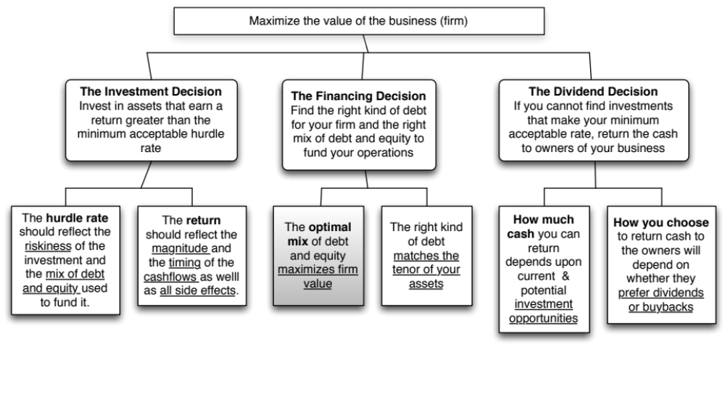
The Big Picture..
Notes:
Is there an optimal mix? And can we find it for a given firm? Time to get down to pragmatic questions.

Slide 6
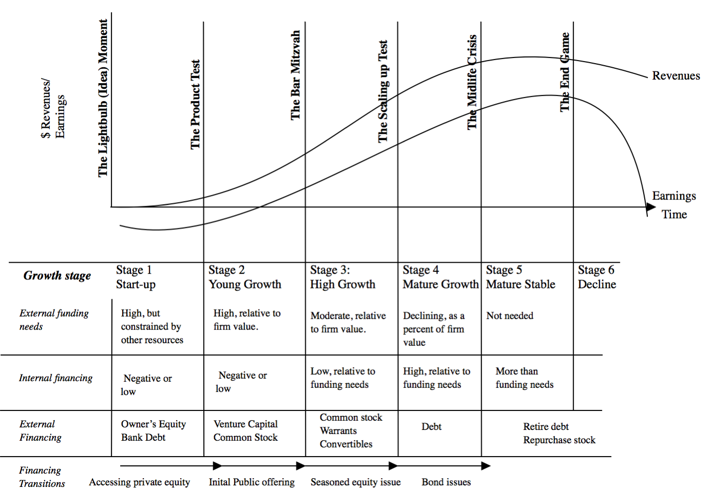
Notes:
The forms that debt and equity take will change as a firm moves through its lifecycle. Early in the process, equity will take the form of owner’s wealth or savings and debt will be bank debt. As the firm evolves, the equity choices will expand first to include venture capital and private equity. When the firm goes public, its choices expand further.
There are three transitional periods: (1) Going from being a private business entirely funded by the owner to accessing the private equity markets (venture capital) (2) Going from private to public with an initial public offering and (3) Public companies making seasoned offerings of debt and equity.

Slide 7
Disney’s Debt Load
At the end of 2013, Disney had $15.96 billion in debt outstanding.
  $13 billion in conventional interest bearing debt (with a book value of $14.3 billion
  $2.96 billion in operating lease debt (with no debt equivalent shown on the balance sheet)
As a percent of its market value as a company, debt was 11.4% of its value. As a percent of book value, debt was 40% of value.
As a multiple of EBITDA, debt was 1.3 times EBITDA.

Slide 8
Tesla: Debt Load over time

Slide 9
1. Define debt broadly
General Rule: Debt generally has the following characteristics:
  Commitment to make fixed payments in the future
  The fixed payments are tax deductible
  Failure to make the payments can lead to either default or loss of control of the firm to the party to whom payments are due.
As a consequence, debt should include
  Any interest-bearing liability, whether short term or long term.
  Any lease obligation, whether operating or capital.

Slide 10

Operating Leases at Disney
The “debt value” of operating leases is the present value of the lease payments, at a rate that reflects their risk, usually the pre-tax cost of debt.
The pre-tax cost of debt at Disney is 3.75%.
Debt outstanding at Disney = $13,028 + $ 2,933= $15,961 million
Disney reported $1,784 million in commitments after year 5. Given that their average commitment over the first 5 years, we assumed 5 years @ $356.8 million each.
Notes:
The pre-tax cost of debt was based upon Disney’s current rating.
Disney reports a lump sum as the amount due after year 6…. We break it up into annual payments based upon the average lease payments over the first 5 years…You could also use the year 5 payment as the basis for making this adjustment (Putting it all in year 6 will overstate the present value).
To get to the total market value of debt, we add the estimated market value of interest bearing debt to the present value of operating leases (already a market value number since you used the current pre-tax cost of borrowing to arrive at the value).

Slide 11
2. The debt decision is driven by a real trade off
Notes:
Brings together the costs and the benefits of debt, with the implications.

Slide 12
Implication 1: The Marginal Tax Rate matters
The tax benefit of debt is directly linked to not only whether you are allowed to deduct interest expenses for tax purposes, but also your marginal tax rate on income.
  If interest tax deductions are limited, companies will borrow less money.
  As the marginal tax rate rises (falls), companies will borrow more (less) money.

Slide 13
Implication 2: Expected Bankruptcy Costs matter
Companies will borrow less money, if expected bankruptcy costs rise.
Expected bankruptcy costs are a function of
  Volatility in earnings: As earnings become less predicable, borrowings will increase
  Bankruptcy laws: As bankruptcy laws become more (less) lenient, companies will borrow more (less)
If the government operates as a bankrupt, bailing out entities that borrow too much, every entity will borrow more.

Slide 14
Implication 3: The wider the chasm between lenders & equity investors..
Agency costs arise because what equity investors want from a business is very different from what lenders want from the business.
When lending money, sensible lenders incorporate this reality into whether they lend, how much they lend, the interest rates they charge and the covenants that they write into loans.
The more difficult it is to monitor what borrowers are doing with the lent money, the greater the agency costs and the less lending there will be.

Slide 15
The Trade off for Disney
Tax Benefits: The US has the highest marginal tax rate in the world. Disney, since it makes money, should benefit from using debt.
Added Discipline: There is a separation of ownership and management at Disney, should lead to more debt.
Expected Bankruptcy costs: Disney is large and spread over multiple entertainment businesses, with a cash cow in ESPN. Should lead to more debt.
Agency Costs: Disney has assets that are physical and tangible (theme parks) against which it should be able to borrow money.
Bottom line: Disney should borrow a substantial amount.
Notes:
None of these firms seems like a candidate for a really high debt ratio. With each firm, one or another cost gets in the way.
For Disney, the biggest impediments to borrowing more are the variability of its income and the fact that its assets are mostly “intangible” and difficult to monitor.
For Aracruz, it is the variability in paper prices.
For Tata Chemicals, it is the cross holding structure and the fear that the debt will be channeled to other subsidiaries.
Notwithstanding these issues, I would expect Disney to have more debt than other entertainment companies because it is larger and more diverse than its competitors. I would also expect to see significant debt on both Tata’s and Aracruz’s balance sheets, given the tax benefits.

Slide 16
The Debt Trade off for Tesla
No tax benefits: It is a company that is not only still losing money but has carried forward losses of close to $4.3 billion, effectively nullifying any tax benefits from debt for the near future.
No disciplinary function: With Elon Musk, the largest stockholder at the company, at the helm, there is no basis for the argument that debt will make managers more disciplined in their investment decisions.
Large bankruptcy risk: The company is still young and losing money, and adding a contractual commitment to make interest payments on top of all of the other capital needs that the company has, strikes me as imprudent, with the possibility that one bad year could its promise at risk.
Agency problems: In a company like Tesla, making large and risky bets in new businesses, the chasm between lenders and equity investors is wide, and lenders will either impose restrictions on the company or price in their fears (as higher interest rates).

Slide 17
3. But many debt choices are driven by illusory trade offs

Slide 18
Or by other motives..
Lack of access to equity: In some cases, companies have to borrow money because they cannot raise equity, either because they are private businesses or because equity markets are undeveloped.
Control: In other cases, companies that should be using equity use debt instead because the company is closely held and the controlling equity interests don’t want to risk giving up control.
Subsidies: Sometimes, lenders lend at ”subsidized” rates and equity investors take advantage of those subsidies.
Which one do you think best explains Tesla?

Slide 19
4. The mix of debt and equity drives your cost of capital, and hence your value
Notes:
The basic inputs for computing cost of capital are cost of equity and cost of debt. This summarizes the basic approach we will use to estimate each.

Slide 20
And changing that mix will change your cost of capital

Slide 21

Here is an example: Disney in 2013
Notes:
Summarizes the cost of equity and debt from prior pages, as well as the cost of capital at different debt ratios.
If the objective is to minimize cost of capital, it occurs at 30 and 40%... We did try for a more precise answer by working in 1% increments and arrived at an optimal of 43% with a cost of capital of 7.28%. (We moved in 1% increments from 30% top 50%)
This will maximize firm value, if operating cashflow (EBITDA) is unaffected by changes in leverage and the consequent changes in ratings. (In other words, we are assuming no indirect bankruptcy costs… If we did, the optimal might be affected, especially if it is at low rating).

Slide 22
Here are the “firm specific” determinants
Marginal tax rate: Holding all else constant, lowering the tax rate will lower the optimal. At a zero percent tax rate, Disney’s optimal debt ratio becomes zero.
Cash Flow Generation: Holding all else constant, the more cash flow that a firm generates, relative to its enterprise value, the more it can borrow. Disney’s EBITDA was 9.35% of its enterprise value in 2013.
Volatility in Cash flows: Holding all else constant, the more volatile cash flows are, the less a company should borrow.

Slide 23
And here is the only macro determinant: The relative prices of risk in equity & debt markets
Notes:
The cost of equity is determined by the equity risk premium and the cost of debt by the default spread. When ERP rise (fall) relative to default spreads, firms will borrow more (less).
This graph has the implied equity risk premium and the default spread on a Baa rated bond going back to 1960. While they generally move together, there have been periods of disconnect between the two.
In the late 1990s, equity risk premiums dropped relative to default spreads: Firms should have shifted to equity from debt and optimal debt ratios should have decreased.
Between 2004 and 2007, default spreads dropped while equity risk premiums remained unchanged. It was a golden age for leveraged transactions.
In 2008, risk premia climbed across the board but default spreads increased at a far faster pace than equity risk premium. On a relative basis, debt became more expensive relative to equity.
We would expect optimal debt ratios to decrease across the board as a consequence. . (Between 2004 and 2007, default spreads fell while equity risk premiums stagnated… ushering in the age of leveraged recaps and buyouts)

Slide 24
5. And the pathway to your optimal debt ratio depends on..
Is the actual debt ratio greater than or lesser than the optimal debt ratio?
Actual > Optimal
Actual < Optimal
Overlevered
Underlevered
Is the firm under bankruptcy threat?
Is the firm a takeover target?
Yes
No
Yes
No
Reduce Debt quickly
Does the firm have good
Increase leverage
Does the firm have good
1. Equity for Debt swap
projects?
quickly
projects?
2. Sell Assets; use cash
ROE > Cost of Equity
1. Debt/Equity swaps
ROE > Cost of Equity
to pay off debt
ROC > Cost of Capital
2. Borrow money&
ROC > Cost of Capital
3. Renegotiate with lenders
buy shares.
Yes
No
Yes
No
Take good projects with
1. Pay off debt with retained
Take good projects with
new equity or with retained
earnings.
debt.
earnings.
2. Reduce or eliminate dividends.
Do your stockholders like
3. Issue new equity and pay off
dividends?
debt.
Yes
No
Pay Dividends
Buy back stock
Notes:
Studies that have looked at the likelihood of a firm being taken over (in a hostile takeover) have concluded that
Small firms are more likely to be taken over than larger firms
Closely held firms are less likely to be taken over than widely held firms
Firms with anti-takeover restrictions in the corporate charter (or from the state) are less likely to be taken over than firms without these restrictions
Firms which have done well for their stockholders (positive Jensen’s alpha, Positive EVA) are less likely to be taken over than firms which have done badly.
Whether a firm is under bankruptcy threat can be assessed by looking at its rating. If its rating is BB or less, you can argue that the bankruptcy threat is real.
Looking at historical ROE or ROC, relative to the cost of equity and capital, does assume that the future will look like the past.

Slide 25
Applied to Disney (in 2013)
Is the actual debt ratio greater than or lesser than the optimal debt ratio?
Actual > Optimal
Actual < Optimal
Overlevered
Actual (11.58%) < Optimal (40%)
Is the firm under bankruptcy threat?
Is the firm a takeover target?
Yes
No
Yes
No. Large mkt cap & positive Jensen’s α
Reduce Debt quickly
Does the firm have good
Increase leverage
Does the firm have good
1. Equity for Debt swap
projects?
quickly
projects?
2. Sell Assets; use cash
ROE > Cost of Equity
1. Debt/Equity swaps
ROE > Cost of Equity
to pay off debt
ROC > Cost of Capital
2. Borrow money&
ROC > Cost of Capital
3. Renegotiate with lenders
buy shares.
Yes
No
Yes. ROC > Cost of capital
No
Take good projects with
1. Pay off debt with retained
Take good projects
new equity or with retained
earnings.
With debt.
earnings.
2. Reduce or eliminate dividends.
Do your stockholders like
3. Issue new equity and pay off
dividends?
debt.
Yes
No
Pay Dividends
Buy back stock
Notes:
This is the analysis for Disney in 2009.
I am assuming that future projects will be more successful than current projects..
Over time, our assessments have changed:
In 2003, we would have pushed for higher dividends (since Disney was earning terrible returns on capital and we did not trust management)
In 2000, Disney would have been a takeover target (because its market cap had dropped and its performance was awful on both accounting and stock price returns)
In 1997, Disney would not have been a takeover target (high market cap, good performance) and its excess debt capacity would have been directed to good investments.

Slide 26


6. The right debt for your firm will look like equity
The objective in designing debt is to make the cash flows on debt match up as closely as possible with the cash flows that the firm makes on its assets.
By doing so, we reduce our risk of default, increase debt capacity and increase firm value.
Matched Debt
Unmatched Debt
Notes:
Your objective is issue securities that bring you all of the tax benefits of debt while providing you with the flexibility of equity. It is not the reduction in risk but the increase in debt capacity that generates the value. A firm that does not use this debt capacity will not gain from matching debt to assets in the first place.

Slide 27
Designing Debt: Bringing it all together
Start with the
Cyclicality &
Cash Flows
Duration
Currency
Effect of Inflation
Growth Patterns
Other Effects
on Assets/
Uncertainty about Future
Projects
Fixed vs. Floating Rate
Straight versus
Special Features
Commodity Bonds
Define Debt
Duration/
Currency
* More floating rate
Convertible
on Debt
Catastrophe Notes
Characteristics
Maturity
Mix
- if CF move with
- Convertible if
- Options to make
inflation
cash flows low
cash flows on debt
- with greater uncertainty
now but high
match cash flows
on future
exp. growth
on assets
Design debt to have cash flows that match up to cash flows on the assets financed
Overlay tax
Deductibility of cash flows
Differences in tax rates
Zero Coupons
preferences
for tax purposes
across different locales
If tax advantages are large enough, you might override results of previous step
Consider
Analyst Concerns
Ratings Agency
Regulatory Concerns
ratings agency
- Effect on EPS
- Effect on Ratios
- Measures used
Operating Leases
& analyst concerns
- Value relative to comparables
- Ratios relative to comparables
MIPs
Surplus Notes
Can securities be designed that can make these different entities happy?
Observability of Cash Flows
Type of Assets financed
Existing Debt covenants
Convertibiles
Factor in agency
by Lenders
- Tangible and liquid assets
- Restrictions on Financing
Puttable Bonds
conflicts between stock
- Less observable cash flows
create less agency problems
Rating Sensitive
and bond holders
lead to more conflicts
Notes
If agency problems are substantial, consider issuing convertible bonds
LYONs
Consider Information
Uncertainty about Future Cashflows
Credibility & Quality of the Firm
Asymmetries
- When there is more uncertainty, it
- Firms with credibility problems
may be better to use short term debt
will issue more short term debt
Notes:
This provides the basic framework for designing the right kind of debt.
You begin by trying to match up financing type to asset type (in terms of duration, currency, growth patterns and special features). By doing so, you reduce your risk of bankruptcy, increase your capacity to borrow and consequently the tax benefits of debt.
Then, you modify the “perfect debt”
For tax factors, to ensure that you get the maximum tax benefit
To meet the needs and objectives of equity research analysts and ratings agencies
To fix any agency conflicts that might prevent lenders from lending
To prevent an undeservedly low rating from pushing up the cost of debt above what it should be. (If you are under rated, you should probably use short term debt until you feel your rating is justified)

Slide 28

Applied to Disney
Notes:
There is plenty of room to be creative in this approach.
Look at firms which operate in each of these businesses and see what financing they use. That might be useful in designing the right kind of debt.

