Slide 1
Applied Corporate Finance & value
Website for this class: http://people.stern.nyu.edu/adamodar/New_Home_Page/triumdesc.html
Aswath Damodaran
www.damodaran.com
Notes:
Sets the agenda for the class. This is a class that will be focused on the big picture of corporate finance rather than details, theories or models on a piecemeal basis.

Slide 2

What is corporate finance?
Every decision that a business makes has financial implications, and any decision which affects the finances of a business is a corporate finance decision.
Defined broadly, everything that a business does fits under the rubric of corporate finance.
Notes:
Every decision is a corporate finance decision. Thus, marketing, accounting, operations and strategy can all be viewed as subsets of corporate finance (self serving, right?)

Slide 3

The Traditional Accounting Balance Sheet
Notes:
Before we embark on the corporate missions, let’s start by changing your mindset, especially if accounting is fresh in your mind. This is an accounting balance sheet and it is worth noting what it is, and what it is not. It is backward looking and done right, it is a recording of what you have done as business. It is constrained by the accounting mindset which is conservative, risk averse and grounded in accounting history. Accounting was designed for the old economy, for the manufacturing firm that bought land, built a factory and produced tangible goods and it is stretched to breaking point by the new economy, not just technology firms but service firms.
Assets are categorized by how long they last and how tangible they are and liabilities reflect original capital raised. While fair value accounting is trying to change this, it is a hopeless venture, since accounting cannot abandon its moorings. It is like a person strapping on wings, while having lead boots.
Three general propositions about accounting mindsets:
They are backward looking. Accountants are historians, not soothsayers.
They are rule-bound.
The rules are not internally consistent and reflect an old-world economy. Looking at accounting rule making, you are reminded of an old car, held together with spare parts and makeshift fixes.

Slide 4

The Financial View of the Firm
Notes:
The financial perspective:
The past is irrelevant and only the future matters.
The value of an asset is determined by its capacity to generate cash flows in the future. It does not matter whether an asset is tangible or not. It does matter whether it exists right now (assets in place) or will be created in the future (growth assets)
There are two ways you can fund a business. You can borrow the money (debt) or use your own money (equity).

Slide 5

First Principles & The Big Picture
Notes:
This is the big picture that will animate how we approach corporate finance. We will use it to anchor the class, introducing each topic by noting its presence in the big picture. Ultimately, everything we do in corporate finance has to be somewhere in the picture.

Slide 6
Theme 1: Corporate finance is “common sense”
There is nothing earth shattering about any of the first principles that govern corporate finance. After all, arguing that taking investments that make 9% with funds that cost 10% to raise seems to be stating the obvious (the investment decision), as is noting that it is better to find a funding mix which costs 10% instead of 11% (the financing decision) or positing that if most of your investment opportunities generate returns less than your cost of funding, it is best to return the cash to the owners of the business and shrink the business.
Shrewd business people, notwithstanding their lack of exposure to corporate finance theory, have always recognized these fundamentals and put them into practice.
Notes:
Do you need a course in corporate finance to run a firm wisely? Obviously not, since shrewd business people through the ages have built up great businesses, without the benefits of corporate financial theory. They have been able to do so because the first principles of corporate finance are common sense ones: try to find the cheapest way to raise financing, make sure that you invest your funds in assets that earn you more than it costs you to raise them and take funds out of the business, if you cannot find these investments. Theories and models are often provided as justifications for actions that violate common sense. It is usually theories and models that are at fault, not common sense.

Slide 7
Theme 2: Corporate finance is focused…
It is the focus on maximizing the value of the business that gives corporate finance its focus. As a result of this singular objective, we can
  Choose the “right” investment decision rule to use, given a menu of such rules.
  Determine the “right” mix of debt and equity for a specific business
  Examine the “right” amount of cash that should be returned to the owners of a business and the “right” amount to hold back as a cash balance.
This certitude does come at a cost. To the extent that you accept the objective of maximizing firm value, everything in corporate finance makes complete sense. If you do not, nothing will.
Notes:
The presences of a singular objective – maximizing firm value – allows corporate finance to be able to hone in on best practices and focused models. To the extent that you agree with this objective, corporate finance makes complete sense. To the extent that you do not, nothing makes sense. That is why we will spend two sessions focusing on why we choose the objective and considering alternative objectives (and why we reject them).

Slide 8

Theme 3: The focus in corporate finance changes across the life cycle…
Notes:
Drawing a contrast between the two companies:
Con Ed, a regulated utility, is a mature company with most of its value derived from investments that it has made in the past. Linkedin derives most of its value from expectations about what it will do in the future.
A very simple way to assess how firms should approach financing and dividend decisions in corporate finance is to look at where they derive value. Con Ed, as a mature company with significant assets in place and large cash flows from these assets, has relatively little need for new investments (since growth is limited) and can afford to both borrow more money and pay larger dividends. Linkedin has relatively little earnings capacity and high investment needs (to fund its growth). It cannot afford to borrow money (you cannot pay interest expenses with expectations) or pay dividends.

Slide 9
Theme 4: Corporate finance is universal…
Every business, small or large, public or private, US or emerging market, has to make investment, financing and dividend decisions.
The objective in corporate finance for all of these businesses remains the same: maximizing value.
While the constraints and challenges that firms face can vary dramatically across firms, the first principles do not change.
  A publicly traded firm, with its greater access to capital markets and more diversified investor base, may have much lower costs of debt and equity than a private business, but they both should look for the financing mix that minimizes their costs of capital.
  A firm in an emerging markets may face greater uncertainty, when assessing new investments, than a firm in a developed market, but both firms should invest only if they believe they can generate higher returns on their investments than they face as their respective (and very different) hurdle rates.
Notes:
The first principles of corporate finance apply for all companies, small and large, public and private, developed market and emerging market. The estimation issues may vary and we may face greater uncertainty in some cases than others, but the first principles will be identical.

Slide 10
Theme 5: If you violate first principles, you will pay a price (no matter who you are..)
There are some investors/analysts/managers who convince themselves that the first principles don’t apply to them because of their superior education, standing or past successes, and then proceed to put into place strategies or schemes that violate first principles.
Sooner or later, these strategies will blow up and create huge costs.
Almost every corporate disaster or bubble has its origins in a violation of first principles.
Notes:
Examples of Steady Safe, the Indonesian taxicab company. Needed to expand and had to borrow money (why.. Because it valued control) and went to Peregrine, one of Asia’s leading investment banks at the time. Was advised to borrow money in US dollars (because it was cheaper to do so.. Another first principle violated) and went bankrupt when the rupiah was devalued.
You can take your pick of bubbles. Here are a few:
Sub-prime crisis: At its core, the sub-prime crisis emanated from the fact that banks/bondholders lent money (or bought bonds) to entities with high credit risk and assumed that these entities would not default (because their models told them so). Reality proved otherwise.
Dot com bubble: We were told that internet companies in the late 1990s did not really have to worry about investing their money in good investments. The sector had so much promise (we were again told) that all investments would ultimately pay off, thus justifying the huge martket values of these firms.

Slide 11

Theme 6: If you cannot apply it, who cares?
Notes:
These companies form lab experiments that will run through the entire class. They represent a spectrum, from small to large, developed to emerging and across sectors and by using them to apply concepts, we will see both how much they share in common and how to deal with differences.

Slide 12

The Objective in Decision Making
In traditional corporate finance, the objective in decision making is to maximize the value of the firm.
A narrower objective is to maximize stockholder wealth. When the stock is traded and markets are viewed to be efficient, the objective is to maximize the stock price.
Maximize equity value
Maximize market estimate of equity value
Maximize firm value
Notes:
Maximizing the value of the business is the most general objective function.
Managers answer to stockholders. Consequently, the objective gets narrowed down to “maximizing equity value”. (Implicit assumption: Bondholders/ Banks can protect themselves by writing in covenants and setting interest rates).
It is tough to assess equity value objectively. It would be nice to have a “third party” estimate that is objective. For publicly traded firms, the market (in spite of all its limitations) provides such an estimate. (Implicit assumption: Markets are rational and reasonably efficient).

Slide 13
The Classical Objective Function
STOCKHOLDERS
Hire & fire
managers
- Board
- Annual Meeting
Maximize
stockholder wealth
Lend Money
No Social Costs
BONDHOLDERS
Managers
SOCIETY
Protect
bondholder
Interests
Costs can be
traced to firm
Reveal
information
honestly and
on time
Markets are
efficient and
assess effect on
value
FINANCIAL MARKETS
Notes:
This is the utopian world. None of the assumptions are really defensible as written, and skepticism is clearly justified:
Why do we need these assumptions?
Since, in many large firms, there is a separation of ownership from management, managers have to be fearful of losing their jobs and go out and maximize stockholder wealth. If they do not have this fear, they will focus on their own interests.
If bondholders are not protected, stockholders can steal from them and make themselves better off, even as they make the firm less valuable.
If markets are not efficient, maximizing stock prices may not have anything to do with maximizing stockholder wealth or firm value.
If substantial social costs are created, maximizing stock prices may create large side costs for society (of which stockholders are members).
Note that corporate finance, done right, is not about stealing from other groups (bondholders, other stockholders or society) but about making the firm more productive and valuable.

Slide 14
What can go wrong?
STOCKHOLDERS
Managers put
their interests
above stockholders
Have little control
over managers
Lend Money
Significant Social Costs
BONDHOLDERS
Managers
SOCIETY
Bondholders can
get ripped off
Some costs cannot be
traced to firm
Delay bad
news or
provide
misleading
information
Markets make
mistakes and
can over react
FINANCIAL MARKETS
Notes:
This is my worst case scenario:
Stockholders have little or no control over managers. Managers, consequently, put their interests above stockholder interests.
Bondholders who do not protect themselves find stockholders expropriating their wealth.
Information conveyed to markets is noisy, biases and sometimes misleading. Markets do not do a very good job of assimilating this information and market price changes have little to do with true value.
Firms in the process of maximizing stockholder wealth create large social costs.
In this environment, stockholder wealth maximization is not a good objective function.

Slide 15

Who’s on Board? The Disney Experience - 1997
Notes:
This may be going back in time but it may help understanding Disney’s present standing. This was Disney’s board at the height of Michael Eisner’s powers. (Eisner became CEO of Disney in 1985 and consolidated power in the years after.)
Note the number of insiders on the board. (Seven out of 16; five current employees & two ex-employees)
Also note the presence of Mr. Eisner’s private attorney (Irwin Russell) and the principal of his childrens’ elementary school (Reveta Bowers) on the board.
How independent was this board likely to be of Mr. Eisner? This may explain some of the actions taken by Disney (and specifically Eisner) during the 1990s… (Read Disney War by James Stewart for the gory details)
When Eisner was hired in 1984, he insisted on bringing in his protégé Jeffrey Katzenberg, a brilliant show-biz exec lacking in social skills, into the firm with him. Katzenberg was largely responsible for the rebirth of Disney Animation (which Eisner had considered shutting down) with The Little Mermaid, Beauty and the Beast and The Lion King all proving to be mega-winners. As a reward for this success, Esiner fired him. His lucrative contract entitled him to 2% of the revenues from the movies he made in posterity but he would have settled for $100 million. Eisner refused to pay; Disney paid $ 250 million in 1999.
In 1995, Eisner hired Ovitz, the leading agent in Hollywood, and then told the board to okay the hire. He regretted it almost immediately and fired him 453 days later for “lying” and “incompetence”. However, rather than argue that this was just cause for firing, he paid Ovitz $ 100 million to leave.

Slide 16
So, what next? When the cat is idle, the mice will play ....
When managers do not fear stockholders, they will often put their interests over stockholder interests
  Greenmail: The (managers of ) target of a hostile takeover buy out the potential acquirer's existing stake, at a price much greater than the price paid by the raider, in return for the signing of a 'standstill' agreement.
  Golden Parachutes: Provisions in employment contracts, that allows for the payment of a lump-sum or cash flows over a period, if managers covered by these contracts lose their jobs in a takeover.
  Poison Pills: A security, the rights or cashflows on which are triggered by an outside event, generally a hostile takeover, is called a poison pill.
  Shark Repellents: Anti-takeover amendments are also aimed at dissuading hostile takeovers, but differ on one very important count. They require the assent of stockholders to be instituted.
  Overpaying on takeovers: Acquisitions often are driven by management interests rather than stockholder interests.
No stockholder approval needed….. Stockholder Approval needed
Notes:
These actions could all suggest that managerial interests are being put over stockholder interests. (Some of these actions, though, may also increase stockholder wealth. Managers will, of course, always claim that these actions are in stockholders’ best interests)
The reason that I have put overpaying on poison pills and shark repellants below greenmail and golden parachutes is not because they create less damage to stockholders but because stockholders at least get a chance to voice their view (they both require stockholder approval). Greenmail and golden parachutes just require board approval.

Slide 17

6Application Test: Who owns/runs your firm?
Look at: Bloomberg printout HDS for your firm
Who are the top stockholders in your firm?
What are the potential conflicts of interests that you see emerging from this stockholding structure?
B HDS Page
PB Page 3-12
Notes:
One of your first tasks when assessing a company is to see whether managers have a significant stake in the company. You can get this information in a variety of places. I use Bloomberg to get the data on the top 17 stockholders and go down the list to see if incumbent managers have a stake in the company. I also check to see if there are other investors on the list who may not be incumbent managers but are strong advocates for stockholders - Berkshire Hathaway at Coca Cola, KKR or Blackstone at many publicly traded firms…
You can also get this information from Yahoo! Finance by going into company profiles and clicking on institutional investors…
As you look at the list of top stockholders, you should be also considering the potential conflicts of interest created by the stockholder structure.
Inside stockholders (Founding family, controlling stockholder/manager) versus outside stockholders
Government as major stockholder (or holder of golden vote)
Employees as major stockholders

Slide 18

Case 1: Splintering of Stockholders
Disney’s top stockholders in 2003
Notes:
Not a single individual investor in the list other than Roy Disney who was the 15th largest stockholder… Managers are not significant stockholders in Disney (and the same can be said for most large publicly traded firms). Consider the following scenarios:
Managers are not significant stockholders in the firm: Significant potential for conflicts of interest between managers and stockholders.
Individuals are significant stockholders in the firm as well as part of top management. Usually, these are founder-owners of the firm and the firms tend to be younger firms or family run businesses that have recently made the transition to publicly traded firms. Smaller potential for conflict between managers and stockholders, but potential for conflict between inside stockholders and outside stockholders.
The government is a large stockholder (or a stockholder with veto power). This may keep managers in some check but it will create potential conflicts of interest between the other stockholders and the government (Consider what would happen if the company tried to minimize taxes paid)
Trusts or descendants of owners are significant stockholders in the firm but are not an active part of incumbent management. Power that these stockholders retain to replace managers reduces potential for conflict of interest but is reduced as holdings get diluted among lots of family members.
Another company is largest stockholder in firm. In this case, trace out who owns stock in the other company….

Slide 19

Case 2: Voting versus Non-voting Shares & Golden Shares: Vale
Vale has eleven members on its board of directors, ten of whom were nominated by Valepar and the board was chaired by Don Conrado, the CEO of Valepar.
Notes:
Voting right differences: When voting rights vary across shares, incumbent managers can consolidate their hold on a company with relatively small holdings. This reduces the power that stockholders have in these companies. Differences in voting rights are common outside the U.S. In Asia and Latin America, incumbent managers or family members can control companies with relatively small holdings with complete impunity.
Golden shares: When the government has veto power over major decisions, that also acts as a constraint on shareholders. Consequently, shareholders have to be realistic about what they can change and not change at these companies.

Slide 20

Case 3: Cross and Pyramid Holdings
Tata Motor’s top stockholders in 2013
Notes:
Cross holding structures are often designed with control in mind. In the case of Tata Motors, other Tata companies (which are part of the Tata family group) represent a large number of the top 15 stockholders in the company. (At least the Tatas are up front and open about their cross holding structures… In many Indian companies, the cross holdings are disguised with front companies holding the stock for families).
In Asia and Latin America, corporate holdings structures are designed to consolidate control.

Slide 21
Case 4: Legal rights and Corporate Structures: Baidu
The Board: The company has six directors, one of whom is Robin Li, who is the founder/CEO of Baidu. Mr. Li also owns a majority stake of Class B shares, which have ten times the voting rights of Class A shares, granting him effective control of the company.
The structure: Baidu is a Chinese company, but it is incorporated in the Cayman Islands, its primary stock listing is on the NASDAQ and the listed company is structured as a shell company, to get around Chinese government restrictions of foreign investors holding shares in Chinese corporations.
The legal system: Baidu’s operating counterpart in China is structured as a Variable Interest Entity (VIE), and it is unclear how much legal power the shareholders in the shell company have to enforce changes at the VIE.
Notes:
When you invest in Baidu, you have to do so with the recognition that your rights to make changes in the company or have a say in how it is run are very limited. There have been cases in the last few years, where US investors in companies structured just like Baidu have found that the Chinese courts are not protective of their legal rights.

Slide 22
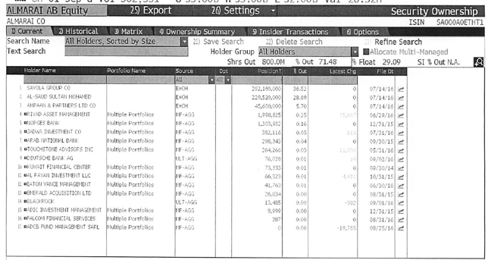
Case 5: An inside game? Almarai’s top stockholders

Slide 23

Things change.. Disney’s top stockholders in 2009
Notes:
Things can change… This is Disney in 2009. Note that there is now an individual at the top of the list – Steve Jobs, whose holdings come from his majority ownership at Pixar that was acquired by Disney.
As a stockholder in Disney, what are your thoughts about Jobs at the top of the list?
I think that it will shake the company up. Jobs has many shortcomings, but he is a visionary who will push Disney to take another look at its established business practices.

Slide 24
When traditional corporate financial theory breaks down, the solution is:
To choose a different mechanism for corporate governance, i.e., assign the responsibility for monitoring managers to someone other than stockholders.
To choose a different objective for the firm.
To maximize stock price, but reduce the potential for conflict and breakdown:
  Making managers (decision makers) and employees into stockholders
  Protect lenders from expropriation
  By providing information honestly and promptly to financial markets
  Minimize social costs
Notes:
At this point, things look pretty bleak for stock price maximization. These are the three choices that we have, if we abandon pure stock price maximization as an objective function.

Slide 25
I. An Alternative Corporate Governance System
Germany and Japan developed a different mechanism for corporate governance, based upon corporate cross holdings.
  In Germany, the banks form the core of this system.
  In Japan, it is the keiretsus
  Other Asian countries have modeled their system after Japan, with family companies forming the core of the new corporate families
At their best, the most efficient firms in the group work at bringing the less efficient firms up to par. They provide a corporate welfare system that makes for a more stable corporate structure
At their worst, the least efficient and poorly run firms in the group pull down the most efficient and best run firms down. The nature of the cross holdings makes its very difficult for outsiders (including investors in these firms) to figure out how well or badly the group is doing.
Notes:
In the 1980s, Michael Porter argued that US companies should move towards the Japanese system. The Japanese and German systems tend to do well in stable environments, where failure tends to be unsystematic ( a firm here and a firm there). They can take care of their “failures” and nurse them back to health, rather than exposing themselves to the costs associated with failure.
These systems break down when problems are wide spread and systematic. Contrast the way US banks dealt with problem loans on their balance sheets (markets forced them to deal with these problems quickly ) and the way Japanese banks have dealt with them (by hiding them and hoping they go away)
In recent years, people have pointed to the Chinese system (centrally planned, quasi market) as the success story. I don’t buy it (yet). The test of a system comes not during periods of success but during periods of failure. Neither the Chinese nor the Indian systems have been tested yet. The next two years will tell us whether either system is a long term sustainable system.

Slide 26
II. Choose a Different Objective Function
Firms can always focus on a different objective function. Examples would include
  maximizing earnings
  maximizing revenues
  maximizing firm size
  maximizing market share
  maximizing EVA
The key thing to remember is that these are intermediate objective functions.
  To the degree that they are correlated with the long term health and value of the company, they work well.
  To the degree that they do not, the firm can end up with a disaster
Notes:
Consider each of these objectives. If you put them through the same tests that we did stock price maximization, you come up with far more problems with each.
Note that firms might pick an intermediate objective (like market share) when it is correlated with firm value but continue to use it, even after it loses this link. Do you want a 100% market share of a losing business?
In the 1980s, American Airlines (under Robert Crandall) set itself the objective of becoming the number one domestic airline in the United States. It succeeded but by 1989, it was losing billions.

Slide 27
III. A Market Based Solution
STOCKHOLDERS
1. More activist
investors
2. Hostile takeovers
Managers of poorly
run firms are put
on notice.
Protect themselves
Corporate Good Citizen Constraints
BONDHOLDERS
Managers
SOCIETY
1. Covenants
2. New Types
1. More laws
2. Investor/Customer Backlash
Firms are
punished
for misleading
markets
Investors and
analysts become
more skeptical
FINANCIAL MARKETS
Notes:
This summarizes the objective function of maximizing stockholder wealth, with the fixes noted on the last few pages.

Slide 28
Disney: Eisner’s rise & fall from grace
In his early years at Disney, Michael Eisner brought about long-delayed changes in the company and put it on the path to being an entertainment giant that it is today. His success allowed him to consolidate power and the boards that he created were increasingly captive ones (see the 1997 board).
In 1996, Eisner spearheaded the push to buy ABC and the board rubberstamped his decision, as they had with other major decisions. In the years following, the company ran into problems both on its ABC acquisition and on its other operations and stockholders started to get restive, especially as the stock price halved between 1998 and 2002.
In 2003, Roy Disney and Stanley Gold resigned from the Disney board, arguing against Eisner’s autocratic style.
In early 2004, Comcast made a hostile bid for Disney and later in the year, 43% of Disney shareholders withheld their votes for Eisner’s reelection to the board of directors. Following that vote, the board of directors at Disney voted unanimously to elect George Mitchell as the Chair of the board, replacing Eisner, who vowed to stay on as CEO.
In October 2005, Eisner stepped down as CEO, to be replaced by Bob Iger.
Notes:
Eisner was a good CEO when he came into Disney, partly because it was a company badly in need of change and partly because he had a solid COO in Frank Wells, who acted as a counterweight. Two things changed in the 1990s. The first was that Eisner was successful, and the ego boost that he received was the basis for acquiring more power (a compliant board). The second was that Frank Wells dies in an air accident, leaving Eisner as the imperial CEO. Power corrupts and absolute power does so absolutely.
As long as Disney was doing well, though, shareholders were willing to cut Eisner slack. However a bad acquisition followed by under performance (share prices and earnings) gradually ate away that support, until you get to the tipping point which in this case were the resignations and the hostile acquisition bid.

Slide 29

A Market Solution: Eisner’s exit… and a new age dawns? Disney’s board in 2008
Notes:
The changes made by Eisner were too little.. Too late,,, and he was forced to leave in 2005, His successor, Bob Iger, has made a break from the past. Note the differences between the board in 2008 and the one in 2004:
It is smaller, 12 members instead of 18.
There is little overlap between this board and the 2003 board, reflecting the fact that this is now Iger’s board and not Eisner’s board.
The directors with the most obvious conflicts of interests are gone.
The question, though, is an open one. As Iger becomes entrenched as CEO, will be find directors who are beholden to him?

Slide 30
But as a CEO’s tenure lengthens, does corporate governance suffer?
While the board size has stayed compact (at twelve members), there has been only one change since 2008, with Sheryl Sandberg, COO of Facebook, replacing the deceased Steve Jobs.
The board voted reinstate Iger as chair of the board in 2011, reversing a decision made to separate the CEO and Chair positions after the Eisner years.
In 2011, Iger announced his intent to step down as CEO in 2015 but Disney’s board convinced Iger to stay on as CEO for an extra year, for the “the good of the company”.
There were signs of restiveness among Disney’s stockholders, especially those interested in corporate governance. Activist investors (CalSTRS) starting making noise and Institutional Shareholder Services (ISS), which gauges corporate governance at companies, raised red flags about compensation and board monitoring at Disney.
Notes:
The longer the tenure of a CEO, the more power he or she accumulates. Perhaps, we need term limits for CEOs.

Slide 31
The Investment Principle: Risk and Return Models
“You cannot swing upon a rope that is attached only to your own belt.”
Notes:
While the general presumption is that risk is a bad thing and some seek to avoid it at any cost, the reality is that businesses will not only always be exposed to risk but success may sometimes ride on seeking out and taking specific risks.

Slide 32

First Principles
Notes:
The focus of the first part of this investment analysis section is on coming up with a minimum acceptable hurdle rate. In the process, we have to grapple with the question of what risk is and how to bring risk into the hurdle rate.

Slide 33
The notion of a benchmark
Since financial resources are finite, there is a hurdle that projects have to cross before being deemed acceptable.
This hurdle will be higher for riskier projects than for safer projects.
A simple representation of the hurdle rate is as follows:
Hurdle rate = Riskless Rate + Risk Premium
The two basic questions that every risk and return model in finance tries to answer are:
  How do you measure risk?
  How do you translate this risk measure into a risk premium?
Notes:
Underlying the idea of a hurdle rate is the notion that projects have to earn a benchmark rate of return to be accepted, and that this benchmark should be higher for riskier projects than for safer ones.

Slide 34
What is Risk?
Risk, in traditional terms, is viewed as a ‘negative’. Webster’s dictionary, for instance, defines risk as “exposing to danger or hazard”. The Chinese symbols for risk, reproduced below, give a much better description of risk:
危机
The first symbol is the symbol for “danger”, while the second is the symbol for “opportunity”, making risk a mix of danger and opportunity. You cannot have one, without the other.
Risk is therefore neither good nor bad. It is just a fact of life. The question that businesses have to address is therefore not whether to avoid risk but how best to incorporate it into their decision making.
Notes:
Note that risk is neither good nor bad. It is a combination of danger and opportunity - you cannot have one without the other. Consequently, risk is neither something to be avoided nor sought out but carefully balanced. Good business avoid some risks, let others pass through to their investors and actively seek out still others.
When businesses want opportunity (higher returns), they have to live with the higher risk.
Any sales pitch that offers returns without risk is a pipe dream.
Bob Citron, treasurer of Orange County (CA), after he lost a chunk of the county’s pension fund money after investing in interest rate derivatives claimed that he was “not a finance person” and that Merrill’s market strategist (Charlie Clough) had told him he could make “15% with no risk”.
Many prominent (and intelligent) people invested with Bernie Madoff because he promised them (through third parties) that he could deliver 8% more than the treasury bill rate, guaranteed. (He was called the Jewish T.Bill). One investor, interviewed by the NY Times said, “I really did not understand what he was doing, but he said was going to do something with calls, something with puts and earn 12% every year. It sounded plausible (and all my friends were investing with him too).

Slide 35

Alternatives to the CAPM
Notes:
Note that all of the models of risk and return in finance agree on the first two steps. They deviate at the last step in the way they measure market risk, with
The CAPM, capturing all of it in one beta, relative to the market portfolio
The APM, capturing the market risk in multiple betas against unspecified economic factors
The Multi-Factor model, capturing the market risk in multiple betas against specified macro economic factors
The Regression model, capturing the market risk in proxies such as market capitalization and price/book ratios

Slide 36
Limitations of the CAPM
1. The model makes unrealistic assumptions
2. The parameters of the model cannot be estimated precisely
  - Definition of a market index
  - Firm may have changed during the 'estimation' period'
3. The model does not work well
  - If the model is right, there should be
    a linear relationship between returns and betas
    the only variable that should explain returns is betas
  - The reality is that
    the relationship between betas and returns is weak
    Other variables (size, price/book value) seem to explain differences in returns better.
Notes:
The first two critiques can be lowered against any model in finance.
The last critique is the most damaging. Fama and French (1991) noted that
Betas explained little of the difference in returns across stocks between 1962 and 1991. (Over long time periods, it should, if the CAPM is right and betas are correctly estimated), explain almost all of the difference)
Market Capitalization and price to book value ratios explained a significant portion of the differences in returns.
This test, however, is a test of which model explains past returns best, and might not necessarily be a good indication of which one is the best model for predicting expected returns in the future.

Slide 37
Why the CAPM persists…
The CAPM, notwithstanding its many critics and limitations, has survived as the default model for risk in equity valuation and corporate finance. The alternative models that have been presented as better models (APM, Multifactor model..) have made inroads in performance evaluation but not in prospective analysis because:
  The alternative models (which are richer) do a much better job than the CAPM in explaining past return, but their effectiveness drops off when it comes to estimating expected future returns (because the models tend to shift and change).
  The alternative models are more complicated and require more information than the CAPM.
  For most companies, the expected returns you get with the the alternative models is not different enough to be worth the extra trouble of estimating four additional betas.
Notes:
It takes a model to beat a model… The CAPM may not be a very good model at predicting expected returns but the alternative models don’t do much better. In fact, the tests of the CAPM are joint tests of both the effectiveness of the model and the quality of the parameters used in the testing (betas, for instance). We will argue that better beta estimates and a more careful use of the CAPM can yield far better estimates of expected return than switching to a different model.
Just as a side note, there are many who either dislike or distrust the CAPM. While we share some of their skepticism about its precision, we would not throw the basic principle that the discount rate has to be adjusted for risk out, just because we do not like the CAPM. In other words, find a different risk and return model, if so inclined, but adjust for risk.

Slide 38

Gauging the marginal investor: Disney in 2013
Notes:
Of Disney’s top 17 investors, only 2 are individuals…. Laurene Jobs and George Lucas are big stockholders (getting those shares when their companies were sold to Disney) but neither is an active trader.

Slide 39


Extending the assessment of the investor base
In five of the publicly traded companies that we are looking at, institutions are big holders of the company’s stock.
Notes:
It may also make sense to look at the proportion of trading at these companies that comes from institutions. Thus, if institutions own 20% of the shares but account for 80% of the trading, they may still be the marginal investors in the company.

Slide 40
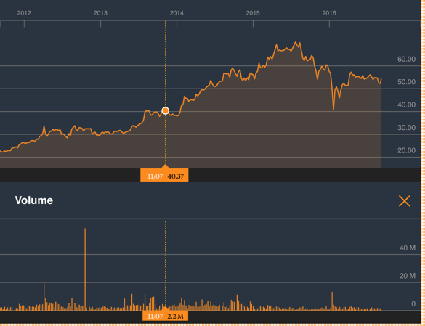
Almarai: Liquidity Problems?

Slide 41
6Application Test: Who is the marginal investor in your firm?
Looking at the breakdown of stockholders in your firm, consider whether the marginal investor is
  An institutional investor
  An individual investor
  An insider
B DES Page 3
PB Page 13
Notes:
For most publicly traded US firms, most, if not all, of the 15 largest investors are institutional investors. In addition, high proportions of both the stock owned and traded are by institutional investors. Thus, the assumption that the marginal investor is well diversified is quite justifiable.
For very small firms, the marginal investor may be an individual investor or even a day trader, who is not diversified. What implications does this have for the use of risk and return models?

Slide 42
Inputs required to use the CAPM -
The capital asset pricing model yields the following expected return:
  Expected Return = Riskfree Rate+ Beta * (Expected Return on the Market Portfolio - Riskfree Rate)
To use the model we need three inputs:
  The current risk-free rate
  The expected market risk premium (the premium expected for investing in risky assets (market portfolio) over the riskless asset)
  The beta of the asset being analyzed.
Notes:
Summarizes the inputs. Note that we are replacing the last component (E(Rm)-Rf) with the expected equity risk premium..

Slide 43
I. A Riskfree Rate
On a riskfree asset, the actual return is equal to the expected return. Therefore, there is no variance around the expected return.
For an investment to be riskfree, then, it has to have
  No default risk
  No reinvestment risk
Time horizon matters: Thus, the riskfree rates in valuation will depend upon when the cash flow is expected to occur and will vary across time.
Not all government securities are riskfree: Some governments face default risk and the rates on bonds issued by them will not be riskfree.
The conventional practice of estimating riskfree rates is to use the government bond rate, with the government being the one that is in control of issuing that currency. In November 2013, for instance, the rate on a ten-year US treasury bond (2.75%) is used as the risk free rate in US dollars.
Notes:
Treasury bills may be default free but there is reinvestment risk when they are used as riskless rates for longer-term cashflows. A 6-month T.Bill is not riskless when looking at a 5-year cashflow.
Would a 5-year treasury be riskfree? Not really. The coupons would still expose you to reinvestment risk. Only a 5-year zero-coupon treasury would be riskfree for a 5-year cash flow.
If you were a purist, you would need different riskfree rates for different cashflows. A pragmatic solution would be to estimate the duration of the cashflows in a valuation and use a treasury of similar duration. (Since the duration is the weighted average of when the cashflows come in, this should be fairly long, especially when you count in the fact that the terminal value is the present value of cashflows forever).

Slide 44
What if there is no default-free entity?
Risk free rates in November 2013
PB Page 14-21
If the government is perceived to have default risk, the government bond rate will have a default spread component in it and not be riskfree. There are three choices we have, when this is the case.
  Adjust the local currency government borrowing rate for default risk to get a riskless local currency rate.
    In November 2013, the Indian government rupee bond rate was 8.82%. the local currency rating from Moody’s was Baa3 and the default spread for a Baa3 rated country bond was 2.25%.
    Riskfree rate in Rupees = 8.82% - 2.25% = 6.57%
  Do the analysis in an alternate currency, where getting the riskfree rate is easier. With Vale in 2013, we could chose to do the analysis in US dollars (rather than estimate a riskfree rate in R$). The riskfree rate is then the US treasury bond rate.
  Do your analysis in real terms, in which case the riskfree rate has to be a real riskfree rate. The inflation-indexed treasury rate is a measure of a real riskfree rate.
Notes:
- Work with the local currency but you cannot use a long-term government bond rate as a riskfree rate if the government has default risk. You need to back into a riskfree rate. If you cannot do this, you have two choices:
Work with a currency where you can get a riskfree rate
Do everything in real terms
For a real riskfree rate, an expected real growth rate for the economy should provide a reasonable approximation.
To do your analysis in real terms, you need a real riskfree rate. In the U.S., you can obtain such a rate by looking at the inflation indexed treasury bond rate. Outside the U.S., you can assume as a rough approximation that the real riskfree rate is equal to your real growth rate. IIf the real growth rate is much lower than the real interest rate, you will have significant deficits - trade or budget - to make up the shortfall. If the real growth rate is much higher than the real interest rate, you will the exact opposite - surpluses. A long term equilibrium can be reached only when the two are equal.

Slide 45
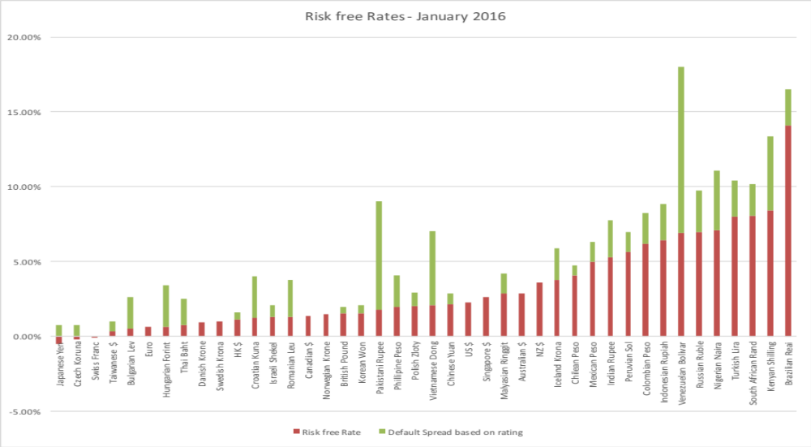
Risk free rates by currency: January 2016

Slide 46
A Synthetic Risk Free Rate
While risk free rates are set by demand and supply, central banks can affect them at the margin and governments can try to control them (or peg them to other currencies), the underlying fundamentals hold:
  Risk free Rate = Expected Inflation + Real Interest Rate
  The global real interest rate today is about 0.75-1%. If you add in capital controls, the risk free rate in some markets may be higher than this number.
  The risk free rate in a currency should then be at least the global risk free rate + expected inflation in that currency.
What is the risk free rate in Saudi Riyals?

Slide 47
II. Equity Risk Premium
The risk premium is the premium that investors demand for investing in an average risk investment, relative to the riskfree rate.
As a general proposition, this premium should be
  greater than zero
  increase with the risk aversion of the investors in that market
  increase with the riskiness of the “average” risk investment
Notes:
Implicit here are two questions - Which investor’s risk premium? What is the average risk investment?
With this assumption it is quite clear that estimating equity risk premiums will be difficult to do because different investors have different degrees of risk aversion (and will demand different premiums) and risk aversion will change over time.

Slide 48
What is your risk premium?
Assume that stocks are the only risky assets and that you are offered two investment options:
  a riskless investment (say a Government Security), on which you can make 3%
  a mutual fund of all stocks, on which the returns are uncertain
How much of an expected return would you demand to shift your money from the riskless asset to the mutual fund?
  Less than 3%
  Between 3 - 5%
  Between 5 - 7%
  Between 7 -9%
  Between 9%- 11%
  More than 11%
Notes:
I usually find that the median number that I get in the US is 7-9%, though the distribution is pretty spread out. This translates into a risk premium of 4-6%. (I have also run a survey on my web site for three years. With more than 30,000 responses, the median risk premium is about 4-6% as well.)
If this were the entire market, the risk premium would be a weighted average of the risk premiums demanded by each and every investor.
The weights will be determined by the wealth that each investor brings to the market. Thus, Warren Buffett’s risk aversion counts more towards determining the “equilibrium” premium than yours’ and mine.
As investors become more risk averse, you would expect the “equilibrium” premium to increase.

Slide 49
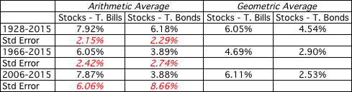
ERP: A Historical Snapshot
If you are going to use a historical risk premium, make it
  Long term (because of the standard error)
  Consistent with your risk free rate
  A “compounded” average
No matter which estimate you use, recognize that it is backward looking, is noisy and may reflect selection bias.
Historical premium for the US

Slide 50
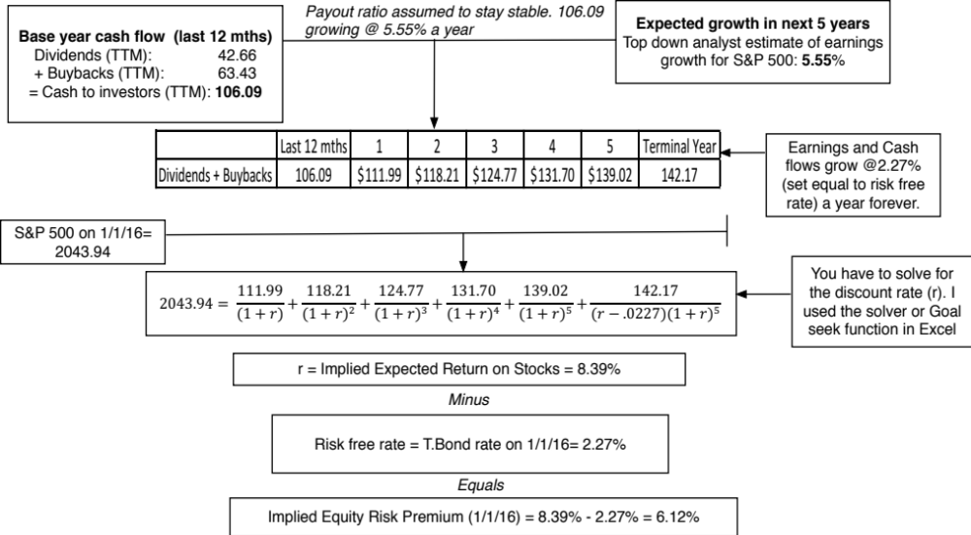
An Implied ERP

Slide 51
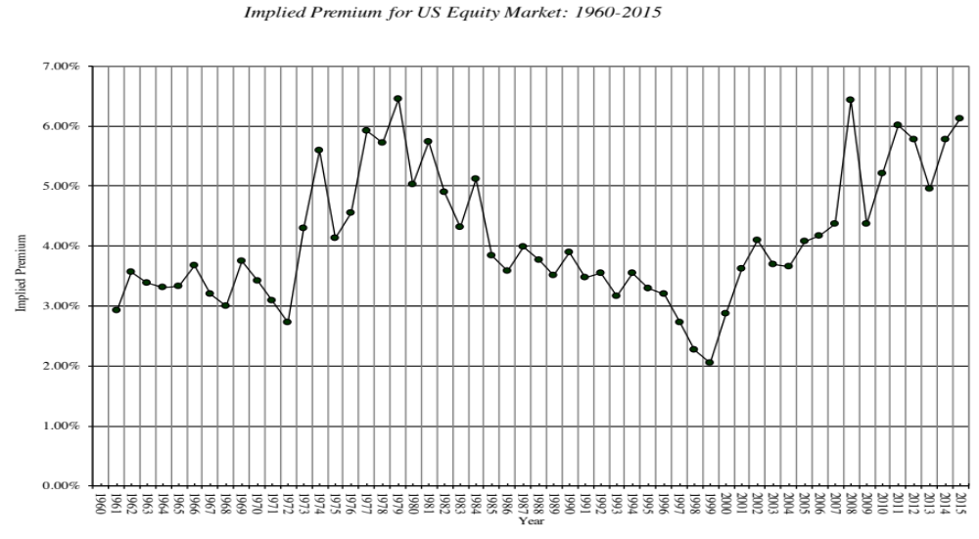
Implied Premiums in the US: 1960-2015
Notes:
As the index changes (and it is the input most likely to change by large amounts in short periods), the implied premium will change. Note that as premiums rise, stock prices drop. Notice two historical phenomena: (1) Equity risk premiums spiked in the 1970s as inflation increased in the US (2) Equity risk premiums bottomed out at 2% at the end of 1999 at the peak of the dot-com boom.
Would you settle for a 2% premium? If your answer is no, you believe that stocks are overvalued.

Slide 52
The bottom line on Equity Risk Premiums in November 2013
Mature Markets: In November 2013, the number that we chose to use as the equity risk premium for all mature markets was 5.5%. This was set equal to the implied premium at that point in time and it was much higher than the historical risk premium of 4.20% prevailing then (1928-2012 period).
For emerging markets, the historical data option is not useful, since most of these markets have too short a history to compute a risk premium. The implied premium can be computed, but some of the inputs (especially growth) are tough to get.
 | Arithmetic Average |  | Geometric Average
 | Stocks - T. Bills | Stocks - T. Bonds | Stocks - T. Bills | Stocks - T. Bonds
1928-2012 | 7.65% | 5.88% | 5.74% | 4.20%
 | 2.20% | 2.33%
1962-2012 | 5.93% | 3.91% | 4.60% | 2.93%
 | 2.38% | 2.66%
2002-2012 | 7.06% | 3.08% | 5.38% | 1.71%
 | 5.82% | 8.11%
Notes:
This is a judgment call and will depend upon your point of view in November 2013. If you believe in mean reversion and that history is the best guide to the future, you have a case for using the historical risk premium (4.20%). If you believe that the world is changing, that mean reversion may not be to historic norms and that risk premiums are dynamic, you will use an implied premium (5.5%).
If you thought that the crisis was just a bump in the road that markets would quickly forget and move on, you would use either the historical risk premium (3.88%) or the average implied premium over time (about 4%) as your mature market premium.
If you thought that the crisis would continue and perhaps even worsen, you would stick with 6.43%.
In hindsight, equity risk premiums dropped dramatically over the rest of 2009 to reach about 4.73% in December 2009.

Slide 53
Country Risk: Look at a country’s bond rating and default spreads as a start
In this approach, the country equity risk premium is set equal to the default spread for the country, estimated in one of three ways. In November 2013, for Brazil, this would have yielded three numbers:
  The default spread on a dollar denominated bond issued by the country. (In November 2013, that spread was 5.25% for the Brazilian $ bond)
  The sovereign CDS spread for the country. In November 2013, the ten year CDS spread for Brazil was 2.59%.
  The default spread based on the local currency rating for the country. Brazil’s sovereign local currency rating is Baa3 and the default spread for a Baa3 rated sovereign was about 2.00% in November 2013.
Many analysts add this default spread to the US risk premium to come up with a risk premium for a country. This would yield a risk premium of 7.50% for Brazil, if we use 5.50% as the US risk premium (in November 2013) and the default spread based on the rating.
Notes:
This approach is simple but it assumes that country default spreads are also good measures of additional country equity risk. The question thought is whether equities (which are riskier than bonds) should command a larger risk premium.

Slide 54
Beyond the default spread
Country ratings measure default risk. While default risk premiums and equity risk premiums are highly correlated, one would expect equity spreads to be higher than debt spreads.
Another is to multiply the bond default spread by the relative volatility of stock and bond prices in that market. Using this approach for Brazil in November 2013, you would get:
  Country Equity risk premium = Default spread on country bond* _{Country Equity} / _{Country Bond}
    Standard Deviation in Bovespa (Equity) = 21%
    Standard Deviation in Brazil government bond = 14%
    Default spread on Brazilian $ bond = 2.00%
  Brazil Country Risk Premium = 2.00% (21%/14%) = 3.00%
  Brazil Total ERP = Mature Market Premium + CRP = 5.5% + 3.00% = 8.50%
Notes:
In In this approach, we scale up the default spread to reflect the additional risk in stocks… This will result in larger equity risk premiums. We are assuming that investors, when pricing equities in an emerging market, look at what they can make on government bonds issued by that market and scale up premiums for additional risk.
There is a third approach which is closely related where you look at the standard deviation of the emerging equity market, relative to the standard deviation of the U.S. equity market, and multiply by the U.S. equity risk premium. Thus, the equity risk premium for an emerging market which is twice as volatile as the the US market should have an equity risk premium of 7.76% (twice 3.88%).

Slide 55

ERP : Nov 2013
Andorra | 7.45% | 1.95% | Liechtenstein | 5.50% | 0.00%
Austria | 5.50% | 0.00% | Luxembourg | 5.50% | 0.00%
Belgium | 6.70% | 1.20% | Malta | 7.45% | 1.95%
Cyprus | 22.00% | 16.50% | Netherlands | 5.50% | 0.00%
Denmark | 5.50% | 0.00% | Norway | 5.50% | 0.00%
Finland | 5.50% | 0.00% | Portugal | 10.90% | 5.40%
France | 5.95% | 0.45% | Spain | 8.88% | 3.38%
Germany | 5.50% | 0.00% | Sweden | 5.50% | 0.00%
Greece | 15.63% | 10.13% | Switzerland | 5.50% | 0.00%
Iceland | 8.88% | 3.38% | Turkey | 8.88% | 3.38%
Ireland | 9.63% | 4.13% | United Kingdom | 5.95% | 0.45%
Italy | 8.50% | 3.00% | Western Europe | 6.72% | 1.22%
Albania | 12.25% | 6.75%
Armenia | 10.23% | 4.73%
Azerbaijan | 8.88% | 3.38%
Belarus | 15.63% | 10.13%
Bosnia | 15.63% | 10.13%
Bulgaria | 8.50% | 3.00%
Croatia | 9.63% | 4.13%
Czech Republic | 6.93% | 1.43%
Estonia | 6.93% | 1.43%
Georgia | 10.90% | 5.40%
Hungary | 9.63% | 4.13%
Kazakhstan | 8.50% | 3.00%
Latvia | 8.50% | 3.00%
Lithuania | 8.05% | 2.55%
Macedonia | 10.90% | 5.40%
Moldova | 15.63% | 10.13%
Montenegro | 10.90% | 5.40%
Poland | 7.15% | 1.65%
Romania | 8.88% | 3.38%
Russia | 8.05% | 2.55%
Serbia | 10.90% | 5.40%
Slovakia | 7.15% | 1.65%
Slovenia | 9.63% | 4.13%
Ukraine | 15.63% | 10.13%
E. Europe & Russia | 8.60% | 3.10%
Bangladesh | 10.90% | 5.40%
Cambodia | 13.75% | 8.25%
China | 6.94% | 1.44%
Fiji | 12.25% | 6.75%
Hong Kong | 5.95% | 0.45%
India | 9.10% | 3.60%
Indonesia | 8.88% | 3.38%
Japan | 6.70% | 1.20%
Korea | 6.70% | 1.20%
Macao | 6.70% | 1.20%
Malaysia | 7.45% | 1.95%
Mauritius | 8.05% | 2.55%
Mongolia | 12.25% | 6.75%
Pakistan | 17.50% | 12.00%
Papua NG | 12.25% | 6.75%
Philippines | 9.63% | 4.13%
Singapore | 5.50% | 0.00%
Sri Lanka | 12.25% | 6.75%
Taiwan | 6.70% | 1.20%
Thailand | 8.05% | 2.55%
Vietnam | 13.75% | 8.25%
Asia | 7.27% | 1.77%
Canada | 5.50% | 0.00%
United States of America | 5.50% | 0.00%
North America | 5.50% | 0.00%
Country | TRP | CRP
Angola | 10.90% | 5.40%
Benin | 13.75% | 8.25%
Botswana | 7.15% | 1.65%
Burkina Faso | 13.75% | 8.25%
Cameroon | 13.75% | 8.25%
Cape Verde | 12.25% | 6.75%
Egypt | 17.50% | 12.00%
Gabon | 10.90% | 5.40%
Ghana | 12.25% | 6.75%
Kenya | 12.25% | 6.75%
Morocco | 9.63% | 4.13%
Mozambique | 12.25% | 6.75%
Namibia | 8.88% | 3.38%
Nigeria | 10.90% | 5.40%
Rwanda | 13.75% | 8.25%
Senegal | 12.25% | 6.75%
South Africa | 8.05% | 2.55%
Tunisia | 10.23% | 4.73%
Uganda | 12.25% | 6.75%
Zambia | 12.25% | 6.75%
Africa | 11.22% | 5.82%
Argentina | 15.63% | 10.13%
Belize | 19.75% | 14.25%
Bolivia | 10.90% | 5.40%
Brazil | 8.50% | 3.00%
Chile | 6.70% | 1.20%
Colombia | 8.88% | 3.38%
Costa Rica | 8.88% | 3.38%
Ecuador | 17.50% | 12.00%
El Salvador | 10.90% | 5.40%
Guatemala | 9.63% | 4.13%
Honduras | 13.75% | 8.25%
Mexico | 8.05% | 2.55%
Nicaragua | 15.63% | 10.13%
Panama | 8.50% | 3.00%
Paraguay | 10.90% | 5.40%
Peru | 8.50% | 3.00%
Suriname | 10.90% | 5.40%
Uruguay | 8.88% | 3.38%
Venezuela | 12.25% | 6.75%
Latin America | 9.44% | 3.94%
Bahrain | 8.05% | 2.55%
Israel | 6.93% | 1.43%
Jordan | 12.25% | 6.75%
Kuwait | 6.40% | 0.90%
Lebanon | 12.25% | 6.75%
Oman | 6.93% | 1.43%
Qatar | 6.40% | 0.90%
Saudi Arabia | 6.70% | 1.20%
United Arab Emirates | 6.40% | 0.90%
Middle East | 6.88% | 1.38%
Australia | 5.50% | 0.00%
Cook Islands | 12.25% | 6.75%
New Zealand | 5.50% | 0.00%
Australia & NZ | 5.50% | 0.00%
Black #: Total ERP
Red #: Country risk premium
AVG: GDP weighted average
Notes:
Updated country risk premiums.

Slide 56
Estimating ERP for Disney: November 2013
Incorporation: The conventional practice on equity risk premiums is to estimate an ERP based upon where a company is incorporated. Thus, the cost of equity for Disney would be computed based on the US equity risk premium, because it is a US company, and the Brazilian ERP would be used for Vale, because it is a Brazilian company.
Operations: The more sensible practice on equity risk premium is to estimate an ERP based upon where a company operates. For Disney in 2013:
Region/ Country | Proportion of Disney’s Revenues | ERP
US& Canada | 82.01% | 5.50%
Europe | 11.64% | 6.72%
Asia-Pacific | 6.02% | 7.27%
Latin America | 0.33% | 9.44%
Disney | 100.00% | 5.76%
Notes:
The ERP for a company should reflect where it does business rather than where it is incorporation. While I have used revenues as my basis for estimating the composite premium for Disney, you may chose an alternate variable (% of production, identifiable assets) to make the allocation. If you use the country of incorporation as your only basis, you will over estimated the costs of capital for emerging market companies and under estimate them for developed market companies.

Slide 57
ERP for the Rest: November 2013
Company | Region/ Country | Weight | ERP
Bookscape | United States | 100% | 5.50%
Vale | US & Canada | 4.90% | 5.50%
 | Brazil | 16.90% | 8.50%
 | Rest of Latin America | 1.70% | 10.09%
 | China | 37.00% | 6.94%
 | Japan | 10.30% | 6.70%
 | Rest of Asia | 8.50% | 8.61%
 | Europe | 17.20% | 6.72%
 | Rest of World | 3.50% | 10.06%
 | Company | 100.00% | 7.38%
Tata Motors | India | 23.90% | 9.10%
 | China | 23.60% | 6.94%
 | UK | 11.90% | 5.95%
 | United States | 10.00% | 5.50%
 | Mainland Europe | 11.70% | 6.85%
 | Rest of World | 18.90% | 6.98%
 | Company | 100.00% | 7.19%
Baidu | China | 100% | 6.94%
Deutsche Bank | Germany | 35.93% | 5.50%
 | North America | 24.72% | 5.50%
 | Rest of Europe | 28.67% | 7.02%
 | Asia-Pacific | 10.68% | 7.27%
 | South America | 0.00% | 9.44%
 | Company | 100.00% | 6.12%
In November 2013, the mature market premium used was 5.5%
Notes:
Bookscape and Baidu are easy, since they get all of their revenues in one market. Baidu, though, may look different in future years if its plans to expand come to fruition. Deutshe, Tata Motors and Vale are multinationals.

Slide 58
A Composite way of estimating ERP for countries
Step 1: Estimate an equity risk premium for a mature market. If your preference is for a forward looking, updated number, you can estimate an implied equity risk premium for the US (assuming that you buy into the contention that it is a mature market)
  My estimate: In January 2016, my estimate for the implied premium in the US was 5.25%. That will also be my estimate for a mature market ERP.
Step 2: Come up with a generic and measurable definition of a mature market.
  My estimate: Any AAA rated country is mature.
Step 3: Estimate the additional risk premium that you will charge for markets that are not mature. You have two choices:
  The default spread for the country, estimated based either on sovereign ratings or the CDS market.
  A scaled up default spread, where you adjust the default spread upwards for the additional risk in equity markets.
Notes:
You could compute implied equity risk premiums for all markets and dispense with this three step process, but the inputs for implied ERP can be difficult to get in many emerging markets.
You may also take issue with my definition of a mature market (AAA) and my use of default spreads as measures of country risk. I share many of your concerns about whether these are adequate measures of country risk, but until we can come up with better measures, we are stuck with these.

Slide 59
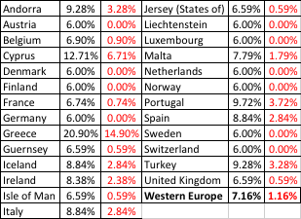
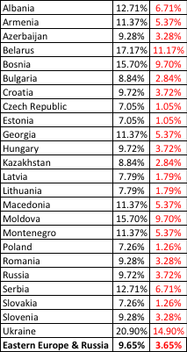
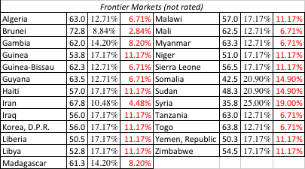
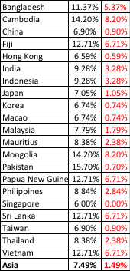

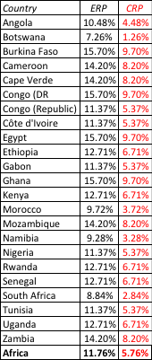
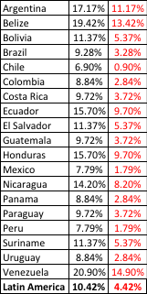
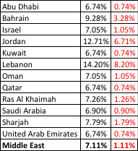

ERP : Jan 2016
Black #: Total ERP
Red #: Country risk premium
AVG: GDP weighted average
Notes:
Updated country risk premiums.

Slide 60
ERP for the Middle East: July 2016
Country | GDP (in billions) | Moody's rating | Adj. Default Spread | Total Risk Premium | Country Risk Premium
Abu Dhabi | 390 | Aa2 | 0.56% | 7.03% | 0.78%
Bahrain | 33.9 | Ba2 | 3.37% | 10.97% | 4.72%
Iraq | 29.54 | B3 | 2.47% | 9.71% | 3.46%
Israel | 305.7 | A1 | 0.79% | 7.36% | 1.11%
Jordan | 35.8 | B1 | 5.05% | 13.32% | 7.07%
Kuwait | 163.6 | Aa2 | 0.56% | 7.03% | 0.78%
Lebanon | 45.7 | B2 | 6.17% | 14.89% | 8.64%
Oman | 81.8 | Baa1 | 1.79% | 8.76% | 2.51%
Qatar | 210.1 | Aa2 | 0.56% | 7.03% | 0.78%
Ras Al Khaimah | 5.2 | A2 | 0.95% | 7.58% | 1.33%
Saudi Arabia | 746.3 | A1 | 0.79% | 7.36% | 1.11%
Sharjah | 1.0 | A3 | 1.35% | 8.14% | 1.89%
UAE | 399.5 | Aa2 | 0.56% | 7.03% | 0.78%
Middle East | 2448.14 |  | 0.93% | 7.56% | 1.31%

Slide 61
III. The Beta
The beta of a stock (asset) measures its exposure to market risk, i.e., the risk that cannot be diversified away by the marginal investors. It is therefore a measure of exposure to broad macroeconomic risk factors.
The beta of a stock is standardized around one.
  A beta that is greater than one indicates above-average risk
  A beta that is close to one indicates average risk
  A beta less than one indicates below average risk
  A beta below zero is a indication of a market risk reducing investment
Implications:
  The weighted average beta of stocks in any market (even the most risky ones) is one. Thus, beta cannot carry the weight of country risk.
  A stock can be risky and have a low beta, if most of the risk in the stock is firm-specific risk.

Slide 62
Almarai’s ERP
 | Revenues | Weight | ERP
Saudi Arabia | ر.س.‏ 8,101.00 | 64.27% | 6.90%
Other Gulf Countries | ر.س.‏ 3,321.00 | 26.35% | 6.83%
Rest of the world | ر.س.‏ 1,183.00 | 9.39% | 7.25%
Company | ر.س.‏ 12,605.00 |  | 6.91%

Slide 63
6 Application Test: Estimating a Market Risk Premium
For your company, get the geographical breakdown of revenues in the most recent year. Based upon this revenue breakdown and the most recent country risk premiums, estimate the equity risk premium that you would use for your company.
This computation was based entirely on revenues. With your company, what concerns would you have about your estimate being too high or too low?
Bloomberg DES Pg 4
Notes:
While revenues are a convenient and accessible measure of operating risk exposure, they are only a piece of the puzzle. A company’s production facilities will also come into play. A Nigerian company that has all of its factories or mines in Nigeria will be heavily exposed to Nigerian country risk, even if its revenues are entirely in Europe. If you have a breakdown of production facilities by region, you can bring those into the weights as well.

Slide 64
Measuring Beta
The standard procedure is to regress stock returns (Rj) against market returns (Rm):
  R_{j} = a + b R_{m}
Risk measure: The slope of the regression (b) corresponds to the beta of the stock, and measures the riskiness of the stock. The regression yields a range on the beta that can be computed from the standard error of the beta estimate.
  Plus (minus) one standard errors: 67% confidence interval
  Plus (minus) two standard errors: 95% confidence interval
Performance measure: The intercept (a) of the regression is a measure of how well or badly the stock performed during the period of the regression, after adjusting for risk and market performance. If the regression is run with raw returns, the intercept has to be compared to Rf (1- Beta) to measure what’s called Jensen’s alpha (a – Rf (1- Beta))
  a > Rf (1-b) : Positive Jensen’s alpha = Stock did better than expected during regression period
  a = Rf (1-b): : Zero Jensen’s alpha = Stock did as wellr than expected during regression period
  a < Rf (1-b) : Negative Jensen’s alpha = Stock did worse than expected during regression period
Risk source: The R squared (R²) of the regression provides an estimate of the proportion of the risk (variance) of a firm that can be attributed to market risk.

Slide 65
Setting up for the Estimation
Decide on an estimation period
  Services use periods ranging from 2 to 5 years for the regression
  Longer estimation period provides more data, but firms change.
  Shorter periods can be affected more easily by significant firm-specific event that occurred during the period.
Decide on a return interval - daily, weekly, monthly
  Shorter intervals yield more observations, but suffer from more noise.
  Noise is created by stocks not trading and biases all betas towards one.
Estimate returns (including dividends) on stock
  Return = (Price_{End} - Price_{Beginning} + Dividends_{Period})/ Price_{Beginning}
  Included dividends only in ex-dividend month
Choose a market index, and estimate returns (inclusive of dividends) on the index for each interval for the period.
Notes:
Note the number of subjective judgments that have to be made. The estimated beta is going to be affected by all these judgments. On each one, there are trade offs to be made, which may explain why different services make different choices.
My personal biases are to
Use five years of data (because I use monthly data)
Use monthly returns (to avoid non-trading problems)
Use returns with dividends
Use an index that is broad, market weighted and with a long history (I use the S&P 500. The NYSE composite is not market weighted, and the Wilshire 5000 has both non-trading and measurement issues that have not been resolved.) You want to get as close the mythical market portfolio as you can get…

Slide 66

Disney: Beta Regression
The risk free rate used in the Jensen’s alpha is the average, short term risk free rate during the period of the regression.

Slide 67
Measuring Performance
The Jensen’s alpha for Disney is 7.19%. This suggests that the stock earned an annual return 7.19% more than the market, after adjusting for risk. Does it follow that the managers of Disney did a good job during this period?
  Yes
  No
  Explain.

Slide 68
The Beta
The beta for Disney in this regression is 1.25. If you check Disney’s beta from a different service (Yahoo, Value Line), would you expect to see the same number?
  Yes
  No
If the betas are different, how do you decide which one to use?
The highest of the numbers
The lowest of the numbers
The average of the numbers
Other

Slide 69
The R-squared
The R-squared measures the proportion of risk in Disney that comes from the market. If you are a diversified investor, would you want this number to be a high or a low number?
  High
  Low
  Would your answer be different if you were not diversified?

Slide 70
Estimating Expected Returns for Disney in November 2013
Inputs to the expected return calculation
  Disney’s Beta = 1.25
  Riskfree Rate = 2.75% (U.S. ten-year T.Bond rate in November 2013)
  Risk Premium = 5.76% (Based on Disney’s operating exposure)
Expected Return = Riskfree Rate + Beta (Risk Premium)
= 2.75% + 1.25 (5.76%) = 9.95%
Notes:
Note that this expected return would have been different if we had decided to use a different equity risk premium. The potential error in the beta will translate into a forecast error on the expected return as well.

Slide 71
Use to a Potential Investor in Disney
As a potential investor in Disney, what does this expected return of 9.95% tell you?
  This is the return that I can expect to make in the long term on Disney, if the stock is correctly priced and the CAPM is the right model for risk,
  This is the return that I need to make on Disney in the long term to break even on my investment in the stock
  Both
Assume now that you are an active investor and that your research suggests that an investment in Disney will yield 12.5% a year for the next 5 years. Based upon the expected return of 9.95%, you would
  Buy the stock
  Sell the stock
Notes:
Both. If the stock is correctly priced, the beta is correctly estimated and the CAPM is the right model, this is what you would expect to make on Disney in the long term. As an investor, this is what you would need to make to break even on the investment. You are not being greedy, just prudent. After all, if you don’t make higher returns when the market is going up, you will find yourself falling behind when the market is going down.
Buy the stock, since you think you can make more than the hurdle rate.

Slide 72
How managers use this expected return
Managers at Disney
  need to make at least 9.95% as a return for their equity investors to break even.
  this is the hurdle rate for projects, when the investment is analyzed from an equity standpoint
In other words, Disney’s cost of equity is 9.95%.
What is the cost of not delivering this cost of equity?
Notes:
The cost of equity is what equity investors in your company view as their required return.
The cost of not delivering this return is more unhappy stockholders, a lower stock price, and if you are a manager, maybe your job.
Going back to the corporate governance section, if stockholders have little or no control over managers, managers are less likely to view this as the cost of equity.

Slide 73

Regression Diagnostics for Tata Motors
Beta = 1.83
67% range
1.67-1.99
69% market risk
31% firm specific
Jensen’s α
= 2.28% - 4%/12 (1-1.83) = 2.56%
Annualized = (1-.0256)¹²-1= 35.42%
Average riskfree rate (2008-13) = 4%
Expected Return (in Rupees)
= Riskfree Rate+ Beta*Risk premium
= 6.57%+ 1.83 (7.19%) = 19.73%
Notes:
Deconstructing Tata Motorl’s beta page, we find that
Tata Motors did better than expected over the period – by 19.73% in an annual basis.
Tata Motors is above average risk (1.83 times as risky as the typical Indian firm)
About 69% of the risk in Tata Motors is market risk

Slide 74
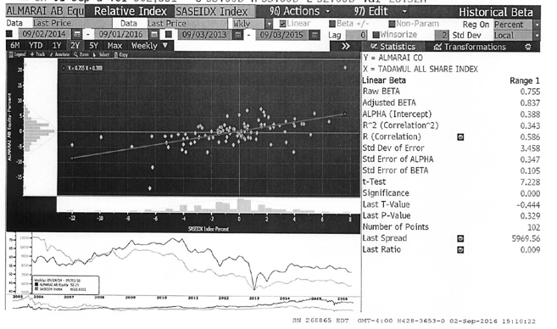
And for Almarai..

Slide 75
6 Application Test: Analyzing the Risk Regression
Using your Bloomberg risk and return print out, answer the following questions:
  How well or badly did your stock do, relative to the market, during the period of the regression?
  Intercept - (Riskfree Rate/n) (1- Beta) = Jensen’s Alpha
    where n is the number of return periods in a year (12 if monthly; 52 if weekly)
  What proportion of the risk in your stock is attributable to the market? What proportion is firm-specific?
  What is the historical estimate of beta for your stock? What is the range on this estimate with 67% probability? With 95% probability?
  Based upon this beta, what is your estimate of the required return on this stock?
  Riskless Rate + Beta * Risk Premium
B Beta Page
PB Page 23-26
Notes:
Try this on your company.

Slide 76
The problem with regression betas
They are backward looking: By definition, a regression beta is backward looking because it is computed based upon past returns. Consequently, if a company’s business mix or financial leverage has changed during the regression period, the regression beta (even if well estimated) is no longer operational.
They are subject to manipulation: Changing the market index used, the time period of the regression or even the return intervals (daily, weekly, monthly) can yield very different regression output.
They are noisy: A regression slope (which is what we use as a beta) comes with a standard error, and if you regress a stock against a broad enough index, the regression beta should have a high standard error (it is a feature, not a bug)>

Slide 77

Beta: Exploring Fundamentals
Notes:
A cross selection of regression betas for companies… Lets try a story for each one:
Bulgari: Small company with mostly luxury products
Qwest: Some business risk but much more substantial overlay of financial risk created by borrowing billions.
Microsoft: Example of beta drift towards one as companies get larger and their product base (and customer base) becomes more diversified. Microsoft’s beta in the lat 1980s was much higher than 2.
GE: Most diversified US company you will find.. Beta will drift towards one for diversified companies. GE Capital’s debt acts as ballast on beta
Philip Morris: Main risk is oil price risk which cuts against the rest of the market (lower oil prices are good for many companies and the economy but not for oil companies). The litigation risk will not show up in the beta because it is firm-specific. (Changing the company name to Altria will not make a difference)
Harmony Gold Mining Company: A negative beta implies that adding this stock on to a diversified portfolio will actually reduce risk (acts as insurance). Gold has historically been an insurance against inflation.
(Consequences of a negative beta: Expected return < Riskfree rate)

Slide 78
Determinant 1: Product Type
Industry Effects: The beta value for a firm depends upon the sensitivity of the demand for its products and services and of its costs to macroeconomic factors that affect the overall market.
  Cyclical companies have higher betas than non-cyclical firms
  Firms which sell more discretionary products will have higher betas than firms that sell less discretionary products
Notes:
Betas measure risk relative to the market.
Firms which are cyclical or sell discretionary products tend to do much better when the economy is doing well (and the market is doing well) and much worse when the economy is doing badly than other firms in the market.
In terms of basic economics, companies that sell products/ services that have elastic demand should have higher betas than ones that sell products/services with inelastic demand.

Slide 79
Determinant 2: Operating Leverage Effects
Operating leverage refers to the proportion of the total costs of the firm that are fixed.
Other things remaining equal, higher operating leverage results in greater earnings variability which in turn results in higher betas.
Notes:
Firms with high fixed costs tend to see much bigger swings in operating income (and stock prices) for a given change in revenues than firms with more flexible cost structures.
Consider the case of the airline sector, which tends to have cost structures which are almost entirely fixed (plane lease expenses, fuel costs …). Firms in the sector have high betas.
Are you destined to have a high beta, once you pick a sector?
To an extent, yes, but you can take action or make decisions to change your destiny. Consider Southwest. By using only one type of aircraft, hedging fuel costs, flying from no-name airports and having a flexible workforce, Southwest has been able to lower its fixed costs as a proportion of total costs. (Focusing less on business travel and high priced tickets has also helped them on the discretionary component).

Slide 80
Measuring Disney’s Operating Leverage: 1987- 2013
Year | Net Sales | % Change in Sales | EBIT | % Change in EBIT
1987 | $2,877 |  | $756
1988 | $3,438 | 19.50% | $848 | 12.17%
1989 | $4,594 | 33.62% | $1,177 | 38.80%
1990 | $5,844 | 27.21% | $1,368 | 16.23%
1991 | $6,182 | 5.78% | $1,124 | -17.84%
1992 | $7,504 | 21.38% | $1,287 | 14.50%
1993 | $8,529 | 13.66% | $1,560 | 21.21%
1994 | $10,055 | 17.89% | $1,804 | 15.64%
1995 | $12,112 | 20.46% | $2,262 | 25.39%
1996 | $18,739 | 54.71% | $3,024 | 33.69%
1997 | $22,473 | 19.93% | $3,945 | 30.46%
1998 | $22,976 | 2.24% | $3,843 | -2.59%
1999 | $23,435 | 2.00% | $3,580 | -6.84%
2000 | $25,418 | 8.46% | $2,525 | -29.47%
2001 | $25,172 | -0.97% | $2,832 | 12.16%
2002 | $25,329 | 0.62% | $2,384 | -15.82%
2003 | $27,061 | 6.84% | $2,713 | 13.80%
2004 | $30,752 | 13.64% | $4,048 | 49.21%
2005 | $31,944 | 3.88% | $4,107 | 1.46%
2006 | $33,747 | 5.64% | $5,355 | 30.39%
2007 | $35,510 | 5.22% | $6,829 | 27.53%
2008 | $37,843 | 6.57% | $7,404 | 8.42%
2009 | $36,149 | -4.48% | $5,697 | -23.06%
2010 | $38,063 | 5.29% | $6,726 | 18.06%
2011 | $40,893 | 7.44% | $7,781 | 15.69%
2012 | $42,278 | 3.39% | $8,863 | 13.91%
2013 | $45,041 | 6.54% | $9,450 | 6.62% | Operating Leverage
Average: 87-13 |  | 11.79% |  | 11.91% | 11.91/11.79 =1.01
Average: 96-13 |  | 8.16% |  | 10.20% | 10.20/8.16 =1.25
Average across entertainment companies = 1.35
Given Disney’s operating leverage measures (1.01 or 1.25), would you expect Disney to have a higher or a lower beta than other entertainment companies?
Higher
Lower
No effect
Notes:
This measures Disney’s operating leverage historically. You need a number of years of data before you can get reasonable estimates.

Slide 81
Determinant 3: Financial Leverage
As firms borrow, they create fixed costs (interest payments) that make their earnings to equity investors more volatile.
This increased earnings volatility which increases the equity beta.
The beta of equity alone can be written as a function of the unlevered beta and the debt-equity ratio
_{L} = _{u} (1+ ((1-t)D/E))
  where
  _{L} = Levered or Equity Beta D/E = Market value Debt to equity ratio
  _{u} = Unlevered or Asset Beta t = Marginal tax rate
Earlier, we estimated the beta for Disney from a regression. Was that beta a levered or unlevered beta?
Levered
Unlevered
Notes:
Same rationale as operating leverage but the focus here is on equity earnings. Put another way, a firm with stable operating income can make its equity income much more volatile by borrowing large sums of money.
This is based upon two assumptions
Debt bears no market risk (which is consistent with studies that have found that default risk is non-systematic)
Debt creates a tax benefit
Assets Liabilities
Assets A (β_{u}) Debt D (β_{D} =0)
Tax Benefits tD (β_{D}=0) Equity E (β_{L})
Betas are weighted averages,
Β_{u} (E + D - tD)/(D+E) = β_{L}(E/(D+E))
Solve for β_{L},
β_{L} = Β_{u} (E + D - tD)/E= Β_{u} (1 + (1-t)D/E)
If debt has a beta (β_{D})
Β_{u} (E + D - tD)/(D+E) + β_{D} tD/(D+E) = β_{L}(E/(D+E)) + β_{D} D/(D+E)
β_{L} = Β_{u} (1 + (1-t)D/E) - β_{D} (1-t) [D/(D+E)]

Slide 82
Effects of leverage on betas: Disney
The regression beta for Disney is 1.25. This beta is a levered beta (because it is based on stock prices, which reflect leverage) and the leverage implicit in the beta estimate is the average market debt equity ratio during the period of the regression (2008 to 2013)
The average debt equity ratio during this period was 19.44%.
The unlevered beta for Disney can then be estimated (using a marginal tax rate of 36.1%)
  = Current Beta / (1 + (1 - tax rate) (Average Debt/Equity))
  = 1.25 / (1 + (1 - 0.361)(0.1944))= 1.1119
Notes:
Note that betas reflect the average leverage over the period and not the current leverage of the firms. Firms whose leverage has changed over the period will have regression betas that are different from their true betas.

Slide 83

Disney : Beta and Financial Leverage
Notes:
Since equity investors bear all of the non-diversifiable risk, the beta of Disney’s equity will increase as the leverage increases.

Slide 84
Betas are weighted Averages
The beta of a portfolio is always the market-value weighted average of the betas of the individual investments in that portfolio.
Thus,
  the beta of a mutual fund is the weighted average of the betas of the stocks and other investment in that portfolio
  the beta of a firm after a merger is the market-value weighted average of the betas of the companies involved in the merger.
Notes:
Betas are always weighted averages - where the weights are based upon market value. This is because betas measure risk relative to a market index.

Slide 85
Bottom-up versus Top-down Beta
The top-down beta for a firm comes from a regression
The bottom up beta can be estimated by doing the following:
  Find out the businesses that a firm operates in
  Find the unlevered betas of other firms in these businesses
  Take a weighted (by sales or operating income) average of these unlevered betas
  Lever up using the firm’s debt/equity ratio
The bottom up beta is a better estimate than the top down beta for the following reasons
  The standard error of the beta estimate will be much lower
  The betas can reflect the current (and even expected future) mix of businesses that the firm is in rather than the historical mix
Notes:
Bottom-up betas build up to the beta from the fundamentals, rather than trusting the regression.
The standard error of an average beta for a sector, is smaller by a factor of √n, where n is the number of firms in the sector. Thus, if there are 25 firms in a sector, the standard error of the average is 1/5 the average standard error.

Slide 86

Disney’s businesses: The financial breakdown (from 2013 annual report)
Notes:
Disney does break down its divisions very well in its financial statements. Not all companies are this forthcoming and you may have to go on much coarser data, in some cases.

Slide 87

Unlevered Betas for businesses
Business | Comparable firms | Sample size | Median Beta | Median D/E | Median Tax rate | Company Unlevered Beta | Median Cash/ Firm Value | Business Unlevered Beta
Media Networks | US firms in broadcasting business | 26 | 1.43 | 71.09% | 40.00% | 1.0024 | 2.80% | 1.0313
Parks & Resorts | Global firms in amusement park business | 20 | 0.87 | 46.76% | 35.67% | 0.6677 | 4.95% | 0.7024
Studio Entertainment | US movie firms | 10 | 1.24 | 27.06% | 40.00% | 1.0668 | 2.96% | 1.0993
Consumer Products | Global firms in toys/games production & retail | 44 | 0.74 | 29.53% | 25.00% | 0.6034 | 10.64% | 0.6752
Interactive | Global computer gaming firms | 33 | 1.03 | 3.26% | 34.55% | 1.0085 | 17.25% | 1.2187
Notes:
Comes from the companies in each sector. Judgment calls had to be made and when the sample size was too small (as was the case with broadcasting and theme parks), I had to broaden my sample, by going up and down the food chain of revenues in the case of broadcasting (by including companies that make revenues from syndicating TV shows, for instance) or going global (with theme parks).

Slide 88

A closer look at the process…
Studio Entertainment Betas
Notes:
This shows the raw numbers behind one of the line items on the previous page – studio entertainment. It lists the companies used, their market values of equity, total debt outstanding and cash.
We show three summary numbers – the average, the aggregate and the median. The average is skewed by outliers. While both the aggregate and median yield meaningful values, we have chosen to go with the median.
In the last three columns, I have computed the enterprise value = mkt cap + debt – cash, revenues and EV/Revenues. These will be used on the next page.

Slide 89

Backing into a pure play beta: Studio Entertainment
1. Start with the median regression beta (equity beta) of 1.24
2. Unlever the beta, using the median gross D/E ratio of 27.06%
Gross D/E ratio = 21.30/78.70 = 27.06%
Unlevered beta = 1.24/ (1+ (1-.4) (.2706)) = 1.0668
3. Take out the cash effect, using the median cash/value of 2.96%
(.0296) (0) + (1-.0296) (Beta of movie business) = 1.0668
Beta of movie business = 1.0668/(1-.0296) = 1.0993
Alternatively, you could have used the net debt to equity ratio
Net D/E ratio = (21.30-2.96)/78.70 = 23.30%
Unlevered beta for movies = 1.24/ (1+(1-.4)(.233)) = 1.0879
Notes:
Using the studio entertainment companies as the base, this page explains the process, step by step.
You always start with a regression or equity beta, then clean up for debt and then for cash. (I assumed a marginal tax rate of 40%, since these were all US firms)
An alternate approach is to net cash out against debt and use a net debt to equity ratio.
If you did that your net debt ratio would be (35.02- 8.93)/ 64.98 = 40.16%
The unlevered beta = 1.57/ (1+ (1-.4) (.4016)) = 1.2652
The answers are close but they will not be the same. With the net debt ratio, you are assuming that debt and cash not only cancel out in terms of risk but also in terms of tax advantages.

Slide 90

Disney’s unlevered beta: Operations & Entire Company
Business | Revenues | EV/Sales | Value of Business | Proportion of Disney | Unlevered beta | Value | Proportion
Media Networks | $20,356 | 3.27 | $66,580 | 49.27% | 1.03 | $66,579.81 | 49.27%
Parks & Resorts | $14,087 | 3.24 | $45,683 | 33.81% | 0.70 | $45,682.80 | 33.81%
Studio Entertainment | $5,979 | 3.05 | $18,234 | 13.49% | 1.10 | $18,234.27 | 13.49%
Consumer Products | $3,555 | 0.83 | $2,952 | 2.18% | 0.68 | $2,951.50 | 2.18%
Interactive | $1,064 | 1.58 | $1,684 | 1.25% | 1.22 | $1,683.72 | 1.25%
Disney Operations | $45,041 |  | $135,132 | 100.00% | 0.9239 | $135,132.11
Disney has $3.93 billion in cash, invested in close to riskless assets (with a beta of zero). You can compute an unlevered beta for Disney as a company (inclusive of cash):
Notes:
I used revenues and revenue multiples to estimate the values of each business. I could have also used EBIT or EBITDA, by business, and applied a multiple but the problem is with divisions that have negative values for either (as is the case with Interactive for Disney).
The reason that I compute two unlevered beta, one for just the operations and one that includes the cash (and is thus for the entire firm) is that each has its use somewhere along. When computing the cost of capital, which is a cost of funding your operating assets, I will use the former. If I needed a beta for a dividend discount model, where the dividends are paid out of composite earnings, I would use the latter.

Slide 91

The levered beta: Disney and its divisions
To estimate the debt ratios for division, we allocate Disney’s total debt ($15,961 million) to its divisions based on identifiable assets.
We use the allocated debt to compute D/E ratios and levered betas.
Business | Unlevered beta | Value of business | D/E ratio | Levered beta | Cost of Equity
Media Networks | 1.0313 | $66,580 | 10.03% | 1.0975 | 9.07%
Parks & Resorts | 0.7024 | $45,683 | 11.41% | 0.7537 | 7.09%
Studio Entertainment | 1.0993 | $18,234 | 20.71% | 1.2448 | 9.92%
Consumer Products | 0.6752 | $2,952 | 117.11% | 1.1805 | 9.55%
Interactive | 1.2187 | $1,684 | 41.07% | 1.5385 | 11.61%
Disney Operations | 0.9239 | $135,132 | 13.10% | 1.0012 | 8.52%
Notes:
I allocated the debt based upon the identifiable assets (since these tend to be large, fixed assets, as defined by accountants) and thus more likely to require the use of debt.

Slide 92
Discussion Issue
Assume now that you are the CFO of Disney. The head of the movie business has come to you with a new big budget movie that he would like you to fund. He claims that his analysis of the movie indicates that it will generate a return on equity of 9.5%. Would you fund it?
  Yes. It is higher than the cost of equity for Disney as a company
  No. It is lower than the cost of equity for the movie business.
What are the broader implications of your choice?
Notes:
The cost of equity for each division should be used. Otherwise, the riskier divisions will over invest and the safest divisions will under invest.
Over time, the firm will become a riskier firm. Think of Bankers Trust from 1980, when it was a commercial bank, to 1992, when it had become primarily an investment bank.
It also means that any multi business company should have different hurdle rates for each business, with higher rates for riskier businesses and lower rates for safer businesses.

Slide 93


Estimating Bottom Up Betas & Costs of Equity: Vale
Notes:
Following the same script that I did for Disney, but I did not attempt to allocate the debt across businesses, partly because there was little information available on the allocation and partly because they businesses are more similar in terms of their debt capacity.

Slide 94


Vale: Cost of Equity Calculation – in nominal $R
To convert a discount rate in one currency to another, all you need are expected inflation rates in the two currencies.
From US $ to R$: If we use 2% as the inflation rate in US dollars and 9% as the inflation ratio in Brazil, we can convert Vale’s US dollar cost of equity of 11.23% to a $R cost of equity:
Alternatively, you can compute a cost of equity, starting with the $R riskfree rate of 10.18%.
  Cost of Equity in $R = = 10.18% + 1.15 (7.38%) = 18.67%
Notes:
The cost of equity can be stated in different currencies. When computing the nominal BR cost of equity, we scale up the risk premium to reflect the fact the the inflation rates (and risk free rates in BR) are much higher.
I prefer the first approach, which is to start with a dollar based cost of capital and scale up for inflation differentials, since all of the risk premiums that I am using come from dollar based markets and scaling up with inflation allows me to scale up the premiums as well..

Slide 95

Bottom up betas & Costs of Equity: Tata Motors & Baidu
Tata Motors: We estimated an unlevered beta of 0.8601 across 76 publicly traded automotive companies (globally) and estimated a levered beta based on Tata Motor’s D/E ratio of 41.41% and a marginal tax rate of 32.45% for India:
  Levered Beta for Tata Motors = 0.8601 (1 + (1-.3245) (.4141)) = 1.1007
  Cost of equity (Rs) = 6.57% + 1.1007 (7.19%) = 14.49%
Baidu: To estimate its beta, we looked at 42 global companies that derive all or most of their revenues from online advertising and estimated an unlevered beta of 1.30 for the business. Levered Beta for Baidu = 1.30 (1 + (1-.25) (.0523)) = 1.356
  Cost of Equity for Baidu (Renmimbi) = 3.50% + 1.356 (6.94%) = 12.91%
Almarai: To estimate its betas, we looked at it as being in two businesses, food processing and agriculture:
  Levered beta = 0.80 (1+(1-0) (.2122)) = 0.97
  Cost of equity = 2.25% + 0.97 (6.91%) = 8.96%
Notes:
Both are single business companies and the beta estimation is made a little easier. I used the global averages for both, simply because there are very few companies in either the domestic markets or even across all emerging markets.

Slide 96


Bottom up Betas and Costs of Equity: Deutsche Bank
We break Deutsche Bank down into two businesses – commercial and investment banking.
We do not unlever or relever betas, because estimating debt and equity for banks is an exercise in futility.
Notes:
Investment banking is riskier and should require a higher return. (In fact, if you could break investment banking down into its component parts, you could get very different costs of equity within that business).

Slide 97
Estimating Betas for Non-Traded Assets
The conventional approaches of estimating betas from regressions do not work for assets that are not traded. There are no stock prices or historical returns that can be used to compute regression betas.
There are two ways in which betas can be estimated for non-traded assets
  Using comparable firms
  Using accounting earnings
Notes:
Private firms are not traded. There are no historical price records to compute betas from.

Slide 98

Using comparable firms to estimate beta for Bookscape
Unlevered beta for book company = 0.8130/ (1+ (1-.4) (.2141)) = 0.7205
Unlevered beta for book business = 0.7205/(1-.05) = 0.7584
Notes:
To estimate the bottom up beta, we initially looked at publicly traded book retail firms but found only two firms. To add to the sample, we looked at publishing firms, arguing that their risk should be similar to that of book retailers (We are open to the critique that the operating leverage can be different in the two businesses).
To avoid outliers, we will use median values for the firms in the sample.

Slide 99
Estimating Bookscape Levered Beta and Cost of Equity
Because the debt/equity ratios used in computing levered betas are market debt equity ratios, and the only debt equity ratio we can compute for Bookscape is a book value debt equity ratio, we have assumed that Bookscape is close to the book industry median market debt to equity ratio of 21.41 percent.
Using a marginal tax rate of 40 percent for Bookscape, we get a levered beta of 0.8558.
  Levered beta for Bookscape = 0.7584[1 + (1 – 0.40) (0.2141)] = 0.8558
Using a riskfree rate of 2.75% (US treasury bond rate) and an equity risk premium of 5.5%:
  Cost of Equity = 2.75%+ 0.8558 (5.5%) = 7.46%
Notes:
If you cannot get a target debt to equity ratio for a private firm, use an industry -average debt to equity ratio to compute the levered beta. It will give you a more meaningful estimate than using book debt to equity ratios.

Slide 100
Is Beta an Adequate Measure of Risk for a Private Firm?
Beta measures the risk added on to a diversified portfolio. The owners of most private firms are not diversified. Therefore, using beta to arrive at a cost of equity for a private firm will
  Under estimate the cost of equity for the private firm
  Over estimate the cost of equity for the private firm
  Could under or over estimate the cost of equity for the private firm
Notes:
Using beta (that looks at only market risk) will tend to under estimate the cost of equity since private owners feel exposed to all risk, if they are not diversified.

Slide 101

Total Risk versus Market Risk
Adjust the beta to reflect total risk rather than market risk. This adjustment is a relatively simple one, since the R squared of the regression measures the proportion of the risk that is market risk.
  Total Beta = Market Beta / Correlation of the sector with the market
In the Bookscape example, where the market beta is 0.8558 and the average R-squared of the comparable publicly traded firms is 26.00%; the correlation with the market is 50.99%.
  Total Cost of Equity = 2.75 + 1.6783 (5.5%) = 11.98%
Notes:
This assumes that
The owner of the private business has all of his or her wealth invested in the business
The reality is that most individuals will fall somewhere between the two extremes. A private equity or VC investor may hold several positions in their portfolio, pushing up the R-squared of their portfolio with the market and pushing down the total beta.
If you were a private business looking at potential acquirers - one is a publicly traded firm and the other is an individual . Which one is likely to pay the higher price and why?
If both acquirers have the same cash flow expectations, the publicly traded firm will win out (Blockbuster Video, Browning-Ferris are good examples of publicly traded firms which bought small private businesses to grow to their current stature.)
This approach can be extended to cover investors who are partially diversified such as venture capitalists and private equity investors. Instead of using the correlation of firms in the business with the market, we would use the correlation of the investor’s portfolio with the market. As the investor gets more diversified, the correlation will rise and the total beta will fall towards the market beta.

Slide 102
6 Application Test: Estimating a Bottom-up Beta
Based upon the business or businesses that your firm is in right now, and its current financial leverage, estimate the bottom-up unlevered beta for your firm.
Data Source: You can get a listing of unlevered betas by industry on my web site by going to updated data.
B DES Page 1
PB Page 27-29
Notes:
The breakdown of a firm into businesses is available in the 10-K. The unlevered betas are available on my web site.

Slide 103
From Cost of Equity to Cost of Capital
The cost of capital is a composite cost to the firm of raising financing to fund its projects.
In addition to equity, firms can raise capital from debt
Notes:
Capital is more than just equity. It also includes other financing sources, particularly debt.

Slide 104
What is debt?
General Rule: Debt generally has the following characteristics:
  Commitment to make fixed payments in the future
  The fixed payments are tax deductible
  Failure to make the payments can lead to either default or loss of control of the firm to the party to whom payments are due.
As a consequence, debt should include
  Any interest-bearing liability, whether short term or long term.
  Any lease obligation, whether operating or capital.
Notes:
Debt is not restricted to what gets called debt in the balance sheet. It includes any financing with these characteristics.
Applying this test to items on the liability side of the balance sheet, we would conclude that
All interest bearing debt, short term as well as long term, is debt
Accounts payable and suppliers should not be considered debt because they don’t carry explicit interest expenses; they should be considered as part of working capital. Alternatively, you can try to make the implicit interest expenses (the discount you could have received by paying early rather than late) explicit and treat it as debt.
Other liabilities such as under funded pension or health care obligations are best not considered as debt (though there may be exceptions) since the commitments are flexible.

Slide 105
Estimating the Cost of Debt
If the firm has bonds outstanding, and the bonds are traded, the yield to maturity on a long-term, straight (no special features) bond can be used as the interest rate.
If the firm is rated, use the rating and a typical default spread on bonds with that rating to estimate the cost of debt.
If the firm is not rated,
  and it has recently borrowed long term from a bank, use the interest rate on the borrowing or
  estimate a synthetic rating for the company, and use the synthetic rating to arrive at a default spread and a cost of debt
The cost of debt has to be estimated in the same currency as the cost of equity and the cash flows in the valuation.
Notes:
There are two key components to the cost of debt:
You want a long-term cost (I use a 10-year cost) of debt even if your debt is short term. You do not want to reward companies that play the term structure by giving them a lower cost of debt and capital. In effect, you are assuming that the rolled over cost of short term debt = cost of long term debt.
You want a current cost. In other words, you do not care about the debt and interest expenses on the books. The book interest rate (interest expense/book debt) is not a good measure of the cost of debt because it does not reflect the current cost of borrowing any may even be lower than the riskfree rate.
While the cost of debt can be estimated easily for some firms, by looking up traded bonds, it can be more difficult for non-rated firms. The default spreads can be obtained from
http://www.bondsonline.com

Slide 106


The easy route: Outsourcing the measurement of default risk
For those firms that have bond ratings from global ratings agencies, I used those ratings:
If you want to estimate Vale’s cost of debt in $R terms, we can again use the differential inflation approach we used for the cost of equity:
Notes:
You are trusting the ratings agencies to be right and to have incorporated all default risk (company as well as country) into the rating.

Slide 107

A more general route: Estimating Synthetic Ratings
The rating for a firm can be estimated using the financial characteristics of the firm. In its simplest form, we can use just the interest coverage ratio:
Interest Coverage Ratio = EBIT / Interest Expenses
For the four non-financial service companies, we obtain the following:
Notes:
Basing the rating on just an interest coverage ratio will give you an approximation for the rating. A more realistic approach would use more than the interest coverage ratio. In fact, we could construct a score based upon multiple ratios (such as a Z-score) and use that score to estimate ratings.
The operating income used to compute the rating does not have to be last year’s number. It can be an average over time or a normalized value.

Slide 108

Interest Coverage Ratios, Ratings and Default Spreads- November 2013
Disney: Large cap, developed 22.57 → AAA
Vale: Large cap, emerging 11.67 → AA
Tata Motors: Large cap, Emerging 4.51 → A-
Baidu: Small cap, Emerging 23.72 → AAA
Bookscape: Small cap, private 5.16 → A-
Notes:
This table is constructed, using smaller non-financial service companies (<$5 billion market cap) that are rated, and their interest coverage ratios. The firms were sorted based upon their ratings, and the interest coverage range was estimated.
These ranges will change over time, especially as the economy strengthens or weakens. You can get the updated ranges on my web site.

Slide 109
Synthetic versus Actual Ratings: Rated Firms
Disney’s synthetic rating is AAA, whereas its actual rating is A. The difference can be attributed to any of the following:
  Synthetic ratings reflect only the interest coverage ratio whereas actual ratings incorporate all of the other ratios and qualitative factors
  Synthetic ratings do not allow for sector-wide biases in ratings
  Synthetic rating was based on 2013 operating income whereas actual rating reflects normalized earnings
Vale’s synthetic rating is AA, but the actual rating for dollar debt is A-. The biggest factor behind the difference is the presence of country risk, since Vale is probably being rated lower for being a Brazil-based corporation.
Deutsche Bank had an A rating. We will not try to estimate a synthetic rating for the bank. Defining interest expenses on debt for a bank is difficult…
Notes:
The synthetic ratings process will deliver reasonably close ratings for any firm with debt of substance. It will tend to overstate ratings for firms with little debt (technology firms often will get AAA ratings because their interest coverage ratios are so high). The fact that these ratings are too high is not an issue because these companies also have so little debt in their capital structure - the cost of capital is very close to the cost of equity.
Can we trust rating agencies? In general, ratings agencies do a reasonable job of assessing default risk and offer us these measures for free (at least to investors). They have two faults: (1) They adjust for changes in default risk too slowly. All too often ratings downgrades follow bond price declines and not the other way around (2) They sometimes get caught up in the mood of the moment and either overestimate default risk or underestimate default risk for an entire sector.
It is a good idea to estimate synthetic ratings even for firms that have actual ratings. If there is disagreement between ratings agencies or a firm has multiple bond ratings, the synthetic rating can operate as a tie-breaker. If there is a significant difference between actual and synthetic ratings and there is no fundamental reason that can be pinpointed for the difference, the synthetic rating may be providing an early signal of a ratings agency mistake.

Slide 110

Estimating Cost of Debt
For Bookscape, we will use the synthetic rating (A-) to estimate the cost of debt:
  Default Spread based upon A- rating = 1.30%
  Pre-tax cost of debt = Riskfree Rate + Default Spread = 2.75% + 1.30% = 4.05%
  After-tax cost of debt = Pre-tax cost of debt (1- tax rate) = 4.05% (1-.40) = 2.43%
For the three publicly traded firms that are rated in our sample, we will use the actual bond ratings to estimate the costs of debt.
For Tata Motors, we have a rating of AA- from CRISIL, an Indian bond-rating firm, that measures only company risk. Using that rating:
  Cost of debt_{TMT} = Risk free rate_{Rupees} + Default spread_{India} + Default spread_{TMT}
  = 6.57% + 2.25% + 0.70% = 9.62%
  After-tax cost of debt = 9.62% (1-.3245) = 6.50%
Notes:
The tax rate used is the marginal tax rate…. Interest saves you taxes on your marginal income, not the first or average dollar of income….
The marginal tax rate comes from the tax code and as relatively little to do with your company. For US companies, it should be 35%+. For non-US companies, it will reflect the tax rates in those countries (low in HK and Singapore, higher in Europe and Latin America…)
For Tata Motors, we added the country default spread on to the company default spread to reflect the fact that Tata has to bear the burden of country risk when it borrows. (We skipped this step with Aracruz because we used the actual rating, which already reflects Brazil country risk)
For Disney, Deutsche Bank and Vale, we chose to use the actual ratings rather than the synthetic rating, because it does contain more information.

Slide 111
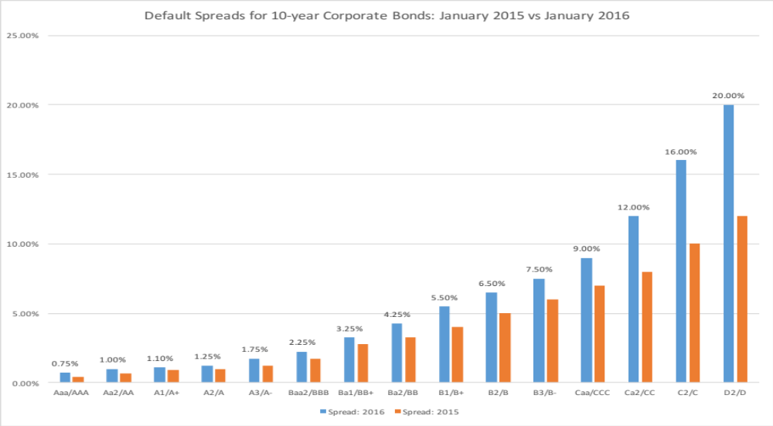
Default Spreads – January 2016
Notes:
This table should be updated frequently and should have current default spreads in it. These will be the spreads you use for your synthetic ratings today.

Slide 112
6 Application Test: Estimating a Cost of Debt
Based upon your firm’s current earnings before interest and taxes, its interest expenses, estimate
  An interest coverage ratio for your firm
  A synthetic rating for your firm (use the tables from prior pages)
  A pre-tax cost of debt for your firm
  An after-tax cost of debt for your firm
B FA page
PB Page 30-32
Notes:
To estimate the after-tax cost of debt, you need a marginal tax rate. Since the federal tax rate for corporations is 35%, I would expect the marginal tax rate to be 35% of higher for US companies. Thus, even if the effective tax rate reported in the financial statements are lower, I would use at least 35%. If the effective tax rate is higher than 35%, I would use the effective tax rate, with the assumption that it is capturing other taxes that the firm has to pay.

Slide 113
Weights for Cost of Capital Calculation
The weights used in the cost of capital computation should be market values.
There are three specious arguments used against market value
  Book value is more reliable than market value because it is not as volatile: While it is true that book value does not change as much as market value, this is more a reflection of weakness than strength
  Using book value rather than market value is a more conservative approach to estimating debt ratios: For most companies, using book values will yield a lower cost of capital than using market value weights.
  Since accounting returns are computed based upon book value, consistency requires the use of book value in computing cost of capital: While it may seem consistent to use book values for both accounting return and cost of capital calculations, it does not make economic sense.
In practical terms, estimating the market value of equity should be easy for a publicly traded firm, but some or all of the debt at most companies is not traded. As a consequence, most practitioners use the book value of debt as a proxy for the market value of debt.
Notes:
Assume that the market value debt ratio is 10%, while the book value debt ratio is 30%, for a firm with a cost of equity of 15% and an after-tax cost of debt of 5%. The cost of capital can be calculated as follows –
With market value debt ratios: 15% (.9) + 5% (.1) = 14%
With book value debt ratios: 15% (.7) + 5% (.3) = 12%
Which is the more conservative estimate?

Slide 114

Disney: From book value to market value for interest bearing debt…
In Disney’s 2013 financial statements, the debt due over time was footnoted.
Disney’s total debt due, in book value terms, on the balance sheet is $14,288 million and the total interest expense for the year was $349 million. Using 3.75% as the pre-tax cost of debt:
Estimated MV of Disney Debt =
Time due | Amount due | Weight | Weight *Maturity
0.5 | $1,452 | 11.96% | 0.06
2 | $1,300 | 10.71% | 0.21
3 | $1,500 | 12.36% | 0.37
4 | $2,650 | 21.83% | 0.87
6 | $500 | 4.12% | 0.25
8 | $1,362 | 11.22% | 0.9
9 | $1,400 | 11.53% | 1.04
19 | $500 | 4.12% | 0.78
26 | $25 | 0.21% | 0.05
28 | $950 | 7.83% | 2.19
29 | $500 | 4.12% | 1.19
 | $12,139 |  | 7.92
Notes:
We first consolidate all of the debt outstanding and obtain an face value weighted average maturity for the debt of 7.92 years.
We then compute the market value of debt, setting the book value = face value, the interest expense = coupon, the average maturity = debt maturity and the pre-tax cost of debt based on the synthetic rating as the cost of debt.
Alternatively, we can compute the market value of each debt item separately and add up the values.

Slide 115

Operating Leases at Disney
The “debt value” of operating leases is the present value of the lease payments, at a rate that reflects their risk, usually the pre-tax cost of debt.
The pre-tax cost of debt at Disney is 3.75%.
Debt outstanding at Disney = $13,028 + $ 2,933= $15,961 million
Disney reported $1,784 million in commitments after year 5. Given that their average commitment over the first 5 years, we assumed 5 years @ $356.8 million each.
Notes:
The pre-tax cost of debt was based upon Disney’s current rating.
Disney reports a lump sum as the amount due after year 6…. We break it up into annual payments based upon the average lease payments over the first 5 years…You could also use the year 5 payment as the basis for making this adjustment (Putting it all in year 6 will overstate the present value).
To get to the total market value of debt, we add the estimated market value of interest bearing debt to the present value of operating leases (already a market value number since you used the current pre-tax cost of borrowing to arrive at the value).

Slide 116
6 Application Test: Estimating Market Value
Estimate the
  Market value of equity at your firm and Book Value of equity
  Market value of debt and book value of debt (If you cannot find the average maturity of your debt, use 3 years): Remember to capitalize the value of operating leases and add them on to both the book value and the market value of debt.
Estimate the
  Weights for equity and debt based upon market value
  Weights for equity and debt based upon book value
B FA page
PB Page 33-35
Notes:
For most firms, the book debt ratio will be much higher than the market debt ratio. Using the book debt ratio will therefore yield a lower cost of capital (which undercuts the conservatism argument used by defenders of book value weights)

Slide 117
Current Cost of Capital: Disney
Equity
  Cost of Equity = Riskfree rate + Beta * Risk Premium = 2.75% + 1.0013 (5.76%) = 8.52%
  Market Value of Equity = $121,878 million
  Equity/(Debt+Equity ) = 88.42%
Debt
  After-tax Cost of debt =(Riskfree rate + Default Spread) (1-t)
  = (2.75%+1%) (1-.361) = 2.40%
  Market Value of Debt = $13,028+ $2933 = $ 15,961 million
  Debt/(Debt +Equity) = 11.58%
Cost of Capital = 8.52%(.8842)+ 2.40%(.1158) = 7.81%
121,878/ (121,878+15,961)
Notes:
This reproduces the current cost of capital computation for Disney, using market value weights for both debt and equity, the cost of equity (based upon the bottom-up beta) and the cost of debt (based upon the bond rating)
The market value of debt is estimated by estimating the present value of total interest payments and face value at the current cost of debt.
One way to frame the capital structure question: Is there a mix of debt and equity at which Disney’s cost of capital will be lower than 7.81%?

Slide 118


Divisional Costs of Capital: Disney and Vale
Disney
Vale
Notes:
For Disney, we used the division specific debt ratio weights we estimated earlier (when estimating the levered beta). We did assume that all divisions borrow at Disney’s pre-tax cost of debt. If the divisions issued debt independently, we would have considered using division-specific costs of debt.
For Vale, we used the same debt ratio and cost of debt for both divisions.
The cost of capital for Vale will be higher in $R, because we expect inflation to be 9% in $R and only 2% in US dollars.

Slide 119

Costs of Capital: Tata Motors, Baidu and Bookscape
To estimate the costs of capital for Tata Motors in Indian rupees:
  Cost of capital= 14.49% (1-.2928) + 6.50% (.2928) = 12.15%
For Baidu, we follow the same path to estimate a cost of equity in Chinese RMB:
  Cost of capital = 12.91% (1-.0523) + 3.45% (.0523) = 12.42%
For Bookscape, the cost of capital is different depending on whether you look at market or total beta:
For Almarai, the cost of capital is based upon the beta of 0.97 (bottom up) and a synthetic cost of debt 3.25%.
  Cost of capital = 8.96% (.825) + 3.25%(1-0) (.175) = 7.96%
Notes:
For Bookscape, the cost of capital is much higher for the undiversified owner than it is for a diversified investor in a similar company.

Slide 120
6 Application Test: Estimating Cost of Capital
Using the bottom-up unlevered beta that you computed for your firm, and the values of debt and equity you have estimated for your firm, estimate a bottom-up levered beta and cost of equity for your firm.
Based upon the costs of equity and debt that you have estimated, and the weights for each, estimate the cost of capital for your firm.
How different would your cost of capital have been, if you used book value weights?
Notes:
To go from unlevered to levered betas and then to the cost of capital, you have to
Define debt and compute market value
Compute the present value of operating leases
Compute the levered beta, using the market value of equity and the consolidated market value of debt (including lease commitmetns)
Compute the cost of capital, using the debt and equity weights.

Slide 121
Choosing a Hurdle Rate
Either the cost of equity or the cost of capital can be used as a hurdle rate, depending upon whether the returns measured are to equity investors or to all claimholders on the firm (capital)
If returns are measured to equity investors, the appropriate hurdle rate is the cost of equity.
If returns are measured to capital (or the firm), the appropriate hurdle rate is the cost of capital.
Notes:
While the cost of equity and capital can be very different numbers, they can both be used as hurdle rates, as long as the returns and cash flows are defined consistently.
If returns and cash flows are equity based (return on equity or cash flow to equity), the appropriate hurdle rate is the cost of equity.
If returns and cash flows are firm or operating asset based (return on capital or cashflows to firm), the appropriate hurdle rate is the cost of capital.

Slide 122
Back to First Principles
Notes:
Took us a while but we have the mechanics of the hurdle rate down..

Slide 123
Measuring Investment Returns
“Show me the money”
from Jerry Maguire
Notes:
If there is a theme to how we think about returns in corporate finance, this line from Jerry Maguire brings it home. We trust the concrete over the vague and cash flows over earnings.

Slide 124

First Principles
Notes:
The next section of the notes will focus on measuring returns on investments, provide an argument for why cash flows make more sense than earnings and weighing those cash flows and discuss how best to bring in side benefits and costs into the returns.

Slide 125
Measures of return: earnings versus cash flows
Principles Governing Accounting Earnings Measurement
  Accrual Accounting: Show revenues when products and services are sold or provided, not when they are paid for. Show expenses associated with these revenues rather than cash expenses.
  Operating versus Capital Expenditures: Only expenses associated with creating revenues in the current period should be treated as operating expenses. Expenses that create benefits over several periods are written off over multiple periods (as depreciation or amortization)
To get from accounting earnings to cash flows:
  you have to add back non-cash expenses (like depreciation)
  you have to subtract out cash outflows which are not expensed (such as capital expenditures)
  you have to make accrual revenues and expenses into cash revenues and expenses (by considering changes in working capital).
Notes:
Accrual accounting income is designed to measure the “income” made by an entity during a period, on sales made during the period. Thus, accrual accounting draws lines between operating expenses (that create income in the current period), financial expenses (expenses associated with the use of debt) and capital expenditures (which create income over multiple periods). It is not always consistent. R&D, for instance, is treated as an operating expense.
Accrual accounting also tries to allocate the cost of materials to current period revenues, leading to inventory, and give the company credit for sales made during the period, even if cash has not been received, giving rise to accounts receivable. In effect, adding in the change in working capital converts accrual earnings to cash earnings.

Slide 126
Measuring Returns Right: The Basic Principles
Use cash flows rather than earnings. You cannot spend earnings.
Use “incremental” cash flows relating to the investment decision, i.e., cashflows that occur as a consequence of the decision, rather than total cash flows.
Use “time weighted” returns, i.e., value cash flows that occur earlier more than cash flows that occur later.
The Return Mantra: “Time-weighted, Incremental Cash Flow Return”
Notes:
These are the basic financial principles underlying the measurement of investment returns.
We focus on cash flows, because when cash flows and earnings are different, cash flows provide a more reliable measure of what an investment generates.
We focus on “incremental” effects on the overall business, since we care about the overall health and value of the business, not just individual projects.
We use time-weighted returns, since returns made earlier are worth more than the same returns made later.

Slide 127
Earnings versus Cash Flows: A Disney Theme Park
The theme parks to be built near Rio, modeled on Euro Disney in Paris and Disney World in Orlando.
The complex will include a “Magic Kingdom” to be constructed, beginning immediately, and becoming operational at the beginning of the second year, and a second theme park modeled on Epcot Center at Orlando to be constructed in the second and third year and becoming operational at the beginning of the fourth year.
The earnings and cash flows are estimated in nominal U.S. Dollars.
Notes:
The earnings and cash flows will really be in Brazilian $R. We will consider later the effects of looking at all the cash flows in a different currency.
Note that this investment is not going to be fully operational until the fourth year.

Slide 128
Key Assumptions on Start Up and Construction
Disney has already spent $0.5 Billion researching the proposal and getting the necessary licenses for the park; none of this investment can be recovered if the park is not built. This expenditure has been capitalized and will be depreciated straight line over ten years to a salvage value of zero.
Disney will face substantial construction costs, if it chooses to build the theme parks.
  The cost of constructing Magic Kingdom will be $3 billion, with $ 2 billion to be spent right now, and $1 Billion to be spent one year from now.
  The cost of constructing Epcot II will be $ 1.5 billion, with $ 1 billion to be spent at the end of the second year and $0.5 billion at the end of the third year.
  These investments will be depreciated based upon a depreciation schedule in the tax code, where depreciation will be different each year.
Notes:
The emphasis in the second item should be on “already spent”.
While we often classify all these investments as “initial investments”, they occur over time. Companies seldom make large investments at an instant in time.
Also worth adding: Disney will fund this investment using the same mix of debt and equity that it uses for theme parks currently.

Slide 129

Step 1: Estimate Accounting Earnings on Project
Direct expenses: 60% of revenues for theme parks, 75% of revenues for resort properties
Allocated G&A: Company G&A allocated to project, based on projected revenues. Two thirds of expense is fixed, rest is variable.
Taxes: Based on marginal tax rate of 36.1%
Notes:
This shows the accounting earnings calculations for the next 10 years. Note the increasing after-tax operating income over time.
Note that loss in year 1. While this loss can be carried forward and offset against profits in future years, we have chosen to claim the losses against Disney’s profits from other projects in year 1. (You would rather save taxes now than the same taxes in the future…)
Where are the interest expenses? They do not show up because we are computing earnings to the firm - operating income - rather than earnings to equity - net income.

Slide 130

And the Accounting View of Return
Based upon book capital at the start of each year
Based upon average book capital over the year
Notes:
This converts the accounting income into a percentage return (to enable us to do the comparison to the hurdle rate, which is a percentage rate). We have computed a simple average return on capital over the next 10 years…
The average book value is computed each year using the beginning and ending book values. The book values themselves are computed as follows:
Ending BV = Beginning BV - Depreciation + Capital Expenditures

Slide 131
Estimating a hurdle rate for Rio Disney
We did estimate a cost of capital of 6.61% for the Disney theme park business, using a bottom-up levered beta of 0.7537 for the business.
This cost of equity may not adequately reflect the additional risk associated with the theme park being in an emerging market.
The only concern we would have with using this cost of equity for this project is that it may not adequately reflect the additional risk associated with the theme park being in an emerging market (Brazil). We first computed the Brazil country risk premium (by multiplying the default spread for Brazil by the relative equity market volatility) and then re-estimated the cost of equity:
  Country risk premium for Brazil = 5.5%+ 3% = 8.5%
  Cost of Equity in US$= 2.75% + 0.7537 (8.5%) = 9.16%
Using this estimate of the cost of equity, Disney’s theme park debt ratio of 10.24% and its after-tax cost of debt of 2.40% (see chapter 4), we can estimate the cost of capital for the project:
  Cost of Capital in US$ = 9.16% (0.8976) + 2.40% (0.1024) = 8.46%
Notes:
Here is the other half of the equation:
The hurdle rate for an investment should reflect its risk. (That is why we use the bottom-up beta that we estimated for theme parks earlier rather than the bottom-up beta for Disney as a company). In addition, the exposure to country risk is incorporated into the investment.
We use Disney’s theme park debt ratio for this theme park, on the assumption that it is not a stand-alone investment with its own debt capacity. If it were, we would have considered using project specific financing weights. (It is usually not a good idea to compute the cost of capital for a project based on how it is financed, since firms can use disproportionate amounts of debt on some projects not because the projects can afford to carry debt but because they (the firms) have excess debt capacity.

Slide 132
Would lead us to conclude that...
Do not invest in this park. The return on capital of 4.18% is lower than the cost of capital for theme parks of 8.46%; This would suggest that the project should not be taken.
Given that we have computed the average over an arbitrary period of 10 years, while the theme park itself would have a life greater than 10 years, would you feel comfortable with this conclusion?
  Yes
  No
Notes:
I would not. I think the accounting return, which cuts off the analysis arbitrarily after 10 years, understates the true return on projects like this one, which have longer expected lives.
In general, while firms claim that using the same life for all projects is not discriminatory, it clearly creates a bias against longer term projects.

Slide 133

A Tangent: From New to Existing Investments: ROC for the entire firm
How “good” are the existing investments of the firm?
Measuring ROC for existing investments..
Notes:
A firm can be viewed as having a portfolio of existing projects. This approach allows you to assess whether that portfolio is earning more than the hurdle rate, but it is based upon the following assumptions:
Accounting earnings are a good measure of the earnings from current projects (They might not be, if items like R&D, which are really investments for the future, extraordinary profits or losses, or accounting changes affect the reported income.)
The book value of capital is a good measure of what is invested in current projects.
Some computational details:
Why do we use book value of debt and equity?
Because we want to focus on capital invested in assets in place. Market value has two problems. It includes growth assets and it updates the value to reflect returns earned. In fact, if you computed market value of just assets in place correctly, you should always earn your cost of capital.
Why end of last year?
To stay consistent with end-of-the-year cash flows and earnings that we use in the rest of the analysis. If we used mid-year conventions, we could use average values instead.

Slide 134
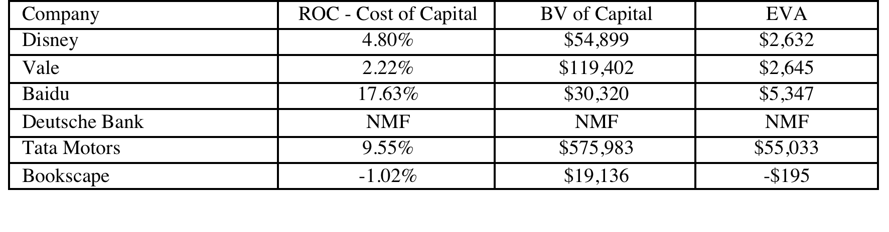
Old wine in a new bottle.. Another way of presenting the same results…
The key to value is earning excess returns. Over time, there have been attempts to restate this obvious fact in new and different ways. For instance, Economic Value Added (EVA) developed a wide following in the the 1990s:
EVA = (ROC – Cost of Capital ) (Book Value of Capital Invested)
The excess returns for the four firms can be restated as follows:
Notes:
The EVA is a measure of dollar value created in a single time period. Thus, it will be affected by how capital is measured and the ups and downs of year-to-year operating income.
EVA just restates the excess returns (ROC – Cost of capital) in dollar value terms. Thus, it will always have the same sign as the excess return, but it will be larger for larger companies. Thus, you cannot compare the EVA across companies but you can compare the EVA for the same company from year to year.

Slide 135
6 Application Test: Assessing Investment Quality
For the most recent period for which you have data, compute the after-tax return on capital earned by your firm, where after-tax return on capital is computed to be
After-tax ROC = EBIT (1-tax rate)/ (BV of debt + BV of Equity-Cash)previous year
For the most recent period for which you have data, compute the return spread earned by your firm:
Return Spread = After-tax ROC - Cost of Capital
For the most recent period, compute the EVA earned by your firm
EVA = Return Spread * ((BV of debt + BV of Equity-Cash)previous year
B FA Page
PB Page 36-39
Notes:
This measure of investment quality is only as good as the measures of operating income and book value that go into it.
Note also that:
A negative EVA in a single period should not be taken as an indicator that the company is a bad or poorly managed company. It may reflect the fact that the firm had a bad year or that macro economic variables conspired to reduce operating income in that period (a recession for a cyclical firm, a downturn in commodity prices for a commodity company).
Even a string of negative EVAs may not be an indicator of a poorly run firm or business. Young businesses and infrastructure companies often have negative EVAs for extended periods (while they are building up infrastructure) before they turn positive.

Slide 136
The cash flow view of this project..
 | 0 | 1 | 2 | 3 | 4 | 5 | 6 | 7 | 8 | 9 | 10
After-tax Operating Income |  | -$32 | -$96 | -$54 | $68 | $202 | $249 | $299 | $352 | $410 | $421
+ Depreciation & Amortization | $0 | $50 | $425 | $469 | $444 | $372 | $367 | $364 | $364 | $366 | $368
- Capital Expenditures | $2,500 | $1,000 | $1,188 | $752 | $276 | $258 | $285 | $314 | $330 | $347 | $350
- Change in non-cash Work Capital |  | $0 | $63 | $25 | $38 | $31 | $16 | $17 | $19 | $21 | $5
Cashflow to firm | ($2,500) | ($982) | ($921) | ($361) | $198 | $285 | $314 | $332 | $367 | $407 | $434
To get from income to cash flow, we
added back all non-cash charges such as depreciation. Tax benefits:
subtracted out the capital expenditures
subtracted out the change in non-cash working capital
 | 1 | 2 | 3 | 4 | 5 | 6 | 7 | 8 | 9 | 10
Depreciation | $50 | $425 | $469 | $444 | $372 | $367 | $364 | $364 | $366 | $368
Tax Bendfits from Depreciation | $18 | $153 | $169 | $160 | $134 | $132 | $132 | $132 | $132 | $133
Notes:
This converts earnings to cash flows.
Depreciation and amortization are just two of the most common non-cash charges.
Any capital expenditures (whether initial or maintenance) need to be subtracted out.
It is only the change in non-cash working capital that needs to be subtracted out.

Slide 137

The incremental cash flows on the project
$ 500 million has already been spent & $ 50 million in depreciation will exist anyway
2/3rd of allocated G&A is fixed.
Add back this amount (1-t)
Tax rate = 36.1%
Notes:
A sunk cost is any cost that has already been incurred and will not be recovered even if the project under consideration is rejected.
The tax savings on the depreciation on the sunk cost is also subtracted out, since that tax savings would accrue to the firm even if it did not take this investment.
Only the after-tax amount of the non-incremental allocated costs are added back because the cash flows are after-tax cash flows.
Alternatively, the cash flows can be estimated from scratch using only the incremental cash flows.

Slide 138
To Time-Weighted Cash Flows
Net Present Value (NPV): The net present value is the sum of the present values of all cash flows from the project (including initial investment).
  NPV = Sum of the present values of all cash flows on the project, including the initial investment, with the cash flows being discounted at the appropriate hurdle rate (cost of capital, if cash flow is cash flow to the firm, and cost of equity, if cash flow is to equity investors)
  Decision Rule: Accept if NPV > 0
Internal Rate of Return (IRR): The internal rate of return is the discount rate that sets the net present value equal to zero. It is the percentage rate of return, based upon incremental time-weighted cash flows.
  Decision Rule: Accept if IRR > hurdle rate
Notes:
Cash flows across time cannot be compared. Discounting brings cash flows back to the same point in time.
The present value factors are in a sense time-weighing factors. The riskier a cash flow and the further it is in the future, the lower the weight you attach to that cash flow.

Slide 139
Closure on Cash Flows
In a project with a finite and short life, you would need to compute a salvage value, which is the expected proceeds from selling all of the investment in the project at the end of the project life. It is usually set equal to book value of fixed assets and working capital
In a project with an infinite or very long life, we compute cash flows for a reasonable period, and then compute a terminal value for this project, which is the present value of all cash flows that occur after the estimation period ends..
Assuming the project lasts forever, and that cash flows after year 10 grow 2% (the inflation rate) forever, the present value at the end of year 10 of cash flows after that can be written as:
  Terminal Value in year 10= CF in year 11/(Cost of Capital - Growth Rate)
  =715 (1.02) /(.0846-.02) = $ 11,275 million
Notes:
When you stop estimating cash flows on a project, you have to either estimate salvage value or terminal value. For projects with finite lives (such as buying a plant or equipment), estimating salvage value is appropriate. For projects with very long lives, estimating a terminal value is more reasonable.
If you assume that the project is liquidated, any investments in working capital have to be salvaged. This does not necessarily mean that you will get 100% back.
A terminal value can also be thought off as the value that you would get by selling this project (as an on-going project) to someone else at the end of the analysis. In this case, we are estimating that the theme park in Bangkok will be worth $ 10,669 million at the end of year 10. (The perpetual growth model gives the value of the asset at the beginning of the year of the cash flow. We used year 11 cash flows in the numerator and have the terminal value as of the start of year 11, which is also the end of year 10)

Slide 140

Which yields a NPV of..
Discounted at Rio Disney cost of capital of 8.46%
Notes:
This is the net present value calculation using the cost of capital of 8.62%, the theme park cost of capital adjusted for emerging market risk in Brazil.

Slide 141
The IRR of this project
Notes:
This is a net present value profile, where NPV is plotted against discount rates. The IRR is that discount rate at which NPV is zero.
The steepness of the slope tells us something about how sensitive this investment is to changes in the discount rate. (It is the equivalent of the duration of a bond, which tells you how sensitive bond prices are to changes in interest rates).
Notice that the NPV is much more sensitive to changes in discount rates, when discount rates are low, than when they are high. (This may have consequences for how value will change in low interest rate scenarios as opposed to high interest rate ones).

Slide 142
Does the currency matter?
The analysis was done in dollars. Would the conclusions have been any different if we had done the analysis in Brazilian Reais?
  Yes
  No
Notes:
No. It should not. A good project should be good in any currency. But showing this in practice requires us to make some key assumptions about how exchange rates will evolve over time.

Slide 143
Disney Theme Park: $R NPV
  Expected Exchange Rate_{t}
  = Exchange Rate today * (1.09/1.02)^{t}
Discount at $R cost of capital
= (1.0846) (1.09/1.02) – 1 = 15.91%
Year | Cashflow ($) | $R/$ | Cashflow ($R) | Present Value
0 | -R$ 2,000.00 | R$ 2.35 | -R$ 4,700.00 | -R$ 4,700.00
1 | -R$ 1,000.00 | R$ 2.51 | -R$ 2,511.27 | -R$ 2,166.62
2 | -R$ 859.03 | R$ 2.68 | -R$ 2,305.29 | -R$ 1,715.95
3 | -R$ 267.39 | R$ 2.87 | -R$ 766.82 | -R$ 492.45
4 | R$ 340.22 | R$ 3.06 | R$ 1,042.63 | R$ 577.68
5 | R$ 466.33 | R$ 3.27 | R$ 1,527.21 | R$ 730.03
6 | R$ 516.42 | R$ 3.50 | R$ 1,807.31 | R$ 745.36
7 | R$ 555.08 | R$ 3.74 | R$ 2,075.89 | R$ 738.63
8 | R$ 614.95 | R$ 4.00 | R$ 2,457.65 | R$ 754.45
9 | R$ 681.46 | R$ 4.27 | R$ 2,910.36 | R$ 770.81
10 | R$ 11,989.85 | R$ 4.56 | R$ 54,719.84 | R$ 12,503.50
 |  |  |  | R$ 7,745.43
NPV = R$ 7,745/2.35= $ 3,296 Million
NPV is equal to NPV in dollar terms
Notes:
The NPV is identical because what we lose by using a higher discount rate is exactly offset by what we gain in growth in the cash flows.
If you are not consistent about estimating the cash flows and the discount rates, the net present values may deviate but only because you have brought your point of view on the currency into the analysis.

Slide 144
Uncertainty in Project Analysis: What can we do?
Based on our expected cash flows and the estimated cost of capital, the proposed theme park looks like a very good investment for Disney. Which of the following may affect your assessment of value?
  Revenues may be over estimated (crowds may be smaller and spend less)
  Actual costs may be higher than estimated costs
  Tax rates may go up
  Interest rates may rise
  Risk premiums and default spreads may increase
  All of the above
How would you respond to this uncertainty?
  Will wait for the uncertainty to be resolved
  Will not take the investment
  Ignore it.
  Other
Notes:
All of the above will affect the actual value of the project. However, note that if your estimates are unbiased, there should be almost a good a chance that the outcome will be better than expected rather than worse than expected.
The uncertainty will never be resolved (new uncertainties will creep up) and if you do wait, you will never invest. The only two choices are to ignore it, arguing that the discount rate already reflects your uncertainty or to try to at least get a better handle on uncertainty before you make your final decision.

Slide 145
One simplistic solution: See how quickly you can get your money back…
If your biggest fear is losing the billions that you invested in the project, one simple measure that you can compute is the number of years it will take you to get your money back.
Year | Cash Flow | Cumulated CF | PV of Cash Flow | Cumulated DCF
0 | -$2,000 | -$2,000 | -$2,000 | -$2,000
1 | -$1,000 | -$3,000 | -$922 | -$2,922
2 | -$859 | -$3,859 | -$730 | -$3,652
3 | -$267 | -$4,126 | -$210 | -$3,862
4 | $340 | -$3,786 | $246 | -$3,616
5 | $466 | -$3,320 | $311 | -$3,305
6 | $516 | -$2,803 | $317 | -$2,988
7 | $555 | -$2,248 | $314 | -$2,674
8 | $615 | -$1,633 | $321 | -$2,353
9 | $681 | -$952 | $328 | -$2,025
10 | $715 | -$237 | $317 | -$1,708
11 | $729 | $491 | $298 | -$1,409
12 | $743 | $1,235 | $280 | -$1,129
13 | $758 | $1,993 | $264 | -$865
14 | $773 | $2,766 | $248 | -$617
15 | $789 | $3,555 | $233 | -$384
16 | $805 | $4,360 | $219 | -$165
17 | $821 | $5,181 | $206 | $41
Payback = 10.3 years
Discounted Payback = 16.8 years
Notes:
There are some decision makers who use payback as a decision rule. In other words, any investment that pays off in less than X years is a good investment. That strikes us as dangerous for many reasons. Payback asks and answers a very narrow question, which is when you make your initial investment back. Once that happens, we lose interest in the project, no matter how large or small the cash flows are after that.
Payback does offer more promise as a risk measure, especially in long term projects where you are concerned about whether the project will last as long as you thought and the cash flows in the later years. In more practical terms, you may accept only those investments that have positive NPV and pay off in less than X years.

Slide 146
A slightly more sophisticated approach: Sensitivity Analysis & What-if Questions…
The NPV, IRR and accounting returns for an investment will change as we change the values that we use for different variables.
One way of analyzing uncertainty is to check to see how sensitive the decision measure (NPV, IRR..) is to changes in key assumptions. While this has become easier and easier to do over time, there are caveats that we would offer.
Caveat 1: When analyzing the effects of changing a variable, we often hold all else constant. In the real world, variables move together.
Caveat 2: The objective in sensitivity analysis is that we make better decisions, not churn out more tables and numbers.
  Corollary 1: Less is more. Not everything is worth varying…
  Corollary 2: A picture is worth a thousand numbers (and tables).
Notes:
It is natural to ask what-if questions about a project once an analysis is complete.
Given how easy it is today to do sensitivity analysis, it is important that we focus only on the most important variables. Doing sensitivity analysis on too many minor variables may draw attention away from the key factors underlying the conclusion.
It is probably a good idea to also focus on variables where you have some effect over the outcome. Thus, asking what will happen if competition increases and margins shrink is useful, since you may be able to increase advertising and fight off the competition but working out what will happen if the economy goes into a recession will yield little of value (unless it affects how much you borrow to fund the investment.)

Slide 147

And here is a really good picture…
Notes:
A good way to show the effects of sensitivity analysis is with a graph and a good graph tells a story. This is one of my all-time favorites, from a book on charting by Edward Tufte (The Visual Display of Information)…
This graph shows the size of Napoleon’s army on his ill-fated attempt to invade Russia on one axis and the temperature on the other. It tells the story without any text… Note that the army shrinks on its way back from Moscow as temperatures drop below freezing.

Slide 148



The final step up: Incorporate probabilistic estimates.. Rather than expected values..
Actual Revenues as % of Forecasted Revenues (Base case = 100%)
Country Risk Premium (Base Case = 3% (Brazil))
Operating Expenses at Parks as % of Revenues (Base Case = 60%)
Notes:
The key to doing simulations is
Picking the variables that you want to use probability distributions for (Hint: Don’t pick every input. Choose only the key inputs)
Choosing the type of distribution to use for each input (Review your probability distributions... And the paper I have on my site on how to pick the right one)
Estimating the parameters of the distribution (Use both historical and industry wide data…)

Slide 149

The resulting simulation…
Average = $3.40 billion
Median = $3.28 billion
NPV ranges from -$1 billion to +$8.5 billion. NPV is negative 12% of the time.
Notes:
This is the output from 100,000 simulations. I used Crystal Ball.
The average should be close to your base case value, though it will not be identical because of the distributional assumptions. The key issues are the spread in the distribution and the probability that the number is a negative value…. You also have the best and worst case scenarios embedded in the distribution.
Here are some questions that you can answer:
What is the likelihood that this is a bad investment? (A little less than 10%)
What are your best case and worst case scenarios? (About $8.5 billion and - $1 billion)
If you are planning on using risk hedging, you can see the effect on the distribution.

Slide 150
A side bar: Should you hedge risks?
Disney can reduce the risk in this project by hedging against exchange rate risk. Should it?
Yes
No
Maybe
Notes:
If it hedges exchange rate risk, the distribution of NPV will get tighter but the NPV will decrease by the cost of hedging. If the investors in Disney could have done the hedging themselves (either in the course of diversification or by hedging using derivatives), this will reduce value.

Slide 151

Notes:
You should hedge only after you have checked not just your options on the issue but your investors’ options.

Slide 152
A final thought: Side Costs and Benefits
Most projects considered by any business create side costs and benefits for that business.
  The side costs include the costs created by the use of resources that the business already owns (opportunity costs) and lost revenues for other projects that the firm may have.
  The benefits that may not be captured in the traditional capital budgeting analysis include project synergies (where cash flow benefits may accrue to other projects) and options embedded in projects (including the options to delay, expand or abandon a project).
The returns on a project should incorporate these costs and benefits.
Notes:
These costs and benefits should be incorporated, but that is easier said than done.
Some projects deliver most of their benefits indirectly…For instance, a Disney animated movie will often make four times as much revenue for Disney from merchandise sales and theme park revenues as it does in gate receipts. Thus, this is not a minor issue.

Slide 153

First Principles
Notes:
Reviewing the big picture…

Slide 154
Capital Structure: The Choices and the Trade off
“Neither a borrower nor a lender be”
Someone who obviously hated this part of corporate finance
Notes:
There is a deep seated feeling, reinforced by centuries of religious edicts, that good people do not borrow and that only the craven and the weak borrow to fund their businesses. In corporate finance, we take a much more sanguine view of debt. It is just another way of raising capital to fund a business. It is no more or less sinful that using equity…

Slide 155

First Principles
Notes:
We shift from the investment principle to the financing principle.

Slide 156
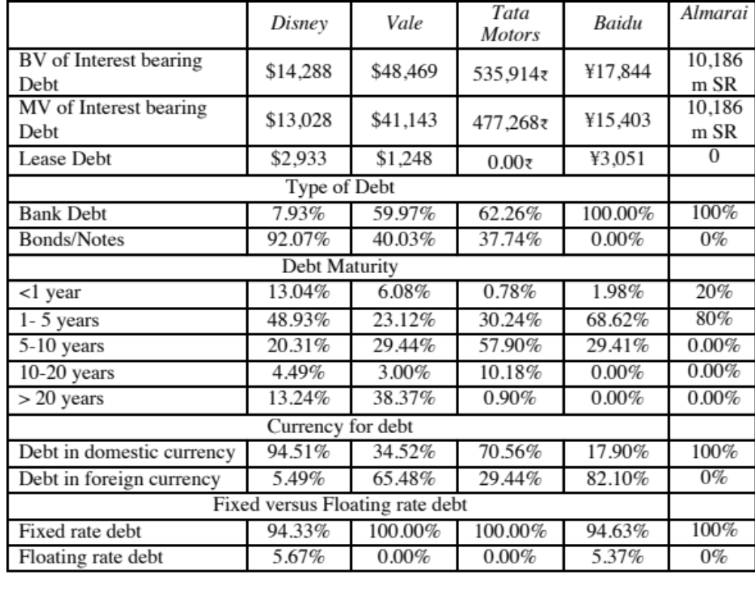
Assessing the existing financing choices: Disney, Vale, Tata Motors & Baidu
Notes:
Disney used the corporate bond market much more extensively than the other companies in this group, with 92% of its debt coming from bonds rather than bank loans.
While Disney has the higher proportion of short term debt of the three companies, it also has some very long term debt. That may also be a reflection of its use of the bond market, since banks, especially in emerging markets, may be unwilling to commit to long term loans.
Disney and Tata Motors both use floating rate debt, but only to a limited extent.
Disney & Tata Motors borrow predominantly in their domestic currencies. Vale and Baidu have most of their debt in foreign currencies.

Slide 157

Debt: Summarizing the trade off
Notes:
Brings together the costs and the benefits of debt, with the implications.

Slide 158

The Trade off for Disney, Vale, Tata Motors and Baidu
Notes:
None of these firms seems like a candidate for a really high debt ratio. With each firm, one or another cost gets in the way.
For Disney, the biggest impediments to borrowing more are the variability of its income and the fact that its assets are mostly “intangible” and difficult to monitor.
For Aracruz, it is the variability in paper prices.
For Tata Chemicals, it is the cross holding structure and the fear that the debt will be channeled to other subsidiaries.
Notwithstanding these issues, I would expect Disney to have more debt than other entertainment companies because it is larger and more diverse than its competitors. I would also expect to see significant debt on both Tata’s and Aracruz’s balance sheets, given the tax benefits.

Slide 159
Debt in a zero tax setting?
If you get no tax savings from debt, the tax benefit of debt becomes zero. If it is zero, there is little good that can come from borrowing and lots of bad.
So, the logical conclusion is that a company in a zero tax rate locale should never borrow.
Almarai borrows money. Why?

Slide 160
6Application Test: Would you expect your firm to gain or lose from using debt?
Consider, for your firm,
  The potential tax benefits of borrowing
  The benefits of using debt as a disciplinary mechanism
  The potential for expected bankruptcy costs
  The potential for agency costs
  The need for financial flexibility
Would you expect your firm to have a high debt ratio or a low debt ratio?
Does the firm’s current debt ratio meet your expectations?
Notes:
This is just a qualitative analysis. It will not give you a specific optimal debt ratio but provides insight into why the firm may be using the financing mix that it is today.

Slide 161
A Hypothetical Scenario
Assume that you live in a world where
  (a) There are no taxes
  (b) Managers have stockholder interests at heart and do what’s best for stockholders.
  (c) No firm ever goes bankrupt
  (d) Equity investors are honest with lenders; there is no subterfuge or attempt to find loopholes in loan agreements.
  (e) Firms know their future financing needs with certainty
Benefits of debt | Costs of debt
Tax benefits | Expected Bankruptcy Cost
Added Discipline | Agency Costs
 | Need for financial flexibility
Notes:
Assume that you super impose these assumptions on the balance sheet on the previous page. The advantages of debt go to zero, as do the disadvantages. Under such a scenario, firms should be indifferent to issuing debt.

Slide 162
The Miller-Modigliani Theorem
In an environment, where there are no taxes, default risk or agency costs, capital structure is irrelevant.
In this world,
  Leverage is irrelevant. A firm's value will be determined by its project cash flows.
  The cost of capital of the firm will not change with leverage. As a firm increases its leverage, the cost of equity will increase just enough to offset any gains to the leverage
Notes:
With the assumptions on the previous page:
The cost of capital will remain unchanged as the debt ratio changes
The value of the firm will not be a function of leverage
Investment decisions can be made independently of financing decisions
Note that if we allow for tax benefits, and keep the other assumptions, the optimal debt ratio will go to 100%.

Slide 163
Pathways to the Optimal
The Cost of Capital Approach: The optimal debt ratio is the one that minimizes the cost of capital for a firm.
The Sector Approach: The optimal debt ratio is the one that brings the firm closes to its peer group in terms of financing mix.
Notes:
We will look at all the approaches, other than APV, though they may yield different results.

Slide 164
I. The Cost of Capital Approach
Value of a Firm = Present Value of Cash Flows to the Firm, discounted back at the cost of capital.
If the cash flows to the firm are held constant, and the cost of capital is minimized, the value of the firm will be maximized.
Notes:
This is the conventional valuation model for a firm.
If the cash flows are the same, and the discount rate is lowered, the present value has to go up. (The key is that cash flows have to remain the same. If this is not true, then minimizing cost of capital may not maximize firm value)

Slide 165


Applying Cost of Capital Approach: The Textbook Example
Notes:
This is a simple example, where both the costs of debt and equity are given. The firm has cash flows, before debt and after taxes and reinvestment, of $200 million and is in stable growth (growing 3% a year). Note that both increase as the debt ratio goes up, but the cost of capital becomes lower at least initially as you take on more debt ( because you are substituting in cheaper debt for more expensive equity)
At 40%, the cost of capital is minimized. It is the optimal debt ratio.
To get firm value, we used the same cash flow ($200 million) and same growth rate and changed the cost of capital.

Slide 166

The U-shaped Cost of Capital Graph…
Notes:
Really adds nothing to the previous page.. But it is in every text book… the famous U-shaped cost of capital graph..
If you had this graph available to you, the optimal capital structure would be obvious. In most firms, all we know at the time we begin the analysis is one point on the graph - the current cost of capital. Our challenge is fleshing out the rest of the graph.

Slide 167

Current Cost of Capital: Disney
The beta for Disney’s stock in November 2013 was 1.0013. The T. bond rate at that time was 2.75%. Using an estimated equity risk premium of 5.76%, we estimated the cost of equity for Disney to be 8.52%:
Cost of Equity = 2.75% + 1.0013(5.76%) = 8.52%
Disney’s bond rating in May 2009 was A, and based on this rating, the estimated pretax cost of debt for Disney is 3.75%. Using a marginal tax rate of 36.1, the after-tax cost of debt for Disney is 2.40%.
After-Tax Cost of Debt = 3.75% (1 – 0.361) = 2.40%
The cost of capital was calculated using these costs and the weights based on market values of equity (121,878) and debt (15.961):
Cost of capital =
Notes:
The one point we do know for Disney…
This reproduces the current cost of capital computation for Disney, using market value weights for both debt and equity, the cost of equity (based upon the bottom-up beta) and the cost of debt (based upon the bond rating)
The market value of debt is estimated by estimating the present value of total interest payments and face value at the current cost of debt.
One way to frame the capital structure question: Is there a mix of debt and equity at which Disney’s cost of capital will be lower than 7.81%?

Slide 168
Mechanics of Cost of Capital Estimation
1. Estimate the Cost of Equity at different levels of debt:
  Equity will become riskier -> Beta will increase -> Cost of Equity will increase.
  Estimation will use levered beta calculation
2. Estimate the Cost of Debt at different levels of debt:
  Default risk will go up and bond ratings will go down as debt goes up -> Cost of Debt will increase.
  To estimating bond ratings, we will use the interest coverage ratio (EBIT/Interest expense)
3. Estimate the Cost of Capital at different levels of debt
4. Calculate the effect on Firm Value and Stock Price.
Notes:
The basic inputs for computing cost of capital are cost of equity and cost of debt. This summarizes the basic approach we will use to estimate each.

Slide 169

I. Cost of Equity
Levered Beta = 0.9239 (1 + (1- .361) (D/E))
Cost of equity = 2.75% + Levered beta * 5.76%
Notes:
This reproduces the levered beta, using the formula developed during the risk and return section. The unlevered beta of 1.0674 is the bottom-up unlevered beta.
Beta_{Levered} = Unlevered Beta (1 + (1-t) (Debt/Equity Ratio)) In calculating the levered beta in this table, we assumed that all market risk is borne by the equity investors; this may be unrealistic especially at higher levels of debt. We will also consider an alternative estimate of levered betas that apportions some of the market risk to the debt:
β_{levered} = β_{u} [1+(1-t)D/E] - β_{debt} (1-t) D/E
The beta of debt is based upon the rating of the bond and is estimated by regressing past returns on bonds in each rating class against returns on a market index. The levered betas estimated using this approach will generally be lower than those estimated with the conventional model

Slide 170

II. Bond Ratings, Cost of Debt and Debt Ratios
Notes:
This is the completed schedule of interest coverage ratios, ratings and costs of debt at different debt ratios ranging up to 90%.
It is significant that EBITDA not change as the debt ratio goes up. The reason is that the new debt is not used to make the firm larger by taking new projects, but to buy back equity. (This isolates the effect of the financing decision on the value of the firm)
We are being simplistic in assuming that the interest coverage ratio solely determines the ratings. We could use more than one ratio, create a consolidated score (like the Altman Z score) and make the rating a function of this score.
Note that the effective tax rate decreases after the 80% debt ratio. That is because we have insufficient income to cover the entire interest expense beyond that point. (EBIT < Interest Expenses) We therefore lose some of the tax advantage of borrowing.

Slide 171

Disney’s cost of capital schedule…
Notes:
Summarizes the cost of equity and debt from prior pages, as well as the cost of capital at different debt ratios.
If the objective is to minimize cost of capital, it occurs at 30 and 40%... We did try for a more precise answer by working in 1% increments and arrived at an optimal of 43% with a cost of capital of 7.28%. (We moved in 1% increments from 30% top 50%)
This will maximize firm value, if operating cashflow (EBITDA) is unaffected by changes in leverage and the consequent changes in ratings. (In other words, we are assuming no indirect bankruptcy costs… If we did, the optimal might be affected, especially if it is at low rating).

Slide 172
The cost of capital approach suggests that Disney should do the following…
Disney currently has $15.96 billion in debt. The optimal dollar debt (at 40%) is roughly $55.1 billion. Disney has excess debt capacity of 39.14 billion.
To move to its optimal and gain the increase in value, Disney should borrow $ 39.14 billion and buy back stock.
Given the magnitude of this decision, you should expect to answer three questions:
  Why should we do it?
  What if something goes wrong?
  What if we don’t want (or cannot ) buy back stock and want to make investments with the additional debt capacity?
Notes:
The cost of capital approach holds investments constant and changes the financial mix to see the effect on the cost of capital. Consequently, the recommendation that flows out of it is a recapitalization: borrow money and buy back stock to increase the debt ratio or issue stock and repay debt to lower the debt ratio.

Slide 173
I. Why should we do this?
In this approach, we start with the current market value and isolate the effect of changing the capital structure on the cash flow and the resulting value.
  Enterprise Value before the change = $133,908 million
  Cost of financing Disney at existing debt ratio = $ 133,908 * 0.0781 = $10,458 million
  Cost of financing Disney at optimal debt ratio = $ 133,908 * 0.0716 = $ 9,592 million
  Annual savings in cost of financing = $10,458 million – $9,592 million = $866 million
  Enterprise value after recapitalization
  = Existing enterprise value + PV of Savings = $133,908 + $19,623 = $153,531 million
Notes:
The reduction in the cost of capital translates into annual savings. Most of these savings are implicit, being savings in the cost of equity. Thus, the firm’s accounting earnings will not reflect these savings directly.
These savings can be converted into a present value by discounting back at the new cost of capital.
It is more realistic to assume growth in firm value. A simple way to estimate what the current growth attributed to the firm by the market is to estimate it using the firm value today, the free cash flow to the firm and the current cost of capital.
Note that the simple valuation formula used above assumes stable growth forever. For high growth firms, this formula will yield an implied growth rate that is too high (It will be very close to the cost of capital). In those cases, it is better to put a cap on the growth rate of around the risk free rate.
In this case, maximizing firm value also maximizes stock price, because we assume that
Debt is refinanced at current market rates, thus protecting bondholders
Markets are rational and efficient.

Slide 174
2. What if something goes wrong?
The Downside Risk
Doing What-if analysis on Operating Income
  A. Statistical Approach
    Standard Deviation In Past Operating Income
    Reduce Base Case By One Standard Deviation (Or More)
  B. “Economic Scenario” Approach
    Look At What Happened To Operating Income During The Last Recession. (How Much Did It Drop In % Terms?)
    Reduce Current Operating Income By Same Magnitude
Constraint on Bond Ratings
Notes:
This analysis is based upon the firm continuing as a going concern. To the extent that more debt can put this survival at risk, it is important to do “what-if” analyses or build in survival constraints into the analysis.

Slide 175

Disney’s Operating Income: History
Recession Decline in Operating Income
2009 Drop of 23.06%
2002 Drop of 15.82%
1991 Drop of 22.00%
1981-82 Increased by 12%
Worst Year Drop of 29.47%
Standard deviation in % change in EBIT = 19.17%
Notes:
These are percentage changes in operating income at Disney.

Slide 176

Disney: Safety Buffers?
Notes:
Disney’s optimal debt ratio is robust and survives up to a 30% drop in EBIT, which is worse than their worst year in the last three decades.

Slide 177
Constraints on Ratings
Management often specifies a 'desired rating' below which they do not want to fall.
The rating constraint is driven by three factors
  it is one way of protecting against downside risk in operating income (so do not do both)
  a drop in ratings might affect operating income
  there is an ego factor associated with high ratings
Caveat: Every rating constraint has a cost.
  The cost of a rating constraint is the difference between the unconstrained value and the value of the firm with the constraint.
  Managers need to be made aware of the costs of the constraints they impose.
Notes:
Rating constraints are one way of buffering your analysis against the assumption that operating income will not change as leverage changes. If the operating income will suffer when ratings fall below a certain point (say BBB or investment grade), it makes sense to build in that constraint into the analysis.
When managers brag about their high ratings, the questions that should come up are whether the high rating is paying off in terms of higher operating income, and if not, how much stockholders are paying for managers’ bragging rights.

Slide 178
Ratings Constraints for Disney
At its optimal debt ratio of 40%, Disney has an estimated rating of A.
If managers insisted on a AA rating, the optimal debt ratio for Disney is then 30% and the cost of the ratings constraint is fairly small:
  Cost of AA Rating Constraint = Value at 40% Debt – Value at 30% Debt = $153,531 m – $147,835 m = $ 5,696 million
If managers insisted on a AAA rating, the optimal debt ratio would drop to 20% and the cost of the ratings constraint would rise:
  Cost of AAA rating constraint = Value at 40% Debt – Value at 20% Debt = $153,531 m – $141,406 m = $ 12,125 million
Notes:
This may be overstated, since it is based upon the assumption that operating income is unaffected by the change in ratings. To the degree that Disney’s operating income will drop if its rating drops below BBB, this will overstate the cost of the constraint.
This process can be modified to allow for other constraints. For instance, some firms do not want their book value debt ratios to rise above a certain level (say, industry averages). In other cases, existing bond covenants may restrict a financial ratio from exceeding a specified number.

Slide 179
3. What if you do not buy back stock..
The optimal debt ratio is ultimately a function of the underlying riskiness of the business in which you operate and your tax rate.
Will the optimal be different if you invested in projects instead of buying back stock?
  No. As long as the projects financed are in the same business mix that the company has always been in and your tax rate does not change significantly.
  Yes, if the projects are in entirely different types of businesses or if the tax rate is significantly different.
Notes:
The analysis is built on the assumption that debt is used to buy back stock. Many firms would rather use the debt to take projects, or might be barred from buying back stock (as is the case in markets like Germany)
If we assume that projects in the same line of business have the same cash flow generating capacity as the current firm (EBITDA/Firm Value), the optimal debt ratio will remain unchanged, but the optimal dollar debt will be a much higher number. (This analysis is impervious to changes in scale. If you double all the numbers, the optimal debt ratio will remain unchanged)
If the business you are expanding into has more risk and more negative cashflows, your optimal will decrease.

Slide 180

Extension to a family group company: Tata Motor’s Optimal Capital Structure
Tata Motors looks like it is over levered (29% actual versus 20% optimal), perhaps because it is drawing on the debt capacity of other companies in the Tata Group.
Notes:
While Tata Motors looks over levered, it is possible that the company is borrowing money on the basis of the Tata Group’s financial strength…. Thus, to assess whether there is too much or too little debt, we should be looking at the overall group’s optimal and actual debt ratio.

Slide 181


Extension to a firm with volatile earnings:
Vale’s Optimal Debt Ratio
Replacing Vale’s current operating income with the average over the last three years pushes up the optimal to 50%.
Notes:
Vale looks over levered at its current operating income, but since it is a mining company and its normalized income is higher, I think it is less worrisome.

Slide 182

Optimal Debt Ratio for a young, growth firm: Baidu
The optimal debt ratio for Baidu is between 0 and 10%, close to its current debt ratio of 5.23%, and much lower than the optimal debt ratios computed for Disney, Vale and Tata Motors.
Notes:
May be a high flyer in terms of market cap, but cannot afford much debt, since its operating income is low, relative to its market value.

Slide 183

Extension to a private business
Optimal Debt Ratio for Bookscape
Debt value of leases = $12,136 million (only debt)
Estimated market value of equity = Net Income * Average PE for Publicly Traded Book Retailers = 1.575 * 20 = $31.5 million
Debt ratio = 12,136/(12,136+31,500) = 27.81%
The firm value is maximized (and the cost of capital is minimized) at a debt ratio of 30%. At its existing debt ratio of 27.81%, Bookscape is at its optimal.
Notes:
The optimal debt ratio for the private firm is 30% but the cost of capital is flat between 10% and 30%. The firm value is maximized at that point.
To the extent that private business owners view default risk more seriously than stockholders in a publicly traded firm, they will probably be more cautious about moving to the optimal.
We can extend the argument to closely held publicly traded firms. We would expect these firms to have lower debt ratios than publicly traded firms with diverse stockholdings.

Slide 184
Almarai’s Optimal Debt Ratio
Debt Ratio | Beta | Cost of Equity | Bond Rating | Interest rate on debt | Tax Rate | Cost of Debt (after-tax) | WACC | Enterprise Value
0% | 0.7897 | 7.71% | Aaa/AAA | 3.60% | 0.00% | 3.60% | 7.71% | $60,793
10% | 0.8774 | 8.31% | A1/A+ | 3.95% | 0.00% | 3.95% | 7.88% | $58,957
20% | 0.9871 | 9.07% | B3/B- | 10.35% | 0.00% | 10.35% | 9.33% | $46,877
30% | 1.1281 | 10.05% | Ca2/CC | 14.85% | 0.00% | 14.85% | 11.49% | $35,915
40% | 1.3162 | 11.34% | D2/D | 22.85% | 0.00% | 22.85% | 15.95% | $24,220
50% | 1.5794 | 13.16% | D2/D | 22.85% | 0.00% | 22.85% | 18.01% | $21,054
60% | 1.9742 | 15.89% | D2/D | 22.85% | 0.00% | 22.85% | 20.07% | $18,619
70% | 2.6323 | 20.44% | D2/D | 22.85% | 0.00% | 22.85% | 22.13% | $16,690
80% | 3.9485 | 29.53% | D2/D | 22.85% | 0.00% | 22.85% | 24.19% | $15,122
90% | 7.8969 | 56.82% | D2/D | 22.85% | 0.00% | 22.85% | 26.25% | $13,824
Given that Almarai has substantial profits and cash flows, why is the optimal debt ratio zero?
Given that the optimal debt ratio is 0%, why does Almarai have an actual debt ratio of almost 19%?

Slide 185
Capital Structure for a bank:
An Alternative Approach
Consider a bank with $ 100 million in loans outstanding and a book value of equity of $ 6 million. Furthermore, assume that the regulatory requirement is that equity capital be maintained at 5% of loans outstanding. Finally, assume that this bank wants to increase its loan base by $ 50 million to $ 150 million and to augment its equity capital ratio to 7% of loans outstanding.
  Loans outstanding after Expansion = $ 150 million
  Equity after expansion = 7% of $150 = $10.5 million
  Existing Equity = $ 6.0 million
  New Equity needed = $ 4.5 million
Your need for “external” equity as a bank/financial service company will depend upon
  Your growth rate: Higher growth -> More external equity
  Existing capitalization vs Target capitalization: Under capitalized -> More external equity
  Current earnings: Less earnings -> More external equity
  Current dividends: More dividends -> More external equity
Notes:
As regulatory capital ratios increase, banks will have to raise more equity to grow.
Conservative banks will raise more equity than aggressive banks.
Assessing the financing mix for a bank or financial service firm boils down to equity. In effect, the firm can have too little or too much book equity, and that judgment is made based upon capital ratios (actual versus required). Unlike non-financial service firms, where debt can be reduced or increased to change the ratio, financial service firms generally have much less flexibility.
So, what can cause book equity to vary across time? Retained earnings obviously. Profits will increase book equity and losses will reduce them. Any dividends paid reduce book equity. For banks, loan losses can reduce book equity dramatically. In other words, a bank can go from being comfortably over funded to significantly under funded overnight.
The one issue in this approach is that it is framed by regulatory defintiions.of equity. Thus, preferred stock is usually counted as equity. After the crisis of 2008, there was a debate about whether wartrants should be counted in book equity.

Slide 186

Determinants of the Optimal Debt Ratio:
1. The marginal tax rate
The primary benefit of debt is a tax benefit. The higher the marginal tax rate, the greater the benefit to borrowing:
Notes:
Note that with zero taxes, the optimal debt ratio goes to zero. Intuitively, if the costs of borrowing (higher bankruptcy cost, agency costs) and the primary benefit disappears, there will always by a net cost to borrowing.
If debt is cheaper than equity on a pre-tax basis (and it generally is), why do we not gain by borrowing?
Because the additional debt makes both debt and equity more expensive. (Ratings drop and betas increase…)

Slide 187

2. Pre-tax Cash flow Return
Notes:
This is the answer to the puzzle of why growth firms, even extremely profitable ones in the high growth space, tend to have low optimal debt ratios. While they may generate huge dollar profits, their market values are very high, relative to their income.

Slide 188
3. Operating Risk
Firms that face more risk or uncertainty in their operations (and more variable operating income as a consequence) will have lower optimal debt ratios than firms that have more predictable operations.
Operating risk enters the cost of capital approach in two places:
  Unlevered beta: Firms that face more operating risk will tend to have higher unlevered betas. As they borrow, debt will magnify this already large risk and push up costs of equity much more steeply.
  Bond ratings: For any given level of operating income, firms that face more risk in operations will have lower ratings. The ratings are based upon normalized income.
Notes:
A risky firm can be very profitable in a good year. However, it should be cautious about borrowing on the basis of that income, since earnings can drop quickly.

Slide 189
4. The only macro determinant:
Equity vs Debt Risk Premiums
Notes:
The cost of equity is determined by the equity risk premium and the cost of debt by the default spread. When ERP rise (fall) relative to default spreads, firms will borrow more (less).
This graph has the implied equity risk premium and the default spread on a Baa rated bond going back to 1960. While they generally move together, there have been periods of disconnect between the two.
In the late 1990s, equity risk premiums dropped relative to default spreads: Firms should have shifted to equity from debt and optimal debt ratios should have decreased.
Between 2004 and 2007, default spreads dropped while equity risk premiums remained unchanged. It was a golden age for leveraged transactions.
In 2008, risk premia climbed across the board but default spreads increased at a far faster pace than equity risk premium. On a relative basis, debt became more expensive relative to equity.

Slide 190
6Application Test: Your firm’s optimal financing mix
Using the optimal capital structure spreadsheet provided:
  Estimate the optimal debt ratio for your firm
  Estimate the new cost of capital at the optimal
  Estimate the effect of the change in the cost of capital on firm value
  Estimate the effect on the stock price
In terms of the mechanics, what would you need to do to get to the optimal immediately?
Bloomberg FA page
Capstru.xls
Notes:
The best way to see how capital structure is determined by fundamentals is to try it for a real firm and see how the optimal changes as you change the inputs.

Slide 191
Another Approach to the Optimal:
Relative Analysis
The “safest” place for any firm to be is close to the industry average
Subjective adjustments can be made to these averages to arrive at the right debt ratio.
  Higher tax rates -> Higher debt ratios (Tax benefits)
  Lower insider ownership -> Higher debt ratios (Greater discipline)
  More stable income -> Higher debt ratios (Lower bankruptcy costs)
  More intangible assets -> Lower debt ratios (More agency problems)
Notes:
Most firms pick their debt ratios by looking at industry averages. By staying close to the average, managers get cover in case they make mistakes - everyone else has made the same mistake.
Managers also try to stay close to the industry average, because ratings agencies and equity research analysts look at these averages.

Slide 192

Comparing to industry averages
Notes:
Based on this comparison, Disney is operating at a debt ratio lower than those of other firms in the industry in both market and book value terms, whereas Aracruz and Tata Chemicals have debt ratios much higher than the averages for their sector.
The underlying assumptions in this comparison are that firms within the same industry are comparable and that, on average, these firms are operating at or close to their optimal. Both assumptions can be questioned, however. Firms within the same industry can have different product mixes, different amounts of operating risk, different tax rates, and different project returns. In fact, most do.

Slide 193
Now that we have an optimal.. And an actual.. What next?
At the end of the analysis of financing mix (using whatever tool or tools you choose to use), you can come to one of three conclusions:
  The firm has the right financing mix
  It has too little debt (it is under levered)
  It has too much debt (it is over levered)
The next step in the process is
  Deciding how much quickly or gradually the firm should move to its optimal
  Assuming that it does, the right kind of financing to use in making this adjustment
Notes:
When a firm is under or over levered, the natural reaction of the analyst looking at the numbers is that the firm should fix the problem instantaneously. However, there is a cost to abrupt shifts in capital structures:
You could be wrong in your assessment of the optimal: In other words, you may have misestimated the optimal, in which case the firm may have to back track, if it has followed your recommendations. That is expensive to do (and sometimes fatal).
Macro variables may shift: If there is a shift in the macro environment (interest rates and risk premiums could change), your recommendations can be wrong in hindisight
Adjustment costs: Changes in capital structure can change the way a company is managed and decision makers may not be ready to make the shift. Managers at highly levered firms have to make decisions differently (and perhaps focus on different decision rules) than managers at lightly levered firms. Increasing the debt ratio for a firm overnight can create adjustment problems for these managers.

Slide 194
A Framework for Getting to the Optimal
Is the actual debt ratio greater than or lesser than the optimal debt ratio?
Actual > Optimal
Actual < Optimal
Overlevered
Underlevered
Is the firm under bankruptcy threat?
Is the firm a takeover target?
Yes
No
Yes
No
Reduce Debt quickly
Does the firm have good
Increase leverage
Does the firm have good
1. Equity for Debt swap
projects?
quickly
projects?
2. Sell Assets; use cash
ROE > Cost of Equity
1. Debt/Equity swaps
ROE > Cost of Equity
to pay off debt
ROC > Cost of Capital
2. Borrow money&
ROC > Cost of Capital
3. Renegotiate with lenders
buy shares.
Yes
No
Yes
No
Take good projects with
1. Pay off debt with retained
Take good projects with
new equity or with retained
earnings.
debt.
earnings.
2. Reduce or eliminate dividends.
Do your stockholders like
3. Issue new equity and pay off
dividends?
debt.
Yes
No
Pay Dividends
Buy back stock
Notes:
Studies that have looked at the likelihood of a firm being taken over (in a hostile takeover) have concluded that
Small firms are more likely to be taken over than larger firms
Closely held firms are less likely to be taken over than widely held firms
Firms with anti-takeover restrictions in the corporate charter (or from the state) are less likely to be taken over than firms without these restrictions
Firms which have done well for their stockholders (positive Jensen’s alpha, Positive EVA) are less likely to be taken over than firms which have done badly.
Whether a firm is under bankruptcy threat can be assessed by looking at its rating. If its rating is BB or less, you can argue that the bankruptcy threat is real.
Looking at historical ROE or ROC, relative to the cost of equity and capital, does assume that the future will look like the past.

Slide 195
Disney: Applying the Framework
Is the actual debt ratio greater than or lesser than the optimal debt ratio?
Actual > Optimal
Actual < Optimal
Overlevered
Actual (11.5%) < Optimal (40%)
Is the firm under bankruptcy threat?
Is the firm a takeover target?
Yes
No
Yes
No. Large mkt cap & positive Jensen’s α
Reduce Debt quickly
Does the firm have good
Increase leverage
Does the firm have good
1. Equity for Debt swap
projects?
quickly
projects?
2. Sell Assets; use cash
ROE > Cost of Equity
1. Debt/Equity swaps
ROE > Cost of Equity
to pay off debt
ROC > Cost of Capital
2. Borrow money&
ROC > Cost of Capital
3. Renegotiate with lenders
buy shares.
Yes
No
Yes. ROC > Cost of capital
No
Take good projects with
1. Pay off debt with retained
Take good projects
new equity or with retained
earnings.
With debt.
earnings.
2. Reduce or eliminate dividends.
Do your stockholders like
3. Issue new equity and pay off
dividends?
debt.
Yes
No
Pay Dividends
Buy back stock
Notes:
This is the analysis for Disney in 2009.
I am assuming that future projects will be more successful than current projects..
Over time, our assessments have changed:
In 2003, we would have pushed for higher dividends (since Disney was earning terrible returns on capital and we did not trust management)
In 2000, Disney would have been a takeover target (because its market cap had dropped and its performance was awful on both accounting and stock price returns)
In 1997, Disney would not have been a takeover target (high market cap, good performance) and its excess debt capacity would have been directed to good investments.

Slide 196
6 Application Test: Getting to the Optimal
Based upon your analysis of both the firm’s capital structure and investment record, what path would you map out for the firm?
  Immediate change in leverage
  Gradual change in leverage
  No change in leverage
Would you recommend that the firm change its financing mix by
  Paying off debt/Buying back equity
  Take projects with equity/debt
Notes:
Map out your firm’s path to the optimal debt ratio depending upon
Urgency: If your is a likely target for an acquisition or bankruptcy, go for an immediate change. If not, go for a gradual change.
If your stock price performance has been poor (Jensen’s alpha < 0) and your project choice has yielded negative excess returns (EVA <0) , go for recapitalization (paying off debt or buying back equity). If you have good projects, go for good investments.

Slide 197


Designing Debt: The Fundamental Principle
The objective in designing debt is to make the cash flows on debt match up as closely as possible with the cash flows that the firm makes on its assets.
By doing so, we reduce our risk of default, increase debt capacity and increase firm value.
Unmatched Debt
Matched Debt
Notes:
Your objective is issue securities that bring you all of the tax benefits of debt while providing you with the flexibility of equity. It is not the reduction in risk but the increase in debt capacity that generates the value. A firm that does not use this debt capacity will not gain from matching debt to assets in the first place.

Slide 198

Design the perfect financing instrument
The perfect financing instrument will
  Have all of the tax advantages of debt
  While preserving the flexibility offered by equity
Notes:
There is ample scope for creativity in trying to design the perfect bond. The idea is to design debt that looks and acts like equity, in terms of the cash flows.
Consider each aspect;
Duration: Companies with long term projects (Boeing) should use long term debt. Companies with short term projects (Dell) should use short term debt.
Currency: Companies that get a high proportion of their revenues from non-domestic operations should use more foreign currency debt (especially if the currency mix is stable.
Inflation: Companies with pricing power can pass inflation through into their cash flows. These companies should be much better candidates for floating rate debt (because interest expenses on the debt will rise and fall with inflation).
Growth pattern: Mature companies with level , steady cash flows should be much better candidates for straight debt, whereas growth companies are much better candidates for convertible debt.

Slide 199

Ensuring that you have not crossed the line drawn by the tax code
All of this design work is lost, however, if the security that you have designed does not deliver the tax benefits.
In addition, there may be a trade off between mismatching debt and getting greater tax benefits.
Notes:
Note though that all is lost if the tax authorities do not allow you to subtract interest expenses for tax purposes.
It is also possible that you could increase your tax benefits by deviating from your perfect bond and issuing bonds in the wrong currency or the wrong maturity.

Slide 200

While keeping equity research analysts, ratings agencies and regulators applauding
Ratings agencies want companies to issue equity, since it makes them safer. Equity research analysts want them not to issue equity because it dilutes earnings per share. Regulatory authorities want to ensure that you meet their requirements in terms of capital ratios (usually book value). Financing that leaves all three groups happy is nirvana.
Notes:
This is a tough balancing act to pull off. You have to issue a security that looks like equity to the ratings agency, debt to the equity research analysts and equity again to your regulatory authorities (if you are a financial service firm).
While it may seem impossible, trust preferred and several other very profitable innovations (at least to investment bankers) have succeeded in doing this.

Slide 201
Debt or Equity: The Strange Case of Trust Preferred
Trust preferred stock has
  A fixed dividend payment, specified at the time of the issue
  That is tax deductible
  And failing to make the payment can cause ? (Can it cause default?)
When trust preferred was first created, ratings agencies treated it as equity. As they have become more savvy, ratings agencies have started giving firms only partial equity credit for trust preferred.
Assuming that trust preferred stock gets treated as equity by ratings agencies, which of the following firms is the most appropriate firm to be issuing it?
  A firm that is under levered, but has a rating constraint that would be violated if it moved to its optimal
  A firm that is over levered that is unable to issue debt because of the rating agency concerns.
Notes:
Ratings agencies have learnt over time, but slowly. As they have learnt, investment banks have come up with new securities that have the same objective.
I would expect under levered firms to gain, and over levered firms to lose by doing this. The latter might fool the ratings agencies but they lose because of the expected default cost that they create for themselves.

Slide 202

Soothe bondholder fears
There are some firms that face skepticism from bondholders when they go out to raise debt, because
  Of their past history of defaults or other actions
  They are small firms without any borrowing history
Bondholders tend to demand much higher interest rates from these firms to reflect these concerns.
Notes:
While adding these conditions to debt may make it less attractive to the firm, it may be only way they can borrow.

Slide 203
And do not lock in market mistakes that work against you
Ratings agencies can sometimes under rate a firm, and markets can underprice a firm’s stock or bonds. If this occurs, firms should not lock in these mistakes by issuing securities for the long term. In particular,
  Issuing equity or equity based products (including convertibles), when equity is under priced transfers wealth from existing stockholders to the new stockholders
  Issuing long term debt when a firm is under rated locks in rates at levels that are far too high, given the firm’s default risk.
What is the solution
  if you need to use equity?
  if you need to use debt?
Notes:
When you feel that your equity or debt is under valued, you do not want to lock in the under valuation. You should use short-term solutions (bridge financing) until they feel more comfortable with the valuations. Bridge financing includes short term debt and short term warrants.

Slide 204

Designing Disney’s Debt
Notes:
There is plenty of room to be creative in this approach.
Look at firms which operate in each of these businesses and see what financing they use. That might be useful in designing the right kind of debt.

Slide 205
Recommendations for Disney
The debt issued should be long term and should have duration of about 4.3 years.
A significant portion of the debt should be floating rate debt, reflecting Disney’s capacity to pass inflation through to its customers and the fact that operating income tends to increase as interest rates go up.
Given Disney’s sensitivity to a stronger dollar, a portion of the debt should be in foreign currencies. The specific currency used and the magnitude of the foreign currency debt should reflect where Disney makes its revenues. Based upon 2013 numbers at least, this would indicate that about 18% of its debt should be foreign currency debt. As its broadcasting businesses expand into Latin America, it may want to consider using either Mexican Peso or Brazilian Real debt as well.
Notes:
Converts the numbers into tangible recommendations…

Slide 206
Analyzing Disney’s Current Debt
Disney has $14.3 billion in interest-bearing debt with a face-value weighted average maturity of 7.92 years. Allowing for the fact that the maturity of debt is higher than the duration, this would indicate that Disney’s debt may be a little longer than would be optimal, but not by much.
Of the debt, about 5.49% of the debt is in non-US dollar currencies (Indian rupees and Hong Kong dollars), but the rest is in US dollars and the company has no Euro debt. Based on our analysis, we would suggest that Disney increase its proportion of Euro debt to about 12% and tie the choice of currency on future debt issues to its expansion plans.
Disney has no convertible debt and about 5.67% of its debt is floating rate debt, which looks low, given the company’s pricing power. While the mix of debt in 2013 may be reflective of a desire to lock in low long-term interest rates on debt, as rates rise, the company should consider expanding its use of foreign currency debt.
Notes:
There may be good reasons for the mismatch but for most firms, the existing debt structure is more a result of history and inertia. Disney’s business mix has changed significantly over the last decade - more broadcasting, less theme park - and it is not surprising that the debt structure has not kept pace.
In some cases, market frictions and limitations may contribute to the mismatch. In fact, many emerging market companies were unable to borrow long term until recently because banks would not lend long term in those markets.

Slide 207
Adjusting Debt at Disney
It can swap some of its existing fixed rate, dollar debt for floating rate, foreign currency debt. Given Disney’s standing in financial markets and its large market capitalization, this should not be difficult to do.
If Disney is planning new debt issues, either to get to a higher debt ratio or to fund new investments, it can use primarily floating rate, foreign currency debt to fund these new investments. Although it may be mismatching the funding on these investments, its debt matching will become better at the company level.
Notes:
Disney’s large size and access to capital markets give it lots of options. Smaller firms and emerging market firms will have fewer options. In the extreme scenario, it may take more time to adjust the debt.

Slide 208
6 Application Test: Choosing your Financing Type
Based upon the business that your firm is in, and the typical investments that it makes, what kind of financing would you expect your firm to use in terms of
  Duration (long term or short term)
  Currency
  Fixed or Floating rate
  Straight or Convertible
Notes:
Based upon what a typical investment looks like, assess the right type of debt for your firm….

Slide 209
Returning Cash to the Owners: Dividend Policy
“Companies don’t have cash. They hold cash for their stockholders.”

Slide 210

First Principles
Notes:
Third and final principle of corporate finance.

Slide 211
I. Dividends are sticky
Notes:
Most companies in most years pay out what they did last year as dividends. Among firms that change dividends, increases are more common than decreases.

Slide 212
II. Dividends tend to follow earnings
Notes:
Dividends tend to follow earnings. They don’t lead them and they are not contemporaneous. In other words, don’t expect a company to pay out more in dividends if their earnings go up… If earnings go up two years in a row, maybe.. Three years in a row and the odds increase.

Slide 213

II. Are affected by tax laws…
In 2003
In the last quarter of 2012
As the possibility of tax rates reverting back to pre-2003 levels rose, 233 companies paid out $31 billion in dividends.
Of these companies, 101 had insider holdings in excess of 20% of the outstanding stock.
Notes:
I picked these years either because tax laws changed drastically (2003) or were expect to (2012).

Slide 214
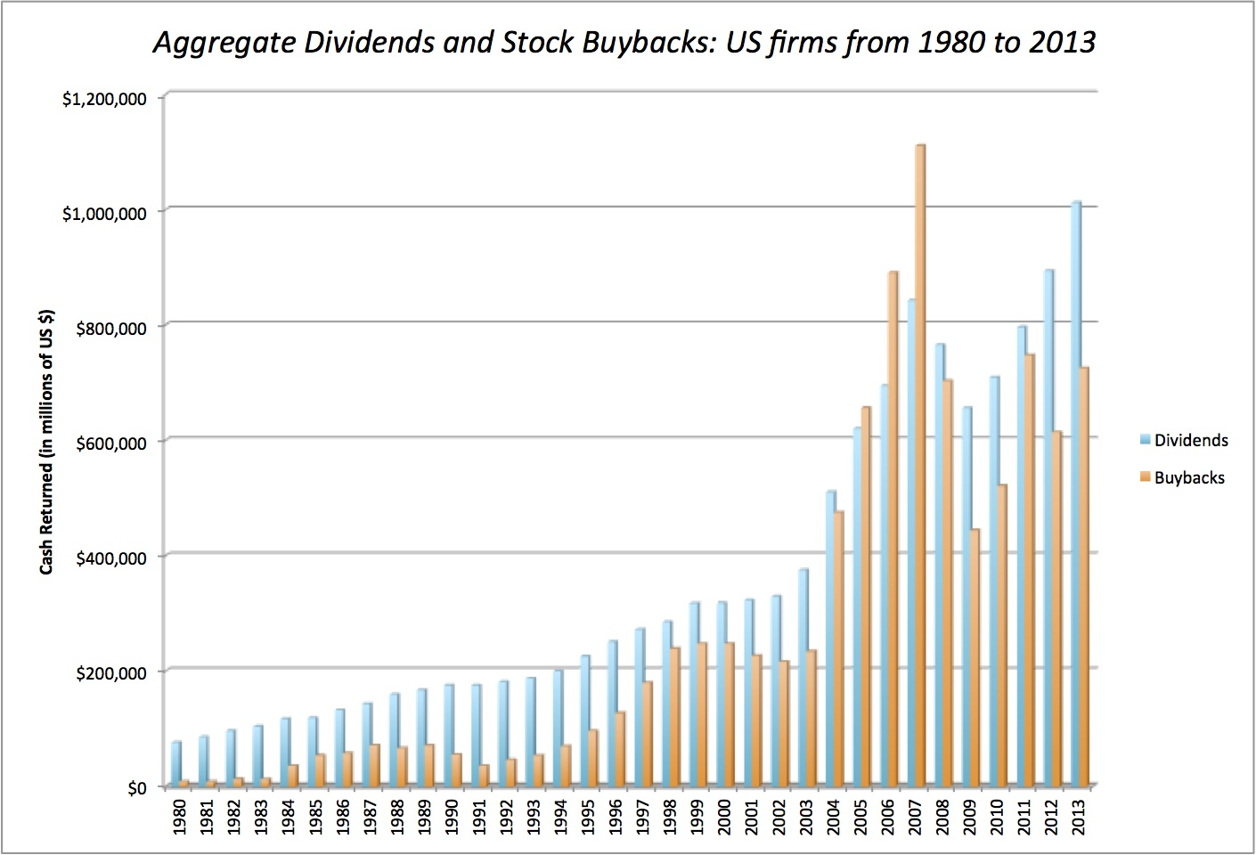
IV. More and more firms are buying back stock, rather than pay dividends...
Notes:
This trend accelerated through the 1990s. It can be partially explained by
An increase in the volatility of earnings at all companies, making dividends much more difficult to maintain
An increasing proportion of investors who invested primarily for capital gains
Managers being compensated with options like stock buybacks more than dividends since the latter leads to lower stock prices.

Slide 215
Measures of Dividend Policy
Dividend Payout = Dividends/ Net Income
  Measures the percentage of earnings that the company pays in dividends
  If the net income is negative, the payout ratio cannot be computed.
Dividend Yield = Dividends per share/ Stock price
  Measures the return that an investor can make from dividends alone
  Becomes part of the expected return on the investment.
B DES Page 3
PB Page 41-43
Notes:
These are the two most common measures of dividend. They both focus on traditional dividends, and could be modified to include stock buybacks.

Slide 216
Dividend Payout Ratios
Notes:
The median payout ratio is between 20 and 30% for firms that pay dividends.
More firms (about 2/3rds of all US firms), however, do not pay dividends than do pay dividends. The trend in the number of non-dividend paying firms has been upwards over the last few decades.
Finally, a few interesting outliers.
The firms that have dividend payout ratios of more than 100% may seem irrational but there are three possible explanations:
Firms having a bad year in earnings, but expect earnings to bounce back.. They continue to pay dividends based upon their normalized earnings
Very stable firms that have little capital expenditures but large depreciation. Their cash flows (which they use for dividends) vastly exceed earnings. These firms are gradually liquidating themselves over time.
Firms that are under levered are paying more in dividends than earnings and funding the difference with new debt to increase debt ratios.

Slide 217
Dividend Yields
Notes:
Here again, there is a trend. Over the last two decades, the dividend yield for U.S. firms has decreased across the board.
In 2009, the dividend yields shot up, not because dividends increased but stock prices decreased.
Bottom line: Volatility in dividend yields is caused more by changes in the denominator (stock prices) than in the numerator (dividends)

Slide 218

Notes:
One way of assessing dividend policy is to look at where a firm stands in the life cycle. As firms grow and mature, their capacity to generate excess cash flows and pay dividends should increase….

Slide 219
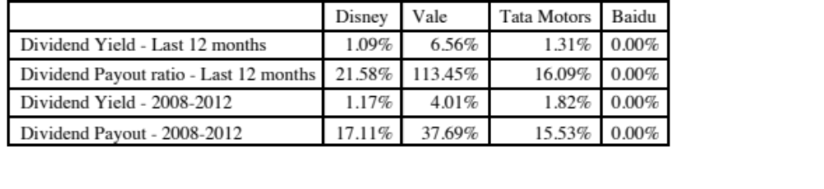
Dividend Policy: Disney et al.
Almarai
Dividend yield in last 12 months = 1.24%
Dividend yield in last 5 years (2011-2015)= 1.68%
Dividend payout ratio in last 12 months = 32.15%
Dividend payout ratio in last 5 years (2011-2015) = 36.38%
Notes:
Baidu pays no dividends (Are you surprised?) Shows the life cycle effect.
Vale’s dividend yield and payout ratio look rich and part of it may be explained by Vale’s use of non-voting shares, which carry a heavy requirement on dividends (if you don’t pay them, you have to give up voting rights). Part of it also reflects the volatility of income over time, since the yield and payout ratio are lower if you use five-year averages.

Slide 220
Three Schools Of Thought On Dividends
If there are no tax disadvantages associated with dividends & companies can issue stock, at no issuance cost, to raise equity, whenever needed
  Dividends do not matter, and dividend policy does not affect value.
If dividends create a tax disadvantage for investors (relative to capital gains)
  Dividends are bad, and increasing dividends will reduce value
3. If dividends create a tax advantage for investors (relative to capital gains) and/or stockholders like dividends
  Dividends are good, and increasing dividends will increase value
Notes:
Note that the schools span the spectrum. Firms which increase, decrease or do nothing on dividends can all find something in one of these schools to justify their actions.
There is truth in each of these schools of thought. The key to sensible dividend analysis is extracting that which makes sense from each school and bringing them all together in a composite analysis.

Slide 221
The balanced viewpoint
If a company has excess cash, and few good investment opportunities (NPV>0), returning money to stockholders (dividends or stock repurchases) is good.
If a company does not have excess cash, and/or has several good investment opportunities (NPV>0), returning money to stockholders (dividends or stock repurchases) is bad.
Notes:
These propositions are really not about dividends, but about returning cash to the owners of the business. Firms which want to return money to stockholders can buy back stock or pay dividends.

Slide 222
Assessing Dividend Policy
Approach 1: The Cash/Trust Nexus
  Assess how much cash a firm has available to pay in dividends, relative what it returns to stockholders. Evaluate whether you can trust the managers of the company as custodians of your cash.
Approach 2: Peer Group Analysis
  Pick a dividend policy for your company that makes it comparable to other firms in its peer group.
Notes:
Two very different approaches to assessing dividend policy. The first is more comprehensive but the second is simpler.

Slide 223
I. The Cash/Trust Assessment
Step 1: How much could the company have paid out during the period under question?
Step 2: How much did the the company actually pay out during the period in question?
Step 3: How much do I trust the management of this company with excess cash?
  How well did they make investments during the period in question?
  How well has my stock performed during the period in question?
Notes:
By paid out to stockholders in this phase of the analysis, we mean both dividends and stock buybacks.

Slide 224
How much has the company returned to stockholders?
As firms increasing use stock buybacks, we have to measure cash returned to stockholders as not only dividends but also buybacks.
For instance, for the companies we are analyzing the cash returned looked as follows.
 | Disney |  | Vale |  | Tata Motors |  | Baidu |  | Deutsche Bank
Year | Dividends | Buybacks | Dividends | Buybacks | Dividends | Buybacks | Dividends | Buybacks | Dividends | Buybacks
2008 | $648 | $648 | $2,993 | $741 | 7,595₹ | 0₹ | ¥0 | ¥0 | 2,274 € | 0 €
2009 | $653 | $2,669 | $2,771 | $9 | 3,496₹ | 0₹ | ¥0 | ¥0 | 309 € | 0 €
2010 | $756 | $4,993 | $3,037 | $1,930 | 10,195₹ | 0₹ | ¥0 | ¥0 | 465 € | 0 €
2011 | $1,076 | $3,015 | $9,062 | $3,051 | 15,031₹ | 0₹ | ¥0 | ¥0 | 691 € | 0 €
2012 | $1,324 | $4,087 | $6,006 | $0 | 15,088₹ | 970₹ | ¥0 | ¥0 | 689 € | 0 €
2008-12 | $4,457 | $15,412 | $23,869 | $5,731 | 51,405₹ | 970₹ | ¥0 | ¥0 | ¥4,428 | ¥0
Notes:
All four companies paid dividends over the five-year period, but there are interesting differences between the companies.
Disney uses buybacks more than the other firms to return cash to investors, though Vale seems to have caught on as wel.
Tata Motors seems intent on increasing dividends every year, even if by a fraction. It takes a really bad year for them to cut dividends (2009)
Deutsche cut dividends after the banking crisis but seems to be returning to the fray.

Slide 225
A Measure of How Much a Company Could have Afforded to Pay out: FCFE
The Free Cashflow to Equity (FCFE) is a measure of how much cash is left in the business after non-equity claimholders (debt and preferred stock) have been paid, and after any reinvestment needed to sustain the firm’s assets and future growth.
  Net Income
  + Depreciation & Amortization
  = Cash flows from Operations to Equity Investors
  - Preferred Dividends
  - Capital Expenditures
  - Working Capital Needs
  - Principal Repayments
  + Proceeds from New Debt Issues
  = Free Cash flow to Equity
Notes:
This cashflow is
Free: because it cashflow left over after debt payments and investment needs have been met
To Equity Investors: because it is after payments to all non-equity claimholders
In coming up with the numbers, we define
Capital expenditures as including all capital investments. We do not distinguish between discretionary and non-discretionary cap ex. Once we assume growth in earnings, all cap ex is non-discretionary.
Working capital needs refers to the increase in non-cash working capital.

Slide 226
Disney’s FCFE: 2008 – 2012
 | 2012 | 2011 | 2010 | 2009 | 2008 | Aggregate
Net Income | $6,136 | $5,682 | $4,807 | $3,963 | $3,307 | $23,895
- (Cap. Exp - Depr) | $604 | $1,797 | $1,718 | $397 | $122 | $4,638
- ∂ Working Capital | ($133) | $940 | $950 | $308 | ($109) | $1,956
Free CF to Equity (pre-debt) | $5,665 | $2,945 | $2,139 | $3,258 | $3,294 | $17,301
+ Net Debt Issued | $1,881 | $4,246 | $2,743 | $1,190 | ($235) | $9,825
= Free CF to Equity (actual debt) | $7,546 | $7,191 | $4,882 | $4,448 | $3,059 | $27,126
Free CF to Equity (target debt ratio) | $5,720 | $3,262 | $2,448 | $3,340 | $3,296 | $18,065
Dividends | $1,324 | $1,076 | $756 | $653 | $648 | $4,457
Dividends + Buybacks | $5,411 | $4,091 | $5,749 | $3,322 | $1,296 | $19,869
Disney returned about $1.5 billion more than the $18.1 billion it had available as FCFE with a normalized debt ratio of 11.58% (its current debt ratio).
Notes:
The depreciation numbers also include amortization and the capital expenditures include cash acquisitions. Increases in noncash working capital, shown as positive numbers, represent a drain on the cash, whereas decreases in noncash working capital, shown as negative numbers, represent positive cash flows. In 2008, for example, noncash working capital decreased by $109 million, increasing the cash available for stockholders in that year by the same amount. Finally, the net cash flow from debt is the cash generated by the issuance of new debt, netted out against the cash outflow from the repayment of old debt. Again, using 2008 as an example, Disney repaid $235 more in old debt than it raised in new debt, and this represents a negative cash flow in that year. We have computed three measures of FCFE, one before the net debt cash flow, one after the actual net debt cash flow and one computed assuming that they had stuck with a target debt ratio of 40%. Using 2008 as an illustration, we compute each as follows:
FCFE_{Before Debt CF}= Net Income + Depreciation – Capital Expenditures – Change in Noncash Working Capital = 3307 -122 –(-109) = 3294
FCFE_{After Debt CF}= FCFE_{Before Debt CF} + Net Debt CF = 3296 - 235 = 3059
FCFE target debt ratio = 3307 – (122-109) (1-.40) =3296

Slide 227
Almarai: FCFE versus Dividends
 | 2011 | 2012 | 2013 | 2014 | 2015
Net Income | ر.س. 1,140 | ر.س. 1,441 | ر.س. 1,502 | ر.س. 1,674 | ر.س. 1,860
+ Deprecn | ر.س. 733 | ر.س. 1,066 | ر.س. 1,331 | ر.س. 1,454 | ر.س. 1,541
- Cap Ex | ر.س. 3,035 | ر.س. 3,138 | ر.س. 2,799 | ر.س. 2,740 | ر.س. 3,380
- Chg WC | ر.س. 172 | -ر.س. 23 | ر.س. 503 | ر.س. 294 | -ر.س. 417
FCFE | -ر.س. 1,334 | -ر.س. 608 | -ر.س. 469 | ر.س. 94 | ر.س. 438
Dividends Paid | ر.س. 516 | ر.س. 512 | ر.س. 499 | ر.س. 598 | ر.س. 598
Payout Ratio | 45.26% | 35.53% | 33.22% | 35.72% | 32.15%
Dividends - FCFE | ر.س. 1,850 | ر.س. 1,120 | ر.س. 968 | ر.س. 504 | ر.س. 160

Slide 228
FCFE for a Bank?
We redefine reinvestment as investment in regulatory capital.
FCFE_{Bank}= Net Income – Increase in Regulatory Capital (Book Equity)
Consider a bank with $ 10 billion in loans outstanding and book equity of $ 750 million. If it maintains its capital ratio of 7.5%, intends to grow its loan base by 10% (to $11 and expects to generate $ 150 million in net income:
FCFE = $150 million – (11,000-10,000)* (.075) = $75 million
Deutsche Bank: FCFE estimates (November 2013)
 | Current | 1 | 2 | 3 | 4 | 5
Asset Base | 439,851 € | 453,047 € | 466,638 € | 480,637 € | 495,056 € | 509,908 €
Capital ratio | 16.00% | 16.00% | 16.00% | 16.00% | 16.00% | 16.00%
Tier 1 Capital | 70,376 € | 72,487 € | 74,662 € | 76,902 € | 79,209 € | 81,585 €
Change in regulatory capital |  | 2,111 € | 2,175 € | 2,240 € | 2,307 € | 2,376 €
Book Equity | 76,829 € | 78,940 € | 81,115 € | 83,355 € | 85,662 € | 88,038 €
ROE | -1.08% | 0.74% | 2.55% | 4.37% | 6.18% | 8.00%
Net Income | -757 € | 584 € | 2,072 € | 3,642 € | 5,298 € | 7,043 €
- Investment in Regulatory Capital |  | 2,111 € | 2,175 € | 2,240 € | 2,307 € | 2,376 €
FCFE |  | -1,528 € | -102 € | 1,403 € | 2,991 € | 4,667 €
Notes:
We draw on the regulatory capital measure to estimate FCFE. Since it is difficult to estimate traditional cap ex and working capital for a bank, we look at additions to regulatory capital as the primary capital expenditure. Thus, conservative banks or banks that want to increase their capital ratio will tend to pay less dividends, as will growing banks.
See how much dividend you could pay, if you were willing to maintain a 6% capital ratio ($90 million) or if your growth were only 5% ($112.5 million).
For Deutsche Bank, we are assuming the following:
We begin with the current values for the asset base and regulatory capital at the end of 2012
2. We assume that the expected growth in the asset base will be 3% a year for the next 5 years and 2% thereafter.
3. We assume a target Tier 1 regulatory capital ratio of 16% in year 5..
4. We assume that the return on equity from the current value of -1.08% to 8% in year 5 and beyond.

Slide 229
Dividends versus FCFE: Across the globe
Notes:
Many firms in 2013 seemed to be paying out more than they could afford to in dividends.

Slide 230
6 Application Test: Estimating your firm’s FCFE
In General, If cash flow statement used
  Net Income Net Income
  + Depreciation & Amortization + Depreciation & Amortization
  - Capital Expenditures + Capital Expenditures
  - Change in Non-Cash Working Capital + Changes in Non-cash WC
  - Preferred Dividend + Preferred Dividend
  - Principal Repaid + Increase in LT Borrowing
  + New Debt Issued + Decrease in LT Borrowing
  + Change in ST Borrowing
  = FCFE = FCFE
Compare to
Dividends (Common)
+ Stock Buybacks
B FA page
PB Page 44
Notes:
Estimate the firm’s FCFE and compare to how much it returned to stockholders.

Slide 231
A Practical Framework for Analyzing Dividend Policy
How much did the firm pay out? How much could it have afforded to pay out?
What it could have paid out
What it actually paid out
Net Income
Dividends
- (Cap Ex - Depr’n) (1-DR)
+ Equity Repurchase
- Chg Working Capital (1-DR)
= FCFE
Firm pays out too little
Firm pays out too much
FCFE > Dividends
FCFE < Dividends
Do you trust managers in the company with
What investment opportunities does the
your cash?
firm have?
Look at past project choice:
Look at past project choice:
Compare
ROE to Cost of Equity
Compare
ROE to Cost of Equity
ROC to WACC
ROC to WACC
Firm has history of
Firm has history
Firm has good
Firm has poor
good project choice
of poor project
projects
projects
and good projects in
choice
the future
Give managers the
Force managers to
Firm should
Firm should deal
flexibility to keep
justify holding cash
cut dividends
with its investment
cash and set
or return cash to
and reinvest
problem first and
dividends
stockholders
more
then cut dividends
Notes:
Most firms return less in cash than they have available to return. Whether they will find themselves under pressure (like Chrysler) or relatively untouched (like Microsoft) will depend upon how much stockholders trust the managers of the firm to use the cash wisely.
Stockholders will tend to be less aggressive about demanding that the cash be returned to them for firms
With a good investment track record
In a sector with high returns
Where managers have substantial equity stakes in the firm
They will tend to be most aggressive when these conditions do not hold.

Slide 232

A Dividend Matrix
Notes:
The freedom that a company will have with dividend policy is directly proportional to its history in delivering high returns both on projects and to its stockholders.

Slide 233
Case 1: Disney in 2003
FCFE versus Dividends
  Between 1994 & 2003, Disney generated $969 million in FCFE each year.
  Between 1994 & 2003, Disney paid out $639 million in dividends and stock buybacks each year.
Cash Balance
  Disney had a cash balance in excess of $ 4 billion at the end of 2003.
Performance measures
  Between 1994 and 2003, Disney has generated a return on equity, on it’s projects, about 2% less than the cost of equity, on average each year.
  Between 1994 and 2003, Disney’s stock has delivered about 3% less than the cost of equity, on average each year.
  The underperformance has been primarily post 1996 (after the Capital Cities acquisition).
Notes:
In 2003, the company had been accumulating cash and had also had a poor track record in picking projects and delivering returns to its stockholders.

Slide 234
Can you trust Disney’s management?
Given Disney’s track record between 1994 and 2003, if you were a Disney stockholder, would you be comfortable with Disney’s dividend policy?
Yes
No
Does the fact that the company is run by Michael Eisner, the CEO for the last 10 years and the initiator of the Cap Cities acquisition have an effect on your decision.
Yes
No
Notes:
The fact that Disney has underperformed the market both in terms of stock price performance and return on equity suggests that stockholders are unlikely to have much patience with Disney accumulating cash (afraid of what they will do with the cash).
That conclusion is reinforced by the fact that the managers responsible for the damage are still at the helm of the firm.

Slide 235
Following up: Disney in 2009
Between 2004 and 2008, Disney made significant changes:
  It replaced its CEO, Michael Eisner, with a new CEO, Bob Iger, who at least on the surface seemed to be more receptive to stockholder concerns.
  Its stock price performance improved (positive Jensen’s alpha)
  Its project choice improved (ROC moved from being well below cost of capital to above)
The firm also shifted from cash returned < FCFE to cash returned > FCFE and avoided making large acquisitions.
If you were a stockholder in 2009 and Iger made a plea to retain cash in Disney to pursue investment opportunities, would you be more receptive?
  Yes
  No
Notes:
I would trust Disney’s management more in 2008 than I did in 2003. I would probably agree that they should retain more cash, especially in light of last year’s liquidity crisis, but it would not be a blank check. I would watch their new investments (say the acquisition of Marvel to see if they are continue to be deserving of my trust.

Slide 236
Final twist: Disney in 2013
Disney did return to holding cash between 2008 and 2013, with dividends and buybacks amounting to $7 billion less than the FCFE (with actual debt used) over this period.
Disney continues to earn a return on capital well in excess of the cost of capital and its stock has doubled over the last two years.
Now, assume that Bob Iger asks you for permission to withhold even more cash to cover future investment needs. Are you likely to go along?
Yes
No
Notes:
Disney continues to do well. That is the good news and will buy them some flexibility.
But Iger needs to mend fences and improve corporate governance.

Slide 237
Case 2: Vale – Dividends versus FCFE
 | Aggregate | Average
Net Income | $57,404 | $5,740
Dividends | $36,766 | $3,677
Dividend Payout Ratio | $1 | $1
Stock Buybacks | $6,032 | $603
Dividends + Buybacks | $42,798 | $4,280
Cash Payout Ratio | $1
Free CF to Equity (pre-debt) | ($1,903) | ($190)
Free CF to Equity (actual debt) | $1,036 | $104
Free CF to Equity (target debt ratio) | $19,138 | $1,914
Cash payout as % of pre-debt FCFE | FCFE negative
Cash payout as % of actual FCFE | 4131.08%
Cash payout as % of target FCFE | 223.63%
Notes:
Vale was clearly paying too much in dividends.

Slide 238
Vale: Its your call..
Vale’s managers have asked you for permission to cut dividends (to more manageable levels). Are you likely to go along?
  Yes
  No
The reasons for Vale’s dividend problem lie in it’s equity structure. Like most Brazilian companies, Vale has two classes of shares - common shares with voting rights and preferred shares without voting rights. However, Vale has committed to paying out 35% of its earnings as dividends to the preferred stockholders. If they fail to meet this threshold, the preferred shares get voting rights. If you own the preferred shares, would your answer to the question above change?
  Yes
  No
Notes:
Vale can make a reasonable case that they should be cutting dividends and reinvesting more back into the business… Whether their investors will accept this reasoning is a different issue. After all, preferred stockholders have not had voting rights and have received large dividends to compensate for the lack of control. At the minimum, I would demand voting rights in exchange for giving up dividends.
The broader lesson: Many emerging market companies have created multiple classes of shares, with different voting rights. The lower voting right shares are often compensated with a higher dividend. Sooner or later, these firms will be confronted by the conflict between their desire to maintain voting control and the need to have a sustainable dividend policy.

Slide 239
Case 3: BP: Summary of Dividend Policy: 1982-1991
Summary of calculations
Average
Standard Deviation
Maximum
Minimum
Free CF to Equity
$571.10
$1,382.29
$3,764.00
($612.50)
Dividends
$1,496.30
$448.77
$2,112.00
$831.00
Dividends+Repurchases
$1,496.30
$448.77
$2,112.00
$831.00
Dividend Payout Ratio
84.77%
Cash Paid as % of FCFE
262.00%
ROE - Required return
-1.67%
11.49%
20.90%
-21.59%
Notes:
BP clearly paid out more than it could have afforded to during this period. It financed the shortfall (in each year except 1987, when it issued stock) by borrowing money.

Slide 240

BP: Just Desserts!
Notes:
While it is pretty clear the BP should cut dividends, the stock price response was not positive when it did. This reflects the fact that investor clienteles cannot be changed overnight. In BP’s case, its history of high dividends had attracted investors who liked the high dividends. When they cut the dividends, these investors sold and a new clientele moved in, but not immediately. (It took a few months)
In hindsight, by cutting dividends, BP became a much healthier firm, with higher returns and lower leverage, after the dividend cut.

Slide 241
Case 4: The Limited: Summary of Dividend Policy: 1983-1992
Summary of calculations
Average
Standard Deviation
Maximum
Minimum
Free CF to Equity
($34.20)
$109.74
$96.89
($242.17)
Dividends
$40.87
$32.79
$101.36
$5.97
Dividends+Repurchases
$40.87
$32.79
$101.36
$5.97
Dividend Payout Ratio
18.59%
Cash Paid as % of FCFE
-119.52%
ROE - Required return
1.69%
19.07%
29.26%
-19.84%
Notes:
A firm with negative FCFE should not pay dividends, especially when its projects earn excess returns.

Slide 242
Growth Firms and Dividends
High growth firms are sometimes advised to initiate dividends because its increases the potential stockholder base for the company (since there are some investors - like pension funds - that cannot buy stocks that do not pay dividends) and, by extension, the stock price. Do you agree with this argument?
  Yes
  No
Why?
Notes:
No. For every investor that these firms gain because they pay dividends, they lose more investors who will not buy the stock any more because the firm pays dividends.
Besides, firms which cannot afford to pay dividends should not be attracting a clientele that wants and likes dividends.

Slide 243
5. Tata Motors
 | Aggregate | Average
Net Income | $421,338.00 | $42,133.80
Dividends | $74,214.00 | $7,421.40
Dividend Payout Ratio | 17.61% | 15.09%
Stock Buybacks | $970.00 | $97.00
Dividends + Buybacks | $75,184.00 | $7,518.40
Cash Payout Ratio | 17.84%
Free CF to Equity (pre-debt) | ($106,871.00) | ($10,687.10)
Free CF to Equity (actual debt) | $825,262.00 | $82,526.20
Free CF to Equity (target debt ratio) | $47,796.36 | $4,779.64
Cash payout as % of pre-debt FCFE | FCFE negative
Cash payout as % of actual FCFE | 9.11%
Cash payout as % of target FCFE | 157.30%
Negative FCFE, largely because of acquisitions.
Notes:
Tata Motors is paying out too much, relative to its actual FCFE and the only reason that it is able to pay dividends is because of its access to debt. Looks like the Tata Group is subsidizing dividend payments to Tata Motors stockholders.

Slide 244
6 Application Test: Assessing your firm’s dividend policy
Compare your firm’s dividends to its FCFE, looking at the last 5 years of information.
Based upon your earlier analysis of your firm’s project choices, would you encourage the firm to return more cash or less cash to its owners?
If you would encourage it to return more cash, what form should it take (dividends versus stock buybacks)?
Notes:
Customize a solution for your firm’s dividend policy… but think about your earlier analysis of its capital structure as well.

Slide 245
II. The Peer Group Approach
In the peer group approach, you compare your company to similar companies (usually in the same market and sector) to assess whether and if yes, how much to pay in dividends.
 | Dividend Yield |  | Dividend Payout
Company | 2013 | Average 2008-12 | 2013 | Average 2008-12 | Comparable Group | Dividend Yield | Dividend Payout
Disney | 1.09% | 1.17% | 21.58% | 17.11% | US Entertainment | 0.96% | 22.51%
Vale | 6.56% | 4.01% | 113.45% | 37.69% | Global Diversified Mining & Iron Ore (Market cap> $1 b) | 3.07% | 316.32%
Tata Motors | 1.31% | 1.82% | 16.09% | 15.53% | Global Autos (Market Cap> $1 b) | 2.13% | 27.00%
Baidu | 0.00% | 0.00% | 0.00% | 0.00% | Global Online Advertising | 0.09% | 8.66%
Deutsche Bank | 1.96% | 3.14% | 362.63% | 37.39% | European Banks | 1.96% | 79.32%
Notes:
All of the companies looks surprisingly similar to their peer groups. (Actually, not so surprising).

Slide 246
Valuation
Cynic: A person who knows the price of everything but the value of nothing..
Oscar Wilde
Notes:
If corporate finance is all about maximizing value, you do have to know how to estimate value.

Slide 247

First Principles
Notes:
Back, full circle to the objective.

Slide 248
Three approaches to valuation
Intrinsic valuation: The value of an asset is a function of its fundamentals – cash flows, growth and risk. In general, discounted cash flow models are used to estimate intrinsic value.
Relative valuation: The value of an asset is estimated based upon what investors are paying for similar assets. In general, this takes the form of value or price multiples and comparing firms within the same business.
Contingent claim valuation: When the cash flows on an asset are contingent on an external event, the value can be estimated using option pricing models.
Notes:
While there are hundreds of valuation models in practice, they will all fall into one of these three categories. There are some who argue that liquidation value is a fourth approach, but we estimate the values of assets in liquidation using either discounted cash flow or relative valuation models.
Intrinsic value and relative value will converge in efficient markets, but can diverge in inefficient markets. One way to frame how companies approach corporate finance is in terms of whether they focus on maximizing intrinsic value or relative value.

Slide 249

Intrinsic Value: Four Basic Propositions
The value of an asset is the present value of the expected cash flows on that asset, over its expected life:
The IT Proposition: If “it” does not affect the cash flows or alter risk (thus changing discount rates), “it” cannot affect value.
The DUH Proposition: For an asset to have value, the expected cash flows have to be positive some time over the life of the asset.
The DON’T FREAK OUT Proposition: Assets that generate cash flows early in their life will be worth more than assets that generate cash flows later; the latter may however have greater growth and higher cash flows to compensate.
The VALUE IS NOT PRICE Proposition: The value of an asset may be very different from its price.
Notes:
Cash is king. A firm with negative cash flows today can be a very valuable firm but only if there is reason to believe that cash flows in the future will be large enough to compensate for the negative cash flows today. The riskier a firm and the longer you have to wait for the cash flows, the greater the cashflows eventually have to be….

Slide 250

DCF Choices: Equity Valuation versus Firm Valuation
Firm Valuation: Value the entire business
Equity valuation: Value just the equity claim in the business
Notes:
A business and the equity in the business can be very different numbers…
A firm like GE in 2005 had a value of $ 500 billion for its business but its equity is worth only $ 300 billion - the difference is due to the substantial debt that GE has used to fund its expansion.
You can have valuable businesses, where the equity is worth nothing because the firm has borrowed too much….

Slide 251

The Ingredients that determine value.
Notes:
Sets up the basic inputs:
1. Discount rates
2. Cash flows
3. Expected Growth
4. Length of the period that they can sustain a growth rate higher than the growth rate of the economy.
How we estimate each of these numbers depends on whether we are taking an equity perspective or a firm perspective.
The answer to the fourth question matters because we cannot estimate cash flows forever and a publicly traded company, at least in theory, can last forever. If cash flows grow at the same rate forever, we can short circuit the cash flow estimation and compute the present value of all cash flows beyond that point in time with one equation (CF/ (r-g)).

Slide 252

I. Estimating Cash Flows
Notes:
Shows the different cash flows that can be used in valuation.
In equity valuation,
The simplest and most direct measure of cash flow is dividends paid (Implicitly we are assuming that companies pay out their residual cash flows as dividends)
A slightly modified approach is to add stock buybacks to dividends. Since buybacks tend to be lumpy, you may need to average buybacks over time.
FCFE: You estimate the residual cash flow, after every conceivable need has been met. Again, there can be volatility in the reinvestment numbers that may need to be normalized.
In firm valuation, you are computing the cash flow to all claim holders in the firm. In effect, you are computing the cash flow before debt payments. That is why we start with operating income (EBIT) and act like we pay taxes on the EBIT. In effect, we ignore any tax benefits from interest expenses, since those will be captured in the cost of capital (through the use of an after-tax cost of debt)
Cap Ex includes acquisitions and the effect of R&D. (R&D is capitalized)

Slide 253
Estimating FCFF: Disney
In the fiscal year ended September 2013, Disney reported the following:
  Operating income (adjusted for leases) = $10,032 million
  Effective tax rate = 31.02%
  Capital Expenditures (including acquisitions) = $5,239 million
  Depreciation & Amortization = $2,192 million
  Change in non-cash working capital = $103 million
The free cash flow to the firm can be computed as follows:
  After-tax Operating Income = 10,032 (1 -.3102) = $6,920
  - Net Cap Expenditures = $5,239 - $2,192 = $3,629
  Change in Working Capital = =$103
  = Free Cashflow to Firm (FCFF) = = $3,188
The reinvestment and reinvestment rate are as follows:
  Reinvestment = $3,629 + $103 = $3,732 million
  Reinvestment Rate = $3,732/ $6,920 = 53.93%
Notes:
We include acquisitions made during 2013 in capital expenditures, but this is a volatile item.

Slide 254
II. Discount Rates
Keep it current: When doing a valuation, you need a discount rate that reflects today’s conditions. Not only does this require you to update the base risk free rate, but also your risk premiums (equity risk premium and default spread) and perhaps even your measures of risk (betas, default risk measures)
Keep it consistent: At an intuitive level, the discount rate used should be consistent with both the riskiness and the type of cash flow being discounted. The cost of equity is the rate at which we discount cash flows to equity (dividends or free cash flows to equity). The cost of capital is the rate at which we discount free cash flows to the firm.
Keep it in perspective: The discount rate obviously matters in a discounted cash flow valuation, but not as much as your other inputs. In fact, as uncertainty about the future increases, the more you should focus on estimating cash flows and the less your should focus on discount rates.
Notes:
Recaps what we stated when we talked about investment analysis.

Slide 255
Current Cost of Capital: Disney
The beta for Disney’s stock in November 2013 was 1.0013. The T. bond rate at that time was 2.75%. Using an estimated equity risk premium of 5.76%, we estimated the cost of equity for Disney to be 8.52%:
Cost of Equity = 2.75% + 1.0013(5.76%) = 8.52%
Disney’s bond rating in May 2009 was A, and based on this rating, the estimated pretax cost of debt for Disney is 3.75%. Using a marginal tax rate of 36.1, the after-tax cost of debt for Disney is 2.40%.
After-Tax Cost of Debt = 3.75% (1 – 0.361) = 2.40%
The cost of capital was calculated using these costs and the weights based on market values of equity (121,878) and debt (15.961):
Cost of capital =
Notes:
The one point we do know for Disney…
This reproduces the current cost of capital computation for Disney, using market value weights for both debt and equity, the cost of equity (based upon the bottom-up beta) and the cost of debt (based upon the bond rating)

Slide 256
But costs of equity and capital can and should change over time…
Year | Beta | Cost of Equity | After-tax Cost of Debt | Debt Ratio | Cost of capital
1 | 1.0013 | 8.52% | 2.40% | 11.50% | 7.81%
2 | 1.0013 | 8.52% | 2.40% | 11.50% | 7.81%
3 | 1.0013 | 8.52% | 2.40% | 11.50% | 7.81%
4 | 1.0013 | 8.52% | 2.40% | 11.50% | 7.81%
5 | 1.0013 | 8.52% | 2.40% | 11.50% | 7.81%
6 | 1.0010 | 8.52% | 2.40% | 13.20% | 7.71%
7 | 1.0008 | 8.51% | 2.40% | 14.90% | 7.60%
8 | 1.0005 | 8.51% | 2.40% | 16.60% | 7.50%
9 | 1.0003 | 8.51% | 2.40% | 18.30% | 7.39%
10 | 1.0000 | 8.51% | 2.40% | 20.00% | 7.29%
Notes:
In the case of Disney, the debt ratio is the number that changes the most. If Disney’s beta & cost of debt had been much higher or lower than that of a mature firm, those would have changed as well.
For evolving firms, with rapidly changing growth rates, the beta, the cost of debt and the debt ratio can all change over time as the firm matures.

Slide 257

III. Expected Growth
Notes:
Note that the approaches are similar, with the only difference being in how we define how much the firm reinvests and how well it reinvests.

Slide 258

Estimating Growth in EBIT: Disney
We started with the reinvestment rate that we computed from the 2013 financial statements:
Reinvestment rate =
  We computed the reinvestment rate in prior years to ensure that the 2013 values were not unusual or outliers.
We compute the return on capital, using operating income in 2013 and capital invested at the start of the year:
Return on Capital₂₀₁₃ =
  Disney’s return on capital has improved gradually over the last decade and has levelled off in the last two years.
If Disney maintains its 2013 reinvestment rate and return on capital for the next five years, its growth rate will be 6.80 percent.
  Expected Growth Rate from Existing Fundamentals = 53.93% * 12.61% = 6.8%
Notes:
The book value of debt is augmented by the present value of operating lease commitments. We checked both numbers (ROC and reinvestment rate) against prior years, to make sure that they looked reasonable. If not, we would have used average values over time.

Slide 259

IV. Getting Closure in Valuation
Since we cannot estimate cash flows forever, we estimate cash flows for a “growth period” and then estimate a terminal value, to capture the value at the end of the period:
When a firm’s cash flows grow at a “constant” rate forever, the present value of those cash flows can be written as:
  Value = Expected Cash Flow Next Period / (r - g)
  where,
  r = Discount rate (Cost of Equity or Cost of Capital)
  g = Expected growth rate forever.
This “constant” growth rate is called a stable growth rate and cannot be higher than the growth rate of the economy in which the firm operates.
Notes:
Firms have infinite lives. Since we cannot estimate cash flows forever, we assume a constant growth rate forever as a way of closing off the valuation.
A very commonly used variant is to use a multiple of the terminal year’s earnings. This brings an element of relative valuation into the analysis. In a pure DCF model, the terminal value has to be estimated with a stable growth rate.

Slide 260
Getting to stable growth…
A key assumption in all discounted cash flow models is the period of high growth, and the pattern of growth during that period. In general, we can make one of three assumptions:
  there is no high growth, in which case the firm is already in stable growth
  there will be high growth for a period, at the end of which the growth rate will drop to the stable growth rate (2-stage)
  there will be high growth for a period, at the end of which the growth rate will decline gradually to a stable growth rate(3-stage)
The assumption of how long high growth will continue will depend upon several factors including:
  the size of the firm (larger firm -> shorter high growth periods)
  current growth rate (if high -> longer high growth period)
  barriers to entry and differential advantages (if high -> longer growth period)
Notes:
This is the shakiest area of valuation. The high growth period should be a function of a firm’s capacity to earn excess returns and erect and maintain barriers to entry. This is where corporate strategy meets corporate valuation.

Slide 261
Estimating Stable Period Inputs: Disney
Respect the cap: The growth rate forever is assumed to be 2.5. This is set lower than the riskfree rate (2.75%).
Stable period excess returns: The return on capital for Disney will drop from its high growth period level of 12.61% to a stable growth return of 10%. This is still higher than the cost of capital of 7.29% but the competitive advantages that Disney has are unlikely to dissipate completely by the end of the 10th year.
Reinvest to grow: Based on the expected growth rate in perpetuity (2.5%) and expected return on capital forever after year 10 of 10%, we compute s a stable period reinvestment rate of 25%:
Reinvestment Rate = Growth Rate / Return on Capital = 2.5% /10% = 25%
Adjust risk and cost of capital: The beta for the stock will drop to one, reflecting Disney’s status as a mature company.
  Cost of Equity = Riskfree Rate + Beta * Risk Premium = 2.75% + 5.76% = 8.51%
  The debt ratio for Disney will rise to 20%. Since we assume that the cost of debt remains unchanged at 3.75%, this will result in a cost of capital of 7.29%
  Cost of capital = 8.51% (.80) + 3.75% (1-.361) (.20) = 7.29%
Notes:
As Disney moves into stable growth, it should exhibit the characteristics of stable growth firms. If you want to be conservative in your estimates, you could set the return on capital = cost of capital in stable growth.
The riskfree rate is a useful proxy for the nominal growth rate in the economy.
Riskfree rate = Expected inflation + Expected real interest rate
Nominal growth rate in economy = Expected inflation + Expected real growth rate
In the long term, expected real growth rate should converge on the expected real interest rate

Slide 262
V. From firm value to equity value per share
Approach used | To get to equity value per share
Discount dividends per share at the cost of equity | Present value is value of equity per share
Discount aggregate FCFE at the cost of equity | Present value is value of aggregate equity. Subtract the value of equity options given to managers and divide by number of shares.
Discount aggregate FCFF at the cost of capital | PV = Value of operating assets + Cash & Near Cash investments + Value of minority cross holdings Debt outstanding = Value of equity Value of equity options =Value of equity in common stock / Number of shares
Notes:
The present value of the cash flows yields different output, depending upon the model used. If the ultimate mission is to compute the value of equity per share, getting there can take quite a trek, especially if you use a firm valuation model.
In effect, you have add the values of any assets whose earnings are not part of operating income (cash and minority cross holdings), subtract out the market value of non equity claims (debt foremost but also leases) and then net out the value of equity in options granted to managers and others to get to the value of equity in common stock. Since we have already considered the effect of options outstanding, this value can then be divided by the primary (not diluted) number of shares to get to value per share.

Slide 263

Disney: Inputs to Valuation
Notes:
The transition period is used as a phase where the inputs from the high growth period can be adjusted towards stable growth levels (which reflect industry or market averages).
Note that we estimate reinvestment needs using the expected growth rate and the return on capital.
We are making the assumption that Disney will continue to earn excess returns even in stable growth. (The return on capital is moved towards the cost of capital, but it is still higher than the cost of capital). If that assumption seems over optimistic, the return on capital in stable growth can be set equal to the cost of capital.
The leverage is pushed up to 20%, which is well below the optimal that we computed earlier, because current management seems intent on paying down debt.

Slide 264

Notes:
Brings it all together. Stock looks slightly over valued… or maybe the valuation is wrong…
Note that the non operating investment is the value of their minority holdings in other companies and that the minority interest reflects the value of others’ holdings in companies that Disney owns a majority stake in (and has consolidated). Both were taken at book value. Optimally, we would like to get both in market value terms.
The equity options is the value of management options, valued using an option pricing model, and adjusted for taxes.

Slide 265

Notes:
Shows the link between our valuation and the earlier corporate financial analysis.

Slide 267

Ways of changing value…
Notes:
To change value, you have to take actions that affect one of four inputs:
Cash flows from existing assets
Expected growth
Cost of capital
Length of the growth period

Slide 268

Notes:
Note that with two changes, a higher return on capital on new investments over the high growth phase (from 12.61% to 14%, with a slight drop in reinvestment) and moving to the optimal debt ratio of 40%, we can raise the value per share from $62.56 to $74.91. The difference of $11.35 can be viewed as the value of control. In general, the better managed a firm is, the lower will be the value of control.

Slide 269

Valuation as a bridge between stories and numbers..

Slide 270
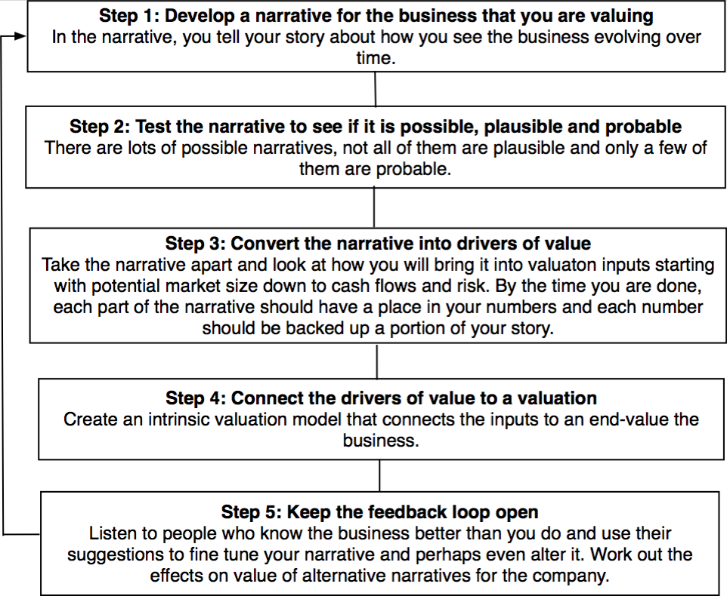
The Steps

Slide 271
Step 1: Survey the landscape
Every valuation starts with a narrative, a story that you see unfolding for your company in the future.
In developing this narrative, you will be making assessments of
  Your company (its products, its management and its history.
  The market or markets that you see it growing in.
  The competition it faces and will face.
  The macro environment in which it operates.

Slide 272
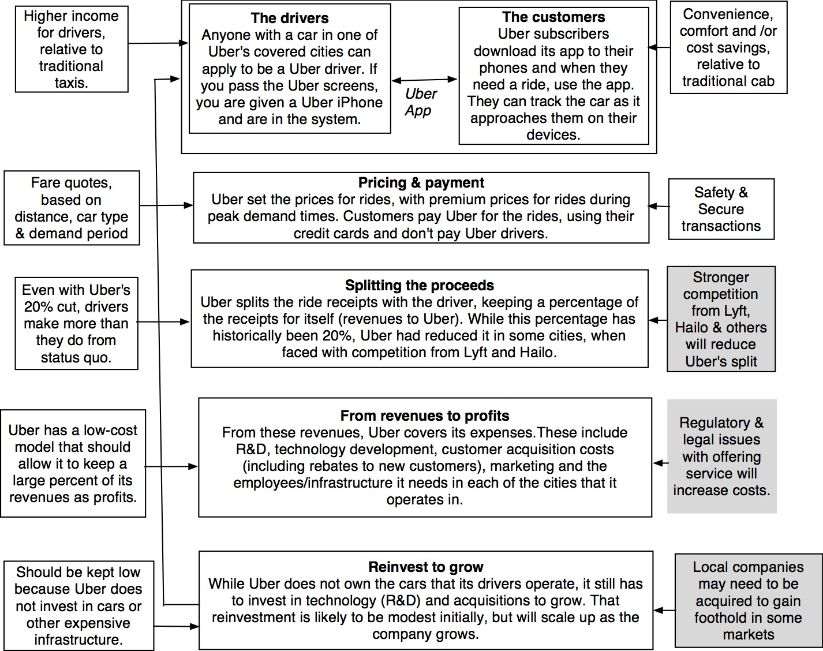

Slide 273
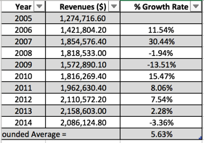
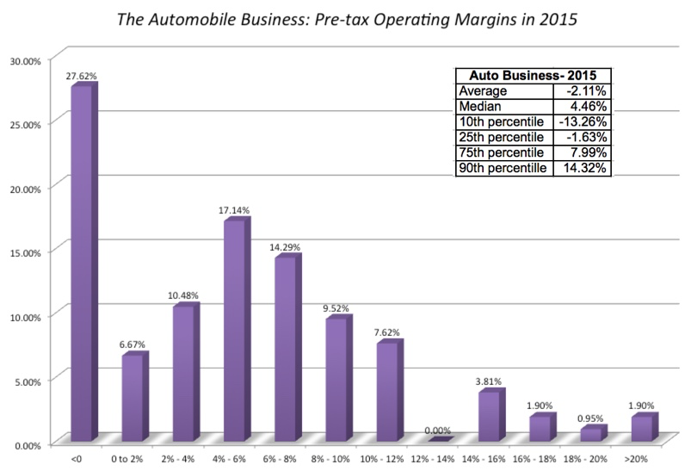
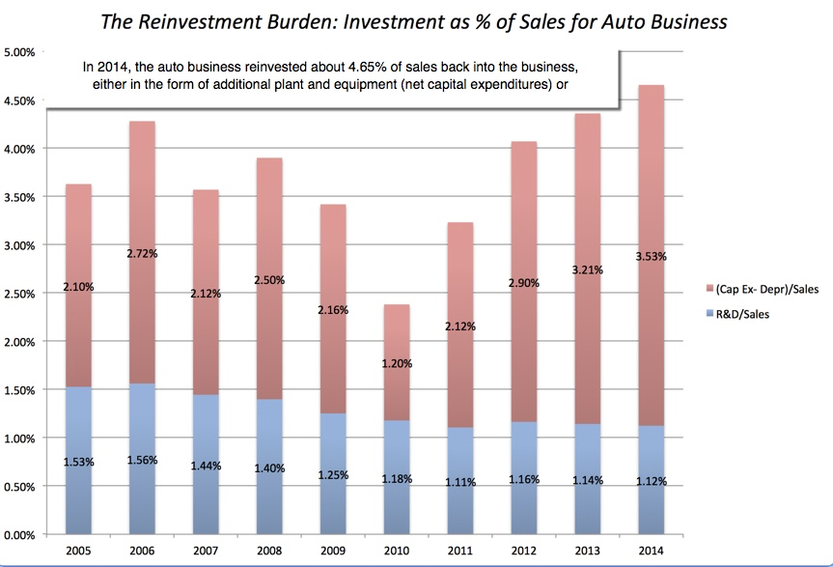
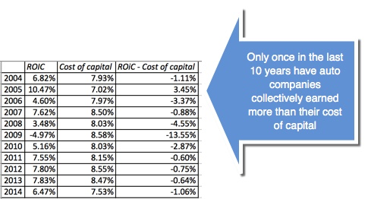
Low Growth
The Auto Business
Low Margins
+
High & Increasing Reinvestment
Bad Business
=

Slide 274
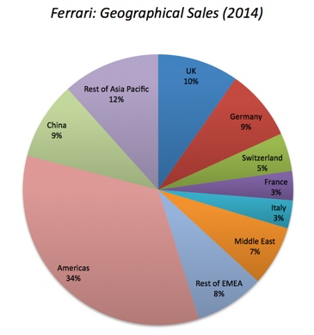
What makes Ferrari different?
Ferrari sold only 7,255 cars in all of 2014
Ferrari sales (in units) have grown very little in the last decade & have been stable
Ferrari had a profit margin of 18.2%, in the 95th percentile, partly because of its high prices and partly because it spends little on advertising.
Ferrari has not invested in new plants.

Slide 275
Step 2: Create a narrative for the future
Every valuation starts with a narrative, a story that you see unfolding for your company in the future.
In developing this narrative, you will be making assessments of your company (its products, its management), the market or markets that you see it growing in, the competition it faces and will face and the macro environment in which it operates.
  Rule 1: Keep it simple.
  Rule 2: Keep it focused.

Slide 276
The Uber Narrative
In June 2014, my initial narrative for Uber was that it would be
An urban car service business: I saw Uber primarily as a force in urban areas and only in the car service business.
Which would expand the business moderately (about 40% over ten years) by bringing in new users.
With local networking benefits: If Uber becomes large enough in any city, it will quickly become larger, but that will be of little help when it enters a new city.
Maintain its revenue sharing (20%) system due to strong competitive advantages (from being a first mover).
And its existing low-capital business model, with drivers as contractors and very little investment in infrastructure.

Slide 277
The Ferrari Narrative
Ferrari will stay an exclusive auto club, deriving its allure from its scarcity and the fact that only a few own Ferraris.
By staying exclusive, the company gets three benefits:
  It can continue to charge nose bleed prices for its cars and sell them with little or no advertising.
  It does not need to invest in new assembly plants, since it does not plan to ramp up production.
  It sells only to the super rich, who are unaffected by overall economic conditions or market crises.

Slide 278
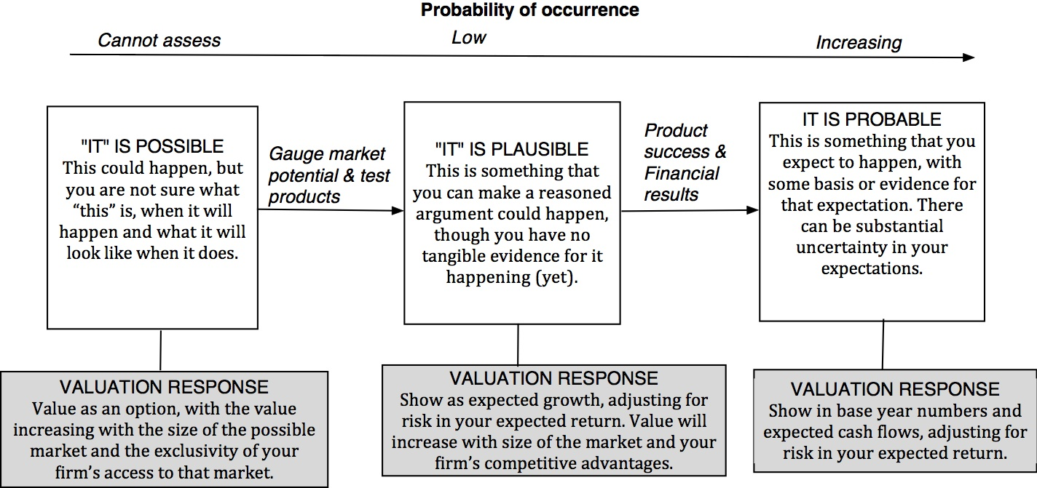
Step 3: Check the narrative against history, economic first principles & common sense

Slide 279
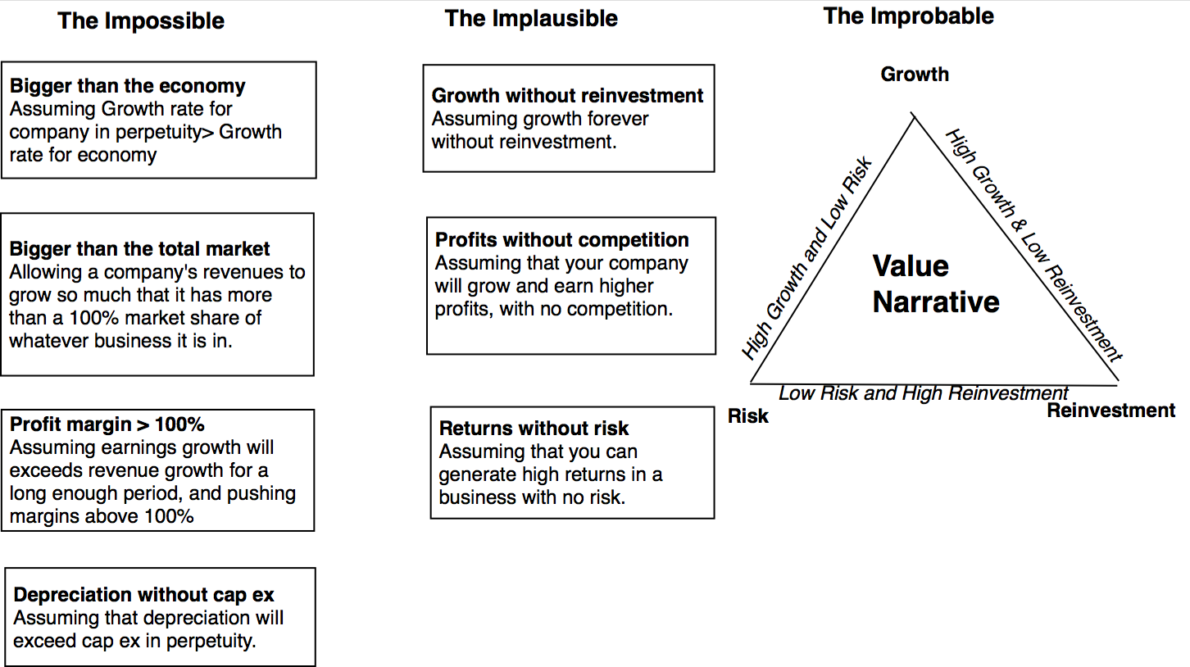
The Impossible, The Implausible and the Improbable

Slide 280
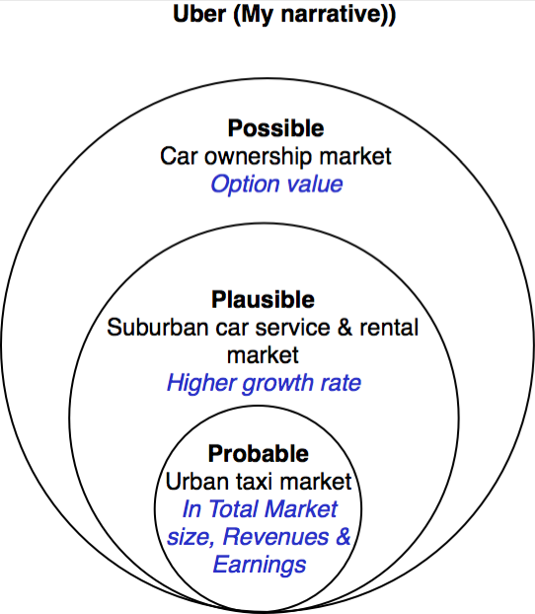
Uber: Possible, Plausible and Probable

Slide 281
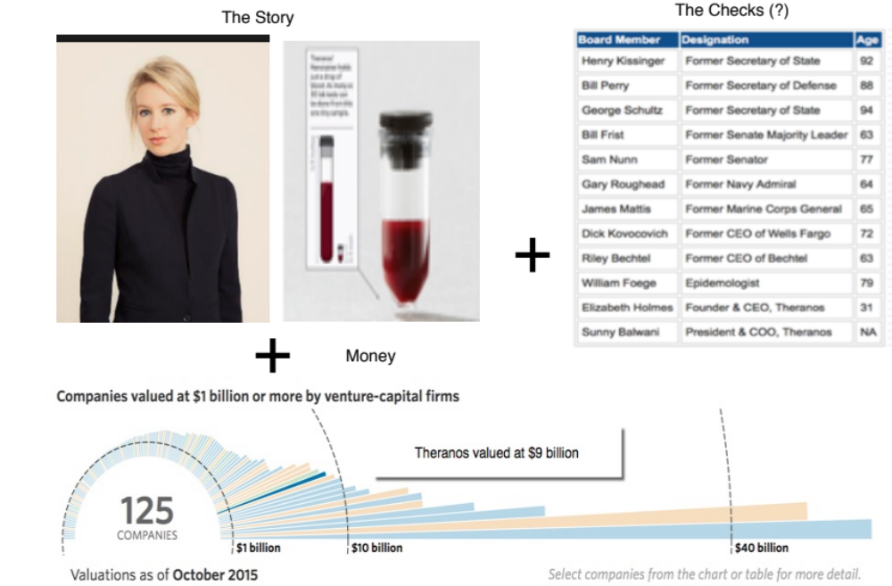
The Impossible: The Runaway Story

Slide 282
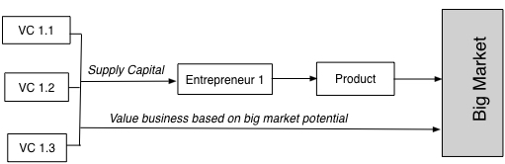
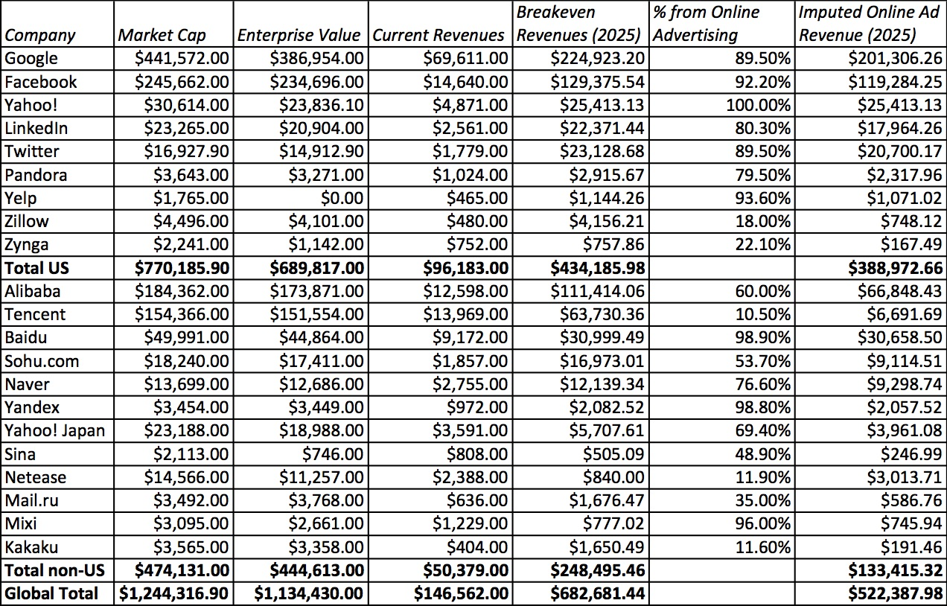
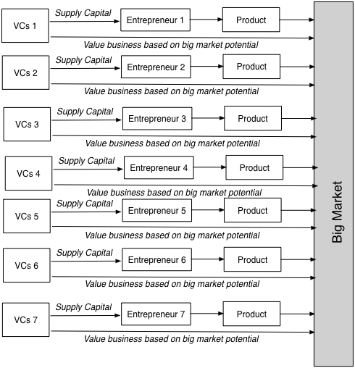
The Implausible: The Big Market Delusion

Slide 283
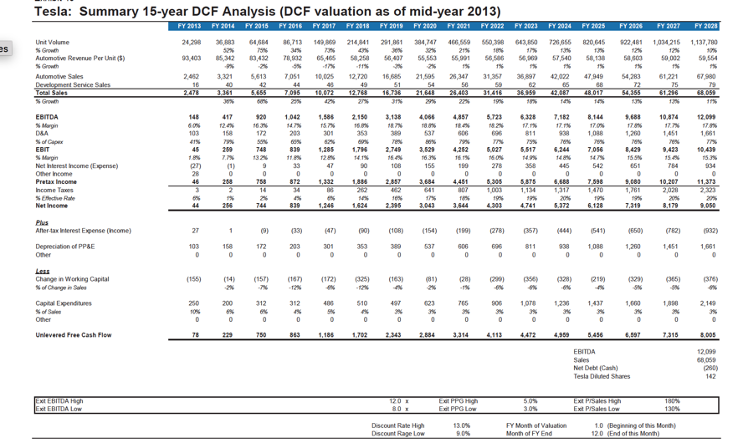
The Improbable: Willy Wonkitis

Slide 284
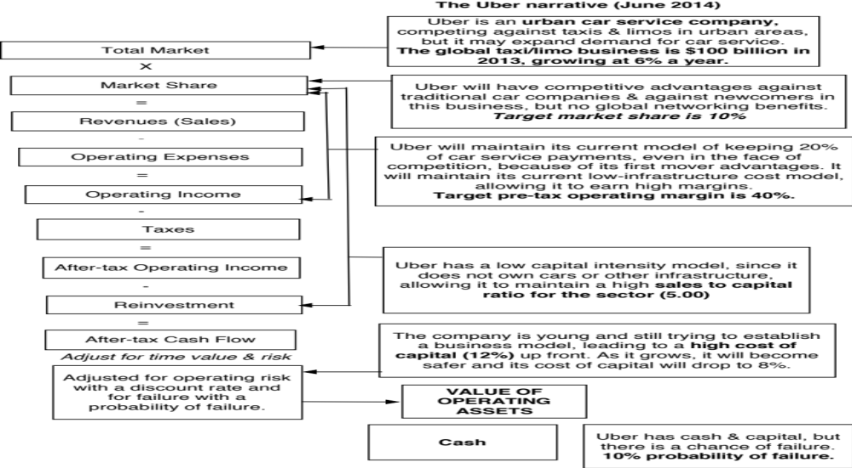
Step 4: Connect your narrative to key drivers of value

Slide 285
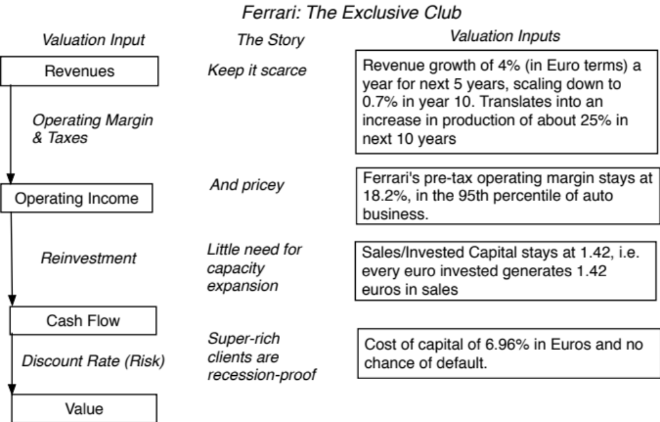
Ferrari: From story to numbers

Slide 286
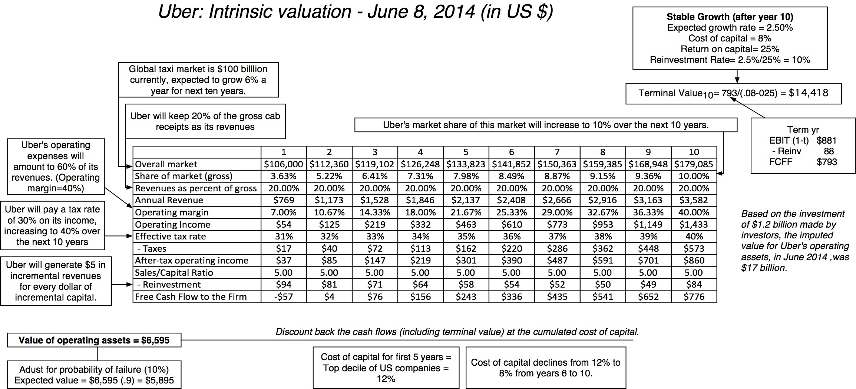
Step 4: Value the company (Uber)

Slide 287
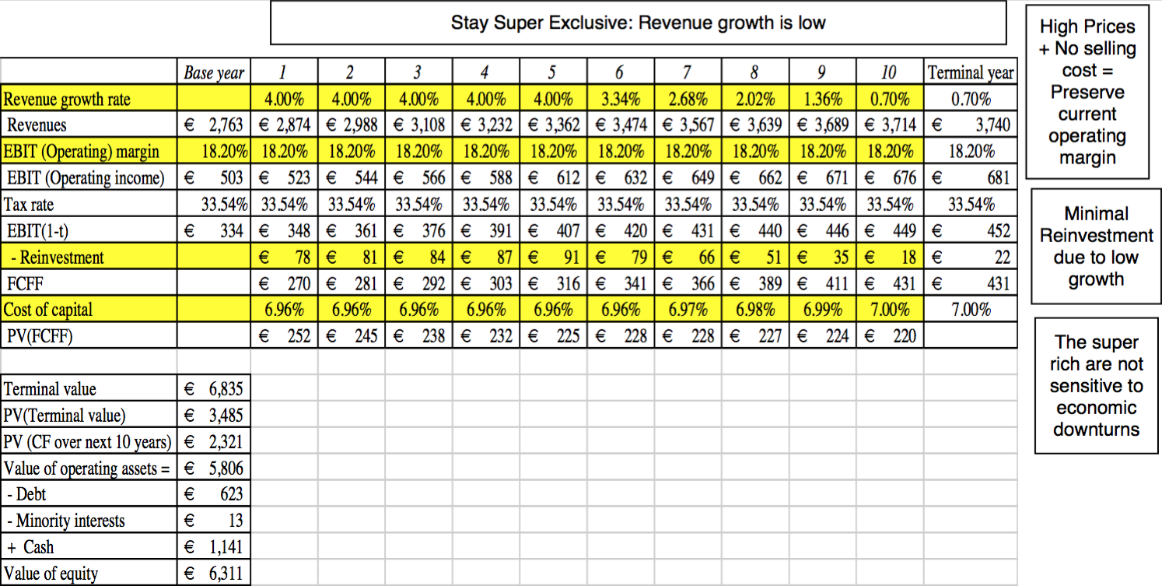
Ferrari: The “Exclusive Club” Value

Slide 288
Step 5: Keep the feedback loop open
When you tell a story about a company (either explicitly or implicitly), it is natural to feel attached to that story and to defend it against all attacks. Nothing can destroy an investor more than hubris.
Being open to other views about a company is not easy, but here are some suggestions that may help:
  Face up to the uncertainty in your own estimates of value.
  Present the valuation to people who don’t think like you do.
  Create a process where people who disagree with you the most have a say.
  Provide a structure where the criticisms can be specific and pointed, rather than general.

Slide 289
The Uber Feedback Loop: Bill Gurley
Not just car service company.: Uber is a car company, not just a car service company, and there may be a day when consumers will subscribe to a Uber service, rather than own their own cars. It could also expand into logistics, i.e., moving and transportation businesses.
Not just urban: Uber can create new demands for car service in parts of the country where taxis are not used (suburbia, small towns).
Global networking benefits: By linking with technology and credit card companies, Uber can have global networking benefits.

Slide 290
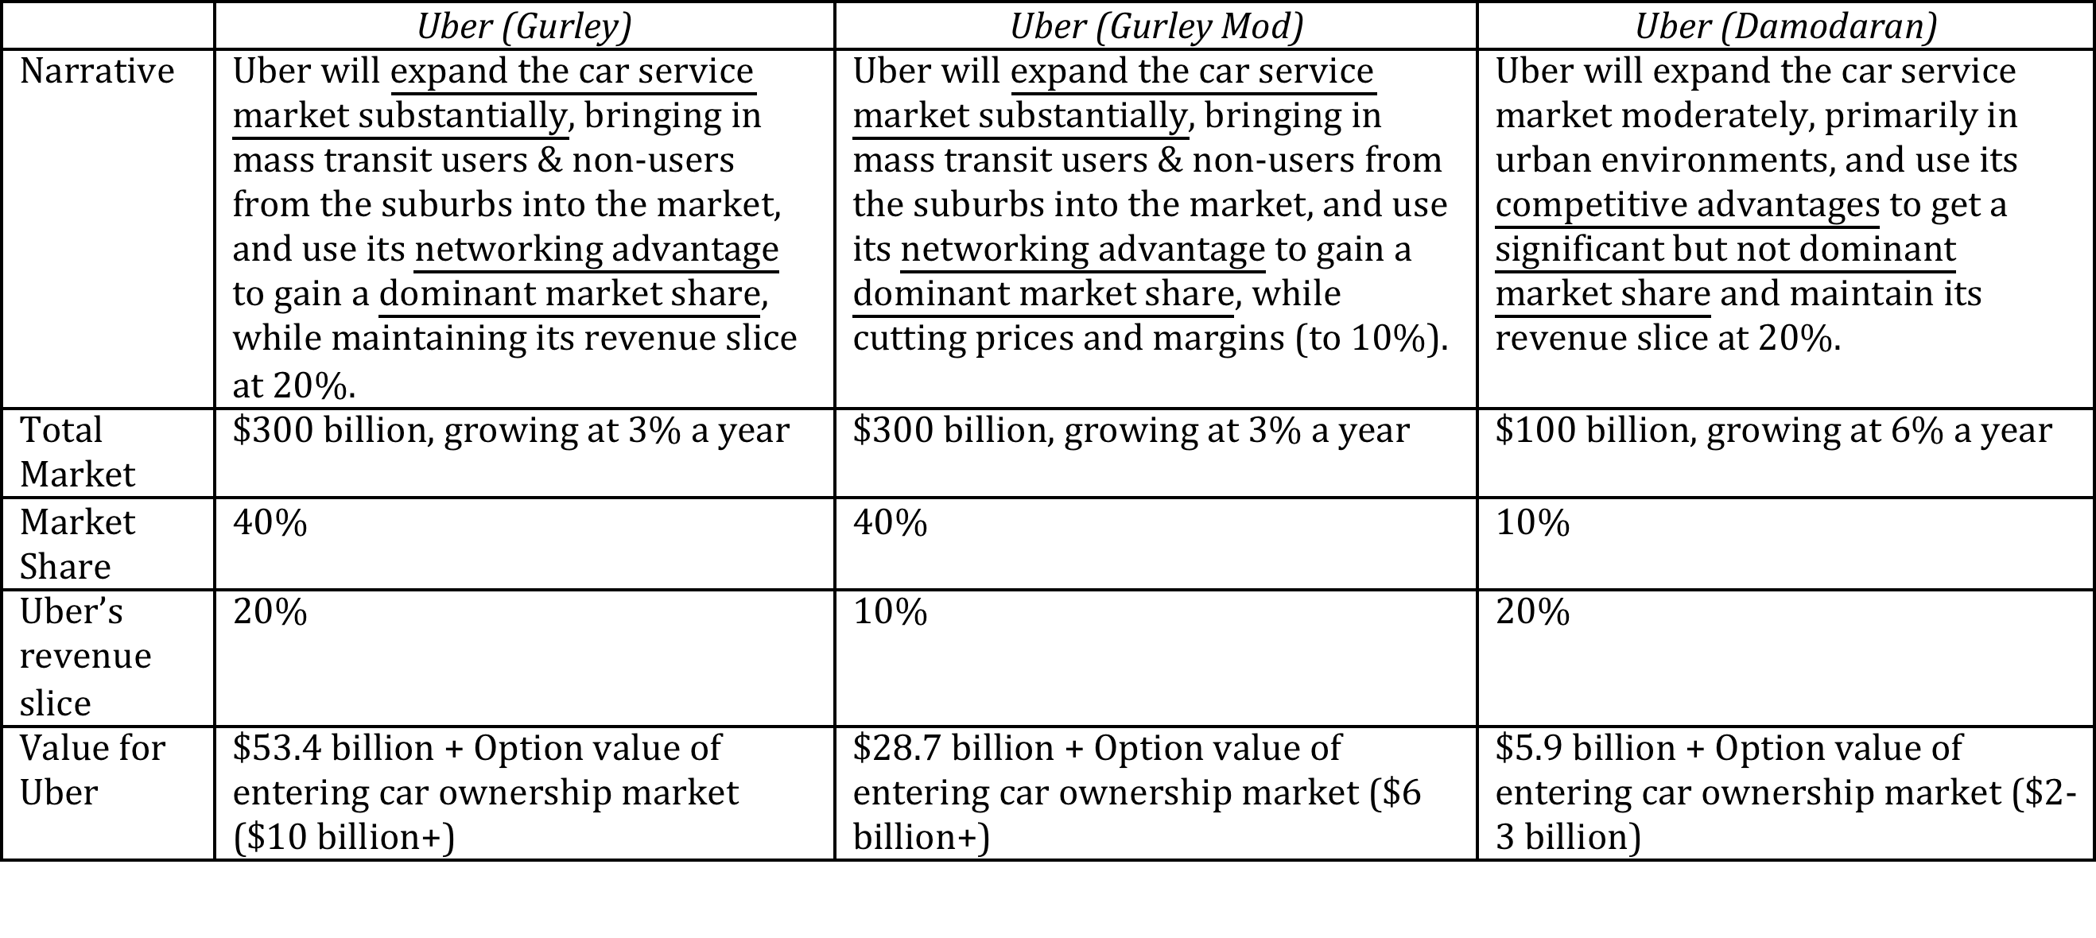
Valuing Bill Gurley’s Uber narrative

Slide 291
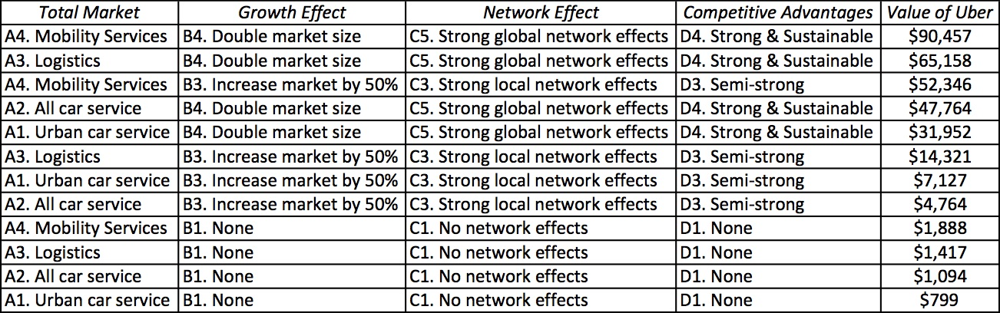
Different narratives, Different Numbers

Slide 292
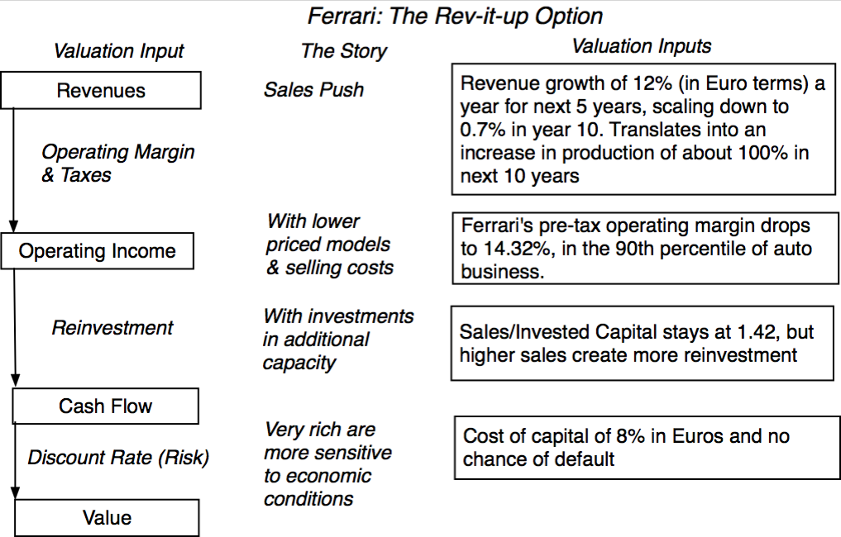
The Ferrari Counter Narrative

Slide 293
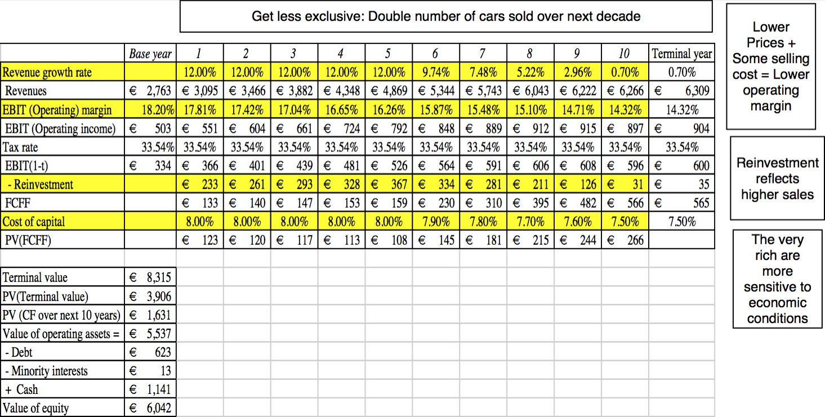
Ferrari: The “Rev-it-up” Alternative

Slide 294

And the world is full of feedback.. My Ferrari afterthought!

Slide 295
Why narratives change
Earnings reports: Every earnings announcement from a firm is a chance to reassess the narrative about the firm.
Corporate actions: Any action that changes the basic construct for the firm, including divestitures, acquisitions and splits offs.
Management change: A new CEO, board of directors or other significant management change.
Macroeconomic changes: A change in the macroeconomic environment, leading to shifts in interest rates, inflation, exchange rates or other variables.
Political changes: A change in government, political system or any structural shift.

Slide 296
How narratives change
Narrative Break/End | Narrative Shift | Narrative Change (Expansion or Contraction)
Events, external (legal, political or economic) or internal (management, competitive, default), that can cause the narrative to break or end. | Improvement or deterioration in initial business model, changing market size, market share and/or profitability. | Unexpected entry/success in a new market or unexpected exit/failure in an existing market.
Your valuation estimates (cash flows, risk, growth & value) are no longer operative | Your valuation estimates will have to be modified to reflect the new data about the company. | Valuation estimates have to be redone with new overall market potential and characteristics.
Estimate a probability that it will occur & consequences | Monte Carlo simulations or scenario analysis | Real Options

Slide 297
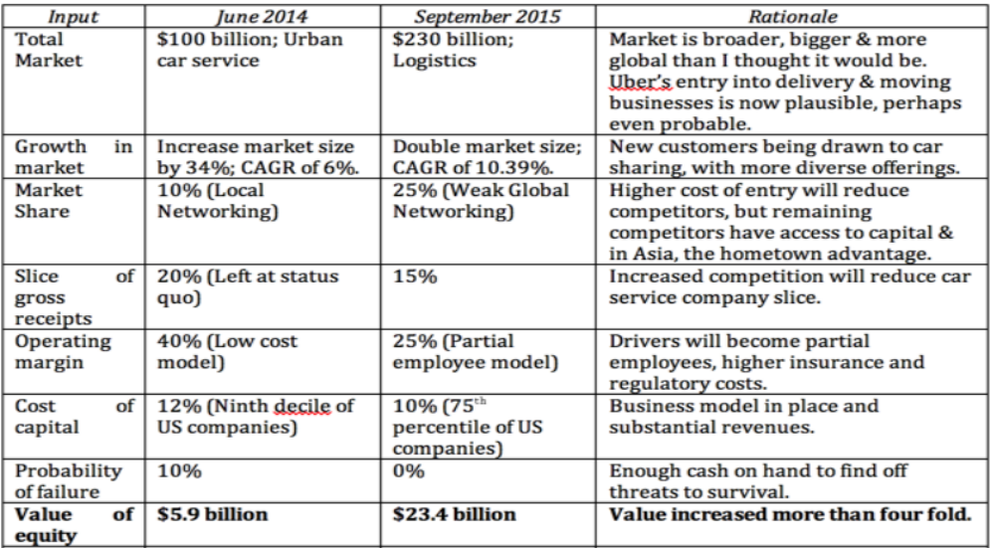
Uber: The September 2015 Update

Slide 298
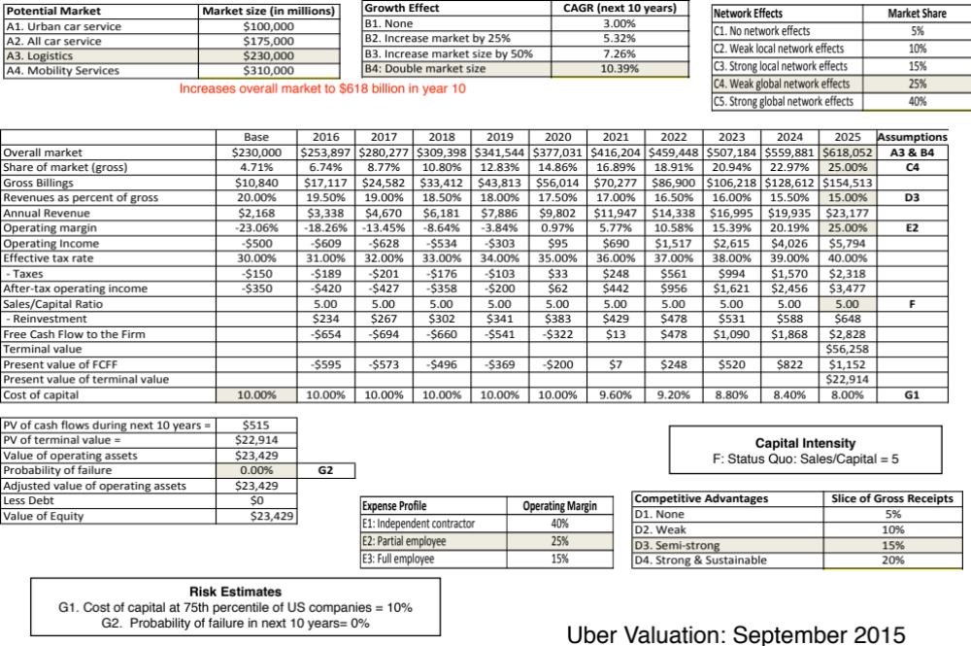

Slide 299

First Principles
Notes:
As we begin, so we end.

