Slide 1
Hurdle Rates VIi: Betas - The Bottom up approach
If you cannot find comparable companies, it is because you have not looked hard enough.
Notes:
Sets the agenda for the class. This is a class that will be focused on the big picture of corporate finance rather than details, theories or models on a piecemeal basis.

Slide 2
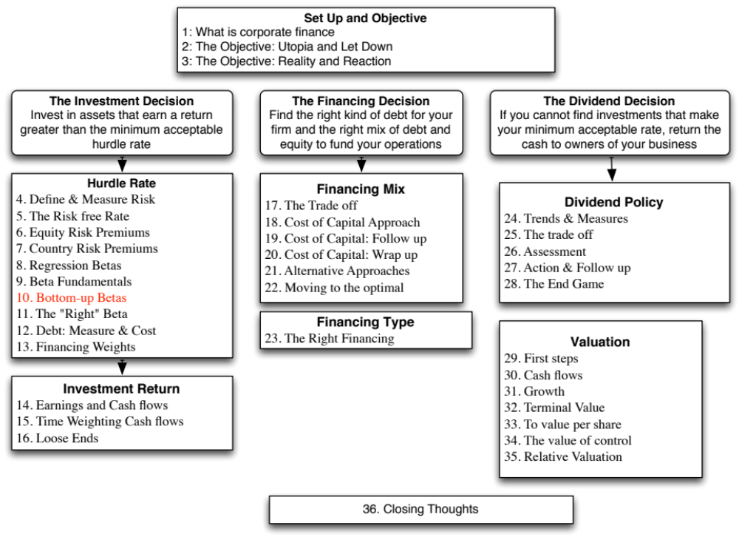

Slide 3
Betas are weighted Averages
The beta of a portfolio is always the market-value weighted average of the betas of the individual investments in that portfolio.
Thus,
  the beta of a mutual fund is the weighted average of the betas of the stocks and other investment in that portfolio
  the beta of a firm after a merger is the market-value weighted average of the betas of the companies involved in the merger.
Notes:
Betas are always weighted averages - where the weights are based upon market value. This is because betas measure risk relative to a market index.

Slide 4
Bottom-up versus Top-down Beta
The top-down beta for a firm comes from a regression
The bottom up beta can be estimated by doing the following:
  Find out the businesses that a firm operates in
  Find the unlevered betas of other firms in these businesses
  Take a weighted (by sales or operating income) average of these unlevered betas
  Lever up using the firm’s debt/equity ratio
The bottom up beta is a better estimate than the top down beta for the following reasons
  The standard error of the beta estimate will be much lower
  The betas can reflect the current (and even expected future) mix of businesses that the firm is in rather than the historical mix
Notes:
Bottom-up betas build up to the beta from the fundamentals, rather than trusting the regression.
The standard error of an average beta for a sector, is smaller by a factor of √n, where n is the number of firms in the sector. Thus, if there are 25 firms in a sector, the standard error of the average is 1/5 the average standard error.

Slide 5
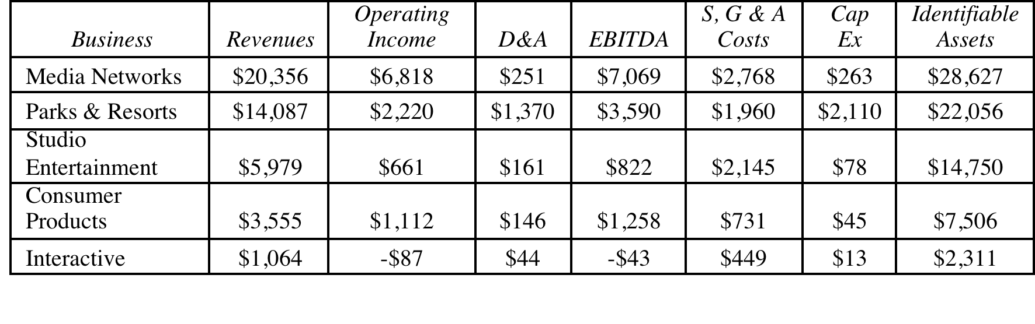
Disney’s businesses: The financial breakdown (from 2013 annual report)
Notes:
Disney does break down its divisions very well in its financial statements. Not all companies are this forthcoming and you may have to go on much coarser data, in some cases.

Slide 6

Unlevered Betas for businesses
Business | Comparable firms | Sample size | Median Beta | Median D/E | Median Tax rate | Company Unlevered Beta | Median Cash/ Firm Value | Business Unlevered Beta
Media Networks | US firms in broadcasting business | 26 | 1.43 | 71.09% | 40.00% | 1.0024 | 2.80% | 1.0313
Parks & Resorts | Global firms in amusement park business | 20 | 0.87 | 46.76% | 35.67% | 0.6677 | 4.95% | 0.7024
Studio Entertainment | US movie firms | 10 | 1.24 | 27.06% | 40.00% | 1.0668 | 2.96% | 1.0993
Consumer Products | Global firms in toys/games production & retail | 44 | 0.74 | 29.53% | 25.00% | 0.6034 | 10.64% | 0.6752
Interactive | Global computer gaming firms | 33 | 1.03 | 3.26% | 34.55% | 1.0085 | 17.25% | 1.2187
Notes:
Comes from the companies in each sector. Judgment calls had to be made and when the sample size was too small (as was the case with broadcasting and theme parks), I had to broaden my sample, by going up and down the food chain of revenues in the case of broadcasting (by including companies that make revenues from syndicating TV shows, for instance) or going global (with theme parks).

Slide 7
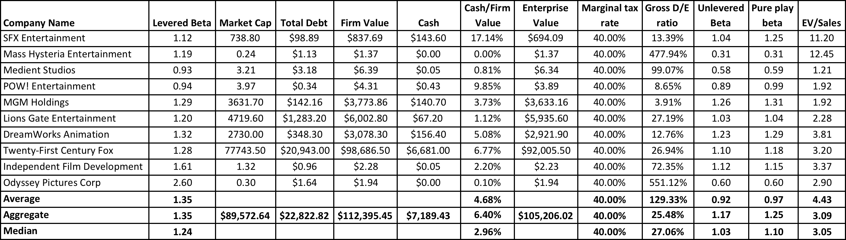
A closer look at the process…
Studio Entertainment Betas
Notes:
This shows the raw numbers behind one of the line items on the previous page – studio entertainment. It lists the companies used, their market values of equity, total debt outstanding and cash.
We show three summary numbers – the average, the aggregate and the median. The average is skewed by outliers. While both the aggregate and median yield meaningful values, we have chosen to go with the median.
In the last three columns, I have computed the enterprise value = mkt cap + debt – cash, revenues and EV/Revenues. These will be used on the next page.

Slide 8
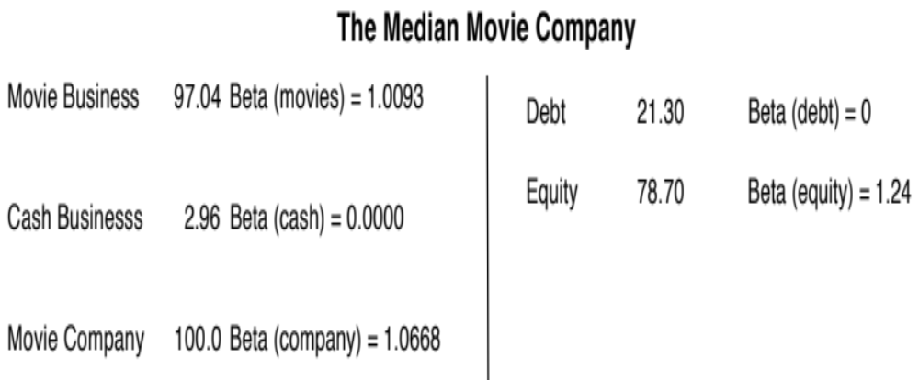
Backing into a pure play beta: Studio Entertainment
1. Start with the median regression beta (equity beta) of 1.24
2. Unlever the beta, using the median gross D/E ratio of 27.06%
Gross D/E ratio = 21.30/78.70 = 27.06%
Unlevered beta = 1.24/ (1+ (1-.4) (.2706)) = 1.0668
3. Take out the cash effect, using the median cash/value of 2.96%
(.0296) (0) + (1-.0296) (Beta of movie business) = 1.0668
Beta of movie business = 1.0668/(1-.0296) = 1.0993
Alternatively, you could have used the net debt to equity ratio
Net D/E ratio = (21.30-2.96)/78.70 = 23.30%
Unlevered beta for movies = 1.24/ (1+(1-.4)(.233)) = 1.0879
Notes:
Using the studio entertainment companies as the base, this page explains the process, step by step.
You always start with a regression or equity beta, then clean up for debt and then for cash. (I assumed a marginal tax rate of 40%, since these were all US firms)
An alternate approach is to net cash out against debt and use a net debt to equity ratio.
If you did that your net debt ratio would be (35.02- 8.93)/ 64.98 = 40.16%
The unlevered beta = 1.57/ (1+ (1-.4) (.4016)) = 1.2652
The answers are close but they will not be the same. With the net debt ratio, you are assuming that debt and cash not only cancel out in terms of risk but also in terms of tax advantages.

Slide 9
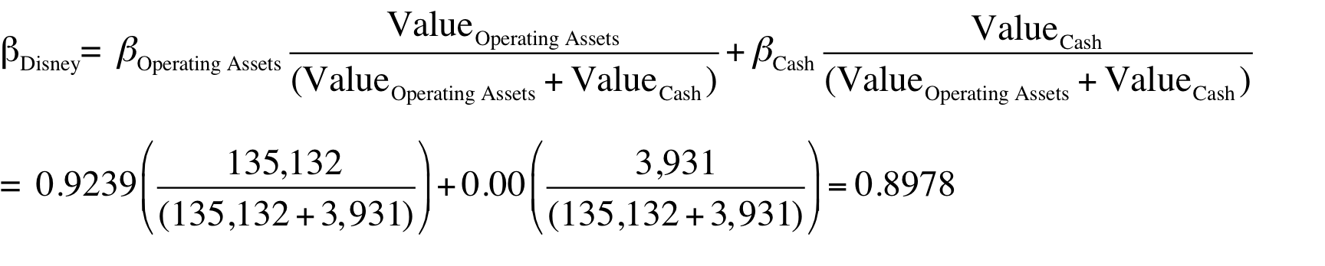
Disney’s unlevered beta: Operations & Entire Company
Business | Revenues | EV/Sales | Value of Business | Proportion of Disney | Unlevered beta | Value | Proportion
Media Networks | $20,356 | 3.27 | $66,580 | 49.27% | 1.03 | $66,579.81 | 49.27%
Parks & Resorts | $14,087 | 3.24 | $45,683 | 33.81% | 0.70 | $45,682.80 | 33.81%
Studio Entertainment | $5,979 | 3.05 | $18,234 | 13.49% | 1.10 | $18,234.27 | 13.49%
Consumer Products | $3,555 | 0.83 | $2,952 | 2.18% | 0.68 | $2,951.50 | 2.18%
Interactive | $1,064 | 1.58 | $1,684 | 1.25% | 1.22 | $1,683.72 | 1.25%
Disney Operations | $45,041 |  | $135,132 | 100.00% | 0.9239 | $135,132.11
Disney has $3.93 billion in cash, invested in close to riskless assets (with a beta of zero). You can compute an unlevered beta for Disney as a company (inclusive of cash):
Notes:
I used revenues and revenue multiples to estimate the values of each business. I could have also used EBIT or EBITDA, by business, and applied a multiple but the problem is with divisions that have negative values for either (as is the case with Interactive for Disney).
The reason that I compute two unlevered beta, one for just the operations and one that includes the cash (and is thus for the entire firm) is that each has its use somewhere along. When computing the cost of capital, which is a cost of funding your operating assets, I will use the former. If I needed a beta for a dividend discount model, where the dividends are paid out of composite earnings, I would use the latter.

Slide 10
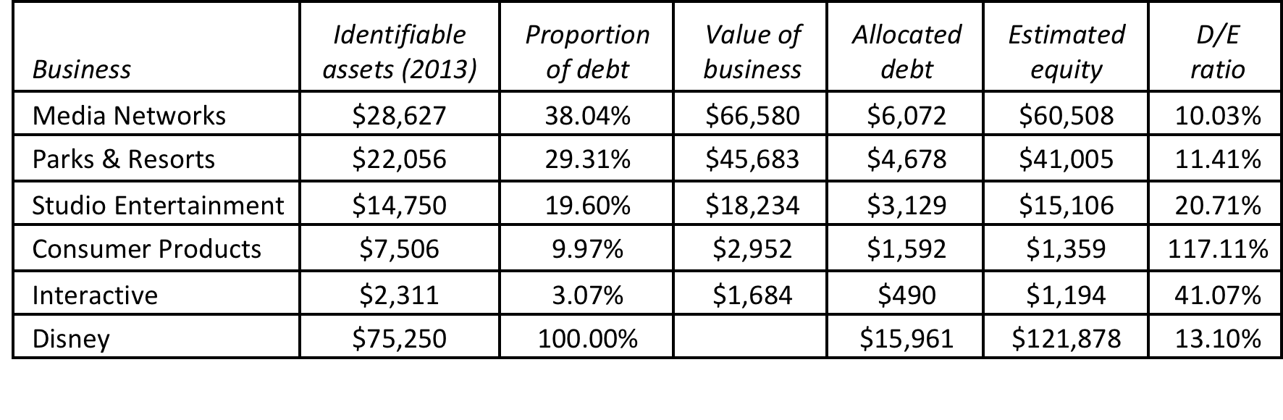
The levered beta: Disney and its divisions
To estimate the debt ratios for division, we allocate Disney’s total debt ($15,961 million) to its divisions based on identifiable assets.
We use the allocated debt to compute D/E ratios and levered betas.
Business | Unlevered beta | Value of business | D/E ratio | Levered beta | Cost of Equity
Media Networks | 1.0313 | $66,580 | 10.03% | 1.0975 | 9.07%
Parks & Resorts | 0.7024 | $45,683 | 11.41% | 0.7537 | 7.09%
Studio Entertainment | 1.0993 | $18,234 | 20.71% | 1.2448 | 9.92%
Consumer Products | 0.6752 | $2,952 | 117.11% | 1.1805 | 9.55%
Interactive | 1.2187 | $1,684 | 41.07% | 1.5385 | 11.61%
Disney Operations | 0.9239 | $135,132 | 13.10% | 1.0012 | 8.52%
Notes:
I allocated the debt based upon the identifiable assets (since these tend to be large, fixed assets, as defined by accountants) and thus more likely to require the use of debt.

Slide 11
Discussion Issue
Assume now that you are the CFO of Disney. The head of the movie business has come to you with a new big budget movie that he would like you to fund. He claims that his analysis of the movie indicates that it will generate a return on equity of 9.5%. Would you fund it?
  Yes. It is higher than the cost of equity for Disney as a company
  No. It is lower than the cost of equity for the movie business.
What are the broader implications of your choice?
Notes:
The cost of equity for each division should be used. Otherwise, the riskier divisions will over invest and the safest divisions will under invest.
Over time, the firm will become a riskier firm. Think of Bankers Trust from 1980, when it was a commercial bank, to 1992, when it had become primarily an investment bank.
It also means that any multi business company should have different hurdle rates for each business, with higher rates for riskier businesses and lower rates for safer businesses.

Slide 12

Task
Estimate a bottom-up beta for your company
Read
Chapter 4

