Slide 1
Hurdle rates iX: debt and its cost
Debt, the double-edged sword!
Notes:
Sets the agenda for the class. This is a class that will be focused on the big picture of corporate finance rather than details, theories or models on a piecemeal basis.

Slide 2
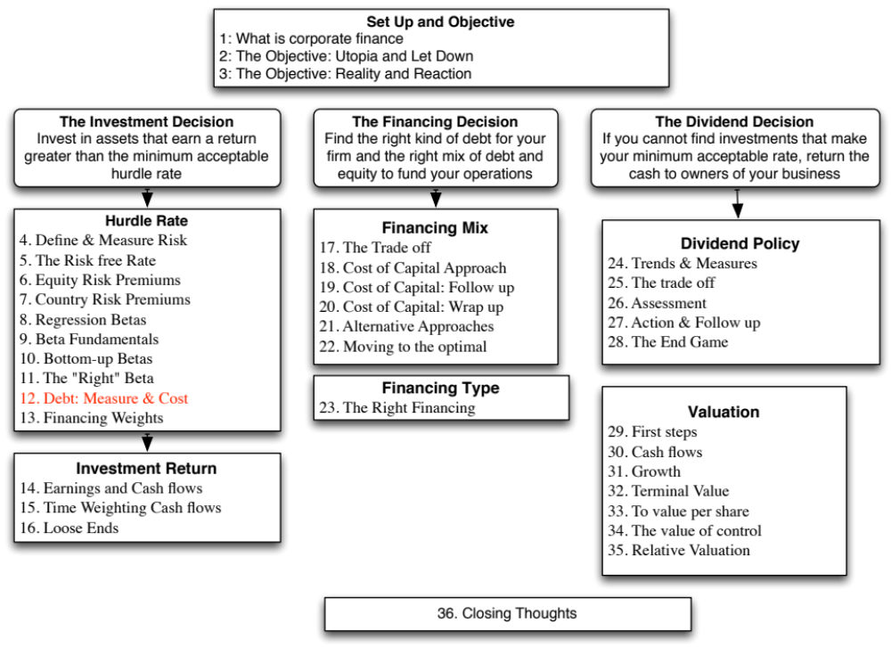

Slide 3
From Cost of Equity to Cost of Capital
The cost of capital is a composite cost to the firm of raising financing to fund its projects.
In addition to equity, firms can raise capital from debt
Notes:
Capital is more than just equity. It also includes other financing sources, particularly debt.

Slide 4
What is debt?
General Rule: Debt generally has the following characteristics:
  Commitment to make fixed payments in the future
  The fixed payments are tax deductible
  Failure to make the payments can lead to either default or loss of control of the firm to the party to whom payments are due.
As a consequence, debt should include
  Any interest-bearing liability, whether short term or long term.
  Any lease obligation, whether operating or capital.
Notes:
Debt is not restricted to what gets called debt in the balance sheet. It includes any financing with these characteristics.
Applying this test to items on the liability side of the balance sheet, we would conclude that
All interest bearing debt, short term as well as long term, is debt
Accounts payable and suppliers should not be considered debt because they don’t carry explicit interest expenses; they should be considered as part of working capital. Alternatively, you can try to make the implicit interest expenses (the discount you could have received by paying early rather than late) explicit and treat it as debt.
Other liabilities such as under funded pension or health care obligations are best not considered as debt (though there may be exceptions) since the commitments are flexible.

Slide 5
Estimating the Cost of Debt
If the firm has bonds outstanding, and the bonds are traded, the yield to maturity on a long-term, straight (no special features) bond can be used as the interest rate.
If the firm is rated, use the rating and a typical default spread on bonds with that rating to estimate the cost of debt.
If the firm is not rated,
  and it has recently borrowed long term from a bank, use the interest rate on the borrowing or
  estimate a synthetic rating for the company, and use the synthetic rating to arrive at a default spread and a cost of debt
The cost of debt has to be estimated in the same currency as the cost of equity and the cash flows in the valuation.
Notes:
There are two key components to the cost of debt:
You want a long-term cost (I use a 10-year cost) of debt even if your debt is short term. You do not want to reward companies that play the term structure by giving them a lower cost of debt and capital. In effect, you are assuming that the rolled over cost of short term debt = cost of long term debt.
You want a current cost. In other words, you do not care about the debt and interest expenses on the books. The book interest rate (interest expense/book debt) is not a good measure of the cost of debt because it does not reflect the current cost of borrowing any may even be lower than the riskfree rate.
While the cost of debt can be estimated easily for some firms, by looking up traded bonds, it can be more difficult for non-rated firms. The default spreads can be obtained from
http://www.bondsonline.com

Slide 6
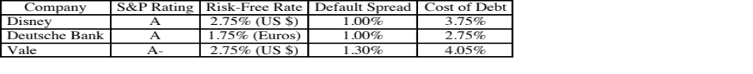
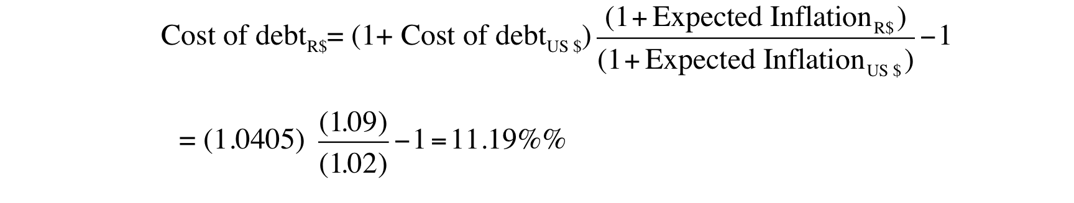
The easy route: Outsourcing the measurement of default risk
For those firms that have bond ratings from global ratings agencies, I used those ratings:
If you want to estimate Vale’s cost of debt in $R terms, we can again use the differential inflation approach we used for the cost of equity:
Notes:
You are trusting the ratings agencies to be right and to have incorporated all default risk (company as well as country) into the rating.

Slide 7
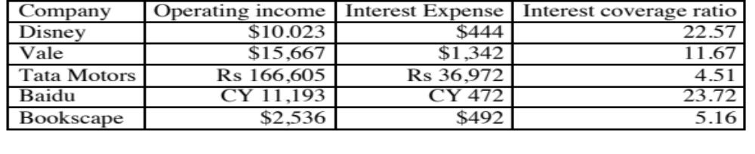
A more general route: Estimating Synthetic Ratings
The rating for a firm can be estimated using the financial characteristics of the firm. In its simplest form, we can use just the interest coverage ratio:
Interest Coverage Ratio = EBIT / Interest Expenses
For the four non-financial service companies, we obtain the following:
Notes:
Basing the rating on just an interest coverage ratio will give you an approximation for the rating. A more realistic approach would use more than the interest coverage ratio. In fact, we could construct a score based upon multiple ratios (such as a Z-score) and use that score to estimate ratings.
The operating income used to compute the rating does not have to be last year’s number. It can be an average over time or a normalized value.

Slide 8
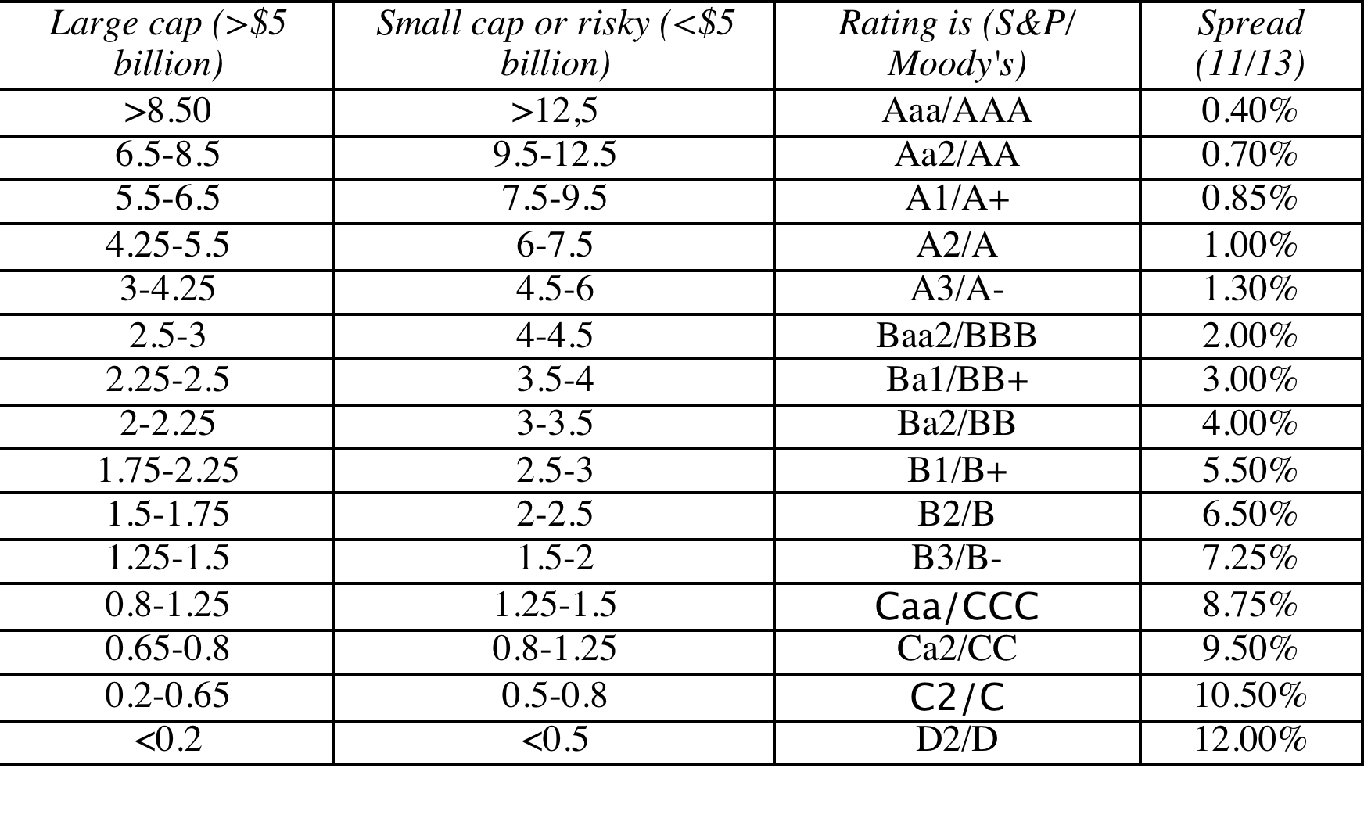
Interest Coverage Ratios, Ratings and Default Spreads- November 2013
Disney: Large cap, developed 22.57 → AAA
Vale: Large cap, emerging 11.67 → AA
Tata Motors: Large cap, Emerging 4.51 → A-
Baidu: Small cap, Emerging 23.72 → AAA
Bookscape: Small cap, private 5.16 → A-
Notes:
This table is constructed, using smaller non-financial service companies (<$5 billion market cap) that are rated, and their interest coverage ratios. The firms were sorted based upon their ratings, and the interest coverage range was estimated.
These ranges will change over time, especially as the economy strengthens or weakens. You can get the updated ranges on my web site.

Slide 9
Synthetic versus Actual Ratings: Rated Firms
Disney’s synthetic rating is AAA, whereas its actual rating is A. The difference can be attributed to any of the following:
  Synthetic ratings reflect only the interest coverage ratio whereas actual ratings incorporate all of the other ratios and qualitative factors
  Synthetic ratings do not allow for sector-wide biases in ratings
  Synthetic rating was based on 2013 operating income whereas actual rating reflects normalized earnings
Vale’s synthetic rating is AA, but the actual rating for dollar debt is A-. The biggest factor behind the difference is the presence of country risk, since Vale is probably being rated lower for being a Brazil-based corporation.
Deutsche Bank had an A rating. We will not try to estimate a synthetic rating for the bank. Defining interest expenses on debt for a bank is difficult…
Notes:
The synthetic ratings process will deliver reasonably close ratings for any firm with debt of substance. It will tend to overstate ratings for firms with little debt (technology firms often will get AAA ratings because their interest coverage ratios are so high). The fact that these ratings are too high is not an issue because these companies also have so little debt in their capital structure - the cost of capital is very close to the cost of equity.
Can we trust rating agencies? In general, ratings agencies do a reasonable job of assessing default risk and offer us these measures for free (at least to investors). They have two faults: (1) They adjust for changes in default risk too slowly. All too often ratings downgrades follow bond price declines and not the other way around (2) They sometimes get caught up in the mood of the moment and either overestimate default risk or underestimate default risk for an entire sector.
It is a good idea to estimate synthetic ratings even for firms that have actual ratings. If there is disagreement between ratings agencies or a firm has multiple bond ratings, the synthetic rating can operate as a tie-breaker. If there is a significant difference between actual and synthetic ratings and there is no fundamental reason that can be pinpointed for the difference, the synthetic rating may be providing an early signal of a ratings agency mistake.

Slide 10
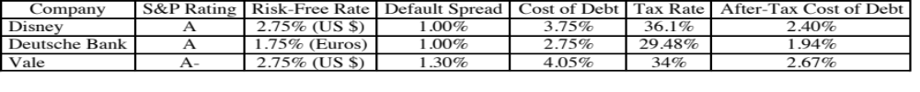
Estimating Cost of Debt
For Bookscape, we will use the synthetic rating (A-) to estimate the cost of debt:
  Default Spread based upon A- rating = 1.30%
  Pre-tax cost of debt = Riskfree Rate + Default Spread = 2.75% + 1.30% = 4.05%
  After-tax cost of debt = Pre-tax cost of debt (1- tax rate) = 4.05% (1-.40) = 2.43%
For the three publicly traded firms that are rated in our sample, we will use the actual bond ratings to estimate the costs of debt.
For Tata Motors, we have a rating of AA- from CRISIL, an Indian bond-rating firm, that measures only company risk. Using that rating:
  Cost of debt_{TMT} = Risk free rate_{Rupees} + Default spread_{India} + Default spread_{TMT}
  = 6.57% + 2.25% + 0.70% = 9.62%
  After-tax cost of debt = 9.62% (1-.3245) = 6.50%
Notes:
The tax rate used is the marginal tax rate…. Interest saves you taxes on your marginal income, not the first or average dollar of income….
The marginal tax rate comes from the tax code and as relatively little to do with your company. For US companies, it should be 35%+. For non-US companies, it will reflect the tax rates in those countries (low in HK and Singapore, higher in Europe and Latin America…)
For Tata Motors, we added the country default spread on to the company default spread to reflect the fact that Tata has to bear the burden of country risk when it borrows. (We skipped this step with Aracruz because we used the actual rating, which already reflects Brazil country risk)
For Disney, Deutsche Bank and Vale, we chose to use the actual ratings rather than the synthetic rating, because it does contain more information.

Slide 11
Updated Default Spreads – January 2017
Notes:
This table should be updated frequently and should have current default spreads in it. These will be the spreads you use for your synthetic ratings today.

Slide 12
6 Application Test: Estimating a Cost of Debt
Based upon your firm’s current earnings before interest and taxes, its interest expenses, estimate
  An interest coverage ratio for your firm
  A synthetic rating for your firm (use the tables from prior pages)
  A pre-tax cost of debt for your firm
  An after-tax cost of debt for your firm
Notes:
To estimate the after-tax cost of debt, you need a marginal tax rate. Since the federal tax rate for corporations is 35%, I would expect the marginal tax rate to be 35% of higher for US companies. Thus, even if the effective tax rate reported in the financial statements are lower, I would use at least 35%. If the effective tax rate is higher than 35%, I would use the effective tax rate, with the assumption that it is capturing other taxes that the firm has to pay.

Slide 13

Task
Estimate the cost of debt for your company
Read
Chapter 4

Slide 14
Chapter 4

