Slide 1
Investment returns II: From earnings to time-weighted cash flows
Time is money.
Notes:
Sets the agenda for the class. This is a class that will be focused on the big picture of corporate finance rather than details, theories or models on a piecemeal basis.

Slide 2
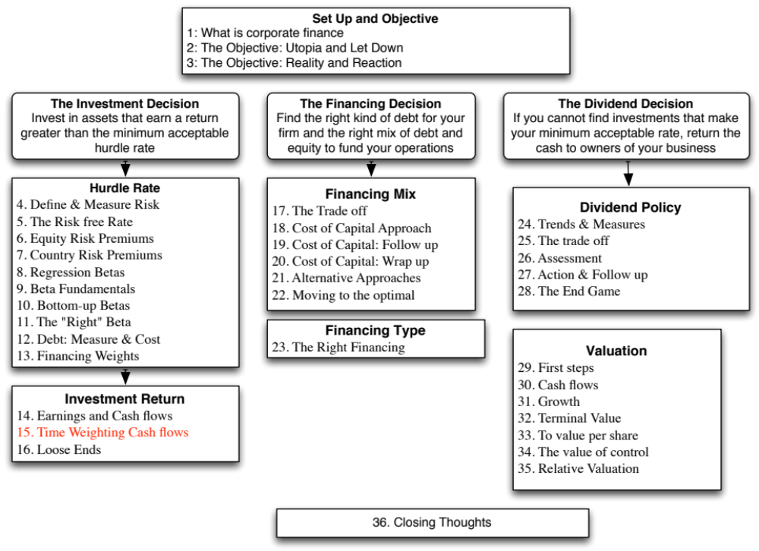

Slide 3
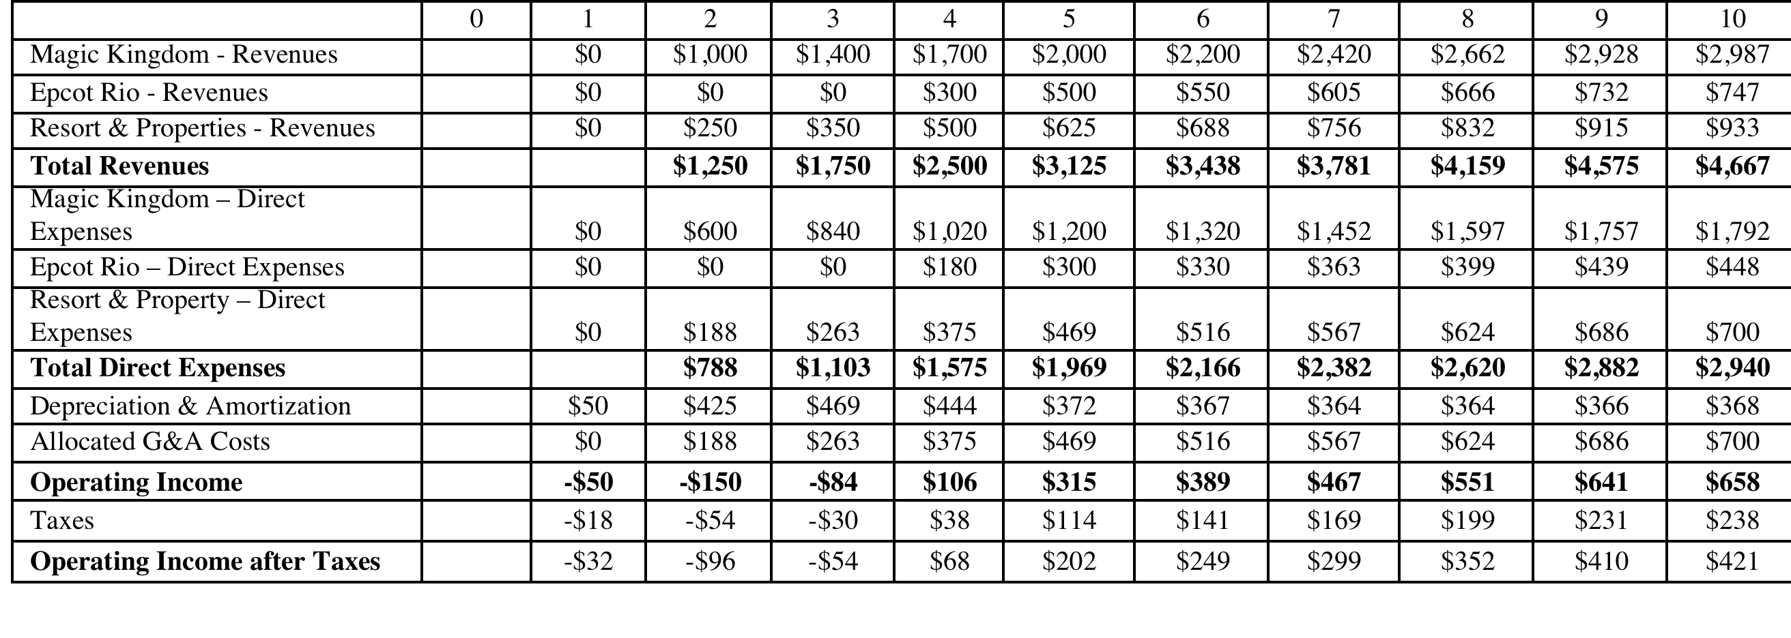
Revisiting accounting earnings on Rio Disney
Direct expenses: 60% of revenues for theme parks, 75% of revenues for resort properties
Allocated G&A: Company G&A allocated to project, based on projected revenues. Two thirds of expense is fixed, rest is variable.
Taxes: Based on marginal tax rate of 36.1%
Notes:
This shows the accounting earnings calculations for the next 10 years. Note the increasing after-tax operating income over time.
Note that loss in year 1. While this loss can be carried forward and offset against profits in future years, we have chosen to claim the losses against Disney’s profits from other projects in year 1. (You would rather save taxes now than the same taxes in the future…)
Where are the interest expenses? They do not show up because we are computing earnings to the firm - operating income - rather than earnings to equity - net income.

Slide 4
The cash flow view of this project..
 | 0 | 1 | 2 | 3 | 4 | 5 | 6 | 7 | 8 | 9 | 10
After-tax Operating Income |  | -$32 | -$96 | -$54 | $68 | $202 | $249 | $299 | $352 | $410 | $421
+ Depreciation & Amortization | $0 | $50 | $425 | $469 | $444 | $372 | $367 | $364 | $364 | $366 | $368
- Capital Expenditures | $2,500 | $1,000 | $1,188 | $752 | $276 | $258 | $285 | $314 | $330 | $347 | $350
- Change in non-cash Work Capital |  | $0 | $63 | $25 | $38 | $31 | $16 | $17 | $19 | $21 | $5
Cashflow to firm | ($2,500) | ($982) | ($921) | ($361) | $198 | $285 | $314 | $332 | $367 | $407 | $434
added back all non-cash charges such as depreciation.
subtracted out the capital expenditures
subtracted out the change in non-cash working capital
 | 1 | 2 | 3 | 4 | 5 | 6 | 7 | 8 | 9 | 10
Depreciation | $50 | $425 | $469 | $444 | $372 | $367 | $364 | $364 | $366 | $368
Tax Bendfits from Depreciation | $18 | $153 | $169 | $160 | $134 | $132 | $132 | $132 | $132 | $133
Notes:
This converts earnings to cash flows.
Depreciation and amortization are just two of the most common non-cash charges.
Any capital expenditures (whether initial or maintenance) need to be subtracted out.
It is only the change in non-cash working capital that needs to be subtracted out.

Slide 5
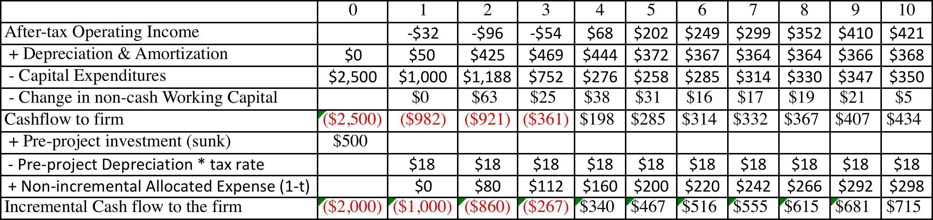
The incremental cash flows on the project
$ 500 million has already been spent & $ 50 million in depreciation will exist anyway
2/3rd of allocated G&A is fixed.
Add back this amount (1-t)
Tax rate = 36.1%
Notes:
A sunk cost is any cost that has already been incurred and will not be recovered even if the project under consideration is rejected.
The tax savings on the depreciation on the sunk cost is also subtracted out, since that tax savings would accrue to the firm even if it did not take this investment.
Only the after-tax amount of the non-incremental allocated costs are added back because the cash flows are after-tax cash flows.
Alternatively, the cash flows can be estimated from scratch using only the incremental cash flows.

Slide 6
To Time-Weighted Cash Flows
Incremental cash flows in the earlier years are worth more than incremental cash flows in later years.
In fact, cash flows across time cannot be added up. They have to be brought to the same point in time before aggregation.
This process of moving cash flows through time is
  discounting, when future cash flows are brought to the present
  compounding, when present cash flows are taken to the future
Notes:
Cash flows across time cannot be compared. Discounting brings cash flows back to the same point in time.
The present value factors are in a sense time-weighing factors. The riskier a cash flow and the further it is in the future, the lower the weight you attach to that cash flow.

Slide 7
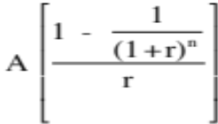

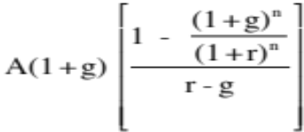
Present Value Mechanics
Cash Flow Type Discounting Formula Compounding Formula
1. Simple CF CF_{n} / (1+r)^{n} CF₀ (1+r)^{n}
2. Annuity
3. Growing Annuity
4. Perpetuity A/r
5. Growing Perpetuity Expected Cashflow next year/(r-g)
Notes:
These are the basic present value formulae. All except the growing annuity, can be done using the PV key on any financial calculator.
These formulae are based upon the assumptions that cash flows occur at the end of each period. If cash flows occur at the end of each period, the equations can be modified by multiplying each one by (1+r) to get end-of-the-period equivalents.

Slide 8
Discounted cash flow measures of return
Net Present Value (NPV): The net present value is the sum of the present values of all cash flows from the project (including initial investment).
  NPV = Sum of the present values of all cash flows on the project, including the initial investment, with the cash flows being discounted at the appropriate hurdle rate (cost of capital, if cash flow is cash flow to the firm, and cost of equity, if cash flow is to equity investors)
  Decision Rule: Accept if NPV > 0
Internal Rate of Return (IRR): The internal rate of return is the discount rate that sets the net present value equal to zero. It is the percentage rate of return, based upon incremental time-weighted cash flows.
  Decision Rule: Accept if IRR > hurdle rate
Notes:
The key difference between these approaches is that Net Present Value is a dollar measure, and it measures surplus value created. Thus, even a small net present value is over and above your hurdle rate.
Internal rate of return is a percentage measure of total return (not excess return). It is only when it is compared to the hurdle rate that is provides a measure of excess return (in percentage terms)

Slide 9
Closure on Cash Flows
In a project with a finite and short life, you would need to compute a salvage value, which is the expected proceeds from selling all of the investment in the project at the end of the project life. It is usually set equal to book value of fixed assets and working capital
In a project with an infinite or very long life, we compute cash flows for a reasonable period, and then compute a terminal value for this project, which is the present value of all cash flows that occur after the estimation period ends..
Assuming the project lasts forever, and that cash flows after year 10 grow 2% (the inflation rate) forever, the present value at the end of year 10 of cash flows after that can be written as:
  Terminal Value in year 10= CF in year 11/(Cost of Capital - Growth Rate)
  =715 (1.02) /(.0846-.02) = $ 11,275 million
Notes:
When you stop estimating cash flows on a project, you have to either estimate salvage value or terminal value. For projects with finite lives (such as buying a plant or equipment), estimating salvage value is appropriate. For projects with very long lives, estimating a terminal value is more reasonable.
If you assume that the project is liquidated, any investments in working capital have to be salvaged. This does not necessarily mean that you will get 100% back.
A terminal value can also be thought off as the value that you would get by selling this project (as an on-going project) to someone else at the end of the analysis. In this case, we are estimating that the theme park in Bangkok will be worth $ 10,669 million at the end of year 10. (The perpetual growth model gives the value of the asset at the beginning of the year of the cash flow. We used year 11 cash flows in the numerator and have the terminal value as of the start of year 11, which is also the end of year 10)

Slide 10
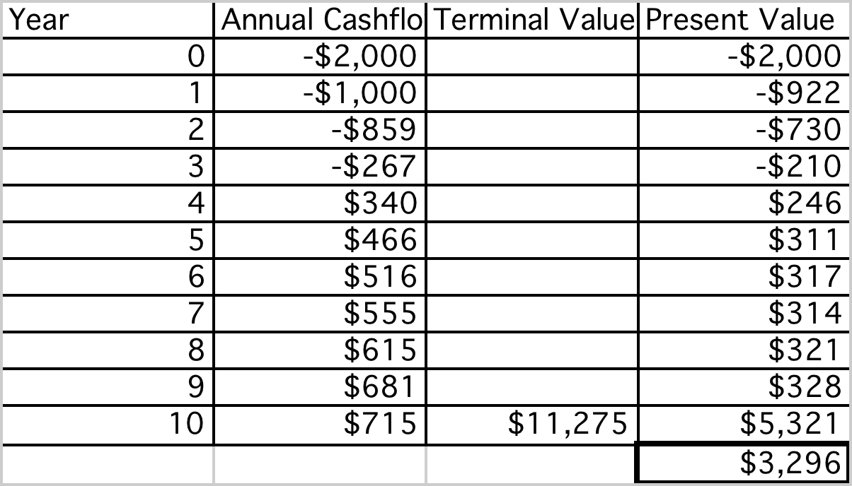
Which yields a NPV of..
Discounted at Rio Disney cost of capital of 8.46%
Notes:
This is the net present value calculation using the cost of capital of 8.62%, the theme park cost of capital adjusted for emerging market risk in Brazil.

Slide 11
Which makes the argument that..
The project should be accepted. The positive net present value suggests that the project will add value to the firm, and earn a return in excess of the cost of capital.
By taking the project, Disney will increase its value as a firm by $3,296 million.
Notes:
The net present value calculation suggests that this project is a good one.
The increase in firm value will not necessarily translate into an increase in market value, since market values reflect expectations. If expectations were such that the market expected Disney to take large positive NPV projects, the $3,296 million will have to be measured against these expectations.
The additive nature of NPV is useful in a variety of contexts:
The value of a business that is composed of many projects can be written as the sum of the NPVs of the projects.
When a firm over pays on an acquisition, it is the equivalent of accepting a negative NPV investment, and the value of its equity should drop by the overpayment.

Slide 12
The IRR of this project
Notes:
This is a net present value profile, where NPV is plotted against discount rates. The IRR is that discount rate at which NPV is zero.
The steepness of the slope tells us something about how sensitive this investment is to changes in the discount rate. (It is the equivalent of the duration of a bond, which tells you how sensitive bond prices are to changes in interest rates).
Notice that the NPV is much more sensitive to changes in discount rates, when discount rates are low, than when they are high. (This may have consequences for how value will change in low interest rate scenarios as opposed to high interest rate ones).

Slide 13
The IRR suggests..
The project is a good one. Using time-weighted, incremental cash flows, this project provides a return of 12.60%. This is greater than the cost of capital of 8.46%.
The IRR and the NPV will yield similar results most of the time, though there are differences between the two approaches that may cause project rankings to vary depending upon the approach used. They can yield different results, especially why comparing across projects because
  A project can have only one NPV, whereas it can have more than one IRR.
  The NPV is a dollar surplus value, whereas the IRR is a percentage measure of return. The NPV is therefore likely to be larger for “large scale” projects, while the IRR is higher for “small-scale” projects.
  The NPV assumes that intermediate cash flows get reinvested at the “hurdle rate”, which is based upon what you can make on investments of comparable risk, while the IRR assumes that intermediate cash flows get reinvested at the “IRR”.
Notes:
The information needed to use IRR in investment analysis is the same as the information need to use NPV.
If the hurdle rate is changing over time, IRR becomes more complicated to use. It has to be compared to the geometric average of the hurdle rates over time.

Slide 14

Task
Describe a typical investment for your company
Read
Chapter 5

