Slide 1
OPTIMAL FINANCING MIX I: THE TRADE OFF
Neither a borrower nor a lender be! Good or bad advice?
Notes:
Sets the agenda for the class. This is a class that will be focused on the big picture of corporate finance rather than details, theories or models on a piecemeal basis.

Slide 2
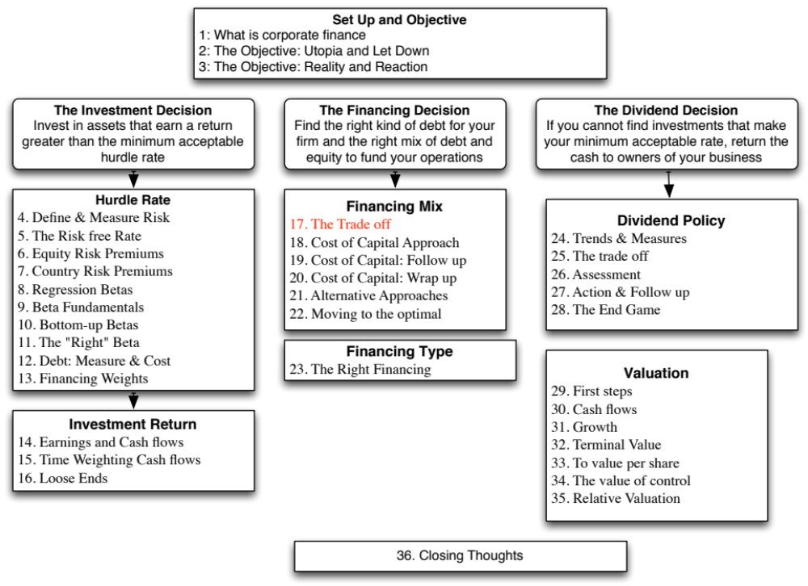

Slide 3
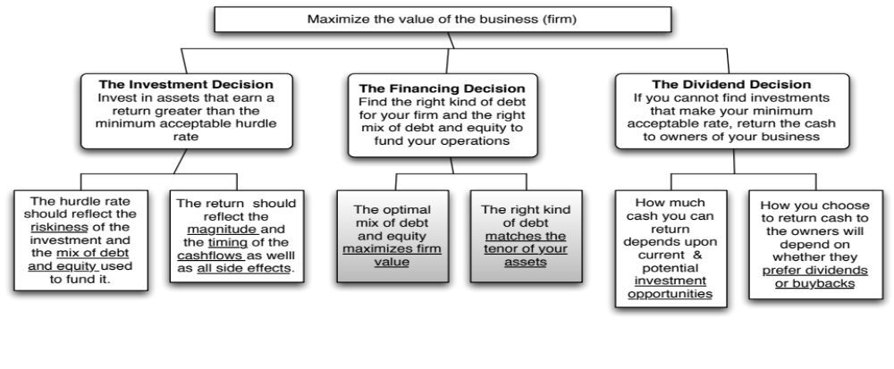
First Principles
Notes:
We shift from the investment principle to the financing principle.

Slide 4
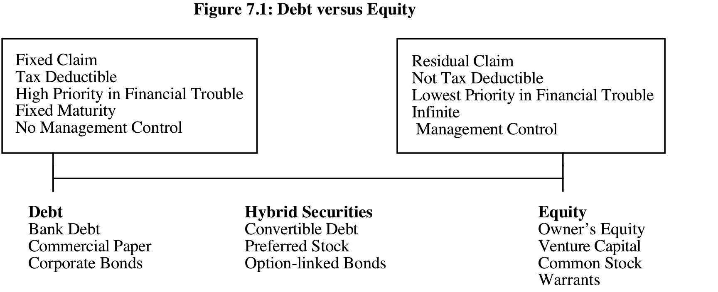
Debt or Equity: The Continuum
The simplest measure of how much debt and equity a firm is using currently is to look at the proportion of debt in the total financing. This ratio is called the debt to capital ratio:
Debt to Capital Ratio = Debt / (Debt + Equity)
In general, this ratio should be computed using market values for both debt and equity, and include all debt.
Notes:
Rather than categorizing financing based on what it is called or categorized as by accountants, we should be thinking whether financing is debt or equity by looking at the following questions:
1. Are the payments on the securities contractual or residual?
If contractually set, it is closer to debt.
If residual, it is closer to equity.
2. Are the payments tax-deductible?
If yes, it is closer to debt.
If no, if is closer to equity.
3. Do the cash flows on the security have a high priority or a low priority if the firm is in financial trouble?
If it has high priority, it is closer to debt.
If it has low priority, it is closer to equity.
4. Does the security have a fixed life?
If yes, it is closer to debt.
If no, it is closer to equity.
5. Does the owner of the security get a share of the control of management of the firm?
If no, it is closer to debt.
If yes, if is closer to equity

Slide 5
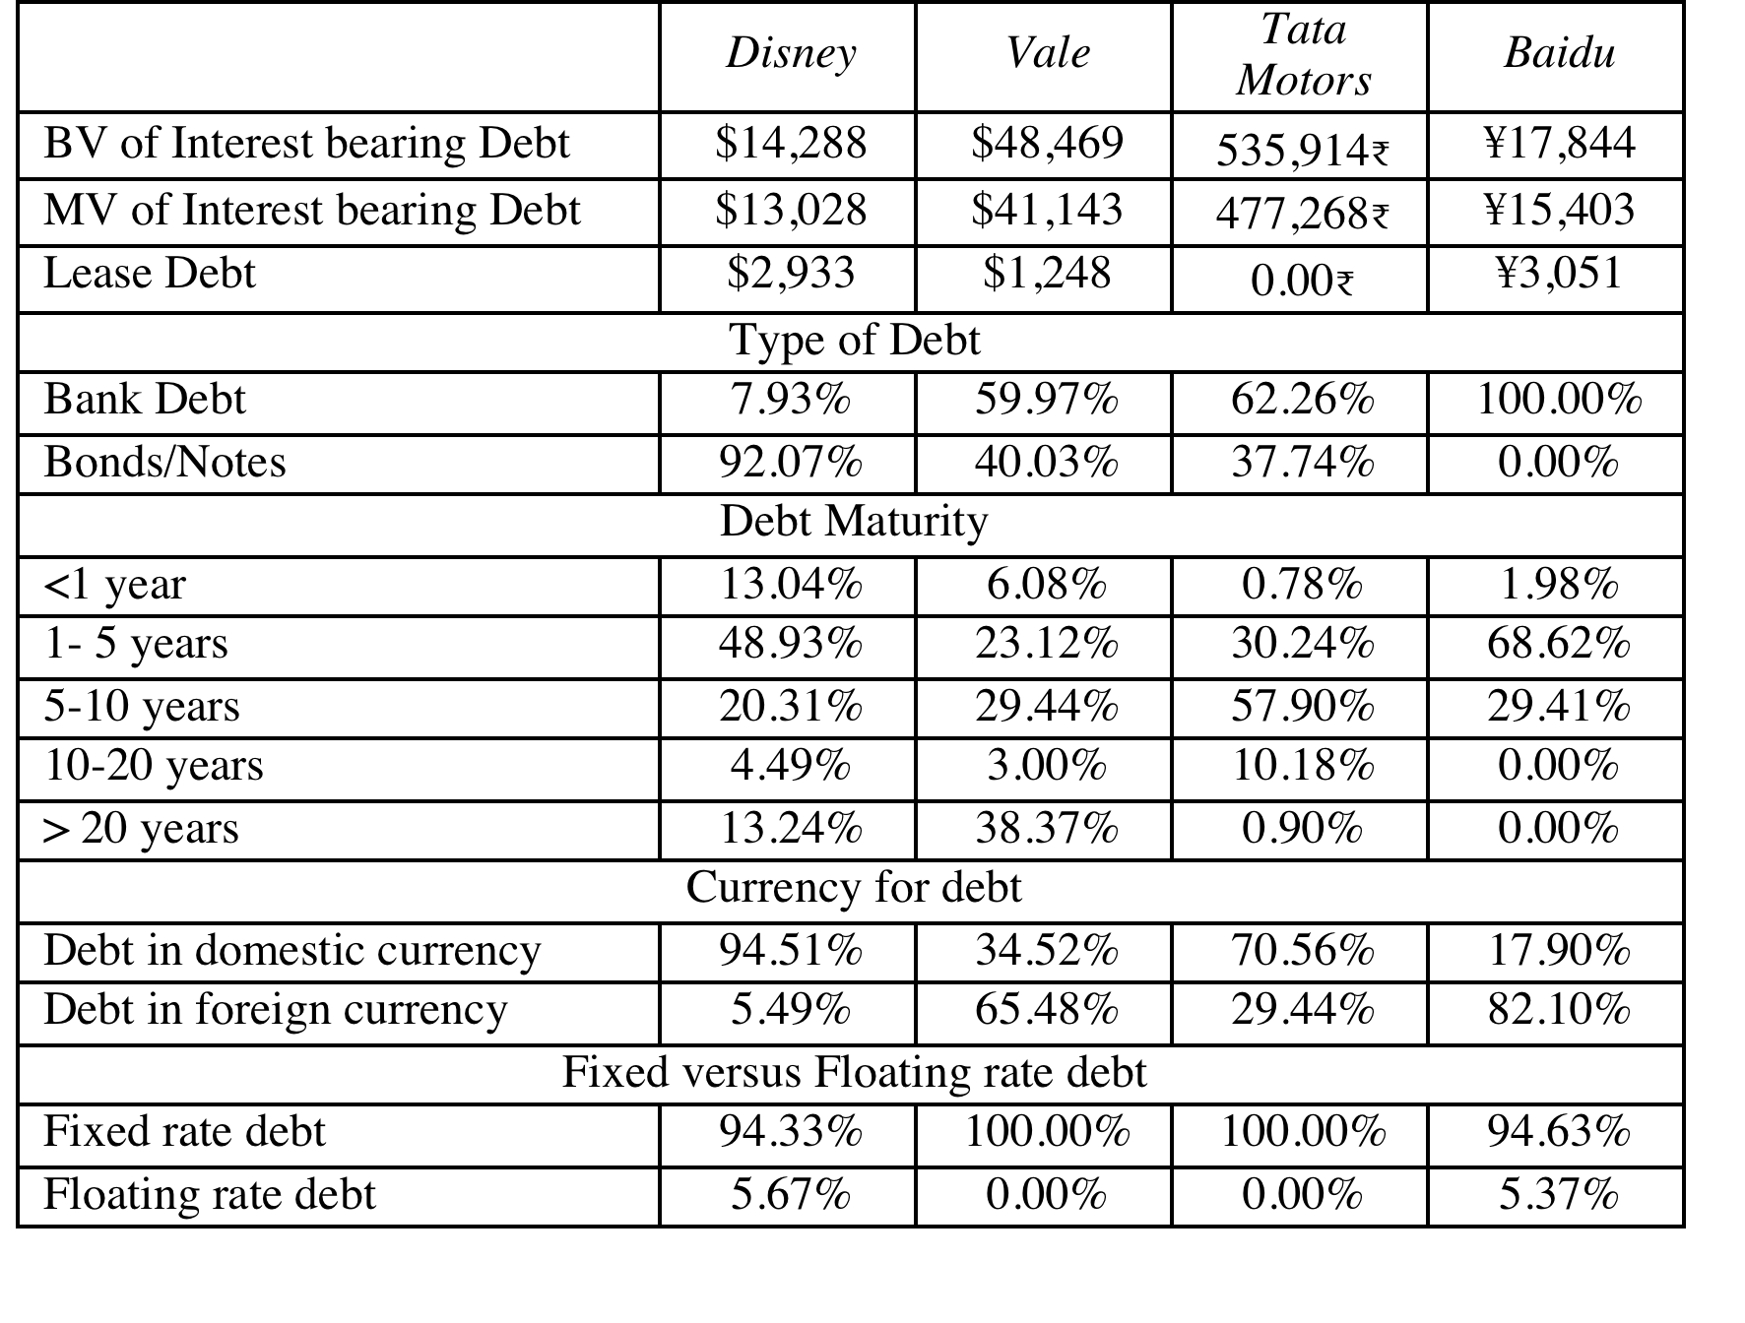
Assessing the existing financing choices: Disney, Vale, Tata Motors & Baidu
Notes:
Disney used the corporate bond market much more extensively than the other companies in this group, with 92% of its debt coming from bonds rather than bank loans.
While Disney has the higher proportion of short term debt of the three companies, it also has some very long term debt. That may also be a reflection of its use of the bond market, since banks, especially in emerging markets, may be unwilling to commit to long term loans.
Disney and Tata Motors both use floating rate debt, but only to a limited extent.
Disney & Tata Motors borrow predominantly in their domestic currencies. Vale and Baidu have most of their debt in foreign currencies.

Slide 6
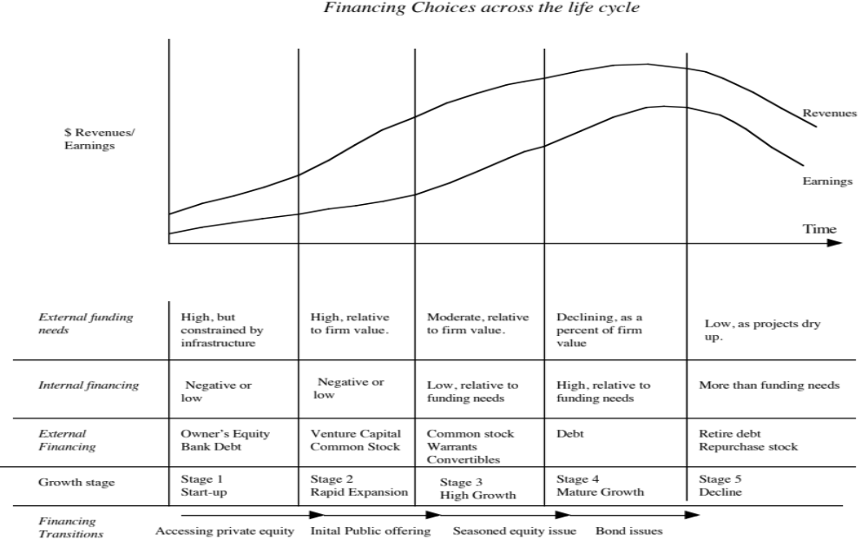
Notes:
The forms that debt and equity take will change as a firm moves through its lifecycle. Early in the process, equity will take the form of owner’s wealth or savings and debt will be bank debt. As the firm evolves, the equity choices will expand first to include venture capital and private equity. When the firm goes public, its choices expand further.
There are three transitional periods: (1) Going from being a private business entirely funded by the owner to accessing the private equity markets (venture capital) (2) Going from private to public with an initial public offering and (3) Public companies making seasoned offerings of debt and equity.

Slide 7

Debt: Summarizing the trade off
Notes:
Brings together the costs and the benefits of debt, with the implications.

Slide 8
Costs and Benefits of Debt
Benefits of Debt
  Tax Benefits: The tax code is tilted in favor of debt, with interest payments being tax deductible in most parts of the world, while cash flows to equity are not.
  Adds discipline to management: When managers are sloppy in their project choices, borrowing money may make them less so.
Costs of Debt
  Bankruptcy Costs: Borrowing money will increase your expected probability and cost of bankruptcy.
  Agency Costs: What’s good for stockholders is not always what’s good for lenders and that creates friction and costs.
  Loss of Future Flexibility: Using up debt capacity today will mean that you will not be able to draw on it in the future.
Notes:
This summarizes the trade off that we make when we choose between using debt and equity. If the benefits exceed the costs, you should borrow. If not, it is better to use equity.

Slide 9
Tax Benefits of Debt
When you borrow money, you are allowed to deduct interest expenses from your income to arrive at taxable income. This reduces your taxes. When you use equity, you are not allowed to deduct payments to equity (such as dividends) to arrive at taxable income.
The dollar tax benefit from the interest payment in any year is a function of your tax rate and the interest payment:
  Tax benefit each year = Tax Rate * Interest Payment
  The caveat is that you need to have the income to cover interest payments to get this tax benefit.
Proposition 1: Other things being equal, the higher the marginal tax rate of a business, the more debt it will have in its capital structure.
Notes:
The tax benefit of debt will be lower if the tax code allows some or all of the cash flows to equity to be tax deductible, as well. For instance, in Germany, dividends paid to stockholders are taxed at a lower rate than retained earnings. In these cases, the tax advantage of debt will be lower.
If you do not pay taxes, debt becomes a lot less attractive. Carnival Cruise Lines, which gets most of its business from the United States pays no taxes because it is domiciled in Liberia. We would expect it to have less debt in its capital structure than a competitor in the US which pays taxes.
Implications:
Debt ratios for firms should go up as corporate tax rates increase.
Debt ratios of firms incorporated in high-tax locales should be higher than debt ratios of firms in low-tax or tax exempt locales.

Slide 10
Debt adds discipline to management
If you are managers of a firm with no debt, and you generate high income and cash flows each year, you tend to become complacent and invest in poor projects.
Forcing such a firm to borrow money can be an antidote to the complacency. The managers now have to ensure that the investments they make will earn at least enough return to cover the interest expenses. The cost of not doing so is bankruptcy and the loss of such a job.
Notes:
Managers of publicly traded firms with substantial cash flows and little debt are much more protected from the consequences of their mistakes (especially when stockholders are powerless and boards toothless).
Left to themselves, managers (especially lazy ones) would rather run all-equity financed firms with substantial cash reserves.
There are two pieces of evidence that you can point to in support of this proposition.
First, poorly managed, poorly run firms, where managers are not significant stockholders, are more likely to be targeted for leveraged buyouts.
Second, there is evidence of improvements in operating efficiency at firms that increase their debt ratio substantially.

Slide 11
Bankruptcy Cost
The expected bankruptcy cost is a function of two variables--
  the probability of bankruptcy, which will depend upon how uncertain you are about future cash flows
  the cost of going bankrupt
    direct costs: Legal and other Deadweight Costs
    indirect costs: Costs arising because people perceive you to be in financial trouble
Proposition 2: Firms with more volatile earnings and cash flows will have higher probabilities of bankruptcy at any given level of debt and for any given level of earnings.
Proposition 3: Other things being equal, the greater the indirect bankruptcy cost, the less debt the firm can afford to use for any given level of debt.
Notes:
Studies (see Warner) seem to indicate that the direct costs of bankruptcy are fairly small (10% or less or firm value)
The indirect cost of going bankrupt comes from the perception that you are in financial trouble, which in turn affects sales and the capacity to raise credit. We would expect indirect bankruptcy costs to vary across firms and be higher at
a. Firms that sell durable products with long lives that require replacement parts and service
b. Firms that provide goods or services for which quality is an important attribute but is difficult to determine in advance.
c. Firms producing products whose value to customers depends on the services and complementary products supplied by independent companies
As an example, when Apple Computer was perceived to be in financial trouble in early 1997, first-time buyers and businesses stopped buying Apple computers and software firms stopped coming up with upgrades for Mac products.
Similarly, Kmart found that suppliers started demanding payments in 30 days instead of 60 days, when it got into financial trouble.
The probability of bankruptcy should be a function of the predictability (or variability) of earnings.

Slide 12
Agency Cost
When you lend money to a business, you are allowing the stockholders to use that money in the course of running that business. Stockholders interests are different from your interests, because
  You (as lender) are interested in getting your money back
  Stockholders are interested in maximizing their wealth
In some cases, the clash of interests can lead to stockholders
  Investing in riskier projects than you would want them to
  Paying themselves large dividends when you would rather have them keep the cash in the business.
Proposition 4: Other things being equal, the greater the agency problems associated with lending to a firm, the less debt the firm can afford to use.
Notes:
What is good for equity investors might not be good for bondholders and lenders…. Equity investors describe the projects that they will be funding with debt as safe and secure. However…
A risky project, with substantial upside, may make equity investors happy, but they might cause bondholders, who do not share in the upside, much worse off.
Similarly, paying a large dividend may make stockholders happier but they make lenders less well off.
Lenders recognize this tendency and factor them into their lending by
charging a higher interest rate up front for the loan
Putting restrictive covenants on the loan
These create costs for the borrower.

Slide 13
Loss of future financing flexibility
When a firm borrows up to its capacity, it loses the flexibility of financing future projects with debt.
Thus, if the firm is faced with an unexpected investment opportunity or a business shortfall, it will not be able to draw on debt capacity, if it has alread used it up.
Proposition 5: Other things remaining equal, the more uncertain a firm is about its future financing requirements and projects, the less debt the firm will use for financing current projects.
Notes:
Firms like to preserve flexibility. The value of flexibility should be a function of how uncertain future investment requirements are, and the firm’s capacity to raise fresh capital quickly.
Firms with uncertain future needs and the inability to access markets quickly will tend to value flexibility the most, and borrow the least.

Slide 14
6Application Test: Would you expect your firm to gain or lose from using debt?
Consider, for your firm,
  The potential tax benefits of borrowing
  The benefits of using debt as a disciplinary mechanism
  The potential for expected bankruptcy costs
  The potential for agency costs
  The need for financial flexibility
Would you expect your firm to have a high debt ratio or a low debt ratio?
Does the firm’s current debt ratio meet your expectations?
Notes:
This is just a qualitative analysis. It will not give you a specific optimal debt ratio but provides insight into why the firm may be using the financing mix that it is today.

Slide 15
A Hypothetical Scenario
Assume that you live in a world where
  (a) There are no taxes
  (b) Managers have stockholder interests at heart and do what’s best for stockholders.
  (c) No firm ever goes bankrupt
  (d) Equity investors are honest with lenders; there is no subterfuge or attempt to find loopholes in loan agreements.
  (e) Firms know their future financing needs with certainty
Benefits of debt | Costs of debt
Tax benefits | Expected Bankruptcy Cost
Added Discipline | Agency Costs
 | Need for financial flexibility
Notes:
Assume that you super impose these assumptions on the balance sheet on the previous page. The advantages of debt go to zero, as do the disadvantages. Under such a scenario, firms should be indifferent to issuing debt.

Slide 16
The Miller-Modigliani Theorem
In an environment, where there are no taxes, default risk or agency costs, capital structure is irrelevant.
In this world,
  Leverage is irrelevant. A firm's value will be determined by its project cash flows.
  The cost of capital of the firm will not change with leverage. As a firm increases its leverage, the cost of equity will increase just enough to offset any gains to the leverage
Notes:
With the assumptions on the previous page:
The cost of capital will remain unchanged as the debt ratio changes
The value of the firm will not be a function of leverage
Investment decisions can be made independently of financing decisions
Note that if we allow for tax benefits, and keep the other assumptions, the optimal debt ratio will go to 100%.

Slide 17

Task
Evaluate the trade off on debt & equity for your company.
Read
Chapter 7

