Slide 1
Dividends: The trade off
“Companies don’t have cash. They hold cash for their stockholders.”
Notes:
The final piece of the corporate finance puzzle.

Slide 2
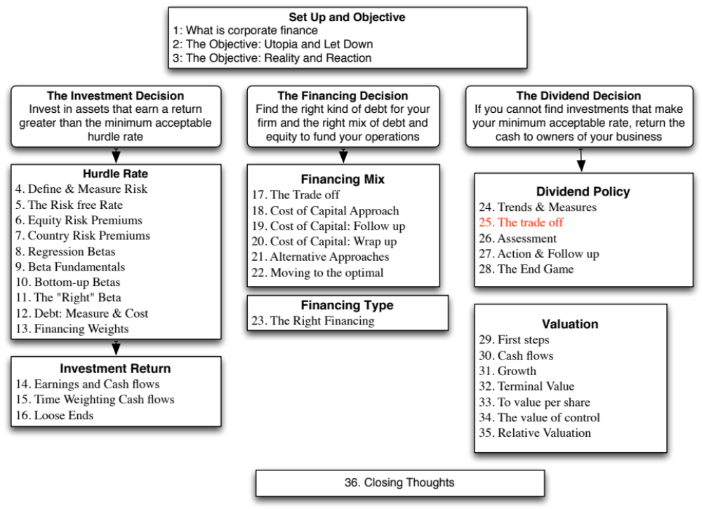

Slide 3
Three Schools Of Thought On Dividends
If there are no tax disadvantages associated with dividends & companies can issue stock, at no issuance cost, to raise equity, whenever needed
  Dividends do not matter, and dividend policy does not affect value.
If dividends create a tax disadvantage for investors (relative to capital gains)
  Dividends are bad, and increasing dividends will reduce value
If dividends create a tax advantage for investors (relative to capital gains) and/or stockholders like dividends
  Dividends are good, and increasing dividends will increase value
Notes:
Note that the schools span the spectrum. Firms which increase, decrease or do nothing on dividends can all find something in one of these schools to justify their actions.
There is truth in each of these schools of thought. The key to sensible dividend analysis is extracting that which makes sense from each school and bringing them all together in a composite analysis.

Slide 4
The Dividends don’t matter school
The Miller Modigliani Hypothesis
The Miller-Modigliani Hypothesis: Dividends do not affect value
Basis:
  If a firm's investment policies (and hence cash flows) don't change, the value of the firm cannot change as it changes dividends.
  If a firm pays more in dividends, it will have to issue new equity to fund the same projects. By doing so, it will reduce expected price appreciation on the stock but it will be offset by a higher dividend yield.
  If we ignore personal taxes, investors have to be indifferent to receiving either dividends or capital gains.
Underlying Assumptions:
  (a) There are no tax differences to investors between dividends and capital gains.
  (b) If companies pay too much in cash, they can issue new stock, with no flotation costs or signaling consequences, to replace this cash.
  (c) If companies pay too little in dividends, they do not use the excess cash for bad projects or acquisitions.
Notes:
This summarizes the MM argument for why dividend policy is irrelevant.
Generally, firms that pay too much in dividends lose value because they cannot take value-creating projects that they should. In the MM world, this cost is eliminated by assuming that these firms can raise the capital (with no transactions costs and no frictions) to take these projects.
Investors who receive dividends often face a much larger tax bill than investors who get capital gains. This is eliminated by assuming that there are no tax disadvantages associated with dividends.
Intuitively, the MM proposition argues that your total returns on a stock will be unaffected by dividend policy.

Slide 5
II. The Dividends are “bad” school: And the evidence to back them up…
Notes:
This has generally been true in the United States, but is not always the case in other markets. For instance, in the UK, where investors are allowed to offset the corporate tax paid on dividends against their taxes, dividends may have a tax advantage for some investors over capital gains.
There are several markets where capital gains are not taxed at all and some where neither dividends nor capital gains are taxed.

Slide 6
What do investors in your stock think about dividends? Clues on the ex-dividend day!
Assume that you are the owner of a stock that is approaching an ex-dividend day and you know that dollar dividend with certainty. In addition, assume that you have owned the stock for several years.
P = Price at which you bought the stock a “while” back
P_{b}= Price before the stock goes ex-dividend
P_{a}=Price after the stock goes ex-dividend
D = Dividends declared on stock
t_{o}, t_{cg} = Taxes paid on ordinary income and capital gains respectively
Initial buy
At $P
Ex-dividend day
Dividend = $ D
P_{b}
P_{a}
Notes:
One of the toughest questions to answer is whether stockholders in your firms specifically pay higher taxes on dividends or capital gains. You may be able to look at how the stock price behaves on the ex-dividend day to get an answer.

Slide 7
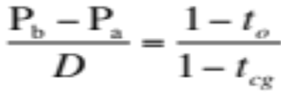
Cashflows from Selling around Ex-Dividend Day
The cash flows from selling before ex-dividend day are:
  P_{b} - (P_{b} - P) t_{cg}
The cash flows from selling after ex-dividend day are:
  P_{a} - (P_{a} - P) t_{cg} + D(1-t_{o})
Since the average investor should be indifferent between selling before the ex-dividend day and selling after the ex-dividend day -
  P_{b} - (P_{b} - P) t_{cg} = P_{a} - (P_{a} - P) t_{cg} + D(1-t_{o})
Some basic algebra leads us to the following:
Notes:
For this market to be stable, the cash flow from selling before has to be equal to the cash flow from selling after for most of the investors in this firm (or for the median investor).
If, for instance, the cash flow from selling before was greater than the cash flow from selling after for the median investor, the market would collapse, with every one selling before the ex-dividend day.
If the cash flow from selling after was greater for the median investor, every one would hold through the ex-dividend day and sell after.
Differences in tax status will mean, however, that there are profit opportunities for investors whose tax status is very different from that of the median investor.

Slide 8
Intuitive Implications
The relationship between the price change on the ex-dividend day and the dollar dividend will be determined by the difference between the tax rate on dividends and the tax rate on capital gains for the typical investor in the stock.
Tax Rates | Ex-dividend day behavior
If dividends and capital gains are taxed equally | Price change = Dividend
If dividends are taxed at a higher rate than capital gains | Price change < Dividend
If dividends are taxed at a lower rate than capital gains | Price change > Dividend
Notes:
This equality has to hold, in equilibrium, for the median investor in the firm to be indifferent between selling before and selling after.
By looking at price behavior on ex-dividend days, we should be able to get a snap shot of what differential tax rate investors in this stock, on average, face on dividends as opposed to capital gains.
If the price drop is much smaller than the dividend, the median investor, it can be argued, faces a tax rate on dividends that is higher than the tax rate on capital gains.
If it is equal, the median investor faces the same tax rate on both (or does not pay taxes at all)
If the price drop is greater than the dividend, the median investor pays more taxes on capital gains than he or she does on dividends.

Slide 9
The empirical evidence…
1966-1969
Ordinary tax rate = 70%
Capital gains rate = 28%
1981-1985
Ordinary tax rate = 50%
Capital gains rate = 20%
1986-1990
Ordinary tax rate = 28%
Capital gains rate = 28%
Price change as % of Dividend = 78%
Price change as % of Dividend = 85%
Price change as % of Dividend = 90%
Notes:
As the difference in marginal tax rates has narrowed from what it used be prior to 1981, the trend in the ex-dividend day measure has been towards one. This may also reflect the greater role played by pension funds (which are tax exempt) in the process.
Note, thought, that even in the 1986-90 time period, when dividends and capital gains were taxed at the same rate, the ratio did not converge on one. This indicates that the timing option (you choose when to take capital gains and you have none on dividends) will make dividends less attractive than capital gains even when the tax rates are the same

Slide 10
Two bad reasons for paying dividends
1. The bird in the hand fallacy
Argument: Dividends now are more certain than capital gains later. Hence dividends are more valuable than capital gains. Stocks that pay dividends will therefore be more highly valued than stocks that do not.
Counter: The appropriate comparison should be between dividends today and price appreciation today. The stock price drops on the ex-dividend day.
Notes:
When dividends are compared to the stock price drop that occurs on the ex-dividend day, this fallacy is exposed. At that point in time, the investor has a choice between receiving the dividends or cashing out on the stock (and getting the higher price).

Slide 11
2. We have excess cash this year…
Argument: The firm has excess cash on its hands this year, no investment projects this year and wants to give the money back to stockholders.
Counter: So why not just repurchase stock? If this is a one-time phenomenon, the firm has to consider future financing needs. The cost of raising new financing in future years, especially by issuing new equity, can be staggering.
Notes:
Excess cash might be a temporary phenomenon. To initiate dividends with the cash will create the expectation that the firm will continue to pay those dividends, which might be unsustainable.
Stock buybacks provide more flexibility in terms of future actions. An alternative is issue a special dividend.

Slide 12
Three “good” reasons for paying dividends…
Clientele Effect: The investors in your company like dividends.
The Signalling Story: Dividends can be signals to the market that you believe that you have good cash flow prospects in the future.
The Wealth Appropriation Story: Dividends are one way of transferring wealth from lenders to equity investors (this is good for equity investors but bad for lenders)
Notes:
Given how many firms pay dividends, there must be good reasons for companies to start paying dividends, continue paying dividends or increase dividends.

Slide 13
I. The Clientele Effect
Basis: Investors may form clienteles based upon their tax brackets. Investors in high tax brackets may invest in stocks which do not pay dividends and those in low tax brackets may invest in dividend paying stocks.
Evidence: A study of 914 investors' portfolios was carried out to see if their portfolio positions were affected by their tax brackets. The study found that
  (a) Older investors were more likely to hold high dividend stocks and
  (b) Poorer investors tended to hold high dividend stocks
Notes:
Investors buy stock in companies which have dividend policies that they like. This self-selection process creates dividend clienteles that each firm caters to. As long as there are sufficient investors in each clientele, having a high dividend or no dividend, by itself, should not affect value.
If an imbalance occurs between supply and demand in any clientele, there can be an effect on stock prices.

Slide 14
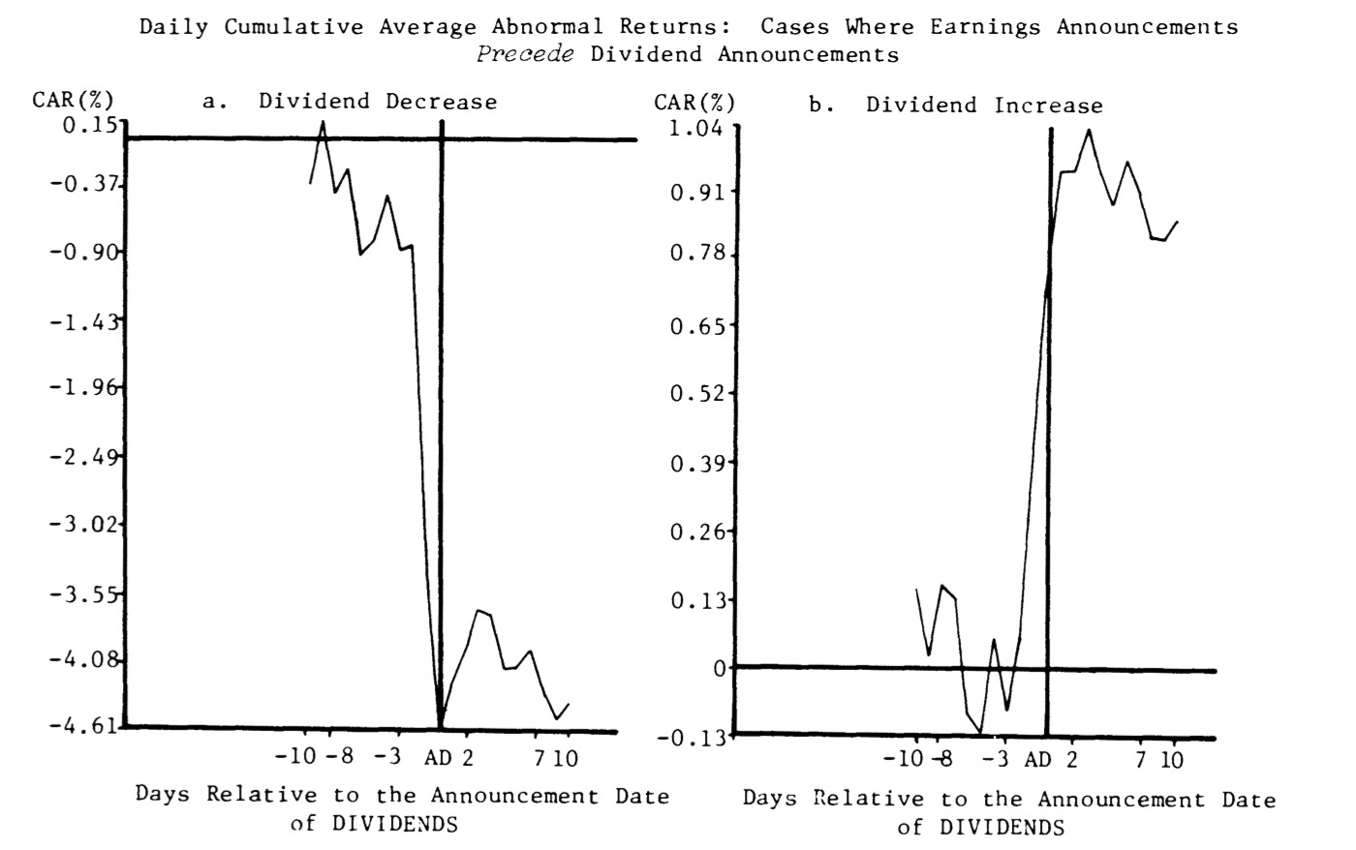
2. Dividends send a signal”
Increases in dividends are good news..
Notes:
A firm which announces an increase in dividends is sending a signal that it expects future cash flows to be strong enough to sustain this dividend. This allows it to set itself apart from other firms, which might say they have great prospects but do not have the confidence in them to raise dividends.
Given how reluctant firms are to cut dividends, the act of cutting dividends is viewed by the market as a signal that the firm is in far worse trouble than they thought. (Note how much larger the stock price drop on a dividend decrease is than the stock price increase on a dividend increase.)

Slide 15
But higher or new dividends may signal bad news (not good)
Notes:
The flip side of the “dividends are good news” signal! A firm that increases or initiates dividends might be signaling that it is running out of investment opportunities. Note that earnings growth peaks around the period when dividends are initiated.

Slide 16
Both dividend increases and decreases are becoming less informative…
Notes:
Over time, as companies have increasingly turned to using stock buybacks to return cash to stockholders, both dividend increases and decreases have become less informative… Investors care less (though they still care) than they used to about both.

Slide 17
















3. Dividend increases may be good for stocks… but bad for bonds..
EXCESS RETURNS ON STOCKS AND BONDS AROUND DIVIDEND CHANGES
0.5
Stock price rises
0
t:-
-12
-9
-6
-3
0
3
6
9
12
15
-0.5
15
CAR (Div Up)
CAR
-1
CAR (Div down)
-1.5
Bond price drops
-2
Day (0: Announcement date)
Notes:
Bondholders view dividend increases as bad news. It makes the bonds much riskier. To the extent that the dividend increase was unanticipated and was not built into interest rate, this transfers wealth from bondholders to stockholders.

Slide 18
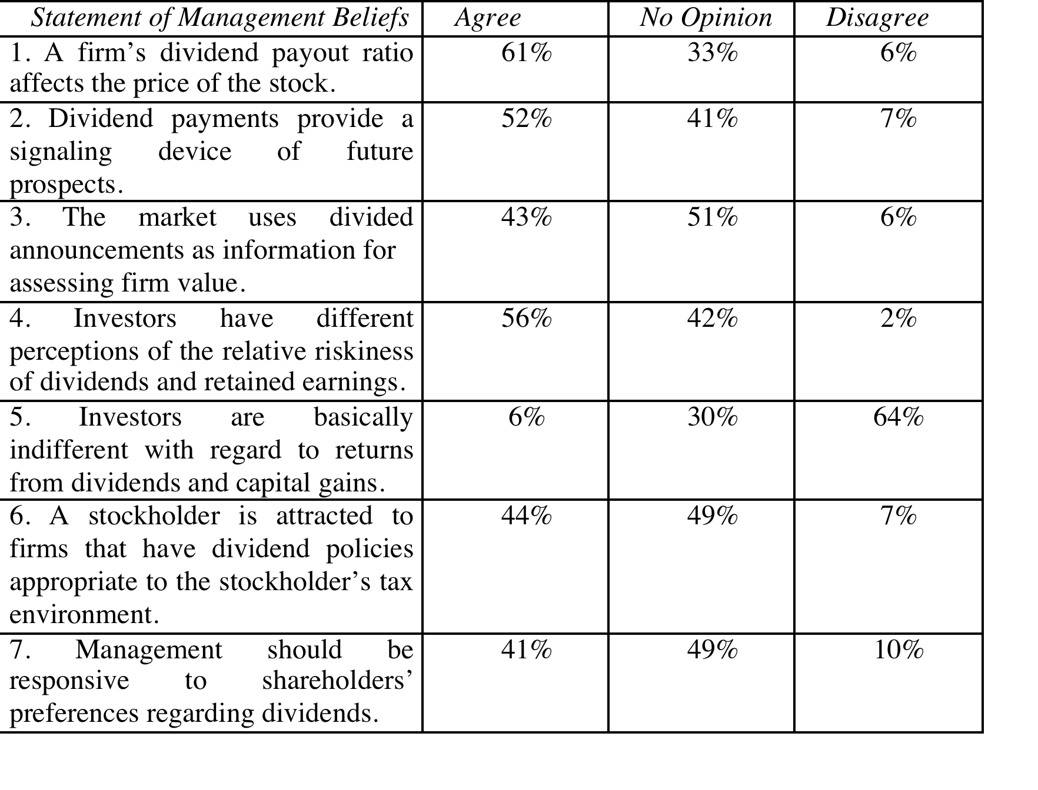
What managers believe about dividends…
Notes:
This survey was from 1985. In an updated and comprehensive survey of dividend policy published in 2004, Brav, Graham, Harvey, and Michaely conclude that management’s focus is not on the level of dividends but on changes in these dividends. Indicating a shift from views in prior studies, many managers in this survey saw little gain from increasing dividends, even in response to higher earnings and preferred stock buybacks instead. In fact, many managers in companies that paid dividends regret the level of dividends paid by their firms, indicating that they would have set the dividend at a much lower level if they had the choice. In contrast to the survey quoted in the last paragraph, managers also rejected the idea that dividends operate as useful financial signals. From the survey, the authors conclude that the rules of the game for dividends are the following: do not cut dividends, have a dividend policy similar to your peer group, preserve a good credit rating, maintain flexibility, and do not take actions that reduce earnings per share. A. Brav, J. R. Graham, C. R. Harvey, and R. Michaely, 2004, “Payout Policy in the 21st Century,” Working Paper, Duke University, Durham, NC.

Slide 19

Task
Examine the trade offs on whether your company should be paying more or less in dividends.
Read
Chapter 10

