Slide 1
Dividends: Peer group analysis
Me too, Me too..
Notes:
Sets the agenda for the class. This is a class that will be focused on the big picture of corporate finance rather than details, theories or models on a piecemeal basis.

Slide 2
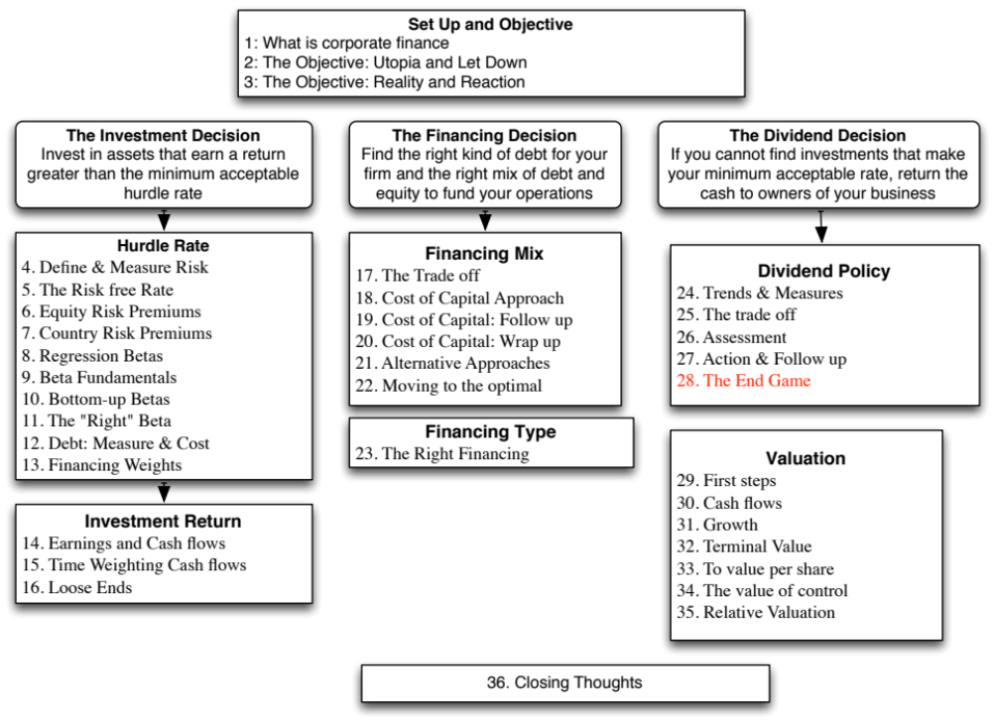

Slide 3
The Peer Group Approach
In the peer group approach, you compare your company to similar companies (usually in the same market and sector) to assess whether and if yes, how much to pay in dividends.
 | Dividend Yield |  | Dividend Payout
Company | 2013 | Average 2008-12 | 2013 | Average 2008-12 | Comparable Group | Dividend Yield | Dividend Payout
Disney | 1.09% | 1.17% | 21.58% | 17.11% | US Entertainment | 0.96% | 22.51%
Vale | 6.56% | 4.01% | 113.45% | 37.69% | Global Diversified Mining & Iron Ore (Market cap> $1 b) | 3.07% | 316.32%
Tata Motors | 1.31% | 1.82% | 16.09% | 15.53% | Global Autos (Market Cap> $1 b) | 2.13% | 27.00%
Baidu | 0.00% | 0.00% | 0.00% | 0.00% | Global Online Advertising | 0.09% | 8.66%
Deutsche Bank | 1.96% | 3.14% | 362.63% | 37.39% | European Banks | 1.96% | 79.32%
Notes:
All of the companies looks surprisingly similar to their peer groups. (Actually, not so surprising).

Slide 4
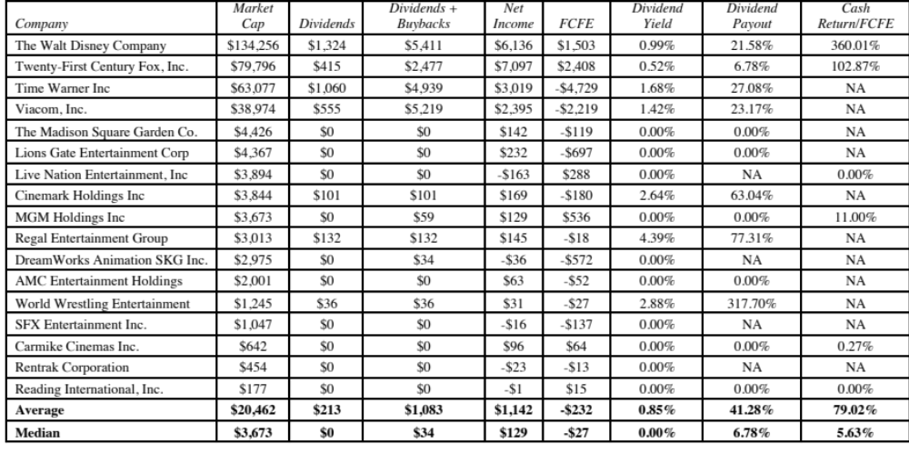
A closer look at Disney’s peer group
Notes:
Of the seventeen companies in this group, only seven paid dividends and six firms bought back stock. Rather than compare to the average or median for the entire sector, which is skewed by the non-dividend payers, we compared Disney to three of the other largest market-cap companies (Twenty-First Century Fox, Time Warner and Viacom) and there are similarities. Not only do they all pay dividends, with yields ranging from 0.52% to 4.39%, but many returned more cash than they had available to pay out (as FCFE).

Slide 5
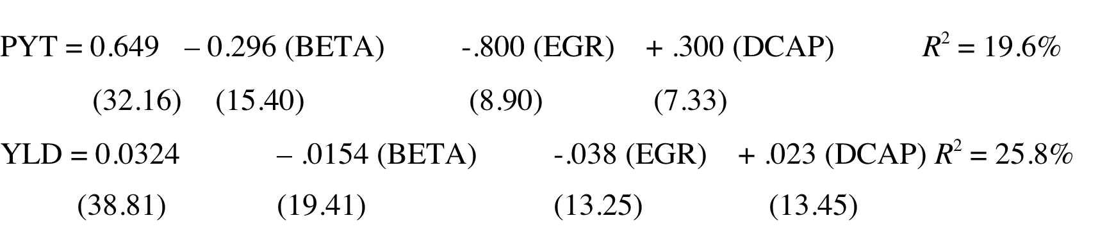
Going beyond averages… Looking at the market
Regressing dividend yield and payout against expected growth across all US companies in January 2014 yields:
  PYT = Dividend Payout Ratio = Dividends/Net Income
  YLD = Dividend Yield = Dividends/Current Price
  BETA = Beta (Regression or Bottom up) for company
  EGR = Expected growth rate in earnings over next 5 years (analyst estimates)
  DCAP = Total Debt / (Total Debt + Market Value of equity)
Notes:
T statistics are in brackets. While the R-squared is unimpressive, the t statistics are all significant. Thus, we will use the regression with the recognition that predicted values will be noisy.
Higher growth companies tend to pay lower dividends. These simple regressions allow us to adjust payout ratios and yields for differences across US companies.

Slide 6
Using the market regression on Disney
To illustrate the applicability of the market regression in analyzing the dividend policy of Disney, we estimate the values of the independent variables in the regressions for the firm.
  Beta for Disney (bottom up) = 1.00
  Disney’s expected growth in earnings per share = 14.73% (analyst estimate)
  Disney’s market debt to capital ratio = 11.58%
Substituting into the regression equations for the dividend payout ratio and dividend yield, we estimate a predicted payout ratio:
  Predicted Payout = .649 – 0.296 (1.00)-.800 (.1473) + .300 (.1158) = .2695
  Predicted Yield = 0.0324 – .0154 (1.00)-.038 (.1473) + .023 (.1158) = .0140
Based on this analysis, Disney with its dividend yield of 1.09% and a payout ratio of approximately 21.58% is paying too little in dividends. This analysis, however, fails to factor in the huge stock buybacks made by Disney over the last few years.
Notes:
Two things to note:
The low R-squared on the regressions will create large prediction ranges. Disney may very well be paying out too little in dividends, but there is enough noise in the predictions that you may not be willing to make that judgment.
We are assuming linear relationships between each of the independent variables and the dividend measures.

Slide 7
The problem with changing dividends
Investors pick companies based on dividend policy and companies generally pick dividend policies that reflect their characteristics (growth, reinvestment needs etc.)
When a company’s characteristics change, and it needs to change its dividend policy, the clientele may not react well to the change, no matter how well intentioned.

Slide 8
Dividend Policy and Clientele
Assume that you run a phone company, and that you have historically paid large dividends. You are now planning to enter the telecommunications and media markets. Which of the following paths are you most likely to follow?
Courageously announce to your stockholders that you plan to cut dividends and invest in the new markets.
Continue to pay the dividends that you used to, and defer investment in the new markets.
Continue to pay the dividends that you used to, make the investments in the new markets, and issue new stock to cover the shortfall
Other
Notes:
Given that the dividend clientele that I have attracted is unlikely to be swayed by my arguments about my investment needs, I would try to spin off my media division and allow it to set a dividend policy very different from mine. In the spin off, investors who would prefer the capital gains will hold on to the media division shares and those who want the dividends will continue to hold the phone company shares.
Many phone companies have separately traded stocks for their wireless arms - one reason may be that the wireless business requires more risk, more growth and more reinvestment. and can afford to pay out less in dividends.

Slide 9
Time for a reset on dividends
Dividends, as we know them, were designed and structured for equity investments a century ago, when these investments were competing with bonds for investor money.
In today’s unpredictable and uncertain world, equity investments in most businesses cannot be viewed as bonds (fixed dividend yield) with price appreciation.
Thus, the notion of fixed dividends may have to be abandoned for more flexible dividends, and this may already be happening in the shift to buybacks.

Slide 10

Task
Relative to the sector in which your company operates, evaluate whether it returns too much or too little cash.
Read
Chapter 11

