Slide 1
Valuation: cash flows & discount rates
Cash is king.
Notes:
If corporate finance is all about maximizing value, you do have to know how to estimate value.

Slide 2
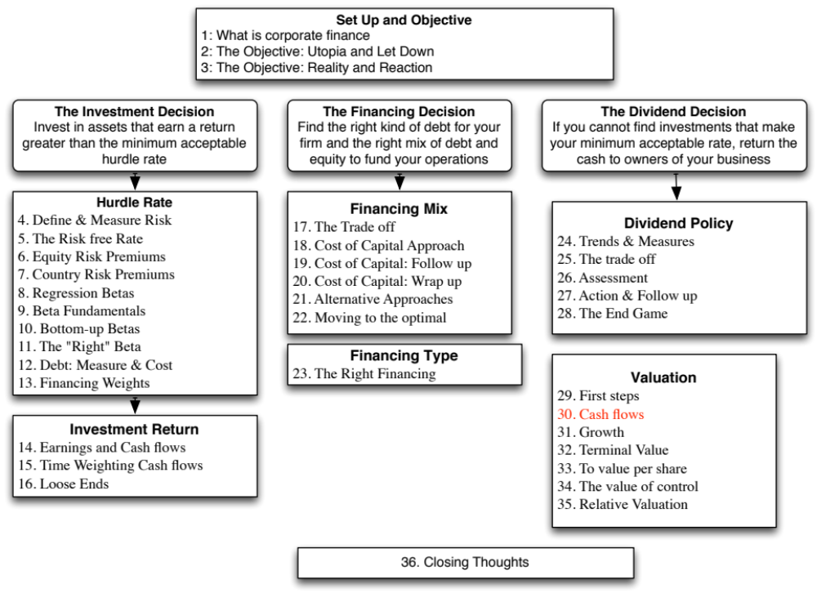

Slide 3
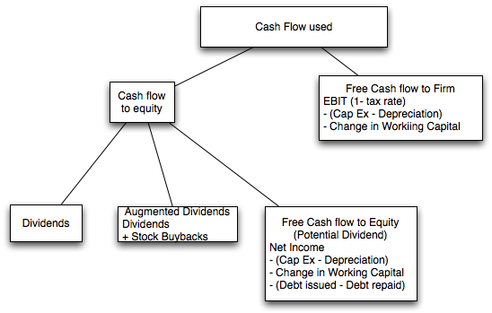
I. Estimating Cash Flows
Notes:
Shows the different cash flows that can be used in valuation.
In equity valuation,
The simplest and most direct measure of cash flow is dividends paid (Implicitly we are assuming that companies pay out their residual cash flows as dividends)
A slightly modified approach is to add stock buybacks to dividends. Since buybacks tend to be lumpy, you may need to average buybacks over time.
FCFE: You estimate the residual cash flow, after every conceivable need has been met. Again, there can be volatility in the reinvestment numbers that may need to be normalized.
In firm valuation, you are computing the cash flow to all claim holders in the firm. In effect, you are computing the cash flow before debt payments. That is why we start with operating income (EBIT) and act like we pay taxes on the EBIT. In effect, we ignore any tax benefits from interest expenses, since those will be captured in the cost of capital (through the use of an after-tax cost of debt)
Cap Ex includes acquisitions and the effect of R&D. (R&D is capitalized)

Slide 4
Dividends and Modified Dividends for Deutsche Bank
In 2007, Deutsche Bank paid out dividends of 2,146 million Euros on net income of 6,510 million Euros. In early 2008, we valued Deutsche Bank using the dividends it paid in 2007. In my 2008 valuation I am assuming the dividends are not only reasonable but sustainable.
In November 2013, Deutsche Bank’s dividend policy was in flux. Not only did it report losses but it was on a pathway to increase its regulatory capital ratio. Rather than focus on the dividends (which were small), we estimated the potential dividends (by estimating the free cash flows to equity after investments in regulatory capital)
 | Current | 2014 | 2015 | 2016 | 2017 | 2018 | Steady state
Asset Base | 439,851 € | 453,047 € | 466,638 € | 480,637 € | 495,056 € | 509,908 € | 517,556 €
Capital ratio | 15.13% | 15.71% | 16.28% | 16.85% | 17.43% | 18.00% | 18.00%
Tier 1 Capital | 66,561 € | 71,156 € | 75,967 € | 81,002 € | 86,271 € | 91,783 € | 93,160 €
Change in regulatory capital |  | 4,595 € | 4,811 € | 5,035 € | 5,269 € | 5,512 € | 1,377 €
Book Equity | 76,829 € | 81,424 € | 86,235 € | 91,270 € | 96,539 € | 102,051 € | 103,605 €
ROE | -1.08% | 0.74% | 2.55% | 4.37% | 6.18% | 8.00% | 8.00%
Net Income | -716 € | 602 € | 2,203 € | 3,988 € | 5,971 € | 8,164 € | 8,287 €
- Investment in Regulatory Capital |  | 4,595 € | 4,811 € | 5,035 € | 5,269 € | 5,512 € | 1,554 €
FCFE |  | -3,993 € | -2,608 € | -1,047 € | 702 € | 2,652 € | 6,733 €
Notes:
Dividends may be the most tangible and observable of all cash flows, but we are implicitly assuming that firms are paying out what they can afford to in dividends. While this may be reasonable for mature firms in stable economies, the assumption can break down (even for these firms). Deutsche Bank is a classic example.
In early 2008, most analysts would have considered Deutsche Bank (with its large size, diversified asset base and long history) to be in steady state and valued it by taking the dividends it paid in 2007 and building on those dividends. The banking crisis of 2008 should have led to a reassessment of that assumption.

Slide 5
Estimating FCFE (past) : Tata Motors
Year | Net Income | Cap Ex | Depreciation | Change in WC | Change in Debt | Equity Reinvestment | Equity Reinvestment Rate
2008-09 | -25,053₹ | 99,708₹ | 25,072₹ | 13,441₹ | 25,789₹ | 62,288₹ | -248.63%
2009-10 | 29,151₹ | 84,754₹ | 39,602₹ | -26,009₹ | 5,605₹ | 13,538₹ | 46.44%
2010-11 | 92,736₹ | 81,240₹ | 46,510₹ | 50,484₹ | 24,951₹ | 60,263₹ | 64.98%
2011-12 | 135,165₹ | 138,756₹ | 56,209₹ | 22,801₹ | 30,846₹ | 74,502₹ | 55.12%
2012-13 | 98,926₹ | 187,570₹ | 75,648₹ | 680₹ | 32,970₹ | 79,632₹ | 80.50%
Aggregate | 330,925₹ | 592,028₹ | 243,041₹ | 61,397₹ | 120,160₹ | 290,224₹ | 87.70%
Notes:
Like most firms, Tata Motors has volatile capital expenditures and its usage of debt varies widely over time. In making our projections, we will also look at averages over time.

Slide 6
Estimating FCFF: Disney
In the fiscal year ended September 2013, Disney reported the following:
  Operating income (adjusted for leases) = $10,032 million
  Effective tax rate = 31.02%
  Capital Expenditures (including acquisitions) = $5,239 million
  Depreciation & Amortization = $2,192 million
  Change in non-cash working capital = $103 million
The free cash flow to the firm can be computed as follows:
  After-tax Operating Income = 10,032 (1 -.3102) = $6,920
  - Net Cap Expenditures = $5,239 - $2,192 = $3,629
  Change in Working Capital = =$103
  = Free Cashflow to Firm (FCFF) = = $3,188
The reinvestment and reinvestment rate are as follows:
  Reinvestment = $3,629 + $103 = $3,732 million
  Reinvestment Rate = $3,732/ $6,920 = 53.93%
Notes:
We include acquisitions made during 2013 in capital expenditures, but this is a volatile item. We also used the numbers that we obtained after adjusting for leases (as financial expenses rather than operating expenses).

Slide 7
II. Discount Rates
Critical ingredient in discounted cashflow valuation. Errors in estimating the discount rate or mismatching cashflows and discount rates can lead to serious errors in valuation.
At an intuitive level, the discount rate used should be consistent with both the riskiness and the type of cashflow being discounted.
The cost of equity is the rate at which we discount cash flows to equity (dividends or free cash flows to equity). The cost of capital is the rate at which we discount free cash flows to the firm.
Notes:
Recaps what we stated when we talked about investment analysis.

Slide 8
Cost of Equity: Deutsche Bank
2008 versus 2013
In early 2008, we estimated a beta of 1.162 for Deutsche Bank, which used in conjunction with the Euro risk-free rate of 4% (in January 2008) and an equity risk premium of 4.50%, yielded a cost of equity of 9.23%.
  Cost of Equity _{Jan 2008} = Riskfree Rate _{Jan 2008} + Beta* Mature Market Risk Premium
  = 4.00% + 1.162 (4.5%) = 9.23%
In November 2013, the Euro riskfree rate had dropped to 1.75% and the Deutsche’s equity risk premium had risen to 6.12%:
  Cost of equity _{Nov ’13} = Riskfree Rate _{Nov ‘13} + Beta (ERP)
  = 1.75% + 1.1516 (6.12%) = 8.80%
Notes:
The cost of equity can change over time, even if the beta for a firm does not change. In this case, the increase in the equity risk premium is pushing up the cost of equity. Even if the dividends were not expected to change, the value of equity in Deutsche will go down.

Slide 9
Cost of Equity: Tata Motors
We will be valuing Tata Motors in rupee terms. That is a choice. Any company can be valued in any currency.
Earlier, we estimated a levered beta for equity of 1.1007 for Tata Motor’s operating assets . Since we will be discounting FCFE with the income from cash included in the cash, we recomputed a beta for Tata Motors as a company (with cash):
  Levered Beta_{Company}= 1.1007 (1428/1630)+ 0 (202/1630) = 0.964
With a nominal rupee risk-free rate of 6.57 percent and an equity risk premium of 7.19% for Tata Motors, we arrive at a cost of equity of 13.50%.
  Cost of Equity = 6.57% + 0.964 (7.19%) = 13.50%
Notes:
Currency is a choice. While it is usually easiest to get financial information in the local currency, there may be times when you choose to value a company in a different currency. Thus, if getting a riskfree rate in the local currency is difficult to do, you may decide to value a company in dollars or Euros.
Since we are discounting FCFE with the income from cash included in the cash flows, we adjust the beta (zero) for Tata Motor’s cash balance (202 billion Rs). If we had planned to discount the FCFE from just the operating assets, we would have used the equity beta of just the operating assets in this valuation.

Slide 10
Current Cost of Capital: Disney
The beta for Disney’s stock in November 2013 was 1.0013. The T. bond rate at that time was 2.75%. Using an estimated equity risk premium of 5.76%, we estimated the cost of equity for Disney to be 8.52%:
Cost of Equity = 2.75% + 1.0013(5.76%) = 8.52%
Disney’s bond rating in May 2009 was A, and based on this rating, the estimated pretax cost of debt for Disney is 3.75%. Using a marginal tax rate of 36.1, the after-tax cost of debt for Disney is 2.40%.
After-Tax Cost of Debt = 3.75% (1 – 0.361) = 2.40%
The cost of capital was calculated using these costs and the weights based on market values of equity (121,878) and debt (15,961):
Cost of capital =
Notes:
The one point we do know for Disney…
This reproduces the current cost of capital computation for Disney, using market value weights for both debt and equity, the cost of equity (based upon the bottom-up beta) and the cost of debt (based upon the bond rating)

Slide 11
But costs of equity and capital can and should change over time…
Year | Beta | Cost of Equity | After-tax Cost of Debt | Debt Ratio | Cost of capital
1 | 1.0013 | 8.52% | 2.40% | 11.50% | 7.81%
2 | 1.0013 | 8.52% | 2.40% | 11.50% | 7.81%
3 | 1.0013 | 8.52% | 2.40% | 11.50% | 7.81%
4 | 1.0013 | 8.52% | 2.40% | 11.50% | 7.81%
5 | 1.0013 | 8.52% | 2.40% | 11.50% | 7.81%
6 | 1.0010 | 8.52% | 2.40% | 13.20% | 7.71%
7 | 1.0008 | 8.51% | 2.40% | 14.90% | 7.60%
8 | 1.0005 | 8.51% | 2.40% | 16.60% | 7.50%
9 | 1.0003 | 8.51% | 2.40% | 18.30% | 7.39%
10 | 1.0000 | 8.51% | 2.40% | 20.00% | 7.29%
Notes:
In the case of Disney, the debt ratio is the number that changes the most. If Disney’s beta & cost of debt had been much higher or lower than that of a mature firm, those would have changed as well.
For evolving firms, with rapidly changing growth rates, the beta, the cost of debt and the debt ratio can all change over time as the firm matures.

Slide 12

Task
Estimate the base year’s cash flows & current discount rate for your firm.
Read
Chapter 12

