Slide 1
Valuation: Terminal value
The tail that wags the valuation dog..
Notes:
If corporate finance is all about maximizing value, you do have to know how to estimate value.

Slide 2
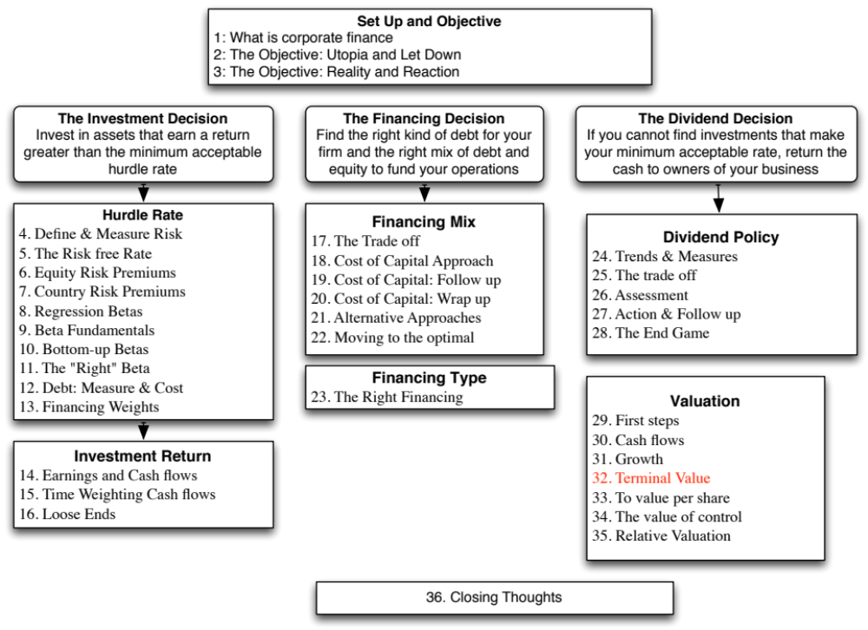

Slide 3
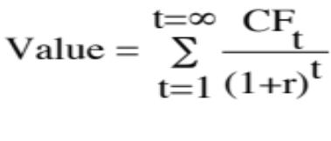
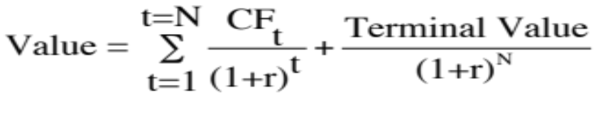
Getting Closure in Valuation
A publicly traded firm potentially has an infinite life. The value is therefore the present value of cash flows forever.
Since we cannot estimate cash flows forever, we estimate cash flows for a “growth period” and then estimate a terminal value, to capture the value at the end of the period:
Notes:
To put closure on valuation, we have to stop forecasting cashflows at some point in time and estimate a terminal value.
It is generally the biggest component of value and estimating it consistently is a key to good valuation.

Slide 4
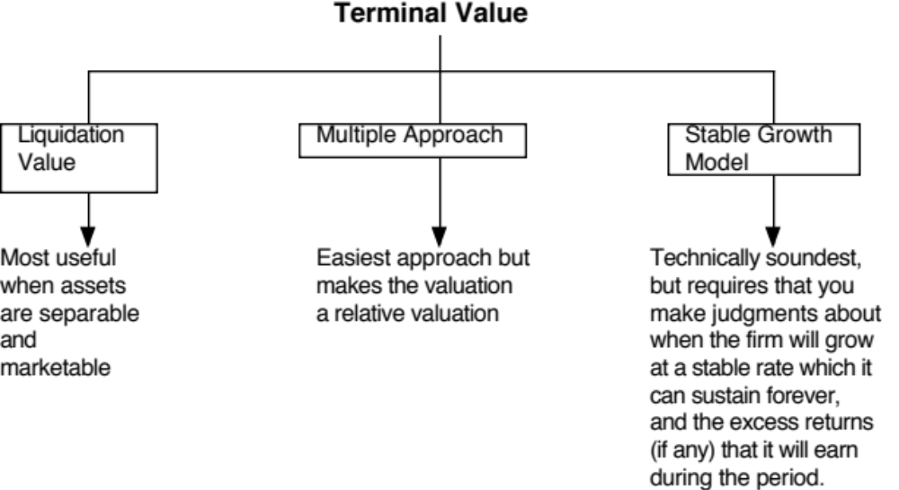
Ways of Estimating Terminal Value
Notes:
Firms have infinite lives. Since we cannot estimate cash flows forever, we assume a constant growth rate forever as a way of closing off the valuation.
A very commonly used variant is to use a multiple of the terminal year’s earnings. This brings an element of relative valuation into the analysis. In a pure DCF model, the terminal value has to be estimated with a stable growth rate.
The real choice is between stable growth models and liquidation value. One values the firm as a going concern and the other is based upon shutting the firm down and getting what you can for its assets. When valuing publicly traded firms, it is generally better practice to value them as going concerns (and use a stable growth rate). With private businesses or finite life public companies (a mining company with limited reserves…), liquidation value is a viable option.

Slide 5
Getting Terminal Value Right
1. Obey the growth cap
When a firm’s cash flows grow at a “constant” rate forever, the present value of those cash flows can be written as:
  Value = Expected Cash Flow Next Period / (r - g)
  where,
  r = Discount rate (Cost of Equity or Cost of Capital)
  g = Expected growth rate
The stable growth rate cannot exceed the growth rate of the economy but it can be set lower.
  If you assume that the economy is composed of high growth and stable growth firms, the growth rate of the latter will probably be lower than the growth rate of the economy.
  The stable growth rate can be negative. The terminal value will be lower and you are assuming that your firm will disappear over time.
  If you use nominal cashflows and discount rates, the growth rate should be nominal in the currency in which the valuation is denominated.
One simple proxy for the nominal growth rate of the economy is the riskfree rate.
Notes:
If the overall economy is composed of high growth and mature companies, and is growing at 5%, the mature companies must be growing at a rate less than 5%. This is a mathematical constraint that cannot be eased. A firm that grows at a rate higher than that of the economy will become the economy.
Should this growth be nominal or real? It depends on how you have estimated all of your inputs prior to getting to the terminal value computation. If everything has been done in real terms (very unusual), then the growth rate has to be a real growth rate. If it is in nominal terms, the growth rate has to be nominal (in the currency chosen for the analysis).
While the stable growth rate cannot exceed the growth rate of the economy, it can be lower. In fact, it should be lower for most mature firms, since an economy is composed of both growth firms and mature firms. If every mature firms grows at the same rate as the economy, then where does the growth rate from growth firms go?
The stable growth rate can be a negative number. This is an intermediate solution between the infinite growth model and liquidation value. Using a negative stable growth rate will make your firm disappear gradually over time.
Riskfree rate = Expected inflation + Expected real interest rate
Nominal growth rate in economy = Expected inflation + Expected real growth
In the long term, expected real interest rate = expected real growth rate

Slide 6
Getting Terminal Value Right
2. Don’t wait too long…
Assume that you are valuing a young, high growth firm with great potential, just after its initial public offering. How long would you set your high growth period?
  < 5 years
  5 years
  10 years
  >10 years
While analysts routinely assume very long high growth periods (with substantial excess returns during the periods), the evidence suggests that they are much too optimistic. Most growth firms have difficulty sustaining their growth for long periods, especially while earning excess returns.
Notes:
It is not uncommon to see analysts use growth periods of longer than 10 years for small, promising companies and even for larger, growth companies (Coke, Microsoft, Walmart..)

Slide 7
And the key determinant of growth periods is the company’s competitive advantage…
Recapping a key lesson about growth, it is not growth per se that creates value but growth with excess returns. For growth firms to continue to generate value creating growth, they have to be able to keep the competition at bay.
  Proposition 1: The stronger and more sustainable the competitive advantages, the longer a growth company can sustain “value creating” growth.
  Proposition 2: Growth companies with strong and sustainable competitive advantages are rare.
Notes:
Firms that grow for longer than 5 years are more the exception rather than the rule. We may be routinely over valuing growth companies as a consequence.
As a consequence, I use only three growth periods in my DCF valuations:
Zero years, for firms that are already large and mature firms (Firms like Toyota and Exxon Mobil)
5 years for firms that still retain moderate growth potential or significant competitive advantages.
10 years for high growth firms.
You do not want to value your firm to be the exception… That is asking for trouble..

Slide 8
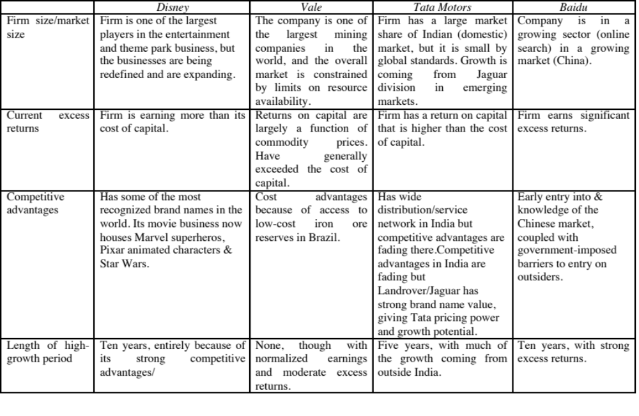
Choosing a Growth Period: Examples
Notes:
I would not be inclined to use growth periods longer than 10 years. While there are firms like IBM, Microsoft and Coca Cola which have been able to sustain growth for much longer periods, they are more the exception than the rule. Most firms are able to maintain high growth for shorter periods.
I am going to use firm valuation for Disney, because I expect leverage to change, and firm valuation is simpler when that occurs
For Tata Motors, I will use FCFE, since I do not expect leverage to change, and do the analysis in real terms, to avoid having to deal with expected inflation in BR
For Deutsche Bank, where it is difficult to estimate free cash flows, I will use dividends and make the assumptions that dividends over time will be equal to FCFE.

Slide 9
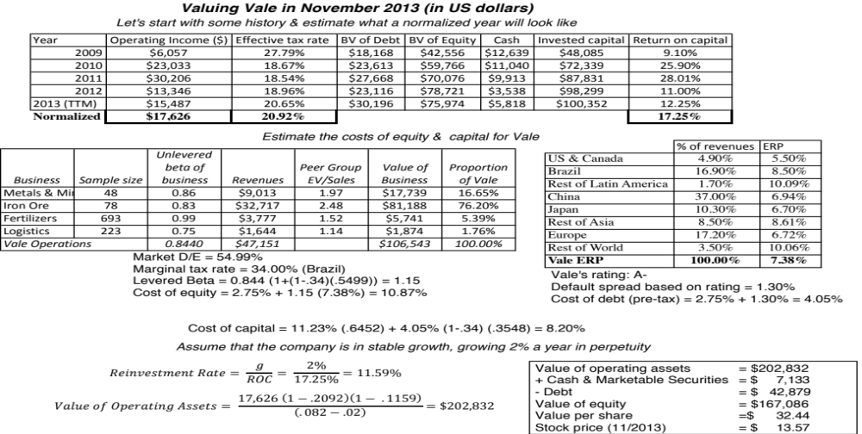
Notes:
Vale is one of the largest commodity firms in the world and we will assume that it is a mature firm. However, commodity prices do go up and down. We allow for this by normalizing earnings (by averaging over time) and use this normalized value to estimate return on capital and value.

Slide 10
Don’t forget that growth has to be earned..
3. Think about what your firm will earn as returns forever..
In the section on expected growth, we laid out the fundamental equation for growth:
Growth rate = Reinvestment Rate * Return on invested capital
+ Growth rate from improved efficiency
In stable growth, you cannot count on efficiency delivering growth (why?) and you have to reinvest to deliver the growth rate that you have forecast. Consequently, your reinvestment rate in stable growth will be a function of your stable growth rate and what you believe the firm will earn as a return on capital in perpetuity:
  Reinvestment Rate = Stable growth rate/ Stable period Return on capital
A key issue in valuation is whether it okay to assume that firms can earn more than their cost of capital in perpetuity. There are some (McKinsey, for instance) who argue that the return on capital = cost of capital in stable growth…
Notes:
This is the key balancing assumption that keeps terminal values from becoming unbounded. If you can change the growth rate without changing the reinvestment assumptions, you can make any firm worth any amount of money.
If you adopt this rule, the terminal value becomes a function of the return on capital:
Terminal value = EBIT (1-t) (1- g/ROC)/ (Cost of capital –g)
If ROC = Cost of capital,
Terminal value = EBIT (1-t)/ Cost of capital
The growth effect is neutralized entirely by the reinvestment requirement and the terminal value is invariant to the growth rate assumed.

Slide 11
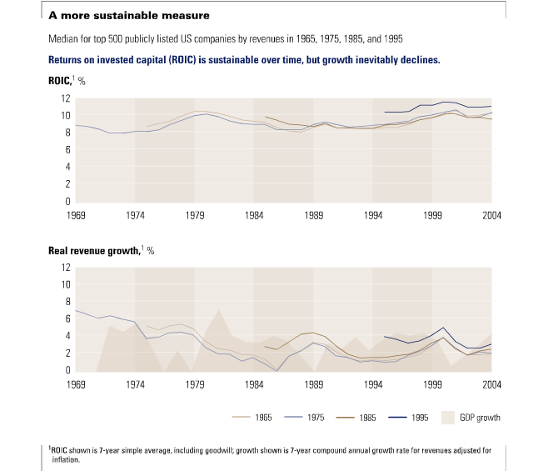
There are some firms that earn excess returns
While growth rates seem to fade quickly as firms become larger, well managed firms seem to do much better at sustaining excess returns for longer periods.
Notes:
There are some DCF practitioners who argue that the only excess return consistent with being a mature firm is zero. While that may make logical sense, it will then require you to forecast cash flows until excess returns become zero (rather than until the growth rate becomes stable).
In reality, firms that have earned excess returns in the past seem to have more success in holding on to excess returns. In other words, an assessment of strategic advantages and barriers to entry may be more relevant to good valuation than the focus on earnings growth.
Bottom line: If you adopt growth periods of 5 or 10 years, there are some firms with exceptional and sustainable competitive advantages that can sustain excess returns for far longer. For these firms, it is prudent to let the excess returns be positive in perpetuity (i.e., let the ROC in stable growth exceed the cost of capital). However, those excess returns should be moderate (my rule of thumb is to not let them exceed 2-3%.

Slide 12
Getting Terminal Value Right
4. Be internally consistent..
Risk and costs of equity and capital: Stable growth firms tend to
  Have betas closer to one
  Have debt ratios closer to industry averages (or mature company averages)
  Country risk premiums (especially in emerging markets should evolve over time)
The excess returns at stable growth firms should approach (or become) zero. ROC -> Cost of capital and ROE -> Cost of equity
The reinvestment needs and dividend payout ratios should reflect the lower growth and excess returns:
  Stable period payout ratio = 1 - g/ ROE
  Stable period reinvestment rate = g/ ROC
Notes:
If you reduce the growth rate but leave the other characteristics of the firm unchanged, you will create internal inconsistencies in your valuation. This can happen if you forecast out the cash flow in your terminal year as the cash flow in the year prior augmented by the stable growth rate. (You are then locking in the reinvestment rate assumptions in the last year of high growth in perpetuity)

Slide 13
And don’t fall for sleight of hand…
A typical assumption in many DCF valuations, when it comes to stable growth, is that capital expenditures offset depreciation and there are no working capital needs. Stable growth firms, we are told, just have to make maintenance cap ex (replacing existing assets ) to deliver growth. If you make this assumption, what expected growth rate can you use in your terminal value computation?
What if the stable growth rate = inflation rate? Is it okay to make this assumption then?
Notes:
The only growth rate that is consistent with this assumption is zero. Even if you set the growth rate = inflation rate, replacing existing assets will cost you more than the depreciation on those assets. Hence you will need to follow the equation on the last page to get to a reinvestment rate.

Slide 14
Estimating Stable Period Inputs after a high growth period: Disney
Respect the cap: The growth rate forever is assumed to be 2.5. This is set lower than the riskfree rate (2.75%).
Stable period excess returns: The return on capital for Disney will drop from its high growth period level of 12.61% to a stable growth return of 10%. This is still higher than the cost of capital of 7.29% but the competitive advantages that Disney has are unlikely to dissipate completely by the end of the 10th year.
Reinvest to grow: Based on the expected growth rate in perpetuity (2.5%) and expected return on capital forever after year 10 of 10%, we compute s a stable period reinvestment rate of 25%:
Reinvestment Rate = Growth Rate / Return on Capital = 2.5% /10% = 25%
Adjust risk and cost of capital: The beta for the stock will drop to one, reflecting Disney’s status as a mature company.
  Cost of Equity = Riskfree Rate + Beta * Risk Premium = 2.75% + 5.76% = 8.51%
  The debt ratio for Disney will rise to 20%. Since we assume that the cost of debt remains unchanged at 3.75%, this will result in a cost of capital of 7.29%
  Cost of capital = 8.51% (.80) + 3.75% (1-.361) (.20) = 7.29%
Notes:
As Disney moves into stable growth, it should exhibit the characteristics of stable growth firms. If you want to be conservative in your estimates, you could set the return on capital = cost of capital in stable growth.
The riskfree rate is a useful proxy for the nominal growth rate in the economy.
Riskfree rate = Expected inflation + Expected real interest rate
Nominal growth rate in economy = Expected inflation + Expected real growth rate
In the long term, expected real growth rate should converge on the expected real interest rate

Slide 15

Task
Evaluate your firm’s expected characteristics when it reaches stable growth
Read
Chapter 12

Slide 16
Chapter 12

