Slide 1
Valuation: The Loose ends
Your work begins, just when you think you are done.
Notes:
If corporate finance is all about maximizing value, you do have to know how to estimate value.

Slide 2
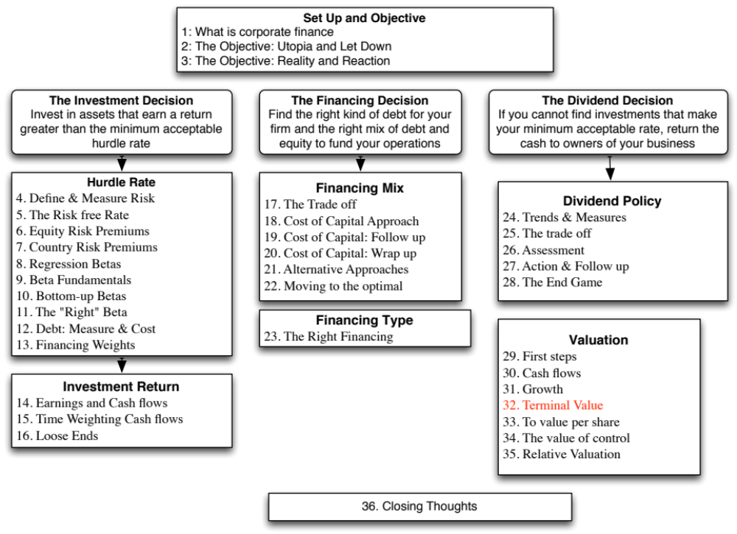

Slide 3
From firm value to equity value per share
Approach used | To get to equity value per share
Discount dividends per share at the cost of equity | Present value is value of equity per share
Discount aggregate FCFE at the cost of equity | Present value is value of aggregate equity. Subtract the value of equity options given to managers and divide by number of shares.
Discount aggregate FCFF at the cost of capital | PV = Value of operating assets + Cash & Near Cash investments + Value of minority cross holdings Debt outstanding = Value of equity Value of equity options =Value of equity in common stock / Number of shares
Notes:
The present value of the cash flows yields different output, depending upon the model used. If the ultimate mission is to compute the value of equity per share, getting there can take quite a trek, especially if you use a firm valuation model.
In effect, you have add the values of any assets whose earnings are not part of operating income (cash and minority cross holdings), subtract out the market value of non equity claims (debt foremost but also leases) and then net out the value of equity in options granted to managers and others to get to the value of equity in common stock. Since we have already considered the effect of options outstanding, this value can then be divided by the primary (not diluted) number of shares to get to value per share.

Slide 4
1. The Value of Cash
An Exercise in Cash Valuation
Company A Company B Company C
Enterprise Value $ 1 billion $ 1 billion $ 1 billion
Cash $ 100 mil $ 100 mil $ 100 mil
Return on Capital 10% 5% 22%
Cost of Capital 10% 10% 12%
Trades in US US Argentina

Slide 5
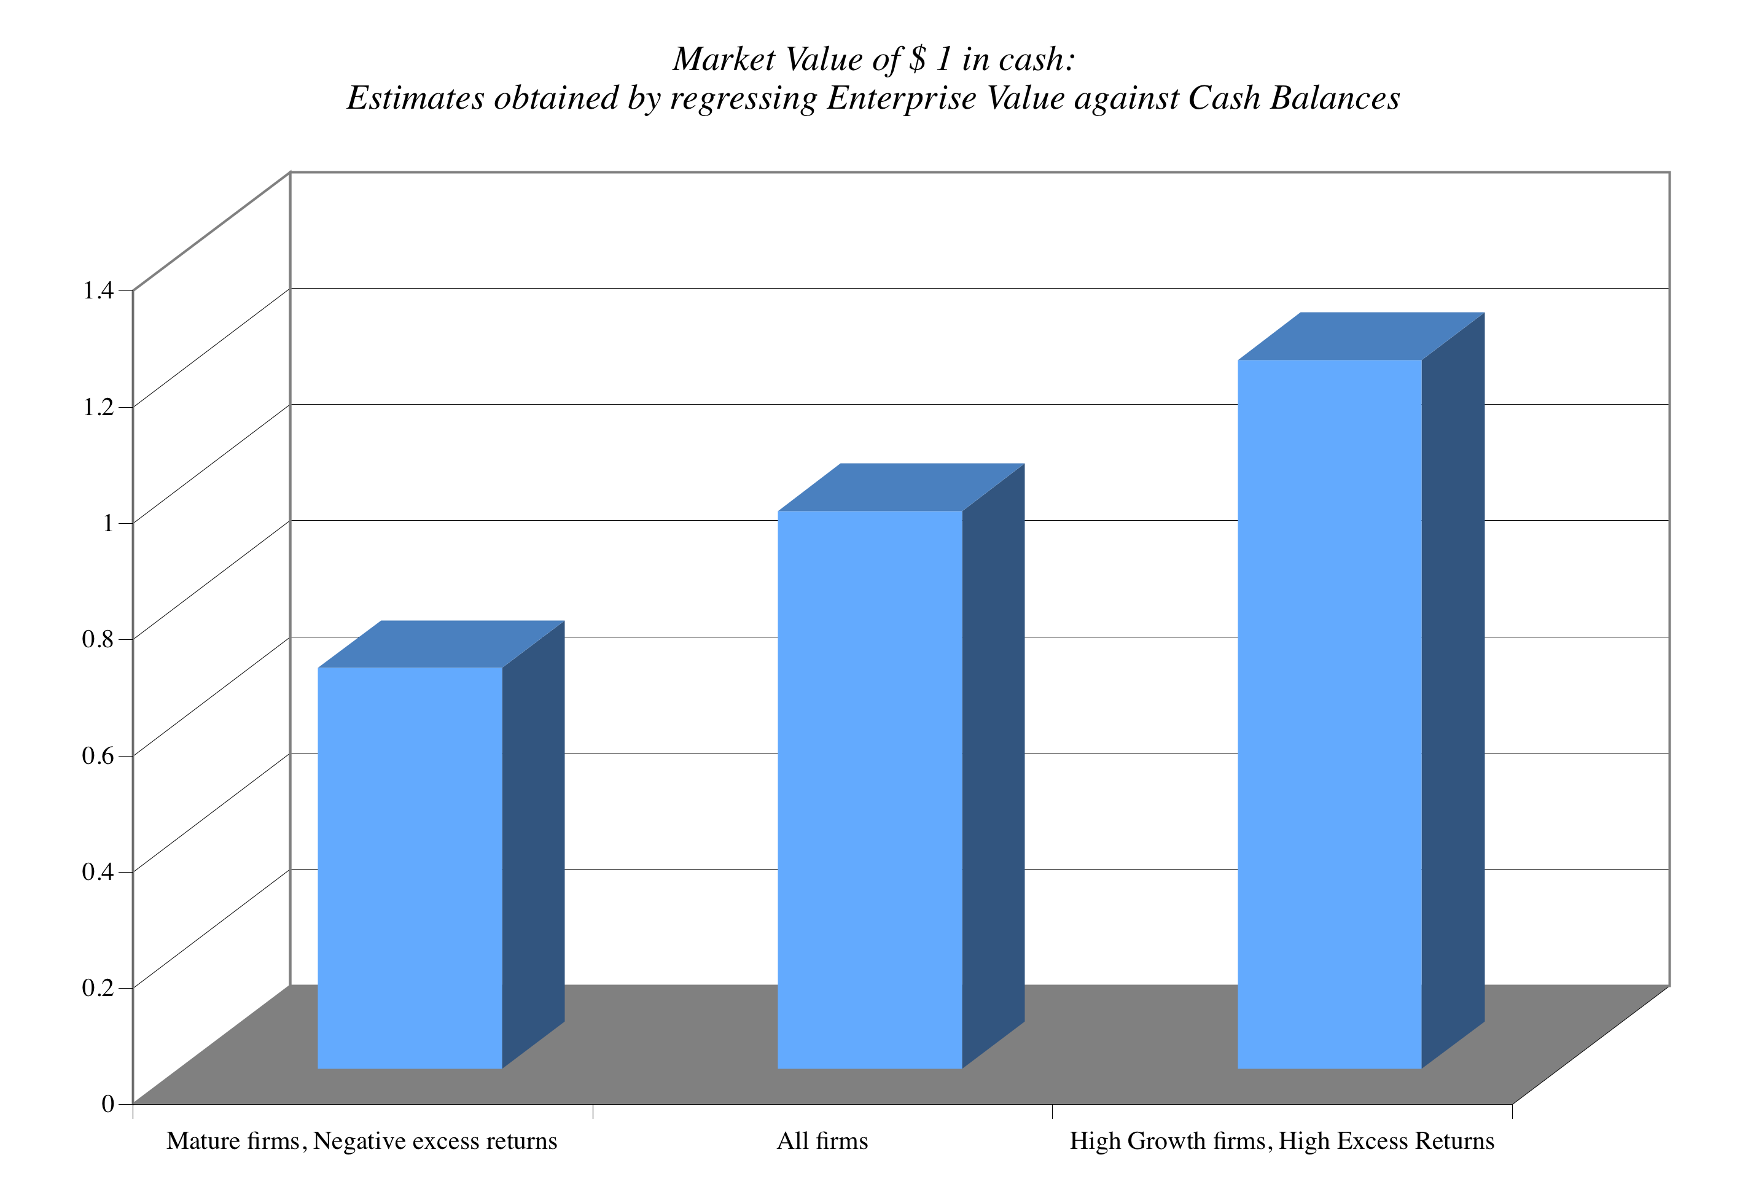
Cash: Discount or Premium?

Slide 6
2. Dealing with Holdings in Other firms
Holdings in other firms can be categorized into
  Minority passive holdings, in which case only the dividend from the holdings is shown in the balance sheet
  Minority active holdings, in which case the share of equity income is shown in the income statements
  Majority active holdings, in which case the financial statements are consolidated.
We tend to be sloppy in practice in dealing with cross holdings. After valuing the operating assets of a firm, using consolidated statements, it is common to add on the balance sheet value of minority holdings (which are in book value terms) and subtract out the minority interests (again in book value terms), representing the portion of the consolidated company that does not belong to the parent company.
Notes:
How you deal with cross holdings depends upon which scenario you face.

Slide 7
How to value holdings in other firms.. In a perfect world..
In a perfect world, we would strip the parent company from its subsidiaries and value each one separately. The value of the combined firm will be
  Value of parent company + Proportion of value of each subsidiary
To do this right, you will need to be provided detailed information on each subsidiary to estimated cash flows and discount rates.
Notes:
If a holding is not consolidated, you have to work to bring the holding into your valuation explicitly since the income from the holding will not be shown as part of operating income. If you are doing equity valuation, you have to be careful to strip out the portion of the net income that is attributable to the holdings - dividends, for instance.
If a holding is consolidated, you are valuing a combined firm - the parent and the subsidiary. You have to ensure that you subtract out the portion of the subsidiary that does not belong to you.

Slide 8
Two compromise solutions…
The market value solution: When the subsidiaries are publicly traded, you could use their traded market capitalizations to estimate the values of the cross holdings. You do risk carrying into your valuation any mistakes that the market may be making in valuation.
The relative value solution: When there are too many cross holdings to value separately or when there is insufficient information provided on cross holdings, you can convert the book values of holdings that you have on the balance sheet (for both minority holdings and minority interests in majority holdings) by using the average price to book value ratio of the sector in which the subsidiaries operate.

Slide 9
3. Other Assets that have not been counted yet..
Unutilized assets: If you have assets or property that are not being utilized (vacant land, for example), you have not valued it yet. You can assess a market value for these assets and add them on to the value of the firm.
Overfunded pension plans: If you have a defined benefit plan and your assets exceed your expected liabilities, you could consider the over funding with two caveats:
  Collective bargaining agreements may prevent you from laying claim to these excess assets.
  There are tax consequences. Often, withdrawals from pension plans get taxed at much higher rates.
  Do not double count an asset. If you count the income from an asset in your cashflows, you cannot count the market value of the asset in your value.

Slide 10
4. Equity to Employees: Effect on Value
In recent years, firms have turned to giving employees (and especially top managers) equity option packages as part of compensation. These options are usually
  Long term
  At-the-money when issued
  On volatile stocks
Are they worth money? And if yes, who is paying for them?
Two key issues with employee options:
  How do options granted in the past affect equity value per share today?
  How do expected future option grants affect equity value today?
Notes:
Any options issued by the firm to its employees or investors qualifies. Options issued by third parties (the CBOE) have no effect on value.

Slide 11
Equity Options and Value
Options outstanding
  Step 1: List all options outstanding, with maturity, exercise price and vesting status.
  Step 2: Value the options, taking into accoutning dilution, vesting and early exercise considerations
  Step 3: Subtract from the value of equity and divide by the actual number of shares outstanding (not diluted or partially diluted).
Expected future option and restricted stock issues
  Step 1: Forecast value of options that will be granted each year as percent of revenues that year. (As firm gets larger, this should decrease)
  Step 2: Treat as operating expense and reduce operating income and cash flows
  Step 3: Take present value of cashflows to value operations or equity.

Slide 12

Task
Estimate the value per share in your company, taking into account it’s non-operating assets & equity options
Read
Chapter 12

