Slide 1
Closing thoughts
Alas, it is time to leave.

Slide 2
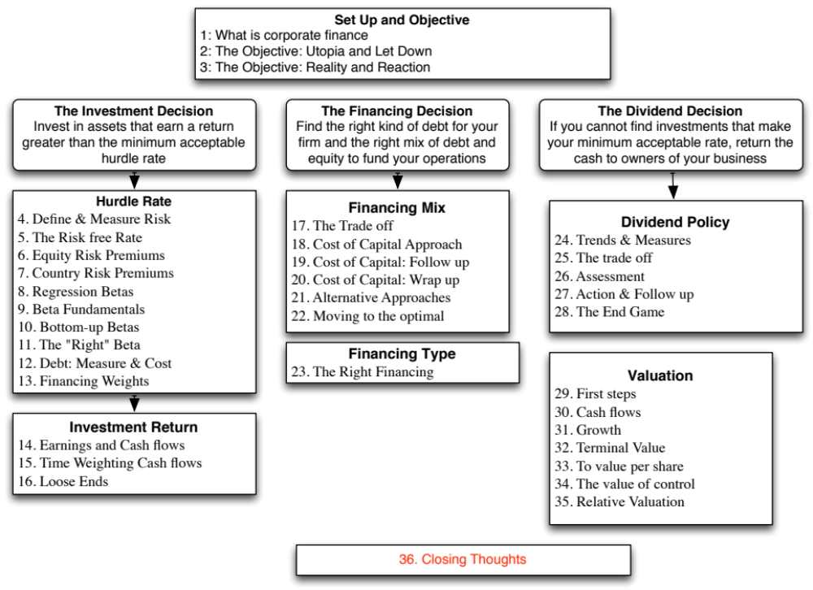

Slide 3
Ponderous Thoughts, or maybe not
There are few facts and lots of opinions.
  Even the givens (cash & risk free rate) are not
  With accounting and market numbers, all bets are off.
The real world is a messy place.
  Money making firms can become money losers
  Companies can be restructured/ given facelifts
Models don’t compute values and optimal paths. You do.
Change is the only constant.
Notes:
Numbers don’t match. Different betas from different sources.
Book value of equity is negative
Optimal debt ratio for Co

Slide 4
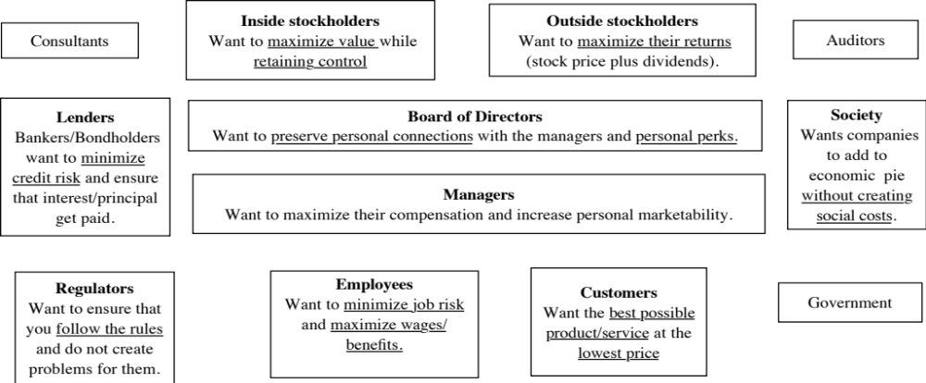
I. What are the conflicts of interest?

Slide 5
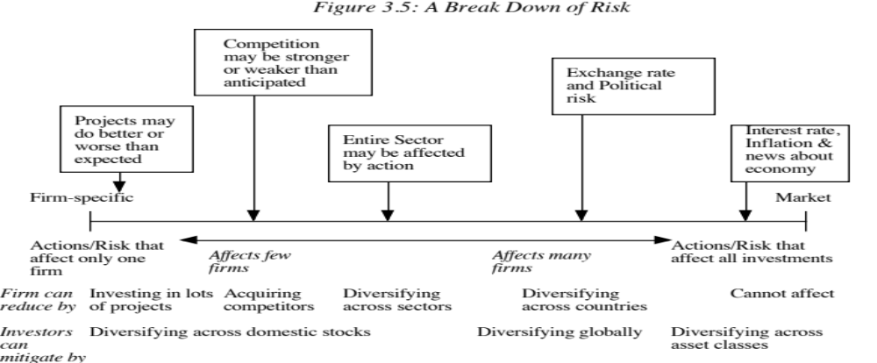
II. Risk and the Marginal Investor

Slide 6
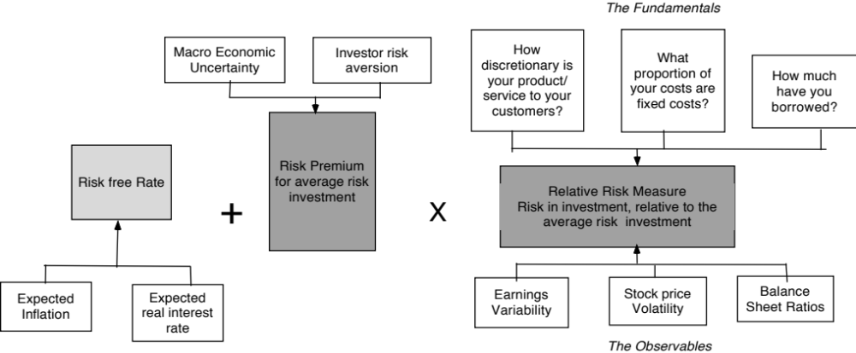
III. Risk Profiles and Costs of Equity

Slide 7
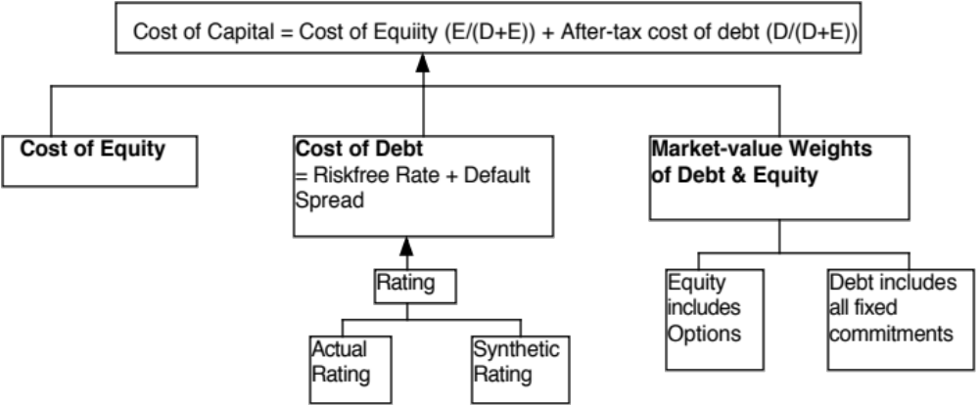
Cost of Capital

Slide 8
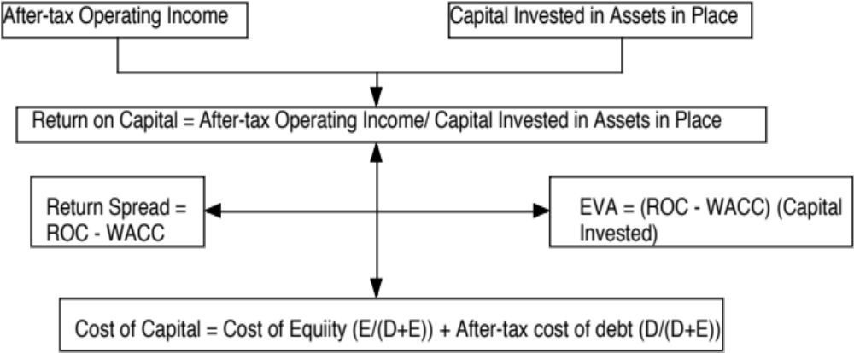
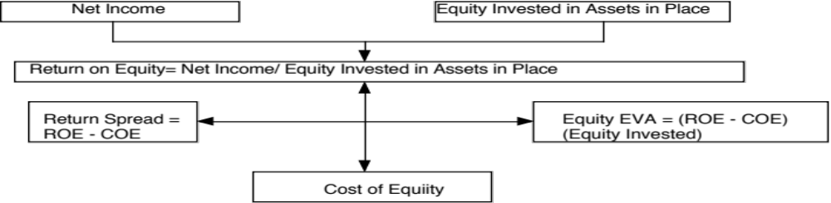
IV. The Quality of Investments: The Firm View

Slide 9

V. The Trade Off on Debt

Slide 10
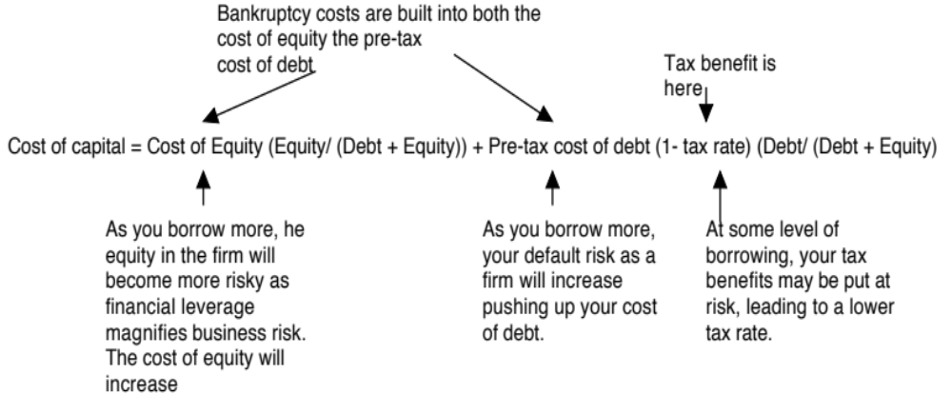
VI. The Optimal Mix of Debt and Equity

Slide 11
VII. Getting to the Optimal Mix
How quickly?
  If under levered, are you the potential target of a hostile acquisition?
  If over levered, are you under threat of bankruptcy?
How?
  Recapitalizations: Borrow money & buy back stock, if under levered, or Issue equity and retire debt, if over levered.
  Investments: Take investments primarily with debt, if under levered, or take investments primarily with equity, if over levered.

Slide 12

VIII. The Right Kind of Financing
The perfect financing: Provides you with the tax benefits of debt, while also giving you the flexibility of equity.

Slide 13
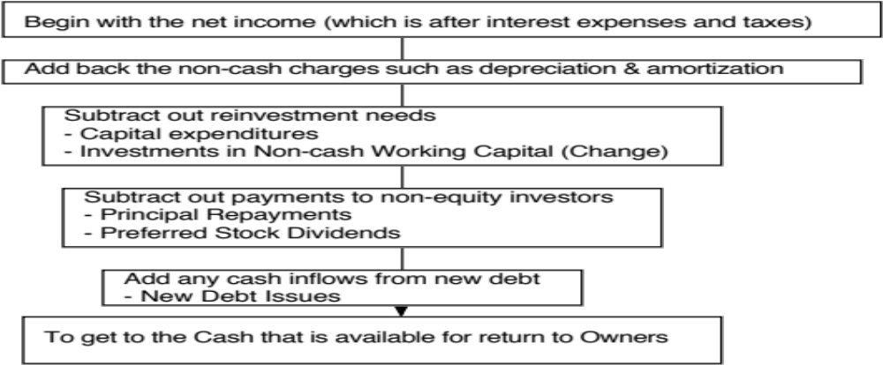
IX. Measuring Potential Dividends

Slide 14
IX. Measuring Potential Dividends

Slide 15
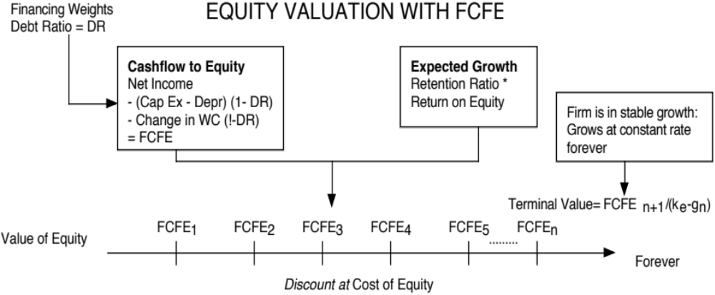
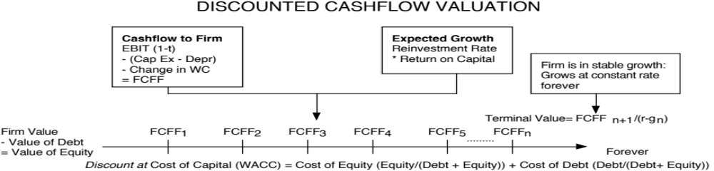
X. Valuation:
Match up cashflows and discount rates…

Slide 16
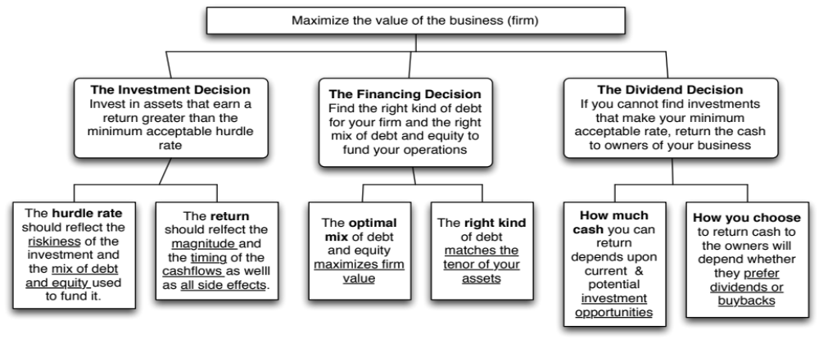
Back to First Principles
Notes:
As we begin, so we end.

Slide 17

Read
Chapter 12
Task
From a first principles standpoint, judge your firm.

