Slide 1
ESTIMATING HURDLE RATES II: RISK FREE RATE
Nothing in life is guaranteed, right?
Notes:
Sets the agenda for the class. This is a class that will be focused on the big picture of corporate finance rather than details, theories or models on a piecemeal basis.

Slide 2
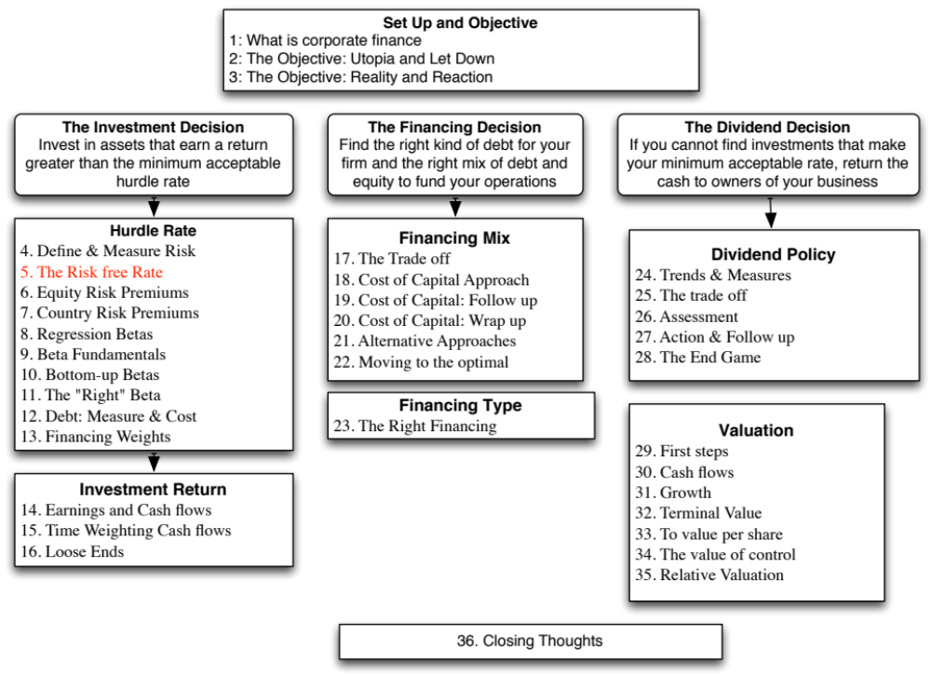

Slide 3
Inputs required to use the CAPM -
The capital asset pricing model yields the following expected return:
  Expected Return = Riskfree Rate+ Beta * (Expected Return on the Market Portfolio - Riskfree Rate)
To use the model we need three inputs:
  The current risk-free rate
  The expected market risk premium (the premium expected for investing in risky assets (market portfolio) over the riskless asset)
  The beta of the asset being analyzed.
Notes:
Summarizes the inputs. Note that we are replacing the last component (E(Rm)-Rf) with the expected equity risk premium..

Slide 4
The Riskfree Rate and Time Horizon
On a riskfree asset, the actual return is always equal to the expected return. For an investment to be riskfree, i.e., to have an actual return be equal to the expected return, two conditions have to be met –
  There has to be no default risk, which generally implies that the security has to be issued by the government. Note, however, that not all governments can be viewed as default free.
  There can be no uncertainty about reinvestment rates, which implies that it is a zero coupon security with the same maturity as the cash flow being analyzed.
Theoretically, this translates into using different riskfree rates for each cash flow - the 1 year zero coupon rate for the cash flow in year 1, the 2-year zero coupon rate for the cash flow in year 2 ...
Practically speaking, if there is substantial uncertainty about expected cash flows, the present value effect of using time varying riskfree rates is small enough that it may not be worth it.
Notes:
Reemphasize that you need to know the expected returns with certainty for something to be riskless.
No default risk and no reinvestment risk. Most people understand the first point, but don’t get the second.
If you need an investment where you will know the expected returns with certainty over a 5-year time horizon, what would that investment be?
From a present value standpoint, using different riskfree rates for each cash flow may be overkill, except in those cases where your interest rates are very different for different time horizons (a very upward sloping or downward sloping yield curve)
A T.Bill would not work - there is reinvestment risk.
Even a 5-year T.Bond would not work, because the coupons will cause the actual return to deviate from the expected return.
Thus, you need a 5-year zero coupon T.Bond

Slide 5
The Bottom Line on Riskfree Rates
Using a long term government rate (even on a coupon bond) as the riskfree rate on all of the cash flows in a long term analysis will yield a close approximation of the true value. For short term analysis, it is entirely appropriate to use a short term government security rate as the riskfree rate.
The riskfree rate that you use in an analysis should be in the same currency that your cashflows are estimated in.
  In other words, if your cashflows are in U.S. dollars, your riskfree rate has to be in U.S. dollars as well.
  If your cash flows are in Euros, your riskfree rate should be a Euro riskfree rate.
The conventional practice of estimating riskfree rates is to use the government bond rate, with the government being the one that is in control of issuing that currency. In November 2013, for instance, the rate on a ten-year US treasury bond (2.75%) is used as the risk free rate in US dollars.
Notes:
Since corporate finance generally looks at long term decisions, we will for the most part use the long term government bond rate.

Slide 6
What is the Euro riskfree rate? An exercise in November 2013
Notes:
Note that there are ten government that issue bonds denominated in Euros… with different rates on each of them. Since they are all in the same currency, the differences have to be attributed to perceptions of default risk. For a riskfree rate in Euros, I would go with the lowest of the rates in this table, which belongs to the German Euro bond; the ten-year rate is 1.75%.
A purist can argue that even the German Euro bond has some default risk embedded in it. The Euro riskfree rate would therefore have to be lower than 1.75%.

Slide 7
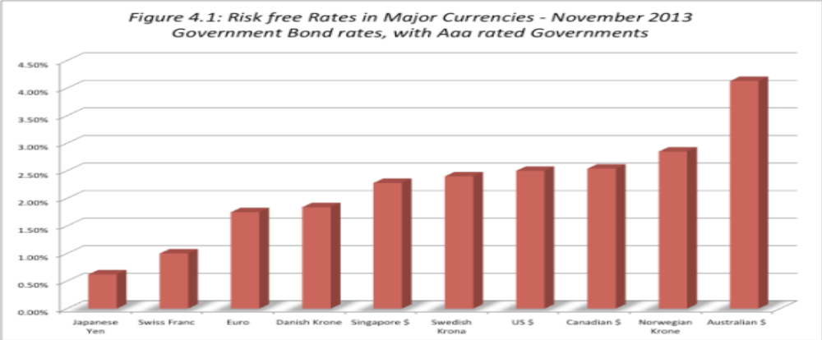
When the government is default free: Risk free rates – in November 2013
Notes:
These are currencies where there is at least one government issuing bonds in that currency that has a Aaa rating. Note, though, that the fact that a ratings agency claims that a rating is Aaa does not necessarily mean that the government is default free.

Slide 8
What if there is no default-free entity?
Risk free rates in November 2013
If the government is perceived to have default risk, the government bond rate will have a default spread component in it and not be riskfree. There are three choices we have, when this is the case.
  Adjust the local currency government borrowing rate for default risk to get a riskless local currency rate.
    In November 2013, the Indian government rupee bond rate was 8.82%. the local currency rating from Moody’s was Baa3 and the default spread for a Baa3 rated country bond was 2.25%.
    Riskfree rate in Rupees = 8.82% - 2.25% = 6.57%
    In November 2013, the Chinese Renmimbi government bond rate was 4.30% and the local currency rating was Aa3, with a default spread of 0.8%.
    Riskfree rate in Chinese Renmimbi = 4.30% - 0.8% = 3.5%
  Do the analysis in an alternate currency, where getting the riskfree rate is easier. With Vale in 2013, we could chose to do the analysis in US dollars (rather than estimate a riskfree rate in R$). The riskfree rate is then the US treasury bond rate.
  Do your analysis in real terms, in which case the riskfree rate has to be a real riskfree rate. The inflation-indexed treasury rate is a measure of a real riskfree rate.
Notes:
- Work with the local currency but you cannot use a long-term government bond rate as a riskfree rate if the government has default risk. You need to back into a riskfree rate. If you cannot do this, you have two choices:
Work with a currency where you can get a riskfree rate
Do everything in real terms
For a real riskfree rate, an expected real growth rate for the economy should provide a reasonable approximation.
To do your analysis in real terms, you need a real riskfree rate. In the U.S., you can obtain such a rate by looking at the inflation indexed treasury bond rate. Outside the U.S., you can assume as a rough approximation that the real riskfree rate is equal to your real growth rate. IIf the real growth rate is much lower than the real interest rate, you will have significant deficits - trade or budget - to make up the shortfall. If the real growth rate is much higher than the real interest rate, you will the exact opposite - surpluses. A long term equilibrium can be reached only when the two are equal.

Slide 9
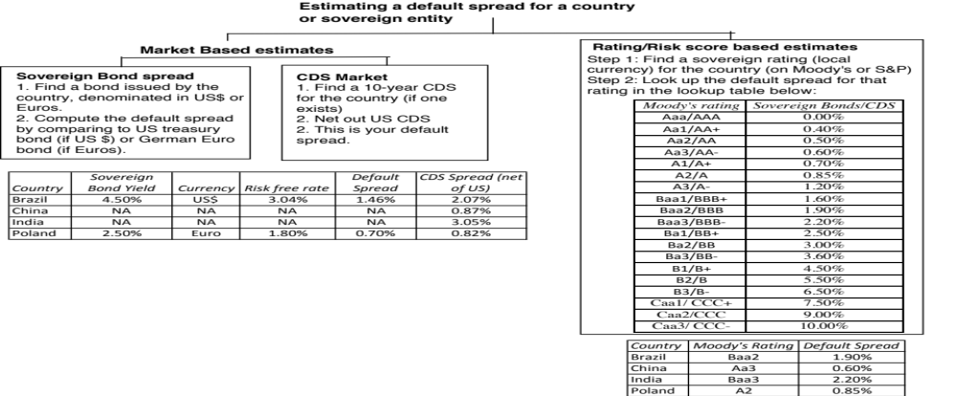
Estimating a sovereign default spread

Slide 10
Risk free rates will vary across currencies: January 2017

Slide 11

Task
Estimate the risk free rate in the currency of your choice
Read
Chapter 4

