Slide 1
Hurdle rates III: Estimating Equity risk premiums Part I
Stocks are risky! Really!
Notes:
Sets the agenda for the class. This is a class that will be focused on the big picture of corporate finance rather than details, theories or models on a piecemeal basis.

Slide 2
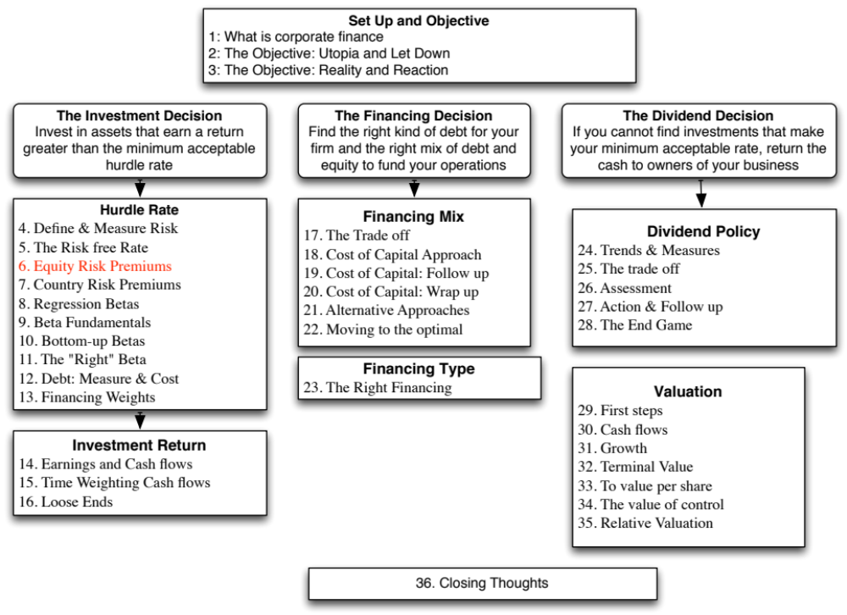

Slide 3
The Equity Risk Premium
The risk premium is the premium that investors demand for investing in an average risk investment, relative to the riskfree rate.
As a general proposition, this premium should be
  greater than zero
  increase with the risk aversion of the investors in that market
  increase with the riskiness of the “average” risk investment
Notes:
Implicit here are two questions - Which investor’s risk premium? What is the average risk investment?
With this assumption it is quite clear that estimating equity risk premiums will be difficult to do because different investors have different degrees of risk aversion (and will demand different premiums) and risk aversion will change over time.

Slide 4
What is your risk premium?
Assume that stocks are the only risky assets and that you are offered two investment options:
  a riskless investment (say a Government Security), on which you can make 3%
  a mutual fund of all stocks, on which the returns are uncertain
How much of an expected return would you demand to shift your money from the riskless asset to the mutual fund?
  Less than 3%
  Between 3 - 5%
  Between 5 - 7%
  Between 7 -9%
  Between 9%- 11%
  More than 11%
Notes:
I usually find that the median number that I get in the US is 7-9%, though the distribution is pretty spread out. This translates into a risk premium of 4-6%. (I have also run a survey on my web site for three years. With more than 30,000 responses, the median risk premium is about 4-6% as well.)
If this were the entire market, the risk premium would be a weighted average of the risk premiums demanded by each and every investor.
The weights will be determined by the wealth that each investor brings to the market. Thus, Warren Buffett’s risk aversion counts more towards determining the “equilibrium” premium than yours’ and mine.
As investors become more risk averse, you would expect the “equilibrium” premium to increase.

Slide 5
Risk Premiums do change..
Go back to the previous example. Assume now that you are making the same choice but that you are making it in the aftermath of a stock market crash (it has dropped 25% in the last month). Would you change your answer?
  I would demand a larger premium
  I would demand a smaller premium
  I would demand the same premium
Notes:
Quite a few will demand a larger premium, suggesting that this is a dynamic estimate, changing from period to period. Some will settle for a smaller premium, arguing that if stocks were a bargain before the drop, they should be even more so now. The broader point is that risk premiums change over time.
You can ask the same question about how a recession or losing your job will affect your risk premium.

Slide 6
Estimating Risk Premiums in Practice
Survey investors on their desired risk premiums and use the average premium from these surveys.
Assume that the actual premium delivered over long time periods is equal to the expected premium - i.e., use historical data
Estimate the implied premium in today’s asset prices.
Notes:
Lists the basic approaches. Not all of them are equally useful… So, let’s look at each one separately.

Slide 7
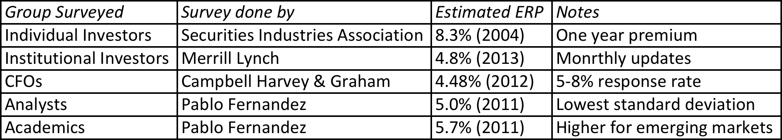
A. The Survey Approach
Surveying all investors in a market place is impractical.
However, you can survey a few individuals and use these results. In practice, this translates into surveys of the following:
The limitations of this approach are:
  there are no constraints on reasonability (the survey could produce negative risk premiums or risk premiums of 50%)
  The survey results are extremely volatile
  they tend to be short term; even the longest surveys do not go beyond one year.
Notes:
Merrill Lynch does surveys of portfolio managers (who presumably have more wealth to invest and hence should be weighted more) asking investors what they think the market will do over the next year. They report the number but do not use it internally as a risk premium.
Morningstar does surveys of individual investors and reports absurdly high premiums. It is not clear whether these are wishes of expectations.
Campbell and Harvey have been doing surveys of CFOs for a decade and they report their results in detail every year. (The full surveys are well worth reading and are on ssrn.com)
Generally survey premiums seem to be more backward looking than forward looking. In other words, they seem to decrease in good times and jump after market crises (the key word is after… no predictive power here)

Slide 8
B. The Historical Risk Premium
United States – January 2017
What is the right premium?
Go back as far as you can. Otherwise, the standard error in the estimate will be large.
Be consistent in your use of a riskfree rate.
Use arithmetic premiums for one-year estimates of costs of equity and geometric premiums for estimates of long term costs of equity.
Notes:
The US has the longest and richest historical data base for stocks (going back as far as the 1800s) and many historical premiums are based upon that data…
We are trusting mean reversion, i.e., that numbers revert back to historical averages over time..
This is based upon historical data available on the Federal Reserve site in St. Louis. There are three reasons for why the premium estimated may differ:
1. How far back you go (My personal bias is to go back as far as possible. Stock prices are so noisy that you need very long time periods to get reasonable estimates)
2. Whether you use T.Bill or T.Bond rates ( You have to be consistent. Since I will be using the T.Bond rate as my riskfree rate, I will use the premium over that rate)
3. Whether you use arithmetic or geometric means (If returns were uncorrelated over time, and you were asked to estimate a 1-year premium, the arithmetic mean would be used. Since returns are negatively correlated over time, and we are estimating premiums over longer holding periods, it makes more sense to use the compounded return, which gives us the geometric average)
Thus, I should be using the updated geometric average for stocks over bonds.

Slide 9
What about historical premiums for other markets?
Historical data for markets outside the United States is available for much shorter time periods. The problem is even greater in emerging markets.
The historical premiums that emerge from this data reflects this data problem and there is much greater error associated with the estimates of the premiums.
Put simply, if you distrust historical risk premiums in the United States, because the estimates are backward looking and noisy, you will trust them even less outside the US, where you have less data.
Notes:
Increasingly, the challenges we face are in estimating risk premiums outside the United States, not only because so many companies that we value are in younger, emerging markets but because so many US companies are looking at expanding into these markets.

Slide 10
One solution: Bond default spreads as CRP – November 2013
In November 2013, the historical risk premium for the US was 4.20% (geometric average, stocks over T.Bonds, 1928-2012)
Using the default spread on the sovereign bond or based upon the sovereign rating and adding that spread to the mature market premium (4.20% for the US):
If you prefer CDS spreads:
 | Arithmetic Average |  | Geometric Average
 | Stocks - T. Bills | Stocks - T. Bonds | Stocks - T. Bills | Stocks - T. Bonds
1928-2012 | 7.65% | 5.88% | 5.74% | 4.20%
 | 2.20% | 2.33%
Country | Rating | Default Spread (Country Risk Premium) | US ERP | Total ERP for country
India | Baa3 | 2.25% | 4.20% | 6.45%
China | Aa3 | 0.80% | 4.20% | 5.00%
Brazil | Baa2 | 2.00% | 4.20% | 6.20%
Country | Sovereign CDS Spread | US ERP | Total ERP for country
India | 4.20% | 4.20% | 8.40%
China | 1.20% | 4.20% | 5.40%
Brazil | 2.59% | 4.20% | 6.79%
Notes:
This approach is simple but it assumes that country default spreads are also good measures of additional country equity risk. The question thought is whether equities (which are riskier than bonds) should command a larger risk premium.

Slide 11
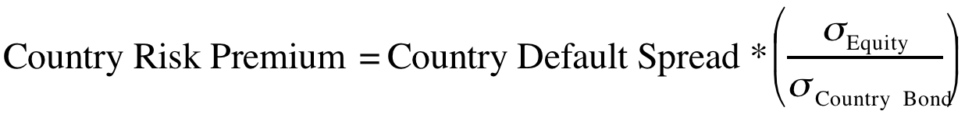
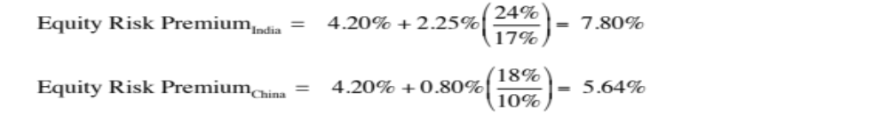
Beyond the default spread? Equities are riskier than bonds
While default risk spreads and equity risk premiums are highly correlated, one would expect equity spreads to be higher than debt spreads. One approach to scaling up the premium is to look at the relative volatility of equities to bonds and to scale up the default spread to reflect this:
Brazil: The annualized standard deviation in the Brazilian equity index over the previous year is 21 percent, whereas the annualized standard deviation in the Brazilian C-bond is 14 percent.
Using the same approach for India and China:
Notes:
In In this approach, we scale up the default spread to reflect the additional risk in stocks… This will result in larger equity risk premiums. We are assuming that investors, when pricing equities in an emerging market, look at what they can make on government bonds issued by that market and scale up premiums for additional risk.
There is a third approach which is closely related where you look at the standard deviation of the emerging equity market, relative to the standard deviation of the U.S. equity market, and multiply by the U.S. equity risk premium. Thus, the equity risk premium for an emerging market which is twice as volatile as the the US market should have an equity risk premium of 8.40% (twice 4.20%).

Slide 12

Task
Estimate the historical equity risk premium in the market of your choice (if you can)
Read
Chapter 4

