Slide 1
Hurdle rates Vi: Betas and fundamentals
Your business choices determine your risk profile!
Notes:
Sets the agenda for the class. This is a class that will be focused on the big picture of corporate finance rather than details, theories or models on a piecemeal basis.

Slide 2
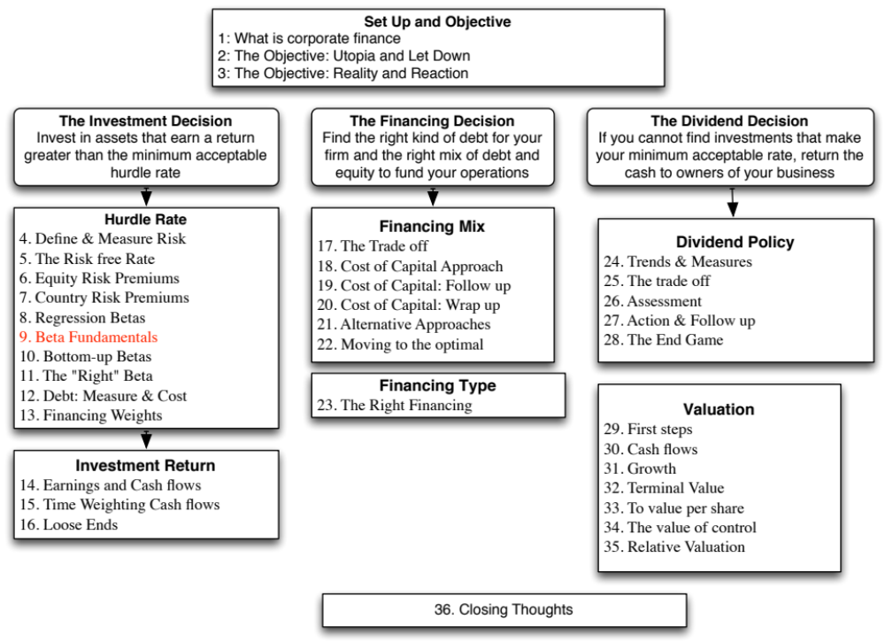

Slide 3

Regression Diagnostics for Tata Motors
Beta = 1.83
67% range
1.67-1.99
69% market risk
31% firm specific
Jensen’s α
= 2.28% - 4%/12 (1-1.83) = 2.56%
Annualized = (1-.0256)¹²-1= 35.42%
Average monthly riskfree rate (2008-13) = 4%
Expected Return (in Rupees)
= Riskfree Rate+ Beta*Risk premium
= 6.57%+ 1.83 (7.19%) = 19.73%
Notes:
Deconstructing Tata Motorl’s beta page, we find that
Tata Motors did better than expected over the period – by 19.73% in an annual basis.
Tata Motors is above average risk (1.83 times as risky as the typical Indian firm)
About 69% of the risk in Tata Motors is market risk

Slide 4
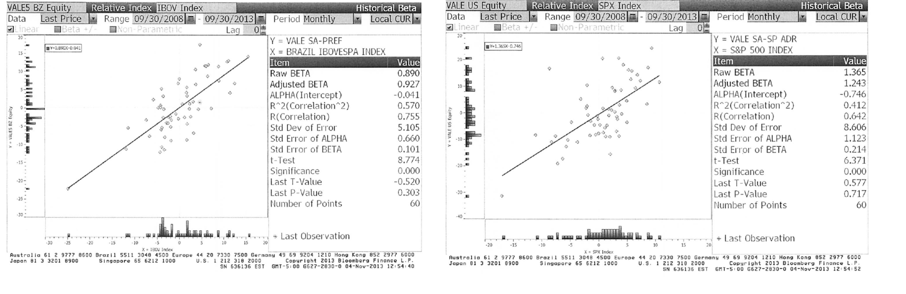
Beta Estimation and Index Choice: Vale
Notes:
Shows how easy it is to get your betas to move, if you get to try different indices (and different time periods and different return intervals).

Slide 5
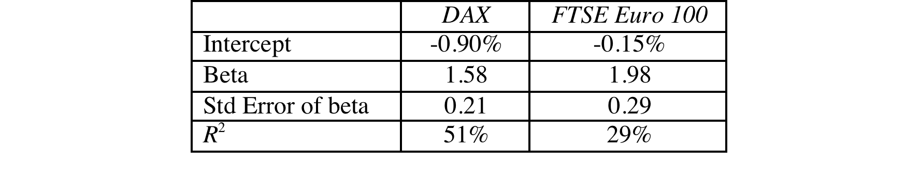
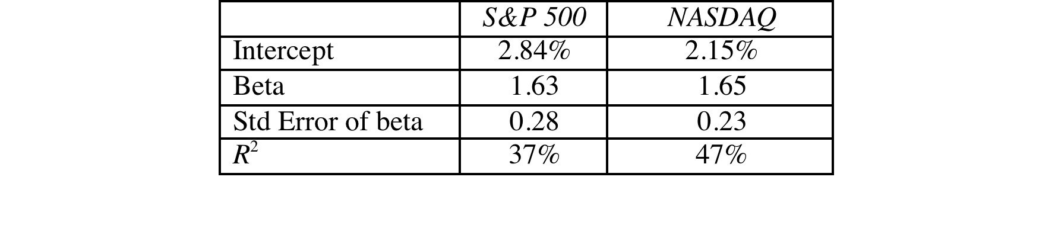
Deutsche Bank and Baidu: Index Effects on Risk Parameters
For Deutsche Bank, a widely held European stock, we tried both the DAX (German index) and the FTSE European index.
For Baidu, a NASDAQ listed stock, we ran regressions against both the S&P 500 and the NASDAQ.
Notes:
As the index used expands and becomes broader, the R-squared drops off and the standard error increases.
Which one would you use? It depends upon who your marginal investors are. If they are investors who are local and stay focused only on the local market, you may be able to get away with the DAX regression. As your marginal investors become more diversified, you should move from the local index to wider indices. The least precise beta estimate (with the highest standard error) may be the most meaningful.
As investors become globalized, there is an argument to be made that we should be abandoning the use of local indices and replacing them with global indices.
With Baidu, the best index is not the one that fits it best (which would be the NASDAQ) but the one that best captures what marginal investors are invested in.

Slide 6
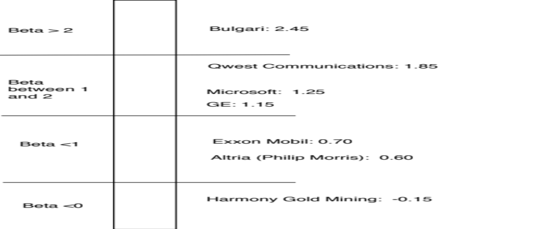
Beta: Exploring Fundamentals
Notes:
A cross selection of regression betas for companies… Lets try a story for each one:
Bulgari: Small company with mostly luxury products
Qwest: Some business risk but much more substantial overlay of financial risk created by borrowing billions.
Microsoft: Example of beta drift towards one as companies get larger and their product base (and customer base) becomes more diversified. Microsoft’s beta in the lat 1980s was much higher than 2.
GE: Most diversified US company you will find.. Beta will drift towards one for diversified companies. GE Capital’s debt acts as ballast on beta
Philip Morris: Main risk is oil price risk which cuts against the rest of the market (lower oil prices are good for many companies and the economy but not for oil companies). The litigation risk will not show up in the beta because it is firm-specific. (Changing the company name to Altria will not make a difference)
Harmony Gold Mining Company: A negative beta implies that adding this stock on to a diversified portfolio will actually reduce risk (acts as insurance). Gold has historically been an insurance against inflation.
(Consequences of a negative beta: Expected return < Riskfree rate)

Slide 7
Determinant 1: Product Type
Industry Effects: The beta value for a firm depends upon the sensitivity of the demand for its products and services and of its costs to macroeconomic factors that affect the overall market.
  Cyclical companies have higher betas than non-cyclical firms
  Firms which sell more discretionary products will have higher betas than firms that sell less discretionary products
Notes:
Betas measure risk relative to the market.
Firms which are cyclical or sell discretionary products tend to do much better when the economy is doing well (and the market is doing well) and much worse when the economy is doing badly than other firms in the market.
In terms of basic economics, companies that sell products/ services that have elastic demand should have higher betas than ones that sell products/services with inelastic demand.

Slide 8
Determinant 2: Operating Leverage Effects
Operating leverage refers to the proportion of the total costs of the firm that are fixed.
Other things remaining equal, higher operating leverage results in greater earnings variability which in turn results in higher betas.
Notes:
Firms with high fixed costs tend to see much bigger swings in operating income (and stock prices) for a given change in revenues than firms with more flexible cost structures.
Consider the case of the airline sector, which tends to have cost structures which are almost entirely fixed (plane lease expenses, fuel costs …). Firms in the sector have high betas.
Are you destined to have a high beta, once you pick a sector?
To an extent, yes, but you can take action or make decisions to change your destiny. Consider Southwest. By using only one type of aircraft, hedging fuel costs, flying from no-name airports and having a flexible workforce, Southwest has been able to lower its fixed costs as a proportion of total costs. (Focusing less on business travel and high priced tickets has also helped them on the discretionary component).

Slide 9
Measures of Operating Leverage
Fixed Costs Measure = Fixed Costs / Variable Costs
This measures the relationship between fixed and variable costs. The higher the proportion, the higher the operating leverage.
EBIT Variability Measure = % Change in EBIT / % Change in Revenues
This measures how quickly the earnings before interest and taxes changes as revenue changes. The higher this number, the greater the operating leverage.
Notes:
The direct measures of fixed costs and variable costs are difficult to obtain. Hence we use the second.

Slide 10
Disney’s Operating Leverage: 1987- 2013
Year | Net Sales | % Change in Sales | EBIT | % Change in EBIT
1987 | $2,877 |  | $756
1988 | $3,438 | 19.50% | $848 | 12.17%
1989 | $4,594 | 33.62% | $1,177 | 38.80%
1990 | $5,844 | 27.21% | $1,368 | 16.23%
1991 | $6,182 | 5.78% | $1,124 | -17.84%
1992 | $7,504 | 21.38% | $1,287 | 14.50%
1993 | $8,529 | 13.66% | $1,560 | 21.21%
1994 | $10,055 | 17.89% | $1,804 | 15.64%
1995 | $12,112 | 20.46% | $2,262 | 25.39%
1996 | $18,739 | 54.71% | $3,024 | 33.69%
1997 | $22,473 | 19.93% | $3,945 | 30.46%
1998 | $22,976 | 2.24% | $3,843 | -2.59%
1999 | $23,435 | 2.00% | $3,580 | -6.84%
2000 | $25,418 | 8.46% | $2,525 | -29.47%
2001 | $25,172 | -0.97% | $2,832 | 12.16%
2002 | $25,329 | 0.62% | $2,384 | -15.82%
2003 | $27,061 | 6.84% | $2,713 | 13.80%
2004 | $30,752 | 13.64% | $4,048 | 49.21%
2005 | $31,944 | 3.88% | $4,107 | 1.46%
2006 | $33,747 | 5.64% | $5,355 | 30.39%
2007 | $35,510 | 5.22% | $6,829 | 27.53%
2008 | $37,843 | 6.57% | $7,404 | 8.42%
2009 | $36,149 | -4.48% | $5,697 | -23.06%
2010 | $38,063 | 5.29% | $6,726 | 18.06%
2011 | $40,893 | 7.44% | $7,781 | 15.69%
2012 | $42,278 | 3.39% | $8,863 | 13.91%
2013 | $45,041 | 6.54% | $9,450 | 6.62% | Operating Leverage
Average: 87-13 |  | 11.79% |  | 11.91% | 11.91/11.79 =1.01
Average: 96-13 |  | 8.16% |  | 10.20% | 10.20/8.16 =1.25
Average across entertainment companies = 1.35
Given Disney’s operating leverage measures (1.01 or 1.25), would you expect Disney to have a higher or a lower beta than other entertainment companies?
Higher
Lower
No effect
Notes:
This measures Disney’s operating leverage historically. You need a number of years of data before you can get reasonable estimates.

Slide 11
Determinant 3: Financial Leverage
As firms borrow, they create fixed costs (interest payments) that make their earnings to equity investors more volatile.
This increased earnings volatility which increases the equity beta.
The beta of equity alone can be written as a function of the unlevered beta and the debt-equity ratio
_{L} = _{u} (1+ ((1-t)D/E))
  where
  _{L} = Levered or Equity Beta D/E = Market value Debt to equity ratio
  _{u} = Unlevered or Asset Beta t = Marginal tax rate
Earlier, we estimated the beta for Disney from a regression. Was that beta a levered or unlevered beta?
Levered
Unlevered
Notes:
Same rationale as operating leverage but the focus here is on equity earnings. Put another way, a firm with stable operating income can make its equity income much more volatile by borrowing large sums of money.
This is based upon two assumptions
Debt bears no market risk (which is consistent with studies that have found that default risk is non-systematic)
Debt creates a tax benefit
Assets Liabilities
Assets A (β_{u}) Debt D (β_{D} =0)
Tax Benefits tD (β_{D}=0) Equity E (β_{L})
Betas are weighted averages,
Β_{u} (E + D - tD)/(D+E) = β_{L}(E/(D+E))
Solve for β_{L},
β_{L} = Β_{u} (E + D - tD)/E= Β_{u} (1 + (1-t)D/E)
If debt has a beta (β_{D})
Β_{u} (E + D - tD)/(D+E) + β_{D} tD/(D+E) = β_{L}(E/(D+E)) + β_{D} D/(D+E)
β_{L} = Β_{u} (1 + (1-t)D/E) - β_{D} (1-t) [D/(D+E)]

Slide 12
Effects of leverage on betas: Disney
The regression beta for Disney is 1.25. This beta is a levered beta (because it is based on stock prices, which reflect leverage) and the leverage implicit in the beta estimate is the average market debt equity ratio during the period of the regression (2008 to 2013)
The average debt equity ratio during this period was 19.44%.
The unlevered beta for Disney can then be estimated (using a marginal tax rate of 36.1%)
  = Current Beta / (1 + (1 - tax rate) (Average Debt/Equity))
  = 1.25 / (1 + (1 - 0.361)(0.1944))= 1.1119
Notes:
Note that betas reflect the average leverage over the period and not the current leverage of the firms. Firms whose leverage has changed over the period will have regression betas that are different from their true betas.

Slide 13

Disney : Beta and Financial Leverage
Notes:
Since equity investors bear all of the non-diversifiable risk, the beta of Disney’s equity will increase as the leverage increases.

Slide 14

Task
Evaluate the business risk, operating leverage & financial leverage for your company
Read
Chapter 4

