Slide 1
APPLIED CORPORATE FINANCE:
AN ONLINE CLASS
It is big picture, it is applied & it is fun!
Notes:
Sets the agenda for the class. This is a class that will be focused on the big picture of corporate finance rather than details, theories or models on a piecemeal basis.

Slide 2

What is corporate finance?
Every decision that a business makes has financial implications, and any decision which affects the finances of a business is a corporate finance decision.
Defined broadly, everything that a business does fits under the rubric of corporate finance.
Notes:
Every decision is a corporate finance decision. Thus, marketing, accounting, operations and strategy can all be viewed as subsets of corporate finance (self serving, right?)

Slide 3
Objectives
To give you the capacity to understand the theory and apply, in real world situations, the techniques that have been developed in corporate finance.
  Motto for class: If it cannot be applied, who cares?.
To give you the big picture of corporate finance so that you can understand how things fit together.
  Motto for class: You can forget the details, but don’t miss the storyline.
To show you that corporate finance is fun.
  Motto for class: Are we having fun yet?
Notes:
We need “applied”: There are so many real world questions that need urgent answers. Why go looking for abstractions?
Big picture: Easy to get lost in the details & distractions. In fact, if you work in corporate finance, you get increasingly specialized and lose perspective. Knowing what the big picture looks like will let you figure out how what you do fits into the larger scheme of things but also lets you do it better.
Corporate finance is number crunching, with lots of room for your creative side to shine through. It provides discipline to creative people and imagination to “just show me the numbers” people. (Story: Steve Jobs was a great CEO at Apple in his second coming but not in his first one. What was different? He had someone who took his flights of imagination and made them operational in Tim Cook).
I am an evangelist when it comes to corporate finance. I will not try to make you bankers but I will try to sell you on the notion that no matter what you choose to do in life (entrepreneur, not-for-profit person, strategy guru, marketing superstar) that having an understanding of corporate finance will make you better at that.

Slide 4
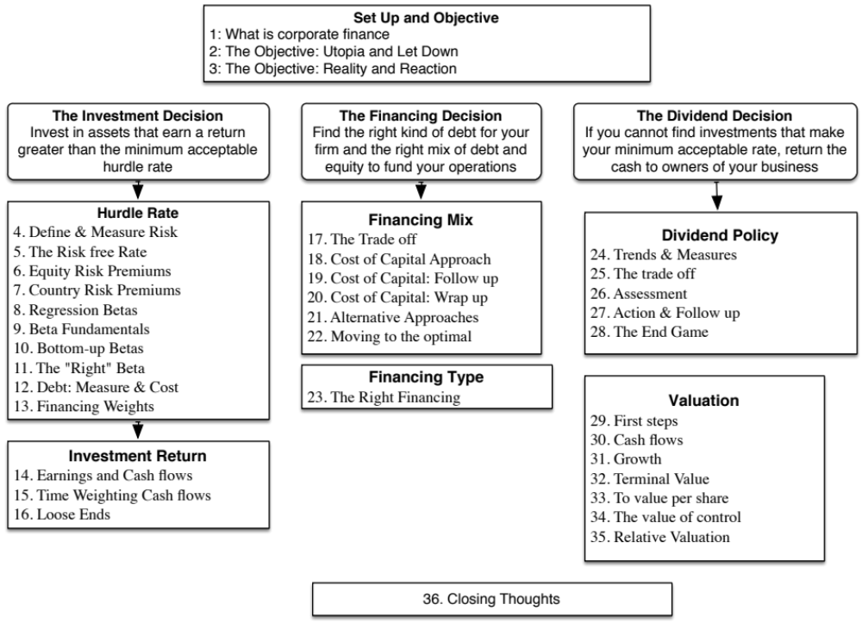

Slide 5

The Book
If you choose to get a book, this is the book that accompanies these sessions
Damodaran.com
This is the website that supports the class.

