Slide 1
Hurdle rates VIII: Bottom up betas II
The law of large numbers is your best friend.
Notes:
Sets the agenda for the class. This is a class that will be focused on the big picture of corporate finance rather than details, theories or models on a piecemeal basis.

Slide 2
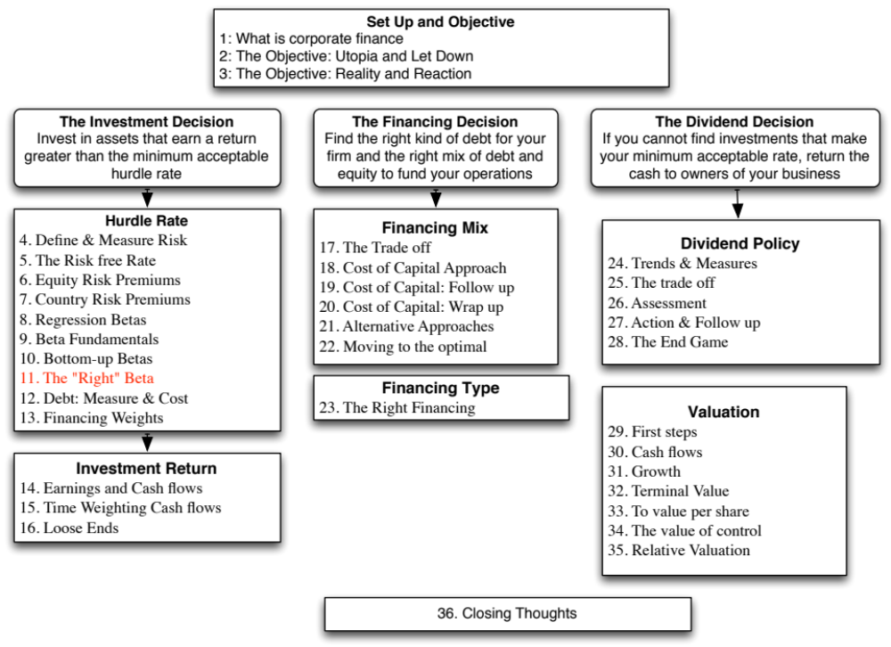

Slide 3
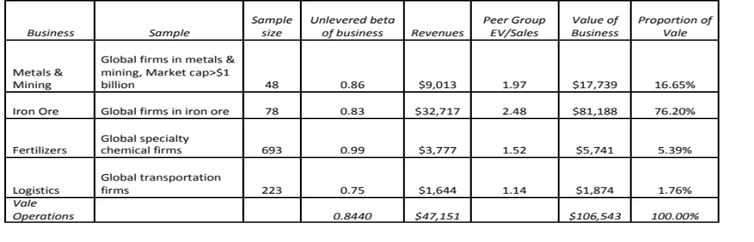
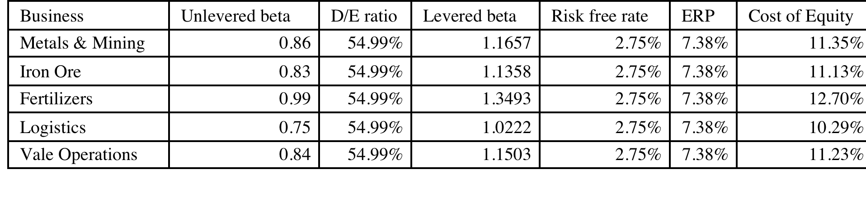
Estimating Bottom Up Betas & Costs of Equity: Vale
Notes:
Following the same script that I did for Disney, but I did not attempt to allocate the debt across businesses, partly because there was little information available on the allocation and partly because they businesses are more similar in terms of their debt capacity.

Slide 4

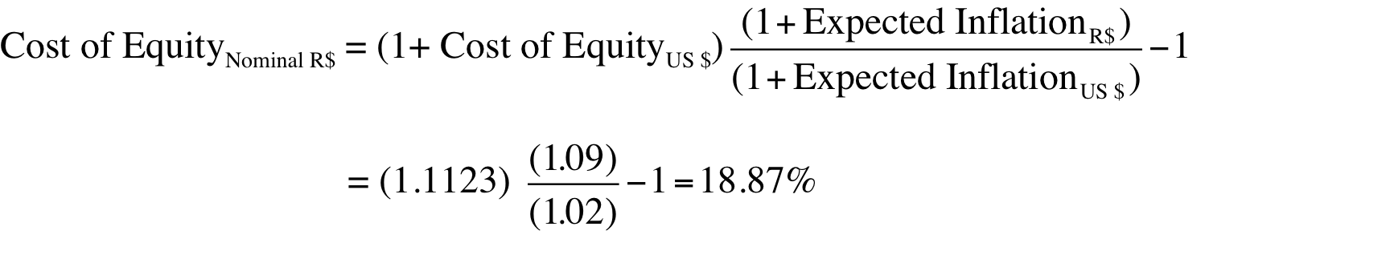
Vale: Cost of Equity Calculation – in nominal $R
To convert a discount rate in one currency to another, all you need are expected inflation rates in the two currencies.
From US $ to R$: If we use 2% as the inflation rate in US dollars and 9% as the inflation ratio in Brazil, we can convert Vale’s US dollar cost of equity of 11.23% to a $R cost of equity:
Alternatively, you can compute a cost of equity, starting with the $R riskfree rate of 10.18%.
  Cost of Equity in $R = = 10.18% + 1.15 (7.38%) = 18.67%
Notes:
The cost of equity can be stated in different currencies. When computing the nominal BR cost of equity, we scale up the risk premium to reflect the fact the the inflation rates (and risk free rates in BR) are much higher.
I prefer the first approach, which is to start with a dollar based cost of capital and scale up for inflation differentials, since all of the risk premiums that I am using come from dollar based markets and scaling up with inflation allows me to scale up the premiums as well..

Slide 5
Bottom up betas & Costs of Equity: Tata Motors & Baidu
Tata Motors: We estimated an unlevered beta of 0.8601 across 76 publicly traded automotive companies (globally) and estimated a levered beta based on Tata Motor’s D/E ratio of 41.41% and a marginal tax rate of 32.45% for India:
  Levered Beta for Tata Motors = 0.8601 (1 + (1-.3245) (.4141)) = 1.1007
  Cost of equity (Rs) = 6.57% + 1.1007 (7.19%) = 14.49%
Baidu: To estimate its beta, we looked at 42 global companies that derive all or most of their revenues from online advertising and estimated an unlevered beta of 1.30 for the business. Incorporating Baidu’s current market debt to equity ratio of 5.23% and the marginal tax rate for China of 25%, we estimate Baidu’s current levered beta to be 1.3560.
  Levered Beta for Baidu = 1.30 (1 + (1-.25) (.0523)) = 1.356
  Cost of Equity for Baidu (Renmimbi) = 3.50% + 1.356 (6.94%) = 12.91%
Notes:
Both are single business companies and the beta estimation is made a little easier. I used the global averages for both, simply because there are very few companies in either the domestic markets or even across all emerging markets.

Slide 6
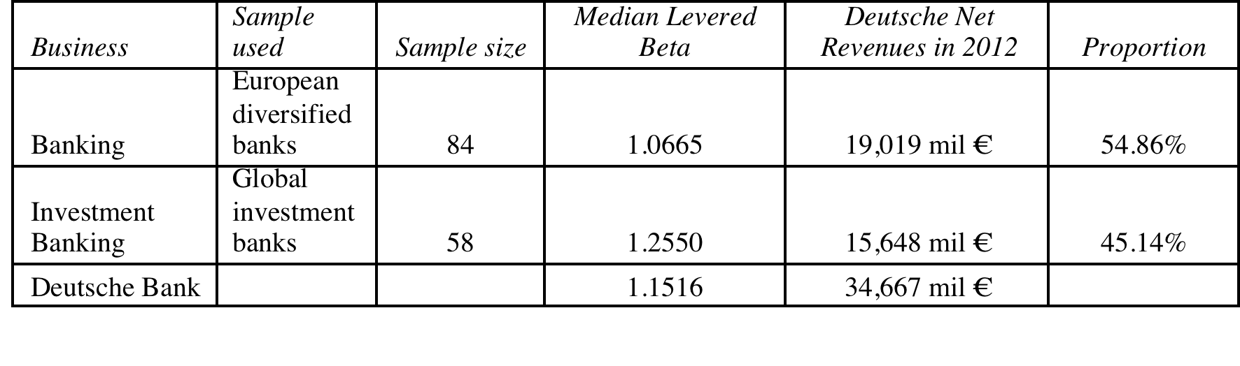
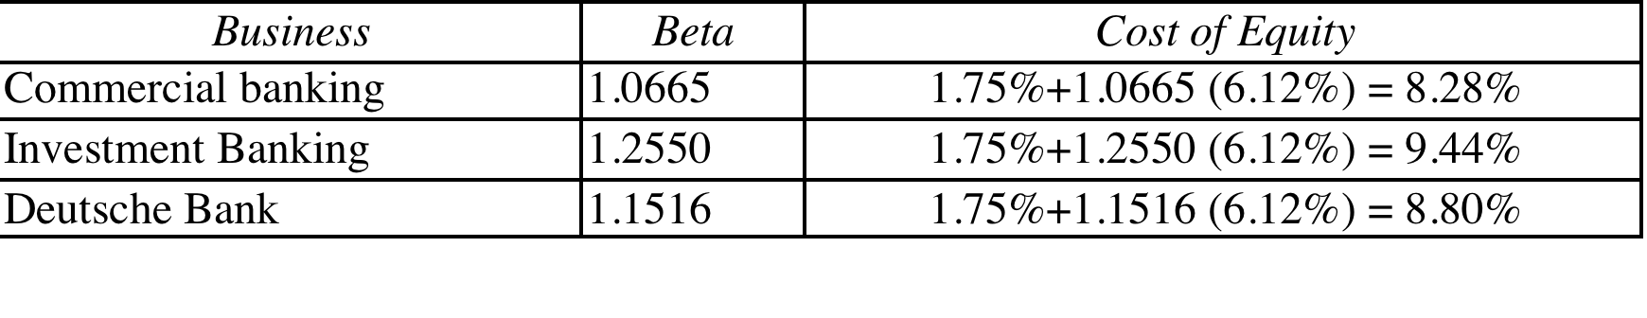
Bottom up Betas and Costs of Equity: Deutsche Bank
We break Deutsche Bank down into two businesses – commercial and investment banking.
We do not unlever or relever betas, because estimating debt and equity for banks is an exercise in futility.
Notes:
Investment banking is riskier and should require a higher return. (In fact, if you could break investment banking down into its component parts, you could get very different costs of equity within that business).

Slide 7
Estimating Betas for Non-Traded Assets
The conventional approaches of estimating betas from regressions do not work for assets that are not traded. There are no stock prices or historical returns that can be used to compute regression betas.
There are two ways in which betas can be estimated for non-traded assets
  Using comparable firms
  Using accounting earnings
Notes:
Private firms are not traded. There are no historical price records to compute betas from.

Slide 8
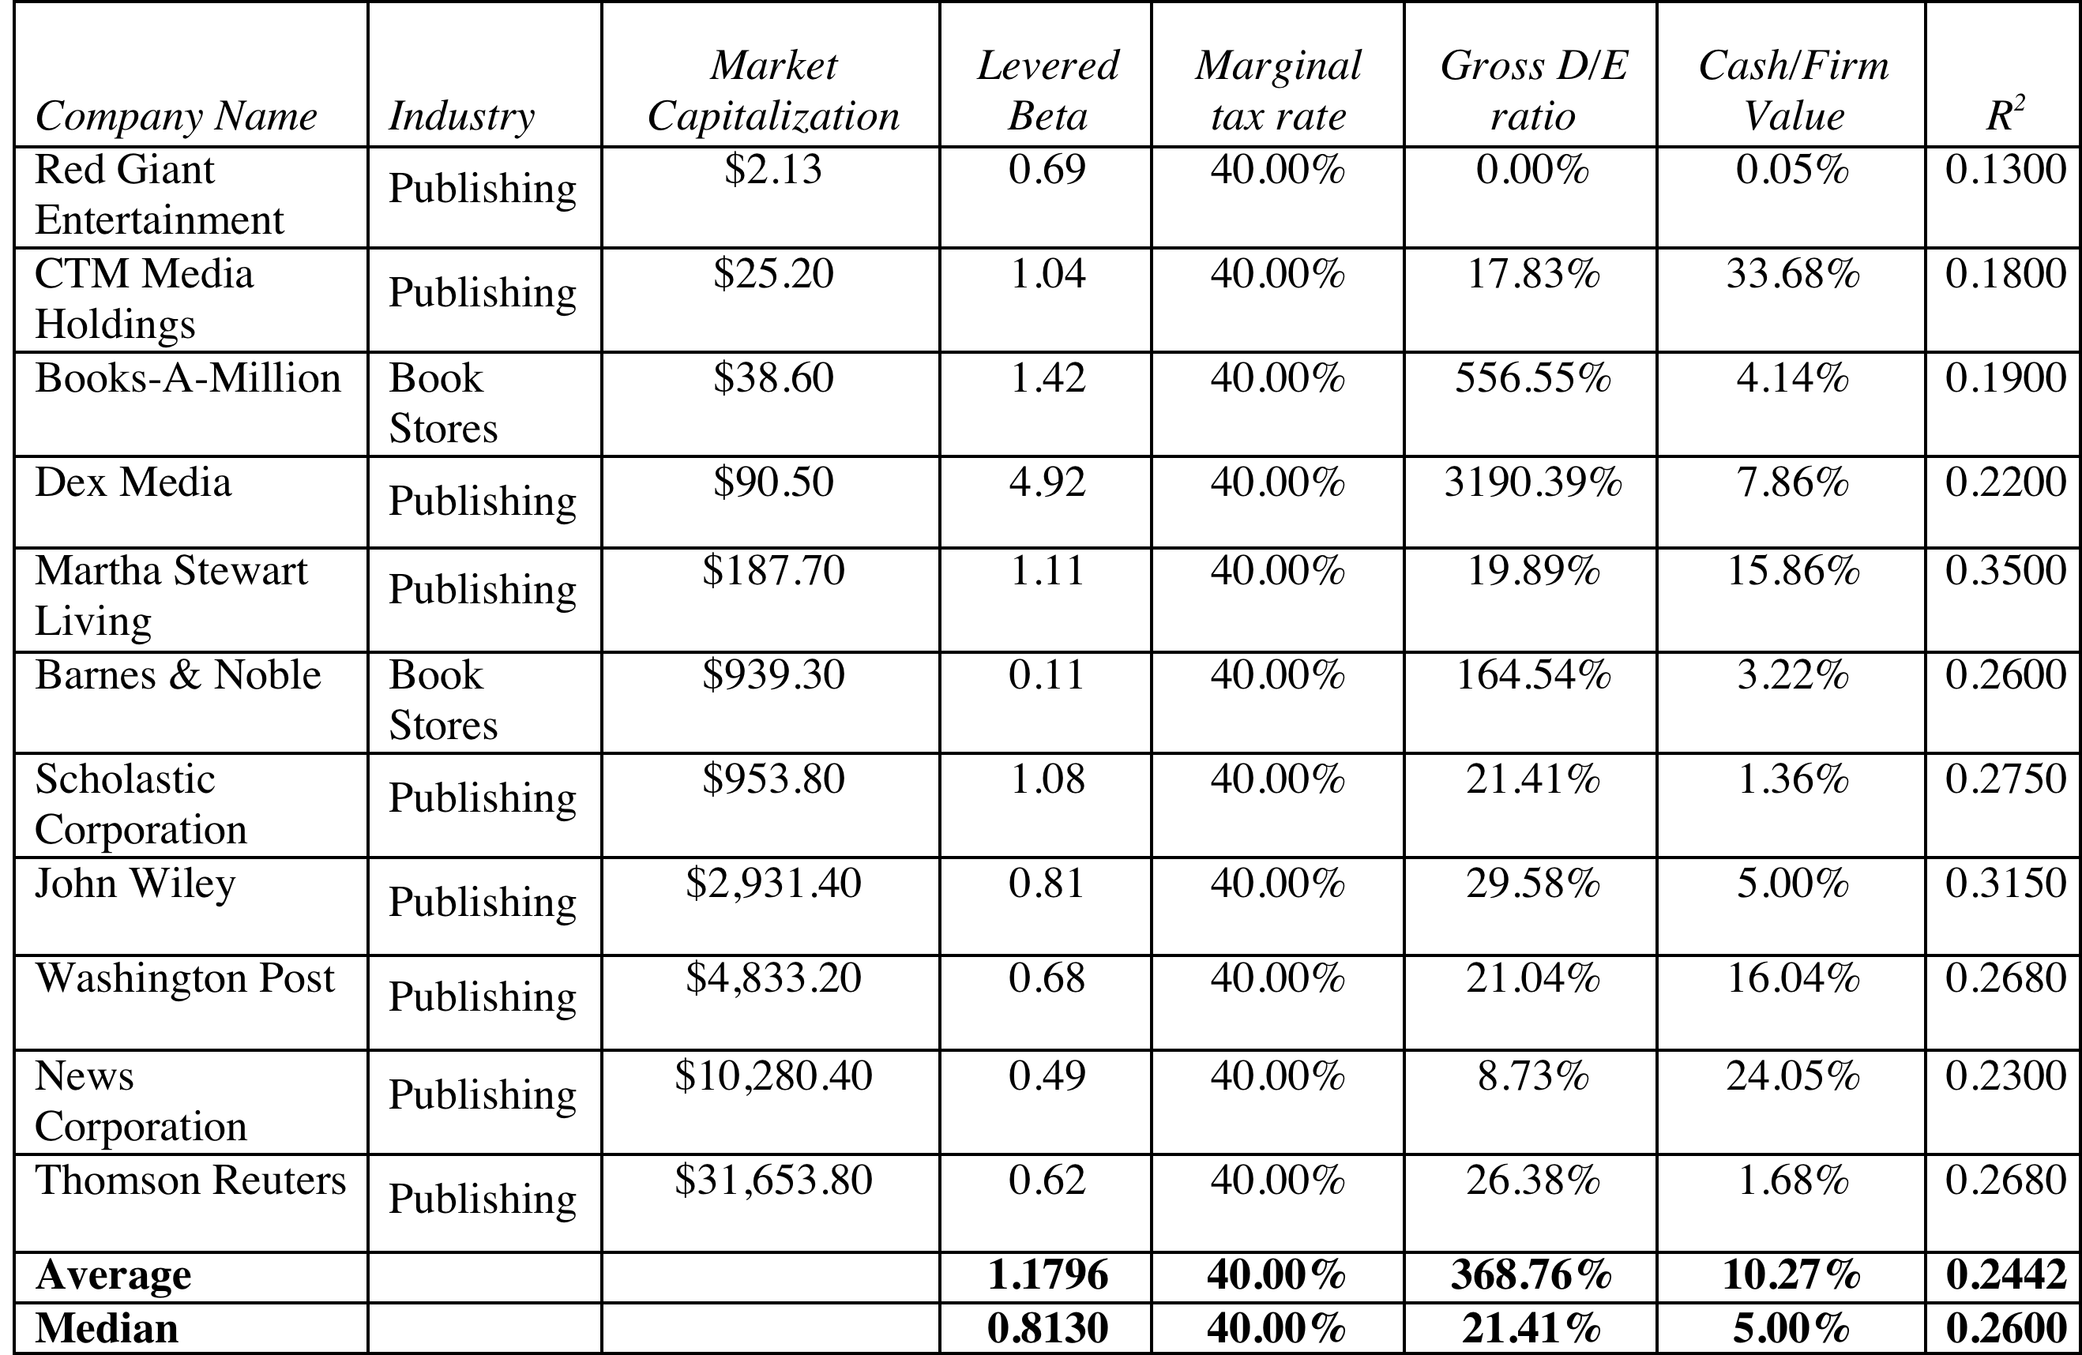
Using comparable firms to estimate beta for Bookscape
Unlevered beta for book company = 0.8130/ (1+ (1-.4) (.2141)) = 0.7205
Unlevered beta for book business = 0.7205/(1-.05) = 0.7584
Notes:
To estimate the bottom up beta, we initially looked at publicly traded book retail firms but found only two firms. To add to the sample, we looked at publishing firms, arguing that their risk should be similar to that of book retailers (We are open to the critique that the operating leverage can be different in the two businesses).
To avoid outliers, we will use median values for the firms in the sample.

Slide 9
Estimating Bookscape Levered Beta and Cost of Equity
Because the debt/equity ratios used in computing levered betas are market debt equity ratios, and the only debt equity ratio we can compute for Bookscape is a book value debt equity ratio, we have assumed that Bookscape is close to the book industry median market debt to equity ratio of 21.41 percent.
Using a marginal tax rate of 40 percent for Bookscape, we get a levered beta of 0.8558.
  Levered beta for Bookscape = 0.7584[1 + (1 – 0.40) (0.2141)] = 0.8558
Using a riskfree rate of 2.75% (US treasury bond rate) and an equity risk premium of 5.5%:
  Cost of Equity = 2.75%+ 0.8558 (5.5%) = 7.46%
Notes:
If you cannot get a target debt to equity ratio for a private firm, use an industry -average debt to equity ratio to compute the levered beta. It will give you a more meaningful estimate than using book debt to equity ratios.

Slide 10
Is Beta an Adequate Measure of Risk for a Private Firm?
Beta measures the risk added on to a diversified portfolio. The owners of most private firms are not diversified. Therefore, using beta to arrive at a cost of equity for a private firm will
  Under estimate the cost of equity for the private firm
  Over estimate the cost of equity for the private firm
  Could under or over estimate the cost of equity for the private firm
Notes:
Using beta (that looks at only market risk) will tend to under estimate the cost of equity since private owners feel exposed to all risk, if they are not diversified.

Slide 11
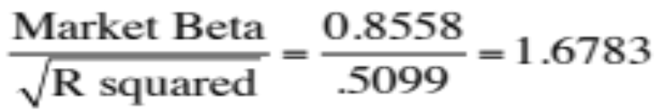
Total Risk versus Market Risk
Adjust the beta to reflect total risk rather than market risk. This adjustment is a relatively simple one, since the R squared of the regression measures the proportion of the risk that is market risk.
  Total Beta = Market Beta / Correlation of the sector with the market
In the Bookscape example, where the market beta is 0.8558 and the average R-squared of the comparable publicly traded firms is 26.00%; the correlation with the market is 50.99%.
  Total Cost of Equity = 2.75 + 1.6783 (5.5%) = 11.98%
Notes:
This assumes that
The owner of the private business has all of his or her wealth invested in the business
The reality is that most individuals will fall somewhere between the two extremes. A private equity or VC investor may hold several positions in their portfolio, pushing up the R-squared of their portfolio with the market and pushing down the total beta.
If you were a private business looking at potential acquirers - one is a publicly traded firm and the other is an individual . Which one is likely to pay the higher price and why?
If both acquirers have the same cash flow expectations, the publicly traded firm will win out (Blockbuster Video, Browning-Ferris are good examples of publicly traded firms which bought small private businesses to grow to their current stature.)
This approach can be extended to cover investors who are partially diversified such as venture capitalists and private equity investors. Instead of using the correlation of firms in the business with the market, we would use the correlation of the investor’s portfolio with the market. As the investor gets more diversified, the correlation will rise and the total beta will fall towards the market beta.

Slide 12
6 Application Test: Estimating a Bottom-up Beta
Based upon the business or businesses that your firm is in right now, and its current financial leverage, estimate the bottom-up unlevered beta for your firm.
Data Source: You can get a listing of unlevered betas by industry on my web site by going to updated data.
Notes:
The breakdown of a firm into businesses is available in the 10-K. The unlevered betas are available on my web site.

Slide 13

Task
Estimate the beta your company would have, if it were a private business.
Read
Chapter 4

